Slide 1



Topic 2 – Personality and Social Engineering in Cybersecurity
CSP002
Presentation by:
Ricardo G. Lugo

Slide 2

Acknowledgement
Co-funded by the European Union. Views and opinions expressed are however those of the author(s) only and do not necessarily reflect those of the European Union or HADEA. Neither the European Union nor the granting authority can be held responsible for them.
Project Agreement no. 101083594

Slide 3



Agenda
Definitions
  Behaviour, Personality, Social Engineering, Cognitive processes
Individual aspects
Research and theories
Practical examples

Slide 4

Individual, social and organisational levels
Joinson, A.N., & van Steen, T. (2018). Human Aspects of Cyber Security: Behaviour or Culture Change? Cyber Security, 1(4), 351-360.

Slide 5

Behaviour
American Psychological Association (APA
  the activities of an organism in response to internal or external stimuli, encompassing objectively observable actions, internally perceived states, and nonconscious processes.
  External
    like moving and speaking
  internal
    mental activities, like thoughts and feelings, as they are influenced by internal or external factors.
    And more (i.e. physiological changes)

Slide 6
Interaction Paradigm
B= ƒ(P x S)

Slide 7
Interaction Paradigm
Other people become person’s situation
B= f(P x S)
Complicated picture:
Behaviour= f_{c}[P_{c}*f_{o}(S*P_{o})]*f_{o}[P_{o}*f_{c}(P_{c}*S)]
C=cyber officer; o=other person

Slide 8

Starting point
Our subjectively experienced rationality is usually overestimated.
Subtle manipulations – deliberate or not – bias our perception and thus influence our decision-making.
This has always been the basis of interpersonal manipulation – from flattering salespeople on medieval markets to the sophisticated phishing email.
As old as our weaknesses are the strategies used to exploit them professionally.
Notes:
We start with personality.
Then we continue with pursuasion techniques.

Slide 9
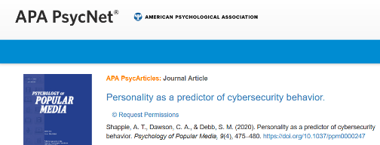
Personality research in Cyberpsychology
Notes:
It is tempting to explain human behavior with personality traits. Why this is also problematic, we will soon see. However, a lot of research is out there – most likely also because it is so easy to assess, intuitive to understand, and offers a simple answer to complex behaviour.
Die Kombination der Suchworte Cyberpsychology und Personality ergibt in Google Scholar 54.700 Funde.
Vom Online-Dating, Spielsucht, Verhalten in anonymen Chaträumen bis natürlich hin zu Cybersecurity-Verhalten oder Fehlverhalten wurde schon alles untersucht.
Die Wahrscheinlichkeit, mit irgendwelchen Ergebnissen und Behauptungen oder Artikeln konfrontiert zu werden, ist also sehr hoch. Daher werden wir einige Zeit dafür aufwenden, dieses Thema etwas weiter zu beleuchten.

Slide 10
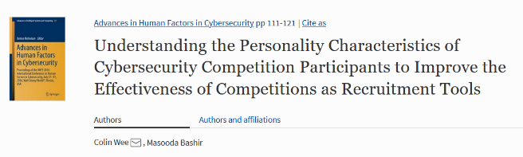
Personality research in Cyberpsychology
Notes:
Aber auch andere Bereiche – bspw. Risikofakt oren für gesundheitsschädliches Gaming-Verhalten – hier sehen wir auch ein Persönlichkeitsprofil welches verschiedene Faktoren unterscheidet und Personen die sehr viel Spielen mit Gelegenheitsspielern vergleichen.

Slide 11

Notes:
Die Kombination der Suchworte Cyberpsychology und Personality ergibt in Google Scholar 54.700 Funde.
Vom Online-Dating, Spielsucht, Verhalten in anonymen Chaträumen bis natürlich hin zu Cybersecurity-Verhalten oder Fehlverhalten wurde schon alles untersucht.
Die Wahrscheinlichkeit, mit irgendwelchen Ergebnissen und Behauptungen oder Artikeln konfrontiert zu werden, ist also sehr hoch. Daher werden wir einige Zeit (2 Sitzungen) dafür aufwenden, dieses Thema etwas weiter zu beleuchten.
Da wir verschiedene Themen der Cyberpsychologie und damit der Informatik behandeln wollen, wird die Auswahl zwangsläufig etwas breit wirken.

Slide 12

What is a personality factor?
A temporally stable characteristic.
Can, but does not have to be observable (but measurable).

Slide 13

Interaction
Open Source Psychometrics Project
BIG-5 personality factors
Please answer the questions to this quick online test to remember the BIG FIVE personality factors.
https://openpsychometrics.org/tests/IPIP-BFFM/
After filling in, please check the analysis and percentiles.
Goldberg, L.R. (1992). The development of markers for the Big-Five factor structure. Psychological Assessment, 4(1), 26.

Slide 14

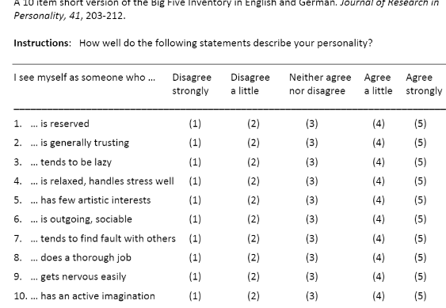

Slide 15

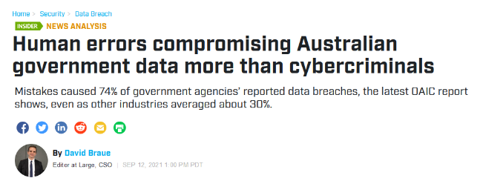
Notes:
You know all about social engineering – perhaps I can show you a few aspects of it that you haven‘t thought about before – thats the goal.
Next week then: more phishing specifics, then on campaigns and culture.

Slide 16

Big-5

Slide 17

Factors and Facets
Openness to experience | Conscientiousness | Extraversion | Agreeableness | Neuroticism
Fantasy | Competence | Warmth | Trust | Anxiety
Aesthetics | Order | Gregariousness | Straightforwardness | Angry hostility
Feelings | Dutifulness | Assertiveness | Altruism | Depression
Actions | Achievement Striving | Activity | Compliance | Self-consciousness
Ideas | Self-discipline | Excitement Seeking | Modesty | Impulsiveness
Values | Deliberation | Positive Emotions | Tender-Mindedness | Vulnerability
Notes:
Kann man beispielsweise extravertiert sein und dennoch ungern vor Gruppen sprechen? – Ja, da die Faktoren nicht sehr hoch miteinander korreliert sind kann man auf Facetten unterschiedlicher Faktoren unterschiedlich „scoren“, bspw. in Anxiety (Neuro) hoch und in Geselligkeit (Extra) ebenfalls hoch. Man ist also eine extravertierte Person die dennoch ängstlich wirken kann.
Gregariousness (gesellig)

Slide 18

Life span and personality
Notes:
SV and SD are components of Extraversion that develop differently, which then neutralizes the influence on the overall score in Extraversion

Slide 19
Personality and Performance
There once was a war
B=f(PxS)

Slide 20
LCFC Findings
Relationship harmony
  High A
  But detrimental to competition
Commitment
  High A, C, O
  Elicit commitment from team!
Trust from coaches
  High A
Goal Setting
  High C

Slide 21
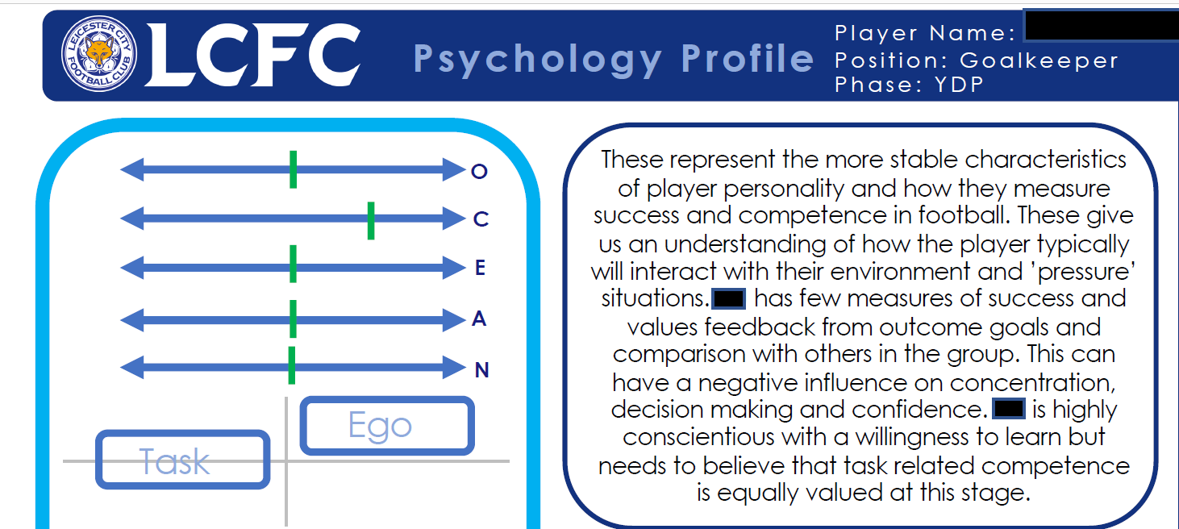

Slide 22
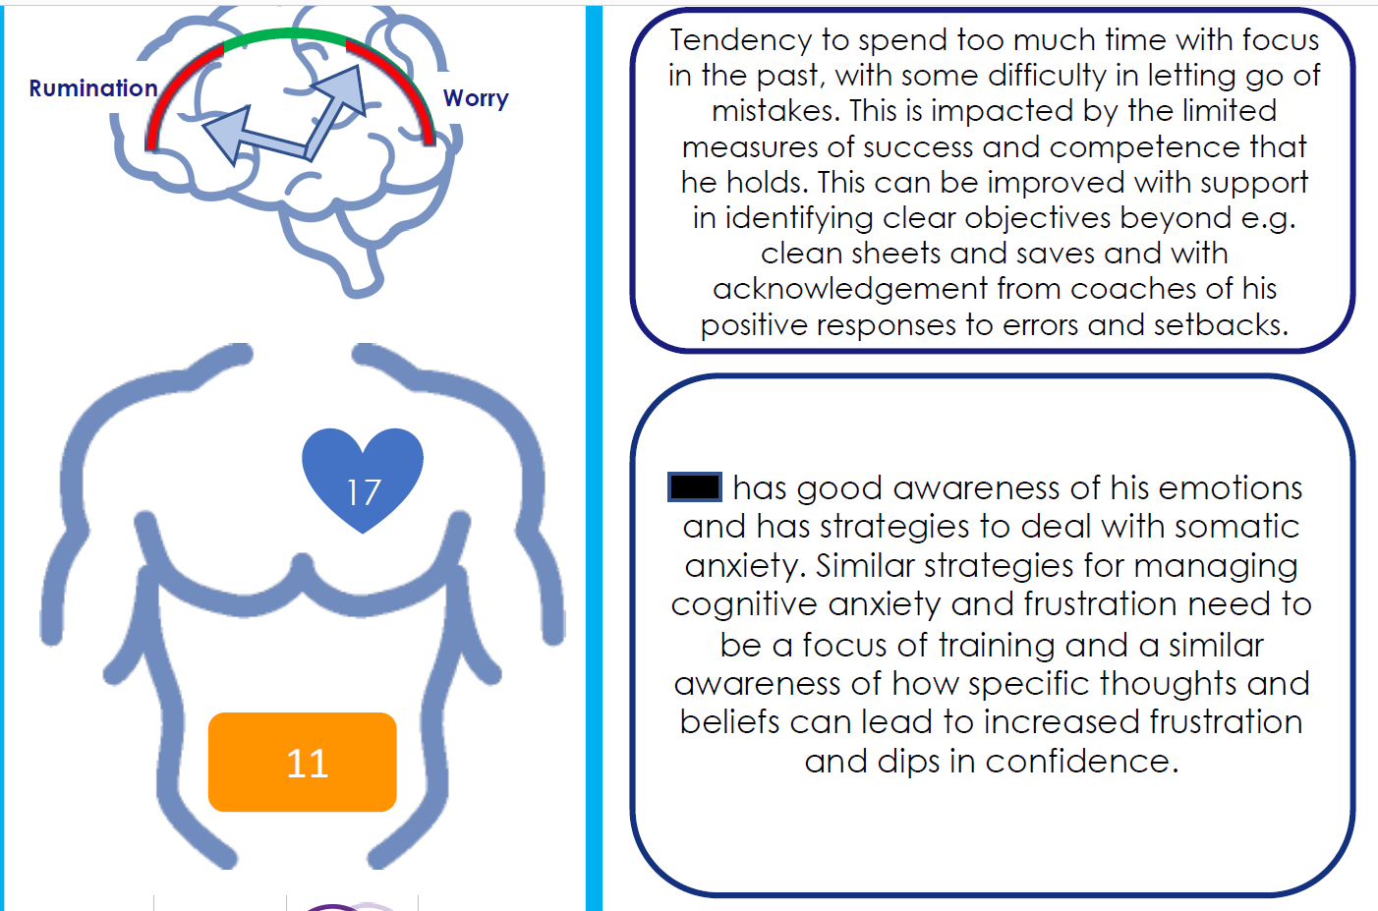

Slide 23
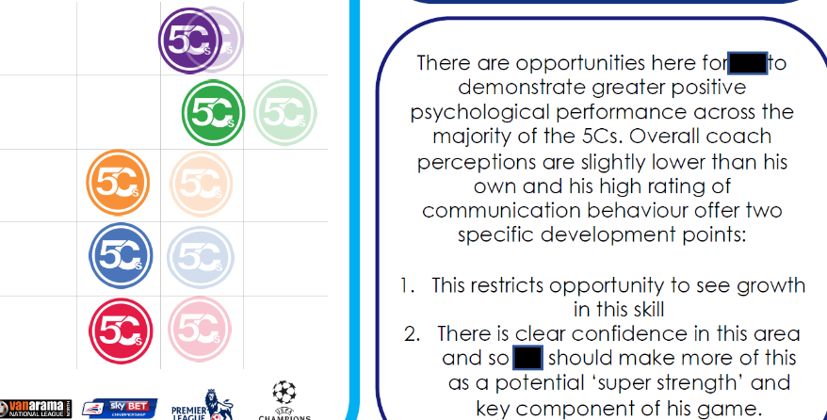
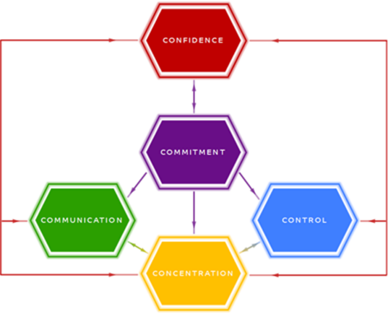

Slide 24

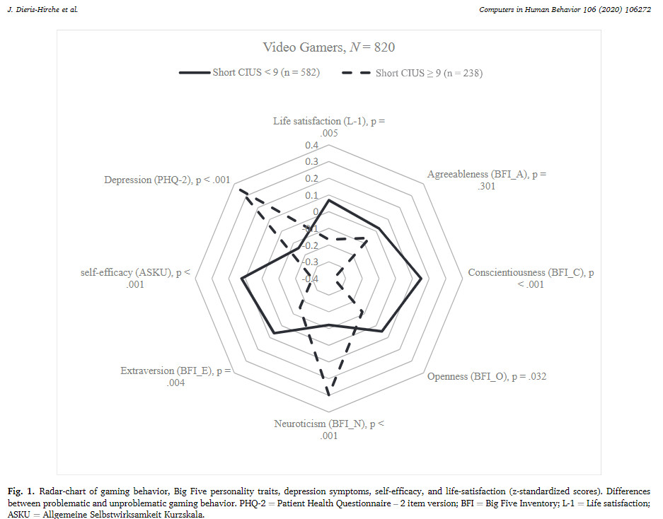
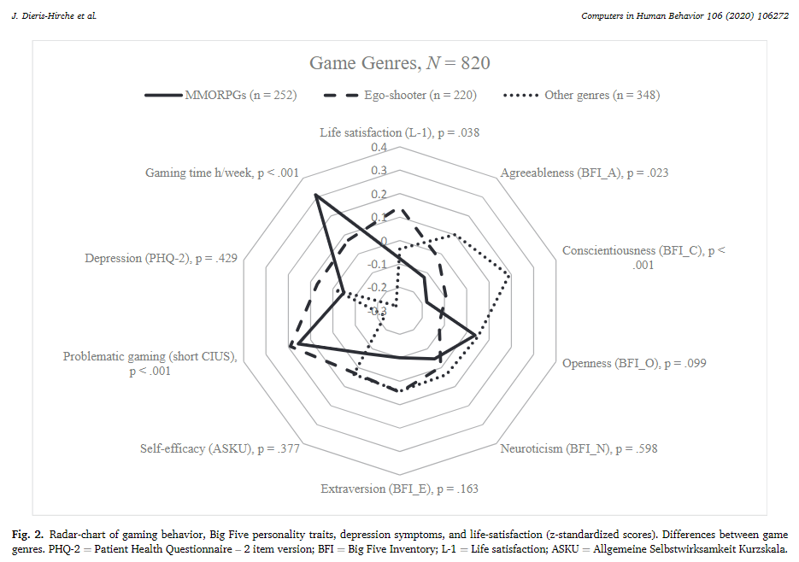
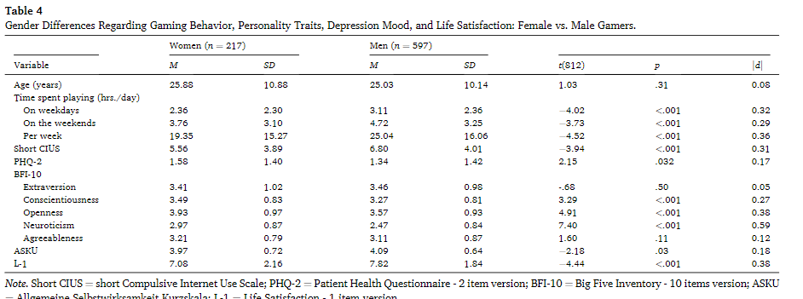
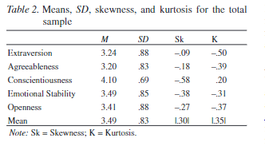
Notes:
But also other areas – e.g. Risk factors for harmful gaming behavior – here we also see a personality profile that distinguishes various factors and people who compare a lot of gaming with casual gamers.
The article "Problematic Gaming Behavior and the Personality Traits of Video Gamers: A Cross-Sectional Survey" explores the psychological factors and personality traits that contribute to problematic gaming behavior, a condition often linked to Internet Gaming Disorder (IGD). The study involved 820 gamers, analyzing personality traits, self-efficacy, depression symptoms, and general life satisfaction.
Key Points:
Internet Gaming Disorder (IGD): Classified in the Diagnostic and Statistical Manual of Mental Disorders (DSM-5) and the International Classification of Diseases (ICD-11), IGD refers to a persistent pattern of gaming behavior that impairs daily functioning, characterized by a lack of control over gaming, prioritizing gaming over other life activities, and continuing gaming despite negative consequences.
Study Findings:
Personality Traits: Gamers with problematic behaviors showed higher levels of neuroticism (emotional instability), and lower levels of conscientiousness (self-discipline), extraversion (social interaction), and openness (curiosity).
Depression and Life Satisfaction: These gamers also exhibited more symptoms of depression and lower levels of life satisfaction and self-efficacy (belief in one's ability to succeed).
Game Genres: Gamers who preferred Massively Multiplayer Online Role-Playing Games (MMORPGs) and First-Person Shooter (FPS) games spent more time gaming and had a higher likelihood of problematic behavior.
Prevalence: About 29% of participants showed signs of problematic gaming behavior, with a higher prevalence in younger players and male gamers.
Hypotheses Tested:
Gamers with problematic behaviors show distinct personality traits compared to non-problematic gamers.
Problematic gamers have higher depression symptoms, lower life satisfaction, and reduced self-efficacy.
Game genres like MMORPGs and FPS are more associated with problematic behaviors.
Males are more likely than females to exhibit problematic gaming behaviors.
I-PACE Model: The study uses the Interaction of Person-Affect-Cognition-Execution (I-PACE) model, which explains how personality traits, emotions, and cognitive responses interact to influence problematic internet use, including gaming.
Acronyms Explained:
IGD (Internet Gaming Disorder): A condition where gaming interferes with daily life, leading to social, educational, and occupational dysfunction.
MMORPG (Massively Multiplayer Online Role-Playing Game): A genre of video games that involves large numbers of players interacting in a virtual world.
FPS (First-Person Shooter): A video game genre where players engage in combat from a first-person perspective.
I-PACE (Interaction of Person-Affect-Cognition-Execution): A theoretical model used to explain internet use disorders.
The study concludes that personality traits like low conscientiousness and high neuroticism, along with depression and excessive gaming, are significant predictors of problematic gaming behavior. These findings support the need for targeted interventions for at-risk gamers.
Cohens d=.54

Slide 25
Personality in Cyber Security
Little research
Personality give behavioural dispositions and tendencies
  Moderated by experience
Social Engineering
  Ergonomics, Team functioning, Training & Development
  But used against you ☺
But also ‘Cognitive styles’

Slide 26
Cyber
Users
  Risk profiles
  Habits
Developers
  Profiles
  Habits
Operators
  Profiles
  Habits
Attackers
  Profiles ?
  Habits?

Slide 27
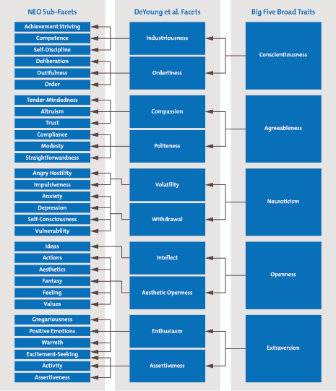
Individual Vulnerabilities
Personality - a person’s relatively stable feelings, thoughts, and behavioural patterns
OCEAN/ FFM/ Big 5
(Costa & McRae, 1990)
Females higher in N & A
Bigger differences in egalitarian cultures
Notes:
DeYoung et al, 2007: These 10 facets were proposed in 2007 by psychologists Colin DeYoung, Lena Quilty and Jordan Peterson in their paper, "Between Facets and Domains: 10 Aspects of the Big Five." This version of the model is known as the Big Five Aspects Personality Test
Neuroticism is the tendency to feel that reality is a problem and to experience readily unpleasant emotions. People that possess high levels of neuroticism are generally sad and sometimes hot tempered Extraversion is the tendency to seek out the company of others and reflects energy and positive emotions in one’s personality. Extraverted personalities often seek excitement and tend to be dominant. Openness is the desire to seek out new experiences without anxiety and an appreciation of different ideas and beliefs. Individuals that exhibit high levels of openness revel in fantasy and appreciate art and nature. Agreeableness is a measure of the quality of the relationships a person has with others. If a person has a high level of agreeableness, they are compassionate and cooperative rather than antagonistic and suspicious. They believe that people they interact with are generally good intentioned and honest. Finally, conscientiousness focuses on self-discipline, dutiful action, and a respect for standards and procedures. These people are known for their prudence and common sense
Recent studies, however, have shown that our personalities do change beyond this age. Another study by Srivastava, Gosling, and Potter (2003) found that Conscientiousness and Agreeableness changed through early and middle adulthood. They also found that Neuroticism declined in females over time, while staying relatively stable in males. They report that their findings could be attributed to a variety of developmental influences such as experience in different areas that correlate with attainment of certain ages.

Slide 28


Notes:
1. a personality trait reflecting the extent to which people demonstrate low levels of compassion and high levels of aggression in social interactions. [proposed by Hans Eysenck]
2. a personality trait characterized by empiricism, materialism, skepticism, and fatalism. Compare tender-mindedness. [first described by William James] —tough-minded adj.
Not spiritual, not esoteric.

Slide 29
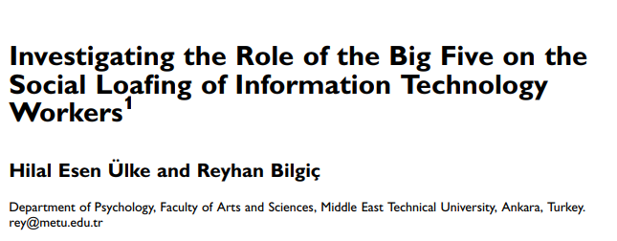
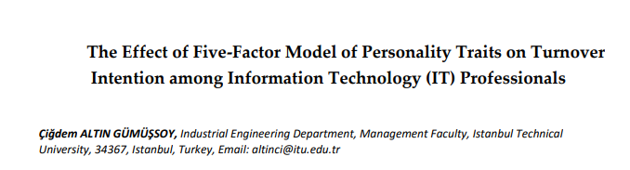
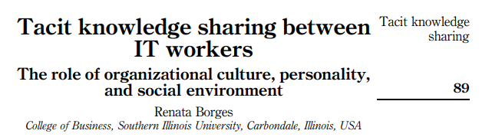
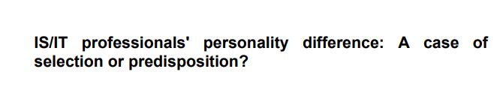

Slide 30

Cognitive Processes

Slide 31
Creating Learning Environments

Slide 32
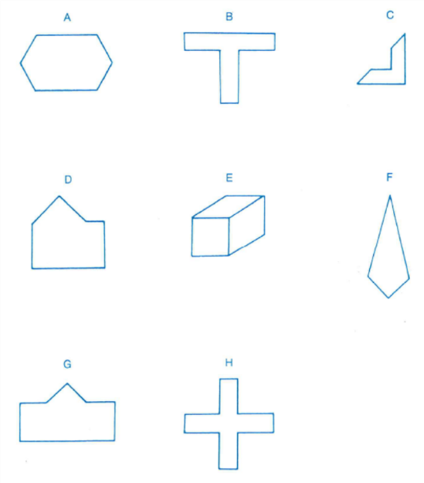


Slide 33




Cognitive Profiles of Female Cyber Defence Operators
Title which simply addresses the nature of the work presented in the poster
Ingrid Trolie Auestad & Ingeborg Åse Horgen, Ricardo Lugo, Inland Norway University of Applied Sciences. Norway
Andrea Firth-Clark, University Campus of Football Business
Benjamin J. Knox, Kirsi Helkala, Øyvind Jøsok, Norwegian Cyber Defence Academy. Norway
Stefan Sütterlin Østfold University College, Oslo University Hospital
Names of those who were involved with this body of work
Contact information provided here to reach the authors of this body of research
Background:
Results
Discussion:
Rapid technological developments and definition of the cyber domain as a battlefield has challenged the cognitive attributes of its operators. Little is known about the cognitive demands on and the profiles of cyber defense officers. While cyber incidents have been more common in recent times. The role of the human factor in cyber defense still lacks a comprehensive scientific framework. The Cyber domain is now considered the 4th domain for warfare. but little is known about the properties of the soldiers who supervise the domain. Psychological determinants (i.e. decision-making) to investigate human factor in cyber defence operations need to be investigated to assess performance in cyber operators.
Field Independent (FID) cognitive style has been shown to be prevalent among individuals in occupations and fields of study consisting of analytical thinking and technical skills. As opposed to Field Dependent (FD) cognitive styles that are more contextually based (Witkin, 1971), high FID individuals also tend to score higher on working memory and linguistic tasks. FID is not advantageous over FD. FID styles are more efficient at problem-solving in ambiguous settings as posed in the cyber domain (Evans, Richardson & Waring, 2013). Recent research has shown that high FID individuals outperform mixed FID/FD and FD individuals in tasks that involve computer settings (Angeli, 2013).
Selection processes are standards in today’s society. are time consuming. but are essential in recruiting the proper personnel for specific jobs (Carretero-Dios & Pérez, 2007). Cognitive ability was found to be a strong predictor for selection and job performance. The FID/FD construct may be a useful tool with predictive validity for selection purposes.
Research in this area is scarce, and also has not reflected gender differences. Psychological factors have been found to influence performance in cyber defence operations (Lugo & Sütterlin, 2018) but these findings did not include females. Female cyber cadet officers were tested against fellow male cadets and non-technical female cadets. Psychological factors tested included cognitive styles, personality, emotion regulation strategies, self-efficacy, and metacognition.
Table 1: Independent Samples Test (FIH vs HINN)
 | FIH: M (SD) | HINN: M (SD) | t | df | p | CI LL | CI UL | Cohen's d
GEFT | 14,94 (2,39) | 11,35 (4,49) | 2,93 | 24,089 | 0,007 | 1,06 | 6,12 | 1,00
RSQ-B | 2,9 (,45) | 2,40 (1,07) | 1,82 | 32 | 0,078 | -0,06 | 1,06 | 0,61
MC-IMS | 1,22 (,13) | 1,12 (,13) | 2,17 | 32 | 0,037 | 0,01 | 0,19 | 0,75
MC-CM | 1,39 (,19) | 1,22 (,24) | 2,20 | 32 | 0,035 | 0,01 | 0,32 | 0,75
MC-E | 1,48 (,23) | 1,28 (,25) | 2,45 | 32 | 0,020 | 0,03 | 0,37 | 0,84
GEFT: Group Embedded Figures Test; RSQ-B: Rumination Brooding; MC-IMS: Metacognition Information Management Strategies; MC-CM: metacognition comprehension management; MC-E: Metacognition Evaluation
Female officer cadets showed worrisome scores on psychological predictors of academic outcomes, but were not different on other cognitive measurements than their male counterparts. Cyber engineering is considered a STEM degree, but due to the novel domain, little is known about female operators. Future research needs to identify how factors used in previous studies might affect female performance in the cyber education and domain.
References:
Angeli, C. (2013). Examining the effects of field dependence–
independence on learners' problem-solving performance and
interaction with a computer modeling tool: Implications for the design of joint cognitive systems. Computers &
Education, 62, 221-230.
Carretero-Dios, H., & Pérez, C. (2007). Standards for the development
and review of instrumental studies: Considerations about test
selection in psychological research. International journal of
clinical and health psychology, 7(3)
Lugo, R.G. & Sütterlin, S. (2018). Performance Predictors in Cyber
Defence Officers. Communications in Computer and
Information Science Volume 714.
Salgado, J. F. (2017). Personnel Selection.Oxford Research ncyclopedia,
Subject: Industrial and Organizational Psychology Online
DOI:10.1093/acrefore/9780190236557.013.8
Witkin, H. A. (1971). A manual for the embedded figures tests.
Consulting Psychologists Press.
Female cyber defence officers were different on several psychological factors than non-technical control females. They showed higher degrees of maladaptive emotion regulation strategies, less assertiveness, and self-efficacy, but had better metacognitive regulation strategies (see table 1).
Compared to male cyber defence officer cadets, females reported less positive affect, more anxiety, and lower self-efficacy. Female cadets also reported lower metacognition (see table 2).
Table 2: Independent Samples Test (FIH Gender Differences)
 | Male FIH M(SD) | Female M(SD) | t | df | p | CI LL | CI UL | Cohen's d
PA | 3,41 (,41) | 2,96 (,45) | 2,18 | 16 | 0,044 | 0,01 | 0,88 | 1,03
Worry | 37,40 (9,66) | 49,38 (9,05) | -2,69 | 16 | 0,016 | -21,42 | -2,53 | -1,28
MC-P | 1,53 (,18) | 1,30 (,25) | 2,25 | 16 | 0,039 | 0,01 | 0,44 | 1,04
PA: Positive Affect; MC-P: Metacognition Planning
Contact Details:
Ingrid Trolie Auestad, ingridtrau@outlook.com
Ingeborg Åse Horgen, ingeborghorgenn@gmail.com
Ricardo G. Lugo, Ricardo.Lugo@inn.no

Slide 34
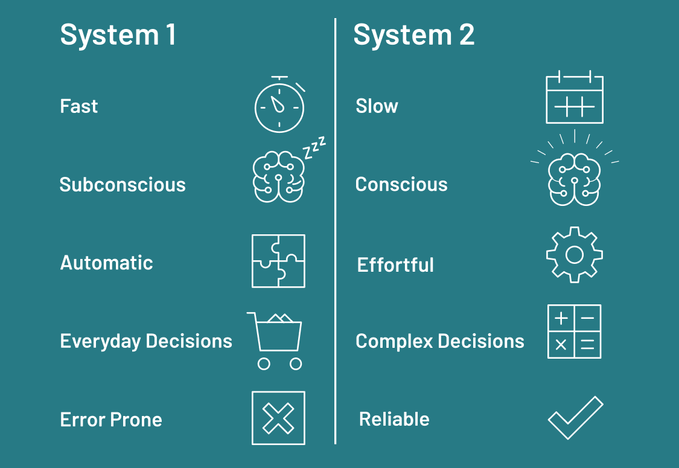


Slide 35

4 Horsemen of Social Cognition (Bargh, 2000)
Naïve researchers
  Use rational, scientific like approaches, cause-effect analysis to understand environment
Cognitive Misers
  Use the least possible for best result
Cognitive consistency
  We like what agrees with us
Motivated tacticians
  Several available strategies, and we choose from goals, needs, or other motives

Slide 36
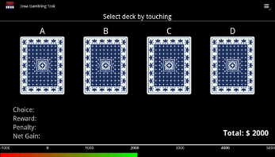
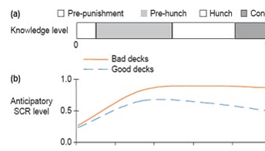
Intuitive Decision-Making
Fast (“quick & dirty”) decisions or tendencies towards decisions triggered by familiar cues.
Unconscious.
Mostly beneficial (evolutionary process).
Involving mostly subcortical brain structures and those involved in inner body perception (“interoception”)
Can be exploited
“Gut feeling”

Slide 37
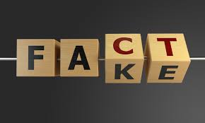
Attitudes and Beliefs
Formation
Cognitive and Affective components
Primacy Recency effects
Exposure
Mere Exposure Effect
We like what we see more of
Fake News
Notes:
Scrolling primacy recency effect

Slide 38
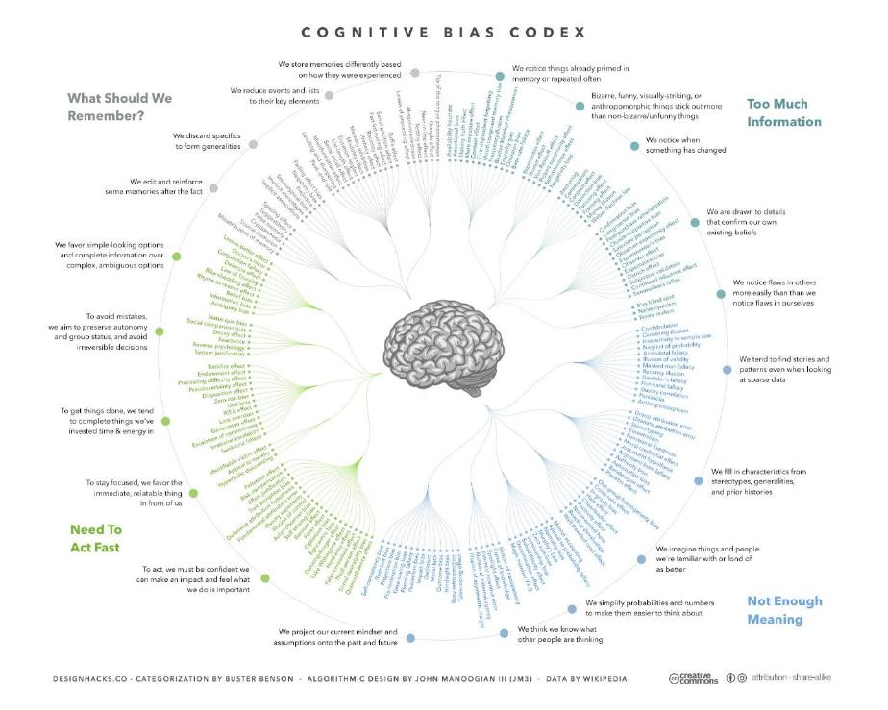

Slide 39

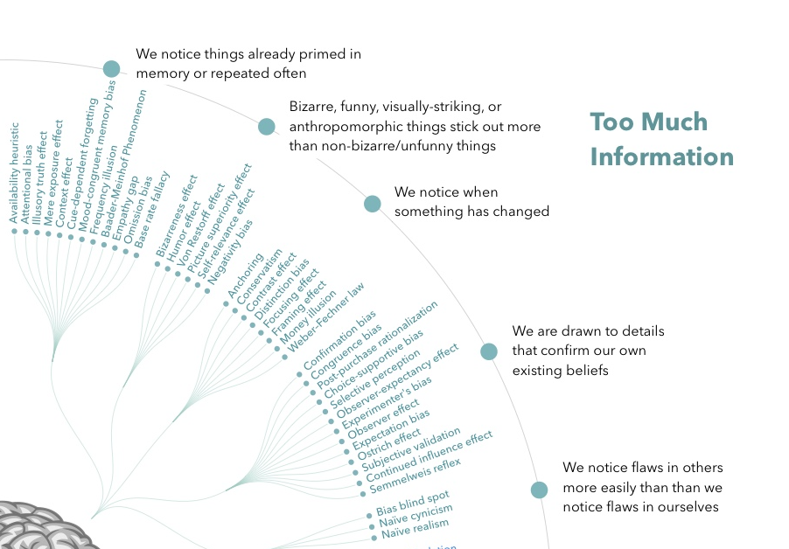
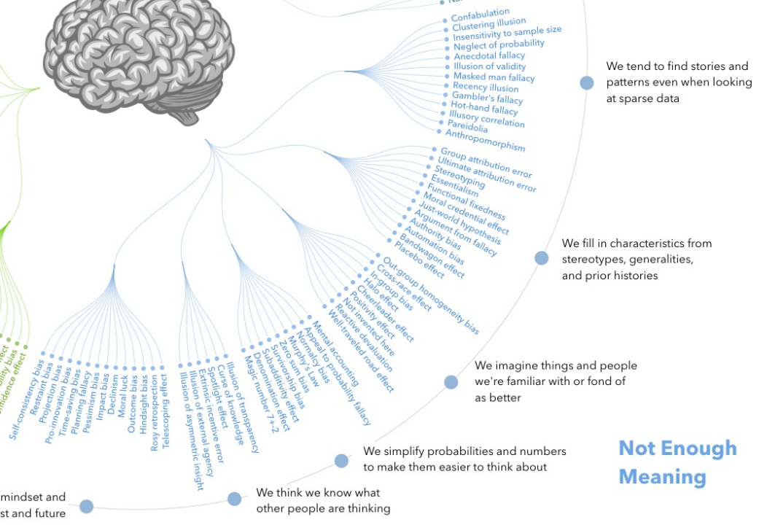
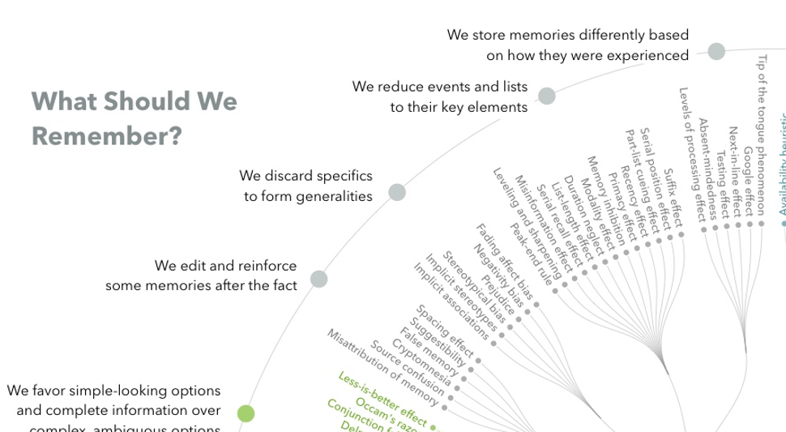

Slide 40
Let’s go EXPLOITING!

Slide 41




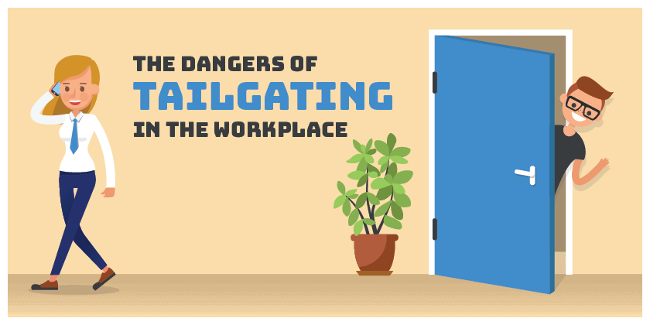
Attack vectors – Social approach
Tailgating
Impersonating
Eavesdropping
Shoulder surfing
Dumpster diving
Reverse social engineering
Notes:
Unter Attack-Vectors verstehen wir wie sonst auch im CS Bereich verschiedene taktische und strategische Angriffsformen. Wenn wir die technischen Hilfsmittel mal ausklammern, so sind diese klassischen Methoden immer noch extrem effizient. Stellen Sie sich einmal vor wie viel technischen Aufwand sie sich sparen wenn Sie jemandem beim Passwort eingeben über die Schulter schauen oder sensitive Daten aus der Mülltonne fischen können.
Beim Tailgating folgt man einer Person die legitimen Zugang zu zugangsbeschränkten Orten, d.h. hängt sich einfach an jemanden dran. Man kann eine Kiste tragen und darum bitten dass ihm die vorausgehende Person die Tür aufhält, oder die Tür einfach selbst aufhalten. Gerade seit es keine oder kaum Raucherzimmer in Unternehmen gibt, ergeben sich dadurch für physische Pen-Tester beliebte Möglichkeiten in Gebäude zu kommen.
Impersonating bedeutet dass man die Identität einer anderen Person annimmt und so von deren Glaubwürdigkeit profitiert. Wenn man das Ausgeben für jemand anderen in einem physischen Kontext nutzt um Zugang zu sensitiven Bereichen zu ergaunern, sich also so bspw. eine Schlüsselkarte organisiert, würde man das Piggybacking nennen. Impersonating nutzt überlicherweise Personen die Autorität oder Glaubwürdigkeit haben, oder beides. Bekannt auch die Anrufe von IT-Technikern die vorgeben ein technisches Problem zu lösen, dass sie einem selbst aufgehalst haben.
Eavesdropping: Lauschen – das kann das simple belauschen von Konversationen von Menschen in der Nähe sein (im Zug, Büro), oder auch das aktive Abhören und Mitlesen von Emails, Anrufen, u.ä.
Shoulder-surfing – wie der Name schon sagt – jemandem bei der Eingabe von Zugangsdaten zuschauen – viel einfacher als man glauben mag.
Dumpster-Diving: Den Müll von jmd durchgehen – da die meisten Leute privat keinen Aktenvernichter benutzen, lässt sich hier wenn man etwas Zeit und Zugang hat, einiges an Daten sammeln.
Beim reverse social engineering verleitet der Angreifer eine Person dazu, selbst die Initiative zu ergreifen und wartet einfach. D.h. man kreiert erst ein Problem, und ist dann die Anlaufstelle für schnelle Hilfe, was besonders unauffällig wirkt. Auch hier können die Kombination aus Malware und IT-Hotlines ein gutes Beispiel sein.
SE-Methoden lassen sich natürlich auch zum Gegenangriff anwenden - Der Australier Karl Rock betreibt einen Youtube Kanal bei dem er sich in auf Betrug spezialiserte indische Callcenter hackt und in einer Kombination aus Impersonating, Eavesdropping und reverse social engineering e-commerce-Betrüger entlarvt and bloßstellt.

Slide 42
Social engineering and Cybersecurity
One of the most effective penetration attacks, responsible for or part of the vast majority of security breaches.
Design and application of deceitful techniques to deliberately manipulate human targets.
Primarily used to induce victims towards disclosing confidential data, or to perform actions that breach security protocols, unknowingly infecting systems or releasing classified information.
Main point in applying SE attack vectors is to avoid CS systems and need to overcome technological countermeasures.
Notes:
SE

Slide 43
Main Categories of Social Engineering
Hunting:
Execute SE attacks through minimal interaction with the target.
Once target has been achieved, communication will be terminated.
Most common methodology
Farming:
Establish a relationship with victim in order to extract information for a longer period of time.
Win personal trust (not generic basic human-to-human trust).
Risk grows on both sides during the process.
Less frequently used.
Notes:
Grundsätzlich unterscheiden wir zwei grundverschiedene Formen des SE – Hunting und Farming.
Beim Jagen ist der Kontakt eher nur kurz und einmalig, beim Farming säht der Social Engineer über längeren Zeitraum das Vertrauen dass das Opfer in ihn investiert. Beim Thema Insider Threats spielt dies eine größere Rolle – ist aber zahlenmäßig wesentlich unbredeutender als Hunting, da sich der farmende SE ja dabei auch einem wesentlichen Risiko aussetzt, wenn er über längere Zeit und häufige Online oder Offline Kontakte mit dem späteren Opfer kommuniziert und dabei zwangsläufig Spuren hinterlässt.

Slide 44
Linking Personality with Social Engineering
Which personality dimension or profile could make a person
particularly vulnerable?

Slide 45
But First we need frameworks

Slide 46
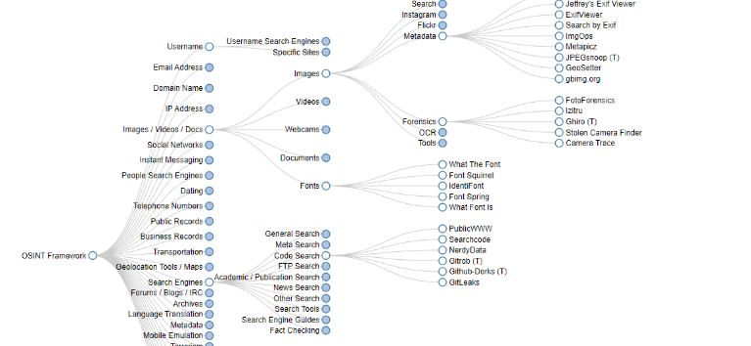

https://haveibeenpwned.com/

Slide 47
What is SE?
The term “Social Engineering” did not develop as a result of systematic research, but as a loose description used in the IT community to describe psychological effects with relevance for cyber security. The attempts to define the term occured years after they had spread. Instead of SE, one could say “deception of a person to gain an advantage”.
Other examples for attempted definitions:
“Any act that influences a person to take an action that may or may not be in their best interest.” (social-engineer.org, 2017)
“Social engineering, in the context of information security, refers to psychological manipulation of people into performing actions or divulging confidential information” (wikipedia.org, 2017)
Goal: gain unauthorized access to systems or information to commit acts such as fraud, network intrusion, industrial espionage, or identity theft.

Slide 48
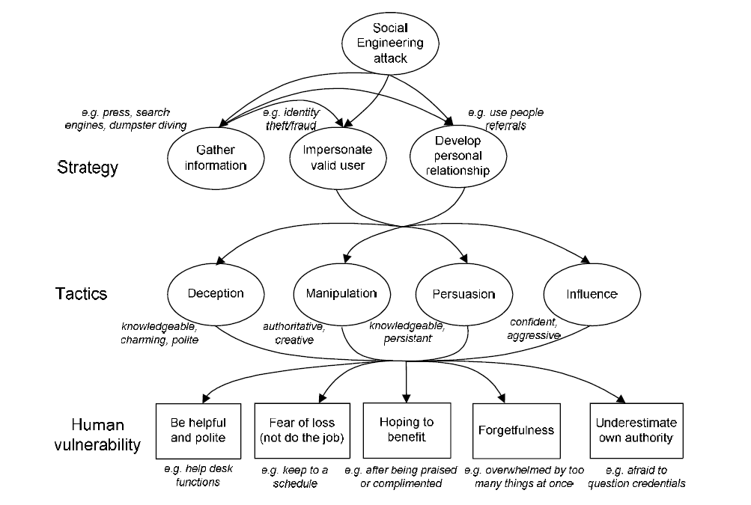
Social Engineering

Slide 49
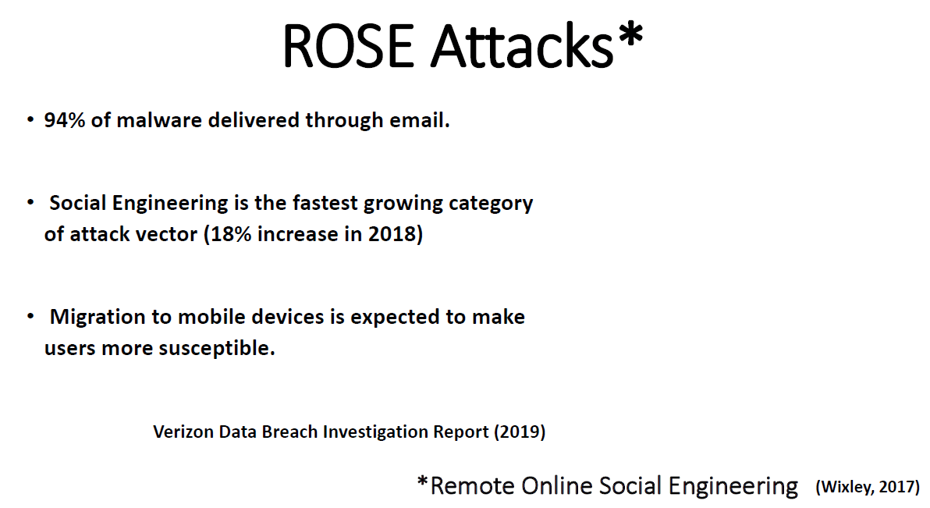
Canham (2019)

Slide 50
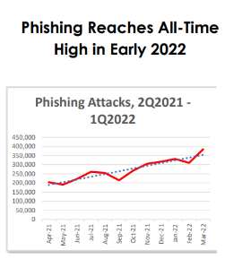

Phishing as most common attack vector
Founded in 2003, the Anti-Phishing Working Group (APWG) is a not-for-profit industry association focused on eliminating the identity theft and frauds that result from the growing problem of phishing, crimeware, and e-mail spoofing. Membership is open to qualified financial institutions, online retailers, ISPs, solutions providers, the law enforcement community, government agencies, multi-lateral treaty organizations, and NGOs. There are more than 2,000 enterprises worldwide participating in the APWG.
https://apwg.org/trendsreports/
Notes:
Wenn Sie Artikel oder Kapitel zum Thema Phishing lesen, fällt Ihnen auf dass die meisten erstmal mit mehreren Absätzen darüber beginnen – wie ernst die Lage ist und wie sehr sie sich verschlimmert hat. Eigentlich ändern sich hier nur die Zahlen von Jahr zu Jahr, die Formulierungen (Definition Phishing und Ernsthaftigkeit des Problems) wirkt manchmal doch sehr repetitiv. Das liegt aber daran dass man auch für ein breiteres Publikum dass nicht unbedingt das Vorwissen hat dieses Thema ausreichend beschreiben muss. Der Bericht der Anti-Phishing Working Group liefert Ihnen quartalsweise die neuesten Zahlen.

Slide 51
Social Engineering „kill chain“
Phases
Research
Reconnaissance.
Identify individual/organisational vulnerabilities.
Hook
Initiate communication with potential victim.
Engage, spin story, build trust, take control.
Play
Accomplish purpose of attack.
Compromise the system.
Exit
Finalize interaction with victim, preferably without arousing any suspicions.
Disappear, erase traces.
Breda et al. (2017)
Notes:
Parallel zur bekannten kill-chain by cyber-attacken lässt sich auch dieses vereinfachte Phasenmodell für SE-Angriffsvektoren aufzeigen, die der kill-chain von Lockheed-Martin sehr ähnelt. Man hat der vielen vielleicht bekannten LM-Kill-chain ja auch vorgeworfen, dass sie zu sehr auf Malware fokussiert, daher ist diese Abwandlung von Breda et al. hier evtl. sinnvoll.
Ich denke die Schritte sind einigermaßen einleuchtend und selbsterklärend.
„build trust“ kann alles sein von einer längeren Bekanntschaft bis zu einer Entscheidung über das Design einer Mail, welches Vertrauen erzeugen soll (bspw. wiedererkennen vertrauenswürdiger Logos etc).

Slide 52

Phishing
Similarity
Familiarity

Slide 53
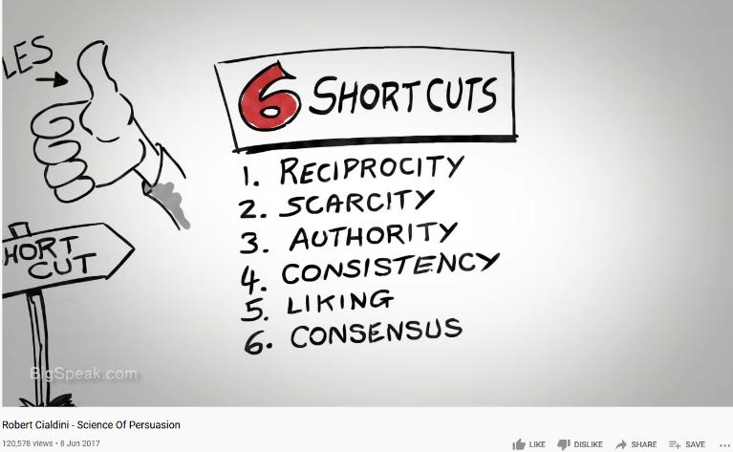
https://youtu.be/kv0sOX6Alrk
Notes:
Schauen Sie sich bitte das komplette Video an – diese hier dargestellten Prinzipien werden nicht nur in Phishing, sondern generell in fast allen SE-Ansätzen verfolgt!
Die drei Prinzipien Social Proof (im Video: Consensus), Scarcity und Authority spielen bei Phishing, wo die bidirektionale Interaktion nicht gegeben ist, eine entscheidendere Rolle.
Das Video dauert knapp 12 Minuten und ist hier nur als Tipp zu verstehen (für die Wiederholung außerhalb der Veranstaltungszeit).

Slide 54
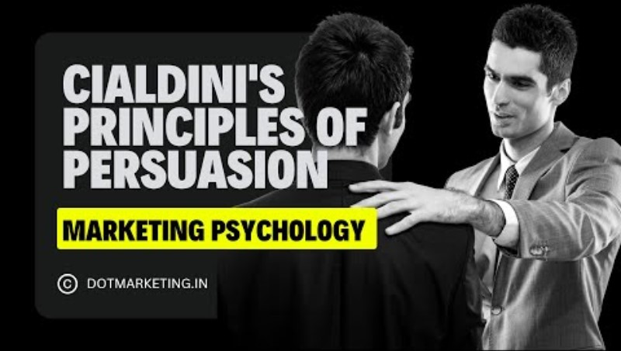
CSP002: Human Factors in Cybersecurity
Notes:
Schauen Sie sich bitte das komplette Video an – diese hier dargestellten Prinzipien werden nicht nur in Phishing, sondern generell in fast allen SE-Ansätzen verfolgt!
Die drei Prinzipien Social Proof (im Video: Consensus), Scarcity und Authority spielen bei Phishing, wo die bidirektionale Interaktion nicht gegeben ist, eine entscheidendere Rolle.
Das Video dauert knapp 12 Minuten und ist hier nur als Tipp zu verstehen (für die Wiederholung außerhalb der Veranstaltungszeit).

Slide 55
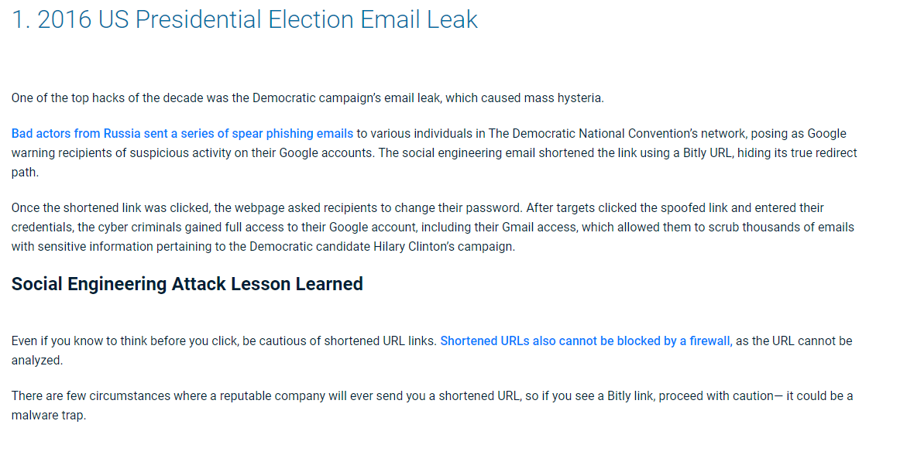
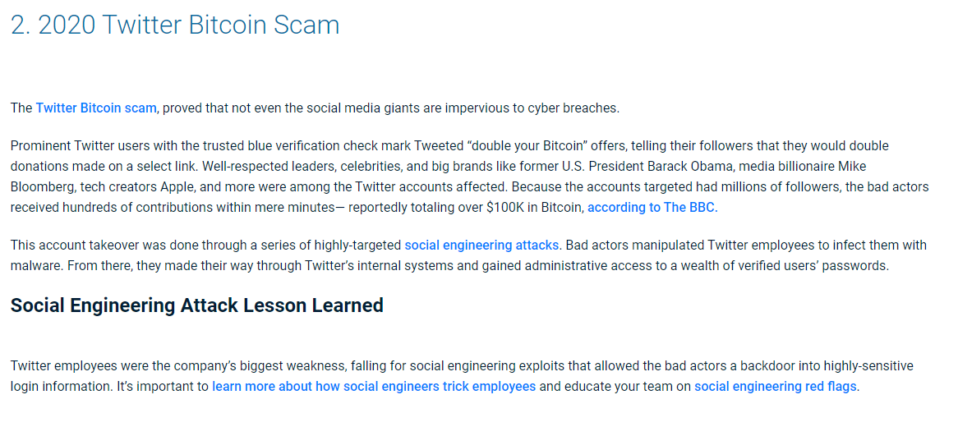
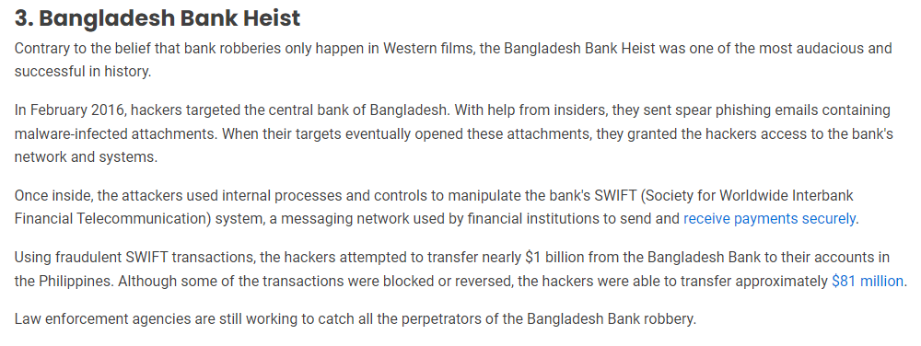

Slide 56
Complete recording can be found on youtube.
Call Between Alexey Navalny and FSB Officer Konstantin Kudryavtsev [English Subtitles] - YouTube
Notes:
Alle Links auf Slides werden im Chat via Zoom geteilt.
SE Gesprächstechniken sind die hohe Kunst des SE. Das Thema erreichte in 2020 große Bekanntheit nach dem Giftanschlag russischer Agenten auf den Oppositionellen Regimekritiker Nawalny, der danach von D. aus einen der FSB-Agenten die an der Vergiftungsaktion in Sibirien beteiligt waren auf dessen Handy anrief und sich für den Mitarbeiter eines Vorgesetzten ausgab und eine fast minutiöse Schilderung der Vorbereitung und Durchführung des Anschlags von ihm bekam.
Das vollstände Gespräch gibt es auf Youtube, Kommentare vom bekannten SE Experten Christopher Hadnagy finden sich im Teams-Ordner.

Slide 57

Mouton et al. (2016)

Slide 58

Mouton et al. (2016)

Slide 59

Cogntive exploits and attack vectors
Notes:
Red Arrow: an attacker that wages a social engineering cyberattack against a victim's human cognition functions (i.e., the oval). The resulting behavior is associated to persuasion (i.e., an attack succeeds when a victim is persuaded to act as intended by the attacker).
Cognitive workload, via mechanisms such as inattentional blindness, can increase vulnerability to social engineering cyberattacks.
Stress may reduce one's ability to detect deception cues in social engineering cyberattack messages but the direct effects of acute stress on cybersecurity social engineering have not been examined.
Attentional vigilance, particularly the vigilance decrement, may be an important influence on susceptibility to social engineering attacks, but more research is needed.
Literature results are not conclusive on how personality may influence one's susceptibility to social engineering cyberattacks.
Domain knowledge helps reduce vulnerability to social engineering cyberattacks.Awareness and general technical knowledge do not necessarily reduce one's susceptibility to social engineering cyberattacks, perhaps because human cognition functions have not been taken into consideration. Self-efficacy, knowledge, and previous encounter of social engineering cyberattacks collectively reduce one's susceptibility to social engineering cyberattacks. In particular, costly phishing experiences would greatly reduce one's susceptibility to social engineering cyberattacks, while non-costly experiences do not.
But Stefan will discuss this
Gender does not have a big impact on the susceptibility to social engineering cyberattacks
Old people with higher education, higher awareness and higher exposure to social engineering cyberattacks are less susceptible to these attacks.
Culture affects privacy and trust attitudes, which indirectly affect one's susceptibility to social engineering cyberattacks.
Long term memory The success of social engineering cyberattacks is inversely related to their prevalence.
Training methods that ask people to consciously think about social engineering cyberattacks are unlikely to be very successful unless the learning reaches the point where it is a habit that, largely unconsciously, guides safer computer use behavior.
Message quality and message appeal, which reflect attacker effort (e.g., using contextualization and personalization), have a significant impact on the attacker's success.
An individual's capabilities in detection of social engineering cyberattacks are affected by their awareness of the threats, their cultural backgrounds, and their individual differences in trust/suspicion.

Slide 60

Notes:
Parrish Jr, J. L., Bailey, J. L., & Courtney, J. F. (2009). A personality based model for determining susceptibility to phishing attacks. Little Rock: University of Arkansas, 285-296.
Personal factors are those that either cannot be changed or are extremely difficult to change and include gender, culture, and age. Experiential factors are those that shape an individual’s personality because of a past event or experience. The Big-Five personality profile classifies the personality differences of individuals among five broad factors as previously discussed. The framework proposes that each of these factors has a role to play with regards to the susceptibility of an individual to a phishing attack.
Kids increase A!
Non tech vs tech. Neg experiences
2 aspects : Susceptibility & Time for takedown
Dawson & Stewart 2018 - Moderating effects. Culture (UK vs USA), Age
a social influence, conformity, obedience, reactance, resistance and authority (Lindsey, 2005; Weatherby et al., 1999) b commitment, affection, normative, continuance, commitment and affective commitment (Allen and Meyer, 1990) c trust and vulnerability (Gendall, 2005) d threat (Pyszczynski et al., 1997)

Slide 61
Individual Vulnerabilities
Personality - a person’s relatively stable feelings, thoughts, and behavioural patterns
OCEAN/ FFM/ Big 5
(Costa & McRae, 1990)
Females higher in N & A
Bigger differences in egalitarian cultures
Notes:
DeYoung et al, 2007: These 10 facets were proposed in 2007 by psychologists Colin DeYoung, Lena Quilty and Jordan Peterson in their paper, "Between Facets and Domains: 10 Aspects of the Big Five." This version of the model is known as the Big Five Aspects Personality Test
Neuroticism is the tendency to feel that reality is a problem and to experience readily unpleasant emotions. People that possess high levels of neuroticism are generally sad and sometimes hot tempered Extraversion is the tendency to seek out the company of others and reflects energy and positive emotions in one’s personality. Extraverted personalities often seek excitement and tend to be dominant. Openness is the desire to seek out new experiences without anxiety and an appreciation of different ideas and beliefs. Individuals that exhibit high levels of openness revel in fantasy and appreciate art and nature. Agreeableness is a measure of the quality of the relationships a person has with others. If a person has a high level of agreeableness, they are compassionate and cooperative rather than antagonistic and suspicious. They believe that people they interact with are generally good intentioned and honest. Finally, conscientiousness focuses on self-discipline, dutiful action, and a respect for standards and procedures. These people are known for their prudence and common sense
Recent studies, however, have shown that our personalities do change beyond this age. Another study by Srivastava, Gosling, and Potter (2003) found that Conscientiousness and Agreeableness changed through early and middle adulthood. They also found that Neuroticism declined in females over time, while staying relatively stable in males. They report that their findings could be attributed to a variety of developmental influences such as experience in different areas that correlate with attainment of certain ages.

Slide 62
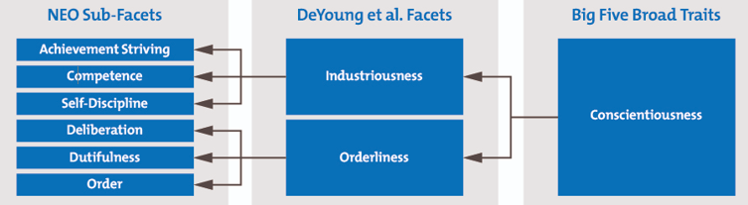
Conscientiousness Strengths & Vulnerabilities
C: High C = lower rates of SE exploitation
Age, standards and procedures
Dutifulness & Order: Continuance Commitment - FITD
Low C = less discipline, rule breaking
Notes:
Uebelacker, Sven, and Susanne Quiel. "The social engineering personality framework." 2014 Workshop on Socio-Technical Aspects in Security and Trust. IEEE, 2014.

Slide 63
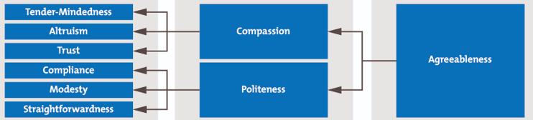
Agreeableness Strengths & Vulnerabilities
No protective aspects found
Trust, normative commitment (with E) with compliance & altruism
Notes:
Most associated with phishing

Slide 64
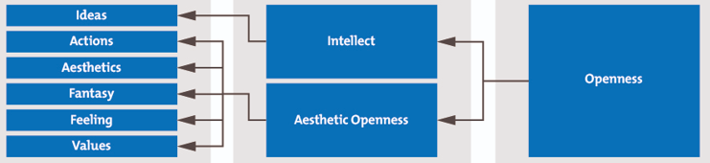
Openness Strengths and Vulnerabilities
High O: less violation of policies (values, actions)
Underestimate risk of new experiences.
Optimum stimulation level (Parrish et al. 2018)
Notes:
People with high openness values are less concerned about privacy problems associated with location-based services [36]. These people’s tendency to seek new experiences influences their risk evaluation [36]. This can be conveyed to SE that open individuals underestimate the risk of becoming a target and subsequently do not develop adequate coping strategies. Controversially, more open individuals are less likely to violate cyber-security policies. However, this effect is contradicted when personality is not evaluated
as direct influence but as a moderating factor. In this case, open individuals have been found to be more likely to violate
cyber-security policies
Openness also has impacts on technological experience in that it has been correlated with the optimum stimulation level (OSD) of individuals. Persons with higher OSD levels are more exploratory and thus spend more time engaging in exploratory behaviors with technology to reach their level of optimum stimulation

Slide 65
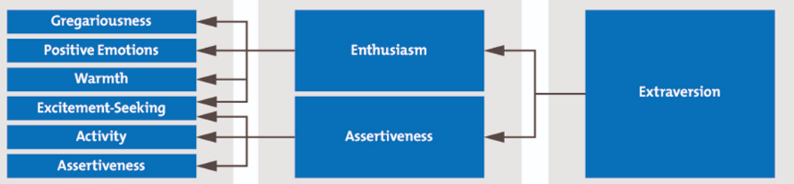
Extraversion Strengths and Vulnerabilities
Low E - Lower risk (More introverted); High E + low preference for consistency
Affective & normative commitment (with A)
Group that is very susceptible for SE
Notes:
Extraversion. Extraverted individuals are becoming a higher security risk [10]. Extraverted persons are also more likely to violate cyber-security policies, thus, accepting to disobey policies in order to comply to (malicious) requests [32]. Workman [7] investigated the effect of different types of commitment to SE susceptibility. He ascertains that people with high affective commitment as well as high normative commitment are more likely to

Slide 66
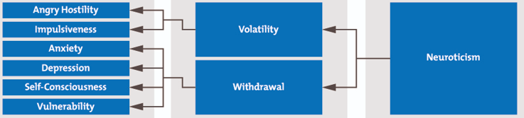
Neuroticism Strengths & Vulnerabilities
Protective in general
Fear driven

Slide 67
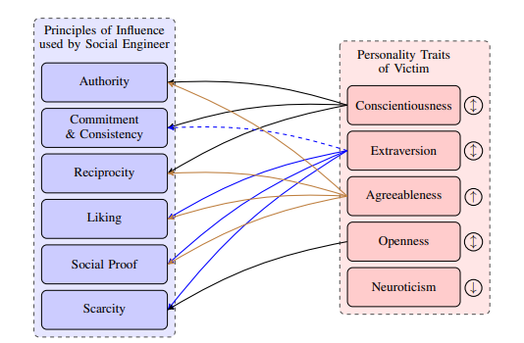
Social Engineering Personality Framework (SEPF)
Attack:
C: rules
E: Excitement
A: Many ways in…
O: Scarcity - restrict freedom
N: Protective factors
Notes:
C. SE that exploits rules makes C more vulnerable - i.e. Commitment and consistency, reciprocity & authority. Inoculated against social proofing, liking, scarcity
A: information if a social engineer established a trust relationship. Regarding the principles of influence, we expect an increased vulnerability towards authority, reciprocity, liking, and social proof.

Slide 68
Stajano & Wilson principles
Distraction
Divert attention buy keeping victim busy with a burdensome and important task. Example: fill in online forms.
Social compliance
Following authority (comp. Cialdini’s consistency & commitment). Example: spearfishing a subordinate by impersonating a leader.
Herd principle
Use majority of others as reference point. Example: Rate someone’s credibility by number of friends - fake account.
Dishonesty
Victims can not complain if they broke the rules. Example: Prepaid card generator.
Need and Greed
Exploiting victim’s current needs, greeds, or interests. Example: Fake password manager.
Time
Like “scarcity” -> Setting people under time pressure hinders System-2 engagement. Example: Various phishing mail ex.

Slide 69
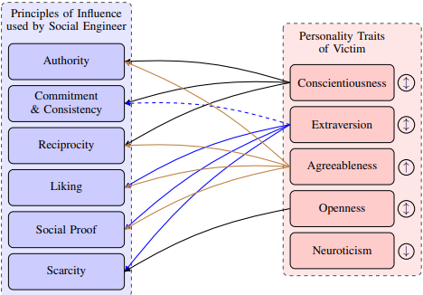

Notes:
Parrish Jr, J. L., Bailey, J. L., & Courtney, J. F. (2009). A personality based model for determining susceptibility to phishing attacks. Little Rock: University of Arkansas, 285-296.
Personal factors are those that either cannot be changed or are extremely difficult to change and include gender, culture, and age. Experiential factors are those that shape an individual’s personality because of a past event or experience. The Big-Five personality profile classifies the personality differences of individuals among five broad factors as previously discussed. The framework proposes that each of these factors has a role to play with regards to the susceptibility of an individual to a phishing attack.
Kids increase A!
Non tech vs tech. Neg experiences
2 aspects : Susceptibility & Time for takedown
Dawson & Stewart 2018 - Moderating effects. Culture (UK vs USA), Age
a social influence, conformity, obedience, reactance, resistance and authority (Lindsey, 2005; Weatherby et al., 1999) b commitment, affection, normative, continuance, commitment and affective commitment (Allen and Meyer, 1990) c trust and vulnerability (Gendall, 2005) d threat (Pyszczynski et al., 1997)
Attack:
C: rules
E: Excitement
A: Many ways in…
O: Scarcity - restrict freedom
N: Protective factors

Slide 70

Phishing mails and repeat offenders
Canham, 2019; The Enduring Mystery of the Repeat Clickers

Slide 71
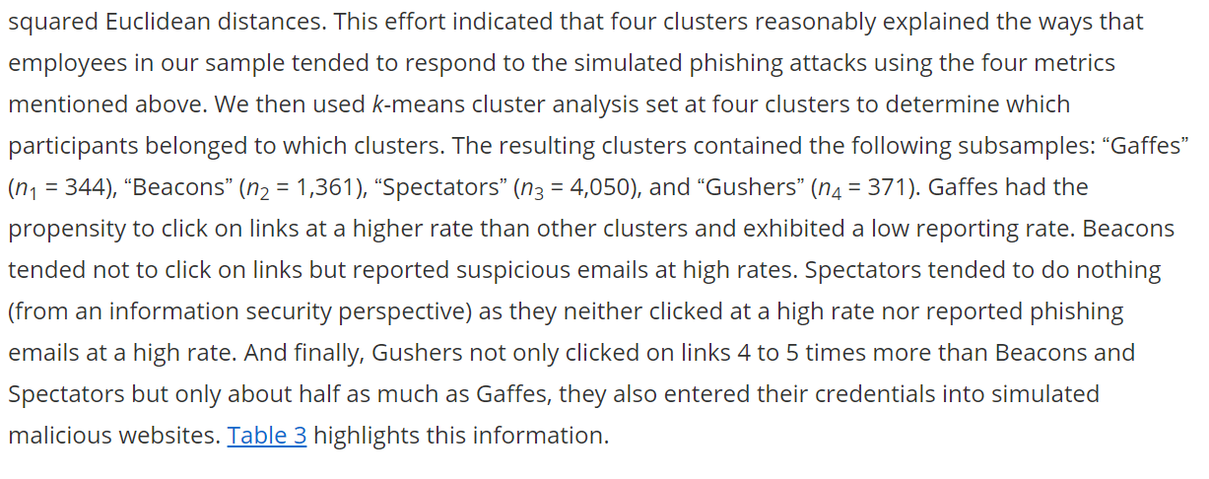

Slide 72
Cogntive exploits and attack vectors
Notes:
Red Arrow: an attacker that wages a social engineering cyberattack against a victim's human cognition functions (i.e., the oval). The resulting behavior is associated to persuasion (i.e., an attack succeeds when a victim is persuaded to act as intended by the attacker).
Cognitive workload, via mechanisms such as inattentional blindness, can increase vulnerability to social engineering cyberattacks.
Stress may reduce one's ability to detect deception cues in social engineering cyberattack messages but the direct effects of acute stress on cybersecurity social engineering have not been examined.
Attentional vigilance, particularly the vigilance decrement, may be an important influence on susceptibility to social engineering attacks, but more research is needed.
Literature results are not conclusive on how personality may influence one's susceptibility to social engineering cyberattacks.
Domain knowledge helps reduce vulnerability to social engineering cyberattacks.Awareness and general technical knowledge do not necessarily reduce one's susceptibility to social engineering cyberattacks, perhaps because human cognition functions have not been taken into consideration. Self-efficacy, knowledge, and previous encounter of social engineering cyberattacks collectively reduce one's susceptibility to social engineering cyberattacks. In particular, costly phishing experiences would greatly reduce one's susceptibility to social engineering cyberattacks, while non-costly experiences do not.
But Stefan will discuss this
Gender does not have a big impact on the susceptibility to social engineering cyberattacks
Old people with higher education, higher awareness and higher exposure to social engineering cyberattacks are less susceptible to these attacks.
Culture affects privacy and trust attitudes, which indirectly affect one's susceptibility to social engineering cyberattacks.
Long term memory The success of social engineering cyberattacks is inversely related to their prevalence.
Training methods that ask people to consciously think about social engineering cyberattacks are unlikely to be very successful unless the learning reaches the point where it is a habit that, largely unconsciously, guides safer computer use behavior.
Message quality and message appeal, which reflect attacker effort (e.g., using contextualization and personalization), have a significant impact on the attacker's success.
An individual's capabilities in detection of social engineering cyberattacks are affected by their awareness of the threats, their cultural backgrounds, and their individual differences in trust/suspicion.

Slide 73


Slide 75
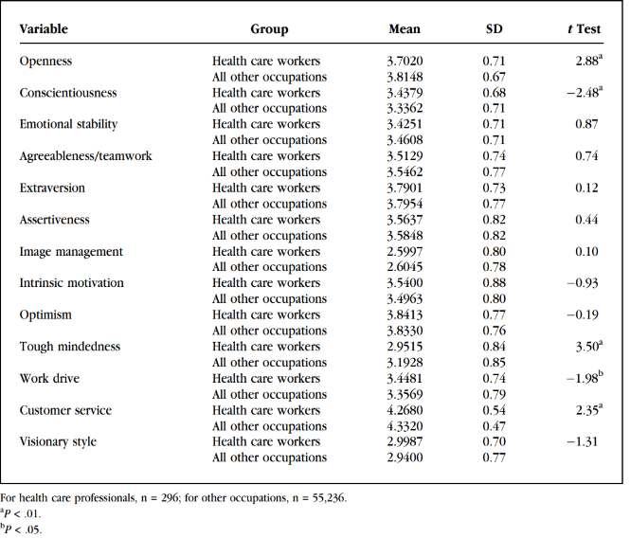
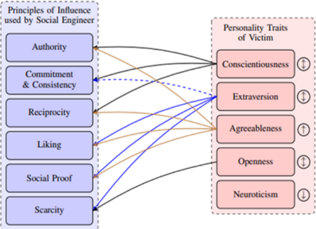
Healthcare worker profiles
Females are 70% of healthcare workforce
Females higher in Neuroticism, Agreeableness, warmth (an extraversion facet) and openness to feelings
Men higher assertiveness (a facet of extraversion) and openness to ideas
Gender differences largest in egalitarian cultures
Notes:
Richardson, J. D., Lounsbury, J. W., Bhaskar, T., Gibson, L. W., & Drost, A. W. (2009). Personality Traits and Career Satisfaction of Health Care Professionals. The Health Care Manager, 28(3), 218–226. doi:10.1097/hcm.0b013e3181b3e9c7

Slide 76
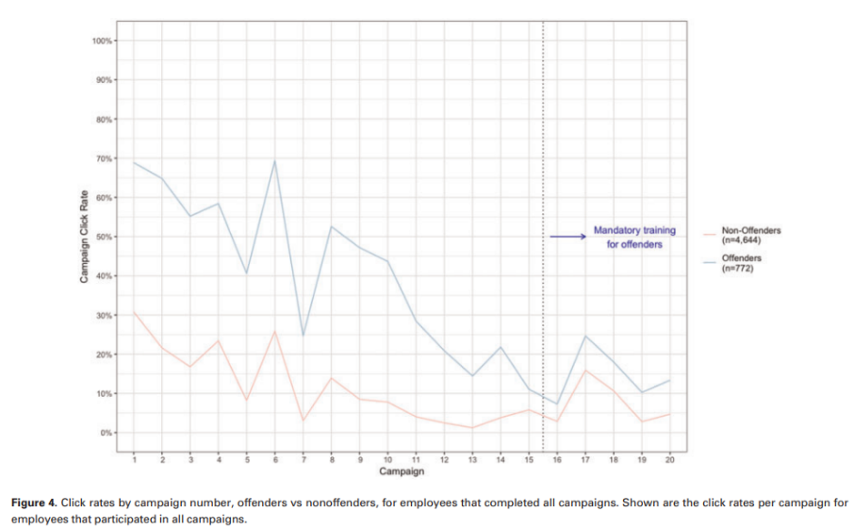
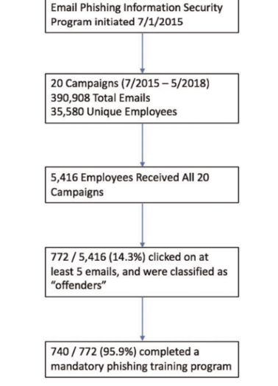
Healthcare workers and repeat clicking
(Gordon et al., 2019)
Notes:
Gordon, W. J., Wright, A., Glynn, R. J., Kadakia, J., Mazzone, C., Leinbach, E., & Landman, A. (2019). Evaluation of a mandatory phishing training program for high-risk employees at a US healthcare system. Journal of the American Medical Informatics Association, 26(6), 547-552.
click rates are alarmingly high, but generally improve with repeated simulated phishing campaigns.
the mandatory training program for employees who clicked on 5 or more simulated phishing campaigns itself did not have a meaningful impact on click rates—the “offenders” remained more likely to click on phishing emails than nonoffenders did, with click rates between 10% and 25% post-training.
The real-time training (provided after an employee clicked on any phishing simulation) may have been more effective at narrowing the gap between offenders and
Because it only takes 1 successful phishing attack to cause substantial damage to a healthcare organization, these click rates (with or without training) are highly concerning.

Slide 77

Familiar examples

Slide 78
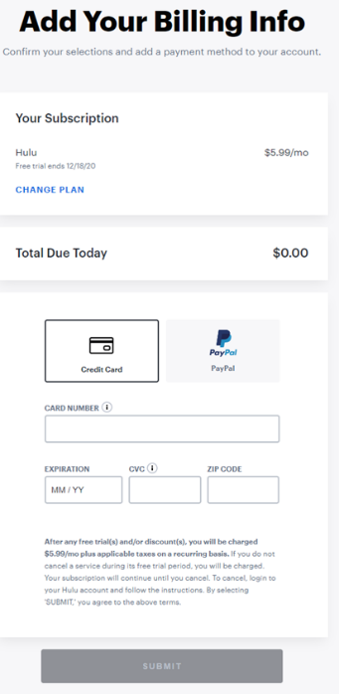
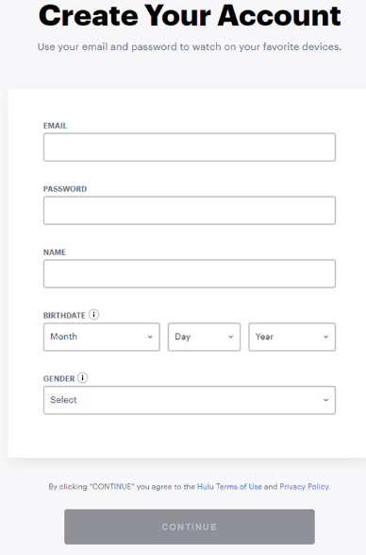



Example Persuasion Technique: Foot-in-the-door
Notes:
Consiency & Commitment: Foot-in-the-door: breaking up single-page forms into multi-step forms. Multiple steps create a sense of process that draws visitors through to completion
an initial question (or three or five) that asks for non-identifiable information. At the completion of the process, visitors submit contact information to receive results
The initial requests are essential disclosures for users to get the answer they want, and until the end of the process, users are uncertain that they’ll even need to enter personally identifiable information. Only then—after having taken all but the last step—are they prompted for contact information.
KlientBoost: from 62%- 381 %

Slide 79



Confirmshaming
Shame: The ‘Master’ emotion. Holds social bonds together(Scheff, 2002)
Notes:
Candy Crush is forced continuity

Slide 80

Framing Effects
The framing effect is when our decisions are influenced by the way information is presented. Equivalent information can be more or less attractive depending on what features are highlighted.
Induce system 1, more peripheral evaluations
Biases
Notes:
The most common framing draws attention to either the positive gain or negative loss associated with an option. We are susceptible to this sort of framing because in accordance with “prospect theory,” we tend to avoid certain losses. A loss is perceived as more significant, and therefore more worthy of avoiding, than an equivalent gain. The way something is framed can influence our certainty that it will bring either gain or loss. This is why we find it attractive when the positive features of an option are highlighted instead of the negative ones.
“Heuristics” or mental shortcuts might also play a role. Due to the availability heuristic, we favor information that is easily understood and recalled. Options and information that is framed this way are favored over those that aren’t. The affect heuristic may cause us to favor information and options that are framed to elicit an immediate emotional response. Research has shown that framing relies on emotional appeals and can be designed to have specific emotional reactions.

Slide 81



Influence: Consistency and Commitment
& Mere Exposure effects
Notes:
Bakshy, E., Messing, S., & Adamic, L. A. (2015). Exposure to ideologically diverse news and opinion on Facebook. Science, 348(6239), 1130-1132.
Facebook algorithms and consumer choices were measured to see what decided the content shown in feeds. Humans made more ideological consistent choices. Seeing cross-cutting content relative to ideologically consistent content is 5% for conservatives and 8% for liberals. Clicking: comparing the likelihood that an individual clicks on a cross-cutting content relative to a consistent content to be 17% for conservatives and 6% for liberals, a pattern that is consistent with prior research, but is somewhat counterintuitive

Slide 82


Forced Choices

Slide 83

Scratch my back,
I scratch yours
(Happ et al., 2016)
9 out of 10 people reveal personal information to online strangers when given some chocolate
  4 out of 10 within 2 minutes
  Stronger when given right before asking for passwords (50%)
Risk factors:
  Men
  Younger age

Slide 84





What to attack??

Slide 85
Cogntive exploits and attack vectors
Notes:
Red Arrow: an attacker that wages a social engineering cyberattack against a victim's human cognition functions (i.e., the oval). The resulting behavior is associated to persuasion (i.e., an attack succeeds when a victim is persuaded to act as intended by the attacker).
Cognitive workload, via mechanisms such as inattentional blindness, can increase vulnerability to social engineering cyberattacks.
Stress may reduce one's ability to detect deception cues in social engineering cyberattack messages but the direct effects of acute stress on cybersecurity social engineering have not been examined.
Attentional vigilance, particularly the vigilance decrement, may be an important influence on susceptibility to social engineering attacks, but more research is needed.
Literature results are not conclusive on how personality may influence one's susceptibility to social engineering cyberattacks.
Domain knowledge helps reduce vulnerability to social engineering cyberattacks.Awareness and general technical knowledge do not necessarily reduce one's susceptibility to social engineering cyberattacks, perhaps because human cognition functions have not been taken into consideration. Self-efficacy, knowledge, and previous encounter of social engineering cyberattacks collectively reduce one's susceptibility to social engineering cyberattacks. In particular, costly phishing experiences would greatly reduce one's susceptibility to social engineering cyberattacks, while non-costly experiences do not.
But Stefan will discuss this
Gender does not have a big impact on the susceptibility to social engineering cyberattacks
Old people with higher education, higher awareness and higher exposure to social engineering cyberattacks are less susceptible to these attacks.
Culture affects privacy and trust attitudes, which indirectly affect one's susceptibility to social engineering cyberattacks.
Long term memory The success of social engineering cyberattacks is inversely related to their prevalence.
Training methods that ask people to consciously think about social engineering cyberattacks are unlikely to be very successful unless the learning reaches the point where it is a habit that, largely unconsciously, guides safer computer use behavior.
Message quality and message appeal, which reflect attacker effort (e.g., using contextualization and personalization), have a significant impact on the attacker's success.
An individual's capabilities in detection of social engineering cyberattacks are affected by their awareness of the threats, their cultural backgrounds, and their individual differences in trust/suspicion.

Slide 87

4 Horsemen of Social Cognition
Naïve researchers
  Use rational, scientific like approaches, cause-effect analysis to understand environment
Cognitive Misers
  Use the least possible for best result
Cognitive consistency
  We like what agrees with us
Motivated tacticians
  Several available strategies, and we choose from goals, needs, or other motives
Usability Principles
Learnability (How quickly can I learn it?)
Efficiency (How quick will I reach my goal?)
Memorability (Easyness of use after a time of absence.)
Errors (How often do I do sth wrong and how easy can I correct myself?)
Satisfaction (How pleasant is the use?)
Notes:
= easiness and pleasantness of use.
1.Learnability (How quickly can I learn it?)
2.Efficiency (How quick will I reach my goal?)
3.Memorability (Easyness of use after a time of absence.)
4.Errors (How often do I do sth wrong and how easy can I correct myself?)
5.Satisfaction (How pleasant is the use?)

Slide 88


Cognitive Dissonance - Cognitive Misers
How long does it take t read a privacy policy (PP)?
Terms of Service (TOS)?
Notes:
●Obar, J. A., & Oeldorf-Hirsch, A. (2020). The biggest lie on the internet: Ignoring the privacy policies and terms of service policies of social networking services. Information, Communication & Society, 23(1), 128-147.●
●Researchers at two universities conducted a study where they asked students to join a fictitious networking website, and as part of the process, asked the participants to agree to terms of service that included the following:
●Terms of use ca. 30 min (privacy policy) & ca 15 Terms of Service: Avg reading time: 77 sec (PP) & 51s TOS
●N=543
●Qualitative findings suggest that participants view policies as nuisance, ignoring them to pursue the ends of digital production, without being inhibited by the means. Implications are revealed as 98% missed NameDrop TOS ‘gotcha clauses’

Slide 89



Who are the attackers

Slide 90
Profiles
Motivations:
  Financial Gain: Many attackers are motivated by financial incentives
  Hacktivism: Some attackers engage in cyberattacks to promote a social or political agenda, often using digital means to make a statement.
  Curiosity: Curiosity-driven attackers, often referred to as "script kiddies," explore vulnerabilities for the thrill of it
  Espionage: State-sponsored attackers or cyber spies aim to gather intelligence, classified information, or trade secrets.
Psychological Characteristics:
  Anonymity
  High Intelligence
  Risk-Taking
  Lack of Empathy
Attack Techniques:
  Phishing: Attackers often use social engineering techniques to trick individuals into revealing sensitive information or clicking on malicious links.
  Malware: Attackers deploy various types of malicious software, like viruses, worms, and Trojans, to compromise systems and steal data.
  Advanced Persistent Threats (APTs): State-sponsored attackers employ APTs to infiltrate and maintain long-term access to target systems discreetly.
Psychological Factors:
  sense of power and control when successfully breaching systems, leading to a cycle of addiction to cybercrime.
  justify their actions by believing they are exposing vulnerabilities or fighting for a cause they deem just.

Slide 91



(very) little examples

Slide 92

Other Factors

Slide 93

The Dark Tetrad/Triad
Psychopathy involves impulsivity, superficial charm, and a disregard for consequences, making individuals prone to reckless crimes.
Narcissism is driven by overconfidence and entitlement, leading to impulsive decisions and antisocial actions when they feel denied what they believe is deserved.
Machiavellianism is characterized by calculated dishonesty and strategic adaptability, engaging in antisocial behavior when it offers long-term benefits.
Sadism is characterized by deriving pleasure from causing others harm or suffering, and individuals with high levels of sadism often engage in cruel and harmful behaviors for personal enjoyment.
Notes:
The Dark Tetrad traits—psychopathy, narcissism, Machiavellianism, and sadism—are all associated with antisocial behavior, driven by manipulation, lack of empathy, and cruelty.
Psychopathy involves impulsivity, superficial charm, and a disregard for consequences, leading to reckless and versatile criminal behavior.
Narcissism is driven by overconfidence and entitlement, causing impulsive actions and antisocial behavior when individuals feel they are denied what they believe they deserve.
Machiavellianism is marked by calculated dishonesty and strategic manipulation, engaging in antisocial behavior when it offers long-term benefits.
Sadism is characterized by deriving pleasure from causing others harm or suffering, and individuals with high levels of sadism often engage in cruel and harmful behaviors for personal enjoyment.
Together, these traits predict unethical, aggressive, and criminal behaviors, including white-collar crimes, manipulation, and various forms of cruelty, with psychopathy and sadism showing the most direct pleasure in causing harm.

Slide 94


Psychoticism and Sports
Adaptive in sports
Aggresion
Machiavellianism (the ‘Dark Triad’)
  Manipulation, power seeking
  E = social influence

Slide 95





Notes:
1: results clearly show the link betweenthe dark triad and intentions to engagein malicious insider threat behavior.While there are strong, positive relationa raise, accessed a restricted databasethat had been left open inadvertently anddiscovered that several peers had 20%higher salaries than the employee

Slide 96






Slide 97
Alright… personality factors can tell a bit about a person‘s vulnerability…
But how do they know about someone‘s personality?
Notes:
-> Kritisch gegenüber Vereinfachungen sein.
-> Neuere technische Entwicklungen bedenken, die diese Verhältnisse (nachhaltig) verändern könnten. Welche könnten dies sein?

Slide 98

The Future
Semi-automatised analyzing tools establish profiles of humans‘ digital pluridentities (multiple digital personas) via collection, combination and thus generation of overexposures.
The emergent information allows for improved accurate personality profiling enabling the optimization of spear-phishing attacks.
The combination and progressing automatization of personality profiling and OSINT techniques can allow for higly automatized „mass spear phishing“ campaigns with increased hit rates.
Notes:
Nach diesen Studien – und es gäbe noch viele mehr in diesem Zusammenhang die ähnliches gemacht haben - die alle versuchten den Zusammenhang zwischen Persönlichkeit und Social Engineering Anfälligkeit zu beschreiben, liegt es auf der Hand, Menschen VOR einer Attacke zu profilien. Da sehr viele Menschen sehr viel Informationen im Internet über sich preisgeben – und vieles auch ohne deren Wissen oder expliziter Zustimmung, gibt es in der letzten Zeit Diskussionen darüber wie Soziale Netzwerkseiten genutzt werden können um Menschen zu profilen, ein Risikoprofil zu erstellen um dieses dann mit gezielt und zunehmend personalisierter durch Phishing-Aktionen oder andere SE Techniken auszunutzen. Das entspräche dann einer Art Massen-Spear-Phishing. Diese Kombination aus semi-automatisierter OSINT mit den entsprechenden Crawlern und Tools aus der OSINT-Kiste gepaart mit dem gesicherten und replizierten Wissen aus der persönlichkeitspsychologischen Forschung könnte die hit rates entsprechender Attacken erhöhen – oder auf der anderen Seite ließen sich Risikoprofile von Personen erstellen, die evtl. Opfer von SE werden könnten – bspw. wenn es um den Zugang zu vertraulichen Informationen und Sicherheitsabklärungen geht.

Slide 99
Personality, Social Networks, and their social engineering potential
Applying OSINT methods to combine digital identities („pluridentities“) to generate emergent system characteristics indicating overexposure.
  Collect available data (Classic OSINT tools) & SE attack frameworks.
  Combine and generate new data (super identities)
  Analyse vulnerabilities (e.g. knowledge based verifications, fake-delivery phishing etc)
Olivero (2020)
Notes:
In such a scenario or following models as recently proposed by Olivero, one would summarize the digital identities of humans and interpret them as systems of systems and apply algorithms in a systems engineering approach that include all three stages of collecting the data, combining and thus generating new, emergent information, and finally vulnerability analysis.
And then? Create a website that catches that person's interest or pretend to be someone more likely to get their trust (classmate) etc.

Slide 100

Patented automated spear-phishing technology

Slide 101




Slide 102

Notes:
he results show that we successfully predicted levels of Big Five personality traits from behavioral patterns, derived from smartphone data, for more than half ofthe domains and facets (57% of all personality dimensions). We found performance levels across all significant models (range = [0.20, 0.40]) to be on average similar to those identified in a metaanalysis of previous studies predicting personality from digital footprints, which reported a mean effect size of r = 0.34 (1). consider that the highest median effect size (rmd = 0.40) is comparable to the tendency of people in a bad mood to be more aggressive than people in a good mood, and the smallest significant effect size is equal to the average reported effect size in personality psychology (42). These performance levels highlight the practical relevance of our results beyond significance.
At the same time, we should not underestimate the potential negative consequences of the routine collection, modeling, and uncontrolled trade of personal smartphone data (20, 21, 47). For example, organizations and companies can obtain information about individuals’ private traits (e.g., the Big Five personality traits), without the personality information ever being deliberately provided or explicitly requested (48). Mounting evidence suggests that these data can and are being used for psychological targeting to influence people’s actions, including purchasing decisions (5, 47) and potentially voting behaviors, which are related to personality traits (49, 50).Many commercial actors already collect a subset of the behavioral data that we have used in this work using publicly available applications (20). In academic settings, such data collection requires institutional review board (IRB) approval of the research study. However, current data protection laws in many nations do not adequately regulate data collection practices in the private sector. For example, in online real-time bidding on advertisements multiple actors exchange cross-device data to win bids to cater personalized ads to single users; this process is complex, happens within milliseconds, and is poorly understood outside of the industry (47). In such cases, once the data are collected from people’s smartphones, the data’s distribution seems to largely escape legislative oversight and legal enforcement (21,47). This is the case even though legal frameworks against the routine collection of these data exist (e.g., the General Data Protection Regulation [GDPR] in the European Union; ref. 51)and reflects the growing asymmetry between one-click privacy permissions and the untraceable ways behavioral data from peoples’ phones can wander.

Slide 103



Notes:
With the exception of the cheerfulness facet (rmd = 0.16, rsd =0.12), the personality trait of extraversion (rmd = 0.37, rsd = 0.09)and its facets were successfully predicted above baseline. Most notably, the facet of sociableness was predicted with the highest performance of all criteria (rmd = 0.40, rsd = 0.10). Besides sociableness, the facets friendliness (rmd = 0.24, rsd = 0.09),assertiveness (rmd = 0.29, rsd = 0.11), dynamism (rmd = 0.29,rsd = 0.10), and adventurousness (rmd = 0.29, rsd = 0.11) were predicted above baseline.Behavioral patterns and class importance (unique and combined) in Fig. 2 suggest that variables related to communication and social behavior (e.g., higher mean number of outgoing calls per day, higher irregularity of all calls, higher mean number of WhatsApp uses per day) were important in the prediction of higher scores in the models of extraversion and its facets. Red circles indicate significant effects tested with the PIMP algorithm. For the personality dimension of emotional stability, onlythe facets of carefreeness (rmd = 0.22, rsd = 0.10) and selfconsciousness (rmd = 0.32, rsd = 0.09) were predicted significantly. Behavioral patterns in Fig. 2 are rather distinct forthe individual facets of emotional stability. Whereas communication and social behavior were significantly predictive forthe facet self-consciousness (e.g., higher number of calls), themodel of carefreeness did not show any significant effects atthe class level.In summary, all behavioral classes had some impact on theprediction of personality trait scores (as seen in Fig. 2). However, behaviors related to communication and social behaviorand app usage showed as most significant in the models.

Slide 104
Summary Personality in SE
Personality profiles can – if accurately assessed - be relatively stable predictors for phishing susceptibility. Effect sizes are moderate and need to consider situational circumstances. However, when being produced in large numbers, this factor becomes very valuable.
As larger the psychological pressure (induced emotional arousal such as anxiety or time pressure in high-stake situations), as less relevant the personality aspect becomes, as more predictable and uniform human behavior becomes („amygdala hijacking“).
In the near future, one can expect increasing reliability of (semi-) automatized technical solutions collecting and analysing publicly available data (e.g. from social media) to approximate reliable personality profile and target persons individually („mass-spearphishing“).

Slide 105
Personality Interactions
Which role do these personality traits play in regards to phishing success and susceptibility?
Previous research (Cho, Cam & Oltramari, 2016):
Agreeableness -> perceive trust
Neuroticism -> risk taking
But how about the attacker->victim combination?
Curtis et al. (2018)
Notes:
The question in this study by Curtis was what role the Dark Triad plays on the side of the attackers and the potential victims, i.e. recipients of phishing emails.
We know from various previous studies conducted after the publication of the previously mentioned framework that agreeable people (high in agreeableness) tend to underestimate dangers due to their leap of faith. Neuroticists tend to be suspicious and therefore protected, but can also tend to take greater risks when fear is induced. But what about the Dark Triad and the view of both sides, attacker and victim?
For this purpose, a study was conducted that simulated phishing emails in which test participants were supposed to slip into either the attacker or victim role, whereby emails were roughly predetermined, but could be further modified by the attackers. The extent of the changes and perfections was understood as "malignant energy", i.e. motivation to exploit, harm and profit.

Slide 106


The „master switch“
Notes:
By the way, here are two small screenshots of emails I received from the research network site "academia.edu" - a social network for people with an interest in research. You can only access the site if you have a paid account - which I don't - but the email doesn't tell you who became aware of your naturally extremely high quality, groundbreaking and world-changing research. These emails are legitimate, not phishing, but dark patterns work along the same lines. As I said, narcissists are not uncommon in academic professions and are a secure source of income.-> It should not be too difficult to use OSINT methods to assess narcissism or identify the most narcissistic person within a public-facing organization. E.g. obvious effort to appear in public, website maintenance, dress, formality (title, email signatures), private websites, - often in combination with extraversion (more data is available, and less distrust of others is expected, as well as more need for recognition by others).>90% hit rate in a UCF study: leaked exam questions from "professorial accounts" (misdirected email)

Slide 107

Thank you

