Slide 1
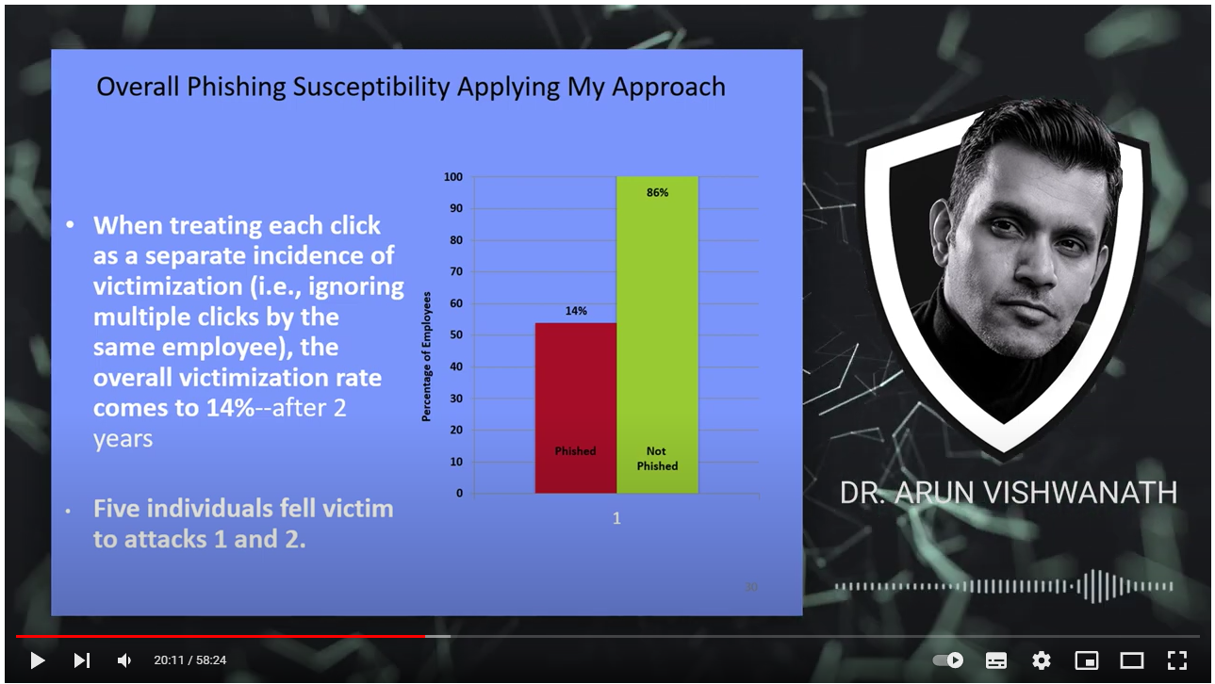


Arun is probably the most cited researcher in „phishing and what you can (not) do against it“
Your task:
Extract the „highlights“ and most important parts of this talk and write them down as bullet points.
Try to summarize the most important elements and underlying assumptions of the proposed „Cyber Risk Index“.
Arun likes to provoke, and he isn‘t exactly shy. Identify statements and claims, with which you would agree – and with which you would disagree. Provide a reason or argument (also own experience, if you like).
Think about a question that you would like to ask Arun, if you were to meet him.
(1157) The Weakest Link and Beyond w/ Dr. Arun Vishwanath | CSI Talks #5 - YouTube

