Slide 1



Topic 13: Designing training and education for CS – Human aspects (double lesson)
Presentation by:
RicardoLugo

Slide 2
Acknowledgement
Co-funded by the European Union. Views and opinions expressed are however those of the author(s) only and do not necessarily reflect those of the European Union or HADEA. Neither the European Union nor the granting authority can be held responsible for them.
Project Agreement no. 101083594

Slide 3
Digitalization in health sector...
… is already changing the work of healthcare professionals
More efficient administration of patient/user data
Data are available instantly and everywhere
Data can be combined and exchanged
Central databases of electronic health records allow for improved research and improved healthcare services via faster and more accurate diagnoses
Cost-efficient non-local interdisciplinary consultation and cooperation
Cost-efficiency
Reaching disadvantaged and structurally weaker or very remote geographical spheres
Notes:
Accessible. Kan make expertise more available to previously hard to reach areas, i.e remote areas, developing countries etc

Slide 4
Digitalization in health sector...
… means increased vulnerability
Data storage in centralized or highly interconnected digital infrastructures
Patient-centered medicine requires autonomy of the patient and the patient’s access to his/her personal data
Ambulatory data collection increases the amount of sensitive data
Insight into patient documentation and personal or anonymized data by various actors, such as insurances, healthcare professionals of various institutions, organisations
Need for constantly updated and modernized hard- and software

Slide 5

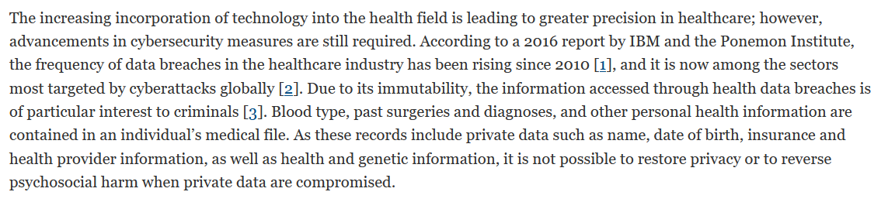
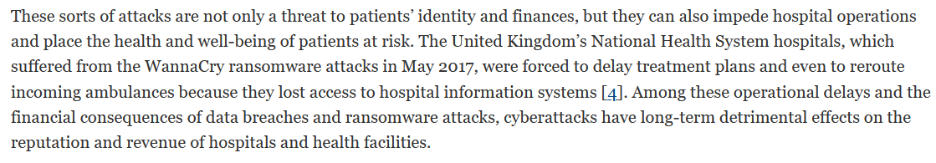

Slide 6
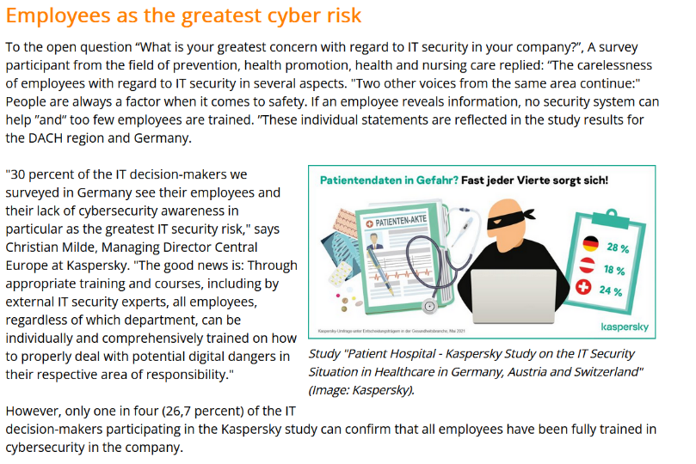
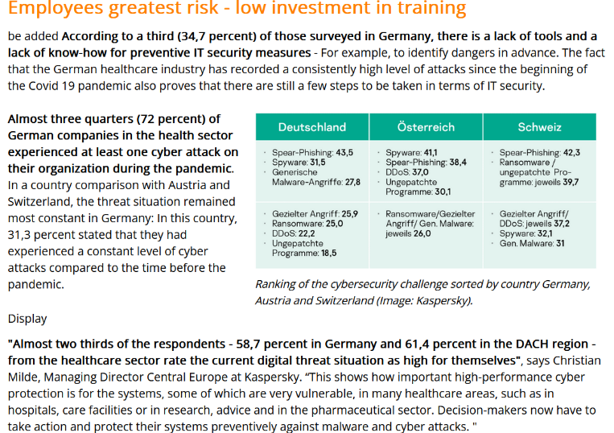
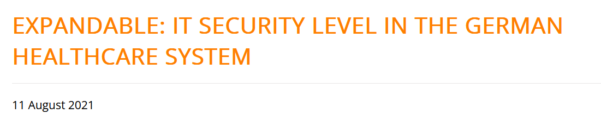
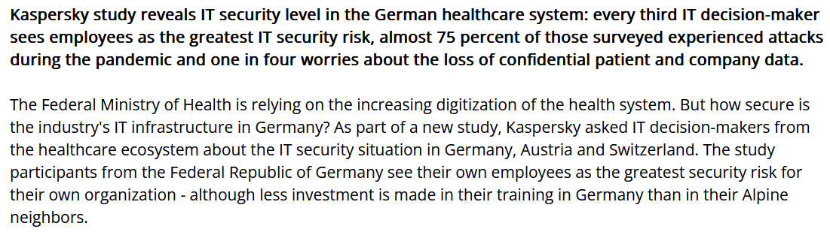

Slide 7
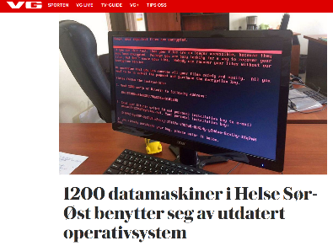
(Known) data breaches
Between 2010 and 2017: 176 million patient records got “stolen” (breached)
Total number of breaches doubles every few years
WannaCry ransomware attack 2017: 230,000 windows systems in 150 countries
2018: health records of 2.9 million Norwegians were taken (more than half of the population) while health authorities in 2017 still used Windows XP, three years after Microsoft ceased its support
Notes:
Cyber attack from russia - wanted to know about nato military staff. Military espionage targeting health care system

Slide 8
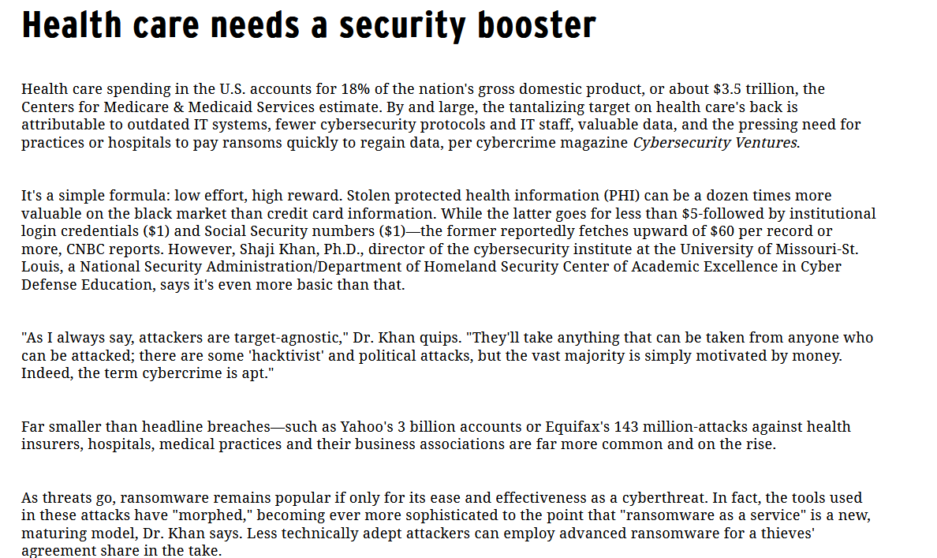
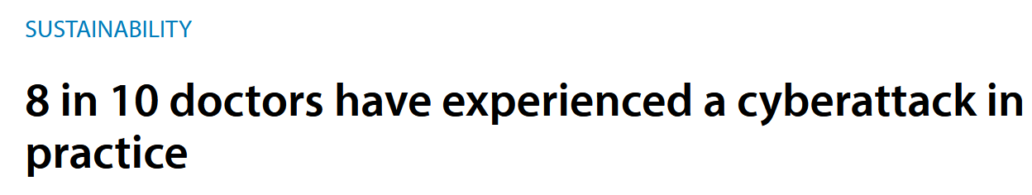

Slide 9
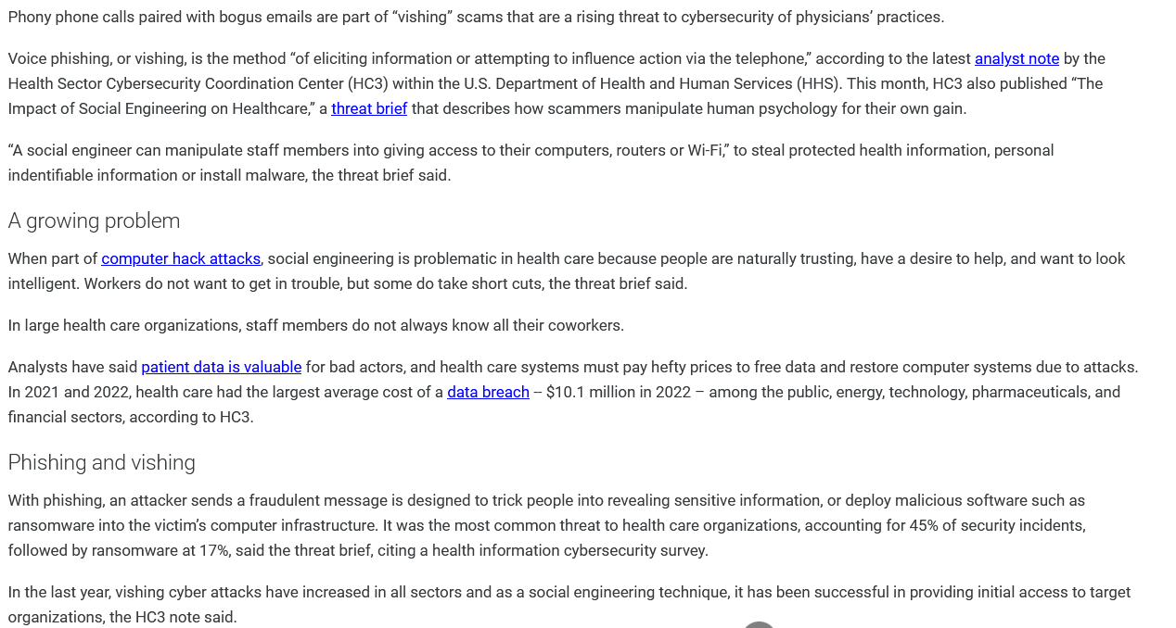

Slide 10
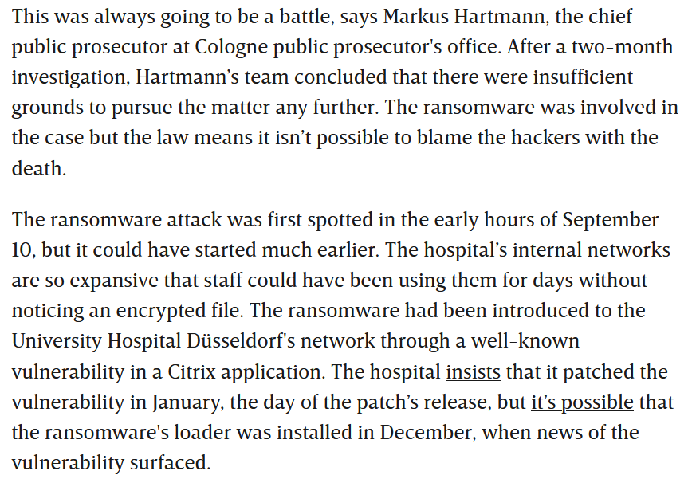
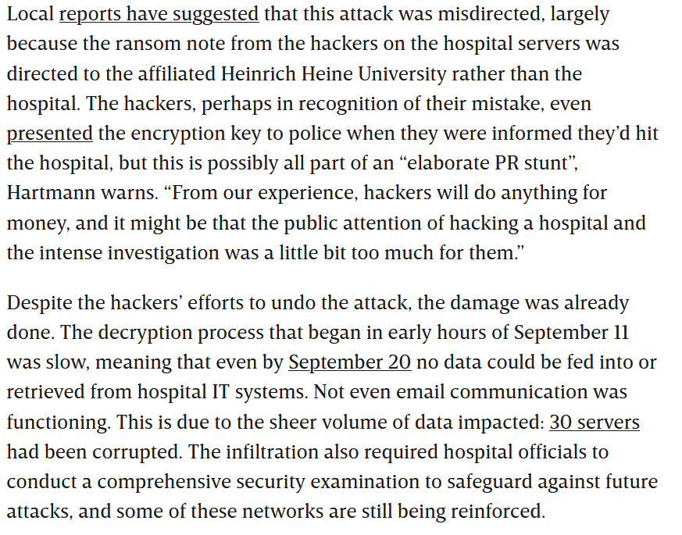
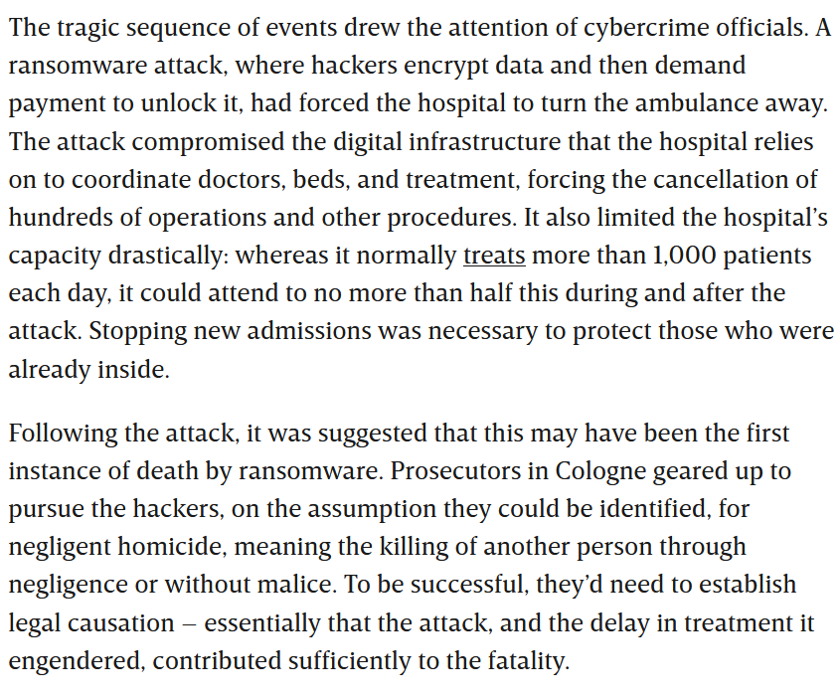

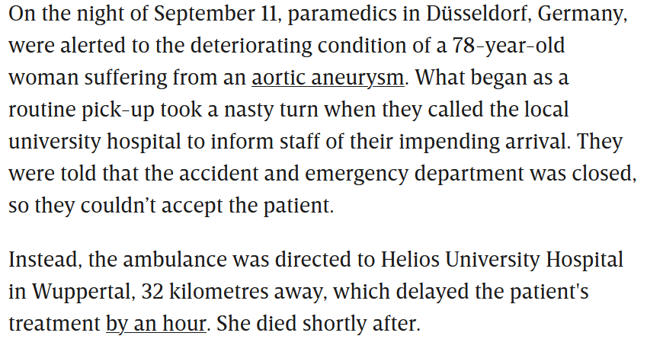
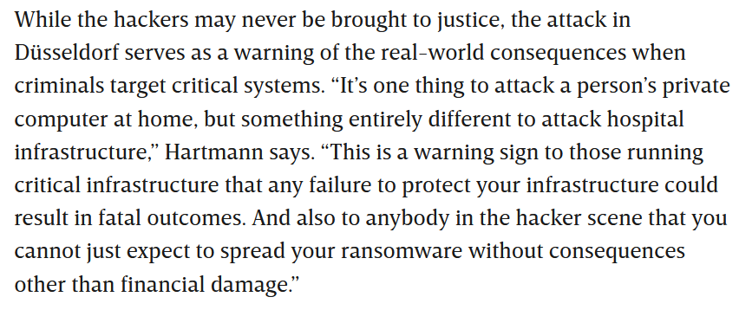

Slide 11
The structural problem: low hanging fruits
Lax technical security standards (e.g. outdated operating systems)
Lack of security awareness
Lack of training
Lack of security-related attitudes (“cyberhygiene”, e.g. relating passwords and their complexity, regular changes and even secrecy)
While there is a focus on data privacy, there is a neglect of data security
The majority of attacks directly target individual hospitals with direct access to patients’ sensitive data, being known to be lagging far behind other institutions of comparable size in terms of their cyber security standards.
Notes:
Shared infrastructure (i.e. hardware) means shared risk

Slide 12
Why are healthcare institutions targeted?
They administer and store data that can be sold on the black market (e.g. insurance data or personal information such as addresses, social security numbers etc.)
Not all attacks are necessarily intended. Some attacks are rather broad and entail collateral damage.
Patient data are precious for YOU. In contrast to “traditional” crime, in online crime “things” (here: data) can be held “hostage”. Hence, do not ask what is attractive for criminals - ask what is important for YOU.
Notes:
Wannacry infected 230.000 windows systems in 150 countries
#Your data are more valuable than you think (black market value in the Dark Web)
But much more important than the value for others is the value it has for your and your work. We often may tend to think: I do not have to lock my door, there is not much of value in my flat. Who should break in HERE? But the point is that things may have value for YOU - and the difference between this digital crime/cybercrime and the traditional crime we are used to is that DATA can be kept hostage. As we learnt from the 20xx wannacry ransomware that encrypted xxxx mio. Computers worldwide.
In some cases one gets the data back after paying via some crypto currency, in other cases not. Some of these criminals have a “reputation” of being “trustworthy”, others not. Some even do have a customer service hotline where one can ask for instructions on how to open up a bitcoin digital wallet, something most of us may not be very familiar with, and then they are happy to help.

Slide 13

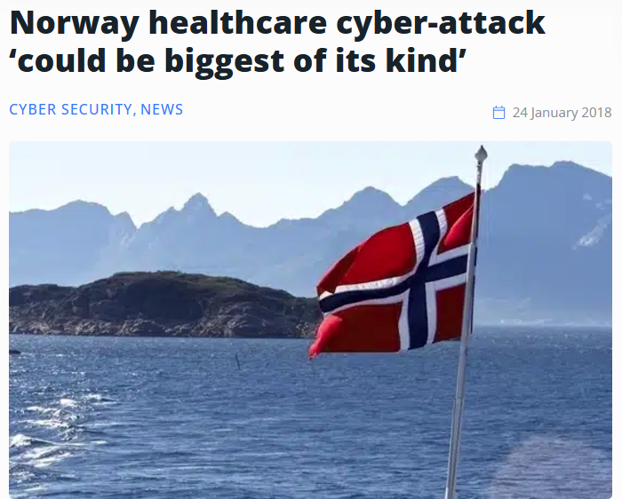
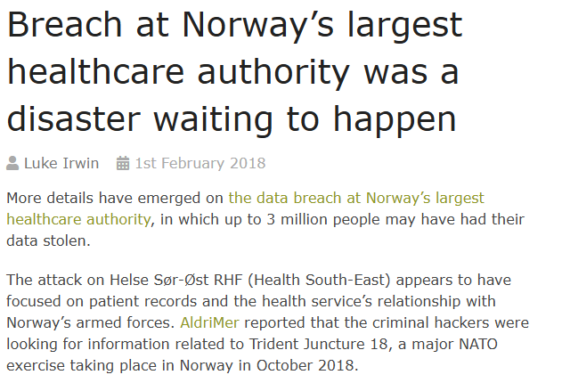
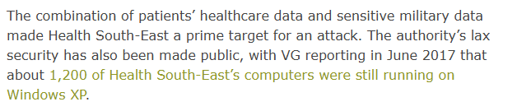
40 000 troops
31 nations
150 aircraft, 70 ships and 10,000 vehicles

Slide 14
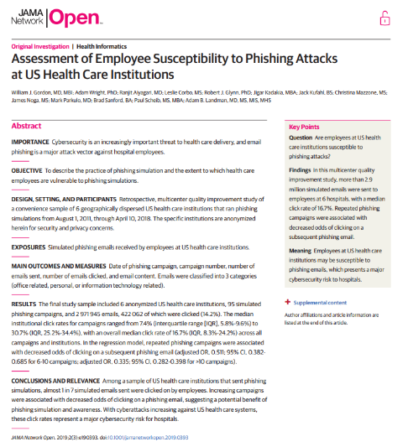
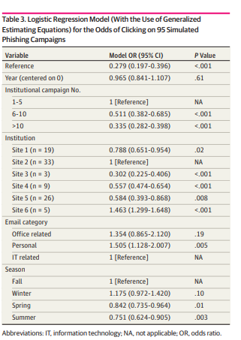
Summary over 95 phishing campaigns
“Repeated campaigns were associated with improved click rates, suggesting that simulated phishing campaigns are an important component of a proactive approach to reducing risk.”
Notes:
stress - patient actual job - PC only medium - often outdated OS and few resources in IT, little awareness, staff turnover.
Perhaps the most extensive among the new ones: 2.9 million mails, 6 gr. Hospitals, 8 years, 95 campaigns.
Odds ratios are the ratios compared to a reference value in a logistic regression, i.e. a statistical linear regression operating with a dichotomous criterion variable.
We see that replicates were meaningful - unfortunately we do not have a more detailed time breakdown/resolution. Between 1-5 and >10, the probability was reduced to 1/3. The correlation between number of campaigns and OR can also be seen implicitly in the comparison of the different sites.
Personal topics in mails seem to be slightly more successful than IT related ones. There were also seasonal effects, but these are not explained in this way.
Overall: clickrates of 13-49% are reported in most studies. There are also outliers.
Why hospitals: low levels awareness, critical infrastructure, large staff turnover.

Slide 15
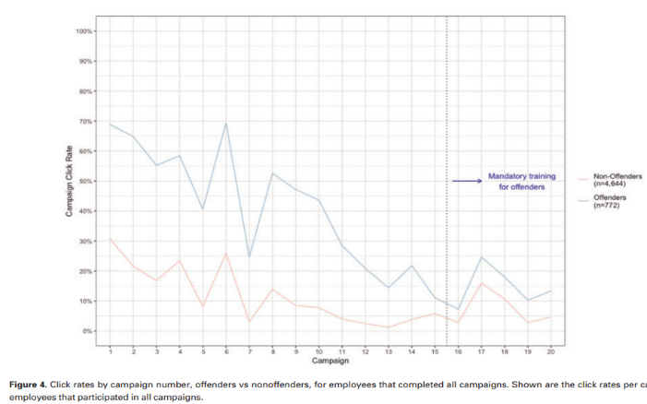
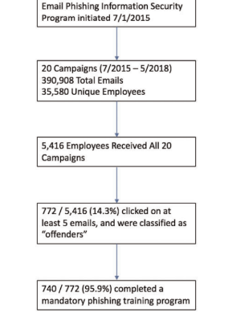
Healthcare workers and repeat clicking
Notes:
Gordon, W. J., Wright, A., Glynn, R. J., Kadakia, J., Mazzone, C., Leinbach, E., & Landman, A. (2019). Evaluation of a mandatory phishing training program for high-risk employees at a US healthcare system. Journal of the American Medical Informatics Association, 26(6), 547-552.
click rates are alarmingly high, but generally improve with repeated simulated phishing campaigns.
the mandatory training program for employees who clicked on 5 or more simulated phishing campaigns itself did not have a meaningful impact on click rates—the “offenders” remained more likely to click on phishing emails than nonoffenders did, with click rates between 10% and 25% post-training.
The real-time training (provided after an employee clicked on any phishing simulation) may have been more effective at narrowing the gap between offenders and non offenders
Because it only takes 1 successful phishing attack to cause substantial damage to a healthcare organization, these click rates (with or without training) are highly concerning.

Slide 16






Why Do Nurses Struggle?
Individual
Social
Organisational
Notes:
Most participants were
nurses (n = 64,250), followed by doctors (n = 36,029), allied health (n = 5068), dentists (n = 4139), unidentified health professionals (n = 2247), paramedics (n = 744), nursing assistants (n = 177 and pathologists (n = 37).

Slide 17
What is Learning?
Learning is defined as “any relatively permanent change in behaviour that occurs as a result of practice and experience”.
  Learning is a change in behaviour—better or worse.
  It is a change that takes place through practice or experience, but changes due to growth or maturation are not learning.
  This change in behaviour must be relatively permanent, and it must last a fairly long time.

Slide 18
What is learning
Memory
  Consolidation and retrieval
  Different memory models
Behavioural
  Rewards/punishments

Slide 19
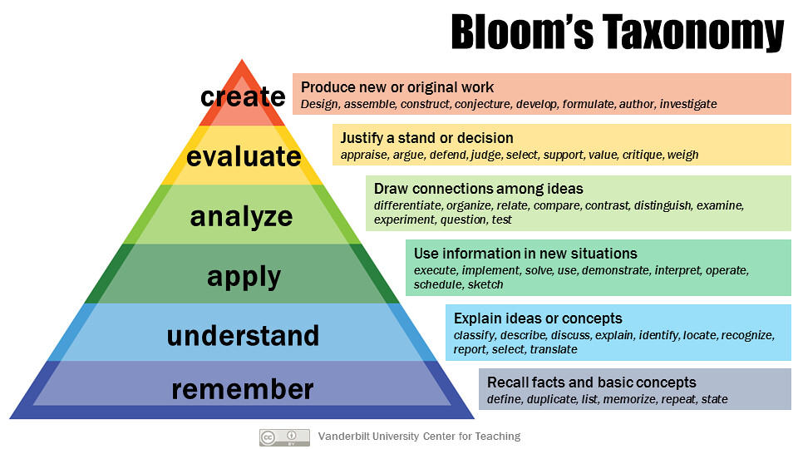

Slide 20
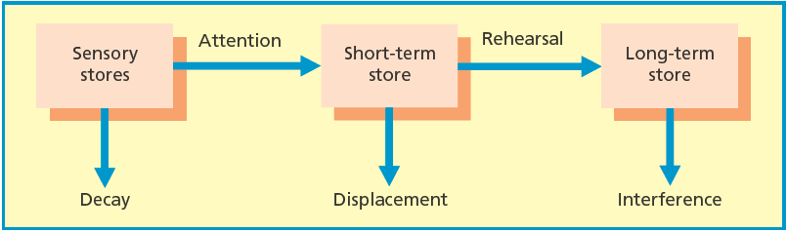
Memory Models

Slide 21
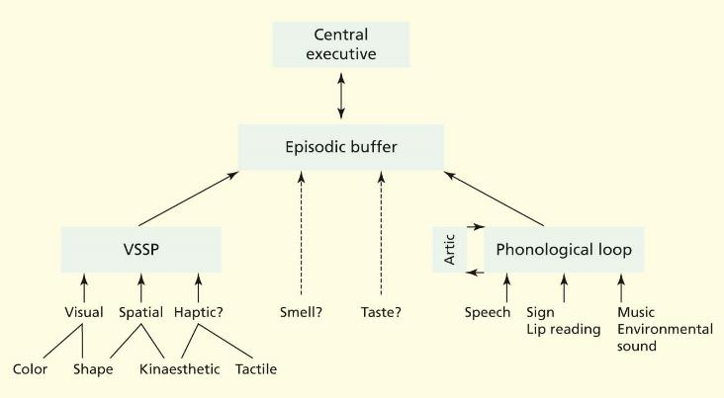
Memory Models

Slide 22
Levels-of-processing theory
The level of depth of processing of a stimulus affects memorability (Craik & Lockhart, 1972)
Deeper levels of analysis produce more elaborate, longer-lasting and stronger memory traces than shallow analyses
  Rehearsal
    Maintenance = simply repeating information
    Elaboration = deep semantic processing
Late craming vs early craming

Slide 23
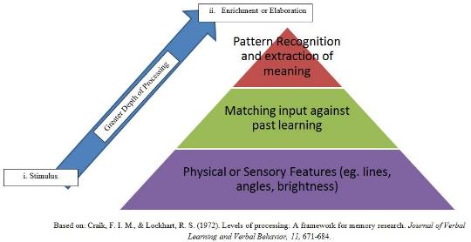
Craik and Tulving (1975)
Shallow Graphemic Task
Intermediate Phonemic Task
Deep Semantic Task
Decide whether each word is in upper- or lower-case letters
Decide whether each word rhymes with a target word
Decide whether each word fits a sentence containing a blank
Produced the best overall memory, especially for ‘Yes’ responses
Notes:
Correct that learning processes have a major impact on LTM
Recognised that perception, attention and memory are all closely interconnected
Helped identify elaboration and distinctiveness of processing

Slide 24
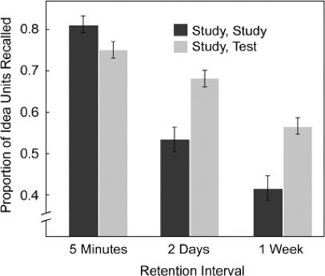
Learning through retrieval
Testing effect:
  Retrieving to-be-remembered information during learning enhances learning (Roediger & Karpicke, 2006)
    Active learning
    Spilt attention
  Testing requires more effortful semantic processing

Slide 25
Metacognition

Slide 26
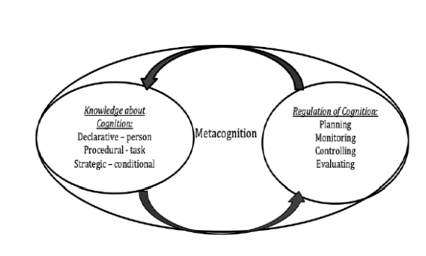
Definitions
thinking about thinking
Knowledge of one’s knowledge
Knowledge of regulation of ones knowledge and cognition self-monitor levels of understanding and predict how well (s)he will do on a particular task.
Self-regulation - students monitoring their own comprehension and assessing their own abilities without teacher help.
Notes:
Interrelated set of competencies for learning and thinking, and include many of the skills required for active learning, critical thinking,reflective judgment, problem solving, and decision-making.

Slide 27
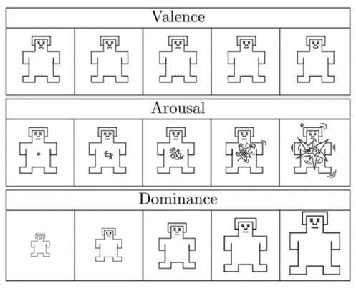
To understand
Initial states
  Where am I
  Judgements of performance
  Expectations
Check in
  What i know

Slide 28
Components (Dawson, 2016)
Metacognition is a regulatory system that includes (a)
knowledge, (b) experiences, (c) goals, and (d) strategies.
Metacognitive knowledge is stored knowledge
or beliefs about
  (1) oneself and others as cognitive agents
  (2) tasks
  (3) actions or strategies
  (4)how all these interact to affect the outcome of any intellectual undertaking

Slide 29
Components continued (Dawson, 2016)
Metacognitive experiences are conscious cognitive or affective experiences that concern any aspect of an intellectual undertaking.

Slide 30
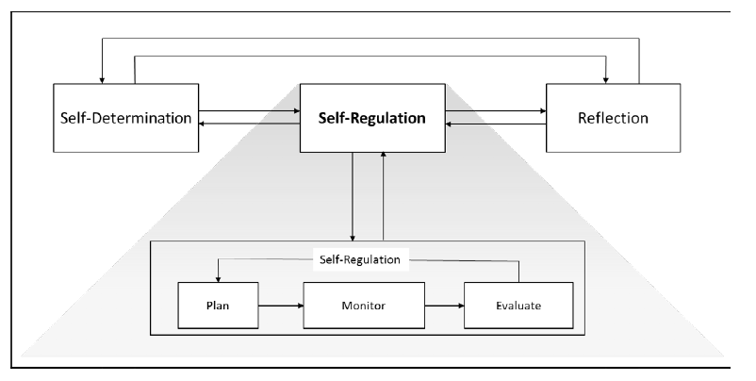
Self-Regulation
Notes:
A process in which a person actively searches for relationships and patterns to resolve contradictions or bring coherence out of a set of experiences.
Contradictions lead to disequilibrium, accommodation, and assimilation.
Self-regulation begins with exploration, and progresses through invention and application.
The work of self-regulation calls for students to identify patterns, draw of inferences, and make comparisons.
Self-regulation is essential in order to increase both declarative and procedural knowledge.

Slide 32
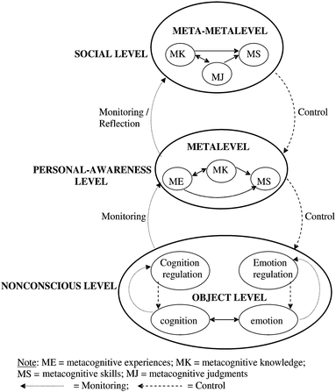
Metacognition (Efklides, 2011)
Behind behavior change
MC knowledge
  Behaviour
  Outcomes
Self-regulation
Experience (habits)
Feedback
Reflection

Slide 33
How to reach
Critical Thinking
Reflection

Slide 34
Realted aspects
Self-efficacy
  Experience
  Role modelling
  Coaching/mentoring
  Physiological responses
Growth Mindset

Slide 35
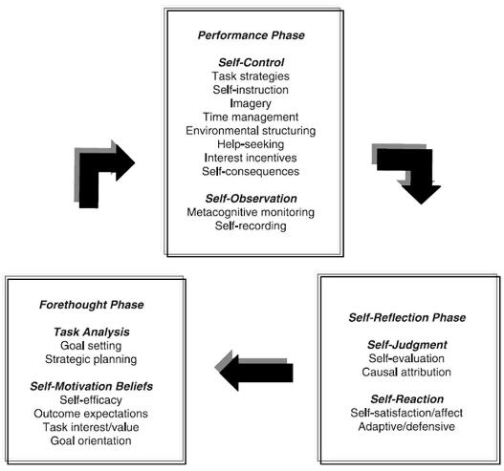
Self-Regulation
Notes:
A process in which a person actively searches for relationships and patterns to resolve contradictions or bring coherence out of a set of experiences.
Contradictions lead to disequilibrium, accommodation, and assimilation.
Self-regulation begins with exploration, and progresses through invention and application.
The work of self-regulation calls for students to identify patterns, draw of inferences, and make comparisons.
Self-regulation is essential in order to increase both declarative and procedural knowledge.

Slide 36
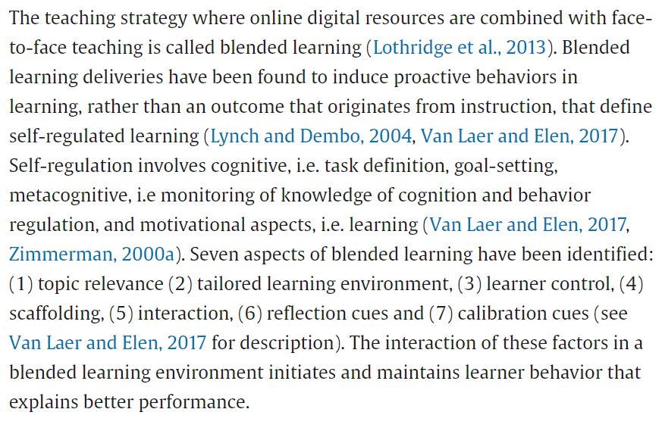
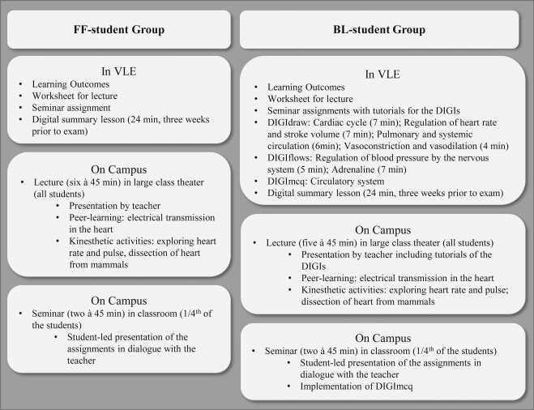

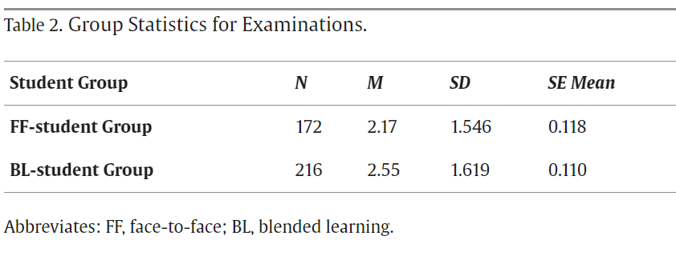

Slide 37
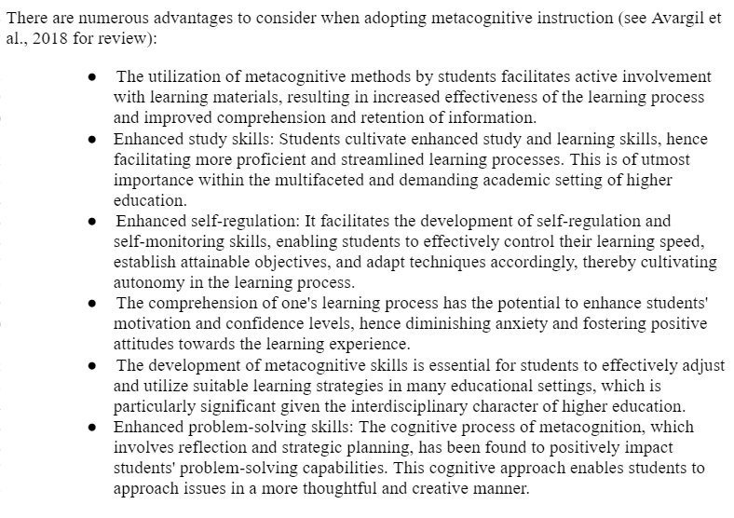
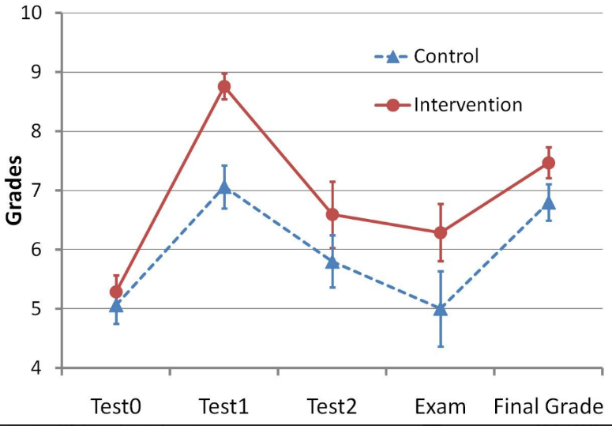
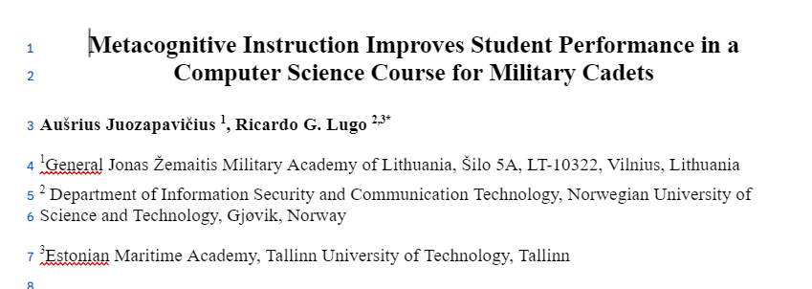
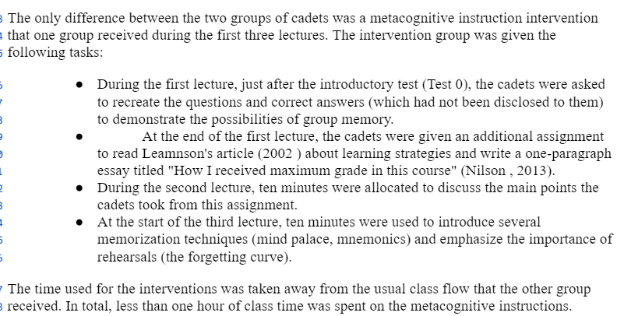

Slide 38

Prevention - Education and Training
Aware of risks and vulnerabilities for both human and technological aspects as well as at the organizational to individual level.
Organizational Goals:
Increase Cyber Resilience
Establishing a Cyber Vigilant Mindset
  Constant awareness and secure promoting behaviours
3 keys for training
Training – Employee email security training on a computer based training module
Evaluation – Periodic testing through the use of simulated phishing that puts their training to the test
Insight – In depth quarterly reporting reveals campaign statistics, vulnerabilities and employee activity
Notes:
What does it have to do with me?
Everyone can be targeted (who has access to data/login)
Risks and vulnerabilities
How can I protect myself?
Cybervigilant mindset
Cyberresilience
Stage 1 – Strategize:-Cyber governance, structure, and sensing capability to anticipate and address adverse business or cyber events.
Stage 2 – Withstand: Adaptive, mission-preserving cyber defense framework that can withstand threats to the business.
Stage 3 – Defend: Defend against disruptive cyber events based on a robust, self-healing digital immunity, and active cyber defense.
Stage 4 – Inspect: Real-time cyber visibility on real-time threats, through machine-added detection, automated hunting, and advanced situational awareness.
Stage 5 – Observe: Reliance on automation, machine learning, and adaptive cyber-threat detection to address future threats to the business.
Stage 6 – Recover: Ability to rapidly restore digital platforms, adapt, and recover mission-critical systems to avoid business interruption.
Stage 7 – Adapt:Continuously self-assess and measure the state of cyber performance and continuous improvement to support the business.
Continuous cybersecurity education and Awareness training as part of all healthcare education
PBL
Institutional preparedness (IT infrastructure and personnel with CS competencies)
signposting
Positive CS culture: encourage people to report suspicions and also own failures. Acceptance for false negatives/positives.

Slide 39
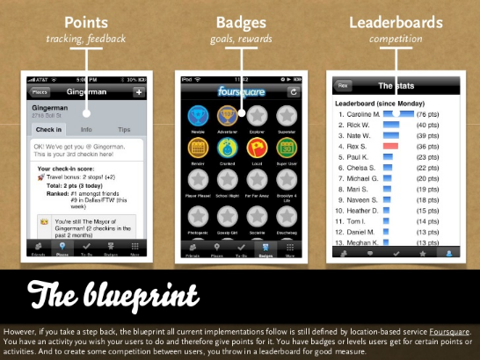
Training cyber secure behaviours (status quo)
Change focus from fear activation to incentive based
Gamification of education and training
Based on Social Cognitive Theory and Behaviourism
Points
Badges
Leaderboards
Helps Increase awareness and persistent behaviour
Periodic testing and updating
Intermittent incentives
Attack development
Exposure and training

Slide 40
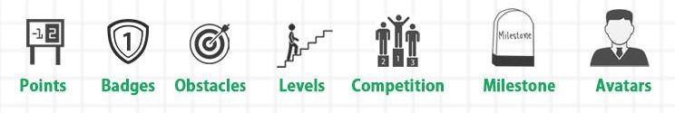
Personality
Points: O/C/E
Badges: E(I)
Obstacles: O/C
Levels: C/E/A
Competition: O/C/E/A
Milestone: O/E(I)
Avatars: E(I)
*N can be a risk factor in education but not in CS!
Notes:
Task: Autonomy/competence
Ego: Social Relatedness

Slide 41
Effects of Gamification
Short-term
Moderate effects (d=.48)
1-7 days d=1.57 vs 20 weeks d=.30
Random effects models showed significant small effects of gamification on cognitive (g = .49), motivational (g = .36), and behavioral learning outcomes (g = .25)
Long-term
Over years d=-.20
Gamification may be best serve to initiate learning and behaviour change
Notes:
Kim, J., & Castelli, D. M. (2021). Effects of gamification on behavioral change in education: A meta-analysis. International Journal of Environmental Research and Public Health, 18(7), 3550.
Sailer, M., & Homner, L. (2020). The gamification of learning: A meta-analysis. Educational Psychology Review, 32(1), 77-112.
Random effects models showed significant small effects of gamification on cognitive (g = .49, 95% CI [0.30, 0.69], k = 19, N = 1686), motivational (g = .36, 95% CI [0.18, 0.54], k = 16, N = 2246), and behavioral learning outcomes (g = .25, 95% CI [0.04, 0.46], k = 9, N = 951). Whereas the effect of gamification on cognitive learning outcomes was stable in a subsplit analysis of studies employing high methodological rigor, effects on motivational and behavioral outcomes were less stable

Slide 42

Frameworks

Slide 43
National Initiative for Cybersecurity Education Framework
Categories | Speciality Areas | No. of Work Roles
Analyse | All-Source Analysis, Exploitation Analysis, Language Analysis, Targets, Threat Analysis | 8
Collect and Operate | Collection Operations, Cyber Operational Planning, Cyber Operations | 6
Investigate | Cyber Investigation, Digital Forensics | 3
Operate and Maintain | Customer Service and Technical Support, Data Administration, Knowledge Management, Network Services, Systems Administration, Systems Analysis | 6
Oversee and Govern | Cybersecurity Management, Executive Cyber Leadership, Legal Advice and Advocacy, Program/Project Management and Acquisition, Strategic Planning and Policy, Training, Education, and Awareness | 14
Protect and Defend | Cyber Defense Analysis, Cyber Defense Infrastructure Support, Incident Response, Vulnerability Assessment and Management | 4
Securely Provision | Risk Management, Software Development, Systems Architecture, Systems Development, Systems Requirements Planning, Technology R&D, Test and Evaluation | 11
NICE framework is not industry or organisation-size specific, thus making it applicable across the board
Cybersecurity governance standard
Interdisciplinary nature
Guide for training cybersecurity professionals.
Provides standards and best practices for the US cybersecurity landscape
Notes:
mission is to “energize, promote, and coordinate a robust community working together to advance an integrated ecosystem of cybersecurity education, training, and workforce development.”
he NICE framework was adapted to accommodate the peculiarities and needs of the EU. Additionally, like other frameworks, we observed that the NICE framework is not industry or organisation-size specific, thus making it applicable across the board. Given the comprehensive nature of NICE, it can yet serve as a reference framework for

Slide 44
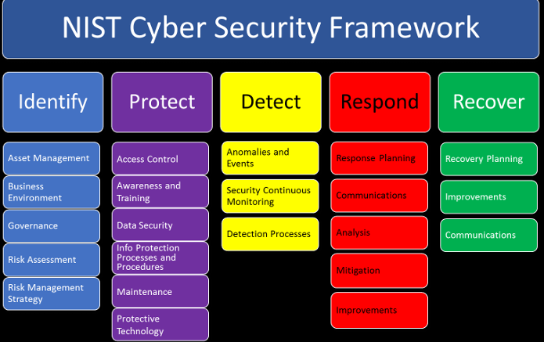
NIST
Employees: Identify & protect
CSO: Identify, Protect, Detect, Respond, Recover

Slide 45

NIS-2

Slide 46

https://www.enisa.europa.eu/publications/european-cybersecurity-skills-framework-ecsf

Slide 47
ENISA European Cybersecurity Skills Framework (ECSF)
Ensures a common terminology and shared understanding between the demand (workplace, recruitment) and supply (qualification, training) of cybersecurity professionals across the EU.
Supports the identification of the critical skill sets required from a workforce perspective. It enables providers of learning programmes to support the development of this critical set of skills and helps policy-makers support targeted initiatives to mitigate the gaps identified in skills.
Facilitates an understanding of leading cybersecurity professional roles and the essential skills they require, including soft skills, along with the legislative aspects (if any). In particular, it enables non-experts and HR departments to understand the requirements for resource planning, recruitment and career planning in supporting cyber-security.
The framework promotes harmonisation in cybersecurity education, training, and workforce development. At the same time, this common European language in the context of cybersecurity skills and roles connects well with the entire ICT professional domain.
Contributes to achieving enhanced shielding against cyberattacks and guaranteeing secure IT (Information Technology) systems in society. It provides a standard structure and advice on how to implement capacity building within the European cybersecurity workforce.
Notes:
The ECSF is a result of a joint work of the European Union Agency for Cybersecurity (ENISA) [28] with members of the AdHoc Working Group [5] to create a common framework that helps identify and assign tasks, competences, skills and knowledge to cybersecurity-specific roles. Both the framework [29] and its "User Manual" [30] detail the particular features of the approach, with the aim of creating a common understanding among all parties involved in the cybersecurity field, in addition to addressing the current gap between academia and the workforce in the labour market.
Specifically, the ECSF groups all cybersecurity-related roles into twelve profiles:

Slide 48
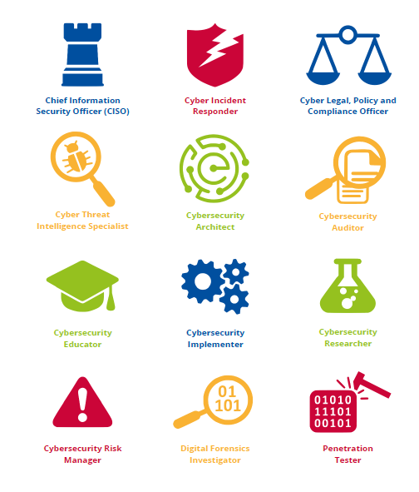
ECSF Roles

Slide 49
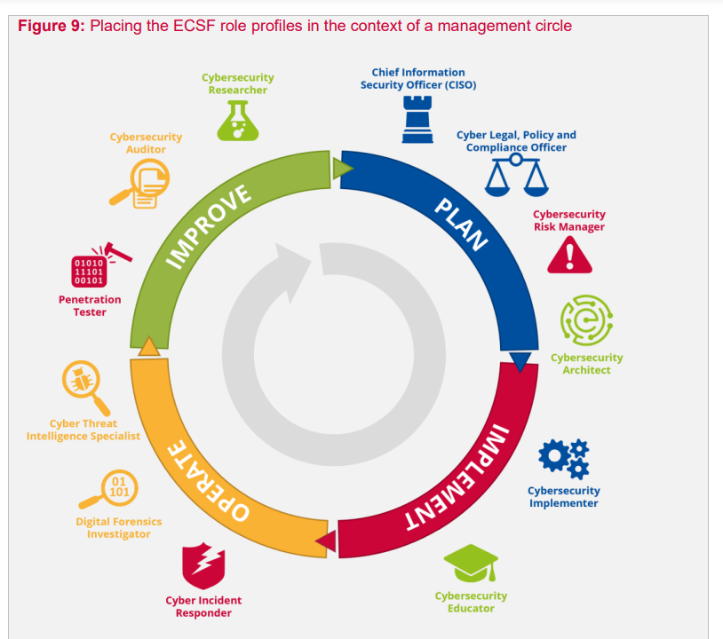

Slide 50
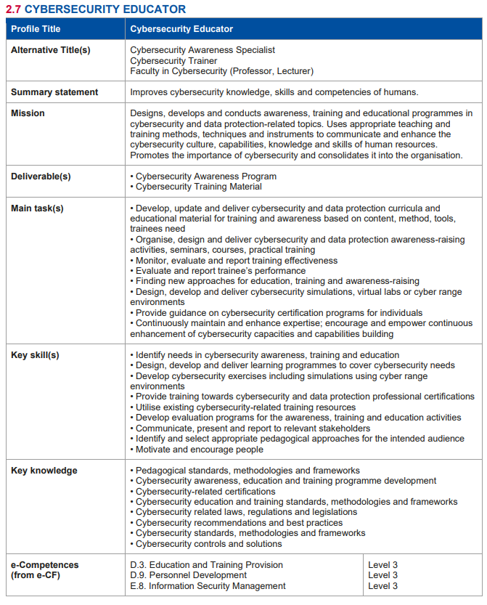
Educator

Slide 51
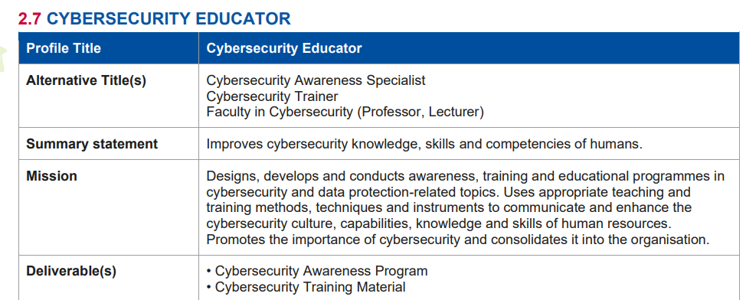

Slide 52
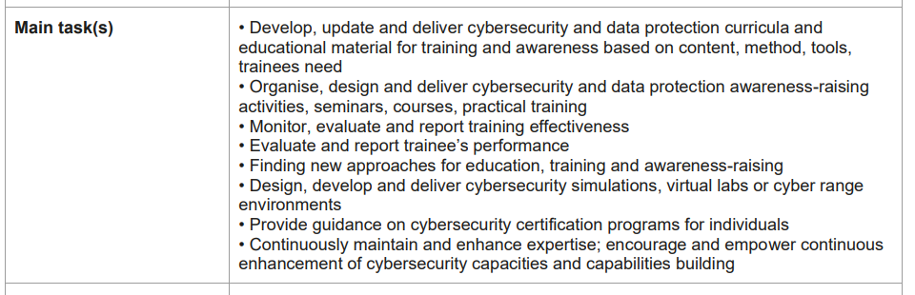
Challenges?
Finding information
Course outcomes

Slide 53
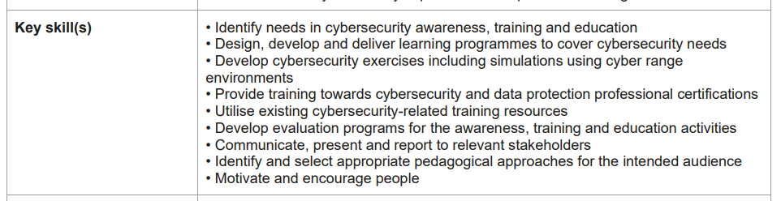
Course outcomes
Personal skills
Organisational aspects

Slide 54
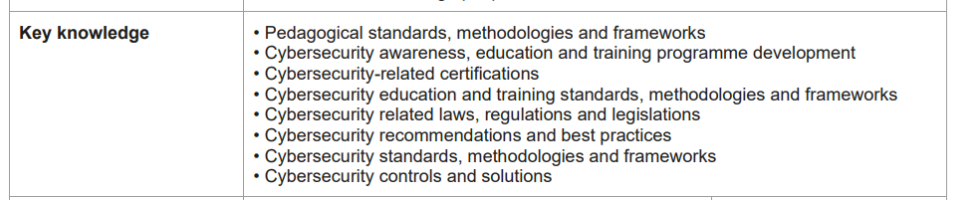
CPD

Slide 55

https://www.enisa.europa.eu/topics/training-and-exercises/trainings-for-cybersecurity-specialists/online-training-material

Slide 56
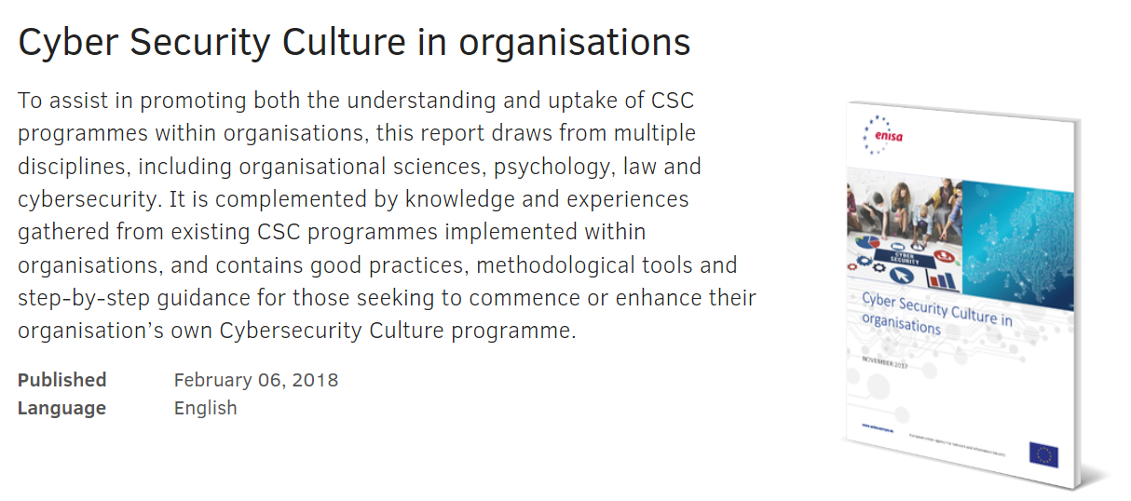
https://www.enisa.europa.eu/publications/cyber-security-culture-in-organisations

Slide 57


Slide 58

Remember Compliance vs Adherence

Slide 59
CSC Summary
Good practices identified from those organisations that have already implemented mature CSC programmes, and specifically categorised and tailored to different audiences within an organisation, from senior management to the information security team;
To facilitate the development and delivery of a Cybersecurity Culture programme, an eight-step Implementation Framework is presented alongside detailed guidance for each of the constituent steps. This Framework encompasses the entire lifecycle of an organisation’s Cybersecurity Culture programmes.
Methods to produce a CSC for an organisation, as well as guidance on suitable metrics for measuring the impact of CSC activities; and
Strategies for building a robust business case for the allocation of internal resources towards future Cybersecurity Culture activities.

Slide 60
Recommendations for a successful CSC programme
Secure buy-in at the highest level Senior buy-in at the highest organizational level is essential for the success of the programme. Senior figures are needed that can to act as champions for the programme and lead by example thereby influencing the staff’s behaviour towards the programme.
Follow the CSC Framework for the implementation of the programme The CSC Framework presented in this report provides a process to guide the CSC programme in the form of a step by step implementation centred around specific activities, their implementation and measurement of impact.
Know your organization so as to ensure success This step within the CSC Framework is key to ensuring the success of the programme, because it will inform the decision making processes that define the goals, success criteria and target audience of the CSC programme.
Measure the current cybersecurity level of the target audience Calculating the current level of CSC of your target audience will assist in measuring the effect of the activities you chose to implement and thus the impact of the CSC programme.
Draw upon the good practices identified in this report A number of good practices have been identified from interviews with CSC professionals within organizations across Europe and desktop research that will assist in planning and executing a successful CSC programme.

Slide 61

Implementation
Needs analysis
Design
Implement
Evaluate

Slide 62

What can we measure (and how)

Slide 63


Slide 64


Slide 65

Designing an Intervention:
Intervention Mapping

Slide 66
Intervention Mapping
Bartholomew et al., 1998 (2016 5th ed)
Ecological approach
  All stakeholders
Specific Populations and settings
Involve participants
Integrate efforts
Link participants concerns
Find and use environmental resources
Policy change
Agency in the Environment
  Gatekeepers – Lewin (McGrath 1995)
  Social Exchange (Coleman, 1990)
  MATCH (Simons-Morton 1988)

Slide 67


Slide 68
Intervention Mapping Planning Steps:
PRECEDE
PROCEED
IM1: Needs Assessment for at risk behaviours
  Scientific, epidemology, behavioral social analysis
  Understand groups involved
IM2:Expected changes
  Performance objectives
  Create matrices of change objectives
IM3: Methods and Strategies
  Evidence based
IM4:Program
  Consulting with participants and implementers
  Protocols
  Pretest
IM5 Adoption and Implementation
  Sustainabilvaity
  Methods and strategies after prestest
IM6: Evaluation
  Describe program and outcomes
  Process questions
  Indicators and measures
  Specify evaluation design

Slide 69
Goal
Enumerate Insecurities: Organizations identify the security issues they are experiencing that are related to employee behaviors. ‘Ask the people’
Identify Underlying Problem Behavior: The security issue is mapped to a particular human behavior that needs to be nudged in a positive direction. Identify behaviours to change
Map Antecedents of Behaviors: The antecedent of the problem behavior is identified using two sources. The first, and most important, is to speak to the people who will receive the training and to ask them about the problems they face with using intervention mapping to breach the cyber-defense deficit respect to the problem behavior. This should help us to identify organization-specific barriers. The second source is the research literature.
Identify Behavioral Change Mechanism: The antecedent is mapped directly to Mechanisms for behavioral Change. (Motivation, Psychological mechanisms, design)
Identify Desired behavior: The problem behavior is mapped directly to changed (desired) behaviors.
Design Interventions: Interventions are proposed that are formulated to change behaviors, is a way that exploits known change mechanisms. It is essentially the deliverable of this process: the security awareness training

Slide 70

What is PRECEDE/PROCEED?
PRECEDE/PROCEED is a community-oriented, participatory model for creating successful community CS (health) promotion interventions.

Slide 71

PRECEDE has five phases:
Phase 1: Social diagnosis.
1
Phase 2: Epidemiological diagnosis.
2
Phase 3: Behavioral and environmental diagnosis.
3
Phase 4: Educational and organizational diagnosis.
4
Phase 5: Administrative and policy diagnosis.
5

Slide 72

PROCEED has four phases:
Phase 6
Implementation.
Phase 7
Process evaluation.
Phase 8
Impact evaluation.
Phase 9
Outcome evaluation.

Slide 73
Phishing, Reporting, VPN, Communication
Phase 4/IM4
Phase 3 /IM3
Phase 2 /IM2
Phase 1 /IM1
Intervention
Online training
Table Top
Cyber Range
CDX
Others
Predisposing factors
Knowledge
Beliefs
Attitudes
Short Term Outcomes
Decrease clicking
CS Outcomes
Phishing
Data Protection
VPN
Communication
Reinforcing Factors
Social support
Feedback
Medium Term
Phase 5 /IM4
Enabling Factors
Organisational factors
Leadership
Longterm
Increase confidence
Behaviour maintanence
Phase 6 /IM5
Phase 7 /IM6
Phase 8 /IM6
Phase 9 /IM6

Slide 74

Assumptions behind PRECEDE/PROCEED:
Since behavior change is by and large voluntary, Cybersecurity is more likely to be effective if it’s participatory.
CS issues must be looked at in the context of the community.
CS are essentially business continuity issues.
CS is a constellation of factors that add up build organizational resilience and personal development.

Slide 75
Why use PRECEDE/PROCEED?
A logic model provides a procedural structure for constructing an intervention.
A logic model provides a framework for critical analysis.
PRECEDE/PROCEED is participatory, thus assuring community involvement.
Community involvement leads to community buy-in.
PRECEDE/PROCEED incorporates a multi-level evaluation, which means you have the chance to constantly monitor and adjust your evaluation.
The model allows leeway to adapt the content and methods of the intervention to your particular needs and circumstances.

Slide 76

How do you use PRECEDE/PROCEED?
In Phase 1, social diagnosis, you ask the community what it wants and needs to improve its quality of life.
In Phase 2, epidemiological diagnosis, you identify the CS issues that most clearly influence the outcome the community seeks.
In these two phases, you create the objectives for your intervention.

Slide 77
How do you use PRECEDE/PROCEED? (cont.)
In Phase 3, behavioral and environmental diagnosis, you identify the behaviors and/or environmental factors that must be changed to affect the issues identified in Phase 2, and determine which of them are most likely to be changeable.
In Phase 4, educational and organizational diagnosis, you identify the predisposing, enabling, and reinforcing factors that act as supports for or barriers to changing the behaviors and environmental factors you identified in Phase 3.
In these two phases, you plan the intervention.

Slide 78

How do you use PRECEDE/PROCEED? (cont.)
In Phase 5, administrative and policy diagnosis, you identify (and adjust where necessary) the internal administrative issues and internal and external policy issues that can affect the successful conduct of the intervention.
Those administrative and policy concerns include generating the funding and other resources for the intervention.

Slide 79
How do you use PRECEDE/PROCEED? (cont.)
In Phase 6, implementation, you carry out the intervention.
In Phase 7, process evaluation, you evaluate the process of the intervention – i.e., you determine whether the intervention is proceeding according to plan, and adjust accordingly.
In Phase 8, impact evaluation, you evaluate whether the intervention is having the intended impact on the behavioral and environmental factors it’s aimed at, and adjust accordingly.
In Phase 9, outcome evaluation, you evaluate whether the intervention’s effects are in turn producing the outcome(s) the community identified in Phase 1, and adjust accordingly.

Slide 80

Intervention Mapping

Slide 81

IM Step 1
Needs Assessment for at risk
  Scientific, epidemology, behavioral social analysis
Understand groups involved
PRECEDE
Phishing
Strong Passwords
VPN use
Reporting

Slide 82

IM Steps 2
Expected changes
Performance objectives
Specify Determinants
Create matrices of change objectives
Awareness, Behaviour, Knowledge
Phishing

Slide 83

IM Steps 3
Methods and Strategies
  Evidence based
  Theoretical methods
  Program methods
  Select/design strategies
  Strategies match change objectives!
Phishing

Slide 84



More Steps
4 Program
  Consulting with participants and implementers
  Protocols
  Pretest
5 Adoption and Implementation
  Sustainability
  Methods and strategies after prestest
6 Evaluation
  Describe program and outcomes
  Process questions
  Indicators and measures
  Specify evaluation design

Slide 85

6. Evaluation (cont’d)

Slide 86
Phishing, Reporting, VPN, Communication
Phase 4/IM4
Phase 3 /IM3
Phase 2 /IM2
Phase 1 /IM1
Intervention
Online training
Table Top
Cyber Range
CDX
Others
Predisposing factors
Knowledge
Beliefs
Attitudes
Short Term Outcomes
Decrease clicking
CS Outcomes
Phishing
Data Protection
VPN
Communication
Reinforcing Factors
Social support
Feedback
Medium Term
Phase 5 /IM4
Enabling Factors
Organisational factors
Leadership
Longterm
Increase confidence
Behaviour maintanence
Phase 6 /IM5
Phase 7 /IM6
Phase 8 /IM6
Phase 9 /IM6

Slide 87
Learning & Pedagogical Approaches

Slide 88
„Knowledge never prevented
a single breach.“
(Carpenter & Roer, 2022)

Slide 89

Knowledge alone doesn‘t help
Sütterlin, S., Lugo, R. G., Ask, T. F., Veng, K., Eck, J., Fritschi, J., Talha-Özmen, M., Bärreiter, B., & Knox, B. J. (2022). The Role of IT Background for Metacognitive Accuracy, Confidence and Overestimation of Deep Fake Recognition Skills. In: Schmorrow, D.D., Fidopiastis, C.M. (eds) Augmented Cognition. HCII 2022. Lecture Notes in Computer Science, vol 13310. Springer, Cham. https://doi.org/10.1007/978-3-031-05457-0_9

Slide 90
The limits of training
“However, even with education, individuals may still be overconfident in their abilities and thus fall prey to phishing. Nevertheless, education and/or training should strongly emphasize the need to tame overconfidence.” (Moody et al., 2017)
“In summary, these mostly positive results indicate that anti-phishing training indeed has a positive impact. However, training design, especially complementing embedded training with standard training sessions and even individualization of training, might also play an important role.” (Jampen et al., 2020)
Jampen et al. (2020)
Notes:
Remember the SCAM-Model? In the studies seen above and many more, influencing factors have been investigated. Here are some of the influencing factors.
Problem: Only ONE of these factors is actually targeted by phishing awareness trainings such as simulations.

Slide 91
Reduction of SE-Susceptibility by training
Typical effect sizes according to scientific publications pre/post phishing campaigns: 20-80% reduction of susceptibility.

Slide 92
Awareness
Intention
Behavior
Habit
Sicherheit

Slide 93


Password regulations
-
Goal: Productivity
Awareness
Password Use
Awareness
Intention
Behavior
Habit

Slide 94

Recent developments towards an individualized approach

Slide 95
Theory of Planned Behaviour (Ajzen, 1991)
Attitude
Subjective Norm
Intention
Behaviour
Perceived
Behavioural Control

Slide 96
COM-B Model (Michie et al. 2011)
Capability
Motivation
Behaviour
Opportunity
Michie, S., van Stralen, M. M., & West, R. (2011). The behaviour change wheel: A new method for characterising and designing behaviour change interventions. Implementation Science. https://doi.org/10.1186/1748-5908-6-42

Slide 97

Protection Motivation Theory
Rogers, R. W. (1975). A protection motivation theory of fear appeals and attitude change. Journal of Psychology. 91: 93–114. doi:10.1080/00223980.1975.9915803.

Slide 98


Cognitive Evaluation Theory
Instrumental/Controlling
Ryan, R. M., & Deci, E. L. (2000). Self-determination theory and the facilitation of intrinsic motivation, social development, and well-being. American Psychologist, 55(1), 68-78. doi:10.1037/0003-066X.55.1.68

Slide 99
Training cyber secure behaviours
Change focus from fear activation to incentive based
Gamification of education and training
Based on Social Cognitive Theory and Behaviourism
Points
Badges
Leaderboards
Helps Increase awareness and persistent behaviour
Periodic testing and updating
Intermittent incentives
Attack development
Exposure and training

Slide 100
Personality
Points: O/C/E
Badges: E(I)
Obstacles: O/C
Levels: C/E/A
Competition: O/C/E/A
Milestone: O/E(I)
Avatars: E(I)
*N can be a risk factor in education but not in CS!
Notes:
Task: Autonomy/competence
Ego: Social Relatedness

Slide 101

ICT8210 11.28.2025
Designing training and education for CS – Human aspects pt II
Ric Lugo

Slide 102
Effects of Gamification
Short-term
Moderate effects (d=.48)
1-7 days d=1.57 vs 20 weeks d=.30
Random effects models showed significant small effects of gamification on cognitive (g = .49), motivational (g = .36), and behavioral learning outcomes (g = .25)
Long-term
Over years d=-.20
Gamification may be best serve to initiate learning and behaviour change
Notes:
Kim, J., & Castelli, D. M. (2021). Effects of gamification on behavioral change in education: A meta-analysis. International Journal of Environmental Research and Public Health, 18(7), 3550.
Sailer, M., & Homner, L. (2020). The gamification of learning: A meta-analysis. Educational Psychology Review, 32(1), 77-112.
Random effects models showed significant small effects of gamification on cognitive (g = .49, 95% CI [0.30, 0.69], k = 19, N = 1686), motivational (g = .36, 95% CI [0.18, 0.54], k = 16, N = 2246), and behavioral learning outcomes (g = .25, 95% CI [0.04, 0.46], k = 9, N = 951). Whereas the effect of gamification on cognitive learning outcomes was stable in a subsplit analysis of studies employing high methodological rigor, effects on motivational and behavioral outcomes were less stable

Slide 103




Nudging, Gamification

Slide 104




Slide 105


Slide 106


Slide 107





Notes:
Correlations are low. Shows relevance of covering that all!
No such thing as „cs knowledge“
Asking just a few questions doesnt tell you what person needs to learn

Slide 108


How to measure „Security Culture“ ?

Slide 109


Notes:
The Five Maturity Levels The model’s range accounts for organizations with no formal or intentional awareness, behavior or culture plan other than to achieve basic compliance (Level 1) all the way up to the most sophisticated organizations that seek to push beyond the pack and are actively working to shape even the unwritten rules and social dynamics of how their employees value security. Learn more about these levels below. Level 1 Basic Compliance Bare minimum of training Limited metrics “Check the box” Level 2 Security Awareness Foundation At least annual and onboarding training Occasional phishing simulations Focus on variety of content Level 3 Programmatic Security Awareness & Behavior Intentional awareness program with integrated tools Quarterly training with simulated phishing Focus on security-aware behaviors Level 4 Security Behavior Management Continuous training across varied delivery methods and audiences Heavy use of integrated tools to inform training strategy Program focused on real behavior change Level 5 Sustainable Security Culture Program that intentionally measures, shapes and reinforces security culture Multiple methods of behavior-based encouragement Security values woven through fabric of entire organization

Slide 110

Culture Maturity Indicators

Slide 111

Support

Slide 112


Slide 113



The Role of Self-Efficacy
A personal judgment of how well or poorly a person is able to cope with a given situation based on the skills they have and the circumstances they face 4 processes:
Mastering
Role-modelling
Feedback/coaching
Physiological changes
SE moderates and mediates behaviour
Notes:
Bandura, A., Freeman, W. H., & Lightsey, R. (1999). Self-efficacy: The exercise of control.
affects every area of human endeavor. By determining the beliefs a person holds regarding their power to affect situations, self-efficacy strongly influences both the power a person actually has to face challenges competently and the choices a person is most likely to make. People with high self-efficacy—that is, those who believe they can perform well—are more likely to view difficult tasks as something to be mastered rather than something to be avoided. Also for development of self-concept where understanding of self is learned, organized how it is applied to one-self), and dynamic (ever changing)
Our research has shown that SE is a key factor alongside situational factors, such as communication and cooperation, in successful cyber security behaviour
Can explained helplessness behaviours

Slide 114
Theory of Planned Behaviour (Ajzen, 1991)
Attitude
Subjective Norm
Intention
Behaviour
Perceived
Behavioural Control

Slide 115
Protection Motivation Theory
Rogers, R. W. (1975). A protection motivation theory of fear appeals and attitude change. Journal of Psychology. 91: 93–114. doi:10.1080/00223980.1975.9915803.

Slide 116
Technology Acceptance Model

Slide 117


Slide 118

Metacognition
Experience
Feedback
Reflection
This all depends on the Organization

Slide 119
Hackathons
Problem-Solving Skills: Hackathons challenge participants to solve real-world cybersecurity problems within a limited time frame. This encourages creative thinking and the application of theoretical knowledge to practical scenarios, enhancing problem-solving skills.
Collaboration and Teamwork: Participants often work in teams during hackathons, fostering collaboration and communication skills. This team-based approach mirrors real-world scenarios where cybersecurity professionals must work together to address threats.
Exposure to New Technologies: Hackathons can introduce participants to the latest cybersecurity technologies, tools, and practices. This exposure helps individuals stay updated on current trends and threats in the cybersecurity landscape.
Awareness of Real-World Threats: By focusing on solving practical cybersecurity challenges, hackathons can raise awareness about the types and severity of real-world threats, helping participants understand the importance of cybersecurity in protecting digital assets.

Slide 120




Slide 121
Traditional Deliveries
In-Person Training Sessions: These are traditional classroom-based sessions where instructors and participants are physically present in the same location. This format is ideal for interactive, hands-on learning and allows for immediate feedback and clarification.
Online Training Courses: These are web-based courses that participants can complete at their own pace. Online training often includes video lectures, readings, quizzes, and interactive simulations. It's flexible and can accommodate a large number of participants from different locations.
Live Webinars: Webinars are live, interactive sessions conducted over the internet, allowing participants to listen to and engage with the instructor in real-time. This format combines the interactive benefits of in-person training with the convenience of online delivery.
Virtual Classrooms: Similar to live webinars, virtual classrooms use video conferencing tools to create an interactive online environment that simulates a physical classroom. Participants can engage in discussions, work on group activities, and receive real-time instruction.
Simulated Cyber Ranges: Cyber ranges are simulated environments used for training and testing cybersecurity skills in a controlled, risk-free setting. Participants can practice responding to cyber threats and attacks, making it an effective hands-on learning tool.
Workshops and Bootcamps: These are intensive, short-term training sessions focused on specific cybersecurity topics or skills. Workshops and bootcamps are typically more hands-on and project-based, providing participants with practical experience.
Self-Guided Learning Modules: These modules allow individuals to learn at their own pace using pre-recorded materials, interactive exercises, and assessments. This format is flexible and can be tailored to individual learning preferences.
On-the-Job Training: This involves learning directly within the work environment, often through mentorship or shadowing experienced cybersecurity professionals. It's a practical approach that allows for immediate application of skills in real-world situations.
Gamified Learning: This approach incorporates game design elements into the learning experience, making it engaging and interactive. Gamified learning can include competitions, point scoring, and leaderboards to motivate participants.
Blended Learning: This is a hybrid approach that combines various methods, such as online courses with in-person workshops or webinars. Blended learning offers both the flexibility of online education and the interactive benefits of face-to-face sessions.

Slide 122
Capture The Flag (CTF) Competitions
Hands-On Experience: CTF competitions offer a gamified approach to cybersecurity training, where participants engage in tasks such as exploiting vulnerabilities, defending against attacks, and solving security puzzles. This hands-on experience is invaluable for understanding and remembering cybersecurity concepts.
Learning in a Safe Environment: CTFs provide a controlled and safe environment for participants to experiment with hacking techniques and defense strategies without the risk of causing real damage. This encourages learning through trial and error.
Competitive Learning: The competitive nature of CTFs motivates participants to engage deeply with the material and strive for continuous improvement. The desire to win or achieve a high score can enhance learning outcomes and retention.
Diverse Skill Development: CTF challenges often cover a wide range of topics, from cryptography and web security to binary exploitation and forensics. This diversity helps broaden participants' understanding of cybersecurity and exposes them to various aspects of the field.
Community Building: Participating in CTFs can help build a sense of community among cybersecurity enthusiasts and professionals. This networking opportunity allows participants to learn from each other and share knowledge and experiences.

Slide 123
Other approaches
Scenario-Based Learning: This approach uses realistic cybersecurity scenarios to engage participants in problem-solving. By simulating real-life situations, such as a phishing attack or a network breach, learners can better understand the implications of cybersecurity threats and the importance of quick, effective responses.
Peer-Led Training: In this model, more experienced employees or team members lead training sessions for their peers. This approach can foster a collaborative learning environment and allow for the sharing of practical experiences and tips that are directly relevant to the organization's specific context.
Microlearning: This involves delivering cybersecurity training in small, manageable chunks that are easier to digest and retain. Microlearning modules can cover specific topics and can be accessed on-demand, making it easier for learners to fit training into their busy schedules.
Interactive E-Learning Platforms: Advanced e-learning platforms can offer interactive courses that include simulations, quizzes, and games. These platforms can adapt to the learner's performance, offering personalized paths that reinforce weak areas and skip over well-understood concepts.
Security Awareness Campaigns: Organizing regular awareness campaigns can help keep cybersecurity at the forefront of employees' minds. These campaigns can use a mix of posters, emails, workshops, and events to reinforce key messages and best practices.

Slide 124
Other approaches (continued)
Incident Response Drills: Similar to fire drills, these exercises simulate cybersecurity incidents to test and improve the organization's response capabilities. Participants can learn about their roles during an incident and practice communication and decision-making under pressure.
Mentorship Programs: Pairing less experienced individuals with cybersecurity mentors can provide them with guidance, insights, and a deeper understanding of cybersecurity principles and practices. This one-on-one approach allows for personalized learning and development.
Augmented Reality (AR) and Virtual Reality (VR) Training: These immersive technologies can simulate real-world cybersecurity scenarios and threats in a virtual environment. AR and VR can provide hands-on experience in a safe, controlled setting, making complex concepts more accessible and engaging.
Community and Forum Participation: Encouraging participation in cybersecurity forums and communities can provide continuous, informal learning opportunities. Engaging with these communities allows individuals to stay updated on the latest threats, solutions, and best practices.
Role-Specific Training: Tailoring cybersecurity training to the specific roles and responsibilities of individuals within an organization can make the training more relevant and effective. For example, training for IT staff can focus on technical defense mechanisms, while training for other employees might emphasize recognizing phishing attempts and practicing safe online behavior.

Slide 125
Table tops
Tabletop exercises teach cybersecurity by simulating real-world scenarios in a structured, discussion-based setting. Participants, including decision-makers and relevant staff, walk through a hypothetical cyber incident, discussing potential responses, decisions, and impacts. This process helps improve understanding of cybersecurity policies, incident response plans, and communication strategies, enhancing preparedness for actual cyber threats.

Slide 126



Slide 127
Scenario-Based Learning
  Realistic Situations: Participants are presented with realistic and plausible cybersecurity scenarios, such as data breaches, ransomware attacks, or insider threats. These scenarios are often based on real-world events or potential threats specific to the organization.
  Critical Thinking: By analyzing these scenarios, participants are encouraged to think critically about how to effectively respond to and manage cyber incidents, considering both technical and non-technical aspects.
Cross-Functional Collaboration
  Teamwork: Tabletop exercises bring together staff from different parts of the organization, fostering a collaborative approach to cybersecurity. This helps break down silos and ensures that all relevant departments understand their roles in incident response.
  Communication: Participants improve their communication skills, learning how to convey technical information to non-technical colleagues and make collective decisions under pressure.
Response Planning and Preparedness
  Incident Response Plans: Through the exercise, participants review and test the organization’s incident response plan, identifying any gaps or weaknesses that need to be addressed.
  Preparedness: By walking through the steps to manage a cyber incident, participants become more familiar with the procedures and resources available, enhancing the organization's overall preparedness.
Decision-Making Skills
  Strategic Decisions: Participants are faced with making strategic decisions on how to respond to various aspects of the cyber incident, balancing factors such as cost, public relations, legal implications, and business continuity.
  Consequence Analysis: The exercise often includes discussions on the potential consequences of each decision, helping participants understand the trade-offs and impacts of their choices.
Awareness and Training
  Cybersecurity Awareness: Tabletop exercises raise awareness about the variety and severity of cyber threats and the importance of cybersecurity measures.
  Educational Opportunity: These exercises serve as an educational tool, allowing participants to learn from the scenario and from each other. They can discover best practices and new strategies for dealing with cyber incidents.
Policy and Procedure Evaluation
  Policy Review: The exercise provides an opportunity to review the organization's cybersecurity policies and procedures, ensuring they are up to date and effective.
  Continuous Improvement: Feedback and insights gained from the exercise can be used to refine and improve incident response plans and cybersecurity policies.
Legal and Regulatory Compliance
  Compliance Considerations: Scenarios can include elements related to legal and regulatory compliance, helping participants understand the legal obligations and implications of cybersecurity incidents.
  Data Protection: Exercises can underscore the importance of protecting sensitive information and complying with data protection laws, such as GDPR or HIPAA.

Slide 128
Evaluation Methods
Process evaluation
  Intervention
  Did it do its job
Impact evaluation
  How has it changed
Outcome evaluation
  Objective
  Subjective
Evaluate the intervention
  Can it deliver the proposed changes
  Effect sizes
Involves stakeholders and participants
Performance measures
Subjective measures

Slide 129


Slide 130


Slide 131
ENISA Design
Pre-Post
No effect sizes given
No methodoligical aspects given (relibility, validity)
No categorical variables reported (gender, culture)
Was intervention correct?

Slide 132


New Education «Models»
Notes:
Advances in generative artificial intelligence show great potential for improving education. Yet little is known about how this new technology should be used and how effective it can be compared to current best practices. Here we report a randomized, controlled trial measuring college students’ learning and their perceptions when content is presented through an AI-powered tutor compared with an active learning class. The novel design of the custom AI tutor is informed by the same pedagogical best practices as employed in the in-class lessons. We find that students learn significantly more in less time when using the AI tutor, compared with the in-class active learning. They also feel more engaged and more motivated. These findings offer empirical evidence for the efficacy of a widely accessible AI-powered pedagogy in significantly enhancing learning outcomes, presenting a compelling case for its broad adoption in learning environments.

Slide 133


Slide 134
Lets analyse
(1) appropriate learning scaffolds or educational frameworks
(2) support diverse learning needs
(3) ChatGPT should be actively integrated into different learning modes to enhance student learning, especially in problem-based learning
(4) continuous use of ChatGPT duration of 4–8 weeks
(5) ChatGPT should be flexibly integrated into teaching as an intelligent tutor, learning partner, and educational tool.
ME!

Slide 135






Slide 136
Definitions
thinking about thinking
Knowledge of one’s knowledge
Knowledge of regulation of ones knowledge and cognition self-monitor levels of understanding and predict how well (s)he will do on a particular task.
Self-regulation - students monitoring their own comprehension and assessing their own abilities without teacher help.
Notes:
Interrelated set of competencies for learning and thinking, and include many of the skills required for active learning, critical thinking,reflective judgment, problem solving, and decision-making.

Slide 137

The NATURE Study (2025)
Notes:
Using EEG scans and linguistic analysis, researchers found that participants who relied on ChatGPT showed weaker neural connectivity and less engagement in memory and decision-making areas of the brain. Their essays were more uniform and less original.

Slide 138

This study focuses on finding out the cognitive cost of using an LLM in the educational context of writing an essay.
LLM group, Search Engine group, and Brain-only group
54 participants for Sessions 1, 2, 3, and 18 participants among them completed session 4.
Brain connectivity systematically scaled down with the amount of external support: the Brain‑only group exhibited the strongest, widest‑ranging networks, Search Engine group showed intermediate engagement, and LLM assistance elicited the weakest overall coupling.
In session 4, LLM-to-Brain participants showed weaker neural connectivity and under-engagement of alpha and beta networks; and the Brain-to-LLM participants demonstrated higher memory recall, and re‑engagement of widespread occipito-parietal and prefrontal nodes,

Slide 139




Slide 140


Slide 141

The NATURE Study
Limitations!!
  limited number of participants
  ChatGPT
  modalities beyond the text, like audio modality.
  We did not divide our essay writing task into subtasks
  Focused on reporting connectivity patterns without examining spectral power changes
  Findings are context-dependent and are focused on writing an essay in an educational setting and may not generalize across tasks.
  explore longitudinal impacts
Notes:
1. In this study we had a limited number of participants recruited from a specific geographical area, several large academic institutions, located very close to each other. For future work it will be important to include a larger number of participants coming with diverse backgrounds like professionals in different areas, age groups, as well as ensuring that the study is more gender balanced.
2. This study was performed using ChatGPT, and though we do not believe that as of the time of this paper publication in June 2025, there are any significant breakthroughs in any of the commercially available models to grant a significantly different result, we cannot directly generalize the obtained results to other LLM models. Thus, for future work it will be important to include several LLMs and/or offer users a choice to use their preferred one, if any.
3. Future work may also include the use of LLMs with other modalities beyond the text, like audio modality.
4. We did not divide our essay writing task into subtasks like idea generation, writing, and so on, which is often done in prior work. This labeling can be useful to understand what happens at each stage of essay writing and have more in-depth analysis.
5. In our current EEG analysis we focused on reporting connectivity patterns without examining spectral power changes, which could provide additional insights into neural efficiency. EEG's spatial resolution limits precise localization of deep cortical or subcortical contributors (e.g. hippocampus), thus fMRI use is the next step for our future work.
6. Our findings are context-dependent and are focused on writing an essay in an educational setting and may not generalize across tasks.
7. Future studies should also consider exploring longitudinal impacts of tool usage on memory retention, creativity, and writing fluency.

Slide 142

Thank you
Please send all questions to trainers.

