Slide 1



Topic 6: Insider Threats -
Prevention, detection, mitigation
Presentation by:
RicardoLugo

Slide 2
Acknowledgement
Co-funded by the European Union. Views and opinions expressed are however those of the author(s) only and do not necessarily reflect those of the European Union or HADEA. Neither the European Union nor the granting authority can be held responsible for them.
Project Agreement no. 101083594

Slide 3
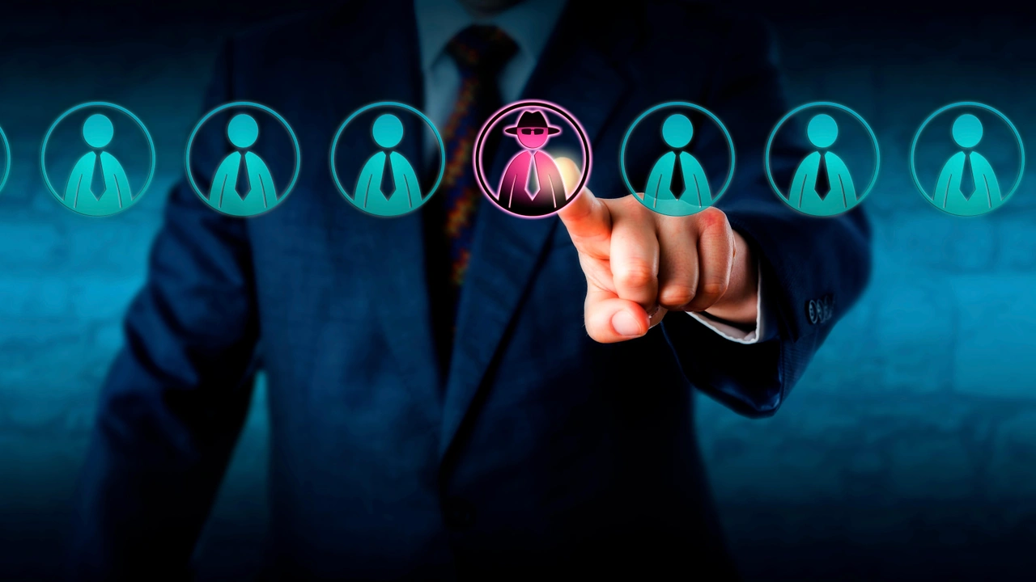
Agenda
Definitions, Impact
Differentiations
Psychological aspects
  Individual, Social
Mitigation Strategies

Slide 4
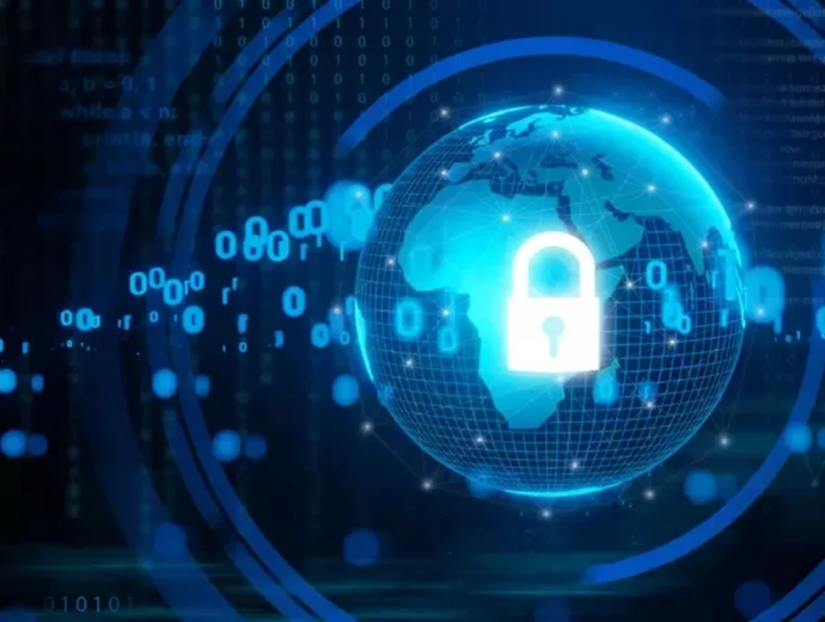
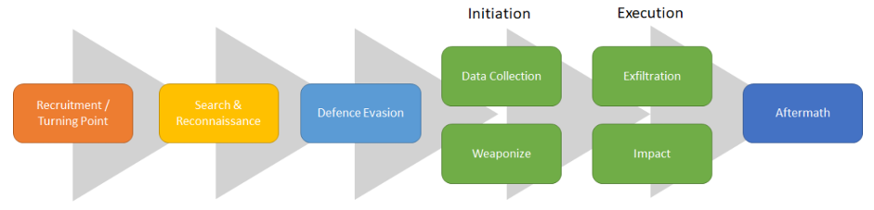
Definition
An Insider Threat is caused by an individual who has or used to have authorized access to an organization’s assets, and who acts either maliciously or unintentionally, in a way that could negatively affect the organization. (Costa, 2017)

Slide 5
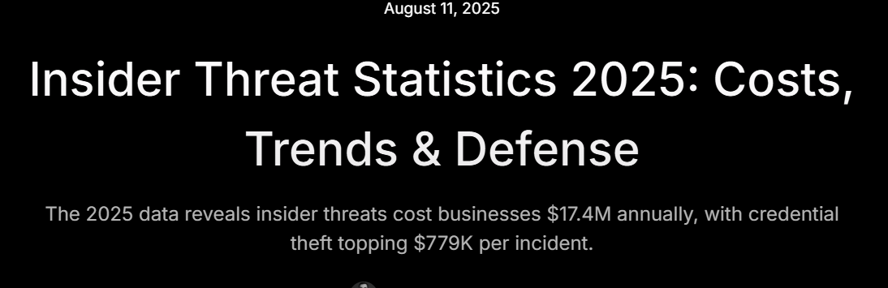
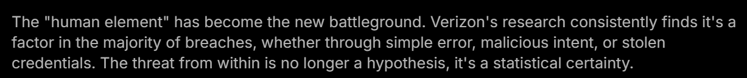
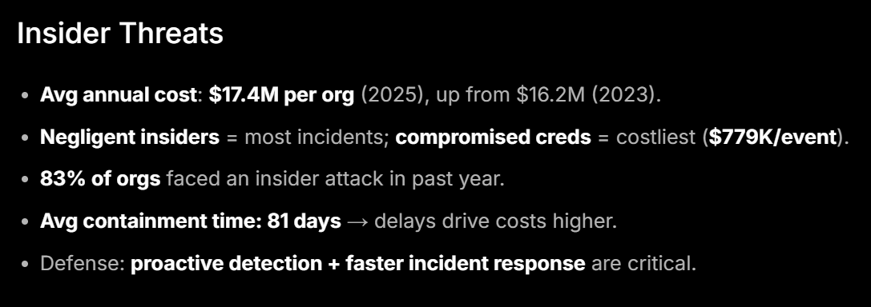
Notes:
Deepstrike

Slide 6

New News!!

Slide 7
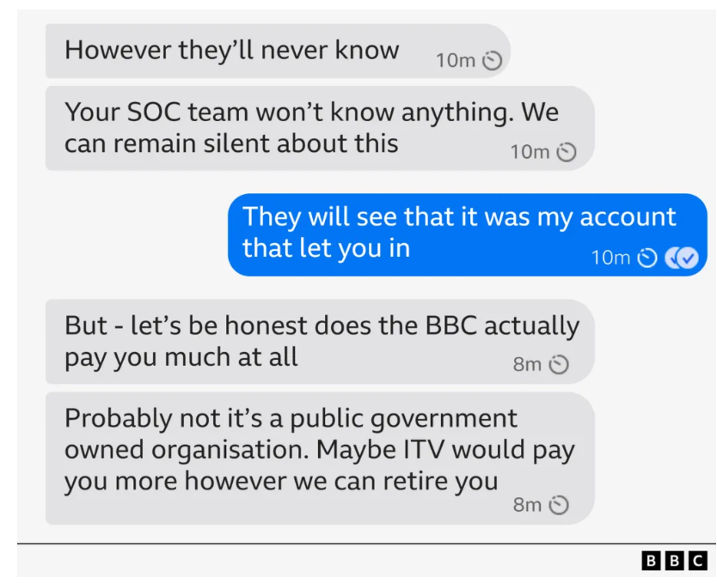
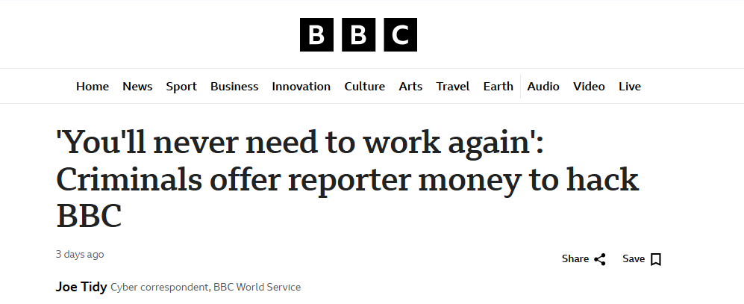
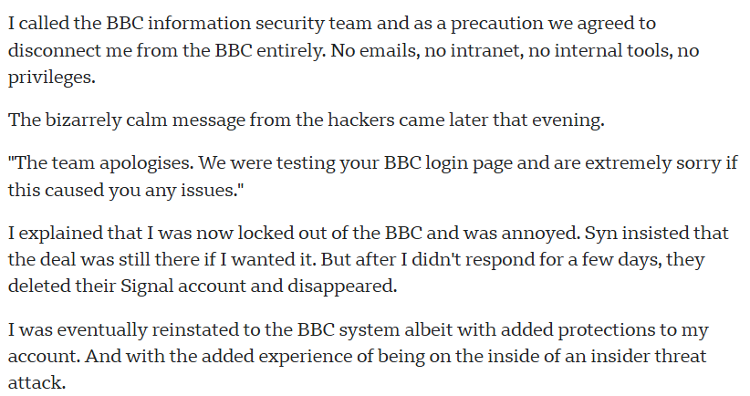
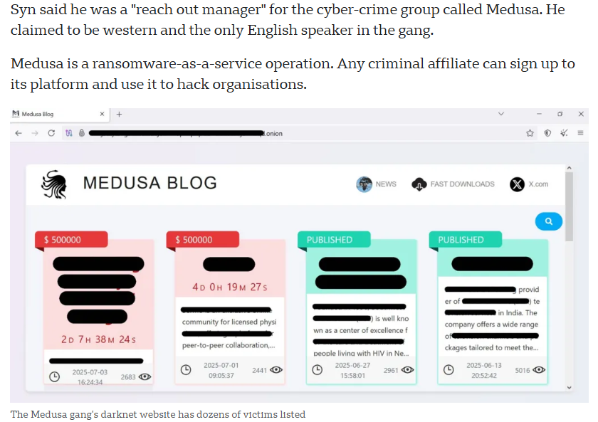
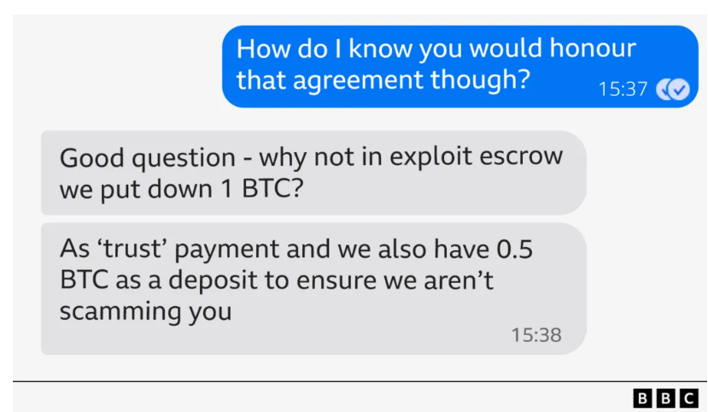
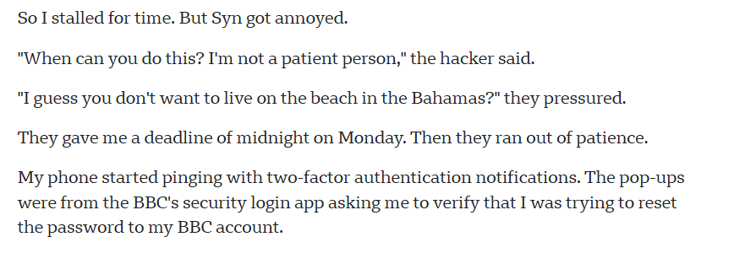
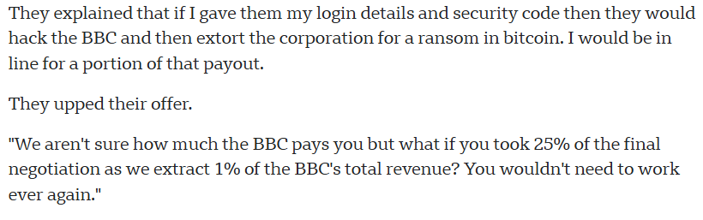
Notes:
Syn proudly sent me a link to a US public warning about Medusa which was put out in March. US cyber authorities said that in the four years that the group has been active, it has hacked "more than 300 victims".

Slide 8

So back to psychology

Slide 9


Why the fish...?

Slide 10
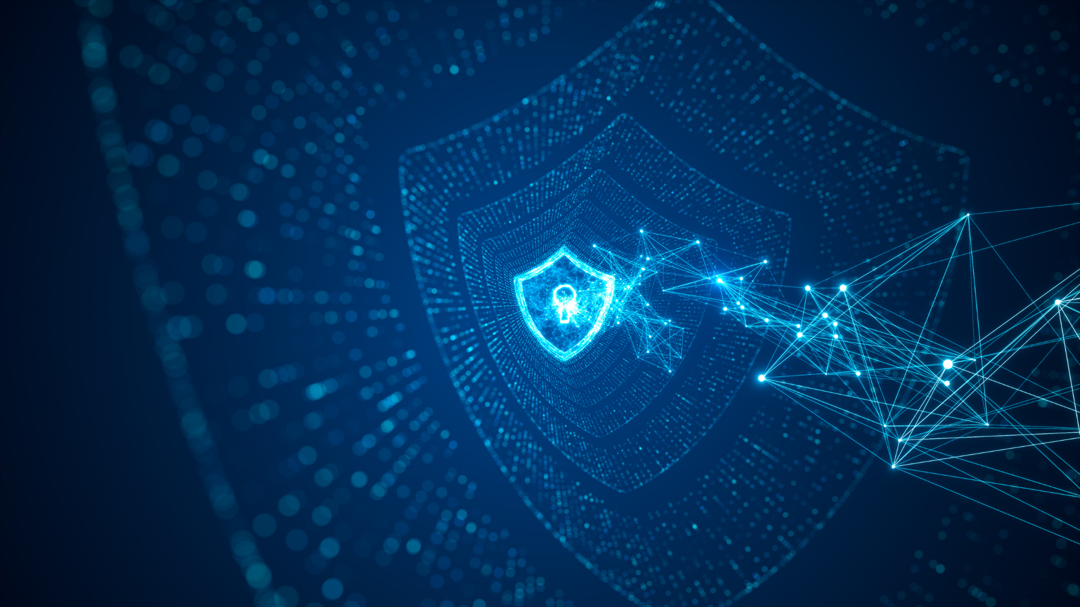
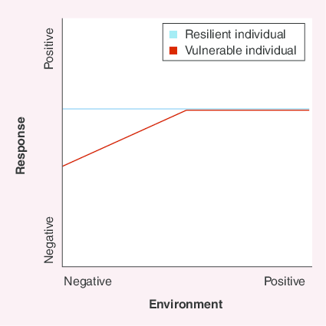
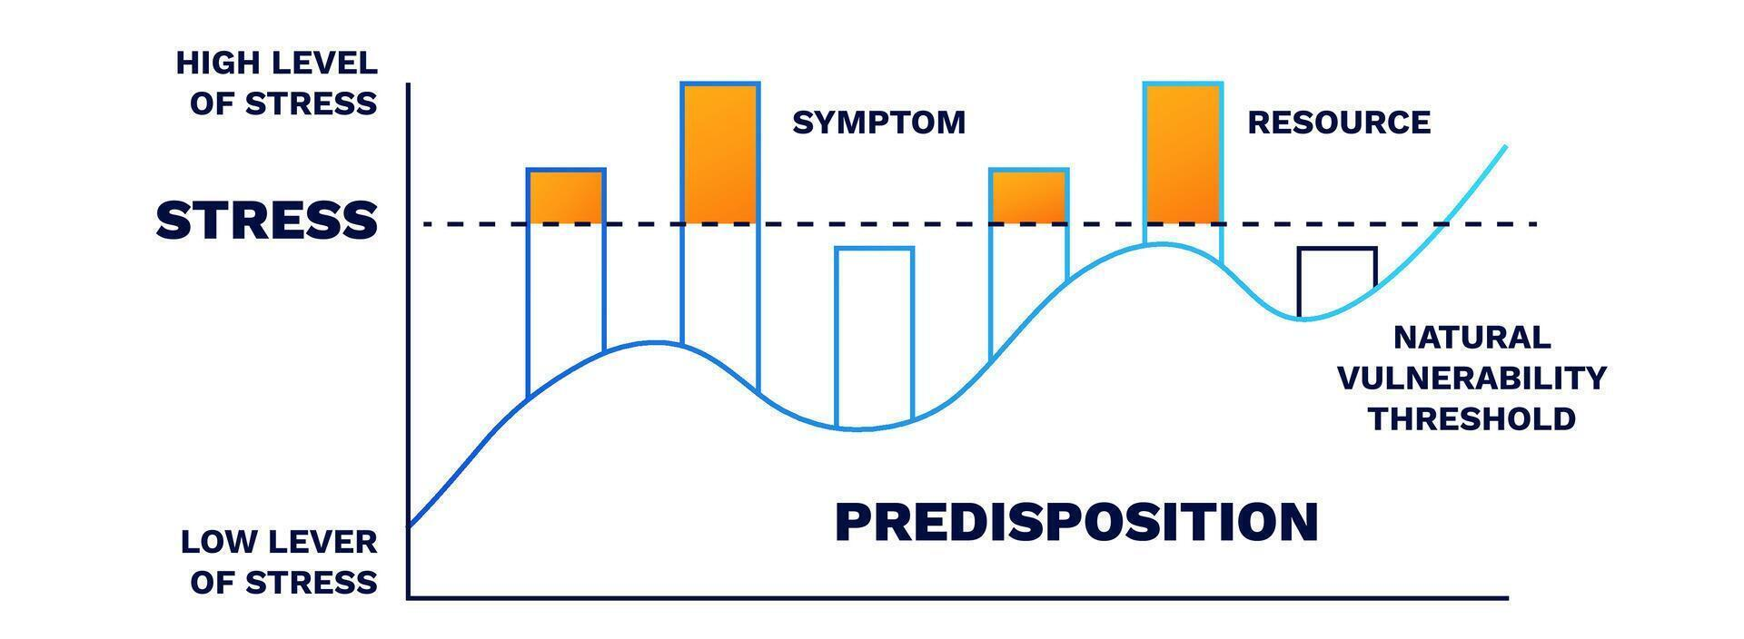
Interaction Paradigm
B= f(P x S)
Diathesis Stress Model

Slide 11
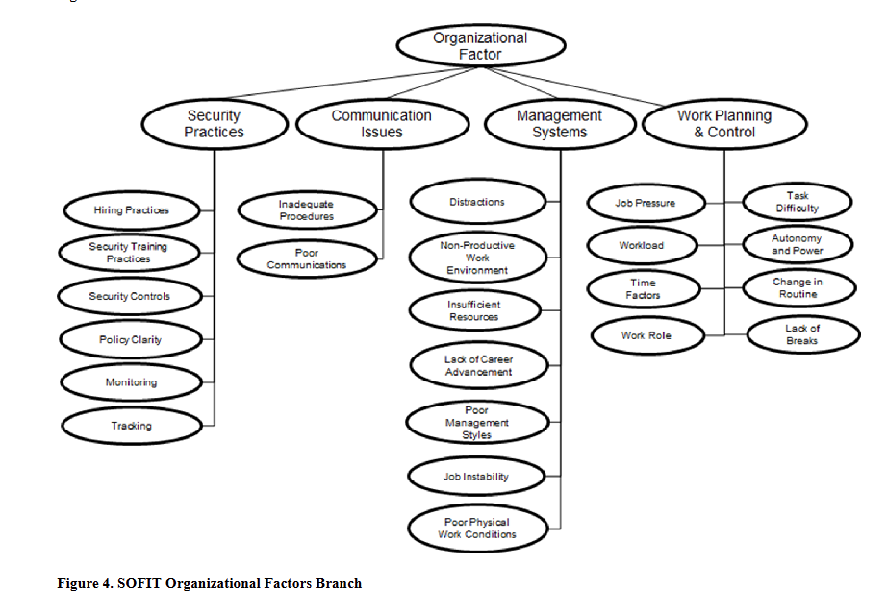
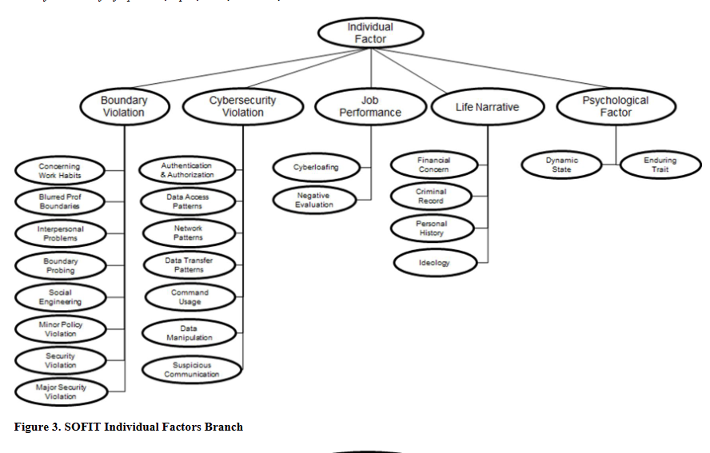
Interactions...SOFIT (Greitzer 2019)
Notes:
individual factors related to insider threats include personal behaviors, psychological states, and sociocultural or ideological influences. These elements, documented in the SOFIT ontology, cover over 270 indicators such as personality traits, personal grievances, or behaviors signaling disengagement. These factors are intended to capture nuances in human behavior that might elevate risk, and studies involving expert judgments have indicated that individual factors, like personality traits or signs of distress, are significant predictors of potential insider threats. These indicators are crucial as they often signal vulnerabilities that may evolve into intentional or unintentional security threats.
Organizational factors, on the other hand, include work environment issues, management practices, and policies that may inadvertently contribute to or fail to mitigate insider risks. Such factors encompass communication breakdowns, lack of clear security policies, and inadequate employee support systems, which can foster dissatisfaction or stress. Organizational oversight issues, such as insufficient monitoring or lack of behavioral training, can exacerbate risks by failing to address signs of distress or disengagement among employees. The SOFIT model suggests that these organizational practices can interact with individual factors, either reducing or intensifying the likelihood of insider threats depending on how effectively the organization manages them

Slide 12
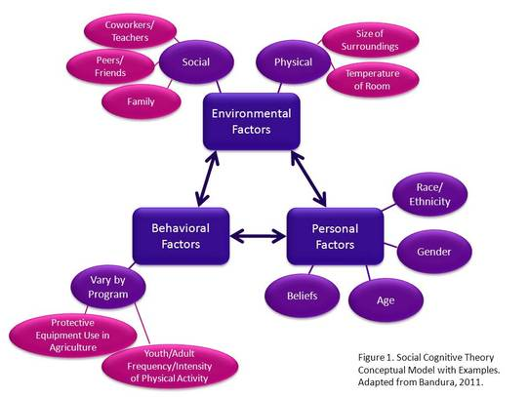
Resiprocal Determinism

Slide 13
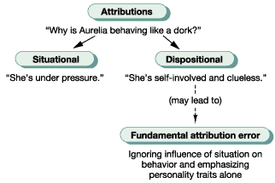
Fundamental Attribution Error
We predict others‘ actions on the basis of our assumptions about their personality
B = P x E

Slide 14
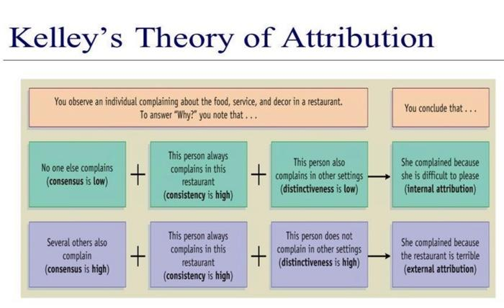
Notes:
Basically there are two terms that we need to know, if it is about personal characteristic it is (internal) or the environment we called it (external). In reality, the behaviour of other people is on a spectrum, they may be a combination of internal and external factors.
Here are the three variables:
Consensus: People who behave in the same way throughout similar situation. E.g., Jamie always cancelled her plans with us with many excuses such as "I have laundry to do", "I need to rest", "I gotta meet my parents", so on and so forth. After a month of time, we realised that Jamie has been displaying the same behaviour over time. So when consistency is high, we're more likely to attribute it towards the internal factor.
Distinctiveness: A person behaves the same way in similar situation. E.g., Jamie eats 2 scramble eggs for breakfast at home every day but you've seen her eating scramble egg at a friend's house, where she only eats one scramble egg. So distinctiveness is high for Jamie's behaviour because it is distinct from the normal behaviour in different locations.
Consistency: A person behave like this every time a situation occurs. E.g., Jamie arrived late to work, but with 10 other people they are all late. There is a high degree of consensus, what that means is that a lot of people are demonstrating the same behaviour. When a lot of people are late, there must be something to do with the environment, "it could be the traffic", "it could be there's no parking, the weather is bad." And when a high level of consensus means that we are more likely to attributes the same behaviour to a situational cause (external) factor

Slide 15
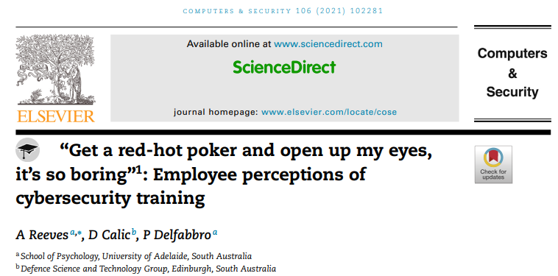
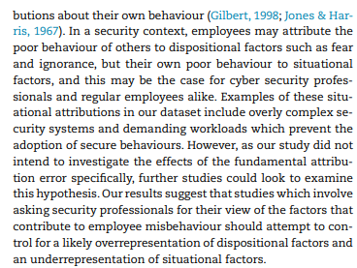
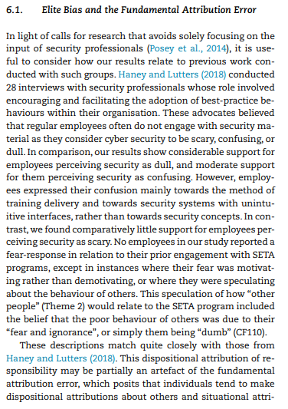
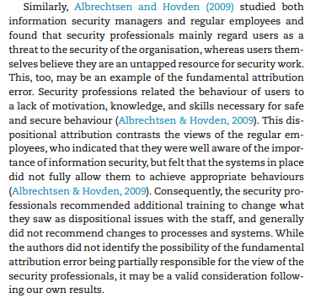
CS‘s and employee‘s perspective differ.
Confusion about situational demands and conflict with goals vs. lack of motivation or disagreement on the goal.
Notes:
CS‘s and employee‘s perspective differ.
Confusion about situational demands and conflict with goals vs. lack of motivation or disagreement on the goal.

Slide 16
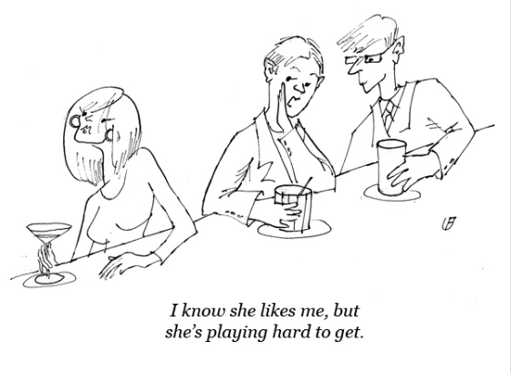
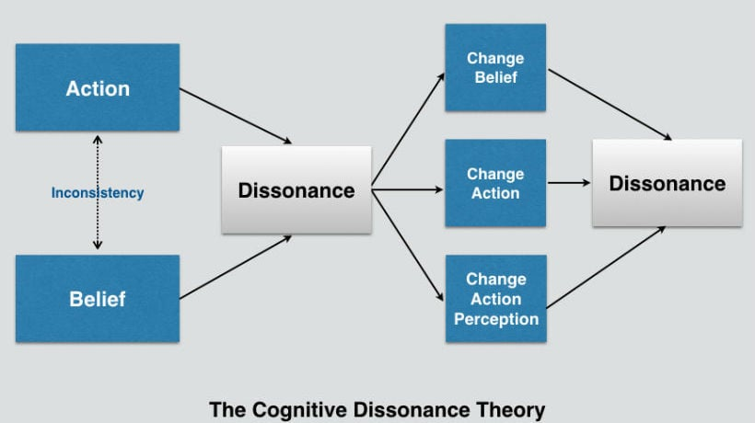
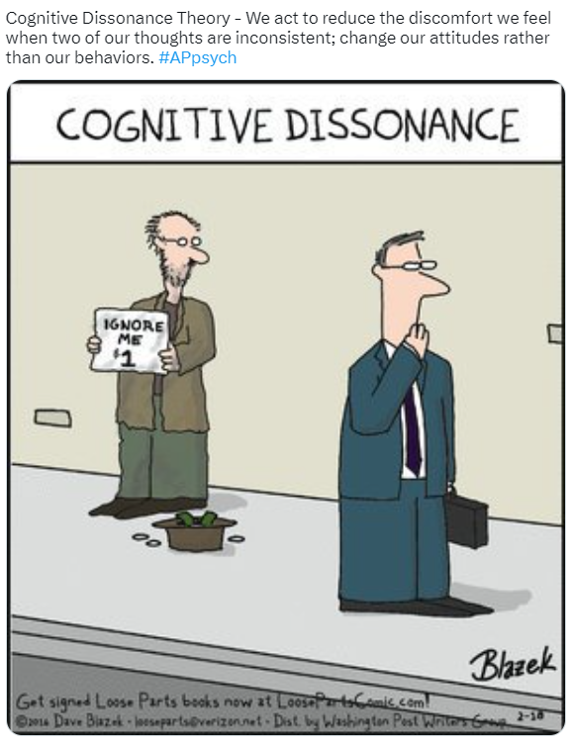
Cognitive Dissonance Reduction /
Self-justification

Slide 17

Back to…. Insider Threats
You can avoid the Fundamental Attribution Error and…
…impact the situational influences
… by reducing risk factors known from the Critical Path Model in the organizational environment.

Slide 18
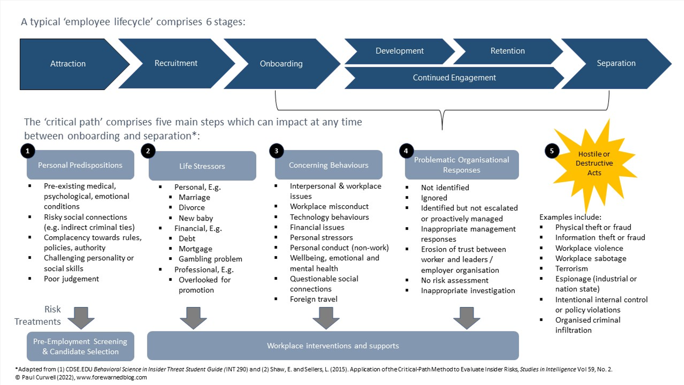
Notes:
The critical-path method, originally a 1960s decision science tool for process management, was applied by Shaw and Sellers in 2015 to understand insider threats. The Critical Pathway to Insider Risk (CPIR) model, serves as a flexible framework for identifying potential insider threats by mapping how various personal, psychosocial, and organizational factors influence employee behaviors over time. Based on the diathesis-stressor model, CPIR proposes that personality traits, stressors, and workplace grievances interact to elevate risk, with certain behaviors escalating if not addressed constructively by the organization. Continuous monitoring and behavioral analytics are used to detect these warning signs, while workplace support programs, such as Employee Assistance Programs, can mitigate risks if employees feel safe to disclose issues without fear of reprisal. As the model is iteratively refined, it provides a probabilistic, multifactorial view of insider risk, emphasizing that not all at-risk individuals will act maliciously and underscoring the need for nuanced, evidence-backed interventions​(Lenzenweger++Shaw+(2022…).Analyzing cases of trusted insiders who became security risks, they identified a four-step pathway: personal predispositions, stressors, concerning behaviors, and inadequate organizational responses. This approach suggests that troubled employees may progress to malicious actions when stressors accumulate and organizational support is lacking. Modern detection systems, such as Insider Risk Detection, employ behavioral analytics to monitor signs along this pathway, combining digital and physical data to alert managers. While these tools help detect general risks, their effectiveness depends on how well they are customized to an organization’s specific threats. With greater openness toward mental health and support programs like counseling and financial advice, organizations now have tools to support employees proactively and potentially prevent insider threats. However, trust is essential; employees need confidence that seeking help won’t have negative repercussions, fostering a culture where insider risk can be managed more effectively.

Slide 19
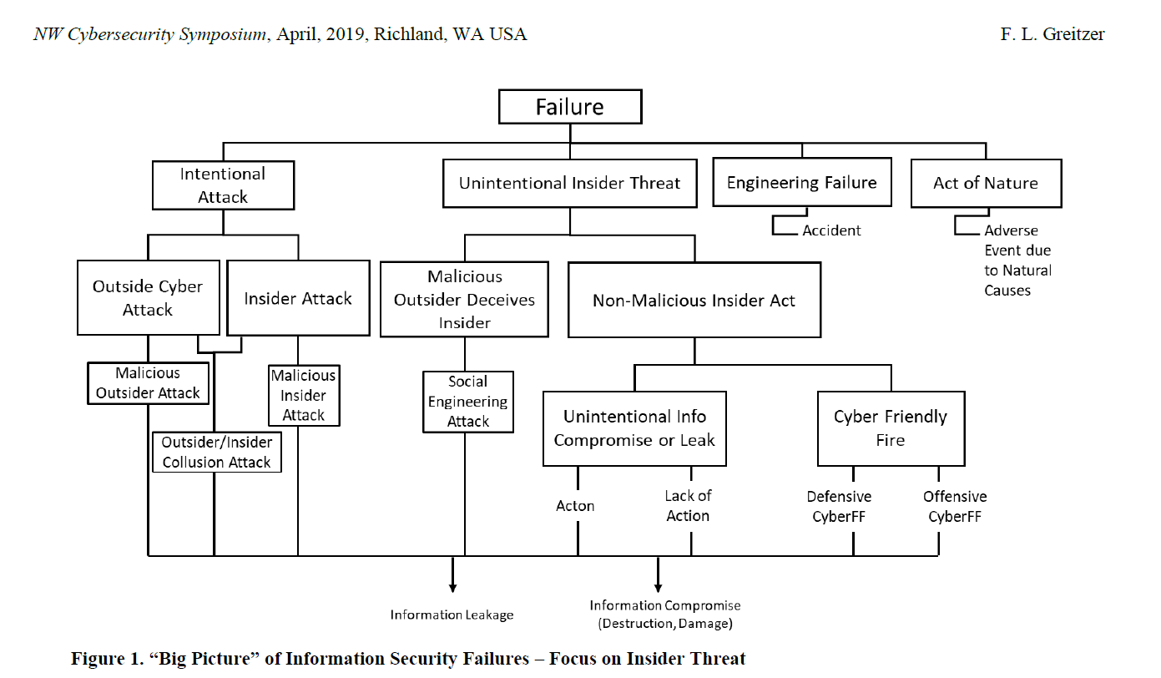
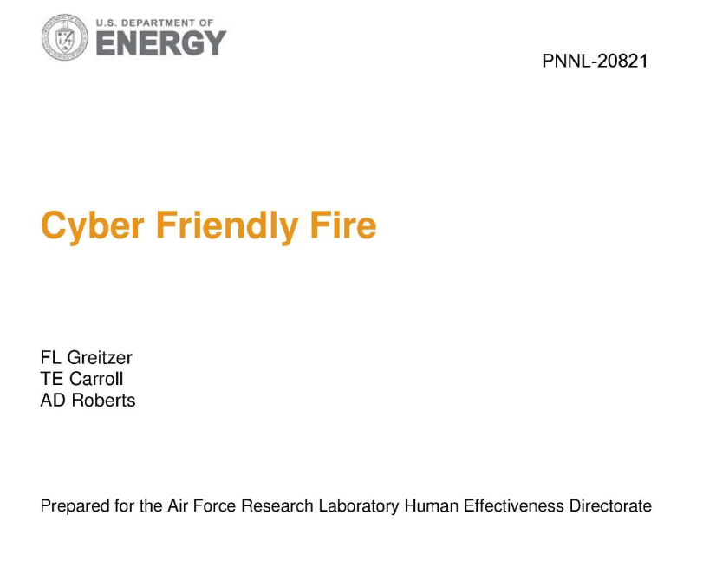
e.g. cyber fratricide
Notes:
Social Engineering usually defined as an Insider Threat.
Much less exciting, not intuitive for most people.
Moving through friendly servers.
the significant threat posed by insiders to organizational security, rivaling external attacks in both prevalence and cost. Despite advancements in cybersecurity, insider threats remain challenging due to the trust and access granted to employees, which enables them to circumvent traditional security measures. Standard insider threat programs often focus on technical monitoring, such as network logs and intrusion detection, but these approaches may overlook human factors. Recognizing this gap, recent research advocates for a more comprehensive approach that incorporates behavioral and organizational indicators to better identify and mitigate insider risks.
Emerging U.S. guidelines support establishing insider threat programs; however, they frequently only mandate minimal monitoring standards. A key barrier to progress is the difficulty in integrating sociotechnical indicators, like psychological and organizational factors, which provide a fuller understanding of potential risks. This research, therefore, aims to develop a framework for these indicators, captured in the SOFIT ontology, which includes both technical and human-related factors, fostering a proactive rather than reactive approach to insider threat detection​

Slide 20

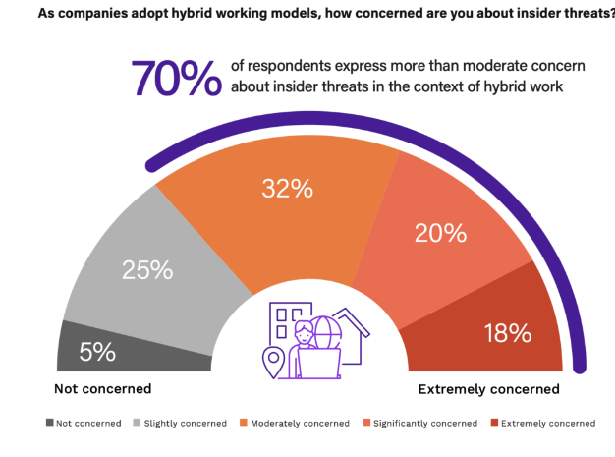
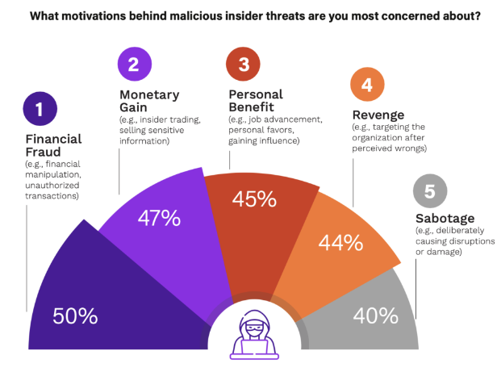
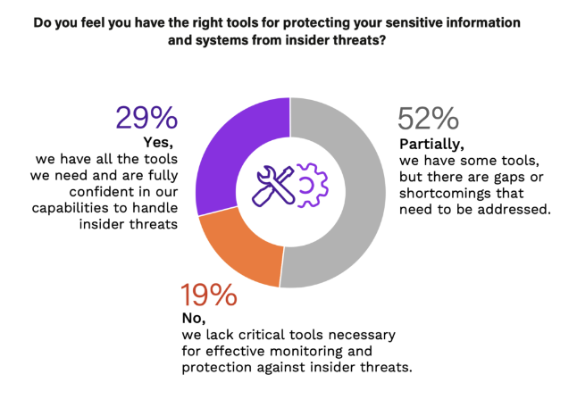
Insider Thttps://www.securonix.com/blog/shifting-perceptions-of-insider-threats-vs-external-cyber-attacks/hreat Report 2024
Notes:
https://www.securonix.com/blog/shifting-perceptions-of-insider-threats-vs-external-cyber-attacks/
The 2024 Insider Threat Report by Cybersecurity Insiders, commissioned by Securonix, reveals a growing concern among cybersecurity professionals regarding insider threats, with 53% finding them more challenging to detect than external attacks—a significant rise over recent years. This shift underscores the need for advanced, layered insider threat detection strategies focused on user behavior analytics to enhance security visibility. Insiders often possess legitimate access to systems, which allows them to bypass external threat defenses, making detection particularly complex. Their motivations, such as financial gain or revenge, further complicate threat profiling, highlighting the necessity for sophisticated threat detection models.
The rise of remote and hybrid work has also blurred the traditional secure boundaries, with employees accessing sensitive data from various, often unsecured, locations and devices, adding complexity to monitoring and enforcing security protocols. Despite adjustments to hybrid work since the pandemic, 70% of cybersecurity professionals report elevated concern over insider risks within these strategies. Balancing security with employee privacy remains critical; the report notes that 66% of respondents are concerned about user privacy, stressing the importance of ethical, transparent monitoring.
Organizations are increasingly leveraging AI, machine learning, and tools like User and Entity Behavior Analytics (UEBA) and Security Information and Event Management (SIEM) systems to identify insider threats. However, these advanced technologies demand skilled personnel, which poses a challenge for some organizations. Additionally, as external defenses improve, attackers may exploit insider pathways, even involving triple extortion techniques, a tactic that 76% of respondents observed rising in frequency. The evolving insider threat landscape emphasizes the need for a comprehensive approach that combines technology, continuous employee education, and robust security culture to manage insider risks effectively.

Slide 21

Bypass security
The use of cloud services increases the attack surface against the stored data. Most of the defenses focus on external cyber-attacks, such as unauthorized access to their data, Denial of Service (DoS) attacks and malware.
Companies (in the US) spend 10% of their IT budget on protecting their assets from external attacks - this amount often proves not to be sufficient.
These breaches are amplified since an insider has knowledge and access to the organization’s assets, has the trust of the organization, and enjoys authorized access. Thus, it is possible to bypass the applied security measures and create a disaster.

Slide 22
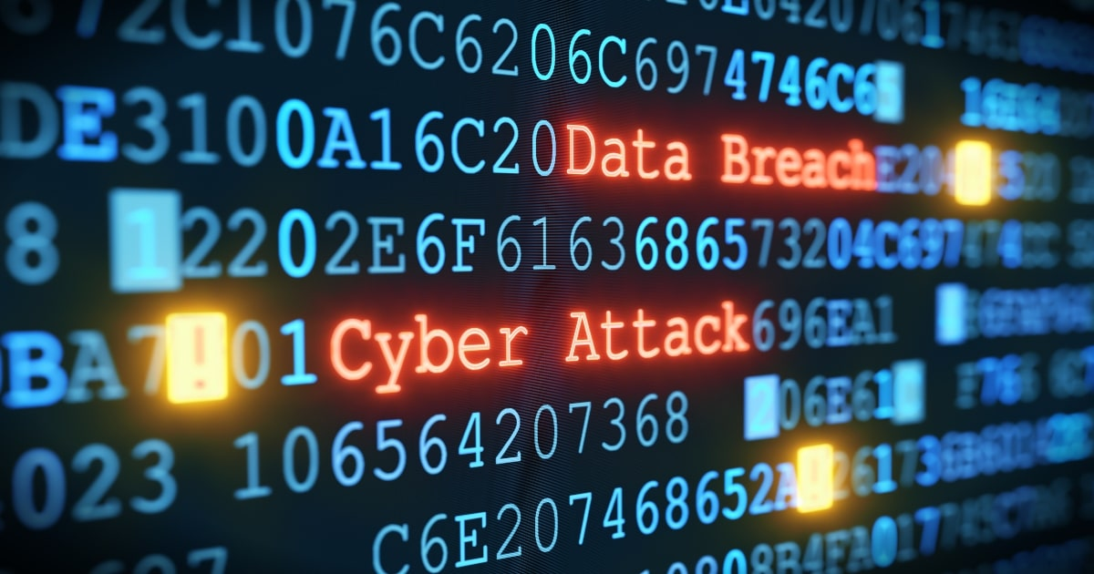
Consequences
Theft or loss of mission critical data or intellectual property
Impact of downtime on organizational productivity
Damages to equipment and other assets
Cost to detect and remediate systems and core business processes
Legal and regulatory impact, including litigation defense cost
Lost confidence and trust among key stakeholders
Diminishment of marketplace brand and reputation
Notes:
That all costs time – in total 85 days

Slide 23
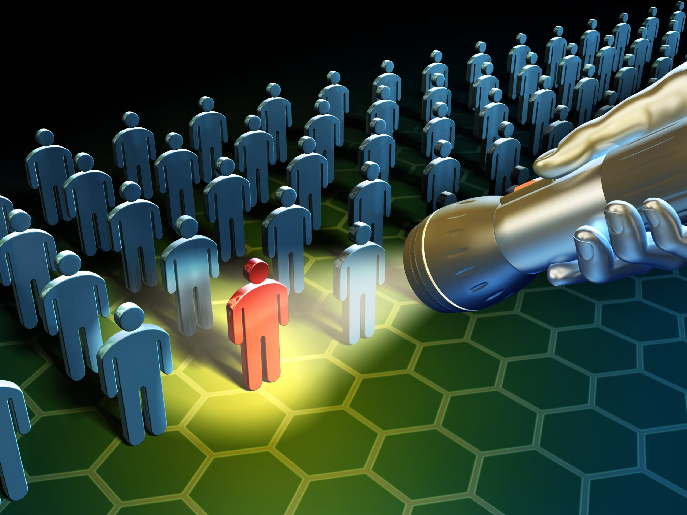
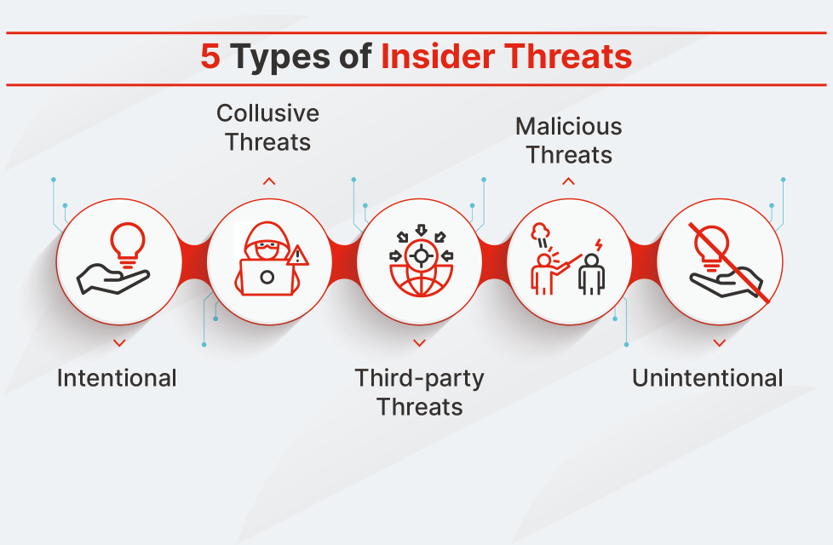
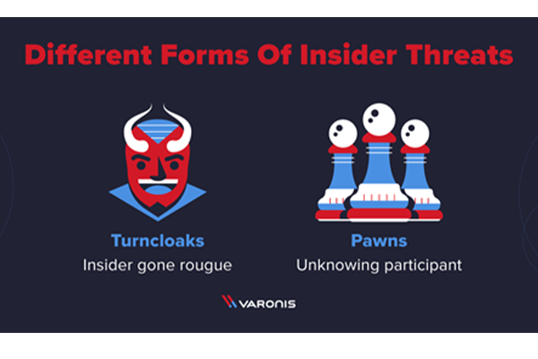
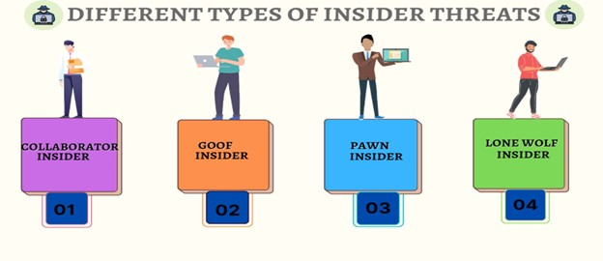
Types
Notes:
1. Intentional
An intentional insider threat occurs when an individual sets out to purposely cause harm to an organization. Many intentional insider threats aim to get even with a company over a lack of recognition or a failure to meet expectations, such as not receiving a desired bonus or promotion.
2. Unintentional
An unintentional insider threat involves data being lost or stolen as a result of employee error or negligence. Accidental unintentional insider threats occur due to human error and individuals making a mistake that leads to data leakage, a security attack, or stolen credentials. Accidental data leaks include sending business information to the wrong email address, mistakenly clicking on malicious hyperlinks or opening malicious attachments in phishing emails, or failing to delete or dispose of sensitive information effectively. These threats can often be avoided by following security best practices.
A negligent unintentional insider threat occurs through carelessness that leads to exposing an organization to a threat. For example, ignoring security and IT policies, misplacing portable storage devices, using weak passwords, and ignoring software updates or security patches can leave organizations vulnerable to a cyberattack.
3. Third-party threats
A third-party threat is typically a business partner or contractor that compromises an organization’s security. Third-party threats can be a result of negligent or malicious activity.
4. Malicious threats
A malicious threat is a form of intentional insider threat that intends to cause harm either for personal benefit or as an act of vengeance.
Malicious insider threats aim to leak sensitive data, harass company directors, sabotage corporate equipment and systems, or steal data to try and advance their careers. Many of these malicious threats are financially motivated, as employees steal corporate data to sell to hackers, third-party organizations, or rival companies.
5. Collusive threats
A collusive threat is a type of malicious insider, in which one or more insider threat individuals work with an external partner to compromise their organization. Collusive insider threats often involve a cyber criminal recruiting an employee to steal intellectual property on their behalf for financial gain.
Insider threat individuals are typically split into two types of actors:
Pawns: Pawns are company employees manipulated into carrying out malicious activity, such as disclosing their user credentials or downloading malware. Pawns are often targeted by attackers through social engineering or spear-phishing campaigns.
Turncloaks: A turncloak is an employee who actively turns on their employer. Turncloaks often act to gain financially or to cause harm to an organization. However, turncloaks also include whistleblowers, who serve to bring public attention to the failings of their employer.
Additional insider threat individuals include:
Collaborators: A collaborator is an employee who collaborates with a cyber criminal and uses their authorized access to steal sensitive data, such as customer information or intellectual property. Collaborators are typically financially motivated or reveal information to disrupt business operations.
Goofs: A goof is an employee who believes they are exempt from their organization’s security policies and bypasses them. Whether through convenience or incompetence, goofs’ actions result in data and resources going unsecured, which gives attackers easy access.
Lone wolf: Lone-wolf attackers work alone to hack organizations or seek out vulnerabilities in code and software. They often seek to gain elevated levels of privilege, such as database or system administrator account passwords, that enable them to gain access to more sensitive information.

Slide 24
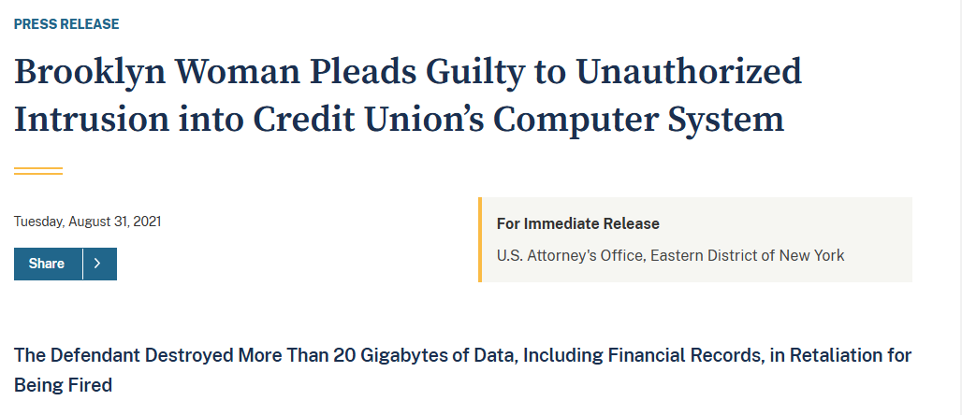
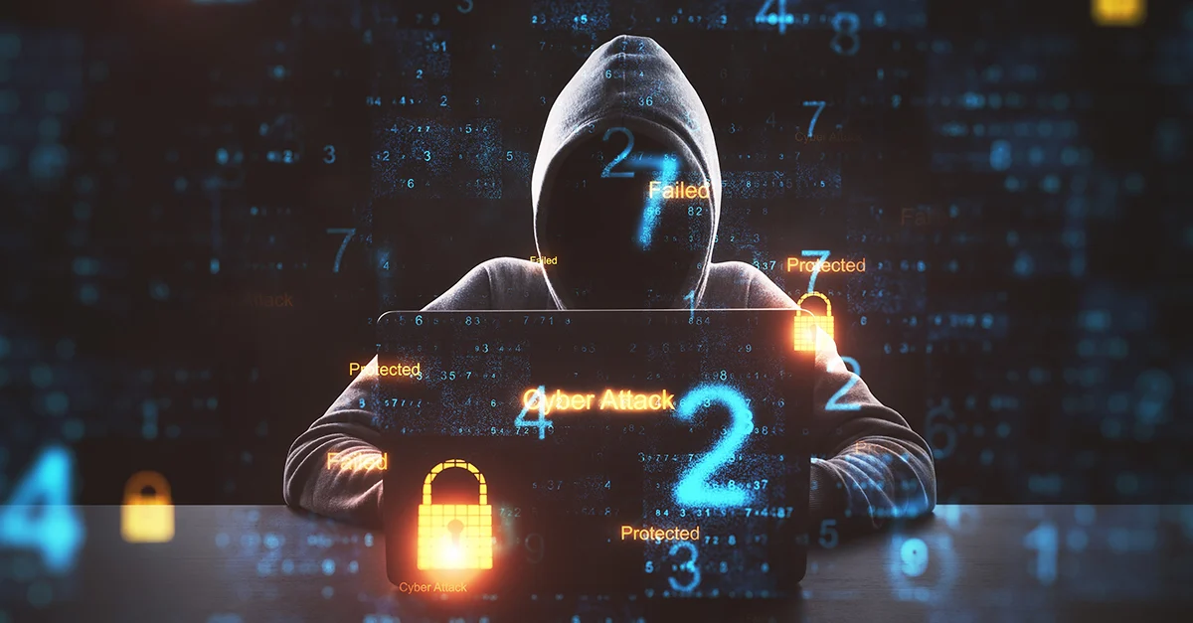
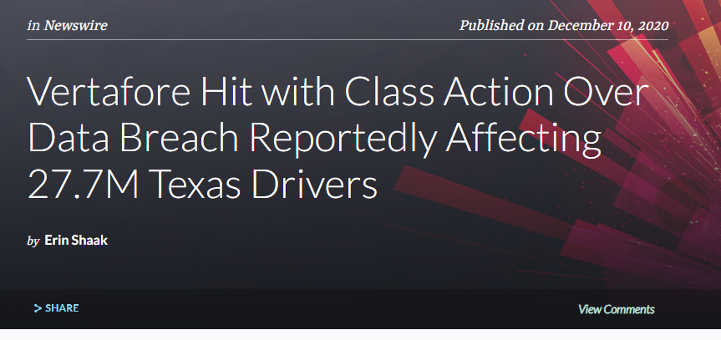
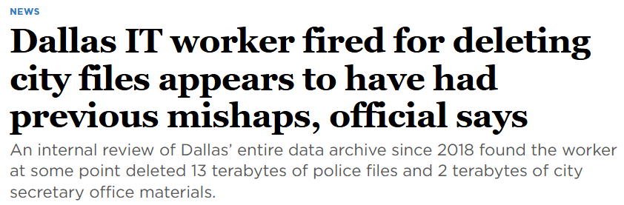
Notes:
In 2021, Juliana Barile, an employee at an undisclosed credit union in New York, decided to exact revenge after being fired from her job. The IT team did not immediately deprovision her access to sensitive systems after termination. So within 40 minutes, Ms. Barile deleted over 21GB of data that included 3,500 directories and 20,000 files. Some of the deleted files were anti-ransomware software and mortgage applications. She was also able to access board minutes and other sensitive information.
2. An insider error steers data of Texas drivers into a hacker’s hands
An employee at tech company Vertafore stored the data of Texas drivers in an insecure offsite location, leaving it vulnerable to a breach. The accidental leak impacted 27.7 million records. Even though the breach did not involve either financial or social security data, Vertafore still ended up covering the cost of incident response—and it is facing a class-action lawsuit as a result.
3. City of Dallas files deleted because of an insider’s mistake
An errant but apparently innocent employee of the City of Dallas was fired after it was discovered they had deleted more than 22TB of data between 2018 and 2021. Among the destroyed files were 13TB of videos, photos, and case notes that belonged to the Dallas Police Department. The investigation revealed that the incident was not a malicious attack. The employee simply failed to follow internal procedures while transferring files.

Slide 25
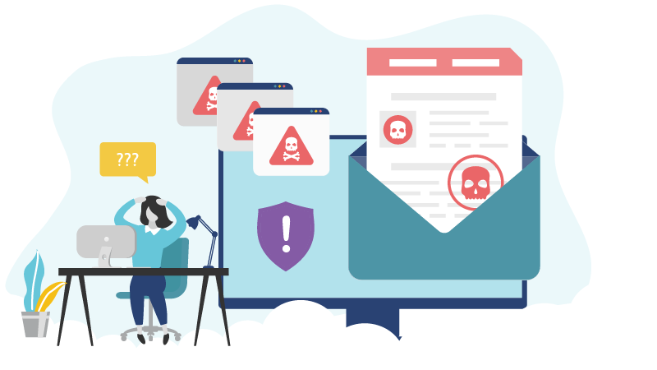
Unintentional

Slide 26
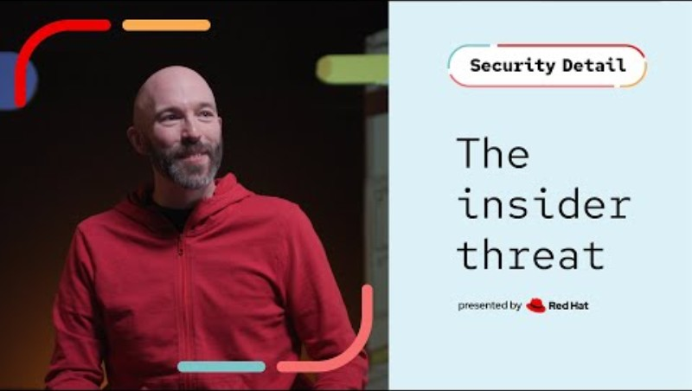


Slide 27
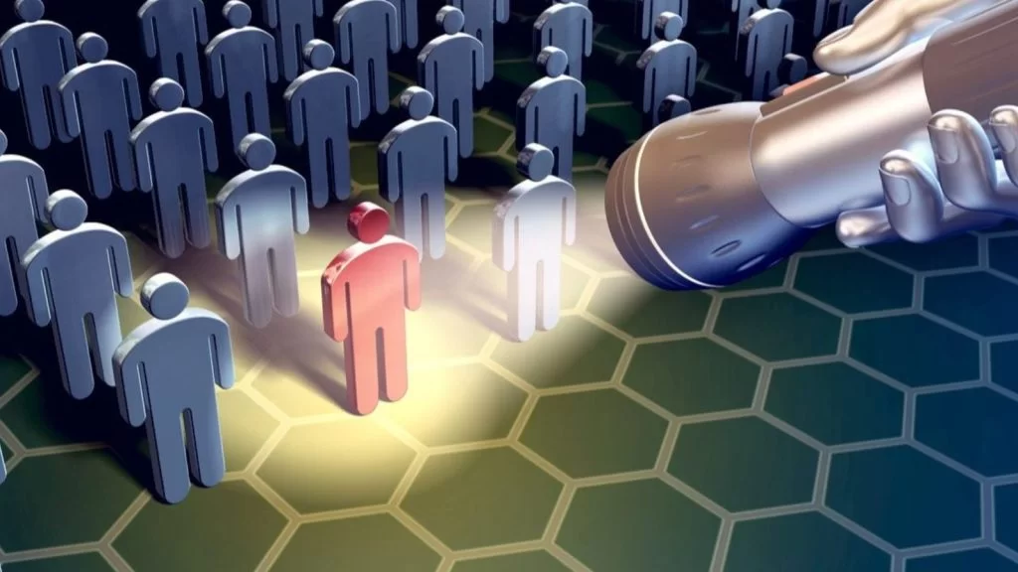
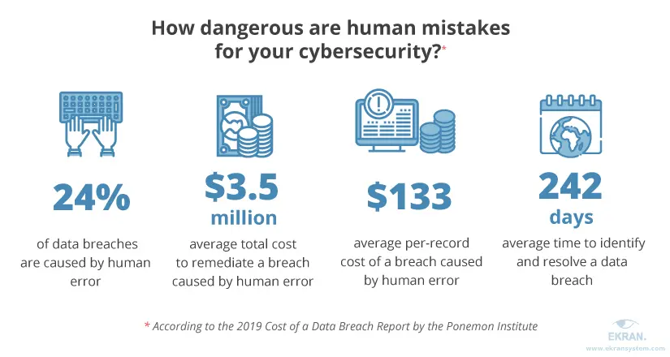
Notes:
Accidental Insider Threat occurs when an employees’ actions lead to damage to a system or network, the loss of critical or sensitive data, or even where a helpful employee holds a door open for a hacker to enter a secure building. These incidents can occur with zero malicious intent, making the incidents accidental in nature, but they still can be very damaging to the company in question.
Examples include: an employee accidentally deletes an important document; an employee falls victim to a spear-phishing attack introducing ransomware into a company’s network; and when an employee accidentally shares more information with a client or 3rd party than they are legally allowed to.

Slide 28

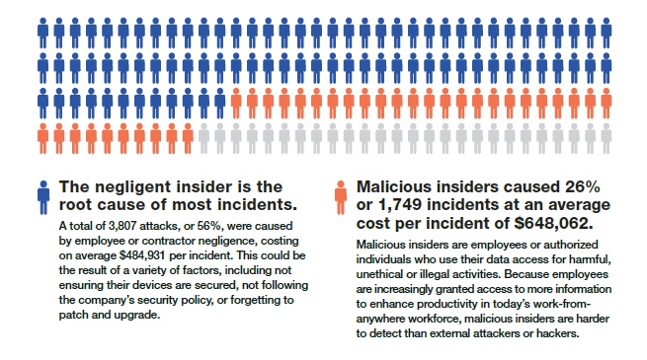
Notes:
Amoutns not so important – how do you measure reputation loss..

Slide 29
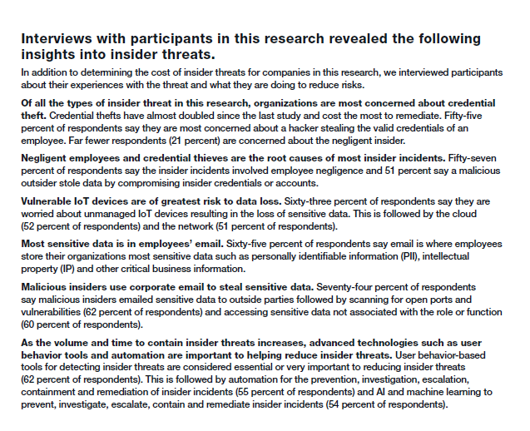
Proofpoint‘s investigation (2022)
Only 21% of respondents are concerned about the negligent insider.
… but 57% said insider actual incidents involved negligent insider.
Email as the central medium for storage and submission of sensitive data.

Slide 30
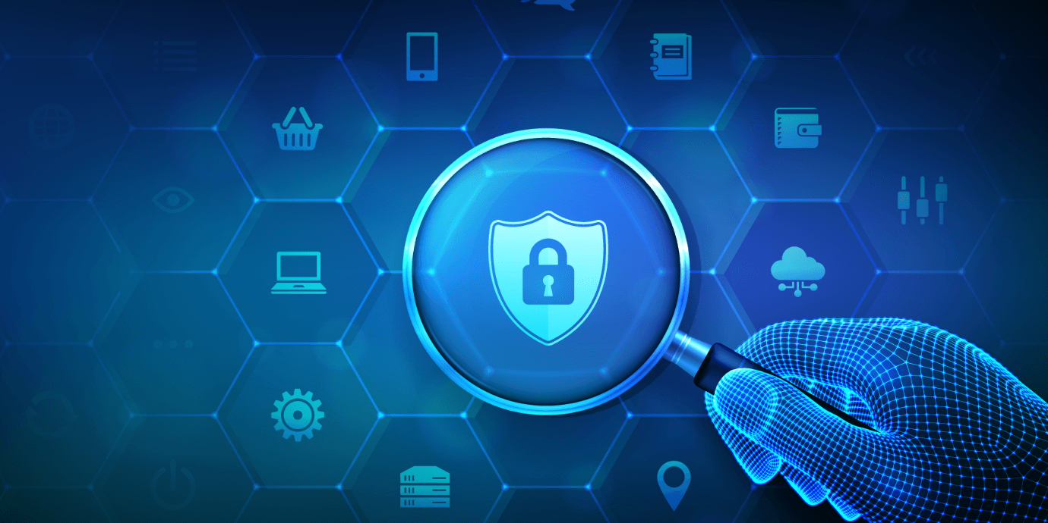
Risk factors
Employees are not trained to fully understand and apply laws, mandates, or regulatory requirements related to their work and that affects the organization’s security.
Employees are unaware of the steps they should take at all times to ensure that the devices they use—both company issued and BYOD—are secured at all times.
Employees are sending highly confidential data to an unsecured location in the cloud, exposing the organization to risk.
Employees break your organization’s security policies to simplify tasks.
Employees expose your organization to risk if they do not keep devices and services patched and upgraded to the latest versions at all times.
Notes:
What is the chance to avoid all of this without a systematic educational program? Right…
Detection and Mitigation come too late – the only way to reduce these risk factors is a behavior change.
UNDERSTAND AND APPLY – awareness + intention/behavior.
AWARENESS of end-user all over.
Last point is sth IT-admin needs to take care of.
Rest is compliance and adherence, awareness, intention, behavior, habits.
The whole stuff.

Slide 31

Response-related activities accounting for the expenditures and time until containment
Notes:
All of these steps happen after someone decided to e.g. leak data. – when it comes to malicious insiders, this is all dealing with consequences of having them, not preventing them to occur.
Time is lost due to communication and organisation, forming the process of a response rather than the acts themselves. – In comparison to „outsider“-based cyberattacks no playbook usually exists.

Slide 32

Intentional

Slide 33


Hot off the Press!!
Notes:
The data breach at Star Health and Allied Insurance Company has raised serious concerns about insider threats and data security. An employee allegedly offered illegal access to the company’s customer medical records for $43,000, later escalating the price to $150,000. However, the buyer exposed the plot, leading to further repercussions. In September 2024, a cybercriminal alias “xenZen” announced on Telegram the full leak of over 31 million customer records, including personal and sensitive medical information, totaling 7.24 terabytes. The breach led to a 1.7% stock decline, prompting Star Health to launch an independent forensic investigation amid suspicions of involvement from the company’s CISO. Star Health, characterizing the incident as a targeted cyberattack, has pledged transparency in collaboration with authorities. The breach underscores the regulatory challenges posed by platforms like Telegram, where such sensitive data can be leaked rapidly.

Slide 35



From 3 to 4...
Notes:
Would 'Fraud triangle be necessary to describe? Kassem, R., & Higson, A. (2012). The new fraud triangle model. Journal of emerging trends in economics and management sciences, 3(3), 191-195.
Ruankaew, T. (2016). Beyond the fraud diamond. International Journal of Business Management & Economic Research, 7(1), 474-476.
Opportunity
If one is talking about theft, there must be something to steal and a way to steal it. Anything of value is something to steal. Any weakness in a system—for example, lack of oversight—is a way to steal. Of the three elements of the Fraud Triangle, opportunity is often hard to spot, but fairly easy to control through organizational or procedural changes.
Pressure
Pressure in this case is another way of saying motivation. What is it in one’s life that drives one to commit fraud? Pressure sometimes involves personal situations that create a demand for more money; such situations might include vices like drug use or gambling or merely life events like a spouse losing a job. At other times, pressure arises from problems on the job; unrealistic performance targets may provide the motive to perpetrate fraud.
Rationalization
There are two aspects to rationalization: One, the fraudster must conclude that the gain to be realized from a fraudulent activity outweighs the possibility for detection. Two, the fraudster needs to justify the fraud. Justification can be related to job dissatisfaction or perceived entitlement, or a current intent to make the victim whole sometime in the future, or saving one’s family, possessions or status. Rationalization is discernible by observation of the fraudster's comments or attitudes.
The Fraud Diamond
Capability
The Fraud Diamond, a newer theory of fraud proposed by David T. Wolfe and Dana R. Hermanson, asserts that the fraudster's capability must also be taken into account. The fraudster, it is said, must have the required traits (e.g., greed, weakness of character, excessive pride, dishonesty, etc.) and abilities (e.g., knowledge of processes and controls) to actually commit the fraud. It can be argued, however, that traits are components of pressure and that abilities are opportunity factors.

Slide 36

Intentional Profiles/ Predispositions
Harms et al 2022
Capability...
Notes:
"Exposing the Darkness Within" provides an extensive review of how dark personality traits—specifically, the Dark Triad (narcissism, Machiavellianism, and psychopathy)—are linked to insider threat behaviors in cybersecurity settings. These traits, characterized by entitlement, manipulation, and impulsive harm, have shown distinct patterns of association with both malicious and non-malicious insider threats. Narcissism, for instance, is connected to self-promoting and blame-shifting tendencies, whereas Machiavellianism reflects strategic manipulation and amoral views, and psychopathy is associated with impulsivity and lack of empathy. Statistical findings indicate that Machiavellianism and psychopathy have a significant positive relationship with malicious insider threats, while traits such as narcissism show weaker associations
Subject matter experts (SMEs) rated various dark traits for relevance to cybersecurity roles, noting that traits like Machiavellianism and psychopathy predict both malicious and non-malicious risks. In contrast, traits such as diligence (mean -1.71, SD .49) were found to correlate negatively with non-malicious threats, suggesting that some "dark" traits may, in specific contexts, predict positive cybersecurity performance. These findings imply that incorporating personality assessments focusing on dark traits could improve insider threat detection, but accurate measurement tools tailored to specific cybersecurity risks are essential for practical application. Overall, the research advocates for using a nuanced approach in monitoring dark traits to bolster organizational cybersecurity and reduce insider threats effectively
Harms, P. D., Marbut, A., Johnston, A. C., Lester, P., & Fezzey, T. (2022). Exposing the darkness within: A review of dark personality traits, models, and measures and their relationship to insider threats. Journal of Information Security and Applications, 71, 103378.

Slide 37

So what to do?

Slide 38
2 options
Insider threat management
Employee training (own lecture!)

Slide 39
Which reasons do you think motivate a business to set up an Insider Threat Management program ?

Slide 40

First things first
Notes:
The three letters in "CIA triad" stand for Confidentiality, Integrity, and Availability. The CIA triad is a common model that forms the basis for the development of security systems. They are used for finding vulnerabilities and methods for creating solutions.
The CIA triad—Confidentiality, Integrity, and Availability—is foundational to information security, forming essential goals that help protect information systems within the broader field of cybersecurity. While originating in the 1980s, the CIA model remains central to understanding and managing security principles, particularly as it appears in standards like ISO/IEC 27002 and ISO/IEC 27000. Confidentiality ensures that access to information is limited to authorized individuals, Integrity safeguards the accuracy and completeness of data, and Availability guarantees that information and resources are accessible to authorized users when needed.
These three elements collectively offer a high-level framework for information security, though they are not exhaustive. As cybersecurity has evolved, other attributes, such as authenticity, accountability, non-repudiation, and reliability, have been added to address modern security challenges. Furthermore, the CIA triad has a structural focus, contrasting with attacker-oriented models like the MITRE ATT&CK framework. Despite this, the CIA principles are fundamental, often extending into areas like privacy, compliance, and data protection, thereby underpinning contemporary cybersecurity practices even as standards and frameworks continue to expand.
But we will get more into this in the Cybersec Culture lecture when we move on to more social aspects

Slide 41


Because we learned it the hard way.
Because we have to.
Because we have to.
Because we have to.
Because we think it is a good thing.
Notes:
Multiple answers were allowed – that makes 1/3 of „insight“-driven motivation looking rather weak…
So there is a lot of convincing to be done in institutions about this – preventive work is always difficult.
Proof of effectiveness is difficult to provide because the deterrent effect is difficult to prove.The longer you study human beings and their psychology, the more you conclude that what improves humans in their own interest is rules, controls and punishment….

Slide 42


Cyber Kill Chain – Detecting Human Indicators of Compromise
Tripwire.com

Slide 43


Classification into 7 types (Tsiostas et al., 2020)
Notes:
Taking into account the effect on the corporate confidentiality,integrity and availability (CIA) as well as the elements that facilitatethe insiders to act as threats, such as their motivation, access tocorporate assets and skills to realize a malicious activity, we classifythe insider threats into seven types: a) IT sabotage, b) IT fraud, c)theft of intellectual property, d) social engineering, e) unintentionalincident, f) cloud computing or service provider, g) national security.A company may be threatened by more than one type at a time. InTable 1 we depict the severity of the effects of an insider attack onan organization’s information security goals as well as the reasonsto misuse the resources [10].

Slide 44

Fun Cases

Slide 45





Slide 46



(Guardian, 29.01.2018)
Notes:
The fitness app Strava inadvertently exposed sensitive locations of U.S. and allied military bases worldwide through its global heatmap, a visualization released in November 2017 that aggregates user-uploaded GPS data. This data, designed to show popular exercise routes, included trillions of GPS points that clearly outlined not only public exercise paths but also secluded routes in conflict zones where foreign military personnel were actively stationed. Analysts noticed that military locations, including forward operating bases in Syria and Afghanistan and installations like Area 51, were highlighted due to unusual exercise patterns by deployed personnel, revealing layouts not visible on public maps.
Military analysts, such as Nathan Ruser, warned that this lapse in operational security (Op-Sec) posed significant risks, as regular exercise routes could betray patrol patterns and base layouts. The heatmap’s release, intended to showcase global activity, demonstrated how easily non-combat zones and recreational areas could become visible, inadvertently aiding adversaries. In response to the growing concerns, Strava suggested that military personnel disable heatmap features to protect location data, underscoring the security challenges associated with seemingly innocuous personal tracking apps in sensitive environments.

Slide 47

Insider IT Sabotage
Actor has adequate skills and awareness to realize an attack.
Targets availability of network services and of applications.
The profile of these actors fits an ex-worker who at this particular moment should not have access to the various corporate assets, like databases, applications or equipment.
Notes:
Christopher Dobbins, a former employee of a medical device packaging company, has been charged with computer intrusion for disrupting the delivery of personal protective equipment (PPE) during the COVID-19 pandemic. After his termination in early March 2020, Dobbins allegedly used a fake user account on March 29 to access the company’s shipping systems, where he reportedly created another fake account to alter over 115,000 records and delete approximately 2,400 records. This interference delayed crucial PPE shipments to healthcare providers.

Slide 48

Insider IT-Fraud
The insider theft of intellectual property threat involves a threat actor who works for a company and spies against corporate assets or even steals them. The profile of these actors is quite similar to the previous category and fits an employee of an organization with permission to view the corporate intellectual property.
These insiders can be pharmacists, IT developers, or even sales executives. They don’t need any particular technical expertise, but it is necessary that they have access to the relevant corporate assets. These assets may include patents, computer programming, sales details, product management specifics and clientele details.
Notes:
Company: General Electric Co.
Type of Incident: IP theft, fraud
Incident Date: 2011-2012
Publicly Disclosed: 2019
After a years-long investigation and lengthy court proceedings, last year the FBI shined light on the brazen theft of intellectual property and trade secrets by a pair of former GE employees, Miguel Sernas and Jean Patrice Delia. The initial theft was committed back in 2011 by Delia, who at the time was working for GE as a performance engineer supporting customer operations of highly complex turbines manufactured by the firm.
Delia not only downloaded files with trade secrets about how to run those turbines using his existing account privileges, but he also convinced an employee in the IT department to give him access to files about cost models, proposals, and contracts in regard to that performance consulting. Using that information, he and Sernas started a competing firm that undercut GE and ran for years while the FBI quietly investigated the theft — subpoenaing email and cloud storage accounts, as well as eventually searching a laptop from Sernas that they were able to access when he was on a travel layover in the US.

Slide 49

Who’s fault
Notes:
Type of Incident: Sabotage through lingering account privileges
Incident Date: 2021
Publicly Disclosed: 2021
In a classic case of deprovisioning gone bad, the former employee of a New York credit union was able to log in to company systems several days after she was fired. Account access lingered when the company’s IT support firm didn’t disable her account as requested by the credit union. In a single, 40-minute rampage Juliana Barile deleted 21.3 GB of company data, including 20,000 files and 3,500 directories, according to the US Attorney’s Office. Among the deleted files were mortgage applications and anti-ransomware software. She also accessed sensitive documents, including board minutes.

Slide 50

Insider in Cloud Computing
Cloud Computing insiders are mainly employees who work in cloud environments and perform malicious actions without the knowledge of the client.
Their goal is usually to damage the confidentiality of their data.
It is very complicate to detect that type of attack because there are no controls to prevent these insider actions.
Cloud computing insiders usually work in a technical position, with fully authorized access to cloud facilities, and have a malicious intent. The main targets of these insiders are databases records, users credentials, and company plans.
Notes:
A class action lawsuit has been filed against Vertafore, Inc., accusing the insurance software provider of negligence after a data breach exposed personal information of approximately 27.7 million Texas drivers. The suit claims Vertafore stored sensitive data, including driver’s license numbers, names, birth dates, addresses, and vehicle histories, on an unsecured external server accessed by unauthorized parties between March and August 2020. Plaintiffs argue that Vertafore’s lack of adequate security measures directly enabled the breach, delayed its detection, and resulted in a months-long delay in notifying affected individuals, increasing potential harm to those impacted.
The complaint asserts that Vertafore, despite handling personal information for numerous clients, including government agencies, failed to meet basic cybersecurity standards, contradicting its assurances of prioritizing data privacy. The suit highlights that the breached data cannot be easily replaced, as in the case of credit card numbers, making Texas drivers vulnerable to identity theft and fraud. The plaintiffs allege Vertafore ignored established industry standards and FTC guidelines, attributing the breach to poor data security practices, inadequate storage, and insufficient employee training, thereby subjecting millions to a significantly elevated risk of identity fraud.

Slide 51






Slide 52


Insider National Security
In the insider national security threat, an insider with the use of authorized access can undermine the national security of a country. This particular threat could harm the country through espionage, sabotage, disclosure of national security information, or loss or misuse of departmental resources or capabilities. The national security intelligence is often their main target.
Case Study:
The largest intelligence leak in the U.S. history was made by a malicious insider (an authorized IT contractor) who worked for the National Security Agency (NSA). Edward Snowden managed to download millions of documents related to classified intelligence collection programs. As part of his work, he had the authorized access to massive electronic surveillance data. Then, he leaked this classified material to the mass media. Since that time, he has uncovered information on how the National Security Agency (NSA) hacks allies and enemies. This disclosure damaged international relations of the USA and drew a considerable attention to the related security issues.
Operation Socialist – Darknet Diaries
Notes:
Snowden was an Insider in NSA – and UK was an insider in EU

Slide 53

INSIDER THREAT MITIGATION
Two categories of insider threat mitigation can be identified
a) technical mitigation approaches, like the IDS, SIEM, DLP, ACS and honey-tokens.
b) non-technical mitigation approaches, like the psychological prediction, security education and awareness,
information security policy, and the hybrid insider threat prediction model. This categorization is fundamental for an organization as a way to moderate these insider threat issues.
According to Table 2 most of the organizations use non-technical mitigation measures to reduce these insider threats, such as capacity building and User Behavior Analytics (UBA).

Slide 54
Technical Controls to Identify Insider Threats
In order to identify and isolate an insider, any related activity should be recognized as suspicious or malicious. Approaches that address this problem only from a technical point of view, cannot include the substantial part of human behavior. The most appropriate technical controls combine the malicious activity monitoring with the insider’s behavioral characteristics.
Two main categories can be identified:
  The first consists of event monitoring and applies methods to distinguish unauthorized activities from authorized ones, and the second focuses on the user’s behavior and attempts to recognize an insider’s intent for a malicious activity or an attack.
To cover all the types of activities, technical control tools could be implemented on networks, hosts, and the cloud.

Slide 55

Intrusion Detection Systems (IDS)
Main focus are external attackers!
The captured information necessary for the detection process is normally huge, and, therefore, further processing is required to reduce its amount.
However, an IDS has serious limitations in dealing with insider threats, such as a high number of false alarms, a huge database log file size, and the requirement that an administrator must analyze the traffic and the users behavior continuously.
Lack of encrypted traffic monitoring. Consequently, IDS are not the ideal candidate for detecting insiders, but the IDS’s main focus is the external attackers.

Slide 56


Slide 57

Security Information and Event Management (SIEM)
one management platform
collects information through secure network channels, and, among others, a variety of security-related logs, workstation logs and application logs (e.g. of client workstations, servers, antivirus systems, network devices, honeypots, firewalls, IDS).
correlates all this information
security administrator can attempt to identify possible insider activity before it harms the system.
after an incident he may conduct forensic analysis.

Slide 58





Slide 59
Data Loss Prevention (DLP)
Flags early detection of data exfiltration attempts by an insider.
It is performed in three steps:
a) System discovery: scanning storage devices, capturing network data flow, and watching user behavior on endpoint devices.
b) Leaked confidential data identification: information discovered in the system discovery step could be identified if it is secret information using techniques like keyword matching, regular expressions, or hashing fingerprinting.
c) Organization policy enforcement: this step prevents any action that could cause any security breach in the identified confidential data in the previous step.
+ The benefit of using a data loss prevention approach is that we can use it to protect three types, or parts, of data in an organization, depending on the business needs. These types are (i) data at rest (ii) data in motion (iii) data in use.

Slide 60
Access Control System
It includes the assignment to subjects (authentication) of permissions to objects (authorization). There are several types of rules based on principals, like allocation of least privileges privilege escalation, or isolation.
Regardless of the model applied, Role-Based Access Control (RBAC), Mandatory Access Control (MAC), or Discretionary Access Control (DAC), an insider is a special type of user that uses access controls in a system. He can easily bypass them, misuse them and then behave maliciously for his own purposes and interest.

Slide 61
Honey-token
A honey-token is a method used to attract malicious insiders, and helps to detect, identify and confirm a malicious insider threat. Moreover, it may be effective in catching insiders who are snooping around a network.
It could be any interactive digital entity, such as a Microsoft Office document, rather than a hardware device or software. The main concept is that no one should interact with the trap, and any interaction with the digital entity will indicate to the security administrator that there could be a the threat of a malicious insider.
As an example, if a company’s general management (GM) suspects that one of their IT staff is checking their emails, owing to the fact that an IT employee has full authorization to access to emails, then they could use the honey-token approach to generate an email to the GM (See Figure 2). This email should contain interesting information so as to attract an insider. Then, this honey-token leads the insider to use a user-name and password within the email to access the honey-token, as no one else has this user name and this password. When a malicious insider accesses the URL, insider information such as the IP address, device name and user domain name will be sent to the IT security team to deal with this breach.

Slide 62

Pros and Cons of technical measures

Slide 63

Greitzer et al. (2019)

Slide 64
Non-Technical Approaches
It has been seen that insiders manage to avoid technical controls at least on the prediction phase.
This constitutes a proof that insider threats should also be faced from different points of view, such as through prediction, training, awareness and appropriate security policies.
Psychology Prediction
Motive
State
+
Opportunity
Behavior
Capability
Notes:
Capability: access to relevant information or tech-skills (not necessarily tech needed)

Slide 65
Security Education and Awareness
Internal menace mishaps could be prevented by means of specialized training on security awareness, laying due emphasis on the aspect of the internal menaces that are not pre-meditated.
This type of training may as well incorporate guest speakers, classroom seminars, workshops via internet, updated feedback inflow from the organization’s internal internet site, e-mail addresses and social media, and even printed handouts.
The training itself could range from standard incident reporting and accountability guidelines to impact and penalty measures, from processing sensitive data to copyright protection, as well as internal threat red flags, psychological manipulation fraud for the purpose of extracting valuable information (social engineering) and last but not least, unintended outflow of information.
Teach staff what is allowed – how to behave – who is responsibly – what to do in suspicious cases => additional effect of deterrence!
Notes:
These internal red flags are mostly non-technical red flags!

Slide 66
Information Security Policy
The organization‘s data protection strategies impose a set of guidelines that constitute the control mechanism regulating the organization itself once it has fully identified its targets.
These strategies are presented in a statement where the operators explicitly express their expectations concerning an organization, and what they are anticipated to perform with regards to data security, including the appropriate behavior and the acceptable work ethics within the organization.
Nevertheless, very often the operators do not comply with the security strategy mainly due to two main reasons. Either the strategy is underdeveloped or the operators are not fully informed of the security strategy.
Notes:
Backing from top leadership – resource allocation – clear procedures and responsibilities and clear formulation of expectations twds empoyees – making clear which rules apply. – also deterrence effect

Slide 67

Hybrid Insider Threat Prediction Model
The above discussed technical and non-technical mitigation measures can also be combined into a hybrid approach.
Analyze misbehavior in data systems at the actual time of occurrence based on data accumulated from Honeypots, Intrusion Detection Systems and system calls.
Then, psychological profiling issues, the system purpose and the operator’s elaborateness and dexterity are inserted into the analysis.

Slide 68
The best of both worlds
On a practical level, user behavior analytics (UBA) that spot suspicious network activities and privileged access management (PAM) solutions, together with other measures that aim at training and awareness building are being implemented.

Slide 69
Deterrence before detection
It is a common understanding that the insider threats are different from the threat caused by outside malicious actors like hackers. Moreover, they are not a technical issue alone. The organizations need to build an effective multidisciplinary insider threat management program involving people, processes, and technology which should:
aim at deterrence instead of detection
focus on the insider threat kill chain
discourage insiders by creating awareness and interaction with all users
use behavioral based techniques
avoid data overload
control access and rights
be prepared for quick incident response
adapt to changes

Slide 70

Conclusion – Summary of combined literature
The insider threat is a characteristic example of a sophisticated attack that cannot be neutralized solely by technical means.
The technology can provide insights, but without the security education and the active collaboration and awareness of the personnel, it is impossible to detect the subtle signals of an ongoing internal attack.
To protect very sensitive information of national or company interest, psychological predictions should be used to reveal employees that are susceptible to manipulation by malicious entities or ar inconsistent with their responsibilities.
Currently, a combined approach of robust cyber-security operations in conjunction with advanced techno-social analysis are viable means to mitigate the insider threat.

Slide 71
Critical-Path-Method
Prevention beats Detection beats Mitigation.
… But when [past] cases are reviewed in depth, it becomes clear that a lack of appreciation exists for the factors that increase the risk that insiders will undertake hostile acts against their organizations.
(Shaw & Sellers, 2015)

Slide 72

(Shaw & Sellers, 2015)

Slide 73
Medical/psychiatric conditions
  Alcohol abuse has reportedly figured prominently in the lives of individuals convicted of espionage.
  A 2010 study of 24 convicted US spies found that 20 had difficulties with alcohol: 11 were characterized as heavy drinkers, nine reported an increase in drinking during spying, seven had DWI* convictions, and, 16 reported a family history of alcoholism.
  * Driving while intoxicated

Slide 74
Personality or Social-Skill Problems
Narcissistic, psychopathic, and avoidant personality characteristics have been cited as prominent in espionage cases, including the case of Jonathan Pollard who is known to have had marked personality issues.

Slide 75
History of Rule Violations
One early study of insiders who used computer technology to attack information systems within US critical infrastructure found that 30 percent of their subjects had significant prior violations, including arrests related to violence, alcohol or drug abuse, and fraud.

Slide 76
Social-Network Risks
Social-network risks included contact—face-to-face, telephone, or digital—with members of an adversarial or competitive group prior to employment with the organizations they betrayed.

Slide 77
The last element in this critical-path model is problematic organizational behavior in response to at-risk employees, including inaction, inattentiveness, or lack of understanding of the factors described above.
Admittedly, formidable—and often understandable—obstacles prevent managers from learning about the concerning behavior of their employees. These include guidelines governing privacy and information exchange, bureaucratic silos, and limited communication between responsible government offices and contracting organizations, local law enforcement, and other outside groups like health-care providers.
In addition, in some settings coworkers are reluctant to report concerns to management for fear of putting a person’s career at risk, anxiety about retribution, or the perception that a troubling employee might even be favored by management.
Certain actions management might take in response to learning of a potential insider threat could, in fact, elevate the risk of damaging actions or even trigger them. For example, overly aggressive investigative steps or interviews uninformed by an appreciation of a subject’s psychology can backfire and increase the risk the employee will act.
For example, several years after being terminated for misusing his position as chief information officer to monitor the communications of key executives, the officer launched hacking attacks against the company. After being caught he said the manner in which security personnel had abruptly, rudely, and angrily dealt with him--humiliating him in the process--motivated his hacking. Finally, organizational leaders often do not sufficiently appreciate how an intervention, especially a termination, can actually escalate insider risk because they have not sufficiently considered the implications of dismissals. The above-cited study shows that more than 80 percent of incidents of sabotage of critical infrastructure information systems were perpetrated by dismissed employees.

Slide 78




Insider Threat Management (ITM)

Slide 79

But…

Slide 80



Slide 81
ITMs work different in Europe (GDPR + national legislation) and other countries (e.g. USA). This has implications for multinational companies applying IPMs.
Germany:
An employer is not allowed to read emails on a business account, when these are marked as privat. This is regardless of whether private use of email accounts are permitted or not. When private use is permitted, then E-mails are never allowed to be read/accessed.
USA:
Email Isn't Private. Courts have found that employers are generally free to read employee email messages, as long as there's a valid business purpose for doing so.
Company email policies. These days, many companies reinforce these rights by adopting email policies telling employees that their email isn't private and that the company is monitoring email messages. Some companies also require employees to sign a form acknowledging that their email isn't private.
Companies without email policies. Even if your employer doesn't have an email policy, it still probably has the legal right to read employee email messages sent using its equipment and network.

Slide 82


Slide 83

Greitzer et al 2019

Slide 84


Hybrid IPM

Slide 85

What you should remember
Pros and Cons of technical and non-technical measures.
Conceptual knowledge: types of insider threats/categories and cases.
Chances and limitations of hybrid IPMs. What‘s your opinion?
The Critical Path Model „in principal“.

Slide 86



Slide 87
Literature
Recommended:
Chattopadhyay, P., Wang, L., & Tan, Y. P. (2018). Scenario-based insider threat detection from cyber activities. IEEE Transactions on Computational Social Systems, 5(3), 660-675.
Greitzer, F., Purl, J., Leong, Y. M., & Becker, D. S. (2018, May). Sofit: Sociotechnical and organizational factors for insider threat. In 2018 IEEE Security and Privacy Workshops (SPW) (pp. 197-206). IEEE.
Posey, C., Bennett, R. J., & Roberts, T. L. (2011). Understanding the mindset of the abusive insider: An examination of insiders’ causal reasoning following internal security changes. Computers & Security, 30(6-7), 486-497.
Tsiostas, D., Kittes, G., Chouliaras, N., Kantzavelou, I., Maglaras, L., Douligeris, C., & Vlachos, V. (2020, November). The Insider Threat: Reasons, Effects and Mitigation Techniques. In 24th Pan-Hellenic Conference on Informatics (pp. 340-345).

Slide 88

Thank you
Please send all questions to trainers.

