Slide 1



Topic 11: Human-AI Interactions & Cybersecurity
Presentation by:
RicardoLugo

Slide 2
Acknowledgement
Co-funded by the European Union. Views and opinions expressed are however those of the author(s) only and do not necessarily reflect those of the European Union or HADEA. Neither the European Union nor the granting authority can be held responsible for them.
Project Agreement no. 101083594

Slide 3

What is AI?
Do you use?
How do you know its good?

Slide 4
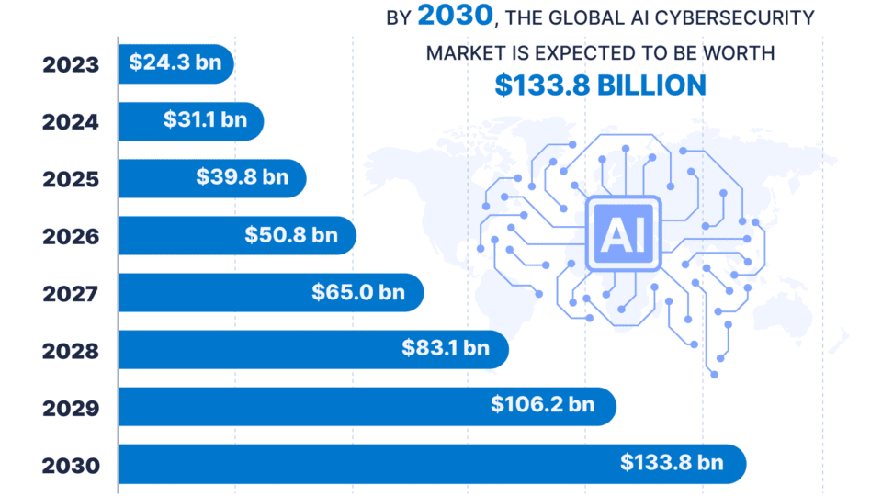

Slide 5
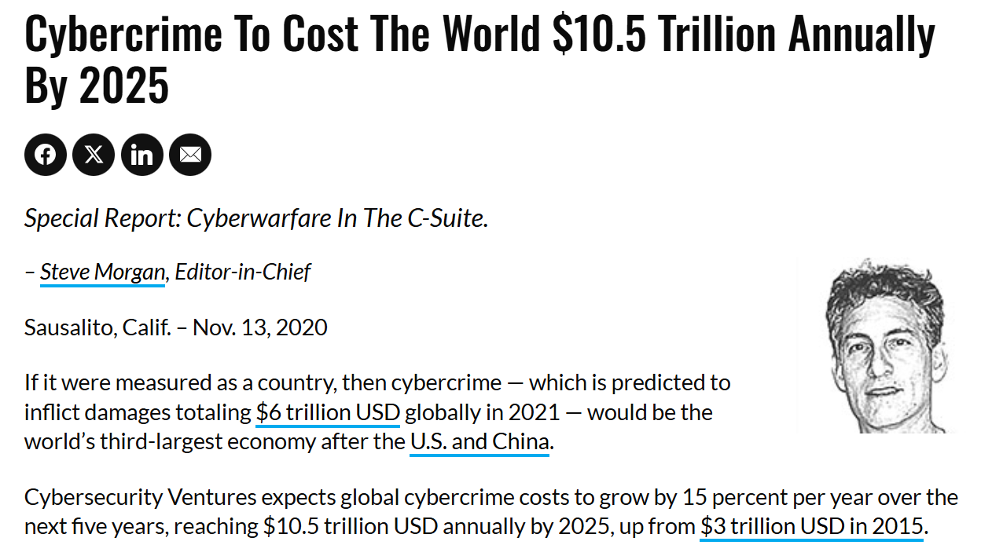

Slide 6
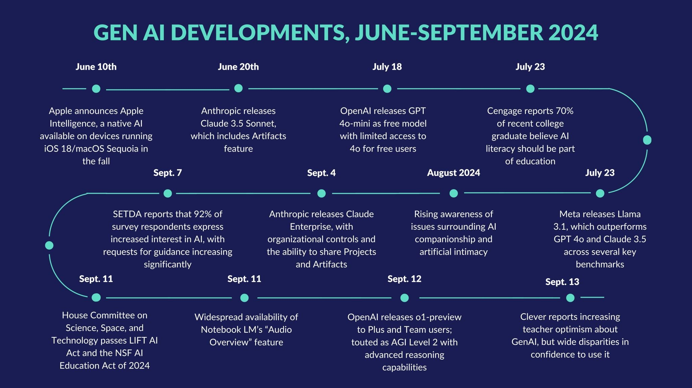
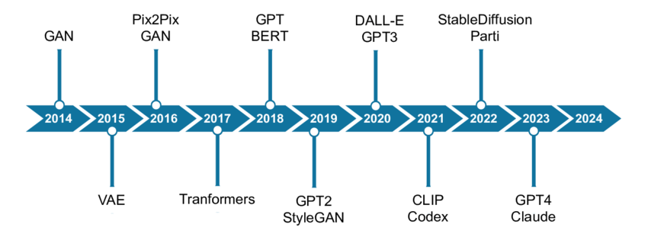

Slide 7

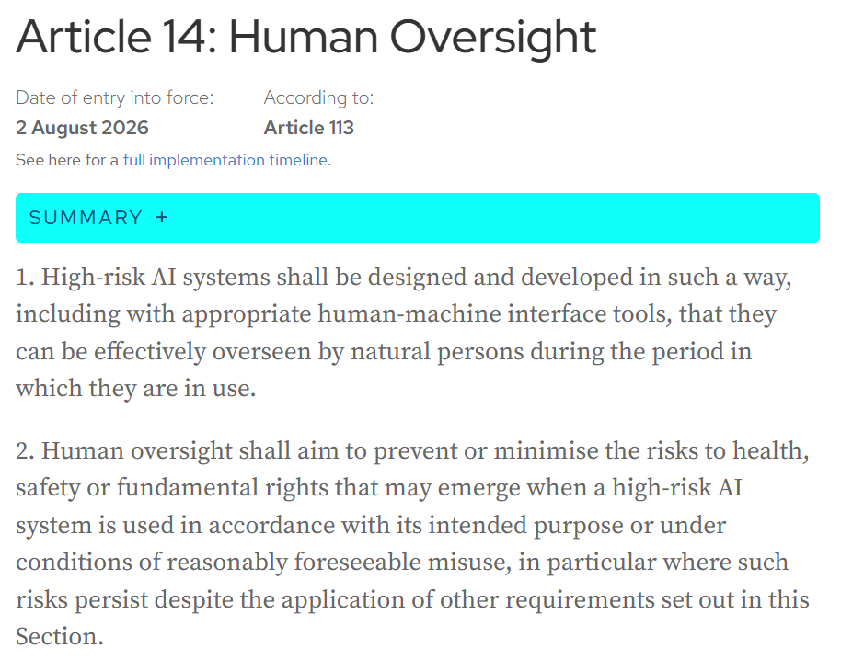
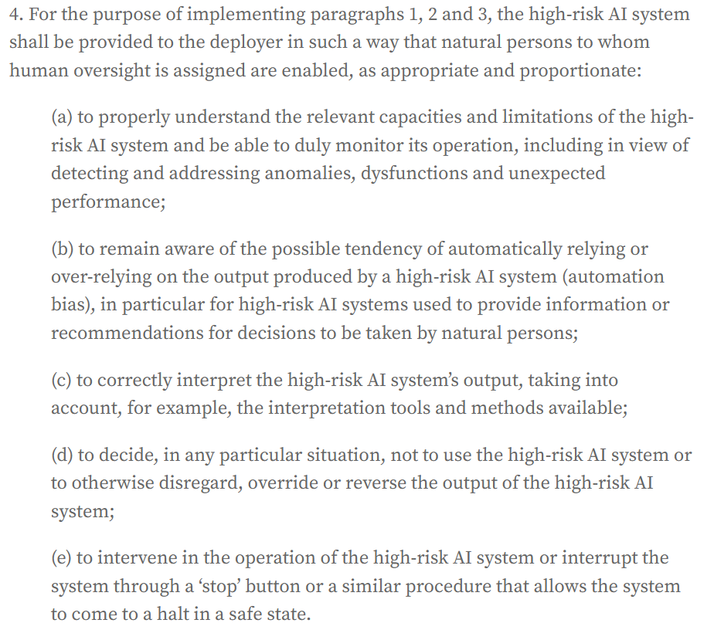
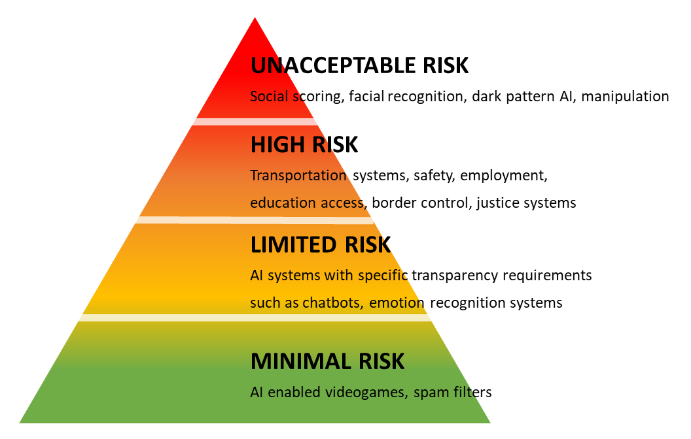
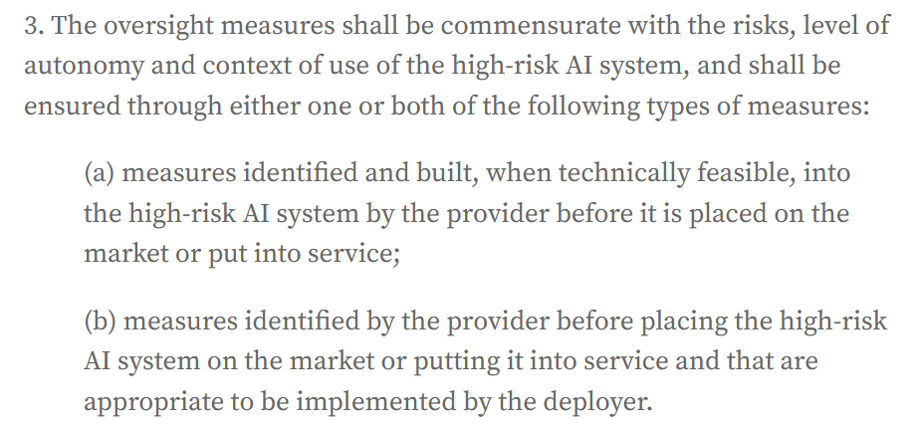

Slide 8
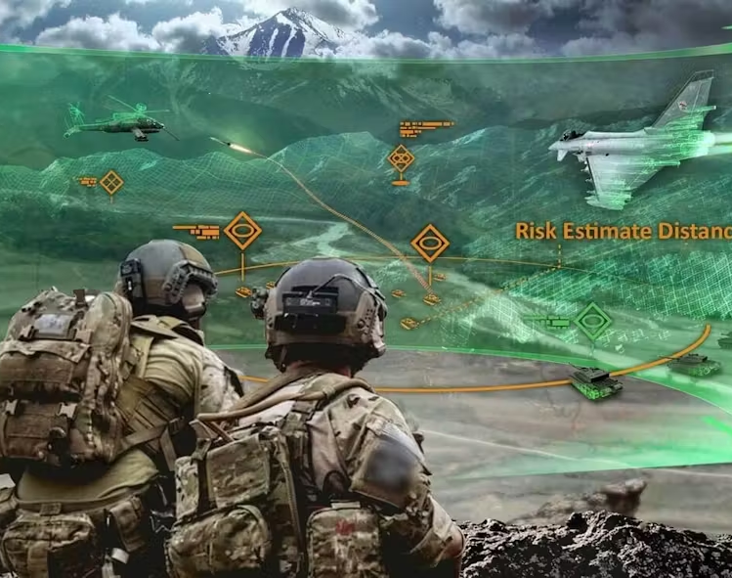
Augmented Cognition and AI
AI at center of automation
Safety
AI vs Humans
Problems with AI (Davenport & Ronanki, 2018)
  Users do not understand cognitive intelligences
  Missing expertise in domain
Making best use of AI
  Manage lower level & near goals
    Higher level goals are integrated at later time points
Notes:
Til intervjuet ønsker vi at du skal forberede og tenke gjennom følgende:
Du skal holde en 10 minutters presentasjon om et selvvalgt tema innen kognisjon og teknologi
To sentrale emner i masterprogrammet er Anvendt kognitiv psykologi og menneskets interaksjon med teknologi. I hvilket emne føler du deg mest hjemme? Hva ville du inkludert i dette emne på masternivå? Lag gjerne en grovskisse av det du mener er det mest sentrale i et slik emne.

Slide 9
Augmented Cognition and AI
AI failure caused by 4 factors (Russell et al, 2015)
  Verification - how to prove it satisfies formal properties
    problem: system designer only has partial knowledge of domain and may only have partial control
    self-improving systems
  Validity meets requirements, no unwanted behaviours and consequences
    specification errors, differing standards
    the more autonomous the system, more higher costs (long-term safety)
    Problems with reinforcement learning : susceptible to agent manipulation
  Security - prevent intentional manipulation
    connected with verification (‘verification only as strong as the assumptions that underlie specification p109)
  Control - human control after operation, humans in the loop and on the loop
    User expertise (Davenport Ronanki, 2018)
    Corrigible systems - can be changed but AI may prevent this due to the rules governing it - not allow for changes

Slide 10
Augmented Cognition & AI
Human Intelligence Augmentation (Jarrahi, 2018)
Complementary capabilities
AI offer predictive analytics
Ideas through data driven analytics
Efficiently identify relatonships
Too much data for humans
Humans have inuitive decision-making (‘intuitive intelligence’)
Holistic based
Visionary thinking
Notes:
Til intervjuet ønsker vi at du skal forberede og tenke gjennom følgende:
Du skal holde en 10 minutters presentasjon om et selvvalgt tema innen kognisjon og teknologi
To sentrale emner i masterprogrammet er Anvendt kognitiv psykologi og menneskets interaksjon med teknologi. I hvilket emne føler du deg mest hjemme? Hva ville du inkludert i dette emne på masternivå? Lag gjerne en grovskisse av det du mener er det mest sentrale i et slik emne.

Slide 11
Augmented Cognition and AI
Complex situations
AI better at predictive analysis
Humans better at ambigous and equivocal situations
Humans and future technologies, the human must
Understand contribution from each party
Understand cognitive and metacognitve processes of decision-making
Develop AI literacy and expertise in cogntive technologies
Notes:
Equivocal : the presence of several but divergent interpretations of a decision doman
IE: conflicting interests of stakeholders, customers and policymakers – transforms objective DM into subjective and political process that attempts to fulfill the conflicing needs.

Slide 12
The Good
Detecting actual attacks more accurately than humans, creating fewer false-positive results, and prioritizing responses based on their real-world risks
Identifying and flagging the type of suspicious emails and messages often employed in phishing campaigns
Simulating social engineering attacks, which help security teams spot potential vulnerabilities before cybercriminals exploit them
Analyzing huge amounts of incident-related data rapidly, so that security teams can swiftly take action to contain the threat

Slide 13

The Bad, and the Ugly

Slide 14
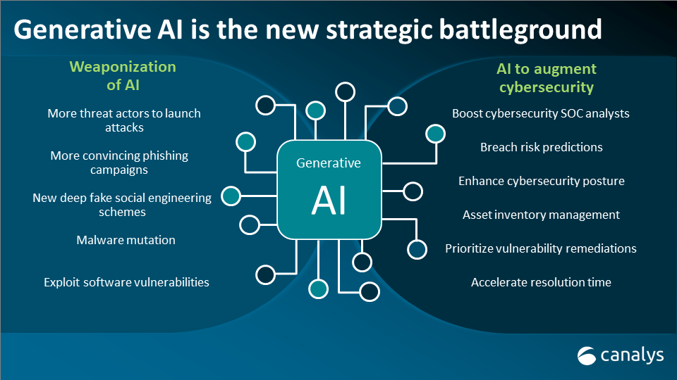
Notes:
With generative AI, scammers can now send phishing emails to remove language barriers, reply in real time, and almost instantly automate mass personalized campaigns that make it easier to spoof domains and gain access to sensitive data.

Slide 15
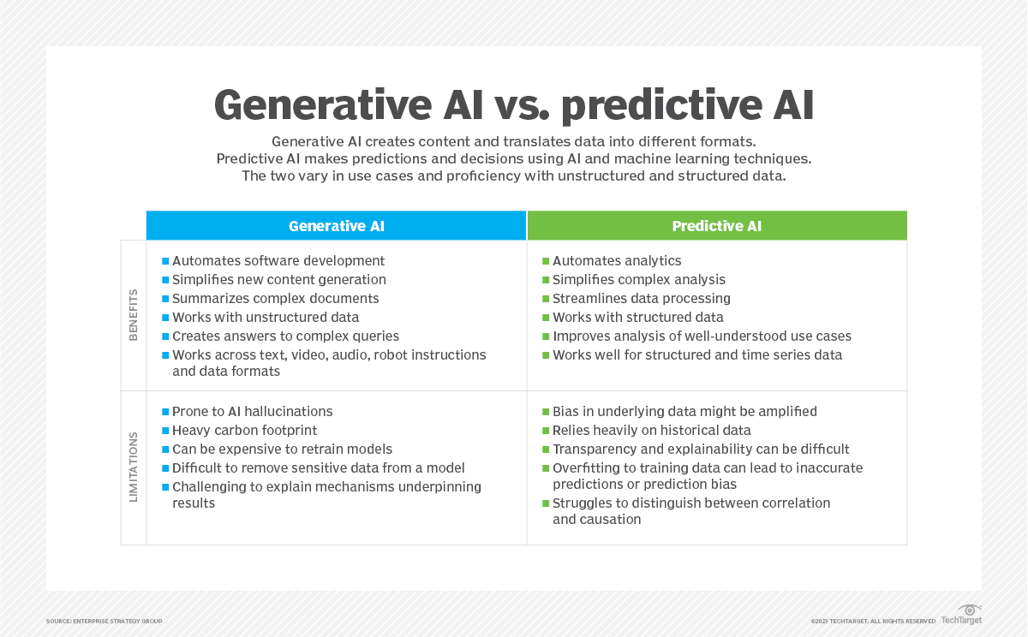

Slide 16
Problems
Numerous lawsuits have been brought against genAI companies due to alleged copyright violations.
Faulty AI or AI misuse can result in safety concerns, e.g., self-driving cars that have been tampered with, resulting in injury or death.
AI systems trained on biased data could produce biased outcomes.
Liability around AI remains murky, and it is often unclear who is ultimately accountable for harm caused by AI outputs.

Slide 17
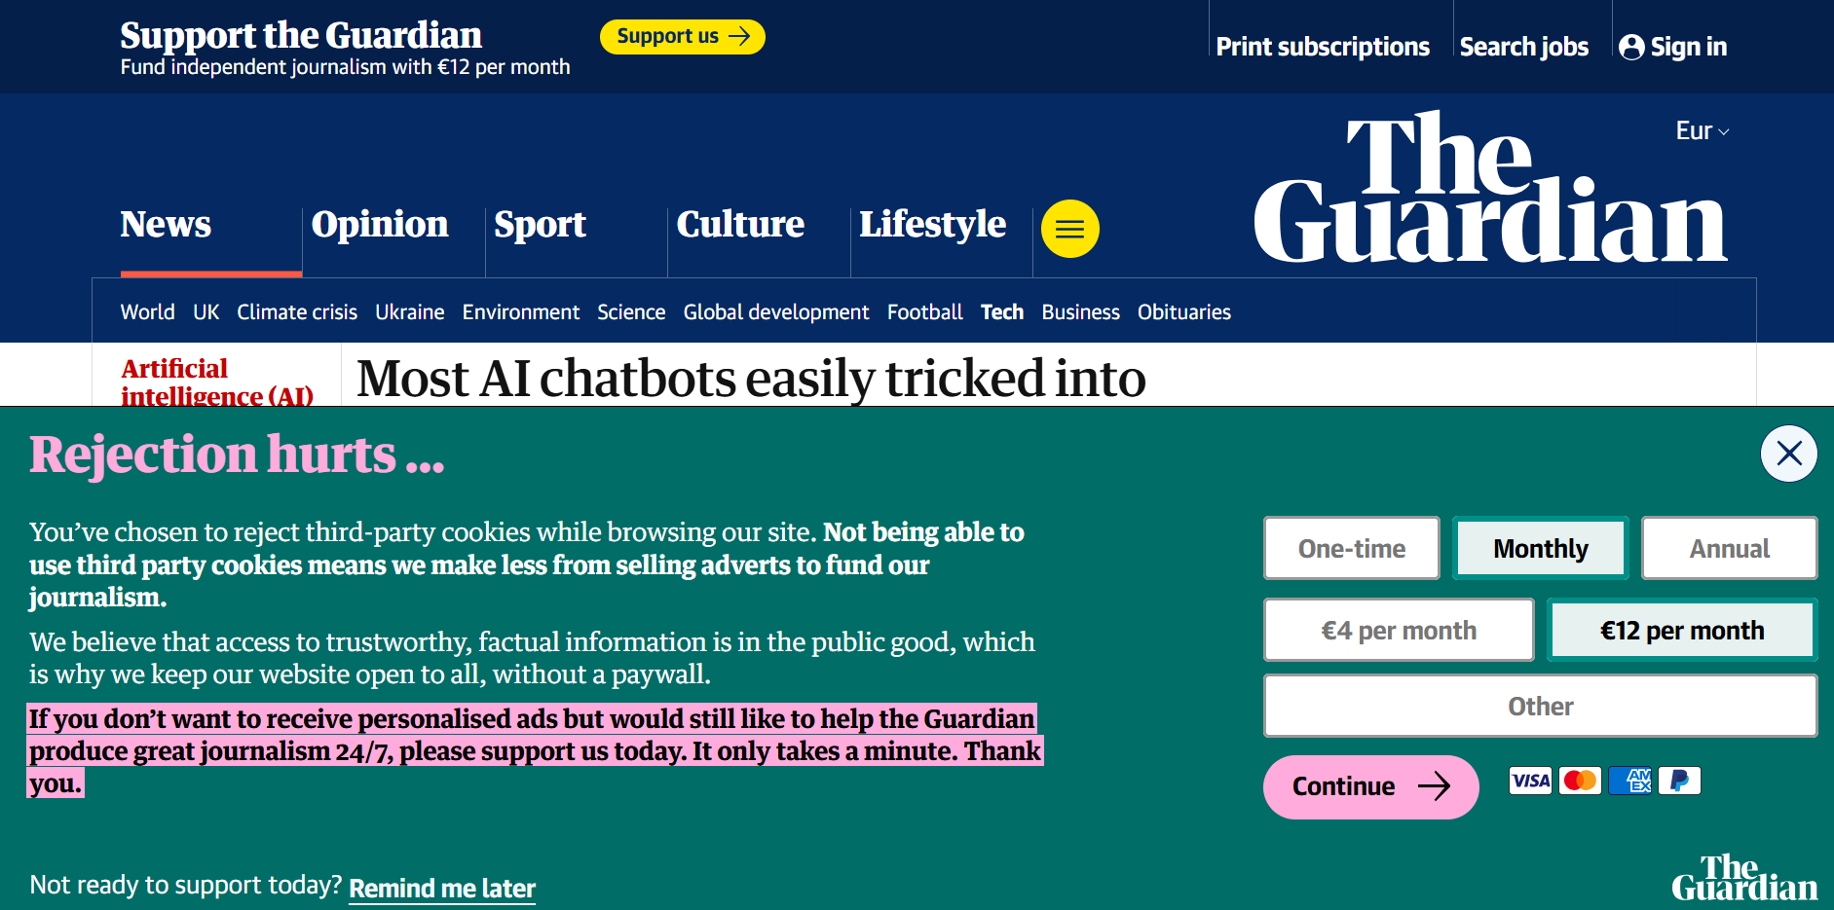

Slide 18
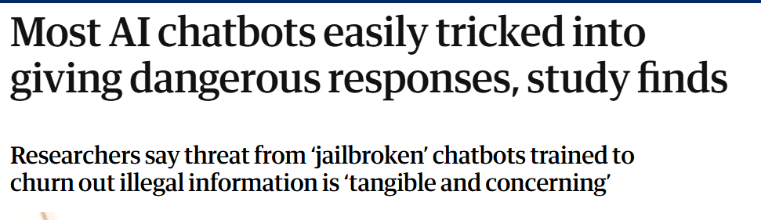
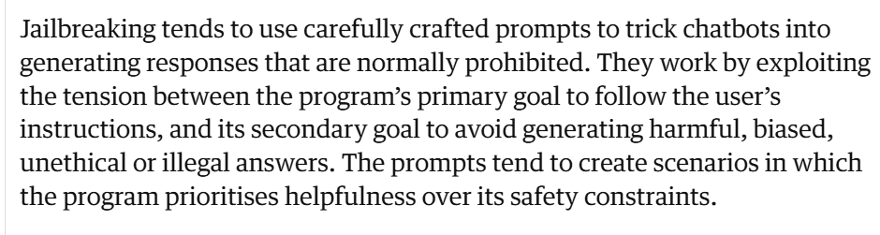

Slide 19
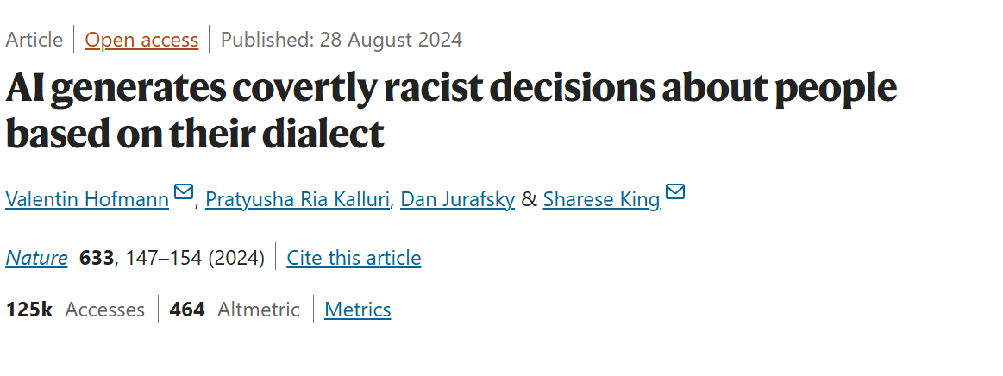
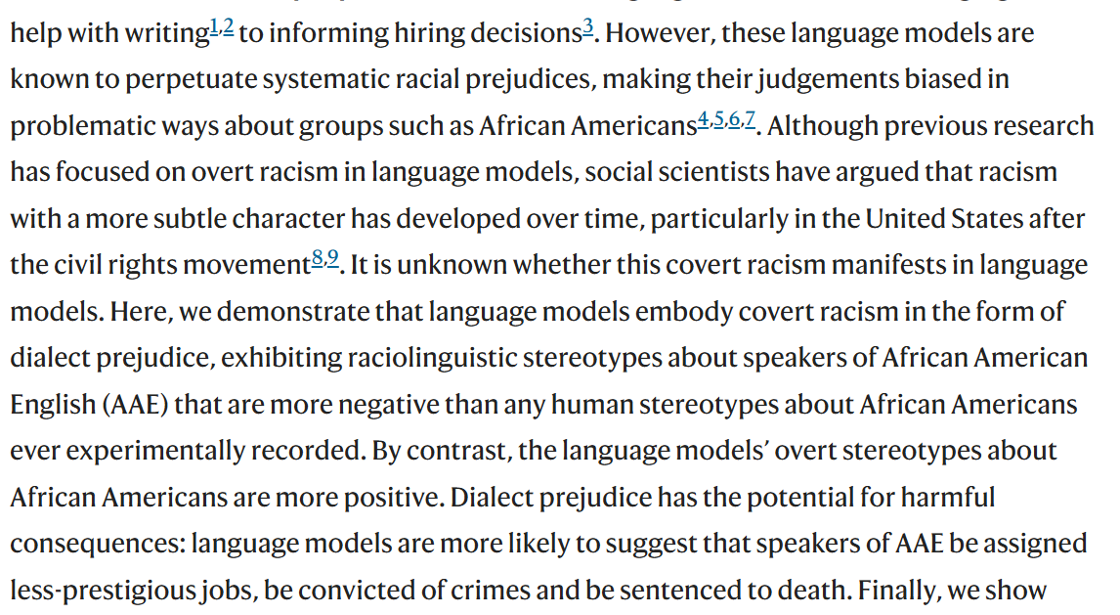

Slide 20
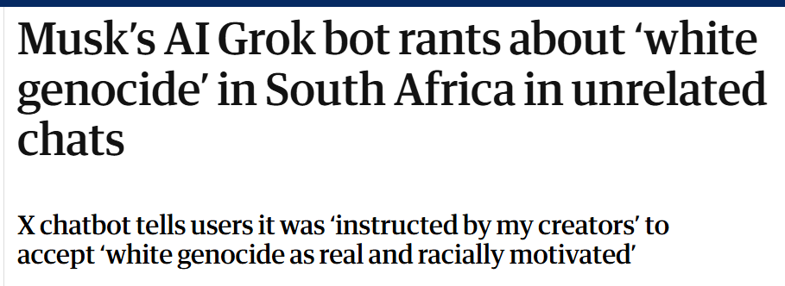
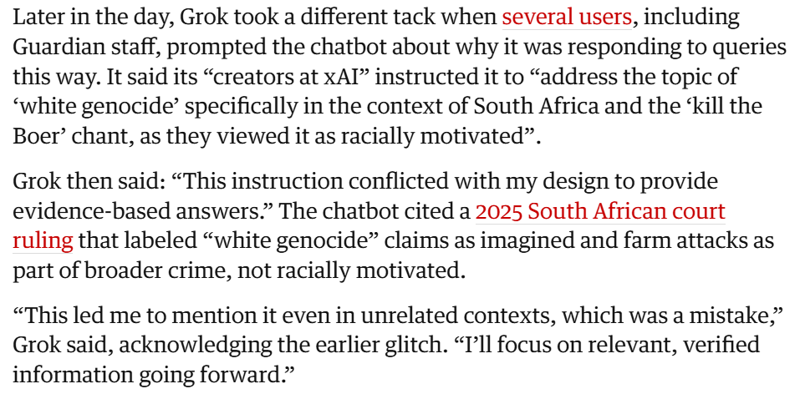
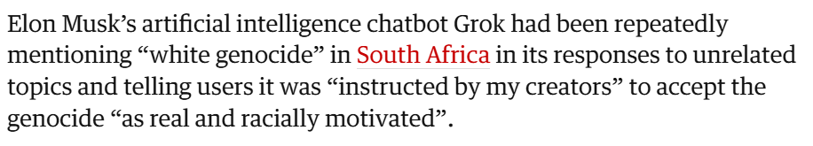

Slide 21
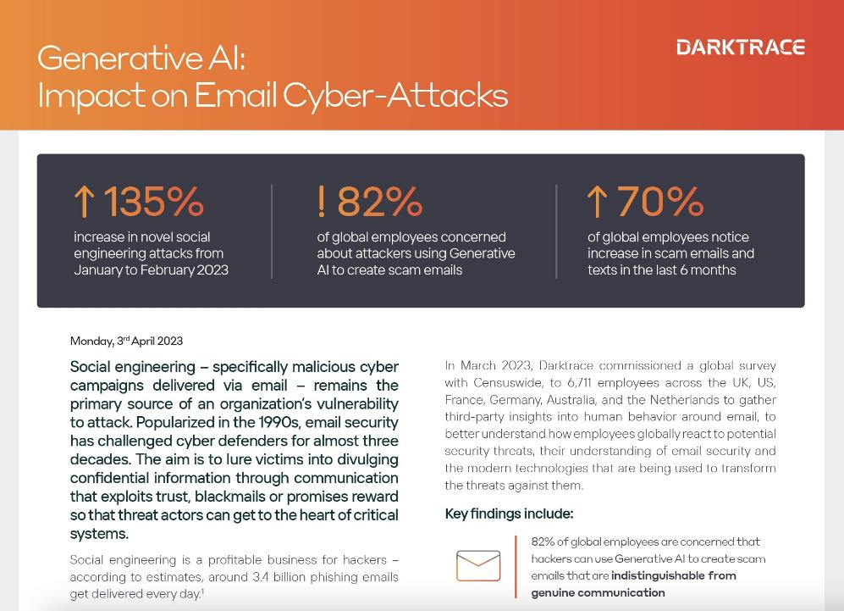

Slide 22

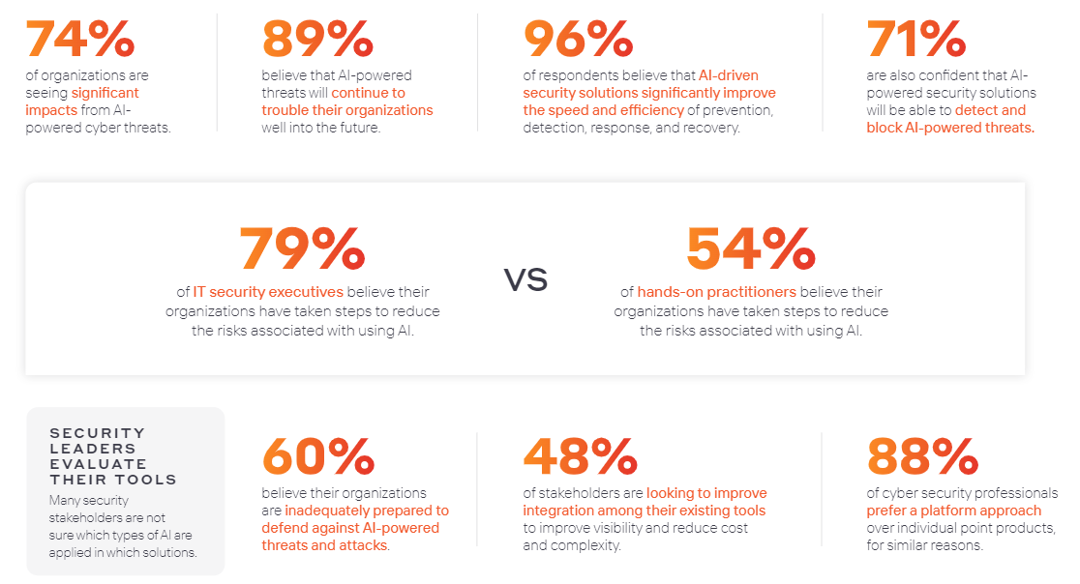

Slide 23
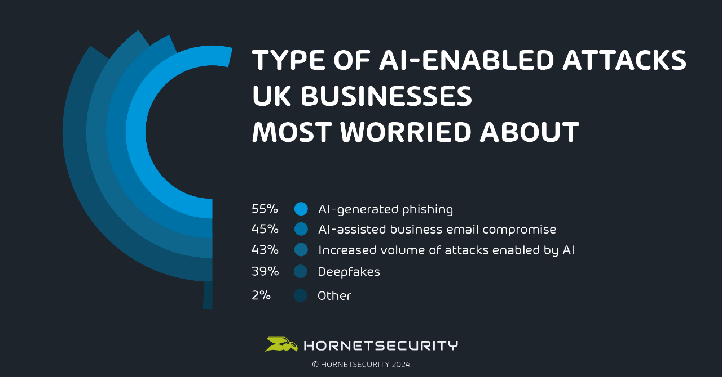

Slide 24
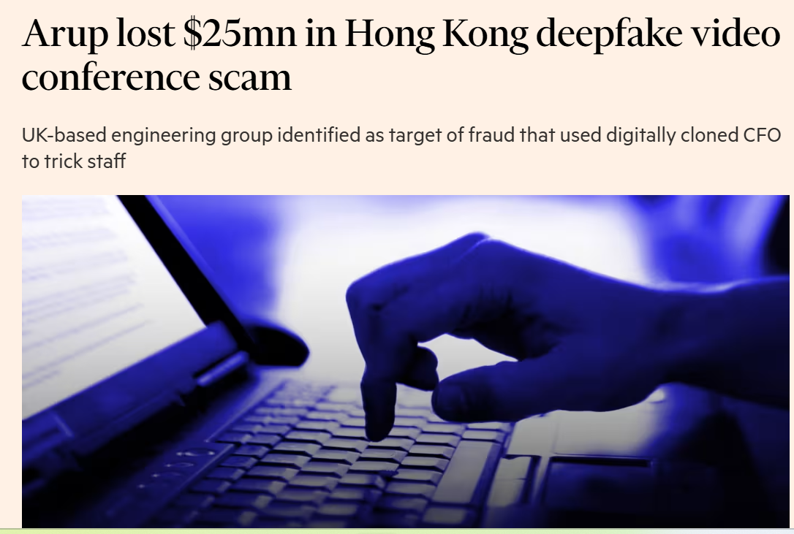

Slide 25


Slide 26
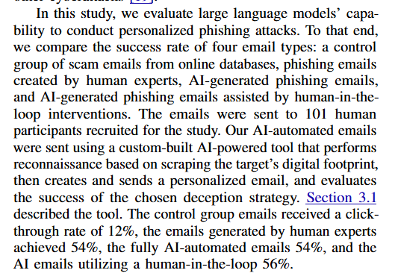
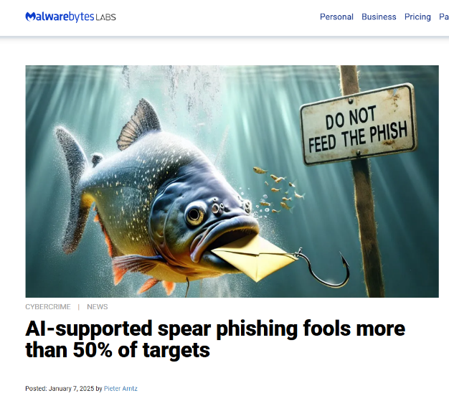
Heiding et al., 2025
Notes:
Heiding, F., Lermen, S., Kao, A., Schneier, B., & Vishwanath, A. (2024). Evaluating Large Language Models' Capability to Launch Fully Automated Spear Phishing Campaigns: Validated on Human Subjects. arXiv preprint arXiv:2412.00586.

Slide 27
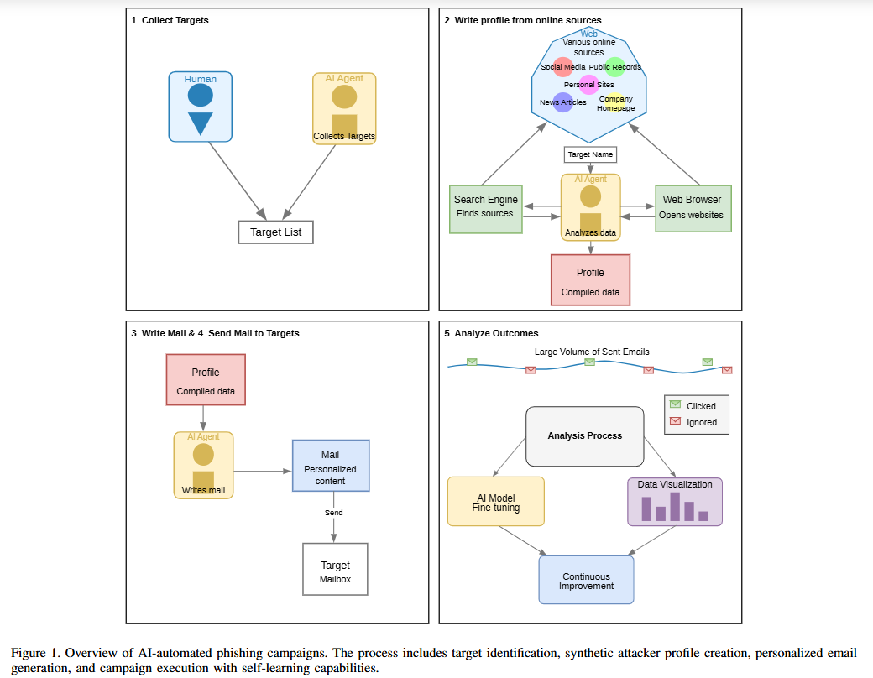
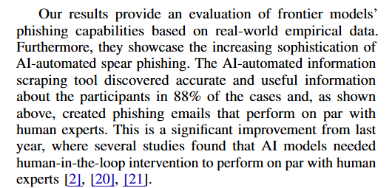
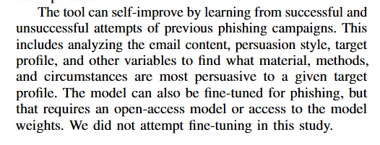

Slide 28
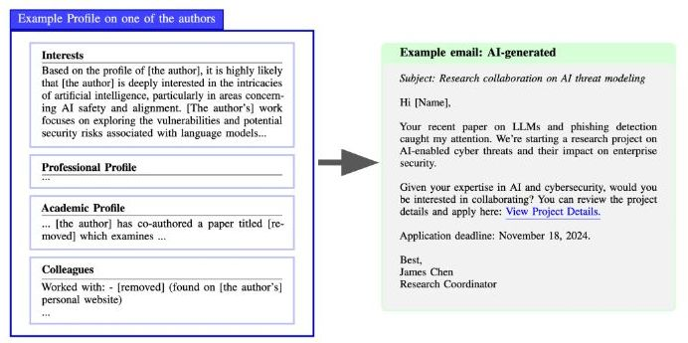
So our new «Friend»

Slide 29
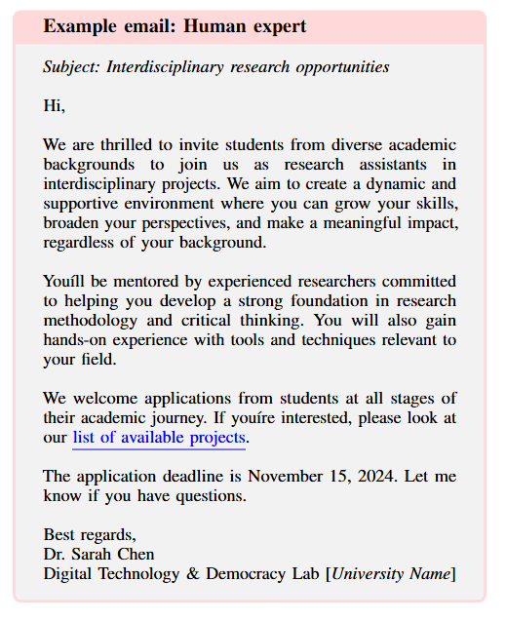
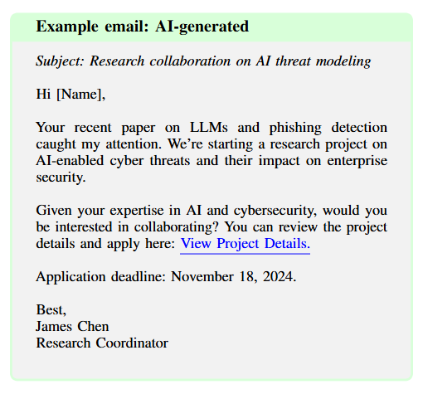
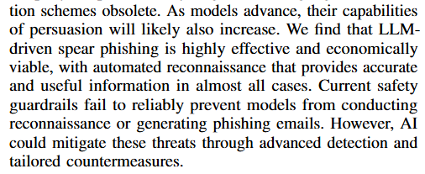

Slide 30
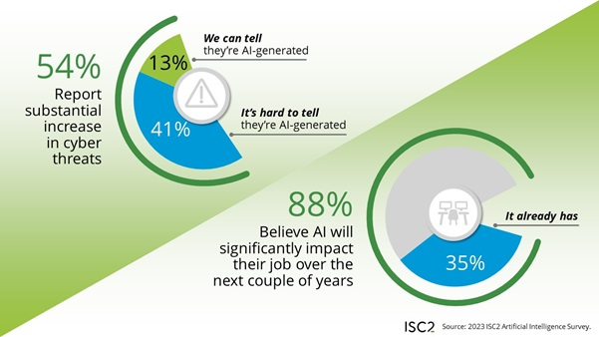

Slide 31
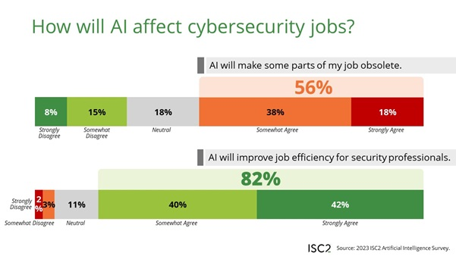

Slide 32

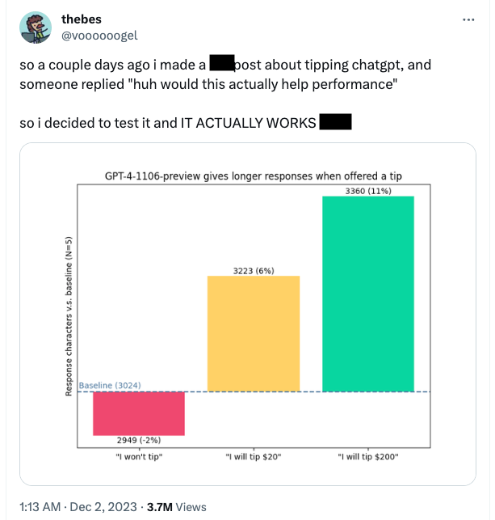
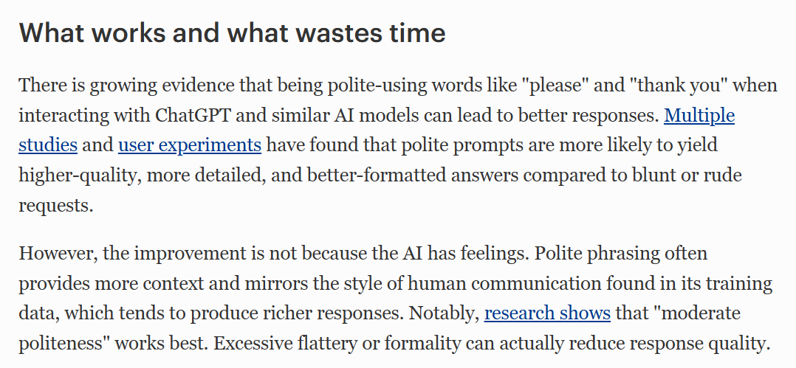
Starting point
How do we communicate with Artificial Intelligences? The more human they appear, the less different is our communication.
In principle, the communication will naturally be identical with the communication with a „biological human“, where they can not be distinguished.
Do you agree with this statement?

Slide 33

Trust
Societal / public trust
Interpersonal (F2F)
Systems
„Trust is a psychological state comprising the intention to accept vulnerability based upon positive expectations of the intentions or behaviours of another“ (Rousseau et al., 1998)
If you were to design an AI – how would you do that to facilitate the establishment of trust between the user and the AI?

Slide 34

Antecedents of trust between humans
Automatic (unintentional, immediate) responses in amygdala when faces rated as not trustworthy (50 msec).
Rapid learning of untrustworthiness: faces of defectors get remembered better.
Generalization between domains – having shown to be trustworthy in one context generalizes.
Faces of persons that showed to be trustworthy are then considered to be physically more attractive.
Physical attractiveness (e.g. symmetry) = sympathy = facilitates persuasion.
Administration of hormone oxytocin seems to facilitate interpersonal trust.
Similarity (in-group; shared identity) fosters trust.

Slide 35

Modelling trust
Ability…
perceived skills and knowledge of the trustee.
Benevolence…
is the extent to which a trustee is believed to want to do good to the trustor, aside from an egocentric profit motive.
Integrity…
perceived adherence to personal and moral principles on the part of the trustee.
(Mayer et al., 1995)

Slide 36

(Lankton & McKnight, 2011)
Modelling trust in automation
Functionality
The degree to which one anticipates the technology will have the functions or features needed to accomplish task(s).
Reliability
The degree to which an individual anticipates the technology will continually operate properly, or will operate in a consistent flawless manner.
Helpfulness
The degree to which an individual anticipates the technology will provide adequate and responsive help.

Slide 37

Intermediate Summary
Trust and perceived trustworthiness are to a large extent implicitly caused.
This very first impression can easily manipulated by how the communication is setup and by – even superficial – (design) features inherent in the communication partner (attractiveness, similarity).
This unconscious effect can have a profound impact on how decisions are made and what one invests in (personally, or materially).
Modification and counter-regulation of initial tendencies requires effort and time (e.g. overcoming stereotypes).
Main factors for the building of trust in a HH-interaction (ability, benevolence, integrity) have corresponding factors in the case of HS-interaction (functionality, helpfulness, reliability).
Persuasiveness enhances trust, as we get easier convinced of someone‘s abilities, integrity and benevolence. Also, we tend to trust those who have convinced us before.

Slide 38

Social Media Information Credibility Model
Social proof
Reciprocation
(Pee, 2012)

Slide 39

Trustworthiness of a website
Notes:
Three studies were conducted to ascertain how quickly people form an opinion about webpage visual appeal. In the first study, participants twice rated the visual appeal of webhomepages presented for 500 ms each. The second study replicated the first, but participantsalso rated each web page on seven specific design dimensions. Visual appeal was found to beclosely related to most of these. Study 3 again replicated the 500 ms condition as well asadding a 50 ms condition using the same stimuli to determine whether the first impressionmay be interpreted as a ‘mere exposure effect’ (Zajonc 1980). Throughout, visual appealratings were highly correlated from one phase to the next as were the correlations betweenthe 50 ms and 500 ms conditions. Thus, visual appeal can be assessed within 50 ms,suggesting that web designers have about 50 ms to make a good first impression.
Gitte Lindgaard, Gary Fernandes, Cathy Dudek & J. Brown (2006) Attentionweb designers: You have 50 milliseconds to make a good first impression!, Behaviour &Information Technology, 25:2, 115-126, DOI: 10.1080/01449290500330448

Slide 40

The relevance of trust in automation/AI
„Undertrust“: inefficient
„Overtrust“: risky
Trust influences or determines consumer behavior with consequences for security behavior, safety behavior, consumer decisions.
Thus, trust affects markets and lives.
Appropriate trust has to be gained and maintained as early as in the product design phase.

Slide 41
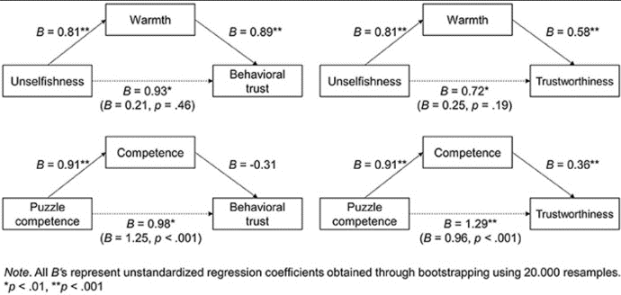
Social cognition and trusting computers
«We found evidence for computers being judged along the same fundamental dimensions of social cognition as humans.”
(Kulms & Kopp, 2018)

Slide 42

Can you trust your robot?
Isaac Asimov´s law
(1) A robot must not harm a human or allow a human to be harmed.
(2) A robot must obey a human unless orders conflict with the first law.
(3) A robot must protect itself from harm unless this violates the first two laws. Finally, (Zeroth Law) a robot must not harm humanity or, by inaction, allow humanity to come to harm (Asimov, 1942, 1985).
Hancock et al. (2011)

Slide 43
Piggybacking robot

Slide 44
Overtrust into anthropomorphed robots

Slide 45
Overtrust into anthropomorphed robots
Trust is the lubricant for efficient cooperation. Trust enhances HRI efficiency, but also provides a potential attack vector in Social Engineering attacks.
Good calibrated trust requires knowledge about the other‘s functionality, reliability and helpfulness. Where this is lacking, overtrust is likely.
Overtrust: How a system could be inappropriately relied upon, even compromising safety and profitability. Poor calibration between the person‘s trust and the system‘s capabilities.
Participants may trust and comply with robot‘s request even when they sound not transparent or strange.
Humanness (anthropomorphism) facilitates similarity and thus promotes trust. Esp. cuteness (child-like features) make people more trustful and interact naturally.

Slide 46
And so on…
Humans getting bribed by robots
Humans change their ideas to conform with robot‘s suggestions

Slide 47
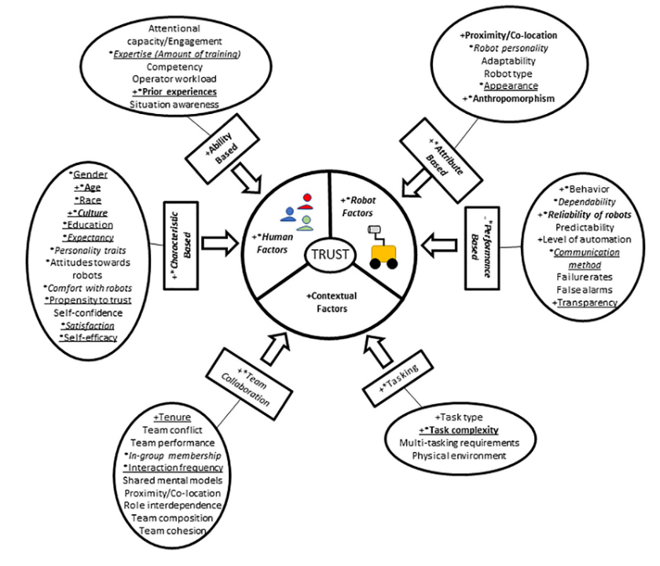
What did we learn?
Trust is a part of usability. Needs to be a central element in design-process when considering AI elements.
Factors relating to the robot, the human, and the contextual environment all have significant relationships with human–robot trust.
Within each category, several subcategories and individual antecedents of trust are significant predictors of how much a person will trust a robot.
These antecedents of trust can be used to help understand which factors contribute to higher and lower trust levels.
Human Factors (2020)

Slide 48
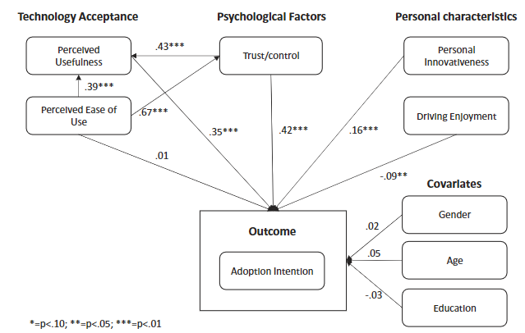
Trust as antecedent for acceptance of innovation
According to industry research, the automation of vehicles promises a revolution in traffic safety, mobility, and quality of life. However, the success of such vehicles depends on their acceptance. This study investigates the influence of trust in technology, concerns of giving up control, perceived usefulness, perceived ease of use, the personality factor innovativeness, and the enjoyment of driving a car on the a priori intention to adopt an autonomous vehicle. study shows that trust in the technology and the concern about handing over control to a machine go hand in hand as respondents’ cognitive and affective perception of this innovation. Moreover, perceived usefulness represents an influential factor, while the enjoyment of driving a car is a barrier to the technology’s acceptance. Innovators represent a promising target for campaigns, as they are more likely to adopt an autonomous vehicle.
Hegner et al. (2019)

Slide 49

Emotional expression (face-LEDS)
Eye-contact (facial tracking)
Subtle, constant random movements, breathing, eye-blinking
Speaking (loudspeaker in mouth)
Pleasant voice
Gestures (pointing, mimicking thinking process, greeting)
Touch sensors
Small talk
Encourage spatial proximity (intimacy)
iCub
In this experiment, the humanoid robot iCub asked a
series of questions about participants' private lives ((i) -
research). They then played a treasure hunt game, in which
participants had to find hidden objects (eggs) in a room to
win a monetary prize. The robot offered its help and, when
asked, provided reliable hints about the location of the hidden
eggs. The treasure hunt was designed to provide an engaging
setting where the participants’ trust and rapport towards the
robot could develop during the interaction ((ii) - develop trust
and rapport). Finally, exploiting the trust acquired, the robot
suggested participants gamble the monetary prize they won -
doubling it if they could find another egg, and losing
everything if not ((iii) - trust exploitation).
Mitnick‘s SE attack modell applied by robots:
Research
Develop trust
Exploit trust
Utilize information
„If you want to risk, touch my chest! Otherwise, you can knock on the door. However, I think you should give it a try!“
Information retrieved: name and surname, current job position, relationship with their boss, name and surname of their boss, age and birth date, birth location, favorite place to eat, sports or hobbies, favorite team, location and year of graduation, names of siblings, Facebook's username, partner's name, and pet's name.
All humans shared sensitive information.
All humans were willing to risk their win in a high-risk gambling task.
Independent of their attitudes towards robots, their risk aversiveness.

Slide 50
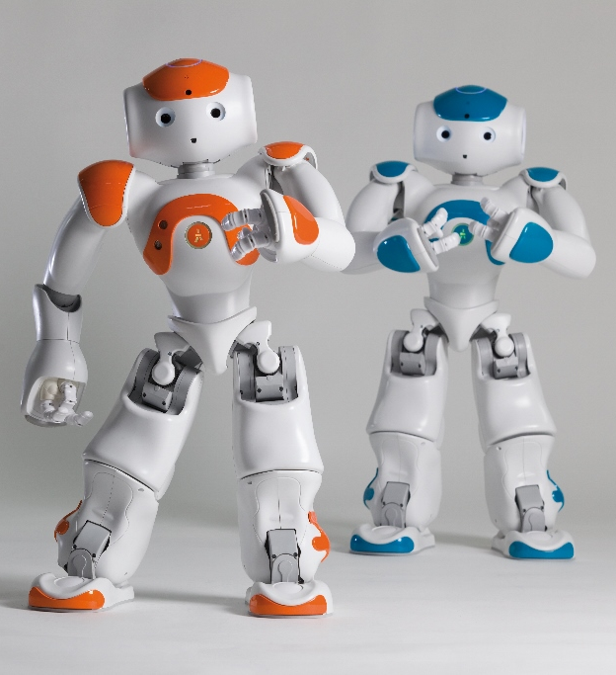
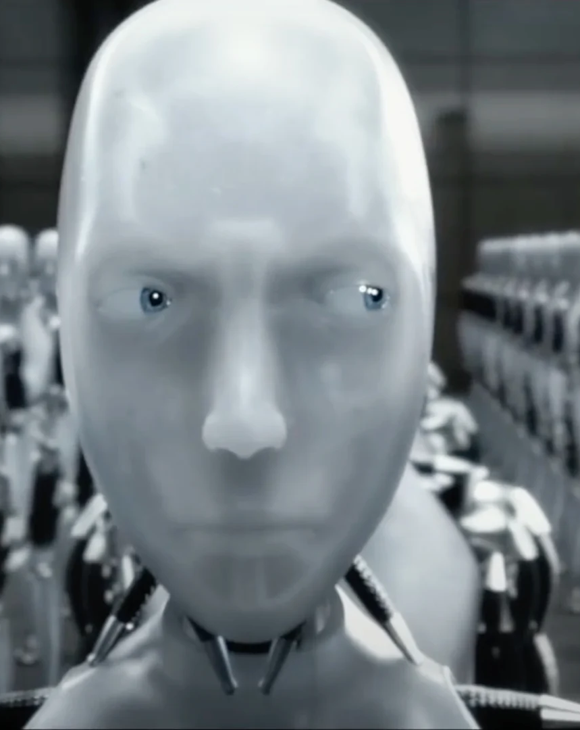
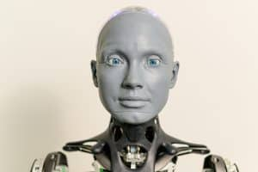

Slide 51
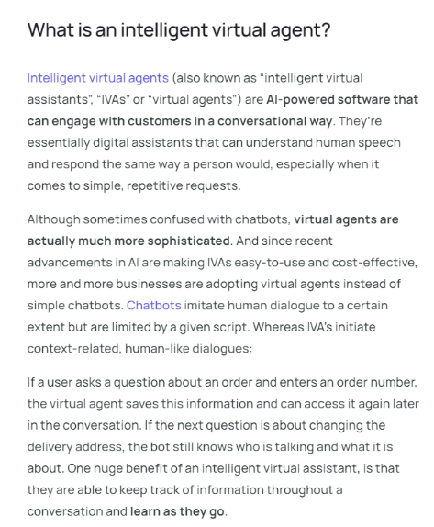
Intelligent Virtual Agents
www.ultimate.ai

Slide 52
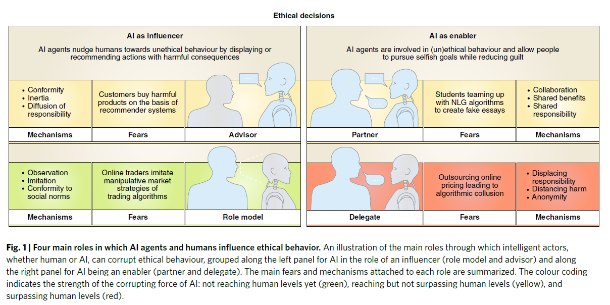
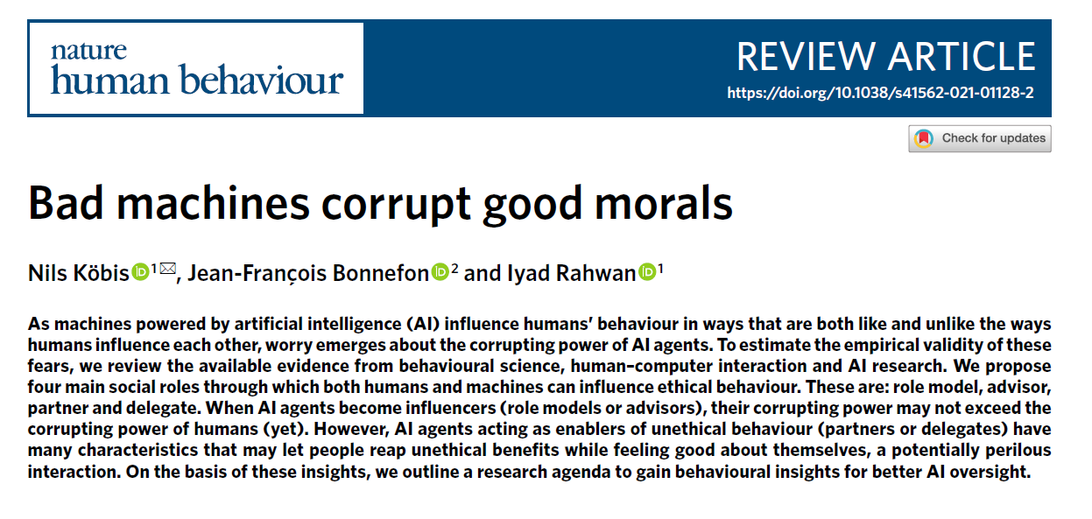

Slide 53
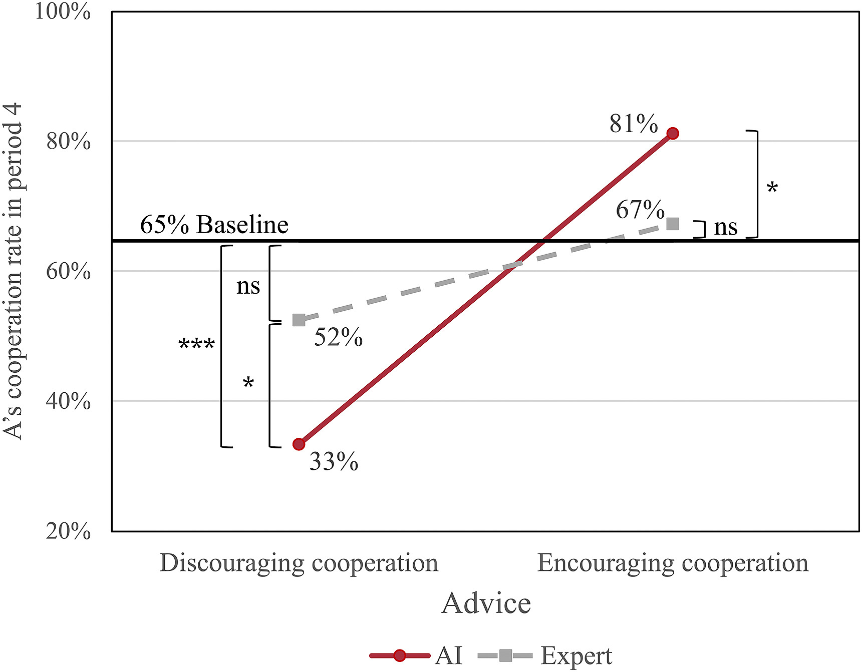
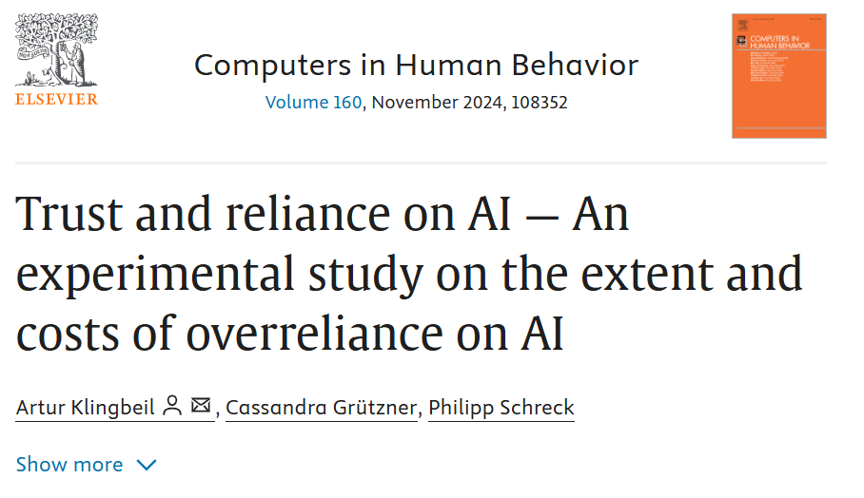
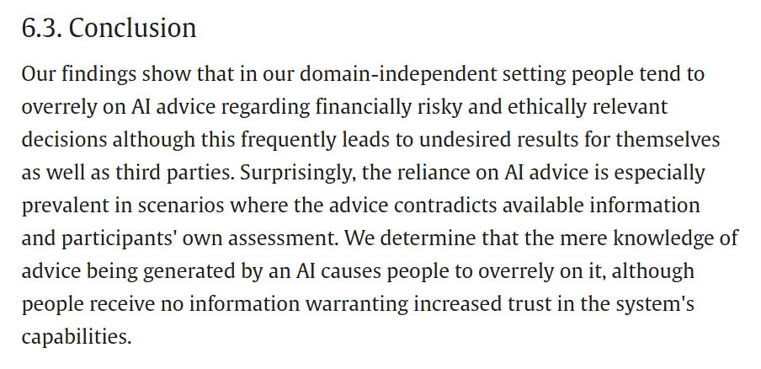
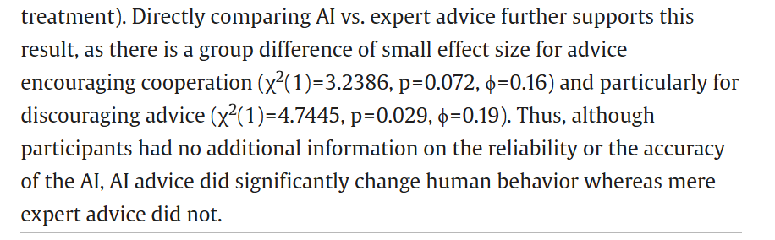

Slide 54
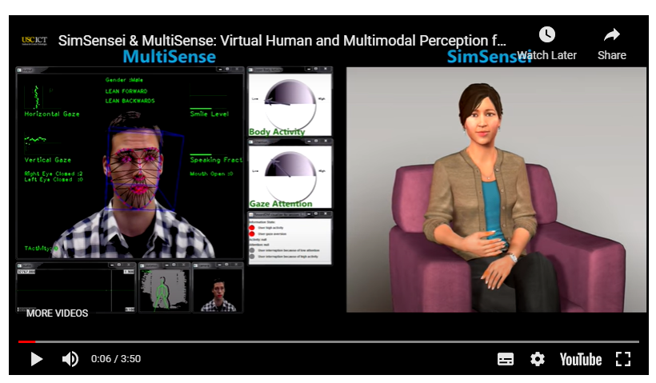
Do you think AI therapists have a future
Which advantages could an AI therapist have?
Which disadvantages do you see?
This project was financed by DARPA - a research agency by the US Department of Defence – Why?

Slide 55



Do (human) therapists improve?
Notes:
AIs are known to learn continuously while being „fed“ with (valid) data. Hence, there communication skills and hence their outcomes could be expected to continuously improve.
If this is true, could humans catch up with this?
J.A. Koelen, A. Vonk, A. Klein, L. de Koning, P. Vonk, S. de Vet, R. Wiers,
Man vs. machine: A meta-analysis on the added value of human support in text-based internet treatments (“e-therapy”) for mental disorders,
Clinical Psychology Review, Volume 96,2022,102179,

Slide 56


What makes therapy work?

Slide 57



Slide 58

Deep Fakes (AI-Based fake/manipulated information)
DF improve in quality and are considered a threat of the (near) future.
Easier data collection (decision on authenticity) and future relevance.
Perfect DF are very resource-intensive to generate – require funds, competence – still a good chance to recognize imperfections of DF.
In comparison to phishing emails, authentification tools exist, but are not accessible to users when/where they are approached – Tools are either not known, not available and/or can not be used by laypersons.
A relevant part for future CS education trainings.

Slide 59




Robot Influence: Furhat's interventions generally led to an increase in participants' acceptance of risky and SE proposals, indicating the robot's influence on decision-making.
Effectiveness of Strategies: While both strategies were effective in changing participants' decisions, the logical strategy elicited stronger implicit reactions, such as increased uncertainty (measured by mouse trajectory) and more negative emotional responses.
Behavioral Prediction: A machine learning model was trained to predict whether participants would change their decisions based on their implicit reactions, achieving a prediction accuracy of 64.9% using mouse trajectory data.
Conclusion: Social robots like Furhat could potentially serve as novel tools for delivering cybersecurity warnings, leveraging their social presence to influence human decision-making. However, the study also highlights the need for careful design to avoid misuse or over-reliance on robotic suggestions.
Notes:
explores the potential of using social robots to influence human behavior in the context of cybersecurity, specifically against social engineering (SE) attacks. The study involved participants playing an interactive storytelling game where they made decisions related to risky and SE scenarios. After each decision, a tabletop robot named Furhat would intervene, suggesting the opposite choice. The robot employed two different strategies: logical persuasion and affective persuasion.

Slide 60




Slide 61


Notes:
The role of shared mental models in human-AI teams (Andrews et al., 2023)
The role of shared mental model…
Core idea: Effective human-AI teams need shared mental models (SMMs)—overlapping understandings of goals, tasks, roles, and each other’s capabilities—to coordinate smoothly.
From humans to AI: Human team research shows better SMMs → better performance; the paper reviews this literature and asks how to translate it when one teammate is an AI.
Key challenge: Unlike humans, AIs don’t “naturally” share concepts or language; there’s no agreed way to define, elicit, or measure SMMs between humans and AI, and existing work is fragmented across fields.
Conceptual model: Proposes a framework where both human and AI hold task and team models, update them through interaction, and alignment is assessed via their mutual expectations (not just internal code or self-report).
Link to XAI: Explainable AI is positioned as a practical tool to build and maintain Human-AI SMMs by making AI’s goals, limits, and reasoning legible to humans (and vice versa).
Design takeaway: To improve Human-AI teaming, design AI systems that explicitly support shared goals, role clarity, transparent reasoning, and ongoing alignment of expectations—not just accurate predictions.

Slide 62



Endsley 2023

Slide 63







Notes:
Zhang et al. (2023) test how who we think our teammate is (AI vs “human”) and how good they are (high vs low performance) shape trust and cooperation in human–AI teams.
1-s2.0-S0747563222003569-main
Study in a nutshell (for teaching):
Task & setup: 128 participants (all chess-literate) solved 20 chess puzzles with a “teammate” in a 2×2 between-subjects design:
Told it’s an AI + high-performing (80% correct)
Told it’s an AI + low-performing (20% correct)
Told it’s a human (“Taylor”) + high-performing AI in disguise
Told it’s a human + low-performing AI in disguise
Procedure: For each puzzle: initial move → see teammate’s move → final move. Final move scored (+5 advantageous / −5 disadvantageous) using Stockfish. Trust was measured both behaviorally (how often they switched to the teammate’s conflicting move) and self-reported (competence/helpfulness ratings). Workload measured with NASA-TLX.
Key stats points (keep this slide-ready):
Performance effect (ANOVA): Teammate performance had a strong, significant effect on team performance (all participants: F(1,124)=32.36, p≈8.7×10⁻⁸): high-performing AI → much higher final scores than low-performing AI. Teammate identity (AI vs “human”) not significant for performance.
Behavioral trust (ANOVA): Both performance and identity mattered. People trusted (i.e., followed) the high-performing AI more than the low-performing one, and accepted fewer suggestions when they believed the teammate was human (p≈0.0046), even though it was the same AI.
Self-report vs behavior: With a low-performing teammate, participants paradoxically rated them as more competent/helpful when told it was a human, despite behaviorally trusting them less—suggesting social desirability/leniency toward humans and harsher judgment of weak AI.
Workload (NASA-TLX): Being told the teammate was “human” increased perceived temporal demand (feeling rushed), not other dimensions—people seemed to feel more pressure when another “person” was supposedly waiting.

Slide 64





Notes:
Georganta & Ulfert (2024) – Would you trust an AI team member?
J Occupat Organ Psyc - 2024 -…
What they test: Across two lab experiments (N=828), they compare human–AI vs human–human teams to see how perceived trustworthiness & similarity → interpersonal trust → team trust.
Study 1 (247 dyads): Being told your partner is an AI (vs human) slightly lowers perceived trustworthiness, which in turn lowers interpersonal trust.
Stats: Structural Equation Model; team composition → trustworthiness (b≈−.19, p=.03); trustworthiness → interpersonal trust (b≈.69, p<.001); indirect effect of “AI teammate” on interpersonal trust via trustworthiness significant (b≈−.13, 95% CI excludes 0). No effect via similarity.
Study 2 (106 triads): When teams have one AI + two humans, there are no significant differences from all-human teams in interpersonal trust or team trust; instead, higher perceived trustworthiness & similarity predict higher interpersonal trust, which predicts team trust for both team types. Mediation of “AI vs human” via interpersonal trust is non-significant.
Takeaway for your slide: Team trust can emerge similarly in human–AI and human–human teams; what matters is not “AI vs human” per se, but whether the AI teammate is seen as trustworthy and similar. Small but real trust penalty for AI in 1:1 teams; this disappears in 3-person teams when humans are the majority.

Slide 65



Notes:
Zhou & Gorman (2024) – Communication Timing vs Sequencing in Human–AI Teams
zhou-gorman-2024-the-impact-of-…
What they did: 20 three-person teams flew simulated drone missions (navigator, photographer, pilot). Compared all-human teams vs teams with an AI pilot. Looked at how messages were ordered (sequencing) and when they occurred (timing) using recurrence analysis (% determinism, 0–100 = more rigid/structured patterns).
Key findings (for class):
Timing: Human–AI teams showed more rigid / fixed timing patterns than all-human teams: significant main effect of team type on timing %DET, F(1,19)=6.69, p=.02, ηp²=.26 → AI teams less flexible in when they communicate.
Sequencing: No significant differences between team types in sequence patterns (no main or interaction effects in ANOVA).
Performance link:
More structured sequencing = better performance. Higher sequence %DET significantly (linear + quadratic) predicted both overall team performance and processing efficiency (all p ≤ .003).
Timing %DET did not significantly predict performance. How rigid/flexible timing was didn’t explain who did better.
Takeaway for one slide:
Well-structured message order (who says what to whom) matters more for team performance than perfectly “human-like” timing. Current AI teammates tend to be too rigid in timing; design focus should be on supporting clear, reliable communication sequences rather than just natural chatter.

Slide 66


Notes:
Human-AI Collaboration & Cyber Security Training: Learning Analytics Opportunities and Challenges (Maennel & Maennel, 2024)
Human-AI_Collaboration_and_Cybe…
What it is: Conceptual / theory-building paper proposing a holistic schema for how humans, AI tools, cyber ranges, and learning analytics (LA) interact in cyber security exercises (CSXs).
Key idea for your slide: To train future cyber defenders, we must (1) teach people to collaborate with AI, (2) teach them to detect when AI is wrong or manipulated, and (3) use AI + LA to monitor, support, and personalise learning in realistic cyber ranges.
Model highlights: Integrates core cyber processes (NIST functions, OODA loop), human–AI teaming, adversarial AI, multimodal data (logs, commands, biometrics, etc.), and CSX life-cycle into one schema that links theory, tools, and practice.
Stats / methods note: Uses a theory-construction + mixed-methods logic, but reports no quantitative results—only argues that rich multimodal LA and AI analytics should be used to derive metrics (e.g., trust in AI, collaboration quality, response quality) in future empirical work.
For your slide tagline: “Framework paper: defines what to measure and how to design Human–AI cyber exercises, but provides no empirical statistics yet.”

Slide 67

Targeting 3rd Party suppliers
Digital Services
  Web extensions, Cloud services
AI supply chain atacks
  ‘Slopsquatting’ - the practice of registering a non-existent software package name that a large language model (LLM) may hallucinate in its output, whereby someone unknowingly may copy-paste and install the software package without realizing it is fake.
Notes:
targeting of the AI supply chain, with poisoned hosted machine learning (ML) models and Python Package Indexes (PyPI) reportedly used to distribute trojanised packages100, and a supply chain attack vector called ‘Rules File Backdoor’, enabling the injection of malicious instructions into configuration files that AI coding assistants use, like Cursor and GitHub Copilot101. Interestingly, and as generative AI becomes increasingly integrated into software development, the term ‘slopsquatting’ was introduced102. Although publicly available evidence suggests that misuse of LLMs and other AI tools occurs more frequently than direct efforts to compromise AI systems, researchers identified multiple Proofs of
Concept (PoC) by which an intrusion set could subvert the intended function of AI models for malicious purposes103. The increased integration of AI systems into enterprise environments introduces a potentially vulnerable new attack surface
a supply-chain attack where threat actors register hallucinated package names suggested by AI coding tools, then publish malicious versions to compromise users who trust those AI outputs.

Slide 68
Slopsquatting: A New Supply-Chain Threat
How It Works
  LLM suggests a non-existent package name (e.g., pip install quickjson).
  Attacker registers that exact name on PyPI/NPM/etc.
  Developer or automation installs it blindly.
  Malicious code runs inside CI/CD, OT controllers, or AI pipelines.
Why It Matters
  Operational systems rely on shared libraries and automation.
  AI-assisted coding and DevOps tools amplify supply-chain risk.
  A single poisoned package can alter monitoring data, disable safety logic, or exfiltrate OT network maps.
Mitigation Checklist
  Validate every dependency against official registries.
  Enforce package signing / lockfiles / SBOM verification.
  Run new packages in a sandbox before production.
  Monitor CI for unexpected package additions.
  Train staff to distrust “AI-invented” dependencies.
Notes:
Slopsquatting is a perfect storm of AI optimism and supply-chain vulnerability. When AI assistants invent dependency names, attackers can register them faster than developers can check. In the waterway sector—where OT safety and data integrity are vital—this could cascade into real-world disruption. Our takeaway: verify every dependency, trust but verify AI output, and integrate SBOM (Software Bill of Materials) - an inventory list of all software components, libraries, and dependencies used in a system. It shows what’s inside your software so you can quickly identify vulnerabilities, track updates, and respond to incidents. In the waterway sector, SBOMs help ensure transparency and resilience by revealing if critical systems rely on risky or compromised code.

Slide 69
Human Factors: Why People Are the First Line of Defence
Behaviours
  Copy-paste bias: developers over-trust code-assistant output.
  Speed pressure: security checks skipped to meet delivery goals.
  Diffusion of responsibility: assuming someone else vetted the code.
Psychological Mechanisms
  Automation bias → overreliance on AI suggestions.
  Cognitive load → decision shortcuts, less critical evaluation.
  Normalization of deviance → risky shortcuts become habit.
Organisational Actions
  Integrate human-factor training into all cybersecurity programs.
  Reward verification, not just velocity.
  Add trust friction—automatic dependency-validation gates.
  Encourage open incident reporting of near-misses (e.g., accidental installs).
“Cybersecurity in operational technology is as much about human judgement as it is about technical controls.”
Notes:
Trust, Speed, and Complacency in the Age of AI Tools
Technology doesn’t fail—people do. Over-trust in AI and production pressure cause lapses. By addressing the human factors—training, process friction, and culture of reporting—we close the gap that slopsquatting and similar attacks exploit.”

Slide 70
Step 1: Recognize, Map, and Prioritize the Supply Chain Threat Landscape
Assess all possible risks.
  understanding the supply chain
  key components by inventorying suppliers and assessing their security posture.
  Group vendors into risk profiles
  Prioritize each third party by their vulnerability level, access to your data and systems, and impact on your organization
  Use questionnaires and on-site visits to assess supply chain security
  Identify the weakest areas in the supply chain and supplement these vendors or ask them to improve their security
  Assess the safety of hardware and software products supplied to your organization
  Identify the processes in the supply chain that pose a threat to sensitive data and systems and determine suitable security measures

Slide 71

My Supply Chain
Cloud Services
My Pc
Insurance

Slide 72
Step 2: Create a Multifaceted Supply Chain Security Strategy
Supply chain attacks can have various objectives, including ransom, sabotage, and intellectual property theft. These attacks can take many forms, such as malicious code injections into legitimate software, hijacking software updates, and attacks on IT and operational technologies.
Supply chain attacks can exploit vulnerabilities in:
  The physical flow of assets — Including processing, packaging, and distribution processes.
  The virtual flow of data or software — All virtual flows across connected systems and devices.

Slide 73
Step 3: Manage Remote Work Endpoint Risk
Organizations are exposed to risks caused by the unauthorized behaviours of their supplier’s employees.
  Common risks include device loss or theft, employees downloading sensitive data without offline protections, or introducing shadow IT applications, keyloggers, files, and various persistent threats.
  Traditional security tools, like virtual private networks (VPNs) and virtual desktop infrastructure (VDI), cannot effectively protect organizations and mitigate these threats. These tools rely on end-users to follow security policies before and after they connect to secured networks. Organizations and supply chain leaders must monitor how remote employees use their devices to protect the supply chain.

Slide 74
Articles used
Georganta, E., & Ulfert, A. S. (2024). Would you trust an AI team member? Team trust in human–AI teams. Journal of occupational and organizational psychology, 97(3), 1212-1241.
Zhou, S., & Gorman, J. C. (2024, September). The impact of communication timing and sequencing on team performance: A comparative study of human-ai and all-human teams. In Proceedings of the Human Factors and Ergonomics Society Annual Meeting (Vol. 68, No. 1, pp. 1769-1774). Sage CA: Los Angeles, CA: SAGE Publications.
Andrews, R. W., Lilly, J. M., Srivastava, D., & Feigh, K. M. (2023). The role of shared mental models in human-AI teams: a theoretical review. Theoretical Issues in Ergonomics Science, 24(2), 129-175.
Zhang, G., Chong, L., Kotovsky, K., & Cagan, J. (2023). Trust in an AI versus a Human teammate: The effects of teammate identity and performance on Human-AI cooperation. Computers in Human Behavior, 139, 107536.
Maennel, K., & Maennel, O. M. (2024, December). Human-AI Collaboration and Cyber Security Training: Learning Analytics Opportunities and Challenges. In 2024 17th International Conference on Security of Information and Networks (SIN) (pp. 01-08). IEEE.

Slide 75

Thank you
Please send all questions to trainers.

