Slide 1



Topic 7: Mental Health and Cybersecurity
Presentation by:
RicardoLugo

Slide 2
Acknowledgement
Co-funded by the European Union. Views and opinions expressed are however those of the author(s) only and do not necessarily reflect those of the European Union or HADEA. Neither the European Union nor the granting authority can be held responsible for them.
Project Agreement no. 101083594

Slide 3
Today
What are you expecting today
What knowledge do you have about the topic
How confident are you about this

Slide 4


Slide 5
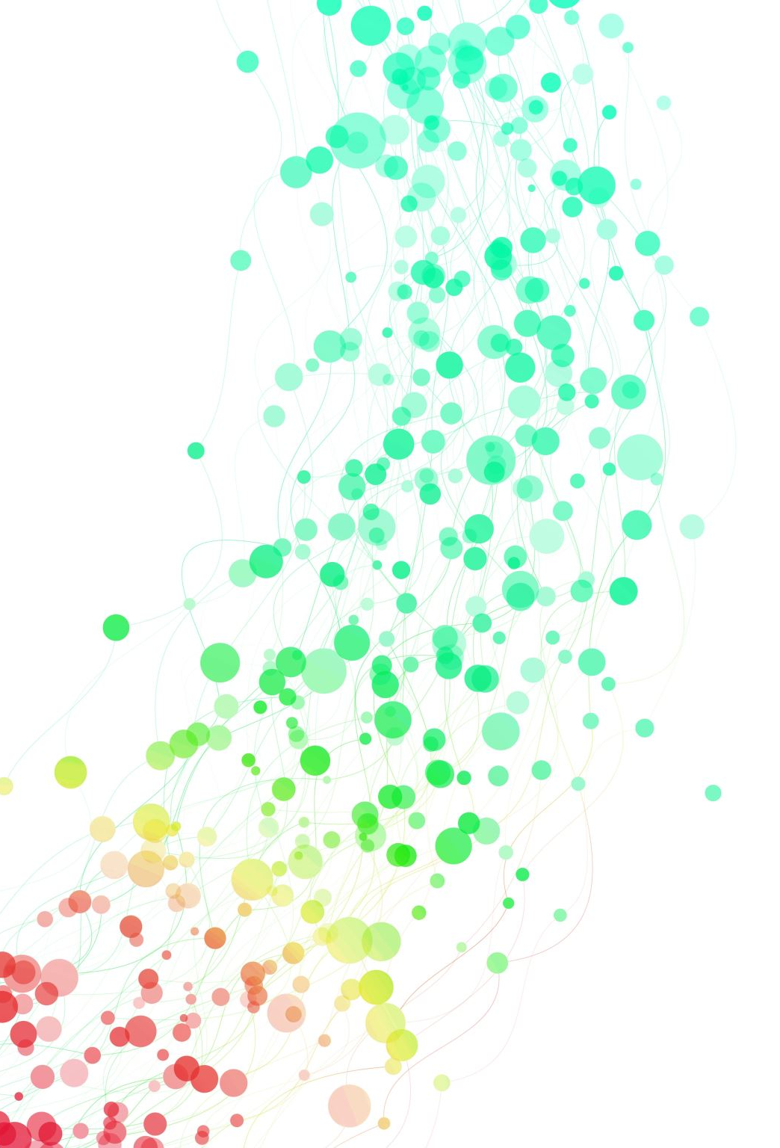
Mental health
WHO (2014)
  Mental health is defined as a state of well-being in which every individual realizes his or her own potential, can cope with the normal stresses of life, can work productively and fruitfully, and is able to make a contribution to her or his community.
  The positive dimension of mental health is stressed in WHO's definition of health as contained in its constitution: "Health is a state of complete physical, mental and social well-being and not merely the absence of disease or infirmity."
Notes:
The term mental illness covers a very broad range of mental health problems which
can involve changes to our thoughts, emotions, behaviours and relationships with
others. Mental illnesses are associated with distress and problems functioning
in our day-to-day lives (social, work, family etc.)… Mental illness is treatable.

Slide 6

THE IMPACT OF MENTAL HEALTH PROBLEMS
• Day-to-day: Mental ill health can make it harder for people to cope
with general day-to-day activities
• Physical health: Mental illness can impair the ability to protect
and develop physical wellbeing
• Work: Obtaining or maintaining a job may be more difficult when
symptoms of a mental health condition make it harder for someone
to function normally
• Education: Studying may be more difficult when living with
a mental health condition and it can prevent students from
reaching their full potential
6

Slide 7

THE IMPACT OF MENTAL HEALTH PROBLEMS CONTINUED
• Driving: Mental health conditions and/or the medication someone
is taking can sometimes affect their ability to drive. The decision on
whether someone can drive or not is based on an assessment from
their GP and the DVLA
• Parenting & children: Mental illness can affect relationships and
family life. Certain medications can also have an effect on pregnancy
• Stigma: Stigma can create barriers for people to seek help for their
mental health condition and can make their situation much worse
7

Slide 8

MENTAL HEALTH STATISTICS
Approximately 1 billion people in the world suffer from a mental health problem
Lost productivity as a result of two of the most common mental health disorders, anxiety
and depression, costs the global economy US $1 trillion each year
An estimated 1 in 6 adults experience a 'common mental health disorder' like depression
or anxiety in any given week
8
Notes:
SOURCE:
www.gov.scot, www.nhs.uk, www.scotpho.org.uk and estimates based on self-reports from the Labour Force Survey, people who have worked in the last 12 months.

Slide 9
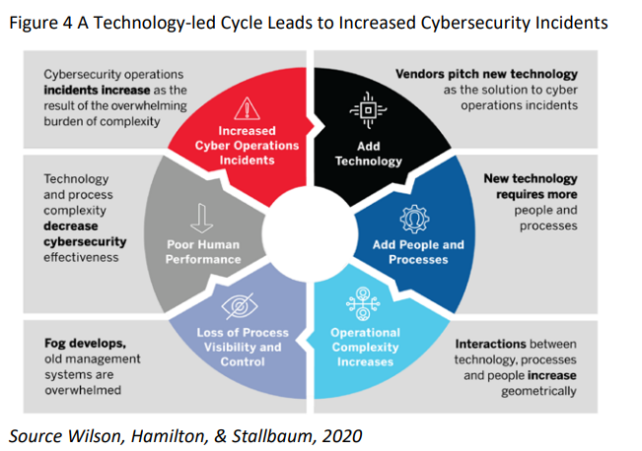
Notes:
Nobles, C. (2022) Stress, burnout and security fatigue in cybersecurity: A human factors problem, Holistica Journal of Business and Public Administration, Vol. 13, Iss. 1, pp. 49-72

Slide 10
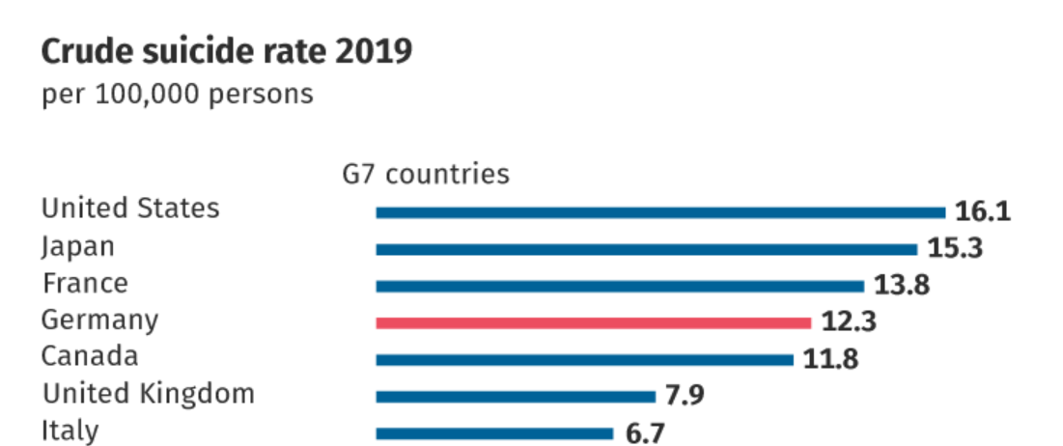
WHO estimates for 2019 show a crude suicide rate of 9.0 per 100,000 population worldwide.
Data from the Federal Statistical Office shows that in 2019 more than 9,000 persons suicide deaths were registered in Germany.
Notes:
This represents almost three times the number of road accident fatalities
1.3 suicide per hour

Slide 11
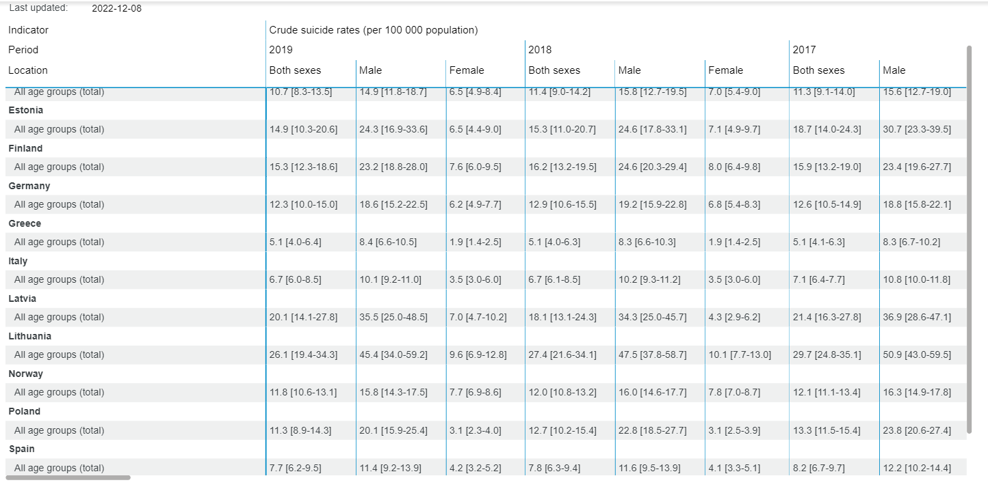

Slide 12
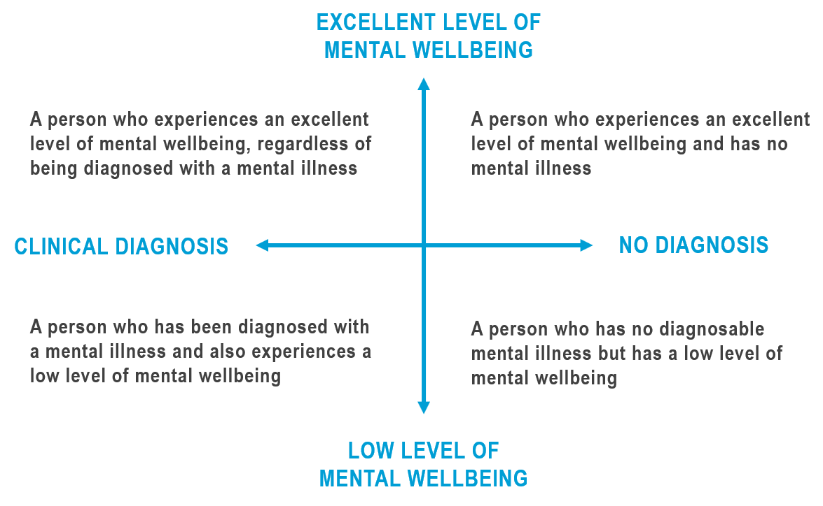
Mental health does not simply mean the absence of a mental illness
– it is possible to have good mental wellbeing whilst living with a
diagnosed mental illness. In contrast, someone who has no diagnosable
Mental illness can still have a low level of mental wellbeing.
MENTAL HEALTH CONTINUUM

Slide 13
MENTAL HEALTH RISK FACTORS
• Discrimination and stigma
• Poverty or homelessness
• Social isolation or loneliness
• Being a long-term carer
• Abuse, trauma or neglect
• Drug or alcohol abuse
• Social disadvantage or financial troubles
• Domestic violence
• Unemployment or losing a job
• Significant trauma as an adult, such as
military combat
• Having a long-term physical health
condition or injury
• The death of a loved one
• Severe or long-term stress
13

Slide 14

EARLY WARNING SIGNS OF A MENTAL HEALTH PROBLEM
Early warning signs of a mental health problem may include:
• Losing interest in activities
that were previously enjoyed
• Changes in appetite such as skipping
meals or over-eating / bingeing
• Underperforming at work with
no apparent explanation
• Changes in perception such as hearing
or seeing things that others don’t
• Increased anxiety levels, feeling
exhausted and restless
• Self-harming behaviour. Signs of cuts or
bruising to uncommon areas of the body
• Isolating themselves and not
wanting to socialise
• Reduced or increased sex drive
14

Slide 15

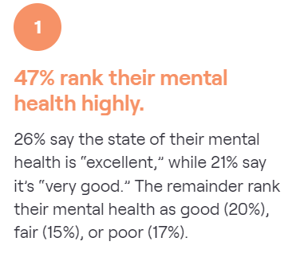
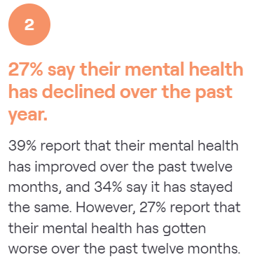
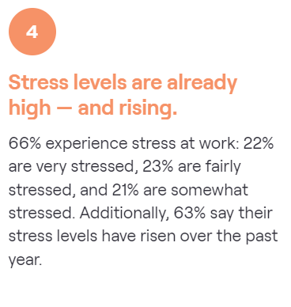
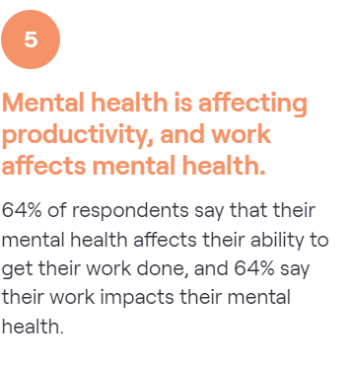
Tines 2022; N=1047 (cybersecurity workforce)
Notes:
Tines 2
Half (50.8%) of respondents say they have been prescribed medication by a doctor for mental health. 58% are currently taking medication for their mental health
49% are currently seeing a therapist

Slide 16

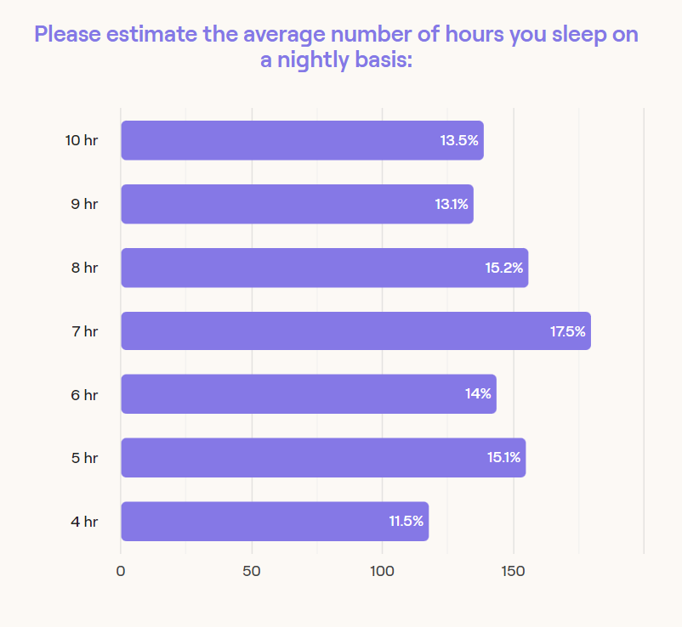

Slide 17

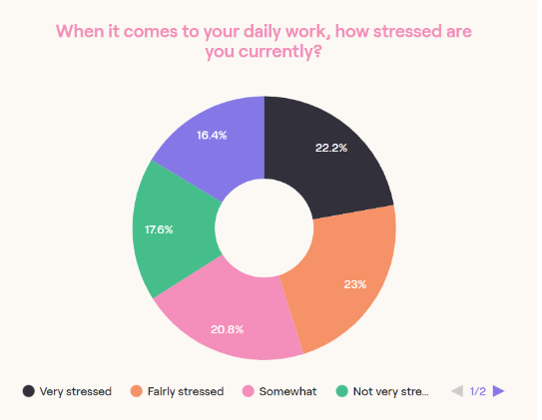
Tines, 2022 (N=1047)
63% say their stress levels are rising
64% say their mental health affects their productivity
64% say their work affects their mental health
54% say their workplace prioritizes mental health

Slide 18

Cybermindz
Burnout rates in cybersecurity may be exceeding those among frontline healthcare workers.
A single failure through a cyber breach that can affect millions of people makes headlines.
The rapidly evolving and relentless attack environment defies the sense of job completion among the cyber workforce.
Cyber professionals live with the notion that the one successful attack that could end their career could be just around the corner.
Cyberattacks are a daily occurrence and, unlike natural disasters, there is no conceivable endpoint in sight

Slide 19

Mimecast’s State of Ransomware survey 2022
Waning confidence: Confidence that security teams can maintain essential email continuity with no disruption following a ransomware attack, for example, has dropped.
Mounting stress: Over half (56%) of respondents said their work stress increases every year.
Mental health: About the same number (54%) reported a negative impact on their mental health.
Absenteeism: One-third said that their teams have experienced an increased number of employee absences following an attack.
Staffing issues: About one-third also have trouble recruiting essential IT staff after an attack.
Resignations: One-third of respondents are thinking of resigning within the next two years due to stress and burnout.

Slide 20
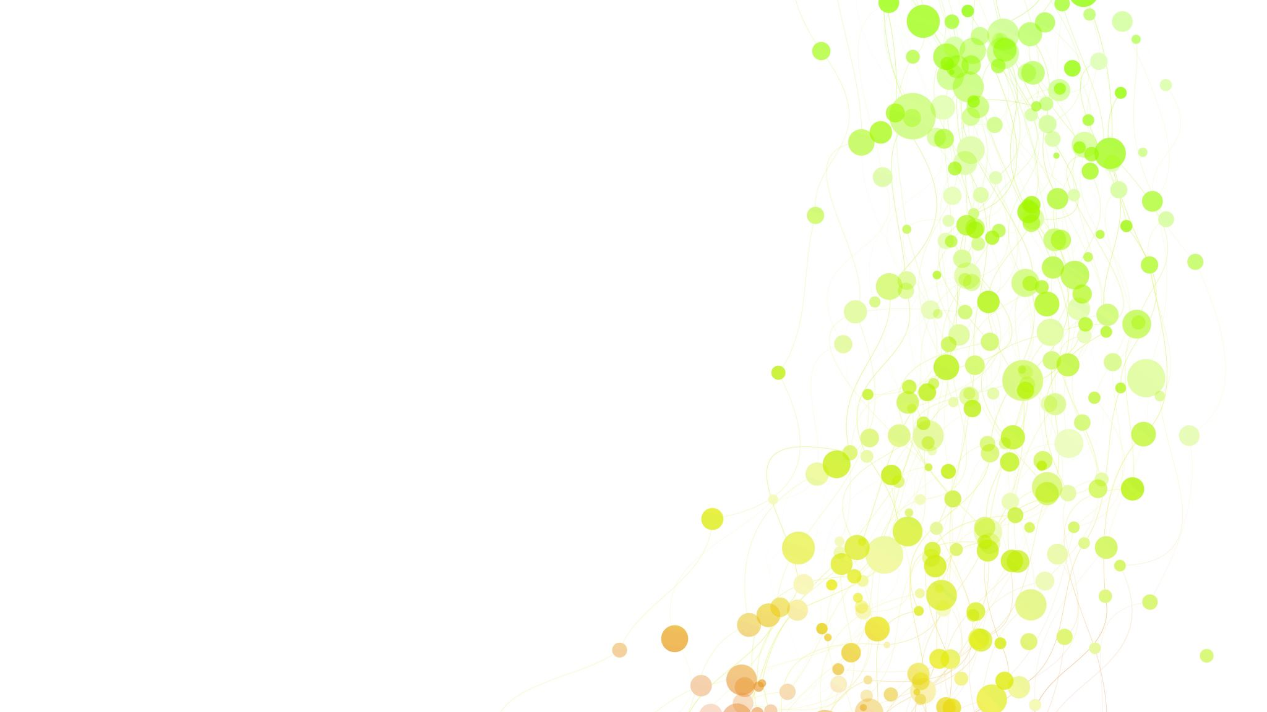
Mental Health in Cyber Security (Nobles, 2022)
technological pace
operational demands
relentless threats coupled with disjointed security capabilities and non-integrated products contribute to job burnout in the cybersecurity domain
security practitioners are overtaxed, stressed out, and inaccessible
Operational stress, fatigue, error, and burnout are extensively documented in the literature (Grier, 2015)
fatigue in cybersecurity is disregarded from leadership
  workload and stress is the scientifically proven correlation of errors and decreased
  operation fatigue and frustration increased throughout the length of the cyber operation
Notes:
Nobles, C. (2022). Stress, Burnout, and Security Fatigue in Cybersecurity: A Human Factors Problem. HOLISTICA–Journal of Business and Public Administration, 13(1), 49-72.

Slide 21
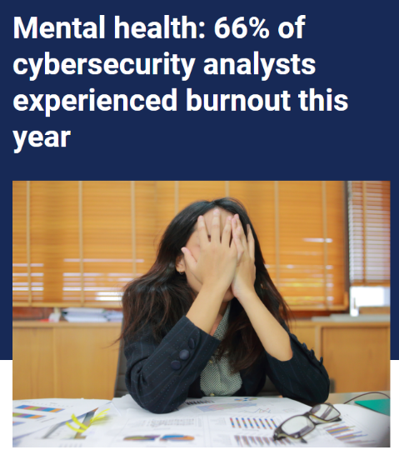
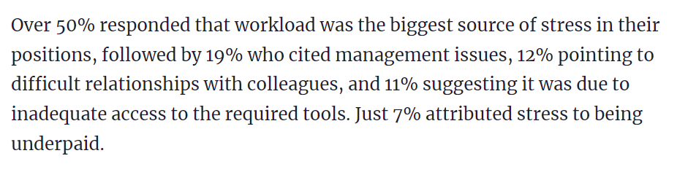
VentureBeat, 2022
Notes:
https://venturebeat.com/security/mental-health-cybersecurity-analysts/

Slide 22

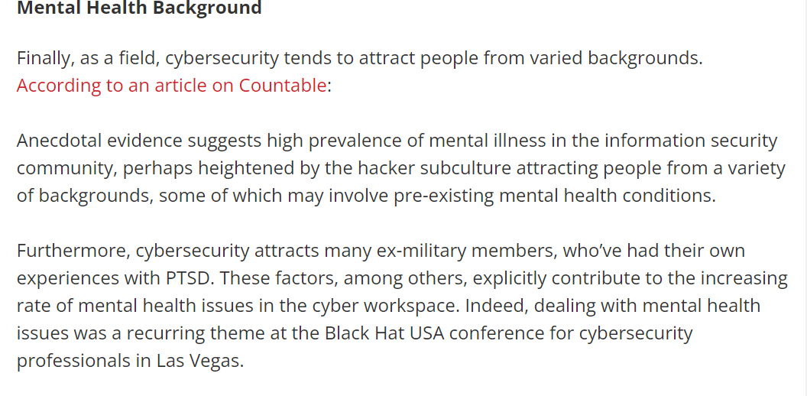
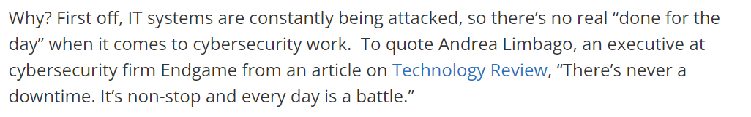
Jay Radcliffe of Boston Scientific, known for hacking devices, states, “In the past year I know several people in the [cybersecurity] community have taken their own lives.” Radcliffe himself struggled with depression and decided to open up about his struggle with mental illness at Black Hat USA.

Slide 23
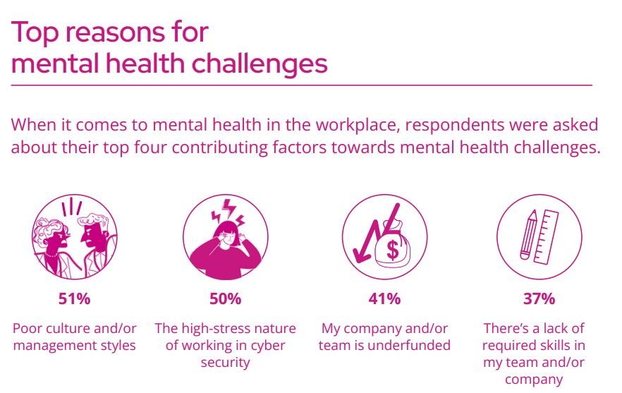
Notes:
SEKURO

Slide 24
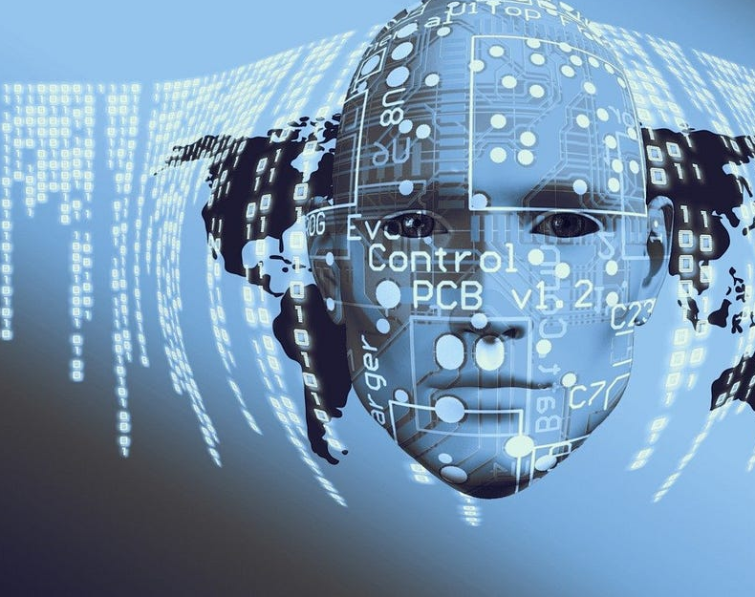
Causes of Mental Health Issues

Slide 25

WHAT IS STRESS?
Stress is the “adverse reaction people
have to excessive pressure or other
types of demand placed on them”.
25

Slide 26
CAUSES OF STRESS
• Work
• Bereavement
• Finances
• Divorce
• Family and friends
• Travel
• Relationships
• Moving house
• Poor physical health
• Bullying
• Poor behaviour
• Personal issues
26

Slide 27
THE EFFECTS OF STRESS
How someone may feel mentally and emotionally:
• Anxious
• Constant worrying
• Low self-esteem
• Lack of concentration
• Overwhelmed
• Difficulty making decisions
• Angry
• Racing thoughts
• Sad
• Frustration
27

Slide 28
THE EFFECTS OF STRESS continued
Physical effects:
Behavioural effects:
• Headaches
• Outbursts of anger
• Tiredness
• Restlessness and constant worrying
• Muscle tension and chest pain
• Social withdrawal
• Nausea and dizziness
• Undereating or overeating
• Shallow breathing
• Exercising less often than usual
• High blood pressure
• Changes in sex drive
28

Slide 29
THE EFFECTS OF STRESS continued
Lots of things can cause someone to be stressed and generally, this isn’t
something to be concerned about. However, the effects of long-term stress
can put their health at risk.
The long-term effects of stress can lead to:
• Mental health conditions
• Digestive problems
• Cardiovascular problems
• Behavioural changes
• Problems with the immune system
• Drug and alcohol misuse
29

Slide 30

Major disorders associated with stress
Depression
Anxiety
Burn-out

Slide 31
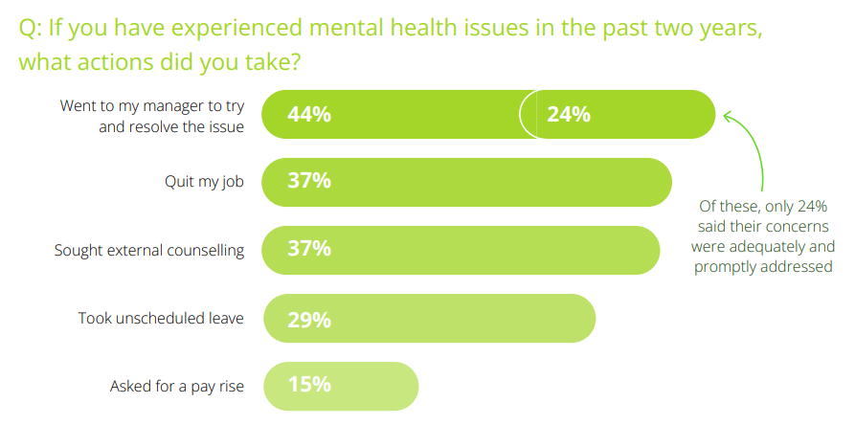
SEKURO 2022
Notes:
Tines, 2022

Slide 32
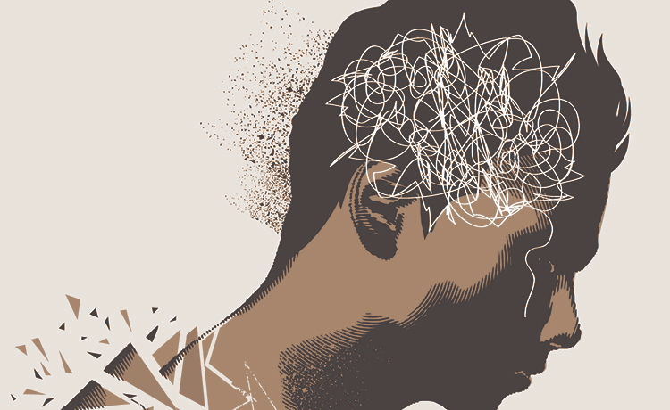
Individual Factors

Slide 33

Diathesis-Stress Model
B= f(P X S)
P=f(G X E)
Predispositions and social interactions

Slide 34

Personality profiles of IT Personell
Little research
Personality give behavioural dispositions and tendencies
  Moderated by experience
But also ‘Cognitive styles’

Slide 35

Individual Risk Factors
Gender
  Female
  Males
Personality
  No real definition but a description of characteristics based on ‘stable’ behaviors
    Eysenck’s theory
    FFM
    CAPS
Cognitive Styles
  STEM profiles
  Related to hormonal exposure during gestation

Slide 36
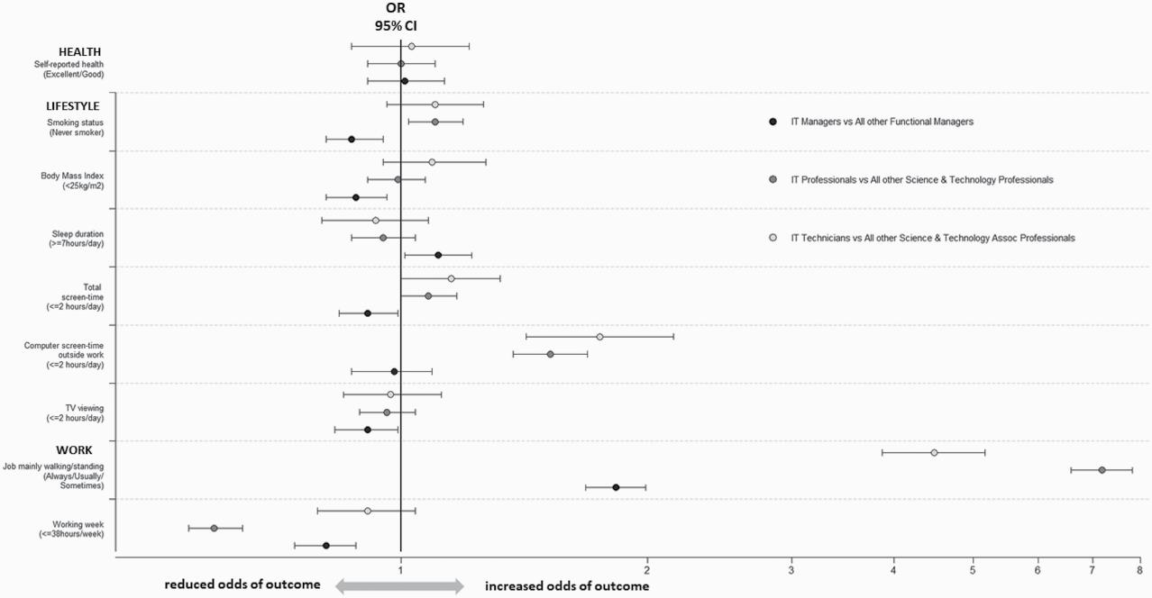
Notes:
D Lalloo, J Lewsey, S V Katikireddi, E B Macdonald, E Demou, Health, lifestyle and occupational risks in Information Technology workers, Occupational Medicine, Volume 71, Issue 2, March 2021, Pages 68–74,
IT: Less smoking than other domains, but IT managers smoke more than IT professionals
Same w BMI. Less than all workers but managers higher BMI (same w sleep)
IT workers more screen time aafter work
Alcohol and other aspects the same
BUT: IT workers Unhappy! (OR1.67) Cohen’sd =.283

Slide 37

While IT has brought us physical activity tracking devices and prompting apps (reminding us to get up and move regularly), our findings highlight that IT workers themselves are not adopting this important health promotion advice. There is a need for interventions focused on reducing sedentary behaviour both within and out with the workplace and for education and awareness among IT workers to minimize sedentary behaviour.
Lalloo et al., 2021

Slide 38
FFM (Costa & McRae, 1992)
O
C
E
A
N
Openness
  IQ
Conscientiousness
  Self-discipline
Extraversion
  Seeking social support
Agreeablenes
  Getting along
Neuroticism
  Emotional stability

Slide 39


Notes:
Tender-mindedness: People who score higher in this facet tend to sympathise easily with others and are deeply concerned with the needs of others. People low in tender-mindedness are less inclined to make decisions based on sympathy, rather they are more likely to use logic in these instances.
five narrow traits, aggression, self-directed learning, optimism, and work drive, tough-mindedness = higher GPA

Slide 40
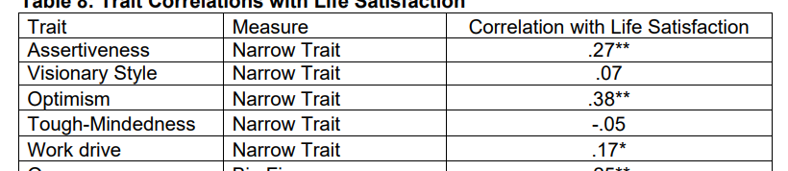

Slide 41
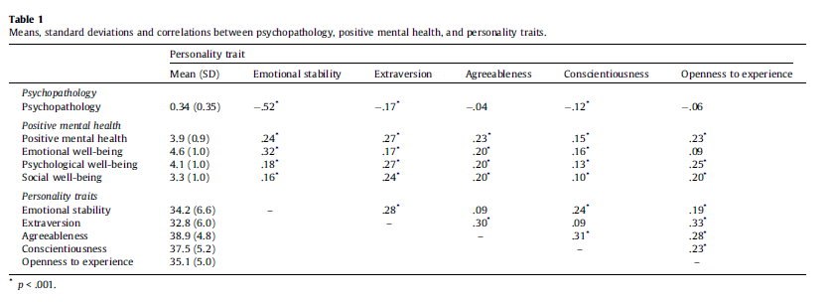
v
Notes:
Lamers, S. M., Westerhof, G. J., Kovács, V., & Bohlmeijer, E. T. (2012). Differential relationships in the association of the Big Five personality traits with positive mental health and psychopathology. Journal of Research in Personality, 46(5), 517-524.
Connor, S. E. (2008). An investigation of the big five, narrow traits, and positive psychology in relation to life satisfaction.

Slide 42
Self-Efficacy (Bandura, 1986)
Beliefs and Expectations
Self-efficacy beliefs
    Perceived self-efficacy: The perceived ability to cope with specific situations
    High vs low
    Self-efficacy vs. self-esteem
    Self-efficacy expectations and outcomes
Spans:
  Specific vs. global

Slide 43

Self-Efficacy (Bandura, 1986)

Slide 44

Competencies and skills
Increase: Self-efficacy
Protective:
  Tough-mindedness
    Fact vs. sympathy
Risks:
  Low extraversion
    Low SS
  Low assertiveness
    Low SE
  Low work drive
    Low C, Motivation

Slide 45



Slide 46
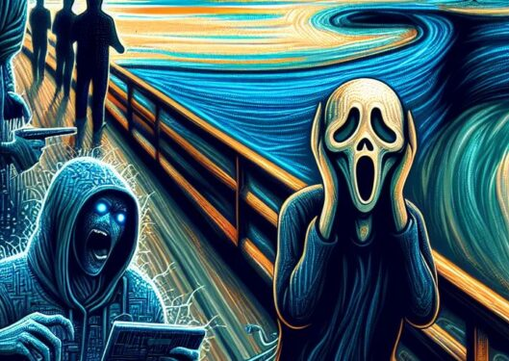
Summary
Inherent risk and vulnerabilies of IT personell
Self-efficacy
  Assertiveness
  Social Support (extraversion)
Easy way to increase SE is communication training

Slide 47

Workplace Factors of Mental Health

Slide 48


FACTORS AFFECTING MENTAL HEALTH IN THE WORKPLACE
Mental health problems can develop outside and inside of the workplace. There are several
internal factors which can have a negative impact on your mental health and make it harder
to cope. Factors can include:
• Unmanageable workloads, long hours
and increasing pressures
• Lack of involvement when the workplace
is undergoing change
• Lack of control over work and poor
supervision from management
• Inadequate pay, problems receiving
pay and lack of reward and recognition
• Bullying, stigmatisation and bad
relationships with peers
• Dangerous or poor physical working
environments
• Traumatic experiences
48

Slide 49
WORK-RELATED STATISTICS 2017/18
• 595,000 workers suffered from work-related stress, depression or anxiety
• 239,000 workers suffered from a new case of work-related stress, depression or anxiety
• 15.4 million working days lost due to work-related stress, depression or anxiety
• Working days lost due to stress, depression or anxiety accounted for 57% of all working
days lost due to ill health
• The main cause of work-related stress, depression or anxiety was due to people’s
‘workload’, accounting for 44% of all cases
Notes:
SOURCE:
Health and Safety Executive (HSE)
Summary statistics for Great Britain 2017/2018

Slide 50

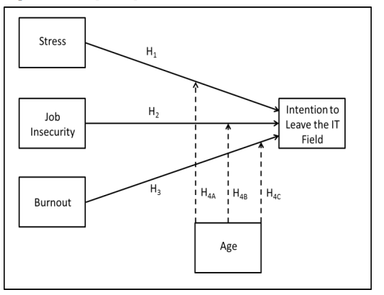
Shropshire, J., & Kadlec, C. (2012).
H1: When distress reaches a level individuals cannot cope with, it will have a positive influence on intention to leave the IT field.
  increased absenteeism, high turnover, emotional exhaustion, deteriorating personal health, reduced organizational commitment , lower job performance
H2: Job insecurity will have a positive influence on intention to leave the IT field
H3: Burnout will have a positive influence on intention to leave the IT field.
H4: The relationship between stress, job insecurity, burnout, and career change will strengthen when IT worker age is lower
Notes:
Shropshire, J., & Kadlec, C. (2012). I’m leaving the IT field: The impact of stress, job insecurity, and burnout on IT professionals. International Journal of Information and Communication Technology Research, 2(1).

Slide 51

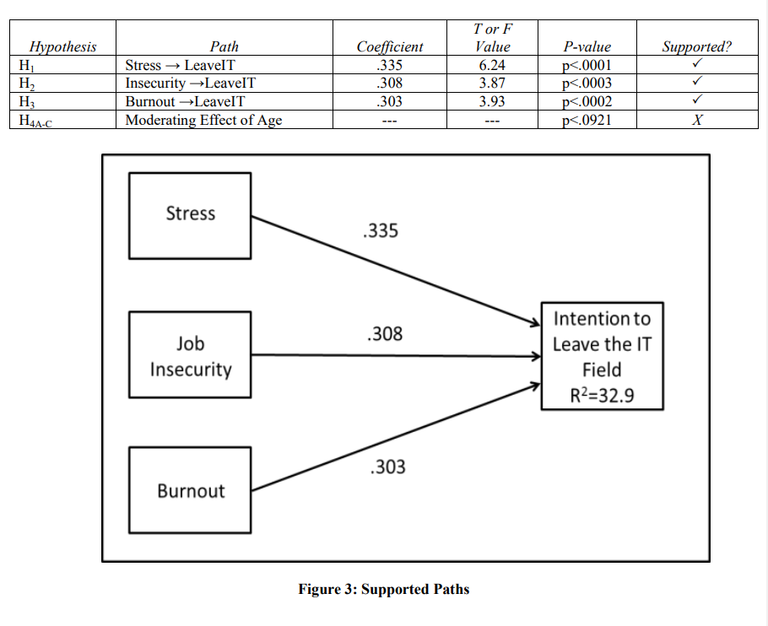

Slide 52

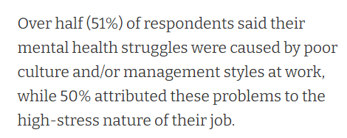
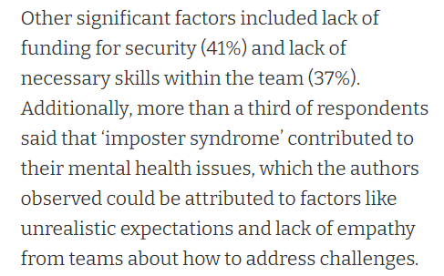
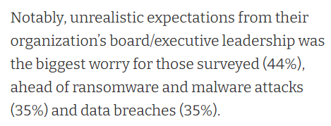
Job Resources
Notes:
SEKURO

Slide 53

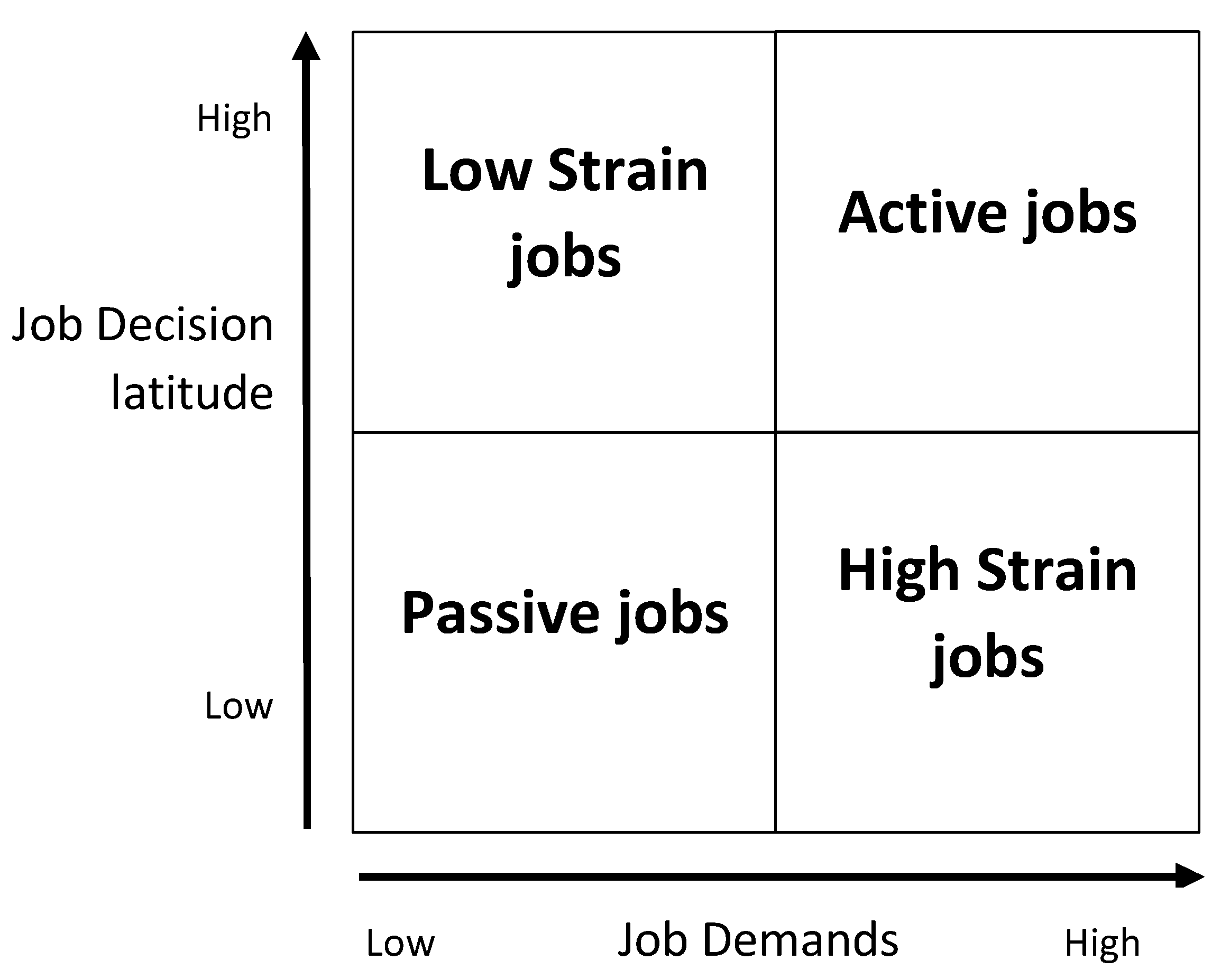
Job-Demands Control Model
Karasek, 1990
Notes:
Karasek, R.; Theorell, T. Healthy Work: Stress, Productivity, and the Reconstruction of Working Life; Basic Books: New York, NY, USA, 1990.
Karasek, R.A. Job Demands, Job Decision Latitude, and Mental Strain: Implications for Job Redesign. Adm. Sci. Q. 1979, 24, 285–308.
JD-C-S is used to assess psychosocial workplace stressors. Job strain is linked to cardiovascular disease, depression, and stress-related ill-health. Active job situations, on the other hand, are linked to work engagement and well health. Support may also moderate strong demand and low control. Managers have higher demands and control than non-managers, and female managers are particularly at risk for burnout due to their higher demands and lower control.

Slide 54
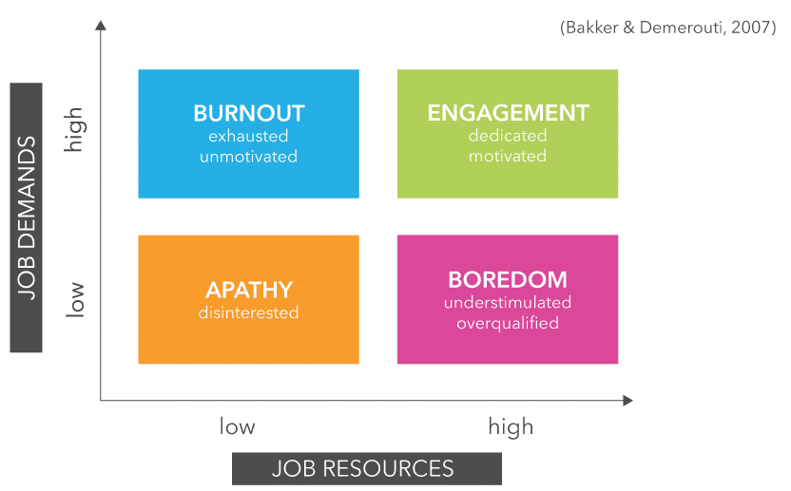
Resources
  Personal
    Self-efficacy
  Work
    Leadership
    Support

Slide 55
RISE
Relation-inferred Self-efficacy (Lent & Lopez 2002)
Scaffolding (Vygotsky, 1987)
Unique relationships
SE
  Own
  Other
  RISE

Slide 56
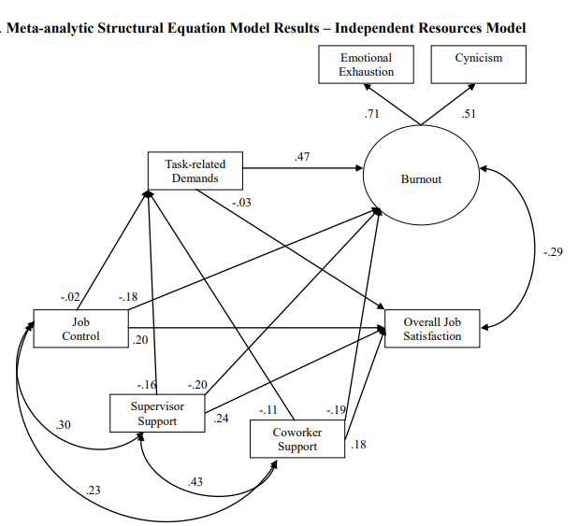
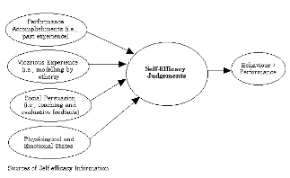
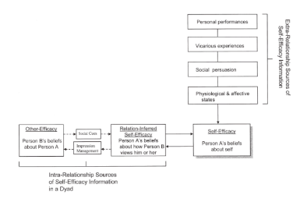
Notes:
Additionally, the variance explained in the outcomes was diminished, with the predictors explaining 21.4% in satisfaction and 29.9% in burnout.
Luchman, J. N., & González-Morales, M. G. (2013). Demands, control, and support: A meta-analytic review of work characteristics interrelationships. Journal of Occupational Health Psychology, 18(1), 37–52. doi:10.1037/a0030541

Slide 57
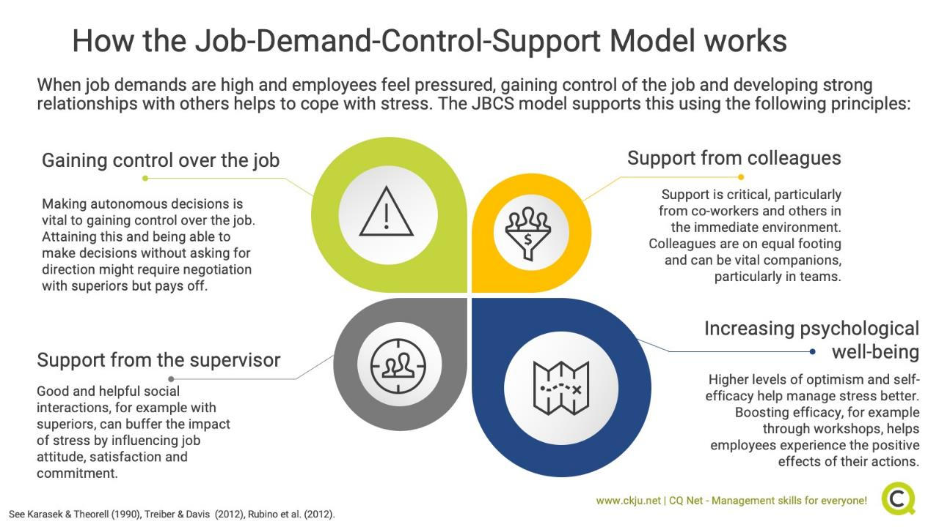

Slide 58
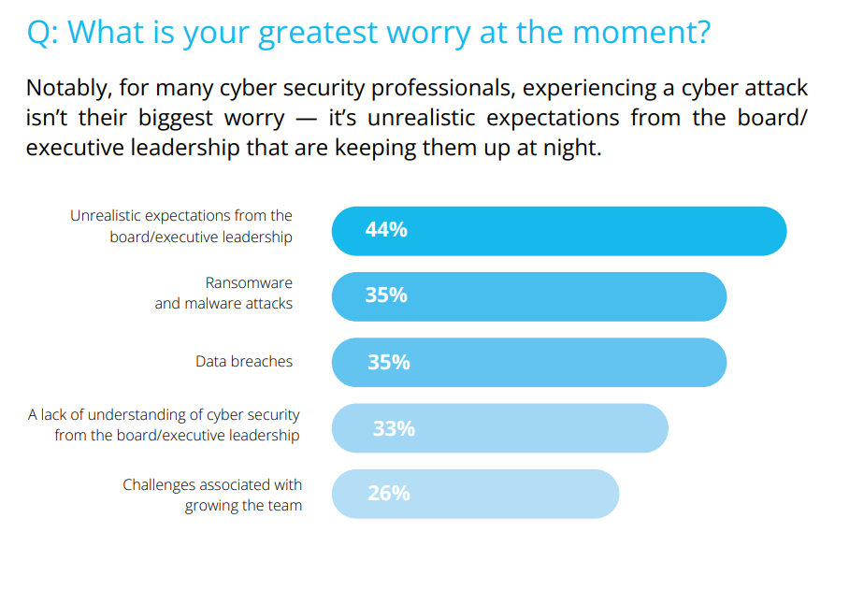
SEKURO 2022

Slide 59
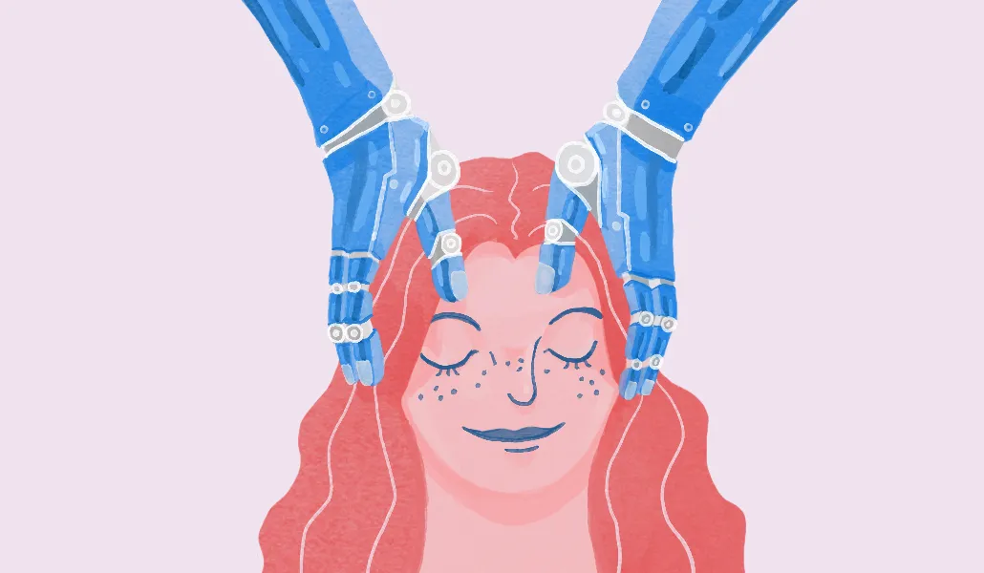
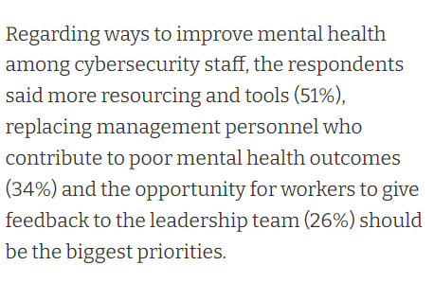
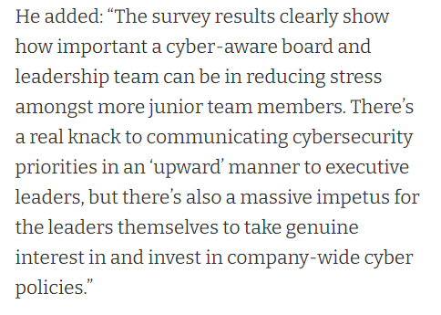
How to improve

Slide 60

Applied Interventions

Slide 61

Performance Psychology
Multidisciplinary approaches
Cybersecurity = High performance domain
Sports = High performance domain
Goal: Create resilient cybersecurity ‘athletes’
We havent talked about nutrition and physical health, but…

Slide 62
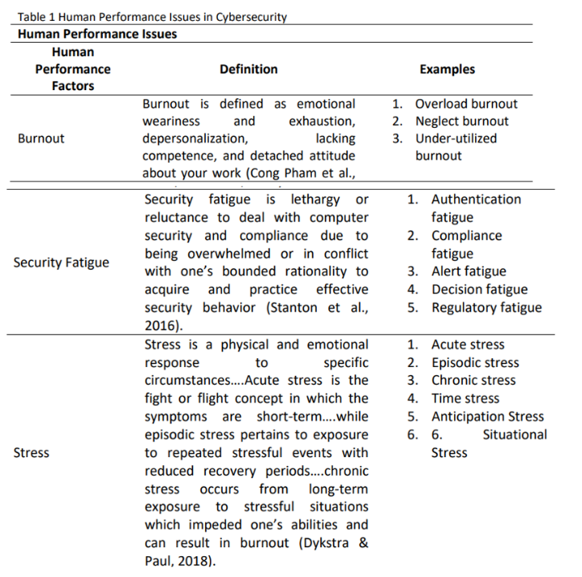
Performance issues in cybersecurity

Slide 63
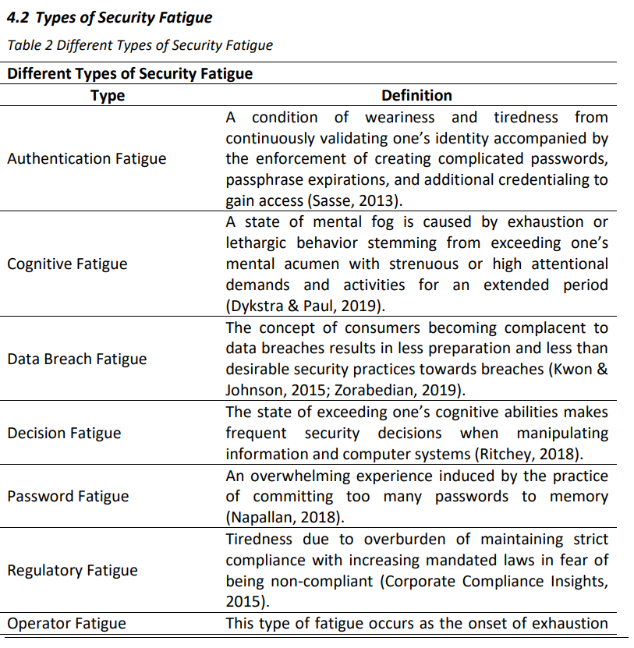
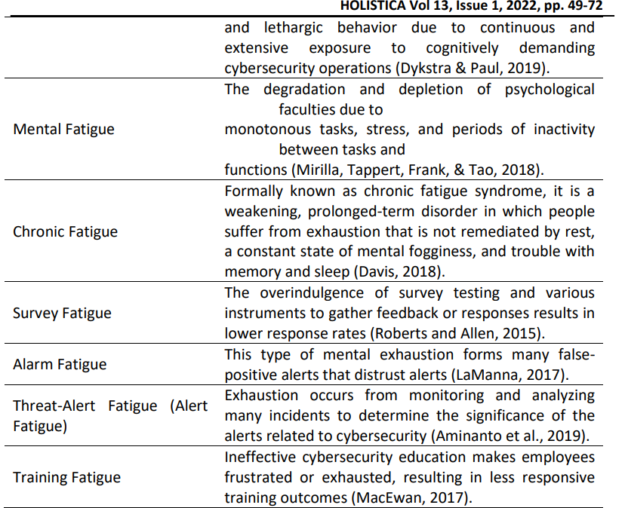

Slide 64
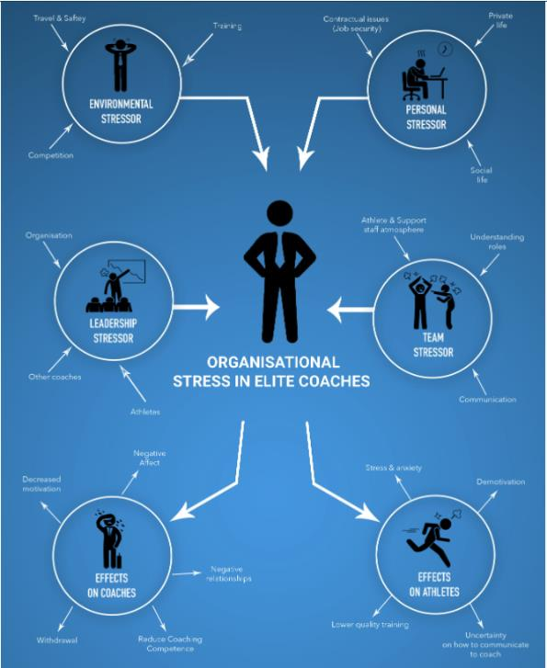
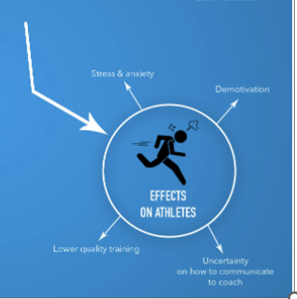
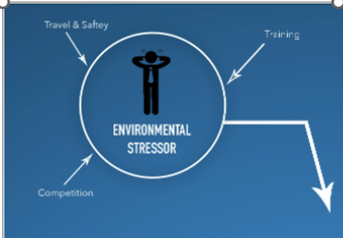
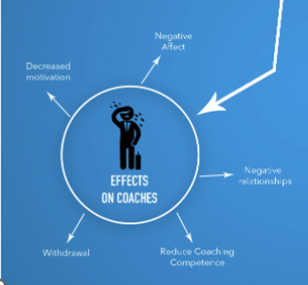
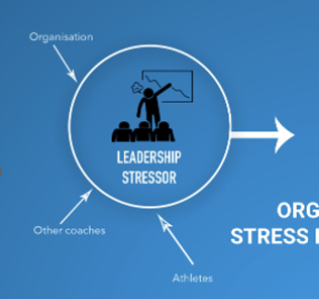
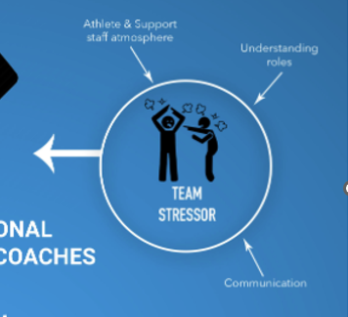
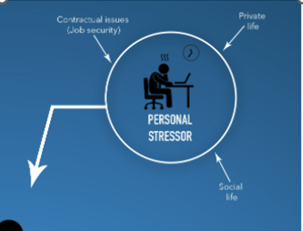

Slide 65
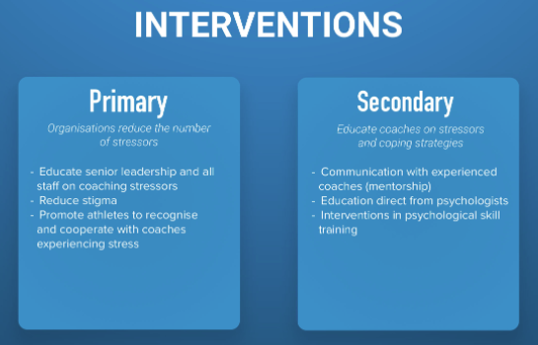

Slide 66


Notes:
The average tenure of a manager in the professional game in England has dropped to just 1.23 years - with the Championship the hardest league in which to keep your job(.86 years !!)
91 games

Slide 68

ENISA
Put on your Job-Demands Skill model

Slide 69



Slide 70



Slide 71



Slide 72



Slide 73



Slide 74



Slide 75



Slide 76



Slide 77



Slide 78



Slide 79



Slide 80



Slide 81

CISO Mental Health
Chief Information Security Officers (CISO)
  overworked impacting their mental health to the degree that 90% are willing to take a pay cut
  continuous stress and mental health implications disrupt the CISOs work-life balance
  88% overly stressed
ISACA, 2020
  Short tenures from 1 to 2 years
    increasing responsibility
    less personal and recovery time
    constant connectivity
WORSE mental health than healthcare professionals
Notes:
Nobles, C. (2022). Stress, Burnout, and Security Fatigue in Cybersecurity: A Human Factors Problem. HOLISTICA–Journal of Business and Public Administration, 13(1), 49-72.
workers are overwhelmed while interacting with computer systems due to experiencing substandard security experiences, resulting in security fatigue and degraded security decision-making (Stanton, Theofanos, Prettyman, & Furman, 2016).

Slide 82
CISO
Notes:
The average tenure of a manager in the professional game in England has dropped to just 1.23 years - with the Championship the hardest league in which to keep your job(.86 years !!)
91 games

Slide 83

BUILDING A positive MENTAL HEALTH culture – Employers
Good mental health and wellbeing is one of the most valuable assets to any organisation.
Here are some steps employers can take to improve the mental health culture of the workplace.
• Develop a mental health action plan and policy
• Provide mental health training across the organisation
• Adjust job roles to accommodate new responsibility
• Publicise the organisation’s commitment to mental health
• Evaluate the possible causes of mental ill-health in the
workplace and signify areas which need improvement

Slide 84

BUILDING A positive MENTAL HEALTH culture – Employers CONTINUED
• Ensuring employers and senior management spend more time
communicating and getting to know employees
• Monitoring employee performance and providing recognition
and reward for achievements
• Introducing networks, initiatives and activities involving mental
health and communicating this via the company’s intranet, news
bulletins and workplace communal areas
• Health services, return to work schemes and allowing flexible
working hours to help employees meet personal responsibilities
• Involving employees in decision making

Slide 85
BUILDING A positive MENTAL HEALTH culture – EMPLOYEES
• Educate yourself on mental health and wellbeing and participate in workplace initiatives
• Make effort to talk to your colleagues and ask them how they are feeling. Take on little tasks to help
make their life easier during tough times
• Don’t be afraid to talk to someone about your own thoughts and feelings
• Challenge workplace ‘politics’ and speak to a manager if something is not quite right
• Show an interest in your colleague’s opinions, cultures and beliefs
• Build friendships with your colleagues and organise to meet up outside of the working environment

Slide 86

• Make the most out of your lunch break – eat healthily, read
a book, listen to music, take a stroll etc.
• Set a challenge by organising charity events for good causes
• Take a break every once in a while and make the most out of
your annual leave
• Time is precious - ensure you have a good work / life balance
and don’t over do it
• Make sure you have a good sleep pattern and listen to what
your body is telling you
BUILDING A positive MENTAL HEALTH culture – EMPLOYEES CONTINUED

Slide 87

THE IMPACT OF A POSITIVE MENTAL HEALTH CULTURE
• Increased awareness of mental health
• Employees more likely to disclose their problems
• Improved productivity, teamwork and morale
• Attracting new job talent
• Enhanced business reputation
• Reduced absence and staff turnover
• Reduced business costs
87

Slide 88

SEKURO 2022
Notes:
https://sekuro.io/Sekuro_Mental_Health_Cyber_Security_Survey.pdf?utm_source=sekuro&utm_medium=webpage&utm_campaign=cyber_mental_health

Slide 89
WHAT CAN YOU DO TO HELP yourself?
• Spend quality time with family and friends
• Start gardening
• Exercise regularly
• Take up a hobby or join a club
• Eat and maintain a healthy diet
• Take a break / holiday
• Get enough sleep
• Volunteer for the community
• Read books or listen to audiobooks
• Meditation and mindfulness techniques
• Listen to your favourite music
• Visit your GP if you have any physical
or mental health concerns
• Learn a new skill

Slide 90



Pillars of Mental Health

Slide 91

Physiological Sigh
The “physiological sigh” is an example of a bottom-up stress management technique that can be used acutely to reduce stress or anxiety. To practice the physiological sigh, receive an inhale, but before you get to the top, take another inhale. Then, expel all your air with an exhale.

Slide 92

FIVE STEPS TO MENTAL WELLBEING CONTINUED
Connect…
Connect with the people around you; your family,
friends, colleagues and neighbours. Spend time
developing these relationships.
Be active…
You don't have to go to the gym. Take a walk, go
cycling or play a game of football. Find an activity
that you enjoy and make it a part of your life.
92
Notes:
SOURCE:
NHS Mood zone: Five steps to mental wellbeing
https://www.nhs.uk/conditions/stress-anxiety-depression/improve-mental-wellbeing/

Slide 93

FIVE STEPS TO MENTAL WELLBEING CONTINUED
Keep learning…
Learning new skills can give you a sense of achievement and a new
confidence. So why not sign up for that cooking course, start learning
to play a musical instrument, or figure out how to fix your bike?
Give to others…
Even the smallest act can count, whether it's a smile, a thank you
or a kind word. Larger acts, such as volunteering at your local
community centre, can improve your mental wellbeing and help
you build new social networks.
93
Notes:
SOURCE:
NHS Mood zone: Five steps to mental wellbeing
https://www.nhs.uk/conditions/stress-anxiety-depression/improve-mental-wellbeing/

Slide 94
Today (see what i did)
What are you expecting today
  Did it meet you expectations?
What knowledge do you have about the topic
  What did you know? What are you more interested in knowing
How confident are you about this
  How confident are you in using this now?

Slide 95
References
Luchman, J. N., & González-Morales, M. G. (2013). Demands, control, and support: A meta-analytic review of work characteristics interrelationships. Journal of Occupational Health Psychology, 18(1), 37–52. doi:10.1037/a0030541
Nobles, C. (2022) Stress, burnout and security fatigue in cybersecurity: A human factors problem, Holistica Journal of Business and Public Administration, Vol. 13, Iss. 1, pp. 49-72
https://sekuro.io/Sekuro_Mental_Health_Cyber_Security_Survey.pdf?utm_source=sekuro&utm_medium=webpage&utm_campaign=cyber_mental_health
https://www.healthcareitnews.com/news/concern-cybersecurity-workforce-mental-health-rising

Slide 96

Thank you
Please send all questions to trainers.

