Slide 1



Topic 10: Cybersecurity Risk Assessment and Management
Presentation by:
RicardoLugo

Slide 2
Acknowledgement
Co-funded by the European Union. Views and opinions expressed are however those of the author(s) only and do not necessarily reflect those of the European Union or HADEA. Neither the European Union nor the granting authority can be held responsible for them.
Project Agreement no. 101083594

Slide 3
Agenda
Context: Maritime
Human factors
Risk assessment & mangement
Supply chain
Humans

Slide 4
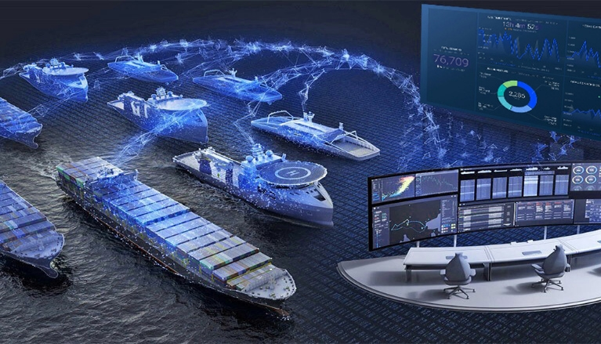
Maritime Digitalization
What is maritime digitalization
  DT refers to organizational changes, caused by digital technologies, which lead to the redefinition of existing business capabilities, processes, and relationships (Tijan et al., 2021)
  Behind other sectors
Importance
  Shipping is volatile industry
  New technologies
    IT/OT
Digitalization currently applies to eight digital domains:
    Autonomous vehicles and robotics; Artificial intelligence; Big Data; Virtual, augmented and mixed reality; Internet of Things; Cloud and edge computing; Digital security; 3D printing; Additive engineering
    Lacks research especially in maritime domain
Notes:
Brief overview of what digitalization means for the maritime industry.
Explain the potential of digital technologies in optimizing maritime operations.
Volatile Industry: Shipping, as a part of logistics chain, is a volatile industry and is in a turbulent condition due to the energy price fluctuations, technological immaturity and upcoming increases in regulations

Slide 5
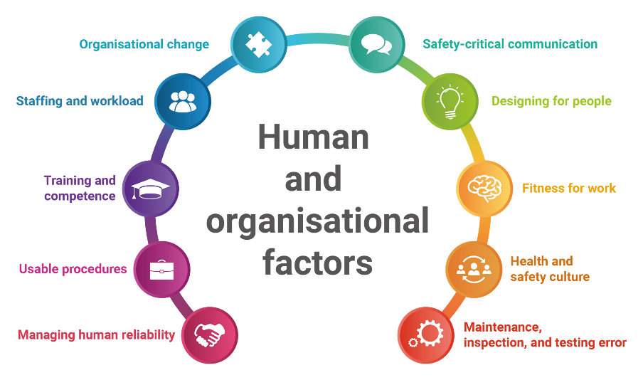
Human factors
Human factors refer to environmental, organisational and job factors, and human and individual characteristics, which influence behaviour at work in a way which can affect health and safety
  The Job
    nature of the task, workload, working environment, design of displays and controls, and the role of procedures
  The Individual
    competence, skills, personality, attitude, and risk perception
  The Organization
    Often overlooked
    work patterns, culture of the workplace, resources, communications, leadership
Notes:
Explain human factors as the interaction of humans with elements of a system.
Discuss why human factors are crucial in maritime operations.

Slide 6
Maritime Cybersecurity
The ability to protect or defend the use of cyberspace from cyber-attacks. (NIST, 2019)
ENISA (2011)
  “key findings of this workshop were that the maritime cyber-security is at a low to non-existent level due, among others, to the small number of known cyber security incidents, no publicity for them, and absence of mechanisms to identify the incidents”
According to what we know so far and the relevant studies almost 80% of the maritime casualties are caused, at least in part, by human error. This assumption also applies to the maritime cyber security. In this context, training and awareness-raising is needed to prevent cyber-attacks in order for the shipping personnel to be able to identify and eliminate the cyber-threats

Slide 7
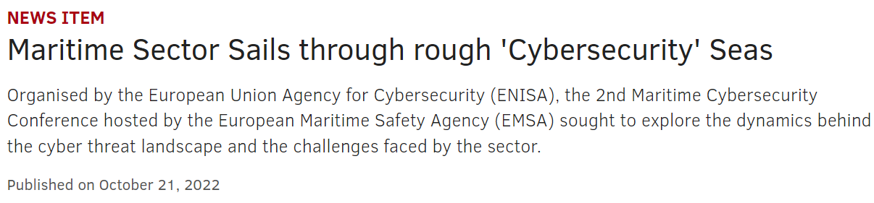
Maritime Cybersecurity Developments
(Pseftelis & Chondrokoukis , 2021)
Baltic and International Maritime Council (BIMCO)
  identify threats, identify vulnerabilities, assess risk exposure, develop protection and detection measures, establish contingency plans, respond to and recover from cyber security incidents.
Maritime Cyber-Risk Assessment (MaCRA)
  model-based framework for maritime cyber-risk assessment (Tam, 2019). A framework has been developed for the quantification and promotion of maritime cyber risks:
    Navigation Systems
    Positioning Systems
    Communication and Networking systems
    Cargo and Machinery management systems
    Human Factor
Notes:
The purpose is to control the average value of the variable, with a control value of seven. This value is chosen because several cyber-security certifications (EC-Council, 2020) require a score of more than or equal to 70% for their successful acquisition.

Slide 8
Cybersecurity (NIST 2019)
Def: “The ability to protect or defend the use of cyberspace from cyber-attacks.”
Cyber-attack: “An attack, via cyberspace, targeting an enterprise's use of cyberspace for the purpose of disrupting, disabling, destroying, or maliciously controlling a computing environment / infrastructure or destroying the integrity of the data or stealing controlled information.”
Cyber safety incidents (BIMCO, 2018) can arise as the result of:
  a cyber security incident, which affects the availability and integrity of Operational technology (OT), for example corruption of chart data held in an Electronic Chart Display and Information System (ECDIS)
  a failure occurring during software maintenance and patching
  loss of or manipulation of external sensor data, critical for the operation of a ship – this includes but is not limited to Global Navigation Satellite Systems (GNSS).

Slide 9
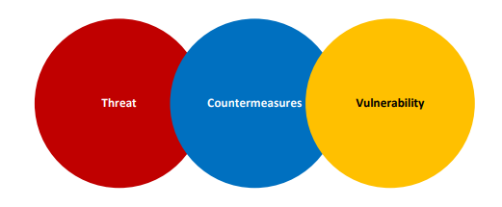
Cybersecurity (NIST 2019)
Threats: “Any circumstance or event with the potential to adversely impact organizational operations (including mission, functions, image, or reputation), organizational assets, or individuals through an information system via unauthorized access, destruction, disclosure, modification of information, and/or denial of service. Also, the potential for a threat-source to successfully exploit a particular information system vulnerability.”
Countermeasures: “Actions, devices, procedures, techniques, or other measures that reduce the vulnerability of an information system.”
Vulnerabilities: “A weakness in an information system, system security procedures, internal controls, or implementation that could be exploited or triggered by a threat source.”
  Includes humans

Slide 10
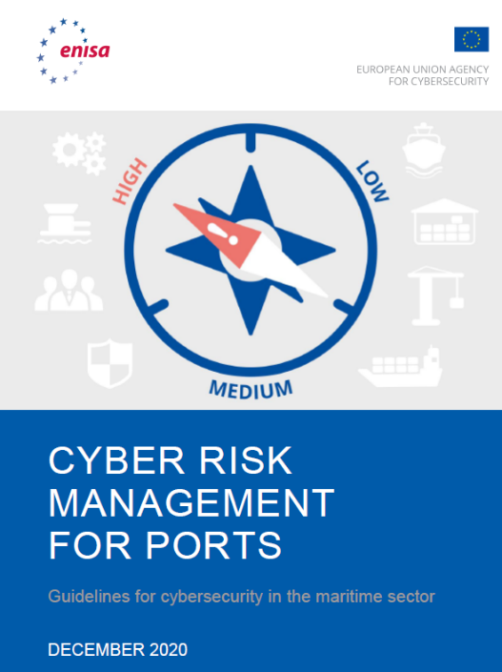
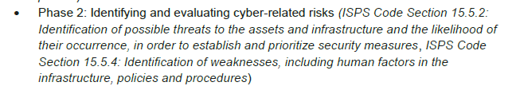

Slide 11
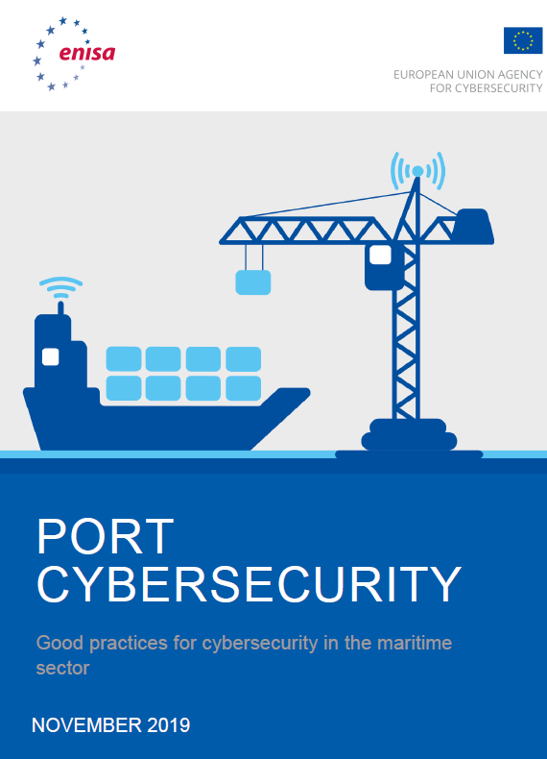
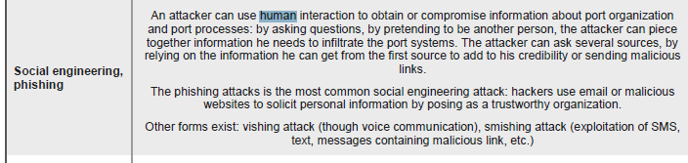

Slide 12
ENISA (2011)
Cybersecurity found to be low-non-existant level in maritme
80% error caused by humans
Recommendations:
  the implementation of cyber security campaigns and training actions for the various parties involved.
  the implementation of security strategies for Maritime Information and Communication Technologies (security by design).
  addition of cyber security to maritime policies.
  identification and registration of critical goods in the maritime sector.
  establishment of common security policies between the European Union and the International Maritime Organization (IMO).
  better exchange of information between the parties involved

Slide 13
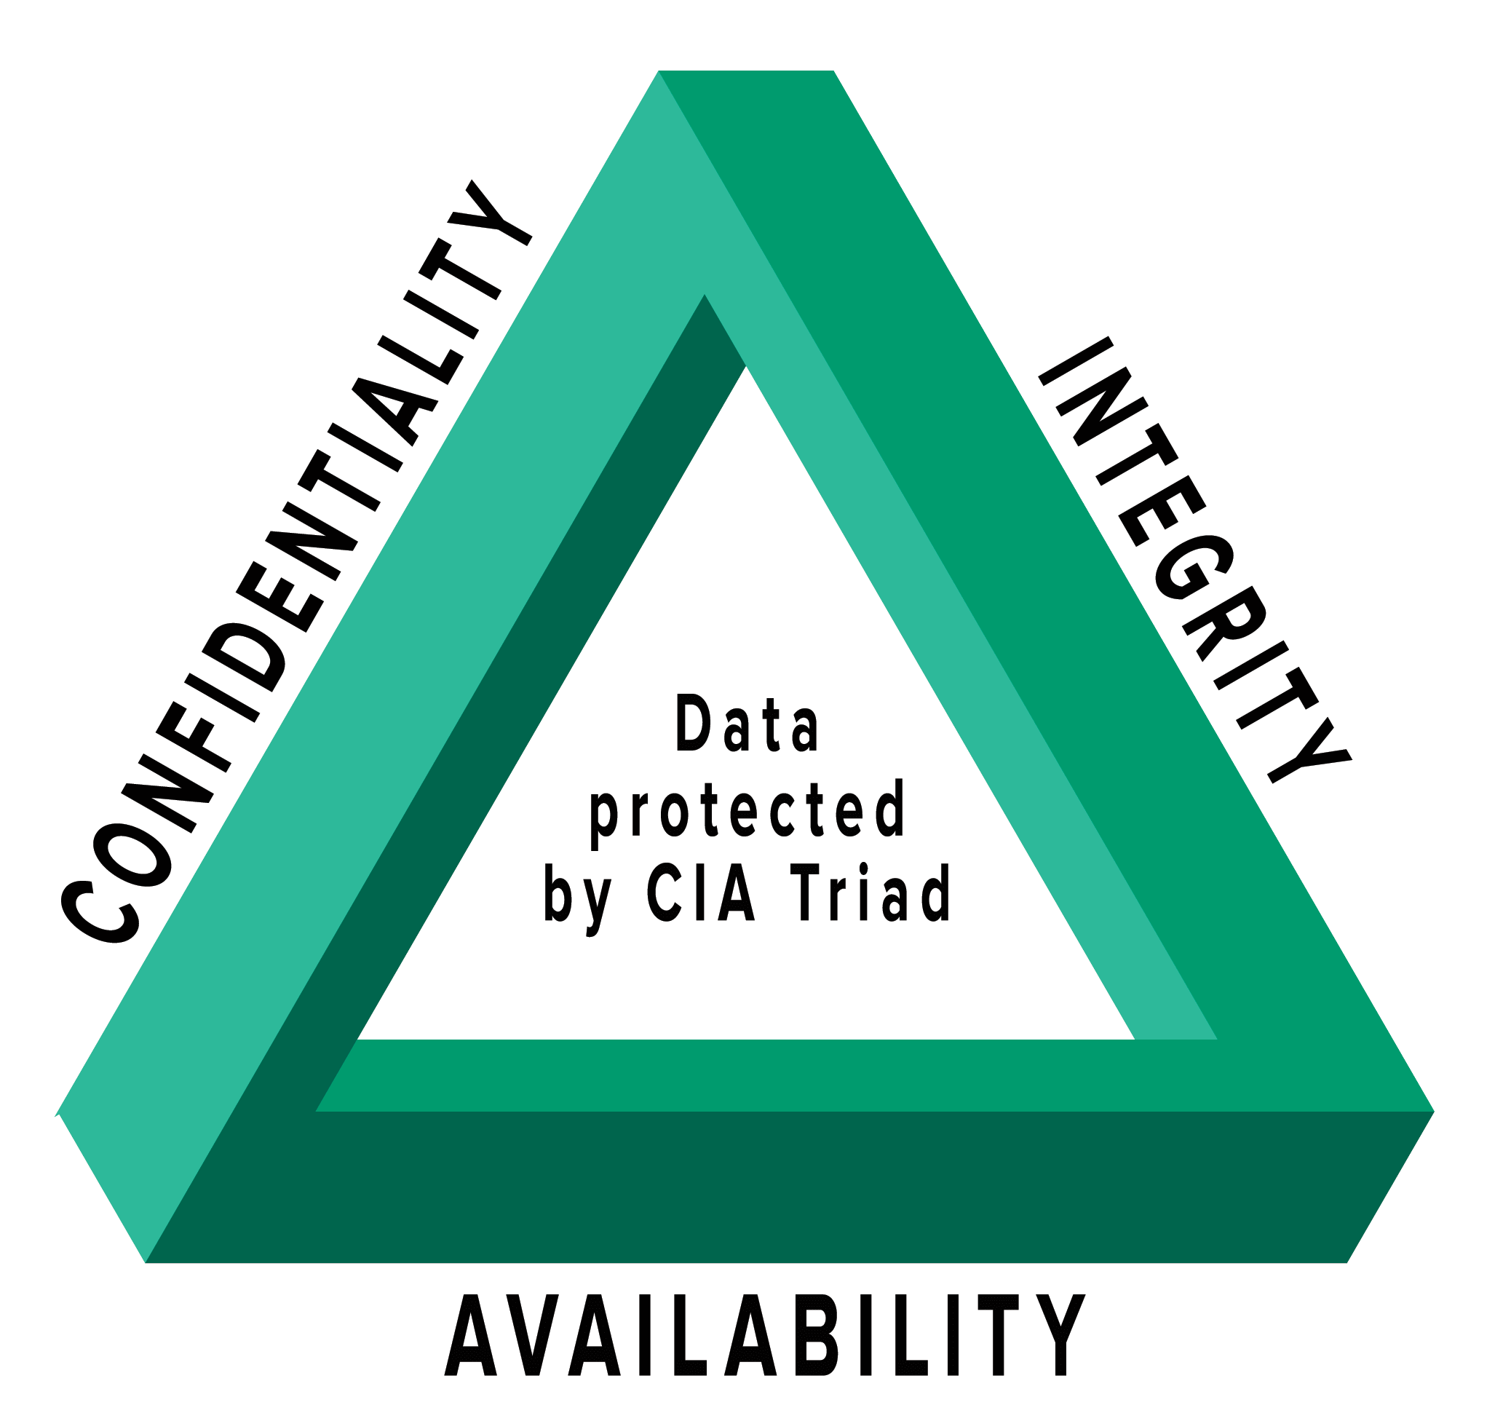
Securing the Maritime Domain: The CIA Triad
Confidentiality
What?
  Protecting sensitive maritime data from unauthorized access.
Why?
  Ensures operational plans, cargo details, and crew information remain secure.
How?
  Utilize encryption, access controls, and secure communication channels.

Slide 14
Securing the Maritime Domain: The CIA Triad
Integrity
What?
  Maintaining the accuracy and trustworthiness of maritime data.
Why?
  Accurate navigation, reliable communication, and verified cargo records are essential for safe maritime operations.
How?
  Implement data validation checks, regular audits, and secure data transmission protocols..

Slide 15
Securing the Maritime Domain: The CIA Triad
Availability
What?
  Ensuring timely access to maritime data and resources.
Why?
  Access to GPS, AIS, weather updates, and emergency channels is vital for operational efficiency and safety.
How?
  Maintain redundant systems, ensure network reliability, and conduct regular system maintenance.

Slide 16
Securing the Maritime Domain: The CIA Triad
Challenges & Solutions
Challenges: Facing threats like cyber-attacks, piracy, and environmental hazards.
Solutions: Adopt robust cybersecurity measures, continuous training for crew, and implement best practices in data management.
The CIA Triad is integral to the security and efficiency of maritime operations.
Commitment to these principles ensures a resilient maritime domain.

Slide 17
Cyber Risk Management
Identify
  The Identify Function assists in developing an organizational understanding of the managing of the cybersecurity risks to systems, people, assets, data, and capabilities.
Protect
  The Protect Function outlines appropriate safeguards to ensure the delivery of critical infrastructure services. The Protect Function supports the ability to limit or contain the impact of a potential cybersecurity event.
Detect
  The Detect Function defines the appropriate activities to identify the occurrence of a cybersecurity event. The Detect Function enables the timely discovery of cybersecurity events.
Respond
  The Respond Function includes appropriate activities to take action regarding a detected cybersecurity incident. The Respond Function supports the ability to contain the impact of a potential cybersecurity incident.
Recover
  The Recover Function identifies appropriate activities to maintain plans for resilience and to restore any capabilities or services that were impaired due to a cybersecurity incident. The Recover Function supports the timely recovery to normal operations, thus reducing the impact of a cybersecurity incident

Slide 18
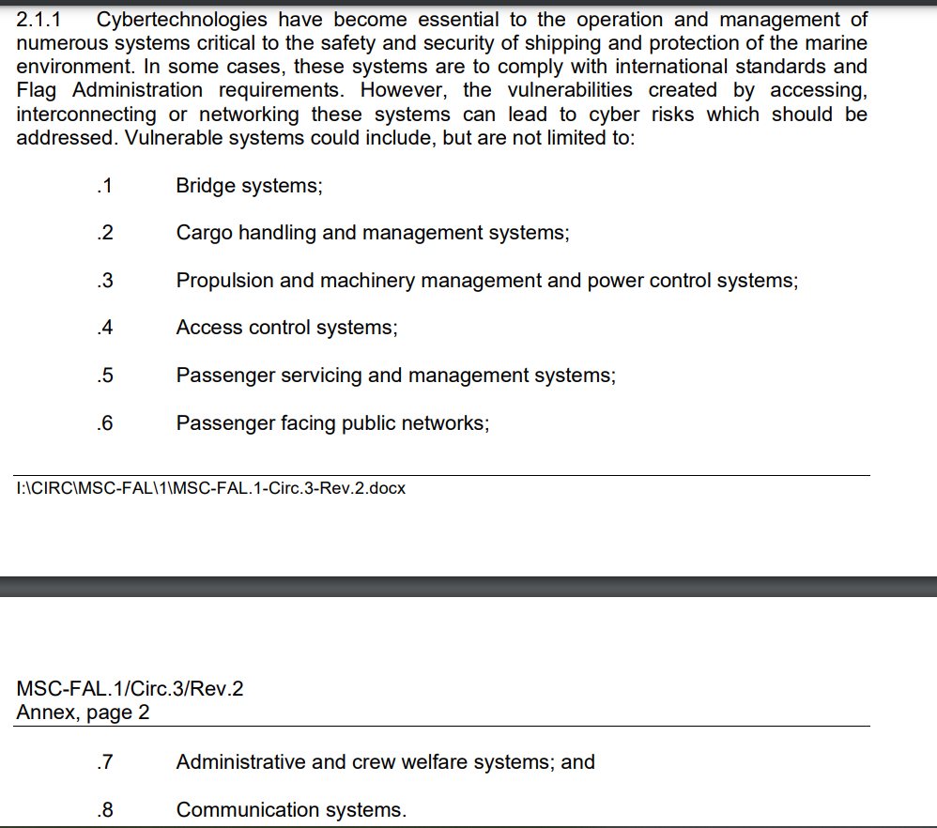
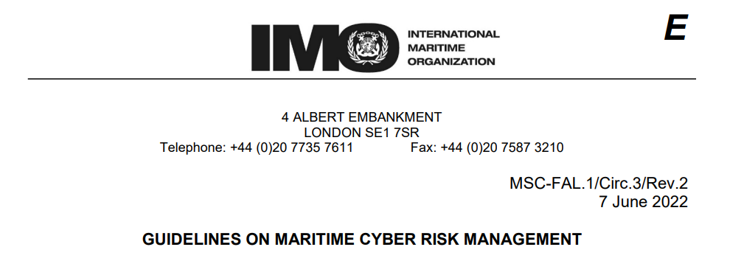

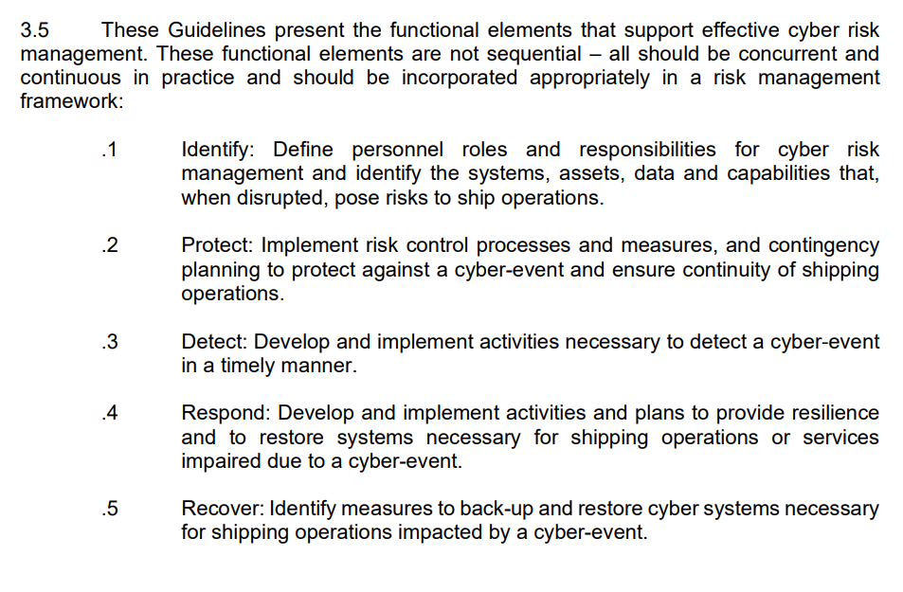
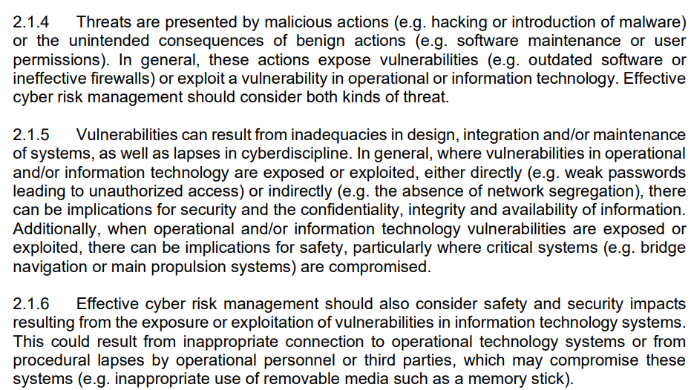
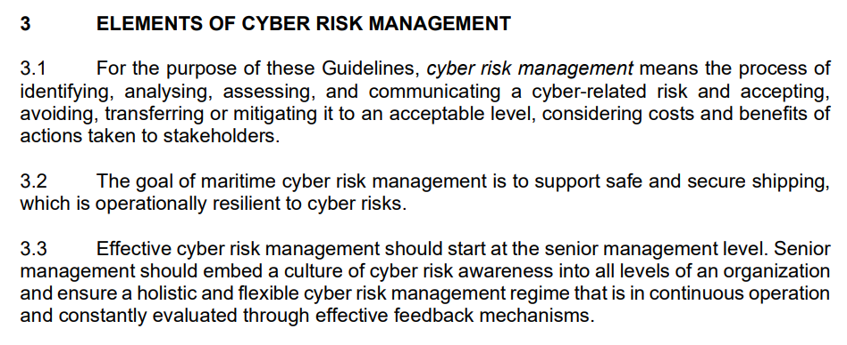
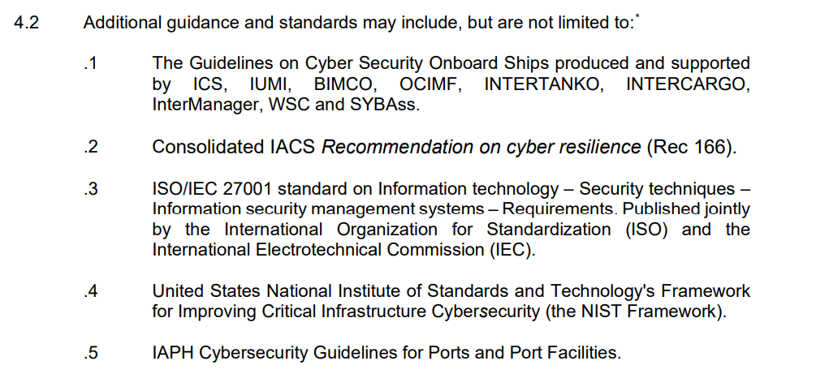
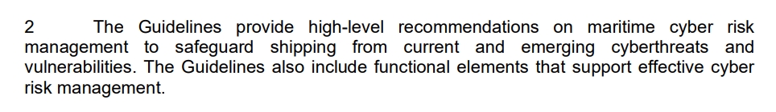

Slide 19







Slide 20
Maritime Cyber Risk Assessment (MaCRA) framework
Scope Definition: Clearly defining the boundaries of the cyber risk assessment to include all relevant aspects of maritime operations, from onboard systems of vessels to port infrastructure and associated supply chain networks.
Threat Identification: Systematically identifying potential cyber threats that could affect maritime operations, considering the unique characteristics of the maritime sector and emerging cyber threat landscapes. Includes vessels, port systems, and supply chain operations.
Vulnerability Analysis: Examining maritime systems and processes to identify vulnerabilities that could be exploited by cyber threats, including technical weaknesses, procedural gaps, and human factors. I.E. penetration testing and security audits to uncover weaknesses.
Impact Assessment: Evaluating the potential consequences of cyber incidents on maritime operations, focusing on aspects such as safety, security, environmental impact, and economic losses.
Risk Evaluation: Combining the insights from threat identification, vulnerability analysis, and impact assessment to evaluate the overall cyber risk, prioritizing risks based on their likelihood and potential impact.
Mitigation and Response Strategies: Developing and implementing strategies to mitigate identified risks to acceptable levels, including technical solutions, policy measures, and training programs. Also, formulating incident response plans to enhance resilience and recovery capabilities.
Review and Continuous Improvement: Recognizing the dynamic nature of cyber threats and the maritime environment, the MaCRA framework advocates for regular reviews and updates to the risk assessment and mitigation strategies, fostering a culture of continuous improvement and adaptation.
Notes:
he Maritime Cyber Risk Assessment (MaCRA) framework is a structured approach designed to identify, analyze, and manage cyber risks in the maritime sector. It aims to safeguard maritime operations, including shipping, port management, and supply chain logistics, against cyber threats and vulnerabilities. The framework emphasizes a comprehensive understanding of the maritime operational environment, the identification of potential cyber threats, the analysis of system vulnerabilities, and the assessment of the potential impact of cyber incidents on maritime safety, security, and environmental protection. The MaCRA framework serves as a comprehensive guide for maritime organizations to systematically manage cyber risks, ensuring the resilience and security of maritime operations in the face of evolving cyber threats. Its Key components are:

Slide 21
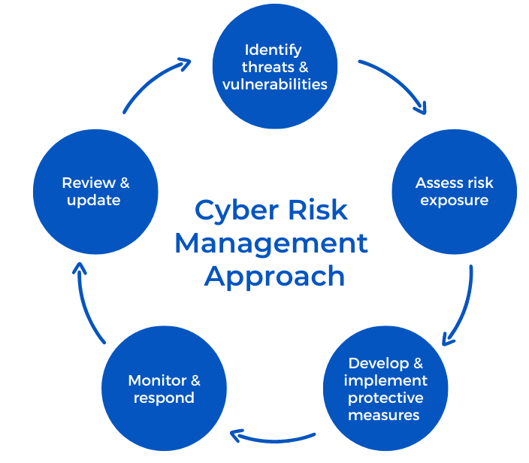
Who
Within the Organisation
  Policies and procedures
  Culture
  Individuals
External aspect
  3rd party

Slide 22




Slide 23
Supply Chain Risk
Disruptions from natural disasters: Hurricanes, earthquakes, and floods can disrupt supply chains by damaging infrastructure, disrupting transportation routes, and causing delays or disruptions in production.
Geopolitical risks: Political instability, trade wars, and sanctions can impact supply chains by causing delays or disruptions in the movement of goods or by creating uncertainty about future trade relationships.
Cybersecurity risks: Cyberattacks can compromise the security of supply chain data and disrupt operations by causing system failures or data breaches.
Supplier bankruptcy or financial instability: If a supplier goes bankrupt or experiences financial instability, it can disrupt the supply chain by causing delays or shortages of key components or materials.
Quality issues: Quality issues with materials or products can lead to delays or disruptions in production, as well as damage to a company's reputation.
Labor disputes: Labor disputes, including strikes or protests, can disrupt the supply chain by causing delays or shutdowns of production facilities or transportation routes.
Transportation disruptions: Port closures or port congestions, trucking strikes, or fuel shortages, can impact the movement of goods and cause delays or disruptions in the supply chain.

Slide 24


Slide 25
Supply Chain Attacks
Supply chain attacks are cyber attacks against third-party vendors in an organization’s supply chain. Historically, supply chain attacks were targeted at trust relationships, where insecure suppliers in the chain were attacked to gain access to their larger partners.
Software supply chains are highly susceptible to attack, because in modern development organizations, software is not created from scratch, and uses many off-the-shelf components such as third-party APIs, open source code, and proprietary code from software vendors. Any of these could be exposed to security threats and vulnerabilities.
A software supply chain attack might inject malicious code into an application and infect all users of the application, while a hardware supply chain attack compromises physical components and uses them to infiltrate an organization’s systems.
3rd party risk management

Slide 26
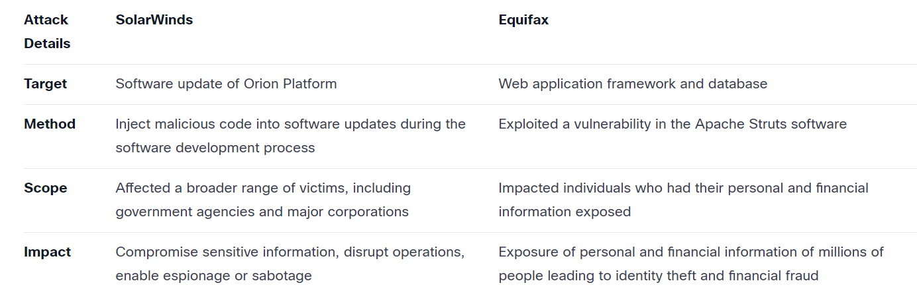
Examples
Notes:
1. SolarWinds
In December 2020, the network management software company SolarWinds got hacked, resulting in a widespread breach of multiple government agencies and private companies. A total of 18,000 customers and businesses were impacted. The attack was traced back to a malicious software update added to SolarWinds’ Orion software, demonstrating the importance of secure software updates in the supply chain.
2. Equifax
In 2017, Equifax's credit reporting company suffered a massive data breach that affected 147 million customers. The breach was later attributed to a vulnerability in Equifax’s website software caused by a failure to patch a known security issue. This case highlights the importance of proper patch management in the software supply chain.
The method, scope, and impact of the SolarWinds attack
The SolarWinds supply chain attack in 2020 occurred due to a sophisticated hacking operation that injected malicious code into SolarWinds' software development process, specifically the Orion software updates. The attackers could infiltrate SolarWinds' build systems and insert malware, which spread among customers as part of legitimate software updates.
Due to the malicious code inserted during the build process of the software update, even though it was delivered to customers via secure signing and verification checks, since the malicious
injection occurred early in the chain, signing and validating software downloads couldn't catch it either.
It was one of the most massive supply chain attacks that started in 2018, and it took almost 15 months to discover the breach. The attack allowed the attackers to access sensitive data and systems of numerous organizations that used SolarWinds' Orion platform.
The method, scope, and impact of the Equifax breach
Attackers could exploit this vulnerability because Equifax had failed to patch the affected software, even though a patch had been available for several months before the breach occurred. The attackers could then move laterally through Equifax's network and exfiltrate sensitive data belonging to approximately 147 million individuals. As a result, the primary cause of Equifax's supply chain breach was inadequately managing the security of third-party software components combined with a failure to apply critical security patches promptly.
Diversity in supply chain attacks
Though similar, the SolarWinds and Equifax supply chain attacks are different in several ways. Just by contrasting these two, we can be mindful of the diversity in attack patterns.

Slide 27
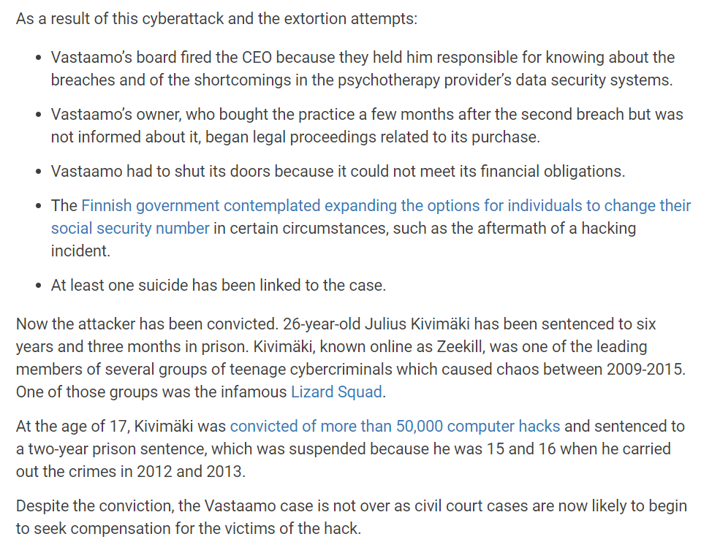
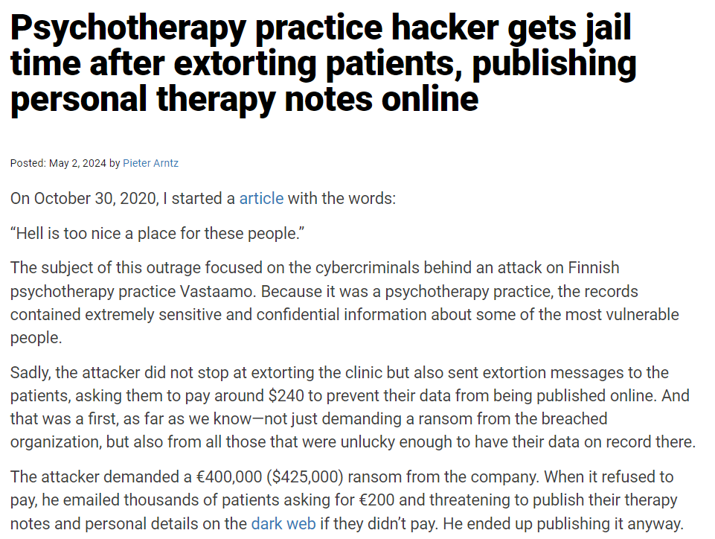
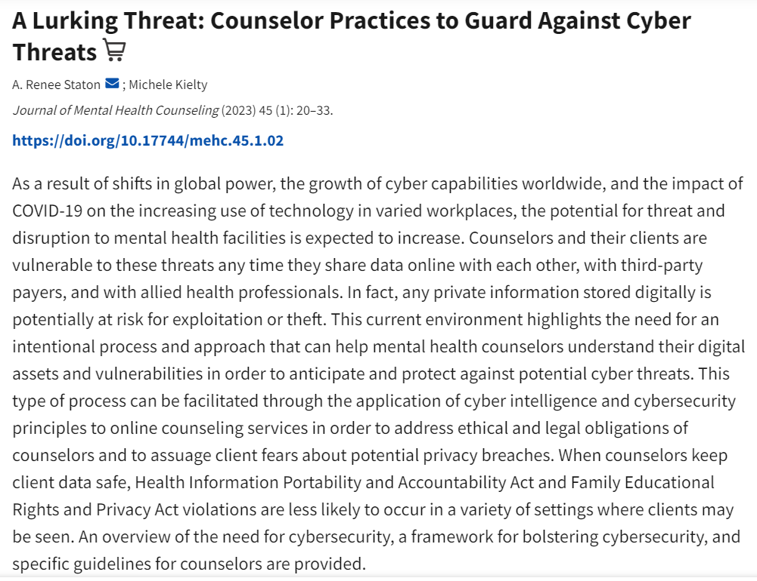

Slide 28
Step 1: Recognize, Map, and Prioritize the Supply Chain Threat Landscape
Assess all possible risks. I
  understanding the supply chain
  key components by inventorying suppliers and assessing their security posture.
  Group vendors into risk profiles
  Prioritize each third party by their vulnerability level, access to your data and systems, and impact on your organization
  Use questionnaires and on-site visits to assess supply chain security
  Identify the weakest areas in the supply chain and supplement these vendors or ask them to improve their security
  Assess the safety of hardware and software products supplied to your organization
  Identify the processes in the supply chain that pose a threat to sensitive data and systems and determine suitable security measures

Slide 29
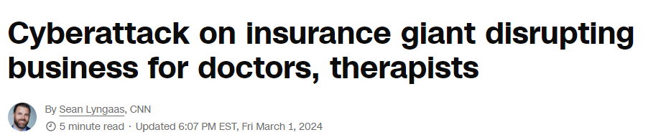
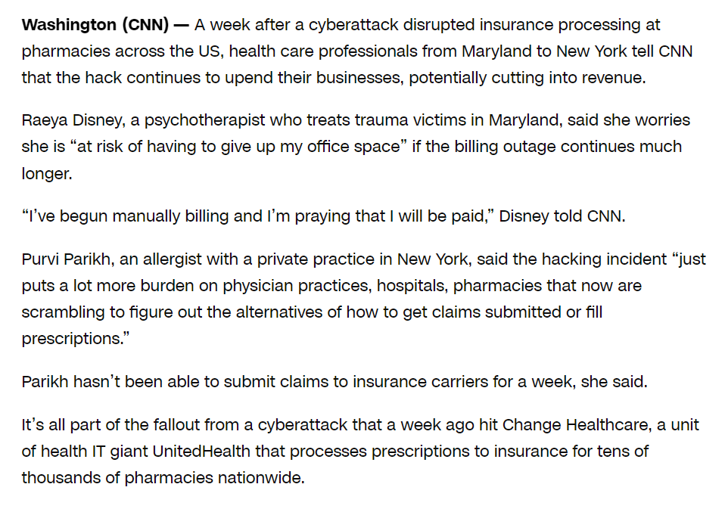
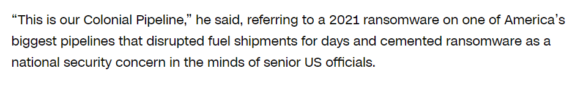

Slide 30

My Supply Chain
Cloud Services
My Pc
Insurance

Slide 31
Step 2: Create a Multifaceted Supply Chain Security Strategy
Supply chain attacks can have various objectives, including ransom, sabotage, and intellectual property theft. These attacks can take many forms, such as malicious code injections into legitimate software, hijacking software updates, and attacks on IT and operational technologies.
Supply chain attacks can exploit vulnerabilities in:
  The physical flow of assets — Including processing, packaging, and distribution processes.
  The virtual flow of data or software — All virtual flows across connected systems and devices.

Slide 32
Step 3: Manage Remote Work Endpoint Risk
Organizations are exposed to risks caused by the unauthorized behaviours of their supplier’s employees.
Common risks include device loss or theft, employees downloading sensitive data without offline protections, or introducing shadow IT applications, keyloggers, files, and various persistent threats.
Traditional security tools, like virtual private networks (VPNs) and virtual desktop infrastructure (VDI), cannot effectively protect organizations and mitigate these threats. These tools rely on end-users to follow security policies before and after they connect to secured networks. Organizations and supply chain leaders must monitor how remote employees use their devices to protect the supply chain.

Slide 33
Step 4: Continuously Monitor Third-Party Risks
Identify the most valuable corporate assets, so that an effective program can prioritize what needs to be defended.
  Proprietary information, customer information, and intellectual property,
Pinpointing attack motivations and sensitive assets can help determine:
  Systems and areas of the supply chain that require protection and how to prioritize cybersecurity investments.
Continuous supply chain protection should help uncover evidence of activity already occurring, gain deep visibility, and identify gaps in the organization’s ability to detect these activities
Notes:
Pt“2: You can implement various measures, including threat hunting, centralized log aggregation, and sensor deployment.

Slide 34
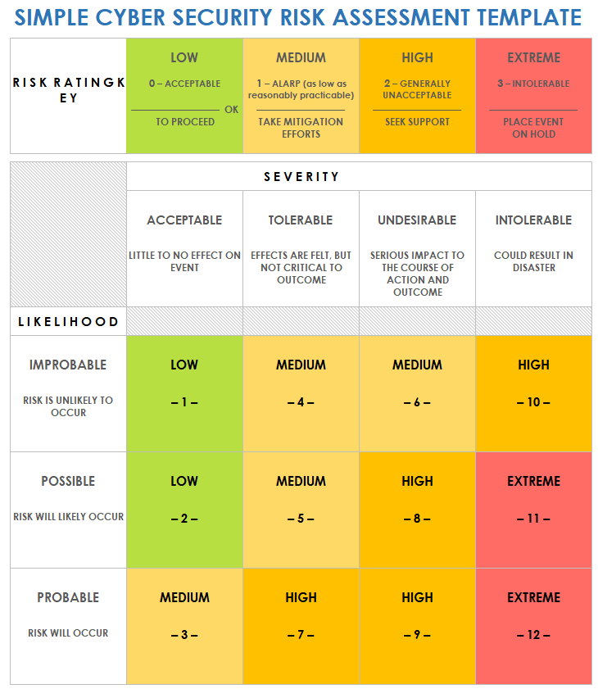
Risk Evaluation

Slide 35
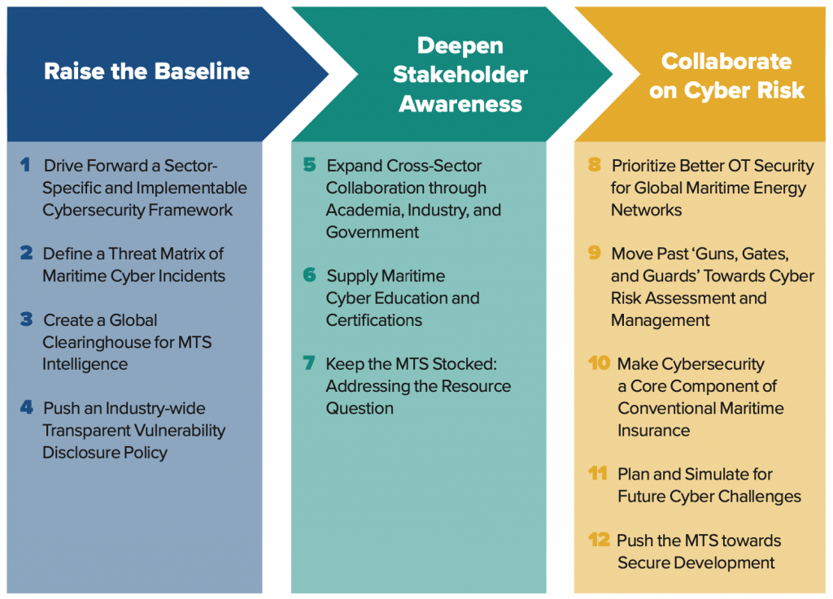
Mitigation Strategies for MTS
Notes:
maturity and effectiveness of contemporary approaches to cybersecurity in the =”Maritime transportation sector”

Slide 36
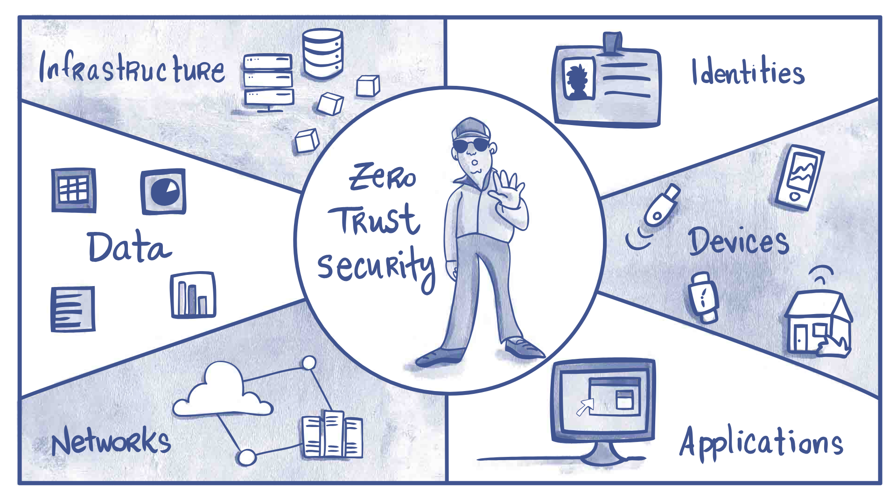
Best Practices
Businesses take a multipronged approach to risk mitigation, and sound practices can significantly reduce anxiety about security threats.
Cybersecurity training programs, along with up-to-date software
Privileged access management solutions, multi-factor authentication, and dynamic data backup are all essential components of an effective strategy
Zero-trust (architecture)

Slide 37
So
People as part of supply chain
Within the organisation
Outside the organisation

Slide 38
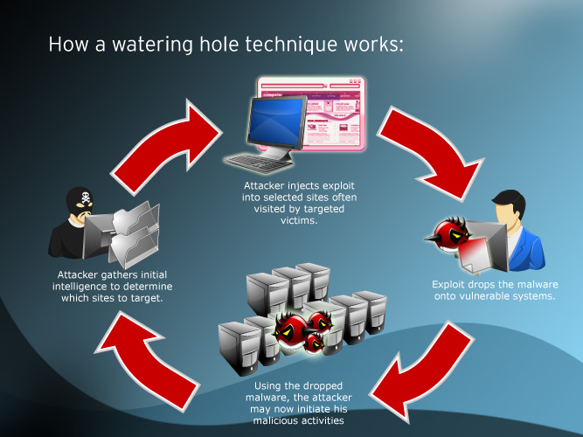
Personal risk analysis
On scale of 1-100 what is your perceived vulnerability to social engineering?
How severe will it be for you?
Tailgating?
Watering hole?

Slide 39
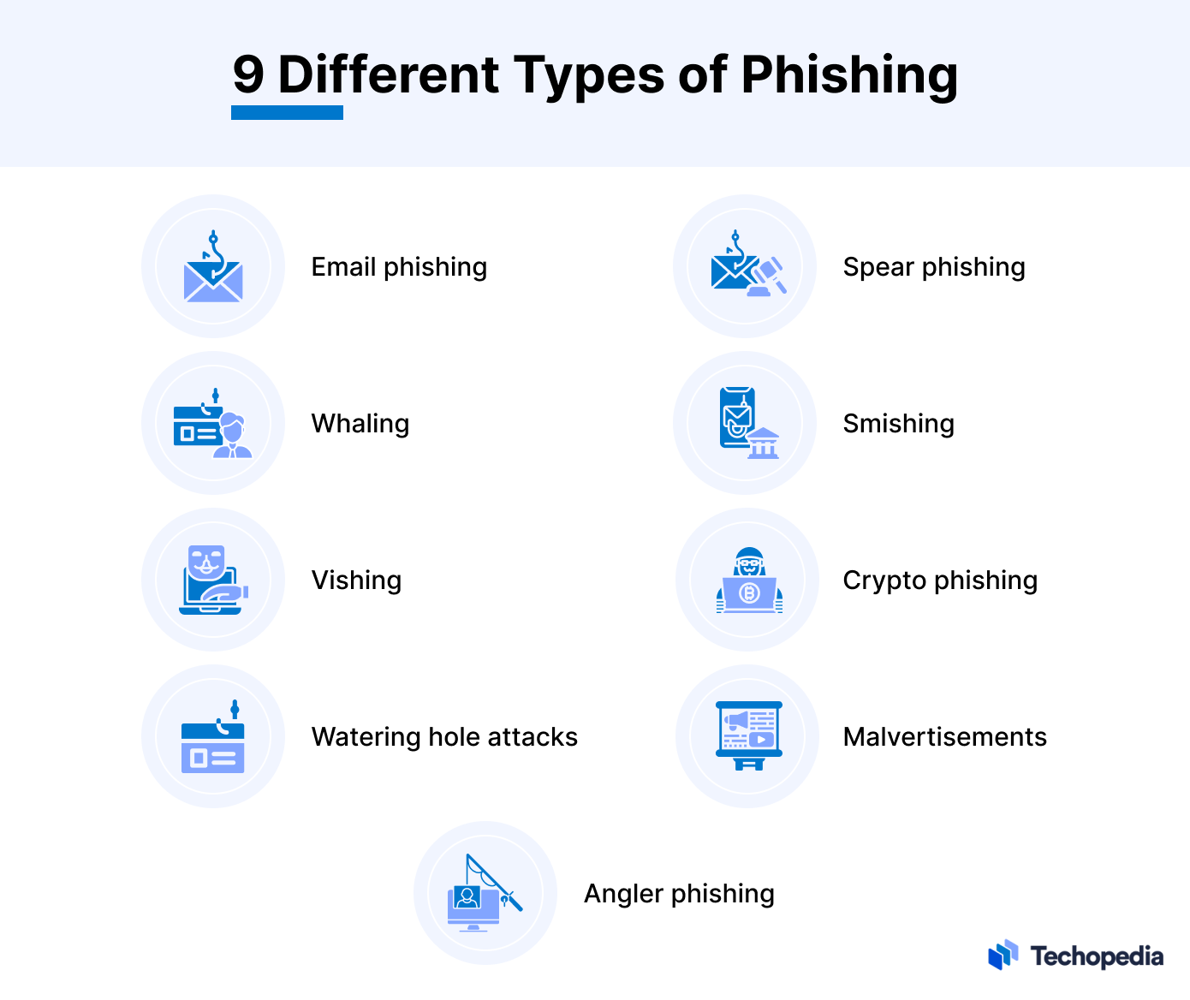
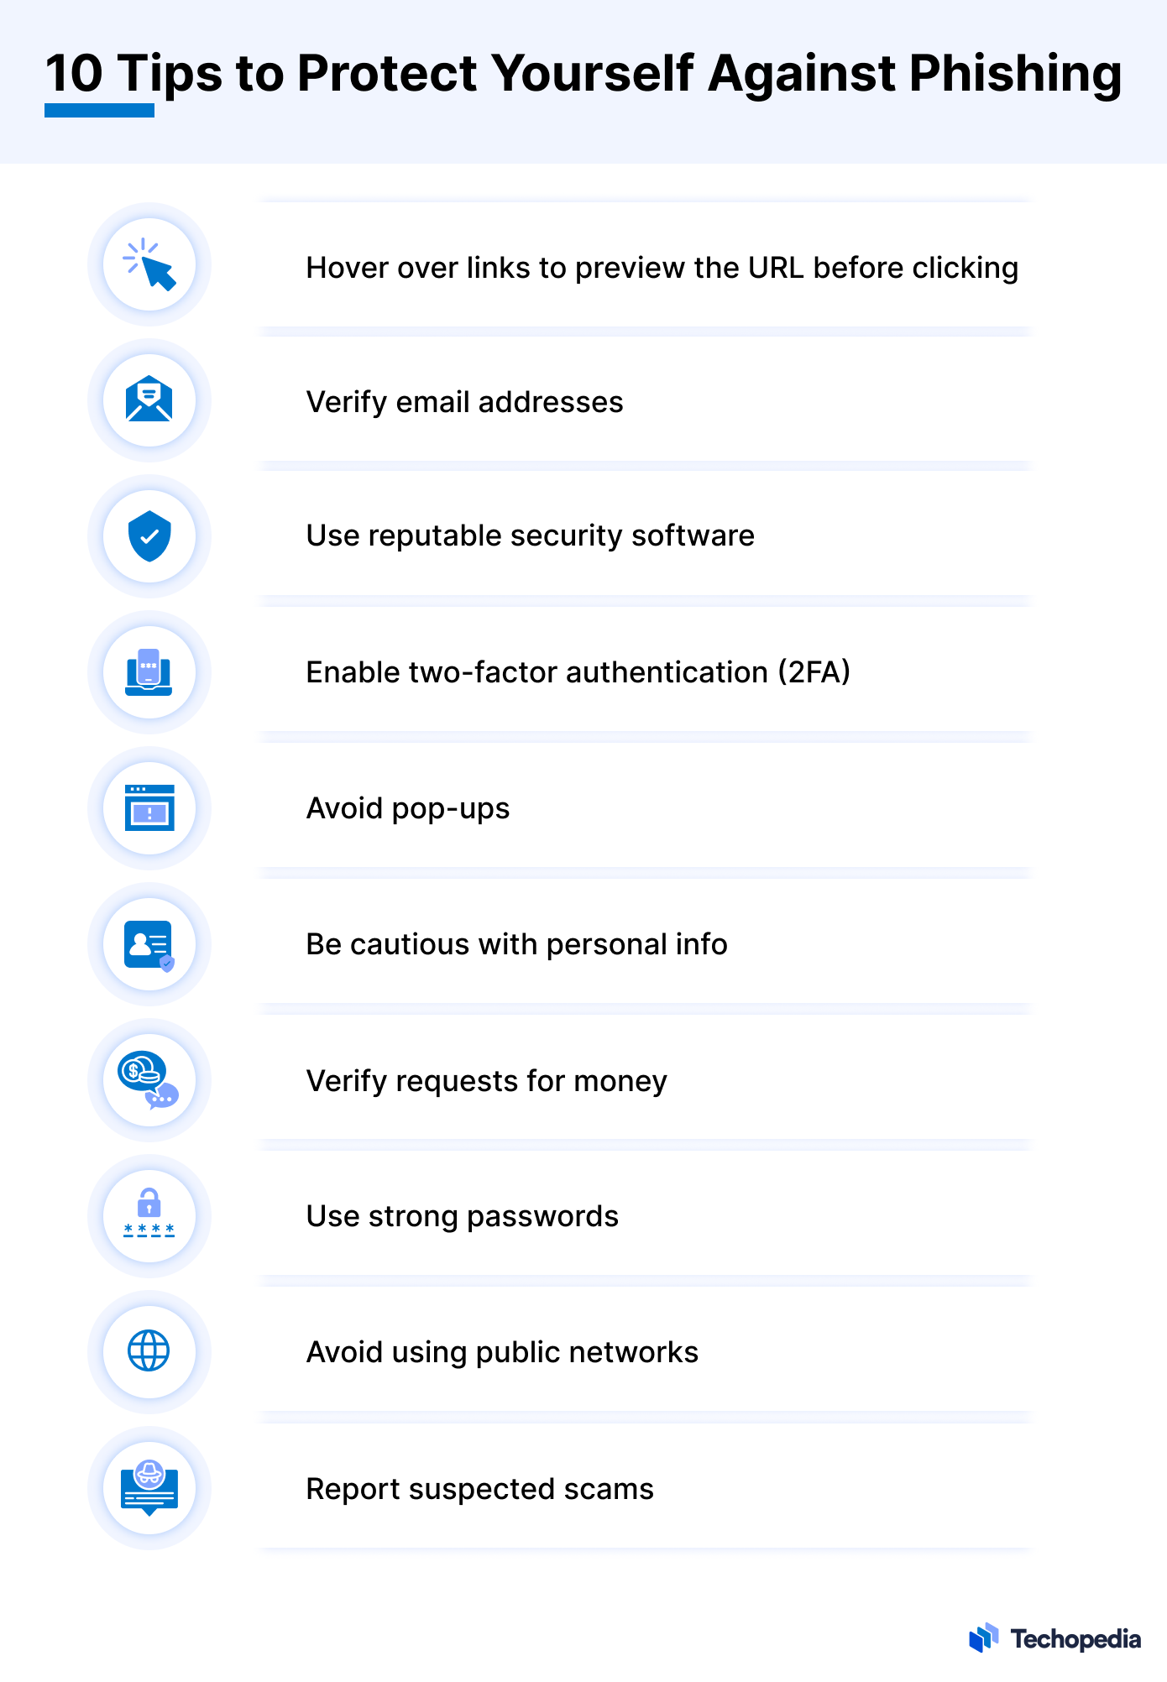
Notes:
Email Phishing: Most common phishing type, where attackers send emails mimicking legitimate sources like banks or government agencies, containing links to fake websites to steal information.Generative AI in Phishing: AI technologies enable phishers to create more convincing emails that appear legitimate, increasing the success rate of scams.Examples of Email Phishing Scams:Invoice Scam: Emails from fake companies about unpaid invoices, leading to fake payment sites.
Password Reset Scam: Emails from fake companies for password resets, leading to fake sites to capture new passwords.
Tech Support Scam: Emails from fake tech support asking to call a number, leading to remote access scams.
Spear Phishing: Targeted attacks using personalized emails based on the victim's interests or work, making the scam more believable.Whaling: A form of spear phishing targeting high-profile executives with the aim of financial loss or data breach.Smishing: Phishing through SMS, sending text messages with links to fake websites to steal personal information.Vishing: Phone call scams impersonating legitimate companies to extract personal information or money.Crypto Phishing: Targeting cryptocurrency users with fake alerts or giveaways to steal login credentials or funds.
Watering Hole Attacks: Compromising websites frequented by a target group to infect their devices or steal credentials.
Malvertisements: Using malicious ads on legitimate sites to redirect users to phishing or malware-infected pages.
Angler Phishing: Using social media to impersonate customer service accounts or offer fake giveaways to direct victims to phishing sites.
Psychological Strategies in Phishing: Exploiting human psychology, such as urgency, fear, curiosity, and authority, to prompt victims into taking desired actions.Technical Techniques in Phishing: Utilizing email spoofing, link manipulation, domain spoofing, and other technical means to make phishing attacks more effective.
Preventing Phishing Attacks: Involves being cautious with email attachments and links, validating URLs, using strong passwords and two-factor authentication, and staying updated with security tools.Psychological Strategies Used in Phishing
Phishing strategies for getting a victim to carry out a specific action on behalf of the attacker often exploit human psychology. By masquerading as trusted entities, creating a sense of urgency, or appealing to victims’ desire to help or be part of a group, an attacker can prompt impulsive responses.
While technical tactics such as email spoofing, domain mimicry, or malware delivery are critical components, it’s the psychological manipulation that often determines success. Ironically, most of the strategies that phishers use are well-known marketing techniques.
Psychological strategies used to carry out successful attacks include:
Creating a Sense of Urgency: Phishers often design their communication to have a sense of urgency. People tend to prioritize urgent matters and are more likely to act impulsively when they perceive a time-sensitive threat.
Inspiring Fear: The attacker’s communication will claim the victim’s account will be suspended, or legal action will be taken unless they act immediately. Fearful individuals are more likely to react impulsively.
Inspiring Curiosity: The attacker’s communication is designed to pique the victim’s curiosity by providing incorrect information or tantalizing details that will prompt them to click on a link or open an attachment to learn more.
Appealing to Authority: The phisher’s communication seems to be from an authority figure like a CEO, IT administrator, or government official.
Appealing to Familiarity: The attacker uses the victim’s trust in a known brand, organization, or individual to create a false sense of security.
Creating a Sense of Scarcity: The attacker creates the perception of exclusivity or limited availability to motivate victims to take action quickly.
Inspiring Guilt: The attacker’s communication is designed to make the victim feel guilty or ashamed for not complying with a request by claiming the communication is not the first one sent.
Using Social Proofs: The attacker provides fake testimonials, endorsements, or references to make the request appear trustworthy and socially validated.
Encouraging Reciprocity: The attacker offers something of perceived value to the victim (such as a discount or freebie) in exchange for their taking a desired action.
Appealing to the Past: The attacker’s communication contains a request that is consistent with a prior action the victim is familiar with.
Appealing to Friendship: The attacker’s communication closely mimics the writing style of a colleague or friend in order to lower the victim’s guard.
Inspiring Sympathy: The attacker’s communication is designed to tap into the victim’s sense of sympathy and desire to help the attacker out of a jam.
Using FOMO (Fear of Missing Out): The attacker’s communication exploits the victim’s fear of missing out on an opportunity or event. Typically, the scammer will claim that immediate action is required to participate.
Appealing to Ingroup Biases: The attacker’s communication is designed to inspire a sense of belonging to a social group or “ingroup” the victim is familiar with. The phisher will craft phishing emails or messages that appear to come from sources that share a common identity or characteristic with the target.
Technical Techniques Used in Phishing
The psychological strategies above, when combined with the technical tactics below, are what make phishing attacks so highly effective. When recipients act on psychological triggers, they often fall victim to the technical traps concealed within phishing emails, vishing phone calls, and SMS text messages. (Editor’s Note: Attackers who lack the technical skills necessary to carry out an attack can purchase phishing kits on the dark web.)
Technical tactics commonly used in phishing attacks include:
Email Spoofing: The attacker manipulates email headers so they appear to be from a trusted source. Email spoofing is facilitated by weaknesses in the standard protocol for sending emails, Simple Mail Transfer Protocol (SMTP). SMTP does not require email senders to verify the accuracy of the “From” address they provide, which makes it relatively easy for attackers to forge this information.
Link Manipulation: The attacker uses bogus links in emails to direct victims to malicious websites. Attackers often embed bogus URLs with legitimate subdomains to bypass URL filters.
Domain Spoofing: The attacker purchases domain names that appear to be legitimate because they closely resemble legitimate and well-known domain names.
Subdomain Takeover: The attacker identifies an organization’s vulnerable subdomains and takes control of them to host phishing sites.
Attachment-Based Attacks: The attacker sends phishing emails with attachments that contain macros or scripts that execute malicious code. The emails typically employ social engineering tactics designed to convince the recipient to enable the macro instructions or malicious scripts within the attachment.
Malicious Redirects: The attacker uses hidden iframes or JavaScript to redirect victims from legitimate sites to phishing pages.
Drive-By Downloads: The attacker exploits vulnerabilities in a victim’s browser or software to download and install malware without the victim’s knowledge.
Obfuscation Techniques: The attacker employs encoding or obfuscation techniques to hide malicious code within emails or websites.
Dynamic Content Loading: The attacker uses a web service or JavaScript framework, such as React or Angular, to create dynamic content that is not embedded in the website’s code. Dynamic content generated on the fly can’t be detected detection by static analysis.
JavaScript-Based Attacks: The attacker inserts malicious JavaScript code in emails or on compromised websites to deliver malware that enables a ransomware attack.
Man-in-the-Middle (MitM) Attacks: The attacker intercepts communication between the victim and a legitimate website to capture sensitive data.
Data Exfiltration: The attacker sends data stolen from victims’ devices to a server the attacker controls, so the information can be used later on.
Credential Harvesting: The attacker creates fake login pages for popular services to capture usernames, passwords, and other credentials.
Session Hijacking: The attacker steals active session cookies or tokens to impersonate a user and gain unauthorized access to their accounts.
Tabnabbing: The attacker exploits the user’s trust in browser tabs by replacing inactive tabs with phishing pages.
Homograph Attacks: The attacker uses Unicode characters that look similar to Latin characters in domain names to deceive victims.
Content Spoofing: The attacker manipulates web content on a compromised website to trick visitors into engaging in actions that benefit the attacker.
Email Forwarding: The attacker sets up email filters (rules) in compromised email accounts that will automatically forward sensitive messages that contain account information to the attacker.
DNS Spoofing: The attacker manipulates DNS records to redirect users to fake websites when they enter legitimate URLs.
Cross-Site Scripting (XSS): The attacker injects a malicious script into a web page’s code that will execute an action on behalf of the attacker. XSS can be used to steal session cookies, which may contain login credentials or other sensitive information that allows the attacker to impersonate the victim.
Brand Impersonation: The attacker solicits sensitive information from the victim by leveraging the trust they have in a particular brand name.
SQL Injection: The attacker enters specially crafted SQL code into a website’s input fields to gain unauthorized access to databases the website uses. While SQL injection is more commonly associated with data breaches and web application attacks, it can be employed in phishing attacks to gather information or deliver malicious payloads.
How to Prevent Phishing Attacks
With the sensitive information obtained from a successful phishing scam, criminals can do damage to their victims’ financial histories, personal reputations, and professional reputations that can take years to unravel. The combination of psychological and technical elements in phishing attacks amplifies their effectiveness and underscores the importance of cybersecurity education and robust defenses to counter these threats.
The following security precautions are recommended to prevent phishing attacks from being successful:
Never open email attachments that are not expected;
Never click on email links that request personal information;
Validate a URL before clicking on it by hovering the mouse cursor over the link to display the actual URL it leads to. The URLs should match;
Never click on links that begin with HTTP instead of HTTPS;
Be suspicious of all phone calls requesting personally identifiable information (PII) or the transfers of funds from one account to another;
Don’t answer cell phone calls from unknown numbers;
If someone calls claiming to be from a government agency or a legitimate company, hang up and call the number on the official website of that agency or company;
Never give out credit card numbers over the phone;
Always allow updates for web browsers, operating systems, and software applications running locally on internet-accessible devices;
Use updated computer security tools, such as anti-virus software and next-gen firewalls;
Verify a website’s phone number before placing any calls to the phone number provided in an email;
Use strong passwords and two-factor authentication (2FA) for all online accounts;
Report suspected scams to the company the phisher is impersonating, as well as government authorities such as the Federal Trade Commission (FTC).

Slide 40
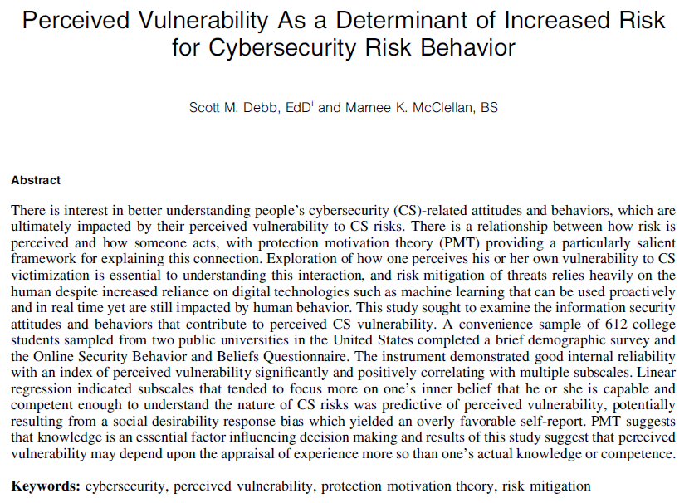
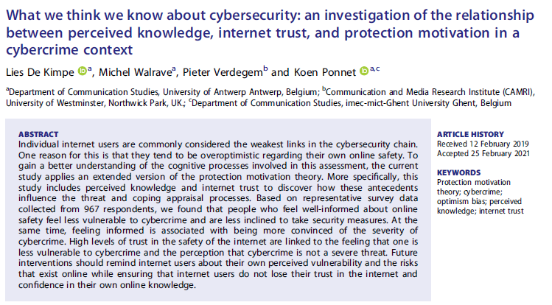

Slide 41



Slide 42
My Supply Chain
Cloud Services
My Pc
Insurance

Slide 43
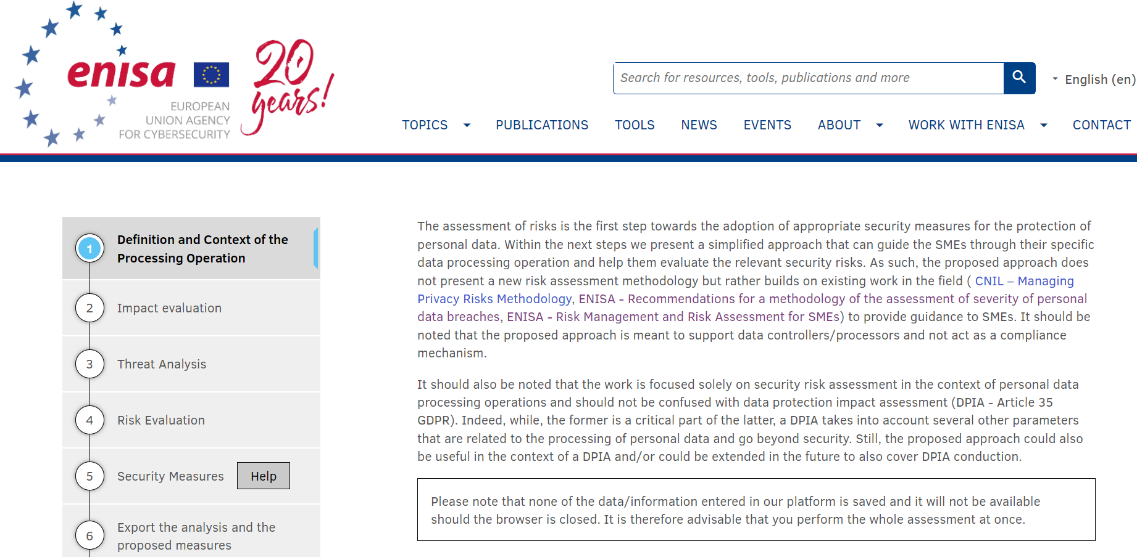
ENISA Tool
https://www.enisa.europa.eu/risk-level-tool/risk

Slide 44
Section V
Security policy and procedures for the protection of personal data
Roles and responsibilities
Access control policy
Resource/asset management
Change management
Data processors
Incidents handling / Personal data breaches
Business continuity
Confidentiality of personnel
Training
Access control and authentication
Training
Access control and authentication
Logging and monitoring
Server database security
Workstation security
Network/communication security
Back-ups
Application lifecycle security
Data deletion/disposal
Physical security

Slide 45
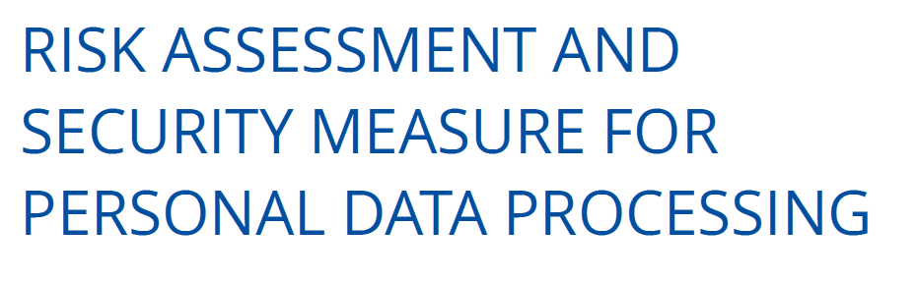
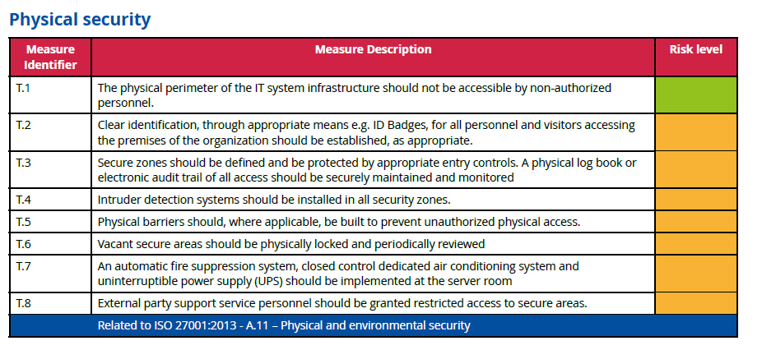
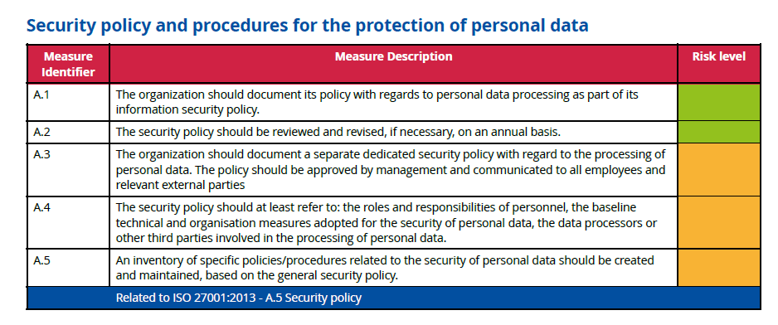
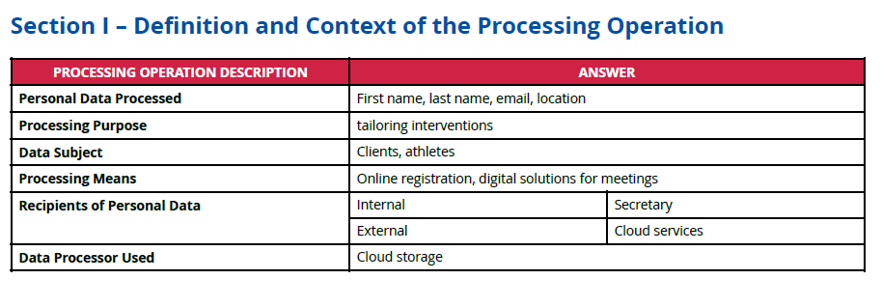
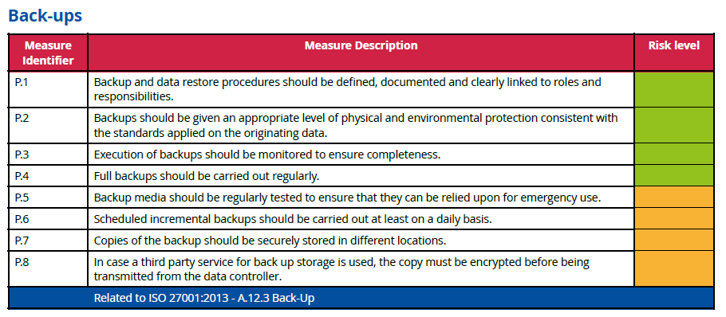
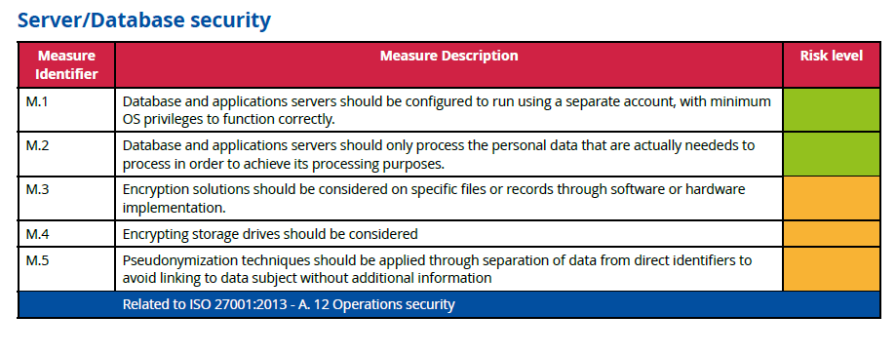
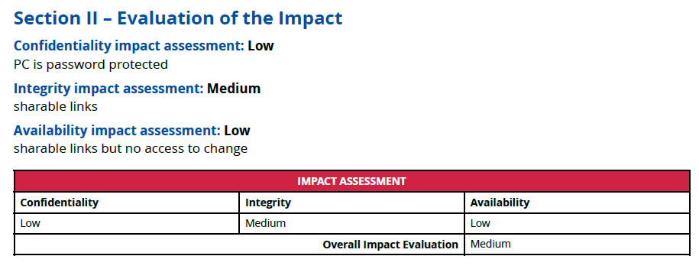
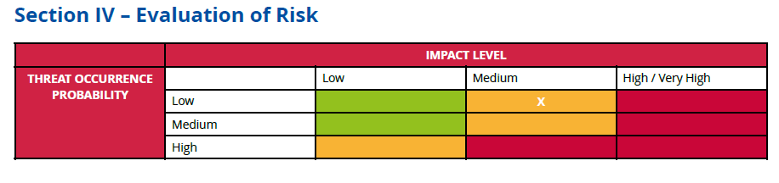

Slide 46
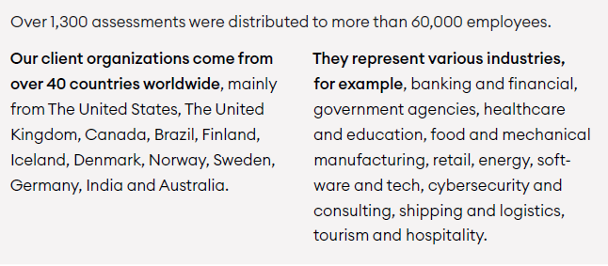
Awarego 2023

Slide 47







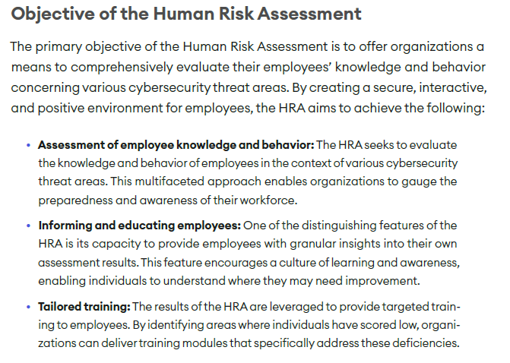
Are we vulnerable (AwareGo 2023)

Slide 48


Awarego 2023

Slide 49
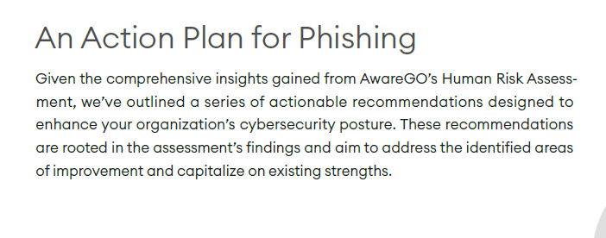
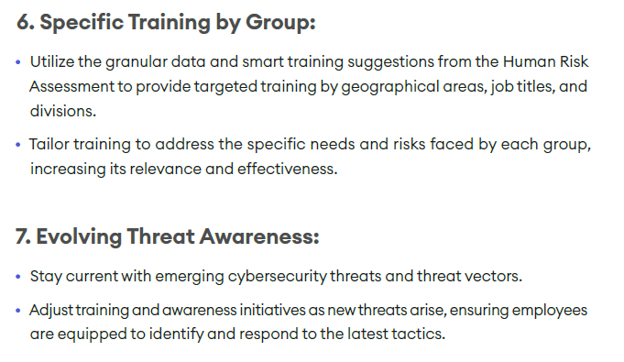
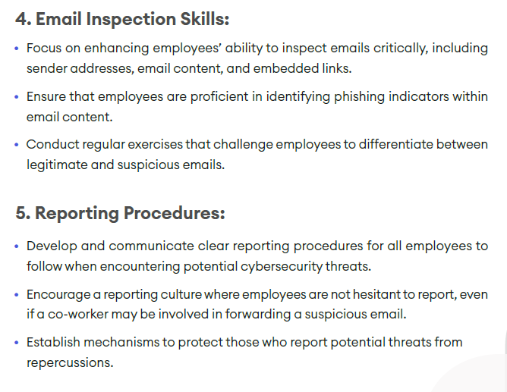
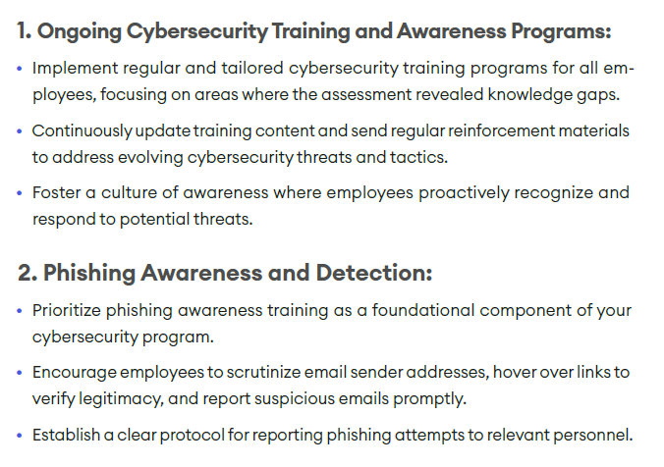
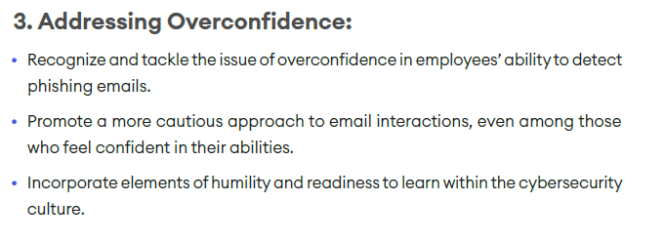
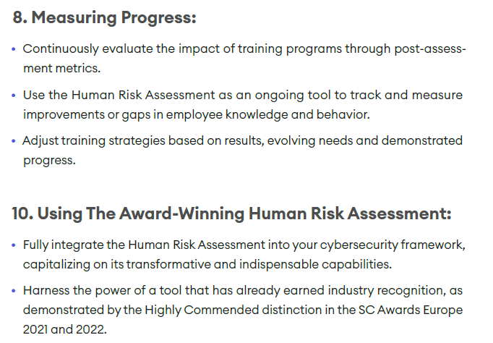

Slide 50
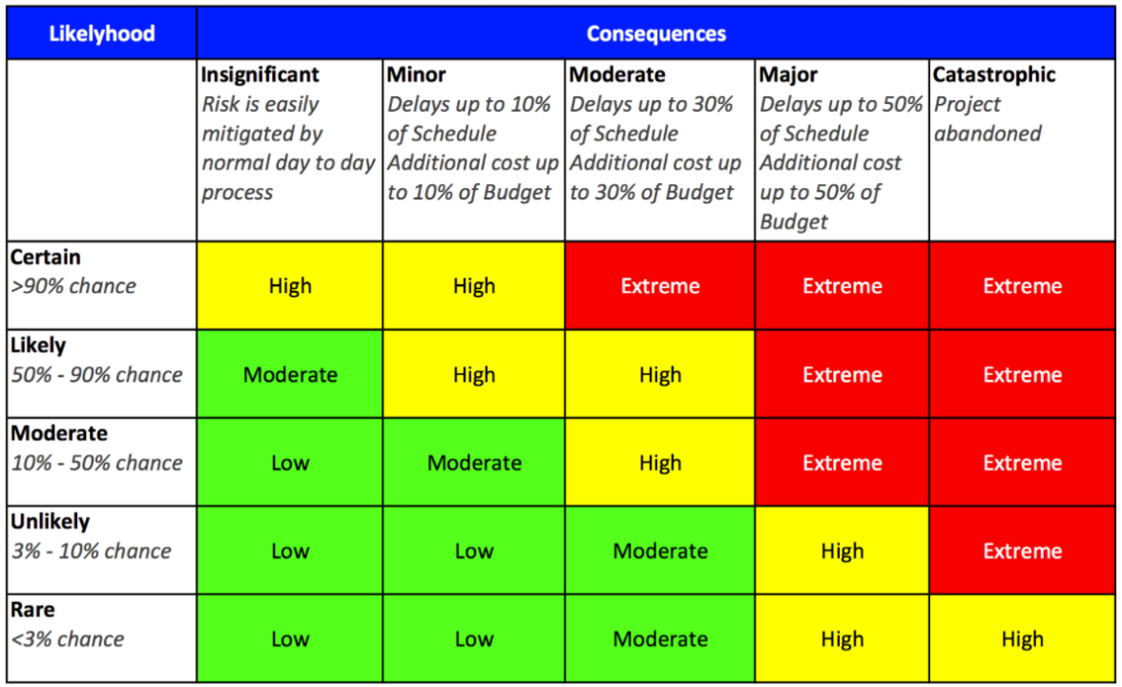

Slide 51


Slide 52

Levels
Cyber incident and responses within an organisation at the individual, social and organisational levels
Joinson, A.N., & van Steen, T. (2018). Human Aspects of Cyber Security: Behaviour or Culture Change? Cyber Security, 1(4), 351-360.

Slide 53

NIS-2

Slide 54
Cyber Crisis
A significant cybersecurity event that disrupts the normal operations of digital systems, leading to widespread impact on individuals, organizations, and society. - ENISA
Individual level
a cyber crisis can lead to loss of personal data, identity theft, financial loss, and a significant breach of privacy. Individuals may find their personal information compromised, leading to long-term repercussions on their financial and personal life
Organizational level,
cyber crisis can result in operational disruptions, financial losses, legal liabilities, and damage to the organization's reputation. Businesses and governmental organizations may face challenges in recovering from such crises, impacting their sustainability and the broader economy.
Societal level
cyber crisis can undermine public trust in digital infrastructures and institutions. It can disrupt essential services, such as healthcare, public utilities, and government services, affecting the daily lives of citizens and the functioning of society

Slide 55
Who
Within the Organisation
  Policies and procedures
  Individuals
  Culture
Between Sectors

Slide 56


https://enisa.europa.eu/sites/default/files/publications/Incident_Management_guide.pdf

Slide 57



Notes:
The mandatory roles are
:● Duty officerA duty officer has to take care of all in-coming requests as well as carry out periodic or ad hoc activities dedicated tothis role.
● Triage officerThe triage officer has to deal with all incidents that are reported to or by the team. He needs to decide whether it is an incident that is to be handled by the team, when to handle it and who is going to be the incident handler according tothe triage process18.He needs to be up to date with all the latest trends, attack vectors and methods used by miscreants. In many cases theduty officers are also the triage officers.
● Incident handlerThe incident handler is a crucial role in the incident handling team. He deals with the incidents – analysing data, creating workarounds, resolving the incident and communicating clearly about the progress he has made to his incident managerand to and with the appropriate constituent(s).
● Incident managerThe incident manager is responsible for the coordination of all ncident handling activities. He represents the incident handling team outside his team.
Public relations officerThe main task for the public relations (PR) officer is to represent the team in front of the press and give advice to teammembers in any situation that could have PR consequences. The PR officer is especially important if you are agovernmental or national CERT or a CERT representing a company with a high media profile. If you do not or cannot havea PR officer within your team, use company resources and assign this role to the incident or team manager. Always keepyour PR officer well informed, but be cautious and clearly communicate which part of the information shared is forinternal use only, so that it does not get disclosed accidentally.One of the most important tasks for a PR officer is to develop a crisis communication strategy. You have to be preparedfor the worst in case an incident leads to difficult questions about your response or the impact on your constituents. APR officer should also provide media training for your team members.
Legal officerThe legal officer ideally takes care of special situations arising from incidents and the team’s internal processes in termsof their compliance with the law. Your legal officer can be of great help to you, as he or she knows the law, your liabilityand your contracts. Of course it helps when the legal officer has an understanding of the specific legal aspects of ITmatters.A legal officer generally operates in two situations:● when your team needs advice on specific legal issues regarding incident management, which can for instance influencethe way that operations are done or presented, evidence is collected, data is verified and retained, and so on;● when a constituent or other stakeholder asks your CERT for legal advice.The first case is standard and is essential in your work. If you do not have a designated legal officer you should useexternal resources to learn the basic rules for your daily operations.It is good practice to train one or a few team members in the most important legal aspects related to youractivities. In any group you can usually find one person who is interested in law.
Team managerIf your CERT team is bigger than just the incident handling team, there is a need for a CERT or team manager. Forexample, in a CERT where you have an incident handling team, R&D team, forensic analysis team, malware analysis team,and an awareness team, having a team manager is really necessary. The tasks of a team manager are to coordinate teamactivities, balance workload, and provide a strategy – in short, manage the team. When dealing with many incidents ormajor incidents, the team manager is also a point of escalation for the incident manager.In the situation where the CERT is just a small organisation, it may not be possible for you to have a dedicated teammanager position. In such cases, probably the best solution is to nominate the incident manager to act as the teammanager. The incident handling service is the core CERT service and this person is the one who is most aware of the issuesthat need to be resolved and prioritised so work can be coordinated. Be aware, though, that managing incidents can bea challenging task. Time may not be available to also manage other parts of the organisation.
Hotline operatorIf you have many requests, inquiries or general calls other than incident reports, you could appoint someone as a hotlineoperator. The main task of the hotline operator is to promptly react to all standard requests and forward these requeststo other team members as needed. Normally the duty officer would handle this role.The tasks related to this role include call handling, providing basic responses and answers to enquiries, and forwardingrequests to the appropriate persons.

Slide 58







Maybe we need a common language

Slide 59

https://www.enisa.europa.eu/publications/european-cybersecurity-skills-framework-ecsf

Slide 60
ENISA European Cybersecurity Skills Framework (ECSF)
Ensures a common terminology and shared understanding between the demand (workplace, recruitment) and supply (qualification, training) of cybersecurity professionals across the EU.
Supports the identification of the critical skill sets required from a workforce perspective. It enables providers of learning programmes to support the development of this critical set of skills and helps policy-makers support targeted initiatives to mitigate the gaps identified in skills.
Facilitates an understanding of leading cybersecurity professional roles and the essential skills they require, including soft skills, along with the legislative aspects (if any). In particular, it enables non-experts and HR departments to understand the requirements for resource planning, recruitment and career planning in supporting cyber-security.
The framework promotes harmonisation in cybersecurity education, training, and workforce development. At the same time, this common European language in the context of cybersecurity skills and roles connects well with the entire ICT professional domain.
Contributes to achieving enhanced shielding against cyberattacks and guaranteeing secure IT (Information Technology) systems in society. It provides a standard structure and advice on how to implement capacity building within the European cybersecurity workforce.
Notes:
The ECSF is a result of a joint work of the European Union Agency for Cybersecurity (ENISA) [28] with members of the AdHoc Working Group [5] to create a common framework that helps identify and assign tasks, competences, skills and knowledge to cybersecurity-specific roles. Both the framework [29] and its "User Manual" [30] detail the particular features of the approach, with the aim of creating a common understanding among all parties involved in the cybersecurity field, in addition to addressing the current gap between academia and the workforce in the labour market.
Specifically, the ECSF groups all cybersecurity-related roles into twelve profiles:

Slide 61


Non-Experts
Experts

Slide 62
If you see something, say something
Homeland Security, 2024
Notes:
On average, it takes 277 days to identify and contain a singular cyber security incident(IBM Security, 2022); therefore, prompt reporting can minimise the extent of damage.Reporting also allows an organisation to learn about the cause of incidents to prevent themfrom reoccurring (Grispos et al., 2014; Mitropoulos et al., 2006). Reporting cyber securityincidents can mitigate risk by launching cyber security initiatives or re-educating staff tosafeguard organisations from past, present and future cyber-attacks (Lee et al., 2016).
data from the Crime Survey for England and Walesshowed that only 2% of computer crimes were reported in 2019 (Correia, 2022), while otherresearch revealed that 62% of cyber security professionals believe cyber-crime is underreported (ISACA, 2023). Therefore, it is important to understand which factors influenceemployees in reporting cyber security incidents.

Slide 63

Whats important in a crisis situation?

Slide 64
Did we answer?
What is known?
  Status
  Levels? (Individual, social, organisational)
  Business continuity
What is unknown?
  Do we know what we don’t know?
What are the projected outcomes?
  And how confident are we in those ‘predicitons’?

Slide 65
The Truth
Are Policies and Procedures public?
Culture
Cooperation
Communication
How often is CS practiced?
Are employees made responsible or part of solution?
Are leaders role models?

Slide 66

What do you want in
Incidence Reponse?

Slide 67

Preparedness & Detection (Analysis)

Slide 68

Situation Awareness - Definition
“The perception of the elements in the environment within a volume of time and space, the comprehension of their meaning and the projection of their status in the near future.” (Endsley, 1988, S. 97)
Originally from aviation (pilots, air traffic control)
Nuclear facilities
Military domain
Train dispatching
Weather forecasting
Driving and automated vehicles
More recently: network security

Slide 69
Levels of SA
Level 1
Perception
Level 2
Comprehension
Level 3
Projection
Notes:
Situational awareness or situation awareness (SA) is the perception of environmental elements and events with respect to time or space, the comprehension of their meaning, and the projection of their future status.^{[1]}
It’s been recognized as a critical foundation for successful decision-making across a broad range of situations, in everday emergency situations, such as law enforcement, aviation, air traffic control, health care, military command and control operations, etc
Lacking or inadequate situation awareness has been identified as one of the primary factors in accidents attributed to human error.
SA is broken down into three segments: perception of the elements in the environment, comprehension of the situation, and projection of future status.^{[7]}
Three facets of SA have also been identified: SA states, SA systems, and SA processes (last two next week)
SA states refers to the actual awareness of the situation.
Objects L1): Awareness of various objects in the world, and their current status. Objects and their status may be indicative of particular situations (that they are about to occur, that they are ongoing, etc.). Then they are often referred to as cues.
Frames (L1): Awareness of what kind of situation is on-going, e.g. a runway incursion where an aircraft is about to collide with some object on the runway.
Implications L2): Awareness of objects within frames, of what their current status means in a particular situation. E.g. the implications of the current speed of the aircraft or network status for CS – gets connected to projection (l3)
Event horizon L3: An awareness of plans and events in time and space. It includes an awareness of what has happened (useful for diagnosis, to achieve SA, to frame situations). It also includes prognosis, an awareness of what might happen next. That includes on the one hand an awareness both of what might occur based on diagnosis and the current situation, and on the other hand on an awareness of current plans and intentions.
SA systems refers to the distribution of SA in teams and between objects in the environment, and to the exchange of SA between system parts. SA processes refers to the updating of SA states, and what guides the moment-to-moment change of SA. These two aspects will be taken up next week lecture
Metacognition
Metacognition is an awareness of one's own thought processes and an understanding of the patterns behind them
two components of metacognition: (1) knowledge about cognition and (2) regulation of cognitionsit
Control Situation awareness

Slide 70


Slide 71
8 Other Threats to SA
Attentional tunneling (or: attentional narrowing)
  Attention can not be divided.
  Get hooked on particular features and inadvertently drop scanning.
  Mind the Gorilla.
Requisite memory trap
  Working memory overload.
  In particular auditory information.
Stressors
  Workload, anxiety, fatigue, etc.
  Time pressure, uncertainty, etc.
  Limits SA via limiting WMC and slowing down information processing, more likely attentional tunneling, disorganized scanning for elements and less attention to peripheral cues.
Data overload
  Volume and rate of change
  Limited bandwith of human sensory and information-processing mechanisms.
  Rate of data flow can be enhanced significantly by ergonomic user interfaces
Misplaced salience
  Some features (size, shape, movement, flashing lights, noise) are prioritized in sensory and attentional processing
  Overuse or inappropriate use degrades SA to other information
Errant mental models
  „representational error“
  A wrong mental model is applied
Out of the loop syndrome
  Automation can eliminate excessive workload, but can also lower SA by putting people out of the loop.
„take-over-time“ where automatisation fails or is not equipped to handle a situation

Slide 72

Goal: Be prepared, Detect and Report!

Slide 73

Report What? How?

Slide 74

Organisational cybersecurity

Slide 75


Organizational Culture
Human Aspects of Information Security Questionnaire (HAIS-Q)
  Information security awareness (ISA) is integral to protecting an organisation from cyber threats.

Slide 76

Cybersecurity Culture – Organizational Level
  measure your security culture by analyzing employee attitudes and perceptions towards cybersecurity and your security training efforts.
  Unintentional Insider threats

Slide 77
Organisational Culture (Chen et al, 2012)
Compliance
Instruction following
Sanction based
Ego motivation
Induces fear behaviours
Passive behaviours
Fluctuating self-efficacy
Adherence
Integrated understanding
Task orientation
Empowers user
Self-directed exercises
Increases autonomous behaviours
More resilient self-efficacy
Both compliance and adherence policies need to be used in CS training and education.
Organisations need to have salient CS values, goals, procedures, and follow-up for training and education programs. Values and goals (adherence increase) increase task oriented behaviours and procedures and follow-up increase ego oriented behaviors
Leadership styles mediates (and moderates) the approaches taken
Notes:
Chen, Y., Ramamurthy, K., & Wen, K. W. (2012). Organizations' information security policy compliance: Stick or carrot approach?. Journal of Management Information Systems, 29(3), 157-188.
Core and Aspirational values will lead to more adherence while Permission-to play and Accidental values will lead to more compliance - ENISA has

Slide 78
Organisational Culture and Social Aspects of Cybersecurity
Is CS a an organisational value?
Core
Aspirational
Permission-to-play
Accidental
Lencioni, 2002
Notes:
Figure: Lee, M. Y. (2007). Understanding changes in team-related and task-related mental models and their effects on team and individual performance (Doctoral dissertation, The Florida State University).
Lencioni, P. M. (2002). Make your values mean something. Harvard business review, 80(7), 113-117.
Companies should establish some basic definitions to ensure that people know what they’re talking about and what they’re trying to accomplish. organize values into four categories.
Core values are the deeply ingrained principles that guide all of a company’s actions and serve as its cultural cornerstones and can never be compromised, either for convenience or short-term economic gain.
Aspirational values are those that a company needs to succeed in the future but currently lacks. A company may need to develop a new value to support a new strategy or to meet the requirements of a changing market or industry. They need to be carefully managed to ensure that they do not dilute the core
Permission-to-play values simply reflect the minimum behavioral and social standards required of any employee.
Accidental values arise spontaneously without being cultivated by leadership and take hold over time. They usually reflect the common interests or personalities of the organization’s employees. Accidental values can be good for a company, such as when they create an atmosphere of inclusivity. But they can also be negative forces such as treating CS as something that has to be done

Slide 79

Accurate Recognized Cyber Picture (RCP) critical for Decision-Making
Decision-making based on human interaction requires shared situational awareness of the CTS
Cyber Situational Awareness (CSA) influence organizational control in its cyberspace
Barford et al. (2009) 7 criteria for CSA
  Awareness of the current situation
  Awareness of the impact of the attack
  Awareness of how situations evolve
  Awareness of adversarial behavior
  Awareness of why and how the current situation is caused
  Awareness of quality and trustworthiness of CSA info
  Assessment of plausible futures of the current situation

Slide 80


Slide 81



Slide 82

Decision Makers
IT

Slide 83

Now some stereotypes

Slide 84



Slide 85



Slide 86
Who are OT engineers?

Slide 87
What are the workloads and stressors of operators?

Slide 88






Why Do Nurses Struggle?
Individual
Social
Organisational
Notes:
Most participants were
nurses (n = 64,250), followed by doctors (n = 36,029), allied health (n = 5068), dentists (n = 4139), unidentified health professionals (n = 2247), paramedics (n = 744), nursing assistants (n = 177 and pathologists (n = 37).

Slide 89

Nursing Workload Demands

Slide 90

Shah et al 2022
Notes:
Shah, M. K., Gandrakota, N., Cimiotti, J. P., Ghose, N., Moore, M., & Ali, M. K. (2021). Prevalence of and factors associated with nurse burnout in the US. JAMA network open, 4(2), e2036469-e2036469.

Slide 91


Target: Nurses (Collins & Hinds, 2021)
What do you think they think?
Notes:
Collins, E. I., & Hinds, J. (2021). Exploring workers' subjective experiences of habit formation in cybersecurity: A qualitative survey. Cyberpsychology, Behavior, and Social Networking, 24(9), 599-604.
N=195

Slide 92

Target: Nurses (Collins & Hinds, 2021)
W?hat do you think they think
Notes:
Collins, E. I., & Hinds, J. (2021). Exploring workers' subjective experiences of habit formation in cybersecurity: A qualitative survey. Cyberpsychology, Behavior, and Social Networking, 24(9), 599-604.
N=195

Slide 93


Target: Nurses (Collins & Hinds, 2021)
W?hat do you think they think
Notes:
Collins, E. I., & Hinds, J. (2021). Exploring workers' subjective experiences of habit formation in cybersecurity: A qualitative survey. Cyberpsychology, Behavior, and Social Networking, 24(9), 599-604.
N=195

Slide 94




Intrinsic Motivation

Slide 95



Slide 96

Role Modelling

Slide 97
Report What? How?

Slide 98


How to train

Slide 99

What to Communicate
Notes:
Attentional tunneling (or: attentional narrowing)
Attention can not be divided.
Get hooked on particular features and inadvertently drop scanning.
Mind the Gorilla.
Requisite memory trap
Working memory overload.
In particular auditory information.
Stressors
Workload, anxiety, fatigue, etc.
Time pressure, uncertainty, etc.
Limits SA via limiting WMC and slowing down information processing, more likely attentional tunneling, disorganized scanning for elements and less attention to peripheral cues.
Data overload
Volume and rate of change
Limited bandwith of human sensory and information-processing mechanisms.
Rate of data flow can be enhanced significantly by ergonomic user interfaces
Misplaced salience
Some features (size, shape, movement, flashing lights, noise) are prioritized in sensory and attentional processing
Overuse or inappropriate use degrades SA to other information
Errant mental models
„representational error“
A wrong mental model is applied
Out of the loop syndrome
Automation can eliminate excessive workload, but can also lower SA by putting people out of the loop.
„take-over-time“ where automatisation fails or is not equipped to handle a situation

Slide 100


Describe the activity you saw (specific but not overly detailed)
What type of incident do you think it was?
If you could suggest anything - which actions should be done?
L1
L2
L3

Slide 101







Slide 102


Slide 103


Slide 104


Reading recommendation
The European Union Agency for Network and Information Security (ENISA) is a centre of network and information security expertise for the EU, its member states, the private sector and EU citizens. ENISA works with these groups to develop advice and recommendations on good practice in information security. It assists member states in implementing relevant EU legislation and works to improve the resilience of Europe’s critical information infrastructure and networks. ENISA seeks to enhance existing expertise in member states by supporting the development of cross-border communities committed to improving network and information security throughout the EU. More information about ENISA and its work can be found at www.enisa.europa.eu.
A detailed report about the behavioural aspects of cybersecurity, current practice, the scientific background and ways to improve the cybersecurity culture in an organization.

Slide 105
Recommendations for specific groups
Policy Makers
Ensure responsibilities are assigned to those who have the capability to discharge those responsibilities
Signpost trustworthy competence - e.g. where to look for guidance on specific issues.
Promoting collaboration and trust-building within and across organisation; promote respect and ban disrespectful language about stakeholders
Support the development and use of evidence-based metrics and measures to assess cybersecurity skills, knowledge and organisational culture.
Encourage and support collaboration between technical and social / behavioural domain experts in tackling cybersecurity behaviours.
Don’t assume that awareness of a threat will lead to protective action! Citizens (and workers) also need the skills to avoid the threat, and an understanding that doing so will be effective.
Management and organisational leadership
Take responsibility: Decide which security risks they want to manage, and commit the resources required. This includes the cost of buying security equipment and services, but more important the total cost of operating those security measures:
  the time staff have to spend on security
  the time and effort required to change insecure behaviours into secure ones
  business that may be lost as a result of staff following the policies
  building the skills different parts of the organisation need
Lead by example: always follow security policies (you are a high-value target) and commit a portion of your time to work with security specialists and staff to finding workable solutions in your areas of expertise (e.g. operations, finance, marketing)
Manage your organisation to help security: The report has found that effective management of security can draw knowledge and tools from safety. Similarly, Human Resources can assist with the design of incentives and KPIs, and helping to identify staff who are interested in acquiring new skills and take on extra responsibilities. Communications and marketing can help to improve effectiveness of awareness materials. Leveraging your own resources and breaking down silos to solve problems is a management task.
Increase cybersecurity literacy and skills.
Perceived competence.
Role modelling – factor contributing to self-efficacy
Notes:
From European Network and Information Security Agency (ENISA) findings:
A thorough review by ENISA lead to some clear recommendations. I will now go through and highlight the key takeaways.
For Policy makers ENISA identified a clear lesson – they found that increasing cybersecurity literacy and skills is an evidenced method to support citizens to protect their cybersecurity.
For Management and organisational leadership the outcome of the reviews is that organisational leaders need to shift their perspective on what their role and responsibilities in managing cybersecurity in their organisation are. Leaders need to see the problem not as a technical one, with little to no consideration of the impact on individual employees going about their daily work tasks. Organisational leadership - while happy to keep saying how important security is to the organisation, need to take an active role to ensure that the security behaviour staff are asked for is doable in the context of the business. Doing so can build self-efficacy.

Slide 106
Recommendations for specific groups
CISO and security specialists
Calculate the impact of your policies. Security policies and measures can only be effective if they are adopted and used correctly. To ensure this, CISOs need to know the impact it has on staff in daily business operations - so they should know the time and effort compliance requires before putting a security measure in place. General MacArthur’s dictum ‘Never give an order that can’t be obeyed’ should be framed and hung over their desk.
Be visible and approachable. CISOs should be security cheerleaders, not policemen - to engage staff, they need to be visible and approachable at all times. And to build trust, they need to listen and negotiate, rather than try to ‘stamp out’ non-compliance and throttle innovation and experimentation.
You need soft skills. CISOs and other security specialists need to acquire the ‘soft skills’ to do this effectively. The programme developed by Ashenden & Lawrence (2016) with funding by the UK NCSC is a pioneer effort that should to be replicated, and become incorporated into academic and professional security courses.
Stop verbally bashing people. Effective engagement and trust require respect for others. The security profession needs to revise its perspective of non-specialists, and accept they are the only stakeholders in the ecosystem for whom security is the primary roles. And they must change the language they use to reflect this - no more referring to humans as ‘the problem’, ‘stupid users’ and the ‘Weakest Link.’z
CSIRT’s /CERT’s & SOC’s
Look after your staff. Burnout is largely driven by overload, but also by boredom through repetitive tasks. Organisations need to ensure sufficient staffing levels - this can be a challenge in CSIRTs where demand is high during incidents, but lower during other times. More flexible task allocations - e.g. having staff work on tool development, skills resources and team building and knowledge-sharing between teams - would be a way forward. Managing incidents affecting safety and cyber physical systems can be stressful - organisations need appropriate support to help staff deal with the aftermath.
Invest in training and personal growth. Having the skills, and ability to grow are key for effective performance, confidence and job satisfaction of security staff. In a rapidly evolving threat environment, funding for research and specialist skills is an essential, not a luxury. Some skill-building can happen through online courses, but hands-on case analysis, master classes and wargaming are more engaging and effective.
Support team and multi-team approaches. Effective cybersecurity defence is a team sport - building trust among analyst teams, and between them and management is essential. This is a new problem for many organisations, so some investment in external expertise (research or consultancy) may be required.
Increase task orientation/
internal motivation
Self-Efficacy: role modeling & coaching
Mode of communication & feedback can
lead to self-efficacy & motivation
decreasing
Motivation Self-determination
Theory: the need for relatedness
Notes:
Studies with CISOs and security specialists showed a need for a shift in what the job entails. The crux being, being visible and approachable. Here again we see the importance of ‘role modelling’ and ‘coaching’ as a performance pathway. Unfortunately what is often observed is a mode of communication that does exactly the opposite.
For Incident response teams (CSIRT’s /CERT’s & SOC’s) and security operations centre staff are among the most important assets in the fight against cyber threats. Enabling them to perform well is clearly important. ENISA found that burnout is a serious problem. This should give rise for concern, especially given the growing shortage of cyber skills professionals (Oltsig, 2017). Organisations need to take steps to manage this precious resource effectively.

Slide 107
Recommendations for specific groups
Software Developers
You cannot be a security expert, but you need to think about security from the start (security by design) and throughout the whole lifecycle (secure software development lifecycle). The longer you leave thinking about security, the more expensive it will be to make it secure.
Security experts can advise and support you - work with them, and tell them everything.
If your code includes a security mechanism, you need to make sure it is usable: how much time will it take? Will they be able to understand the decisions you are asking them to take? Work with usability experts to help you design and test for usable security.
Those who manage and educate
Compulsory security courses.
Teach to program securely, rather than just how to program.
Material in all other modules should be reviewed to remove or annotate examples that would lead to insecure code.
Awareness raising managers - for ALL the other important people in your organisation
Awareness based around THREAT not effective
Strategically tailoring awareness campaigns
Time to learn & practice >
Compliance / avoid cyber elitism
Sense of relatedness (SDT) – Vital for a
multidisciplinary team to function
Create a culture of
empowerment for
compliance & adherence
Notes:
For Software Developers the review revealed the similar issue to what the well-known internet essayist Norton (2014) noted in her much-shared opinion piece for The Message, that “Everything is broken.” in that there are high-impact first steps that can be taken to make it easy for developers to produce more secure code - by ensuring that platforms, tools and APIs they use have secure defaults and settings, and that code that is frequently copied is vetted and made safe. ENISA also highlighted that enabling security experts to become more approachable and supportive can lead to more - and most critically earlier - engagement between security and staff.
Re emphasising what Ric mentioned regarding striking the balance in an organisation, those who manage and educate
need to make sure that problems arising with security end up at the right “help” desk with people who have the right skills. There needs to be clear roles and responsibilities based upon skills. And all staff, not just those such as developers or security specialists need time to keep up-to-date with threats and update their skills. So they can ‘speak the language’ and not be demotivated by cyber-elitism.
And lastly - the critical aspect for capturing the rest, meaning all the other essential people in your organisation. Tailoring is key. One size does not fit all. As we have shown, people need to feel a sense of relatedness.
Your adversary is tailoring their attacks so you should consider doing the same if you want to avoid pain.

Slide 108
Key Takeaways
Communication- - center of crisis management and incidence response
Culture
  Leadership and rolemodelling
Joint Training
Preincidence planning

Slide 109
References
Tijan, E., Jović, M., Aksentijević, S., & Pucihar, A. (2021). Digital transformation in the maritime transport sector. Technological Forecasting and Social Change, 170, 120879.
PwC Norway. (2017).The Digital Transformation of Shipping: Opportunities and Challenges for Norwegian and Greek Companies. Retrieved from: https://www.pwc.no/no/publikasjoner/shipping/The-Digital-Transformation-of-Shipping_HE-NO.pdf
Pseftelis, T., & Chondrokoukis, G. (2021). A study about the role of the human factor in maritime cybersecurity. SPOUDAI-Journal of Economics and Business, 71(1-2), 55-72.
Heering, Dan. (2020). Ensuring Cybersecurity in Shipping: Reference to Estonian Shipowners. 14. 271-278. 10.12716/1001.14.02.01.
ENISA. (2019). PORT CYBERSECURITY: Good practices for cybersecurity in the maritime sector. Retrieved online at: https://www.enisa.europa.eu/publications/port-cybersecurity-good-practices-for-cybersecurity-in-the-maritime-sector
ENISA. (2020). Guidelines - Cyber Risk Management for Ports. Retrieved online at: https://www.enisa.europa.eu/publications/guidelines-cyber-risk-management-for-ports/

Slide 110

Thank you
Please send all questions to trainers.

