Slide 1



Topic 12: OrganisationalCulture, Leadership, and Cybersecurity
Presentation by:
RicardoLugo

Slide 2
Acknowledgement
Co-funded by the European Union. Views and opinions expressed are however those of the author(s) only and do not necessarily reflect those of the European Union or HADEA. Neither the European Union nor the granting authority can be held responsible for them.
Project Agreement no. 101083594

Slide 3

Plan
Background factors
Organizational perspectives
Leadership styles
Psychological safety in the workplace
Leadership in cybersecurity

Slide 4

Interaction Paradigm
Other people become person’s situation
B= f(P x S)
Complicated picture:
Behaviour= f_{c}[P_{c}*f_{o}(S*P_{o})]*f_{o}[P_{o}*f_{c}(P_{c}*S)]
C=cyber officer; o=other person

Slide 5



How would you describe these?
Notes:
Christian Streich
Because of his immediate success at the club and his enigmatic and, oftentimes, energetic personality, Streich has been called a "cult figure",^{[3]} a "firebrand",^{[4]} and a "football philosopher

Slide 6



Ledership style
Marit
  1 OL gold; 1 WC; 4 EC
vs
Yevgeni
  4 WC, 1 OL Gold, 1 EC Silver

Slide 7

What is the truth
Key words:
  ‘Goodness –of –fit’

Slide 8

Self-Efficacy (Bandura, 1986)

Slide 9

Self-efficacy – Role Models & Observation
Similarities
  Transfer of skills
Comparisons to others
  Increase/decrease
Mastery Models
  Boxing (Legrain et al,2003)
  Climbing (Boschker & Baker, 2002)
  Mistake → Inadequate skills
Coping models
  Include feedback skills
  Anxiety
  More prefered

Slide 10

RISE
Relation-inferred Self-efficacy (Lent & Lopez 2002)
Scaffolding (Vygotsky, 1987)
Unique relationships
  Athlete-coach
SE
  Own
  Other
  RISE

Slide 11
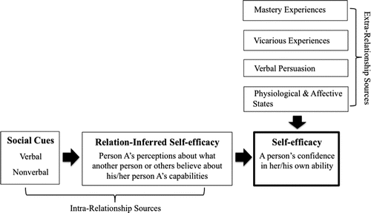
RISE
Other-Efficacy
Person B beliefs about Person A
Social Cues
Impression management
Notes:
Reciprocal influence
Mediation effects
Other SE on SE
Coping effects
Skill development and deployment
Appraisal of social support
Relationship satisfaction
Persistance

Slide 12

Background factors

Slide 13

What is the Cybersecurity Domain?

Slide 14



Slide 15
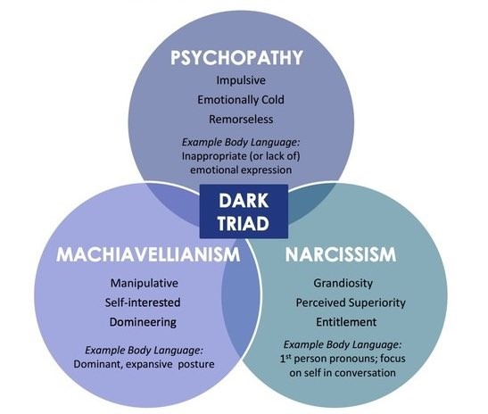
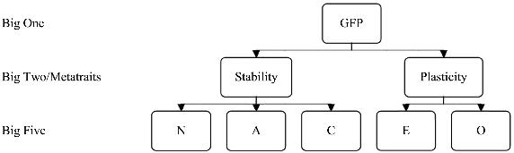

Personality of Leaders
Notes:
This study integrates prior research findings via meta-analysis to make 4 contributions to theory on narcissism and leadership, by (a) distinguishing between leadership emergence and leadership effectiveness, to reveal that narcissism displays a positive relationship with leadership emergence, but no relationship with leadership effectiveness; (b) showing narcissism's positive effect on leadership emergence can be explained by leader extraversion; (c) demonstrating that whereas observer-reported leadership effectiveness ratings (e.g., supervisor-report, subordinate-report, and peer-report) are not related to narcissism, self-reported leadership effectiveness ratings are positively related to narcissism; and (d) illustrating that the nil linear relationship between narcissism and leadership effectiveness masks an underlying curvilinear trend, advancing the idea that there exists an optimal, midrange level of leader narcissism.
Narcissism and Leadership: A Meta-Analytic Review of Linear and Nonlinear Relationships
Emily Grijalva, Peter D. Harms, Daniel A. Newman, Blaine H. Gaddis, R. Chris Fraley

Slide 16

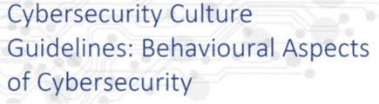
Reading recommendation
The European Union Agency for Network and Information Security (ENISA) is a centre of network and information security expertise for the EU, its member states, the private sector and EU citizens. ENISA works with these groups to develop advice and recommendations on good practice in information security. It assists member states in implementing relevant EU legislation and works to improve the resilience of Europe’s critical information infrastructure and networks. ENISA seeks to enhance existing expertise in member states by supporting the development of cross-border communities committed to improving network and information security throughout the EU. More information about ENISA and its work can be found at www.enisa.europa.eu.
A detailed report about the behavioural aspects of cybersecurity, current practice, the scientific background and ways to improve the cybersecurity culture in an organization.

Slide 17



Recommendations for specific groups
Policy Makers
Ensure responsibilities are assigned to those who have the capability to discharge those responsibilities
Signpost trustworthy competence - e.g. where to look for guidance on specific issues.
Promoting collaboration and trust-building within and across organisation; promote respect and ban disrespectful language about stakeholders
Support the development and use of evidence-based metrics and measures to assess cybersecurity skills, knowledge and organisational culture.
Encourage and support collaboration between technical and social / behavioural domain experts in tackling cybersecurity behaviours.
Don’t assume that awareness of a threat will lead to protective action! Citizens (and workers) also need the skills to avoid the threat, and an understanding that doing so will be effective.
Management and organisational leadership
Take responsibility: Decide which security risks they want to manage, and commit the resources required. This includes the cost of buying security equipment and services, but more important the total cost of operating those security measures:
  the time staff have to spend on security
  the time and effort required to change insecure behaviours into secure ones
  business that may be lost as a result of staff following the policies
  building the skills different parts of the organisation need
Lead by example: always follow security policies (you are a high-value target) and commit a portion of your time to work with security specialists and staff to finding workable solutions in your areas of expertise (e.g. operations, finance, marketing)
Manage your organisation to help security: The report has found that effective management of security can draw knowledge and tools from safety. Similarly, Human Resources can assist with the design of incentives and KPIs, and helping to identify staff who are interested in acquiring new skills and take on extra responsibilities. Communications and marketing can help to improve effectiveness of awareness materials. Leveraging your own resources and breaking down silos to solve problems is a management task.
Notes:
From European Network and Information Security Agency (ENISA) findings:
A thorough review by ENISA lead to some clear recommendations. I will now go through and highlight the key takeaways.
For Policy makers ENISA identified a clear lesson – they found that increasing cybersecurity literacy and skills is an evidenced method to support citizens to protect their cybersecurity.
For Management and organisational leadership the outcome of the reviews is that organisational leaders need to shift their perspective on what their role and responsibilities in managing cybersecurity in their organisation are. Leaders need to see the problem not as a technical one, with little to no consideration of the impact on individual employees going about their daily work tasks. Organisational leadership - while happy to keep saying how important security is to the organisation, need to take an active role to ensure that the security behaviour staff are asked for is doable in the context of the business. Doing so can build self-efficacy.

Slide 18
Recommendations for specific groups
CISO and security specialists
Calculate the impact of your policies. Security policies and measures can only be effective if they are adopted and used correctly. To ensure this, CISOs need to know the impact it has on staff in daily business operations - so they should know the time and effort compliance requires before putting a security measure in place. General MacArthur’s dictum ‘Never give an order that can’t be obeyed’ should be framed and hung over their desk.
Be visible and approachable. CISOs should be security cheerleaders, not policemen - to engage staff, they need to be visible and approachable at all times. And to build trust, they need to listen and negotiate, rather than try to ‘stamp out’ non-compliance and throttle innovation and experimentation.
You need soft skills. CISOs and other security specialists need to acquire the ‘soft skills’ to do this effectively. The programme developed by Ashenden & Lawrence (2016) with funding by the UK NCSC is a pioneer effort that should to be replicated, and become incorporated into academic and professional security courses.
Stop verbally bashing people. Effective engagement and trust require respect for others. The security profession needs to revise its perspective of non-specialists, and accept they are the only stakeholders in the ecosystem for whom security is the primary roles. And they must change the language they use to reflect this - no more referring to humans as ‘the problem’, ‘stupid users’ and the ‘Weakest Link.’z
CSIRT’s /CERT’s & SOC’s
Look after your staff. Burnout is largely driven by overload, but also by boredom through repetitive tasks. Organisations need to ensure sufficient staffing levels - this can be a challenge in CSIRTs where demand is high during incidents, but lower during other times. More flexible task allocations - e.g. having staff work on tool development, skills resources and team building and knowledge-sharing between teams - would be a way forward. Managing incidents affecting safety and cyber physical systems can be stressful - organisations need appropriate support to help staff deal with the aftermath.
Invest in training and personal growth. Having the skills, and ability to grow are key for effective performance, confidence and job satisfaction of security staff. In a rapidly evolving threat environment, funding for research and specialist skills is an essential, not a luxury. Some skill-building can happen through online courses, but hands-on case analysis, master classes and wargaming are more engaging and effective.
Support team and multi-team approaches. Effective cybersecurity defence is a team sport - building trust among analyst teams, and between them and management is essential. This is a new problem for many organisations, so some investment in external expertise (research or consultancy) may be required.
Notes:
Studies with CISOs and security specialists showed a need for a shift in what the job entails. The crux being, being visible and approachable. Here again we see the importance of ‘role modelling’ and ‘coaching’ as a performance pathway. Unfortunately what is often observed is a mode of communication that does exactly the opposite.
For Incident response teams (CSIRT’s /CERT’s & SOC’s) and security operations centre staff are among the most important assets in the fight against cyber threats. Enabling them to perform well is clearly important. ENISA found that burnout is a serious problem. This should give rise for concern, especially given the growing shortage of cyber skills professionals (Oltsig, 2017). Organisations need to take steps to manage this precious resource effectively.

Slide 19
Recommendations for specific groups
Software Developers
You cannot be a security expert, but you need to think about security from the start (security by design) and throughout the whole lifecycle (secure software development lifecycle). The longer you leave thinking about security, the more expensive it will be to make it secure.
Security experts can advise and support you - work with them, and tell them everything.
If your code includes a security mechanism, you need to make sure it is usable: how much time will it take? Will they be able to understand the decisions you are asking them to take? Work with usability experts to help you design and test for usable security.
Those who manage and educate
Compulsory security courses.
Teach to program securely, rather than just how to program.
Material in all other modules should be reviewed to remove or annotate examples that would lead to insecure code.
Awareness raising managers - for ALL the other important people in your organisation
Awareness based around THREAT not effective
Strategically tailoring awareness campaigns
Notes:
For Software Developers the review revealed the similar issue to what the well-known internet essayist Norton (2014) noted in her much-shared opinion piece for The Message, that “Everything is broken.” in that there are high-impact first steps that can be taken to make it easy for developers to produce more secure code - by ensuring that platforms, tools and APIs they use have secure defaults and settings, and that code that is frequently copied is vetted and made safe. ENISA also highlighted that enabling security experts to become more approachable and supportive can lead to more - and most critically earlier - engagement between security and staff.
Re emphasising what Ric mentioned regarding striking the balance in an organisation, those who manage and educate
need to make sure that problems arising with security end up at the right “help” desk with people who have the right skills. There needs to be clear roles and responsibilities based upon skills. And all staff, not just those such as developers or security specialists need time to keep up-to-date with threats and update their skills. So they can ‘speak the language’ and not be demotivated by cyber-elitism.
And lastly - the critical aspect for capturing the rest, meaning all the other essential people in your organisation. Tailoring is key. One size does not fit all. As we have shown, people need to feel a sense of relatedness.
Your adversary is tailoring their attacks so you should consider doing the same if you want to avoid pain.

Slide 20

Problems in CS
, the turnover rate in cybersecurity leadership positions across the industry has been very high, with most Chief Information Security Officers (CISO) only lasting 2 to 4 years. When surveyed, CISO’s cite a lack of executive management support or insufficient budgets were the pervasive motivators. But that is only one side of the story as many CISO’s have been let go.
‘Masters of all’
Rosenquist, 2018

Slide 21
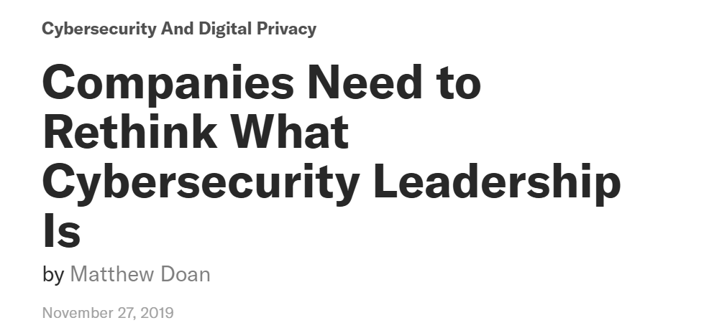
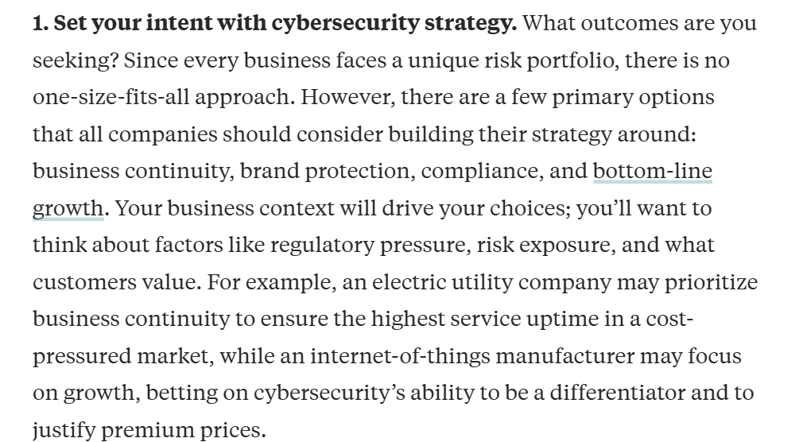
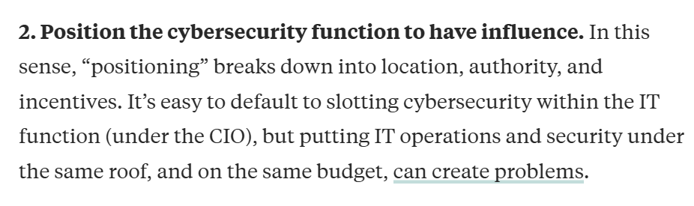
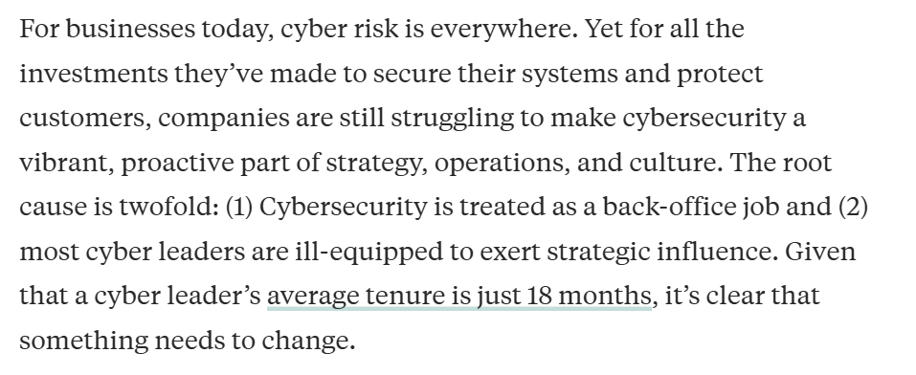
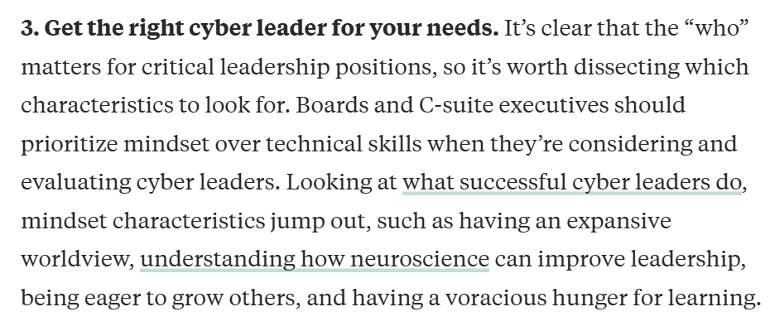
Notes:
The article "Companies Need to Rethink What Cybersecurity Leadership Is" from Harvard Business Review emphasizes the evolving role of Chief Information Security Officers (CISOs) in today's digital landscape. Traditionally, CISOs have focused on technical aspects of cybersecurity, but the article argues that they must now adopt a more strategic and business-oriented approach.
Key points include:
Strategic Alignment: CISOs should align cybersecurity initiatives with business objectives, ensuring that security measures support and enhance overall organizational goals.
Risk Management: Beyond technical defenses, CISOs need to assess and manage risks from a business perspective, understanding the potential impact of cyber threats on operations and reputation.
Communication Skills: Effective communication with executive leadership and the board is crucial. CISOs must articulate cybersecurity issues in business terms to facilitate informed decision-making.
Leadership and Influence: Building a security-conscious culture requires CISOs to lead cross-functional teams and influence stakeholders across the organization.
The article concludes that as cyber threats become more sophisticated, the role of the CISO must evolve to encompass broader business responsibilities, integrating cybersecurity into the fabric of organizational strategy and operations.

Slide 22

Cultural considerations
Background
Education
Perspectives
Ambitions
Stressors
Values

Slide 23

Approaches to culture
Evoked
Transmitted
How environmental factors evoke responses
  Universal mechanisms
  Environmental factors that cause differences
Helping and sharing
Aggression
Ideals, values, attitudes
Shared between members
Individual vs collectivist (Markus & Kitayama, 1998)
  Person/ situation

Slide 24



Slide 25
Norwegian 3rd Variable – 10 Rules
You're not to think you are anything special.
You're not to think you are as good as we are.
You're not to think you are smarter than we are.
You're not to imagine yourself better than we are.
You're not to think you know more than we do.
You're not to think you are more important than we are.
You're not to think you are good at anything.
You're not to laugh at us.
You're not to think anyone cares about you.
You're not to think you can teach us anything.
An eleventh rule recognized in the novel as 'the penal code of Jante' is:
Perhaps you don't think we know a few things about you?
Notes:
re are ten rules in the law as defined by Sandemose, all expressive of variations on a single theme and usually referred to as a homogeneous unit: You are not to think you're anyone special, or that you're better than us.
Although intended as criticism of society in general, the meaning of the Law of Jante has shifted to refer to personal criticism of people who want to break out of their social groups and reach a higher position

Slide 26

Organizational Perspectives

Slide 27

ISACA
Notes:
https://www.isaca.org/resources/isaca-journal/issues/2019/volume-2/implementing-a-cybersecurity-culture
The ISACA article "Implementing a Cybersecurity Culture" emphasizes the importance of fostering a cybersecurity culture within organizations to enhance information security. It defines cybersecurity culture as the collective knowledge, beliefs, perceptions, attitudes, assumptions, norms, and values of individuals regarding cybersecurity, which manifest in their behavior with information technologies. ISACA
Key components of a robust cybersecurity culture include:
Trust: Building interpersonal trust among coworkers to facilitate open communication about security concerns.
Information Systems: Implementing systems that effectively convert data into actionable information.
Communication: Encouraging human interactions necessary for knowledge transfer and security awareness.
Organizational Structure: Designing structures that promote knowledge sharing and accountability in security practices.
Reward Systems: Establishing motivating mechanisms to encourage adherence to security protocols.
The article also highlights the need for continuous research to define and measure cybersecurity culture effectively, suggesting that this area presents opportunities for further study by scholars and practitioners.

Slide 28

Security Operation Centers (SOCs)
Organizations assign their cybersecurity operations to SOCs
SOC teams cover multiple security activities and analyze
large and continuous streams of data
Technical tasks and decision-making assigned to different
positions in the SOC (Muniz et al., 2015)

Slide 29

Skills needed
Notes:
1 Different management skills required by manager level (Adapted from Daft, 2003; Dance, 2011; Katz, 1974)

Slide 30

Orient-Locate-Bridge – The role of Cognisance and Communication (Knox et al, 2018)

Slide 31
Organisational Culture and Social Aspects of Cybersecurity
Is CS an organisational value?
Core
Aspirational
Permission-to-play
Accidental
Lencioni, 2002
Notes:
Figure: Lee, M. Y. (2007). Understanding changes in team-related and task-related mental models and their effects on team and individual performance (Doctoral dissertation, The Florida State University).
Lencioni, P. M. (2002). Make your values mean something. Harvard business review, 80(7), 113-117.
Companies should establish some basic definitions to ensure that people know what they’re talking about and what they’re trying to accomplish. organize values into four categories.
Core values are the deeply ingrained principles that guide all of a company’s actions and serve as its cultural cornerstones and can never be compromised, either for convenience or short-term economic gain.
Aspirational values are those that a company needs to succeed in the future but currently lacks. A company may need to develop a new value to support a new strategy or to meet the requirements of a changing market or industry. They need to be carefully managed to ensure that they do not dilute the core
Permission-to-play values simply reflect the minimum behavioral and social standards required of any employee.
Accidental values arise spontaneously without being cultivated by leadership and take hold over time. They usually reflect the common interests or personalities of the organization’s employees. Accidental values can be good for a company, such as when they create an atmosphere of inclusivity. But they can also be negative forces such as treating CS as something that has to be done

Slide 32
Organisational Culture (Chen et al, 2012)
Compliance
Instruction following
Sanction based
Ego motivation
Induces fear behaviours
Passive behaviours
Fluctuating self-efficacy
Adherence
Integrated understanding
Task orientation
Empowers user
Self-directed exercises
Increases autonomous behaviours
More resilient self-efficacy
Both compliance and adherence policies need to be used in CS training and education.
Organisations need to have salient CS values, goals, procedures, and follow-up for training and education programs. Values and goals (adherence increase) increase task oriented behaviours and procedures and follow-up increase ego oriented behaviors
Leadership styles moderates the approaches taken
Notes:
Chen, Y., Ramamurthy, K., & Wen, K. W. (2012). Organizations' information security policy compliance: Stick or carrot approach?. Journal of Management Information Systems, 29(3), 157-188.
Core and Aspirational values will lead to more adherence while Permission-to play and Accidental values will lead to more compliance - ENISA has

Slide 33
Recommendations for better practice
Cyber Security has to become Core or Aspirational value more so than a Permission-to-play or Accidental value
Leadership has to embody the behaviour to influence self-efficacy
Training and education need to promote both Cyber Security compliance and adherence through human factor tailored programs that incorporate both microcognitive (individual: i.e. motivation, self-efficacy) and macrocognitive (situational: i.e. role-modelling, communication) aspects.
Notes:
Core values are the deeply ingrained principles that guide all of a company’s actions and serve as its cultural cornerstones and can never be compromised, either for convenience or short-term economic gain.
Aspirational values are those that a company needs to succeed in the future but currently lacks.
Permission-to-play values simply reflect the minimum behavioral and social standards required of any employee.
Accidental values arise spontaneously without being cultivated by leadership and take hold over time.

Slide 34


Communication
(2-way)
How does communication flow upward?
How does communication flow downward?

Slide 35



Slide 36




What to Communicate - SITREPS
Notes:
Attentional tunneling (or: attentional narrowing)
Attention can not be divided.
Get hooked on particular features and inadvertently drop scanning.
Mind the Gorilla.
Requisite memory trap
Working memory overload.
In particular auditory information.
Stressors
Workload, anxiety, fatigue, etc.
Time pressure, uncertainty, etc.
Limits SA via limiting WMC and slowing down information processing, more likely attentional tunneling, disorganized scanning for elements and less attention to peripheral cues.
Data overload
Volume and rate of change
Limited bandwith of human sensory and information-processing mechanisms.
Rate of data flow can be enhanced significantly by ergonomic user interfaces
Misplaced salience
Some features (size, shape, movement, flashing lights, noise) are prioritized in sensory and attentional processing
Overuse or inappropriate use degrades SA to other information
Errant mental models
„representational error“
A wrong mental model is applied
Out of the loop syndrome
Automation can eliminate excessive workload, but can also lower SA by putting people out of the loop.
„take-over-time“ where automatisation fails or is not equipped to handle a situation

Slide 37


Where in the Kill Chain is attack 1?
How critical is the system?
How severe was the attack?

Slide 38

Describe the activity you saw (specific but not overly detailed)
What type of incident do you think it was?
If you could suggest anything - which actions should be done?
L1
L2
L3

Slide 39

Leadership styles

Slide 40

Framework for Excellence
Psychological Safety
Accountability
Culture
Leadership
Teamwork &
Communication
Engagement of Patients & Family
Transparency
Negotiation
Reliability
Continuous Learning
Learning System
Improvement
&
Measurement

Slide 41
What is leadership style?
Leaders’ styles encompass how they relate to others within and outside the organization, how they view themselves and their position, and—to a large extent—whether or not they are successful as leaders.

Slide 42
How important is a leader?
In most cases, people will perform at about 60% of their potential with no leadership at all
Thus, an additional 40% can be realized if effective leadership is available

Slide 43
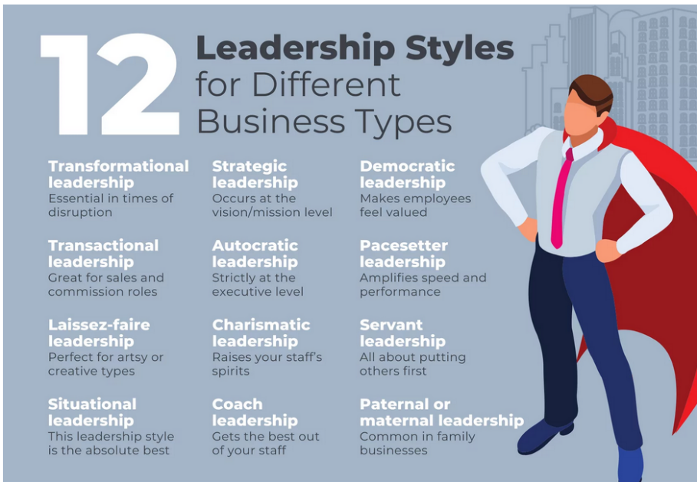

Slide 44
Inclusive Leadership
Empowering leadership (Choeng et al, 2016)
an enabling process of empowering leadership is enhancing followers' self-efficacy and performance,
Transformational Leadership (Hannah et al., 2016)
leadership promotes performance by enhancing followers’ beliefs in their own capabilities (i.e., self-efficacy)
Notes:
Empowering
there is a burdening process in which specific empowering behaviors of the leader increase followers' job induced tension, which in turn diminishes the positive influence of empowering leadership on followers' work role performance. The results generally support these contrasting notions, suggesting that there are two faces, enabling and burdening, of empowering leadership. Implications for future research and professional practice on empowering leadership are also discussed.
Transformational Leadership: Hannah, S. T., Schaubroeck, J. M., & Peng, A. C. (2016). Transforming followers’ value internalization and role self-efficacy: Dual processes promoting performance and peer norm-enforcement. Journal of Applied Psychology, 101(2), 252.
There are 4 components to transformational leadership the 4 I's: Bass. (1999) Two decade of research and development in transformational leadership. European Journal of Work and Organizational Psychology
Idealized Influence (II) – the leader serves as an ideal role model for followers; embodies the qualities that he/she wants in his/her team. In this case, the followers see the leader as a model to emulate. For the followers, it is easy to believe and trust in a transformational leader.
Inspirational Motivation (IM) – Transformational leaders have the ability to inspire and motivate followers through having a vision and presenting that vision. Combined, these first two I's are what constitute the transformational leader's productivity. A transformational leader manages to inspire the followers easily with clarity..
Individualized Consideration (IC) – Transformational leaders demonstrate genuine concern for the needs and feelings of followers and help them self-actualize. This personal attention to each follower assists in developing trust among the organization's members and their authority figure(s).
Intellectual Stimulation (IS) – the leader challenges followers to be innovative and creative, they encourage their followers to challenge the status quo, constantly challenge followers to higher levels of performance

Slide 45
Styles of leadership
9
Benevolent
Leader
(Y)
Team
Leader
(Z)
→
concern for
people
Laissez-faire
Leader
(L)
Autocratic
Leader
(X)
1
concern for production →
9

Slide 46
Theory “L”: Laissez-faire leader
Uninvolved - “leave them alone”
Sees main role as passer of information
Lets others make decisions
Basically abdicates responsibility for team or unit
Pros?
Cons?

Slide 47
Theory “X”: Autocratic leader
Lacks flexibility
Controlling and demanding
“carrot and stick” approach
Focused solely on productivity
Pros?
Cons?

Slide 48
Theory “Y”: Benevolent leader
Very people oriented; encouraging
Organizes around people
Can be paternalistic
“country club” atmosphere: non-competitive
Pros?
Cons?

Slide 49
Theory “Z”: Team leader
Balances production and people issues
Builds a working team of employees
Team approach: involves subordinates
Organization is a vehicle for carrying out plans
Pros?
Cons?

Slide 50
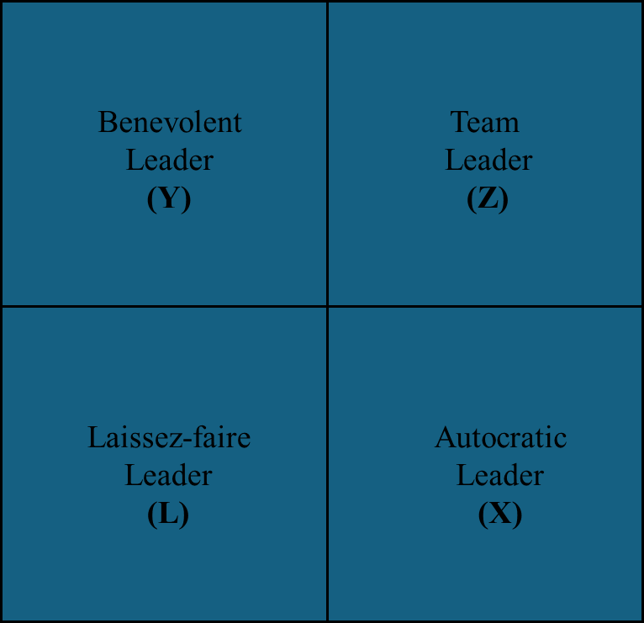
Results of leadership styles
Theory L: “missing management”
  Very low productivity
Theory X: “my way or the highway”
  Job stress; low satisfaction; unions form
Theory Y: “country club”
  Low achievement; good people leave
Theory Z: “good manager”
  High productivity, cooperation, low turnover, employee commitment

Slide 51
Origins of leadership
Are leaders born or made?
  BOTH. Evidence that both inherent personality and environment are factors
What kind of leader would you be?
Notes:
Is there a set of characteristics
that determine a good leader?
Personality?
Dominance and personal presence?
Charisma?
Self confidence?
Achievement?
Ability to formulate a clear vision?

Slide 52
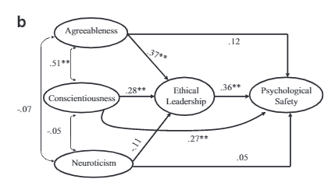
Leadership styles
Walumbwa & Schaubroeck 2009
  Ethical Leadership
    provide followers with voice
    speak out publicly against inappropriate organizational behaviors
    do the right thing
    convey high moral standards
    encourage to voice opinions and suggestions on ethical matters & other work-related processes

Slide 53
Psychological safety
We are both image consultants and protectors
To protect one’s image, if you don’t want to look:
STUPID
Don’t ask
INCOMPETENT
Don’task for feedback
NEGATIVE
Don’t criticize
DISRUPTIVE
Don’t come with novel ideas
Notes:
In order for the learning system to generate and institutionalize improvements, we need to make sure there is psychological safety.
Amy Edmondson states that we are the owners of our image, our own “image consultants”.
In order to protect our image we don’t want to look:
Stupid; therefore Don’t ask questions
Incompetent; therefore Don’t ask for feedback
Negative; therefore Don’t be doubtful or criticize
Disruptive; therefore Don’t suggest anything innovative
When psychological safety exists in a unit or organization, these things don’t exist, and, in fact, aren’t tolerated. Creating psychological safety is one of the critical roles of leaders at all levels of the organization.

Slide 54

Psychological Safety
Psychological safety is a belief that one will not be punished or humiliated for speaking up with ideas, questions, concerns, or mistakes.
A shared sense of psychological safety is a critical input to an effective learning system.
Allows cross-disciplinary teams to overcome inhibiting effects of status differences
Psychological safety predicts engagement in quality improvement work
Psychological Safety and Learning Behavior in Work Teams. Administrative Science Quarterly, Vol. 44, No. 2 (Jun., 1999), pp. 350-383, Amy Edmondson

Slide 55
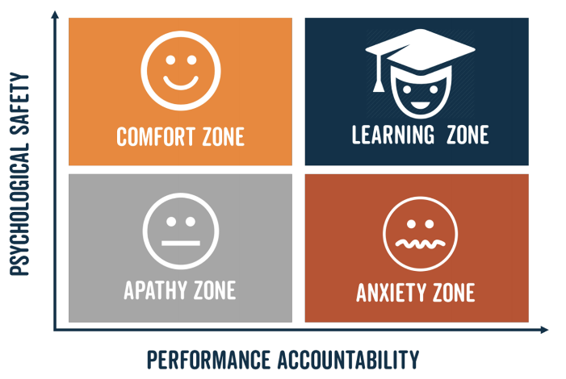
Psychological Safety (Edmondson, 1999)
Leaders:
Questions disruptions in professionalism and psychological safety
Encourages team to cross-monitor and report difficult interactions
                Creates personal connections with all team members
                Ensures trust among team members
                Model who positively respond to feedback
                Don’t judge person, question process
Psychological Safety and Learning Behavior in Work Teams. Administrative Science Quarterly, Vol. 44, No. 2 (Jun., 1999), pp. 350-383, Amy Edmondson
Notes:
Leroy and colleagues (2012) studied nursing
teams and found that team leaders who admit their mistakes can improve the team’s compliance
with safety protocols and psychological safety to report errors (Salas et al 2019)

Slide 56


Missing psychological safety
Groupthink

Slide 57
Missing psychological safety
Symptoms
Type I: Overestimation of group power & values
  ‘Illusions of invulnerability’ too much optimism & promotes risk-taking
  ‘Unquestioned belief’ - ignores consequences
Type II: Closed-mindedness
  Rationalization of warnings that can go against group beliefs
  Stereotyping people against
Type III: Pressures toward uniformity
  Self-censoring of own ideas that differ from group
  Illusions of unanimity – silence is seen as agreement
  Direct pressure to conform
  Mindguards— self-appointed group protectors

Slide 58

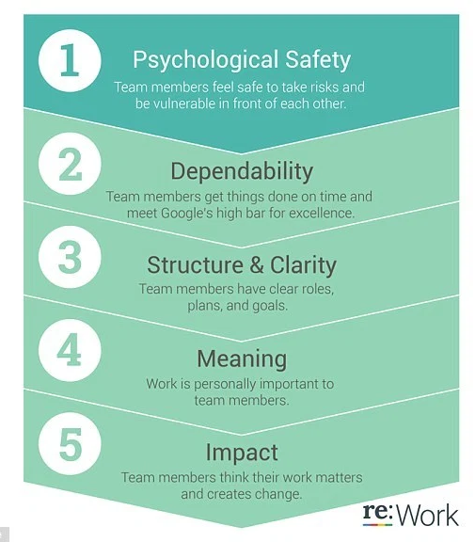


Google Aristotle Project
Notes:
In 2012, Google initiated Project Aristotle to determine the key factors that make teams effective. After analyzing over 180 teams, the study identified five critical elements:
Psychological Safety
Project Aristotle, Google’s internal study, identified psychological safety as the most crucial factor for team success. It emphasizes creating an environment where employees feel safe to express concerns, share ideas, and take risks without fear of punishment. However, the actions described in the protest article—terminating employees and placing others on leave for internal advocacy—seem to undermine this principle. Such measures can create a culture of fear, discouraging employees from speaking up and eroding trust.
Dependability and Structure
The study also found that dependability and clear structures are essential for effective teams. When team members trust each other to fulfill their roles consistently, collaboration thrives. Yet, the perception that Google’s actions against employees were punitive and inconsistent could erode this trust. Employees may view such disciplinary measures as prioritizing authority over fairness, damaging dependability within teams.
Meaning and Impact
According to Project Aristotle, employees are more motivated when their work feels meaningful and contributes to a larger purpose. For those advocating for ethical practices and workplace improvements, their activism likely represented meaningful engagement. Google’s response to this activism—penalizing those involved—could demoralize employees, reducing their sense of purpose and impact within the organization.

Slide 59
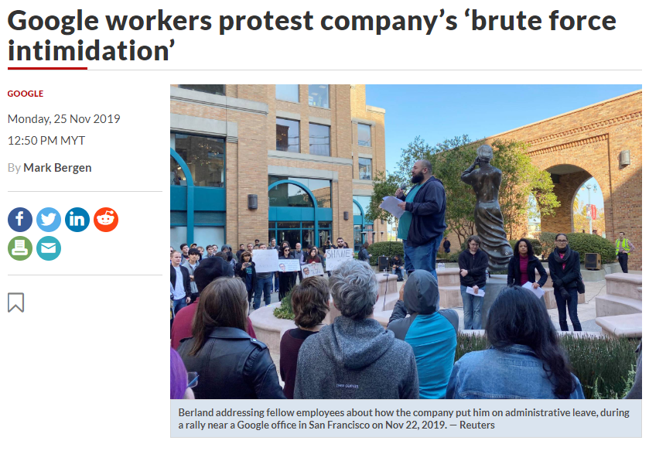
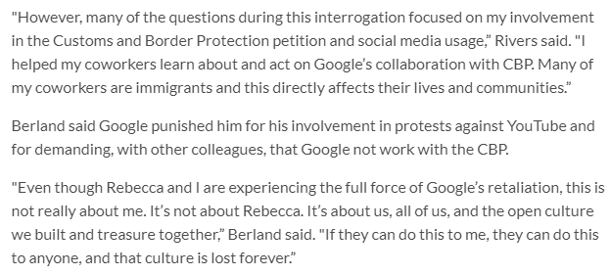
Notes:
But inn November 2019, Google employees organized a protest in response to the company's decision to terminate an employee accused of leaking personal information to the media and to place two others on administrative leave for allegedly accessing documents unrelated to their roles. The protest, which included full-time employees, temporary workers, vendors, and contractors, took place outside Google's offices. Participants expressed concerns that these actions were attempts to suppress internal dissent and discourage workers from voicing concerns about workplace conditions and company policies.
The two articles—“Google Workers Protest Company’s Treatment of Fired Worker, Employees Forced Leave” and “What Google Learned From Its Quest to Build the Perfect Team”—highlight a notable contradiction between Google's stated values for fostering effective teams and its approach to handling workplace dissent.
The Contradiction
While Google champions openness, collaboration, and psychological safety as cornerstones of team effectiveness, its handling of dissent appears to conflict with these principles. Actions perceived as suppressing internal advocacy risk creating a workplace culture that stifles the very qualities Google claims are essential for high-performing teams.
Broader Implications
This contradiction highlights a broader challenge for organizations: aligning their internal practices with their stated values. Balancing business priorities, security concerns, and a commitment to fostering a safe and open environment is essential for credibility and long-term success. Bridging this gap will be crucial for Google to maintain trust and embody the principles it promotes.
4o

Slide 60


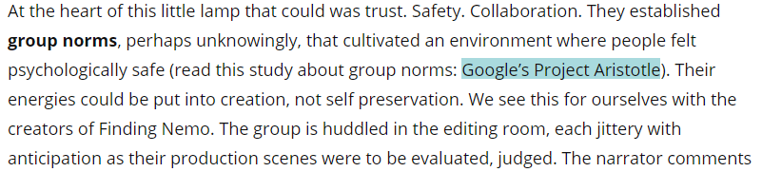
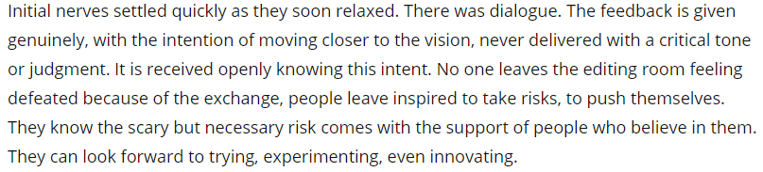
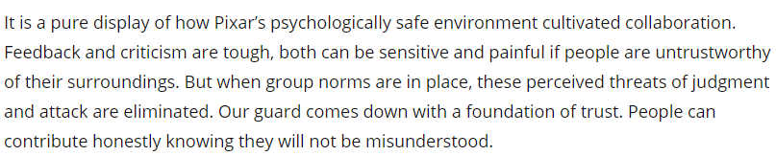
Childhood memories…
Notes:
Pixar Animation Studios has cultivated a workplace culture that emphasizes vulnerability, creativity, and collaboration. This environment encourages employees to openly share ideas and feedback, fostering innovation and continuous improvement.
A key component of Pixar's approach is the "Braintrust" meetings, where directors present their projects to a group of peers for candid feedback. These sessions are characterized by open dialogue and constructive criticism, allowing filmmakers to refine their work without fear of judgment.
Additionally, Pixar promotes a culture where failure is viewed as a learning opportunity rather than a setback. By normalizing vulnerability and embracing mistakes, the studio creates a safe space for employees to take creative risks, leading to groundbreaking storytelling and artistic achievements.
This commitment to vulnerability and open communication has been instrumental in Pixar's success, enabling the studio to produce critically acclaimed and beloved films.

Slide 61
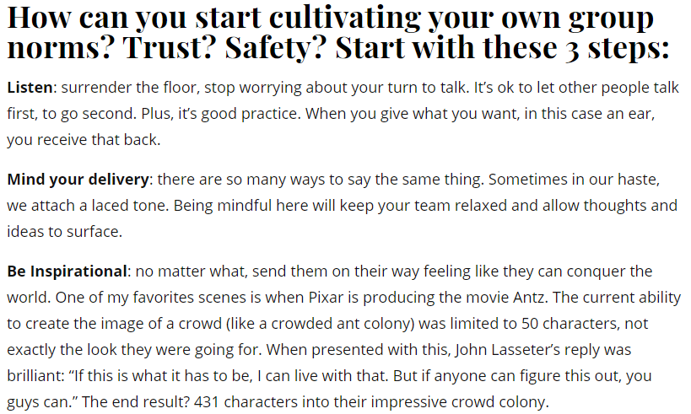
Pixar…

Slide 62
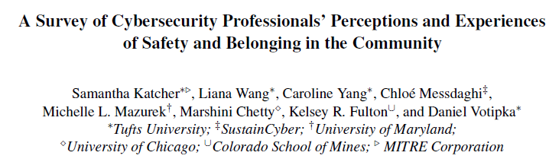
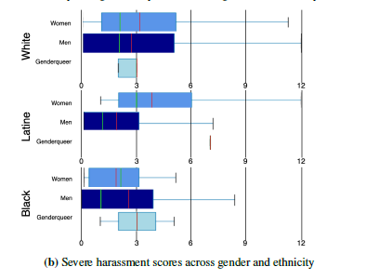
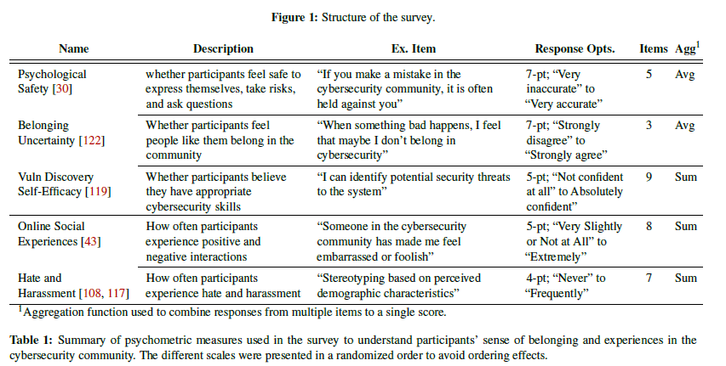
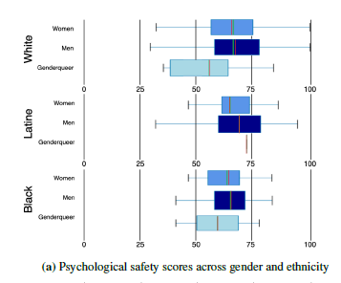

Professional Perceptions
Notes:
The document, "A Survey of Cybersecurity Professionals’ Perceptions and Experiences of Safety and Belonging in the Community," explores the challenges faced by marginalized groups in cybersecurity. Here’s a summary:
Key Findings:
Diversity Challenges:
The cybersecurity field lacks diversity, with fewer than 10% representation from women, Latine, and Black professionals.
Marginalized groups face barriers such as harassment, stereotyping, and exclusion from supportive networks.
Psychological Safety:
Across all demographics, professionals reported low psychological safety, meaning they often do not feel comfortable speaking up or taking risks in their community.
Harassment and Identity-Based Challenges:
Women reported significantly higher rates of harassment, stereotyping, and othering than men.
Genderqueer participants also reported challenges but had too small a sample size for generalizable findings.
Support Networks:
Black participants found community organizations more helpful compared to their White counterparts.
Women preferred identity-focused groups like “Women in Cybersecurity,” while men tended to join general-interest organizations.
Early Experiences and Psychological Impact:
Early programming experiences in high school correlated with both increased confidence in technical skills and higher rates of harassment.
Recommendations:
Cultural Changes: Leaders must foster inclusive environments by emphasizing safety and inclusivity as shared community values.
Training and Policies: Implement training for allyship and bystander intervention and enforce clear policies against harassment.
Support Systems: Encourage mentoring programs and identity-based support networks.
Welcoming Early Education: Address barriers in early development stages, making learning environments inclusive and supportive.
Broader Implications:
The study highlights a need for systemic changes in the cybersecurity field to improve diversity and inclusion. While some progress has been made, persistent challenges underscore the importance of targeted interventions and community-building efforts to create a more equitable profession.

Slide 63
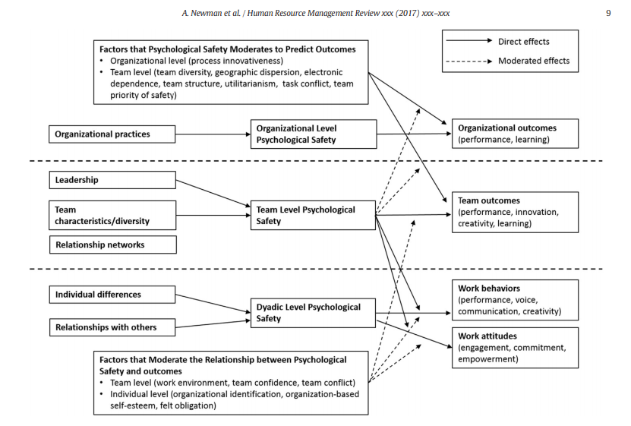
Notes:
Newman, A., Donohue, R., & Eva, N. (2017). Psychological safety: A systematic review of the literature. Human resource management review, 27(3), 521-535.
The article "Psychological Safety: A Systematic Review of the Literature" provides a comprehensive examination of psychological safety, defining it as a shared belief among team members that the team is a safe space for interpersonal risk-taking. The review highlights the critical role of psychological safety in fostering learning, collaboration, and performance in organizations, particularly in complex and hazardous work environments.
Key Highlights:
Importance:
Psychological safety is essential for learning, innovation, and error reduction.
It enables open communication, feedback exchange, and risk-taking in teams.
Antecedents:
Supportive leadership behaviors (e.g., inclusiveness, trustworthiness).
Organizational practices (e.g., diversity initiatives, mentoring).
Strong social networks and relationships within teams.
Outcomes:
Improved team learning, creativity, and performance.
Enhanced individual attitudes, such as engagement and commitment.
Research Gaps:
Limited understanding of the negative consequences of "too much" psychological safety.
Need for longitudinal studies to explore its dynamic development over time.
Insufficient integration of theories explaining how psychological safety evolves.
Theoretical Contributions:
Suggests using Conservation of Resources (COR) theory to explain resource-driven psychological safety outcomes.
Recommends Trait Activation Theory (TAT) to understand how individual traits interact with psychological safety climates.
The paper concludes by urging future research to address these gaps and explore cultural and multi-level influences on psychological safety to maximize its benefits in diverse organizational contexts.

Slide 64


Slide 66

Decision Makers
IT

Slide 67
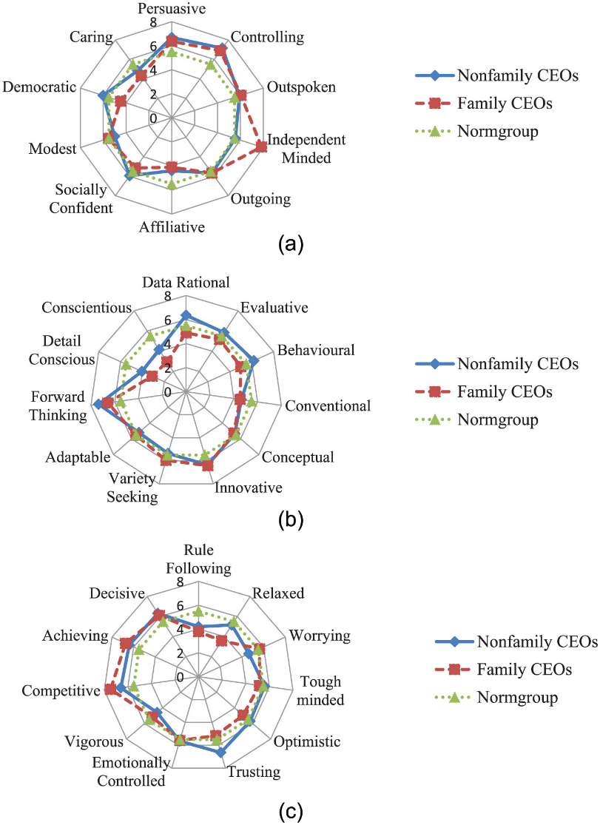


Slide 68
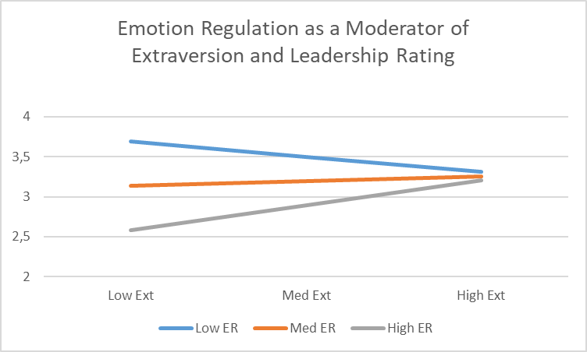
Leadership
Better rated leaders were worse at emotion regulation
  not typical leadership qualities, not E,C,A, rather I
    R² = .466, F (2,20) = 8.74, p = .002
Emotion Regulation strategies moderated leadership scores:
  R² = 11.7%, F (1,19) = 5.3 p = .03

Slide 69
Females and STEM
a) staff composition and behaviours
  The Commandant of the institute is female and the students have access to female professors in STEM subjects. But only 3 of the 20 teachers are females.
b) institutional support
  Norway’s minister of defence from 2013 to 2017 was also female and was the first woman to hold this position.
c) accessible job market
d) sufficient number of females in the study.
  During this time period, there has been a 2.5% total dropout rate; 2.7% for females and 2.5% for males. The drop-out rate does not include two females that left within the first school week having been offered places at civilian engineer universities. In cases where female officer cadets decided to leave the school, poor academic performance was not the motivation.
Percentage of females at NDCA
Year Total Students Females % (number)
2013 37 18.9% (7)
2014 38 18.4% (7)
2015 40 10% (4)
2016 35 28.6% (10)
2017 40 12.5% (5)
Total 190 17.4% (33)
Notes:
The role models the female cadets are exposed too, both nationally and locally at the institution also have cultural aspects that represent equality and support.

Slide 70
What leaders have and do
Source of expertise and authority
Decision-maker
Role-modelling
Mentoring
Resilience
Self-efficacy
  Mastery
  Role-modelling
  Coaching
  (Physiological responses)

Slide 71
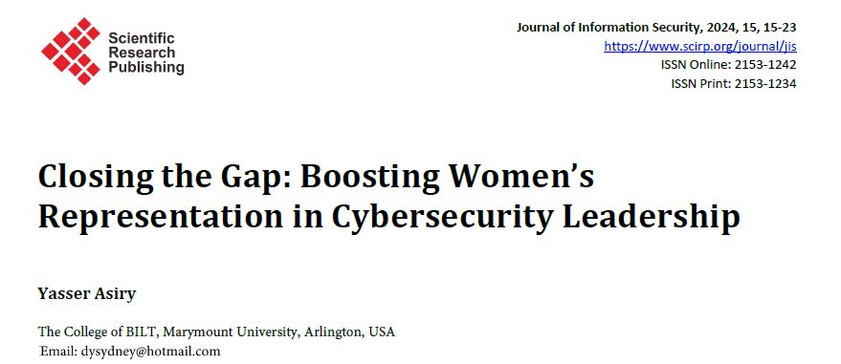
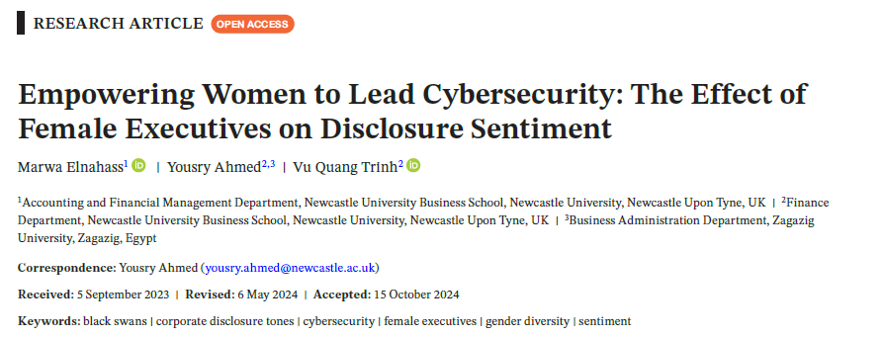
Leadership...
Notes:
The article "Closing the Gap: Boosting Women’s Representation in Cybersecurity Leadership" highlights the significant gender disparity in cybersecurity, particularly in leadership roles, and emphasizes the need for targeted interventions. Challenges include biased recruitment practices with masculine-coded job descriptions, workplace cultures that marginalize women, a lack of flexible policies for work-life balance, and the absence of female role models and mentors. To address these issues, the article suggests adopting gender-neutral language in job postings, implementing blind recruitment processes, promoting STEM education for girls, and establishing mentorship programs and inclusive networking spaces. Flexible work arrangements and policies valuing diversity are essential to retaining female talent, while celebrating the achievements of women leaders can inspire future generations. Collaboration with industry and government, combined with regular data collection to assess progress, is vital to creating a more equitable and innovative cybersecurity sector. Diversity in leadership is framed not just as an ethical imperative but as a strategic advantage for combating evolving cyber threats​
The study "Empowering Women to Lead Cybersecurity: The Effect of Female Executives on Disclosure Sentiment" highlights the critical role of female executives in enhancing corporate cybersecurity disclosure practices. It finds that companies with gender-diverse boards are 38.65% more likely to disclose cybersecurity-related information, with female executives contributing to more detailed and transparent disclosures. Their approach often includes a conservative, litigious, and uncertain tone, reflecting risk-aversion and a focus on robust governance. The research aligns with theories like upper echelon and human capital, suggesting that the diverse perspectives of women improve decision-making, risk management, and stakeholder trust. These findings emphasize the strategic value of gender diversity in corporate leadership, particularly in navigating complex risks like cybersecurity, while addressing stakeholder demands for transparency and accountability

Slide 72
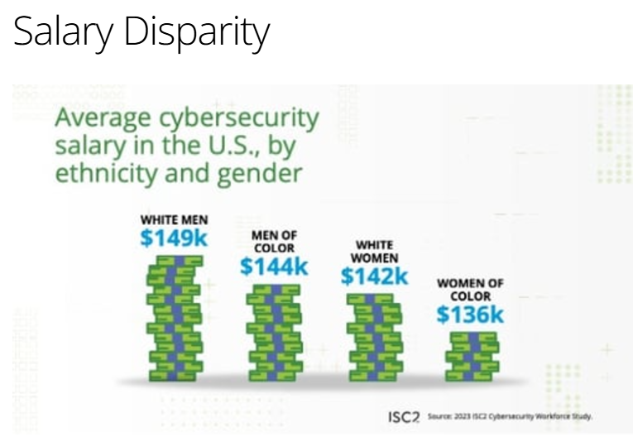


But...

Slide 73
What does this mean for Cybersecurity

Slide 74

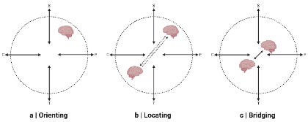
COs collaborative practices during RCP creation and sharing
COs communicate with other COs when tailoring RCPs to their clients
  Less common further up in SOC organizational hierarchy
  HS: Problems when DM and COs are located in different quadrants
  Beliefs and expectations affect sharing and absorption → RCP and CSA
Centralized/official systems are circumvented
  Information sharing between COs not incentivized
  Use of Gamification

Slide 75
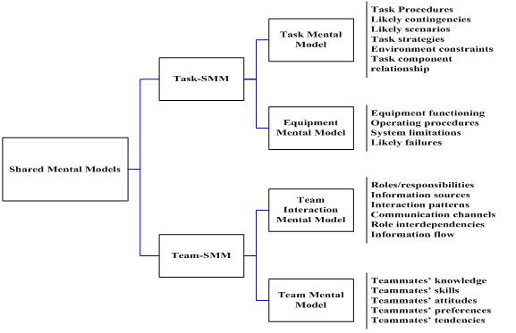
Organisational Culture and Social Aspects of Cybersecurity
Is CS a an organisational value?
Core
Aspirational
Permission-to-play
Accidental
Transformational Leadership
leadership promotes performance by enhancing followers’ beliefs in their own capabilities (i.e., self-efficacy)
Situational Leadership is the idea that effective leaders adapt their style to each situation. No one style is appropriate for all situations. Leaders may use a different style in each situation, even when working with the same team, followers or employees.
Notes:
Figure: Lee, M. Y. (2007). Understanding changes in team-related and task-related mental models and their effects on team and individual performance (Doctoral dissertation, The Florida State University).
Lencioni, P. M. (2002). Make your values mean something. Harvard business review, 80(7), 113-117.
Companies should establish some basic definitions to ensure that people know what they’re talking about and what they’re trying to accomplish. organize values into four categories.
Core values are the deeply ingrained principles that guide all of a company’s actions and serve as its cultural cornerstones and can never be compromised, either for convenience or short-term economic gain.
Aspirational values are those that a company needs to succeed in the future but currently lacks. A company may need to develop a new value to support a new strategy or to meet the requirements of a changing market or industry. They need to be carefully managed to ensure that they do not dilute the core
Permission-to-play values simply reflect the minimum behavioral and social standards required of any employee.
Accidental values arise spontaneously without being cultivated by leadership and take hold over time. They usually reflect the common interests or personalities of the organization’s employees. Accidental values can be good for a company, such as when they create an atmosphere of inclusivity. But they can also be negative forces such as treating CS as something that has to be done
Transformational Leadership: Hannah, S. T., Schaubroeck, J. M., & Peng, A. C. (2016). Transforming followers’ value internalization and role self-efficacy: Dual processes promoting performance and peer norm-enforcement. Journal of Applied Psychology, 101(2), 252.
There are 4 components to transformational leadership the 4 I's: Bass. (1999) Two decade of research and development in transformational leadership. European Journal of Work and Organizational Psychology
Idealized Influence (II) – the leader serves as an ideal role model for followers; embodies the qualities that he/she wants in his/her team. In this case, the followers see the leader as a model to emulate. For the followers, it is easy to believe and trust in a transformational leader.
Inspirational Motivation (IM) – Transformational leaders have the ability to inspire and motivate followers through having a vision and presenting that vision. Combined, these first two I's are what constitute the transformational leader's productivity. A transformational leader manages to inspire the followers easily with clarity..
Individualized Consideration (IC) – Transformational leaders demonstrate genuine concern for the needs and feelings of followers and help them self-actualize. This personal attention to each follower assists in developing trust among the organization's members and their authority figure(s).
Intellectual Stimulation (IS) – the leader challenges followers to be innovative and creative, they encourage their followers to challenge the status quo, constantly challenge followers to higher levels of performance

Slide 76
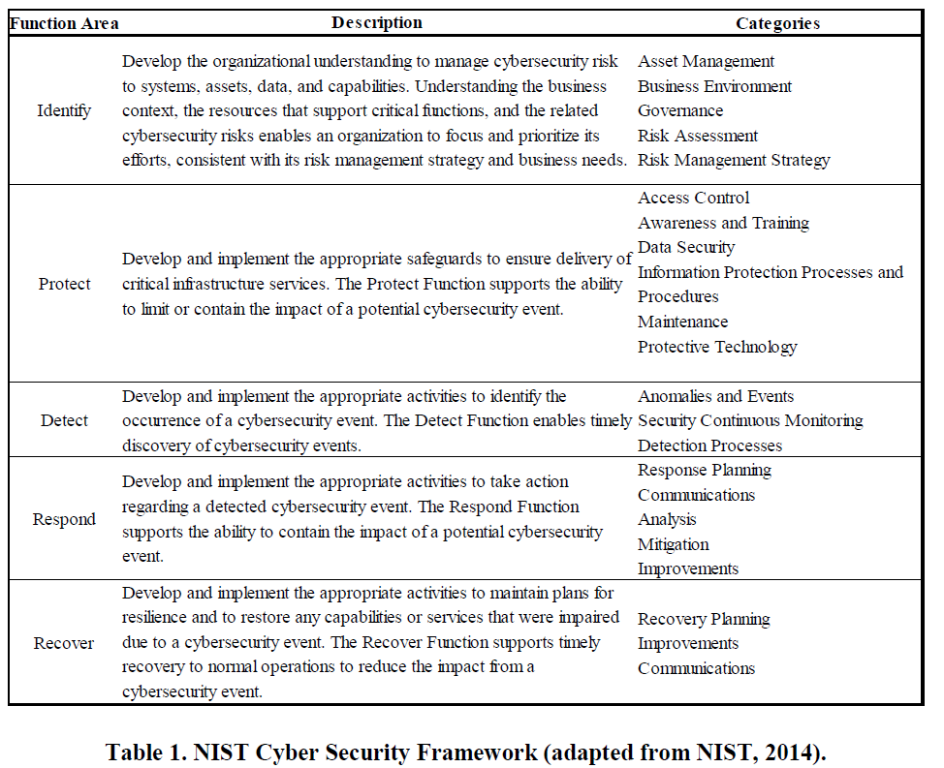
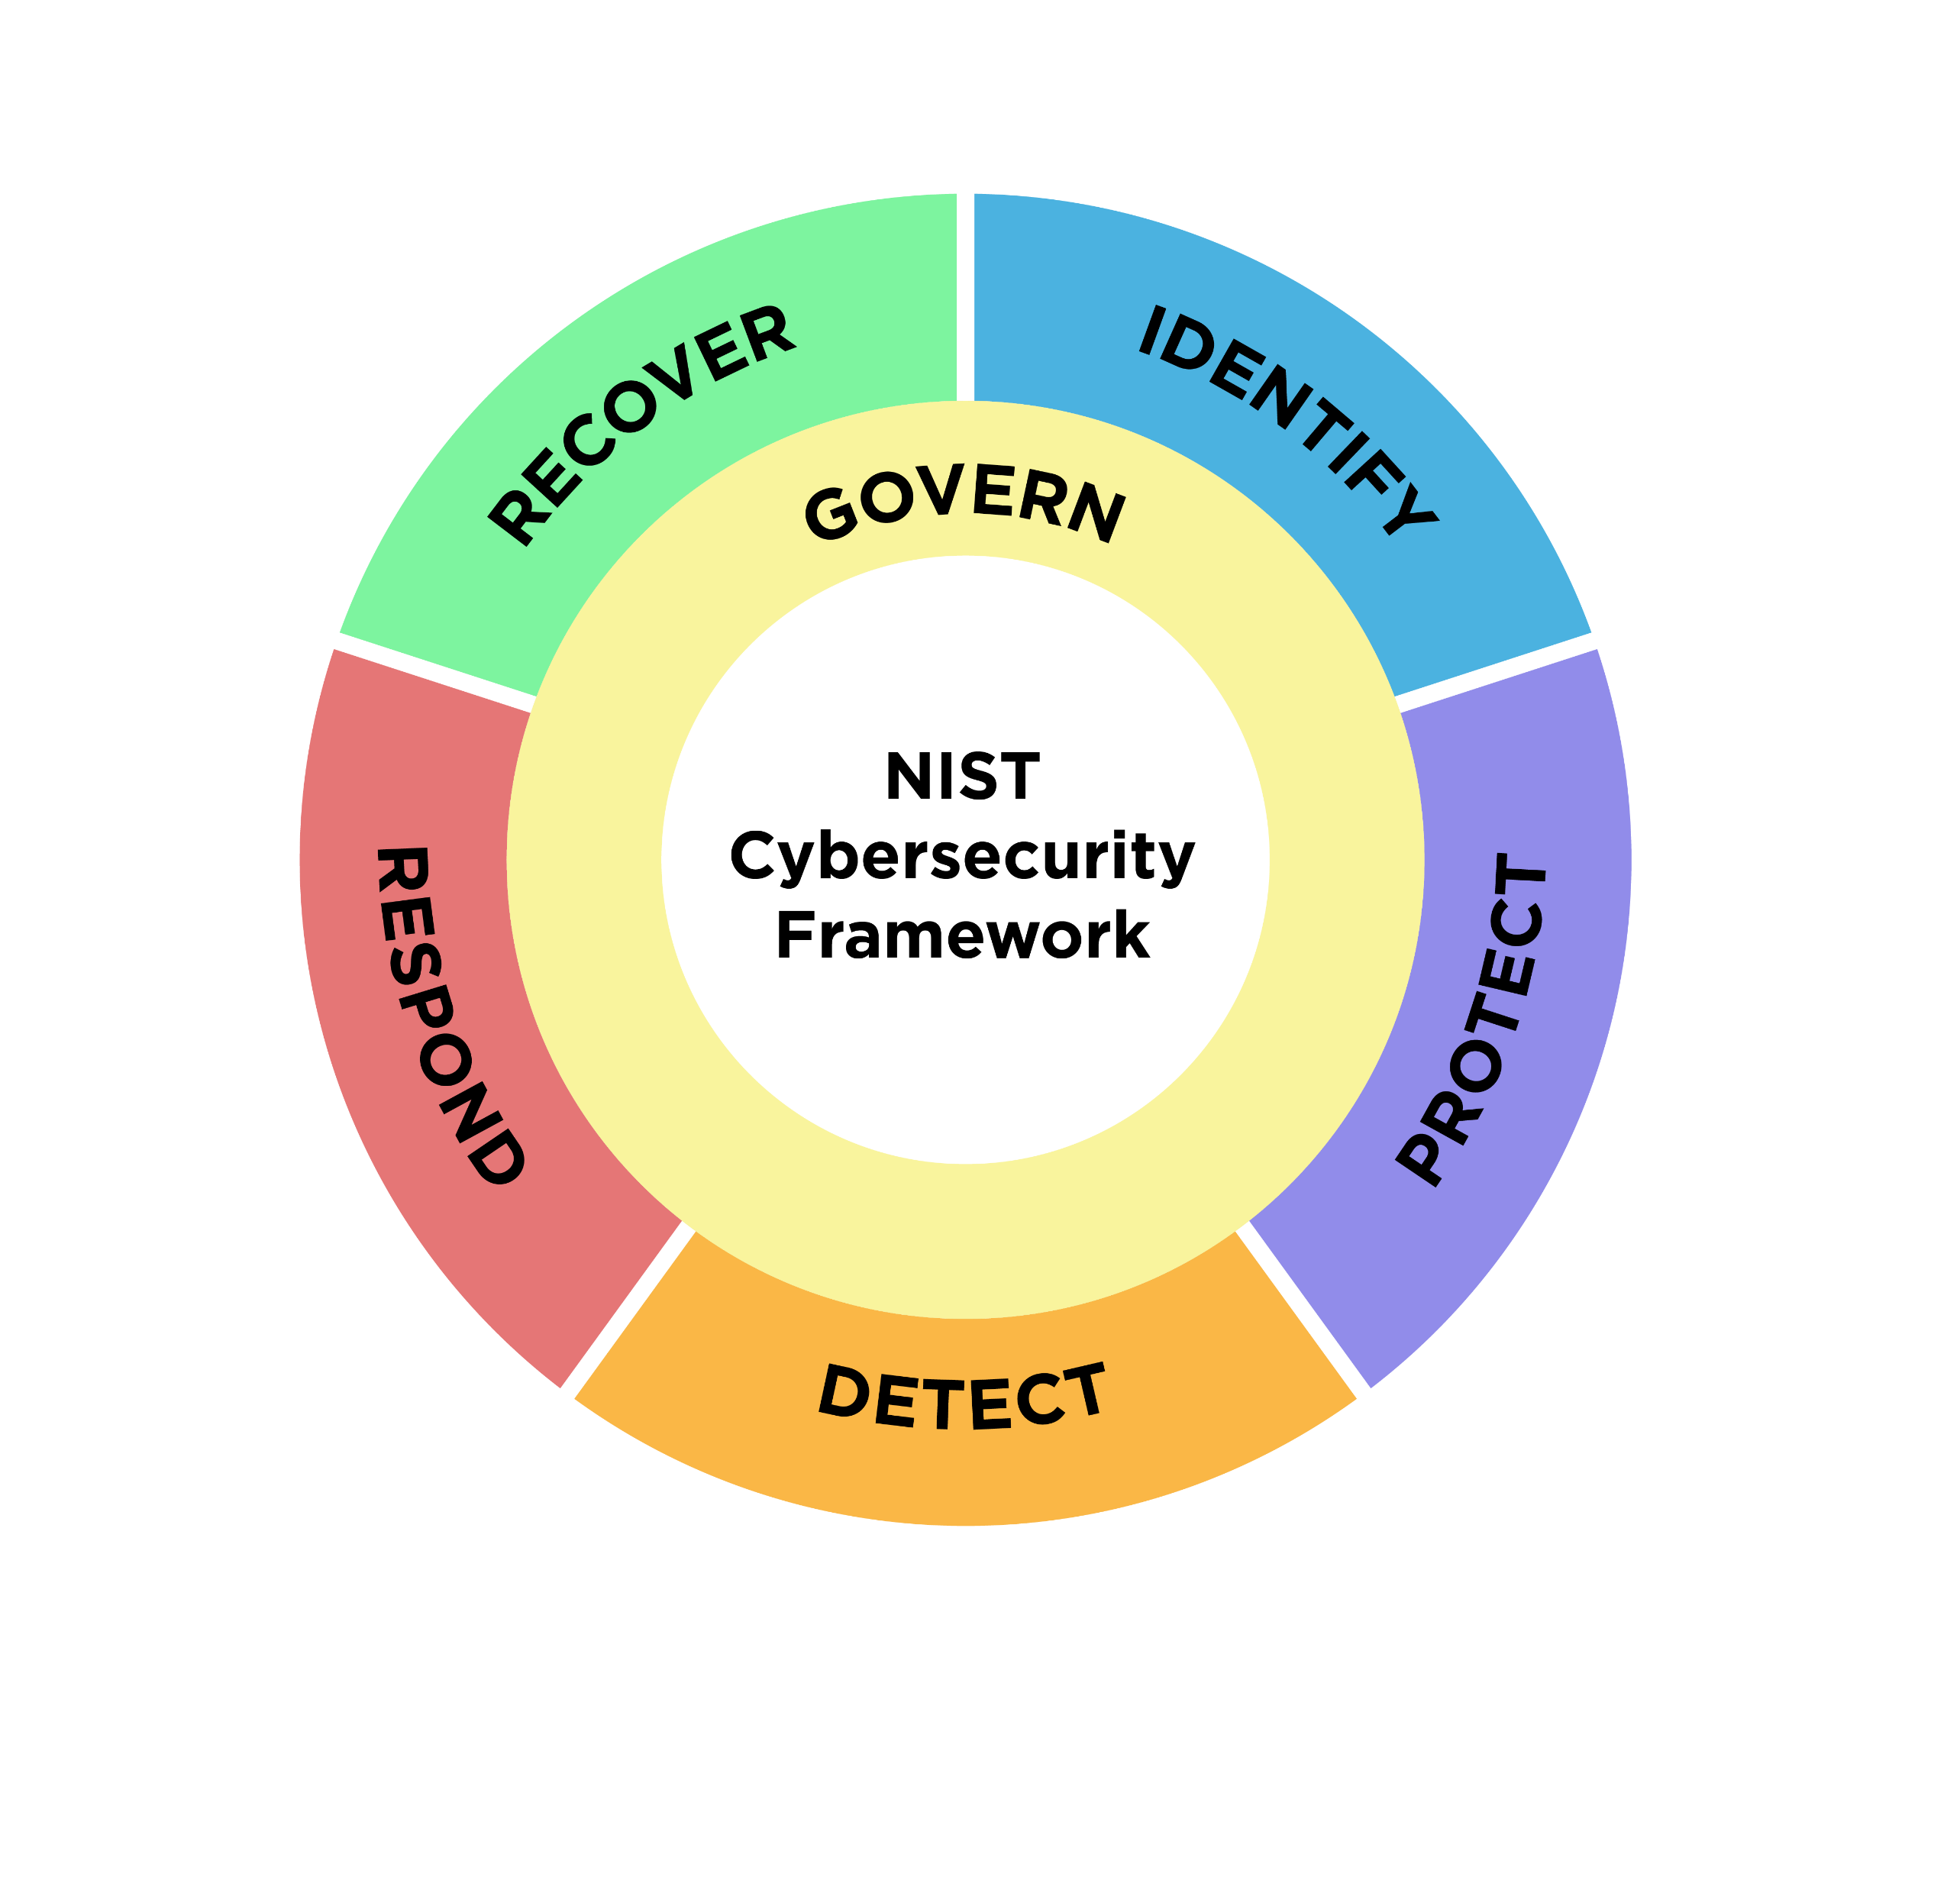

Slide 77
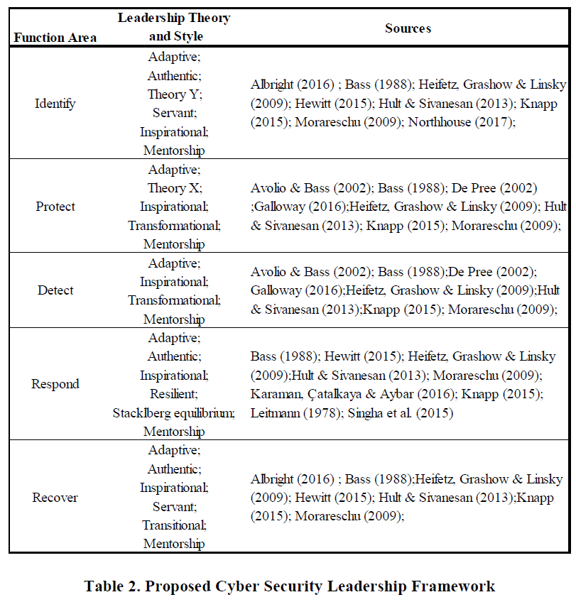
CS Leadership
Chief Information Security Officer (CISO)
  strategic planning
  implementation of cybersecurity programs
  Needs power and authority
  Consider negative impacts
  Requirements: technical, personal (resilience), team building
Notes:
Even with robust and resilient controls in place, the global nature of information technology systems makes the response in the moments after a cyberattack much more than technological. The response from leadership must be obtained by recognizing a broad scope of factors: behavior, culture, socioeconomic context, and a single organization or across multiple organizations. Auffret et al. (2017) argued that many of these factors have led to the creation of the Chief Information Security Officer (CISO) role in Cleveland et al. Toward Cybersecurity Leadership Framework
Proceedings of the Thirteenth Midwest Association for Information Systems Conference, Saint Louis, Missouri May 17-18, 2018 3
organizations. The leader in this role is responsible for the strategic planning and implementation of the cybersecurity programs that can enhance the defense of the organization against cyber threats. As such, the person in this role needs to have power and authority to assemble the required resources in place to make the program a success, while taking into account the variety of factors that can have negative impacts on the implementation of the program. As a result, this CISO as a leader needs to possess not only technical skills, but also business acumen, resilience, and team building skills.

Slide 78
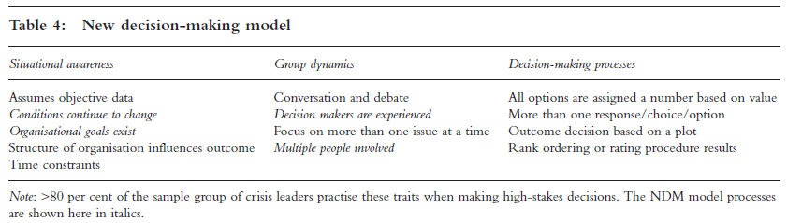
Cyber security and attacks are…
Ambiguous(van der Hoek et al., 2021)
leaders in ambiguous contexts narrow the range of their actions, and a lack of authority in particular constrains the available repertoire
Crisis situations (Oroszi, 2018)
Crises have distinct factors:
they are time-sensitive, pose significant risks and require consequential decisions.

Slide 79
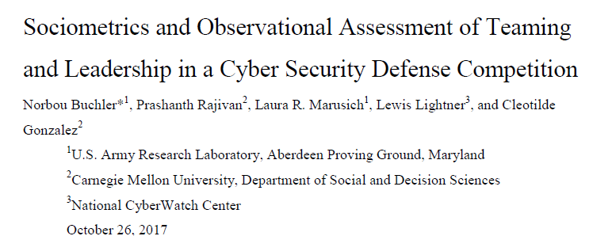
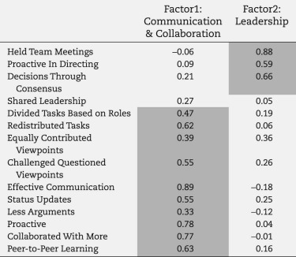
Effective and Adaptive leadership (situational leadership)
Psychological Safety Principles
Notes:
The study "Sociometrics and Observational Assessment of Teaming and Leadership in a Cybersecurity Defense Competition" examines the factors influencing the effectiveness of cyber defense teams by analyzing team processes, leadership, and sociometric data collected during a collegiate cybersecurity competition.
Key Findings:
Team Performance Dimensions:
Teams were evaluated across three dimensions: maintaining services, incident response, and scenario injects. Performance varied based on task types and the interplay of team dynamics and leadership styles.
Leadership and Interaction:
Effective leadership and structured interactions were critical to team success.
Directive leadership was found to benefit tasks requiring focused outputs, such as incident response.
Consensus-driven leadership styles improved collaboration and performance in tasks involving team-wide coordination, like scenario injects.
Face-to-Face Interactions:
High face-to-face interaction density was a negative predictor for tasks like maintaining services and incident response, where functional specialization and reduced distractions were advantageous.
For scenario inject tasks, richer face-to-face communication was positively associated with higher scores, emphasizing the need for flexibility in communication strategies based on task requirements.
Sociometric Insights:
Teams with well-distributed leadership and a balance of communication showed higher effectiveness.
Sociometric badges captured data on team dynamics, such as proximity, speech patterns, and interaction frequencies, providing quantitative insights into collaboration and leadership.
Implications:
The study underscores the importance of adapting leadership and communication strategies to the nature of specific cybersecurity tasks. It highlights the role of functional specialization, task-specific collaboration, and dynamic leadership in optimizing team performance, offering valuable insights for training and evaluating cybersecurity professionals.

Slide 80
Recommendations for specific groups
Policy Makers
Ensure responsibilities are assigned to those who have the capability to discharge those responsibilities
Signpost trustworthy competence - e.g. where to look for guidance on specific issues.
Promoting collaboration and trust-building within and across organisation; promote respect and ban disrespectful language about stakeholders
Support the development and use of evidence-based metrics and measures to assess cybersecurity skills, knowledge and organisational culture.
Encourage and support collaboration between technical and social / behavioural domain experts in tackling cybersecurity behaviours.
Don’t assume that awareness of a threat will lead to protective action! Citizens (and workers) also need the skills to avoid the threat, and an understanding that doing so will be effective.
Management and organisational leadership
Take responsibility: Decide which security risks they want to manage, and commit the resources required. This includes the cost of buying security equipment and services, but more important the total cost of operating those security measures:
  the time staff have to spend on security
  the time and effort required to change insecure behaviours into secure ones
  business that may be lost as a result of staff following the policies
  building the skills different parts of the organisation need
Lead by example: always follow security policies (you are a high-value target) and commit a portion of your time to work with security specialists and staff to finding workable solutions in your areas of expertise (e.g. operations, finance, marketing)
Manage your organisation to help security: The report has found that effective management of security can draw knowledge and tools from safety. Similarly, Human Resources can assist with the design of incentives and KPIs, and helping to identify staff who are interested in acquiring new skills and take on extra responsibilities. Communications and marketing can help to improve effectiveness of awareness materials. Leveraging your own resources and breaking down silos to solve problems is a management task.
Increase cybersecurity literacy and skills.
Perceived competence.
Role modelling – factor contributing to self-efficacy
Notes:
From European Network and Information Security Agency (ENISA) findings:
A thorough review by ENISA lead to some clear recommendations. I will now go through and highlight the key takeaways.
For Policy makers ENISA identified a clear lesson – they found that increasing cybersecurity literacy and skills is an evidenced method to support citizens to protect their cybersecurity.
For Management and organisational leadership the outcome of the reviews is that organisational leaders need to shift their perspective on what their role and responsibilities in managing cybersecurity in their organisation are. Leaders need to see the problem not as a technical one, with little to no consideration of the impact on individual employees going about their daily work tasks. Organisational leadership - while happy to keep saying how important security is to the organisation, need to take an active role to ensure that the security behaviour staff are asked for is doable in the context of the business. Doing so can build self-efficacy.

Slide 81
Recommendations for specific groups
CISO and security specialists
Calculate the impact of your policies. Security policies and measures can only be effective if they are adopted and used correctly. To ensure this, CISOs need to know the impact it has on staff in daily business operations - so they should know the time and effort compliance requires before putting a security measure in place. General MacArthur’s dictum ‘Never give an order that can’t be obeyed’ should be framed and hung over their desk.
Be visible and approachable. CISOs should be security cheerleaders, not policemen - to engage staff, they need to be visible and approachable at all times. And to build trust, they need to listen and negotiate, rather than try to ‘stamp out’ non-compliance and throttle innovation and experimentation.
You need soft skills. CISOs and other security specialists need to acquire the ‘soft skills’ to do this effectively. The programme developed by Ashenden & Lawrence (2016) with funding by the UK NCSC is a pioneer effort that should to be replicated, and become incorporated into academic and professional security courses.
Stop verbally bashing people. Effective engagement and trust require respect for others. The security profession needs to revise its perspective of non-specialists, and accept they are the only stakeholders in the ecosystem for whom security is the primary roles. And they must change the language they use to reflect this - no more referring to humans as ‘the problem’, ‘stupid users’ and the ‘Weakest Link.’z
CSIRT’s /CERT’s & SOC’s
Look after your staff. Burnout is largely driven by overload, but also by boredom through repetitive tasks. Organisations need to ensure sufficient staffing levels - this can be a challenge in CSIRTs where demand is high during incidents, but lower during other times. More flexible task allocations - e.g. having staff work on tool development, skills resources and team building and knowledge-sharing between teams - would be a way forward. Managing incidents affecting safety and cyber physical systems can be stressful - organisations need appropriate support to help staff deal with the aftermath.
Invest in training and personal growth. Having the skills, and ability to grow are key for effective performance, confidence and job satisfaction of security staff. In a rapidly evolving threat environment, funding for research and specialist skills is an essential, not a luxury. Some skill-building can happen through online courses, but hands-on case analysis, master classes and wargaming are more engaging and effective.
Support team and multi-team approaches. Effective cybersecurity defence is a team sport - building trust among analyst teams, and between them and management is essential. This is a new problem for many organisations, so some investment in external expertise (research or consultancy) may be required.
Increase task orientation/
internal motivation
Self-Efficacy: role modeling & coaching
Mode of communication & feedback can
lead to self-efficacy & motivation
decreasing
Motivation Self-determination
Theory: the need for relatedness
Notes:
Studies with CISOs and security specialists showed a need for a shift in what the job entails. The crux being, being visible and approachable. Here again we see the importance of ‘role modelling’ and ‘coaching’ as a performance pathway. Unfortunately what is often observed is a mode of communication that does exactly the opposite.
For Incident response teams (CSIRT’s /CERT’s & SOC’s) and security operations centre staff are among the most important assets in the fight against cyber threats. Enabling them to perform well is clearly important. ENISA found that burnout is a serious problem. This should give rise for concern, especially given the growing shortage of cyber skills professionals (Oltsig, 2017). Organisations need to take steps to manage this precious resource effectively.

Slide 82
Recommendations for specific groups
Software Developers
You cannot be a security expert, but you need to think about security from the start (security by design) and throughout the whole lifecycle (secure software development lifecycle). The longer you leave thinking about security, the more expensive it will be to make it secure.
Security experts can advise and support you - work with them, and tell them everything.
If your code includes a security mechanism, you need to make sure it is usable: how much time will it take? Will they be able to understand the decisions you are asking them to take? Work with usability experts to help you design and test for usable security.
Those who manage and educate
Compulsory security courses.
Teach to program securely, rather than just how to program.
Material in all other modules should be reviewed to remove or annotate examples that would lead to insecure code.
Awareness raising managers - for ALL the other important people in your organisation
Awareness based around THREAT not effective
Strategically tailoring awareness campaigns
Time to learn & practice >
Compliance / avoid cyber elitism
Sense of relatedness (SDT) – Vital for a
multidisciplinary team to function
Create a culture of
empowerment for
compliance & adherence
Notes:
For Software Developers the review revealed the similar issue to what the well-known internet essayist Norton (2014) noted in her much-shared opinion piece for The Message, that “Everything is broken.” in that there are high-impact first steps that can be taken to make it easy for developers to produce more secure code - by ensuring that platforms, tools and APIs they use have secure defaults and settings, and that code that is frequently copied is vetted and made safe. ENISA also highlighted that enabling security experts to become more approachable and supportive can lead to more - and most critically earlier - engagement between security and staff.
Re emphasising what Ric mentioned regarding striking the balance in an organisation, those who manage and educate
need to make sure that problems arising with security end up at the right “help” desk with people who have the right skills. There needs to be clear roles and responsibilities based upon skills. And all staff, not just those such as developers or security specialists need time to keep up-to-date with threats and update their skills. So they can ‘speak the language’ and not be demotivated by cyber-elitism.
And lastly - the critical aspect for capturing the rest, meaning all the other essential people in your organisation. Tailoring is key. One size does not fit all. As we have shown, people need to feel a sense of relatedness.
Your adversary is tailoring their attacks so you should consider doing the same if you want to avoid pain.

Slide 83
References
ENISA, “Good Practice Guide on Training Methodologies,” Report/Study, ENISA Eu-ropa, accessed April 4th 2022, https://www.enisa.europa.eu/publications/good-prac-tice-guide-on-training-methodologies.
Rosenquist, M. (2018). When the Wrong Person Leads Cybersecurity. Retrieved April 4th 2022 https://www.linkedin.com/pulse/when-wrong-person-leads-cybersecurity-matthew-rosenquist/
Markus, H. R., & Kitayama, S. (1998). The cultural psychology of personality. Journal of cross-cultural psychology, 29(1), 63-87.
Lencioni, P. M. (2002). Make your values mean something. Harvard business review, 80(7), 113-117.
Transformational Leadership: Hannah, S. T., Schaubroeck, J. M., & Peng, A. C. (2016). Transforming followers’ value internalization and role self-efficacy: Dual processes promoting performance and peer norm-enforcement. Journal of Applied Psychology, 101(2), 252.
Denison, D. R., Hooijberg, R., & Quinn, R. E. (1995). Paradox and performance: Toward a theory of behavioral complexity in managerial leadership. Organization science, 6(5), 524-540.
Chen, Y., Ramamurthy, K., & Wen, K. W. (2012). Organizations' information security policy compliance: Stick or carrot approach?. Journal of Management Information Systems, 29(3), 157-188.
Edmondson, A. (1999). Psychological safety and learning behavior in work teams. Administrative science quarterly, 44(2), 350-383.
Cheong, M., Spain, S. M., Yammarino, F. J., & Yun, S. (2016). Two faces of empowering leadership: Enabling and burdening. The Leadership Quarterly, 27(4), 602-616.
Walumbwa, F. O., & Schaubroeck, J. (2009). Leader personality traits and employee voice behavior: mediating roles of ethical leadership and work group psychological safety. Journal of applied psychology, 94(5), 1275.
Newman, A., Donohue, R., & Eva, N. (2017). Psychological safety: A systematic review of the literature. Human resource management review, 27(3), 521-535.
van der Hoek, M., Beerkens, M., & Groeneveld, S. (2021). Matching leadership to circumstances? A vignette study of leadership behavior adaptation in an ambiguous context. International Public Management Journal, 24(3), 394-417.
Oroszi, T. (2018). A preliminary analysis of high-stakes decision-making for crisis leadership. Journal of business continuity & emergency planning, 11(4), 335-359.
Cleveland et al. Toward Cybersecurity Leadership Framework Proceedings of the Thirteenth Midwest Association for Information Systems Conference, Saint Louis, Missouri May 17-18, 2018 3
Cleveland, S., & Cleveland, M. (2020). Leadership competencies for sustained project success. International Journal of Applied Management Theory and Research (IJAMTR), 2(1), 35-47.
Salas, E., Bisbey, T. M., Traylor, A. M., & Rosen, M. A. (2020). Can teamwork promote safety in organizations?. Annual Review of Organizational Psychology and Organizational Behavior, 7, 283-313.

Slide 84

Thank you
Please send all questions to trainers.

