Slide 1



Topic 5: Information and Deception
Presentation by:
RicardoLugo

Slide 2
Acknowledgement
Co-funded by the European Union. Views and opinions expressed are however those of the author(s) only and do not necessarily reflect those of the European Union or HADEA. Neither the European Union nor the granting authority can be held responsible for them.
Project Agreement no. 101083594

Slide 3
Agenda
Information
Psychological theories
Deep fakes
Research

Slide 4
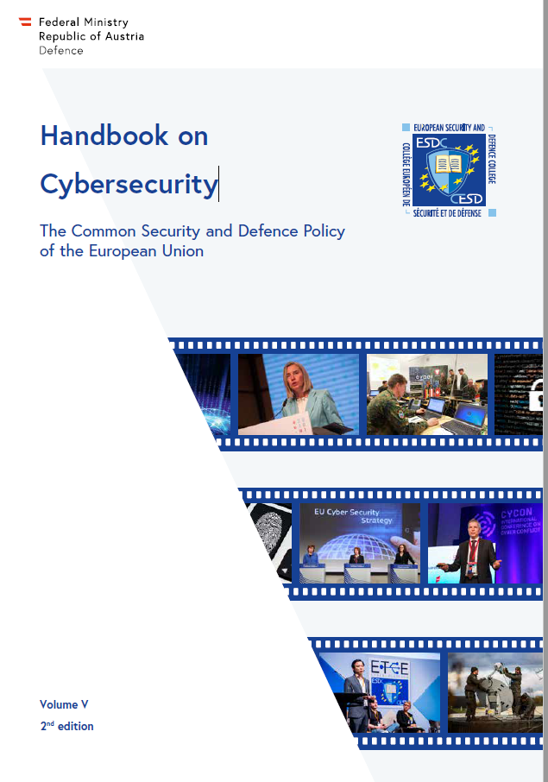
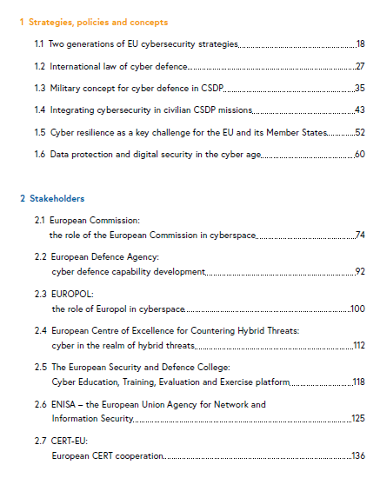


Slide 5
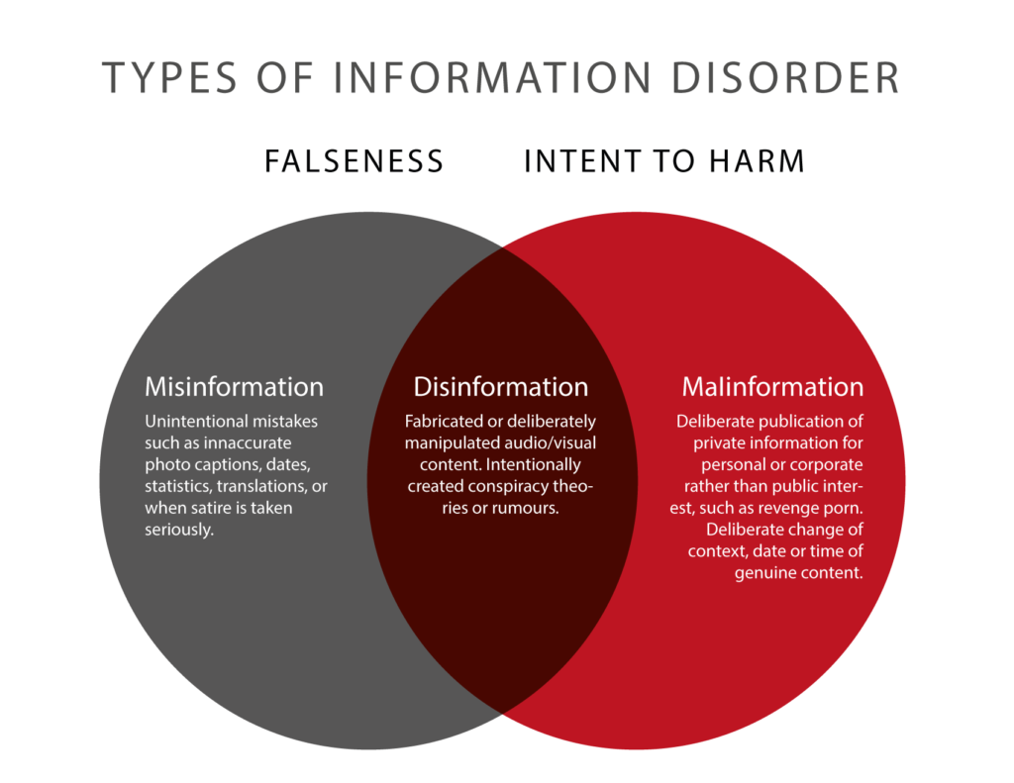
Mis-information is when false information is shared, but no harm is meant.
Dis-information is when false information is knowingly shared to cause harm (“fake news”).
Mal-information is when genuine information is shared to cause harm, often by moving information designed to stay private into the public sphere. Also: “hate-speech”.
Propaganda: Disinformation paired with an explicit or implicit political agenda.
Notes:
Wardle 2017

Slide 6

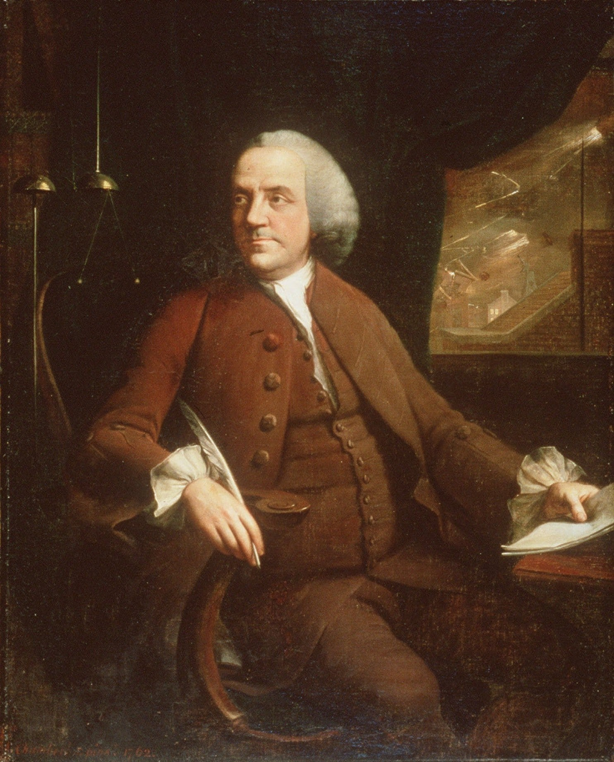
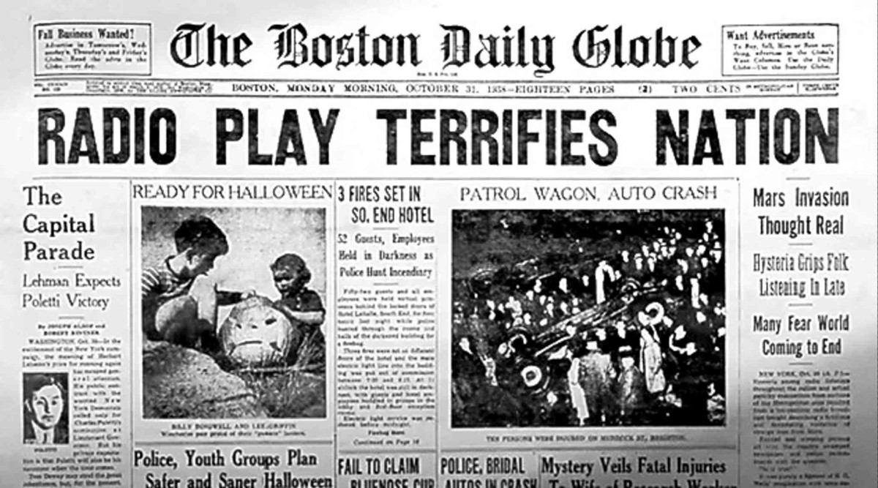

In 1782, Benjamin Franklin printed a fake issue of a real newspaper in Boston and reported that British forces had hired Native Americans to kill and scalp American soldiers, women and children, aiming to push for America‘s Independence.
Benjamin Franklin (1762)
Notes:
Fake news? That’s a very old story. - The Washington Post
Last week, The Post reported that Paul Horner, “the 38-year-old impresario of a Facebook fake-news empire,” believes he turned the election in favor of Donald Trump. For many, the claim signals an alarming turn into uncharted political territory. But fake news is part of American history. In fact, it goes back to the founding of the republic.
In 1769, John Adams gleefully wrote in his diary about spending the evening occupied with “a curious employment. Cooking up Paragraphs, Articles, Occurrences etc. — working the political Engine!” Adams, along with his cousin Sam and a handful of other Boston patriots, were planting false and exaggerated stories meant to undermine royal authority in Massachusetts.
Several other leaders of the American Revolution likewise attempted to manage public opinion by fabricating stories that looked like the real thing. William Livingston, then governor of New Jersey, secretly crafted lengthy pieces that newspaper publishers featured. One, titled “The Impartial Chronicle,” was anything but, claiming that the king was sending tens of thousands of foreign soldiers to kill Americans.
But the most important was crafted in 1782 at a makeshift printing press in a Paris suburb. Benjamin Franklin, taking time out from his duties as American ambassador to France, concocted an entirely fake issue of a real Boston newspaper, the Independent Chronicle. In it, Franklin fabricated a story allegedly from the New York frontier .
The story was gruesome: American forces had discovered bags containing more than 700 “SCALPS from our unhappy Country-folks.” There were bags of boys’, girls’, soldiers and even infants’ scalps, all allegedly taken by Indians in league with King George. There was also a note written to the tyrant king hoping he would receive these presents and “be refreshed.”
None of this was true, of course, but it struck a frightful chord. To drive the point home, Franklin composed a fake letter from a real person, naval hero John Paul Jones, that ventriloquized almost verbatim the Declaration of Independence, including the accusation toward the end of that document suggesting the colonies must declare independence because the king has “engage[d] savages to murder . . . defenseless farmers, women, and children.”
Franklin sent copies of his fake newspaper to colleagues insisting, “the substance is truth.” Sure enough, the story appeared in real papers in New Jersey, Pennsylvania, Connecticut, New York and Rhode Island. What did those readers believe? Did they know they were being manipulated?
Franklin wrote a friend about the power of what he had just done. “By the press we can speak to nations,” he wrote with pride. With the power of the newspaper, politicians could not only “strike while the iron is hot,” but also stoke those fires by “continual striking,” Franklin wrote with a wink.
Franklin’s concoction didn’t swing the Revolution. By this time, the Americans had defeated the British at Yorktown, and independence was all but secured. But the topic of Franklin’s gory hoax was significant: What an independent United States would do about the people Franklin spread this untruth about was entirely up in the air.
To be sure, many Native Americans had allied with the British and inflicted deep wounds to families across the frontier. But not all of them had. Franklin’s lies added to the notion that all Indians were “merciless,” as the Declaration referred to them. None of them, by that reasoning, could be Americans, even the thousands who served alongside George Washington. By the “continual striking” of that idea, Franklin’s bags of scalps obliterated such nuance. They were all enemies to the republic.
Flash forward 30 years. It is 1813, and America is again at war with Britain. The king’s men are again making alliances with native people. At the Raisin River in Michigan, a combined force of British soldiers and natives routed the Americans, killing hundreds of Kentucky militiamen. An outraged public then adopted the rallying cry “Remember the Raisin!” for the remainder of the War of 1812.
How did newspaper publishers remember the Raisin River massacre? By resurrecting Franklin’s hoax. That spring, to illustrate the long roots of this terrible bloodshed, U.S. newspapers introduced a new generation to Franklin’s fake bags of scalps, heating up the iron once again. And, once again, reinforcing the idea that Indians — supposedly bloodthirsty, dangerous and in league with the British — were America’s enemy.
Our own fake news purveyor, Paul Horner, suggests that Americans today are “definitely dumber” than they used to be. Perhaps. But we are not the only ones who fell for hoaxes, and American leaders — even ones we revere as Founding Fathers — were not above embracing such fabrications to shape opinion.
These stories from America’s past, however, are not dissimilar to ones in our own time. Then, as now, they were about who belongs to the republic and who does not. Then, as now, they were about stirring up fear and passions. We need to proceed cautiously. Stories that we think may vanish as a blip in our social media news feeds may end up having a longer life than we expect, causing more damage than we can anticipate.

Slide 7
Starting point
Disinformation problem is getting worse, aggravated by influx of online media, social media and the resulting ability of individuals to reach larger audiences.
83% of Europeans think that Fake News is a threat to democracy (Eurobarometer, 2018)
News organizations launched fact-checking initiatives.
Technology companies started to remove accounts, warn, inform, etc.
People start to get educated about the fake news phenomenon and how to spot them (e.g. bbc.co.uk/beyondfakenews)
Ultimate question: What makes people believe in fake news?

Slide 8
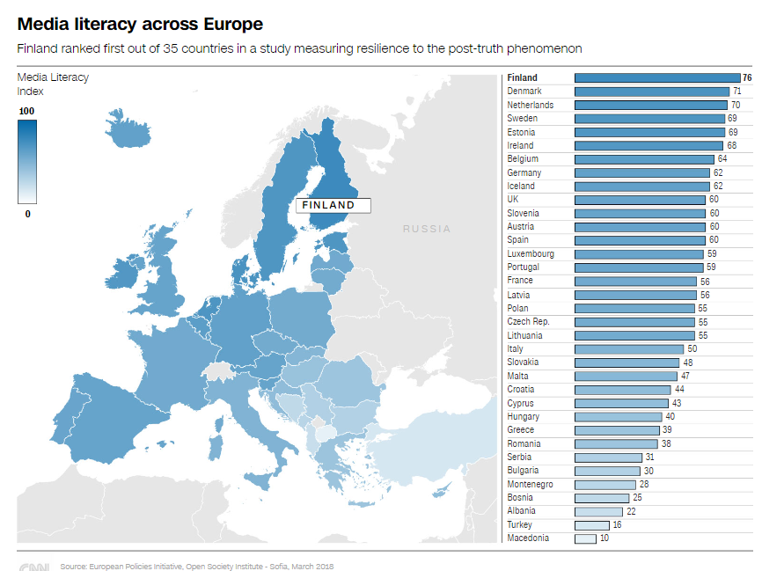

Slide 9
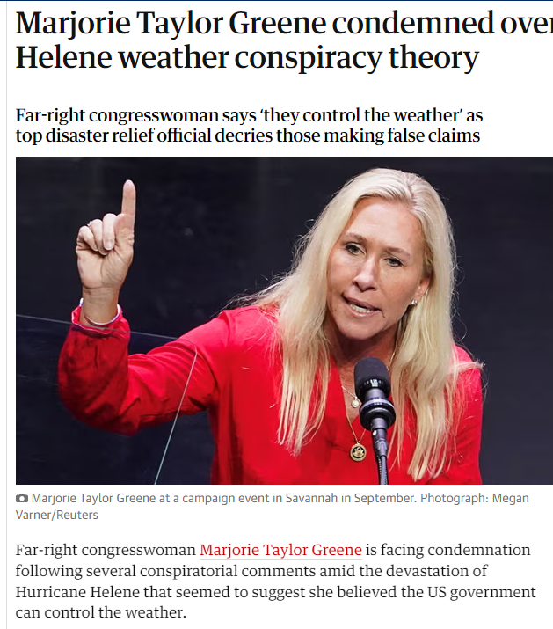
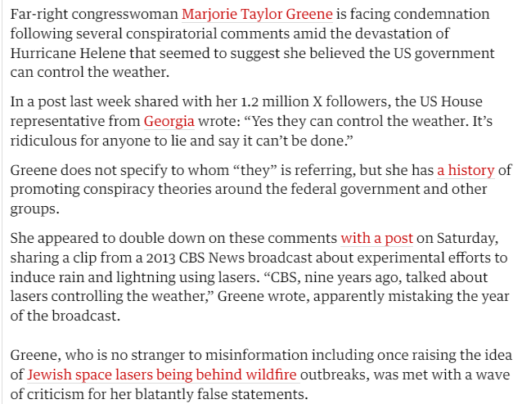

Slide 10
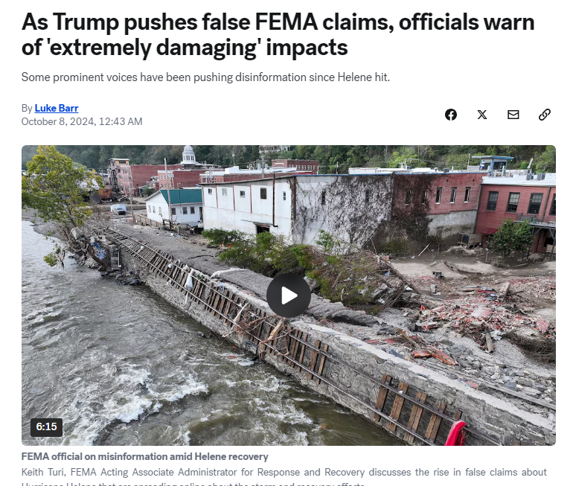
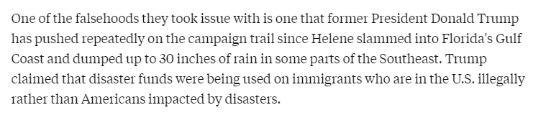
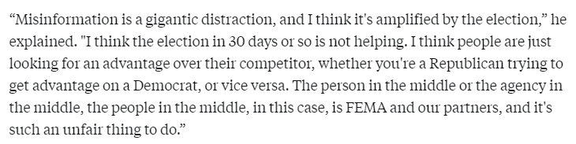

Slide 11
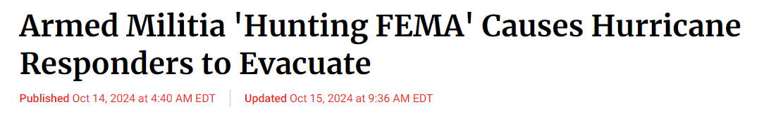

Consequences

Slide 12
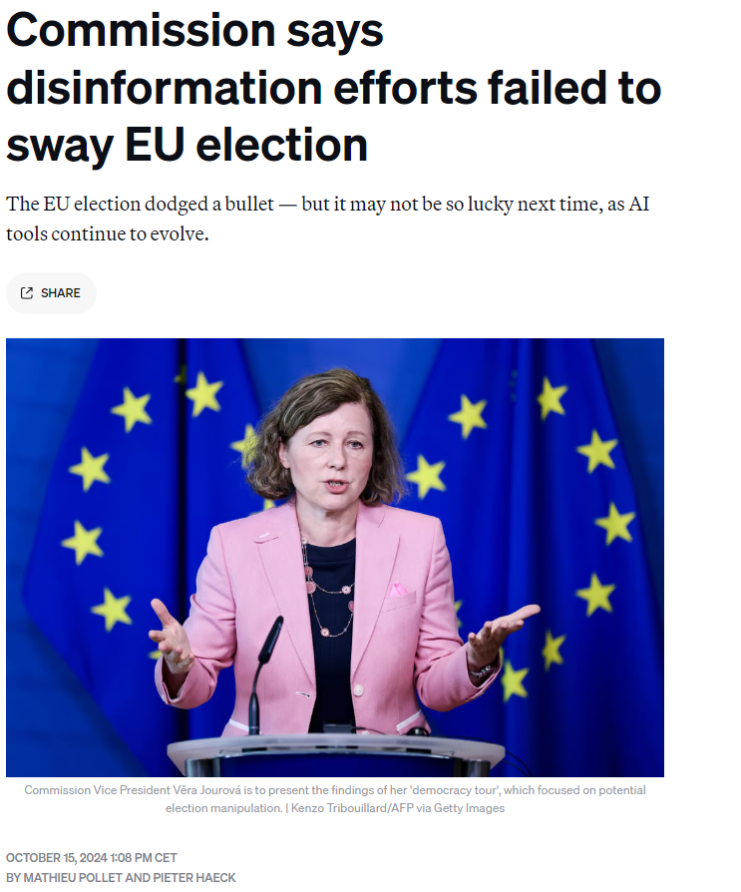
EU?

Slide 13
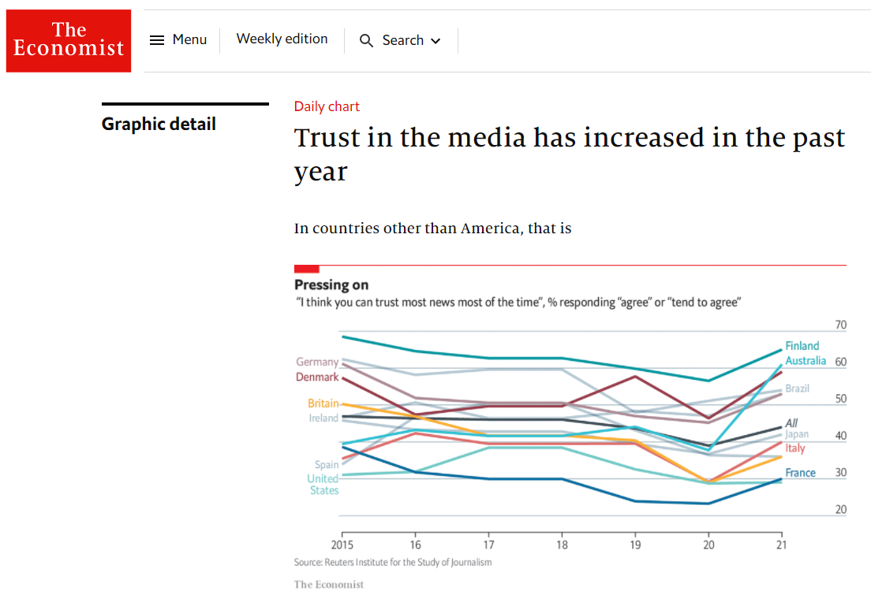
Notes:
Also internationally, tendency goes towards more trust, although in some cases from a low level – note the number of countries and the „All“ average – still below 50%!
The worldwide pandemic is often discussed in the context of fake news – but credibility of media increased overall.

Slide 14
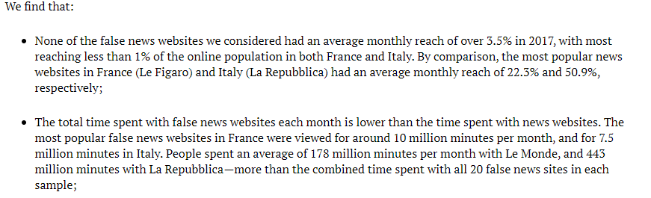
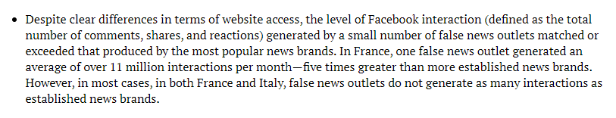
Them but not us (remeber this for later)
Notes:
https://reutersinstitute.politics.ox.ac.uk/our-research/measuring-reach-fake-news-and-online-disinformation-Europe
This factsheet, authored by Richard Fletcher, Alessio Cornia, Lucas Graves, and Rasmus Kleis Nielsen, presents an analysis of the reach and engagement of false news websites in France and Italy in 2017. Key findings include:
False news websites had a limited reach, with none exceeding 3.5% of the online population in either country. In comparison, top news sites like Le Figaro and La Repubblica had much higher reach (22.3% and 50.9%, respectively).
Time spent on false news sites was significantly lower than on legitimate news sites. For instance, people spent 10 million minutes per month on the most popular false news sites in France versus 178 million minutes on Le Monde.
However, some false news sites generated significant interactions on Facebook, occasionally exceeding those of established news brands. In France, one false news site averaged over 11 million interactions monthly.
The study concludes that while online disinformation is a serious issue, its actual reach is more limited than often assumed.

Slide 15
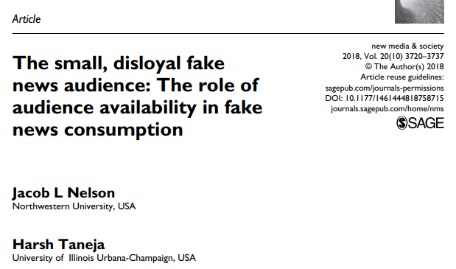
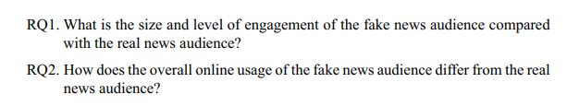
“Our findings indicate that the fake news audience is small and comprises a subset of the Internet’s heaviest users, while the real news audience commands a majority of the total Internet audience. Not only are established news brands’ audiences significantly larger, but they are more loyal as well. Fake news sites, on the other hand, suffer the downside of the Law of Double Jeopardy—small, disloyal audiences. These findings are consistent with prior research that concludes that light users tend to stick to the most popular content, while heavy users consume both the popular content while also venturing out to more obscure fare.”
“The use of these platforms alone does not lead to the consumption of fake news. Rather, it is the amount of time a user spends with Facebook that is likely correlated with levels of fake news use.”
“In light of this theoretical basis, we believe that fake news is likely to remain a small audience phenomenon, especially considering that even during an election cycle, when news appetite is highest (Mitchelstein and Boczkowski, 2010), we saw that the audience for fake news was still both small and disloyal.”
Notes:
Double jeopardy is an empirical law in marketing where, with few exceptions, the lower-market-share brands in a market have both far fewer buyers in a time period and also lower brand loyalty.
The term was originally coined by social scientist William McPhee in 1963 who observed the phenomenon, first in awareness and liking scores for Hollywood actors, and later in behaviours (e.g. reading of comic strips and listening to radio presenters).^{[1]} Shortly afterwards Andrew Ehrenberg discovered the double jeopardy law generalised to brand purchasing.^{[2]} Subsequently, double jeopardy has been shown to apply across categories as diverse as laundry detergent to aviation fuel,^{[3]} across countries and time.^{[4]}
This empirical law-like phenomenon is due to a statistical selection effect that occurs if brands are broadly substitutable selling to much of the same types of people (often referred to as a lack of product differentiation and market partitioning). The double jeopardy empirical generalization is explained and predicted by the NBD-Dirichlet theory of repeat purchase.^{[5][6]} See also Schmittlein, Bemmaor and Morrison (1985).^{[7]}

Slide 16
But…
“This suggests that even if individual fake news sites continue to draw small audiences, fake news in general could have a corrosive effect on the news media environment, by making it more difficult for audiences to determine what is real and what is not.” (“Dilution”)
“When it comes to news audiences in the United States, our findings suggest that the current news crisis may be less about an abundance of fake news than a lack of trust when it comes to real news. Only about a third of Americans currently have confidence in the mass media “to report the news fully, accurately and fairly”—the lowest level of trust since Gallup began asking the question in 1972.”
“Dark social web”

Slide 17
?
What does that have to do with you/IT/CS?
Notes:
Hacking of credible sources is a major enhancement of reach and perceived trust.
Recognizing fake news faster for debunking/removing requires is an interdisciplinary effort.

Slide 18
Definition of „fake news“
It is false.
It is intended to deceive people (mostly political agenda).
It does so by trying to look like real news (look and feel).
What psychological mechanisms does it influence?

Slide 19
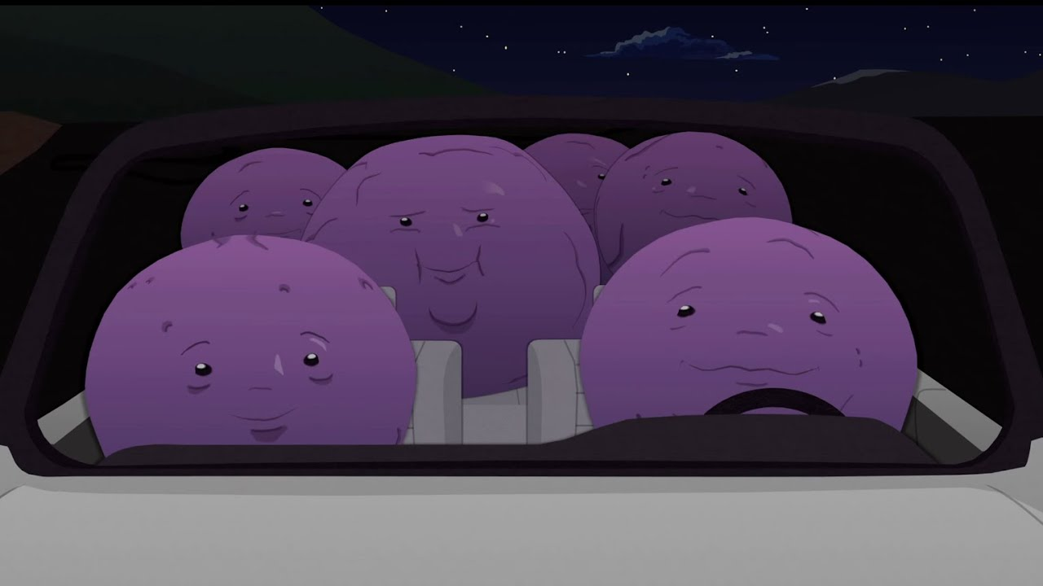
Perception (remember me!)
Bottum – Up
  Direct perseption
  Template
  ‘Feature-matching’
  Recognition-by-components (RBC)
Top – Down
  Perseption not automatic
  Cues and context
  Experience based

Slide 20
Attitudes and beliefs
’Yale’ group
  Carl Iver Hovland & Janis (1959)
  Who (source)
    Experts vs. Non-experts
    Popularity
    Quick talkers
  What
    Influence
    Fear arousal
  Who (receiver))
    Self-esteem
    Attention
    Age

Slide 21
Attitudes and Beliefs
Compliance vs conformity (vs obedience)
Ingratiation (Jones, 1964)
Reciprocity Principle (Regan, 1971)
Notes:
The fundamental difference between conformity and compliance is that compliance involves people going along with an explicit request, whereas conformity involves people adhering to 'unspoken rules'. We comply with people's requests because we like to be seen as helpful.

Slide 22
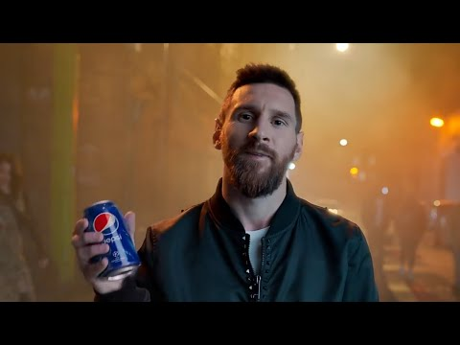
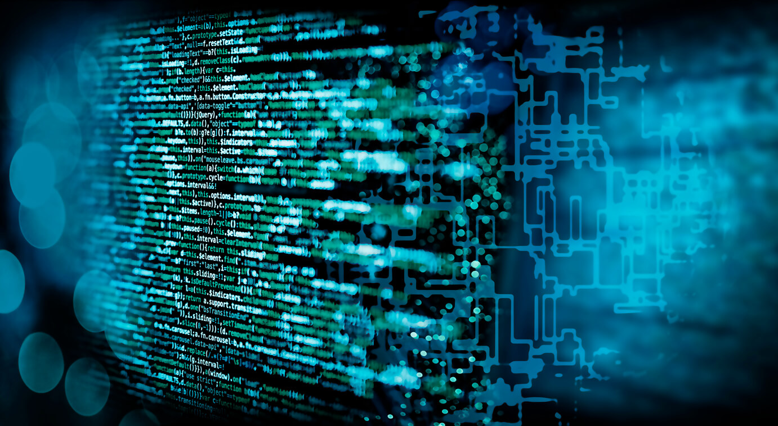
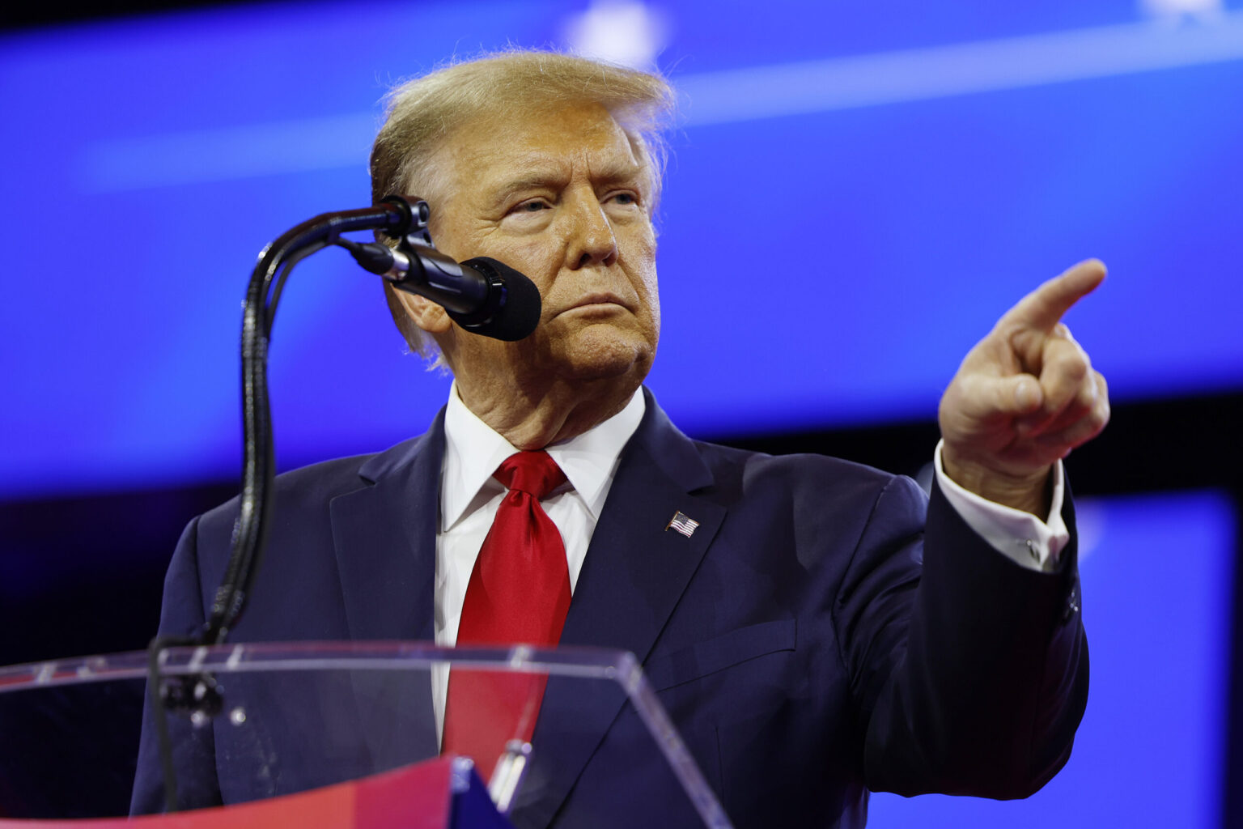
Attitudes and Beliefs
Source:
  Credibility
  Similarity
  Involvolvement

Slide 23
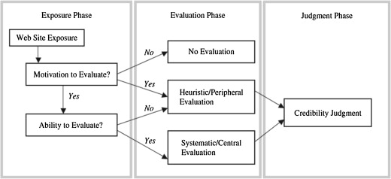
Sender Factors
Obvious: Message from a credible source is perceived as credible.
Judging the source‘s credibility rather than the message content is a cognitive low-cost way for quick judgment.
A news story posted on facebook is considered to be more credible by a traditional news media account, than when the same story is shared by a personal contact.
This difference narrows when the news article is of lower relevance. Fake news are thus easier to convey when they are not actively „imposed“ on us and appear more as a subtle side „activity“.
A low motivation to process information -> apply heuristics.
Effects:
  mimicking layouts
  quoting experts
Luo et al. (2013)
Media competencies
Notes:
So what makes fake news credible? Let‘s look at Sender, Message, Content and Receiver characteristics.
A low motivation to process information -> apply heuristics. Just like IT_Professionals in a phishing campaign – low motivation compred to scared stuff, motivated by anxiety.

Slide 24
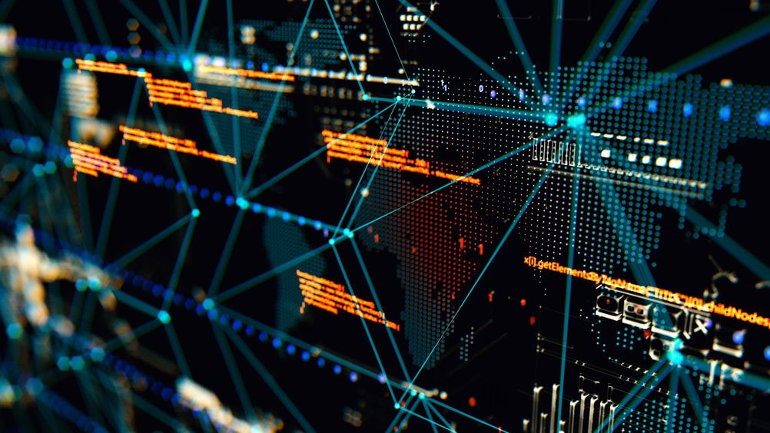
Attitudes and Beliefs
Message
  1 side vs. 2 side of arguement
  ’Mere exposure effect’
  Fear
  Emotion vs Fact
    Transfer of effect
      Assosiations
  Message Framing
    Prevention loss vs. Promotion gain

Slide 25
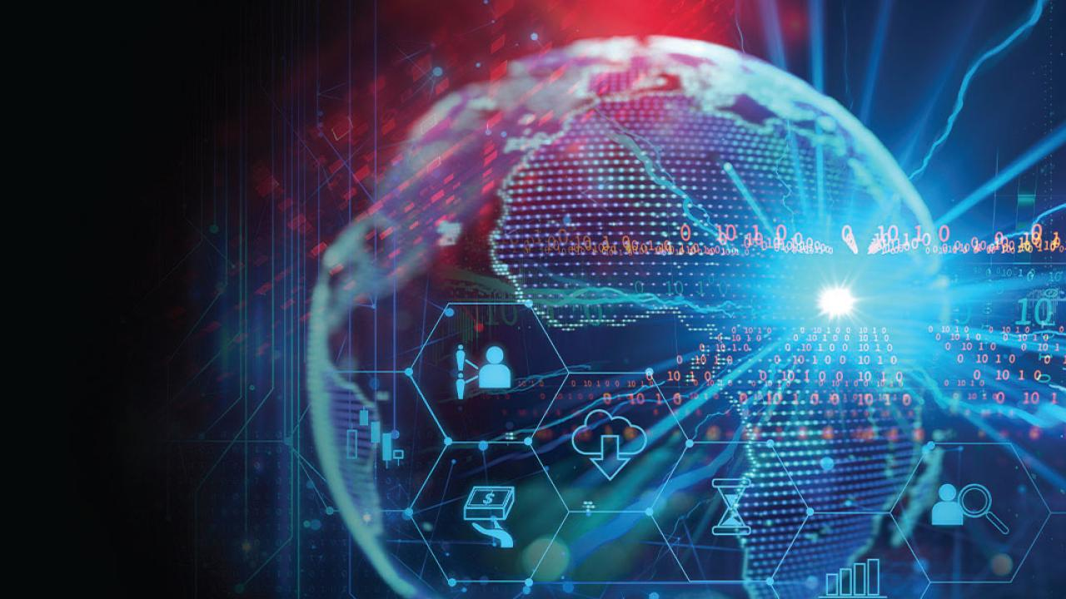
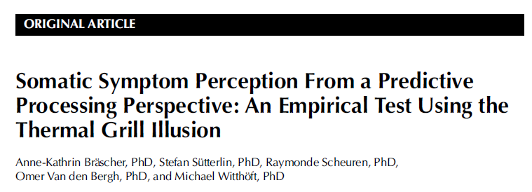
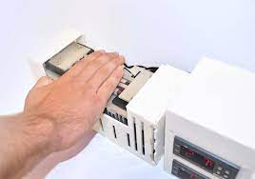
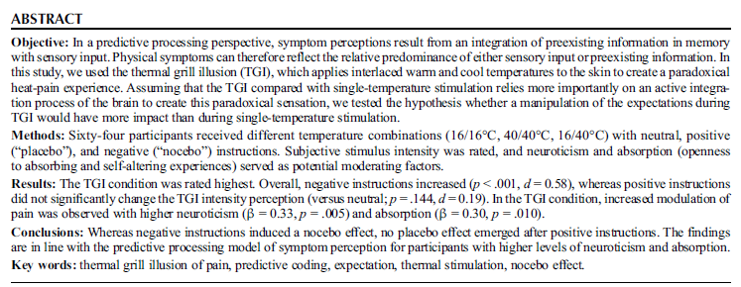
Message Factors
Popularity heuristic („Social Proof“; ->One of Cialdini‘s Persuasion Principles)
Clickbait content, click farms, paid trolls, bots
Social Proof is a particularly powerful tool: -> Thermal Grill Illusion of Pain induced by verbal cues.
IEEE Haptics Symposium (2018)
Notes:
Herdentrieb
Erkennen von Bots ist eine Aufgabe der IT – Bots simulieren aber auch Menschen immer besser.

Slide 26
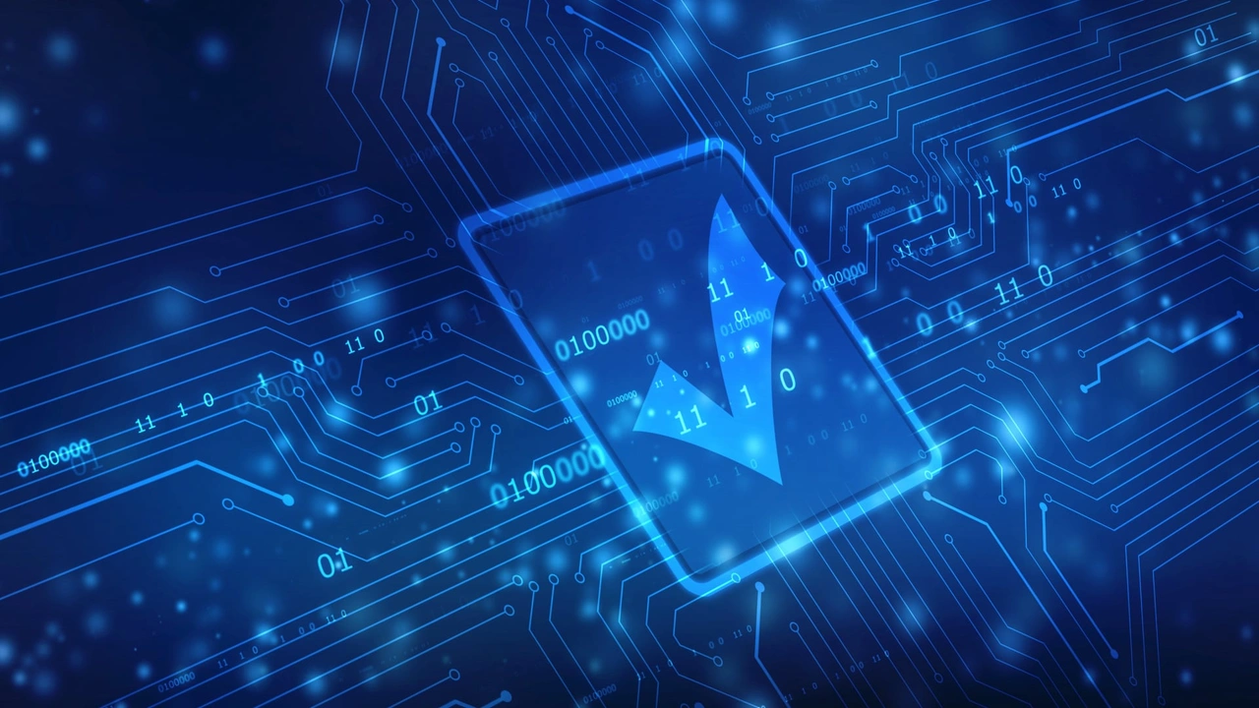
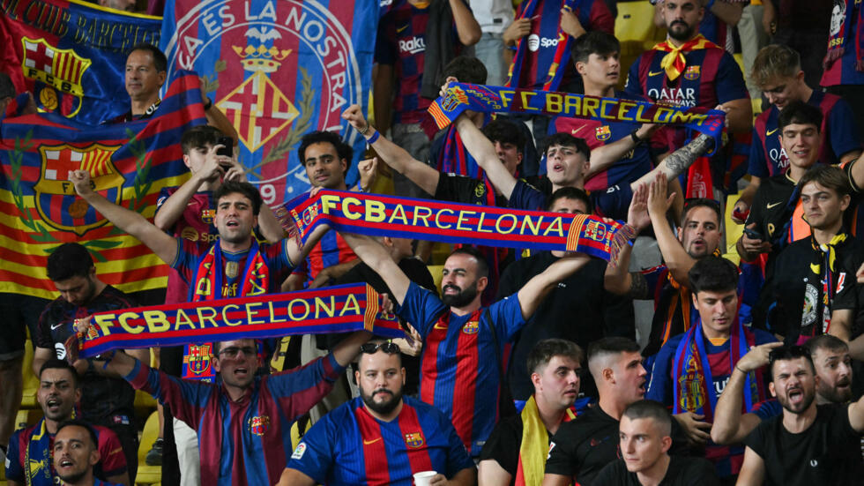
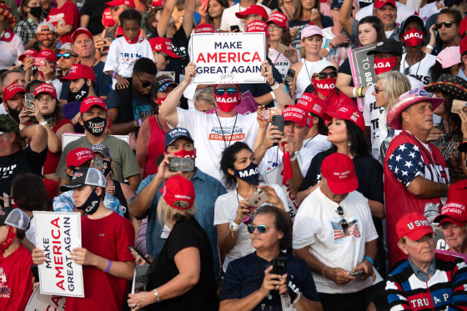
Attitudes and Beliefs
Receiver
  Self-esteem
  Age
  Gender
  Individual differences

Slide 27


Attitudes and Beliefs
ELM (Petty & Cacioppo, 1986) & Heuristic - Systematic Model (Chaiken, 1987)
Sentral – Conscious route
Heuristic – Peripheral route

Slide 28
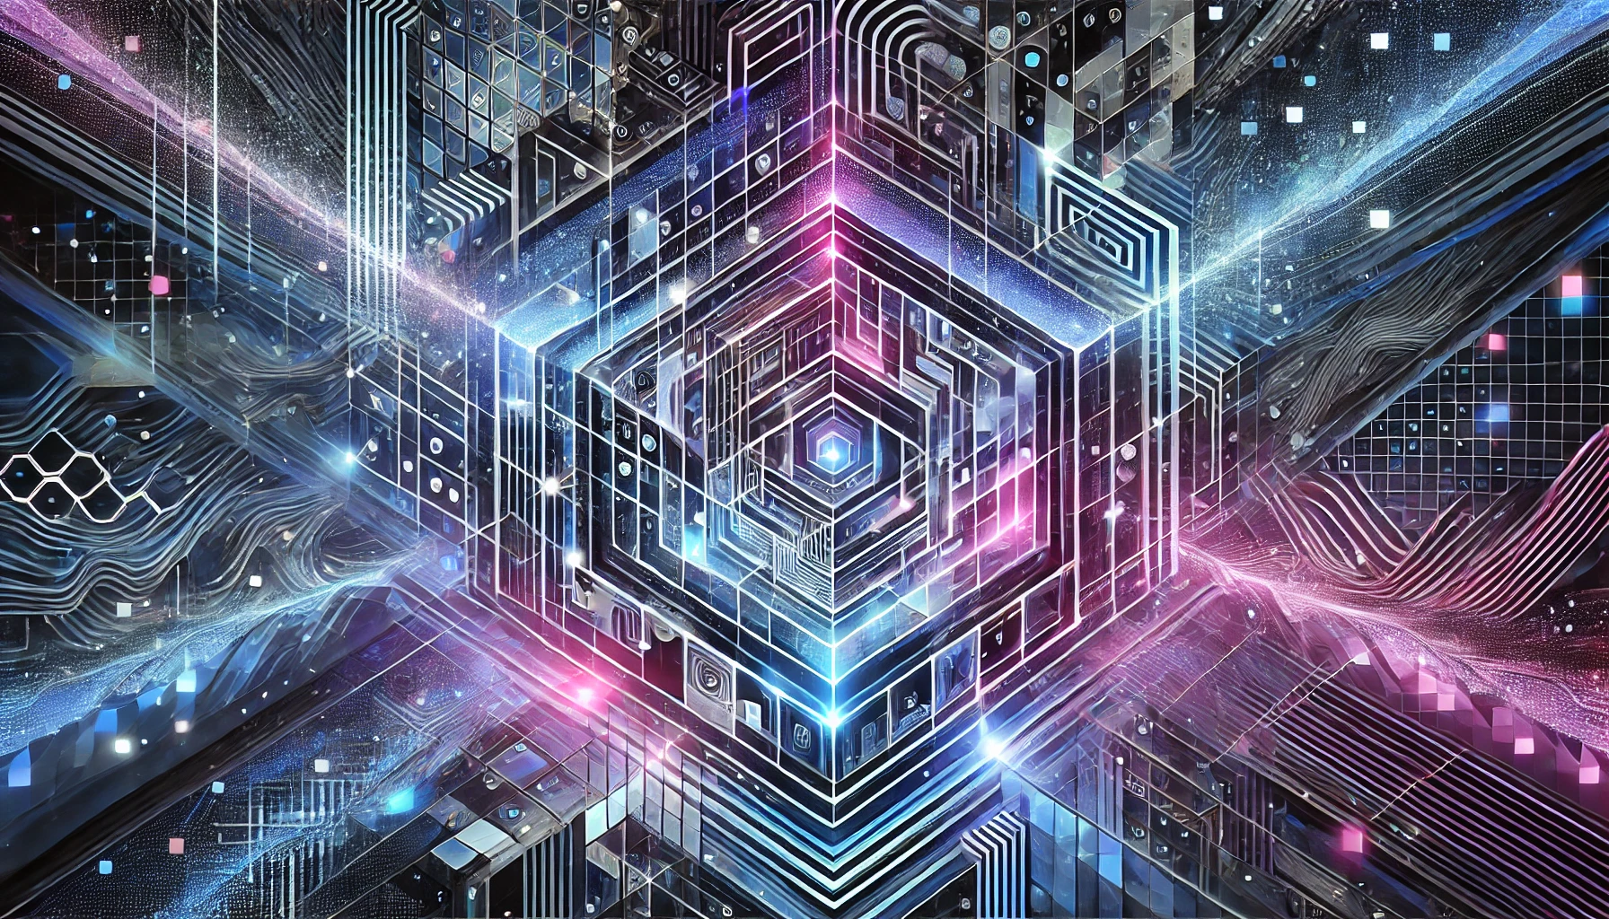
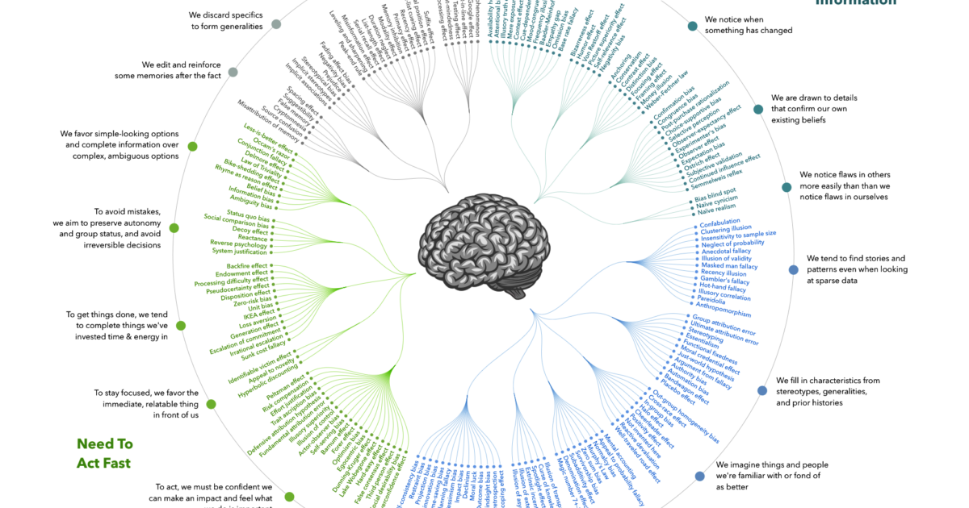
Attitudes and Beliefs
Cognitive Biases (cognitive bias codex)
  Anchoring and Adjustment (Tversky & Kahnemann, 1974)
  Confirmation Bias (Plous, 1993)
    Attitude polarization
  Belief Bias (Markovits, 1989)

Slide 29
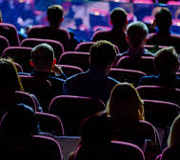

Other Receiver Factors
Selective exposure: select outlets that match beliefs and predispositions
Reduce „cognitive dissonance“, increase consistency
Social networks: Selection shifts from choosing sources to choosing messages (indirectly by friends and previous behavior)

Slide 30

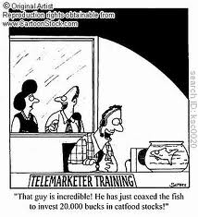
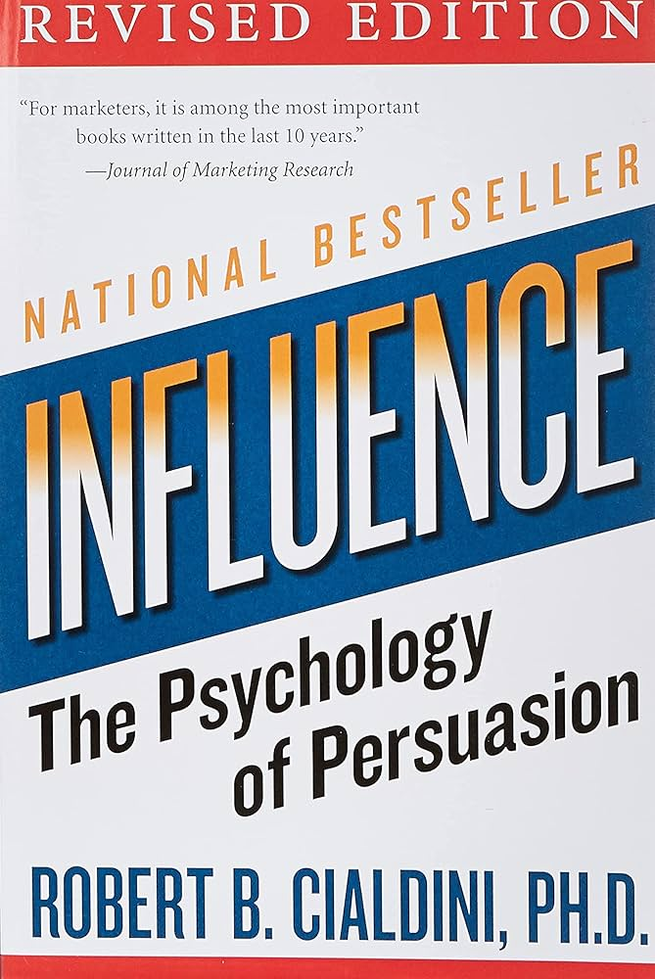
Attitudes and Beliefs Interactions
Sender & Message & Receiver (& Channel)
Multiple ’Requests’
  Foot-in-the door
  Door-in-the-face
  Low-ball
Cialdini (2001)

Slide 31



Influence: Consistency and Commitment
& Mere Exposure effects
Notes:
Bakshy, E., Messing, S., & Adamic, L. A. (2015). Exposure to ideologically diverse news and opinion on Facebook. Science, 348(6239), 1130-1132.
Facebook algorithms and consumer choices were measured to see what decided the content shown in feeds. Humans made more ideological consistent choices. Seeing cross-cutting content relative to ideologically consistent content is 5% for conservatives and 8% for liberals. Clicking: comparing the likelihood that an individual clicks on a cross-cutting content relative to a consistent content to be 17% for conservatives and 6% for liberals, a pattern that is consistent with prior research, but is somewhat counterintuitive

Slide 32

Channel Factors
Option to flag fake news
Alerting user when they are about to share fake news
Third-party fact checkers
Increase of FN spreading in closed social media applications
Whattsapp response: suspend accounts that behave like bots (too fast, too many groups per account) -> bots imitate humans
Limited size of groups
Limited forwarding
Forward indicator
Results: slow down of FN spreading (at best)

Slide 33
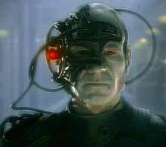
Resistance is Futile?
Reactance
Forewarning
Innoculation
More in designing training!

Slide 34
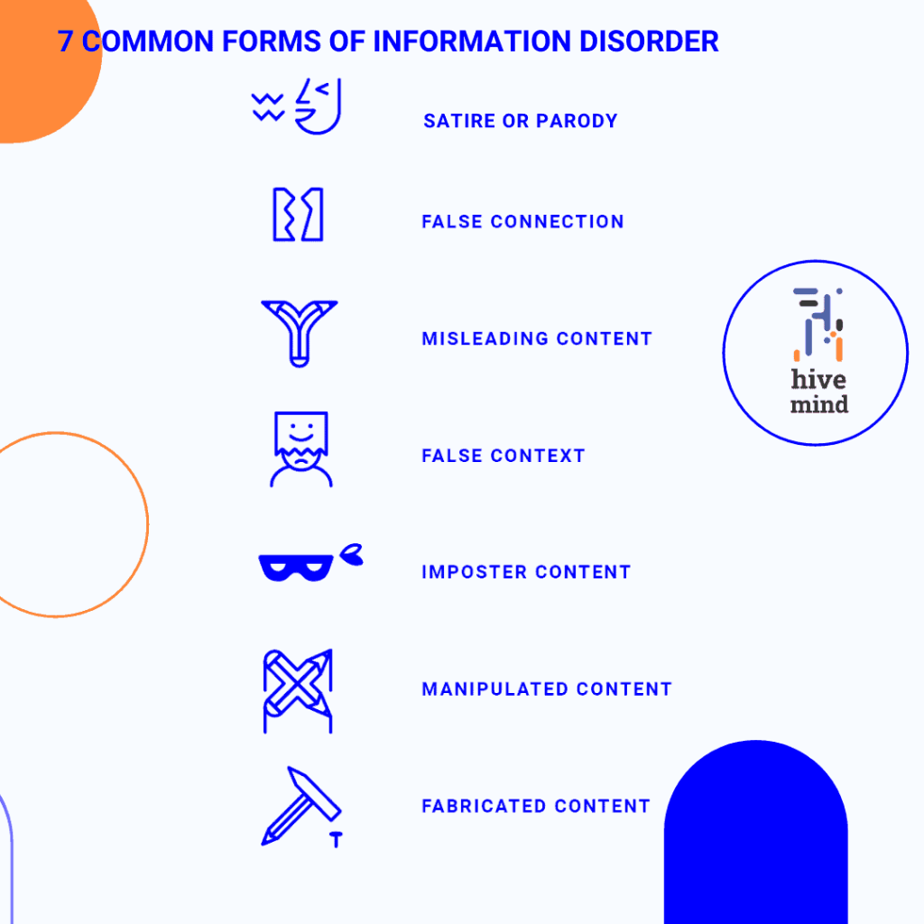
Information Manipulation
Notes:
Eight reasons for production and spread of FN
Poor Journalism
Parody
Provoke
Passion
Partisanship
Profit
Political influence/Power
Propaganda

Slide 35
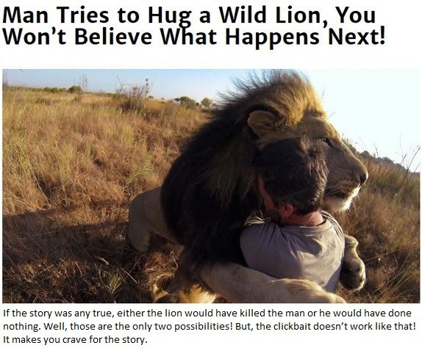
Types of Fake News - Misleading content
Editing with omissions, a misleading title etc.
Clickbaiting - content whose main purpose is to attract attention and encourage visitors to click on a link to a particular web page.
Notes:
Intentionally misleading content can create anger
People might share information in misleading way to frame an event, issue or person in a particular way. An example is when an old photo is used on a recent social media post. It might spread outrage or fear until the photo receives the right context.

Slide 36
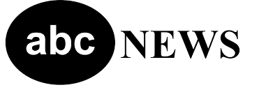

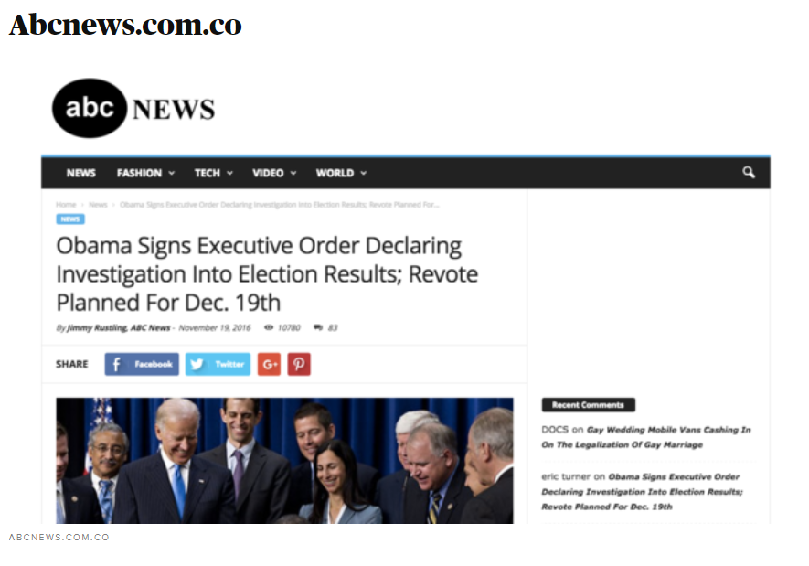
Types of Fake News – Imposter Content
Notes:
Left one is a fake news site that has been brought down. A fake news channel that even managed to fool journalists.
Fake news creators frequently use web addresses that are subtle variations of well-known news websites.
Impersonation can cause harm in many ways
This is when a person, group or organisation pretends they are another person or source. Imposter content can trick people into:
sending money
sharing personal information
further spreading misinformation.

Slide 37
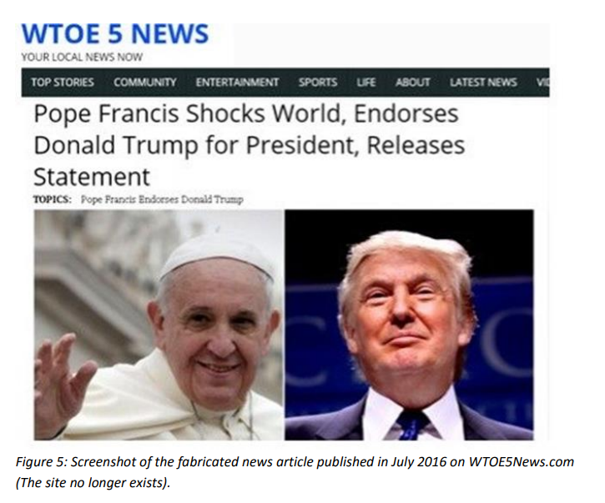
Types of Fake News - Fabricated content
Notes:
Completely false information can lead to harm
Fabricated content is disinformation created without any connection to truth. Its overall intention is to deceive and harm. Fabricated content can quickly become misinformation.

Slide 38
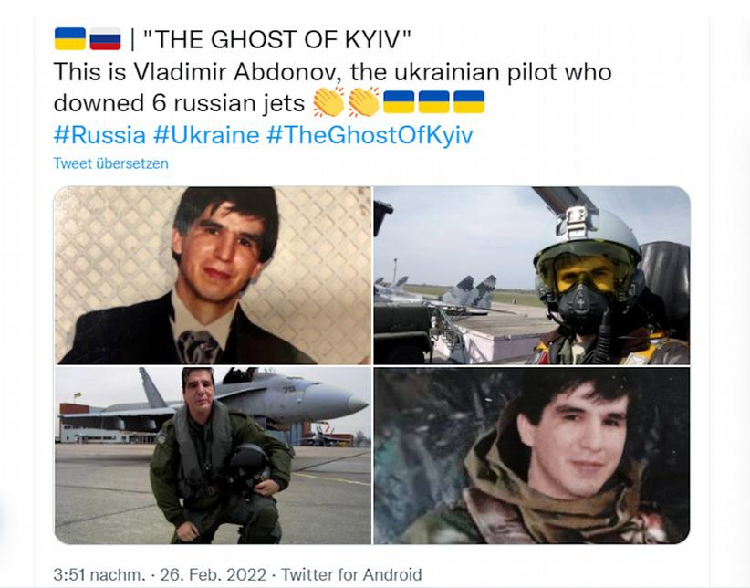
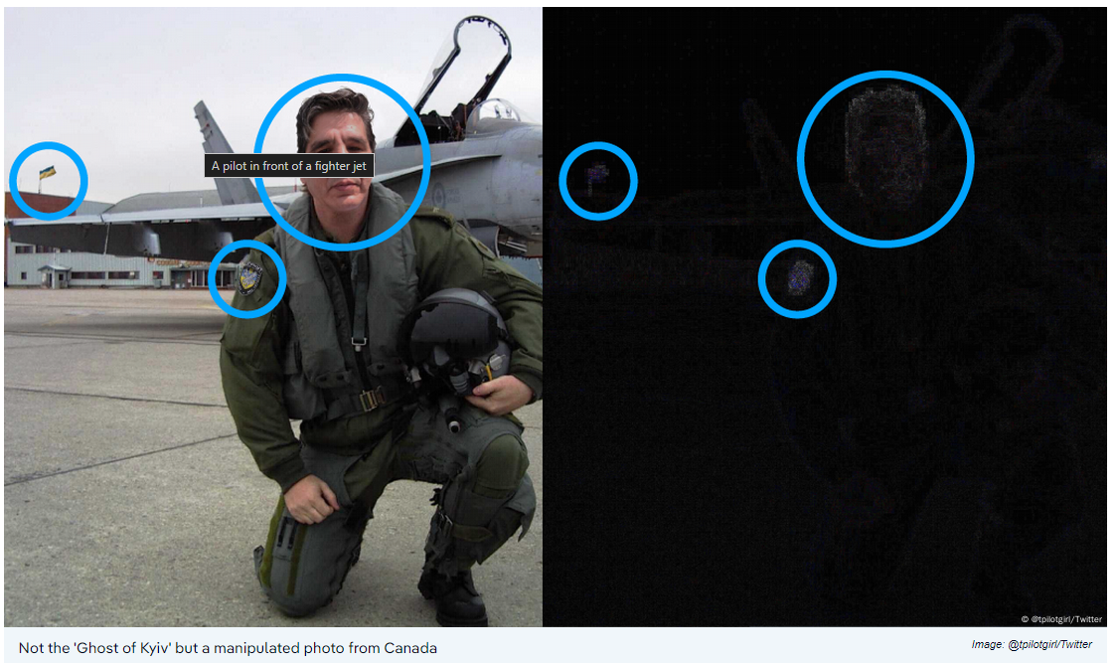
Types of Fake News – False Connection
Notes:
Content is put in the wrong relationship. For example, headlines or images do not match the content.
2. False Connection
When headlines, visuals or captions don’t support the content.
Although we can at first think that false connections, such as, for example, clickbait headlines, can do no harm, only irritate; in a larger perspective this practice may undermine trust in media and promote polarization.
False connections utilize real facts or images along with made up content (or vice versa).
You may have heard of the ‘Ghost of Kyiv’ stories that spread in the news shortly after the Russian invasion of Ukraine. There was no such Ukrainian pilot, but it did not stop the Ukrainian Armed Forces from circulating old photos of unidentifiable pilots from years prior claiming them to be the Ghost. Once the belief in the pilot became widespread, streaming content was altered to further validate the lie. Captured video game content was used and spliced into real video making the claim that it was indeed the ‘Ghost’ in action chasing Russian pilots. An abbreviated story about this, along the shared photos can be found through the Associated Press:
A reverse image search confirms the suspicion that it's a fake. The same photo appeared online years ago, but with a different head, a different badge on the arm and no flag in the background. If you look closely at the plane behind the pilot, you can see a gray maple leaf — a symbol used by the Royal Canadian Air Force. This was presumably missed when the picture was manipulated, and it gives away that most likely it's a picture from Canada.
In fact, the man rumored to be "Vladmir Abdonov" whose face has been cropped into other images is an Argentine lawyer from Buenos Aires, who was amused about his new hero status and posted about it on Twitter.

Slide 39
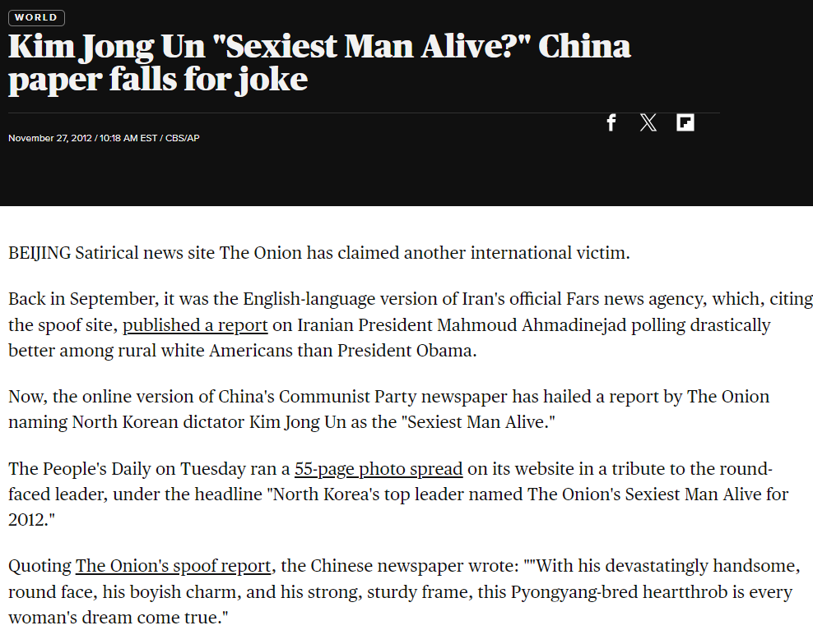
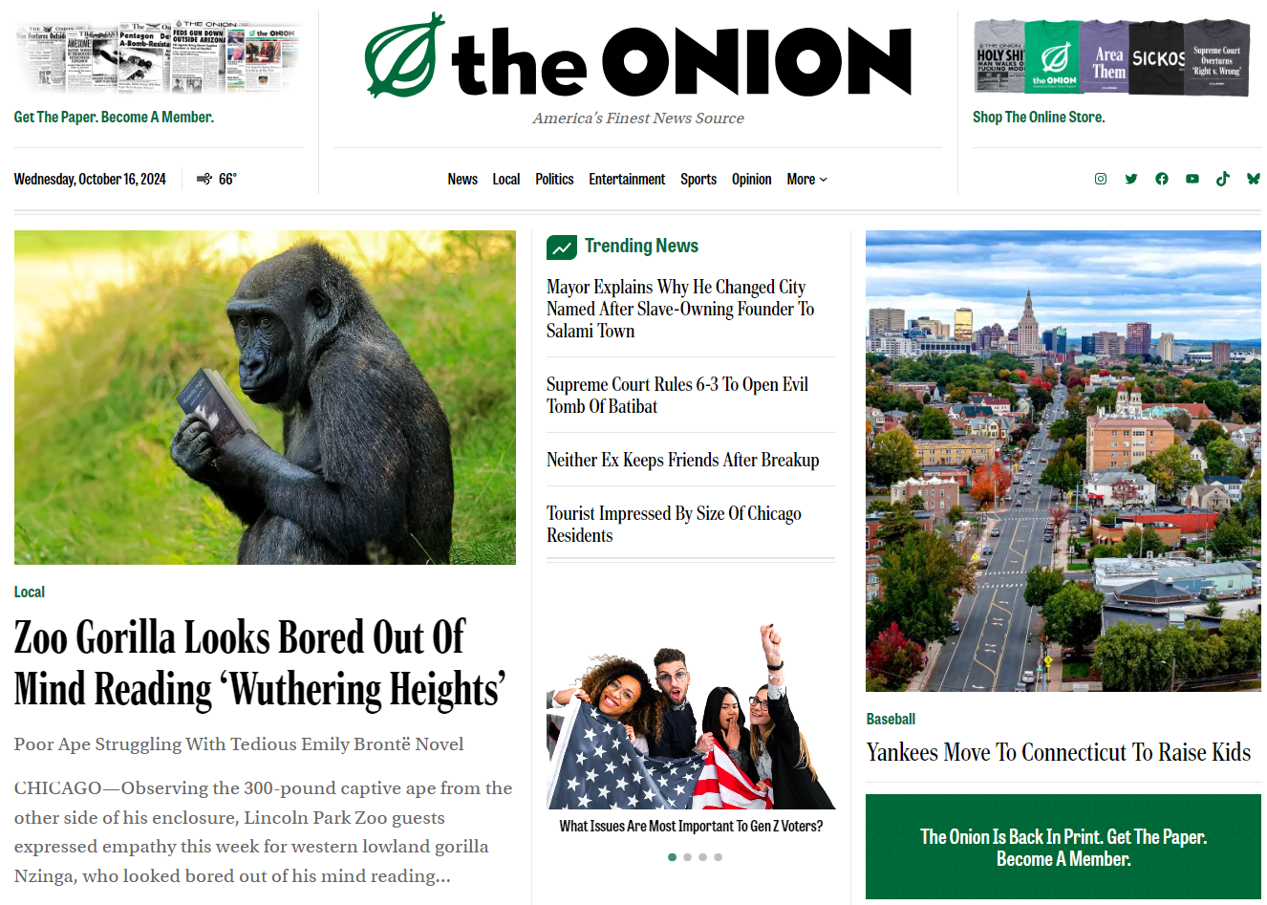
Types of Fake news - Satire/Parody
Notes:
Satirical content and parodies can spread misinformation
This is misleading information that is not intended to harm. Creators of the content know the information is false, but share it for humour. However, if people misunderstand the intent, they might spread it as true.

Slide 40
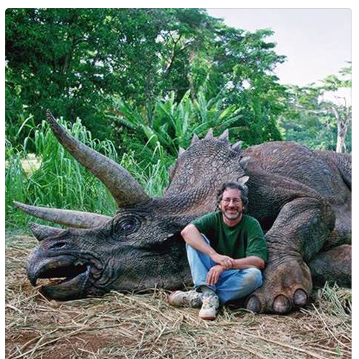
False context
„Correct“ photos or statements appear in a context where they did not originate from – a mix of truths resulting in a lie.
Notes:
Giving fake context can cause unnecessary outrage
Fake context is when information is shared with incorrect background information.
A lighthearted example is a popular photo of young director Steven Spielberg posing and smiling with a large dead animal. Many people felt outrage for his hunting of an endangered animal. However, the correct context was that he was on set of Jurassic Park and posing with a prop triceratops.
Usually, someone spreading disinformation will ‘alter’ the context of information. The intention is to convince people of their belief or viewpoint.
True information that’s altered is hard to notice
Manipulated content is real information, images or videos that are altered or changed in some way to deceive others. Some deepfakes are an example of such content.

Slide 41
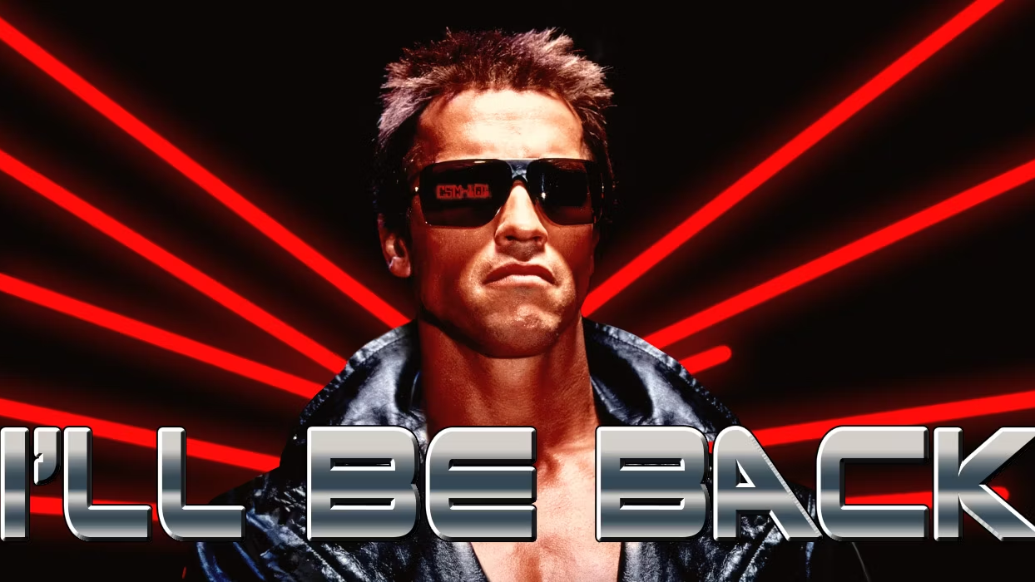
Types of Fake News - Manipulated content
Deepfakes, photoshopped photos, etc.

Slide 42

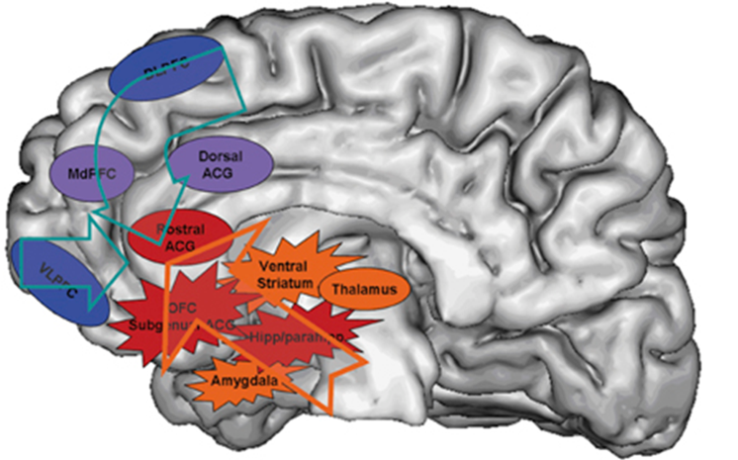
Psychology of Fake News
Consistency bias (confirmation of own opinion -> message appears more credible)
Illusory truth effect (repetition increases credibility, even if initially low) – Mere Exposure
System-1 thinking (-> Cog. Refl. Task)
A bat and a ball cost $1.10 in total. The bat costs $1.00 more than the ball.
How much does the ball cost?
Notes:
Example for illusory truth effect: the stolen presidency – the BIG LIE

Slide 43
Other influencing factors for believing in FN
Put the following potential factors of influence in an order, start with the one you consider most relevant.
  Age
  Gender
  Education
  Political orientation
Notes:
Pol orientation – we already had that – and somewhere in the same league >65 year olds.
Gender and education have no effect.

Slide 44

?
What is the relationship between belief in fake news and education levels/intelligence in complex matters (e.g. vaccination topic in C-19 pandemic)?

Slide 45
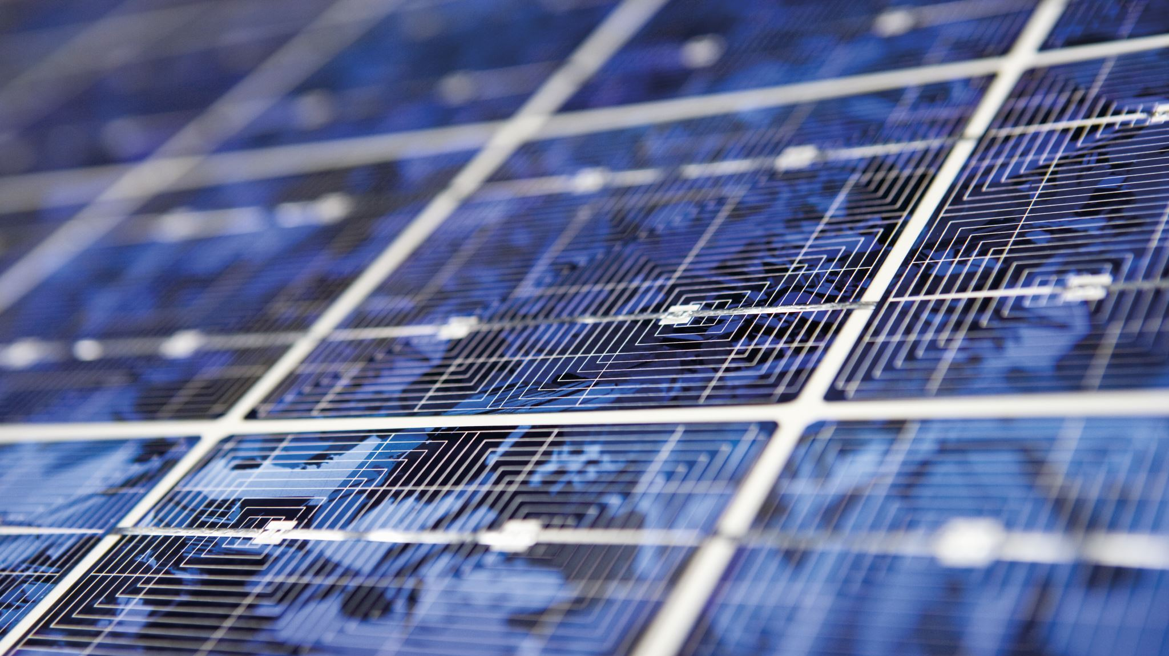
Answer
Political orientation: Conservatism
Gender: no effect
Education: no effect (except in complex matters)
Age: 7x higher probability to share FN >65y comp. 18-29y
Stable after controlling for pol.or.
-> ? Media consumption patterns, used to high-qual journalism -> prevalence effect?

Slide 46



“Thus, we conclude that analytic thinking is used to assess the plausibility of headlines, regardless of whether the stories are consistent or inconsistent with one’s political ideology. Our findings therefore suggest that susceptibility to fake news is driven more by lazy thinking than it is by partisan bias per se – a finding that opens potential avenues for fighting fake news.”
Notes:
So you have to get people to think critically – so there are possibilities for effects.
You don't bend it so much, you just don't think about it at all. Consequences? Information about FN and how to recognize it has a very limited use. You need a more intuitive approach.

Slide 47
Judgment of Plausibility
Mental model is instantly and automatically activated or created and fed with (Top-Down):
Information from the text
Preexisting knowledge
Preconceptions
Long-term memory
We automatically confirm our (positive or negative) expectations.
Only if we are aware of these biases, we can (if motivated) counteract them with following strategies to reduce the text-conception-discrepancy-bias:
Systematic argumentation against conception-inconsistent arguments.
Alternating reading of pro-/con-information

Slide 48



Even when people acknowledge that their views are based on erroneous information, they find it difficult to adopt an alternative view.
Notes:
Affirm identity: „vaccination is patriotic“

Slide 49


High verbal intelligence serves political polarization.

Slide 50
Deep Fakes
Manipulated information

Slide 51



The «New» Challenge: Deep Fakes
In “conventional” SE attacks low-tech attacks meet unprepared “brains”
In an evolving SE landscape, AI-based DF become the new powerful threat
While the same principles apply, the information is now conveyed by a person of authority or trust, rather than from “outside” and only in written/unpersonal form, making the application of the same principles more convincing.

Slide 52


https://www.syzygy-group.net/en/imagine/

Slide 53



Creators of DF tech claim that DF can be used for fun and entertainment.
However, besides classic cybercrime and social engineering, DF are expected to play an increasing role in political disinformation campaigns.

Slide 54



DF Detection
Some DF are perfectionist and not distinguishable from unauthentic information.
Most DF, however, have technical imperfections, recognizable by the attentive human. In addition to technical imperfections, the content transported in the message may also provide a clue.
Gupta et al. (2020)

Slide 55






A Parent’s Love

Slide 56

Types of DF
Face-swap/identity-swap,
Face-reenactment/puppet-mastery,
Lip-syncing,
Facial attribute manipulation, and
Entire face synthesis (Masood et al., 2021) which can be separated into two main cat-egories of facial manipulation methods (Zollhöfer et al., 2018):
  1) facial expression manipulation and
  2) facial identity manipulation. Glitches and minor errors in imper-fect deep fakes such as asynchronous lip movements can reveal the inauthenticity.
Notes:
Eye-tracking studies revealed the interplay between attentional focus and imperfec-tions of DF, resulting in an eye- tracking database provided by Gupta and colleagues (2020). The cognitive processes involved make DF recognition a perceptual task ben-efitting from experience and knowledge (top-down), but also determined by attention-al control and shifts (bottom-up).

Slide 57

Go see video
Notes:
https://www.youtube.com/watch?v=B4jNttRvbpU&ab_channel=CBCNews%3ATheNational

Slide 58

Deepfakes are concerning for several reasons:
Disinformation and Manipulation:
  Deepfakes can create highly realistic but entirely fabricated videos or images of public figures, celebrities, or anyone, making them appear to say or do things they never actually did. This can be used maliciously to spread disinformation, defamation, or propaganda.
Erosion of Trust:
  The increasing prevalence and sophistication of deepfakes can undermine public trust in digital media and online information. It becomes harder to distinguish between real and fake, which can have serious implications for journalism, politics, and public discourse.
Invasion of Privacy and Consent:
  Deepfakes can be used to create non-consensual explicit or intimate content, which is a form of image-based sexual abuse and a violation of privacy.
Potential for Exploitation:
  Deepfakes could be exploited for financial gain, such as creating fake endorsements or advertisements, or for political manipulation and cybercrime.
Ethical and Legal Concerns:
  The creation and distribution of deepfakes raise complex ethical and legal questions around issues like freedom of expression, defamation, and intellectual property rights.

Slide 59




Slide 60



Slide 61

AI-based DF meet unprepared humans, who do not have technical tools for DF detection available, or are not aware of it.
To design effective training methods to increase DF recognition skills, we need an empirical-based understanding on the reasons for individual differences in DF detection skills.
Our main research question:
Is the individual skill in deep fake recognition related to the viewers’ personal political orientation?
Notes:
Wie gehen wir diese Forschungsfrage also ganz systematisch an?

Slide 62

Political ideology is not only a set of beliefs. Sets of beliefs, attitudes and cognitive patterns are hardwired and have neuronal correlates responsible for cognitive processes such as attention, emotional reactions to certain stimuli and priorities (subjective value) of competing goals, etc. Thus, it is only logic to conclude that stable political-psychological traits can be found in the processing of perceptual characteristics of politically relevant content.

Slide 63


Deepfake in Social Engineering
Conservatism:
Greater sensitivity to threatening stimuli
Liberals Vs Conservatives: Psychological Differences Between Brains (businessinsider.com)
DFs allow cybercriminals to impersonate other individuals
Few individuals have the technical tools and background needed to detect DFs
People will have to rely on their DF detection skills to avoid Social Engineering
Now one of the fastest-growing forms of adversarial AI, deepfake-related losses are expected to soar from $12.3 billion in 2023 to $40 billion by 2027, growing at an astounding 32% compound annual growth rate.

Slide 64



Knowledge-driven perception
Notes:
B or 13? Horse or Seal?
These pictures were presented for 400msec and the perception of viewers could be influenced by previous exposure. One of the possible interpretations was previously related to something nice and pleasant, whereas the other with something neutral. [give example on how that was done - Lexical Decision Task LDT]
One could argue that participants saw both and only chose to report the one they thought the experimenter wanted to hear - this alternative explanation, however, was dismissed after eye-tracking measurements assessing the first so-called “saccade” (eye-movemenet and fixation) which cannot be consciously controlled predicted their choice.
This may be one first evidence of motivational influences on perception.
The short presentation time in the previous experiment was followed by a longer time people had to report. So it is not entirely clear whether the process influencing the perception is a very early one of visual perception, or a later, higher cognitive one, of personal judgment. One way to to find out whether the effect is a very basic, early one is to use the concept of binocular rivalry.

Slide 65


Notes:
Here the coloured goggles made one of the two superimposed images invisible. Only one of the images was previously associated with financial gain, and this one was dominant.
So, what influences the perception? Our wishes and goals –

Slide 66




Looks like we cannot completely rely on our judgment of very simple physical characteristics.
Notes:
How much you want something – i.e. motivation – can also influence very basic assessments that subjectively seem absolutely rational and straightforward for the person.
People who are currently on a diet and have recently been exposed to images and thus thoughts of high-sugar food estimate the physical size of muffins to be greater in this study.

Slide 67

Mechanism: Attention narrowing
Positive feelings associated with approach cause the narrowing of cognitive and visual attention.
When pictures of desirable foods appear in the center of a computer screen, observers’ attention narrows, leading them to better recognize words presented in the center of the screen than words presented at the periphery.
“Participants showed less global attentional focus after viewing high-approach-motivating positive stimuli than after viewing low-approach-motivating positive stimuli.”
Narrowed attention limits access to relevant information such as alternative explanations and cues, such as cues of depth required to code distance.
Notes:
In the brain, we process a three-dimensional representation of the space around us – albeit not exactly. The focus of attention can only ever refer to a certain point in space, similar to a flashlight light, therefore also called "spotlight metaphor". Various brain injuries, esp. in the right hemisphere of the brain can impair or distort this representation of space – but that's another topic. In most cases, the focus of attention also corresponds to the visual focus – i.e. the point of sharpest vision that is projected in the fovea in the so-called yellow spot with maximum cone density – you may still know from biology class. Especially with positive emotions, the focus of attention is lower. Positive emotions tend to indicate that there is no danger from the periphery of the visual field and facilitate approach behavior. The term approach behavior is a biological one that goes hand in hand with clearly defined neuronal structures in motivation-related brain areas. Of course, this narrowing is then at the expense of this other information from the periphery, which is important for information such as the assessment of spatial depth – i.e. distance.
So this could also be an explanation for the fact that information that corresponds to me politically – i.e. my values and attitudes – and that I like with it, is judged less critically.

Slide 68






Notes:
The study by Garrett and Bond examines how conservatives and liberals differ in their susceptibility to political misperceptions. Using a 12-wave panel study and social media data, the researchers found that conservatives exhibited significantly lower sensitivity (AUC area under curve = 0.63) than liberals (AUC = 0.77) when distinguishing between truths and falsehoods.
Figure 2 The study also measured response bias, where conservatives were more likely to label all claims as true (truth bias), while liberals showed more significant improvements in sensitivity as the proportion of partisan news increased. Conservative respondents had a higher truth bias than liberals, meaning they were more likely to believe both true and false claims. The sensitivity gap was partially explained by the prevalence of politically charged misinformation favoring conservatives, while accurate news often benefited liberal positions. Effect sizes indicated that conservatives' sensitivity was closer to chance levels compared to liberals. The political information environment played a role, but ideological differences persisted even when controlling for the types of political claims. This study emphasizes the importance of addressing the information environment to reduce conservative misperceptions.
Figure 3 of the study highlights the ideological implications of political claims by comparing widely shared true and false statements. It shows that 65% of true statements favored the political left, while only 10% favored the right. In contrast, 45.8% of false statements benefited the political right, compared to 23.3% benefiting the left. This distribution suggests that accurate news tends to advantage liberals, while misinformation disproportionately supports conservatives, contributing to the gap in belief accuracy between the two ideological groups.
Figure 4 in the study shows how sensitivity to political claims varies by ideology and the proportion of statements that either benefit or harm the ingroup.
Liberals demonstrate a greater increase in sensitivity as the proportion of true statements that harm their political ingroup rises, indicating better discrimination between truth and falsehood in such cases.
Conservatives, in contrast, show a less pronounced increase in sensitivity when true statements favor their ingroup and exhibit smaller declines in sensitivity when falsehoods benefit their ingroup.
This suggests ideological differences in how individuals respond to politically charged information.

Slide 69


Slide 70
Research Methods
Correlational design based on self-reported data
Online Survey Microsoft Forms; (HSAS), n=163, 44% females
SECS to assess general conservatism across societal and economic topics
12 Political Statements across political spectrum (7 fakes)
Assess agreement with specific statement
Sociodemographic data: age, gender, educational level
Programm: Wav2Lip
  Insert audio track (.wav) and video (mp4) into the program
  Wav2Lip changes lip movements, not the face

Slide 71

Results
Social conservatism was negatively correlated with DF recognition skills (r=.27).
Agreement with individual statements was negatively correlated with DF recognition skills (r=-.35).
The effect remained unchanged, when controlled for age.

Slide 72

Device choice
Situational awareness reduced due to screen size and multitasking?
0,41 SD
Notes:
The difference seems moderate in the graphics – we don't use gut feelings for something like that. In the normal distribution, the area around the mean value plus-minus 1SD corresponds to 68% of the population, so here at 0.41 SD we are definitely dealing with a substantial part of the population that is additionally influenced by this. According to the general convention of 1988, this is referred to as a medium-strong effect.
Interpretation:
- with a larger screen (PC), more videos were correctly recognized on average
- Smallest screen (smartphone) detected the least on average
- Effect size between PC & smartphone is strongest (0.41), i.e. here the mean values differ the most
(- Standard deviation highest for tablet -> possibly because of different size?)

Slide 73


Slide 74


Field Dependence/Independence
Eta
DV: Correctly identified DF
η²=.06
Notes:
If we now take a closer look, i.e. look at subgroups, we see that new effects can be discovered that explain the phenomenon better. If you divide the group into three subgroups, i.e. the group that was particularly good (field independent, FI), the group that scored particularly low (FD) and the usual "moderate" groups, then there are differences that are very clear. These are extreme groups plus those that were particularly average, so the total sample size is smaller. This allows us to better contrast existing effects to draw conclusions about the effects of extreme values.
The Kruskal-Wallis test (please google for details) is a nonparametric method of the group of variance analyses. Here you look at whether there are significantly different subgroups from each other that need to be considered separately. So if you do this three-way division and calculate the K-W test, you can see that the p-value (the only important number for us in the left table) is p=0.011, i.e. very clearly p<.05 - so the result is (highly) significant (with p-values, the lower the better, but at least below 5%, because it indicates the probability of a random result).
The number below, the Greek eta-square, is 0.06. The zero is omitted because the value cannot exceed 1.
See here: Effect Size in Statistics - The Ultimate Guide (spss-tutorials.com)
Similar to the r in the Pearson correlation, here in the analysis of variance ("ANOVA") it is the eta-square, which indicates how large the effect is (i.e. p-Who always "if" and the respective effect size always "how much"). And according to common convention, eta-square is exactly in the "medium" range with 0.06. (0.01 is also okay, but low, 0.14 is super-high, there is almost nothing above that in reality).
So we now know that the three groups differ significantly and considerably. However, you can only see in which direction which group differs when you look at the descriptive statistics on the right. Here we see that the two "extreme" groups, i.e. high and low GEFT values, are clearly different from the moderate ones. So it is very much the case that people with a high GEFT score (FI) are much better at judging the information than people with moderate scores. This corresponds to our original hypothesis and thus confirms our assumptions. This effect is significant. But what is added - unforeseen - is that people who do particularly poorly in the GEFT (FD). How do I have this explained? This is the stuff of future hypotheses. One would be that interindividual differences in the recognition of DF could on the one hand make up technical details (e.g. Small glitches around the mouth area) and on the other hand you could also include the context - e.g. Inconsistency between age and voice, or intonation and content, or posture or anything else. We will continue to look into the data and see if we can find evidence of this.

Slide 75

0=male
1=female
Notes:
Now that we've found out that gender makes a difference, and since we remember that the GEFT score played a role, here's another analysis of both variables.
This is a more detailed analysis of the previous one by means of an ANOVA in which both gender and GEFT score were included
Here we see that the effect previously found in the earlier analysis, that people at the two ends of the GEFT scores are stronger than those in the middle, is mainly carried by women. So it is women who do particularly well or particularly poorly in the GEFT and are still very good at recognizing DF in both extreme cases. We cannot yet answer why this is the case, as this has not been investigated, and may be the subject of future studies.

Slide 76

Summary
Stronger social conservatism is related with lower DF recognition skills.
As more one agrees to the statements made, as lower the probability of recognizing the technical imperfections characterizing the DF.
Female participants showed lower DF recognition skills, which was mainly explained by the lack of recognized DF (whereas authentic clips were usually recognized as such).
Differences in age showed no relevant effect on the results.
Smaller/portable devices reduce the DF recognition performance.
Notes:
Zusammenfassend, haben wir folgende Effekte nachweisen können:
1.) führt die eine Stärkere soz. Konservatismus zu schlechterer Erkennung von DF.
2.) Je mehr mit der getroffenen Aussage im Video übereingestimmt wurde, desto unwahrscheinlicher ist es ein DF zu erkennen.
3.) Geschlechtereffekt zeigt, dass männer tendenziell Videos besser als Fake oder Wahr unterscheiden konnent
Frauen hingegen in der Tendenz FakeVideos häufiger nicht als solche erkannt haben
4.) Über kleinere Bildschirme werden DF schlechter erkannt.

Slide 77

Now we Focus On You
77

Slide 78


Socio-Cognitive Theory
Important concept that is essential for many things we will go over this semester
Beliefs and expectations
Competencies and Skills
Environmental perception

Slide 79

Self-Efficacy (Bandura, 1986)
Beliefs and Expectations
Self-efficacy beliefs
    Perceived self-efficacy: The perceived ability to cope with specific situations
    High vs low
    Self-efficacy vs. self-esteem
    Self-efficacy expectations and outcomes
Spans:
  Specific vs. global

Slide 80
SCT (Bandura 1986)
Beliefs and expectancies
  Expectancies: What the individual anticipates or predicts will occur as the result of specific behaviors in specific situations (anticipated consequences)
    Domain-specific
    Group situations idiosyncratically
    Origin of individual differences

Slide 81

Self-Efficacy (Bandura, 1986)

Slide 82
Self-efficacy – Direct experience
Practical implications
  Designing trainings
  Resilience significance
    Leader’s role
Practice, Practice, Practice
Test, Test, Test
Practice, Practice, Practice
Expectations and Outcomes

Slide 83
Self-efficacy – Role Models & Observation
Similarities
  Transfer of skills
Comparisons to others
  Increase/decrease
Mastery Models
Coping models
Chaudhary (2024)
  Management behaviours and role modelling
Notes:
Chaudhary, S. (2024). Driving behaviour change with cybersecurity awareness. Computers & Security, 103858.

Slide 84
Self-efficacy – Feedback/ Coaching
Mueller & Dweck (1998)
Set vs Incremental
Feedback
  Outcome vs Process
Mindsets
  Fixed vs malleable
Practical implications
  Leadership behaviors
    Experts vs non experts
    Believable & Persuasion
    Modelling
    Training and education

Slide 85
SE & Emotions
Facilitative vs Debilitative
Emotional inclusion and control
Practical implications
Motivational Climate
  Positive reinforcement
  Support

Slide 86
Self-Efficacy (Bandura, 1986)
Resiprocal determinism (Bandura, 1986)
  The mutual, back-and-forth effects of variables on one another; in social-cognitive theory, a fundamental causal principle in which personal, environmental, and behavioral factors are viewed as causally influencing one another
  Person is:
    Responsive AND
    Constructs AND
    Influences the situation

Slide 87

The Role of IT Background for Metacognitive Accuracy, Confidence and Overestimation of Deep Fake Recognition Skills
Stefan Sütterlin, Ricardo G. Lugo, Torvald F. Ask, Karl Veng, Jonathan Eck, Jonas Fritschi, Muhammed-Talha Özmen, Basil Bärreiter, Benjamin J. Knox.
Faculty of Computer Science, Albstadt-Sigmaringen University, Germany
Faculty of Health, Welfare and Organisation, Østfold University College, Norway
Centre for Cyber and Information Security, Norwegian University of Science and Technology, Norway
Cyber Warfare Centre, Norwegian Armed Forces Cyber Defence, Norway
HCI International – Augmented Cognition (Best Paper)
28.06.2022

Slide 88



Perceived competence -> basis of risk assessment and subsequent decision-making
Metacognitive accuracy
.
We know that, but why do we not measure it?

Slide 89

Overconfidence (Cheng et al., 2020)
IT self-efficacy, a construct that originates from the term “computer self-efficacy,” refers to the ability, confidence, and application of a broad range of skills in using IT devices

Slide 90


Surprising (?) Findings
In phishing simulations, persons with IT-background performed similar to persons without IT-background. When participants where informed about the upcoming simulations, persons with IT-background showed a relative decline compared to Non-IT participants.
.
Notes:
Jampen, D., Gür, G., Sutter, T., & Tellenbach, B. (2020). Don’t click: towards an effective anti-phishing training. A comparative literature review. Human-centric Computing and Information Sciences, 10(1), 1-41

Slide 91

Hypotheses

Slide 92
Our research on deepfake recognition skills
IT professionals not better than non-professionals to detect DFs
IT professionals tend to be overconfident in their DF detection abilities
Sütterlin et al., 2022

Slide 93

Results
There were no significant differences in DF recognition (DF videos rated as authentic) for IT and non-IT (H = 0.08(2), p = .774, η2 = -.003) or CS and non-CS professionals (H = .21(1), p = .649, η2 = -.003).

Slide 94
Performance and (Over-)confidence
„Knowledge never prevented
a single breach.“
(Carpenter & Roer, 2022)

Slide 95

Females showed higher DF recognition scores.
Females show lower overconfidence levels.

Slide 96

Summary & Discussion
Having relevant education or IT-background is not per se a protective factor.
Knowledge about technical glitches/cues of DF is not activated, where a heuristic cognitive style is employed.
Self-assessment accuracy is a relevant predictor for actual performance.
Females show better MC accuracy and higher actual performance, most likely due to more systematic cognitive processing (and more comprehensive assessment – data not shown here).
Feedback mechanisms are required to detect security risks and mitigate them with individualised training.
Future studies should actively manipulate task-related self-efficacy in a randomized controlled design (currently ongoing study).

Slide 97


How easy??
Now combine everything we talked about today
I can easily record her voice
AI does the rest

Slide 98
Literature
Further reading
  Appel, M., & Doser, N. (2020). Fake News. In Die Psychologie des Postfaktischen: Über Fake News,„Lügenpresse “, Clickbait & Co. (pp. 9-20). Springer, Berlin, Heidelberg.
  Jayakumar, S., Ang, B., & Anwar, N. D. (Eds.). (2021). Disinformation and Fake News. Springer Singapore.
  Federal Ministry of Defence of the Republic of Austria (2019). Handbook on Cybersecurity (Chapter 3). European Security and Defence College.
  Roozenbeek, J., & Van der Linden, S. (2021). Inocculation Theory and Misinformation. NATO Strategic Communications Centre of Excellence.

Slide 99

Thank you
Please send all questions to trainers.

