Slide 1



Topic 3 – Research in HF & CS
CSP002
Presentation by:
Ricardo G. Lugo

Slide 2

Acknowledgement
Co-funded by the European Union. Views and opinions expressed are however those of the author(s) only and do not necessarily reflect those of the European Union or HADEA. Neither the European Union nor the granting authority can be held responsible for them.
Project Agreement no. 101083594

Slide 3

Outcomes
Introduction to research methods for human factors in CS
Understanding source validity
Understanding research design and outcomes
Understanding research evidence

Slide 4
Important Concepts
Power
Population/ Sample
Experimentation
Generalization (?)
Hypothetical Contructs
Research Cycle
Reliability
Validity
Experiments

Slide 5

Research methods in HF & CS
What can we measure?
Attitude and motivation
Preferences
Knowledge
Skills and abilities (physical and mental)
Aptitude and potential to perform/succeed
Emotion (happy, sad, mad, excited, tense)
Physiological states
Behavior
Performance
Both Qualitatively and Quantitatively

Slide 6
Differences
Qualitative
Quantitative
In depth
Descriptions
Across samples
How it presents in real life

Slide 7

Dimensions of research methodologies
Tradeoff: Experimental Control vs Real-World Relevance
Degree of Control: over conditions of observation over "treatment" (independent) variables
Degree to which behavioural (dependent) variables are representative of some larger population
Will the results "scale up" to complex real-life situations?
Generilasability

Slide 8

Research methodology “in a nutshell”
Define problem and hypotheses
What questions do you want to answer?
What cause/effect relationships do you expect to see?
Specify the experimental plan
Independent variables (Treatment)
Dependent variables (Effect)
Experimental design
Specifics:

Slide 9
Research methodology “in a nutshell”
Conduct the study
Follow the plan you defined
use a “pilot study” if you are unsure of your plan
Analyze the data
Quantitative/objective data
Subjective data
Protocol analyses

Slide 10

Research methodology “in a nutshell” (cont.)
Draw conclusions
Were the hypotheses supported by the results of the experiment?
  Statistically significant? (Usually use p = 0.05 or 0.01, but these are notcarved in stone!)
Type I and Type II errors ...
If not significant, are there interesting trends in the data?
Interaction effects? (e.g., mouse vs keyboard confounded with type of input required when filling out online forms)
Can you say why?
Will effect the degree to which you can generalize your results.
Can you explain interaction effects, trends that are not statistically significant?

Slide 11

Laboratory Experiment
Gold Standard for experimental design
Operationalised constructs
  Hypothetical construct
  Behaviour
Randomisation must be present
Control
  Group
  Measurement

Slide 12

An overview of experimental types:
Field Experiment / Quasi-Experiment
  Examples:
  Comparing new ATC interface with existing using real air traffic controllers in real-life settings (field experiment).
  Comparing "New Math" to conventional instruction by assigning programs to different classrooms (quasi-experiment).

Slide 13

An overview of experimental types:
Simulation Study
  Flight simulators, power plant control simulators.

Slide 14

An overview of experimental types in HF:
Field Study (Case study)
  flight crew task analyses conducted in-flight to determine task allocation, workload, etc. prior to specification and design of automated systems;
  investigators observation and modelling of satellite ground operations
Investigator observes and records real-life activities without any experimental manipulations.
Typically, such a study seeks to articulate how and why some behavioral phenomenon occurs.
Generally, should be the first step in investigating human interaction with complex systems.
This Photo by Unknown Author is licensed under CC BY-SA

Slide 15

Descriptive methods
Survey/Questionnaire
Used to gauge attitudes, preferences, etc., often on a numericalscale
  (e.g., 1=strongly disagree, ..., 5=strongly agree).
  Amenable to statistical analyses.
Problems:
  How to avoid biased questions
  Respondents may not be totally truthful
This Photo by Unknown Author is licensed under CC BY-NC-ND

Slide 16
Descriptive methods (cont.)
Interview
Also used to gauge attitudes, preferences, etc.
Can delve into the reasons behind those attitudes.
Can be used with a questionnaire to clarify or expand onresponses.
Problems:
Same as with survey/questionnaire.
Tricky to analyze.

Slide 17
Descriptive methods used in HF
Concurrent Verbal Protocols
While the subject performs a task (in a laboratory, field, or simulationsetting), he/she verbalizes- thoughts, reasons for actions, etc.
This is often very illuminating in terms of identifying subject strategies, difficulties, etc.
But difficult to analyze and may affect taskperformance itself.
Retrospective Verbal Protocols
After the subject has performed a task (in a laboratory, field, or simulation setting), he/she verbalizes thoughts, reasons for actions, etc.
This may also be quite interesting, but again is difficult to analyze.
Also this relies on the subject's memory, which is prone to error.
Also: critical incident technique, accident analysis.

Slide 18
Hypothetical Concepts
Essential for theory building
How to measure
Test items
Behavioral observation
What is stress?
What is motivation?
What is will-power?
What is mental toughness?

Slide 19
Operationalizing
Def: Making a hypothetical concept measurable
Not many directly…
  But indirectly
Lets try one:
Stress (Arousal)
How much of it matters
Did we leave anything out
Lets measure it
Reliability/Validity(?)

Slide 20

Research Cycle
Question
Theory
Hypothesis
Testing
Conclusion/ Revisions
This Photo by Unknown Author is licensed under CC BY

Slide 21

Research Cycle
Question
Theory
Hypothesis
Testing
Conclusions
Good/Bad
Formulating a good hypothesis
This Photo by Unknown Author is licensed under CC BY-SA-NC

Slide 22
Hypothesis Testing
Hypothesis
Prediction
Test of Prediction
Induction (often qual)
Deduction (often Quant)
Observation

Slide 23
7 steps to Hypotheses…
Operationalize variables that can be seen in the population
Define H_{o}
Define H₁
Which statistical approach?
Where do we accept?
  alpha
Statistical computation
Conclusion?

Slide 24
Type I and Type II Errors
True State of Nature
The null
hypothesis is
true
The null
hypothesis is
false
Type I error
(rejecting a true
null hypothesis)
α
We decide to
reject the
null hypothesis
Correct
decision
Decision
Type II error
(rejecting a false
null hypothesis)
β
We fail to
reject the
null hypothesis
Correct
decision
Notes:
page 376 of text

Slide 25
What is a good theory??
Criteria
  Formulates variables and concepts
  Relation between variables
  Research based
Hypothesis
  Less complex than theories
  Able to test relationship of variables
  Specific

Slide 26
These two you need to understand
Reliability
Validity
Measure the same every time
Test/retest
Interrater
Split half
Can be reliable…
Measuring what you say you measure
Situational validity
Can only be valid if also reliable

Slide 27
Contruct Validity
Contruct Validity
Face
Discriminant
Content
Convergent
Predictive

Slide 28
Some criteria…
Public
Replication
Peer Review
Falsification

Slide 29
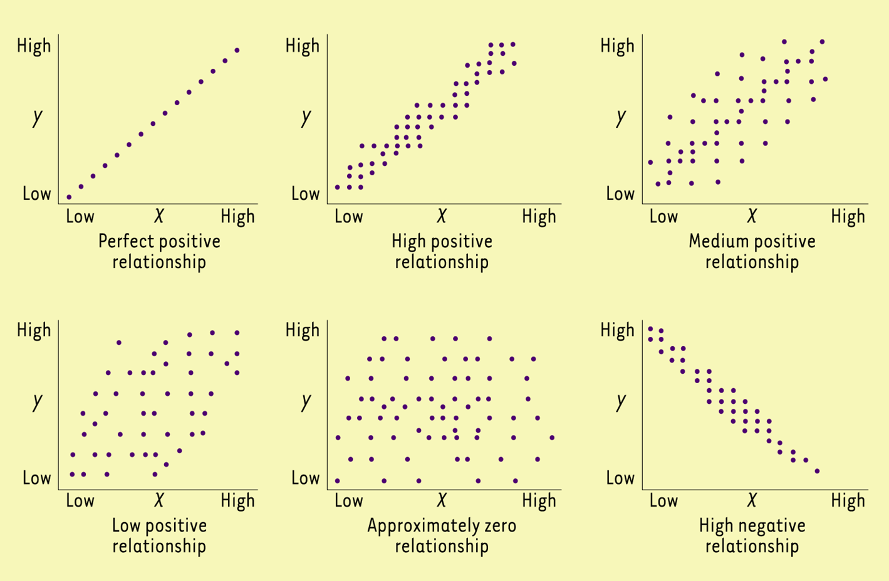
Correlation (Pearson’s r)
Gives an indication of covariance between two variables
  Sweat & stress
Strength & Direction
  Strength: From 0 to 1
  Direction: Positive or negative
There has to be a linear relation between them

Slide 30
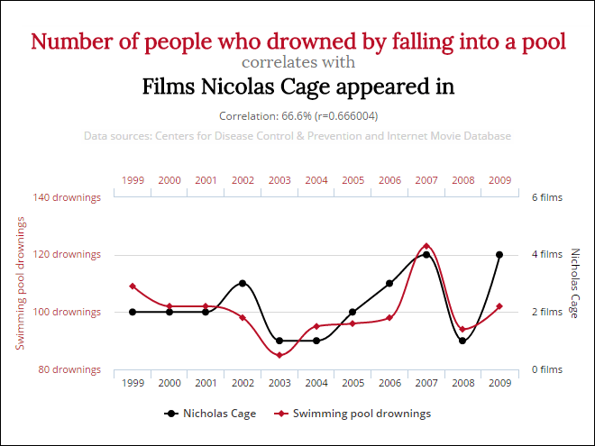
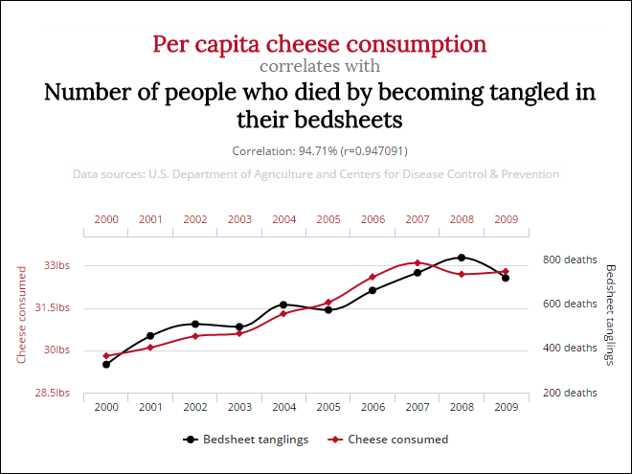
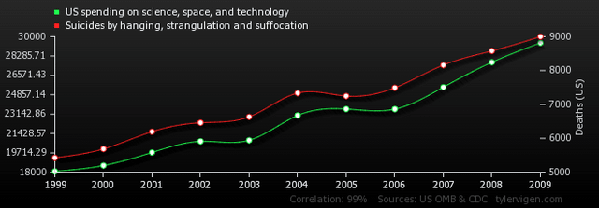
Correlations
Not Hard…Everything can correlate
Often deemed experiments
Give me enough people and i can correlate anything
Pathway
3rd variables
Causality

Slide 31
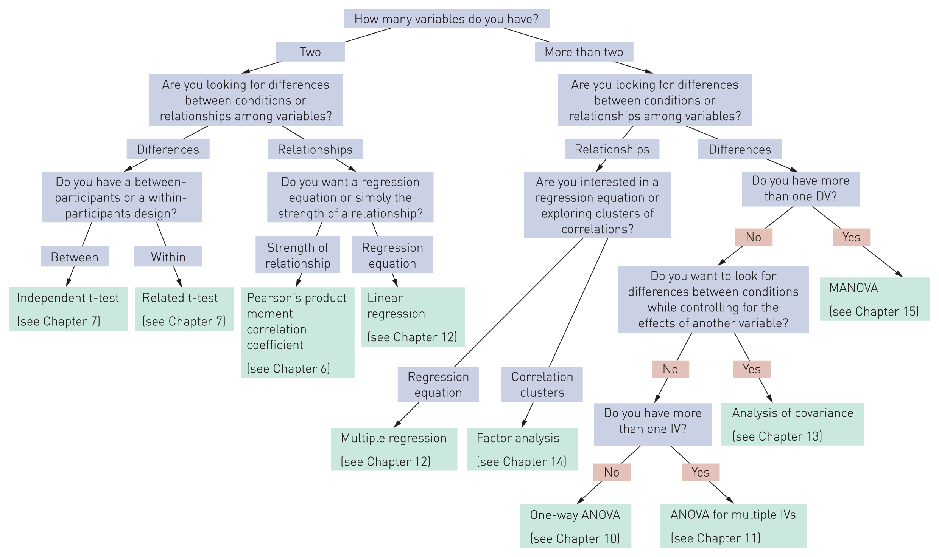
Figure 5.11 Flow diagram as a guide to choosing the most suitable test for the design of a study

Slide 32
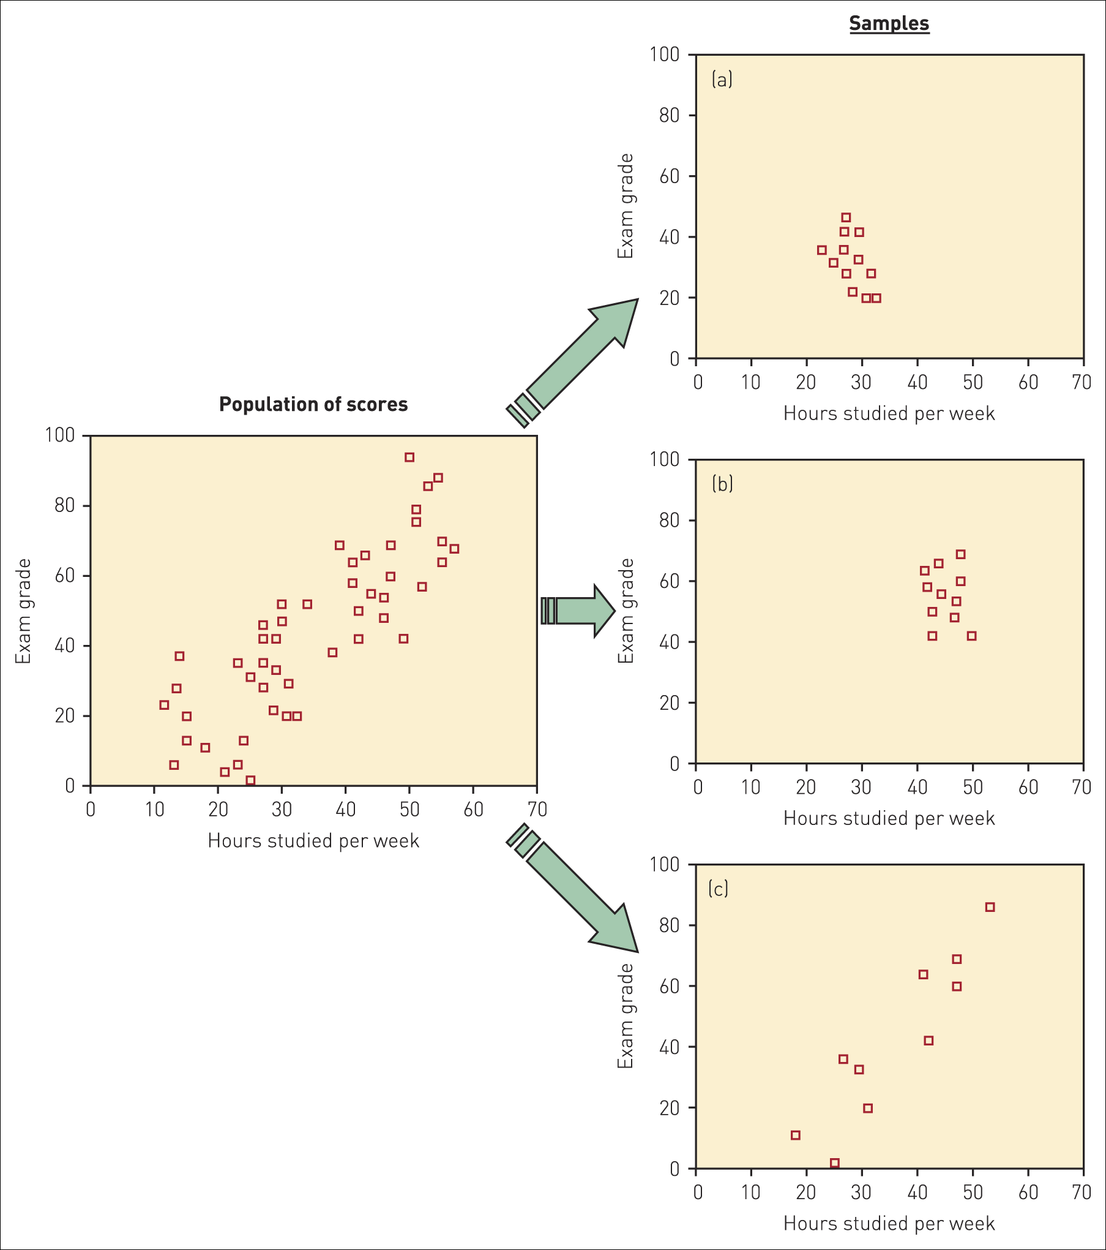
Figure 5.1 Scattergrams illustrating possible samples selected from a population with a positive relationship between number of hours spent studying and exam grades

Slide 33
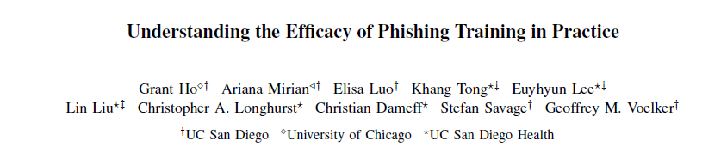
First, we find no significant relationship between whether users have recently completed cybersecurity awareness training and their likelihood of failing a phishing simulation.
Second, when evaluating recipients of embedded phishing training, we find that the absolute difference in failure rates between trained and untrained users is extremely low across a variety of training content.
Third, we observe that most users spend minimal time interacting with embedded phishing training material in-the-wild; and that for specific types of training content, users who receive and complete more instances of the training can have an increased likelihood of failing subsequent phishing simulations.
Taken together, our results suggest that anti-phishing training programs, in their current and commonly deployed forms, are unlikely to offer significant practical value in reducing phishing risks.

Slide 34
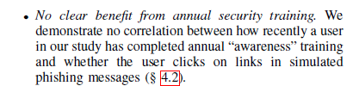


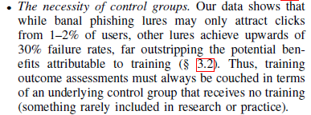

Slide 35
So what is good research
Experimentation
Public
Replication
Peer Review
Falsification
How to find??
Journals are evaluated
  Some ‘better’ than others
Web of Science
Scopus
Scimago
Google Scholar

Slide 36
Experimentation
Sampling
Randomisation
  Intervention group
  Control group
  Minimum
    Placebo
Some Prerequisites
  Power analysis

Slide 37
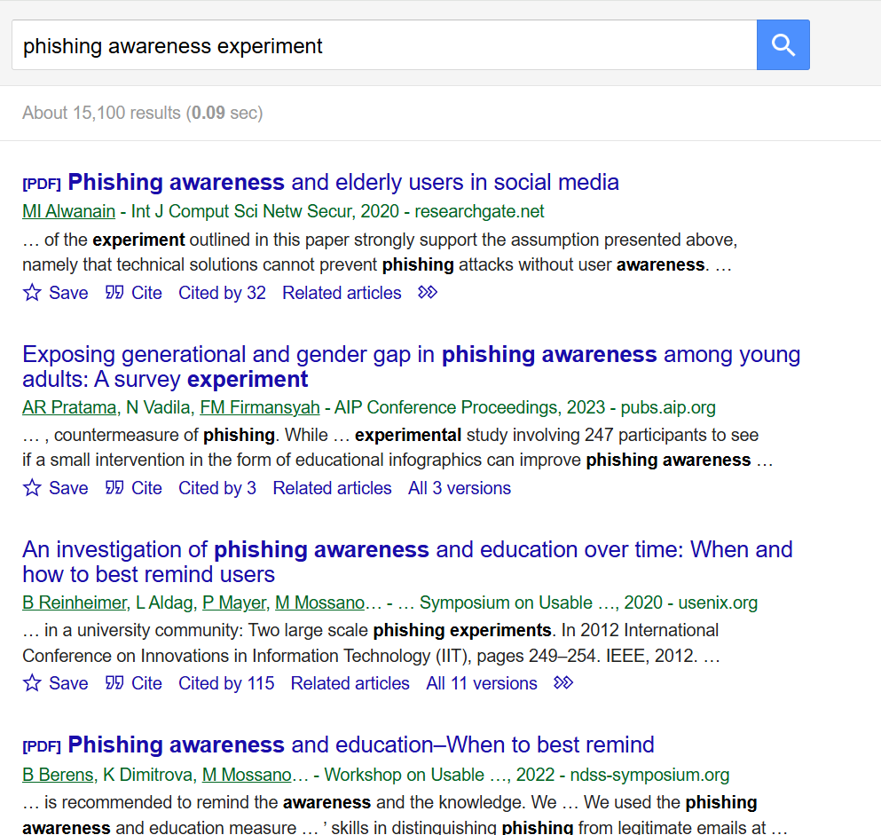
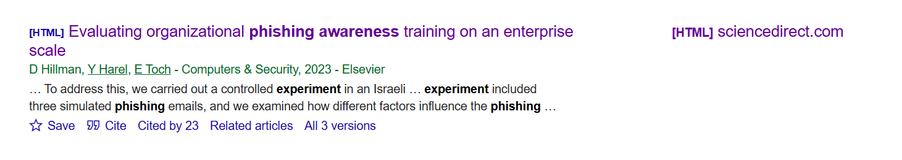
Lets go phish
https://scholar.google.no/scholar?hl=en&as_sdt=0%2C5&as_ylo=2020&q=phishing+awareness+experiment&btnG=

Slide 38
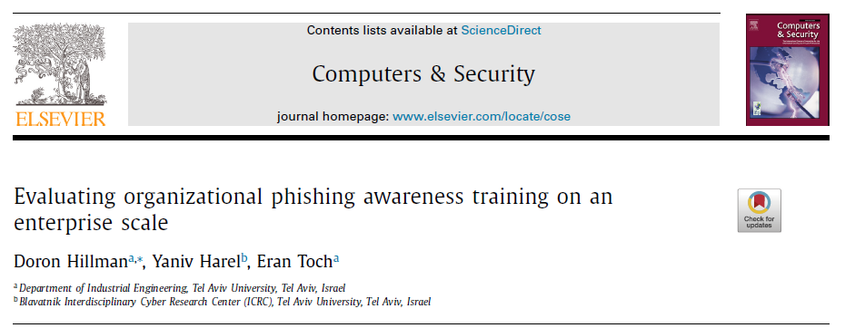
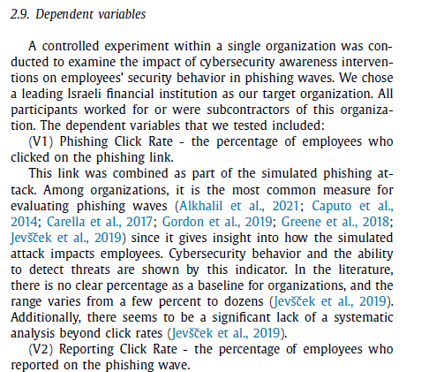
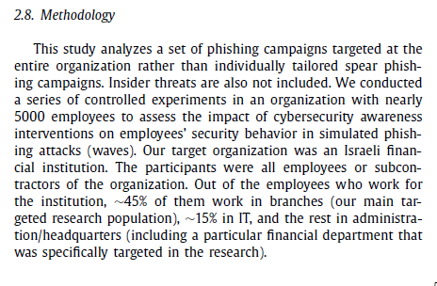

Slide 39
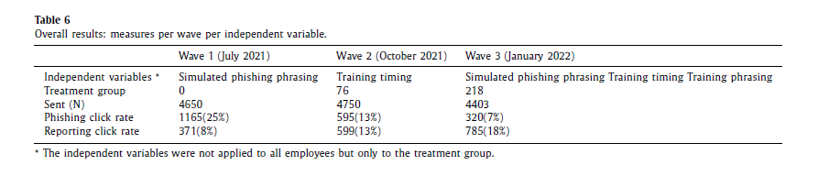
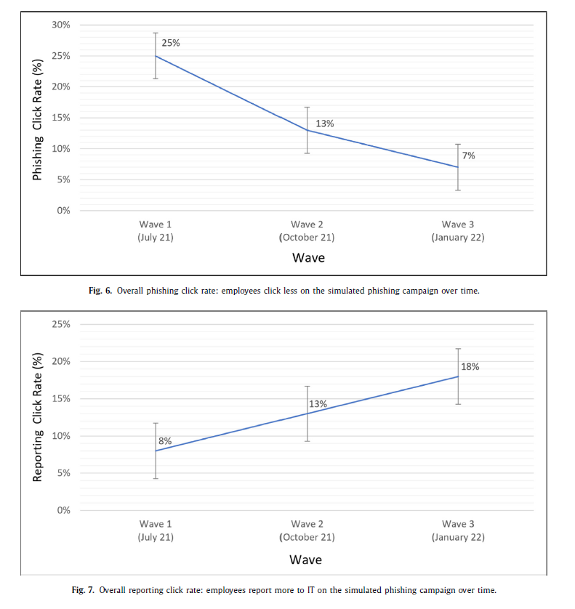
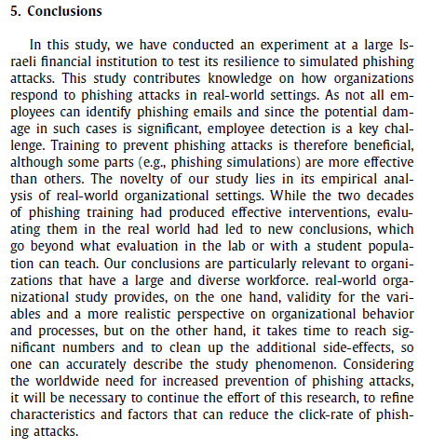

Slide 41
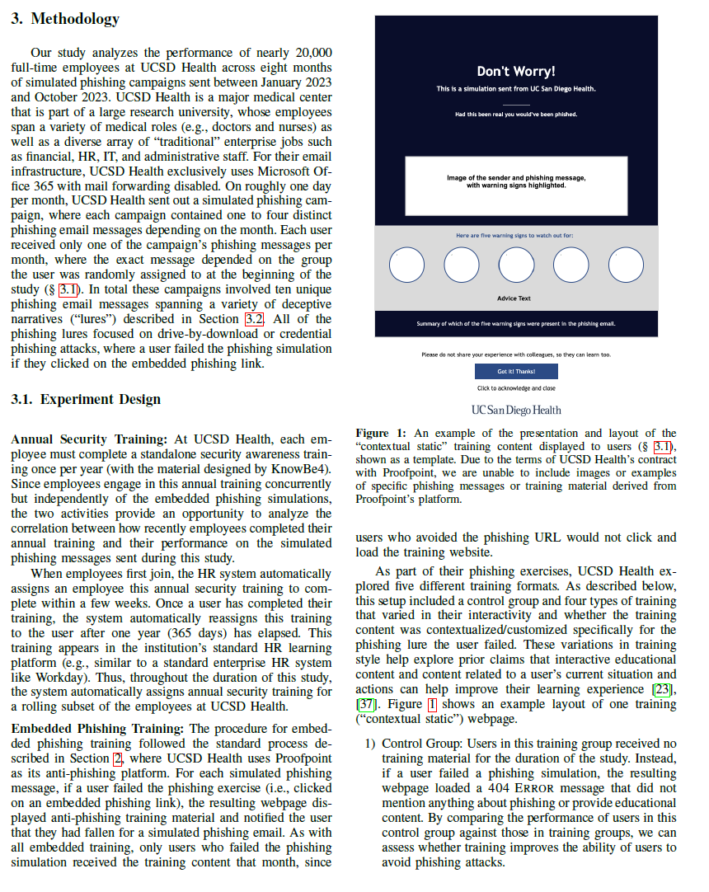
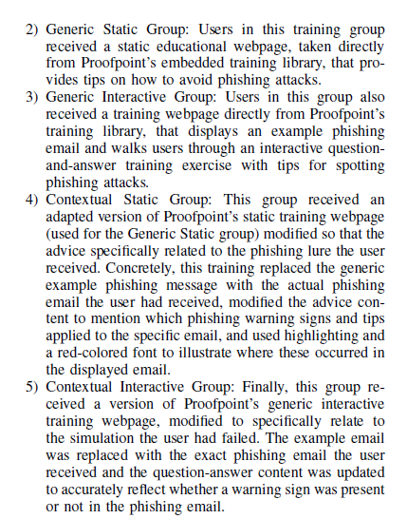

Slide 42
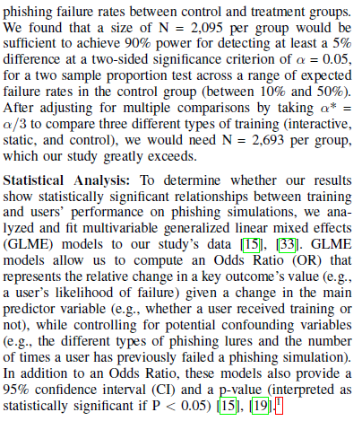



Slide 43
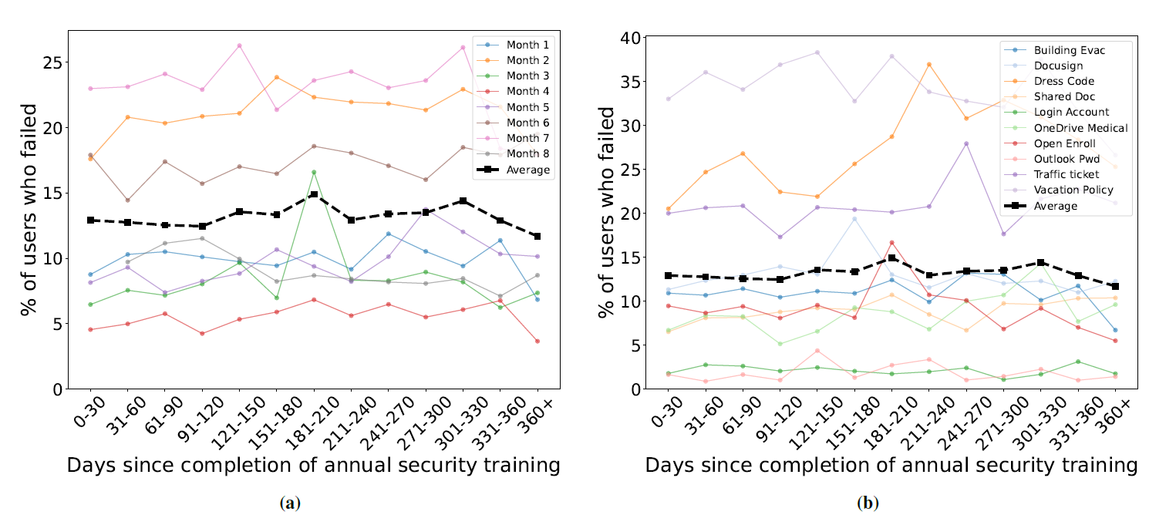
Is this experimental?

Slide 44
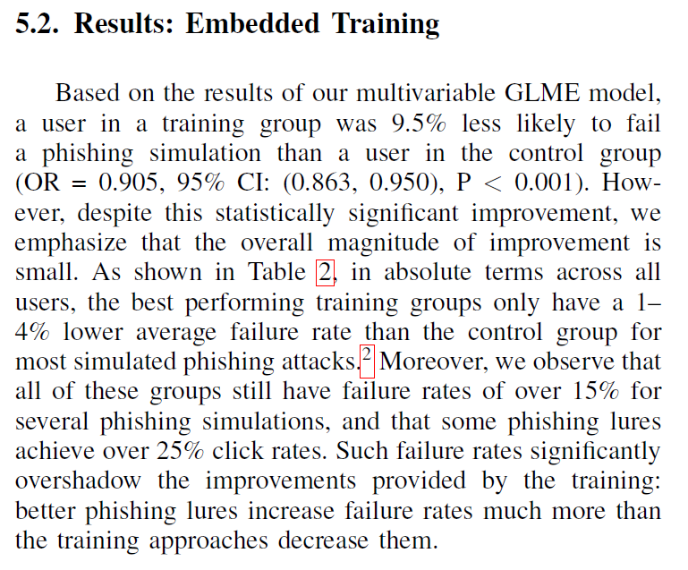
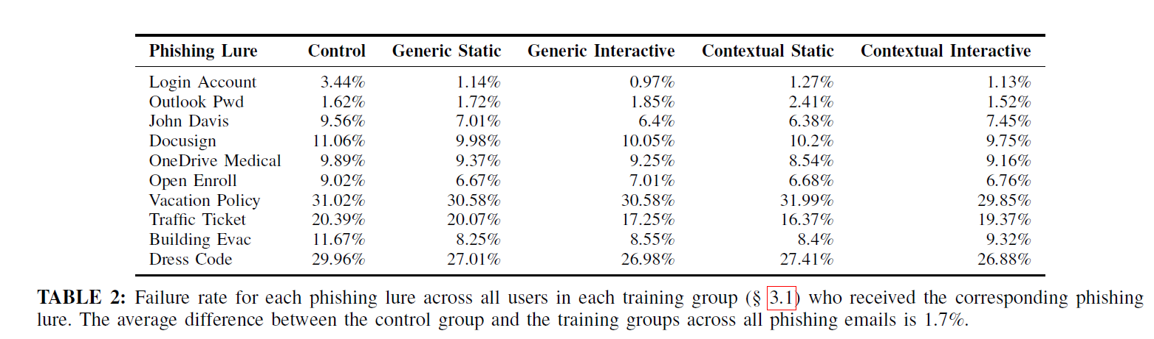
Is this experimental?
Can we draw a conclusion?

Slide 45
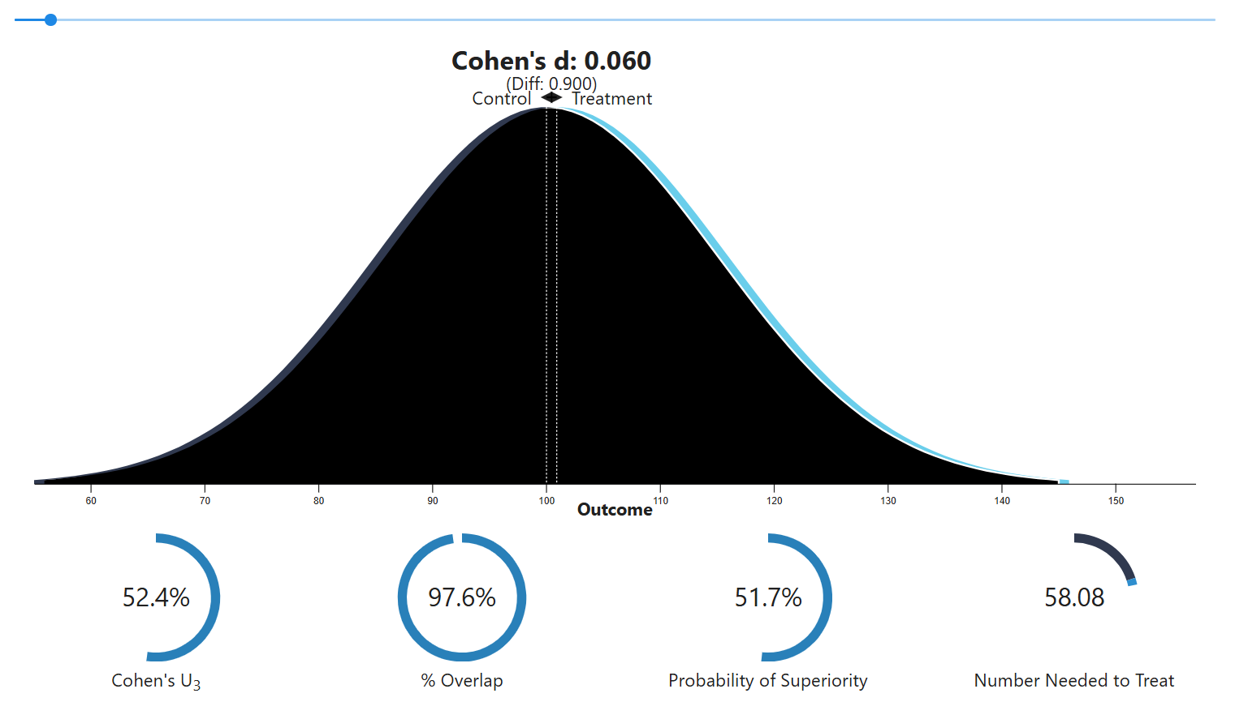
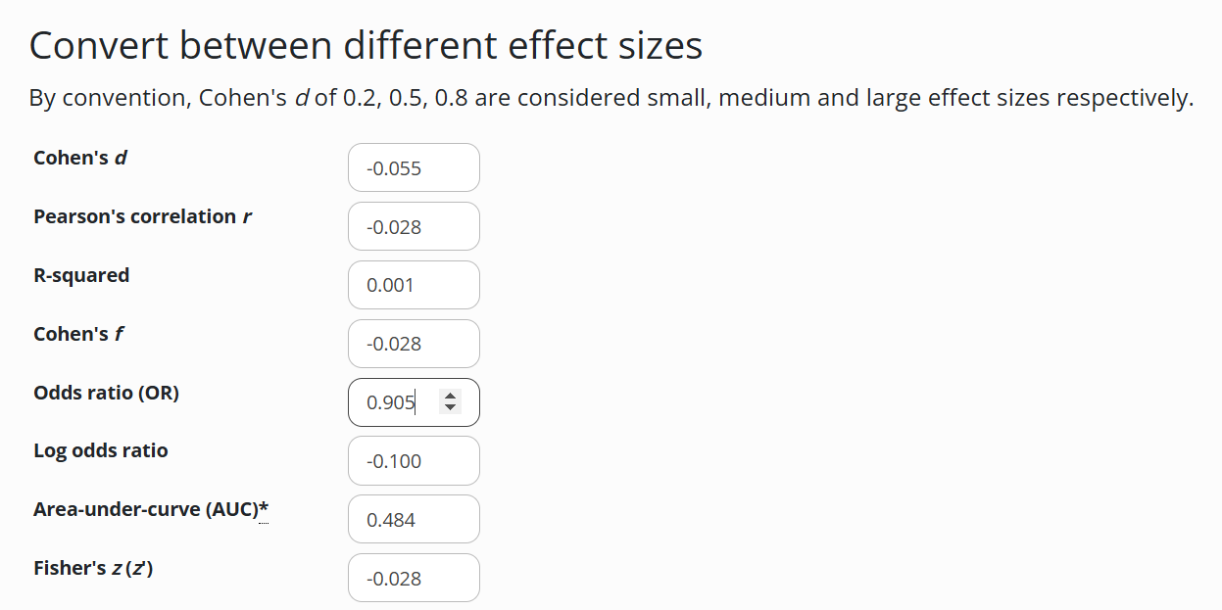
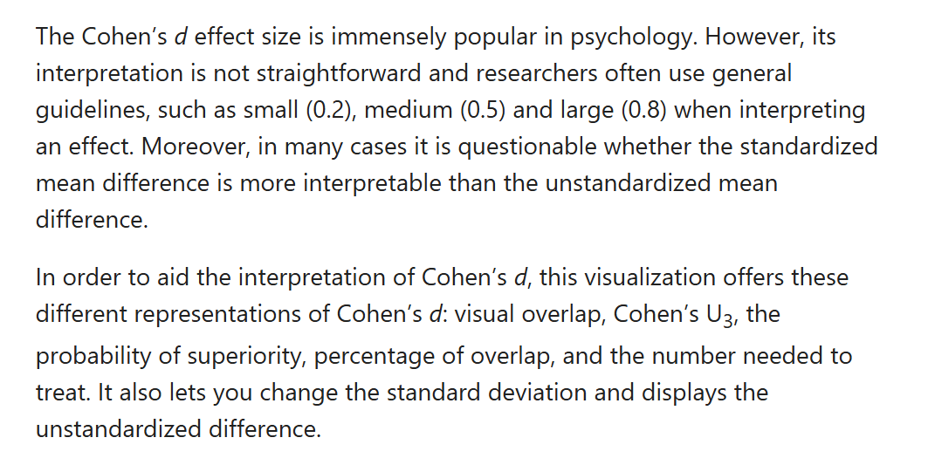
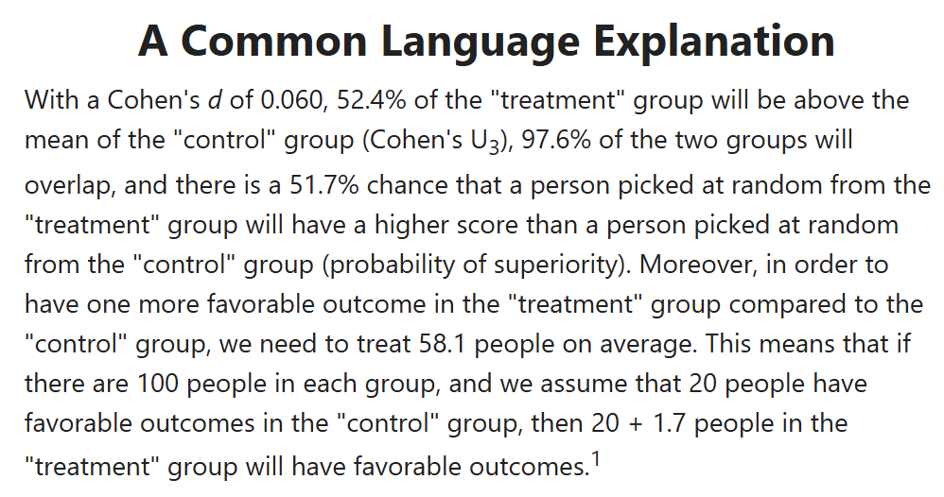
What does OR=.905 mean?

Slide 46
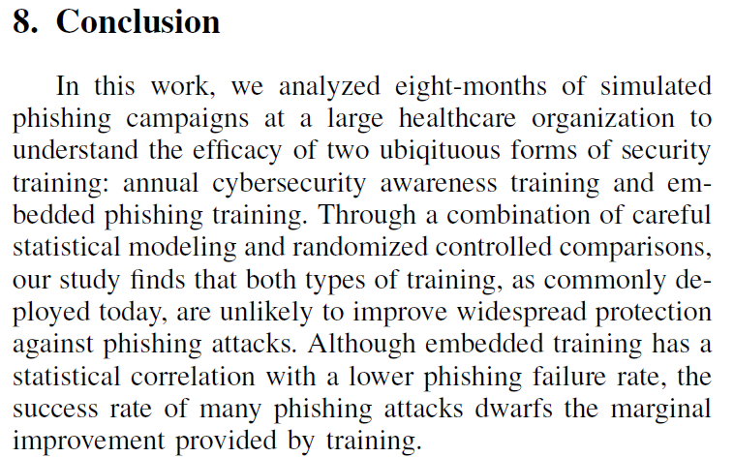

Slide 47
https://www.scimagojr.com/
Does peer reviewed mean good?
  Conference papers are «peer reviewed»

Slide 48
General Format (cont’d)
References
Your tasks and essay should include four major sections:
Main Body
Abstract
Title page
Notes:
This slide introduces four required part of an APA paper: a title page, abstract, main body (essay itself), and a list of References. An abstract page and list of references are titled as Abstract and Reference, respectively.
It is important to remind students that each page should have a page header with a short title and page number.
This slide can be supplemented by the “General Format” section from OWL http://owl.english.purdue.edu/owl/resource/560/01/

Slide 49
REFERENCES
Level 1
heading
Guns and Chewing Gum 9 References Berliner, D.C., & Biddle, B.J. (1996). The manufactured crisis: Myths, fraud, and the attack on America’s public schools. Boston. Addison-Wesley. Gallup poll of public attitudes toward the public schools. (1987) Phi Delta Kappan, 69, 28-29. King-Stoops, J., & Meier, W. (1978). Teacher analysis of the discipline problem. Phi Delta Kappan, 59, 354. Males, M. (1992). Top school problems are myths. Phi Delta Kappan, 72, 54-55. O’Neill, B. (1994, March 6). The history of a hoax. New York Times Magazine, 31, 15-21.
Book
reference
Journal
article
references
Magazine/
Periodical
reference

Slide 50
Your individual Tasks and Essay
Tasks (not obligatory
  500-1000 words
  APA
Essay (final examination)
  3000 words (± 300)
  APA

Slide 51

Task (not obligatory)
Find 2 (or more if you wish) articles that is an experiment within cyber security with the topic virtual learning assistants for cybersecurity. There might be other synonyms (i.e. Virtual assistants, pedagogocal avatars, etc). Key words can be tricky but try them out.
You task will be formatted in IMRaD (click for link).
  The Introduction will be what and how do virtual learning assistance. This should be in the articles you choose.
  For the Method/Result section – describe the procedure for identifying and selecting the articles. Include the ky words you used.
  For the Discussion, evaluate the articles’ evidence the best you can
    Design
    Methods
    Results
    And a small conclusion
500-700 words
  Remember APA, including in text referencing
Deadline: 30 September

Slide 52

Thank you

