Slide 1



Topic 9: Strategic Communications and CyberSecurity
Presentation by:
RicardoLugo

Slide 2
Acknowledgement
Co-funded by the European Union. Views and opinions expressed are however those of the author(s) only and do not necessarily reflect those of the European Union or HADEA. Neither the European Union nor the granting authority can be held responsible for them.
Project Agreement no. 101083594

Slide 3
Today
What are you expecting to learn today?
How confident are you about this?
Situational Awareness (the human kind)
Shared Mental Modelling
Communication and Cybersecurity
  Aspects and challenges
Some research

Slide 4
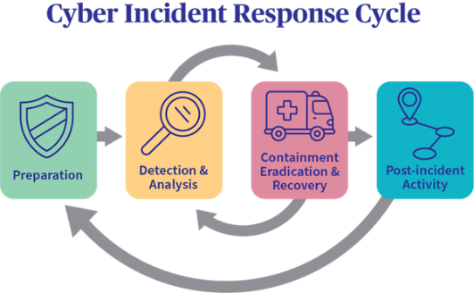
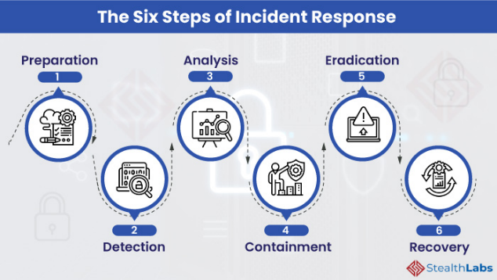
What is a cyber Incident
Proactive Capabilities
Responsive Capabilities

Slide 5
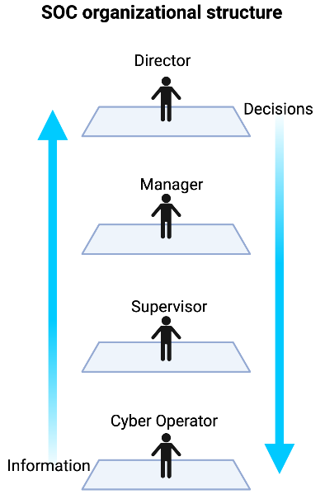
Security Operation Centers (SOCs)
Organizations assign their cybersecurity operations to SOCs
SOC teams cover multiple security activities and analyze
large and continuous streams of data
Technical tasks and decision-making assigned to different
positions in the SOC (Muniz et al., 2015)

Slide 6
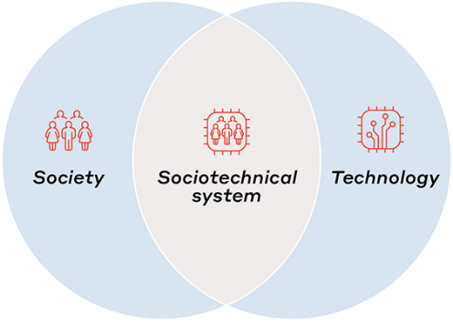
Socio-Technical Systems (STSs)
Cyber Operators (COs) = Technical personnel in SOCs
Face challenges spanning the cyber, physical, and social domain (Jøsok et al., 2016)
Human-machine and human-human interaction = STS
Cyber-physical working environment is subject to high rates of change and innovation

Slide 7

Situation Awareness - Definition
“The perception of the elements in the environment within a volume of time and space, the comprehension of their meaning and the projection of their status in the near future.” (Endsley, 1988, S. 97)
Originally from aviation (pilots, air traffic control)
Nuclear facilities
Military domain
Train dispatching
Weather forecasting
Driving and automated vehicles
More recently: network security

Slide 8
Levels of SA
Level 1
Perception
Level 2
Comprehension
Level 3
Projection
Notes:
Situational awareness or situation awareness (SA) is the perception of environmental elements and events with respect to time or space, the comprehension of their meaning, and the projection of their future status.^{[1]}
It’s been recognized as a critical foundation for successful decision-making across a broad range of situations, in everday emergency situations, such as law enforcement, aviation, air traffic control, health care, military command and control operations, etc
Lacking or inadequate situation awareness has been identified as one of the primary factors in accidents attributed to human error.
SA is broken down into three segments: perception of the elements in the environment, comprehension of the situation, and projection of future status.^{[7]}
SA states refers to the actual awareness of the situation.
Objects L1): Awareness of various objects in the world, and their current status. Objects and their status may be indicative of particular situations (that they are about to occur, that they are ongoing, etc.). Then they are often referred to as cues.
Frames (L1): Awareness of what kind of situation is on-going, e.g. a runway incursion where an aircraft is about to collide with some object on the runway.
Implications L2): Awareness of objects within frames, of what their current status means in a particular situation. E.g. the implications of the current speed of the aircraft or network status for CS – gets connected to projection (l3)
Event horizon L3: An awareness of plans and events in time and space. It includes an awareness of what has happened (useful for diagnosis, to achieve SA, to frame situations). It also includes prognosis, an awareness of what might happen next. That includes on the one hand an awareness both of what might occur based on diagnosis and the current situation, and on the other hand on an awareness of current plans and intentions.
SA systems refers to the distribution of SA in teams and between objects in the environment, and to the exchange of SA between system parts. SA processes refers to the updating of SA states, and what guides the moment-to-moment change of SA.

Slide 9
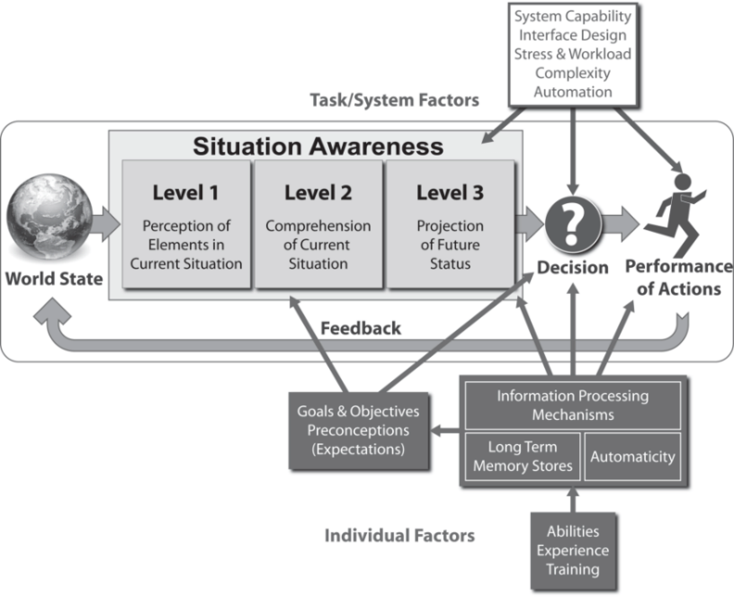

Slide 10
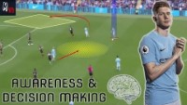
From My Domain
Notes:
58
138
340

Slide 11
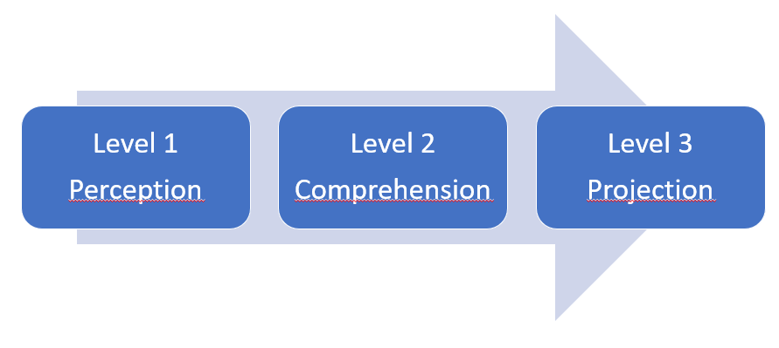
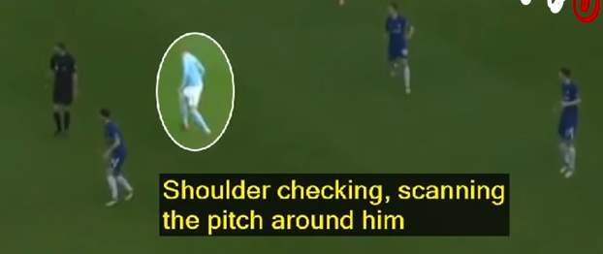
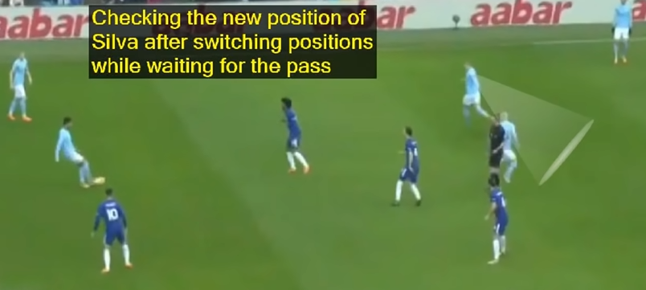
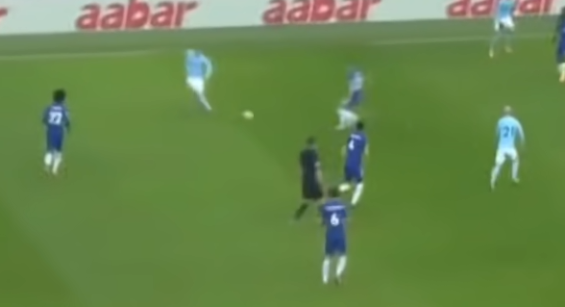

Slide 12
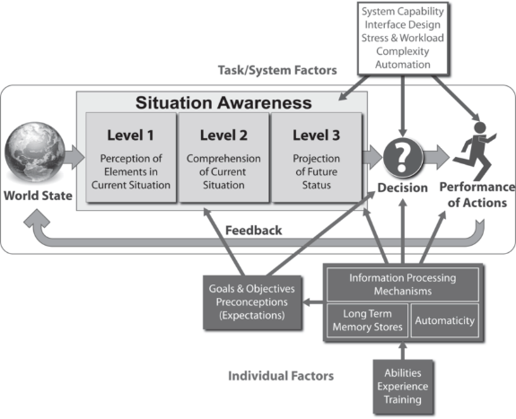
Bottom-up / data-driven processing
Short-term sensory memory, perception, working memory and long-term memory form SA.
Initial processing of environmental elements parallel and pre-attentive.
Certain properties are detected, such as spatial proximity, color, simple properties or shapes and movement, providing cues for further focalized attention (focalzied attention= conscious and higher cognition).
But: previously learned information (mental models) shape our expectations of what is „normal“ and guide our perception.

Slide 13
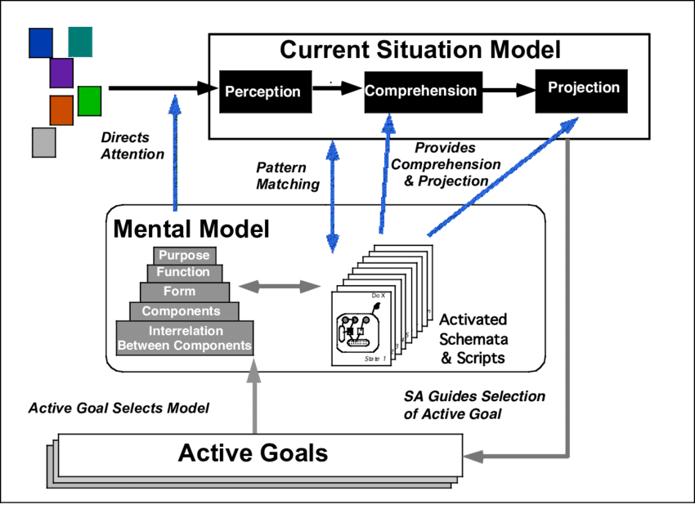
Pattern Matching
Activated by „pattern matching“: „oh, this is just like what happened last month!“ – „this is just like what happened to the aircrew in the Azores incident!“
„Recognition-primed decision-making“.
Shortcut for SA and decision-making: Processing data to determine Level 2 or 3 (requires working memory or exercising the mental model), that information is already part of experience („Schema“) and must only be recalled.
The crucial point here is to recognize the „critical cues“ and having a good stock of these in memory.
Thus Levels 2 & 3 (Comprehension, Projection) are „filled in“ following pattern matching.
Similarity is sufficient, depending on pattern-matching abilities.
Level 1
Perception
Level 2
Comprehension
Level 3
Projection

Slide 14
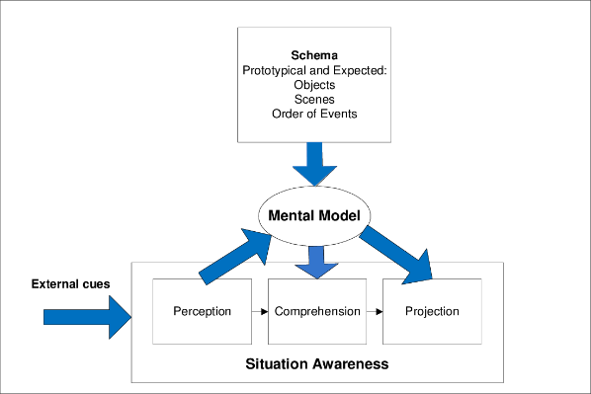
Mental Models
Mechanisms whereby humans are able to generate descriptions of system purpose and form, explanations of system functioning and observed system states, and predictions of future states. (Rouse & Morris, 1985).
Knowledge regarding which aspects of environment are relevant; identify critical cues, direct attention to these, classify information, making this process more efficient in large amounts of data.
Helps to integrate elements efficiently to form an understnading of their total meaning (Level 2) in terms of the goals.
Helps to project future states accurately and efficiently based on current states and dynamics. (Level 3)
(Endsley, 2000)
Level 1
Perception
Level 2
Comprehension
Level 3
Projection
Notes:
This then becomes metacognitive skills

Slide 15
Interrelationship between SA levels
Level 1
Perception
Level 2
Comprehension
Level 3
Projection
data-driven/ BU
goal-driven/ TD
Match patterns based on experience and accelerate L2 and L3.
Goal-driven filling of L1.
Iterative process to search and analyze goal-relevant data.
Highly efficient SA generation process.
Vulnerable to biases such as Anchoring and Confirmation Bias.

Slide 16
Factors affecting SA in novices and experts
Novice Expert
SA is fast, can be effortless, more complete, greater comprehension & projection
SA is demanding, frequently incomplete and erroneous
Limited attention
Limited working memory
Schema of prototypical situations
Mental models of domain
Automaticity of processes
Learned skills (e.g. scan patterns, communications)

Slide 17
Notes:
Inattentional blindness
¨24 radiologists to perform amiliar lung – nodule detection task
A gorilla 48x bigger than a nodule inserted in the last case
Even experts are vulnerable

Slide 18
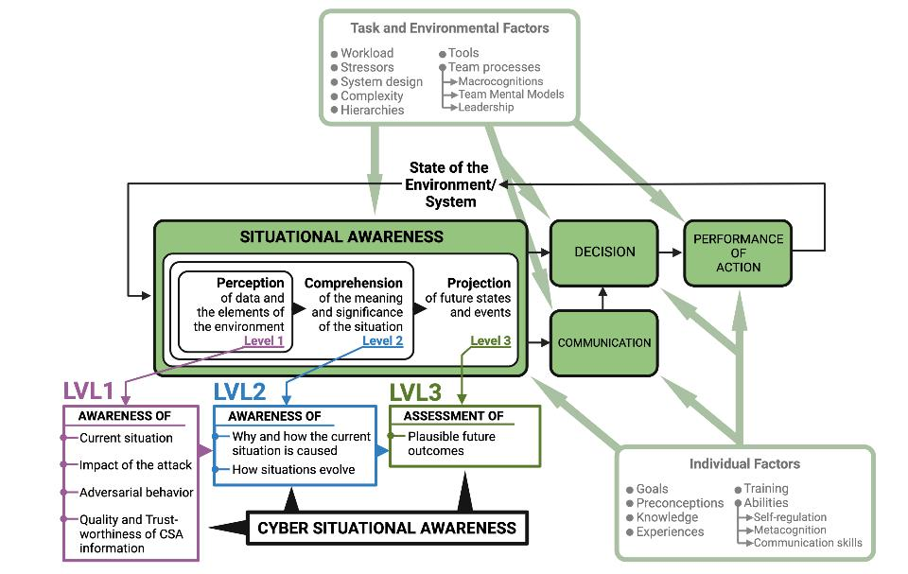
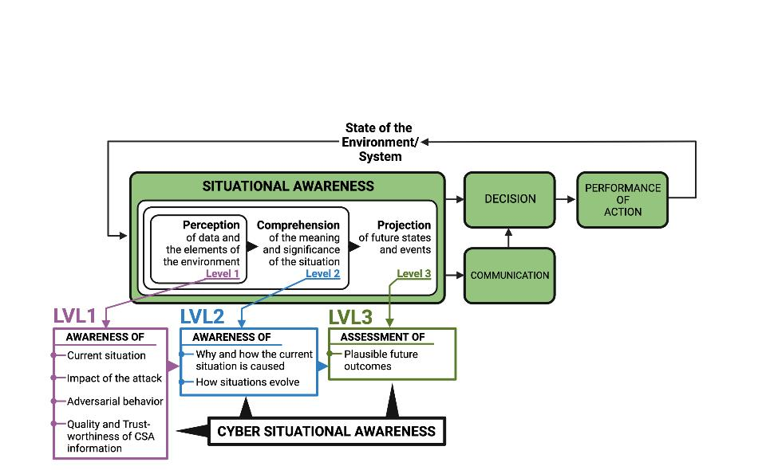
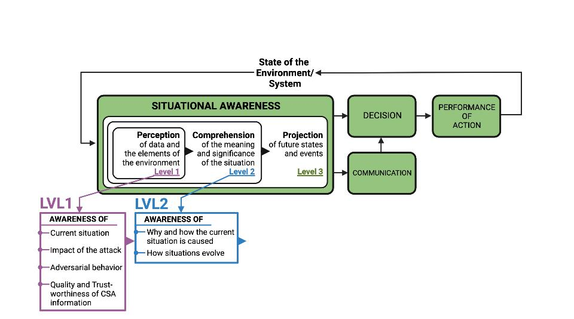
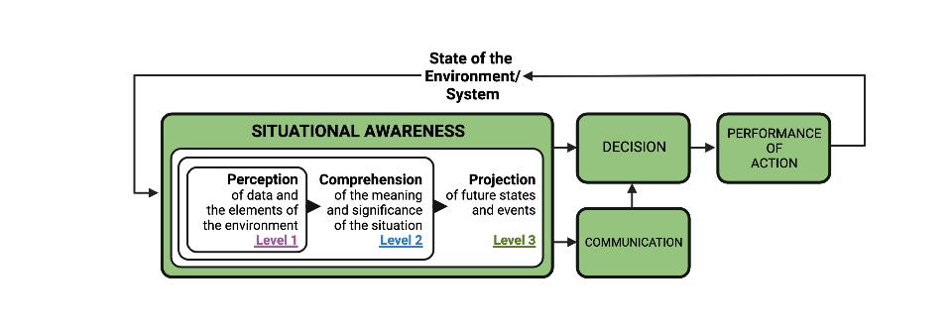
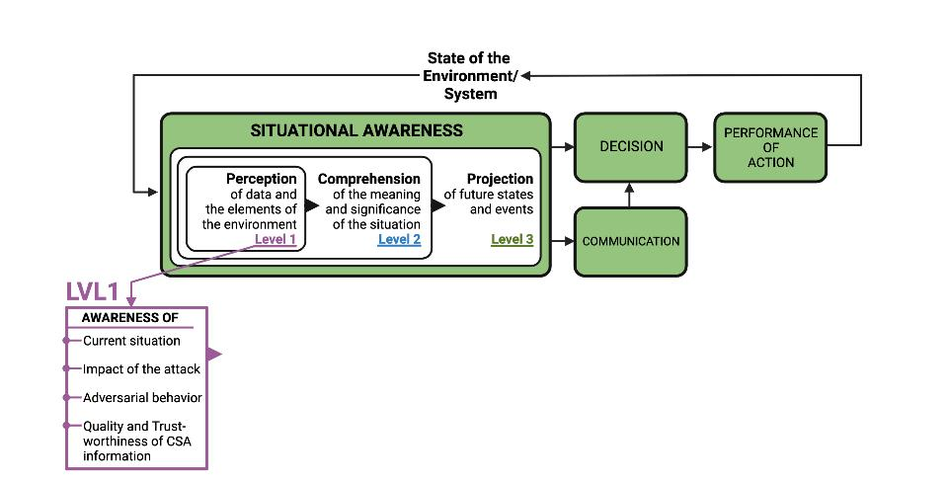
Situational Awareness and Cyber Situational Awareness
Stress
SA: bottom-up perceptual processes
going from concrete to abstract
CSA: starts with perceiving indicators of compromise
Already abstract
Stress
Endsley, 1995
Barford et al., 2009

Slide 19
8 Other Threats to SA
Attentional tunneling (or: attentional narrowing)
  Attention can not be divided.
  Get hooked on particular features and inadvertently drop scanning.
Requisite memory trap
  Working memory overload.
  In particular auditory information.
Stressors
  Workload, anxiety, fatigue, etc.
  Time pressure, uncertainty, etc.
  Limits SA via limiting WMC and slowing down information processing, more likely attentional tunneling, disorganized scanning for elements and less attention to peripheral cues.
Data overload
  Volume and rate of change
  Limited bandwith of human sensory and information-processing mechanisms.
  Rate of data flow can be enhanced significantly by ergonomic user interfaces
Misplaced salience
  Some features (size, shape, movement, flashing lights, noise) are prioritized in sensory and attentional processing
  Overuse or inappropriate use degrades SA to other information
Errant mental models
  „representational error“
  A wrong mental model is applied
Out of the loop syndrome
  Automation can eliminate excessive workload, but can also lower SA by putting people out of the loop.
„take-over-time“ where automatisation fails or is not equipped to handle a situation

Slide 20
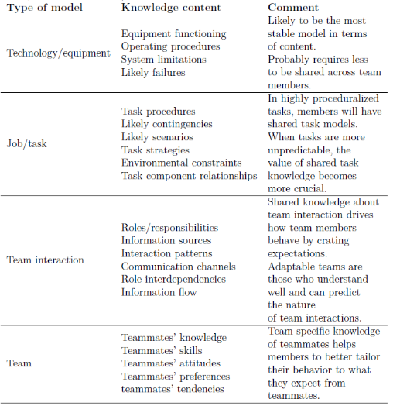
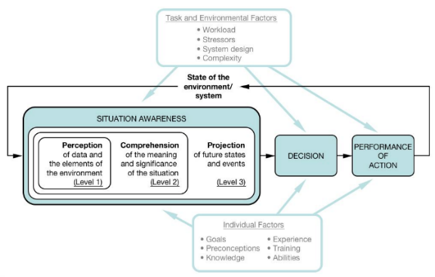
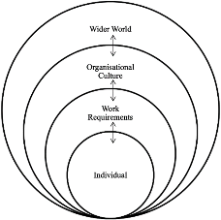
Social Aspect of CS, SA & SMM
Shared Mental Models
Schema
Objects
Scenario
Order of effect
Notes:
Figure: Relationship between the mental model and situation awareness,Endsley, M. R. (2015). Final reflections: situation awareness models and measures. Journal of Cognitive Engineering and Decision Making, 9(1), 101-111.
Table: Mathieu, J. E., Heffner, T. S., Goodwin, G. F., Salas, E., & Cannon-Bowers, J. A. (2000). The influence of shared mental models on team process and performance. Journal of applied psychology, 85(2), 273.

Slide 21
Team Cognition
Cognitive processes that arise from complex and dynamic interactions (Salas & Fiore 2004)
Goal:
How can technology be used augment shared situational assessments
  Situated cognition (SA)
  Distributed cognition
    What the individuals know individually
  Communication processes
    Facilitating, debilitating
  Team Cognition

Slide 22
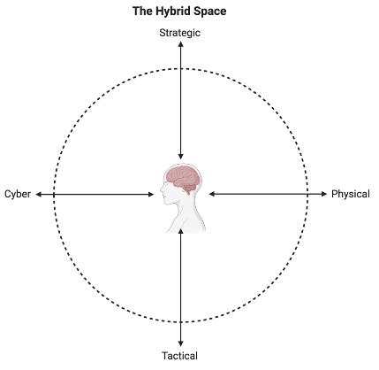
Macrocognition
Sensemaking
  Problems
  Team Performance
  Situational
    Proximal – Distal factors influence on tactical-strategic decisions
Team
    Coordination, communication
Individual
  PxE (Lewin, 1956)
  Cognitions & Metacognitions
  Regulatory processes
Notes:
The HS is a macrocognitive model that describes functions and processes into a conceptual framework that maps cognitive processes along cyber-physical and tactical-strategic dimensionst. Macrocognition emerged from a need to address the broad variety of cognitive processes in a natural setting (Fiore et al., 2010; Hoffman & Mcneese, 2009). Macrocognition is subject to a variety of definitions that resemble each other by the commonality of explaining cognition in natural environments and later as ‘the adaptation to complexity’ (Hoffman & McNeese, 2009;
This helps to understand environmental complexity, and how operators behave. Current experience from conducting these exercises have implications for future education and training of operators.
Currently, there is no consensus on how to assess the performance of teams in a cyber operation context (Forsythe et al., 2013). This may be due to limited understanding of team processes in the complex problem solving environment of the cyber domain, when they are assessed against existing ‘team’ research that is generally considered to have flaws and limitations (Fiore et al, 2010). Therefore we must assumes that good team performance cannot be assessed simply based upon the team who captured the flag first. Instead we argue that there is a need to investigate team processes in cyber defence training exercises as a path to assessing team and judging performance.
While sensemaking is considered a process in macrocognition (Klein et al., 2003), in the cyber context it relies on a state of cyber situational awareness. But it may have several overlaps with metacognition. While experts heavily rely on recognition of patterns in their environment in most domains, this is not true in cyber operations. One would probably have to engage in “complex recognition primed decision making strategy” (Klein & Klinger, 1991), where the precondition is that the situation does not match the experts’ prior experiences. Hence, the expert cannot apply recognition-primed decision making directly, meaning they are required to engage in learning and discovering new knowledge and exploring new and adaptable ways to tackle the current issue. This shifts how team research must be conducted. Hybrid Space framework is appropriate to gain insight into cyber-physical understanding and complex socio-technical systems.
While previous attempts to understand problem detection has been more incremental towards a threshold of detection, more complex domains seem to take advantage of higher level cognitive skills like re-conceptualization (Hoffman & Shattuck, 2006; Klein et al., 1999).
Where the Hybrid Space conceptual framework (Jøsok et al., 2016) describes the environment in which cyber teams operate, the macrocognitive framework (Schraagen et al., 2008) adds understanding to the functions and processes that individuals and teams engage in within this space. Knowledge gained from observing and studying cognition in naturalistic settings in a cyber operation context (D'Amico, Whitley, Tesone, O'Brien, & Roth, 2005) shed light on the current problems that have to be tackled to ensure that individuals and teams receive proper education and training (Arnold, Harrison, & Conti, 2014) to operate in this complex multi-domain environment.

Slide 23
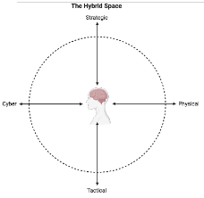
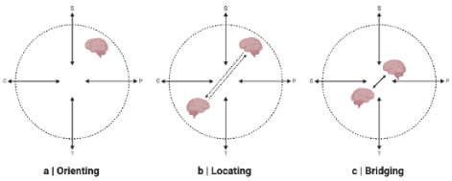
Cognitive Engineering approaches to communication in the HS
Orienting, Locating, Bridging (OLB) model (Knox et al., 2018)
Foster metacognitive awareness of own and a partner’s location within the HS
to improve flow of communication
Situational Analysis and Shared Mental Modelling

Slide 24
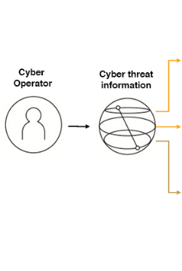

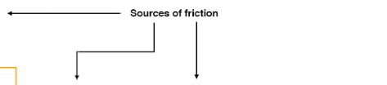
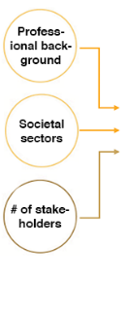
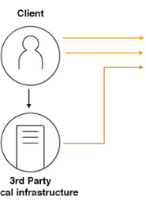

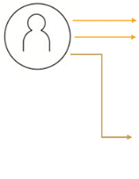

Human communication in Cyber Threat Situations (CTSs)
Communication between humans at the core of cyber defense decision-making
Communication in CTSs is like a software design-problem
Communication must be modular (frictionless) enough to be useful for all stakeholders

Slide 25
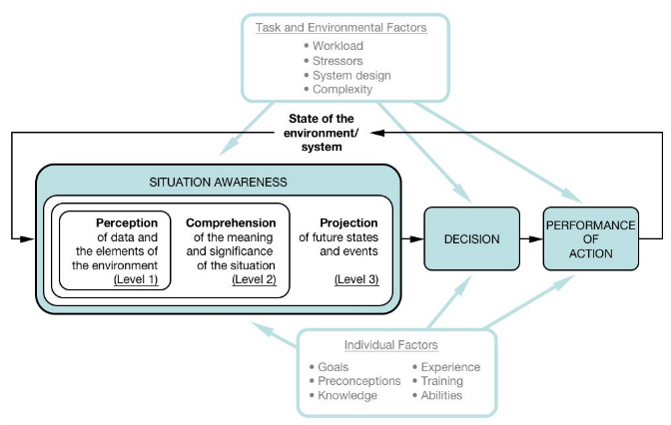



Situational Awareness (SA): Endsley
Level 1 SA: Perception
Something happens (or not)
Level 2 SA: Cpmprehension
Why is it happening what are the consequences
Level 3 SA: Projection
What can and will happen? What can be the possible consequences?
Shared Mental Models
SA₁+SA₂+SA₃

Slide 26
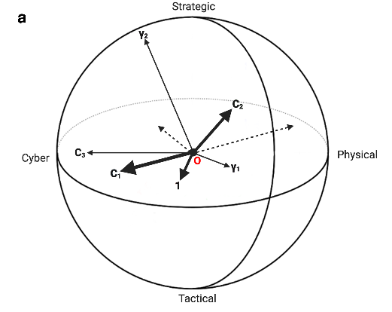
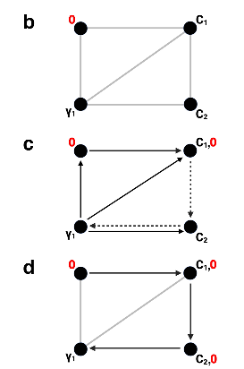
Decision-Making in Socio-Technical Systems
Interconnectedness between agents and
assets in the STS → decision-making
(Tikka-Ringas et al., 2014)
Persisting element of uncertainty
Multiple impact-dimensions
  Client assets
  Third party assets
  Agents in the network
  Adversarial behavior
  Etc....

Slide 27
Situational Awareness vs Situational Understanding

Slide 28
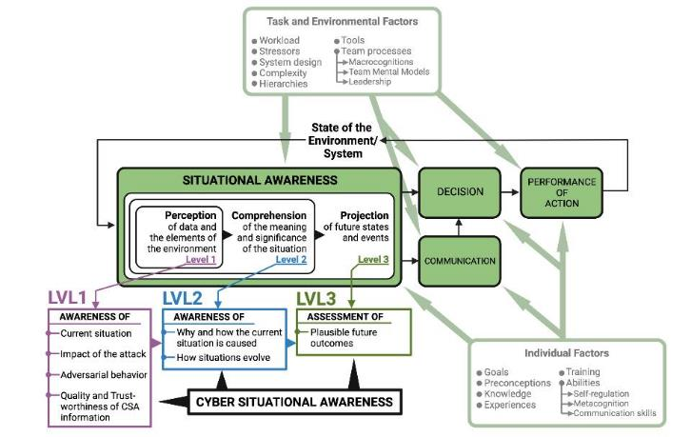
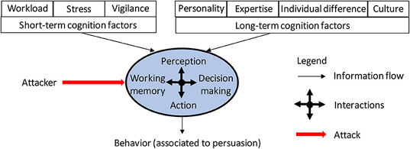
?

Slide 29
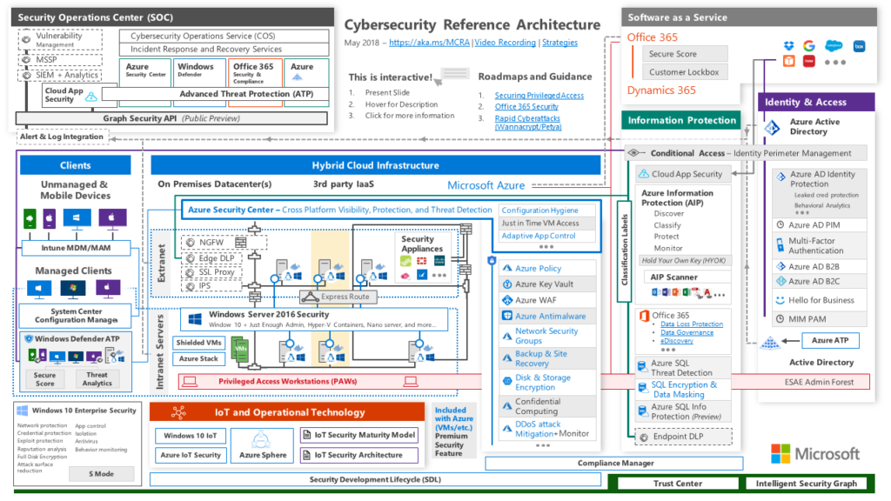
Cyber Security and Situational Analysis
Notes:
Operational engineering is distinctly different than technology engineering, which is currently in use today. Technology engineering assumes the value of the technology so its functional utility is not analyzed. This approach adds to the proliferation of technological silos. In many cases it does not perform as intended and thus operator-developed workarounds become the norm.
Operational engineering, as an alternative, is informed by technology and, importantly, by what constitutes mission success. Mission critical events, therefore, become the major design drivers. Operational engineering recognizes risk can continue to rise up to a point beyond which catastrophic mission failure occurs. Such a point is called the critical event horizon. Knowing key points where mission failure can occur is some of the bedrock knowledge of a super-function.

Slide 30
About visualizations
“Cyber operations provide a unique challenge in terms of the sheer size of the networks involved and their inherent level of dynamics. Understanding the topography of the cyber network is a key component to being able to understand the potential impact of a particular event or attack on a given mission or operation. This has proven to be quite challenging in many cases. New research will be need to help operators to better visualize existing networks, particularly as they change. As we develop networks that dynamically morph as a function of their design, as well as a function of other factors (e.g. computers or software getting added or deleted, mobile users joining the network at various locations and times), the understandability of the network will be severely strained. New methods to support operators by mapping system topology to operational decisions are needed. This research will need to address not just abstract visualization, but also the types of display support that are needed for addressing the various types of comprehension and projection needs of operators who are answering very real questions about the system’s performance (e.g. see Table 1 ). For example, displays that assist the operator in assessing the impact of a malicious activity on current protection schemes and needed assets. These sorts of SA requirements have been found to be very poorly supported in many existing tools.»
Endsley (since 2014)

Slide 31
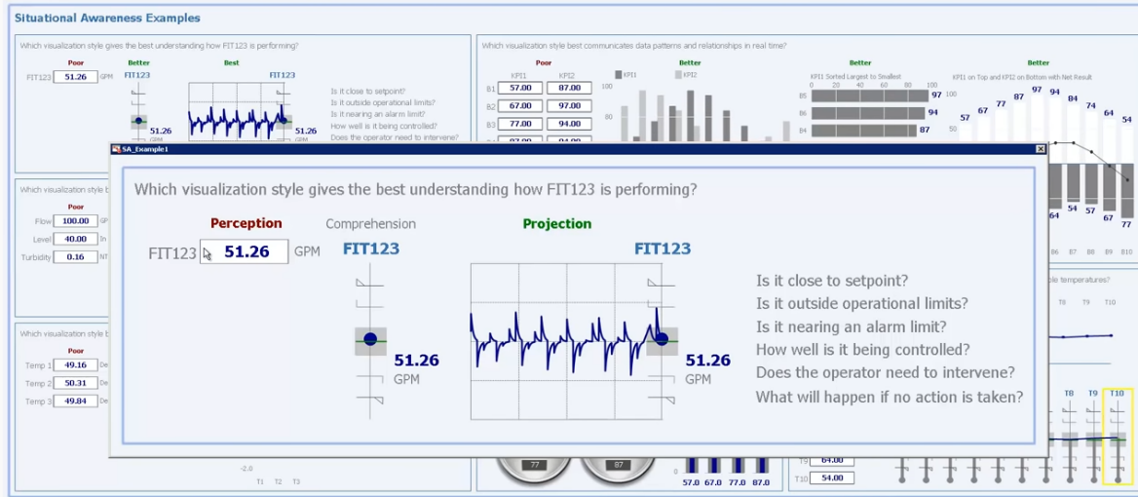
SA-improving visualizations: a SCADA-example

Slide 32
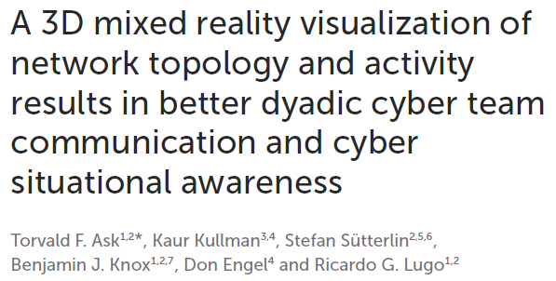
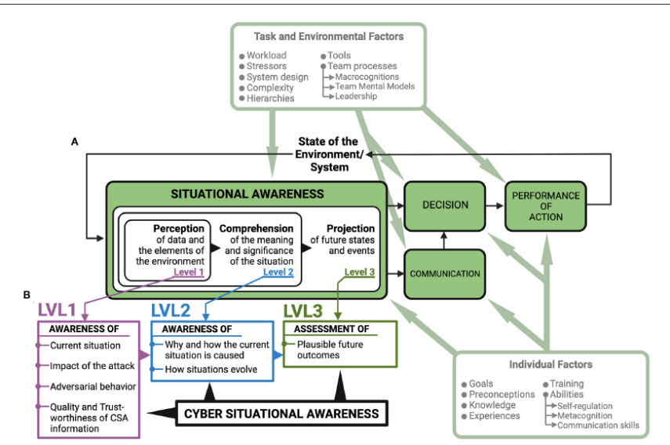
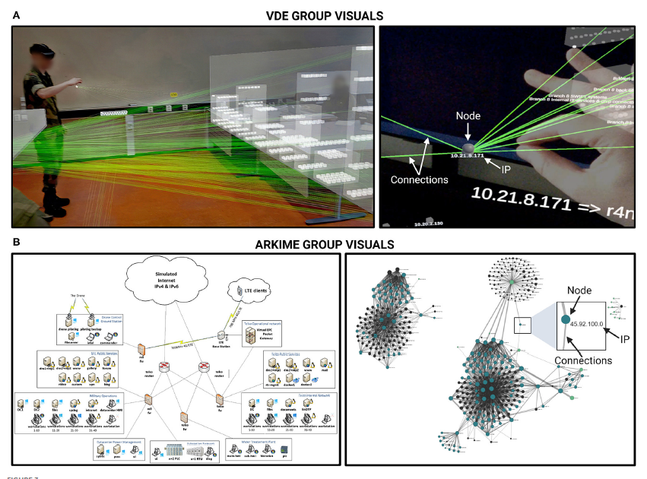
first study comparing the e􀀀ect of 3D mixed reality and 2D visualizations of network topology on dyadic cyber team communication and cyber situational awareness. Using 3D mixed reality visualizations resulted in better cyber situational awareness and team communication.

Slide 33
Summary: Principles of SA-centered design
Organize technology around the user‘s goals, tasks, and abilities.
  Interfaces and capabilities need to be designed to support the changing goals of the operator in a dynamic fashion.
Technology should be organized around the way users process information and make decisions.
  Before decisions are made in complex domains, users try to achieve understanding of the situation as a whole. Goes beyond simply perceiving state of environment, there must be understanding of its meaning in light of current goals.
Technology must keep the user in control and aware of the state of the system
  High levels of automation -> user put out of loop -> SA compromised and prolonged take-over time. Involvement should be kept sufficiently high or interface designed to allow for SA maintenance or regaining SA.
Technology can aid in organizing and making information available to users

Slide 34
Communication of RCP

Slide 35
Current problems facing the field and scientific literature
Knowledge gap between COs and decision-makers.
High levels of situational uncertainty impedes communication and decision-making.
How cyber threats are communicated and acted upon in the physical world
is not well understood.
No established common best practices for communication.
Human factors in cybersecurity have been ignored for a long time = very little research.
First step towards solution: systematic review of current literature

Slide 36
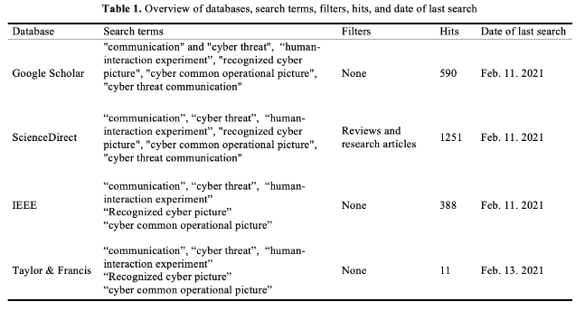
Methods
Identify literature on human-human communication in CTSs through database searches.
Categorize the publications according to type and methodological approaches.
Provide a summary of the selected articles in order of methodological approaches and which aspect of communication that was studied.
Synthesis and discussion of findings followed by suggestions for future research.

Slide 37
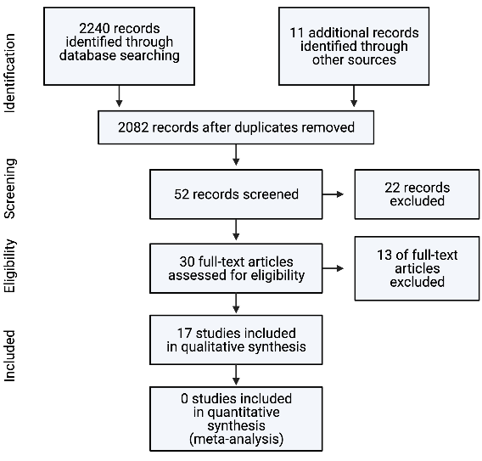
Number of studies identified in different phases of the review
Very few studies; only 17 studies fit criteria

Slide 38
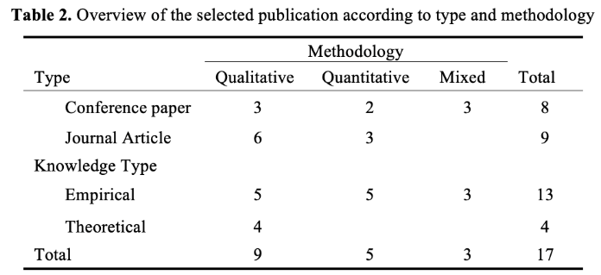
Types and methodology of identified studies
Approx. 50/50 qualitative and
quantitative/mixed studies
Mostly empirical and exploratory
Only one experiment
No studies prior to 2012; avg. year 2016
10 studies assessed cognitive factors
Half of quantitative studies do not report
effect sizes; 1 did not report p-value

Slide 39
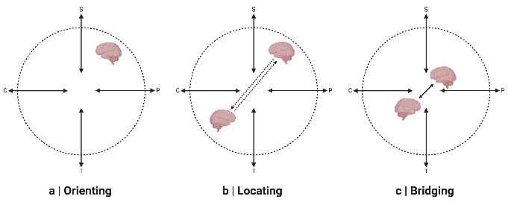
Information requirements for stakeholders RCP
Only one study assessed what information was useful for stakeholders RCP
(Varga et al., 2018)
None of the stakeholders listed information on adversarial behavior
  Barford et al. (2009) 4th criteria for CSA...
Stakeholder blindspots in cyber domain?
  Use case for HS framework and OLB model

Slide 40
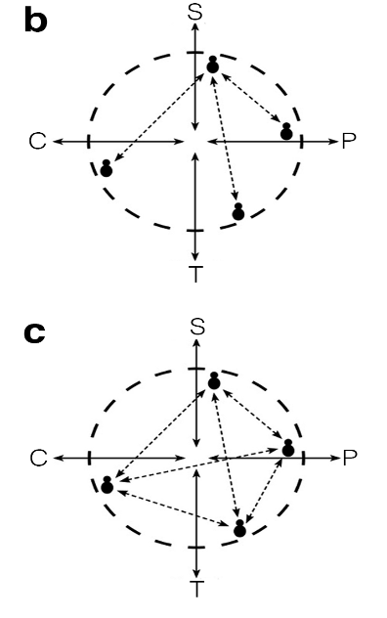
Considerations for flow of cyber threat communication
Enriched one-way communication
  Friction/modularity → HS, OLB model
Effective team mental models and transactive memory
Needs to be updated prior to threat occurrence to save
time and reduce need for communication
Training, briefings, electronic maps of expertise…

Slide 41
Amount and characteritics of communication according to shifting situatonal demands
Too much communication during cyber threat incidents can be detrimental to performance
Might depend on level of expertise
Might depend on quality and type of communication and nature of task
  Under-communication and lack of feedback
  Cognitive load
Handling of maintenance tasks, unforeseen scenarios, update task progression and help
Distributed team leadership might mitigate some of the problems

Slide 42
Summary and Conclusions
Only 17 studies; only one experiment; little reporting of useful statistics
Few replication studies but all studies converge on common principles
Few studies report which sectors participants belong to → who are findings
relevant for?

Slide 43
A 3D Mixed Reality Visualization of Network Topology and Activity Results in Better Dyadic Cyber Team Communication and Cyber Situational Awareness
Torvald F. Ask
Dr. Kaur Kullman
Dr. Ricardo Lugo
Dr. Benjamin J. Knox
Dr. Don Engel
Prof. Dr. Stefan Sütterlin

Slide 44
Situational Awareness and Cyber Situational Awareness
SA: bottom-up perceptual processes
going from concrete to abstract
CSA: starts with perceiving indicators of compromise
Already abstract
Endsley, 1995
Barford et al., 2009

Slide 45
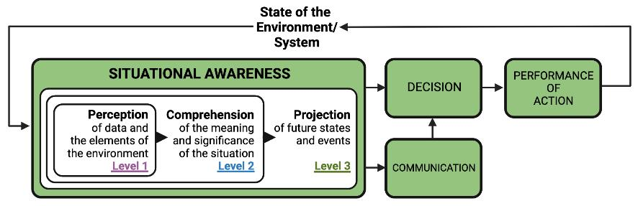
Situational Awareness
Cyber defense decision-making in cyber threat situations is based on communication between a human cyber analyst and a human decision-maker
The aim of communication is for cyber analysts to share their CSA with the decision-maker
The shared CSA is the basis for decision-making → communication errors influence decision-making

Slide 46
Questions
What do we know?
Cyber operators do not have direct sensory access to the environment they want to perceive, understand or predict the future state of.
Consequence → Cyber threat information is complex and communicating one’s CSA is difficult if people have different mental models of the cyber domain.
Q: Is there a way to present cyber threat information that provide teams with the same mental models of their cyber domain (their network)?
Q: Will it improve CSA, communication, and decision-making?

Slide 47



Questions
What do we know?
Traditional visual representations of network topology are 2D schematics or graphs that do not scale well with increased (but necessary) complexity.
The human brain is designed to understand events in time and space and processes this information without conscious effort.
Q: Will a 3D mixed reality visualization of network topology result in better CSA, team communication and decision-making compared to 2D visualizations?

Slide 48
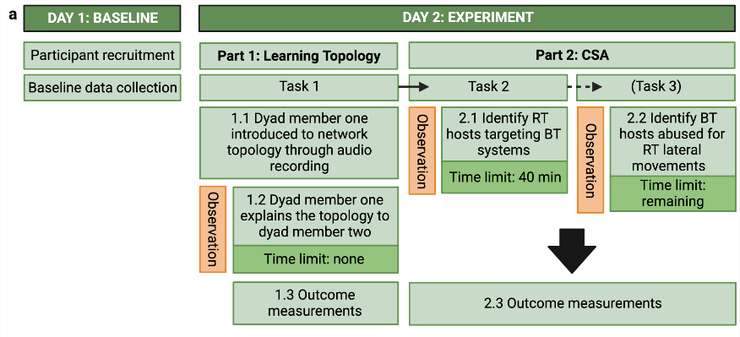
Methods
All the
One
Two
three
Cyber cadets at CISK
N = 22, mean age = 22.5, female = 5
Divided in cooperative dyads
Two groups seeing the same network data
  Arkime (2D), n = 10
  VDE (3D), n = 12
Three tasks
  Explain the normal network topology (layout) to teammate
  Find adversaries (red team) targeting the allied (blue team) network during simulated attack
  Find where the network was abused for red team access (lateral movements)
Network data from NATO 2022 Locked Shields cyber defense exercise

Slide 49
Methods
Outcomes
Topology recognition in 2D
Cyber situational awareness (CSA)
Observed communication & Self-reported communication demands
Decision-making
All the
One
Two
three

Slide 50
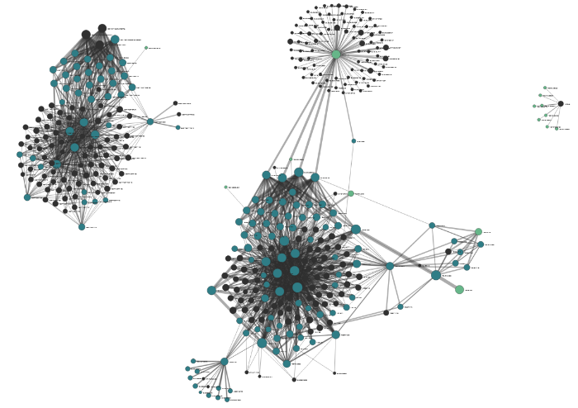
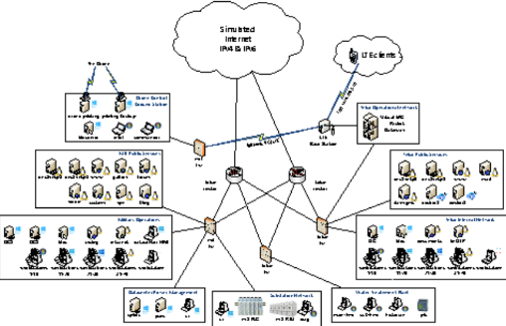
Visualizations in the Arkime (2D) condition
All the text
One
Two
three
Edge: connection
Edge width = traffic
Node = host/IP address
2D Schematics on paper
Click node to see exclusive connections
Hover over edge to see traffic statistic (e.g. 9000 sessions)
Graph view of network in Arkime software

Slide 51
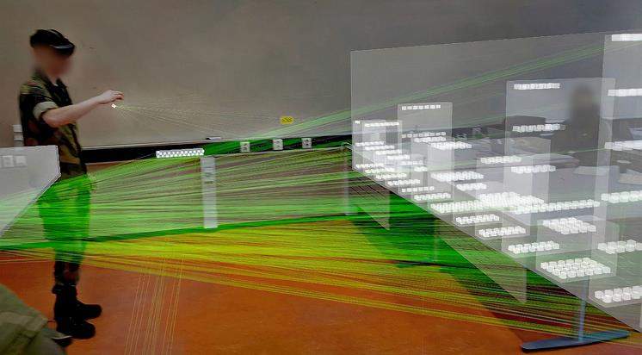
Visualizations in the VDE (3D) condition
All the text
One
Two
three
Overview of network in VDE, visualized in mixed reality with HoloLens 2
Box = node/host. Can be pinched and lifted to better see connections
Edge = connection between nodes, brightness = traffic
Close-up of user mechanics in VDE Kullman & Engel, 2022
Kaur et al., 2018

Slide 52
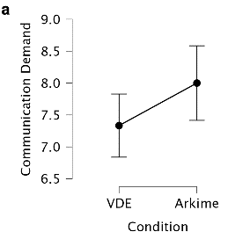



Communication is better in the VDE group
Structured observation (ICC = .871) noting the frequency of communication types + self-reported communication demands
All the text
One
Two
three
Self-report
Observations
H(1) = 3.91, p = .048, η² = .145
F(1), = 5.62, p = .028, ω² = .174
H(1), = 15.968, p < .001, η² = .748
H(1), = 4.10, p = .043, η² =.155
Kruskal-Wallis
ANOVA
Kruskal-Wallis
Kruskal-Wallis

Slide 53

Communication is better in the VDE group
Linear regression analysis on communication variables and SA variables that were significantly different between groups
All the text
One
Two
three
Task two task resolution was a significant negative predictor of :
Total identified RT hosts targeting BT systems
β = -.763, p < .001, R²_{Adj} = .561, F(1) = 27.845
Correctly identified RT hosts targeting BT systems
β = -.630, p = .002, R²_{Adj} =.366, F(1) = 13.142
Traffic associated with correctly identified RT hosts targeting BT systems
β = -.665, p < .001, R²_{Adj} = .415, F(1) = 15.889
Identifying compromised BT segments
β = -.547, p = .008, R²_{Adj} = .264, F(1) = 8.531

Slide 54


Communication is better in the VDE group
Linear regression analysis on communication variables and SA variables that were significantly different between groups
All the text
One
Two
three
Task two task communication dysfunction was a significant negative predictor of
The accuracy of the description of network activity
β = -.524, p = .012, R²_{Adj} = .238, F(1) =7.553
Confidence in having identified BT hosts abused to access network
β = -.525, p = .012, R²_{Adj} = .239, F(1) = 7.594
Self-reported communication demand was a significant negative predictor of
Correctly identified RT hosts targeting BT systems
β = -.454, p = .034, R²_{Adj} = .166, F(1)= 5.178

Slide 55

Condition had no effect on decision-making
Forced decision-making choice task: If you could only pick one course of action, which would you pick?
  Cut off all connectivity from the friendly networks to outside
  Start incident response on selected hosts
  Launch attacks against the hosts that the suspected adversaries might be using
  Cut off connectivity to a selection of network segments
Answers:
2. Start incident response on selected hosts” option on the forced-choice decision-making task (n = 20).
1. Cut off all connectivity from the friendly networks to outside (n = 1, VDE)
4. Cut off connectivity to a selection of network segments (n = 1, VDE)

Slide 56

Summary and discussion
The 3D mixed reality visualization did not give a false sense of confidence as suggested by 3D group having lower condifence when having lower network topology recognition scores
Overconfident cybersecurity professionals are worse at detecting cyber threats (Butavicius et al., 2016; Jampen et al., 2020; Sütterlin et al., 2022).
Participants in the 3D group had higher scores on CSA measures → especially pronounced for the task where they were supposed to identify top 5 red team hosts targeting blue team systems
3D group had better scores on both self-reported and observed communication measures
Communication measures that were different between groups predicted performance on CSA variables that also were different between groups
Most participants picked the same decision regardless of CSA → cohort effects (training) or sample size? Will increasing sample size or heterogeneity change decisions-making outcomes?
Limitations
Experiment lasted 2 hours → cyber analysts that work with network intrusion detection systems work for 12 hours at a time
Increasing number of alarms degrade cyber analyst performance (Agyepong et al., 2019) → no alarms in study
Ranking connections between hosts based on traffic is a process that is automated → more realistic to use VDE for communication and CSA sharing when cyber analyst already knows the state of the network

Slide 57

Conclusion
A 3D mixed reality visualization of network topology improves CSA and communication in cooperating dyads during simulated network attack
Applying psychological and neuroscientific knowledge about perception can improve analytical and communication processes in complex socio-technical working environments → more need for psychological inputs to user-centric design in cybersecurity

Slide 58

What to Communicate

Slide 59
Security Operation Centers (SOCs)
Organizations assign their cybersecurity operations to SOCs
SOC teams cover multiple security activities and analyze
large and continuous streams of data
Technical tasks and decision-making assigned to different
positions in the SOC (Muniz et al., 2015)

Slide 60
Socio-Technical Systems (STSs)
Cyber Operators (COs) = Technical personnel in SOCs
Face challenges spanning the cyber, physical, and social domain (Jøsok et al., 2016)
Human-machine and human-human interaction = STS
Cyber-physical working environment is subject to high rates of change and innovation

Slide 61

Accurate Recognized Cyber Picture (RCP) critical for Decision-Making
Decision-making based on human interaction requires shared situational awareness of the CTS
Cyber Situational Awareness (CSA) influence organizational control in its cyberspace
Barford et al. (2009) 7 criteria for CSA
  Awareness of the current situation
  Awareness of the impact of the attack
  Awareness of how situations evolve
  Awareness of adversarial behavior
  Awareness of why and how the current situation is caused
  Awareness of quality and trustworthiness of CSA info
  Assessment of plausible futures of the current situation

Slide 62

Accurate Recognized Cyber Picture (RCP) critical for Decision-Making
Accurate RCP cruical for CSA
RCPs consist of actively selected and actionable information specifically pertaining to CTS
COs investigate threats to create RCP → Share RCP (sRCP) with decision-maker
Cyber-to-physical relay of RCP is subject to many challenges

Slide 63
Research in Communication in CDX
Novices
Experts
Cyber-physical interactions facilitated by team communication and coordination demands and restricted by dissatisfaction with team performance.
Strategic – tactical decision making facilitated through Communication Demands but restricted through higher time-share demands.
Novices are dependent on communication interactions
  Difference task workloads and team-task workloads
Lugo, R. G., & Sütterlin, S. (2018, July). Cyber officer profiles and performance factors. In International Conference on Engineering Psychology and Cognitive Ergonomics (pp. 181-190). Springer, Cham.
“effective collaboration, experience, and functional role-specialization within the teams are important factors that determine the success of these teams in the competition and are important observational predictors of the timely detection and effective mitigation of ongoing cyber attacks. These results support theories of team maturation and the development of functional team cognition applied to mastering cybersecurity”
Experts need less communication
More experience requires less leadership
Buchler, N., La Fleur, C. G., Hoffman, B., Rajivan, P., Marusich, L., & Lightner, L. (2018). Cyber teaming and role specialization in a cyber security defense competition. Frontiers in psychology, 9, 2133.

Slide 64


Orient-Locate-Bridge – The role of Cognisance and Communication (Knox et al, 2018)

Slide 65


Cognisance as a Human Factor
To present an approach to training that supports better situational awareness
Training
Incidence response
Snapshot of SOC Retrospective-timeline [1]
The role of Table Top Exercises

Slide 66


COs collaborative practices during RCP creation and sharing
COs communicate with other COs when tailoring RCPs to their clients
  Less common further up in SOC organizational hierarchy
  HS: Problems when DM and COs are located in different quadrants
  Beliefs and expectations affect sharing and absorption → RCP and CSA
Centralized/official systems are circumvented
  Information sharing between COs not incentivized

Slide 67



Slide 68

Decision Makers
IT

Slide 69



Slide 70


How to train

Slide 71




What to Communicate - SITREPS
Notes:
Attentional tunneling (or: attentional narrowing)
Attention can not be divided.
Get hooked on particular features and inadvertently drop scanning.
Mind the Gorilla.
Requisite memory trap
Working memory overload.
In particular auditory information.
Stressors
Workload, anxiety, fatigue, etc.
Time pressure, uncertainty, etc.
Limits SA via limiting WMC and slowing down information processing, more likely attentional tunneling, disorganized scanning for elements and less attention to peripheral cues.
Data overload
Volume and rate of change
Limited bandwith of human sensory and information-processing mechanisms.
Rate of data flow can be enhanced significantly by ergonomic user interfaces
Misplaced salience
Some features (size, shape, movement, flashing lights, noise) are prioritized in sensory and attentional processing
Overuse or inappropriate use degrades SA to other information
Errant mental models
„representational error“
A wrong mental model is applied
Out of the loop syndrome
Automation can eliminate excessive workload, but can also lower SA by putting people out of the loop.
„take-over-time“ where automatisation fails or is not equipped to handle a situation

Slide 72


Where in the Kill Chain is attack 1?
How critical is the system?
How severe was the attack?

Slide 73

Describe the activity you saw (specific but not overly detailed)
What type of incident do you think it was?
If you could suggest anything - which actions should be done?
L1
L2
L3

Slide 74

How high is the quality/trustworthiness of your threat information?
How urgent is it to take action?
How confident are you in the descriptions above (0-100%)?

Slide 75
Why?
Level 1
  Between COs
  Between CO + CISO
  Between CO/CISO+DM
Level 2
  Between COs
  Between CO + CISO
  Between CO/CISO+DM
Level 3
  Between COs
  Between CO + CISO
  Between CO/CISO+DM

Slide 76
Let’s talk
Human communication in Cyber Threat Situations (CTSs)
Communication between humans at the core of cyber defense decision-making
Communication in CTSs is like a software design-problem
Communication must be modular (frictionless) enough to be useful for all stakeholders
HOW are you with communication?
How do you prefer to be talked to?
  Under pressure?
  CS attack?
How do SITREPS differ?
  CO→CO
  CO→CISO
  CISO→DM/Client

Slide 77



Slide 78



Raman & Koka, 2015
Notes:
Raman, M., & Koka, A. S. (2015, September). The ever-increasing demand for soft skills at workplace: A Study on IT professionals’ perspectives. In International Conference on Management and Information Systems (Vol. 18, pp. 4-8).

Slide 79

Now some stereotypes

Slide 80
Using SMM for Mitigating CS Attacks
Before Attack
  Training
    Technical, behaviors, communication
During Attck
  Communication, Psychological Safety in the workplace
After Attack
  Good communication helps maintain financial interestes
  Critical Incidence Review
    Create/update communication plan
Notes:
Before an Attack
employees and training (periodical), technology will not protect from an attack.
Make sure that your security team is trained periodically. It is also recommended that the best practices around spear phishing (the use of fraudulent emails aimed at specific users to launch an attack) so that your people know how to recognise suspicious emails, links and attachments which can harm your systems.
A trusting work environment coupled with busy people can easily lead to poor split-second decisions around opening emails and exposing your most critical systems to attack, regardless of the sophistication of security technology you’ve deployed. 91 percent of cyberattacks start with a spear phishing email, according to research from TechWorld. So, proactive and sustained education around security risks is critical. Hackers are constantly refining their “phishing” techniques to trick users and you need to not only alert them to the latest threat but remind them to keep security top-of-mind on top of all their other work.
Protecting users from making such damaging mistakes is a big win. So, make sure the C-suite understands the business risks and the significance of developing a proactive strategy. CISOs should also lobby for them to back education programs – financially and personally, by setting the best example of safe computing themselves.
During an Attack
During an attack, a lack of communications can really hurt. A breach of security is also a breach of trust, and it’s a vital component in customer and partner relations. Every headline about privacy and data breaches, any failure to protect your systems and data will damage your organisation and brand.
The difference between a breach being a minor bump or a major impact to your organisation and its market value, is communication.
Think for a moment, about the impact of proactive and prescriptive notifications for example, to all employees drastically increasing the damage from an attack by compromising even more IT equipment as employees link their laptops to the company network.
Alternate communications platforms, out of band, from the company’s infrastructure, for use during an attack may need to be established, especially if the regular telecommunication network and email systems are compromised, just like in the Sony Pictures hack. While quick and targeted communication with the relevant IT experts will be key, don’t forget you may also need frequent updates with management, legal, marketing, key stakeholders and partners to comply with regulations governing data privacy and security reporting.
After the Attack
History dictates that those organisations that handled communications well after a breach suffered only small fluctuations in stock price and customer confidence. Those that couldn’t get the message out, or bungled the message, suffered far greater and longer-lasting damage. Don’t leave this to chance in a crisis.
A sound post-attack communication plan must describe what happened as honestly and completely as possible. It will explain correction steps taken for all affected parties, and (as soon as possible) what is planned to prevent a recurrence. This is difficult to do in the middle of a crisis, so have a response plan in place. Also have a tested communication system to alert all stakeholders.

Slide 81

Summary
Did you meet your expectations?
How confident are you about this?
How can this be understood in different contexts?
How can I apply this to my experiences (learning/work)?

Slide 82
References
Endsley, M. R. (2015). Final reflections: situation awareness models and measures. Journal of Cognitive Engineering and Decision Making, 9(1), 101-111.
Mathieu, J. E., Heffner, T. S., Goodwin, G. F., Salas, E., & Cannon-Bowers, J. A. (2000). The influence of shared mental models on team process and performance. Journal of applied psychology, 85(2), 273.
Endsley, M. R. (1988, October). Design and evaluation for situation awareness enhancement. In Proceedings of the Human Factors Society annual meeting (Vol. 32, No. 2, pp. 97-101). Sage CA: Los Angeles, CA: Sage Publications.
Ask, T. F., Knox, B. J., Lugo, R. G., Hoffmann, L., & Sütterlin, S. (2023, June). Gamification as a neuroergonomic approach to improving interpersonal situational awareness in cyber defense. In Frontiers in Education (Vol. 8, p. 988043). Frontiers.
Berg, H. P. (2013). Human factors and safety culture in maritime safety. Marine Navigation and Safety of Sea Transportation: STCW, Maritime Education and Training (MET), Human Resources and Crew Manning, Maritime Policy, Logistics and Economic Matters, 107, 107-115.
Chen, Y., Ramamurthy, K., & Wen, K. W. (2012). Organizations' information security policy compliance: Stick or carrot approach?. Journal of Management Information Systems, 29(3), 157-188.
Psychological Safety and Learning Behavior in Work Teams. Administrative Science Quarterly, Vol. 44, No. 2 (Jun., 1999), pp. 350-383, Amy Edmondson
Sætrevik, B., & Hystad, S. W. (2017). Situation awareness as a determinant for unsafe actions and subjective risk assessment on offshore attendant vessels. Safety science, 93, 214-221.
Borgersen, H. C., Hystad, S. W., Larsson, G., & Eid, J. (2014). Authentic leadership and safety climate among seafarers. Journal of Leadership & Organizational Studies, 21(4), 394-402.

Slide 83

Thank you
Please send all questions to trainers.

