Slide 1



Topic1 – Introduction to Human Factors in Cybersecurity
CSP002
Presentation by:
Ricardo G. Lugo

Slide 2

Acknowledgement
Co-funded by the European Union. Views and opinions expressed are however those of the author(s) only and do not necessarily reflect those of the European Union or HADEA. Neither the European Union nor the granting authority can be held responsible for them.
Project Agreement no. 101083594

Slide 3


Cybersecurity Essentials and Management
o1.
Goals: Who-What-Why you need to take this training
o2.
Training logistics: When-Where-How
o3.
Learning outcomes
o4.
Training outlines
o5.
Exercises details
o6.
Practical information and requirements
o7.
Registration information and contacts

Slide 4


ISACA
Notes:
https://www.isaca.org/resources/isaca-journal/issues/2019/volume-2/implementing-a-cybersecurity-culture
The ISACA article "Implementing a Cybersecurity Culture" emphasizes the importance of fostering a cybersecurity culture within organizations to enhance information security. It defines cybersecurity culture as the collective knowledge, beliefs, perceptions, attitudes, assumptions, norms, and values of individuals regarding cybersecurity, which manifest in their behavior with information technologies. ISACA
Key components of a robust cybersecurity culture include:
Trust: Building interpersonal trust among coworkers to facilitate open communication about security concerns.
Information Systems: Implementing systems that effectively convert data into actionable information.
Communication: Encouraging human interactions necessary for knowledge transfer and security awareness.
Organizational Structure: Designing structures that promote knowledge sharing and accountability in security practices.
Reward Systems: Establishing motivating mechanisms to encourage adherence to security protocols.
The article also highlights the need for continuous research to define and measure cybersecurity culture effectively, suggesting that this area presents opportunities for further study by scholars and practitioners.

Slide 5

What is the Cybersecurity Domain?

Slide 6


Skills needed
Notes:
1 Different management skills required by manager level (Adapted from Daft, 2003; Dance, 2011; Katz, 1974)

Slide 7

Interaction Paradigm
Other people become person’s situation
B= f(P x S)
Complicated picture:
Behaviour= f_{c}[P_{c}*f_{o}(S*P_{o})]*f_{o}[P_{o}*f_{c}(P_{c}*S)]
C=cyber officer; o=other person

Slide 8

Cyber incident and responses within an organisation at the individual, social and organisational levels
Joinson, A.N., & van Steen, T. (2018). Human Aspects of Cyber Security: Behaviour or Culture Change? Cyber Security, 1(4), 351-360.

Slide 9

https://www.enisa.europa.eu/publications/european-cybersecurity-skills-framework-ecsf

Slide 10
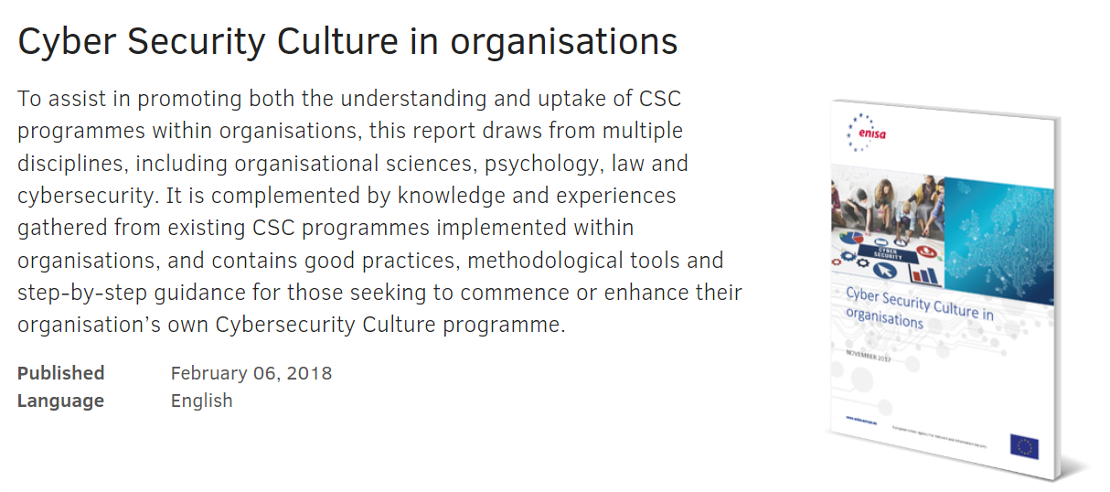
https://www.enisa.europa.eu/publications/cyber-security-culture-in-organisations

Slide 11

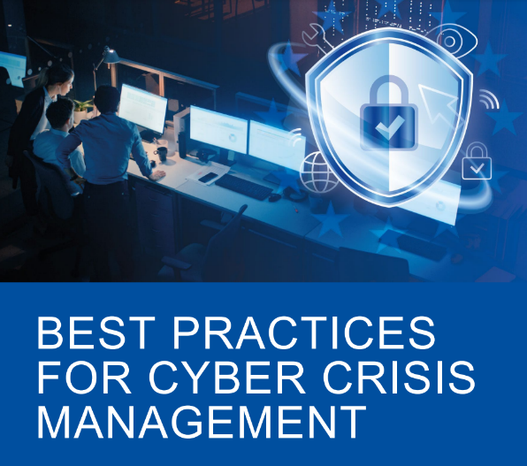





Maybe we need a common language

Slide 12


Reading recommendation
The European Union Agency for Network and Information Security (ENISA) is a centre of network and information security expertise for the EU, its member states, the private sector and EU citizens. ENISA works with these groups to develop advice and recommendations on good practice in information security. It assists member states in implementing relevant EU legislation and works to improve the resilience of Europe’s critical information infrastructure and networks. ENISA seeks to enhance existing expertise in member states by supporting the development of cross-border communities committed to improving network and information security throughout the EU. More information about ENISA and its work can be found at www.enisa.europa.eu.
A detailed report about the behavioural aspects of cybersecurity, current practice, the scientific background and ways to improve the cybersecurity culture in an organization.

Slide 13
Recommendations for specific groups
Policy Makers
Ensure responsibilities are assigned to those who have the capability to discharge those responsibilities
Signpost trustworthy competence - e.g. where to look for guidance on specific issues.
Promoting collaboration and trust-building within and across organisation; promote respect and ban disrespectful language about stakeholders
Support the development and use of evidence-based metrics and measures to assess cybersecurity skills, knowledge and organisational culture.
Encourage and support collaboration between technical and social / behavioural domain experts in tackling cybersecurity behaviours.
Don’t assume that awareness of a threat will lead to protective action! Citizens (and workers) also need the skills to avoid the threat, and an understanding that doing so will be effective.
Management and organisational leadership
Take responsibility: Decide which security risks they want to manage, and commit the resources required. This includes the cost of buying security equipment and services, but more important the total cost of operating those security measures:
  the time staff have to spend on security
  the time and effort required to change insecure behaviours into secure ones
  business that may be lost as a result of staff following the policies
  building the skills different parts of the organisation need
Lead by example: always follow security policies (you are a high-value target) and commit a portion of your time to work with security specialists and staff to finding workable solutions in your areas of expertise (e.g. operations, finance, marketing)
Manage your organisation to help security: The report has found that effective management of security can draw knowledge and tools from safety. Similarly, Human Resources can assist with the design of incentives and KPIs, and helping to identify staff who are interested in acquiring new skills and take on extra responsibilities. Communications and marketing can help to improve effectiveness of awareness materials. Leveraging your own resources and breaking down silos to solve problems is a management task.
Notes:
From European Network and Information Security Agency (ENISA) findings:
A thorough review by ENISA lead to some clear recommendations. I will now go through and highlight the key takeaways.
For Policy makers ENISA identified a clear lesson – they found that increasing cybersecurity literacy and skills is an evidenced method to support citizens to protect their cybersecurity.
For Management and organisational leadership the outcome of the reviews is that organisational leaders need to shift their perspective on what their role and responsibilities in managing cybersecurity in their organisation are. Leaders need to see the problem not as a technical one, with little to no consideration of the impact on individual employees going about their daily work tasks. Organisational leadership - while happy to keep saying how important security is to the organisation, need to take an active role to ensure that the security behaviour staff are asked for is doable in the context of the business. Doing so can build self-efficacy.

Slide 14
Recommendations for specific groups
CISO and security specialists
Calculate the impact of your policies. Security policies and measures can only be effective if they are adopted and used correctly. To ensure this, CISOs need to know the impact it has on staff in daily business operations - so they should know the time and effort compliance requires before putting a security measure in place. General MacArthur’s dictum ‘Never give an order that can’t be obeyed’ should be framed and hung over their desk.
Be visible and approachable. CISOs should be security cheerleaders, not policemen - to engage staff, they need to be visible and approachable at all times. And to build trust, they need to listen and negotiate, rather than try to ‘stamp out’ non-compliance and throttle innovation and experimentation.
You need soft skills. CISOs and other security specialists need to acquire the ‘soft skills’ to do this effectively. The programme developed by Ashenden & Lawrence (2016) with funding by the UK NCSC is a pioneer effort that should to be replicated, and become incorporated into academic and professional security courses.
Stop verbally bashing people. Effective engagement and trust require respect for others. The security profession needs to revise its perspective of non-specialists, and accept they are the only stakeholders in the ecosystem for whom security is the primary roles. And they must change the language they use to reflect this - no more referring to humans as ‘the problem’, ‘stupid users’ and the ‘Weakest Link.’z
CSIRT’s /CERT’s & SOC’s
Look after your staff. Burnout is largely driven by overload, but also by boredom through repetitive tasks. Organisations need to ensure sufficient staffing levels - this can be a challenge in CSIRTs where demand is high during incidents, but lower during other times. More flexible task allocations - e.g. having staff work on tool development, skills resources and team building and knowledge-sharing between teams - would be a way forward. Managing incidents affecting safety and cyber physical systems can be stressful - organisations need appropriate support to help staff deal with the aftermath.
Invest in training and personal growth. Having the skills, and ability to grow are key for effective performance, confidence and job satisfaction of security staff. In a rapidly evolving threat environment, funding for research and specialist skills is an essential, not a luxury. Some skill-building can happen through online courses, but hands-on case analysis, master classes and wargaming are more engaging and effective.
Support team and multi-team approaches. Effective cybersecurity defence is a team sport - building trust among analyst teams, and between them and management is essential. This is a new problem for many organisations, so some investment in external expertise (research or consultancy) may be required.
Notes:
Studies with CISOs and security specialists showed a need for a shift in what the job entails. The crux being, being visible and approachable. Here again we see the importance of ‘role modelling’ and ‘coaching’ as a performance pathway. Unfortunately what is often observed is a mode of communication that does exactly the opposite.
For Incident response teams (CSIRT’s /CERT’s & SOC’s) and security operations centre staff are among the most important assets in the fight against cyber threats. Enabling them to perform well is clearly important. ENISA found that burnout is a serious problem. This should give rise for concern, especially given the growing shortage of cyber skills professionals (Oltsig, 2017). Organisations need to take steps to manage this precious resource effectively.

Slide 15
Recommendations for specific groups
Software Developers
You cannot be a security expert, but you need to think about security from the start (security by design) and throughout the whole lifecycle (secure software development lifecycle). The longer you leave thinking about security, the more expensive it will be to make it secure.
Security experts can advise and support you - work with them, and tell them everything.
If your code includes a security mechanism, you need to make sure it is usable: how much time will it take? Will they be able to understand the decisions you are asking them to take? Work with usability experts to help you design and test for usable security.
Those who manage and educate
Compulsory security courses.
Teach to program securely, rather than just how to program.
Material in all other modules should be reviewed to remove or annotate examples that would lead to insecure code.
Awareness raising managers - for ALL the other important people in your organisation
Awareness based around THREAT not effective
Strategically tailoring awareness campaigns
Software Developers
You cannot be a security expert, but you need to think about security from the start (security by design) and throughout the whole lifecycle (secure software development lifecycle). The longer you leave thinking about security, the more expensive it will be to make it secure.
Security experts can advise and support you - work with them, and tell them everything.
If your code includes a security mechanism, you need to make sure it is usable: how much time will it take? Will they be able to understand the decisions you are asking them to take? Work with usability experts to help you design and test for usable security.
Notes:
For Software Developers the review revealed the similar issue to what the well-known internet essayist Norton (2014) noted in her much-shared opinion piece for The Message, that “Everything is broken.” in that there are high-impact first steps that can be taken to make it easy for developers to produce more secure code - by ensuring that platforms, tools and APIs they use have secure defaults and settings, and that code that is frequently copied is vetted and made safe. ENISA also highlighted that enabling security experts to become more approachable and supportive can lead to more - and most critically earlier - engagement between security and staff.
Re emphasising what Ric mentioned regarding striking the balance in an organisation, those who manage and educate
need to make sure that problems arising with security end up at the right “help” desk with people who have the right skills. There needs to be clear roles and responsibilities based upon skills. And all staff, not just those such as developers or security specialists need time to keep up-to-date with threats and update their skills. So they can ‘speak the language’ and not be demotivated by cyber-elitism.
And lastly - the critical aspect for capturing the rest, meaning all the other essential people in your organisation. Tailoring is key. One size does not fit all. As we have shown, people need to feel a sense of relatedness.
Your adversary is tailoring their attacks so you should consider doing the same if you want to avoid pain.

Slide 16

Now some selected snippets about what to expect

Slide 17

(Norwegian Consumer Protection Agency, 2019)
Facebook
Notes:
Hier ein Beispiel aus einem Bericht vom norwegischen Äquivalenz dessen was wir Verbraucherschutzzentrale nennen. Hier hat man sich das Kontoeröffnen von Facebook vorgenommen. Entsprechende ähnliche Berichte gibt es natürlich auch zu anderen Anbietern.
Sie sehen hier in grün den Pfad “des geringsten Aufwandes”, der kaum kognitiven Aufwand oder aktive opt-outs aus default-Einstellungen verlangt. Hier klicken Sie sich einfach rasch durch, akzeptieren u.a. personalisierte Werbung aufgrund tiefergehender Analysen ihres Nutzerverhaltens, das Teilen Ihrer Nutzerdaten mit anderen Geschäftspartnern von Facebook, Verarbeitung biometrischer Daten und natürlich ganz am Ende erst die Allgemeinen Geschäftsbedingungen.
Falls Sie diese “freiwilligen” Einverständniserklärungen nicht abgeben wollen, müssen Sie sich durch ein Labyrinth von Menüs mit teilweise kontraintuitiven Anweisungen (doppelte Verneinungen o.ä.) durcharbeiten.
Sie haben es hier also zu tun mit intrusiven “default settings”, irreführenden Formulierungen, dem Vermitteln einer Illusion von Kontrolle und Auswahl, dem Verstecken von privacy-freundlichen Wahlen, take-it-or-leave-it Entscheidungen, und allgemein einer Interface-Architektur wo die privatfreundlichen Alternativen immer mit wesentlich mehr Aufwand verbunden sind.

Slide 18

Notes:
Hier haben wir kurz – nicht direkt prüfungsrelevant – eine grobe Skizze. Die orangenen Bereiche verarbeiten emotionale Eindrücke und die blauen und violetten sind an der Regulation des Impacts von emotionalen Informationen zuständig. Sie sehen also den Unterschied zw. subkortikal und präfrontal.
Emotionale Einflüsse sind natürlich sinnvoll – sie geben wichtige Signale relevant für gesunde soziale Interaktion, gute Entscheidungen, sind wichtig für Empathie usw usw – es geht also nicht um die Unterdrückung von Emotionen, sondern um die Regulation auf das korrekte und in der Situation angepasste Niveau.
Das ist jetzt alles stark vereinfacht. Natürlich gibt es nicht „emotionale Informationen“ und natürlich sind noch viel mehr Bereiche involviert, so einfach lässt sich das aber nicht darstellen.
Für uns soll das jetzt so erstmal genug sein, dass wir wissen, dass es eine neuroanatomische und neurophysiologische (also die Funktionen betreffende) bekannte Bereiche gibt denen sich die verschiedenen Denkstile zuordnen lassen. Auf diese Art hat man in der Forschung gelernt zu verstehen, wie verschiedene chemische Zustände (z.B. durch Drogen), Medikamente oder Verletzungen, Demenzformen usw. die Handlungskontrolle und emotionale Zustände beeinflussen und erklären.

Slide 19

I can read your mind.
Look at the 6 cards below.
Now pick one card, just one, and remember that card.
Hold that card in your mind.
Concentrate!

Slide 20
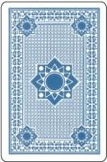
Are you thinking of your card?
Excellent.
Now through the power of PowerPoint, I will read your mind…

Slide 21
Ok, I’ve got it.
I know which card you chose.
I will now make your card disappear…

Slide 22

Abracadabra!
Your card is gone!
Amazing, isn’t it?

Slide 23
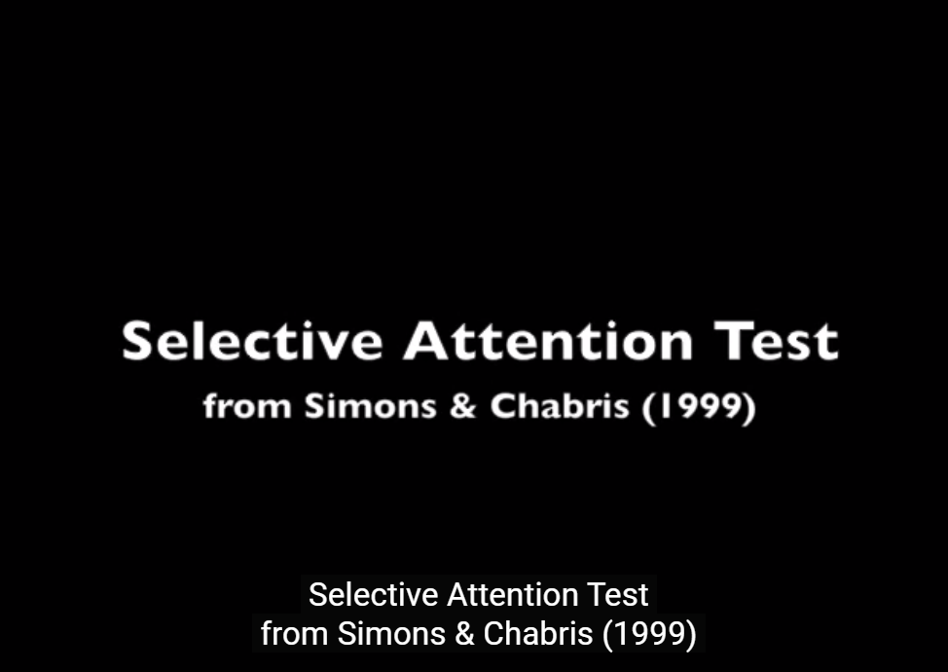
What happened?
(3030) selective attention test - YouTube

Slide 24

(601) Test Your Awareness : Whodunnit? - YouTube

Slide 25
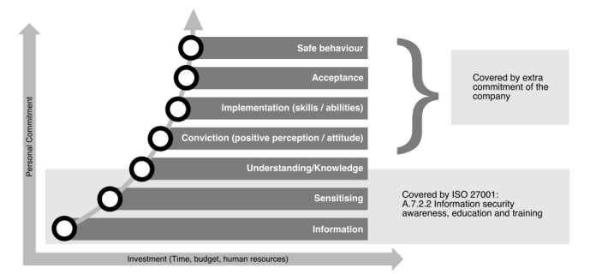

Slide 26

Social Engineering
Social Engineering is the acquisition of sensitive information or inappropriate access privileges by an outsider, based upon the building of an inappropriate trust relationship with insiders.
The goal of social engineering is to trick someone into providing valuable information or access to that information.

Slide 27

(very) little examples

Slide 28
Social Engineering Personality Framework
(Uebelacker, 2014)
Notes:
Im sog. SE Personality Framework hat Uebelacker diese Überzeugungstechniken dann mit Persönlichkeitsfaktoren der Big-5 kombiniert und auf theoretischer Basis erklärt, welche Persönlichkeitstypen am ehesten auf welche Überzeugungsstrategien ansprechen, und welche SE Techniken diese wiederum am meisten ausnutzen. Sozusagen eine Übersicht von „exploits“, wenn man so will.
Conscientiousness – also Gewissenhaftigkeit – bedeutet dass Menschen sich sehr an existierende Regeln halten, soziale Normen, und allg. Gepflogenheiten. Es ist daher anzunehmen dass Personen mit hohen Scores ehere ansprechen auf SE Attacken in denen sich der Angreifer der Überzeugungsstrategien Autorität, Reziprozität und Commitment bedient. Beispiel: In den meisten Organisationen erhalten hochrangige VIPS besondere Behandlung. Sich für einen VIP am Telefon oder via eines DeepFakes auszugeben und den Reset eines Passworts zu fordern hat hier größere Erfolgschancen. Was eine Organisation hier tun kann ist das Bewusstsein dafür zu schärfen, dass in sog. „scarcity attacks“, wo Notfallprotokolle notwendig werden mit denen man wenig Routine hat, erst einmal die Glaubwürdigkeit einer Anordnung über Routinen geprüft wird. Außerdem hilft es hier besonders, ausbleibende Meldungen aus Angst und Scham zu vermeiden, indem man eine Organisationssicherheitskultur pflegt bei denen das Melden menschlicher Fehler nicht sanktioniert sondern anerkannt wird.
Extraversion: Extravertierte Menschen sozialisieren sich gern und suchen nach neuen Anreizen und Herausforderungen. Sie haben Lust am Besonderen. Sehr extravertierte Menschen suchen oft soziale Aufmerksamkeit und sind im Gegensatz eher bereit, für den Preis der sozialen Anerkennung auch interne Informationen auszutauschen, wenn sie etwas Vertrauen gefasst haben. Eine Möglichkeit mit sehr extravertieren umzugehen ist ihnen zu schmeicheln und sie damit zu belohnen, bspw. indem man ihre Erfolge bei Cybersecurity-Awareness-Trainings individualisiert und im Intranet hervorhebt, oder Vorschläge zur Verbesserung der Sicherheit explizit und gut für andere sichtbar belohnt.
Agreeableness/Verträglichkeit: Menschen die hier hohe Punktzahlen erreichen sind die, die wir als besonders „nett“ und angenehm, verträglich eben, wahrnehmen. Sie haben generell eine starke Tendenz anderen Menschen – auch die ihnen nicht persönlich bekannt sind – zu vertrauen. Also ein Vertrauensvorschuss für Mitmenschen, geringes Misstrauen. Hier sind „Farming“-Ansätze potenziell erfolgreicher. Wenn ein SE sich bsp. Zeit nimmt, ist das Teilen privater und persönlicher Informationen hier wahrscheinlicher. Hier gibt es ebenfalls eine höhere Vulnerabilität gegenüber Autorität, Reziprozität, Liking und Social Proof. Auch der Hinweis auf andere Autoritäten kann hier helfen („Ihr Chef XY sagte dass das okay geht wenn Sie mir das direkt schicken“). Verträgliche Menschen neigen auch eher dazu, soziale Konflikte zu vermeiden – ein verärgerter Kommunikationspartner der droht die Geduld zu verlieren, kommt hier eher zum Ziel. Beispiel Attacke: Ein kleines Geschenk zum noch schnelleren Vertrauensaufbau, danach bitten um einen Gefallen um aus einer unangenehmen sozialen Situation zu helfen.
Offenheit für Erfahrungen: Offenheit gegenüber dem neuen, unbekannten, ist grundsätzlich ein Risiko aus dieser Sicht. Da offene Menschen am ehesten immer alternative Sichtweisen einnehmen, sind sie weniger manipulierbar und weniger durch ihre Optionen einengende Überzeugungen zu steuern. Evtl. ist Scarcity, also Knappheit, etwas zum Einhaken. Wenn bspw. dazu aufgerufen wird, im Gegenzug zu einer mit einer Überraschung versehenen Preisausschreibung Verbesserungsvorschläge für eine Website zu machen, sich aber nur die ersten 10 Personen einer bestimmten Gruppe einloggen können, dann wäre dies evtl. hier erfolgreich.
Neuotizismus, also emotionale Instabilität: Neurotische Menschen sind eher misstrauisch und pessimistisch. D.h. sie sind eher weniger anfällig. Wenn überhaupt, dann gegenüber Autoritäten die die Macht haben eine Bedrohung also eine Quelle negativen Affekts, darzustellen, worauf neurotische Menschen besonders reagieren. Aber das ist so noch nicht belegt und es sieht so aus als wären neurotische Menschen etwas erfolgreicher im Erkennen und Abwehren von SE. Ein Problem kann sein das Neurotiker eher zu Angst neigen und evtl. begangene Fehler ungern zugeben – das ist aber nicht das gleiche wie die Anfälligkeit gegenüber SE Attacken.

Slide 29

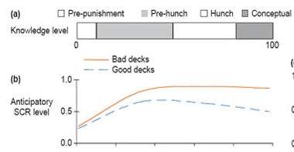
Intuitive decisions
Bechara (1994)
Notes:
Jeder kennt den Ausdruck „nach dem Bauchgefühl entscheiden“ und kennt das Konzept Intuition.
Was weniger bekannt ist, ist dass Intuition existiert, relativ einfach nachweisbar ist, und auch biologisch – genauer: neurophyisiologisch – gut erklärbar und verstanden ist.
Genauer genommen sind beteiligte Strukturen bestimmte – sog. ventromediale – Teile des PFC – wo Entscheidungen mit bestimmt werden, der anteriore insuläre Kortex, der Signale aus dem Körperinenren – ja! Bauchgefühle eben – „mapped“, d.h. zentralnervös, also im Gehirn – repräsentiert, und der afferente 10. Hirnnerv, der nervus vagus, also der von den Eingeweiden ins Hirn geleiteten sensorischen Signale leitende Nerv. Und noch einige andere. Kurzum: die Strukturen sind recht klar und involvieren zentralnervöse und periphere Nervenstrukturen und Hirnbereiche die in Körperwahrnehmung, Emotionsverarbeitung und die Integration von Emotion und Rationalen Abwägungen zuständige Hirnbereiche.
Inuitives Denken ist stark von Gefühlen beeinflusst und es funktioniert evolutionär gesehen relativ gut. Es funktioniert immer dort gut, wo eine deutliche emotionale Komponente in einer Entscheidung sinnvoller ist als rein rational-logisches Denken. Das ist vor allem in sozialen Interaktionen oft der Fall. Wenn man bspw. jemandem misstraut, ohne genau erklären zu können warum.
Das Erfassen von Intuition ist relativ einfach. Schon seit 1994 gibt es die sogenannte „Iowa Gambling Task“. [ERKLÄR IGT]
Diese simple Aufgabe – die es zumindest vor ein paar Jahren auch als Android-App gab (ohne die Hautleitwiderstandsmessung) – ist ein psychophysiologischer Beleg für das Vorhandensein für Entscheidungen sinnvoller Informationen, die unbewsust vorhanden sind und genutzt werden, unsere „freien Entscheidungen“ beeinflussen und eine nicht unwesentliche Auswirkung auf bspw. unser Kaufverhalten, die Wirkung von Werbung, von sozialen Manipulationen, usw. haben.
Dies ist also der Mechanismus mit dem Emotionen subtiler Art Wirkungen auf als rational empfundene Entscheidungen erklären.
In Cyberpsychologie geht es eben nicht nur um das Beschreiben von Verhalten, sondern um den Versuch, die Ursachen dafür herauszufinden – Denken Sie davon wie von einer Art „Reverse Engineering“ – wir wissen dass Verhalten emotional und unbewusst beeinflusst werden kann – und hier ist die Erklärung wie. Welches Problem Sie damit Lösen können? Das ist keine entscheidende Frage in diesem Bereich. Aber ja, es gibt Möglichkeiten, bspw. können Sie mit TMS die Feedbackschleife aus dem Körper manipulieren und Intuition verstärken. Auch erklärt dieses Phänomen warum Personen mit Substanzabhängigkeiten häufig irrationale Entscheidungen treffen in solchen Aufgaben.

Slide 30

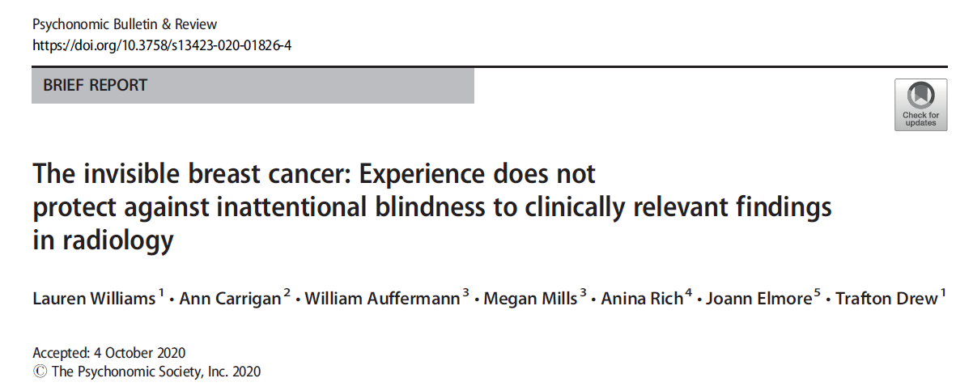


Slide 31
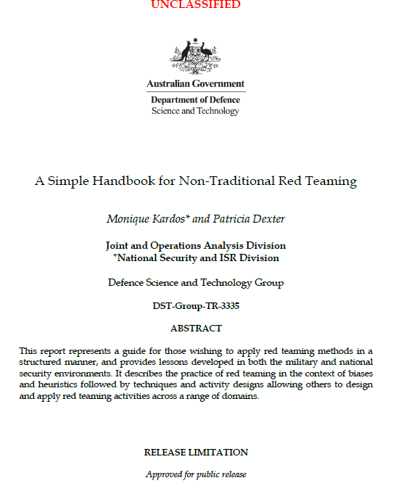
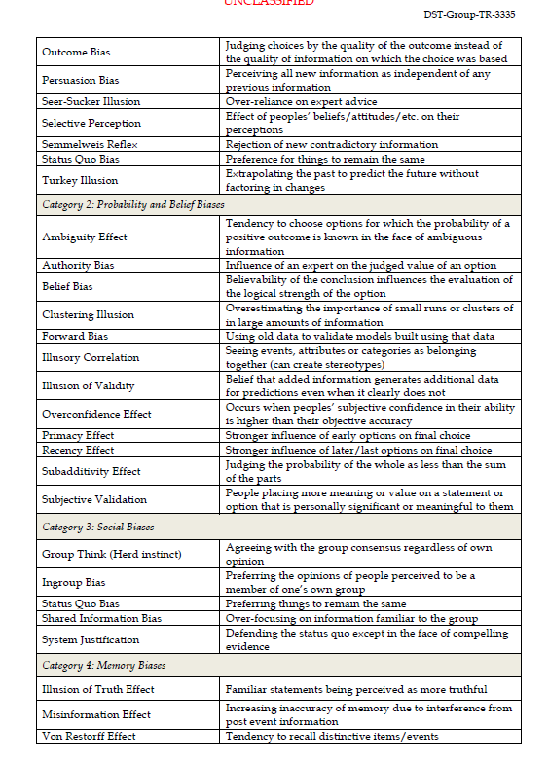

Slide 32
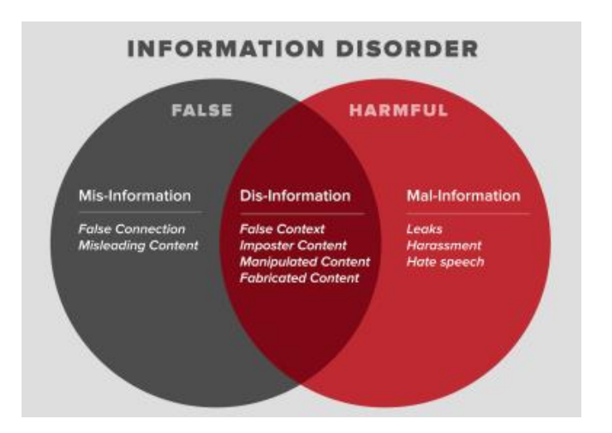
Mis-information is when false information is shared, but no harm is meant.
Dis-information is when false information is knowingly shared to cause harm (“fake news”).
Mal-information is when genuine information is shared to cause harm, often by moving information designed to stay private into the public sphere. Also: “hate-speech”.
Propaganda: Disinformation paired with an explicit or implicit political agenda.
Notes:
Wardle 2017

Slide 33
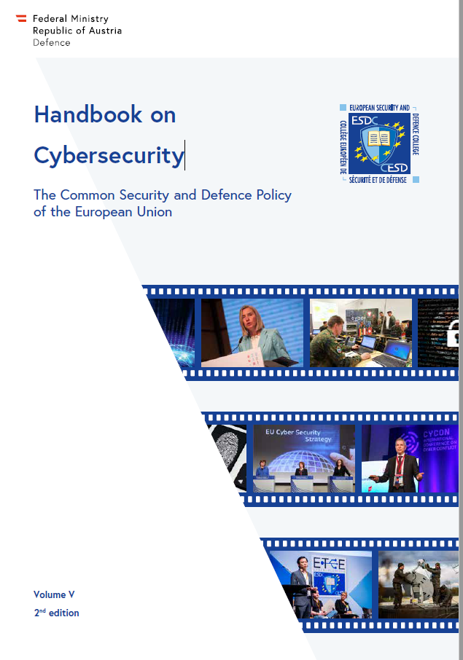
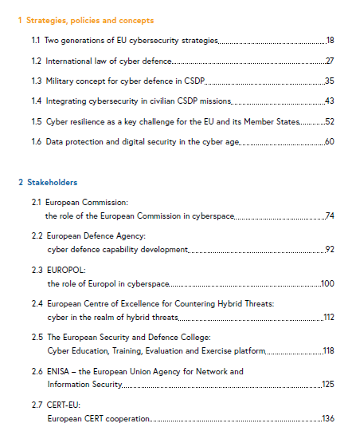


Slide 34
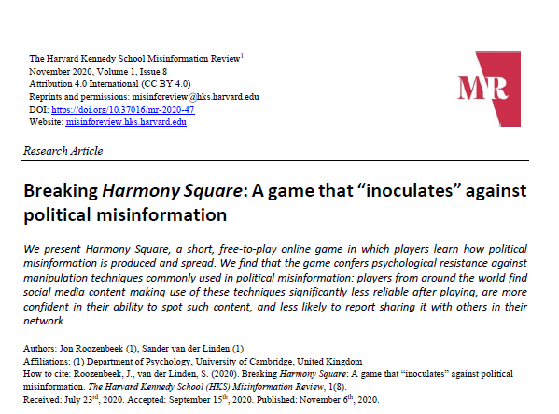
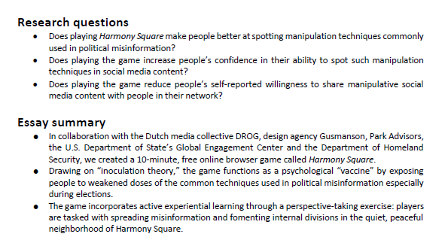

Slide 35
Game elements addressing psychological needs to build up motivation
Points
immediate positive reinforcements, direct feedback.
Badges
status symbol, group identification, goal-setting, feeling of competence.
Leaderboards
achievement and power, competence, social relatedness (for team scores, stimulating collaboration via shared goals and experiences).
Progress bars and performance graphs
provide feedback, provide clear goals, improvement and mastery.
Quests
clear goals, consequences of a goal, importance of players action.
Meaningful stories
increase interest, meaningful choices incr. autonomy, incr. positive feelings.
Avatars and profiles
autonomy, positive feelings and emotional bonds.
Notes:
In dieser Übersicht sehen sie, wie die zuvor genannten Spielelemente direkt verschiedene die Motivation beeinflussende psychologische Funktionen aktivieren und Bedürfnisse erfüllen. Sie können hier langsam die jeweiligen Spielelemente anschauen und sich überlegen, wie unterschiedliche Menschen mit unterschiedlich stark ausgeprägten Bedürfnissen auf die verschiedenen Spielelemente reagieren, auch abhängig von Alter, Geschlecht, Erfahrung, sozialen Fähigkeiten usw.
Ich empfehle Ihnen hier zur Vertiefung auch den im Teams-Ordner hochgeladenen Originalartikel von Sailer 2013, wo Sie auch nochmal eine Übersicht finden.
Beachten Sie hier auch, dass all diese Spielelemente in einem Zusammenhang stehen, d.h. insbesondere miteinander interagieren, nicht nur unabhängig voneinander, also additiv, wirken. Die resultierenden positiven Emotionen, das Gefühl der Immersion bzw das Aufgehen im Spiel in einem sog. Flow State, erfordern das Zusammenspiel vieler Elemente die dann gesammelt positive Emotionen erzeugen.

Slide 36
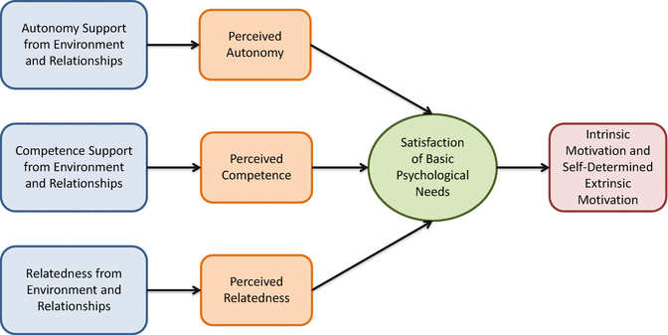
Closer look: Self-Determination-Theory
(Ryan & Deci, 2000)
(Sailer, 2017)
Notes:
Die sog. Self-determination-Theorie versucht zu beschreiben, wie Menschen motiviert warden Entscheidungen zu treffen. Externe Störeinflüsse warden dabei ausgeklammert, da es hier nur um selbstmotivierte und selbstbestimmte Handlungen geht. Man spricht auch von intrinsischer Motivation, also die Motivation die bedeutet, dass eine Handlung “in sich selbst” belohnend ist und nicht im Tausch für eine Gegenleistung erbracht wird – so wie man das ja auch bei Spielen sieht. Durch externe Einflüsse wie Spielelemente kann extrinsische Motivation ausgelöst werden.
Drei basale psychologische Bedürfnisse müssen nach dieser Theorie erfüllt sein, um ein Verhalten zu initiieren, und tragen auch langfristig zu Zufriedenheit bei. Hierbei handelt es sich um Autonomie, Kompetenz und Beziehung. Wenn diese drei Bedürfnisse bedient und als erfüllt wahrgenommen werden, entsteht die Motivation zur selbstbestimmten Handlung.
In der Tabelle unten können Sie sehen, wie diese drei Bedürfnisse durch Mechanics/Mechanismen adressiert adressiert warden und wie verschiedene Spielelemente diese auf unterschiedliche Weise erfüllen. Das Bedürfnis nach Autonomie wird hierbei aufgeteilt in zwei Unterformen, das Gefühl selbst Entscheidungen treffen zu können un ddas Gefühl dass die selbstgewählte Aufgabe bedeutungsvoll/sinnvoll ist.

Slide 37
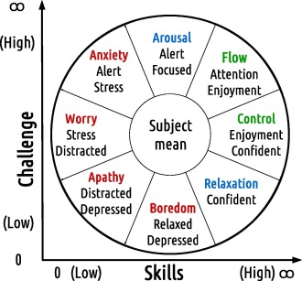
Notes:
Das Anforderung und Fähigkeit ausgewogen sein sollten, hatten wir gerade schon erwähnt. Der Zusammenhang ist ja bei allen Spielen wichtig – also dass das Spiel schwieriger wird während man sich darin verbessert. Man spricht hier auch von der skills-challenge-balance.
Das ursprüngliche klassische Model (rechts oben), das „channel model“ ging davon aus, dass optimaler Flow dann gegeben ist wenn Anforderung und Fähigkeit in einem ausgewogenen Verhältnis stehen – und dass Flow unabhängig vom Niveau des Spielers entstehen kann. Selbst Anfänger können also dann flow-states erleben wenn sie ein neues Spiel beginnen.
Eine Alternative zu diesem klassischen Modell, und vermutlich relevanter bei größeren Spielen die eine größere Leistungsspanne abdecken – also mehr Levels, breitere Anforderungsprofile – ist das sogenannte Quadrantenmodell (rechts unten). Spieler mit geringen Skills die fühlen dass sie ein wenig herausforderndes Spiel auf niedrigem Niveau spielen, enden eher in Apathie. Nach diesem Modell das für viele Computerspiele vermutlich das passendere ist, ist ein gewisser Skill-Level vorausgesetzt. Das impliziert dass der Einstieg in ein neues Spiel nicht zu lange dauern sollte – etwas was man im Design der Game Mechanics (Schwierigkeit von Quests, Auswahl der Gegner usw.) berücksichtigen sollte.
Der Kreis ist eine ausführlichere Darstellung des Quadranten-Modells und beschreibt etwas genauer, welche skill-challenge-Kombination zu welcher Reaktion führen kann. Grün motiviert, rot schreckt ab und führt zur Vermeidung, blau kann eine zeitlang das Verhalten aufrechterhalten.
Auch wenn nicht immer von vornherein klar ist, bei welchem Spiel welches Modell das bessere ist, scheint es aber doch so zu sein, dass der flow-state als stärker wahrgenommen wird bei Menschen mit higher skills. Eine Möglichkeit ist, dass sie das Spiel so gut beherrschen, dass weniger kognitive Ressourcen für profane Tätigkeiten der Steuerung notwendig sind, weniger Novelty-Reize den State stören indem sie Aufmerksamkeit auf sich ziehen.

Slide 38




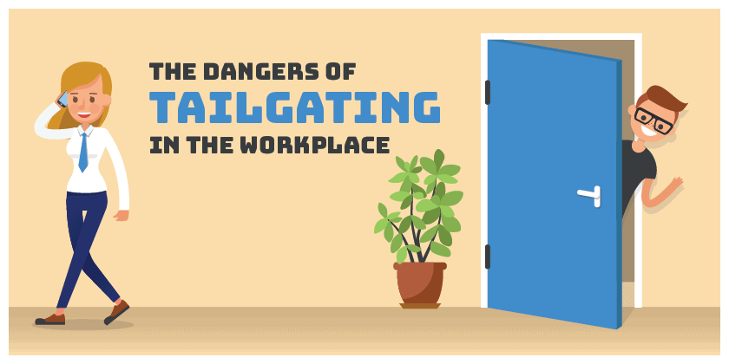
Attack vectors – Social approach
Tailgating
Impersonating
Eavesdropping
Shoulder surfing
Dumpster diving
Reverse social engineering
Notes:
Unter Attack-Vectors verstehen wir wie sonst auch im CS Bereich verschiedene taktische und strategische Angriffsformen. Wenn wir die technischen Hilfsmittel mal ausklammern, so sind diese klassischen Methoden immer noch extrem effizient. Stellen Sie sich einmal vor wie viel technischen Aufwand sie sich sparen wenn Sie jemandem beim Passwort eingeben über die Schulter schauen oder sensitive Daten aus der Mülltonne fischen können.
Beim Tailgating folgt man einer Person die legitimen Zugang zu zugangsbeschränkten Orten, d.h. hängt sich einfach an jemanden dran. Man kann eine Kiste tragen und darum bitten dass ihm die vorausgehende Person die Tür aufhält, oder die Tür einfach selbst aufhalten. Gerade seit es keine oder kaum Raucherzimmer in Unternehmen gibt, ergeben sich dadurch für physische Pen-Tester beliebte Möglichkeiten in Gebäude zu kommen.
Impersonating bedeutet dass man die Identität einer anderen Person annimmt und so von deren Glaubwürdigkeit profitiert. Wenn man das Ausgeben für jemand anderen in einem physischen Kontext nutzt um Zugang zu sensitiven Bereichen zu ergaunern, sich also so bspw. eine Schlüsselkarte organisiert, würde man das Piggybacking nennen. Impersonating nutzt überlicherweise Personen die Autorität oder Glaubwürdigkeit haben, oder beides. Bekannt auch die Anrufe von IT-Technikern die vorgeben ein technisches Problem zu lösen, dass sie einem selbst aufgehalst haben.
Eavesdropping: Lauschen – das kann das simple belauschen von Konversationen von Menschen in der Nähe sein (im Zug, Büro), oder auch das aktive Abhören und Mitlesen von Emails, Anrufen, u.ä.
Shoulder-surfing – wie der Name schon sagt – jemandem bei der Eingabe von Zugangsdaten zuschauen – viel einfacher als man glauben mag.
Dumpster-Diving: Den Müll von jmd durchgehen – da die meisten Leute privat keinen Aktenvernichter benutzen, lässt sich hier wenn man etwas Zeit und Zugang hat, einiges an Daten sammeln.
Beim reverse social engineering verleitet der Angreifer eine Person dazu, selbst die Initiative zu ergreifen und wartet einfach. D.h. man kreiert erst ein Problem, und ist dann die Anlaufstelle für schnelle Hilfe, was besonders unauffällig wirkt. Auch hier können die Kombination aus Malware und IT-Hotlines ein gutes Beispiel sein.
SE-Methoden lassen sich natürlich auch zum Gegenangriff anwenden - Der Australier Karl Rock betreibt einen Youtube Kanal bei dem er sich in auf Betrug spezialiserte indische Callcenter hackt und in einer Kombination aus Impersonating, Eavesdropping und reverse social engineering e-commerce-Betrüger entlarvt and bloßstellt.

Slide 39
Phases
Breda et al. (2017)
Research
Reconnaissance (Aufklärung).
Identify individual/organisational vulnerabilities.
Hook
Initiate communication with potential victim.
Engage, spin story, build trust, take control.
Play
Accomplish purpose of attack.
Compromise the system.
Exit
Finalize interaction with victim, preferably without arousing any suspicions.
Disappear, erase traces.
Notes:
Parallel zur bekannten kill-chain by cyber-attacken lässt sich auch dieses vereinfachte Phasenmodell für SE-Angriffsvektoren aufzeigen, die der kill-chain von Lockheed-Martin sehr ähnelt. Man hat der vielen vielleicht bekannten LM-Kill-chain ja auch vorgeworfen, dass sie zu sehr auf Malware fokussiert, daher ist diese Abwandlung von Breda et al. hier evtl. sinnvoll.
Ich denke die Schritte sind einigermaßen einleuchtend und selbsterklärend.
„build trust“ kann alles sein von einer längeren Bekanntschaft bis zu einer Entscheidung über das Design einer Mail, welches Vertrauen erzeugen soll (bspw. wiedererkennen vertrauenswürdiger Logos etc).

Slide 40
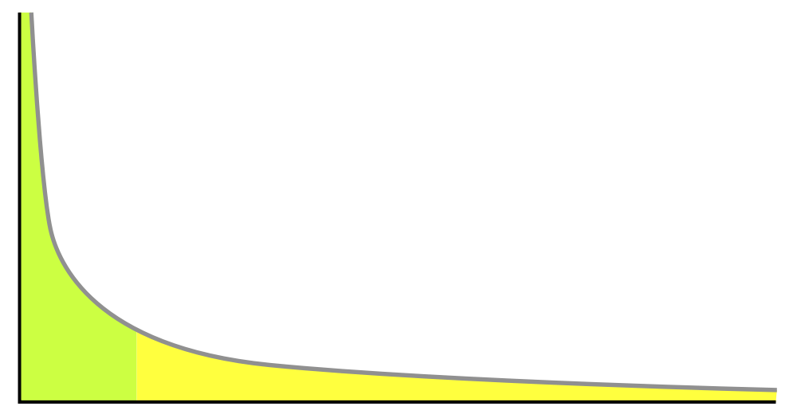
„prototype“= judgment reference
Frequency
Ph.email difficulty
aware
unaware or not received
Notes:
Nicht wie gut wir sind, bestimmt unser Handeln, sondern wie gut wir glauben zu sein.
Diesen „glauben“ – Selbstwirksamkeitserwartung bzw Self-efficacy, wird durch folgende Faktoren bestimmt: frühere performance, Lernbemühungen/-aufwand (viel lernen und schlechte Note: ungerecht), verbaler Zuspruch, positive Stimmung UND arousal.
Unsere Selbsteinschätzung von Ph.Vulnerabilität ist der wohl wichtigste Prädiktor ob wir uns Mühe geben eine Email genau anzuschauen, oder ob wir oberflächlich darüber hinweggehen.
Unsere SE hängt also von performance accomplishment ab, dies liegt in der Vergangenheit. Das problem bei Ph ist dass wir es ja nicht bemerken, wenn wir falsch liegen, und nur bemerken, wenn wir eine Ph zu erkennen glauben. Damit sind die besonders guten Ph. Nicht Teil der Gleichung. Da die guten per definition nicht wahrgenommen werden, machen Sie nicht den Prototyp dessen aus, was wir für eine Ph.mail halten.
Was wir hier sehen ist also dass wir al „performance accomplishment“ nur Daten zur Verfügung haben (Erfolge), die eine nicht repräsentative Positiv-Auswahl von (einfacheren) Ph.mails darstellen. Das führt zu einer Erhöhung der SE. Phishing-Simulationen können durch Rückmeldungen von Fehlleistungen und differenzierteren Lernerfahrungen allerdings korrigierend eingreifen.

Slide 41

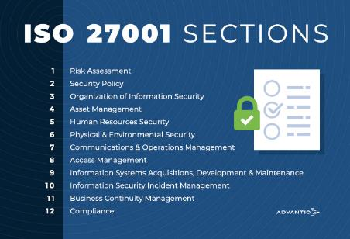
Annex A.7 Human Resources Security
Screening of future employees and contractors
Management responsibilities
  Know about IT-Sec threats, vulnerabilities, controls
  Proactive and adequate support of IT-Sec policies
  „Develop a security culture“
Information Security Awareness, Education & Training
  All relevant employees and contractors must receive appr. Awareness education and training.
  IT partnering with HR or a learning & development team
  Skills, knowledge, competence and awareness assessments
  Plan and implement a programme throughout employment lifecycle. “You need to be able to demonstrate that training and compliance to auditors.”

Slide 42


Secure behaviour
-
Goal: Productivity
Awareness
Password Use
Awareness
Intention
Behavior
Habit

Slide 43
Modelling trust
Ability…
perceived skills and knowledge of the trustee.
Benevolence…
is the extent to which a trustee is believed to want to do good to the trustor, aside from an egocentric profit motive.
Integrity…
perceived adherence to personal and moral principles on the part of the trustee.
(Mayer et al., 1995)

Slide 44
(Lankton & McKnight, 2011)
Functionality
The degree to which one anticipates the technology will have the functions or features needed to accomplishe task(s).
Reliability
The degree to which an individual anticipates the technology will continually operate properly, or will operate in a consistent flawless manner.
Helpfulness
The degree to which an individual anticipates the technology will provide adequate and responsive help.

Slide 46
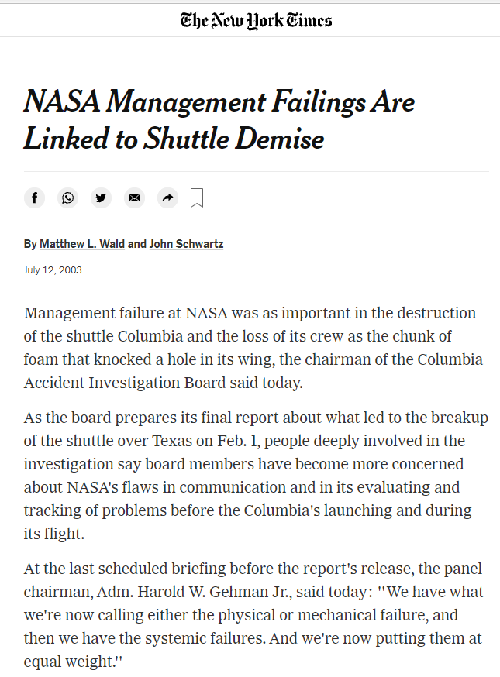

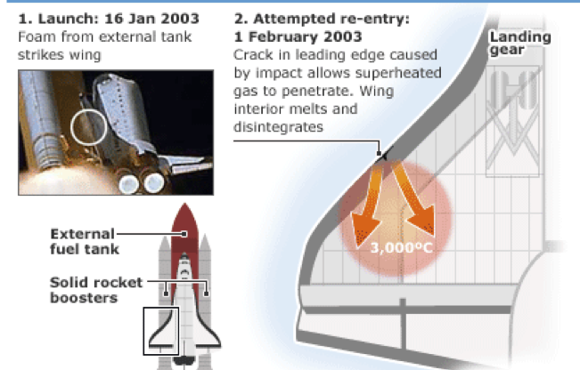


Space Shuttle Columbia re-entry crash Feb 1st, 2003
Mismanagement, or rather a „natural, albeit unfortunate, pattern of behavior common to many organizations“?
(Harvard Business Review, 2006)

Slide 47
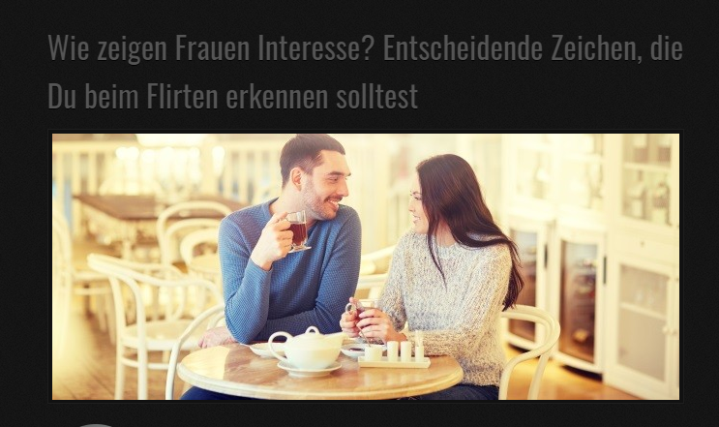


Risk types
Clear and obvious threat -> clear and obvious response (earthquake)
Clear and obvious threat -> unclear response (explosion of O2-tank in Apollo 13)
THE MOST DANGEROUS SITUATIONS ARISE WHEN THE THREAT IS AMBIGUOUS. THIS LEADS MANAGERS TO IGNORE OR DISCOUNT THE RISK AND TAKE A WAIT-AND-SEE ATTITUDE. SUCH AN APPROACH CAN BE CATASTROPHIC.
In the context of social interaction, social cognition is required…
Notes:
Es gibt dann…. Rechtfertigungsmöglichkeiten.

Slide 48
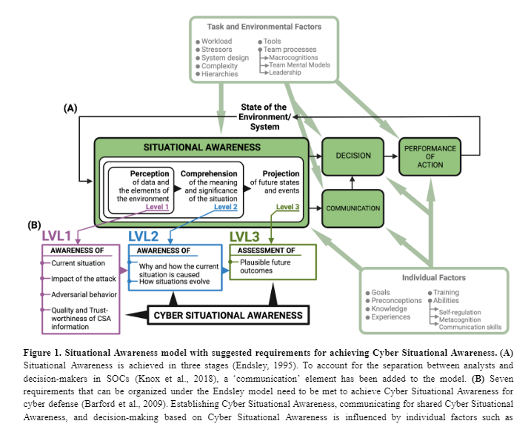
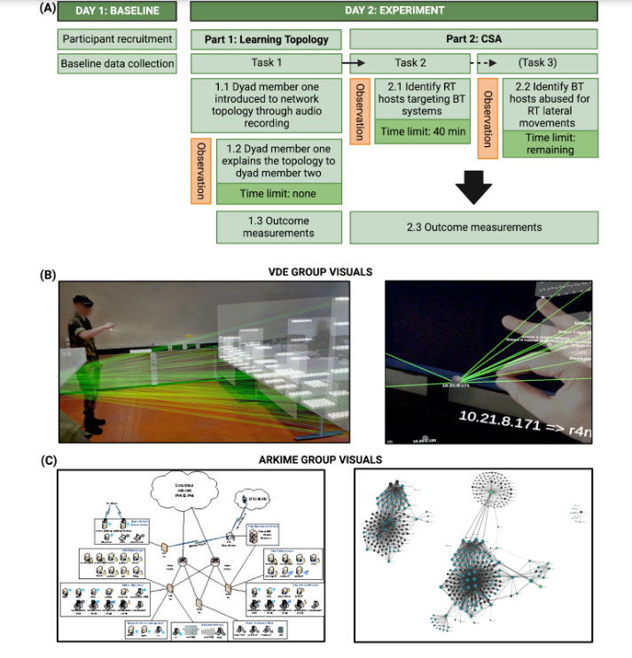
Neuroergonomics/SA-based Design

Slide 49
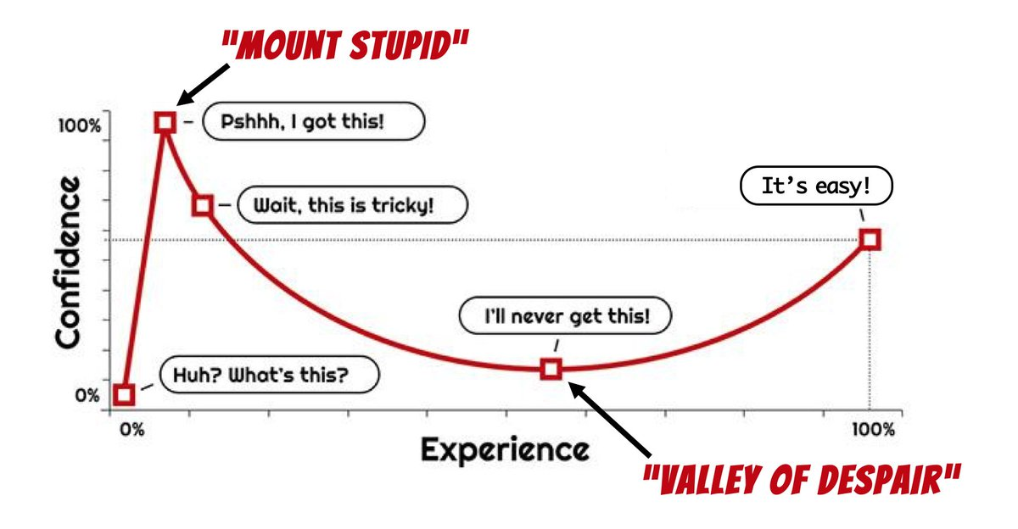
Einzelperson: Dunning-Kruger Effect
https://www.sw-engineering-candies.com/blog-1/how-good-i-really-am-as-developer--the-dunning-kruger-effect-in-software-engineering
Notes:
Nun bestehen Gruppen natürlich aus Einzelpersonen, die jeweils ihren eigenen Anfälligkeiten in Entscheidungsprozessen ausgesetzt sind. Insbesondere bei interdisziplinären Teams oder solchen die sich aus Personen mit mehrheitlich unerfahrenen Personen zusammensetzen, spielt der Dunning-Kruger Effekt (Oder Kruger-Dunning-Effekt) sehr oft eine wichtige Rolle. Wenn sie glauben, dass in ihrer Gruppe ein Risiko besteht dass ein wesentlicher Teil der Mitglieder noch in der zeitlichen Anfangsphase dieses im Effekt beschriebenen Zeitverlaufes steht, dann müssen Sie besonders vorsichtig sein und ggf. die Gruppenentscheidungen noch einmal anderweitig überprüfen lassen, bspw. Experten hinzuziehen, versuchen durch gezielte Gegenargumente die Robustheit einer Argumentation zu prüfen oder die Gruppe erweitern.
Der DKE beschreibt das Problem, dass bei mangelndem oder nur bruchstückhaft vorhandenem Wissen die eigene mangelnde Kompetenz nicht wahrgenommen werden kann. Das Erkennen der Komplexität einer Situation setzt ein gewisses Grundverständnis voraus.
Vielleicht erkenne Sie sich in der Abbildung wieder wenn Sie an bestimmte Module denken oder evtl. auch das Studium allgemein, Aufgaben im Praktikum oder ähnliches.
Ein Bereich in dem es besonders wichtig ist sich an diesen Effekt zu erinnern ist die interdisziplinäre Zusammenarbeit. Wenn Sie vor einem gemeinsamen Problem stehen und gemeinsam mit Leuten mit anderen fachlichen Hintergründen diskutieren, oder auch und gerade wenn Sie Menschen mit anderem fachlichem Hintergrund von Ihrem Standpunkt überzeugen wollen. Es kann schwierig sein bei Personen anderer Disziplinen einzuschätzen, wo in der KD-Kurve sie sich gerade befinden. Bei anderen Fächern können wir fachliche Kompetenz naturgemäß nicht einschätzen, bestenfalls die Kompetenz zu vermitteln/zu präsentieren, aber nicht vorhandene zugrundeliegende Kompetenzen. Daher verwenden wir Proxies, also Ersatzindikatoren die Kompetenz signalisieren, wie bspw. Titel und geschützte Berufsbezeichnungen. Geschützte Bezeichnungen wie „Zahnarzt“, „Psychotherapeut“ oder „staatlich geprüfte XY“ weisen darauf hin, dass man Kriterien und Ausbildungen erfüllt hat die von Dauer und Intensität ein Ankommen am Ende der Experience-Achse signalisiert. Wenn man das Konzept aber nicht auf berufliche Laufbahnen, sondern nur auf einzelne Projekte oder Anwendungen bezieht, ist es schon viel schwieriger. Wie Sie sicher leicht erkennen, kann dies in sicherheitsrelevanten Fragestellungen, bspw. Cybersecurity, ein Risikofaktor darstellen. Suchen Sie also in interdisziplinären Teams nach Informationen die Ihnen helfen können eine Person auf der Kruger-Dunning-Kurve zu lokalisieren, wenn Sie von dieser Person direkt oder indirekt abhängen.
Wenn Sie also für Teammitglieder Veantwortung haben die wesentlich weniger Erfahrung haben als Sie, kann es sinnvoll sein zu erkennen wenn diese im „Valley of Despair“ sind, und sie ggf. darauf bereits vorzubereiten um die Motivation zu fördern und sichtbare Lernschritte zu ermöglichen – also das Aufgabenprofil so anzupassen dass Teilaufgaben gut zu bewältigen sind, Erfolgserlebnisse passieren und so die Erfahrung allmählich wächst. Gleichzeitig geht es nicht darum Scheitern bei risikoarmen Aufgaben immer zu vermeiden, weil das Durchschreiten dieses Valley of Despair sehr nützlich sein kann um eine realistische Selbsteinschätzung zu entwickeln. Nur wenn die eigenen Grenzen einmal erkannt wurden, vermeidet man auf Dauer das Risiko einer Selbstüberschätzung und die damit verbundenen Risiken. Sehr hilfreich ist das aktive Einholen von Feedback von anderen.
lm
Wichtig für interdisziplinäre teams!
Glaubwürdigkeit liegt v.a. an Proxies. Bspw Titel.
Doch was wenn der DKE für Leute in der Gruppe eintritt? Zu hohe Confidence in Gruppenentscheidungen
Typisch auch für psychologie“fans“.

Slide 50
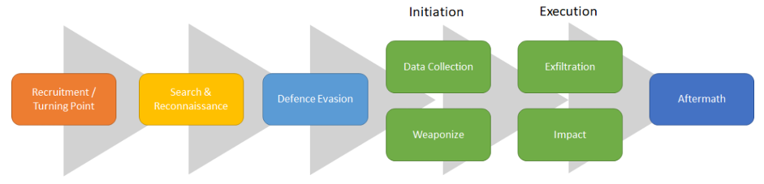
Definition
An Insider Threat is caused by an individual who has or used to have authorized access to an organization’s assets, and who acts either maliciously or unintentionally, in a way that could negatively affect the organization. (Costa, 2017)

Slide 51
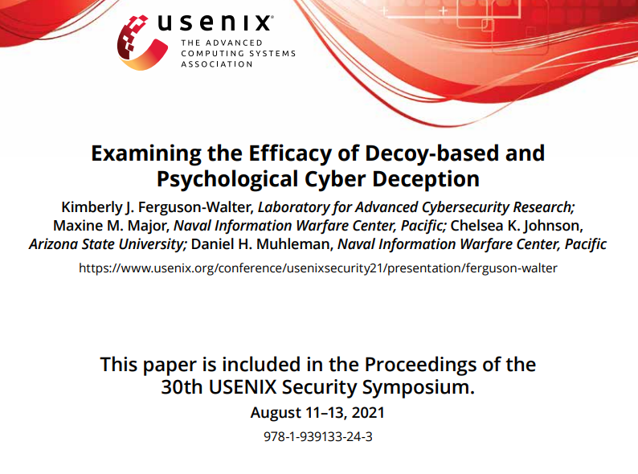

Slide 52

Thank you

