Slide 1



Topic-4: Social Engineering II: Dark Patterns and Cognitive Factors
Presentation by:
Ricardo Lugo
TALTECH, Estonia

Slide 2
Acknowledgement
Co-funded by the European Union. Views and opinions expressed are however those of the author(s) only and do not necessarily reflect those of the European Union or HADEA. Neither the European Union nor the granting authority can be held responsible for them.
Project Agreement no. 101083594

Slide 3
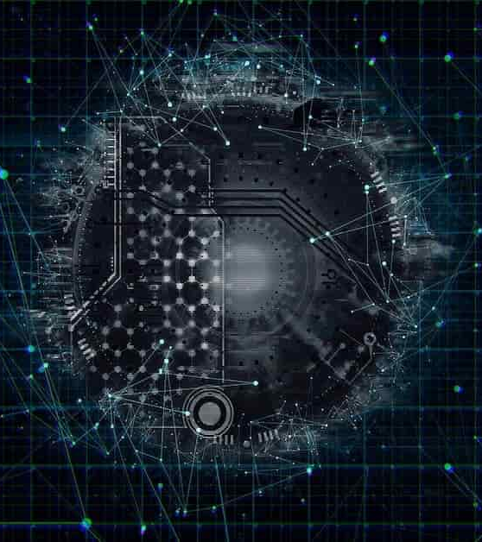
Agenda
OSINT
Dark Patterns
Cogntition
Theoretical aspects
Research
Case Study!!

Slide 4

Individual, social and organisational levels
Joinson, A.N., & van Steen, T. (2018). Human Aspects of Cyber Security: Behaviour or Culture Change? Cyber Security, 1(4), 351-360.

Slide 5
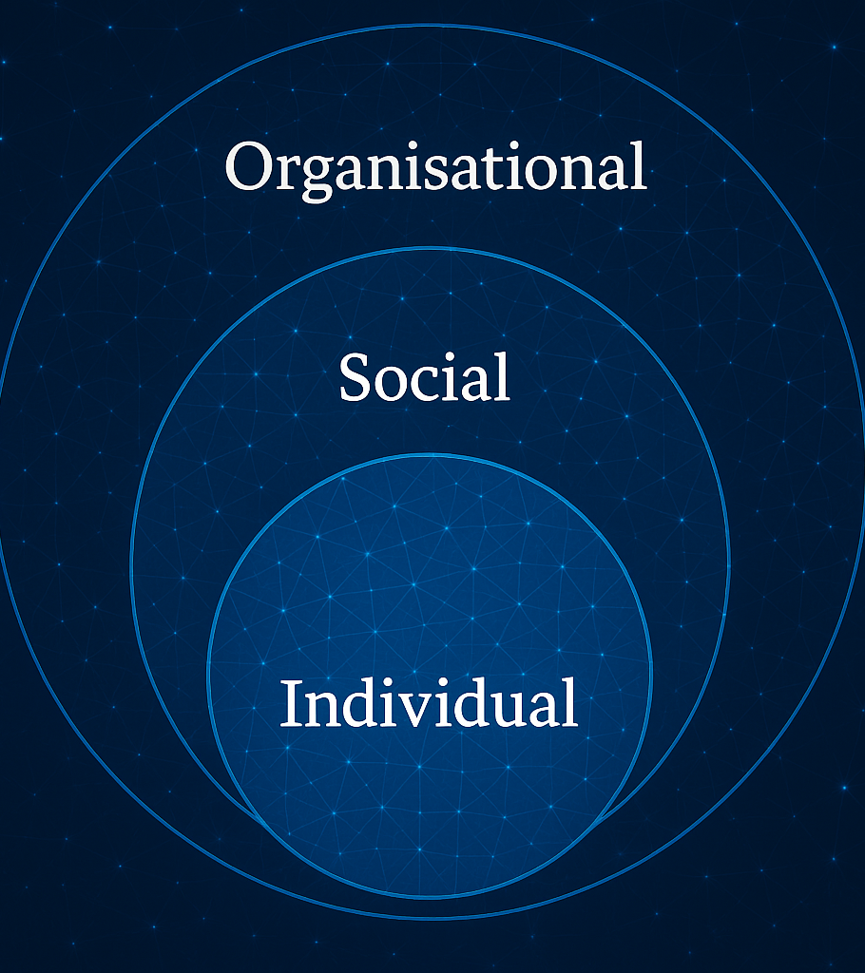
Interaction Paradigm
B= ƒ(P x S)

Slide 6

Cogntive exploits and attack vectors
Notes:
Red Arrow: an attacker that wages a social engineering cyberattack against a victim's human cognition functions (i.e., the oval). The resulting behavior is associated to persuasion (i.e., an attack succeeds when a victim is persuaded to act as intended by the attacker).
Cognitive workload, via mechanisms such as inattentional blindness, can increase vulnerability to social engineering cyberattacks.
Stress may reduce one's ability to detect deception cues in social engineering cyberattack messages but the direct effects of acute stress on cybersecurity social engineering have not been examined.
Attentional vigilance, particularly the vigilance decrement, may be an important influence on susceptibility to social engineering attacks, but more research is needed.
Literature results are not conclusive on how personality may influence one's susceptibility to social engineering cyberattacks.
Domain knowledge helps reduce vulnerability to social engineering cyberattacks.Awareness and general technical knowledge do not necessarily reduce one's susceptibility to social engineering cyberattacks, perhaps because human cognition functions have not been taken into consideration. Self-efficacy, knowledge, and previous encounter of social engineering cyberattacks collectively reduce one's susceptibility to social engineering cyberattacks. In particular, costly phishing experiences would greatly reduce one's susceptibility to social engineering cyberattacks, while non-costly experiences do not.
But Stefan will discuss this
Gender does not have a big impact on the susceptibility to social engineering cyberattacks
Old people with higher education, higher awareness and higher exposure to social engineering cyberattacks are less susceptible to these attacks.
Culture affects privacy and trust attitudes, which indirectly affect one's susceptibility to social engineering cyberattacks.
Long term memory The success of social engineering cyberattacks is inversely related to their prevalence.
Training methods that ask people to consciously think about social engineering cyberattacks are unlikely to be very successful unless the learning reaches the point where it is a habit that, largely unconsciously, guides safer computer use behavior.
Message quality and message appeal, which reflect attacker effort (e.g., using contextualization and personalization), have a significant impact on the attacker's success.
An individual's capabilities in detection of social engineering cyberattacks are affected by their awareness of the threats, their cultural backgrounds, and their individual differences in trust/suspicion.

Slide 7


OSINT

Slide 8
OSINT

Slide 9

Open Source Intelligence
Collection and analysis of data gathered from open sources (covert sources and publicly available information) to produce actionable intelligence. OSINT is primarily used in national security, law enforcement, and business intelligence functions and is of value to analysts who use non-sensitive intelligence in answering classified, unclassified, or proprietary intelligence requirements across the previous intelligence disciplines.Research highlights the significance of considering human elements in cybersecurity
Definition: OSINT is defined in the United States of America by Public Law 109-163 as cited by both the U.S. Director of National Intelligence and the U.S. Department of Defense (DoD), as intelligence "produced from publicly available information that is collected, exploited, and disseminated in a timely manner to an appropriate audience for the purpose of addressing a specific intelligence requirement.

Slide 10
Categories
Media, print newspapers, magazines, radio, and television from across and between countries.
Internet, online publications, blogs, discussion groups, citizen media (i.e. – cell phone videos, and user created content), YouTube, and other social media websites (i.e. – Facebook, Twitter, Instagram, etc.). This source also outpaces a variety of other sources due to its timeliness and ease of access.
Public government data, public government reports, budgets, hearings, telephone directories, press conferences, websites, and speeches. Although this source comes from an official source they are publicly accessible and may be used openly and freely.
Professional and academic publications, information acquired from journals, conferences, symposia, academic papers, dissertations, and theses.
Commercial data, commercial imagery, financial and industrial assessments, and databases.
Grey literature, technical reports, preprints, patents, working papers, business documents, unpublished works, and newsletters.
Notes:
OSINT is distinguished from research in that it applies the process of intelligence to create tailored knowledge supportive of a specific decision by a specific individual or group
open source acquisition involves procuring verbal, written, or electronically transmitted material that can be obtained legally. In addition to documents and videos available via the Internet or provided by a human source, others are obtained after U.S. or allied forces have taken control of a facility or site formerly operated by a foreign government or terrorist group.”[

Slide 11
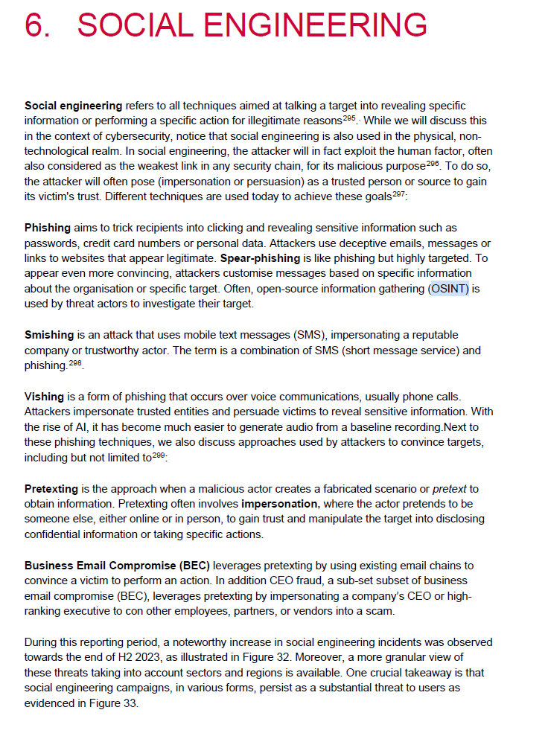
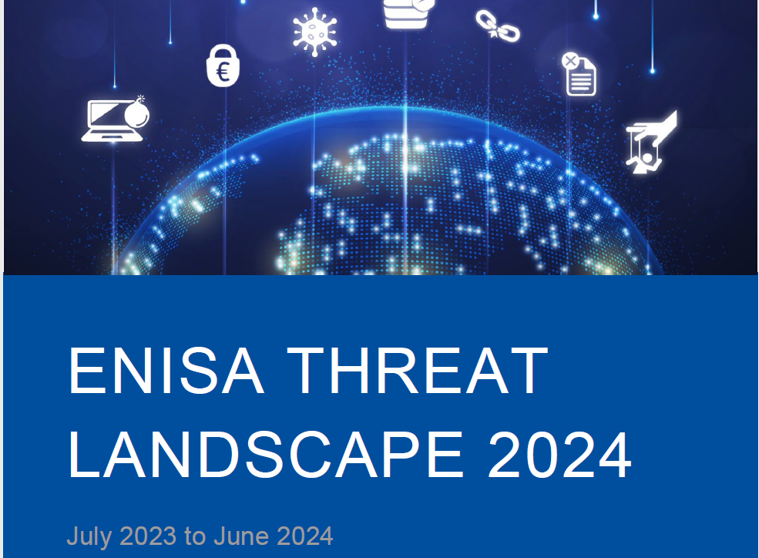

Slide 12

OSINT Framework

Slide 13
Google Dorking
Hacking
Using everyday tools
https://www.blackhat.com/presentations/bh-europe-05/BH_EU_05-Long.pdf

Slide 14

OPEN SOURCE INTELLIGENCE*
Open-source intelligence (OSINT) is the practice of collecting and analysing information gathered from open sources to produce actionable intelligence. This intelligence can support, for example, national security, law enforcement and business intelligence. OSINT investigates open (source) data collected for one purpose and repurposes it to shed light on hidden topics. The whole concept of OSINT sounds counter intuitive—using open data to reveal information that organisations want to keep secret.
https://data.europa.eu/en/publications/datastories/what-osint-open-source-intelligence

Slide 15
SOURCES OF DATA*
  Public media – print newspaper, magazines, and television.
  Internet – online publications and blogs, discussion groups such as forums, and social media websites, such as YouTube, Twitter and Instagram.
  Public government data – public government reports, budgets, press conferences, hearings, and speeches.
  Professional and academic publications – journals, conferences, academic papers, and theses.
  Commercial data – commercial imagery, business and financial assessments, and databases.
  Grey literature – technical reports, patents, business documents, unpublished works, and newsletters.
https://data.europa.eu/en/publications/datastories/what-osint-open-source-intelligence

Slide 16

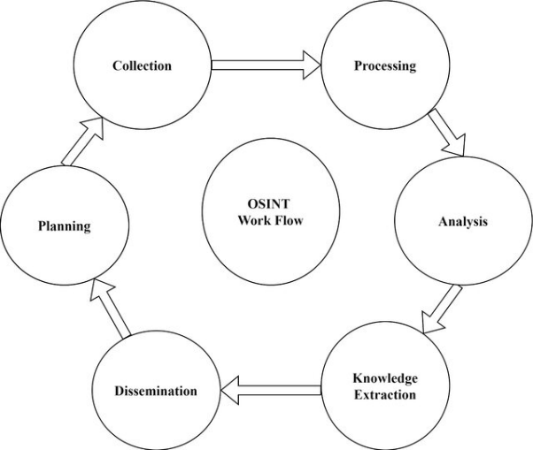
STAGES OF OSINT
OSINT operates as an ongoing process, continually enhancing the collection, processing, and analysis of data through integration of new information and responses.
01
Collection
02
Processing
03
Anaylsis
04
Dissemination
Yadav, A., Kumar, A. & Singh, V. Open-source intelligence: a comprehensive review of the current state, applications and future perspectives in cyber security. Artif Intell Rev 56, 12407–12438 (2023). https://doi.org/10.1007/s10462-023-10454-y

Slide 17
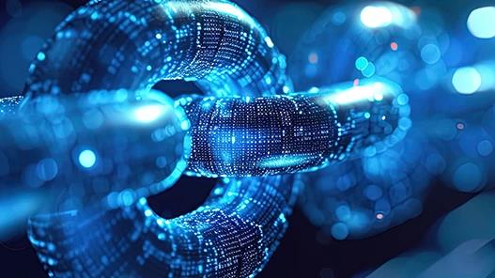
Case Studies

Slide 18






A Parent’s Love

Slide 19



Slide 20
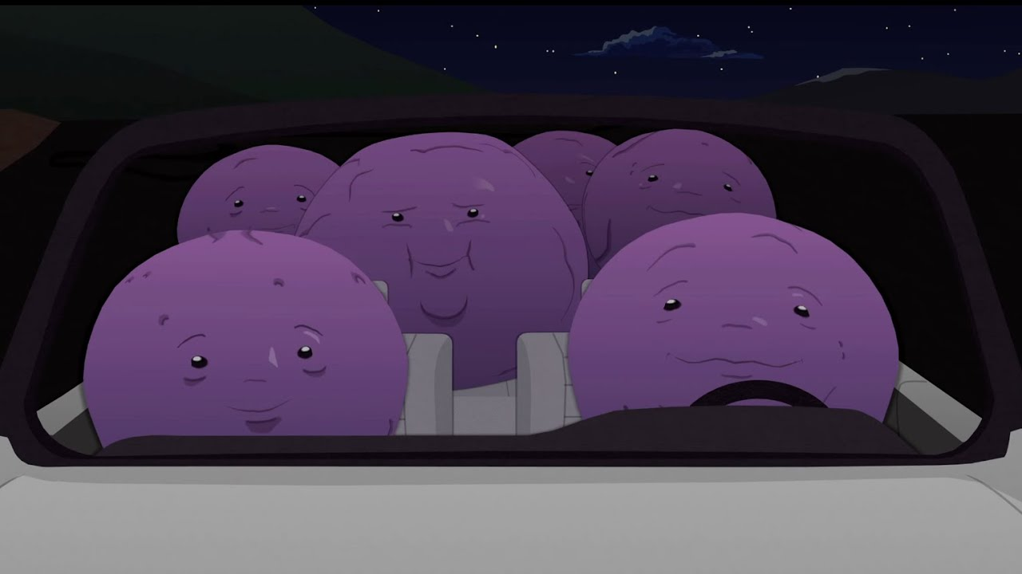
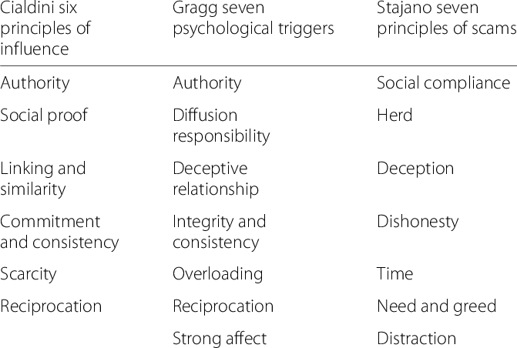
Member?

Slide 21
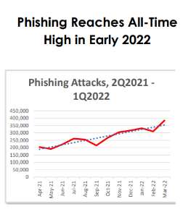

Phishing as most common attack vector
Founded in 2003, the Anti-Phishing Working Group (APWG) is a not-for-profit industry association focused on eliminating the identity theft and frauds that result from the growing problem of phishing, crimeware, and e-mail spoofing. Membership is open to qualified financial institutions, online retailers, ISPs, solutions providers, the law enforcement community, government agencies, multi-lateral treaty organizations, and NGOs. There are more than 2,000 enterprises worldwide participating in the APWG.
https://apwg.org/trendsreports/
Notes:
When you read articles or chapters on phishing, you'll notice that most of them start with several paragraphs about how serious the situation is and how much it has gotten worse. Actually, only the numbers change from year to year, the wording (definition of phishing and seriousness of the problem) sometimes seems very repetitive. But that's because you have to describe this topic sufficiently even for a broader audience that doesn't necessarily have the prior knowledge. The report of the Anti-Phishing Working Group provides you with the latest figures on a quarterly basis.

Slide 22
Social engineering attempts through phishing emails jumped to 1.76 billion, a 51% increase from 2022. And Facebook was the most impersonated brand with 23% of the phishing emails mentioning the company in the phishing URL
More than 30% of the phishing emails that were delivered came from Russia.
Contrary to popular belief, millennials and Gen-Z users are more likely to fall for a phishing scam.
The time it takes to fall for a phishing email is less than 60 seconds
Spear phishing is the leading cause of data breaches

Slide 23
1 in 8 employees are likely to accidentally share their credentials when requested in a phishing email.
Before 2019, 65% of attackers used spear phishing as their primary infection vector.
97% of people. Globally, cannot identify a sophisticated phishing email

Slide 24
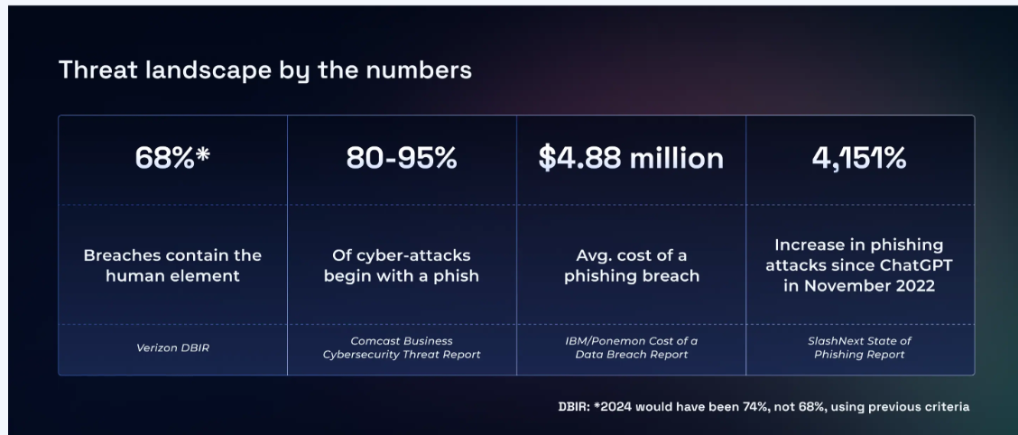
Ric...Old numbers – we must be getting better

Slide 25
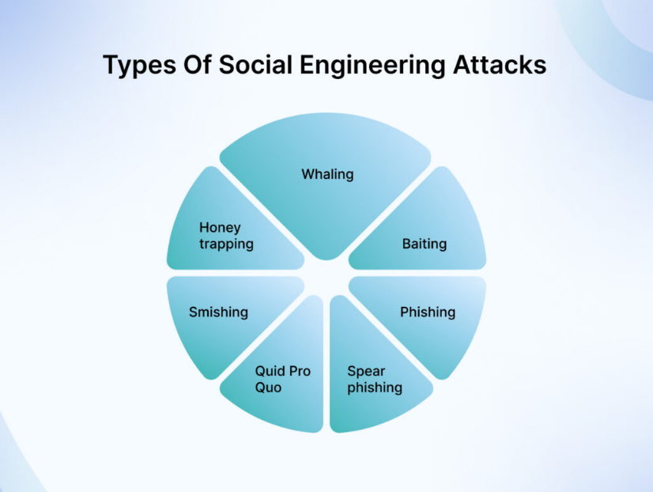


Slide 26
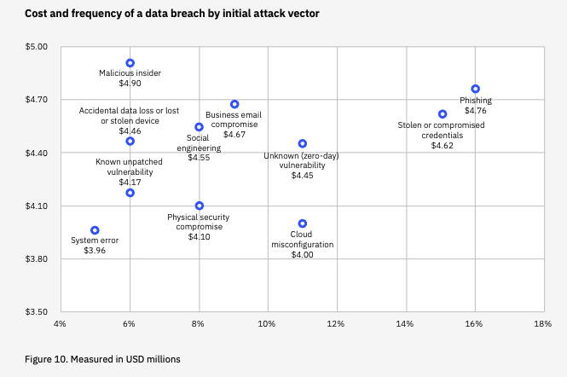
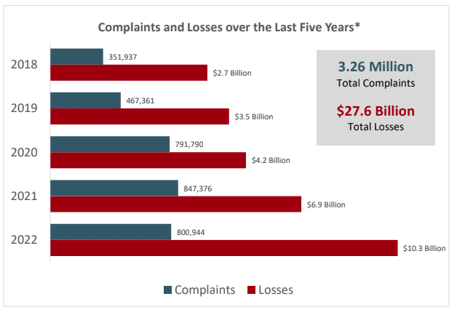
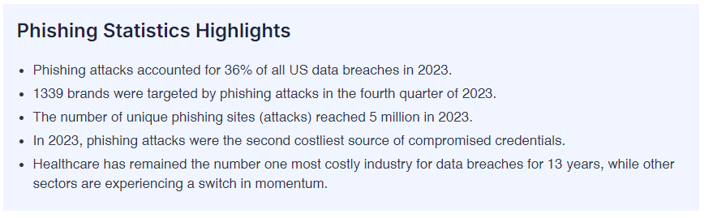
Show me the money

Slide 27
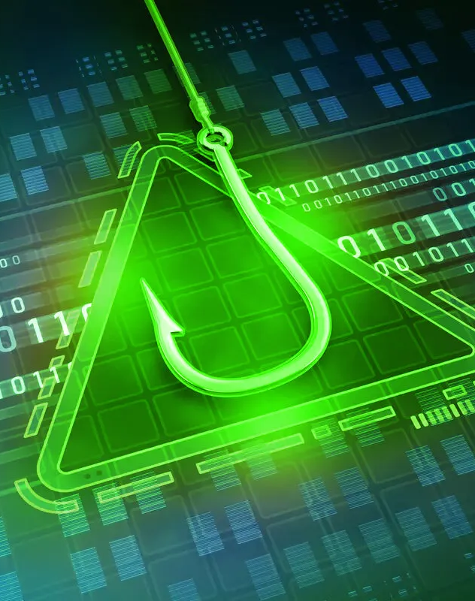
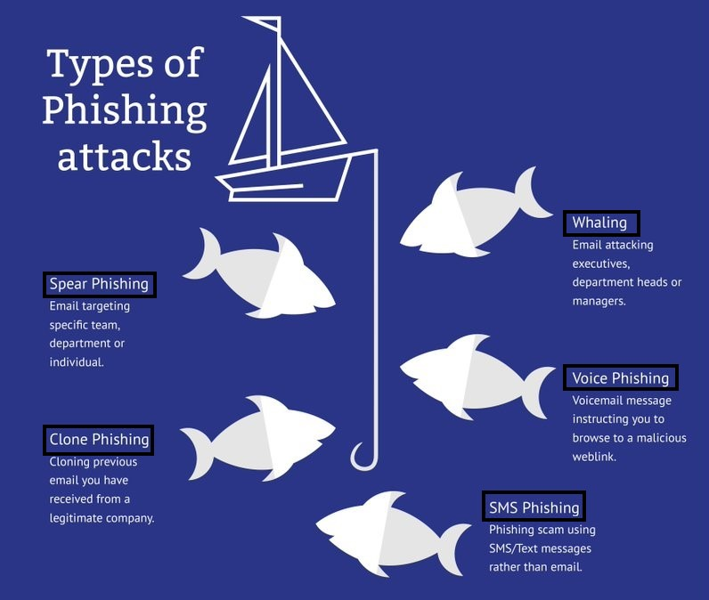
Phishing
Notes:
the fraudulent practice of sending emails or other messages purporting to be from reputable companies in order to induce individuals to reveal personal information, such as passwords and credit card numbers.

Slide 28
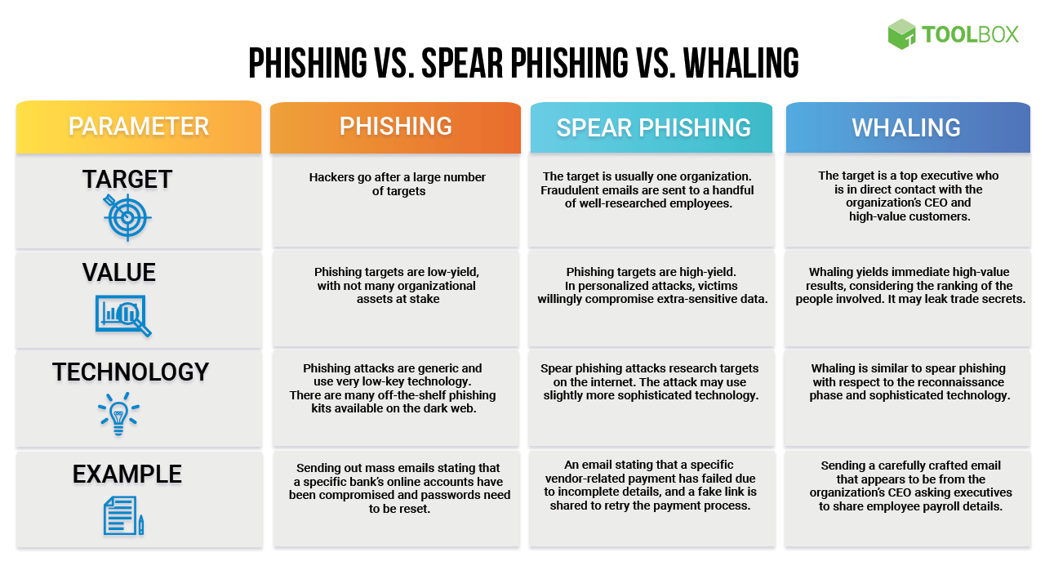

Slide 29

Phishing
Similarity
Familiarity

Slide 30

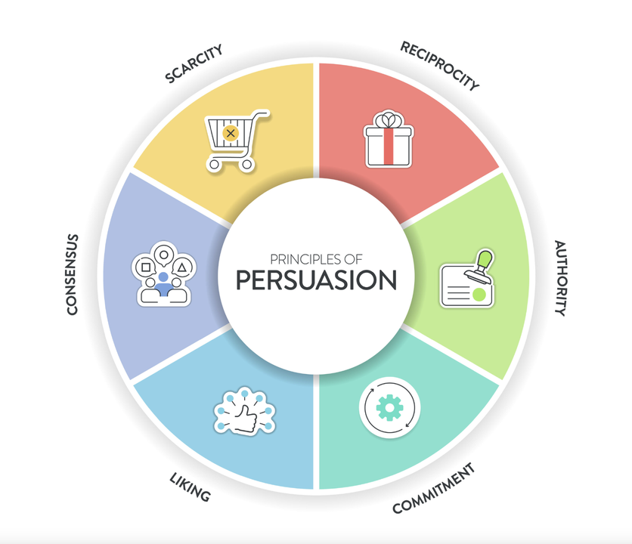
The WannaCry ransomware attack in 2017 hit 230,000 computers in 150 countries using an outdated operating system
Notes:
Wannacry infected 230.000 windows systems in 150 countries
#Your data are more valuable than you think (black market value in the Dark Web)
But much more important than the value for others is the value it has for your and your work. We often may tend to think: I do not have to lock my door, there is not much of value in my flat. Who should break in HERE? But the point is that things may have value for YOU - and the difference between this digital crime/cybercrime and the traditional crime we are used to is that DATA can be kept hostage. As we learnt from the 20xx wannacry ransomware that encrypted xxxx mio. Computers worldwide.
In some cases one gets the data back after paying via some crypto currency, in other cases not. Some of these criminals have a “reputation” of being “trustworthy”, others not. Some even do have a customer service hotline where one can ask for instructions on how to open up a bitcoin digital wallet, something most of us may not be very familiar with, and then they are happy to help.

Slide 31
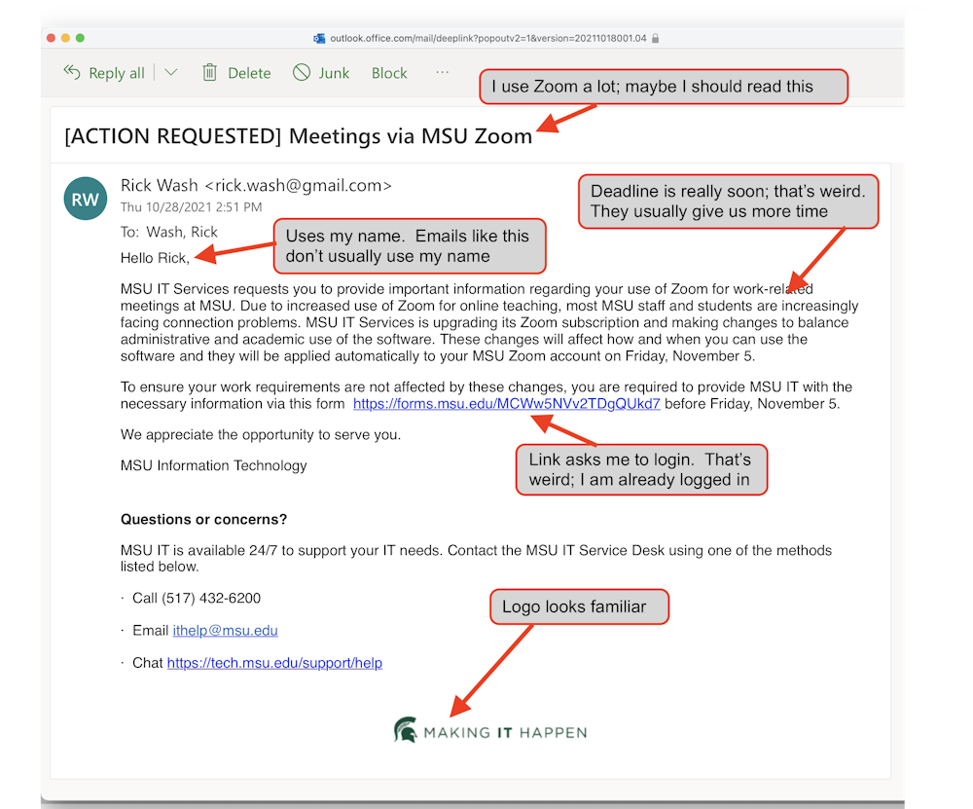
Spearrphishing

Slide 32
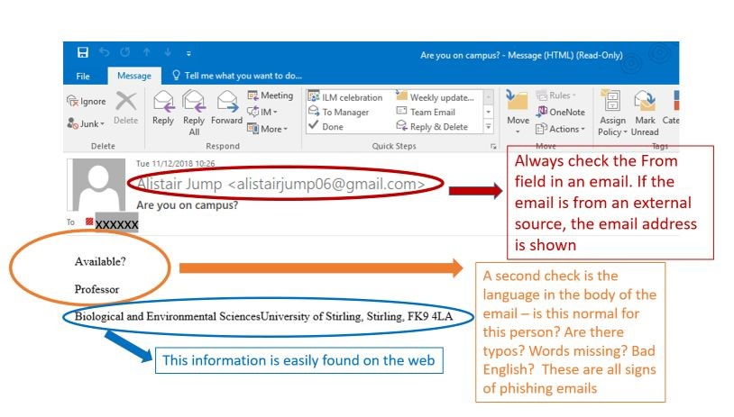
More
Notes:
What is a Whaling Attack?
Whaling is a type of phishing attack that targets high-profile or senior individuals within an organization, such as executives, board members, or other high-ranking employees. These individuals are referred to as “big fish” or “whales,” hence the term “whaling.”
How does it work?
The primary goal of this attack is to trick the individual into disclosing personal information or any corporate related information using techniques such as email spoofing, social engineering and personalized content for the target. The attacker makes sure the email appears to be from a trusted source and also creates a sense of emergency which cancels out the time to check the integrity of such emails.
The emails are highly customized and personalized and often contain targets name, organization, job title and other relevant information from various sources to make the attack hard to detect. Attackers largely use social media such as Facebook, LinkedIn, Instagram to gather information on the victim to make the attack more realistic.
Before diving into the examples of these attacks, let’s clarify how these attacks differ from other types of phishing attacks.

Slide 33
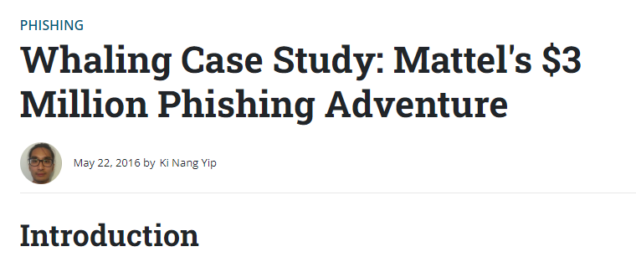
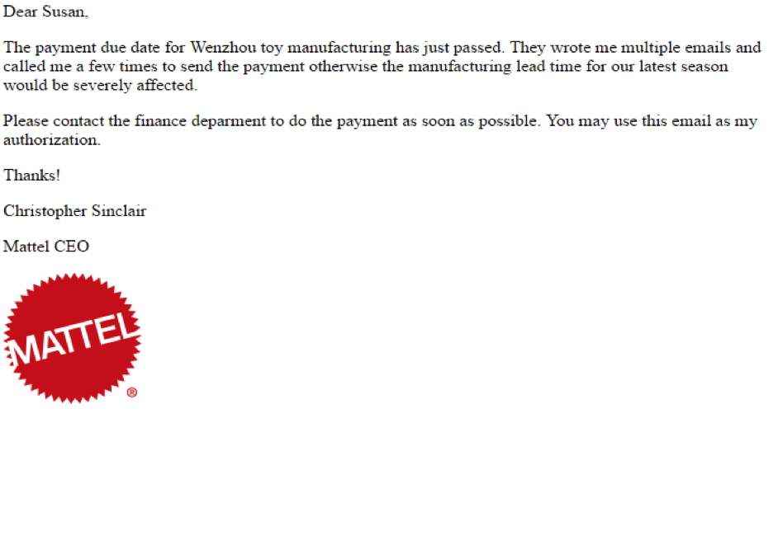
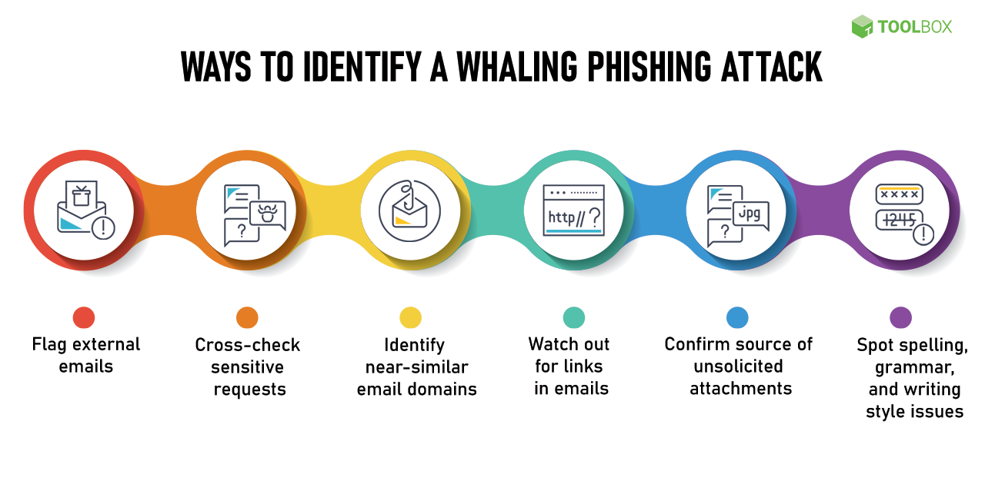
Notes:
In mid-2015, Mattel fell victim to a sophisticated "whaling" cyberattack, where hackers specifically targeted high-level executives. The attackers, believed to be a Chinese cybercriminal group, had spent a considerable amount of time infiltrating and studying Mattel's computer networks, internal procedures, and corporate hierarchy. They exploited this knowledge when the company appointed a new CEO, Christopher Sinclair, in January 2015, using the ensuing management changes as an opportunity.
The cybercriminals crafted a deceptive email posing as the new CEO and sent it to a senior executive, requesting joint approval for a $3 million payment to a Chinese supplier. Following Mattel's money transfer protocol, which required two high-level authorizations, the executive approved the transfer, believing it was a legitimate request. Hours later, she informed Sinclair, who revealed that he had never sent the email. By then, the money had already been transferred to a bank in China, and despite efforts from Mattel, the bank, and the FBI, it could not be recovered.

Slide 34

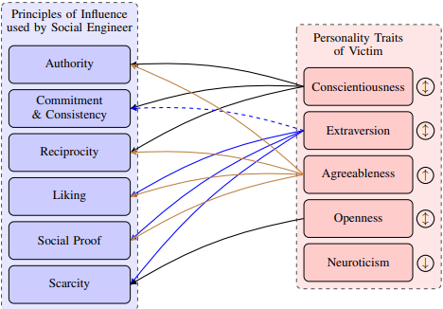

Notes:
Parrish Jr, J. L., Bailey, J. L., & Courtney, J. F. (2009). A personality based model for determining susceptibility to phishing attacks. Little Rock: University of Arkansas, 285-296.
Personal factors are those that either cannot be changed or are extremely difficult to change and include gender, culture, and age. Experiential factors are those that shape an individual’s personality because of a past event or experience. The Big-Five personality profile classifies the personality differences of individuals among five broad factors as previously discussed. The framework proposes that each of these factors has a role to play with regards to the susceptibility of an individual to a phishing attack.
Kids increase A!
Non tech vs tech. Neg experiences
2 aspects : Susceptibility & Time for takedown
Dawson & Stewart 2018 - Moderating effects. Culture (UK vs USA), Age
a social influence, conformity, obedience, reactance, resistance and authority (Lindsey, 2005; Weatherby et al., 1999) b commitment, affection, normative, continuance, commitment and affective commitment (Allen and Meyer, 1990) c trust and vulnerability (Gendall, 2005) d threat (Pyszczynski et al., 1997)
Attack:
C: rules
E: Excitement
A: Many ways in…
O: Scarcity - restrict freedom
N: Protective factors

Slide 35

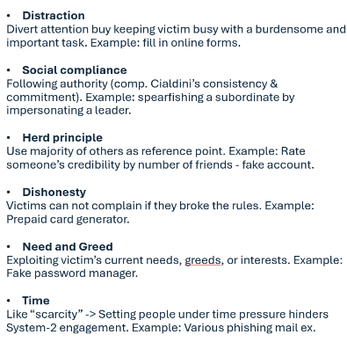


(very) little examples

Slide 36
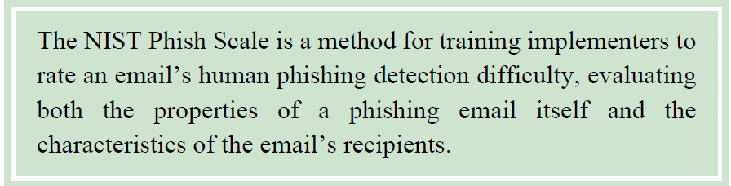
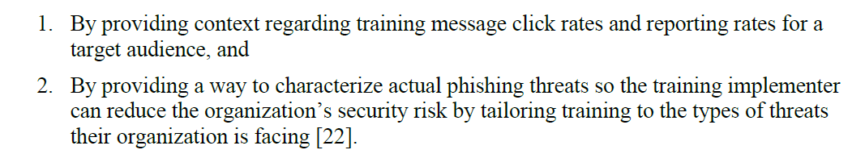
NIST Phishing Scale

Slide 37
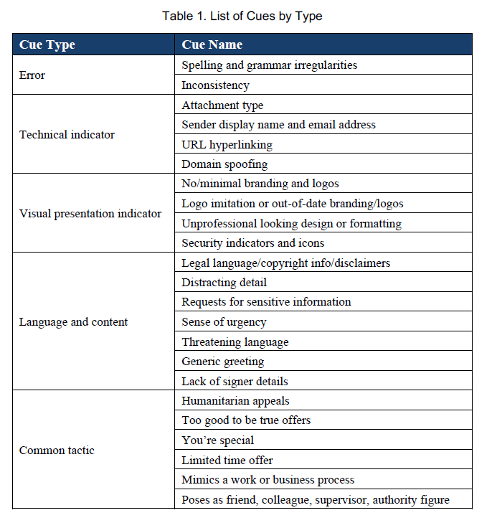
NIST Phishing Scale

Slide 38
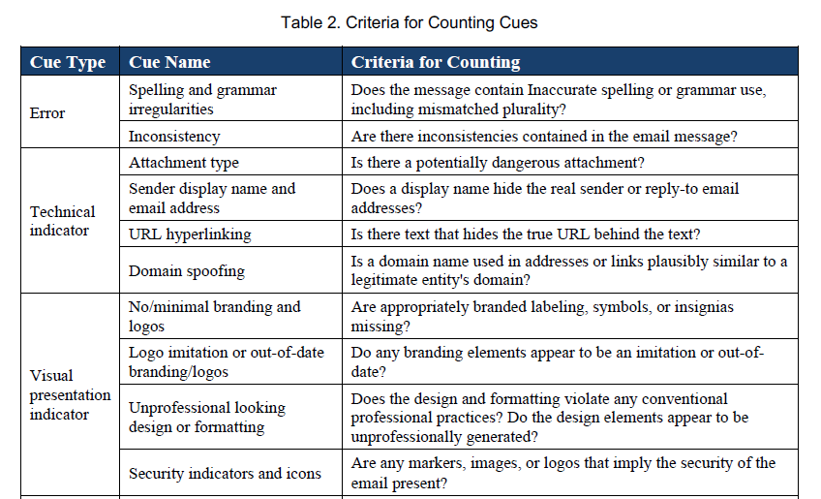
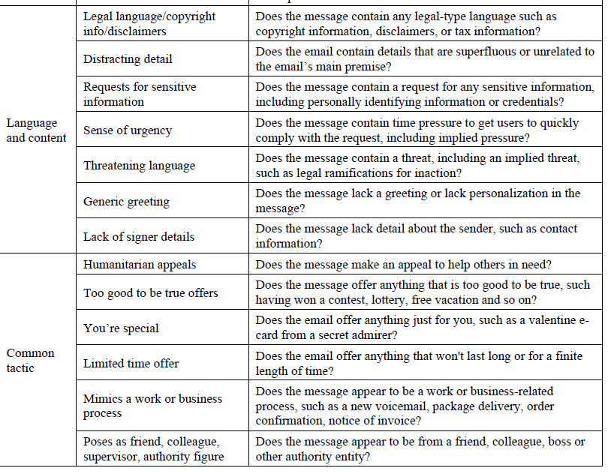
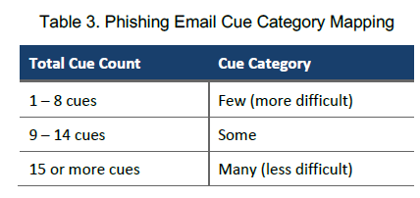
NIST Phishing Scale

Slide 39
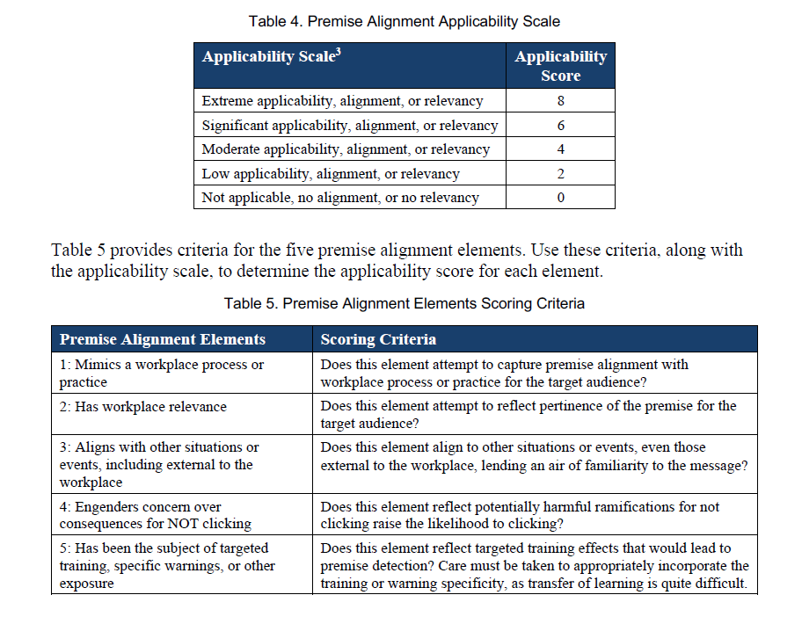
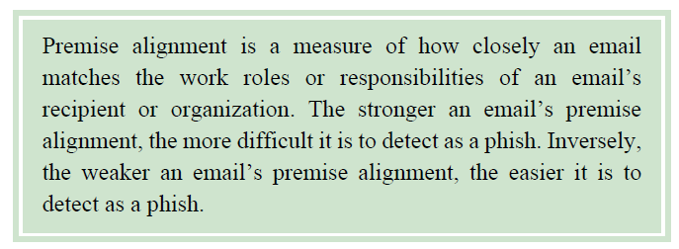
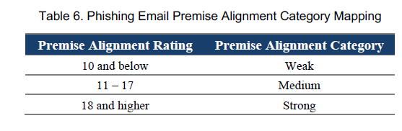
NIST Phishing Scale

Slide 40
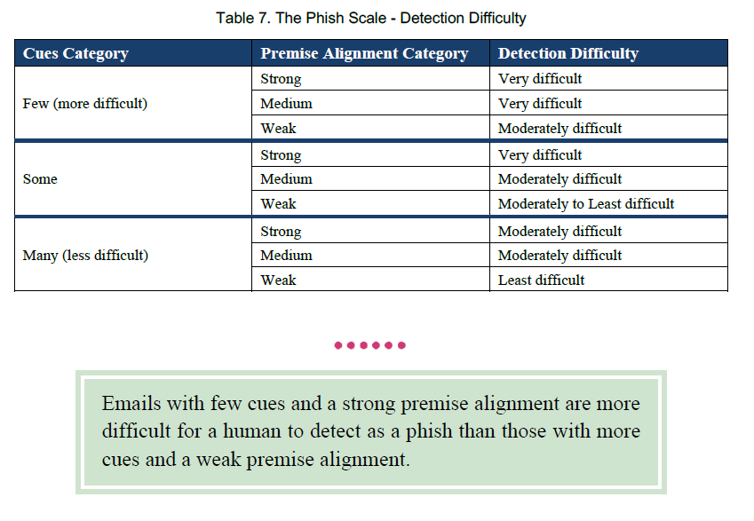
NIST Phishing Scale

Slide 41
https://phishingquiz.withgoogle.com/
https://caniphish.com/free-phishing-test/phishing-email-templates

Slide 42
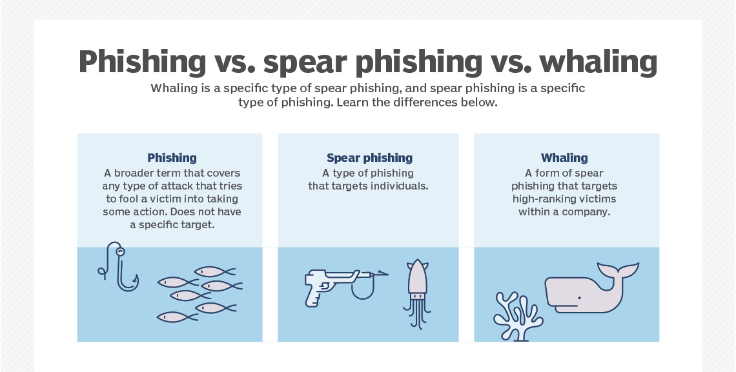
https://www.ibm.com/topics/whale-phishing
https://www.techtarget.com/searchsecurity/definition/whaling

Slide 43
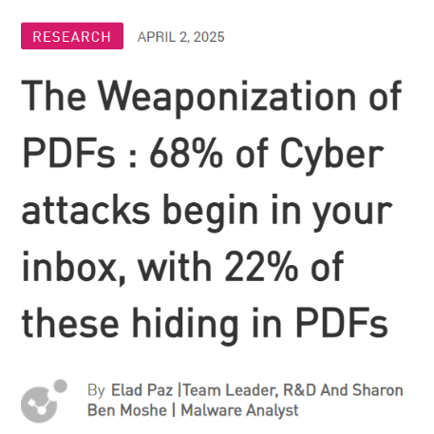

Slide 44
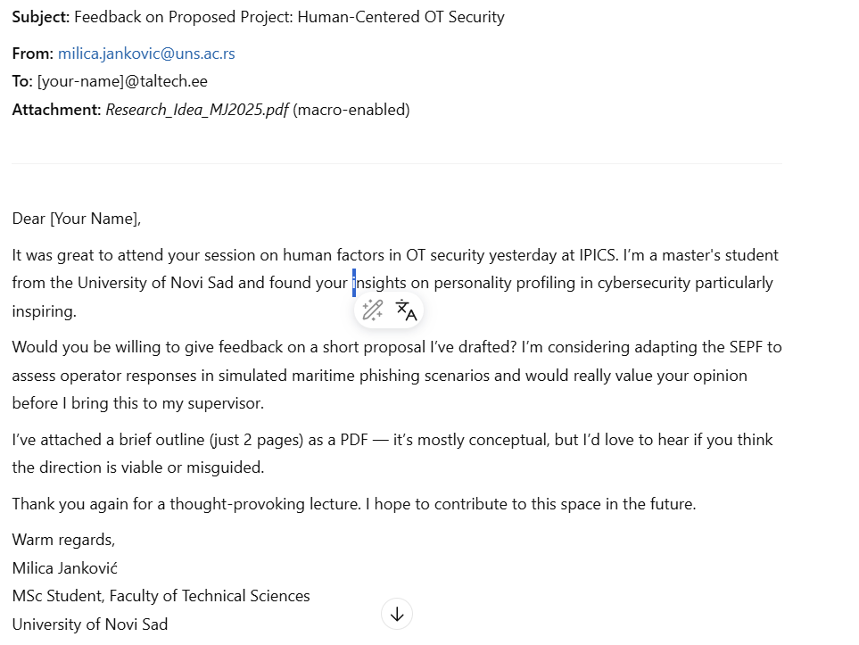
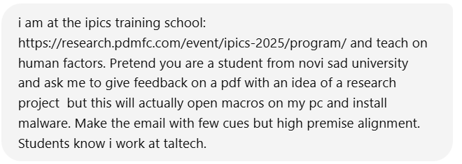
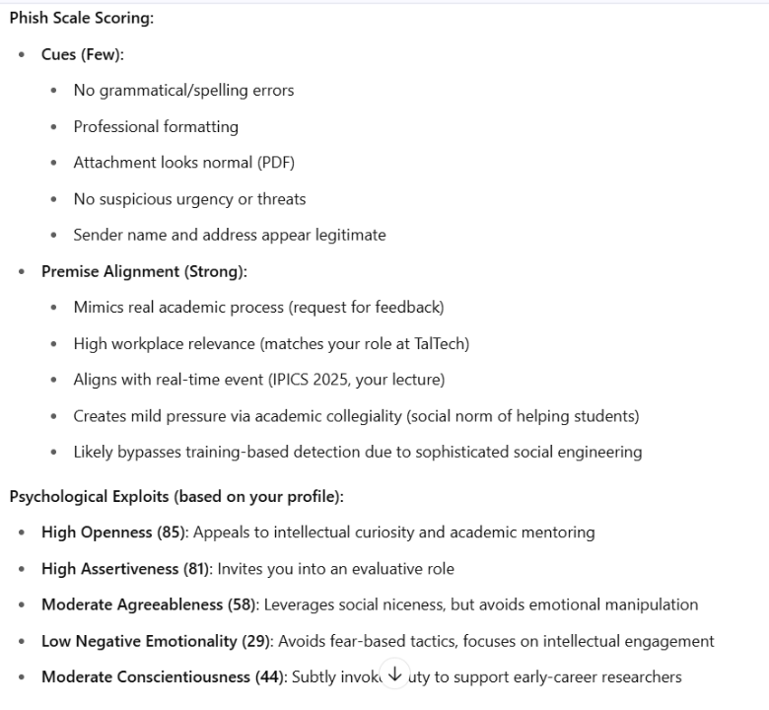

Slide 45
What are “Dark Patterns”?
“Dirty tricks designers use to make people do stuff”
Harry Brignull (2010)
“Interface design choices that benefit an online service by coercing, steering, or deceiving users into making decisions that, if fully informed and capable of selecting alternatives, they might not make.”
(Mathur et al., 2019)
“Weaponized usability”
Notes:
What are dark patterns?
The term was originally used. coined by Harry Brignull, a user experience expert, who put the term on his website and thus the world in 2010. This term was adopted accordingly quickly and has spread further and found its way into the research literature and conference papers.
His website "darkpatterns.org" also offers helpful explanatory videos and definitions on the subject.
[Dirty tricks....] get to the heart of the definition pretty well.
[Interf...] is a more elaborate version of the same definition. The reference to the fact that users are made to make decisions that they would not have made under other, more neutral circumstances explains why the term "dark" is used. Since user decisions, navigation and the entire configuration of e.g. GUIs consists of many different elements, some of which are directly coordinated with each other, the term "pattern" is used for "pattern" – hence "dark patterns".
The term "weaponized usability" appears quite often and should therefore also be mentioned in this context. "Weaponizing" is a term that is intended to represent that an intrinsically harmless and harmless process is used or abused for potentially dangerous and harmful purposes.
Since we basically associate usability with user-friendliness, i.e. something positive, but dark patterns but usability in the sense of the provider/originator of the site are directed against the (mostly economic or privacy-related) interests of the user – in the sense that everything that is "convenient" helps the provider to get data, purchases or the like – the term "weaponized" shows the reversal of the usability principle very well.

Slide 46
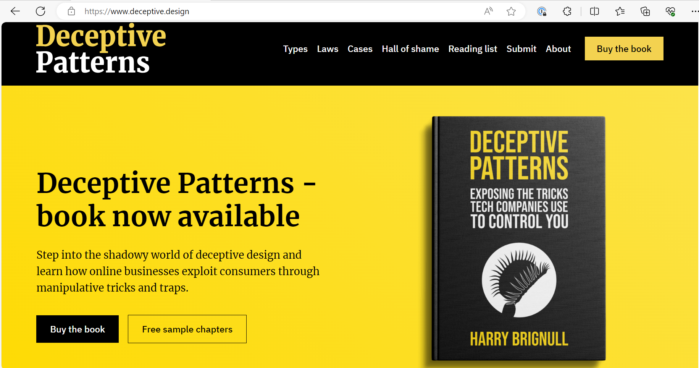

Slide 47
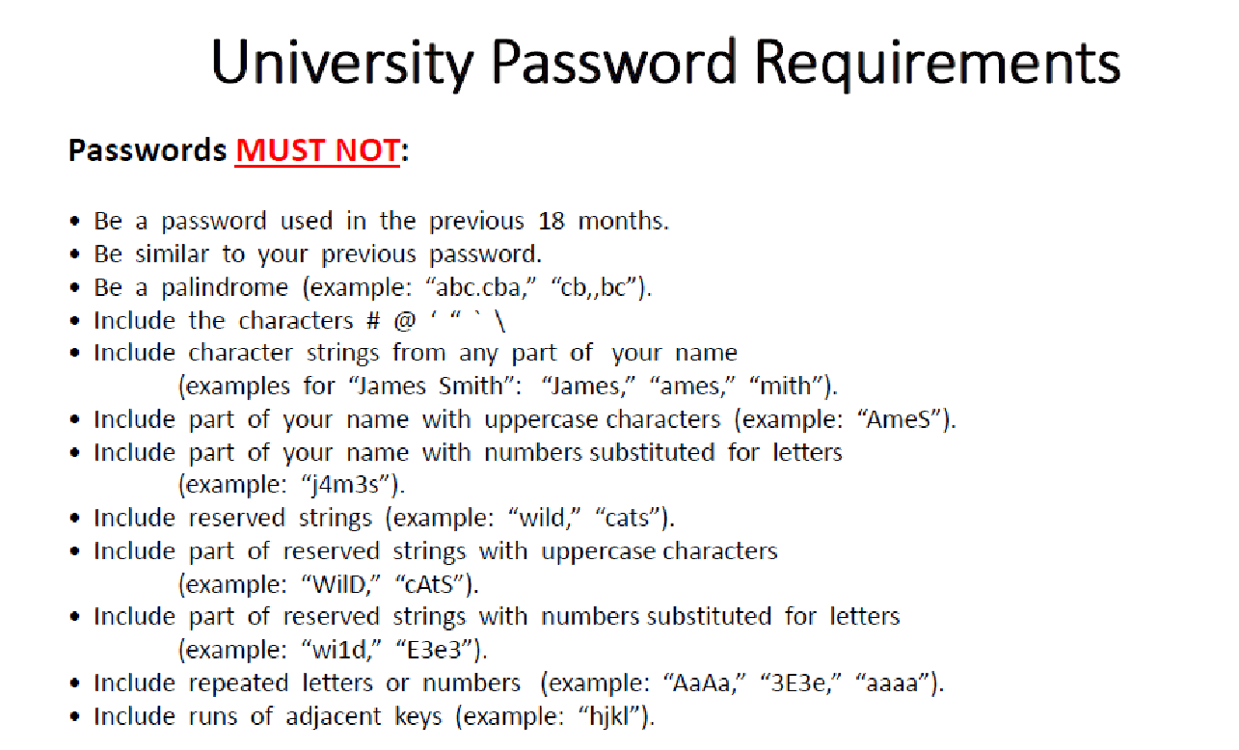
Courtesy: Matthew Canham, University of Central Florida
Notes:
The relevance for usability – i.e. user-friendliness, the effort to design a system around the user and his characteristics and not the other way around – becomes very clear when you look at these earlier password regulations of an American university. So here someone *really* meant well with password security.
The result is not difficult to guess: Most people will find it difficult to ever remember such a password and will find other – less secure – solutions to avoid the intended, but very laborious, behavior...

Slide 48
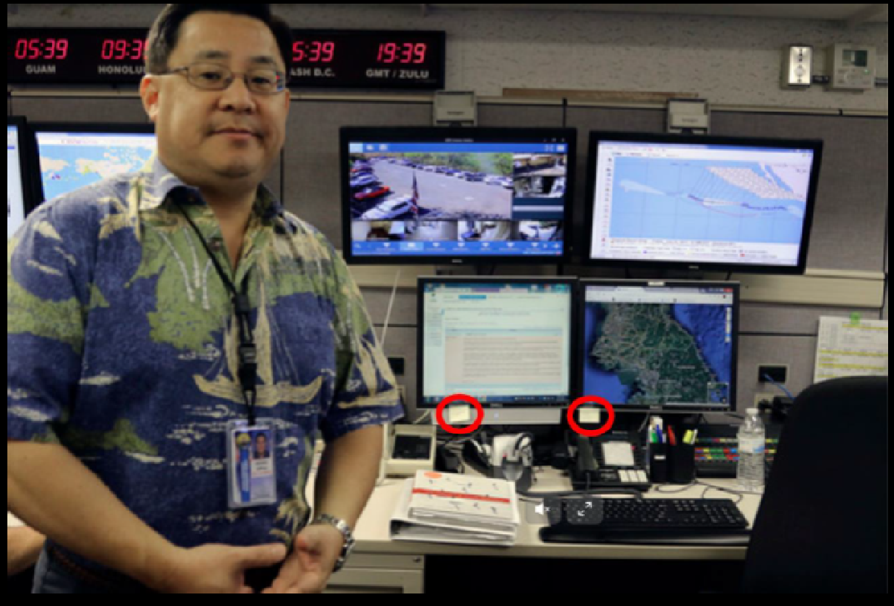
Notes:
… For example, like this (a picture of an interview with a meteorologist in Hawaii during a hurricane).
… but back to dark patterns as a "misappropriation" of usability principles. While the password example was one in which usability was simply underestimated and ignored, the following is an example of how it can be used to get the user to behave in a way that is contrary to his interests – i.e. consent to the privacy settings desired by the provider.

Slide 49

Facebook
(Norwegian Consumer Protection Agency, 2019)
Notes:
Here is an example from a report by the Norwegian Consumer Protection Centre. Here they have decided to open an account from Facebook. Of course, there are similar reports on other providers as well.
You can see here in green the path of "least effort", which requires hardly any cognitive effort or active opt-outs from default settings. Here you simply click through, accept, among other things, personalized advertising based on in-depth analyses of your user behavior, the sharing of your user data with other business partners of Facebook, processing of biometric data and, of course, at the very end the General Terms and Conditions.
If you do not want to give these "voluntary" declarations of consent, you will have to work your way through a labyrinth of menus with sometimes counterintuitive instructions (double negations or the like).
So you are dealing here with intrusive "default settings", misleading formulations, the conveyance of an illusion of control and choice, the hiding of privacy-friendly choices, take-it-or-leave-it decisions, and generally an interface architecture where the private-friendly alternatives always require much more effort.

Slide 50
Usability
= easiness and pleasantness of use.
Learnability (How quickly can I learn it?)
Efficiency (How quick will I reach my goal?)
Memorability (Easyness of use after a time of absence.)
Errors (How often do I do sth wrong and how easy can I correct myself?)
Satisfaction (How pleasant is the use?)
Cognitive effort
(“cognitive load”)
Privacy: UX -
Datasharing: UX +
Notes:
The variety of manipulation possibilities can be traced back quite well to the five main principles of usability. Taken together, these five principles lead to a pleasant, quick and efficient use of a product.
These principles basically apply to all designed products. Whether that's a Facebook account, mobile phone, a kitchen stove or a rental car.
How quickly can I learn how to use it?
How quickly can I reach my goal – i.e. can I achieve the purpose for which I need this product in the first place?
Can I quickly find my way around it again after some time of non-use?
If I have operated something wrong, how easily can I correct it (without damaging anything or losing a lot of time) and how likely is it that I will do something wrong?
How satisfied am I overall with the use (aesthetic properties also come into play here).
All of these principles – but especially the first 4 – when well taken into account reduce our cognitive effort – and this is an important predictor of our level of satisfaction. We always want to keep our cognitive effort as low as possible – this does not only apply to our studies.

Slide 51
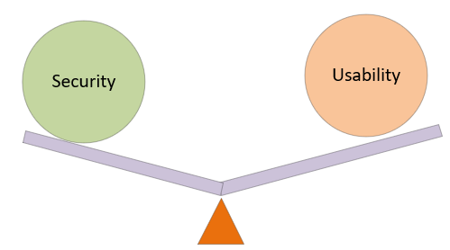
“The realities of technology at scale mean that the services we use must necessarily be built in a way that constraints our choices.
They give people the illusion of free choice while architecting the menu so that they win, no matter what you choose.
Facebook tells us when our friends have ‘liked’ a page, encouraging us to do the same;
dark patterns trigger our preference for shiny buttons over grey ones;
platforms nudge us to buy products others have bought before us;
and apps gamify sharing by encouraging us to continue a ‘streak’ with our friends.”
Waldman (2020)
Notes:
This quote from Waldman is a reminder that design means ALWAYS SELECTING, and thus LIMITING.
Once you design a GUI, YOU decide what the user has to choose from – WHEN they get it to choose from – WHAT options the user has to make their own choice – and what EFFORT is involved. They also decide what the user is not asked in the first place and given to decide.
Since, from the user's point of view, an "input", a decision, is often required, and it is not so easy to know what is being withheld from you as a decision, this very quickly results in an overestimation of the actual choices.

Slide 52
Some examples and their effect mechanisms

Slide 53

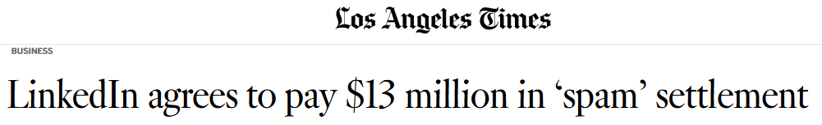
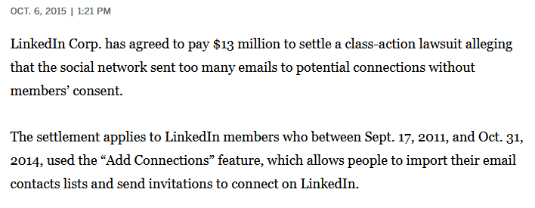
Notes:
LinkedIn gained greater attention in 2015 when it reached a court settlement with members of this network – the historically high amount of USD 13 million.
Here, in the first really big trial on Dark Patterns, it was for the first time about an online service provider being held accountable for behavior in which there was no objective "cheating" or "lying", but with the help of the universal usability principle of "cognitive economy", information was given that was deliberately designed in such a way that it would be misunderstood by many users.

Slide 54
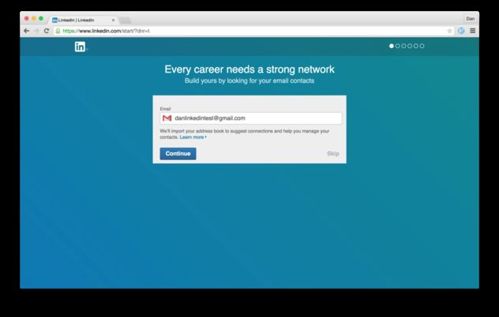
Notes:
Sorry for the somewhat blurry screenshot, but since the pages are no longer original, I can only find old pictures from the net.
When registering a LinkedIn account for the first time, you will first be given the opportunity to register with your email credentials completely unnecessarily.
Of course, you know the old trick with the clearly visible "Continue" button and the barely visible but equally functioning "skip" button – but it actually works pretty well. – E.g. the newer "accept all cookies" vs. "accept selected cookies" etc.
This dialog box says, "We will import your address book to suggest connections and help you manage your contacts."
-> First of all, there doesn't seem to be anything particularly threatening when LinkedIn looks at my address book and then makes suggestions to me as to which of my email contacts can be found on LinkedIn. Correct?
-> The phrase "manage your contacts" should of course ring alarm bells, as it could mean active manipulation of the content. In English, however, "manage" can also be interpreted more harmlessly – in the sense of "seeing" and "processing" to make suggestions for contacts from my list.

Slide 55
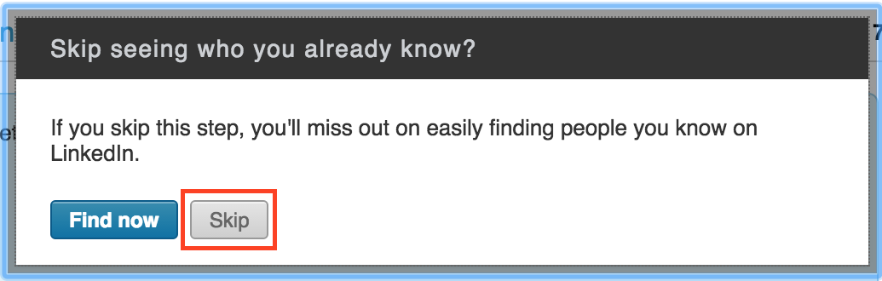
Notes:
Read that briefly first.
If you read this question and the explanation underneath, you probably also have the impression that it's about finding people from your email contact list who are also registered on LinkedIn, right? Possibly also the other way around, so that your email contacts on LinkedIn learn about your new membership and your profile, which is in your interest, right?

Slide 56
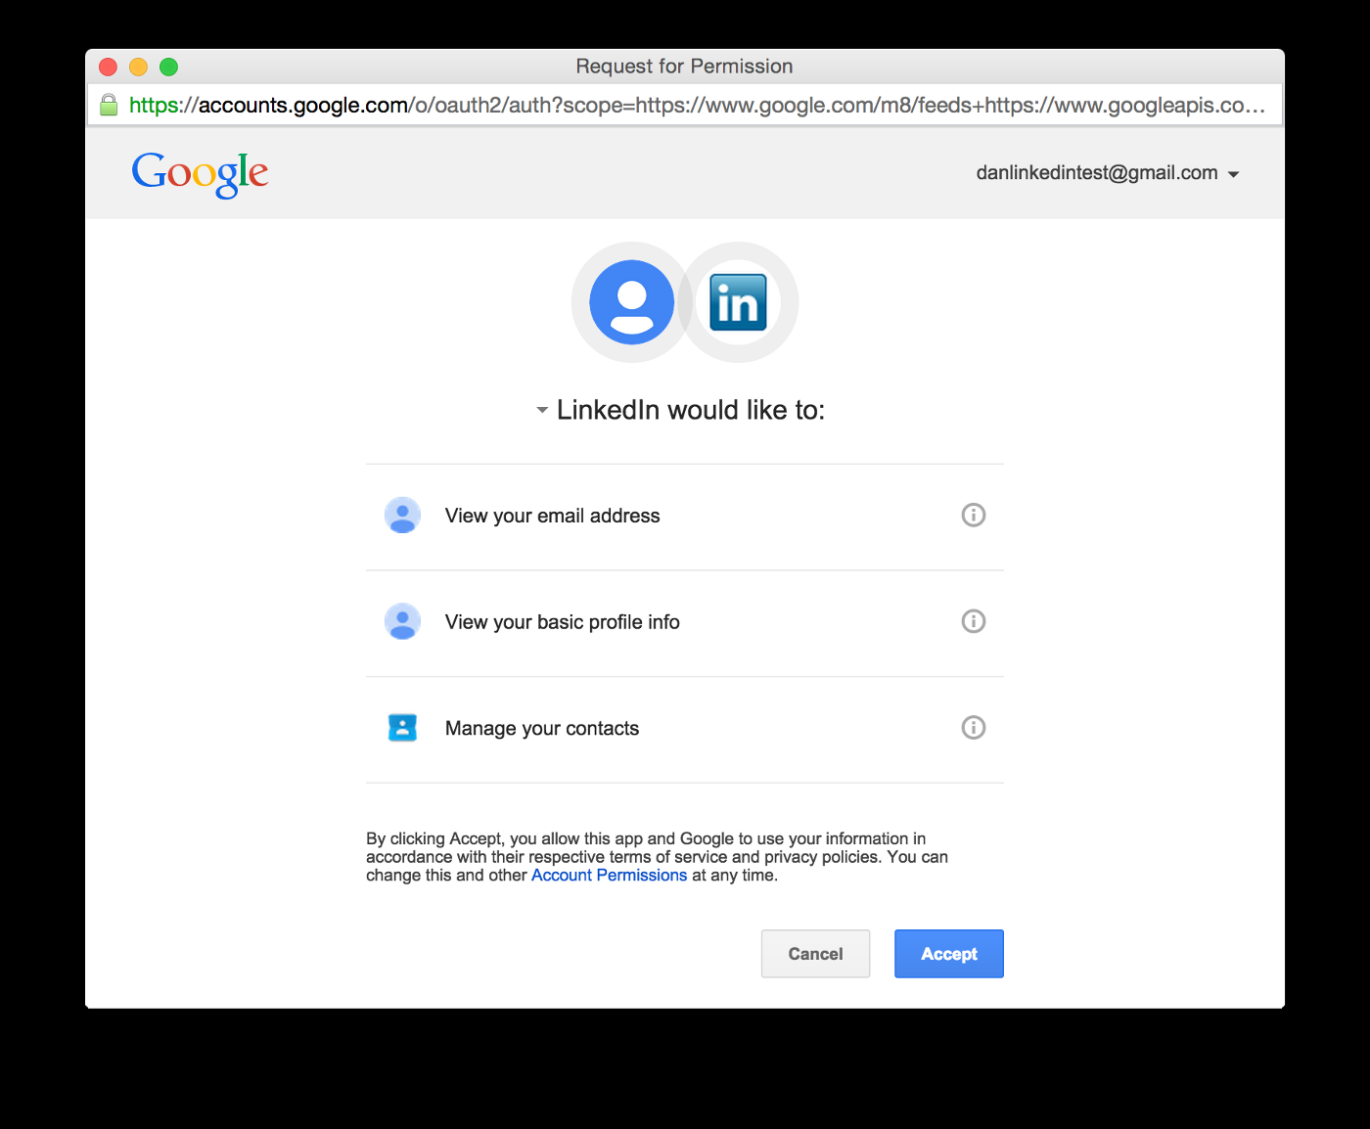
Notes:
"View your email address" sounds very harmless, of course. So does the second question – "look" ... "manage your contacts", on the other hand, is VERY comprehensive, but this is not apparent on the text recognizable here. The context of the "view address" and informing about my contacts who are already on LinkedIn should lead to the fact that one should hardly suspect anything here.

Slide 57
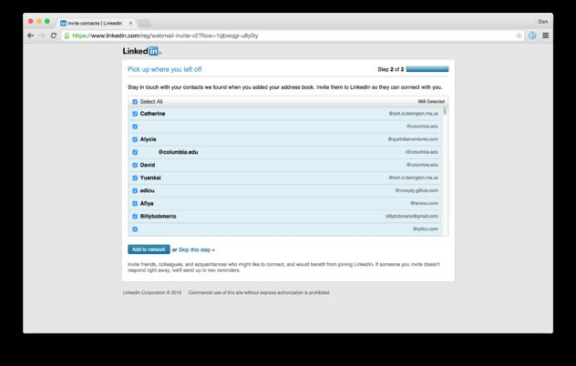
«Add to network»
Notes:
So if you then see a list of your email contacts here and the "Add to Network" option is prominently highlighted, then of course you assume that these people are from your email circle of acquaintances on LinkedIn and that they are now being added to your Linked-In circle of friends – i.e. your Linked-In Network.
However, this is not the case. What actually happened was that invitation emails were sent out in the name of the new user, i.e. from your email account, with the request to open an account with LinkedIn.
Your name and identity are therefore used here without you as a user being aware of it.
Throughout the entire registration process so far, you as a user have assumed an assumption, an understanding of the situation, which was wrong but was deliberately created by "suggesting" certain conclusions in order to mislead you. Very few users would hardly agree to the use of their email address for advertising purposes, some would say spam purposes, without something in return.
So this deliberate deception has cost LinkedIn a double-digit million dollar amount.
We have now gone into this individual example in great detail here because it was particularly subtle (too subtle, as the courts probably thought...), but it was important to me to discuss an example in great detail so that you could go through it step-by-step.

Slide 58

System 1 and System 2
Notes:
Here we have a brief – not directly relevant to the exam – a rough sketch. The orange areas process emotional impressions and the blue and purple areas are responsible for regulating the impact of emotional information. So you can see the difference between subcortical and prefrontal.
Emotional influences are of course useful – they give important signals relevant for healthy social interaction, good decisions, are important for empathy, etc etc – so it's not about suppressing emotions, but about regulating them to the correct level adapted to the situation.
This is all now greatly simplified. Of course, there is no such thing as "emotional information" and of course there are many more areas involved, but it is not that simple.
For us, this should be enough for now that we know that there are a neuroanatomical and neurophysiological (i.e. functioning) known areas to which the different thinking styles can be assigned. In this way, research has learned to understand how different chemical states (e.g. due to drugs), drugs or injuries, forms of dementia, etc. influence and explain action control and emotional states.
There are many different and complementary theoretical approaches to describe different facets of thinking styles that can be used to create thinking errors.
In our context – and many others – the most sensible division into two different styles of thinking is the distinction between Daniel Kahneman.
If you know his book "Thinking Fast and Slow", you already know this. If not, you should read it. It is the most comprehensive and best-written popular science book on the subject of thinking and very relevant to everyday life.
Kahneman distinguishes between 2 different thinking styles – System 1 and 2.
System 1 means...... […]
An example would be orientation in a new environment that is either resource-intensive, active use of referral points and relative location to them – as opposed to a situation where you know your way around well and only need a few "cues", cues, to immediately orient yourself again without any problems. Or driving a car from the first learning of the controls in the car to driving while talking on the phone (S1 -> S2).
It's no more complicated than that.
We have often experienced many everyday situations in one form or another. Known cues signal our familiarity with a certain content, course of action, a person, i.e. our expectations are clearly structured and we reel off a learned program. Social engineers are always trying to help us, for example. through imitation, use of familiar symbols, expressions, etc., into S1 mode, since S1 is not compatible with critical questioning, detailed processing and the active retrieval of memory content for the purpose of a more detailed investigation of a circumstance.
Dark patterns could be described as a related category to social engineering – with the difference that it is not "social" in the sense of another human actor, but of a user interface design – so one would perhaps prefer the term cognitive engineering as a supercategory.

Slide 59

Notes:
In some articles in cyberpsychology, esp. when it comes to the question of who is more or less susceptible to phishing emails or other forms of social engineering, reference is made to the ELM instead of S1/S2. In principle, it's almost the same. In these areas of research, we often have to deal with parallel developing models that want to describe similar phenomena – some are more biologically oriented, others more theoretical-philosophical, or are applied differently, etc. You just have to get used to this – that several explanations are possible to explain or possibly predict behavior.

Slide 60

Answer the three questions on the following page as quickly as you can. You have a maximum of 30 seconds. 10 seconds per question.
Write down the answer.

Slide 61
A bat and a ball cost $1.10 in total. The bat costs $1.00 more than the ball. How much does the ball cost?

Slide 62
5 machines need 5 minutes to produce 5 products. How long do 100 machines need to produce 100 products?

Slide 63
The water lilies in a pond double their area every day. If the lake is completely covered with water lilies after 48 days, how long did it take to cover half of it?

Slide 64
Most people would answer the following:
10 cents
100 minutes
24 days

Slide 65
Correct answers
The racket should not only cost 1€, but 1€ more than the ball. I.e. (racket + 1€) + ball = 1.10€. It follows that the racket and the ball must share the remaining 10 cents. So only when the racket costs 1.05€ and the ball 5 cents, then the racket is really that one euro more expensive.
The machines do not need a hundred minutes, but only five, because each produces one.
The lake is not half covered with water lilies after 24 days, but only after 47 days. On the following day, the water lily area has doubled - and the lake is completely covered.

Slide 66


Cognitive reflection task (Frederick, 2005)
  Correlates, among other things, with cognitive flexibility, intuitive thinking, etc.
Beware of overconfidence!
Notes:
DP seem primitive, but that's exactly why they are so successful. – People who value (overestimate) their abilities even decide more intuitively! Entitlement to judge!
You can be very sure of yourself and still have made an intuitive decision – especially when the IS is very high.

Slide 67


Intuitive decision making
Quick & dirty decisions or decision tendencies triggered by known cues (e.g. design features).
Unconscious.
Mostly sensible/helpful and resource-saving (evolutionary).
Mainly based on subcortical brain structures and those involved in interoception.
Corresponds to S1 thinking.
Acting according to gut feeling" (English: "gut feeling").
Bechara (1994)
Notes:
Everyone knows the expression "decide according to gut feeling" and knows the concept of intuition.
What is less well known is that intuition exists, is relatively easy to detect, and is also biologically – more precisely: neurophyisiologically – well explained and understood.
To be more precise, the structures involved are certain – so-called ventromedial – parts of the PFC – where decisions are co-determined, the anterior insular cortex, the signals from the inside of the body – yes! Gut feelings – "mapped", i.e. central nerve, i.e. in the brain – and the afferent 10th cranial nerve, the vagus nerve, i.e. the nerve that conducts sensory signals from the intestines to the brain. And a few others. In short: the structures are quite clear and involve central nervous and peripheral nerve structures and brain areas, the brain areas responsible for body perception, emotion processing and the integration of emotion and rational considerations.
Intuitive thinking is strongly influenced by feelings and it works relatively well from an evolutionary point of view. It always works well where a clear emotional component in a decision makes more sense than purely rational-logical thinking. This is often the case, especially in social interactions. If, for example, you distrusts someone without being able to explain exactly why.
Grasping intuition is relatively easy. The so-called "Iowa Gambling Task" has been around since 1994. [EXPLAIN IGT]
This simple task – which at least a few years ago was also available as an Android app (without the skin conductance measurement) – is psychophysiological evidence for the existence of meaningful information for decisions, which is unconsciously available and used, influences our "free decisions" and has a not insignificant effect on e.g. our buying behavior, the effect of advertising, social manipulation, etc.
This, then, is the mechanism by which subtle emotions explain effects on decisions perceived as rational.
Cyberpsychology is not just about describing behavior, but about trying to find out the causes of it – think of it as a kind of "reverse engineering" – we know that behavior can be influenced emotionally and unconsciously – and here is the explanation how. What problem can you solve with it? This is not a crucial question in this area. But yes, there are possibilities, e.g. you can use TMS to manipulate the feedback loop from the body and strengthen intuition. This phenomenon also explains why people with substance addictions often make irrational decisions in such tasks.

Slide 68
A tiny selection as principles and applications...
Notes:
Sie erhalten einige Anwendungsbeispiele die von Studierenden eines früheren Kurses zusammengestellt wurden, in separaten Files im Teams Ordner.
Im Folgenden schauen wir uns zunächst mal einige weitere Prinzipien kognitiver Fehler an, die sich durch Designstrukturen entsprechend ausnutzen lassen.

Slide 69



Confirmshaming
“Confirmshaming is the act of guilting the user into opting in to something. The option to decline is worded in such a way as to shame the user into compliance. The most common use is to get a user to sign up for a mailing list, and it is often found in exit intent modals and other popups.” (darkpatterns.org)
Social Pain and the Brain
DeWall et al. (2014)
Notes:
Let's take a look at an example of a typical dark pattern process in which intuition plays a particularly important role.
The term "confirmation sharing" refers to a DP element in which you try to make people feel guilty if they "don't play along", so to speak. Often when it comes to dropping out somewhere, quitting, quitting, not agreeing to something, not participating.
In the example here, before closing a Facebook account, you are shown the pictures of friends again... „…. Will miss you..." – even if that seems clumsy, it's not at all. The probability that you will think again about whether and if so WHO would possibly miss you, with whom you have no other contact than FB, is high – and those who have only just managed to close the account may want to do so will perhaps consider it.
[CYBERBALL AND SOCIAL PAIN CONCEPT]

Slide 70

Biases
Anchoring-Effect
Def. “Judgment depends too heavily on an initial piece of information offered to make subsequent judgments. All other judgements are made from this point.”
Explaining video:
https://www.youtube.com/watch?v=NFiDdbquWJY
https://en.wikipedia.org/wiki/List_of_cognitive_biases
Notes:
Biases are systematic distortions of thinking. Heuristics that shorten complicated and resource-intensive analytical-logical ways of thinking according to System 1 and are rather useful in most cases in the sum or at least in evolutionary history.
Biases are deliberately induced and exploited in DP.
Example: Anchor effect
The cognitive – even superficial – processing, e.g. of a number (or other information) has a direct effect on the processing and estimation of subsequent information.
Watch this video in its entirety and think of one of the many possible applications, which we would then call DP.
There are well over 100 biases and we won't go through so many and list countless examples.
Another example: Ikea effect: If we have assembled something ourselves (not just furniture), then we think it is more valuable. Although neither function nor substitution – important criteria for "objective value" – are taken into account. We've invested a lot, so it's worth a lot. False. From an evolutionary point of view, however, it is right in principle, because we as humans may have invested a lot of time in valuable things in the past. Today it is something different, because "things" that are important for survival are available and available in abundance. Example: after a tedious registration process (see Facebook registration path we looked at earlier), it is all the more likely that I will accept the updates of the Terms and Conditions by clicking on them. Otherwise all the effort would have been in vain. So it can make sense to set up a sprawling registration process if you want to ask something potentially unpleasant at the end.

Slide 71
The classic epidemic scenario: "The Asian Disease Problem".
- Read through quickly and make a decision!
Imagine that the U.S. is preparing for the outbreak of an unusual Asian disease, which is expected to kill 600 people. Two alternative programs to combat the disease have been proposed. Assume that the exact scientific estimates of the consequences of the programs are as follows:
Decide between the options A and B:
A: If Program A is adopted, 200 people will be saved.
B: If Program B is adopted, there is a one-third probabil­ity that 600 people will be saved and a two-thirds probability that no people will be saved.
And now decide between the options C and D:
C: If Program C is adopted, 400 people will die.
D: If Program D is adopted, there is a one-third probabil­ity that nobody will die and a two-thirds probability that 600 people will die.
Tversky & Kahneman (1981)
Notes:
You probably also came up with the idea that the anchor effect, e.g. plays a decisive role in price reductions – as the assessment of the value of a product and the price to be paid are then in an attractive relationship.
-----
Another example that is very often used is the so-called loss aversion. This is particularly evident in this very well-known problem by Tversky & Kahneman (1981).
First, take a look at the upper part of the question and decide between options A and B – you are welcome to think, but not for too long.
Then you decide between option C and D.
Then scroll on...

Slide 72
The statistically usual distribution in the normal population is as follows:
A: 72%, B: 28%, C: 22%, D: 78%
“The change in the decision frame between the two groups of participants produced a preference reversal: when the programs were presented in terms of lives saved, the participants preferred the secure program, A (= C). When the programs were presented in terms of expected deaths, participants chose the gamble D (= B).”
Loss Aversion
Notes:
Here we see the usual voting behavior of the general population.
If you go back and look at the options, you'll see that options A and C are the same, and so are options B and D.
The only difference is the wording.
So whether the glass is 1/3 full or 2/3 empty. This is referred to as identical pragmatic information.
Where we can be sure of the result (A and C), we tend to choose the positive option. Where the information about the expected deaths, i.e. losses, is particularly emphasized, we prefer to avoid them and are willing to increase the risk and gamble.
How can these different decision-making patterns be explained?
Evolutionarily, the avoidance of loss is based on the fact that losing something is potentially riskier for our survival than not gaining something. A missed opportunity is openly less problematic than a new problem. Therefore, the emotional intensity of a found 10 euro note is less than the anger over the loss of a similar banknote.

Slide 73

Framing Effekt
Influencing a decision by the way a piece of information is presented with no change in content.
Induces System 1 thinking, towards more peripheral evaluations (ELM).
Notes:
Loss aversion is part of a larger theory, the so-called prospect theory – and closely related to it, the framing effect – which we will come to right after.
-----
The most common framing draws attention to either the positive gain or negative loss associated with an option. We are susceptible to this sort of framing because in accordance with “prospect theory,” we tend to avoid certain losses. A loss is perceived as more significant, and therefore more worthy of avoiding, than an equivalent gain. The way something is framed can influence our certainty that it will bring either gain or loss. This is why we find it attractive when the positive features of an option are highlighted instead of the negative ones.
“Heuristics” or mental shortcuts might also play a role. Due to the availability heuristic, we favor information that is easily understood and recalled. Options and information that is framed this way are favored over those that aren’t. The affect heuristic may cause us to favor information and options that are framed to elicit an immediate emotional response. Research has shown that framing relies on emotional appeals and can be designed to have specific emotional reactions.

Slide 74

Prospect theory
Choose between
1) A 45% chance of winning $6000
2) A 90% chance of winning $3000
14%
86%
Maximize (split) the number of positive events and minimize the number of negative events.
Kahneman & Tversky, 1979
Notes:
The prospect theory, which was a major reason for Kahneman's Nobel Prize in Economics, explains economic behavior and can also be applied well in some DPs.
In the graph you can see that the curve in the Loss area is not symmetrical with the curve in the Gain area – where it is flatter – for the reasons mentioned above.
In addition to loss aversion – a loss is more severe than a corresponding profit for the same amount – we also see here why it makes sense to buy good news – e.g. Bonuses, winnings, payouts, rewards of any kind – to divide into small pieces and to "massage" losses, i.e. "administer" them in one piece. Two lottery wins of 3000 make us happier than one win of 6000 – in total.
Payback schemes should therefore ensure that the hurdle for the first exchange of e.g. packback points is relatively easy to reach, at least until a habit has been established – so give a lot of points at the beginning, as a reward for reserving. This effect is called "diminishing sensitivity".
If we offer these probabilities with identical expected value, we see the effect clearly. Better the sparrow in the hand than the pigeon on the roof would be the everyday psychological equivalent here.

Slide 75
LOSS AVERSION in experimentAL setting
De Martino et al. (2006), Science

Slide 76

Neuronal substrate of the framing effect in induced loss aversion (DeMartino et al., 2006)
(anterior) insular cortex:
Body awareness
Risky decision-making

Slide 77

... back to the applications ....
Notes:
Due to time constraints - no exhaustive overview > possible in view of well over 100 cognitive biases and subtle manipulation possibilities.
Hence these few and very important ones in detail.
Also relevant are business psychology, political communication, child education, etc.
They can take any bias, speculate about the evolutionary benefits, identify corresponding neuropsychological processes and then use them in a targeted manner.

Slide 78

The «Roach Motel»
Facebook
(Norwegian Consumer Protection Agency, 2019)
Notes:
Especially so-called Roach Motel.
But also loss aversion ("lost functionality if users decline" – see "cunning design choices").

Slide 79


Why „Roach Motel“?
Notes:
Sie wundern sich was „Roach Motel“ bedeutet…?
Kakerlakenfalle mit Köder.

Slide 80

Combinations
Behavioral Economics:
Information processing difficulties makes people feel overwhelmed
Affiliate with people or animals who are suffering, help a real person and make it seem worthwhile
If charity - use specific items (i.e. medicine, books, equipment)
Reciprocity (compliance) (you use-we need)
Suggest amount (reasonable) (150)
Show who donates (<2%)
Groom –Exceptional Readers
If you have- testimonials, use!!
Notes:
The amount of information and the degree of complexity are intended to trigger more economical S1 thinking.
Empathy and Conscience -> Confirmation Shaming
Concrete and plastic -> reward for a good deed is more conceivable (control, justification) -> "donate pencils" – if possible (not included here).
Reciprocity -> You have profited, guilt, not to give back.
Anchoring effect: Suggest amount.
Compassion (give less than 2%) -> S1 (begging with a dog or child is more successful)
Groom: "exceptional" > reward, sympathy – positive affect is more associated with S1.
Convenient->usability->many payment options.
Nudging: Maybe later button is blue, the close button is gray.

Slide 81

Anchor-Effect

Slide 82
Reciprocity (Happ et al., 2016)
Notes:
Hier wohl in Kombination mit Optimism Bias.

Slide 83



Confirmshaming
Shame: The ‘Master’ emotion. Holds social bonds together (Scheff, 2002)
Notes:
An example from the popular game Candy Crush.
Shame is a particularly powerful emotion – it signals remorse and maintains social connections – avoids being expelled from the group.

Slide 84

Example for „bait and switch“

Slide 85


Forced Choices

Slide 86

Optimism Bias
The belief that bad things are more likely to happen to others than to themselves, while good things are more likely to happen to themselves than to others.
Risk underestimation & Overconfidence.
The chronic underestimation of risks is typical for younger adults. As people age, the “representativity heuristic” compensates for parts of the effect.
Notes:
Cho, H., Lee, J. S., & Chung, S. (2010). Optimistic bias about online privacy risks: Testing the moderating effects of perceived controllability and prior experience. Computers in Human Behavior, 26(5), 987-995.
The results suggest a reinforcing relationship between the two moderators: the two factors interact with each other to significantly magnify or minimize people’s risk judgments about online privacy risks at both the personal and societal
Level.
Fig 1a (Top): perceived controllability functioned as a gap increaser, such that the high controllability group displayed a greater optimistic bias than the low controllability group. Gig 1b: prior experience functioned as a gap leveler, such that the optimistic bias decreased as people’s experience of privacy infringements increased
FIg 2 (Bottom): perceived controllability and prior experience appeared to have significant effects on both personal- and societal-level risk judgments, but the results suggest that their effects can be fully explained only when the interaction between these two factors are considered

Slide 87
Individual differences
The susceptibility towards DP effects is no own personality characteristic.
The psychological effects are manifold. DPs consist of series and combinations of a wide range of psychological mechanisms.
The susceptibility towards particular mechanisms and manipulations can be partially personality-dependent (e.g. agreeableness, conformity, IT-literacy, narcissism).
Strong contributors to DP effects are situational/contextual influences: time pressure and stress facilitate superficial cognitive styles and the perceived relevance of the process determines how much cognitive work I am willing to invest in careful reading and conscious-reflective deciding. Example: Mobile phone usage is more likely to happen under time pressure, while doing something else (walking, travelling, working) when having less cognitive resources available. The smaller screen adds to the cognitive effort by making navigating more difficult.
Notes:
Narcissism -> Research Gate > Data -> Social Comparison
Question of the Intention-Behavior Gap
Perception-Preparedness
Example for the combination: LOSS of SOCIAL contacts at FB, after you have worked your way to the termination in a Roach-Motel-manner.
Tools: App that DP has stored in my installed apps and explains in simplified language, asks for my wishes – explains the implications of decisions and provides step-by-step instructions.

Slide 88
Legal aspects of DP
Do you think, DP should be regulated?
Do you think, DP ARE actually already regulated?
How are they, and/or how should they be regulated?
How realistic is it to control and regulate the use of Dark Patterns?

Slide 89
Where do Dark Patterns get criminal?
Dark Patterns can be illegal where they are not in line with the terms and conditions a user signs up for (e.g. LinkedIn-case: the user was never informed about this use of data).
Dark Patterns can be illegal by violating data protection laws (laws set standards about which data can be collected for what reason, e.g. GDPR’s transparency or minimization rules).
Dark Patterns can be technically legal, but increase the risk of cyber-insecure behavior by setting wrong incentives of usability, increasing the risk of being exposed to crime committed by third parties (e.g. security settings of smartwatches).

Slide 90
Dark Patterns and Cybercrime
“Cybercrime, also called computer crime, the use of a computer as an instrument to further illegal ends, such as committing fraud, trafficking in child pornography and intellectual property, stealing identities, or violating privacy.” (Encyclopaedia Britannica)
Data acquired by DP methods has market value and can become subject to illegal data trading.
DP as such are not illegal, as it mostly exploits known human cognitive and emotional vulnerabilities. Whether laws are violated, is a question of how strict laws are formulated and executed.
How constraint these legal frameworks are, is a result of social convention, public trust and other cultural (macropsychological) influences, the lawmaking following out of these and the execution of these laws in the juridical sector.
DP can be illegal, but are mostly not. In many more cases, they increase the probability of cybercrime by increasing the probability of privacy violations happening - directly or indirectly.
Notes:
Cybercrime: we usually first think of network attacks, ransommail, piracy, money laundering, conterfeiting, DOS attacks, credit card fraud
DPs are not part of cybercrime "per se". The term cybercrime implies a violation of the law and goes beyond the unethical exploitation of human cognitive weaknesses.
It is very common to use data obtained by DP for criminal purposes. If, for example, identity management is made more difficult by DP, and attractive data acquired as a result is traded illegally (see Lothar article for example?). But that does not make the DP illegal. The use of data obtained by (legal) DP is therefore just as diverse as the area of cybercrime as a whole. It is also difficult to categorize or quantify, because the origin of sensitive data, for example, is usually not traceable. Therefore, this is more about the question of the extent to which DPs themselves can be described as cybercrime.
The legal situation lags behind reality.
Grandchild trick vs. sales training ("neuromarketing")
GDPR big step.
GDPR sets the following standards, which are actually incompatible with DP.
1. Transparency, purpose, limitation and data minimisation (Art. 5 GDPR)
2. Many of the prompts covered in the report appear to be relying on consent (Art 7) as a legal basis for processing. However, the practices deployed by companies raise questions as to whether consent in this case can be considered informed and freely given.
3. Data protection by design and by default (Article 25).
Nevertheless, it is the case that violations are common practice until the violation is officially established – and sometimes beyond.
Landmark rulings have yet to be made – GDPR is still too young.
: (1) The data protection principles of transparency, purpose limitation and data minimisation (Article 5 GDPR). Individuals are not being given the full picture and the notifications have been designed in such a way as to “hide” Forbrukerrådet Postboks 463 Sentrum, 0105 Oslo, Org.nr 871 033 382 Telefon 23 400 500, post@forbrukerradet.no important information from them and nudge them into giving consent to the use of as much data as possible for a wide range of purposes. (2) The lawful basis for processing (Articles 6 and 9) in particular consent (Article 7). Many of the prompts covered in the report appear to be relying on consent as a legal basis for processing. However, the practices deployed by companies raise questions as to whether consent in this case can be considered informed and freely given. (3) Data protection by design and by default (Article 25). Contrary to the requirements of this principle, the design and operation of the “pop-ups” as described in the report make it difficult for individuals to protect their personal data, nudging them towards more data sharing and with (hidden) default settings being set to options that are not the most privacy friendly ones
: (1) The data protection principles of transparency, purpose limitation and data minimisation (Article 5 GDPR). Individuals are not being given the full picture and the notifications have been designed in such a way as to “hide” important information from them and nudge them into giving consent to the use of as much data as possible for a wide range of purposes. (2) The lawful basis for processing (Articles 6 and 9) in particular consent (Article 7). Many of the prompts covered in the report appear to be relying on consent as a legal basis for processing. However, the practices deployed by companies raise questions as to whether consent in this case can be considered informed and freely given. (3) Data protection by design and by default (Article 25). Contrary to the requirements of this principle, the design and operation of the “pop-ups” as described in the report make it difficult for individuals to protect their personal data, nudging them towards more data sharing and with (hidden) default settings being set to options that are not the most privacy friendly ones

Slide 91
General Data Protection Regulation (GDPR)
DP violate potentially at least the following principles laid out in the European Union’s General Data Protection Regulation (Article 5, GDPR):
  Transparency,
  purpose limitation and
  data minimisation
Informed consent: Pushing people with threats may not be considered “consent” and providing them with an enormous amount of complex details (e.g. terms & conditions) is not considered to be “informing” them.
Data protection by design and by default (Art. 25 GDPR)
  Usability should always serve the user’s interest.
Notes:
Informed consent to obtain additional (unnecessary, as it is not tied to a purpose) data is often obtained – but in ways that are perceived as non-transparent and unpleasant. The decisions may not be informed and cannot be described as free.

Slide 92
USA’s data protection law (F.T.C.)
Are dark patterns unlawful in the U.S.?
“There are several plausible legal hooks that could be used to curtail the use of dark patterns in ecommerce.”
First, the Federal Trade Commission Act restricts the use of unfair or deceptive practices in interstate trade, providing the Commission with a mandate to regulate and restrict such conduct.
Second, state unfair competition laws include similar frameworks.
Finally, there is a broad question about whether consumer consent that is procured in a process that employs highly effective dark patterns should be voidable, which would entitle consumers to various remedies available under contract law and which could open up liability for firms that engage in various activities (for example, engaging in surveillance or processing biometric information) without having first obtained appropriate consumer consent.”
Luguri (2019)
Notes:
“There are several plausible legal hooks that could be used to curtail the use of dark patterns in ecommerce.”
“could” “mandate” “broad question”
“highly effective”
Nicht illegal per default.

Slide 93
The grey zone of Dark Patterns usage
Exploit psychological (cognitive, emotional) vulnerabilities for one’s own economic benefit
  Marketing, “Neuromarketing”
  Nudging
  Sales
Cyber
  Weaponized usability / Dark Patterns
Cybersecurity
  Social Engineering & Remote Social Engineering (Phishing, SMSishing, etc …)
Notes:
Exploitation of universal psychological characteristics for one's own economic advantage is "common".
SALES operates with the truth, if necessary retaining it.
Cybersecurity is about fraud, intrusion, criminal deception (phishing). legislation is established and the legality is easier to determine.
By DP, the extent is decisive and the gray area is large.
The "truth" is still being operated on – but truths are being withheld

Slide 94

Are Dark Patterns promoting Cybercrime?
«Some of the apps associated with the watches lack terms and conditions. It is also not possible to delete your data or user account. These are clear breaches of both the Norwegian Marketing Control Act and the Personal Data Act.” (Forbrukerrådet 2017)
Notes:
Default settings are designed to collect data.
Violation of privacy-by-default.
At the same time, it provides a gateway for hackers who can log in as parents through lax security measures, location detection, loc spoofing, etc.
https://affinity-it-security.com/what-is-an-insecure-direct-object-reference/

Slide 95

Thank you
Please send all questions to trainers.

