Slide 1



Topic 8: Situational Awareness and Shared Mental Modelling
Presentation by:
RicardoLugo

Slide 2
Acknowledgement
Co-funded by the European Union. Views and opinions expressed are however those of the author(s) only and do not necessarily reflect those of the European Union or HADEA. Neither the European Union nor the granting authority can be held responsible for them.
Project Agreement no. 101083594

Slide 3
Today
What are you expecting today
What knowledge do you have about the topic
How confident are you about this

Slide 4
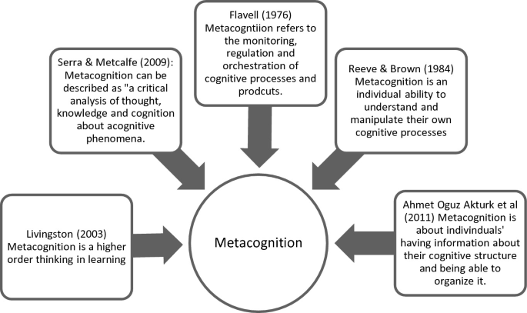
Metacognition

Slide 5
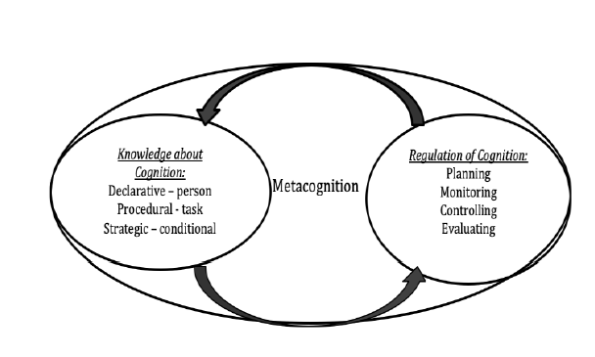
Definitions
thinking about thinking
Knowledge of one’s knowledge
Knowledge of regulation of ones knowledge and cognition self-monitor levels of understanding and predict how well (s)he will do on a particular task.
Self-regulation - students monitoring their own comprehension and assessing their own abilities without teacher help.
Notes:
Interrelated set of competencies for learning and thinking, and include many of the skills required for active learning, critical thinking,reflective judgment, problem solving, and decision-making.

Slide 6
Components (Dawson, 2016)
Metacognition is a regulatory system that includes (a)
knowledge, (b) experiences, (c) goals, and (d) strategies.
Metacognitive knowledge is stored knowledge
or beliefs about
  (1) oneself and others as cognitive agents
  (2) tasks
  (3) actions or strategies
  (4)how all these interact to affect the outcome of any intellectual undertaking

Slide 7
Components continued (Dawson, 2016)
Metacognitive experiences are conscious cognitive or affective experiences that concern any aspect of an intellectual undertaking.

Slide 8
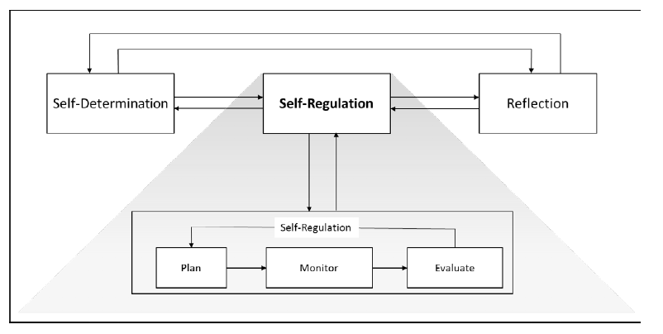
Self-Regulation
Notes:
A process in which a person actively searches for relationships and patterns to resolve contradictions or bring coherence out of a set of experiences.
Contradictions lead to disequilibrium, accommodation, and assimilation.
Self-regulation begins with exploration, and progresses through invention and application.
The work of self-regulation calls for students to identify patterns, draw of inferences, and make comparisons.
Self-regulation is essential in order to increase both declarative and procedural knowledge.

Slide 10
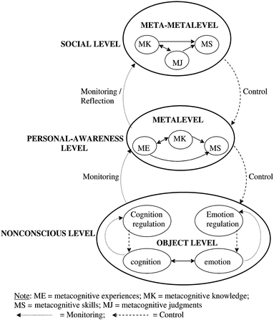
Metacognition (Efklides, 2011)
Behind behavior change
MC knowledge
  Behaviour
  Outcomes
Self-regulation
Experience (habits)
Feedback
Reflection

Slide 11
How to reach
Critical Thinking
Reflection
Applied to all!

Slide 12
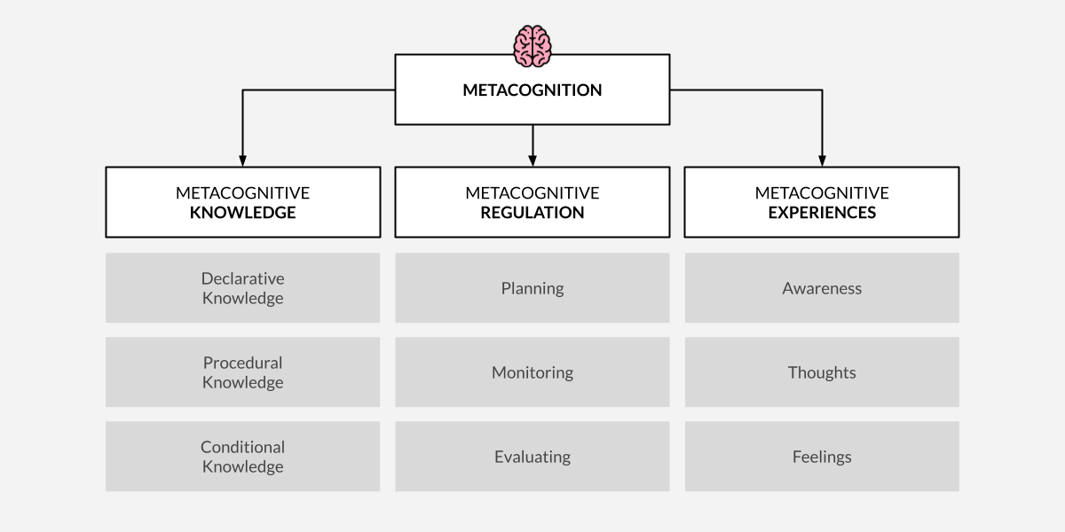
Metacognition

Slide 13
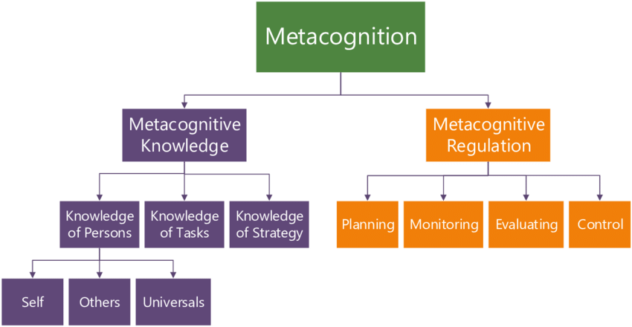
Metacognition continued
Knowledge of systems

Slide 14
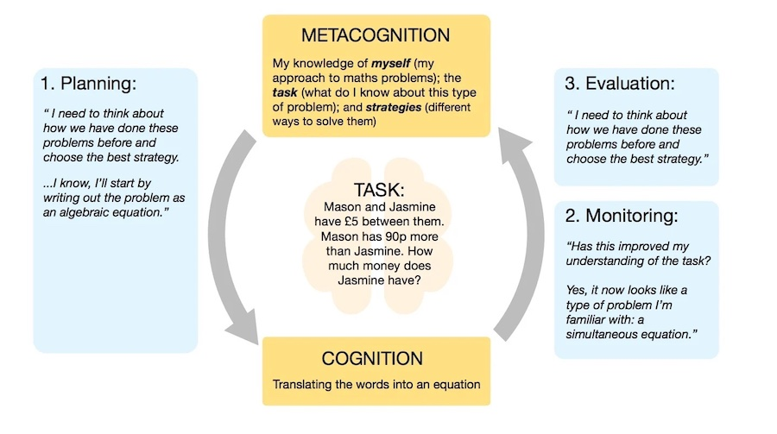
Metacognitive Regulation

Slide 15

Situation Awareness - Definition
“The perception of the elements in the environment within a volume of time and space, the comprehension of their meaning and the projection of their status in the near future.” (Endsley, 1988, S. 97)
Originally from aviation (pilots, air traffic control)
Nuclear facilities
Military domain
Train dispatching
Weather forecasting
Driving and automated vehicles
More recently: network security

Slide 16

Levels of SA
Level 1
Perception
Level 2
Comprehension
Level 3
Projection
Notes:
Situational awareness or situation awareness (SA) is the perception of environmental elements and events with respect to time or space, the comprehension of their meaning, and the projection of their future status.^{[1]}
It’s been recognized as a critical foundation for successful decision-making across a broad range of situations, in everday emergency situations, such as law enforcement, aviation, air traffic control, health care, military command and control operations, etc
Lacking or inadequate situation awareness has been identified as one of the primary factors in accidents attributed to human error.
SA is broken down into three segments: perception of the elements in the environment, comprehension of the situation, and projection of future status.^{[7]}
Three facets of SA have also been identified: SA states, SA systems, and SA processes (last two next week)
SA states refers to the actual awareness of the situation.
Objects L1): Awareness of various objects in the world, and their current status. Objects and their status may be indicative of particular situations (that they are about to occur, that they are ongoing, etc.). Then they are often referred to as cues.
Frames (L1): Awareness of what kind of situation is on-going, e.g. a runway incursion where an aircraft is about to collide with some object on the runway.
Implications L2): Awareness of objects within frames, of what their current status means in a particular situation. E.g. the implications of the current speed of the aircraft or network status for CS – gets connected to projection (l3)
Event horizon L3: An awareness of plans and events in time and space. It includes an awareness of what has happened (useful for diagnosis, to achieve SA, to frame situations). It also includes prognosis, an awareness of what might happen next. That includes on the one hand an awareness both of what might occur based on diagnosis and the current situation, and on the other hand on an awareness of current plans and intentions.
SA systems refers to the distribution of SA in teams and between objects in the environment, and to the exchange of SA between system parts. SA processes refers to the updating of SA states, and what guides the moment-to-moment change of SA. These two aspects will be taken up next week lecture
Metacognition
Metacognition is an awareness of one's own thought processes and an understanding of the patterns behind them
two components of metacognition: (1) knowledge about cognition and (2) regulation of cognitionsit
Control Situation awareness

Slide 17
Do not confuse
Situational Assessment
Situational Understanding
(same as L2)
Mental Models
(Later)
Sensemaking
(later)
Notes:
Situational Understanding is often confused with situation awareness (SA) but has a distinct meaning, particularly in military command contexts. It refers to analyzing and interpreting awareness of a situation to determine relationships between factors, assess threats and opportunities, and identify informational gaps. This aligns with Level 2 SA in the Endsley model, which involves comprehending the implications of information in light of one’s goals, answering the "so what" of perceived data.
Situational Assessment involves the processes required to achieve SA. Endsley emphasizes the distinction between SA as a knowledge state and the varied processes (situational assessment) used to attain it. SA both influences and is shaped by these processes, driving continuous attention and interpretation cycles.
Mental Models are essential for achieving SA, particularly for experienced decision-makers who use stored conceptual patterns to interpret current situations and make decisions. Novices, however, may struggle due to information overload, as they lack well-formed mental models to streamline their understanding.
Sensemaking is distinct from SA and focuses on the continuous, motivated effort to understand connections in situations to predict and act effectively. While SA is often instantaneous, driven by pattern recognition, sensemaking is more reflective and backward-looking, forming explanations for past events. SA, in contrast, is typically forward-looking, aiding in predicting outcomes and guiding immediate decisions.

Slide 18
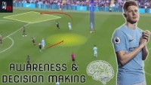
From My Domain
Notes:
45
138
340

Slide 19
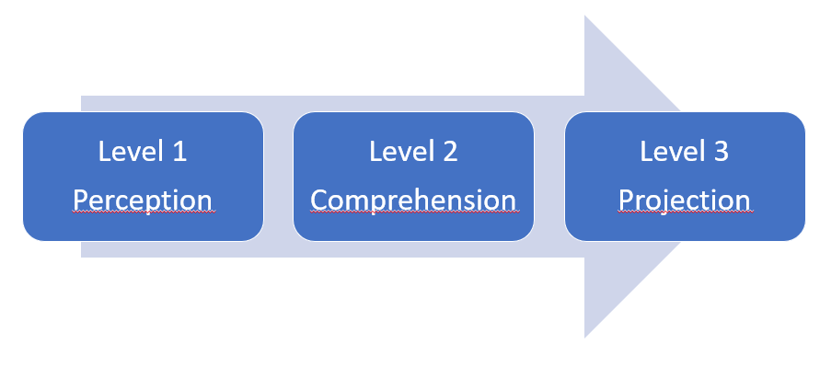
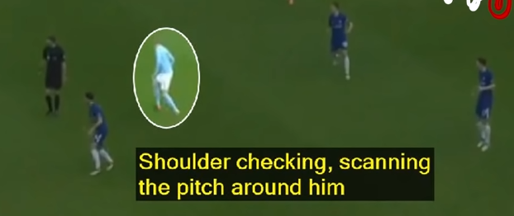
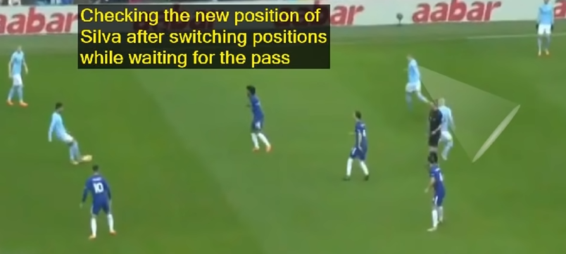
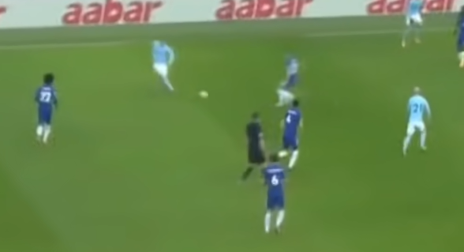

Slide 20


Slide 21

Bottom-up / data-driven processing
Short-term sensory memory, perception, working memory and long-term memory form SA.
Initial processing of environmental elements parallel and pre-attentive.
Certain properties are detected, such as spatial proximity, color, simple properties or shapes and movement, providing cues for further focalized attention (focalzied attention= conscious and higher cognition).
But: previously learned information (mental models) shape our expectations of what is „normal“ and guide our perception.

Slide 22
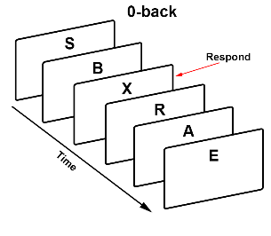
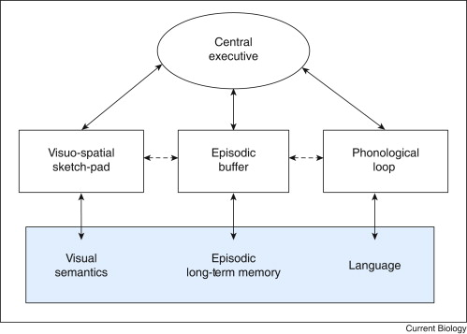

Working Memory
n-back
Truth!
3±1
Level 1
Perception
Level 2
Comprehension
Level 3
Projection
(Baddeley, 1986-today)

Slide 23
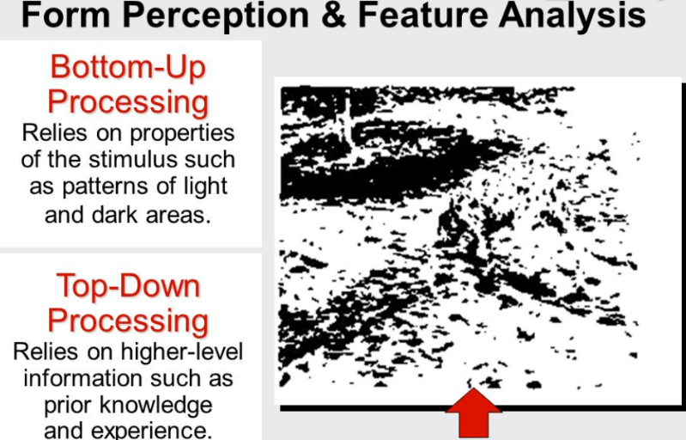
Top-down / goal-driven process
Notes:
In human perception, we always have elements of data-driven bottom-up and goal-driven top-down processes.
While pattern matching and its activation of mental models is data-driven, some people have strong tendencies towards a more goal-driven approach.
Risk to miss key information when a change of goal is needed.

Slide 24
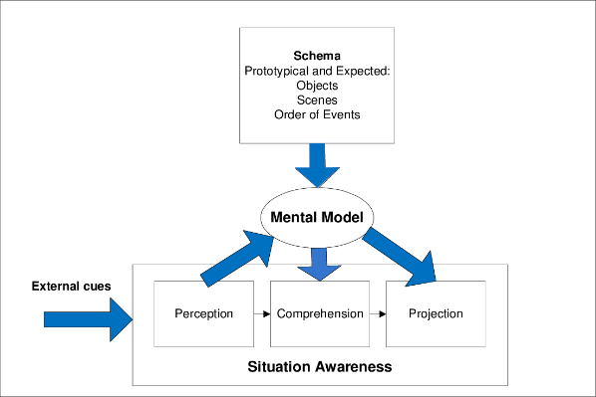
Mental Models
Mechanisms whereby humans are able to generate descriptions of system purpose and form, explanations of system functioning and observed system states, and predictions of future states. (Rouse & Morris, 1985).
Knowledge regarding which aspects of environment are relevant; identify critical cues, direct attention to these, classify information, making this process more efficient in large amounts of data.
Helps to integrate elements efficiently to form an understnading of their total meaning (Level 2) in terms of the goals.
Helps to project future states accurately and efficiently based on current states and dynamics. (Level 3)
(Endsley, 2000)
Level 1
Perception
Level 2
Comprehension
Level 3
Projection
Notes:
This then becomes metacognitive skills

Slide 25
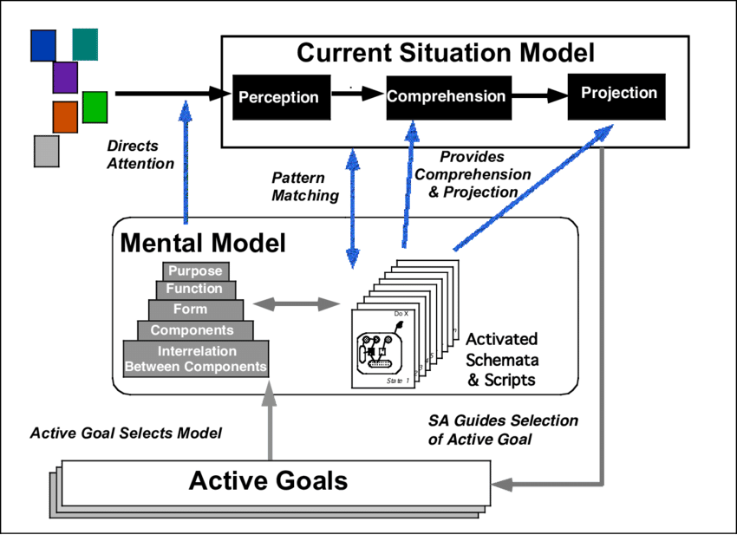
Pattern Matching
Activated by „pattern matching“: „oh, this is just like what happened last month!“ – „this is just like what happened to the aircrew in the Azores incident!“
„Recognition-primed decision-making“.
Shortcut for SA and decision-making: Processing data to determine Level 2 or 3 (requires working memory or exercising the mental model), that information is already part of experience („Schema“) and must only be recalled.
The crucial point here is to recognize the „critical cues“ and having a good stock of these in memory.
Thus Levels 2 & 3 (Comprehension, Projection) are „filled in“ following pattern matching.
Similarity is sufficient, depending on pattern-matching abilities.
Level 1
Perception
Level 2
Comprehension
Level 3
Projection

Slide 26
Interrelationship between SA levels
data-driven/ BU
Level 1
Perception
Level 2
Comprehension
Level 3
Projection
goal-driven/ TD
Match patterns based on experience and accelerate L2 and L3.
Goal-driven filling of L1.
Iterative process to search and analyze goal-relevant data.
Highly efficient SA generation process.
Vulnerable to biases such as Anchoring and Confirmation Bias.

Slide 27
Factors affecting SA in novices and experts
SA is fast, can be effortless, more complete, greater comprehension & projection
SA is demanding, frequently incomplete and erroneous
Novice Expert
Limited attention
Limited working memory
Schema of prototypical situations
Mental models of domain
Automaticity of processes
Learned skills (e.g. scan patterns, communications)

Slide 28
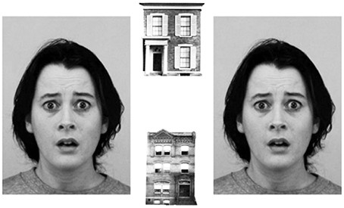
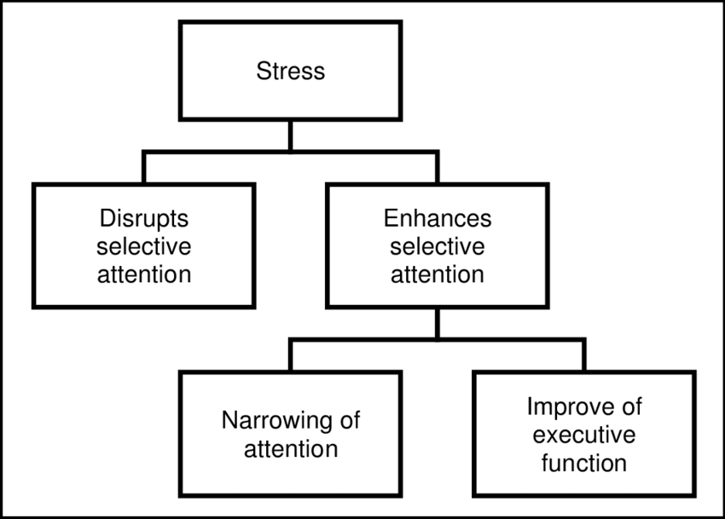
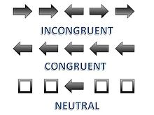
Examples of Threats to Situational Analysis
SAME??
Modality Conflicts
Initial states
  Stress
  Priming
    Biases
Level 1
Perception
Level 2
Comprehension
Level 3
Projection

Slide 29
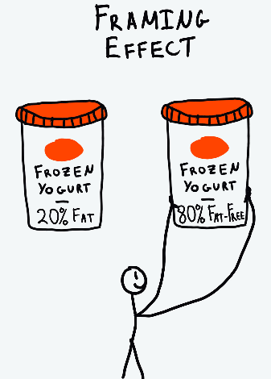
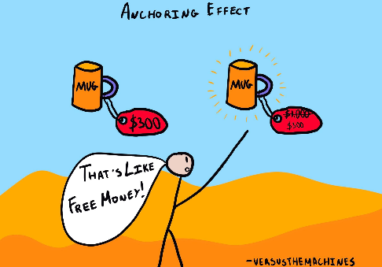

Biases - not just manipulation

Slide 30
Notes:
Inattentional blindness
¨24 radiologists to perform amiliar lung – nodule detection task
A gorilla 48x bigger than a nodule inserted in the last case
Even experts are vulnerable

Slide 31

8 Other Threats to SA
Attentional tunneling (or: attentional narrowing)
  Attention can not be divided.
  Get hooked on particular features and inadvertently drop scanning.
  Mind the Gorilla.
Requisite memory trap
  Working memory overload.
  In particular auditory information.
Stressors
  Workload, anxiety, fatigue, etc.
  Time pressure, uncertainty, etc.
  Limits SA via limiting WMC and slowing down information processing, more likely attentional tunneling, disorganized scanning for elements and less attention to peripheral cues.
Data overload
  Volume and rate of change
  Limited bandwith of human sensory and information-processing mechanisms.
  Rate of data flow can be enhanced significantly by ergonomic user interfaces
Misplaced salience
  Some features (size, shape, movement, flashing lights, noise) are prioritized in sensory and attentional processing
  Overuse or inappropriate use degrades SA to other information
Errant mental models
  „representational error“
  A wrong mental model is applied
Out of the loop syndrome
  Automation can eliminate excessive workload, but can also lower SA by putting people out of the loop.
„take-over-time“ where automatisation fails or is not equipped to handle a situation

Slide 32
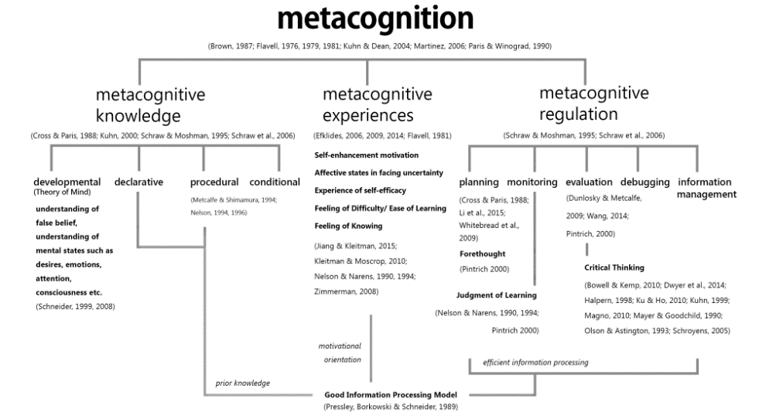
Level 1
Perception
Level 2
Comprehension
Level 3
Projection
Notes:
Through SA training MC can be developed – MC contains cognitive perspectives from sensemaking and experience

Slide 33

Conclusions and what has been learnt on SA in recent years
Much research explained individual differences in SA
Training programs have been developed to improve SA
Design methodologies are informed to adjust for improving SA
Examples for applications
  Automation (human-in-the-loop), e.g. autonomous driving
  Cybersecurity and network defence

Slide 34
Situation awareness-oriented design
Reduce human error by not only maximizing functionality, but also include the problems of information overload, cognitive confusion and inefficient processes into design process.
Human-centered design process to optimize user-SA can help with:
  How to organize information and present (-> L1++) it to facilitate higher-level understanding (L2) and projections (L3).
  How to deal with uncertainty (alarms, diagnosis, system complexity, automation, and distributed team operations).
  Provide metrics on whether full SA is delivered.
Level 1
Perception
Level 2
Comprehension
Level 3
Projection

Slide 35


Slide 36
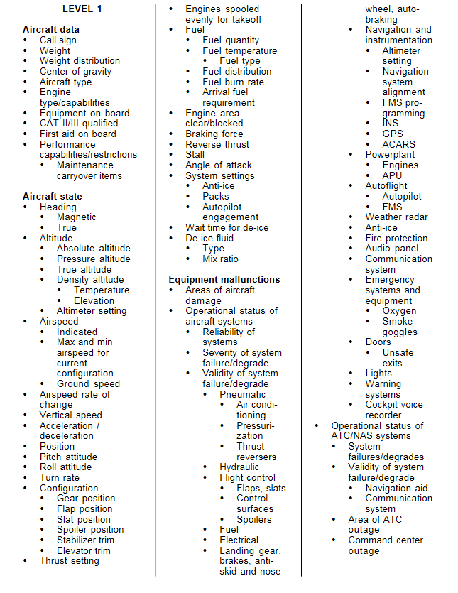
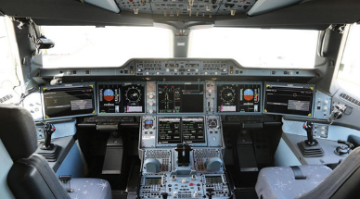
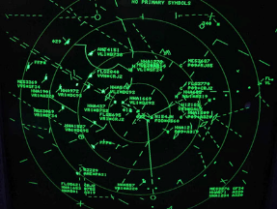
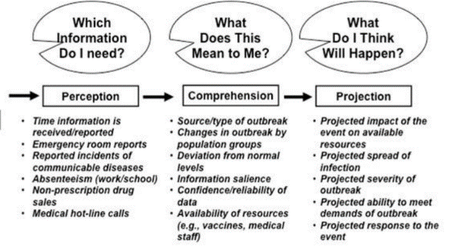
Level 1: Perception
Notes:
Perceive status, attributes and dynamics of relevant elements in the environment.
Example
Pilot: other aircraft, terrain, system status, warning lights with their relevant characteristics, etc.
Sources
Information displays, direct observation in environment, other team members
Attentional tunneling (or: attentional narrowing)
Attention can not be divided.
Get hooked on particular features and inadvertently drop scanning.
Mind the Gorilla.
Requisite memory trap
Working memory overload.
In particular auditory information.
Stressors
Workload, anxiety, fatigue, etc.
Time pressure, uncertainty, etc.
Limits SA via limiting WMC and slowing down information processing, more likely attentional tunneling, disorganized scanning for elements and less attention to peripheral cues.
Data overload
Volume and rate of change
Limited bandwith of human sensory and information-processing mechanisms.
Rate of data flow can be enhanced significantly by ergonomic user interfaces
Misplaced salience
Some features (size, shape, movement, flashing lights, noise) are prioritized in sensory and attentional processing
Overuse or inappropriate use degrades SA to other information
Errant mental models
„representational error“
A wrong mental model is applied
Out of the loop syndrome
Automation can eliminate excessive workload, but can also lower SA by putting people out of the loop.
„take-over-time“ where automatisation fails or is not equipped to handle a situation

Slide 37
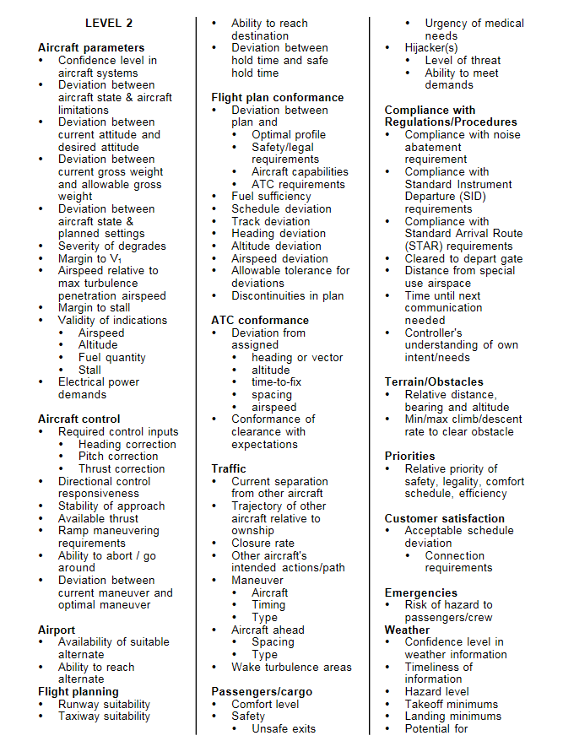
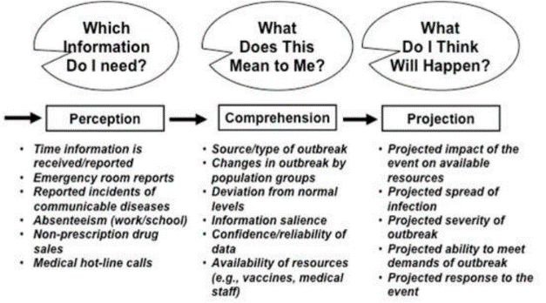
Level 2: Comprehension
Notes:
Synthesis of disjointed Level-1 elements.
Understand their significance in the light of one‘s goals.
Enables for risk assessment and assessing relevance of all types of deviations from expected states, making sense of situations in general.
„So what?“
Attentional tunneling (or: attentional narrowing)
Attention can not be divided.
Get hooked on particular features and inadvertently drop scanning.
Mind the Gorilla.
Requisite memory trap
Working memory overload.
In particular auditory information.
Stressors
Workload, anxiety, fatigue, etc.
Time pressure, uncertainty, etc.
Limits SA via limiting WMC and slowing down information processing, more likely attentional tunneling, disorganized scanning for elements and less attention to peripheral cues.
Data overload
Volume and rate of change
Limited bandwith of human sensory and information-processing mechanisms.
Rate of data flow can be enhanced significantly by ergonomic user interfaces
Misplaced salience
Some features (size, shape, movement, flashing lights, noise) are prioritized in sensory and attentional processing
Overuse or inappropriate use degrades SA to other information
Errant mental models
„representational error“
A wrong mental model is applied
Out of the loop syndrome
Automation can eliminate excessive workload, but can also lower SA by putting people out of the loop.
„take-over-time“ where automatisation fails or is not equipped to handle a situation

Slide 38
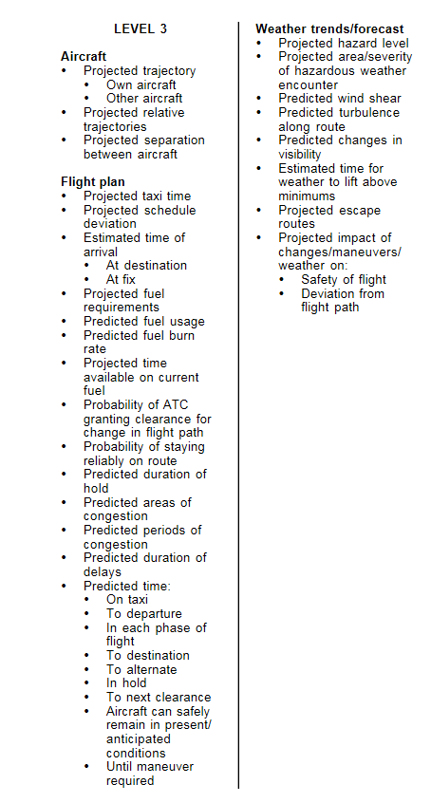

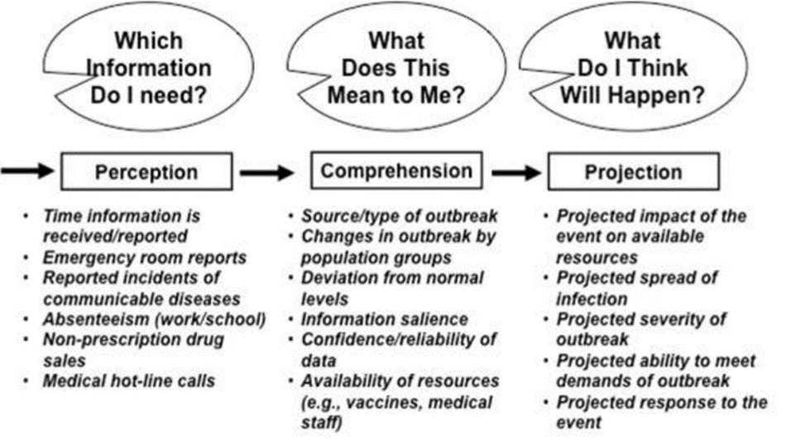
Level 3: Projection
Notes:
Project the future actions of the elements in the environment.
Based on knowledge of the status and dynamics of the elements and a comprehension of the situation (L1 and L2).
Allows for proactive action rather than reactions.
„Now what?“
Attentional tunneling (or: attentional narrowing)
Attention can not be divided.
Get hooked on particular features and inadvertently drop scanning.
Mind the Gorilla.
Requisite memory trap
Working memory overload.
In particular auditory information.
Stressors
Workload, anxiety, fatigue, etc.
Time pressure, uncertainty, etc.
Limits SA via limiting WMC and slowing down information processing, more likely attentional tunneling, disorganized scanning for elements and less attention to peripheral cues.
Data overload
Volume and rate of change
Limited bandwith of human sensory and information-processing mechanisms.
Rate of data flow can be enhanced significantly by ergonomic user interfaces
Misplaced salience
Some features (size, shape, movement, flashing lights, noise) are prioritized in sensory and attentional processing
Overuse or inappropriate use degrades SA to other information
Errant mental models
„representational error“
A wrong mental model is applied
Out of the loop syndrome
Automation can eliminate excessive workload, but can also lower SA by putting people out of the loop.
„take-over-time“ where automatisation fails or is not equipped to handle a situation

Slide 39
The ‘Usual’
„Human error“ as cause of accidents/failures usually in presence of high demands and high complexity.
Frequent response: add more systems to solve the problem, and add more procedures.
Examination of accidents in a variety of industries:
  Operators have NO difficulties in physiclally performing required tasks.
  Operators have the knowledge to know WHAT the correct action would be.
  Stress and subsequent failures result from trying to understand what is going on in a given situation.
Remember L1: Technology-centered systems require the operator to mentally search through multiple data sources and ascertain their meaning and significance. Leads to overload and susceptibility to missing critical factdors. The cognitive bottleneck is to be alleviated by human-centered design principals to facilitate SA.
Level 1
Perception
Level 2
Comprehension
Level 3
Projection
Notes:
Chesley Sully Sullenburger
Personal:
Work-life balance
Risk expertise – started own company
Knowledge of accidents with birds
Practice: Airforce, (won award) MSc in HF
Understood procedure limits and sacrificing future outcomes
Situational:
Rested!! (did not go out for fun night before)
Experienced team

Slide 40
Summary: Principles of SA-centered design
Organize technology around the user‘s goals, tasks, and abilities.
  Interfaces and capabilities need to be designed to support the changing goals of the operator in a dynamic fashion.
Technology should be organized around the way users process information and make decisions.
  Before decisions are made in complex domains, users try to achieve understanding of the situation as a whole. Goes beyond simply perceiving state of environment, there must be understanding of its meaning in light of current goals.
Technology must keep the user in control and aware of the state of the system
  High levels of automation -> user put out of loop -> SA compromised and prolonged take-over time. Involvement should be kept sufficiently high or interface designed to allow for SA maintenance or regaining SA.

Slide 41
SA-oriented design principles quick summary
Organize information around goals
Present L2 information directly to support comprehension
Provide assistance for L3 projections
Support global SA
Support trade-offs between goal-driven and data-driven processing
Make critical cues for schema activation salient
Take advantage of parallel processing capabilities
Use information filtering carefully

Slide 42
Now how to get needed SA information
1. Query techniques, in which the subjects are asked (“queried”) directly about their perception of certain aspects of the situation.
2. Rating techniques, in which either the subjects themselves, or observers of the subjects, are asked to rate SA along a number of dimensions, typically presented in a series of scales.
3. Performance-based techniques, in which the level of SA is inferred from the level of performance. The rationale underlying this technique is that good SA is needed to achieve a good performance.
Notes:
A number of measures of SA have been developed over the years. Each has its advantages and disadvantages, and some their well-publicized protagonists. The measures can be grouped in three categories:

Slide 43
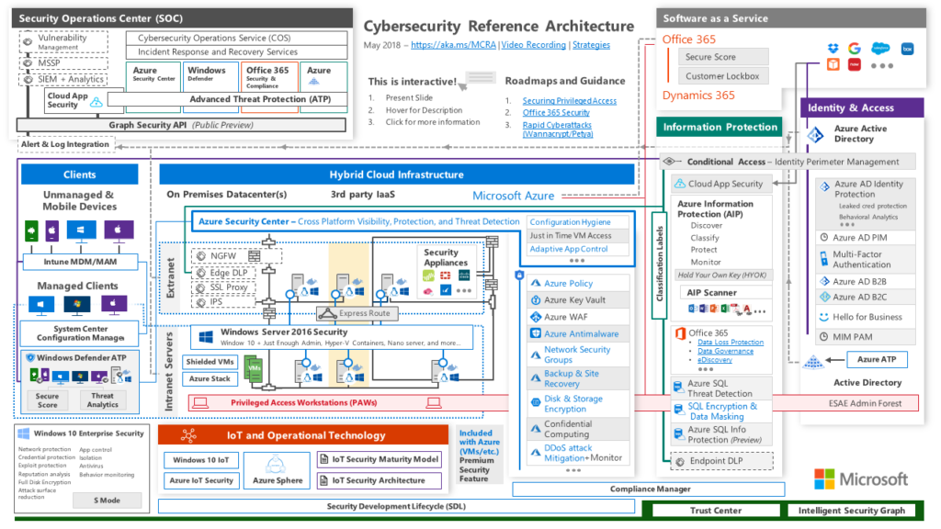
Cyber Security and Situational Analysis
Notes:
Operational engineering is distinctly different than technology engineering, which is currently in use today. Technology engineering assumes the value of the technology so its functional utility is not analyzed. This approach adds to the proliferation of technological silos. In many cases it does not perform as intended and thus operator-developed workarounds become the norm.
Operational engineering, as an alternative, is informed by technology and, importantly, by what constitutes mission success. Mission critical events, therefore, become the major design drivers. Operational engineering recognizes risk can continue to rise up to a point beyond which catastrophic mission failure occurs. Such a point is called the critical event horizon. Knowing key points where mission failure can occur is some of the bedrock knowledge of a super-function.

Slide 44
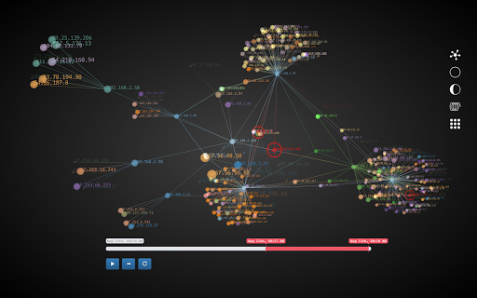
About visualizations
“Cyber operations provide a unique challenge in terms of the sheer size of the networks involved and their inherent level of dynamics. Understanding the topography of the cyber network is a key component to being able to understand the potential impact of a particular event or attack on a given mission or operation. This has proven to be quite challenging in many cases. New research will be need to help operators to better visualize existing networks, particularly as they change. As we develop networks that dynamically morph as a function of their design, as well as a function of other factors (e.g. computers or software getting added or deleted, mobile users joining the network at various locations and times), the understandability of the network will be severely strained. New methods to support operators by mapping system topology to operational decisions are needed. This research will need to address not just abstract visualization, but also the types of display support that are needed for addressing the various types of comprehension and projection needs of operators who are answering very real questions about the system’s performance (e.g. see Table 1 ). For example, displays that assist the operator in assessing the impact of a malicious activity on current protection schemes and needed assets. These sorts of SA requirements have been found to be very poorly supported in many existing tools.»
Endsley (since 2014)

Slide 46
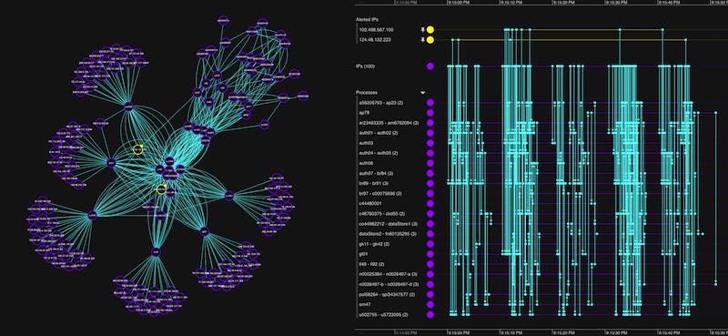
Examples
Do they promote SA?
How?
Could it be better?

Slide 47
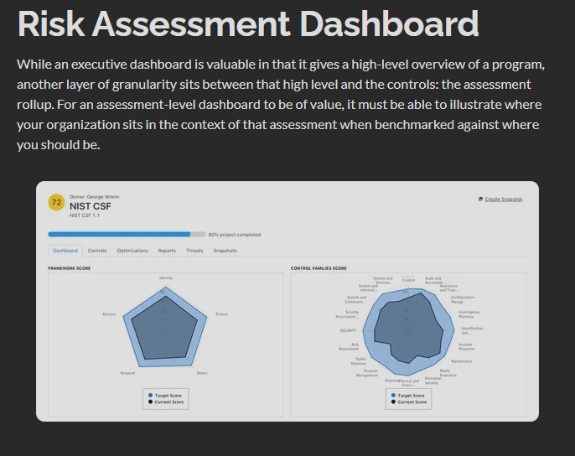

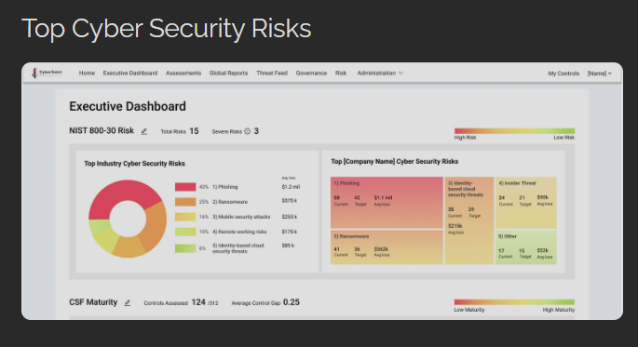

Slide 48

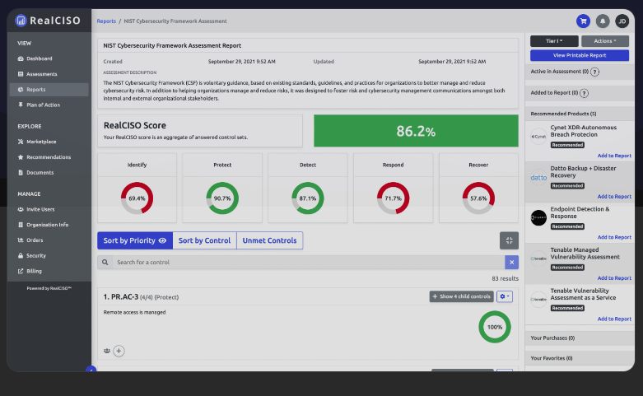

Slide 49
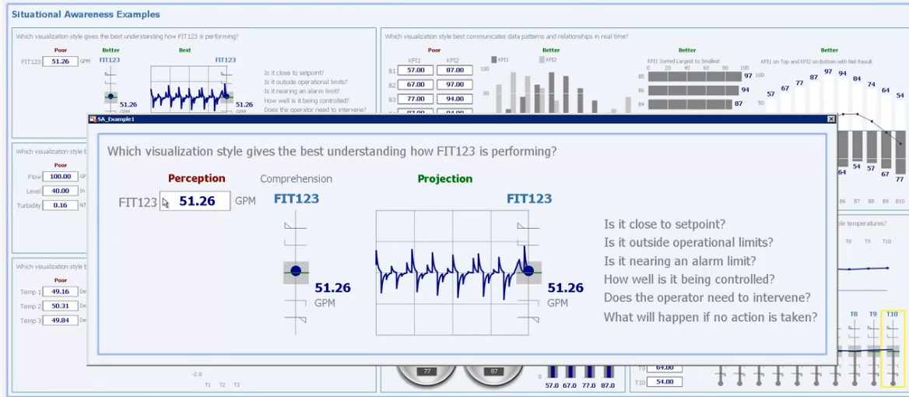
SA-improving visualizations: a SCADA-example

Slide 50

Security Operation Centers (SOCs)
Organizations assign their cybersecurity operations to SOCs
SOC teams cover multiple security activities and analyze
large and continuous streams of data
Technical tasks and decision-making assigned to different
positions in the SOC (Muniz et al., 2015)

Slide 51
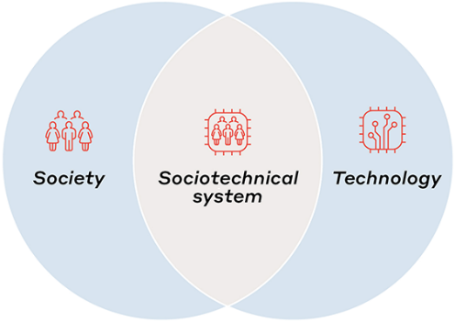
Socio-Technical Systems (STSs)
Cyber Operators (COs) = Technical personnel in SOCs
Face challenges spanning the cyber, physical, and social domain (Jøsok et al., 2016)
Human-machine and human-human interaction = STS
Cyber-physical working environment is subject to high rates of change and innovation

Slide 52

Cogntive exploits and attack vectors
Notes:
Red Arrow: an attacker that wages a social engineering cyberattack against a victim's human cognition functions (i.e., the oval). The resulting behavior is associated to persuasion (i.e., an attack succeeds when a victim is persuaded to act as intended by the attacker).
Cognitive workload, via mechanisms such as inattentional blindness, can increase vulnerability to social engineering cyberattacks.
Stress may reduce one's ability to detect deception cues in social engineering cyberattack messages but the direct effects of acute stress on cybersecurity social engineering have not been examined.
Attentional vigilance, particularly the vigilance decrement, may be an important influence on susceptibility to social engineering attacks, but more research is needed.
Literature results are not conclusive on how personality may influence one's susceptibility to social engineering cyberattacks.
Domain knowledge helps reduce vulnerability to social engineering cyberattacks.Awareness and general technical knowledge do not necessarily reduce one's susceptibility to social engineering cyberattacks, perhaps because human cognition functions have not been taken into consideration. Self-efficacy, knowledge, and previous encounter of social engineering cyberattacks collectively reduce one's susceptibility to social engineering cyberattacks. In particular, costly phishing experiences would greatly reduce one's susceptibility to social engineering cyberattacks, while non-costly experiences do not.
But Stefan will discuss this
Gender does not have a big impact on the susceptibility to social engineering cyberattacks
Old people with higher education, higher awareness and higher exposure to social engineering cyberattacks are less susceptible to these attacks.
Culture affects privacy and trust attitudes, which indirectly affect one's susceptibility to social engineering cyberattacks.
Long term memory The success of social engineering cyberattacks is inversely related to their prevalence.
Training methods that ask people to consciously think about social engineering cyberattacks are unlikely to be very successful unless the learning reaches the point where it is a habit that, largely unconsciously, guides safer computer use behavior.
Message quality and message appeal, which reflect attacker effort (e.g., using contextualization and personalization), have a significant impact on the attacker's success.
An individual's capabilities in detection of social engineering cyberattacks are affected by their awareness of the threats, their cultural backgrounds, and their individual differences in trust/suspicion.

Slide 53

Accurate Recognized Cyber Picture (RCP) critical for Decision-Making
Decision-making based on human interaction requires shared situational awareness of the CTS
Cyber Situational Awareness (CSA) influence organizational control in its cyberspace
Barford et al. (2009) 7 criteria for CSA
  Awareness of the current situation
  Awareness of the impact of the attack
  Awareness of how situations evolve
  Awareness of adversarial behavior
  Awareness of why and how the current situation is caused
  Awareness of quality and trustworthiness of CSA info
  Assessment of plausible futures of the current situation

Slide 54


Orient-Locate-Bridge – The role of Cognisance and Communication (Knox et al, 2018)

Slide 55


Cyber Security Performance
Personality
  Self-efficacy
  Metacognition
    JoP
Situational Aspects
  Individual States
  Recognized Cyber Picture
  Team Aspects
Notes:
Attentional tunneling (or: attentional narrowing)
Attention can not be divided.
Get hooked on particular features and inadvertently drop scanning.
Mind the Gorilla.
Requisite memory trap
Working memory overload.
In particular auditory information.
Stressors
Workload, anxiety, fatigue, etc.
Time pressure, uncertainty, etc.
Limits SA via limiting WMC and slowing down information processing, more likely attentional tunneling, disorganized scanning for elements and less attention to peripheral cues.
Data overload
Volume and rate of change
Limited bandwith of human sensory and information-processing mechanisms.
Rate of data flow can be enhanced significantly by ergonomic user interfaces
Misplaced salience
Some features (size, shape, movement, flashing lights, noise) are prioritized in sensory and attentional processing
Overuse or inappropriate use degrades SA to other information
Errant mental models
„representational error“
A wrong mental model is applied
Out of the loop syndrome
Automation can eliminate excessive workload, but can also lower SA by putting people out of the loop.
„take-over-time“ where automatisation fails or is not equipped to handle a situation

Slide 56
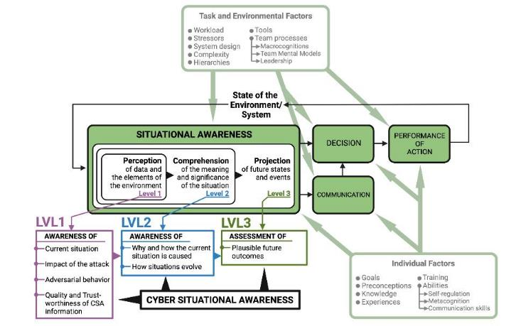

Back to reality
?

Slide 57

Situational Awareness vs Situational Understanding

Slide 58
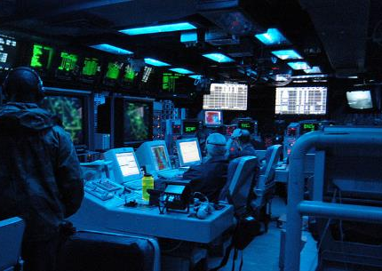
Accurate Recognized Cyber Picture (RCP) critical for Decision-Making
Accurate RCP cruical for CSA
RCPs consist of actively selected and actionable information specifically pertaining to CTS
COs investigate threats to create RCP → Share RCP (sRCP) with decision-maker (next week)
Cyber-to-physical relay of RCP is subject to many challenges

Slide 59
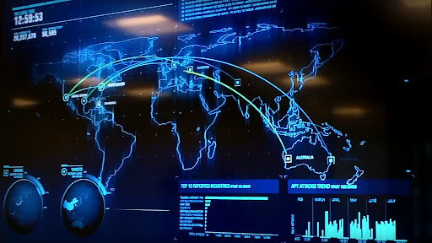
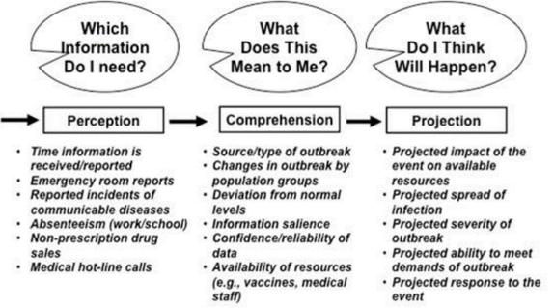
SA Requirements Analysis
Find out what aspects of the situation are important for a particular operator‘s SA?
Run a goal-directed cognitive task analysis (GDTA)
Then identify the major decisions that need to be made
Identify SA needed for these decisions
  Methods: expert interviews, observations, verbal protocols, analyses of written material and documentation, formal questionnaires – pooling of data of a sample
  Capture the full range of possible goals and sub-goals: What information is needed, how is the information used/interpreted (L1/L2) to project (L3)?
Notes:
ACDICOM Previous studies focused on L1/L2
New Data collection looks at L3

Slide 60
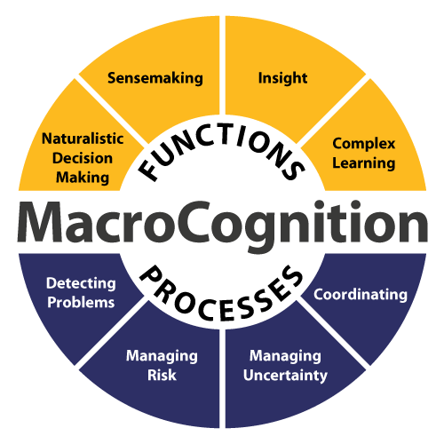
Macrocognition (Klein et al 2003)
Vs Microcognition
Emergent phenomena and systems perspective
Natural decision making
Cognitive processes
Notes:
Macrocognition by Klein et al. (2003) introduces macrocognition as a concept to describe cognitive functions in real-world settings, contrasting it with microcognition, which typically focuses on cognitive processes under controlled, laboratory conditions. The authors emphasize that traditional cognitive science has primarily studied isolated cognitive tasks (e.g., puzzle-solving, attention mechanisms), referred to as microcognitive functions, aiming to break down cognition into foundational processes. In contrast, macrocognition addresses complex, high-stakes, real-world decision-making involving practitioners facing dynamic, often unpredictable conditions.
Theoretical Aspects of Macrocognition
Macrocognition vs. Microcognition: Macrocognition encompasses functions and processes such as sensemaking, problem detection, planning, and coordination, all of which emerge naturally in real-world settings where tasks are complex, often high-risk, and time-constrained. Unlike microcognition, which seeks reductionist explanations of cognitive tasks, macrocognition operates at a higher level, recognizing that cognitive processes are interdependent and context-sensitive.
Emergent Phenomena and Systems Perspective: Macrocognitive functions are described as emergent, meaning they arise naturally from the complex interplay of various cognitive processes. For example, rather than isolating attention management or uncertainty reduction as separate, static tasks, macrocognition studies how these processes interact dynamically to support overall goals in complex environments. This systems perspective allows researchers to explore how different cognitive functions, like problem detection and decision making, are interwoven in naturalistic settings.
Naturalistic Decision Making (NDM): Macrocognition incorporates the Recognition-Primed Decision (RPD) model, developed through studies of experienced professionals (e.g., firefighters) who make decisions based on pattern recognition rather than systematic comparison of options. Unlike traditional decision-making models that emphasize logical evaluation of all possible outcomes, RPD suggests that expert decision-makers often identify a single viable course of action and mentally simulate its effectiveness, bypassing exhaustive deliberation. This model exemplifies how macrocognition applies heuristics and domain-specific expertise to enable rapid and effective decision-making under uncertainty.
Supporting Cognitive Processes: Macrocognition includes a range of supporting processes like mental simulation, maintaining common ground, and attention control. These processes are not treated as isolated tasks but as integral parts of higher-order functions, such as adaptation and replanning in dynamic situations. For example, maintaining common ground is essential for coordinated team performance and requires an ongoing alignment of situational understanding among team members.
Methodological Implications: The authors advocate for a naturalistic approach to studying macrocognition, moving beyond lab experiments to field studies that capture cognitive work as it unfolds in real contexts. This methodology, while less controlled, is argued to be essential for understanding macrocognitive functions since these functions are inherently tied to the dynamic and unpredictable nature of real-world tasks.
Conclusion
Klein et al. argue that understanding macrocognitive functions is vital for designing systems that support complex decision-making environments. Macrocognition research emphasizes the necessity of descriptive models that reflect the interrelated cognitive functions needed in complex domains, such as firefighting or military operations. By focusing on cognition as it naturally occurs, the macrocognitive framework provides a broader perspective that complements traditional cognitive science and has practical implications for designing human-centered technology and training programs.

Slide 61
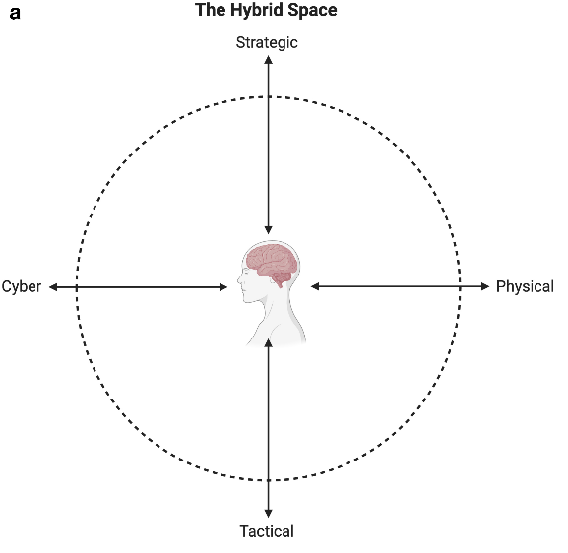
The Hybrid Space (HS) Framework
COs must change mindset frequently to
reflect the challenges they meet
High cognitive agility over physical performance contrary to traditional civil or military security
HS framework conceptualize the complexity of the cognitive landscape COs navigate
(Jøsok et al., 2016)
Interconnectedness between cyberspace
and the physical domain,
Tension between tactical and strategic
goals in decision-making and action.

Slide 62
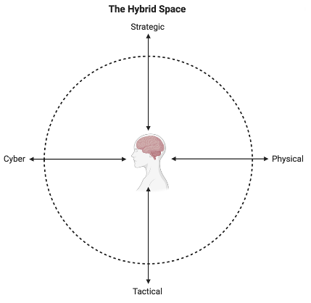
Macrocognition & HS
Sensemaking
  Problems
  Team Performance
  Situational
    Proximal – Distal factors influence on tactical-strategic decisions
Team
    Coordination, communication
Individual
  PxE (Lewin, 1956)
  Cognitions & Metacognitions
  Regulatory processes
Notes:
The HS is a macrocognitive model that describes functions and processes into a conceptual framework that maps cognitive processes along cyber-physical and tactical-strategic dimensionst. Macrocognition emerged from a need to address the broad variety of cognitive processes in a natural setting (Fiore et al., 2010; Hoffman & Mcneese, 2009). Macrocognition is subject to a variety of definitions that resemble each other by the commonality of explaining cognition in natural environments and later as ‘the adaptation to complexity’ (Hoffman & McNeese, 2009;
This helps to understand environmental complexity, and how operators behave. Current experience from conducting these exercises have implications for future education and training of operators.
Currently, there is no consensus on how to assess the performance of teams in a cyber operation context (Forsythe et al., 2013). This may be due to limited understanding of team processes in the complex problem solving environment of the cyber domain, when they are assessed against existing ‘team’ research that is generally considered to have flaws and limitations (Fiore et al, 2010). Therefore we must assumes that good team performance cannot be assessed simply based upon the team who captured the flag first. Instead we argue that there is a need to investigate team processes in cyber defence training exercises as a path to assessing team and judging performance.
While sensemaking is considered a process in macrocognition (Klein et al., 2003), in the cyber context it relies on a state of cyber situational awareness. But it may have several overlaps with metacognition. While experts heavily rely on recognition of patterns in their environment in most domains, this is not true in cyber operations. One would probably have to engage in “complex recognition primed decision making strategy” (Klein & Klinger, 1991), where the precondition is that the situation does not match the experts’ prior experiences. Hence, the expert cannot apply recognition-primed decision making directly, meaning they are required to engage in learning and discovering new knowledge and exploring new and adaptable ways to tackle the current issue. This shifts how team research must be conducted. Hybrid Space framework is appropriate to gain insight into cyber-physical understanding and complex socio-technical systems.
While previous attempts to understand problem detection has been more incremental towards a threshold of detection, more complex domains seem to take advantage of higher level cognitive skills like re-conceptualization (Hoffman & Shattuck, 2006; Klein et al., 1999).
Where the Hybrid Space conceptual framework (Jøsok et al., 2016) describes the environment in which cyber teams operate, the macrocognitive framework (Schraagen et al., 2008) adds understanding to the functions and processes that individuals and teams engage in within this space. Knowledge gained from observing and studying cognition in naturalistic settings in a cyber operation context (D'Amico, Whitley, Tesone, O'Brien, & Roth, 2005) shed light on the current problems that have to be tackled to ensure that individuals and teams receive proper education and training (Arnold, Harrison, & Conti, 2014) to operate in this complex multi-domain environment.

Slide 63
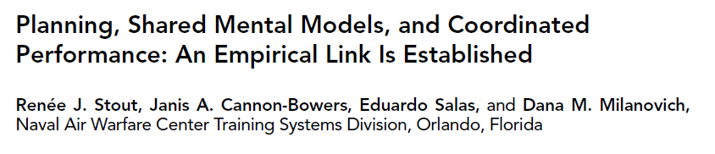
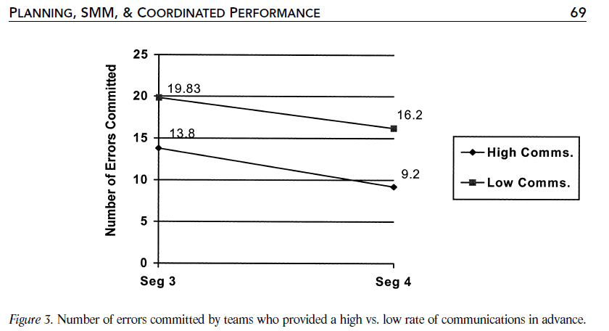
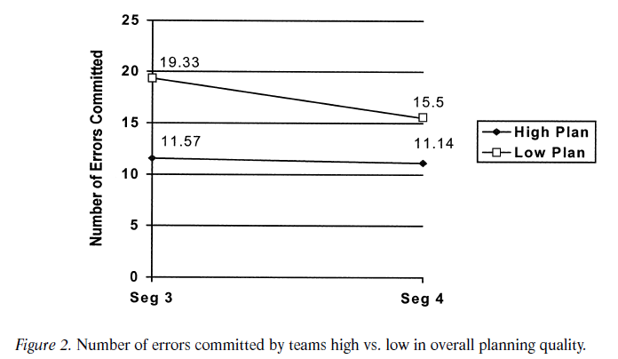
Notes:
Stout et al. (1999) explores the relationship between team planning, shared mental models (SMMs), and coordinated team performance under high-workload conditions. The authors investigate how planning behaviors in teams facilitate the development of SMMs, leading to efficient communication strategies and improved performance.
Key Theoretical Concepts
Shared Mental Models (SMMs): SMMs are conceptual frameworks that provide team members with a common understanding of task roles, information needs, and individual responsibilities. Teams with well-developed SMMs can anticipate one another’s needs, which is especially valuable under high workload and stress, such as in aviation, medical, or nuclear contexts. SMMs improve team performance by enabling efficient communication, allowing team members to provide essential information without being explicitly asked, thus reducing the need for reactive communication.
Planning and SMM Formation: Planning is theorized as a key driver in building SMMs within teams. Planning activities, such as setting goals, clarifying roles, and discussing task expectations, help team members align their mental models before high-stress situations. In the study, planning also involves anticipating information needs and discussing the allocation of tasks and resources in advance. These pre-performance planning sessions were found to establish SMMs that enhanced team coordination.
Efficient Communication: A major theoretical component is the role of SMMs in fostering communication efficiency. In high-stakes or high-stress scenarios, communication channels may become restricted due to cognitive overload. Teams with strong SMMs communicate proactively, delivering information when it’s needed, rather than waiting for explicit requests. This proactive communication style is essential in minimizing errors and achieving high performance.
Hypotheses and Findings
The study tested five hypotheses related to planning, SMMs, communication efficiency, and team performance. Key findings included:
Planning Quality and SMM Development: High-quality planning significantly enhances the development of SMMs, allowing team members to understand one another’s informational needs better. This shared understanding leads to fewer errors and better coordinated performance.
SMM and Communication Efficiency: While teams with high-quality planning had better-developed SMMs, the study found mixed results regarding whether SMMs directly lead to more efficient communication under high workload. This points to the possibility that while SMMs support performance, other factors might also drive efficient communication strategies.
Error Reduction: Teams with better SMMs and planning quality made fewer errors, particularly under high-workload conditions, suggesting that planning and SMMs are essential for maintaining performance as workload increases.
Practical Implications
The study’s findings highlight the importance of pre-performance planning for team training in high-stakes environments, such as military, aviation, and healthcare. By emphasizing planning and the development of SMMs, teams can be better prepared to handle unexpected events and high workload, enhancing both safety and performance.

Slide 64
Team Cognition
Cognitive processes that arise from complex and dynamic interactions (Salas & Fiore 2004)
Goal:
How can technology be used augment shared situational assessments
  Situated cognition (SA)
  Distributed cognition
    What the individuals know individually
  Communication processes
    Facilitating, debilitating
  Team Cognition

Slide 65
Mental Models

Slide 66
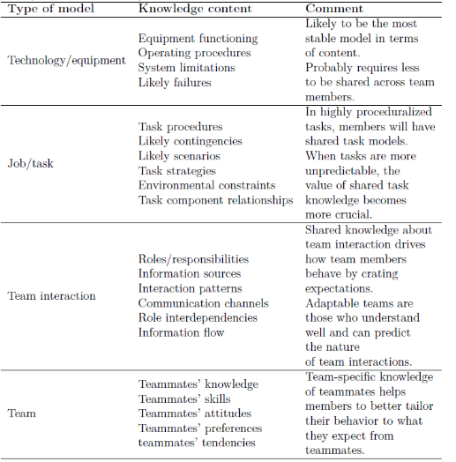

Organisational Culture and Social Aspects of Cybersecurity
Shared Mental Model of CS
Notes:
Figure: Relationship between the mental model and situation awareness,Endsley, M. R. (2015). Final reflections: situation awareness models and measures. Journal of Cognitive Engineering and Decision Making, 9(1), 101-111.
Table: Mathieu, J. E., Heffner, T. S., Goodwin, G. F., Salas, E., & Cannon-Bowers, J. A. (2000). The influence of shared mental models on team process and performance. Journal of applied psychology, 85(2), 273.

Slide 67


Cognitive Engineering approaches to communication in the HS
Orienting, Locating, Bridging (OLB) model (Knox et al., 2018)
Foster metacognitive awareness of own and a partner’s location within the HS
to improve flow of communication
Situational analysis and Shared Mental Modelling

Slide 68
Team Cognition
Cognitive processes that arise from complex and dynamic interactions (Salas & Fiore 2004)
Goal:
How can technology be used augment shared situational assessments
  Situated cognition (SA)
  Distributed cognition
    What the individuals know individually
  Communication processes
    Facilitating, debilitating
  Team Cognition

Slide 69


Cognitive Engineering approaches to communication in the HS
Orienting, Locating, Bridging (OLB) model (Knox et al., 2018)
Foster metacognitive awareness of own and a partner’s location within the HS
to improve flow of communication
Situational Analysis and Shared Mental Modelling

Slide 70


Decision-Making in Socio-Technical Systems
Interconnectedness between agents and
assets in the STS → decision-making
(Tikka-Ringas et al., 2014)
Persisting element of uncertainty
Multiple impact-dimensions
  Client assets
  Third party assets
  Agents in the network
  Adversarial behavior
  Etc....

Slide 71









Human communication in Cyber Threat Situations (CTSs)
Communication between humans at the core of cyber defense decision-making
Communication in CTSs is like a software design-problem
Communication must be modular (frictionless) enough to be useful for all stakeholders

Slide 72



Methods - Measurement
The Self-assessment Manikin (SAM; Bradley & Lang 1994) was used to measure affective states.
  Affective variability
  Self-Efficacy
Notes:
The SAM is a 3-item 9-point Likert-scale (1 to 9) that measures mood (negative to positive), physiological activation (PA; little to much), and control (little to much). The SAM is a a validated culture- and language independent visual scale that is used in performance [18] research in different domains and populations including cyber environments [77-79].
Both mean and variability scores were computed. where N is the total number of R peaks, RR _{j} is the jth RR interval, RR is the mean of the RR intervals, $\overline{RR}$_{j} denotes the average of the RR intervals up to the jth. This resulted in three independent variables: Mood, Activation and Control. Higher mood indicates more positive mood, higher activation indicates more arousal, and higher control indicates higher self-efficacy.
Cronbach’s a
Control=.633
Activation=.891
Control=.928

Slide 73

Measuring HF in Cyber
NCR
Trait (distal)
Situational (proximal)
Variable (experiental)

Slide 74


Results – TWLQ Teamwork
Variable control was associated with less team performance monitoring (team workload)
  β = -.558, R² = .311, F = 4.96, p =.048

Slide 75


Results – TWLQ Task-Team
Higher mood variability (β = -.322) and higher activation (more aroused; β =-.511) predicted less team support demands
  R² = .448, F = 4.06, p = .026 1-tailed
Higher variability predicted less team support demands (R² = .523, F = 3.29, p = .036 1-tailed)
  Mood (β = -.423)
  Activation (β = -.282)
  Control (β = -.323)
Higher variable control was associated with lower team emotional support but this was not significant
  (r = -.473, p = .051)

Slide 76


Cognisance as a Human Factor in Cyber Defence Education
To present an approach to cyber defence training that supports better cyberpower praxis
Snapshot of SOC Retrospective-timeline [1]
Results: Through the inclusion of scientifically validated concepts that benefit insight, accurate self-perception, motivation and decreased team workload, the NDCA is able to preserve complexity during protracted periods of cyber defence training for novice level cyber operators.
1. This is a segment of an expert mentor timeline produced during the 2018 CDX. Used with permission of the mentor, Maj Dyrkolbotn PhD

Slide 77
Too much communication during cyber threat incidents can be detrimental to performance
Might depend on level of expertise
Might depend on quality and type of communication and nature of task
  Under-communication and lack of feedback
  Cognitive load
Handling of maintenance tasks, unforeseen scenarios, update task progression and help
Distributed team leadership might mitigate some of the problems
Amount and characteritics of communication according to shifting situatonal demands

Slide 78


COs collaborative practices during RCP creation and sharing
COs communicate with other COs when tailoring RCPs to their clients
  Less common further up in SOC organizational hierarchy
  HS: Problems when DM and COs are located in different quadrants
  Beliefs and expectations affect sharing and absorption → RCP and CSA
Centralized/official systems are circumvented
  Information sharing between COs not incentivized
  Use of Gamification

Slide 79

Relationship of micro-macro factors
All cognitive factors at unconscious level?
  Metacognition the bridge to macrocognitive aspects?
  Social level
    Sensemaking
    Missing adequate tools
    Expert-Performance paradigm (Ericsson & Ward, 2009)
      Feedback, Retrospective reports, CTA

Slide 80




What to Communicate - SITREPS
Notes:
Attentional tunneling (or: attentional narrowing)
Attention can not be divided.
Get hooked on particular features and inadvertently drop scanning.
Mind the Gorilla.
Requisite memory trap
Working memory overload.
In particular auditory information.
Stressors
Workload, anxiety, fatigue, etc.
Time pressure, uncertainty, etc.
Limits SA via limiting WMC and slowing down information processing, more likely attentional tunneling, disorganized scanning for elements and less attention to peripheral cues.
Data overload
Volume and rate of change
Limited bandwith of human sensory and information-processing mechanisms.
Rate of data flow can be enhanced significantly by ergonomic user interfaces
Misplaced salience
Some features (size, shape, movement, flashing lights, noise) are prioritized in sensory and attentional processing
Overuse or inappropriate use degrades SA to other information
Errant mental models
„representational error“
A wrong mental model is applied
Out of the loop syndrome
Automation can eliminate excessive workload, but can also lower SA by putting people out of the loop.
„take-over-time“ where automatisation fails or is not equipped to handle a situation

Slide 81


Where in the Kill Chain is attack 1?
How critical is the system?
How severe was the attack?

Slide 82

Describe the activity you saw (specific but not overly detailed)
What type of incident do you think it was?
If you could suggest anything - which actions should be done?
L1
L2
L3

Slide 83
Examples from different domains
EY’s annual Global Information Security report
  50 % (N=1,735 organization) confident they could detect an attack (the highest level of confidence since 2013),
  42% do not have an agreed communications strategy or plan in place if an attack happened.
Consequences for GDPR
  Many breaches not identified until later
No communication to stakeholders
Notes:
The biggest challenge faced by today’s organisations is the lack of effective internal and external communication before, during and after an attack.

Slide 84



US Airways
L1?
L2?
L3?
  LGA
  TEB
  Hudson
  When?
    1:28
Level 1
Perception
Level 2
Comprehension
Level 3
Projection
Notes:
Chesley Sully Sullenburger
Personal:
Work-life balance
Risk expertise – started own company
Knowledge of accidents with birds
Practice: Airforce, (won award) MSc in HF
Understood procedure limits and sacrificing future outcomes
US Airways Flight 1549 that crashed in the Hudson, January 15, 2009. It is supplemented by ATC (air traffic control) audio and CVR (cockpit voice recorder, as text) information that details the situation as it unfolded for captain Sullenberger and copilot Skiles as the men made the best of their powerless Airbus A320.
Situational:
Rested!! (did not go out for fun night before)
Experienced team
All 155 people aboard survive

Slide 85
Using SMM for Mitigating CS Attacks
Before Attack
  Training
    Technical, behaviors, communication
During Attck
  Communication, Psychological Safety in the workplace
After Attack
  Good communication helps maintain financial interestes
  Critical Incidence Review
    Create/pdate communication plan
Notes:
Before an Attack
employees and training (periodical), technology will not protect from an attack.
Make sure that your security team is trained periodically. It is also recommended that the best practices around spear phishing (the use of fraudulent emails aimed at specific users to launch an attack) so that your people know how to recognise suspicious emails, links and attachments which can harm your systems.
A trusting work environment coupled with busy people can easily lead to poor split-second decisions around opening emails and exposing your most critical systems to attack, regardless of the sophistication of security technology you’ve deployed. 91 percent of cyberattacks start with a spear phishing email, according to research from TechWorld. So, proactive and sustained education around security risks is critical. Hackers are constantly refining their “phishing” techniques to trick users and you need to not only alert them to the latest threat but remind them to keep security top-of-mind on top of all their other work.
Protecting users from making such damaging mistakes is a big win. So, make sure the C-suite understands the business risks and the significance of developing a proactive strategy. CISOs should also lobby for them to back education programs – financially and personally, by setting the best example of safe computing themselves.
During an Attack
During an attack, a lack of communications can really hurt. A breach of security is also a breach of trust, and it’s a vital component in customer and partner relations. Every headline about privacy and data breaches, any failure to protect your systems and data will damage your organisation and brand.
The difference between a breach being a minor bump or a major impact to your organisation and its market value, is communication.
Think for a moment, about the impact of proactive and prescriptive notifications for example, to all employees drastically increasing the damage from an attack by compromising even more IT equipment as employees link their laptops to the company network.
Alternate communications platforms, out of band, from the company’s infrastructure, for use during an attack may need to be established, especially if the regular telecommunication network and email systems are compromised, just like in the Sony Pictures hack. While quick and targeted communication with the relevant IT experts will be key, don’t forget you may also need frequent updates with management, legal, marketing, key stakeholders and partners to comply with regulations governing data privacy and security reporting.
After the Attack
History dictates that those organisations that handled communications well after a breach suffered only small fluctuations in stock price and customer confidence. Those that couldn’t get the message out, or bungled the message, suffered far greater and longer-lasting damage. Don’t leave this to chance in a crisis.
A sound post-attack communication plan must describe what happened as honestly and completely as possible. It will explain correction steps taken for all affected parties, and (as soon as possible) what is planned to prevent a recurrence. This is difficult to do in the middle of a crisis, so have a response plan in place. Also have a tested communication system to alert all stakeholders.

Slide 86

Diversity in Teams
"It's always good not to be a bunch of young guys or a bunch of old guys, or whatever," Harbaugh said. "It's good to have a nice mix of experience. Some guys can train some younger guys into a certain way of doing things. It begins to permeate everything that you are. And then those young guys, in turn, teach others. It just becomes a perpetuating type of situation."

Slide 87
When Shared Mental Modelling Goes Bad
Emotional Contagion (Hatfield, Cacioppo, and Rapson, 1994)
Conscious or unconscious an individual is able to influence the emotions of others through verbal and nonverbal cues.
Nonverbal cues
  touches, body language, facial expressions, speech patterns, vocal tones
When you see someone expressing an emotion, you will tend to mimic that expression causing you to feel the same emotion
Feel happier around happy people; sadder around sad people; nervous around nervous people; Confident around Confident people
  Self-efficacy
Influence teams functioning and performance
  Team cohesion, team efficacy
Notes:
1: . The contagion happens through imitation.
2: Monkey see Monkey Do
3: Positive emotions spread slower and negative emotions are experienced stronger – neuroscience
4: Positive emotions give boost, negative emotions cause stress - performance

Slide 88
Liverpool–Barcelona 7 May 2019 (0-3 1st Leg)
Emotional Intensity
  Homefield advantage
  UCL Semi-final
History
Milan-Liverpool 3-3 (3-0 Halftime),Liverpool win on penalties (2005)
Liverpool-Borussia Dortmund 4-3 (SF UCL 2016)
Rome-Barcelona 2018 UCL QF 3-0 (BFC 4-1 1st leg; lose on away goal)

Slide 89





Liverpool Experience
Notes:
Barcelona’s Uruguayan striker Luis Suarez reacts after Liverpool scored their third goal during the UEFA Champions league semi-final second leg football match between Liverpool and Barcelona at Anfield in Liverpool, north west England on May 7, 2019.

Slide 90







Barcelona Experience

Slide 91

Emotional Contagion
Remain Neutral when negative situations occur
  Think about HOW this happened - process
    Team/Own performnce, strategy, decision
    Helps identify mistakes
Give positive support to affected teammates
  High 5, help up, share team values
Identify and use positve EC at correct times
  Before game
    Bus, locker room, warm-ups
  After scoring and good plays
  After negative situations
Needs to be PRACTICED at practice

Slide 92

Summary of Approach of Metacognitive Development for SA & SMM
Before and During Scenario (SA training)
After (metacognitive development)
Design
  Identification of situational factors
  Mode of delivery
  Individual/ team
  Case, scenario
Possible manipulation of variables
‘Think Aloud’ procedure
  Ability to re-visit scenario
  CTA
AAR
  Cognitive task analysis
  ‘Think aloud’ procedure
    Revisit scenario
Feedback
  OSCE
  Learning Outcomes
  Performance

Slide 93
Literature
Kokkonen et al. (2016). Model for sharing the information of cyber security situation awareness between organizations. 23rd International Conference on Telecommunications.
Fink et al. (2013). Gamification for measuring cyber security situational awareness. Human-Computer-Interaction International 2013.
Gutzwillser et al. (2020). Gaps and opportunities in situational awareness for cybersecurity. Digital Threats: Research and Practice, 1(3), 18.
Endsley (2013). Situation Awareness. In: Lee & Kirlik, Oxford Handbook of Cognitive Engineering. Oxford Library.
Franke & Brynielsson (2014). Cyber situational awareness – A systematic review of the literature. Computers & Security, 18-31.

Slide 94
Recommended reading
Endsley, M.R. (1995). Towards a theory of situation awareness in dynamic systems. Human Factors, 37(1), 32-64.
Lee, J. D., Kirlik, A., & Dainoff, M. J. (Eds.). (2013). The Oxford Handbook of Cognitive Engineering. Oxford University Press.
Ward, P., Schraagen, J. M., Gore, J., & Roth, E. M. (Eds.). (2019). The Oxford Handbook of Expertise. Oxford University Press.

Slide 95

Thank you
Please send all questions to trainers.

