Slide 1
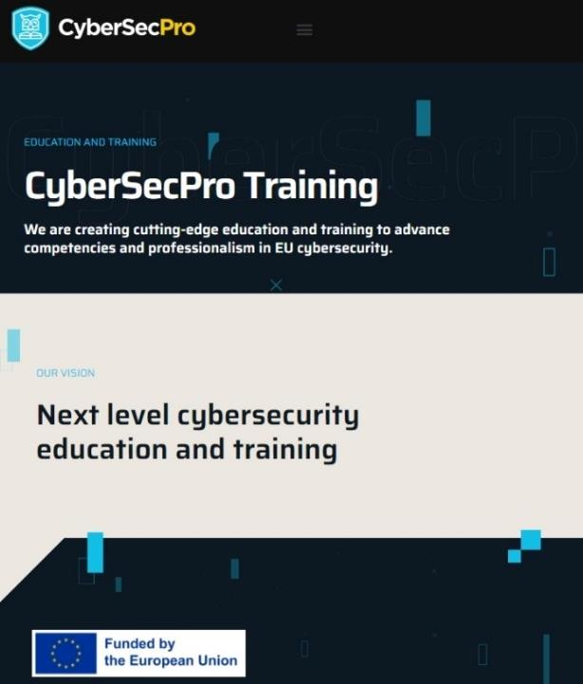
Digital Forensics for Maritime
CSP0012_S_M
Presentation by: Bruno BENDER

Slide 2
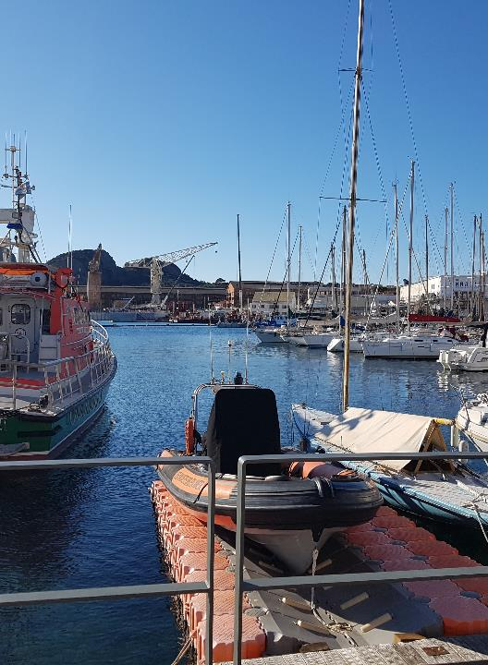

Digital Forensics for Maritime
o1.
Introduce Digital Forensics for Maritime to Students
o2.
Annual course in June (Dunkerque - Toulon)
o3.
Cyber risks and Forensics for Maritime
o4.
Legal, technical, organizational Risks on specific maritime systems will be described
o5.
A complementary AIS Based Systems on-hands practice will be made available if wished
o6.
Student should be familiar with the Maritime operations and / or systems
o7.
C2B Consulting
115 rue du maréchal Foch –F83.200 LE REVEST – France

Slide 3



Goals: Who-What-Why you need to take this training
WHO
WHAT
WHY
WHO can attend the training modules and profiles of the attendees
Foundational of cybersecurity essentials and management for managers, leaders and working-professionals
Equipping participants with the knowledge and skills necessary to make a strategy to protect critical systems and data

Slide 4



CSP Training Logistic: CSP0012_S_M_Digital Forensic for Maritime
WHEN
WHERE
HOW
Time schedule: Autumn 2024
ONSITE-Location Information
Delivery Method

Slide 5
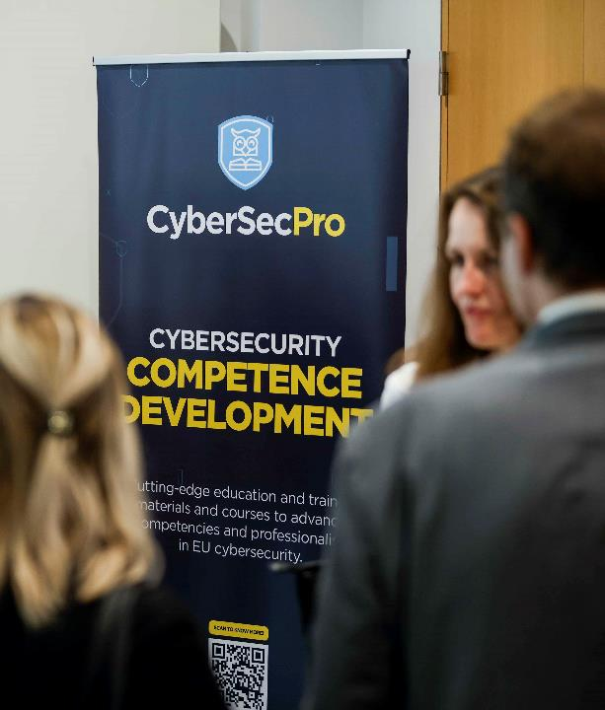
Value Propositions
Benefits to Participants
Level of Training Module: Basic / Advance
Cybersecurity Professional Training
Hands-on and Practical Skills Development
Rooted with European Cybersecurity Skills Framework
Cutting-edge insights from industry-academic experts
Certificate of the completion
Helps with skills development and career advancement

Slide 6
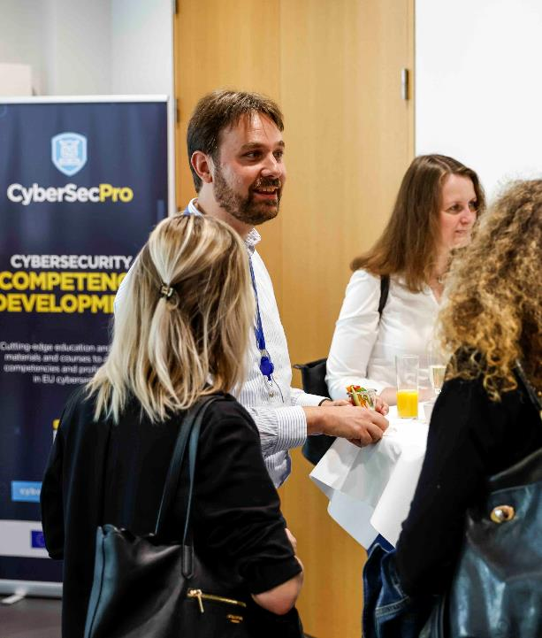
WHO
Profile of Training Participants
Managers and Leaders
Working-life professionals
SMEs and Public Sector Employees
Cybersecurity practitioners and enthusiasts

Slide 7
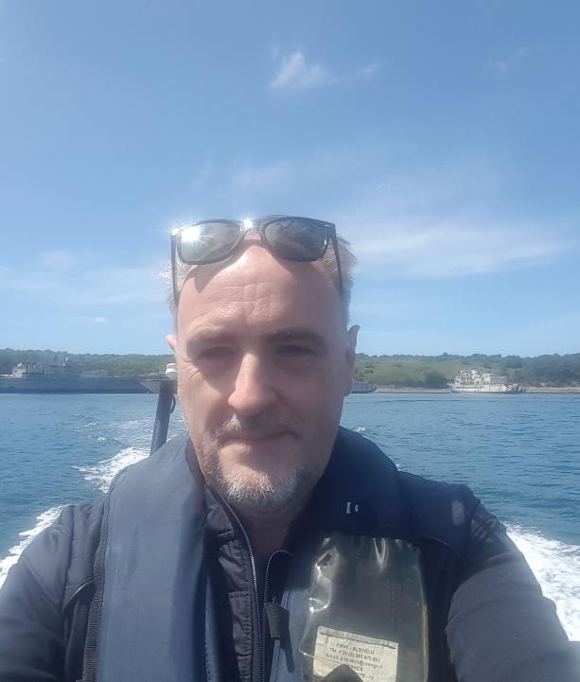
WHO
Profile of Trainer
Bruno BENDER
C2B CONSULTING
Former Navy Officer / CIS specialist
Information Security officer
  NATO
  Nationally
  EU
Since 2017 founder of C2B
  SME specialised in Maritime security / Cybersecurity

Slide 8
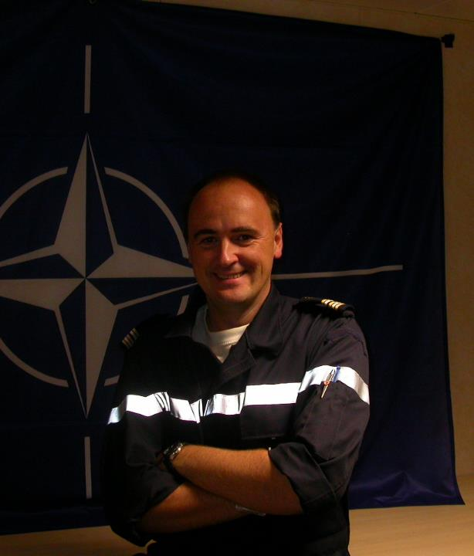
WHAT
Training Topics
Threats and vulnerabilities
Legal aspects of Maritime
Cybersecurity threat Intelligence specific to maritime
Information Security Governance (ISG) and Information Security Risk Management (ISRM)
Security Architecture Design and Implementation
Security Controls Selection and Implementation

Slide 9
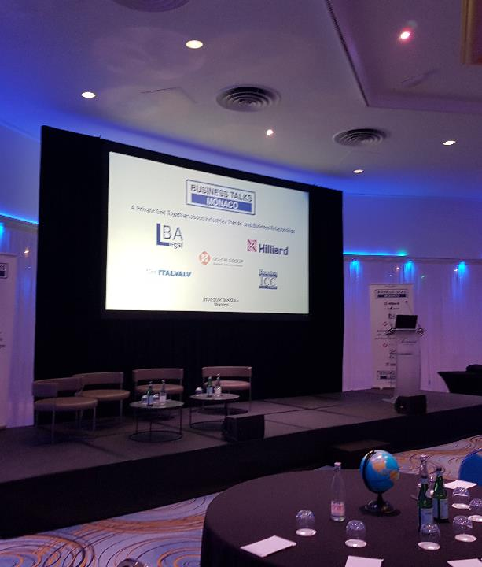
WHY
Learning Outcomes
Demonstrate ethical and professional conduct in all aspects of information and cybersecurity management.
Comprehend and articulate the key concepts and principles of information and cybersecurity.
Understand the evolving cyber threat landscape and the diverse range of cyberattacks.
Identifies the cybersecurity threats, vulnerabilities, and risks to an organisation.
Recognises the human factor's role in cybersecurity breaches and risk mitigation strategies.
Ability to help and select appropriate security controls to protect against identified cybersecurity threats and risks.

Slide 10

Training Outline
Day-1
Topic-1: Legal aspects
Maritime environment
Cyber laws and regulations
Analigies between Maritime and Cyber regulatory frameworks
Topic-2: Risk in the maritime domain
Specificities of maritime Systems
Administrations and Cybersecurity
Topic-3: AIS forensics.
AIS spoofing use case
ELBA use case
DEU Police AIS Spoofing

Slide 11
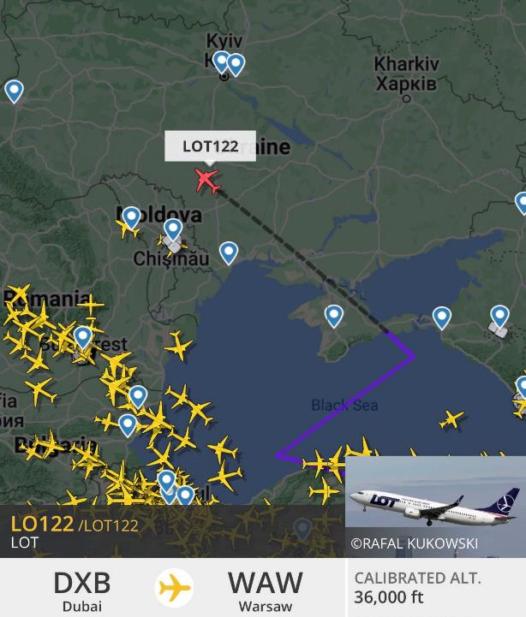
Topic-1: Legal Framework
We will cover these skills
Introduction to legal and regulatory aspects of the maritime domain : This part will detail laws and regulations that govern maritime digital security in the maritime environment and its specificities..
Legal and regulatory requirements: This section will discuss the legal and regulatory requirements that apply to the maritime, such as the General Data Protection Regulation (GDPR) and NIST directive (V2).

Slide 12

Topic-2:
Cybersecurity Risks in the Maritime Domain
We will cover these skills
Introduction to information security: This section will introduce the concept of information security and its importance to organisations. It will also discuss the different types of information assets that need to be protected, as well as the different threats and vulnerabilities that these assets face.
Introduction to cybersecurity: This section will focus on the specific threats and vulnerabilities that exist in the cyber domain. It will also discuss the different types of cyber attacks that can be launched, as well as the different ways to mitigate these attacks.
The CIA triad: This section will discuss the three pillars of information security: confidentiality, integrity, and availability. It will explain what each pillar means and why it is important.
Other security models: This section will discuss other security models that can be used to protect information assets. These models include the NIST Cybersecurity Framework, the ISO/IEC 27001 standard, and the COBIT framework.

Slide 13
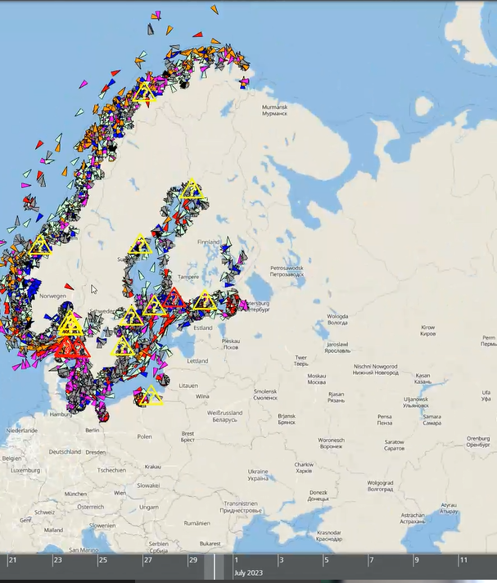
Topic-3:
AIS Forensics
We will cover these skills
1. Attacks on AIS: It covers the different types of attacks and the methods used to avoid or defend against them. It includes topics such as:
2. Systems Security: It covers the security of Automatic information system (AIS), including hardware, software, and networks.
3. Software and Platform Forensic investigations after an attack: including;
  Deployment of solutions
  Analysis of proofs
  Investigations and lessons learned

Slide 14

Evaluation method
Outline the evaluation elements and assessment process
Evaluation Element | How | Notes
Multiple Choice Quizzes | Online Quizz
Applied Tasks (Individual) | Problem solution to be submitted
Teamwork | Team project to submitted later
Group discussion | During workshop
Quizz | At the end of the session | X

Slide 15

Background Knowledge and Prerequisites
Background knowledge:
Basic understanding of computers and networking
Familiarity with common internet Maritime security threats and vulnerabilities
Awareness of cybersecurity
Prerequisites:
Knowledge on Maritime systems
Legal inceptive knowledge – Mariitime Law UNCLOS

Slide 16

Technical Tools and Other Requirement
Technical Tools
Computer with Internet Access
Web Browser and Cloud Computer Access
Office Software:
Other Requirements
Knowledge of Basic Computer Concepts / Awareness of Internet Security Practices / Willingness to Learn and Experiment / Active Participation

Slide 17

Resources: Books & Reference Materials
[1] ITU Recommendation ITU-R M.1371-4 (04/2010) - Technical characteristics for an automatic identification system using time-division multiple access in the VHF maritime mobile band.
[2] International Electrotechnical Commission International standard IEC61097-14 Ed 1 (02/2010) - Global maritime distress and safety system (GMDSS) – Part 14: AIS search and rescue transmitter (AIS-SART) – Operational and performance requirements, methods of testing and required test results
[3] IEC62320-1, Ed 1 (2007) - Maritime navigation and radiocommunication equipment and systems — Automatic Identification Systems (AIS) — Part 1: AIS Base Stations — Minimum operational and performance requirements, methods of testing and required test results
[4] IEC62320-2 Ed 1 (03/2008) - Maritime navigation & radiocommunication equipment & systems – Automatic identification system (AIS) – Part 2: AIS AtoN Stations – Operational & performance requirements, methods of testing & test
[5] UNCLOS

Slide 18
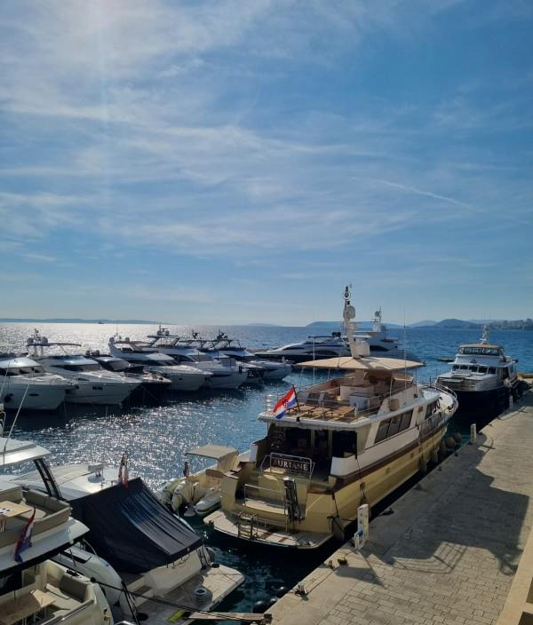
Assets & Threats
Maritime
Harbours & Maritime Stakeholders

Slide 19
Maritime Framework – Legal (International)
IMO RESOLUTIONS
MSC.428(98) (16 June 2017) MARITIME CYBER RISK MANAGEMENT IN SAFETY MANAGEMENT SYSTEMS:
an approved safety management system should take into account cyber risk management
Administrations should ensure that cyber risks are appropriately addressed in safety management systems 01 January 2021 (Survey ?)
Particular systems that should be considered:
Bridge systems
Cargo handling and management systems
Propulsion and machinery management and power control systems
Access control systems
Passenger servicing and management systems
Passenger facing public networks
Administrative and crew welfare systems
Communication systems
Incident Notification requirements
- Specific criteria/thresholds for incident notification

Slide 20



Maritime Framework – Legal (EU) - Reminder
 | Reference | User | Net | SI | Who is concerned | Preventive measures | Ability to defend | Reconquest (Judicial)
C I (Nations : after- 2013) | Directive 2005/65/EC National regulation | +++ | ++ | +++ | Ports Cable Oil & gaz HAZMAT and their critical systems | EU has identified ports as critical infrastructure” Port = specified area of land and water, with boundaries defined by the MS, containing works and equipment designed to facilitate transport operations | Event Logging and Ability to Analyze Logs Probes to systems (State or qualified service provider. ANSSI permalink Crisis management | Retention of technical records for 6 months
OES (NIS – 2018 - 22) | Dir (EU) 2016/1148 of the European Parliament and of the Council (6/07/16 - measures to ensure a level of security of systems and networks | 0 | +++ | ++ | OES List provided by Nations (harbours, Maritime Companies) | List of essential services Political and technical governance. Network and IS protection. PM Decision Controls, Standards Cloud Provider Rules | Defense of networks and information systems; Use of hardware/software devices or IT services that have been certified for security. Reporting incidents to the National Security Agency. | Business resilience.
Data (GDPR-2018) | EU Regulation 2016/679 - 27/04/16 data - physiical person protection Regulation | +++ | 0 | ++ | Entity managing personal data (Ferry transport agent) | Protection of fundamental freedoms in the digital world (erasure and data portability. | Protected systems and networks at the level to prevent loss of control of personal information | Possible recourse to CERTs in the event of data loss/leakage.

Slide 21
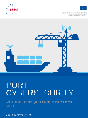
Maritime Framework – Technical
Digitalised Harbor
Interactions
SEA
PORT INFRASTRUCTURE
Docks, Basins, Sloops, Signalling, Locks,...
Local authorities
CUSTOMS
PORT
DOCKSIDE / ANCHORAGE RECEPTION SERVICES
Steering, towing, mooring, connections, protection/safety, dredging
POLICE
LOADING/UNLOADING SERVICES
Cranes, gantries, ducts, walkways/cutters
COAST GUARD
PORT STORAGE
Silos, hangars, tanks, fridges, car parks, passenger areas (terminals, lounges, restaurants, press point, etc.)
FIREMEN
DISTRIBUTION & TRANSFER NETWORKS
CIVIL SECURITY
Terminals
Bulk
Terminals
Containers
Terminals
Hydrocarbons
Terminals
Fishing
Terminaux
Ro-ro
Terminals
Passengers
Waterways
SAFTEY
Routes
Distribution infrastructure: Road, bridges, rails, pipelines, high/low voltage networks
HINTERLAND
EMERGENCY
Railways
SERVICES
DE SOUTIEN
Cargo Tracking
Vessel traffic control
Protection and security
MARITIME AFFAIRS
Pipes
Endpoint Management
Port Maneuver Management
HAZMAT
Sanitary facilities
Facility Management
Maintenance management
Port Authority
IMMIGRATION SERVICES
PROTECTION & SECURITY
Communications, broadcasts/alarms, cameras, radars, access protection, sensors/detectors,

Slide 22
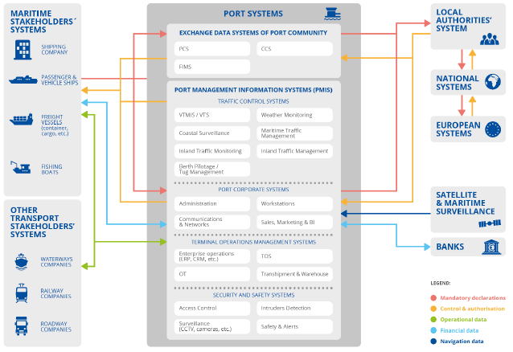
Marine Systems
Shipping companies
Passenger transport
Freight
Transport
Fishing
PORT SYSTEMS
Authorities
Port data exchange systems
Port Community System
Cargo Community System
Fishery Information manag. System
National systems
Port Information Management System (PMIS)
Traffic Management System
European Systems
Port systems
VTS / VTMIS
Coastal surveillance
Maritime Traffic Management
Inland navigation management
Port management
Internal Port Management System
Satellite Systems (GNSS, Monitoring)
Other systems
River transport
Rail transport
Road transport
Administration
Workstations
Network and Communications
Commercial services
Systèmes de gestion des opérations
Banks
OPS LOG
(ERP, CRM)
Term. Oper. System (TOS)
OT
Loading / Unloading
Protection et sécurité
Mandatory declarations
Permissions and Controls
Operational data
Financial data
Browsing data
Access control
Detection systems
CCTV, caméras,..
Alarms
Notes:
ERP: Enterprise Resource Planning

Slide 23
What objective for Attackers?
Information Assurance
Information is not disclosed to system entities (users, processes, devices) unless they have been authorized to access the information
Confidentiality
KY
The property whereby an entity has not been modiﬁed in an
unauthorized manner.
Integrity
ACCESS CTRL / RIGHT
Being accessible and useable upon demand by an authorized entity.
Availability
PCA/PRA
Assurance that the sender of information is provided with proof of delivery and the recipient is provided with proof of the sender’s identity, so neither can later deny having processed the information.
Non-
Repudiation
D.SIGN
PWD
Verifying the identity or other attributes claimed by or assumed of an entity (user, process, or device), or to verify the source and integrity of data.
Authentication
Notes:
Confidentiality: Safeguarding data from unauthorized access ensures that only authorized individuals can access and view sensitive information. Encryption, access controls, and secure communication protocols play a pivotal role in maintaining confidentiality.
Example: An organization implements strong encryption protocols to protect customer data during transmission. To keep your data locked away from prying eyes, organizations employ advanced encryption algorithms like AES (Advanced Encryption Standard) or RSA (Rivest-Shamir-Adleman).
These algorithms act like digital bodyguards, ensuring that even if someone manages to intercept your data, it's like reading a jumble of secret code.
Integrity : Maintaining data integrity ensures that information remains accurate, complete, and unaltered throughout its lifecycle. Techniques such as data validation, checksums, and digital signatures are employed to detect and prevent unauthorized modifications.
Example: A financial institution employs data validation techniques in its banking systems.
When you make a transaction, the system is there to safeguard your data's integrity. It carefully checks if everything matches the rules and criteria in place.
If anything seems off, like an incorrect account number or an unusually large transaction amount, the system steps in as a protector and blocks the transaction. This ensures that your data remains accurate and shielded, preserving the trustworthiness of your information.
Availability: To ensure information availability, resilient systems and processes are crucial. This information assurance model component checks on backup and disaster recovery strategies, redundancy measures, and proactive monitoring.
Example: an e-commerce website ensures uninterrupted service by employing multiple synchronized servers and a load balancer. This smart setup evenly distributes incoming requests, preventing disruptions caused by server failures or sudden traffic surges.
As a result, customers can seamlessly browse, shop, and complete transactions, even during peak times or when a server encounters issues.
Non-Repudiation : Non-repudiation ensures that the origin and integrity of data cannot be denied by the sender. Digital signatures, audit trails, and timestamping mechanisms are utilized to provide evidence of the authenticity and integrity of digital transactions.
Example: An organization implements a digital signature mechanism in its document management system. A distinct cryptographic signature is generated and added to the document when it is digitally signed by an authorised user. This signature prevents the signer from later disputing their involvement in the document by providing proof of the document's integrity, legitimacy, and identity.

Slide 24
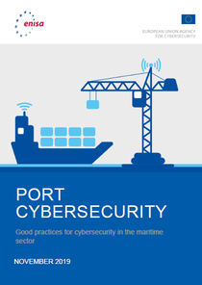
Functionnal areas
(CYBERSECPRO Taxonomy)
Privacy and Data protection
Human aspect of cybersecurity
Cybersecurity Risk management
Cybersecurity Threat management
Cyber Incident Response
Tools and Technology
Penetration testing
Network and Communications security
Cybersecurity Management
Cybersecurity Policy, Process, Compliance

Slide 25
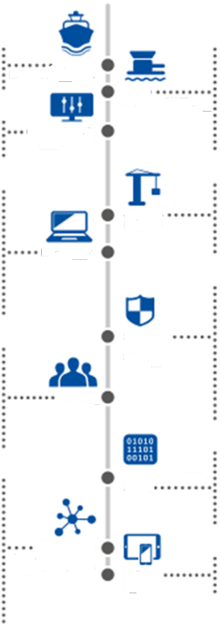

Assets
Asset
Taxonomy
Post Service Ships
Special vehicles
Physical floating barriers
Industrial Control Systems (ICS)
ICS Communication Network & Components
Port Community systems (PCS)
Cargo Community Systems (CCS)
Fisheries Information Management Systems (FIMS)
Port Coporate syste,s
Terminal Operations Management Systems
VTS / VTMIS
Berth management Systems
Port Authority Staff
Permanenent Commercial Staff
IT/OT Staff
External Staff
Ship Crews
Passengers
General Public
Mobile
Infrastructure
Seaside Connectivity
Port infrastructure
Buildings
Energy
Waste treatment Systems
Hinterland connectivity
Safety & Security
Port Facility specific Layout
Vessel berthing
Vessel loading and unloading
Temporary storage
Hinterland Connectivity
Detection systems
Emergency Communication systems
Access control systems
Traffic monitoring systems
Surveillance & Inspection systems
Evacuation Systems
Identification Systems
Alerting Systems
Fixed
Infrastructure
OT Systems
& Networks
OT End
Sevices
IT Systems
Safety &
Security
Systems
People
Information &
data
Network &
Communication
Components
IT End
Device

Slide 26
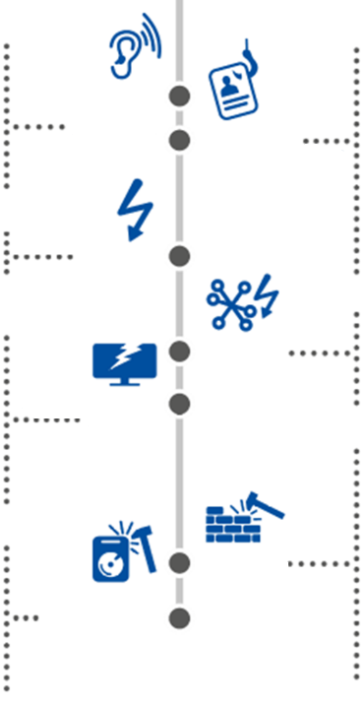
Threat Taxonomy
Threats
Maritime Domain Threats
Interception of emissions
Interception of sensitive
information
Man in the middle! session
hijacking
Network reconnaissance
Network traffic manipulation
Environmental disasters
Natural disasters
Use of unreliable source
Erroneous administration of IT! OT systems
Resulting from penetration testing
Data deletion
3rd party security failure
Information leakage
Systems
Devices
Navigation and communication
systems
Main supply systems
Failure or disruption of service
providers
Denial ot Service [DoS)
Malware
Brute force
identity theft
Phishlngf Social engineering
Targeted attacks
Abuse and theft of data
anipulatlon of information
Geolocalisatlon signals
Spooﬂng / jammlng
Main supply outage
Network outage
Absence of personnel
Loss of support
Fraud
Sabotage
Vandalism
Theft
Unauthorised access
Terrorism
Hacktivism
Coercion, extortion or
corruption
Piracy! illegal crime} Mafia
Eavesdropping
Interception
Hijacking
Nefarious
Activiy & abuse
Disaster
Outage
Unintentional
Damage
Physical
Attacks
Failures &
Malfunctions

Slide 27

Course progress
o1.
Maritime systems / AIS / GNSS
o2.
Use Case 1
o3.
Use Case 2
o4.
Anaysis
o5.
Lessons Learned

Slide 28
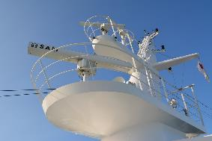
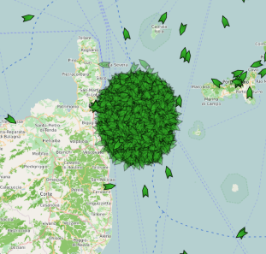
AIS & CYBERSECURITY FOCUS
Jamming / Spoofing Detection
  Nautical training on redundancy
  Best management practices
  Development of technical equipment
Outcome : How can we protect our activities and detect illegal activities?
IT Security Concept (Vessels)
  Holistic approach
  How to protect shipborne Computer systems
  Best management practices
Outcome : How can we enhance IT Security and Information assurance

Slide 29
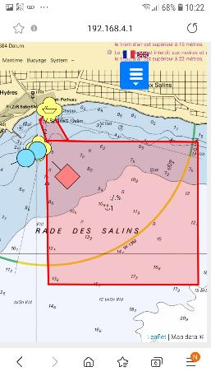
AUTOMATIC IDENTIFICATION SYSTEM (AIS)
AIS AIM
AIS is primarily a collision avoidance system . Due to the limitations of VHF radio communications, and because not all vessels are equipped with AIS, the system is meant to be used primarily as a means of situational awareness and to determine risk of collision rather than as an automated collision avoidance system, in accordance with the International Regulations for Preventing Collisions at Sea (COLREGS).
While requirements of AIS are only to display a very basic text information, the data obtained can be integrated with a graphical electronic chart or a radar display, providing consolidated navigational information on a single display.
AIS is a LOS coastal tracking system used on ships and by Vessel Traffic Services (VTS) to identify and locate vessels by automated data exchange with other nearby ships and VTS stations. Information such as unique identification, position, course, and speed can be displayed on a screen or an ECDIS

Slide 30


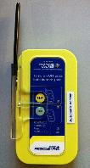

What is AIS ?
Objective : AIS & CPA
Solutions
AIS - SART
T/R VHF Marine JHS-800S
With ASN Function
Architecture

Slide 31
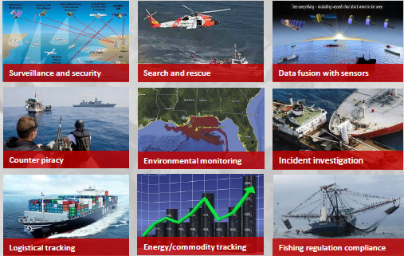
AIS / GNSS – Users and use
Public administrations
Surveillance et security
SAR
Intelligence
Public
Private
Counter-piracy
Environment
Inquiry
Private
Logistics
Oil & Gaz
Fishery

Slide 32




AIS Transponder – How does it Work ?
AIS Transponder
Most popular AIS devices
Class A: T/R all Messages
Class B: T/R limited Messages
Warship AIS : Encrypted (military)
GNSS / VHF
Antenna
Class B
Transponder
Display
Optical Range formula
VHF waveform
Maritime Spectrum
Robust
LOS
Low Bandwidth
R
H
h
Range (Nm) = 2,2 ($\sqrt{H(ft)}+ \sqrt{h\left(ft\right)})$
Example:
1 / How far can I see a 20 m high vessel if I am on a 100 m high tower
2/ How far can I see a 20 m high vessel if I am on the beach
1 ft = 0,305 m
1/ 102 km
2/ 34 km

Slide 33



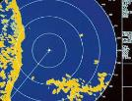

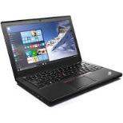
AIS / GNSS – Interconnexion / Intrusion Points
GPS Antenna
VHF Antenna
NAV (ECDIS, ARPA)
Navigation Aid functions
AIS
Transponder
Display of data on digital Map
User Interface
HMI
Update
Loch
AC / DC
Monitoring of alarms
Compass
(very unlikely)
CCV

Slide 34
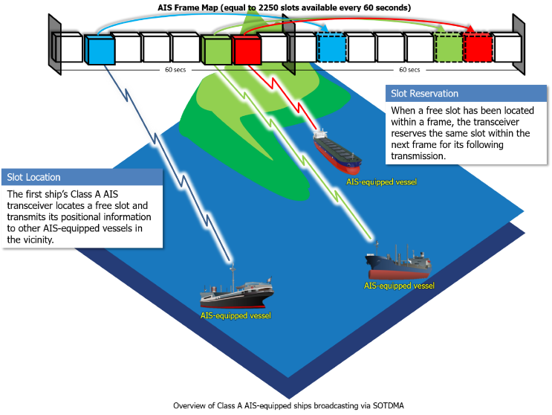
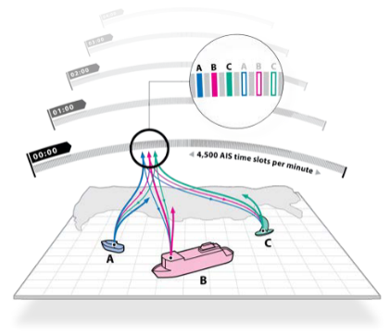
Communication Principles – TDMA 1/2
AIS Frame Map (equal to 2250 slots available every 60 seconds)
Slot reservation
When a free slot has been located within a frame, the transceiver reserves the same slot within the next frame for its following transmission.
Slot Location
The first ship’s Class A AIS transceivers locates a free slot and transmits its positional information to other AIS equipped vesselsin the vicinity.
Slots are available on 2 frequencies
  - F1 : 2250 slots
  - F2 : 225 slots
Overview of a class A AIS-equipped ships broadcasting via SOTDMA

Slide 35
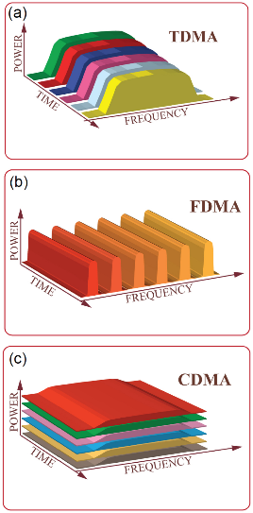

Communication Principles – TDMA 2/2
TDMA: the users share the same frequency at different time slots.
FDMA: different frequency bands are assigned to different data-streams.
CDMA: the entire spectrum is utilized to encode the information from all users, and different users are distinguished with their own unique codes. Each user in the network is represented by a different color.

Slide 36

TDMA application to AIS
Each time slot represents 26.6 ms
Ship A sends a PSN MSG in a time slot, reserving another slot for the next PSN message
The same procedure is repeated by all other AIS-equipped ships.
Ship B
Ship C
Ship A
Emissions alternate on two identified channels (AIS1 & AIS2)
In most areas Channels 87 B (161.975 MHz) & 88 B (162.025 MHz) are used for both AIS1 & AIS2.
Some countries have enforced other channels to avoid interference with pre-existing non-AIS services.
Shore station commands automatically request ship transponders which frequencies to use for AIS1 & AIS2, avoiding any channel adjustment by operators.

Slide 37
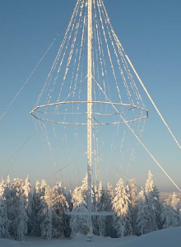

TDMA Services used in AIS
SAR
SART
AtoN
Class A
Class B
Class B SO
Base
Station
Not Yet
defined
Nodified
SOTDMA
(PATDMA)
FATDMA
RATDMA
SOTDMA
RATDMA
ITDMA
CSTDMA
SOTDMA
RATDMA
ITDMA
FATDMA
RATDMA

Slide 38
Le gal Framework
UNCLOS
United Nations Convention of the law of the seas

Slide 39



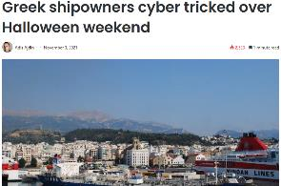
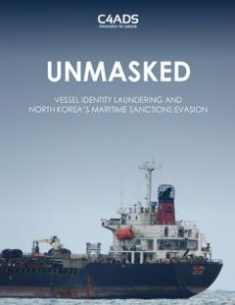


The Cybersecurity Risk Threats
Objectives
Avoid Concurrence
Hide illegal activities (Dark fleet Bunkering, Truck driver)
Deny use of systems (GNSS)
Risk
Employee
Driver
Concurrent
Greek Shipowners cyber tricked over Halloween weekend
Rogue
States
GNSS
Jamming
Criminal
Entreprise
GNSS Spoofing
AIS Spoofing
In Port
worldwide
IVO identified
Coastline,
choke points
IVO Ports
Occurrence
/ Location

Slide 40

2022 Kaliningrad
GNSS Spoofing
Jamming
Observed Attacks & incidents
2022 – 24 B. Sea
AIS Spoofing & Jamming
War area
April 2021
(Bourbon)
DoS
Activity
Trust
May 2021
(Colonial Pipeline)
DoS
Image
Activity
Activity
Trust
Trust
Activity
Image
Image
Trust
Image
Jul 2021
(5 M/V GoO)
AIS/GNSS Spamming
2021
(CMA-CGM)
CCS Attack
Activity
Trust
Activity
Image
Trust
2022 - 24
Greece
AIS Jamming
Jul 2021
Tokyo Marine (Insurance)
Data Leakage
Image
May 2021
(VNF)
DoS
Activity
2021 - 24 Syria
AIS / GNSS Spoofing
Trust
Activity
Impact
Image
High
Activity
Trust
Trust
Activity
Image
Trust
Medium
Trust
Trust
Trust
Limited
Image
Image

Slide 41

Jamming at Sea
Source : UNCLOS
Article 109
Unauthorized broadcasting from the high seas
1. All States shall cooperate in the suppression of unauthorized
broadcasting from the high seas.
2. For the purposes of this Convention, "unauthorized broadcasting"
means the transmission of sound radio or television broadcasts from a ship or installation on the high seas intended for reception by the general public
contrary to international regulations, but excluding the transmission of
distress calls.
3. Any person engaged in unauthorized broadcasting may be
prosecuted before the court of:
  (a) the flag State of the ship;
  (b) the State of registry of the installation;
  (c) the State of which the person is a national;
  (d) any State where the transmissions can be received; or
  (e) any State where authorized radio communication is suffering
  interference.
4. On the high seas, a State having jurisdiction in accordance with
paragraph 3 may, in conformity with article 110, arrest any person or ship
engaged in unauthorized broadcasting and seize the broadcasting apparatus.

Slide 42
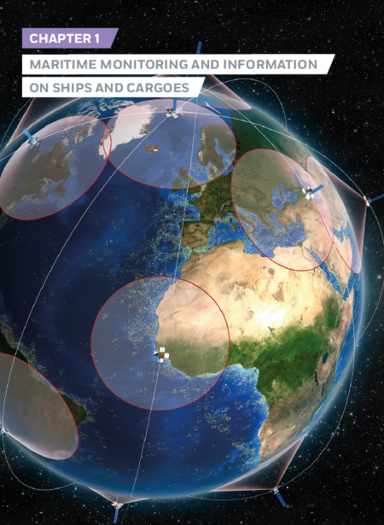
AIS ARCHITECTURE & USE CASES
Technical Description
Use cases – Spoofing
Forensic evidence capture

Slide 43
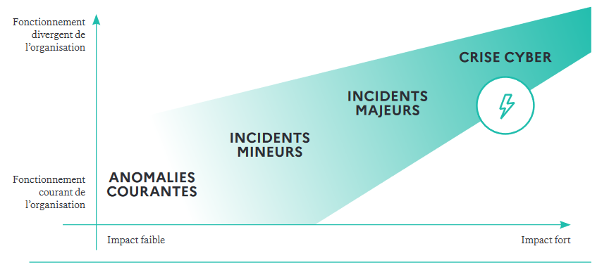

The road towards a major Cyber crise
Exceptional functioning of the Entity
Collection of Evidence
Cyber Crise
Major Incidents
Minor Incidents
Normal Daily Routine of the Entity
Daily Incidents
Low Impact
High Impact

Slide 44
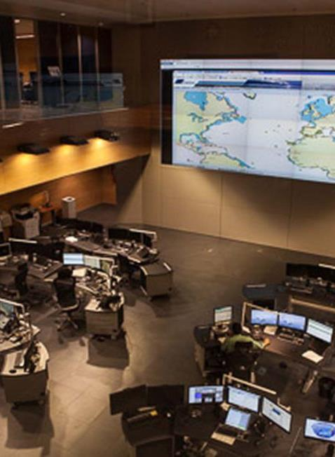
Course progress
o1.
Maritime systems / AIS / GNSS
o2.
Use Case 1
o3.
Use Case 2
o4.
Anaysis
o5.
Lessons Learned

Slide 45
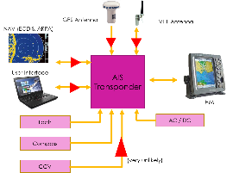
AIS – interfacing modules and standards
GPS antenna
VHF antenna
Coaxial
GNSS signal quality analyser
Internal
Display Control
Unit
Management systen
Other connexions (CCS, CNY, ECDIS)
AIS message authenticity analyser
NMEA
serial
Evidence capture
AIS
CPU
Management System
Evidence capture
serial
NMEA
ETH
Web
services
Web
services
ETH
Port Control / Track table conrol
serial
ETH
serial
NMEA
IP
NMEA
Means of capturing evindence
External sensors (radar / optronic)
Display

Slide 46
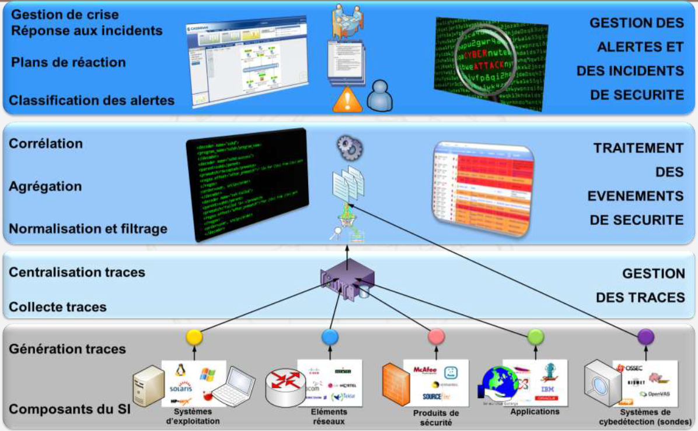
Crisis Management
Incident Response
Reaction Plan
Classification of alerts
Management of alerts and security incidents
Corelation
Agregation
Standardisation
Filtering
Management of digital Forensic
Management
Of
Security
Events
Centralising of Traces
Managing Traces
Generating Traces
CIS Components
Operating System
Network devices
Security products
Applications
Cybersecurity Devices (Sonde)

Slide 47
Course progress
o1.
Maritime systems / AIS / GNSS
o2.
Use Case 1
o3.
Use Case 2
o4.
Anaysis
o5.
Lessons Learned

Slide 48
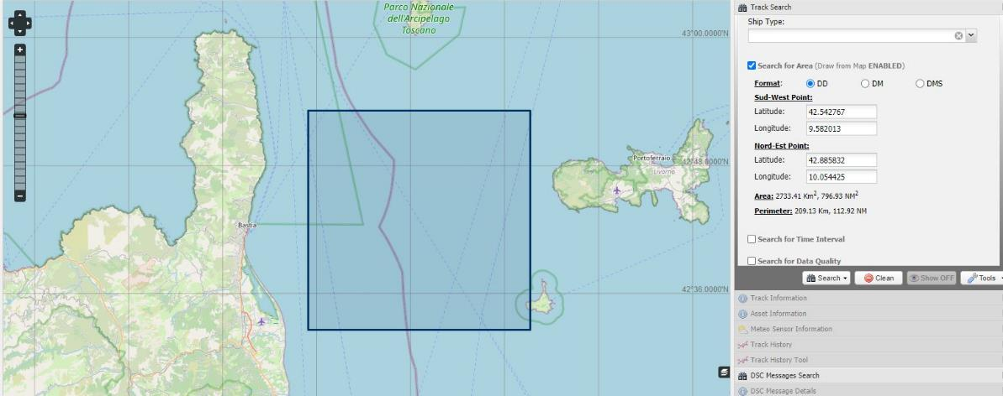
Use case 1 – Digital Forensic for Maritime
On December 3rd 2019, starting from 13:13 UTC, in the maritime area between the island of Elba and Corsica, hundreds of AIS information were received from naval units of Dutch flag, created artificially, having different identification codes, positions, routes and speeds.

Slide 49
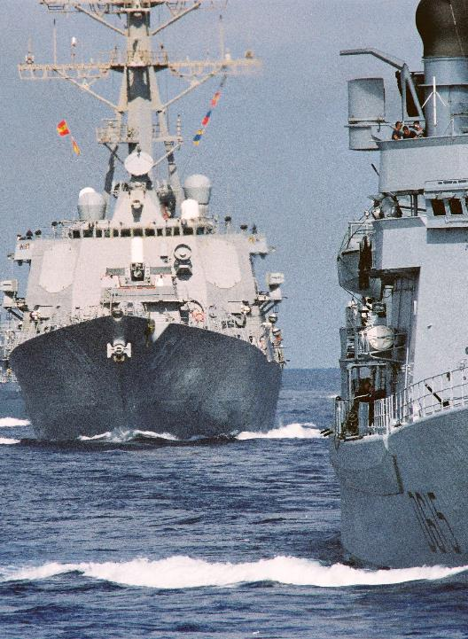
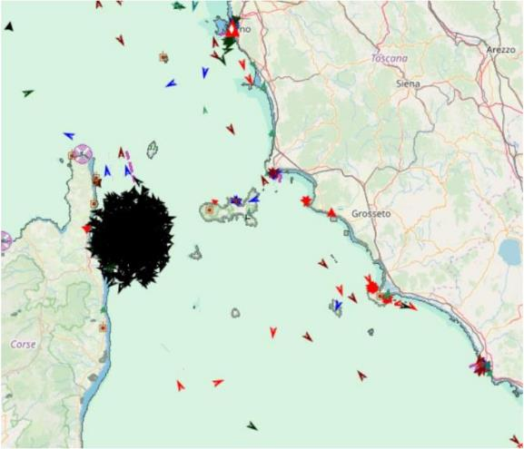
Use case 1 – Digital Forensic for Maritime
These information had completely saturated a circular maritime area with a radius of about 15 Nm. The area affected from the attack was saturated with the insertion of over 850 false targets.

Slide 50

Use case 1 – Digital Forensic for Maritime
The attack was repeated twice, at 13:13 UTC (duration 3 minutes) and at 13:28 (duration 4 minutes).
Spoofing Spoofing

Slide 51
Use case 1 – Digital Forensic for Maritime
From a first analysis, carried out mainly with a VHF Data Link Analyzer tool implemented in the authorities AIS network management application, it was possible assess that the attack:
was conducted on the radiofrequency used by AIS systems, probably through a transceiver device, even of a portable type, with low transmission power;
was received only by the National AIS Network and in particular by a Base Station located on the Elba Island (Monte Capanne), while, for example, only 20 messages were received by the French AIS network, the nearest AIS network overlapped with the national network in that geographic area;
required, from the originator, knowledge of both radio communications and AIS messages broadcasting;
was probably conducted with a radioelectric apparatus located on the Elba Island.

Slide 52

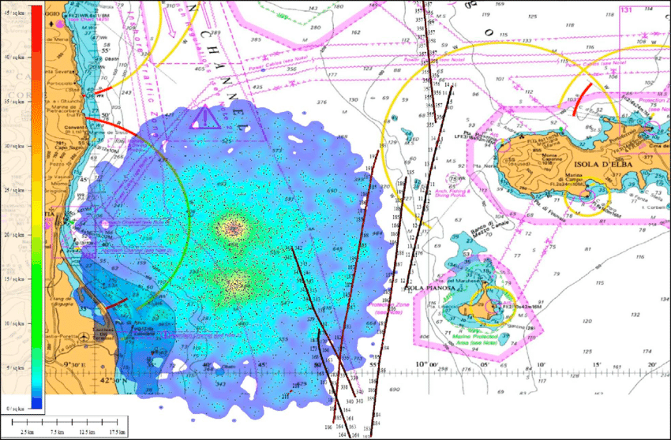
Use case 1 – Digital Forensic for Maritime
This type of attack could also have had a negative impact in terms of navigation safety, given that the high number of slots occupied for the transmission of false targets have been removed from the availability of the on-board AIS systems present in the nearby of the broadcasting station, whose main purpose is anti-collision.

Slide 53
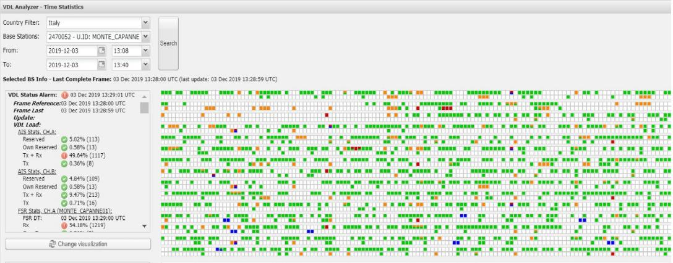
Use case 1 – Digital Forensic for Maritime
Using a VDL analyzer tool it was possible to analyze the time slot occupation during the attack: each slot is represented with a color which depends on its status - free, occupied by own reservation, occupied by other reservations, occupied by message reception/transmission - eventually in combination with each others

Slide 54
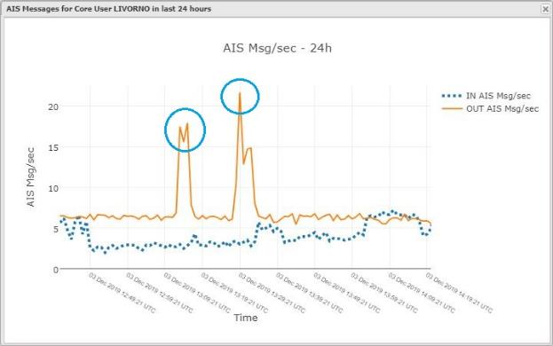
Use case 1 – Digital Forensic for Maritime
It’s probable that who issued the false messages did not necessarily want to create discomfort or problems, given the low power of the received signal and very limited reception (only one BS continuously received the synthetic signal) and maybe neither there was intentionality to create these broadcasts.
An experiment in a flat or office for demonstration purposes is not excluded.

Slide 55
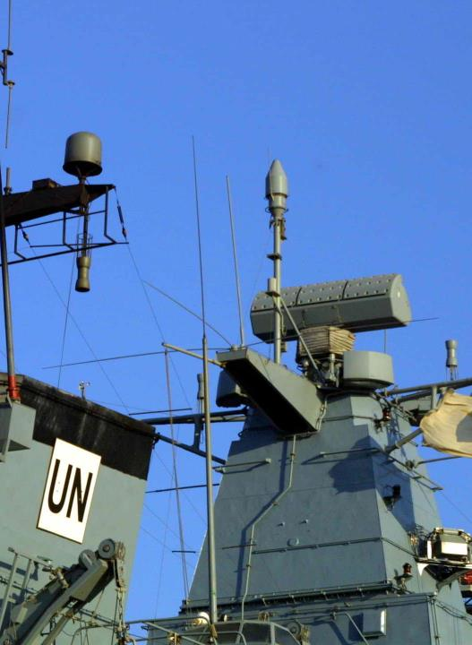
Course progress
o1.
Maritime systems / AIS / GNSS
o2.
Use Case 1
o3.
Use Case 2
o4.
Anaysis
o5.
Lessons Learned

Slide 56
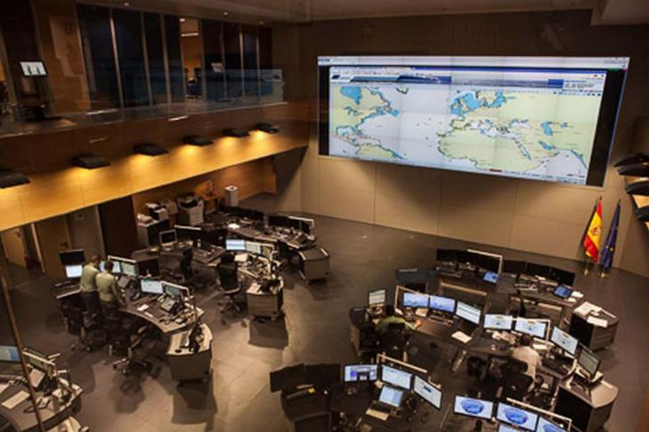
Use case 2 – Digital Forensic for Maritime

Slide 57
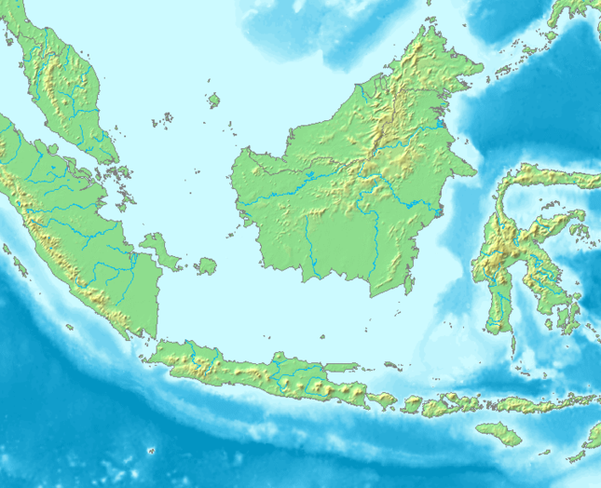






IOT AIS / T
IOT Satellite
Constellation
Satellite N
Satellite N+1
1
  The vessel has no Satellite connectivity but stores its position every 5 minutes
  Once connected to a satellite, the vessel sends its position every 5 minutes and the stored positions
1
2
2
Land AIS sites
Legend
Maritime route
Recorded AIS position
Land AIS coverage
IOT Satellite transmission slot
AIS storage period

Slide 58
Investigations
Traces
Yes
Fusion / Corelation
No
Reference Indexes
Two step Investingation process
Fusion of Information sources
The very first step to achieve is to have the most updated information sources
Enriching the identity of objects and integrating them in the Spatial Index
Compare Traces with existing Paterns of life with different surces
vendors,
AIS providers
Maritime community
  Harbors / Maritime operators
  Shipping
  Administrations
Index
Cohérence check
Viruses
Troyans
No
Yes
Identification
Update
Paterns of life (PoL)
Addition to PoL Database
IS
OS
Network Spec.
Comparaison
System Spec.
Coginitive
Track Update
Alert
Yes
Anomaly
No
Attribution Classification

Slide 59
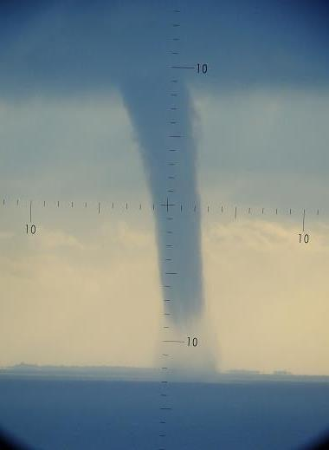
Course progress
o1.
Maritime systems / AIS / GNSS
o2.
Use Case 1
o3.
Use Case 2
o4.
Anaysis
o5.
Lessons Learned

Slide 60
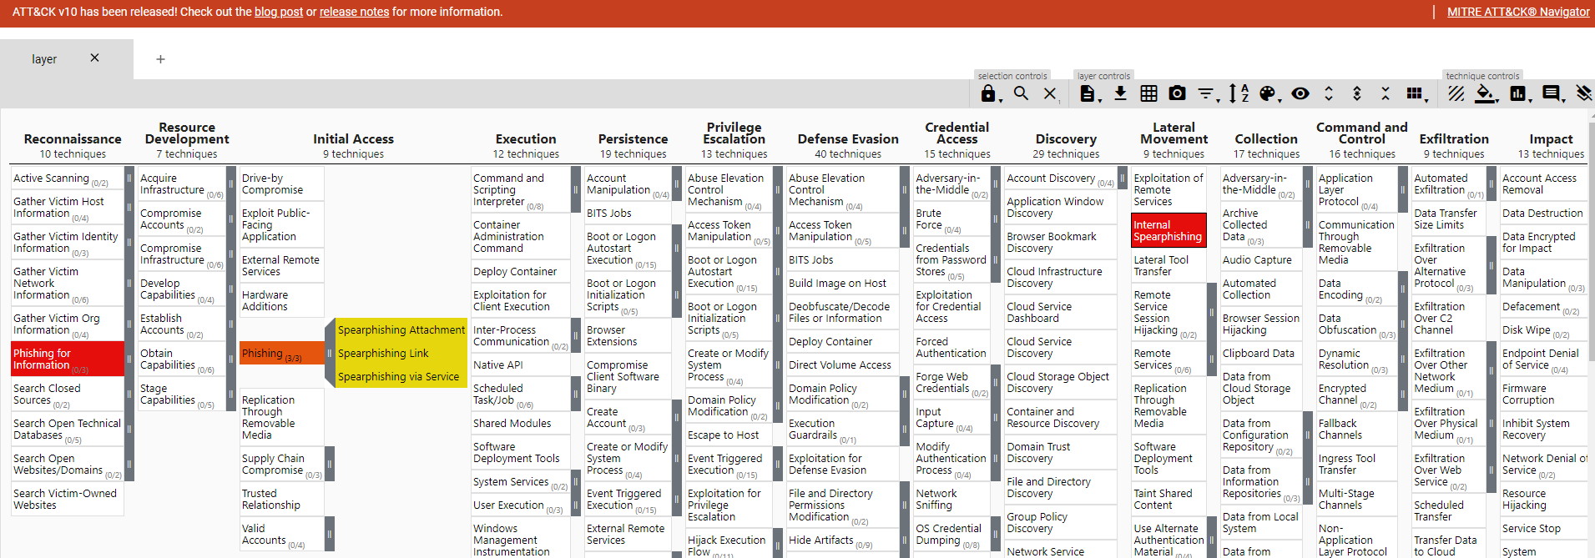
MITRE ATT&CK Navigator
Adversarial Tactics, Techniques, and Common Knowledge
Choice of an adapted framework
Notes:
What’s inside MITRE ATT&CK ransomware guide
The Mitre ATT&CK Framework is a platform providing knowledge on tracking cyber adversary tactics and techniques. It gives curated insights into the threats they use across the entire attack lifecycle. This framework works more than a collection of data, and to analyze this data, you need to use a Mitre ATTACK navigator tool.
The MITRE ATT&CK Navigator is a powerful tool for organizing, visualizing and analyzing information that is related to MITRE ATT&CK Framework. This tool can significantly help many blue teams using MITRE ATTACK Navigator for their detection and response technique. Progressing defenders can use the framework resources to understand attacks and the rules and methods for detection. The navigator tool simplifies those methods in an interactive way.
How Can MITRE ATT&CK Framework Help? MITRE created ATT&CK for documenting attack techniques that are used in adversary emulations. This common knowledge base documents tactics and techniques, reflecting real adversary behaviors. Hence, every defender should have an awareness of each tactic and technique. You can start by diving into each technique listed in the ATT&CK Matrix from left to right for self-progression. An easier way to work on them is via using the MITRE ATTACK Navigator tool.
The tool can download the Matrix of MITRE ATT&CK Framework to an Excel file. The MITRE DEFEND navigator works as an extracting tool to extract D3FEND techniques from the raw text to map them automatically to ATT&CK. Blue teams can install this tool to explore and understand the relationships between defensive tactics and techniques. MITRE DEFEND navigator knowledge base would offer you a graphical interface.
It displays the relationships between different defensive techniques and threats designed to protect against detection. By exploring these techniques, a blue team can create custom maps of defensive strategies. The MITRE DEFEND navigator is designed for cybersecurity professionals, security analysts and other professionals who want to understand and improve their organization’s defensive posture. But all these are possible due to sourcing knowledge from MITRE ATT&CK Framework Here are some benefits you get from Xcitium EDR.,
A Step-By-Step Method To Use MITRE ATTACK Navigator
You can use the MITRE ATTACK Navigator tool to identify gaps in an organization’s network security measures. The MITRE ATTACK Navigator can be used in a variety of scenarios. Some of them include adversary emulation, threat intelligence, incident response, and security assessments. In order to know how to use the tool, you need to install MITRE ATTACK-Navigator first. Now follow the below step-by-step method for using MITRE ATTACK Navigator in your security assessment:
Choose An Attack Scenario
Start with choosing a scenario use case for the navigator. The scenario could be an emulation exercise, an incident response investigation, or it could be a threat intelligence analysis.
Select A Technique Or Tactic
Once you have decided on a scenario, use the MITRE ATTACK Navigator tool to select a specific tactic or technique from the MITRE ATT&CK Framework. For instance, if you are conducting an adversary emulation exercise, choose a tactic like “Initial Access” and then select a technique for “Phishing.”
Analyze The Technique
Once you have selected a technique, explore it in detail using MITRE ATTACK Navigator. The Technique layer on the MITRE ATTACK Navigator tool would include information on the techniques, including descriptions, examples of real-world usage, and relevant mitigations. The layer on MITRE ATTACK Navigator may also include information on related tactics and techniques along with any relevant data sources and detection methods.

Slide 61
Analysis – Digital Forensic for Maritime
Even if attacks on AIS appear most times as isolated incident, the problem is a recurrent threat in certain identified crisis areas
Similar incidents are more and more often reported by security agencies and nationals coast guards all around the word.
Automatic filtering techniques are not known yet as fully available to prevent these phenomena from compromising the monitoring capabilities of maritime traffic.
The only method is an acknowledgment of the phenomenon arising from monitoring of the AIS network by technical staff who, if necessary or required, shall locally disable the affected AIS base stations.
As a consequence, these actions are more often conducted with National security / Frequency agencies.

Slide 62
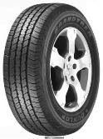
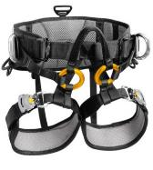
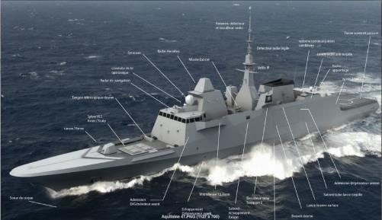
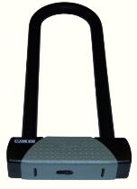


Certification – Classification - Qualification
All domain Mandatory Process
Trust
Example : All toys must comply with the requirements of the new European directive [...] thus, manufacturers, as well as importers, will have to carry out a risk analysis before manufacturing and keep the technical documentation for ten years. The risk analysis must be included in the technical documentation made available to the supervisory authorities..

Slide 63
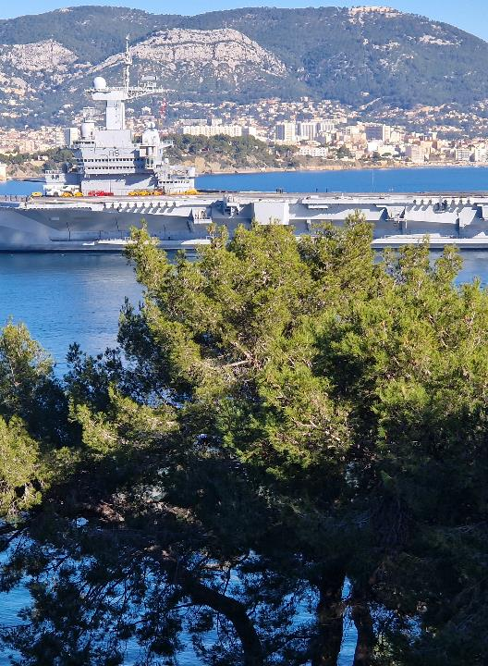
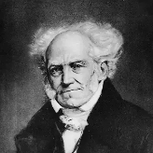
Classification / Certification / Qualification
Philosophy
What is the difference ?
What Aim in support to Forensics ?
In cybersecurity Is it better to classify or certify ?
Do we classify persons?
Do we certifiy persons ?
Notes:
Schopenhauer

Slide 64

Risk assessment / management
Risk Management approach (on a case-by-case basis)
Formalized risk analysis
Considering the appropriate level
Part of a system's lifecycle
The security process and objective (INFOSEC, Information Assurance, ….)
Don’t Mix the Approval (temporary and between parties)
and Certification (against a standard)
Qualification (for an individual mainly)
Notes:
Agrément :
Produit – reconnaissance par ANSSI que le produit évalué peur protéger des informations niveau spécifié dans les conditions d'emploi définies
Obligatoire pour les produits de chiffrement protégeant la confidentialité d’informations classifiées (IGI 1300)
Certification :
Attestation de la confiance dans les mesures de sécurité spécifiées avec cible de sécurité.
Qualification :
Certification d’un produit répondant à des exigences de sécurité validées par l’ANSSI
3 niveaux : élémentaire (CSPN), standard, renforcé

Slide 65
Accreditation
Who, How, what process, what perimeter...
SSRS specifications
What, what need, what environment (physical, legal, ...)
Threat Assessment
SECOPS
Risk analysis (EBIOS, M@RGERIDE, ISO,27 XXX,...)
Taking into account needs
Environment / Critical Asset (Physical, persons, ….)
Technical and organizational objectives

Slide 66




Certification
Evaluation and in-situ audit
Homologation :
A formal act by which an authority ensures that the system under its responsibility, in a given environment, guarantees risk control at the right level.
Notes:
C’est-à-dire acceptation des risques résiduels dans un environnement donné.

Slide 67
Risk Analysis / Response
Context
Environment
Threat Scenarii
Events
Feared
Risks
Security Response

Slide 68


Cybersecurity posture

Slide 69



Permanent cybersecurity posture
A necessary refoundation
  Back to basics : best practices
  Don’t forget legal aspects
Protection : cybersecurity by-design
  Waterproof to all comers
  Traceability and integrity of the delivered code
  Mapping and control of flows
  Pragmatism for the benefit of the forces!
Defense
  Dynamic Security Monitoring:
  Forensics : Probes and console
Business Continuity /Recovery – Resilience
  BCP / BRP
  Security status
  Continuity and Disaster Recovery Plans

Slide 70

Posture permanente de cybersécurité
Rise in power
  Quantitative
  Qualitative
  Commune
Training / Education
  Sensibilisation
  University Training
  CYBERSECPRO
TT Exercices
  Exercises on safety topics
  Disaster-fighting
  Integration into the infrastructures Skills

Slide 71
Protection
Identification / authentification
  Users, services, equipment...
  Strong authentication
Malicious code protection
  Antivirus, inbound and outbound health check
  Resistant to attack
Configure to Strictly Necessary
Flow control
  Network control
  Filtering Income / outcome
Data Protection
  Access control, surveillance (DLP, etc.)
  Data encryption

Slide 72
Defence
  Logs
  Exploitation
  Abnormal Event Testing
Safe maintenance
  Monitoring
  Update components in a formalized process
  Dynamic Security Monitoring
  Centralization of logs: single console
  Intrusion detection probes
  Correlation...

Slide 73
Permanent cybersecurity posture
Conception / design
  Controlled application of good practices
  Guarantees on the security of the delivered code
  Increased integration of the dependability logic: degraded modes
Cybersecurity Maintenance
  Security Maintenance included in the overall maintenance
  Action Tracking
  Widening the circle of trust
Cyber-resilience
  Evolving monitoring, adaptative and integrated
  Adapted training
  Crisis plans

Slide 74


Forensics
Action plan

Slide 75
ACTION PLAN – Inceptive activities
I | Raising awareness and training | STANDARD | RENFORCE
1 | Train operational teams in information systems security
2 | Educate users in basic IT security best practices
3 | Managing the risks of outsourcing
II | Know the information system
4 | Identify the most sensitive information and servers and maintain a network map
5 | Have a comprehensive inventory of privileged accounts and keep it up to date
6 | Organize procedures for the arrival, departure and change of function of users
7 | Authorise the connection to the entity's network only to controlled equipment
III | Authenticate and control access
8 | Identify each person accessing the system by name and distinguish between user/administrator roles
9 | Assign the right rights to sensitive information system resources
10 | Define and verify password choice and sizing rules
11 | Protect passwords stored on systems
12 | Change the default authentication elements on devices and services
13 | Favor strong authentication when possible
Example

Slide 76
ACTION PLAN - Prevention
IV | Secure workstations
14 | Implement a minimum level of security across the entire IT estate
15 | Protect yourself from the threats of using removable media
16 | Use a centralized management tool to standardize security policies
17 | Enable and configure the local desktop firewall
18 | Encrypt sensitive data transmitted over the Internet
V | Secure the network
19 | Segment the network and set up a partitioning between these areas
20 | S’assSecurity of Wi-Fi access networks and separation of uses
21 | Use secure protocols as soon as they exist
22 | Setting up a secure gateway to the Internet
23 | Compartmentalize the services visible from the Internet from the rest of the information system
24 | Protect your professional email
25 | Secure dedicated network interconnections with partners
26 | Control and protect access to server rooms and technical rooms
Example

Slide 77
ACTION PLAN – Preventive measures
VI | Secure administration
27 | Prohibit access to the Internet from workstations or servers used for the administration of the information system
28 | Use a dedicated, partitioned network for information system administration
29 | Limit administrative rights on workstations to the strict operational need
VII | Managing mobility
30 | Take physical security measures for mobile devices
31 | Encrypt sensitive data, especially on potentially “loseable hardware”
32 | Secure the network connection of mobile workstations used in distant scenarios
33 | Adopt mobile device security policies
VIII | Keeping the information system up to date
34 | Define a policy for updating the components of the information system
35 | Anticipate the end of software and system maintenance and limit software adhesion
IX | Supervise, audit, react
36 | Enable and configure logs for the most important components
37 | Define and enforce a backup policy for critical components
38 | Conduct regular security checks and audits and apply the associated corrective actions
39 | Designate an information systems security referent and make him known to staff
40 | Define a security incident management procedure
X | To go further
41 | Conduct a formal risk analysis
42 | Favor the use of products and services qualified by the National Security Agency
Example

Slide 78

Mitigation
Step 1 – Certification / Classification
Exemple from the Automotive
IACS (industrial automation and control systems) Unified Requirement
Cyber resilience of ships
1. Introduction
Interconnection of computer systems on ships, together with the widespread use onboard of commercial-off-the-shelf (COTS) products, open the possibility for attacks to affect personnel data, human safety, the safety of the ship, and threaten the marine environment.
Attackers may target any combination of people and technology to achieve their aim, wherever there is a network connection or any other interface between onboard systems and the external world. Safeguarding ships, and shipping in general, from current and emerging threats involves a range of measures that are continually evolving.
It is then necessary to establish a common set of minimum functional and performance criteria to deliver a ship that can indeed be described as cyber resilient.
IACS considers that minimum requirements applied consistently to the full threat surface using a goal-based approach is necessary to make cyber resilient ships.
Facts
Threat
Measures
1. This Unified Requirement is to be uniformly implemented by IACS Societies on ships contracted for construction on or after 1 January 2024 and may be used for other ships as non-mandatory guidance. In order to allow sufficient time for non-mandatory pilot application of this UR, the application date of 1 January 2024 has been selected.
2. The “contracted for construction” date means the date on which the contract to build the vessel is signed between the prospective owner and the shipbuilder. For further details regarding the

Slide 79

HANDS - ON
TRAINING
AIS /GNSS Spoofing (1)
Pentest platform (2)
RF /USB demodulation (3)
Jamming (4) – Administrations Only

Slide 80
Course progress
o1.
Maritime systems / AIS / GNSS
o2.
Use Case 1
o3.
Use Case 2
o4.
Anaysis
o5.
Lessons Learned

Slide 81

Analysis - Digital Forensic for Maritime
Use Case 1 – AIS Spoofing
One of the most basic methods of attention is to monitor AIS signals using a VHF data link (VDL) to understand if the transmitting station is using an internal or external UTC synchronization mode (sync state may be direct or indirect).

Slide 82

Analysis - Digital Forensic for Maritime
Use Case 1 – AIS Spoofing
The use of an external system can in fact be a first clue, since system spoofing is usually achieved by using an appropriately modified external GPS or a PC equipped with special software which, connected to the transmitter apparatus, alter its parameters, sending false signals.

Slide 83
Analysis - Digital Forensic for Maritime
LESSON LEARNED
Those who decide to create interference using AIS spoofing do not need to equip themselves with sophisticated equipment, requiring, on the other hand, modest investments in terms of people and resources.
Even relatively simple and inexpensive tools are often enough to be able to produce attacks that lead to the desired results.
In practice, even a single individual can pose a threat, being able to strike even from great distances, anywhere in the world where to have an access to the internet and being able to act in such a time as not to allow an effective defensive reactions.

Slide 84

Lessons Identified
Conclusions
Use case – Digital Forensic for Maritime
AIS & Safety
It becomes more and more necessary to focus the attention on this issue and raise the awareness that AIS spoofing, as well as the others similar threats, are a serious problem for navigation safety.

Slide 85

Thank you
Office hours:
M-Th 2:00pm-6:00 pm
Location : Toulon
Please send all questions to:
Bruno.bender@ventura-associate.com

Slide 86

Questions ?

