Slide 1



Data Protection and Privacy Technologies for Healthcare
CSP_005_S_H
PRESENTATION BY:
TRAINNERS NAMES

Slide 2


Slide 3


Data Protection and Privacy Technologies for Healthcare
o1.
Goals: Who-What-Why you need to take this training
o2.
Training logistics: When-Where-How
o3.
Learning outcomes
o4.
Training outlines
o5.
Exercises details
_{o6.}
Practical information and requirements
_{o7.}
Registration information and contacts

Slide 4



Goals: Educate participants about essential data protection and privacy technologies in healthcare.
WHO
WHAT
WHY
No technical background is necessary to enroll. This course covers basic and advanced topics aimed for any participant in the health sector and any cybersecurity enthusiast.
Learn the foundations of digital forensics and how they impact the health sector with real life scenarios.
Ensure understanding of regulatory compliance requirements, and foster improved management of healthcare data security.

Slide 5



CSP Training Logistic: When-Where-How
WHEN
WHERE
HOW
Time schedule: Autumn 2024
TBD
Interactive lectures, and group discussions.

Slide 6

Value Propositions
Benefits to Participants
Enhanced Knowledge of Data Protection: Gain a comprehensive understanding of data protection principles, regulatory frameworks, and privacy-preserving technologies specific to the healthcare sector.
Practical Implementation Skills: Develop hands-on experience with encryption, secure communication, access control, and health information exchange standards, enabling effective application in real-world healthcare settings.
Regulatory Compliance Competence: Acquire the ability to navigate and ensure compliance with key regulations such as GDPR and HIPAA, minimizing the risk of legal penalties and data breaches.
Improved Data Security Management: Learn best practices for managing and securing sensitive healthcare data, enhancing overall data security and protecting patient privacy.

Slide 7

WHO
Profile of Training Participants
Healthcare Professionals
Healthcare IT Staff
Healthcare Administrators
Cybersecurity Enthusiasts
Anyone willing to learn

Slide 8
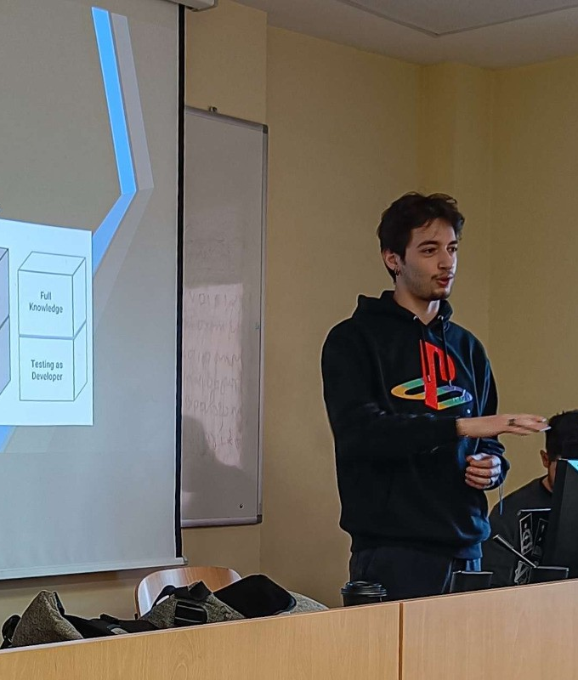
WHO
Trainer: Thanos Apostolidis
Software Developer & Security Analyst @ Zelus
Cyber Security Enthusiast
Competitive “Capture the Flag (CTF)” player.

Slide 9

WHAT
Training Topics
Introduction to Data Protection and Privacy in Healthcare
Regulatory Frameworks and Compliance
Data Encryption and Secure Communication
Health Information Exchange and Interoperability

Slide 10

WHY
Learning Outcomes
Comprehend Data Protection Principles: Understand the foundational principles of data protection and privacy, particularly in the context of healthcare, including key concepts, risks, and real-world implications.
Navigate Regulatory Compliance: Gain the ability to interpret and apply major regulatory frameworks such as GDPR and HIPAA, ensuring compliance in healthcare data management and understanding the consequences of data breaches.
Implement Security Technologies: Develop practical skills in implementing encryption, secure communication, access control, and authentication methods to safeguard healthcare data.
Facilitate Secure Health Information Exchange: Acquire knowledge and experience in setting up and managing secure and interoperable health information exchange systems, utilizing standards like HL7 and FHIR to maintain privacy and security.

Slide 11

Training Outline
Day-1
Topic-1: Introduction to Data Protection and Privacy in Healthcare
Gain an understanding of the importance of data protection in healthcare, including key concepts, privacy risks, and real-world examples of data breaches.
Topic-2: Regulatory Frameworks and Compliance
Learn about major data protection regulations like GDPR and HIPAA, their compliance requirements, and the legal implications of data breaches.

Slide 12
Training Outline:
Day-2
Topic-3: Data Encryption and Secure Communication
Explore the basics of encryption, standards and protocols for securing healthcare data, and techniques for establishing secure communication channels.
Topic-4: Health Information Exchange and Interoperability
Discover standards and protocols for health information exchange, ensuring privacy and security in interoperable systems, and analyzing successful case studies.

Slide 13

Topic-1: Introduction to Data Protection and Privacy in Healthcare
We will cover these skills
Identifying Key Privacy Risks and Threats: Understand various privacy risks specific to healthcare data and how they can impact patient confidentiality.
Defining Essential Privacy and Security Concepts: Gain clarity on critical terms such as Personally Identifiable Information (PII), Protected Health Information (PHI), anonymization, and pseudonymization.
Understanding the Importance of Data Protection: Recognize the significance of data protection and privacy in maintaining patient trust and ensuring compliance with legal and ethical standards.
Analyzing Real-World Data Breach Examples: Learn to examine real-world cases of data breaches in healthcare, identifying causes, consequences, and preventive measures.

Slide 14

Topic-2:
Regulatory Frameworks and Compliance
We will cover these skills
Comparing Key Regulatory Frameworks: Understand and differentiate between major data protection regulations such as GDPR and HIPAA, including their core components and requirements.
Interpreting Compliance Requirements: Learn to interpret and apply the specific compliance obligations of various regulatory frameworks to healthcare settings.
Analyzing Legal Implications of Data Breaches: Assess the legal consequences of data breaches under different regulatory regimes, and understand the importance of compliance to avoid penalties.

Slide 15

Topic-3:
Data Encryption and Secure Communication
We will cover these skills
Understanding Encryption Basics: Grasp the fundamental concepts of encryption, including the differences between symmetric and asymmetric encryption methods.
Implementing Encryption Standards: Learn to apply common encryption standards and protocols such as AES and RSA to secure healthcare data.
Establishing Secure Communication Channels: Gain skills in setting up secure communication channels, including TLS and VPNs, to protect data in transit.
Practicing Encryption Techniques: Acquire hands-on experience with encryption tools and techniques through practical lab exercises, enhancing the security of healthcare information systems.

Slide 16

Topic-4:
Health Information Exchange and Interoperability
We will cover these skills
Implementing Health Information Exchange Standards: Learn to apply standards and protocols like HL7 and FHIR to facilitate secure and efficient health information exchange.
Ensuring Privacy and Security in Interoperable Systems: Understand the challenges and solutions for maintaining privacy and security when integrating various healthcare information systems.
Analyzing Successful Health Information Exchanges: Study case examples of effective health information exchanges to identify best practices and common obstacles.
Configuring Secure Data Exchange Protocols: Gain hands-on experience in setting up and using FHIR for secure data exchange, ensuring compliance with privacy and security requirements.

Slide 17

Evaluation method
Outline the evaluation elements and assessment process
Evaluation Element | How
Multiple Choice Quizzes | Online Quizzes

Slide 18

Background Knowledge and Prerequisites
Background knowledge:
Basic understanding of computers and networking is appreciated but not required.
_{Prerequisites:}
None

Slide 19

Technical Tools and Other Requirement
Technical Tools
Computer with Internet Access
Web Browser Access (for final Quiz)
_{Other Requirements}
Willingness to Learn and Experiment / Active Participation

Slide 20

Registration: How to register and other practical information
The specific registration process for the Digital Forensics in the Health Sector training may vary depending on the training provider or institution. However, the general steps are typically straightforward and can be completed online or in person.
Online Registration
In-Person Registration

Slide 21

Thank you
Please send all questions to:
t.apostolidis@zelus.gr

