Slide 1



Digital Forensics in the Health Sector
CSP_012_SA_H
PRESENTATION BY:
TRAINNERS NAMES

Slide 2


Slide 3


Digital Forensics in the Health Sector
o1.
Goals: Who-What-Why you need to take this training
o2.
Training logistics: When-Where-How
o3.
Learning outcomes
o4.
Training outlines
o5.
Exercises details
_{o6.}
Practical information and requirements
_{o7.}
Registration information and contacts

Slide 4



Goals: Gain proficiency in data analysis, piece together event timelines, and deploy protective measures to avert future incidents.
WHO
WHAT
WHY
No technical background is necessary to enroll. This course covers basic and advanced topics aimed for any cybersecurity enthusiast.
Learn the foundations of digital forensics and how they impact the health sector with real life scenarios.
Participants will gain their first insights on how to protect their assets to avert future incidents.

Slide 5



CSP Training Logistic: When-Where-How
WHEN
WHERE
HOW
Time schedule: Autumn 2024
TBD
Video demonstrations and live online labs with realistic scenarios.

Slide 6

Value Propositions
Benefits to Participants
Level of Training Module: Module covers both basic and advanced scenarios.
Professional Training by security professionals
Hands-on and Practical Skills Development
Rooted with European Cybersecurity Skills Framework
Cutting-edge insights from industry-academic experts
Get hands on experience on realistic and production-like scenarios.

Slide 7

WHO
Profile of Training Participants
Managers and Leaders
Cybersecurity Professionals
Cybersecurity Enthusiasts
Anyone willing to learn

Slide 8
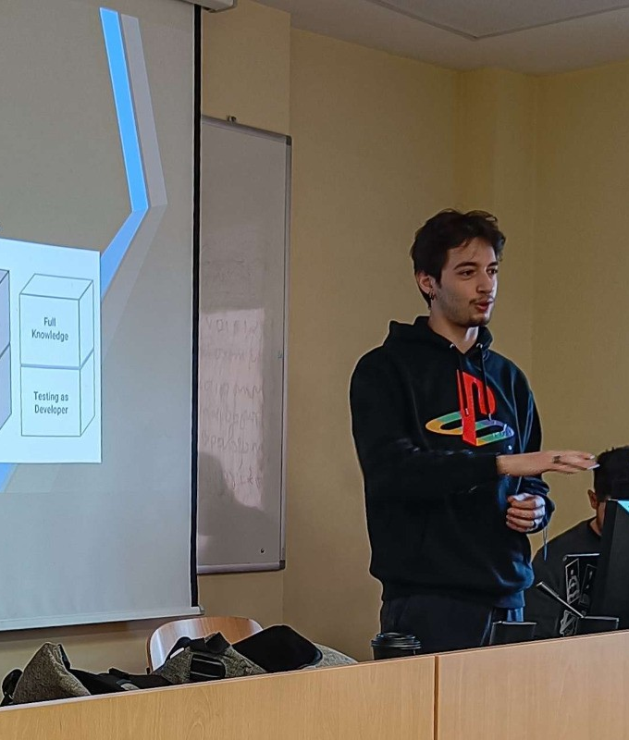
WHO
Trainer: Thanos Apostolidis
Software Developer & Security Analyst @ Zelus
Cyber Security Enthusiast
Competitive “Capture the Flag (CTF)” player.

Slide 9

WHAT
Training Topics
Introduction to Digital Forensics
Cyber Threats and Vulnerabilities in Healthcare
Use Case of a Digital Forensics Investigation
Preparation, Response and Resilience

Slide 10

WHY
Learning Outcomes
Get aware of definitions and methodologies used in Digital Forensics.
Learn about the landscape of cyber threats facing healthcare along with common vulnerabilities.
Get insights from realistic step by step demos using forensics visualization tools.
Learn best practices aiming to enhance the cybersecurity posture of a healthcare ICT.

Slide 11

Training Outline
Day-1
Topic-1: Introduction to Digital Forensics
Introduction to definitions and methodologies used in digital forensics
Topic-2: Cyber Threats and Vulnerabilities in Healthcare
Overview of the landscape of cyber threads facing healthcare along with common vulnerable points.

Slide 12
Training Outline:
Day-2
Topic-3: Use Cases of a Digital Forensics Investigation
Overview and hands-on demos on realistic incidents in the health
sector followed by a step by step approach to analyze and mitigate
threats with visualization tools.
Topic-4: Preparation, Response and Resilience
Introduction to best practices aimed at enhancing the cybersecurity
posture of healthcare ICT.

Slide 13
Training Outline:
Day-3
Hands-on Exercises: Use Cases of a Digital Forensics Investigation
Simulated Data Breach Investigation: Conduct a mock investigation of a data breach scenario within a healthcare organization. Identify the entry point, analyze compromised systems, and document the findings.
Malware Analysis Exercise: Analyze a piece of malware discovered on a healthcare network. Use forensic tools to dissect the malware, understand its behavior, and determine its impact on patient data.
Deleted File Recovery Drill: Perform a hands-on exercise in recovering deleted files from a digital device used in a healthcare setting. Validate the recovered data to ensure its integrity and relevance to the investigation.
Forensic Imaging of Digital Devices: Create forensic images of various digital devices commonly used in healthcare, such as computers and mobile devices. Ensure that the imaging process follows best practices to maintain the integrity of the evidence.

Slide 14
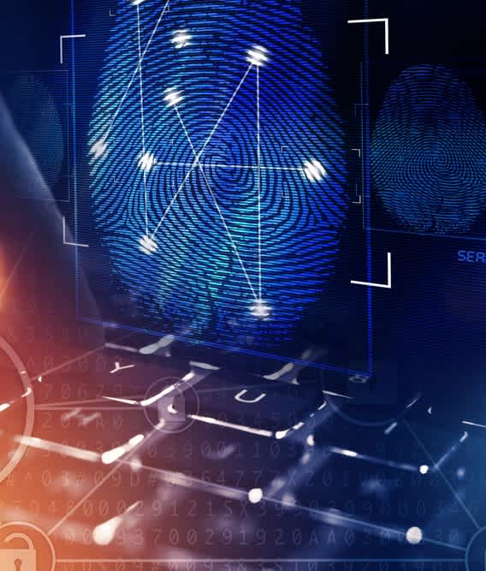
Topic-1: Introduction to Digital Forensics
We will cover these skills
Introduction to digital forensics, definitions and methodologies.
Evidence collection and preservation: Learn the best practices for identifying, collecting, and preserving digital evidence.
Data Recovery and Analysis: Gain skills in recovering deleted or corrupted data from various digital devices and analyzing it for relevant information.
Forensic Tools and Techniques: Get hands-on experience with industry-standard digital forensics tools and techniques used to investigate cybercrimes.
Legal and Ethical Considerations: Understand the legal frameworks, ethical issues, and guidelines governing digital forensic investigations, ensuring compliance with laws and professional standards.

Slide 15

Topic-2:
Cyber Threats and Vulnerabilities in Healthcare
We will cover these skills
Identifying Common Cyber Threats: Learn to recognize and understand the various types of cyber threats that specifically target healthcare systems, such as ransomware, phishing, and insider threats.
Vulnerability Assessment: Gain skills in conducting thorough vulnerability assessments to identify weaknesses in healthcare IT infrastructure that could be exploited by cyber attackers.
Implementing Security Measures: Understand and apply best practices for implementing robust security measures, including encryption, access controls, and network security, to protect sensitive healthcare data.
Incident Response and Management: Develop the ability to effectively respond to and manage cybersecurity incidents, including detecting breaches, mitigating damage, and ensuring a rapid recovery to maintain healthcare services.

Slide 16

Topic-3:
Use Cases of a Digital Forensics Investigation
We will cover these skills
Investigating Data Breaches: Learn how to conduct thorough investigations into data breaches, including identifying the source, method of attack, and extent of the data compromised.
Analyzing Malware Attacks: Gain skills in dissecting and understanding malware, tracing its origin, behavior, and impact on the affected systems to prevent future attacks.
Recovering Deleted Files: Master techniques for recovering and analyzing deleted, hidden, or encrypted files to uncover crucial evidence during digital forensic investigations.
Examining Digital Devices: Develop expertise in examining various digital devices, such as computers, mobile phones, and IoT devices, to extract and analyze evidence relevant to criminal investigations and legal cases.

Slide 17

Topic-4:
Preparation, Response and Resilience
We will cover these skills
Developing Incident Response Plans: Learn to create comprehensive incident response plans that outline the steps to take when a cybersecurity incident occurs, ensuring quick and effective action.
Conducting Risk Assessments: Gain skills in performing detailed risk assessments to identify potential threats and vulnerabilities, helping to prioritize security efforts and resources.
Building Cyber Resilience: Understand strategies to build cyber resilience within an organization, focusing on the ability to recover quickly and effectively from cyber attacks and disruptions.

Slide 18

Training Practical Exercises
Practical exercises requiring both personal and team effort
 | Title | Goal of Exercise
Exercise-1 (Day-3) | Simulated Data Breach Investigation | Conduct a mock investigation of a data breach scenario within a healthcare organization. Identify the entry point, analyze compromised systems, and document the findings.
Exercise-2 (Day-3) | Malware Analysis Exercise | Analyze a piece of malware discovered on a healthcare network. Use forensic tools to dissect the malware, understand its behavior, and determine its impact on patient data.
Exercise-3 (Day-3) | Deleted File Recovery Drill | Perform a hands-on exercise in recovering deleted files from a digital device used in a healthcare setting. Validate the recovered data to ensure its integrity and relevance to the investigation.
Exercise-4 (Day-3) | Forensic Imaging of Digital Devices | Create forensic images of various digital devices commonly used in healthcare, such as computers and mobile devices. Ensure that the imaging process follows best practices to maintain the integrity of the evidence.

Slide 19

Evaluation method
Outline the evaluation elements and assessment process
Evaluation Element | How
Multiple Choice Quizzes | Online Quizzes
Applied Tasks (Individual) | Problem solution to be submitted later
Group discussion | During workshop

Slide 20

Background Knowledge and Prerequisites
Background knowledge:
Basic understanding of computers and networking is appreciated but not required.
_{Prerequisites:}
None

Slide 21

Technical Tools and Other Requirement
Technical Tools
Computer with Internet Access
Web Browser Access
Technical Tools: Kali Linux
_{Other Requirements}
Willingness to Learn and Experiment / Active Participation

Slide 22

Registration: How to register and other practical information
The specific registration process for the Digital Forensics in the Health Sector training may vary depending on the training provider or institution. However, the general steps are typically straightforward and can be completed online or in person.
Online Registration
In-Person Registration

Slide 23

Thank you
Please send all questions to:
t.apostolidis@zelus.gr

