Slide 1


Alerting, Reporting, & Monitoring Strategies for Cybersecurity in Healthcare Sector
CSP011_S_H
PRESENTATION BY: Dimitra Siaili

Slide 2


Slide 3



Goals: Who-What-Why you need to take this training
WHO
WHAT
WHY
Cybersecurity strategies tailored for healthcare domain & demo of alerting reporting &monitoring via Security information & event management tool
Attendees will gain practical insights through demos on topics such as real-time notifications, reports on system status, &continuous monitoring of critical infrastructures.
Healthcare domain and/or IT professionals with Basic IT Knowledge

Slide 4



CSP Training Logistic: When-Where-How
WHEN
WHERE
HOW
Time schedule:
2024 – 2025
CyberSecPro EU funded project
ONSITE & ONLINE
Hands on Training

Slide 5

Value Propositions
Benefits to Participants
Level of Training Module: Basic
Understanding of cyber threats and vulnerabilities specific to the healthcare sector.
Familiarity with real-time threat notification systems and basic implementation skills.
Knowledge of cloud-based security management platforms for infrastructure monitoring.
Ability to configure basic real-time threat notifications via email and Slack alerts.
Introduction to using the Security Infusion tool for vulnerability identification.
Basic proficiency in generating simple reports on system status and vulnerabilities.
Introduction to setting up continuous infrastructure monitoring using cloud-based tools.
Basic skill in analyzing historical events for surveillance of critical healthcare systems.
Awareness of cybersecurity strategies tailored to healthcare sector.
Introduction to responding to cybersecurity incidents.

Slide 6

WHO
Profile of Training Participants
Healthcare IT Professionals: This includes network administrators, IT support staff, and cybersecurity specialists who are directly responsible for implementing and maintaining the security of healthcare systems.
Healthcare Administrators and Executives: Chief Information Officers (CIOs), Chief Technology Officers (CTOs), and Chief Information Security Officers (CISOs) who oversee the overall IT strategy and cybersecurity policies in healthcare organizations.
Clinical Staff with IT Responsibilities: Physicians, nurses, and other healthcare providers who use digital systems and need to understand the importance of cybersecurity to protect patient data.
Health Information Management (HIM) Professionals: Individuals who manage patient data, including health information managers and medical records technicians, as they need to ensure the confidentiality and integrity of health records.
Compliance and Risk Management Officers: Professionals who oversee compliance with healthcare regulations such as HIPAA, GDPR, and other data protection laws. They need to understand the cybersecurity measures necessary to maintain compliance.

Slide 7
WHO
Profile of Training Participants
Hospital and Clinic Management: Directors and managers of hospitals, clinics, and other healthcare facilities who need to be aware of the importance of endpoint protection to make informed decisions about resource allocation and security investments.
Healthcare Consultants and Auditors: Those who provide consulting services or conduct audits in healthcare settings, as they need to be up-to-date with the latest best practices in cybersecurity.
Software Developers and Vendors: Developers who create healthcare software and applications, as well as vendors who supply IT solutions to healthcare organizations, to ensure their products meet security standards.
Public Health Officials: Individuals working in public health agencies who manage large-scale health data and need to ensure its security against cyber threats.
Students and Academics: Students studying healthcare administration, health informatics, or cybersecurity, as well as academic researchers focusing on healthcare IT and cybersecurity.

Slide 8


WHO
Profiles of Trainer
Dimitra Siaili is an accomplished Researcher and Project Manager specializing in EU-funded cybersecurity projects at ITML. Leveraging her academic foundation in Electrical Engineering and Computer Technology from the Polytechnic School of Patras, encompassing both undergraduate and postgraduate studies, she has demonstrated proficiency in spearheading extensive research initiatives. In addition to her cybersecurity prowess, Dimitra brings extensive experience in the realms of smart cities and IoT, having contributed significantly to projects aimed at enhancing urban infrastructure and connectivity. ITML stands at the forefront of innovation, pioneering cybersecurity solutions through involvement in dozens of groundbreaking research projects. With a steadfast commitment to excellence, ITML harnesses its expertise on cybersecurity to deliver cutting-edge technologies and services tailored to meet the evolving challenges of the digital landscape. Renowned for its strategic collaborations and track record of success in securing EU funding, ITML continues to shape the future of cybersecurity, empowering businesses, and organizations worldwide to navigate the complexities of cyberspace with confidence.

Slide 9

WHAT
Training Topics
Introduction to Cyber Ranges in Healthcare
Real-time Threat Notifications and Response
Vulnerability Management and Reporting
Continuous Infrastructure Monitoring with Cloud-Based Tools
Future Trends and Considerations in Cybersecurity Healthcare Domain

Slide 10

WHY
Learning Outcomes
Understanding of cyber threats and vulnerabilities specific to the healthcare domain.
Familiarity with real-time threat notification systems.
Basic knowledge of cloud-based security management platforms for infrastructure monitoring.
Ability to configure basic real-time threat notifications via email and Slack alerts.
Introduction to using the Security Infusion tool for vulnerability identification.
Basic proficiency in generating simple reports on system status and vulnerabilities.
Introduction to setting up continuous infrastructure monitoring using cloud-based tools.
Awareness of cybersecurity strategies tailored to the healthcare domain.
Introduction to responding to cybersecurity incidents in healthcare environments.

Slide 11

Training Outline
Part-1
Topic-1 Introduction to Cybersecurity in Healthcare
Cybersecurity challenges specific to healthcare domain
Consequences of Network Security Breaches
Case studies illustrating the importance of cybersecurity in healthcare.
Topic-2 Vulnerability Management and Reporting
Vulnerability Management lifecycle diagram
Overview of vulnerability management principles in healthcare.
Best Practices in Vulnerability Management.

Slide 12
Training Outline
Part-2
Topic-3: Real-time Threat Notifications and Response
Common Cyber Threats Targeting Healthcare.
Best Practices for Swift Cyber Incident Response
Overview of Cyber Ranges and SIEM Tools
Topic-4: Continuous Infrastructure Monitoring with Cloud-Based Tools
Introduction to cloud-based management platforms for infrastructure monitoring.
Hands-on exercises on using the Security Infusion tool to identify and remediate vulnerabilities.
Creating actionable reports on system status and vulnerabilities for stakeholders
Live demonstration of setting up continuous monitoring of critical healthcare systems.
Demonstration of how to use a centralized dashboard to analyze historical events and ensure 24x7 surveillance and examining any low-level historical event, if needed.

Slide 13
Training Outline
Part-2
Topic-5 Collaboration & Knowledge Sharing
Discussion on the importance of ongoing education and training for cybersecurity professionals in the field of healthcare.
Reflection on key takeaways from the seminar and recommendations for continued improvement in healthcare cybersecurity strategies

Slide 14


Evaluation method
Outline the evaluation elements and assessment process
Self-assessment forms a fundamental component, providing each participant with an opportunity to reflect on their learning journey and gauge their understanding of the cybersecurity strategies discussed.
Additionally, evaluation from the trainer encompasses participant communication and interaction, with a focus on fostering critical thinking through open discussions. This collaborative environment not only enhances participants' comprehension of cybersecurity concepts but also encourages exploration of critical aspects specific to the energy domain.
Upon successful completion of the seminar, participants will receive a Certificate of Attendance, acknowledging their dedication to expanding their knowledge of cybersecurity within the context of Healthcare.

Slide 15

Background Knowledge and Prerequisites
Background knowledge:
Basic understanding of computers and networking
Basic IT and security Knowledge
Awareness of cybersecurity
_{Prerequisites:}
None

Slide 16

Technical Tools and Other Requirement
Technical Tools
Nothing Prerequisite
_{Other Requirements}
Knowledge of Basic Computer Concepts / Awareness of Internet Security Practices / Willingness to Learn and Experiment / Active Participation

Slide 17

Resources: Books and Reference Material
ENISA. (2019). Good Practices for Cybersecurity in the Maritime Sector. Drougkas, A., Sarri, A., Kyranoudi, P., Zisi, A.
ENISA. (2023). ENISA Transport Threat Landscape. Theocharidou, M., Stanic, Z., Drougkas, A., De Sousa Figueiredo, R., Tsekmezoglou, E., Naydenov, R., Lella, I., Malatras, A.
Police warning after drug traffickers' cyber-attack. Available at: https://www.bbc.com/news/world-europe-24539417
The Untold Story of NotPetya, the Most Devastating Cyberattack in History. Available at: https://www.wired.com/story/notpetya-cyberattack-ukraine-russia-code-crashed-the-world/
Troubled waters: Cyber-attacks on San Diego and Barcelona’s ports. Available at: https://darktrace.com/blog/troubled-waters-cyber-attacks-on-san-diego-and-barcelonas-ports
CyBOK (2021). "Web & Mobile Security Knowledge Area” Version 1.0.1.
NIST Special Publication 800-115. Technical Guide to Information Security Testing and Assessment.
OWASP Top 10:2021. Available at: https://owasp.org/Top10/
Synopsys. OWASP Top 10 2021. Available at: https://www.synopsys.com/glossary/what-is-owasp-top-10.html#A

Slide 18

Registration: How to register and other practical information
The specific registration process for the Cybersecurity Essentials and Management training may vary depending on the training provider or institution. However, the general steps are typically straightforward and can be completed online or in person.
Online Registration
In-Person Registration
Additional Practical Information

Slide 19

Course progress
o1.
Introduction to Cybersecurity in Healthcare
o2.
Vulnerability Management and Reporting
o3.
Real-time Threat Notifications and Response
o4.
Continuous Infrastructure Monitoring with Cloud-Based Tools
o5.
Collaboration & Knowledge Sharing.

Slide 20

Introduction to Cybersecurity in Healthcare
The critical role of network security in healthcare cannot be underestimated.
Ensuring the confidentiality, integrity, and availability of sensitive patient data is paramount.
Healthcare organizations face unique challenges and vulnerabilities due to the complex and interconnected nature of their systems.

Slide 21
Introduction to Cybersecurity in Healthcare
Challenges in Healthcare
  Complex IT Ecosystems: Healthcare facilities operate diverse and integrated IT systems, including electronic health records (EHRs), medical devices, and administrative systems, creating a broad attack surface.
  High Value of Data: Medical records are lucrative targets for cybercriminals due to their detailed personal, financial, and medical information, making healthcare a prime target for data breaches.
  Interconnectedness/Interoperability: The interconnectedness of healthcare systems poses unique challenges, including diverse devices and legacy systems. The need for seamless data exchange among various healthcare providers and systems increases the risk of vulnerabilities being exploited.
  Regulatory Compliance: Compliance with stringent regulations (e.g., HIPAA, GDPR) adds layers of complexity to managing and securing networks.

Slide 22

Introduction to Cybersecurity in Healthcare
Consequences of Network Security Breaches
Patient Safety
  Disrupted Care: Cyberattacks can disrupt critical healthcare services, potentially leading to adverse patient outcomes.
  Tampering with Medical Devices: Compromised medical devices can lead to incorrect dosages or malfunctions, posing direct risks to patient health.
Financial and Reputational Damage
  Costly Breaches: The financial repercussions of data breaches include fines, legal fees, and the cost of remediation.
  Reputation Loss: Breaches erode patient trust and damage the reputation of healthcare institutions, affecting patient retention and acquisition.
Regulatory Consequences
  Non-Compliance Penalties: Failure to comply with regulations like HIPAA can result in severe penalties.
  Increased Scrutiny: Breaches can lead to heightened regulatory scrutiny and the need for more stringent compliance measures.

Slide 23
Introduction to Cybersecurity in Healthcare
Case Study 1: Ransomware Attack on a Major Hospital
Case Study 2: Data Breach at a Healthcare Provider
Incident: A major hospital fell victim to a ransomware attack, leading to the encryption of patient records and operational disruption.
Impact: Delayed medical procedures, compromised patient safety, and significant financial loss.
Response: Implementation of advanced threat detection & regular backups mitigated future risks.
Incident: A healthcare provider experienced a data breach, exposing sensitive patient information.
Impact: Loss of patient trust, legal penalties, and regulatory scrutiny.
Response: Strengthened access controls, employee training on phishing, and enhanced encryption protocols.
Case Study 3:
Insider Threat at a Medical Facility
Incident: An employee misused access to leak patient data.
Impact: Erosion of patient confidence, legal consequences, and internal turmoil.
Response: Tightened user access policies, increased monitoring of user activities, and rigorous insider threat training.

Slide 24
Introduction to Cybersecurity in Healthcare
Case Study 1: Ransomware Attack on a Major Hospital
Case Study 2: Data Breach at a Healthcare Provider
Incident: A major hospital fell victim to a ransomware attack, leading to the encryption of patient records and operational disruption.
Impact: Delayed medical procedures, compromised patient safety, and significant financial loss.
Response: Implementation of advanced threat detection & regular backups mitigated future risks.
_{Lessons Learned:}
Importance of proactive threat detection and response.
Necessity for regular data backups and encryption.
Critical need for employee training on cybersecurity best practices.
The value of continuous monitoring and quick incident response.
Incident: A healthcare provider experienced a data breach, exposing sensitive patient information.
Impact: Loss of patient trust, legal penalties, and regulatory scrutiny.
Response: Strengthened access controls, employee training on phishing, and enhanced encryption protocols.
Case Study 3:
Insider Threat at a Medical Facility
Incident: An employee misused access to leak patient data.
Impact: Erosion of patient confidence, legal consequences, and internal turmoil.
Response: Tightened user access policies, increased monitoring of user activities, and rigorous insider threat training.

Slide 25
Course progress
o1.
Introduction to Cybersecurity in the Energy Sector
o2.
Vulnerability Management and Reporting
o3.
Real-time Threat Notifications & Response
o4.
Continuous Infrastructure Monitoring with Cloud-Based Tools
o5.
Collaboration & Knowledge Sharing.

Slide 26
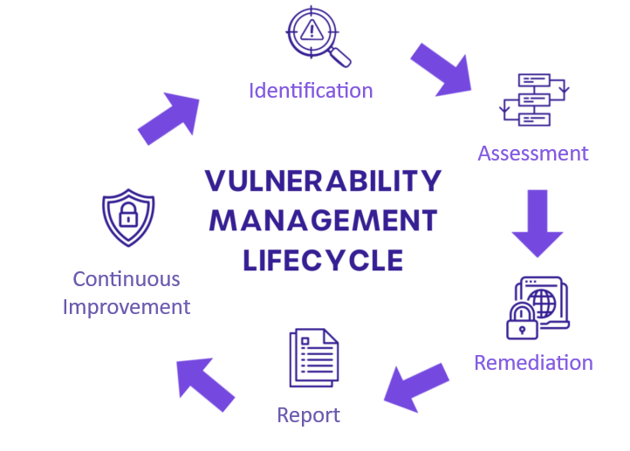
Vulnerability Management and Reporting
Principles of Vulnerability Management
In Helathcare
Vulnerability management is a critical component of cybersecurity, aimed at identifying, assessing, and mitigating security weaknesses within systems and infrastructure.

Slide 27
Vulnerability Management and Reporting
Identification
Conduct regular and comprehensive scans to detect vulnerabilities across all assets, including software, hardware, and network components.
Utilize automated tools and threat intelligence to stay updated on emerging vulnerabilities.
Assessment
Risk Analysis: Evaluate the potential impact and likelihood of identified vulnerabilities.
Prioritization: Prioritize vulnerabilities based on criticality and risk to patient safety and data integrity.
Contextual Evaluation: Consider the specific healthcare environment and operational context.
Continuous Improvement:
Periodic Reviews: Regularly review and update vulnerability management processes.
Training & Awareness: Continuously train staff on the importance of vulnerability management.
Metrics & KPIs: Track and analyze key performance indicators to measure effectiveness.
Remediation
Patch Management: Implement timely patches and updates for all software and systems.
Mitigation Strategies: Apply temporary fixes or workarounds until permanent solutions are available.
Configuration Management: Ensure secure configuration of all systems and devices.
Reporting
Documentation: Maintain detailed records of identified vulnerabilities and remediation actions.
Communication: Regularly update stakeholders on vulnerability status and remediation progress.
Compliance Reporting: Ensure adherence to regulatory requirements for reporting vulnerabilities.

Slide 28
Vulnerability Management and Reporting
Best Practices in Vulnerability Management
Proactive Vulnerability Identification
              Regular Scanning: Conduct frequent vulnerability scans to identify potential security gaps.
                Threat Intelligence Integration: Use threat intelligence feeds to stay updated on new vulnerabilities and threats.
                Comprehensive Asset Management: Maintain a detailed and current inventory of all IT assets, including IoT devices and medical equipment.
Effective Risk Assessment
Impact Analysis: Evaluate the potential impact of vulnerabilities on patient safety, data privacy, and operational continuity.
Prioritization: Use risk-based prioritization to address the most critical vulnerabilities first.
Contextual Evaluation: Assess vulnerabilities in the context of specific healthcare operations and regulatory requirements.
Efficient Remediation Strategies
Timely Patch Deployment: Implement patches and updates promptly to close security gaps.
Alternative Mitigation: Apply temporary measures to mitigate risks when immediate patching is not possible.
Configuration Management: Ensure that systems and devices are configured securely and according to best practices.
Continuous Monitoring and Improvement
Ongoing Monitoring: Continuously monitor systems for new vulnerabilities and threats.
Incident Response Planning: Develop and regularly update incident response plans to handle potential breaches.
Staff Training: Provide ongoing training to staff on the latest security practices and awareness.
Robust Reporting and Documentation
Detailed Documentation: Keep comprehensive records of vulnerabilities, remediation actions, and security incidents.
Stakeholder Communication: Regularly communicate vulnerability status and actions taken to relevant stakeholders.
Regulatory Compliance: Ensure that all vulnerability management practices meet healthcare regulatory standards.

Slide 29
Course progress
o1.
Introduction to Cybersecurity in the Energy Sector
o2.
Vulnerability Management and Reporting
o3.
Real-time Threat Notifications & Response
o4.
Continuous Infrastructure Monitoring with Cloud-Based Tools
o5.
Collaboration & Knowledge Sharing

Slide 30
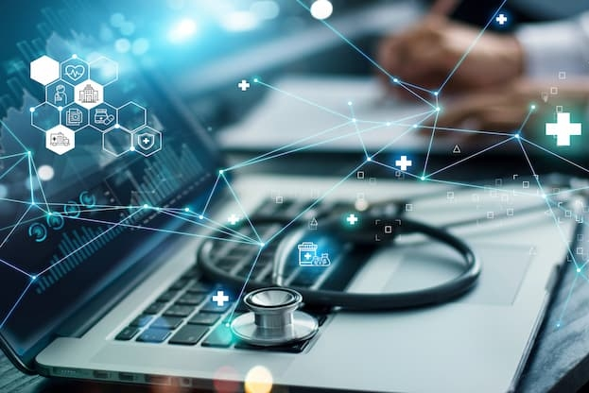
Real-time Threat Notifications & Response
Common Cyber Threats
Targeting Healthcare
Ransomware Attacks: Malicious software that encrypts data and demands a ransom for its release.
Data Breaches: Unauthorized access to confidential patient information, leading to identity theft and other malicious activities.
Advanced Persistent Threats (APTs): Prolonged and targeted cyberattacks aimed at stealing data or compromising systems over an extended period.

Slide 31
Real-time Threat Notifications & Response
Ransomware and Data Breaches:
Primary Threats to Healthcare
Ransomware Attacks
  Mechanism: Attackers use phishing emails, exploit vulnerabilities, or deploy malicious software to encrypt critical data.
  Impact: Disruption of healthcare services, loss of access to patient records, and significant financial demands for decryption keys.
  Example: The WannaCry ransomware attack in 2017 affected numerous healthcare organizations worldwide, causing widespread disruption.
Data Breaches
  Sources: Can result from insider threats, phishing attacks, or direct hacking of systems.
  Consequences: Exposure of sensitive patient data, leading to identity theft, financial loss, and damage to the organization's reputation.
  Regulatory Implications: Non-compliance with regulations like HIPAA can result in hefty fines and increased scrutiny.

Slide 32
Real-time Threat Notifications & Response
Beyond Ransomware and Data Breaches: Other Threats
Phishing and Social Engineering
  Methods: Attackers use deceptive emails, messages, or calls to trick healthcare staff into revealing sensitive information or installing malware.
  Impact: Compromise of user credentials, unauthorized access to systems, and initiation of further attacks.
Medical Device Hacking
  Vulnerabilities: Many medical devices have outdated software, weak security configurations, and are connected to the internet.
  Risks: Compromised devices can lead to incorrect dosages, disrupted treatment, or altered diagnostic data, posing direct risks to patient safety.
Supply Chain Attacks
  Definition: Attacks that target third-party vendors or software used by healthcare organizations.
  Impact: Compromised software or hardware can serve as a backdoor into the healthcare network, leading to widespread infection and data theft.

Slide 33
Real-time Threat Notifications & Response
Best Practices
for Swift Cyber Incident Response
Incident Response Plan (IRP):
Develop and regularly update a comprehensive IRP.
Ensure it includes procedures for detection, containment, eradication, & recovery.
Regular Training and Drills:
Conduct regular training sessions and simulation exercises for staff.
Use cyber ranges to simulate real-world attack scenarios.
Real-Time Monitoring and Alerts:
Implement continuous monitoring using SIEM tools.
Set up real-time alerts for suspicious activities and anomalies.
Rapid Containment Strategies:
Isolate affected systems to prevent the spread of threats.
Use network segmentation to limit the impact of breaches.
Effective Communication:
Establish clear communication channels for internal and external stakeholders.
Ensure timely and accurate information dissemination during incidents.
Swift Cyber Incident Response (CIR)
refers to the procedures and actions taken by organizations to respond promptly and effectively to cyber incidents.
The objective of a swift response is to mitigate the damage, recover systems and data, and prevent future incidents.

Slide 34
Real-time Threat Notifications & Response
Best Practices
for Swift Cyber Incident Response
Incident Response Plan (IRP):
Develop and regularly update a comprehensive IRP.
Ensure it includes procedures for detection, containment, eradication, & recovery.
Regular Training and Drills:
Conduct regular training sessions and simulation exercises for staff.
Use cyber ranges to simulate real-world attack scenarios.
Real-Time Monitoring and Alerts:
Implement continuous monitoring using SIEM tools.
Set up real-time alerts for suspicious activities and anomalies.
Rapid Containment Strategies:
Isolate affected systems to prevent the spread of threats.
Use network segmentation to limit the impact of breaches.
Effective Communication:
Establish clear communication channels for internal and external stakeholders.
Ensure timely and accurate information dissemination during incidents.
Swift Cyber Incident Response (CIR)
refers to the procedures and actions taken by organizations to respond promptly and effectively to cyber incidents.
The objective of a swift response is to mitigate the damage, recover systems and data, and prevent future incidents.

Slide 35
Real-time Threat Notifications & Response
Overview of Cyber Ranges and SIEM Tools
SIEM tools
Cyber Ranges
Definition: Security Information and Event Management (SIEM) tools collect and analyze security data.
Functions: Real-time threat detection, incident response, and compliance reporting.
Role in Training: SIEMs can be used in cyber ranges to simulate and understand real-time threat detection and incident response.
Examples: Security Infusion by itml, Splunk, IBM QRadar, ArcSight.
Definition: Virtual environments for simulating cyberattacks and defenses.
Purpose: Training, testing, and improving cybersecurity skills and strategies.
Benefits: Realistic practice scenarios, enhanced preparedness, and improved incident response.

Slide 36
Course progress
o1.
Introduction to Cybersecurity in the Energy Sector
o2.
Vulnerability Management and Reporting
o3.
Real-time Threat Notifications & Response
o4.
Continuous Infrastructure Monitoring with Cloud-Based Tools
o5.
Collaboration & Knowledge Sharing.

Slide 37
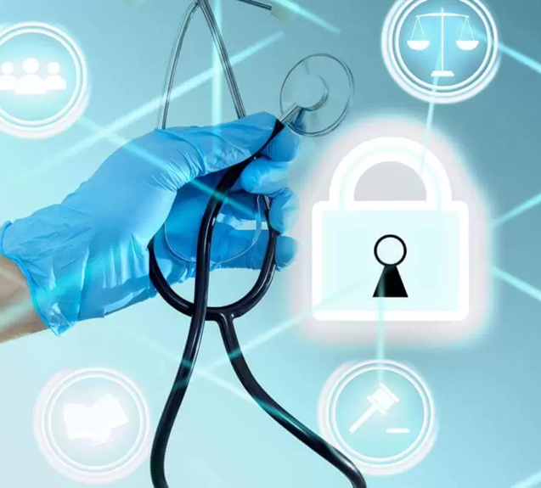
Continuous Infrastructure Monitoring with Cloud-Based Tools
Live Demonstrations (Security Infusion)
Introduction to cloud-based management platforms for infrastructure monitoring.
Hands-on exercises on using the Security Infusion tool to identify and remediate vulnerabilities.
Creating actionable reports on system status and vulnerabilities for stakeholders
Live demonstration of setting up continuous monitoring of critical energy systems.
Demonstration of how to use a centralized dashboard to analyze historical events and ensure 24x7 surveillance and examining any low-level historical event, if needed.

Slide 38
Course progress
o1.
Introduction to Cybersecurity in the Energy Sector
o2.
Real-time Threat Notifications & Response
o3.
Vulnerability Management and Reporting
o4.
Continuous Infrastructure Monitoring with
Cloud-Based Tools
Collaboration & Knowledge Sharing.
o5.

Slide 39

Collaboration & Knowledge Sharing
Please Raise Your Hand &
Introduce Yourself!
Profile info: Do you work within the healthcare sector? Are you a cybersecurity specialist? How familiar are you with the discussed topics?
Thoughts on the Seminar: What aspects resonated with you the most?
Additional Thoughts: Do you have anything to add?

Slide 40

Thank you
Please send all questions to:
disiaili@itml.gr

