Slide 1
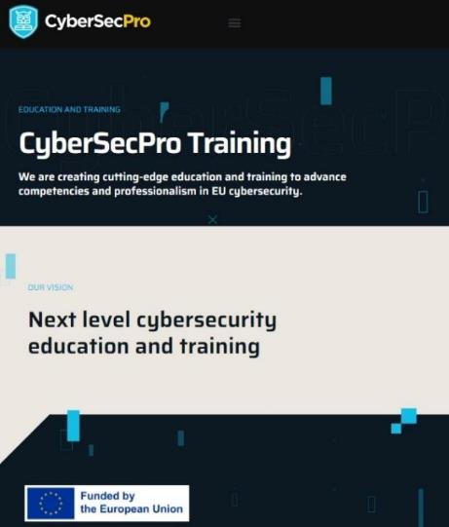
Cyber range and operations on SCADA
CSP0011_S_E
Presentation by: Bruno BENDER
https://www.cybersecpro-project.eu/
Notes:
Good morning and welcome to the CYBERSECPRO Training session CSP 0011 S E.
This module is part of a general CYBESECPRO training dedicated to Cyber range and operations on SCADA.

Slide 2


Cyber range & operations on SCADA
o1.
Introduce PLC / SCADA to Students
o2.
Annual courses - presential
o3.
Cyber risks and Forensics on PLC / SCADA
o4.
Security architectures
o5.
A complementary on-hands practice
o6.
Risks scenarios - Security incidents
o7.
Your security provider - C2B Consulting
115 rue du maréchal Foch –F83.200 LE REVEST – France

Slide 3



Goals: Who-What-Why you need to take this training
WHO
WHAT
WHY
WHO can attend the training modules and profiles of the attendees
Foundational of cybersecurity essentials and management for managers, leaders and working-professionals
Equipping participants with the knowledge and skills necessary to make a strategy to protect critical systems and data
https://www.cybersecpro-project.eu/

Slide 4



CSP Training Logistic: CSP0009_S_E
Cyber range & operations on SCADA
WHEN
WHERE
HOW
Time schedule: Autumn 2024
ONSITE-Location Information
Delivery Method
https://www.cybersecpro-project.eu/

Slide 5

Value Propositions
Benefits to Participants
Level of Training Module: Basic / Advance
Cybersecurity Professional Training
Hands-on and Practical Skills Development
Rooted with European Cybersecurity Skills Framework
Cutting-edge insights from industry-academic experts
Certificate of the completion
Helps with skills development and career advancement

Slide 6
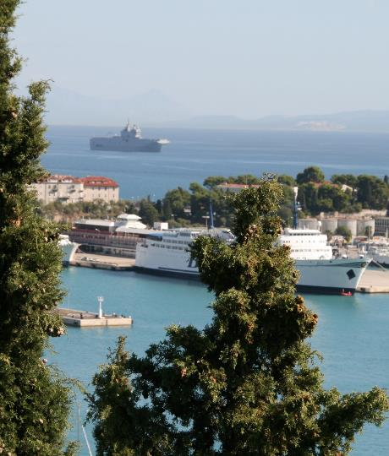
WHO
Profile of Training Participants
Managers and Leaders
Working-life professionals
SMEs and Public Sector Employees
Cybersecurity practitioners and enthusiasts

Slide 7

WHO
Profile of Trainer
Bruno BENDER
C2B CONSULTING
Former Navy Officer / CIS specialist
Information Security officer
  NATO
  Nationally
  EU
Since 2017 founder of C2B
  SME specialised in Maritime security / Cybersecurity

Slide 8

WHAT
Training Topics
Threats and vulnerabilities
Legal aspects
Cybersecurity threat Intelligence specific to maritime
Information Security Governance (ISG) and Information Security Risk Management (ISRM)
Security Architecture Design and Implementation
Security Controls Selection and Implementation

Slide 9
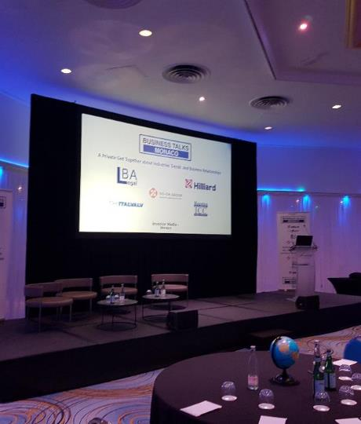
WHY
Learning Outcomes
Demonstrate ethical and professional conduct in all aspects of information and cybersecurity management.
Comprehend and articulate the key concepts and principles of information and cybersecurity.
Understand the evolving cyber threat landscape and the diverse range of cyberattacks.
Identifies the cybersecurity threats, vulnerabilities, and risks to an organisation.
Recognise the human factor's role in cybersecurity breaches and risk mitigation strategies.
Ability to help and select appropriate security controls to protect against identified cybersecurity threats and risks.

Slide 10

Training Outline
Day-1
Topic-1: Definition IT / OT
Industrial Control Systems environment
PLC / SCADA
Example : Pipelines
Topic-2: Digital Forensic for PLC / SCADA
Topologies / taxonomies
Live Forensics
Topic-3: Detailed Architectures
OSI Level
IT / OT
Introduction to vulnerabilities and threats
Notes:
To successfully connect and secure the industrial environment, all stakeholders must work together. Operational technology (OT) teams understand the industrial environment—the devices, the protocols, and the operational processes. Information technology (IT) teams understand the network. The security team understands threats and vulnerabilities. By working together, these specialists can leverage existing networking and security technologies, tools, and expertise to constantly protect the industrial systems without disrupting production safety and uptime.
The Cisco Industrial Threat Defense solution is intended to be used by IT, OT, and security teams and their relevant partners and system integrators. Operations will appreciate the ease of use and simple deployment, as well as the broad support of various IACS vendors and protocols. IT network managers will appreciate the ability to apply skills, technology, and applications already deployed in the enterprise when looking to integrate production environments. Security teams will have visibility into industrial assets and security events with context enriched by control engineers.
Security Challenges
As highlighted in Figure 1, the first key challenge when securing the IACS is collaboration between IT and OT teams. The view that OT and IT are distinctly separate entities is antiquated. Failing to acknowledge the increasingly interconnected nature of OT and IT can have detrimental consequences for industrial organizations. A lack of trust, understanding, and collaboration between OT and IT departments can have a devastating impact on the security posture of an organization.

Slide 11
Training Outline
Day-2
Topic-4: Vulnerabilities
Security challenges
List of vulnerabilities
Methodology
Range scenarios
Topic-5 : Penetration platform
References
Hands on training
Exploitation of results
LL / LI
Notes:
To successfully connect and secure the industrial environment, all stakeholders must work together. Operational technology (OT) teams understand the industrial environment—the devices, the protocols, and the operational processes. Information technology (IT) teams understand the network. The security team understands threats and vulnerabilities. By working together, these specialists can leverage existing networking and security technologies, tools, and expertise to constantly protect the industrial systems without disrupting production safety and uptime.
The Cisco Industrial Threat Defense solution is intended to be used by IT, OT, and security teams and their relevant partners and system integrators. Operations will appreciate the ease of use and simple deployment, as well as the broad support of various IACS vendors and protocols. IT network managers will appreciate the ability to apply skills, technology, and applications already deployed in the enterprise when looking to integrate production environments. Security teams will have visibility into industrial assets and security events with context enriched by control engineers.
Security Challenges
As highlighted in Figure 1, the first key challenge when securing the IACS is collaboration between IT and OT teams. The view that OT and IT are distinctly separate entities is antiquated. Failing to acknowledge the increasingly interconnected nature of OT and IT can have detrimental consequences for industrial organizations. A lack of trust, understanding, and collaboration between OT and IT departments can have a devastating impact on the security posture of an organization.

Slide 12

Topic-1: Definitions
We will cover these skills
Introduction to legal and regulatory aspects of PLC / SCADA : This part will detail PLC and SCADA in their operational environment as well as their specificities when used in support of Industrial control systems (ICS).
IT / OT: This section will discuss the lsegregation between IT and OT as well as as their specificities when used in support of Industrial control systems (ICS).
The example of indusctrial control Systems for pipelines will be used as an example

Slide 13

Topic-2: Digital Forensic on PLC/ SCADA
We will cover these skills
The concept of information security on OT and its importance to industrial organisation will be presented. Types of information assets that need to be protected, as well as the different threats and vulnerabilities that these assets face will be introduced via several use cases and scenarios.
A section dedicated to evidence of attacks incidents on SCADA/ PLC will allow to establish the specific threats and vulnerabilities that exist in the industrial domain. It will also present the different types of attacks and the attackers that launch them, as well as the different solutions to mitigate them.
The module will present several scenarios within the framework of CIA (the three pillars of information security: confidentiality, integrity, and availability). It will explain what each scenario represents as a risk to each pillar and why it could impact the industrial activities.
Other security models that can be used to protect information assets will be used during the workshop. These models include the NIST Cybersecurity Framework, the ISO/IEC 27001 standard, and the COBIT framework.

Slide 14

Topic-3:
Detailed Architectures
We will cover these skills
Topologies / taxonomies will introduce the level of operation of the elements of an ICS and the place of PLC / SCADA within these architectures
Industrial environments that will be considered encompass the following sectors:
        Energy
        Oil & Gas
        Maritime
IT / OT networks implication and the way to come from on and go to the other will be presented

Slide 15
Topic-4:
Vulnerabilities
We will cover these skills
Security challenges for PLC /SCADA and their environment
List of most recognized vulnerabilities will be presented on an ICS architecture
The general methodology used within the range will be described
At least the vulnerabilities will face the 7 Range Scenarios that have been identified

Slide 16
Topic-5:
Penetration platform
We will cover these skills
To present the penetration platform, references and sources will allow to present three or more specific scenarios
The three identified scenarios will be presented in a “on-hands training that will encompass
- IT to OT transitions
- Man in the middle
- Malicious PLC / SCADA
The exploitation of results will the finalise the workshop / sceminar presening some lessons learned and lessons identified as well as best practices
End evaluation

Slide 17

Evaluation method
Outline the evaluation elements and assessment process
Evaluation Element | How | Notes
Multiple Choice Quizzes | Online Quizz | X
Applied Tasks (Individual) | Problem solution to be submitted
Teamwork | Team project to submitted later
Group discussion | During course / Workshop | X
Quizz | At the end of the session | X

Slide 18


Cyber range & operations on SCADA
Topic 1 – PLC / SCADA
Programmable Logic Controller
Supervisory Control and Data Acquisition

Slide 19
SOME DEFINITIONS
Operational technology (OT) is hardware and software that detects or causes a change, through the direct monitoring / control of industrial equipment, assets, processes and events.
The term has become established to demonstrate the technological & functional differences between information technology (IT) systems and industrial control systems (ICS) environment
Examples of operational technology include:
  Programmable logic controllers (PLCs)
  Supervisory control and data acquisition systems (SCADA)
  Distributed control systems (DCS)
  Computer numerical control (CNC) systems, including computerized machine tools
  Scientific equipment (e.g. digital oscilloscopes)
  Building Management System (BMS) and building automation systems (BAS)
The term usually describes environments containing industrial control systems (ICS), such as supervisory control and data acquisition (SCADA) systems, distributed control system (DCS), remote terminal units (RTU) and programmable logic controllers (PLC), as well as dedicated networks and organization units.
The environment, whether commercial or domestic uses IoT devices within edge IoT platforms / "cloud" based applications. Embedded Systems can also be included in the sphere of OT (e.g. smart instrumentation), along with scientific data acquisition, control, and computing devices.
Source : Wikipedia
Notes:
Operational technology (OT) is hardware and software that detects or causes a change, through the direct monitoring / control of industrial equipment, assets, processes and events.
The term has become established to demonstrate the technological & functional differences between information technology (IT) systems and industrial control systems (ICS) environment
Examples of operational technology include:
Programmable logic controllers (PLCs)
Supervisory control and data acquisition systems (SCADA)
Distributed control systems (DCS)
Computer numerical control (CNC) systems, including computerized machine tools
Scientific equipment (e.g. digital oscilloscopes)
Building Management System (BMS) and building automation systems (BAS)
The term usually describes environments containing industrial control systems (ICS), such as supervisory control and data acquisition (SCADA) systems, distributed control system (DCS), remote terminal units (RTU) and programmable logic controllers (PLC), as well as dedicated networks and organization units.
The environment, whether commercial or domestic uses IoT devices within edge IoT platforms / "cloud" based applications. Embedded Systems can also be included in the sphere of OT (e.g. smart instrumentation), along with scientific data acquisition, control, and computing devices.

Slide 20
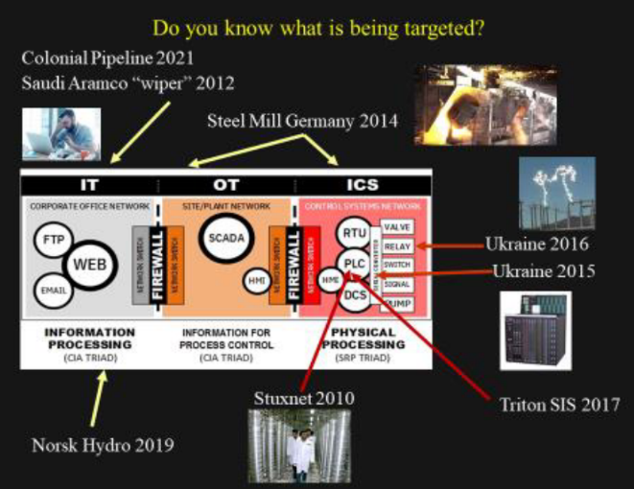
Colonial Pipeline 2021
Saudi ARAMCO Wiper 2012
Steel Mill Germany 2014
IT OT ICS
Corporate Office Network
Site / Plant Network
Control SystemsNetwork
FTP
SCADA
RTU
VALVE
Ukraine 2016
Ukraine 2015
WEB
PLC
RELAY
Network Switch
FIREWALL
Network Switch
Network Switch
FIREWALL
Network Switch
HMI
SWITCH
Mail
HMI
PLC
SIGNAL
PUMP
Information Processing
Information for Process Control
Physical Processing
STUXNET 2010
Triton SIS 2017
Norsk Hydro 2019

Slide 21
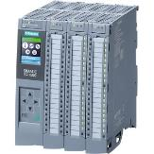
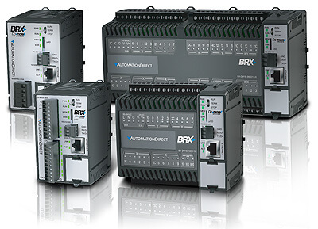

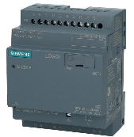
PLC / SCADA
industrial automation and control system
Programmable logic controller (often assimilated to HW)
supervisory control and data acquisition (SW)
Notes:
An industrial automation and control system is a set of devices that regulate the behavior of physical processes.
A thermostat for example is an elementary control system sensing the temperature and turning a heater on or off to maintain the temperature at a set point. These systems are used to monitor and control industrial and infrastructure processes such as plants, oil refinery operations, electricity generation and distribution, and water management.
A programmable logic controller (PLC) or programmable controller is an industrial computer that has been ruggedized and adapted for the control of manufacturing processes, such as assembly lines, machines, robotic devices, or any activity that requires high reliability, ease of programming, and process fault diagnosis.
A control system that is spread over a wide area and can supervise its individual components is often called a supervisory control and data acquisition (SCADA) system.
However, the term SCADA refers to all kinds of control systems that share a common key characteristic:
they are connected to physical processes and thus need to be continuously available and able to respond within a
deterministic time bound.
Early SCADA systems were intended to run as isolated networks, not connected to the Internet, and thus did not
require any specific cybersecurity mechanisms.
These systems consisted of simple I/O devices that transmitted the signals between master and remote termina l units. In
recent years, SCADA systems have evolved to communicate over public IP networks.2 Some are also connected to a
corporate intranet or directly to the Internet to seamlessly integrate SCADA data with external information such as
corporate email or weather data.
The integration of SCADA systems within a much wider network brings threats that were unimagined at the time
these systems were conceived. During the past decade, vendors, asset owners, and regulators recognized this
growing concern and began to address it through new laws and various security mechanisms, processes, and
standards.
The discoveries in the wild of Stuxnet in 2010 and Flame in 2012 were additional eye-openers for owners and operators of SCADA.
Stuxnet, the first known malware designed to target automation systems, infected 50000 to 100000 computers worldwide, while
Flame is a cyberespionage tool an order of magnitude more sophisticated than Stuxnet

Slide 22
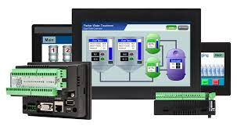
SCADA System Components - Functions
Data acquisition → Sensors
Data collection → Remote telemetry units (RTU)Data dissemination → Communications Networks
Data Presentation & control → SCADA master unit regulates in
particular the managed system
in responses for the sensors inputs

Slide 23
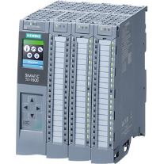
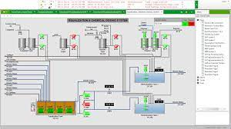
What are PLC / SCADA components in detail
Industrial controller with programmable memory who can store program instructions and functions :
One CPU) interpreting inputs, executing the control program stored in memory and sending output signals, to
A power supply unit converting AC to DC,
One memory unit storing data from inputs & program to be executed by the processor,
One input / output interface, (the controller receives and sends data from / to external effectors),
One communications interface receiving / transmitting data on networks to other PLCs.
PLCs require programming device used to develop and download the created program into the memory of the controller(real-time operating systems)
PLCs HMI

Slide 24
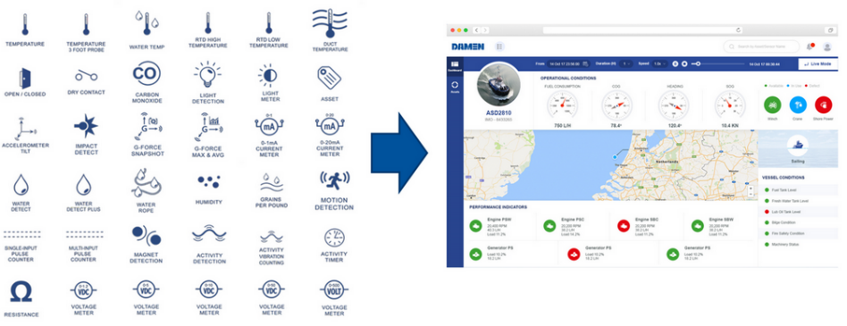
Human Machine Interface
Temperature Sensors
Visual detection sensors
Movement sensors
Acceleration sensors
Water / Humidity / level sensors
Activity sensors
Electricity sensors

Slide 25
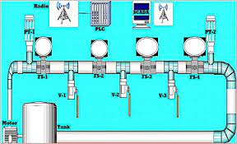

Example : Pipeline IACS
In a pipeline system, the protection of the industrial automation & control systems (IACS) includes the hardware & software to monitor & control physical processes.
In pipeline operations these technologies are found in the control center, pumping stations, depots, fueling stations, seaports, access pits and associated infrastructure elements such as:
Monitoring and Control systems
DCS, SCADA, PLC
Networked sensing and control, diagnostic systems
Leak Detection System
Process sensors
Basic Process Control, Safety Instrumented Systems,
Advanced/multivariable control, Online optimizers
Dedicated equipment monitors
Human Machine Interface (HMI)
Process historians
Notes:
In a pipeline system, besides protecting the fuel pipes and other physical structures, the protection of the industrial automation and control systems (IACS) is a priority.
IACS is a “collection of personnel, hardware, software, procedures and policies involved in the operation of the industrial process and that can affect or influence its safe, secure and reliable operation as defined by the International Society of Automation.
This includes the hardware and software used to monitor and control the physical processes unique to industrial operations. However, this technology is broadly used in industrial operations. In pipeline operations for example these technologies are found in the dispatch (control center), pumping stations, depots, fueling stations, seaports (where product enters the pipeline), access pits and associated infrastructure elements such as:
Monitoring and Control systems
- DCS, SCADA, PLC
- Networked sensing and control, diagnostic systems
- Leak Detection System
- Process sensors
- Basic Process Control System
- Safety Instrumented Systems
Associated information systems
- Advanced/multivariable control
- Online optimizers
- Dedicated equipment monitors
- Graphical interfaces (Human Machine Interface –HMI)
- Process historians13

Slide 26
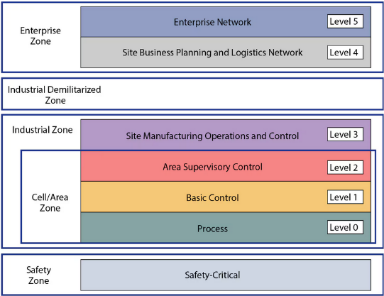
Reminder
IT / OT - General framework of an industrial automation & control systems (IACS)
Entriprise Zone
Entreprise network
Level 5
Corporate Business Planning and Logistics Network
Level 4
Industrial Demilitarized Zone
Industrial Zone
Site Manufacturing Operations and Control
Level 3
Area Supervisory Control
Level 2
Cell Area Zone
Basic Control
Level 1
Process
Level 0
Safety
Zone
Safety Critical

Slide 27
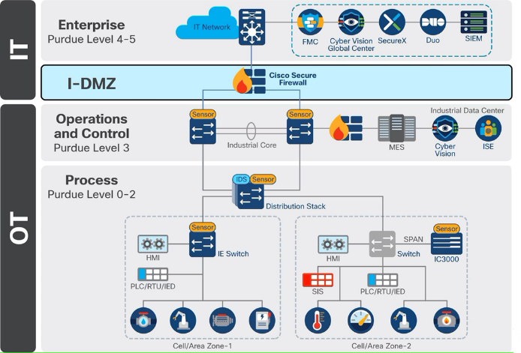
System architecture (IT and ICS /OT)
Entreprise
Purdue Level 4-5
I-DMZ
Operations
And Controm
Purdue Level 3
Process
Purdue Level 0-2
https://www.cisco.com/c/en/us/td/docs/Technology/industrial-automation-security-design-guide/m-introduction.html
© CISCO
Notes:
ICS : Industrial Control Systems / Operation Technologies

Slide 28


Example : Pipeline IACS
Attacking method - Steps
Initial Access
Discovery
Lateral Movement
Command & Control

Slide 29

Pipeline IACS
Initial Access attempt
Initial Access is an adversary attempting to get into the IACS environment.
This is traditionally accomplished by exploiting public facing applications, or the exploitation of remote services.
The Colonial Pipeline attack for example, while not an entry into the OT network, was a result of a forgotten Virtual Private Network (VPN) termination point with stolen credentials and no Multi-Factor Authentication (MFA).
In the case where initial access security is poorly implemented, or an exploit has been found, the first thing an adversary will do on the network is try to find information to identify and assess targets in the IACS.
Triton malware is an example of a python script executed in the network to discover Triconex safety controllers distributed by Schneider Electric. These controllers use a proprietary protocol on UDP port 1502, and Triton used this knowledge to scan the network for the devices. The malware can then read the firmware version and use this information in the next phase of an attack.
Takeway : Network segmentation is a great way to combat this threat, as if an attacker does manage to exploit a machine in the network, their reach should not be able to extend beyond the network segment.

Slide 30
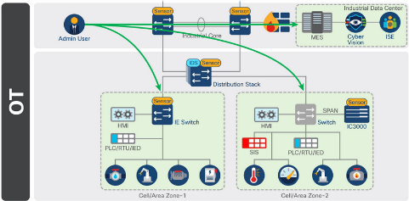
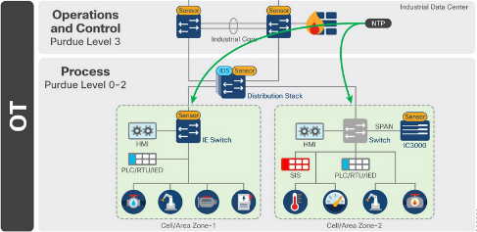
System architecture – Admin / Application accesses
Aministrative user (1) or applications within the industrial data center (2) have specific access requirements (a limited cell) and/or can require access to all zones in the network.
They may be responsible for configuration of the network infrastructure, or the application of control logic.
Their access should not be limited, but their data should be protected. Administrative Users need access to all zones

Slide 31
Pipeline IACS
Lateral Movements
Lateral Movement refers to the adversary attempting to move through the IACS environment.
This could involve jumping to engineering workstations using Remote Desktop Protocol (RDP) with weak or default credentials
In the case of the WannaCry vulnerability, protocol exploits to hop across machines in the network were used.
Takeway: Other than making sure default credentials are not used within the IACS, network segmentation helps solve this problem too, by containing an adversary to the zone in which the initial exploit occurred.

Slide 32
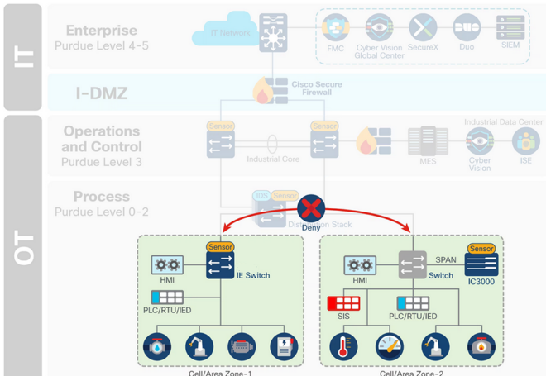
System architecture – Network Segmentation
Lateral Movement is an attempt to move through the IACS using Remote Desktop Protocol with weak credentials, or using protocol exploits to hop across machines in the network.
Default credentials should not be used within the IACS,
Network segmentation helps solve this problem too, by containing an attack to the zone in which the initial exploit occurred
Cell/Area Zone to Cell/Area Zone denied by default.
No segmentation inside the zone.

Slide 33
Pipeline IACS
Command & Control (C2)
Finally, the adversary will try and communicate with, and control compromised systems, controllers, and applications within the IACS environment. This is known as command & control (C2).
Access via PLC control workstation
Access by exploiting interlocking PLC connections
Remote Access

Slide 34
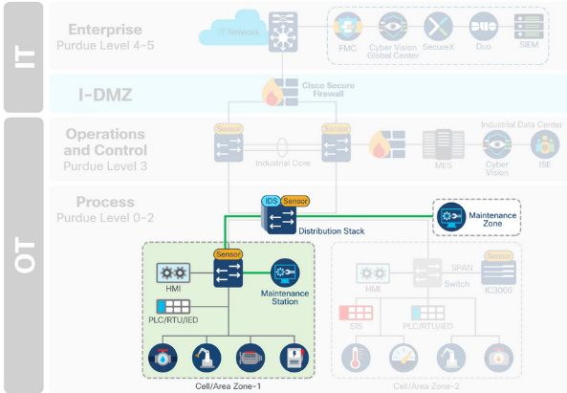
Maintenance Control Station
Maintenance Workstations: Maintenance workstations can either:
reside in a zone outside of the cell/area, and act as the maintenance tool for selected zones, but need important operations for each cell
or reside within the cell/area zone itself and require additional privileges when leaving the zone. This solution facilitates the administration but opens new perspectives for potential attacks

Slide 35
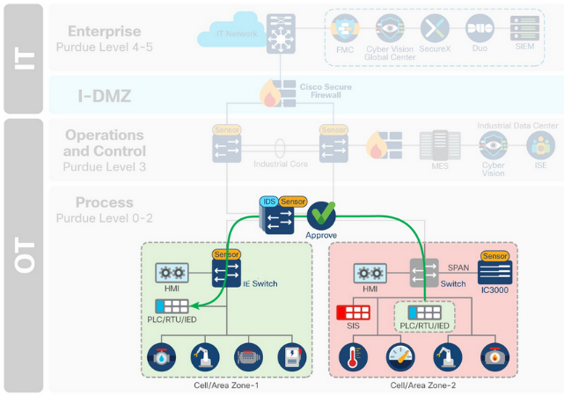
Interlocking PLC Control Station
Interlocking Programmable logic controllers (PLC) / Interzone communication: While most control traffic is contained within a cell/area zone, industrial communications may need to cross zones for distributed automation functions.
A PLC in a zone should not have full access to services in another zone
Least privilege policy should be applied.
It is important that a potential malware has no automated mechanism to spread to other zones.

Slide 36
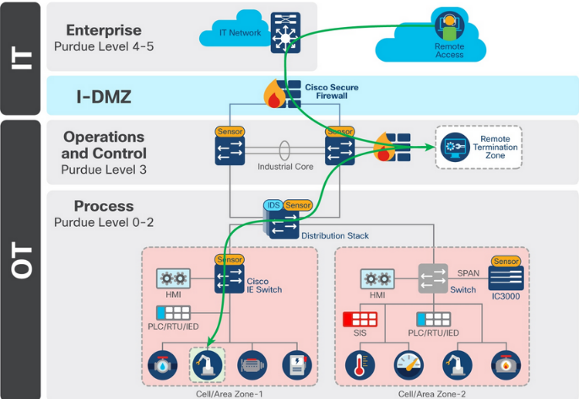
Remote access
Entreprise
Purdue Level 4-5
Remote Users:
Remote access is commonly granted to personas such as employees, partners and vendors for maintenance, process optimization and troubleshooting purposes.
Remote access should be controlled and restricted to selected devices on the plant floor for a limited amount of time.
I-DMZ
Operations
And Controm
Purdue Level 3
Process
Purdue Level 0-2

Slide 37
Cyber range & operations on SCADA
Topic 2 – Digital Forensic
What ?
Where ?
How ?

Slide 38
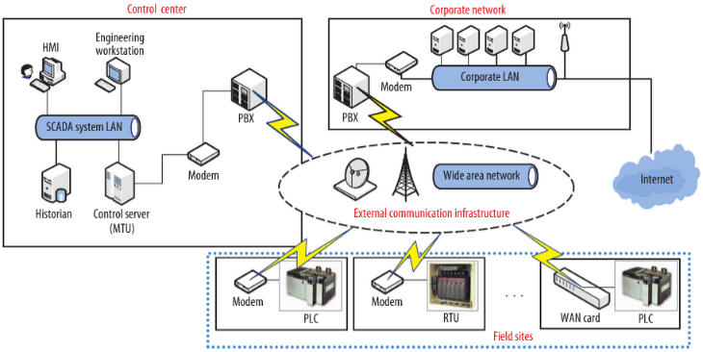
typical SCADA system for controlling infrastructures
Control Center
Corporate network
Engineering
Workstation
HMI
Modem
Corporate LAN
SCADA System LAN
PBX
PBX
Modem
Wide Area Network
Internet
Historian
Control Server
(MTU)
Exernal Communication infrastructrure
Modem
Modem
WAN card
Field sites
Entry point
Notes:
This figure shows, a typical SCADA system for controlling infrastructures for utilities such as power, gas, oil, or water generally consists of a control center and numerous field sites. The sites are distributed over a wide geographical area and are connected to the control center by different communication media such as satellites, wide area net works (WANs), and radio, microwave, or cellu-lar networks. Field sites are equipped with devices such as programmable logic controllers (PLCs) or remote terminal units (RTUs) that control the on-site machines and periodically send information about the state of the field equipment to the control center.
The control center is the SCADA system’s hub. Its major components include a human-machine interface (HMI), the database management system (historian), and the server or master terminal unit (MTU). The MTU initiates all communication with field sites and receives the data sent from the field devices. If necessary, it then preprocesses the data and sends it to the historian for archiving.

Slide 39
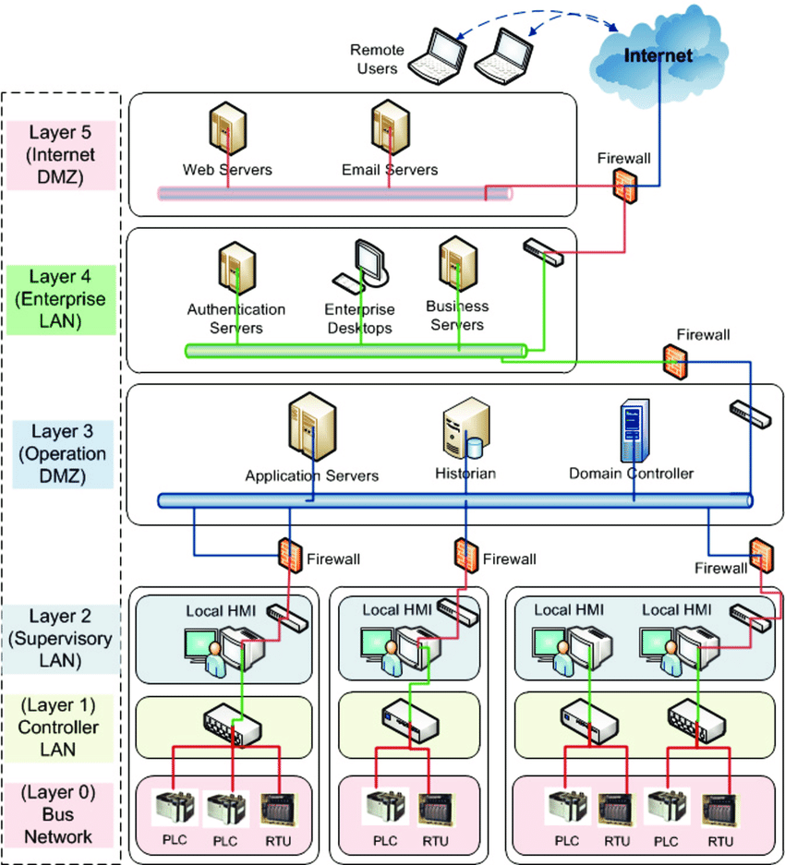
Digital forensics & PLC / SCADA
Remote
Users
Internet
Web Servers
Email Servers
Firewall
Authentication
Servers
Entreprise
Desktops
Business
Servers
Firewall
Layer 3
Operation
DMZ
Application Servers
Historian
Domain Controler
Firewall
Firewall
Firewall
Layer 2
Supervisory
LAN
Local HMI
Local HMI
Local HMI
Local HMI
PLC / SCADA
OSI model
Forensic Level of operating
Layer 1
Controler
LAN
Layer 0
Bus
Network
Notes:
Digital forensics is an aspect of cyberdefense that becomes essential in the event of a security breach. It can generally be defined as the collection and analysis of digital data from different sources such as computer systems, storage devices, and network streams to investigate the causes and consequences of an intrusion or some other incident. If investigators find traces of a crime such as unauthorized network access or theft of a digital file, they can present such data as evidence in a court of law. Digital forensics is also commonly used in internal corporate investigations to help limit the possibility of an incident
occurring again in the future.
The recent attacks against SCADA systems by powerful malware such as Stuxnet and Flame highlight the need for forensic investigations to improve cyberdefenses against both internal and externa l perpetrators with malicious intent and to thwart entities that try to sabotage a country’s critical infrastructure. In addition to playing a vital role in developing a protection strategy for SCADA systems and assisting in the identification and prosecution of attackers, digital forensics can help deal with non-malicious but harmful events such as malfunctioning servers /disks or other hardware by performing a deep analysis of the underlying SCADA IT system.
A forensic investigation can be the most effective, if not the only, way to answer many questions about an incident. For example, consider a scenario in which malware attacks a SCADA system, causing it to malfunction :
- A virus scan revealed that the Java cache contains a known exploit. Was the exploit successful? What
payload does it have? Is this what compromised the system?
- How can the operator clean the system and reliably return it to a known good state without having to shut
down the complete system?
- An operator has installed a suspicious, untrusted application downloaded from the Internet. Did that application change components that are important for the system’s stable operation?
From a forensics perspective, a SCADA system can be seen in different layers based on the connectivity of the various components with each other as well as with other networks such as the Internet.
OSI layer 0 contains the individual field devices connected via a bus network.
Layer 1 has controllers that receive input signals from the field devices and other controllers upon which they
perform operations to steer the field devices by sending output signals to them.
Layer 2 consists of the supervisory
network, typically a local network connected to the lower layers for specific operations such as showing the current
monitoring state at the HMI.
Layer 3 is the operation DMZ, where historians, domain controllers, and application servers are located.
Layers 4 and 5 correspond to the enterprise IT networks, in which the enterprise desktops and business servers operate.
Most forensic analyses of SCADA systems involve layers 0-2, as they contain the components that control the un-

Slide 40
Live Forensics
Because SCADA must be operational 24/7, investigators cannot turn it off to capture /analyze data.
In this case, live forensics is a viable solution for a digital investigation.
Live forensics involves
Performing data acquisition
Analysis on a running system.
However, their 24/7 availability requirement dictate that forensic investigation spends as little time as possible on a live SCADA system.
Consequently, live data is subsequently analyzed offline.
Live data acquisition includes
volatile data such as the contents of physical memory
Non-volatile data such as data stored on a hard disk.
This differs from traditional dead data acquisition, which involves first taking the system offline, losing all volatile data.
However, volatile data is needed for investigation.
- in physical memory it contains information about the system’s current state, such as the number of open network connections, process information, and encryption keys.
Notes:
LIVE FORENSICS
Because a SCADA system must be continuously operational, a forensic investigator cannot turn it off to capture
and ana lyze data.8 In this case, live forensics is a viable solution for a digital investigation.
A relatively new and emerging field in digital forensics, live forensics involves performing data acquisition and analysis on a running system. However, the critical nature of SCADA systems and their 24/7 availability requirement dictate that forensic in-
vestigators spend as little time as possible on a live SCADA system. Consequently, the investigators typically acquire
live data and subsequently analyze it offline.
Live data acquisition includes both volatile data such as the contents of physical memory and nonvolatile data
such as data stored on a hard disk. This differs from traditional dead data acquisition, which involves first taking
the system offline, losing all volatile data. However, volatile data plays a significant role in an effective forensic inves-
tigation. For instance, volatile data in physical memory contains information about the system’s current state, such
as the number of open network connections, process information, and encryption keys.

Slide 41
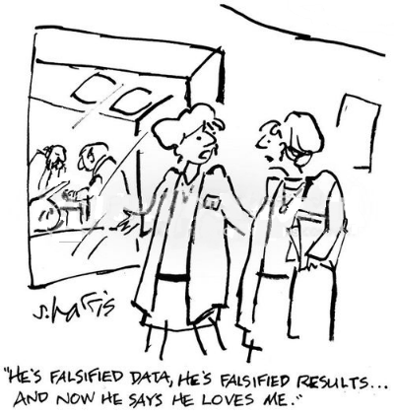
PLC / SCADA live data acquisition challenges
Early data evidence acquisition after an incident
Capture incident traces before over-writing
Ressource consuming process
Digital Evidence Validity
Digital data might not be admissible in court if its integrity is violated
Intent = Prevent malicious manufacturing of evidence
Avoid errors while handling evidence during investigation
He’s falsified data, He’s falsified results…
And now he says he loves me.
Notes:
Live data acquisition challenges
Because volatile data changes continuously on a running system, capturing live data presents two key challenges for forensic investigators.
Early data acquisition after an incident. Live data must be acquired as quickly as possible after an incident to capture any of the incident’s traces before processes or services on the running system overwrite useful volatile data — for example, data about recently unloaded kernel modules or drivers.
Digital evidence validity. Digital data might not be admissible in court if its integrity is violated. The intention is to prevent the malicious manufacturing of evidence against an innocent person and to avoid errors while handling evidence in the course of an investigation. Forensic investigators normally prove the integrity of evidence by computing a cryptographic hash of the actual evidence on the compromised system and its acquired copy, which is used for all examinations and analysis. If, however, the compromised system remains live, the data’s state might change bet ween the copying and the hash calculation,
rendering hashing ineffective as an integrity check.
This also creates an inconsistent data image that does not accurately represent the state when data acquisition starts or after it ends, which can cause difficulty in analyzing the acquired data. For example, due to data inconsistency, sometimes an operating system in the disk image cannot boot for experimental analysis.
Live data acquisition on SCADA systems
It is still unclear how to acquire live data on a SCADA system in a way that minimizes risk to the system’s services. To the best of our knowledge, no guidelines for accomplishing this are currently available. However, safe data acquisition should be possible under many circumstances.
Specifically, SCADA systems typically have a primary and a backup system. When the primary system is broken or malfunctioning, operators switch to the backup system.
Forensic investigators could leverage this capability by switching the system to the backup and performing live data acquisition on the infected system without worrying about the availability of SCADA services. However, this approach might not be feasible when the malware that has infected the primary system has also infected the backup system. That scenario might even demand immediate recovery if the SCADA owners and operators decide that the incident can jeopardize the system’s normal functionality.
This usually results in flushing all the infected system components and bringing them back to their normal state, which would not allow sufficient time for the investigator to perform data acquisition.

Slide 42

Cyber range & operations on SCADA
Topic 3 – Detailled Architectures
Basic Architecture
Complex architecture
Industrial Internet of Things (IIoT)
Cloud hybrid Architecture

Slide 43
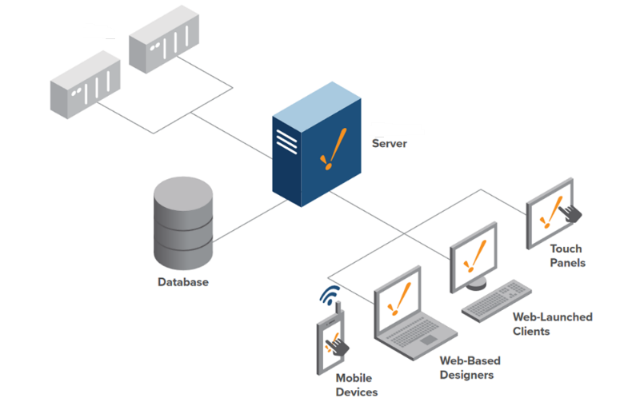
Basic Network Architecture
PLC / SCADA
Server
Touch Panels
DataBase
Web-Launched Clients
https://inductiveautomation.com/ignition/architectures
Web-Launched Designers
PLC : Programmable Logic Controller
SCADA: Supervisory Control and Data Acquisition
Mobile Devices
Notes:
Ignition Basic Architecture
The basic architecture is best suited for applications that require a scalable, centrally managed SCADA system using only one on-premise Ignition server and select modules. This implementation is the most cost-effective setup since you only pay for one license to have unlimited connections, tags, databases, and web-deployable clients.

Slide 44
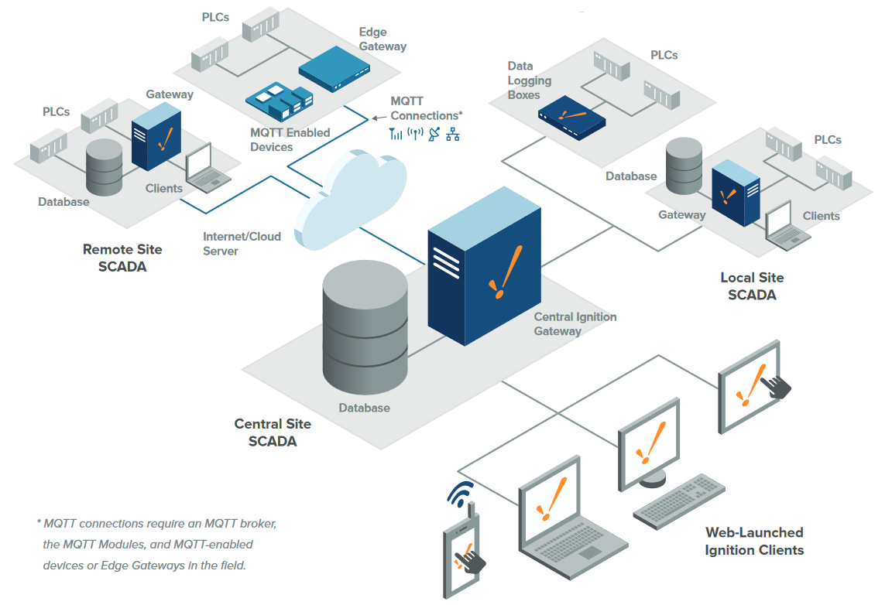
Complex Network Architecture
WAN / LAN
Edge Gateway
Data Lodging Boxes
Local site
PLC / SCADA
MQTT
Connections
Database
Database
Internet/Cloud Server
Remote Site SCADA
Internet/Cloud Server
Local site
SCADA
Central Ignition Gateway
Database
Central site SCADA
* MQTT connections require an MQTT broker, the MQTT Modules, and MQTT-enabled devices or Edge Gateways in the field
Web-Launched ignition Clients
Notes:
The hub and spoke architecture consists of two pieces. The hub piece consists of a central Ignition Gateway with Vision, Reporting and Mobile Modules and a database server. The spoke piece consists of a stripped-down Ignition Gateway with OPC UA and SQL Bridge Modules, dedicated for data logging. Each site is fully independent, operating with its own history, alarms, and clients, with the client Gateway being used for coordination and long-term history storage.

Slide 45
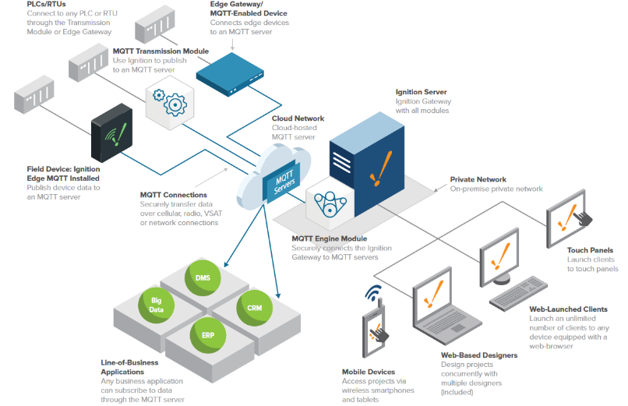
PLCs/RTUs
Connect to any PLC or RTU
through the Transmission
Module or Edge Gateway
Edge Gateway
MQTT-Enabled Device Connects edge devices to an MQTT service
Industrial IoT Architecture
MQTT Transmission Module
Use Ignition to publish
to an NIOTT server
Ingnition Server
Ignition gateway with all modules
Cloud Network
Cloud hosted
MQTT server
Field Device Ignition
Edge MQTT Installed
Publish device data l0
an MQTT server
Private Network
On-premise private network
MQTT Connections
Securely transfer data
over cellular, radio, VSAT or network connections
MQTT Engine Module
Securely connects the ignition Gateway to MQTT servers
Touch Panels
Launch clients
To touch panels
Web-launched Clients
Launch an unlimited number of clients to any device equipped with a web-browser
Web-based Designers Design projects concurrently with multiple designers (included)
Line of business applications
Any business application can subscribe to data through the MQTT server
Mobile devices
Access projects via wireless smartphones and tablets
Notes:
Ignition IIoT Architecture
Ignition IIoT can collects data from any devices at the edge of the network, publish that data
to a central broker, and push that data to subscribed industrial and line-of-business applica-
tions. Ignition IIoT can connect to PLCs in the field through the use of the MQTT Transmission
module, field devices with Ignition Edge MQTT installed, and/or MQTT-enabled edge
gateways and field devices that use the Cirrus Link Sparkplug MQTT specification. This data
is published to an MQTT broker, this broker can be located on-premise, in the cloud, or a
hybrid of the two. The MQTT Engine module located on an Ignition Gateway can subscribe
to any data published from the broker, this data can be use in any Ignition application.

Slide 46
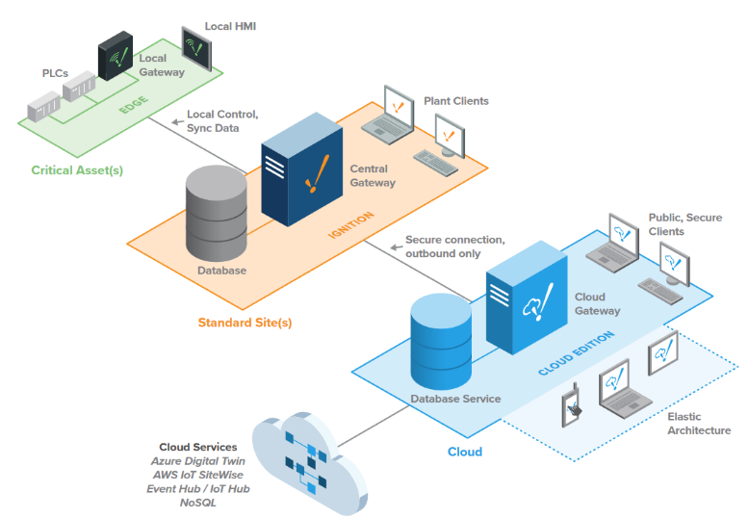
Local HMI
Cloud Hybrid Architecture
Plant Clients
Local Control,
Sync Data
Critical Asset(s)
Central Gateway
Public Secure
Clients
Database
Standard Site(s)
Elastic
Architecture
Cloud Services
Azue Digital twin
AWS IoT SiteWise
Event Hub / IOT Hub
No SQL
Cloud
Notes:
Cloud Hybrid Architecture
The Cloud Hybrid architecture enables you to secure and distribute data at any level.
Use Ignition Edge to ensure data from critical assets is never compromised. Use
standard Ignition to connect multiple sites to a central corporate server. And use Ignition
Cloud Edition to build elastic enterprise architectures that scale on demand using public
or private clouds. Because AWS and Azure host Ignition Cloud Edition, users aren't
responsible for maintaining cloud server hardware; this means you can provision and
release additional storage and cloud computing power based on demand, allowing you
to develop and deploy enterprise applications and grow their architecture more quickly

Slide 47
Cyber range & operations on SCADA
Topic 4 – Vulnerablities

Slide 48

Security Challenges
Ineffective workflow between IT and OT
Limited visibility of OT assets / Legacy
Lack of segmentation
Prevention of Malicious actions
Notes:
To successfully connect and secure the industrial environment, all stakeholders must work together. Operational technology (OT) teams understand the industrial environment—the devices, the protocols, and the operational processes. Information technology (IT) teams understand the network. The security team understands threats and vulnerabilities. By working together, these specialists can leverage existing networking and security technologies, tools, and expertise to constantly protect the industrial systems without disrupting production safety and uptime.
The Cisco Industrial Threat Defense solution is intended to be used by IT, OT, and security teams and their relevant partners and system integrators. Operations will appreciate the ease of use and simple deployment, as well as the broad support of various IACS vendors and protocols. IT network managers will appreciate the ability to apply skills, technology, and applications already deployed in the enterprise when looking to integrate production environments. Security teams will have visibility into industrial assets and security events with context enriched by control engineers.
Security Challenges
As highlighted in Figure 1, the first key challenge when securing the IACS is collaboration between IT and OT teams. The view that OT and IT are distinctly separate entities is antiquated. Failing to acknowledge the increasingly interconnected nature of OT and IT can have detrimental consequences for industrial organizations. A lack of trust, understanding, and collaboration between OT and IT departments can have a devastating impact on the security posture of an organization.

Slide 49
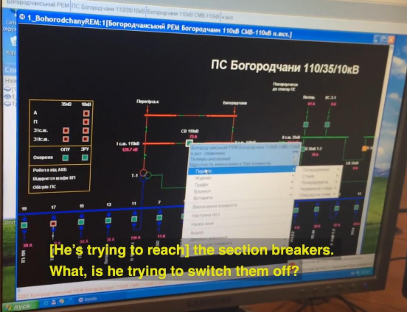
Observed Attacks
Actual moment when an operator realized he lost the view and control of a power grid during a cyber-attack on a regional power utility in Ukraine on Dec 23, 2015.
For a while he thought the about a funny trick on him as he watched how the mouse moved by itself and clicked open the breakers at 30 substations.
The investigation after the attack revealed that the system was penetrated and compromised
months before.

Slide 50
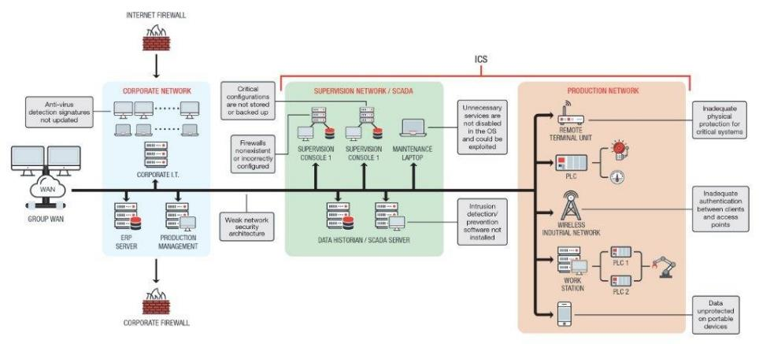
List of vulnerabilities
Industrial Control System
2
1
Critical Configurations are not stored or backed up
5
7
Anti-Virus detection Signatures not updated
Unnecessary services are not disabled in the OS and could be exploited
Inadequate Physical protection for critical systems
3
Firewall non existent or incorectly configured
8
6
Inadequate authentication between clients and access points
4
Intrusion detection / prevention software not installed
Weak network security architecture
9
I T
O T

Slide 51
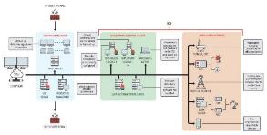
Analysis of the 9 Use Cases - Methodology
Who : Pepetrator / potential source of the incident
Where : Potential point of weakness within the architecture
What : Description of the incident
When : Preferred timing for an attack
What for : Impact / effect on the targeted infrastructure / capability
How : Way the incident is happening
Example Provent indident of the type in the past decade
1
2
5
7
3
4
6
8
9

Slide 52
Use cases - vulnerabilities
1
Viral attack
Who : Operator used to the environment
Where : Locally within the control Center / Room
What : Viral attack on OT network controlling a capability
When : At any time
What for : Disable a system (e.g. a production capability)
How : Introducing a virus in a « non up-to-date » contrôler
Example STUXNET
1
2
5
7
3
4
6
8
9

Slide 53
Use cases - vulnerabilities
2
Resilience default
Who : Entity Admin
Where : On the Supervision storage of the Entity / industrial facility
What : External incident conducting to loss of administration service
When : In particular when the facility endures other issues / incidents (loss of electricity)
What for : Disable the system for a longer period
How : By insufficient or non-adapted Security Operating Procedures (SECOPS)
Example MAERSK
1
2
5
7
3
4
6
8
9

Slide 54
Use cases - vulnerabilities
3
Firewall outage
Who : Co-worker
Where : Locally within the control Center / Room – remote if distant administration deployed
What : Attack on non existing or uncorrectly configured firewall
When : At any time
What for : Take the control of a system (e.g. a production capability)
How : Escalation of rights
Example Classic attack
1
2
5
7
3
4
6
8
9

Slide 55
Use cases - vulnerabilities
4
Network weakness
Who : Network Engineer
Where : Entreprise Local Area Network
What : Weak network architecture
When : At any time
What for : Find identified / weak elements of the network to target them
How : Access to OT architecture via IT network (no segregation)
Example Intelligence acquisition to plan future attack
1
2
5
7
3
4
6
8
9

Slide 56
Use cases - vulnerabilities
5
Exploitation of services in the OS
Who : Maintenance Engineer
Where : SCADA Maintenance Laptop localisation (can be remote)
What : Unnecessary services are not disabled in the OS
When : During Maintenance operations
What for : Introduce malicious code
How : Access via non-disabled services (writting, erasing,…)
Example : Dataset extraction
1
2
5
7
3
4
6
8
9

Slide 57
Use cases - vulnerabilities
6
Lack of Intrusion Detection capabilities
Who : Internal ICT expert
Where : ICT Security room / Data Historian / SCADA server
What : Lack of Cybersecurity services
When : Any time
What for : Introduction in a specific type of automate
How : Direct access of Data Historian / SCADA server via right escalation
Example Intelligence acquisition to plan future attack
1
2
5
7
3
4
6
8
9

Slide 58
Use cases - vulnerabilities
7
Physical access to PLC
Who : Coworker on site
Where : On industrial production site
What : Acces via accessible remote terminal unit
When : Mostly out of normal working periods
What for : Disable /destroy the production capacity
How : Access to OT architecture via IT network (no segregation)
Example UKR sabotage of Oil & Gaz facilities
1
2
5
7
3
4
6
8
9

Slide 59
Use cases - vulnerabilities
8
Access via OT wireless Network
Who : Potentially every co-worker/person in range of Wifi network
Where : Wireless PRC / SCADA Network
What : Weak Authentification provide access to connected PRC/ SCADA
When : At any time
What for : Disable PRC network or establish a cartography
How : Access Wireless network via weak network
Example /
1
2
5
7
3
4
6
8
9

Slide 60
Use cases - vulnerabilities
9
Acces to PRC / SCADA data
Who : Concurrent Company
Where : SCADA Laptop / tablet used to exploit data provided by SCADA
What : Access to poorly secured data
When : At any time
What for : Exploit data - Intelligence
How : Access to devices
Example Economical Intelligence
1
2
5
7
3
4
6
8
9

Slide 61
Cyber range & operations on SCADA
Topic 5 – Penetration Platform
Reference
Scenarios
Hands on training
Exploitation of results
LL / LI

Slide 62
References
NIST SP 800-82: Guide to Industrial Control Systems (ICS) Security
ISA : International society of automation
ISA/IEC 62443 Cybersecurity for Industrial Automation and Control Systems
NIST Cybersecurity Framework (CSF)
ISO/IEC 27001: Information security management systems
OWASP Top 10 security risk for ICS Security
SANS : Institute Top 20 Critical Security Controls for Effective Cyber Defense
ENISA : (EU Agency for Cybersecurity) Good Practices for Industrial Control Systems Security CIS Controls for OT Security
FERC : (Federal Energy Regulatory Commission) Cyber Security and Physical Security Standards.
NATO ENSEC COE : Guide for protecting industrial automation and control systems against cyber incidents (NATO energy Security center of excellence)

Slide 63


References – NATO ENSEC COE

Slide 64

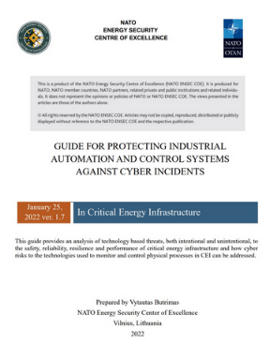
GUIDE FOR PROTECTING INDUSTRIAL AUTOMATION AND CONTROL SYSTEMS AGAINST CYBER INCIDENTS
I. Industrial cyber security
II. IACS operator considerations
III. How we can protect identified assets from identified threats?
IV. Tools in the enterprise Cybersecurity Program toolbox.
Asset management system
Standards
Documentation
Testing /exercices to improve the level of maturity in industrial cybersecurity
Secure Coding Practices for PLC’s
Patching and updating software and firmware
Network security
Project management with integration firm
Backups
Source code control system
Self-integrity monitoring
User and role access ids
Industrial Cybersecurity Operations Center ICOC
V. Thoughts for the future

Slide 65
Scenarios description - Modules
CIRM Level 0
CIRM Level 1
CIRM Level 2
SCADA
Pentesting
Network & Memory Forensic
SQL Injection
Wanacry
IT to OT
DDoS
Data extraction
Lateral Movement Web2LAN
Botnet infection and DDoS Attack
SQL injection
Man in the Middle Attack
DDos
Duqu Infection & Spreading
Evolved Scenario
Social Engineering & Brutal Force
Malicious PLC
Crypto locker
Remote Access Trojan
Evolved Scenario with Multi-exploitation
2FA Hacking & Data Exfiltration

Slide 66
Hands on Training
CIRM Level 0
IT to OT : OT / ICS Penetration testing identifies potential entry points using non-intrusive techniques to identify vulnerabilities in the OT network. These techniques can include vulnerability scanning, network mapping, and analysis of network traffic.
OT Penetration Testing can also involve more intrusive techniques, such as attempting to exploit vulnerabilities discovered during the initial assessment. This allows the penetration tester to demonstrate the potential impact of an attack and provide recommendations for improving the security of the OT environment.
Vulnerabilities in the PLCs (software and hardware) as well as weaknesses in the network architecture and configurations are exploited using vulnerability scanning, network mapping, and analysis of network traffic.
CIRM Level 1
CIRM Level 2
SCADA
Pentesting
Man in the middle Attack : A man-in-the-middle attack is a form of eavesdropping attack in which an attacker intercepts a information or data transfer in progress. The attacker poses as genuine participant after inserting himself in the “middle”. This allows him to intercept information from both parties and perform malicious tasks.
Basically, every ICS/SCADA device is monitored and controlled via an controller /HMI system and its graphic interface allowing to monitor the sensors and activate the effectors (a given pressure level activates a pump and can open a circuit).
Imagine a scenario where the HMI sends a signal to turn OFF a device but the signal is sniffed midway by an attacker and changed the signal to turn ON and then transmitted. This attack can cause mass destruction to an industrial facility.
Network & Memory Forensic
SQL Injection
Wanacry
IT to OT
DDoS
Malicious PLC: Programmable logic controllers (PLCs) are parts of industrial control systems (ICS). They receive data from sensors, process it and – based on the data and their pre-programmed logic – deliver outputs to effectors that control industrial processes (pumps, engines,…).
n recent years the PLC’s firmware layer, have begun to include an embedded webserver to ease configuration and control via customizable web services and APIs. Unfortunately, it also improved remote access possibilities for attackers.
While previous attacks on PLCs infected either the control logic or firmware portions of PLC computation, Malicious PLC’s attacks exclusively infects the web application hosted by the embedded webservers within the PLCs.
Data extraction
Lateral Movement Web2LAN
Botnet infection and DDoS Attack
SQL injection
Man in the Middle Attack
DDos
Duqu Infection & Spreading
Evolved Scenario
Social Engineering & Brutal Force
Malicious PLC
Crypto locker
Remote Access Trojan
Evolved Scenario with Multi-exploitation
2FA Hacking & Data Exfiltration

Slide 67
Hands-on Training – Additional use-cases
Programming a PLC / HMI + Integrating Level-0 Field devices (1 day)
Securing Architectures (1 day)
Communication protocols –(Network / Industry protocols) – (1 day)
Hands-on specific use cases
  Finding Passwords in Embedded Devices
  Exploring Fieldbus communication protocols
  Network Capture and forensics of an attack
  Bypassing Auth via SQL Injection
  Password Fuzzing / Brutte force
  Finding Remote Access
  Baselining with PowerShell
  Configuration of Host-Based Firewalls
  Analysis of Windows Event Logs
  Incident Response Tabletop Exercise
Notes:
Fieldbus Protocol : Fieldbus is a communication protocol used in automation and control systems to facilitate real-time data exchanges between different connected

Slide 68
Hands-on Training – Additional use-cases
Dedicated session - Links
  Finding passwords in Embedded Devices
  Exploring Fieldbus Comms protocols
  Network Capture and forensics of an attack
  Bypassing Auth via SQL Injection
  Password Fuzzing / Brutte force
  Finding Remote Access
  Configuration of Host-Based Firewalls
  Analysis of Windows Event Logs
  Incident Response Tabletop Exercise

Slide 69
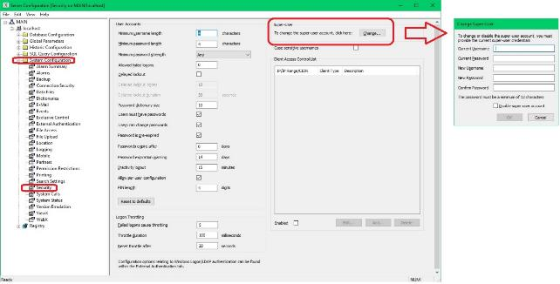
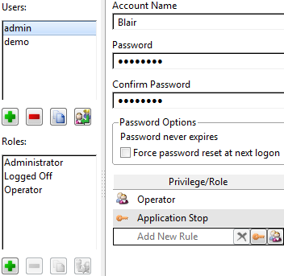
Hands-on Training – Additional use-cases
Dedicated session - Links
  Finding passwords in Embedded Devices
List of default passwords for widespread SCADA systems
Russian security researchers - SCADA Strangelove team - have published a list of
ICS/SCADA manufacturers that put their clients at risk by providing equipment with weak default access credentials.
This is a list of SCADA equipment, used in various industry fields, which comes with simplistic default administration credentials. These admin logins are shipped with every product, and they are detailed in each product's manual. Usually, the equipment’s new owners change these credentials as soon as the equipment is installed. Or at least in theory.

Slide 70
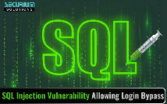
Hands-on Training – Additional use-cases
Dedicated session - Links
  Bypassing Auth via SQL Injection
SQL injection is a web security vulnerability that allow attackers to interfere with the queries that an App makes to its database. It allows to view data that they are not normally able to retrieve, including data belonging to other users. Attackers can modify or delete data, causing persistent changes to the application’s content or behavior.
A successful SQL injection attack can result in unauthorized access to passwords or user information. In some cases, an attacker can obtain a persistent backdoor into a systems, leading to a long-term compromise.
SQL injection can be detected using sets of tests against every entry point in the application :
Submitting the single quote character ‘ and looking for errors or other anomalies.
Submitting some SQL-specific syntax that evaluates to the base (original) value of the entry point, and to a different value, and looking for systematic differences in the resulting application responses.
Submitting Boolean conditions such as OR 1=1 and OR 1=2 and looking for differences in the application’s responses.
Submitting payloads to trigger time delays when executed via SQL query & looking for differences in the responses.
Submitting OAST payloads designed to trigger an out-of-band network interaction when executed within an SQL query, and monitoring for any resulting interactions.
Notes:
What is SQL Injection?
SQL injection is a web security vulnerability that allows an attacker to interfere with the queries that an application makes to its database. It generally allows an attacker to view data that they are not normally able to retrieve. This might include data belonging to other users, or any other data that the application itself is able to access. In many cases, an attacker can modify or delete this data, causing persistent changes to the application’s content or behavior.
What is the impact of a successful SQL injection attack?
A successful SQL injection attack can result in unauthorized access to sensitive data, such as passwords, credit card details, or personal user information. Many high-profile data breaches in recent years have been the result of SQL injection attacks, leading to reputational damage and regulatory fines. In some cases, an attacker can obtain a persistent backdoor into an organization’s systems, leading to a long-term compromise that can go unnoticed for an extended period.
SQL injection examples
There are a wide variety of SQL injection vulnerabilities, attacks, and techniques, which arise in different situations. Some common SQL injection examples include:
Retrieving hidden data, where you can modify an SQL query to return additional results.
Subverting application logic, where you can change a query to interfere with the application’s logic.
UNION attacks, where you can retrieve data from different database tables.
Examining the database, where you can extract information about the version and structure of the database.
Blind SQL injection, where the results of a query you control are not returned in the application’s responses.
How to detect SQL injection vulnerabilities
The majority of SQL injection vulnerabilities can be found quickly and reliably using Burp Suite’s web vulnerability scanner.
SQL injection can be detected manually by using a systematic set of tests against every entry point in the application. This typically involves:
Submitting the single quote character ‘ and looking for errors or other anomalies.
Submitting some SQL-specific syntax that evaluates to the base (original) value of the entry point, and to a different value, and looking for systematic differences in the resulting application responses.
Submitting Boolean conditions such as OR 1=1 and OR 1=2, and looking for differences in the application’s responses.
Submitting payloads designed to trigger time delays when executed within an SQL query, and looking for differences in the time taken to respond.
Submitting OAST payloads designed to trigger an out-of-band network interaction when executed within an SQL query, and monitoring for any resulting interactions.

Slide 71
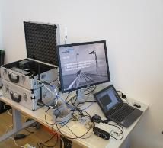
Hands-on Training – Additional use-cases
Dedicated session - Links
On Hands Training
  Configuration of Host-Based Firewalls

Slide 72
Hands-on Training – Additional use-cases
Dedicated session - Links
  Exploring Fieldbus Comms protocols
On Hands Training

Slide 73
Hands-on Training – Additional use-cases
Dedicated session - Links
  Password Fuzzing / Brutte force
On Hands Training

Slide 74
Hands-on Training – Additional use-cases
Dedicated session - Links
  Analysis of Windows Event Logs
On Hands Training

Slide 75
Hands-on Training – Additional use-cases
Dedicated session - Links
  Network Capture and forensics of an attack
On Hands Training

Slide 76
Hands-on Training – Additional use-cases
Dedicated session - Links
  Finding Remote Access
On Hands Training

Slide 77

Hands-on Training – Additional use-cases
Dedicated session - Links
  Incident Response Tabletop Exercise
On Hands Training

Slide 78

Questions ?

Slide 79
Avis ANSSI – 5 mai 2024
Dedicated session - Links
ÉTATS-UNIS - Publication d'un avis conjoint sur la défense des systèmes industriels ciblés par des hacktivistes
Le 1er mai 2024, le journal Bleeping Computer rapporte la publication, d'un avis nommé « Défendre les opérations des technologies industrielles contre l'activité hacktiviste pro-russe en cours » par six entités gouvernementales étatsuniennes (CISA, FBI, NSA, EPA (Agence de Protection Environnementale), DOE (Département de l'Énergie), USDA (Département de l'Agriculture des États-Unis ), FDA (Food and Drug Administration) et le Centre de partage et d'analyse d'informations multi-États (MS-ISAC)) ainsi que le Centre canadien pour la cybersécurité (CCCS) et le Centre national de cybersécurité du Royaume-Uni ( NCSC-Royaume-Uni). Ce document a pour objectif de mettre en garde les sociétés contre « les hacktivistes pro-russes ciblant les appareils des technologies industrielles non sécurisés et mal configurés depuis 2022 pour perturber les opérations ou créer des effets de nuisance ». Il y est également partagé des mesures de mitigation, surtout pour VNC particulièrement ciblé

