Slide 1


Alerting, Reporting, & Monitoring Strategies for Cybersecurity in the Energy Sector
CSP011_S_E
PRESENTATION BY: Dimitra Siaili

Slide 2


Slide 3



Goals: Who-What-Why you need to take this training
WHO
WHAT
WHY
Cybersecurity strategies tailored for the energy sector & demo of alerting reporting &monitoring via Security information & event management tool.
Attendees will gain practical insights through demos on topics such as real-time notifications, reports on system status, &continuous monitoring of critical infrastructures.
Energy sector professionals
and/or IT professionals with Basic IT Knowledge

Slide 4



CSP Training Logistic: When-Where-How
WHEN
WHERE
HOW
Time schedule:
2024 – 2025
CyberSecPro EU funded project
ONSITE & ONLINE
Hands on Training

Slide 5

Value Propositions
Benefits to Participants
Level of Training Module: Basic
Understanding of cyber threats and vulnerabilities specific to the energy sector.
Familiarity with real-time threat notification systems and basic implementation skills.
Knowledge of cloud-based security management platforms for infrastructure monitoring.
Ability to configure basic real-time threat notifications via email and Slack alerts.
Introduction to using the Security Infusion tool for vulnerability identification.
Basic proficiency in generating simple reports on system status and vulnerabilities.
Introduction to setting up continuous infrastructure monitoring using cloud-based tools.
Basic skill in analyzing historical events for surveillance of critical energy systems.
Awareness of cybersecurity strategies tailored to the energy sector.
Introduction to responding to cybersecurity incidents in energy environments.

Slide 6

WHO
Profile of Training Participants
Energy sector professionals
In particular:
IT Security Professionals on energy sector
Even at a basic level, this seminar can reinforce fundamental concepts and provide hands-on experience with specific tools, which is valuable for individuals responsible for safeguarding the digital infrastructure of energy companies, especially entry-level ones.
System Administrators & Network Engineers
These roles are directly responsible for configuring and maintaining IT infrastructure within energy companies, making them essential participants in basic cybersecurity training to ensure they have a solid understanding of security principles.
Managers and Executives
Decision-makers within energy companies should have a foundational understanding of cybersecurity concepts and strategies to make informed decisions regarding resource allocation and risk management.
Compliance Officers within Energy Companies
Individuals responsible for ensuring regulatory compliance in the energy sector should be aware of cybersecurity best practices to avoid potential breaches and penalties.
Selected Employees
such as those involved in critical operations or handling sensitive data, could benefit from basic cybersecurity training to enhance overall organizational resilience.

Slide 7
WHO
Profile of Training Participants
Irrespective of their affiliation with the energy sector:
  IT Security Professionals (particularly those at the entry level)
  System Administrators, Network Engineers
  Cybersecurity students & enthusiasts
The seminar offers a valuable opportunity for participants to gain practical insights into cybersecurity strategies and to develop an understanding of industry challenges.
Moreover, the hands-on demonstrations and exercises featured in the seminar serve to complement theoretical knowledge, enhancing their understanding of cybersecurity concepts and tools.

Slide 8

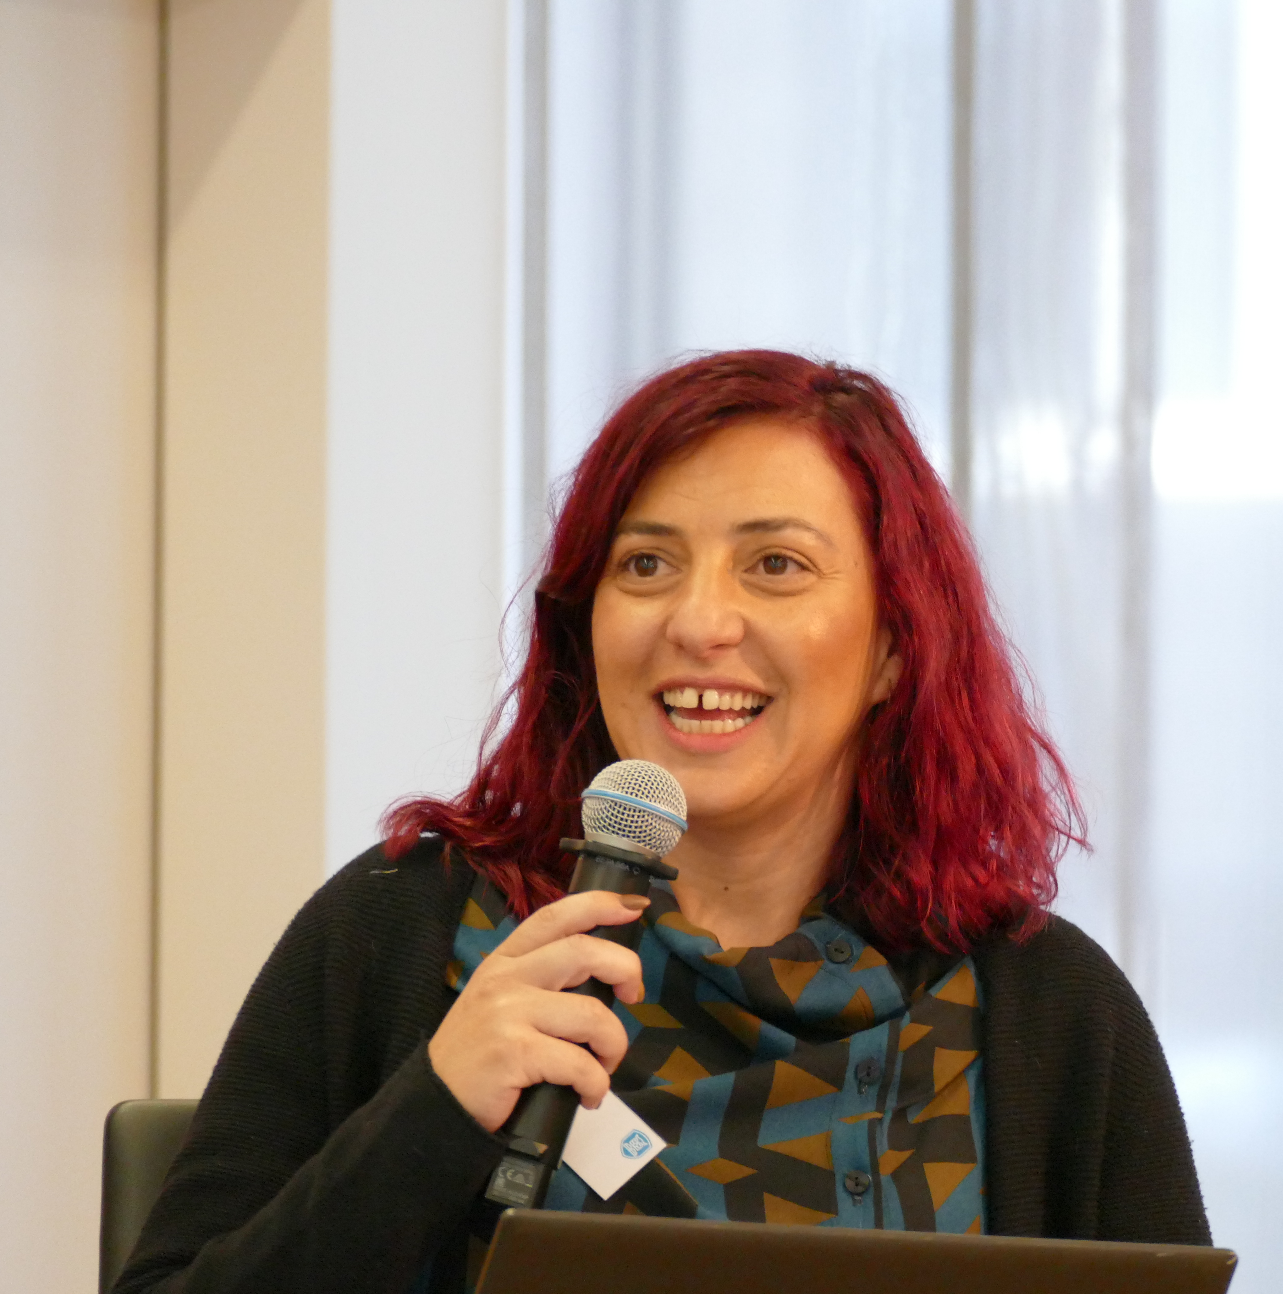
WHO
Profiles of Trainer
Dimitra Siaili is an accomplished Researcher and Project Manager specializing in EU-funded cybersecurity projects at ITML. Leveraging her academic foundation in Electrical Engineering and Computer Technology from the Polytechnic School of Patras, encompassing both undergraduate and postgraduate studies, she has demonstrated proficiency in spearheading extensive research initiatives. In addition to her cybersecurity prowess, Dimitra brings extensive experience in the realms of smart cities and IoT, having contributed significantly to projects aimed at enhancing urban infrastructure and connectivity. ITML stands at the forefront of innovation, pioneering cybersecurity solutions through involvement in dozens of groundbreaking research projects. With a steadfast commitment to excellence, ITML harnesses its expertise on cybersecurity to deliver cutting-edge technologies and services tailored to meet the evolving challenges of the digital landscape. Renowned for its strategic collaborations and track record of success in securing EU funding, ITML continues to shape the future of cybersecurity, empowering businesses, and organizations worldwide to navigate the complexities of cyberspace with confidence.

Slide 9

WHAT
Training Topics
Introduction to Cyber Ranges in the Energy Sector
Real-time Threat Notifications and Response
Vulnerability Management and Reporting
Continuous Infrastructure Monitoring with Cloud-Based Tools
Future Trends and Considerations in energy domain

Slide 10

WHY
Learning Outcomes
Understanding of cyber threats and vulnerabilities specific to the energy sector.
Familiarity with real-time threat notification systems.
Basic knowledge of cloud-based security management platforms for infrastructure monitoring.
Ability to configure basic real-time threat notifications via email and Slack alerts.
Introduction to using the Security Infusion tool for vulnerability identification.
Basic proficiency in generating simple reports on system status and vulnerabilities.
Introduction to setting up continuous infrastructure monitoring using cloud-based tools.
Awareness of cybersecurity strategies tailored to the energy sector.
Introduction to responding to cybersecurity incidents in energy environments.

Slide 11

Training Outline
Part-1
Topic-1 Introduction to Cybersecurity in the Energy Sector
Cybersecurity challenges specific to the energy industry
Case studies illustrating the importance of cybersecurity in energy infrastructure protection
Topic-2 Vulnerability Management and Reporting
Vulnerability Management lifecycle diagram
Overview of vulnerability management principles in energy operations.
Best Practices in Vulnerability Management.

Slide 12
Training Outline
Part-2
Topic-3: Real-time Threat Notifications and Response
Common Cyber Threats Targeting Energy Infrastructure.
Best Practices for Swift Cyber Incident Response
Overview of Cyber Ranges and SIEM Tools
Topic-4: Continuous Infrastructure Monitoring with Cloud-Based Tools
Introduction to cloud-based management platforms for infrastructure monitoring.
Hands-on exercises on using the Security Infusion tool to identify and remediate vulnerabilities.
Creating actionable reports on system status and vulnerabilities for stakeholders
Live demonstration of setting up continuous monitoring of critical energy systems.
Demonstration of how to use a centralized dashboard to analyze historical events and ensure 24x7 surveillance and examining any low-level historical event, if needed.

Slide 13
Training Outline
Part-2
Topic-5 Collaboration & Knowledge Sharing
Discussion on the importance of ongoing education and training for cybersecurity professionals in the energy domain.
Reflection on key takeaways from the seminar and recommendations for continued improvement in energy cybersecurity strategies

Slide 14


Evaluation method
Outline the evaluation elements and assessment process
Self-assessment forms a fundamental component, providing each participant with an opportunity to reflect on their learning journey and gauge their understanding of the cybersecurity strategies discussed.
Additionally, evaluation from the trainer encompasses participant communication and interaction, with a focus on fostering critical thinking through open discussions. This collaborative environment not only enhances participants' comprehension of cybersecurity concepts but also encourages exploration of critical aspects specific to the energy domain.
Upon successful completion of the seminar, participants will receive a Certificate of Attendance, acknowledging their dedication to expanding their knowledge of cybersecurity within the context of Healthcare.

Slide 15

Background Knowledge and Prerequisites
Background knowledge:
Basic understanding of computers and networking
Basic IT and security Knowledge
Awareness of cybersecurity
_{Prerequisites:}
None

Slide 16

Technical Tools and Other Requirement
Technical Tools
Nothing Prerequisite
_{Other Requirements}
Knowledge of Basic Computer Concepts / Awareness of Internet Security Practices / Willingness to Learn and Experiment / Active Participation

Slide 17

Resources: Books and Reference Material
Ferrag et al., "Cyber Ranges and TestBeds for Education, Training, and Research," discusses the development and application of cyber ranges, highlighting their importance in training and preparing cybersecurity professionals​ (MDPI)​.
"A Review of Cyber-Ranges and Test-Beds: Current and Future Trends," reviews various cyber range platforms and their applications in training scenarios, emphasizing their role in enhancing cyber situational awareness​ (MDPI)​.
The European Union Agency for Cybersecurity (ENISA) has several reports on best practices for threat detection and real-time response in critical infrastructure sectors, including energy​ (ECSO)​.
The World Economic Forum discusses the specific vulnerabilities of the energy sector to cyber attacks and the importance of real-time threat management systems​ (World Economic Forum)​.
The ENISA provides guidelines and case studies on the use of cloud-based monitoring tools for securing energy infrastructure​ (ECSO)​.
Research articles discuss the benefits and challenges of implementing continuous monitoring systems in the energy sector, with a focus on cloud-based solutions​ (ECSO)​.
The World Economic Forum and other industry reports outline future trends and innovations in cybersecurity for the energy sector, including the increasing use of AI and blockchain technologies​ (World Economic Forum)​.
Research papers on the future of cyber ranges highlight their evolving capabilities and potential future applications​ (MDPI)​​ (MDPI)​.

Slide 18

Registration: How to register and other practical information
The specific registration process for the Cybersecurity Essentials and Management training may vary depending on the training provider or institution. However, the general steps are typically straightforward and can be completed online or in person.
Online Registration
In-Person Registration
Additional Practical Information

Slide 19

Course progress
o1.
Introduction to Cybersecurity in the Energy Sector
o2.
Vulnerability Management and Reporting
o3.
Real-time Threat Notifications and Response
o4.
Continuous Infrastructure Monitoring with Cloud-Based Tools
o5.
Collaboration & Knowledge Sharing.

Slide 20

Introduction in Cybersecurity in the Energy Sector
The energy sector is critical for national security, economic stability, and public safety.
Increasing digitalization and interconnectivity expose energy infrastructure to cyber threats.

Slide 21
Introduction to Cybersecurity in the Energy Sector
Key Challenges
Complexity of Infrastructure
  Integration of legacy systems with modern technologies.
  Diverse range of devices and protocols.
High Value Targets
  Energy infrastructure is a prime target for nation-state actors and cybercriminals.
  Potential for large-scale disruptions and economic impact.
Regulatory Compliance
  Stringent regulations and standards (e.g., NERC CIP, ISO 27001).
  Ensuring compliance while maintaining operational efficiency.

Slide 22
Introduction to Cybersecurity in the Energy Sector
Key Challenges
Advanced Persistent Threats (APTs)
  Sophisticated, long-term cyber-attacks aimed at stealing data or disrupting operations.
  Often involve multiple attack vectors and evasion techniques.
Insider Threats
  Risks from employees or contractors with privileged access.
  Potential for accidental or malicious actions leading to security breaches.

Slide 23
Introduction to Cybersecurity in the Energy Sector
Case Study 1: Ukraine Power Grid Attack (2015)
Case Study 2: Colonial Pipeline Ransomware Attack (2021)
Description: Coordinated cyberattack on Ukraine’s power grid causing widespread outages.
Impact: Disruption of power supply to approximately 230,000 people.
Lessons Learned: Importance of incident response plans and real-time monitoring.
Description: Ransomware attack leading to the shutdown of a major U.S. fuel pipeline.
Impact: Fuel shortages and significant economic disruption.
Lessons Learned: Need for robust cybersecurity measures and contingency planning.
Case Study 3:
Triton Malware Incident
(2017₎
Description: Malware targeting industrial
control systems (ICS) in a petrochemical plant.
Impact: Attempted to cause physical damage by disabling safety systems.
Lessons Learned: Criticality of securing ICS and implementing layered defenses.

Slide 24
Introduction to Cybersecurity in the Energy Sector
Overview of Cyber Ranges and SIEM Tools
SIEM tools
Cyber Ranges
Visuals?
Diagram illustrating how a cyber range operates.
Flowchart showing the functionality of SIEM tools within a cyber range.

Slide 25
Course progress
o1.
Introduction to Cybersecurity in the Energy Sector
o2.
Vulnerability Management and Reporting
o3.
Real-time Threat Notifications & Response
o4.
Continuous Infrastructure Monitoring with Cloud-Based Tools
o5.
Collaboration & Knowledge Sharing.

Slide 26
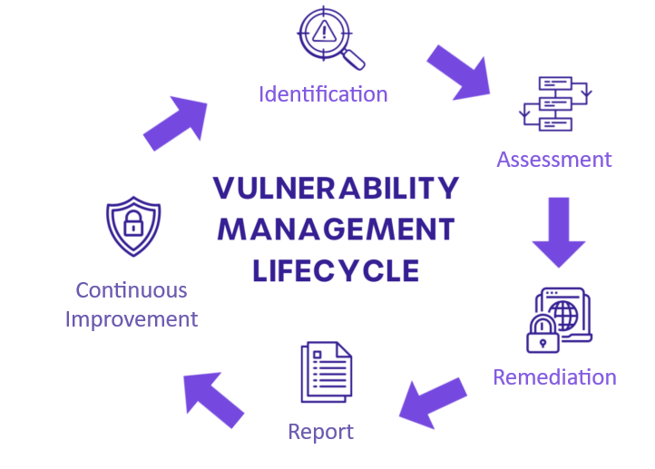
Vulnerability Management and Reporting
Principles of Vulnerability Management
in Energy Operations
Vulnerability management is a critical component of cybersecurity, aimed at identifying, assessing, and mitigating security weaknesses within systems and infrastructure.

Slide 27
Vulnerability Management and Reporting
Identification
Conduct regular and comprehensive scans to detect vulnerabilities across all assets, of both IT and Operational Technology (OT) environments to identify vulnerabilities.
Utilize automated tools specifically designed for industrial control systems (ICS) and SCADA systems.
Assessment
Prioritize vulnerabilities based on potential impact on critical energy infrastructure, their severity and exploitability
Apply risk assessment methodologies to determine the urgency of remediation efforts, in the context of both cyber and physical security
Consider factors specific to energy operations, such as the criticality of affected systems and regulatory requirements.
Continuous Improvement:
Continuously monitor systems for new vulnerabilities and re-evaluate existing ones.
Update vulnerability management processes and tools to adapt to evolving threats and technologies.
Conduct regular reviews and audits to ensure the effectiveness and compliance of the vulnerability management program.
Remediation
Develop and implement a remediation plan that includes patch management, configuration changes, and other corrective actions.
Coordinate with various teams, including IT, OT, and compliance, to ensure timely and effective remediation.
Establish a timeline for remediation based on the risk assessment and criticality of assets.
Reporting
Maintain detailed records of identified vulnerabilities, assessment results, and remediation actions.
Provide regular reports to stakeholders, including management and regulatory bodies (e.g., NERC CIP) to demonstrate compliance and transparency.
Use dashboards and visualizations to track and communicate the status of vulnerability management efforts.

Slide 28
Vulnerability Management and Reporting
Best Practices in Vulnerability Management for the Energy Sector
Regular Scanning and Monitoring
                Schedule frequent vulnerability scans and continuous monitoring to detect new vulnerabilities promptly.
                Use both automated tools and manual reviews to ensure comprehensive coverage.
                Use specialized tools for monitoring industrial control systems (ICS).
Patch Management
Establish a systematic patch management process to apply security updates promptly, ensuring minimal disruption to critical operations.
Test patches in a controlled environment before deployment to avoid disrupting critical operations.
Risk-Based Approach
Prioritize vulnerabilities based on risk, focusing on those that pose the highest threat to critical infrastructure.
Use risk metrics such as CVSS scores, potential impact, and exploit availability.
Cross-Functional Collaboration
Foster collaboration between IT, OT, and security teams to address vulnerabilities effectively.
Ensure all stakeholders are aware of their roles and responsibilities in the vulnerability management process.
Incident Response Integration
Integrate vulnerability management with the incident response plan to ensure swift action when vulnerabilities are exploited.
Conduct joint drills and simulations to improve coordination and response capabilities.
Regulatory Compliance
Ensure adherence to industry-specific regulations and standards such as NERC CIP, ISO 27001, and IEC 62443.
Maintain documentation and evidence of compliance to facilitate audits and demonstrate commitment to security.

Slide 29
Course progress
o1.
Introduction to Cybersecurity in the Energy Sector
o2.
Vulnerability Management and Reporting
o3.
Real-time Threat Notifications & Response
o4.
Continuous Infrastructure Monitoring with Cloud-Based Tools
o5.
Collaboration & Knowledge Sharing

Slide 30

Real-time Threat Notifications & Response
Common Cyber Threats
Targeting Energy Infrastructure
Phishing Attacks
Description: Deceptive emails designed to trick recipients into revealing sensitive info.
Impact: Can lead to unauthorized access to networks and systems.
Ransomware
Description: Malicious software that encrypts data & demands a ransom for its release.
Impact: Can disrupt operations and lead to significant financial losses.
Advanced Persistent Threats (APTs)
Description: Long-term targeted attacks often conducted by nation-state actors.
Impact: Infiltration of networks to steal information or sabotage operations.
Denial of Service (DoS) Attacks
Description: Overloading systems with traffic to make them unavailable.
Impact: Can interrupt services and impact operational continuity.
Malware
Description: Malicious software designed to damage or disable systems.
Impact: Can compromise the integrity and availability of critical systems.

Slide 31
Real-time Threat Notifications & Response
Best Practices
for Swift Cyber Incident Response
Incident Response Plan (IRP):
Develop and regularly update a comprehensive IRP.
Ensure it includes procedures for detection, containment, eradication, and recovery.
Regular Training and Drills:
Conduct regular training sessions and simulation exercises for staff.
Use cyber ranges to simulate real-world attack scenarios.
Real-Time Monitoring and Alerts:
Implement continuous monitoring using SIEM tools.
Set up real-time alerts for suspicious activities and anomalies.
Rapid Containment Strategies:
Isolate affected systems to prevent the spread of threats.
Use network segmentation to limit the impact of breaches.
Effective Communication:
Establish clear communication channels for internal and external stakeholders.
Ensure timely and accurate information dissemination during incidents.

Slide 32
Real-time Threat Notifications & Response
Best Practices
for Swift Cyber Incident Response
Incident Response Plan (IRP):
Develop and regularly update a comprehensive IRP.
Ensure it includes procedures for detection, containment, eradication, and recovery.
Regular Training and Drills:
Conduct regular training sessions and simulation exercises for staff.
Use cyber ranges to simulate real-world attack scenarios.
Real-Time Monitoring and Alerts:
Implement continuous monitoring using SIEM tools.
Set up real-time alerts for suspicious activities and anomalies.
Rapid Containment Strategies:
Isolate affected systems to prevent the spread of threats.
Use network segmentation to limit the impact of breaches.
Effective Communication:
Establish clear communication channels for internal and external stakeholders.
Ensure timely and accurate information dissemination during incidents.

Slide 33
Real-time Threat Notifications & Response
Overview of Cyber Ranges and SIEM Tools
SIEM tools
Cyber Ranges
Definition: Security Information and Event Management (SIEM) tools collect and analyze security data.
Functions: Real-time threat detection, incident response, and compliance reporting.
Role in Training: SIEMs can be used in cyber ranges to simulate and understand real-time threat detection and incident response.
Examples: Security Infusion by itml, Splunk, IBM QRadar, ArcSight.
Definition: Virtual environments for simulating cyberattacks and defenses.
Purpose: Training, testing, and improving cybersecurity skills and strategies.
Benefits: Realistic practice scenarios, enhanced preparedness, and improved incident response.

Slide 34
Course progress
o1.
Introduction to Cybersecurity in the Energy Sector
o2.
Vulnerability Management and Reporting
o3.
Real-time Threat Notifications & Response
o4.
Continuous Infrastructure Monitoring with Cloud-Based Tools
o5.
Collaboration & Knowledge Sharing.

Slide 35
Continuous Infrastructure Monitoring with Cloud-Based Tools
Live Demonstrations (Security Infusion)
Introduction to cloud-based management platforms for infrastructure monitoring.
Hands-on exercises on using the Security Infusion tool to identify and remediate vulnerabilities.
Creating actionable reports on system status and vulnerabilities for stakeholders
Live demonstration of setting up continuous monitoring of critical energy systems.
Demonstration of how to use a centralized dashboard to analyze historical events and ensure 24x7 surveillance and examining any low-level historical event, if needed.

Slide 36
Course progress
o1.
Introduction to Cybersecurity in the Energy Sector
o2.
Real-time Threat Notifications & Response
o3.
Vulnerability Management and Reporting
o4.
Continuous Infrastructure Monitoring with
Cloud-Based Tools
Collaboration & Knowledge Sharing.
o5.

Slide 37

Collaboration & Knowledge Sharing
Please Raise Your Hand &
Introduce Yourself!
Profile info: Do you work within the Energy sector? Are you a cybersecurity specialist? How familiar are you with the discussed topics?
Thoughts on the Seminar: What aspects resonated with you the most?
Additional Thoughts: Do you have anything to add?

Slide 38

Thank you
Please send all questions to:
disiaili@itml.gr

