Slide 1


2
B
Pentesting for Maritime
Workshop
Focus on
AIS / GNSS / ECDIS
onsulting
CSP0010_W_M
www.cybersecpro-project.eu
PRESENTATION BY: BRUNO BENDER
Notes:
Good morning dear audience
The AIS hacking work-place training aims at describing the maritime environment and specificities. A focus is done on the AIS standards and specificities as well as on international regulation. Common vulnerabilities of AIS/GNSS systems and applications are detailed; Methods and examples of hacking and spoofing of these systems are demonstrated during the course.
Risk analysis, security plans, policies and processes, regulatory framework and security standards continuity and recovery measures are presented.

Slide 2




Pentesting for Maritime
Workshop (AIS – GNSS – ECDIS)
o1.
Identify vulnerabilities of Maritime System for advanced administrators
o2.
Annual course as part of Maritime workshops – presential - Toulon)
o3.
Function and Vulnerabilities of Maritime AIS
o4.
AIS vulnerabilities and example of attacks on AIS systems will be described
o5.
On-hands practice will be made available via a training / Spoofing platform
_{o6.}
Student should be familiar with communication protocols and Maritime systems
_{o7.}
C2B Consulting
115 rue du maréchal Foch –F83.200 LE REVEST – France

Slide 3

www.cybersecpro-project.eu

Slide 4



Goals: This workshop, designed for CIS admin of Maritime systems aims at demonstrating vulnerabilities of AIS to improve their skills for recognizing same attacks
WHO
WHAT
WHY
Mqritime CIS qdministrqtors
Foundational of cybersecurity advanced pentesting for CIS ADMINISTRATORS in the maritime domain
Equipping participants with the knowledge and skills necessary to avoid attacks on their systems

Slide 5



CSP Training Logistic: CSP0010_ Pentesing for Maritime
WHEN
WHERE
HOW
Time schedule: Autumn 2024
ONSITE-Location
Toulon (France)
NMIOTC 5Greece) TBC
On Hands training
Theory
On-hands training

Slide 6

WHO
Profile of Training Participants
Managers and Leaders
Working-life professionals
SMEs and Public Sector Employees
Cybersecurity practitioners and enthusiasts
Maritime CIS developers

Slide 7

WHO
Profile of Trainer
Bruno BENDER
C2B CONSULTING
Former Navy Officer / CIS specialist
Information Security officer
  NATO
  Nationally
  EU
Since 2017 Cybersecurity expert & founder of C2B
  SME specialized in Maritime security / Cybersecurity to support
  Critical Infrastructures
  Operators of essential services
  Maritime companies & harbors
  Public administrations operating at sea

Slide 8
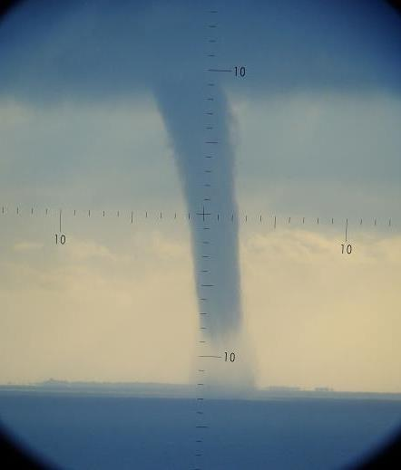
WHAT
Training Topics
What is AIS
User communities
Technical architectures / CIS
  Administrations & AIS
  Technical description
Threats and vulnerabilities
Security Architecture Design and Implementation of AIS
Security Controls Selection and Implementation

Slide 9

WHY
Learning Outcomes
Demonstrate ethical and professional conduct in all aspects of information and cybersecurity management.
Comprehend and articulate the key concepts and principles of information and cybersecurity.
Understand the evolving cyber threat landscape and the diverse range of cyberattacks.
Identifies the cybersecurity threats, vulnerabilities, and risks to an organisation.
Recognises the human factor's role in cybersecurity breaches and risk mitigation strategies.
Ability to help and select appropriate security controls to protect against identified cybersecurity threats and risks.

Slide 10

Topic-1:
Cybersecurity Risks in the Maritime Domain
We will cover these skills
Introduction to information security: This section will introduce the concept of information security and its importance to organisations. It will also discuss the different types of information assets that need to be protected, as well as the different threats and vulnerabilities that these assets face.
Introduction to cybersecurity: This section will focus on the specific threats and vulnerabilities that exist in the cyber domain. It will also discuss the different types of cyber attacks that can be launched, as well as the different ways to mitigate these attacks.
The CIA triad: This section will discuss the three pillars of information security: confidentiality, integrity, and availability. It will explain what each pillar means and why it is important.
Other security models: This section will discuss other security models that can be used to protect information assets. These models include the NIST Cybersecurity Framework, the ISO/IEC 27001 standard, and the COBIT framework.

Slide 11

Topic-2:
AIS Threats and vulnerabilities
We will cover these skills
1. AIS: What is AIS – Legal use and specificities of a system recognized by the Internation Maritime organization (IMO) and the International Transmission Union (ITU)
2. Description of AIS including hardware, software, and networks.
3. Ways AIS has been attecked
  RF jamming
  CYBER Spoofing
  Other

Slide 12
Topic-3:
AIS Forensics
We will cover these skills
1. Attacks on AIS: It covers the different types of attacks and the methods used to avoid or defend against them. It includes topics such as:
2. Systems Security: It covers the security of Automatic information system (AIS), including hardware, software, and networks.
3. Software and Platform Forensic investigations after an attack: including;
  Deployment of solutions
  Analysis of proofs
  Investigations and lessons learned

Slide 13

2
B
Pentesting for Maritime
Workshop
Focus on
AIS / GNSS / ECDIS
onsulting
CSP0010_W_M
PRESENTATION BY: BRUNO BENDER
Notes:
Good morning dear audience
The AIS hacking work-place training aims at describing the maritime environment and specificities. A focus is done on the AIS standards and specificities as well as on international regulation. Common vulnerabilities of AIS/GNSS systems and applications are detailed; Methods and examples of hacking and spoofing of these systems are demonstrated during the course.
Risk analysis, security plans, policies and processes, regulatory framework and security standards continuity and recovery measures are presented.

Slide 14
AIS hacking work-place training
Objectives
CSP0010_W_M is a workshop that should be operated on a physical installation operated by an end-user (In this case, preferred AIS transponder provider).
The course aims at providing a training on AIS devices detained by an entity willing to improve the skills of its personnel.
It aims at helping to identify digital anomalies as spoofing and even jamming of AIS / GNSS.
During the course a group of trainees (4 – 6 trainees) will have the opportunity to face the symptoms of attacks, simulated on the devices they are normally operating.
Most often observed attacks of AIS (including attacks via GNSS) are presented and described and even simulated (if the legal environment allows it for the training purpose).

Slide 15


Pentesting for Maritime
What is AIS
User communities
Functionning / Architecture(s)
  Functionnal
  Administrations & AIS
Technical description

Slide 16
AUTOMATIC IDENTIFICATION SYSTEM
AIS AIM
AIS is primarily a collision avoidance system . Due to the limitations of VHF radio communications, and because not all vessels are equipped with AIS, the system is meant to be used primarily as a means of situational awareness and to determine risk of collision rather than as an automated collision avoidance system, in accordance with the International Regulations for Preventing Collisions at Sea (COLREGS).
While requirements of AIS are only to display a very basic text information, the data obtained can be integrated with a graphical electronic chart or a radar display, providing consolidated navigational information on a single display.
AIS is a LOS coastal tracking system used on ships and by Vessel Traffic Services (VTS) to identify and locate vessels by automated data exchange with other nearby ships and VTS stations. Information such as unique identification, position, course, and speed can be displayed on a screen or an ECDIS

Slide 17

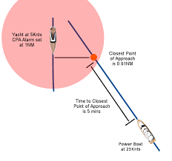
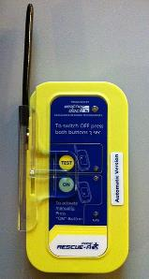

WHAT is AIS ?
AIS & CPA
JRC – E/R VHF Marine JHS-800S
With ASN Function

Slide 18
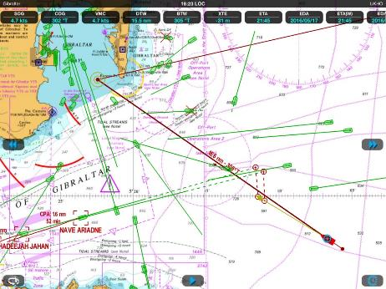
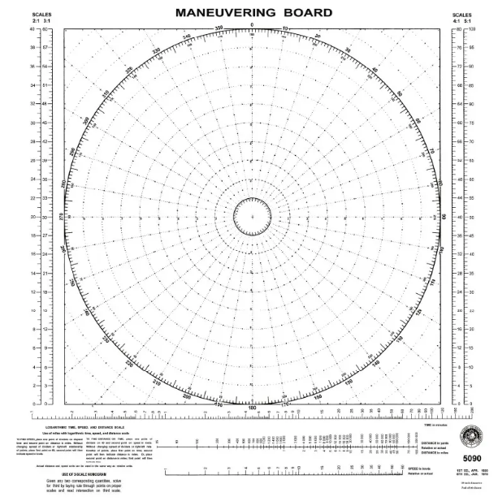

The Ultimate Aim of AIS
Help to calculation of CPA – to avoid collision
C_{B}, V_{B}
C_{A}, V_{A}
B
C rel _{B}, V Rel _{B}
CPA
A

Slide 19
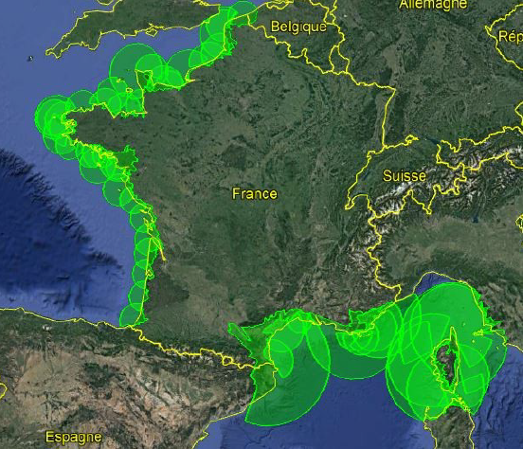
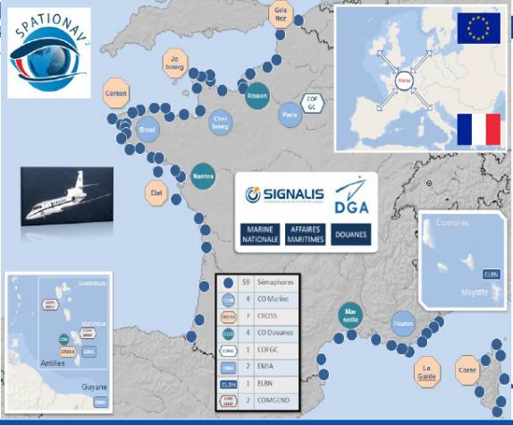
AIS / GNSS – Organisation (shore)
Coastal AIS Network in France (40 sites)
Military AIS / Radar stations (130 sites)

Slide 20
Pentesting for Maritime
What is AIS
User communities
Functionning / Architecture(s)
  Functionnal
  Administrations & AIS
Technical description

Slide 21

AIS / GNSS – Users and use
Public administrations
Surveillance et security
SAR
Intelligence
Public
Private
Counter-piracy
Environment
Inquiry
Private
Logistics
Oil & Gaz
Fishery

Slide 22
Pentesting for Maritime
What is AIS
User communities
Functionning / Architecture(s)
  Functionnal
  Administrations & AIS
Technical description

Slide 23




AIS Transponder – How does it Work ?
AIS Transponder
Class A: T/R all Messages
Class B: T/R limited Messages
GNSS / VHF
Antenna
Class B
Transponder
Display
VHF waveform
Robust
LOS
Low available Bandwidth
Optical Range formula
P
H
h
1 ft = 0,305 m
Example:
1 / How far can I see a 20 m high vessel if I am on a 100 m high tower
2/ How far can I see a 20 m high vessel if I am on the beach
1/ 102 km
2/ 34 km

Slide 24





AIS / GNSS – Inteconnection / Functionalities
GPS Antenna
VHF Antenna
Navigation Aid functions
User Interface
(ECS / ECDIS)
AIS
Transponder
Display of data on digital Map
HMI
Update
Loch
AC / DC
Monitoring of alarms
CCV (Compass)
GPS

Slide 25
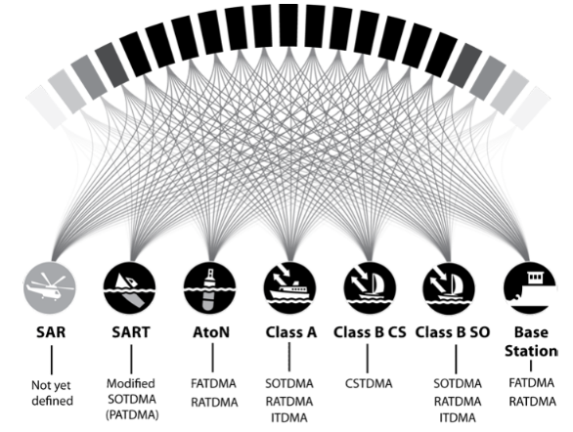
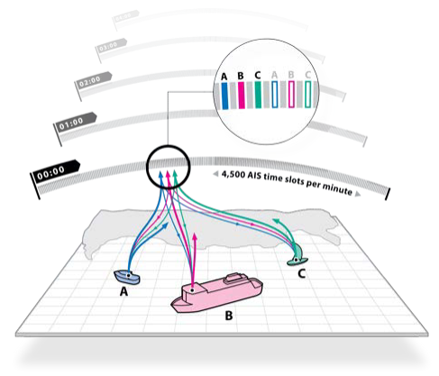
COMMUNICATIONS
TDMA usage by device type
Slots are available on 2 frequencies
F1 : 2250 slots
F2 : 225 slots

Slide 26
Pentesting for Maritime
SUMMARY OF AIS TDMA ACCESS SCHEMES
SOTDMA - Self Organised Time Division Multiple Access
RATDMA – Random Access Time Division Multiple Access
ITDMA - Incremental Time Division Multiple Access
FATDMA – Fixed Access Time Division Multiple Access
CSTDMA – Carrier Sense Time Division Multiple Access
Modified SOTDMA – Modifier Self Organised Time Division Multiple Access (also known as PATDMA, Pre-Announced Time Division Multiple Access)

Slide 27
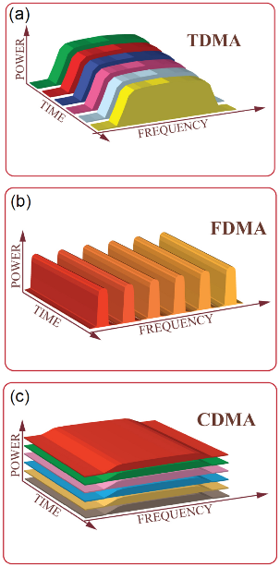

Communication Modulation for dummies
TDMA: the users share the same frequency at different time slots.
FDMA: different frequency bands are assigned to different data-streams. CDMA: the entire spectrum is utilized to encode the information from all users, and different users are distinguished with their own unique codes. Each user in the network is represented by a different color.

Slide 28
TDMA ACCESS SCHEMES for AIS
1. SOTDMA - Self Organised Time Division Multiple Access
SOTDMA is the most complex TDMA access scheme defined for AIS. It provides the backbone for autonomous operation of the network offshore. The complete technical definition of SOTDMA can be found in ITU-R M.1371-4 [1] Annex 2.
Key elements of SOTDMA operation :
All stations share a common time reference (GPS time) ensuring they can determine the start time of each TDMA slot.
Each data transmission includes indication of the TDMA slot that will be used by the transmitting station for subsequent transmissions. This allows receiving stations to build up a ‘map’ of which slots are in use by which station.
Each station avoids slots known to be in use by other stations for its own transmissions. This prevents two stations in range of one another using the same slot.
As mobile stations move from one area to another they encounter new stations with different slot allocations. This may cause the station to modify its own slot allocation leading to a dynamic and self organising system over time and space.
SOTDMA also provides for dynamic and autonomous management of capacity in busy areas. Should a situation occur where all TDMA slots are occupied ‘slot re-use’ rules are applied. This allows the slots occupied by the stations most distant to a particular mobile station to be
re-used for its own transmissions. This effectively reduces the size of an AIS ‘cell’ and ensures that position reports from the nearest vessels (which are most relevant to safety of navigation) are not affected.
Essential hardware requirements to support SOTDMA
VHF transmitter capable of operating on any AIS channel in the marine VHF band
Two VHF receivers capable of operating on any AIS channel in the marine VHF band
Full time decoding of all received messages in order to populate an internal slot map
GPS receiver to provide a time reference for TDMA timing
Sufficient memory (RAM) to store a slot map for at least five minutes of TMDA slot allocations (the allocation status for 22500 TDMA slots)

Slide 29


TDMA Communication Principle of AIS
Each time slot represents 26.6 ms
Ship A sends a PSN MSG in a time slot, reserving another slot for the next PSN message
The same procedure is repeated by all other AIS-equipped ships.
Emissions alternate on two identified channels (AIS1 & AIS2)
In most areas Channels 87 B (161.975 MHz) & 88 B (162.025 MHz) are used for both AIS1 & AIS2.
Some countries have enforced other channels to avoid interference with pre-existing non-AIS services.
Shore station commands automatically request ship transponders which frequencies to use for AIS1 & AIS2, avoiding any channel adjustment by operators.

Slide 30
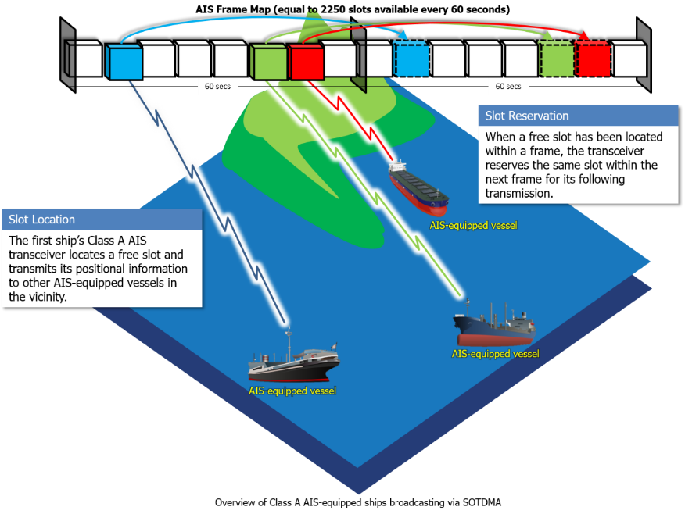
TDMA
Source : CA CG

Slide 31
TDMA ACCESS SCHEMES for AIS
2. RATDMA – Random Access Time Division Multiple Access
RATDMA is a simple TDMA access scheme available for certain types of data transmission and AIS device types. RATDMA is defined in ITU-R M.1371-4 [1] Annex 2, §3.3.4.2.
RATDMA is used when a station needs to allocate a slot, which has not been pre-announced. This is generally done for the first transmission slot during data link network entry, or for messages of a non-repeatable character (such as transmission of text messages).
Key elements of RATDMA operation :
All stations share a common time reference (GPS time) to determine the start time of each TDMA slot.
The station transmitting using RATDMA uses its internal ‘slot map’ to randomly select a slot that is not currently used by another station. It does not announce use of this slot, or subsequent slots used for non-periodic transmissions.
RATDMA is not suitable for periodic transmissions as slots allocated using this technique can not be known by other AIS devices. Use of RATDMA for periodic transmissions by many devices would result in significant data collisions and compromise the integrity of the system.
RATDMA is used by Class A AIS stations for ‘network entry’. This occurs when a Class A device is first switched on and has not previously announced its own slot allocation using SOTDMA. An initial RATDMA transmission is used to solve this problem.
Hardware requirements to support RATDMA:
VHF transmitter capable of operating on any AIS channel in the marine VHF band
Two VHF receivers capable of operating on any AIS channel in the marine VHF band
Full time decoding of all received messages in order to populate an internal slot map
GPS receiver to provide a time reference for TDMA timing
Sufficient memory (RAM) to store a slot map for at least five minutes of TMDA slot allocations (the allocation status for 22500 TDMA slots)

Slide 32
TDMA ACCESS SCHEMES for AIS
3. ITDMA – Incremental Access Time Division Multiple Access
ITDMA is used in specific situations to pre-announce the transmission slots for non-periodic messages. ITDMA is defined in ITU-R M.1371-4
[1] Annex 2, §3.3.4.1.
Key elements of ITDMA operation
All stations share a common time reference (GPS) ensuring they can all accurately determine the start time of each TDMA slot.
The station transmitting using ITDMA uses its internal ‘slot map’ to randomly select a slot that is not currently in use by another station for its own future use. It uses ITDMA transmission to announce use of this slot.
ITDMA is used when a station needs to announce a temporary change in the reporting interval of a periodic message, to pre-announce a non-periodic message (such as a safety related message) or during network entry.
ITDMA is required to support SOTDMA operation; however it is not used as a standalone access scheme.
Hardware requirements to support ITDMA:
VHF transmitter capable of operating on any AIS channel in the marine VHF band
Two VHF receivers capable of operating on any AIS channel in the marine VHF band
Full time decoding of all received messages in order to populate an internal slot map
GPS receiver to provide a time reference for TDMA timing
Sufficient memory (RAM) to store a slot map for at least five minutes of TMDA slot allocations (the allocation status for 22500 TDMA slots

Slide 33
TDMA ACCESS SCHEMES for AIS
4. FATDMA – Fixed Access Time Division Multiple Access
FATDMA is a manually managed TDMA access scheme where AIS devices are pre-configured to use specific TDMA slots for all transmissions. FATDMA is used only for AIS base stations and AIS AtoN stations. FATDMA is defined in ITU-R M.1371-4 [1] Annex 2, §3.3.4.3.
Key elements of FATDMA operation:
All stations share a common time reference (GPS) ensuring they can all accurately determine the start time of each TDMA slot.
Stations are configured at installation to transmit in a specific TDMA slot or slots.
Stations configured for FATDMA operation transmit a Data Link Management message which advises other stations of the FATDMA slot allocations. This blocks these slots from use by any other station in range. For this reason the use of FATDMA is minimised in order to minimise impact on the dynamic behaviour of the AIS network.
Stations configured for FATDMA operation transmit only into the pre-defined slots.
Hardware requirements to support FATDMA:
VHF transmitter capable of operating on any AIS channel in the marine VHF band
GPS receiver to provide a time reference for TDMA timing
Note that no receiver capability is required to support the FATDMA access scheme.

Slide 34
TDMA ACCESS SCHEMES for AIS
5. CSTDMA – Carrier Sense Time Division Multiple Access
CSTDMA is defined for Class B AIS stations and permits development of a low cost transceiver that is fully interoperable with SOTDMA transmissions whilst ensuring priority is always given to SOTDMA transmissions. CSTDMA is defined in ITU-R M.1371-4 [1] Annex 7.
Key elements of CSTDMA operation :
TDMA slot timing is determined from the timing of AIS Class A or AIS base station transmissions within receiver range.
GPS based timing is not required.
Stations using CSTDMA continuously monitor the AIS radio channels background noise level. This background level is used as a reference for a received signal strength measurement at the start of each TDMA slot.
When a transmission is required a TDMA slot is randomly selected and the signal strength at the start of the slot measured. If the signal strength is significantly above the background level the slot is assumed to be in use and the transmission is deferred. If the signal strength at the start of the slot is close to the background level the slot is assumed to be unused and the transmission is made.
The ‘listen before transmit’ or ‘carrier sense’ scheme works on a slot by slot basis; this limits CSTDMA transmissions to a single TDMA slot. Multiple consecutive slots cannot be allocated using this technique.
Hardware requirements to support CSTDMA:
VHF transmitter capable of operating on any of the AIS channel in the marine VHF band
Two VHF receivers capable of operating on any of the AIS channel in the marine VHF band
Full time decoding of all received messages in order perform carrier sense measurements.

Slide 35
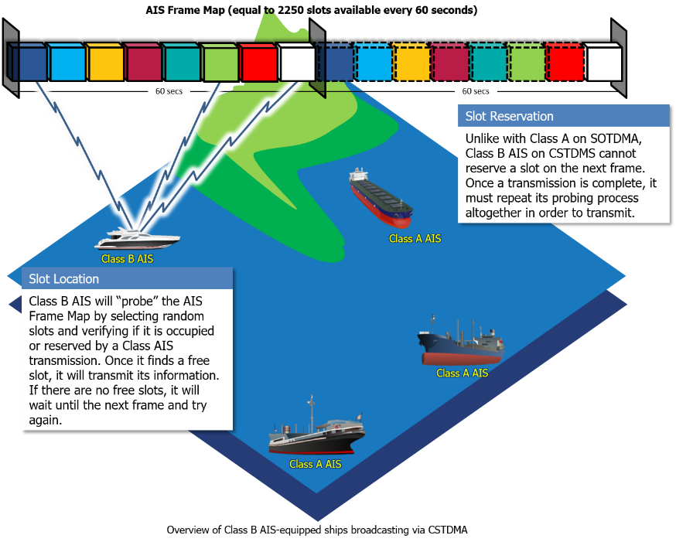
CSTDMA
Source : CA CG

Slide 36
TDMA ACCESS SCHEMES for AIS
6. Modified SOTDMA – Modified Self Organised Time Division Multiple Access (or PATDMA)
Modified SOTDMA (or Pre-Announced TDMA) is a simple TDMA access scheme defined for use in transmit only devices. It has specific application in emergency beacons such as AIS Search and Rescue transceivers (SART).
Whilst sharing the ‘SOTDMA’ name with the SOTDMA access scheme described in section 1 this technique has little else in common with SOTDMA. Modified SOTDMA is defined in ITU-R M.1371-4 Annex 9 and described for use in “devices that have limited range and
operate in a low volume”. Further definition of the access scheme is given in the AIS SART equipment standard IEC61097-14 [2] .
Key elements of modified SOTDMA operation are as follows:
All stations share a common time reference (GPS) ensuring they can all accurately determine the start time of each TDMA slot.
A station randomly selects a slot for transmission. In the first transmission it announces its intention to use this slot for the following 8 minute period. At the start of the next period a new slot is randomly selected.
Transmissions are made in ‘bursts’ of 8 messages once per minute. This is intended to ensure successful transmission when the device is operating near the surface of the sea and may be blocked from reception by periodic swell.
The system is referred to as ‘modified’ SOTDMA as it uses the same pre-announcement system for future transmissions as the complete SOTDMA.
• As modified SOTDMA randomly selects transmission slots without knowledge of their use by other stations it is likely to create data collisions. This has been deemed acceptable for use in emergency beacons where the cost benefits of the modified SOTDMA system outweigh the impact of data collisions (which are small as emergency beacons do not operate regularly or in high densities).
• Due to the likelihood of random transmissions colliding with transmissions from other AIS transceivers the modified SOTDMA technique is not suited to use in systems installed in large volume, or where large numbers of systems are used in a small area.
Hardware requirements to support modified SOTDMA are:
VHF transmitter capable of operating on any AIS channel in the marine VHF band
GPS receiver to provide a time reference for TDMA timing
Note that no receiver capability is required to support the modified SOTDMA access scheme.

Slide 37

TDMA usage per service
TDMA usage by device type

Slide 38
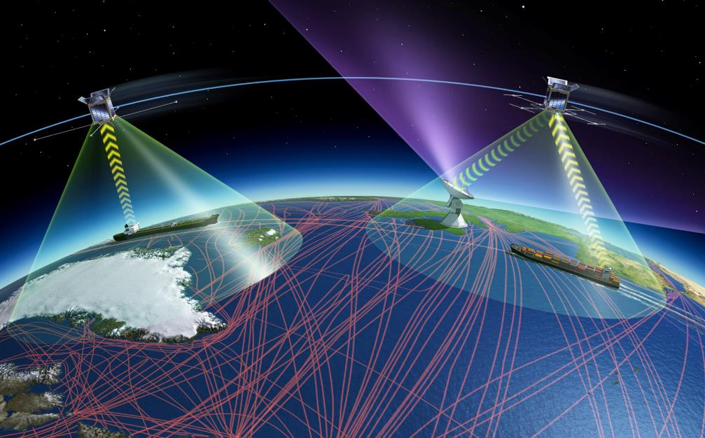
AIS Architecture

Slide 39
AIS – interfacing modules
AIS antennas
(GNSS / VHF)
UHF antenna
(feasability study)
GNSS signal quality analyser
UHF module
Internal
Display Control
Unit
Other connected systems
(CCS, CNY)
Data model converter
AIS message authenticity analyser
NMEA
link
serial
AIS management software
NMEA
serial
Calculator
Web
services
ETH
Web
services
ETH
Sensor drivers
Track table
serial
ETH
serial
NMEA / IP link
NMEA link
External sensors (radar / optronic)
Display, (e.g. ECDIS)

Slide 40
HARDWARE – Detailled view
UHF
Antenna
(next Generation standard)
VHF
Antenna
Sensors (radar & optronics)
ECDIS
GNSS
Antenna
RS232 Port 2 & Ethernet port 2
RS232 Port 3
VHF
Port 4
RF
Port 5 (UHF)
AIS/D
UHF Front End
AIS MSG Converter
GNSS Receiver
UHF
COMM Driver
Other
System
C2 Interface
CDU Interface
Control Display Unit
Legacy AIS
Processor
RS232 port 0
RS232 port 1
AIS Cyber Analysing
Status
AIS management software
Ethernet port 0
AIS Module
Ethernet port 1
Processing
Data
Settings
Data Model Translator
AIS Data
AIS Track Record

Slide 41
FUNCTIONAL architecture
VHF
E/R
GNSS Receiving
UHF E/R
Next Generation Standard
Sensors (radar & optronics)
ECDIS
AIS/D
Data Acquisition from sensors
ECDIS Interface Management
UHF SDR
GNSS Processing
Ext Syst. Interface
CDU Interface
Generate NMEA message
Generate NMEA Message
Ext
System
Control Display Unit
Processing
AIS / Data
AIS alerts
GNSS
Generate Web services
Status
Web Service server
Position
AIS Database
Data
Settings
Translate Data Model

Slide 42
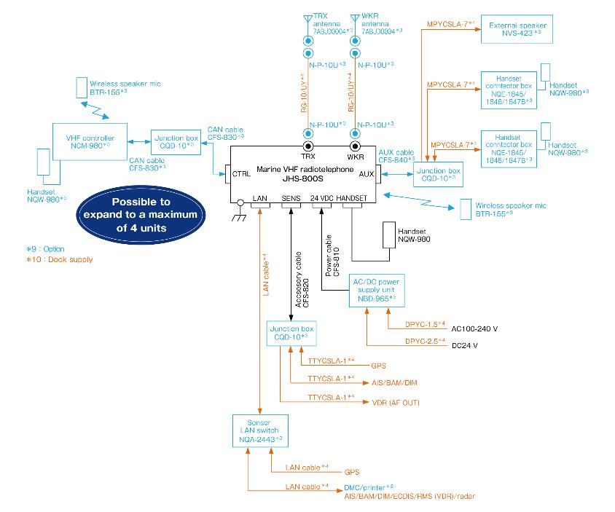

Slide 43
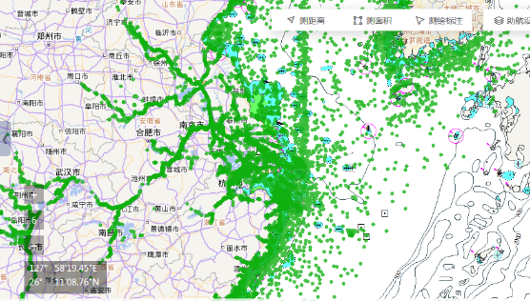
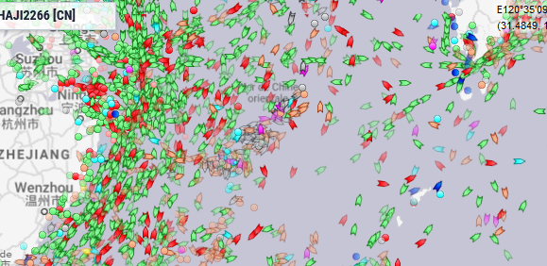
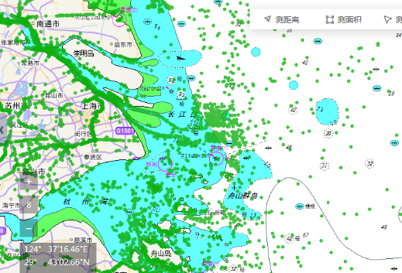
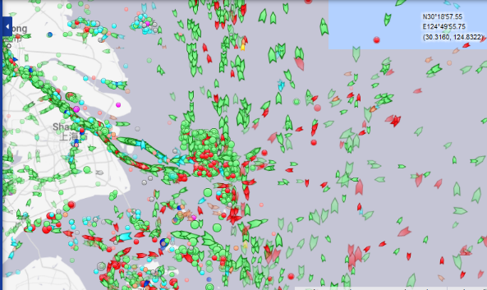
Cartographie AIS
Marinetraffic.com (satellites)

Slide 44
CYBERSECURITY & AIS
Type of Attacks most commonly observed
Spoofing
Jamming
Remediation

Slide 45

Attacks most commonly observed on AIS
Ship spoofing – AIS message is broadcast giving details of a non-existent ship. Scenarios where this could be used include spoofing a ship of one nation into the territorial waters of a hostile nation, leading that nation to take countermeasures. Alternatively, multiple versions of the details of a real ship can be broadcast, placing it in many different locations simultaneously to obscure its true location (e.g. illegal fishing).
Aid-to-navigation spoofing – Fake aid-to-navigation, such as a buoy warning of hidden shoals, are broadcast in order to force a ship to change its course. This might be done to force a vessel into a region where it can be hijacked.
Collision spoofing – Collision avoidance is one of the primary uses of AIS. By providing spoofed details of a vessel on a collision course, an attacker can force a ship to change course to avoid the anticipated collision. This could, for example, be used to steer the ship into a real collision
AIS-SART spoofing – Search & rescue is another of the primary uses of AIS. This attack generates a spoofed SAR-T transponder signal, which gives details of a distress. As ships are legally obliged to assist, SART spoofing can be used as a decoy to lure vessels to a location where they can be attacked.
Weather forecast spoofing – AIS can be used to relay information about prevailing weather conditions between marine craft. A fake forecast, particularly one that predicts fine conditions when a storm is incoming, could be used to lead vessels into difficulties.
AIS hijacking – It is also possible to override signals being sent by vessels, by broadcasting a higher-power signal at the same time and frequency. The attacker can then change some details of the original message, for example to suggest that the vessel has a nuclear cargo in an area where such cargoes are illegal.

Slide 46
CYBERSECURITY & AIS
Type of Attacks most commonly observed
Spoofing
Jamming
Remediation

Slide 47

COASTAL AIS / VS Satellite AIS
Marinetraffic.com

Slide 48

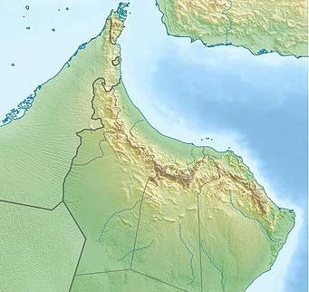






TYPE OF ATTACKS
General Principle
GPS Satellites
SAT AIS RECEIVER
GPS Spoofing
Bearer : GPS network
False positions
Impacts the GPS coverage (Several hundreds of km)
Global Spoofing
Bearer : AIS SAT network
False AIS Message
Impacts regional areas
Local Spoofing
Bearer : VHF network
False AIS Message
Impacts local situational awareness
Attack on AIS operator
Bearer : AIS operator facilities
Impacts potenitally the worldwide AIS reporting via Satellite

Slide 49

GNSS SPOOFING
General Principle
3
Satellites Position are shifted
2
Spoofing Signal is sent to satellite
(PSN – TMG)
1
Hacker enters
GNS system
4
False Position
Transponder receives
False Information
True Position

Slide 50
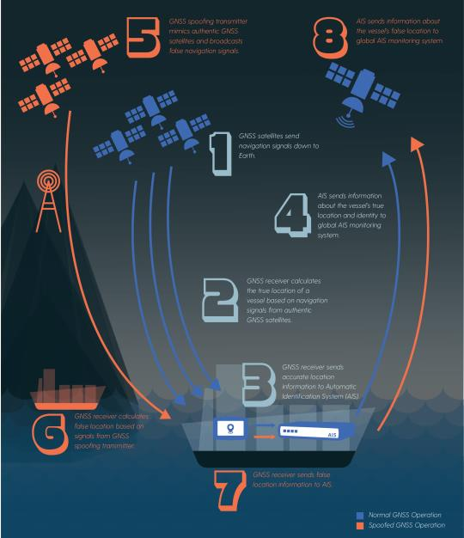
How can AIS be spoofed ?
GPS satellites send signals to the ship;
The GPS receiver calculates the ship's position based on signals from authentic GPS satellites;
The GPS receiver sends accurate position information to the AIS;
AIS sends information on the actual position of the vessel and identifies it to the AIS Global Monitoring System;
The GNSS spoofing transmitter mimics the genuine GNSS satellite signal and broadcasts fake navigation signals;
The GNSS receiver calculates the false position based on the signals from the spoofing GNSS transmitter;
The GNSS receiver sends false location information to AIS;
The AIS sends information about the vessel's false position to the AIS Global Monitoring System.

Slide 51
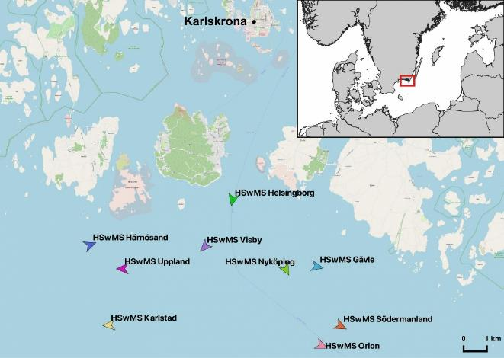
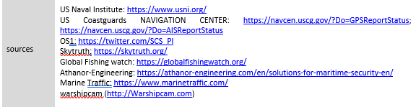
Examples : AIS SPOOFING – Feb 2021
Swedish AIS Spoofing in the Baltic (Feb 21)
Modified AIS tracks appearing south of Karlskrona. Initially, these false positions seemed indistinguishable from legitimate AIS tracks and followed the AIS system's broadcast protocols.
A pattern specific to simulated false AIS positions was able to be established from automated computer requests to identify other vessels with this same AIS broadcast model.
Almost a hundred warships had same message segments than the ones observed next to Karlskrona. Using additional sources of information, the locations and identities of the vessels have be confirmed.
False AIS positions for 15 naval vessels from seven countries have been identified in addition to the 9 Swedish ships.

Slide 52
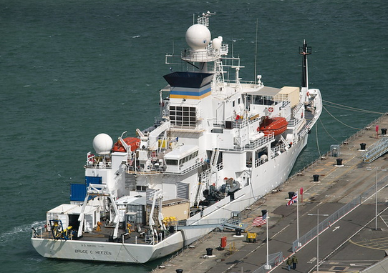
AIS SPOOFING
USN research Vessel Spoofing in the Blatic / Atlantic (Sep 20)
AIS position on Sept 18th showed USNS HEEZEN in the Baltic.
Radar imagery from EU Sentinel-1 satellite showed that no ship the size of USNS Bruce C. HEEZEN (100-metre-sized vessel) was present in the area.
Only two smaller Norwegian trawlers (20 to 30 meter long) were clearly visible on SAT images next to the spoofed position.
Other false AIS trail showed the ship entering the Baltic Sea on September 23rd 2020 when on the same time she is observed on the 27th of September in vicinity of Norfolk.

Slide 53
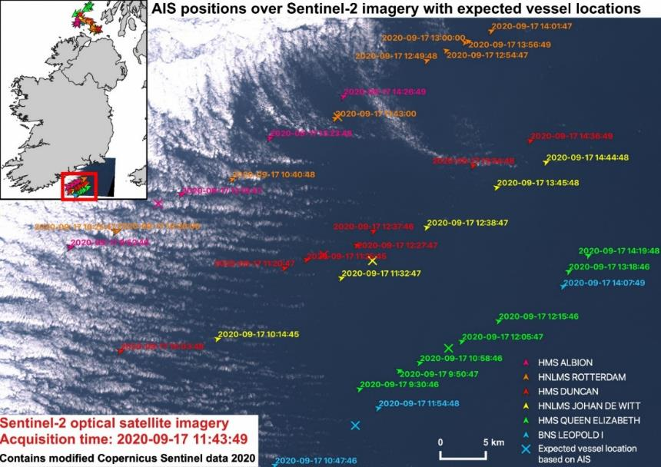
AIS SPOOFING
HMS QUEEN ELISABETH
False AIS traces of six warships from UK, the Netherlands and Belgium, superposed on a Sentinel S-2 satellite image of the same day,
Revealing that none of the ships were present at the time of the acquisition of the S2 Satellite image.

Slide 54
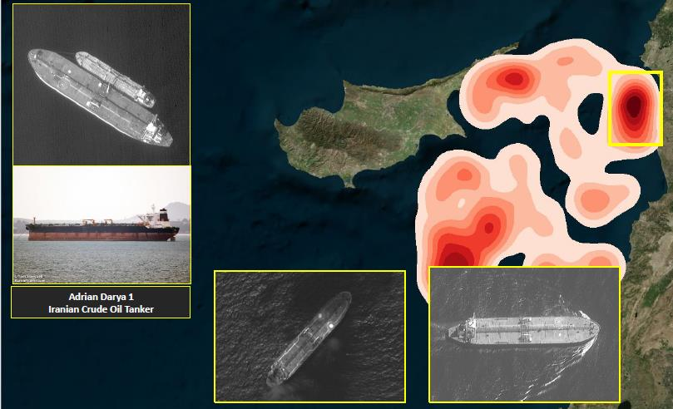
Illegal Use of AIS – Dark fleets

Slide 55
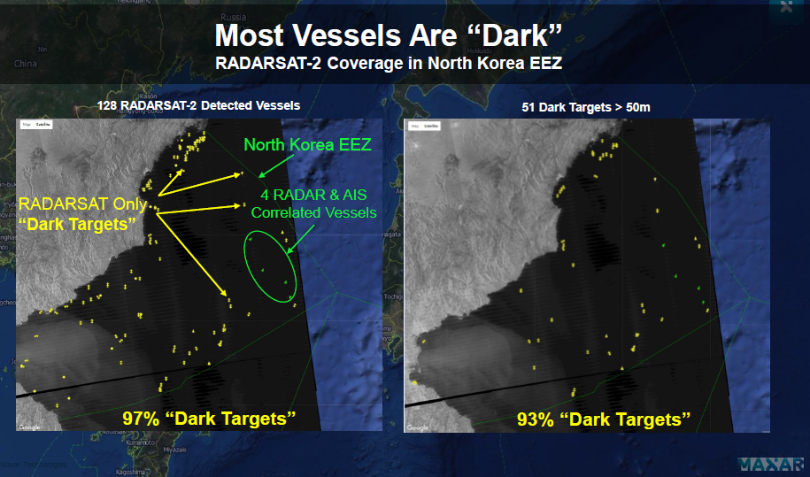
Illegal Use of AIS – Dark fleets

Slide 56
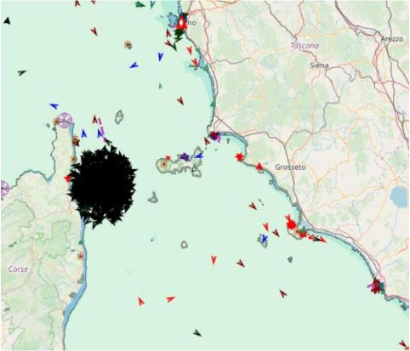
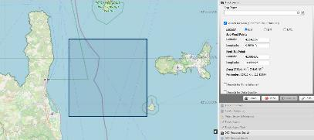
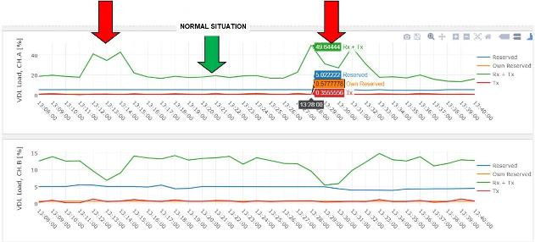
Example Spoofing attack
MINISTRY OF SUSTAINABLE INFRASTRUCTURE AND MOBILITY
ITALIAN COAST GUARD
On 3/12/19 between the island of Elba and Corsica, hundreds of AIS information were received from naval units of Dutch flag, created artificially, having different identification code, position, route & speed.
These information had completely saturated a circular maritime area with a radius of about 15 Nm. The area affected from the attack was saturated with the insertion of over 850 false targets.
The attack was repeated twice, at 13:13 UTC (duration 3 minutes) and at 13:28 (duration 4 minutes).

Slide 57
CYBERSECURITY & AIS
Type of Attacks most commonly observed
Jamming
Spoofing
Remediation

Slide 58

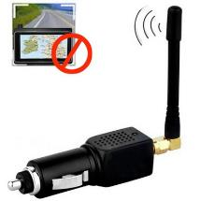

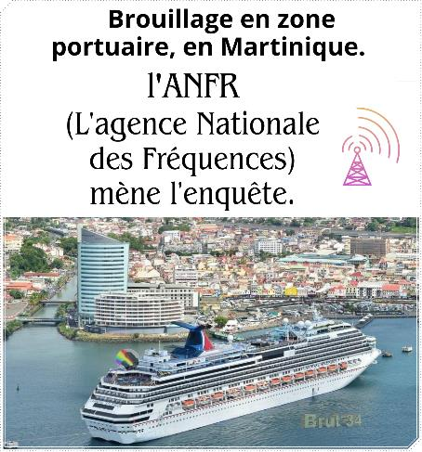
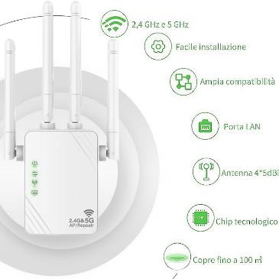
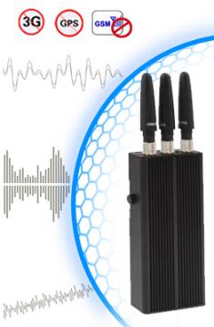
Jaming

Slide 59
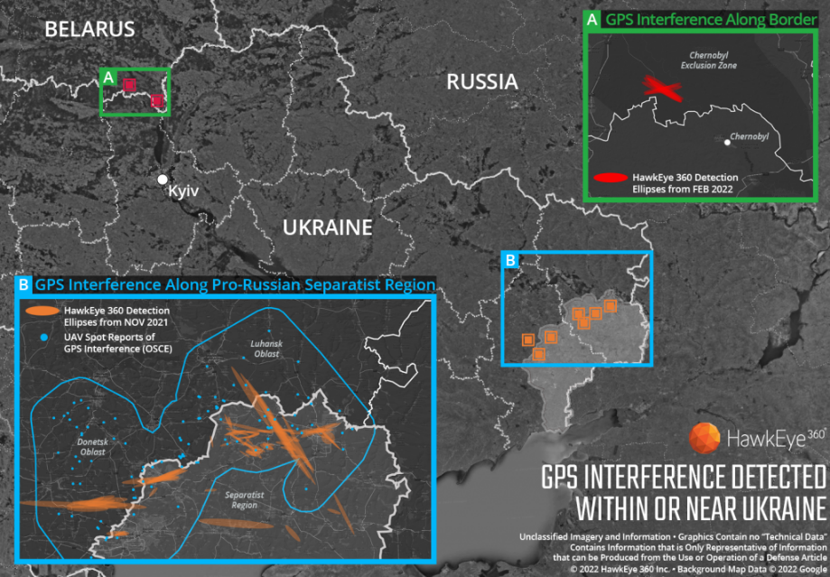
Area Jaming
Notes:
Shortly before the Russian invasion started in February, there were massive GPS interference along the Ukraine-Belarus border. The activity was detected just north of Chernobyl, within the Chernobyl Exclusion Zone, HawkEye 360, said on March 4, calling it a demonstration of the “integration of electronic warfare tactics into Russian military operation to further degrade Ukraine’s ability for self-defense”.
“This is a modern war, with the Russians leveraging the latest in Electronic Warfare technologies. This is representative of the tactics that Russian troops are deploying to degrade the effectiveness of space based assets, such as the United States Global Positioning System. GPS jamming is one facet that we are seeing evidence through the use of our signal detection constellation and processing capabilities,” HawkEye 360 CEO John Serafini told Geospatial World over email.
HawkEye 360’s unique satellites can monitor radio frequency signals from space over hundreds of millions of square kilometers daily.
Analysis of the GPS signals around Ukraine over the past four months revealed continued and increased GPS interference across this particular region. The analysts discovered extensive GPS interference as far back as November 2021 along the boundary of the Luhansk and Donetsk, regions controlled by pro-Russian separatist forces.
“We started to collect GPS interference signals back in the Fall, quickly recognizing it as a useful signal to monitor. We continue to collect that signal and other data across Eastern Europe, as it has emerged as a critical indicator of human activity,” Serafini added.
Open-source information also confirmed Unmanned Aerial Vehicles (UAVs) operating in the area were disrupted due to lost GPS connections.
ALSO READ: Vulnerabilities of GPS is a big concern: Dana Goward
Jamming happening since much longer
Pentagon officials had recently said that localized Russian jamming of GPS signals in Ukraine has been detected by US forces in the region, but so far has not interfered with US support operations. Breaking Defense reported that jamming was detected as far out as the Black Sea by US reconnaissance aircraft, but that didn’t have any impact on mission capability.
Way back in April 2021, the Organization for Security and Cooperation in Europe had warned of GPS signal interference in the region. On the evening of 6 April, an SMM long-range unmanned aerial vehicle (UAV) was unable to take off from its base in government-controlled Stepanivka (54 km north of Donetsk) to conduct regular monitoring of areas on both sides of the contact line, due to dual GPS signal interference assessed as caused by jamming. “This is the first time such interference has prevented a take-off since the Mission launched long-range UAV operations in October 2014,” OSCE had said in a statement on April 7, 2021.
It added that since late March, the SMM’s long-range UAVs have been experiencing increased levels of GPS signal interference on take-off and landing, affecting both of their GPS receivers, in areas near their base in Stepanivka, located approximately 25km west-north-west of the contact line.
ALSO READ: EOS DA Issues Urgent Plea for Satellite Data to Help Ukraine
A second OCSE report on April 9, 2021 had stressed that the problem was continuing leading to missions being aborted. “Any GPS signal interference hinders the Mission’s ability to conduct effective monitoring and reporting of the security situation in line with its mandate. Long-range UAVs are an essential part of SMM operations, especially at night and in areas where the Mission’s monitoring and freedom of movement are restricted,” it said.
GPS jamming is a major issue
Since military forces regularly use GPS jammers to obscure and protect critical troops, facilities, and equipment from attack, this can be a leading indicator of future military activity in a region. While interference can be inadvertent when multiple equipment operate too close to GPS frequency bands, incidents of deliberate GPS interference has spiked across the world over the past years. This has been possible mainly due to low cost, ease of deployment, and general availability of GPS jamming technology. Extremist organizations and nefarious elements such as drug cartels use GPS jammers to deter surveillance from overhead drones even though their use is illegal in most developed parts of the world.
“GPS is a fundamental ‘global commons’ service that all modern economies depend upon. GPS signal interference has the potential to significantly disrupt air travel, logistics, finance, transportation, communication, and many other basic services,” Serafini earlier said in a statement. “Whether unintentional or deliberate, interference that prevents people, vehicles, ships, and planes from determining accurate locations can be devastating to government and commercial activities alike.
Last year, the Herndon, Virginia-based company announced that it has acquired the capability to detect and geolocate interference in GPS signals, which may threaten military and civil navigation applications. The capability was tested last year in a variety of exercises and is currently available as part of HawkEye 360’s RFGeo signal product catalogue.

Slide 60
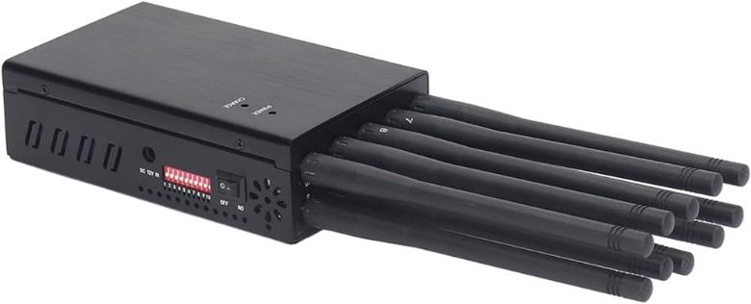
HANDS-ON TRAINING – Use case 1
Use case 1 – Jamming of AIS signal
Jamming device (VHF Band)
100 – 145 Mhz multiband V/H
  Power output 0,2 2, 10, 20 Watt
  Ranges
  Level of perturbations
  Waveforms
  Modulations
  TDMA pros / contra

Slide 61
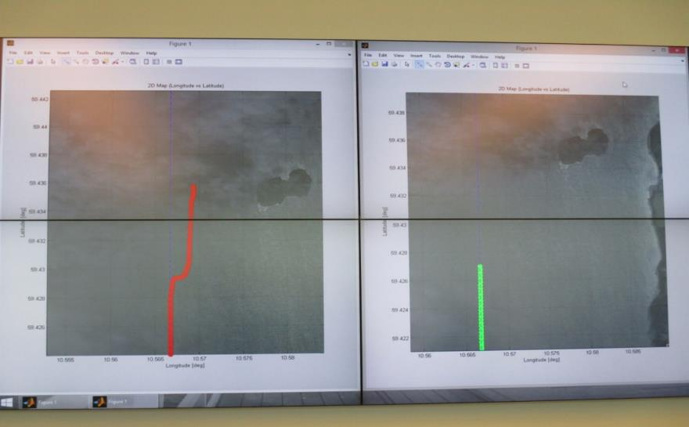
AIS / GNSS Spoofing
Official source
Spoofed
position
Real
position

Slide 62
CYBERSECURITY & AIS
Type of Attacks most commonly observed
Jamming
Spoofing
Remediation

Slide 63
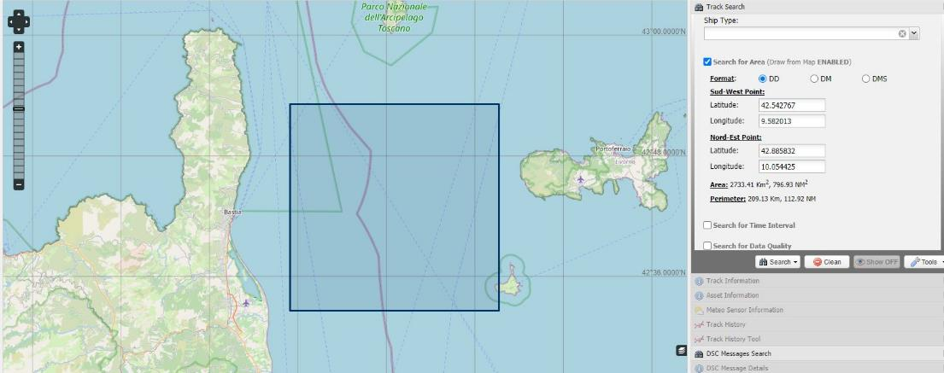
Example of active spoofing of a coastal station
On December 3rd 2019, starting from 13:13 UTC, in the maritime area between the island of Elba and Corsica, hundreds of AIS information were received from naval units of Dutch flag, created artificially, having different identification codes, positions, routes and speeds.

Slide 64

FACTS
These information had completely saturated a circular maritime area with a radius of about 15 Nm. The area affected from the attack was saturated with the insertion of over 850 false targets.

Slide 65

FACTS
The attack was repeated twice, at 13:13 UTC (duration 3 minutes) and at 13:28 (duration 4 minutes).
Spoofing Spoofing

Slide 66
FACTS
From a first analysis, carried out mainly with a VHF Data Link Analyzer tool implemented in the national AIS network management application, it was possible assess that the attack :
was conducted on the radiofrequency used by AIS systems, probably through a transceiver device, even of a portable type, with low transmission power;
was received only by the Italian National AIS Network and in particular by a Base Station located on the Elba Island (Monte Capanne), while, for example, only 20 messages were received by the French AIS network, the nearest AIS network overlapped with the national network in that geographic area;
required, from the originator, knowledge of both radio COMMs & AIS messages broadcasting;
was probably conducted with a radioelectric apparatus located on the Elba Island.

Slide 67

Impacts
This type of attack could :
a negative impact in terms of navigation safety, given that the high number of slots occupied for the transmission of false targets have been removed from the availability of the on-board AIS systems present in the nearby of the broadcasting station, whose main purpose is anti-collision.
Offer an opportunity to hide
Impact equipment reliability
Media

Slide 68
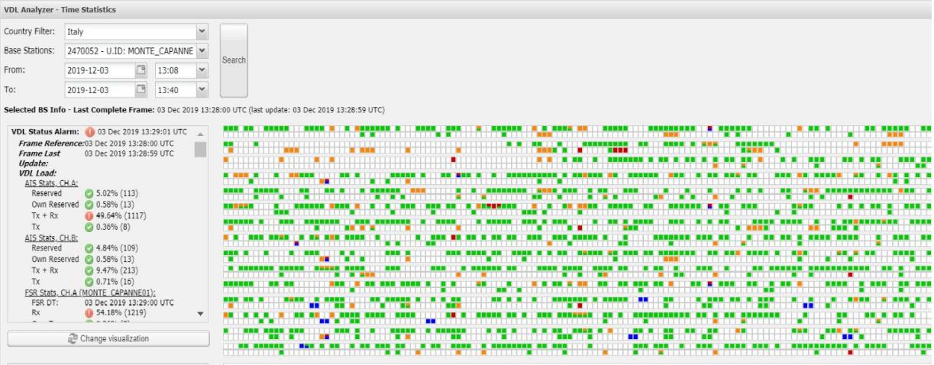
Analysis
Using a VHF Data Link (VDL) analyzer it was possible to analyze the time slot occupation during the attack: each slot is represented with a color which depends on its status - free, occupied by own reservation, occupied by other reservations, occupied by message reception/transmission - eventually in combination with each others.

Slide 69
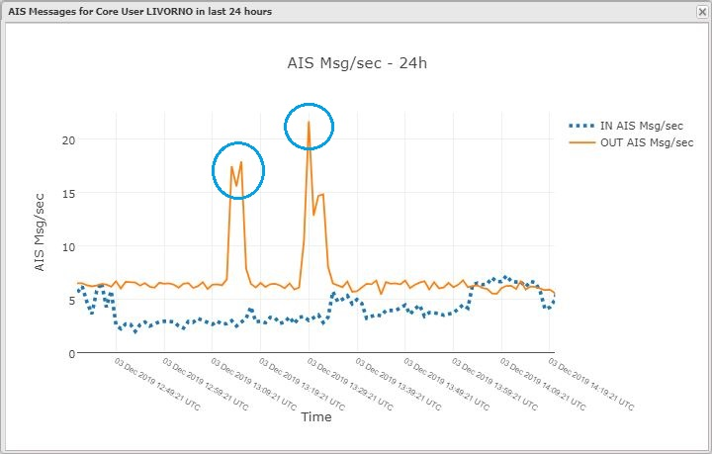
Analysis
It’s probable that who issued the false messages did not necessarily want to create discomfort or problems, given the low power of the received signal and very limited reception (only one BS continuously received the synthetic signal) and maybe neither there was intentionallity to create these broadcasts. An experiment in a flat or office for demonstration purposes is not excluded.

Slide 70
Analysis – Lessons Learned
Even if it appear as an isolated incident, the problem exist and several similar incidents are often reported by security agencies and nationals coast guards all around the word.
At the moment, automatic filtering techniques are not known as fully available to prevent these phenomena from compromising the monitoring capabilities of maritime traffic.
The only method is an acknowledgment of the phenomenon arising from monitoring of the AIS network by technical staff who, if necessary or required, shall disable the affected AIS base stations.

Slide 71

Analysis
One of the most basic methods of attention is to monitor AIS signals using a VHF data link (VDL) to understand if the transmitting station is using an internal or external UTC synchronization mode (sync state may be direct or indirect).

Slide 72
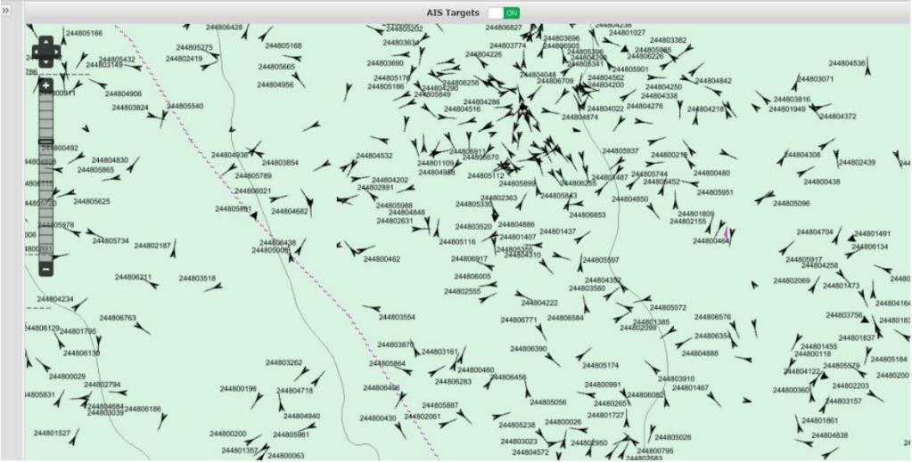
Lessons learned
The use of an external system can in fact be a first clue, since system spoofing is usually achieved by using an appropriately modified external GPS or a PC equipped with special software which, connected to the transmitter apparatus, alter its parameters, sending false signals.

Slide 73
Lessons Learned
Those who decide to create interference using AIS spoofing do not need to equip themselves with sophisticated equipment, requiring, on the other hand, modest investments in terms of people and resources.
Even relatively simple and inexpensive tools are often enough to be able to produce attacks that lead to the desired results.
In practice, even a single individual can pose a threat, being able to strike even from great distances, anywhere in the world where to have an access to the internet and being able to act in such a time as not to allow an effective defensive reactions.

Slide 74
Pentesting for Maritime
AIS Messages
Attack scenario

Slide 75
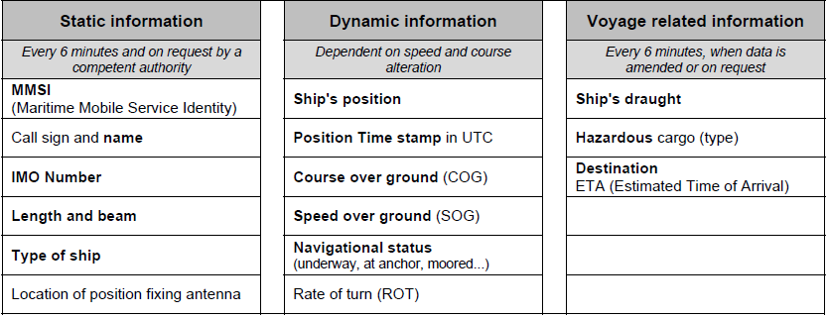
Data transmitted by AIS

Slide 76
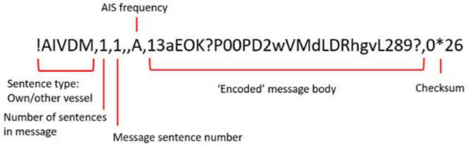
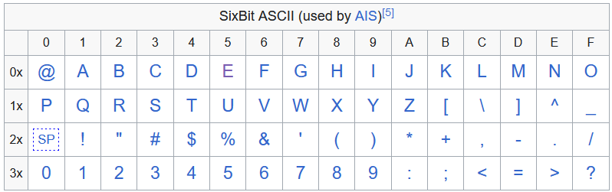
AIS Message
Messages may be fragmented owing to the NMEA0183 82-character maximum sentence size, hence there may be multiple sentences for one message.
!AIVDM refers to AIS from another vessel, !AIVDO refers to AIS data from one’s own vessel.
Whilst the message body encoding looks complex, it’s simply 6-bit ASCII!
Finally, there’s a message checksum as expected with NMEA0183 – CRC16
Decoding the sample message
13aEOK?P00PD2wVMdLDRhgvL289
1 – 000001
3 – 000011
a – 101001
E – 010101
O – 011111
etc…
Stringing this together:
000001000011101001010101011111…
Field 1-5: message type
Field 42-49, 4 character ROT
Field 61-88, 28 character longitude
Field 89-115, 27 character latitude
etc…
From this we can construct the vessel position:
Longitude: 4.379285
Latitude: 51.89475
ROT: -127
etc…

Slide 77
Exemple of attacks
Attacks with AIS
Owing to the lack of encryption and message validation, Trend showed several years ago that it was possible to spoof AIS over RF or server side.
AIS supports a large number of message types. The most common are types 1, 2 & 3 for navigational information.
Fields 98-104 of the area notice describe the notice description, for example:
Type 25: High waves
Type 38: Drifting mines
Type 72: Distress area: Vessel listing/capsizing
IMO236 Meteorological & Hydrological notices contain fields that describe wind speed. Fields 318-321 cover Beaufort Scale, so one could broadcast a Force13 gale.
EMMA Warning Reports are used for inland navigation, usually capable of being auto populated on an ECDIS if suitable interfaces exist.
Fields 222-225 describe weather type.
Type 4: storm would be of concern. Hopefully the ships master would check other sources of weather information before solely trusting AIS.
Developing apps to provide useful ‘big data’ analysis of shipping from AIS data.
For example, fishing patterns can be analysed. Illegal fishing can be tracked and prosecuted. Ocean currents can be tracked using AIS.
Container and tanker shipments can be made more efficient, ensuring transport capacity is in the right part of the globe to optimise use.
Yet, the AIS data that these decisions are made on is unencrypted. Vessel operators could be fooled through tampered AIS data in to making bad investments and business decisions.

Slide 78
Exemple of attacks
Attacks with AIS
Owing to the lack of encryption and message validation, Trend showed several years ago that it was possible to spoof AIS over RF or server side.
AIS supports a large number of message types. The most common are types 1, 2 & 3 for navigational information.
Fields 98-104 of the area notice describe the notice description, for example:
Type 25: High waves
Type 38: Drifting mines
Type 72: Distress area: Vessel listing/capsizing
AIS message type 3, fields 232-239, code 30 describes a fishing vessel.
That vessel then appears to be fishing illegally, particularly if the AIS plot is modified to show typical fishing movements. Code 33 describes a dredger. One could display dredging activity over submerged cables and pipelines. Whilst these aren’t genuine, false alarms will damage response to genuine incidents.
Possible solutions
It is possible to encrypt AIS data. Warship AIS already supports this facility. However, if nearby vessels don’t have the ability to decrypt the data, the safety benefit of AIS is lost.
If all AIS transceivers were to support encryption, AIS could be relied on more heavily. The issue with key distribution and backward compatibility is significant.
Finally, even if all transceivers featured and used encryption, a rogue user could simply purchase a legitimate transceiver from which to transmit tampered data.
AIS signals have already been tampered with in order to obscure activities of vessels from countries facing sanctions. There is money at stake, so transmitting rogue data may allow those under sanction to evade detection

Slide 79
AIS technical description
Functionalities
Description / architecture
Legal framework
AIS messages
Strengh and weaknesses
AIS and Cyber risk
Hands on training

Slide 80
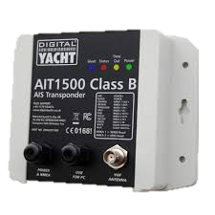
Maritime Pentesting
On hands AIS training

Slide 81
References
[1] ITU Recommendation ITU-R M.1371-4 (04/2010) - Technical characteristics for an automatic identification system using time-division multiple access in the VHF maritime mobile band.
[2] International Electrotechnical Commission International standard IEC61097-14 Ed 1 (02/2010) - Global maritime distress and safety system (GMDSS) – Part 14: AIS search and rescue transmitter (AIS-SART) – Operational and performance requirements, methods of testing and required test results
[3] IEC61993-2 Ed 1 (12/2001) - Maritime navigation and radiocommunication equipment and systems – Automatic identification systems (AIS) Part 2: Class A shipborne equipment of the universal automatic identification system (AIS) – Operational and performance requirements, methods of test and required test results.
[4] IEC62287-1 Ed 2 (11/2010) - Maritime navigation and radiocommunication equipment and systems – Class B shipborne equipment of the automatic identification system (AIS) – Part 1: Carrier-sense time division multiple access (CSTDMA) techniques
[5] IEC62287-2, CDV Draft - Maritime navigation & radiocommunication equipment & systems – Class B shipborne equipment of the automatic identification system (AIS) – Part 2: Self-organising time division multiple access (SOTDMA) techniques
[6] IEC62320-1, Ed 1 (2007) - Maritime navigation and radiocommunication equipment and systems — Automatic Identification Systems (AIS) — Part 1: AIS Base Stations — Minimum operational and performance requirements, methods of testing and required test results
[7] IEC62320-2 Ed 1 (03/2008) - Maritime navigation & radiocommunication equipment & systems – Automatic identification system (AIS) – Part 2: AIS AtoN Stations – Operational & performance requirements, methods of testing & test

Slide 82

QUESTIONS ?
-
BREAK

