Slide 1


Healthcare sector cyber security
CSP008_SA_H
Presentation by:
Prof Dr. Shareeful Islam

Slide 2


Slide 3


Healthcare sector cyber security
o1.
Goals: Who-What-Why you need to take this training
o2.
Training logistics: When-Where-How
o3.
Learning outcomes
o4.
Training outlines
o5.
Exercises details
o7.
Registration information and contacts

Slide 4



Goals: Who-What-Why you need to take this training
WHO
WHAT
WHY
WHO can attend the training modules and profiles of the attendees
basic concepts regarding Cybersecurity Risk Management and Governance as seen and applied within the Energy domain
Equipping participants with the knowledge and skills necessary to implement concepts of governance within an organization

Slide 5



CSP Training Logistic: When-Where-How
WHEN
WHERE
HOW
Time schedule: …..
ONLINE-ONSITE-Location Information
Delivery Method

Slide 6

WHO
Profile of Training Participants
IT professional
Heath care practitoners
Security professionals
Admins
.

Slide 7
WHO
Prof. Dr. Shareeful Islam
Highly motivated and committed cyber security and risk management professional with experience in research, training and consultancy.
Consultant for managing cyber security risks and information security management system to develop risks management framework following ISO 27001:2013, ISO31000:2018, NIST-CSF, STIX threat modelling, CIS_CSC and other relevant standards in various business environments.
Certified Management of Risks (MoR), PRINCE 2 practitioner and a subject matter expert in Risk Management
Over 90 peer reviewed publications with top journals and conference
https://scholar.google.com/citations?user=IAxS1lsAAAAJ&hl=en

Slide 8

WHY
Learning Outcomes
Demonstrate knowledge and understanding of threat and risks in healthcare system.
Identify and critically analyse the healthcare assets and their dependencies.
Critically appraise the cyber security risk and control within overall healthcare ecosystem
Demonstrate an in-depth understanding of an effective security practice and document accordingly in a professional manner

Slide 9

Training Topics:
Cyber security in healthcare: concepts, technology, services, challenges
Vulnerabilities and threats in healthcare
Cyber-attack path discovery model
Risk assessment and management in healthcare
Secure patient data
Policy and best practice
Case study in healthcare

Slide 10
Information Security Vs. Cyber Security
Information security
  Protecting information and information systems from unauthorized use, assess, modification or removal.
  Two sub-categories
    Physical environment by ensuring the premises is secure
    No one can access information electronically
  Concerned with making sure data in any form is kept secure and is a bit more broad than cybersecurity
Cyber Security
  How individuals and organisations reduce the risk of cyber attack.
  Cyber security is the practice of protecting information and data from outside sources on the Internet.
  cyber security focuses on digital information but also, it deals with other things as well: Cyber crimes, cyber attacks, cyber frauds, law enforcement.

Slide 11
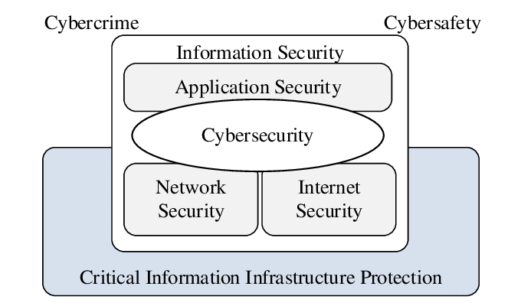

Slide 12
Security Target
The desired levels of security and assurance varies between organization, industries, even departments
There is not single approach applies to every one
Three main security goals
  Confidentiality(C)
  Integrity(I)
  Availability(A)
Three security services necessary to support the CIA
  Identification
  Authentication
  Authorization

Slide 13
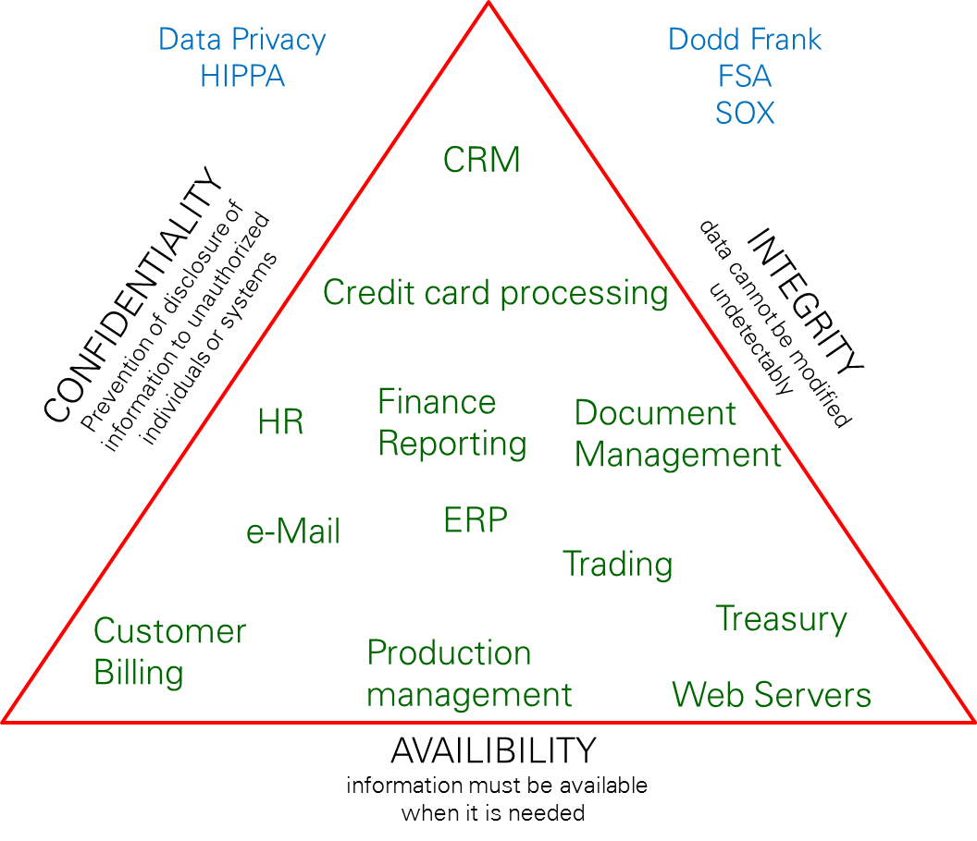
CIA
Ability to control or restrict access so that only authorized individuals can view sensitive information. Classification’s may include
Secret
Confidential
Internal &
Public
Typical risks: Loss of privacy, unauthorised access to information, Identity theft, etc.
Information is accurate and reliable and has not been tampered or changed in an unauthorized way. Integrity controls ensure that the information is authentic, accurate and reliable.
Typical risks: Fraudulent activities, manufacturing defects, inaccurate financial reporting, etc.
Data is available to the users when needed
Typical risks: Business disruption, loss of customer confidence, loss of revenue, etc.

Slide 14
Key Information Security Concepts
Access - a subject or object’s ability to use, manipulate, modify, or affect another subject or object.
Asset – anything that has value to an individual, an organization or a government
Cyber Space- interconnected digital environment of networks, services, systems, and processes
Threat: potential cause of an unwanted incident, which may result in harm to a system, individual or organization
Vulnerability: weakness of an asset or control that can be exploited by a threat
Cyber incident- cyber event that involves a loss of information security or impacts business operations

Slide 15
Key Information Security Concepts
Attack - an act that is an intentional or unintentional attempt to cause damage or compromise to the information and/or the systems that support it.
Control countermeasure- means of managing risk, including policies, procedures, guidelines, practices or organizational structures, which can be administrative, technical, management, or legal in nature
Exploit - to take advantage of weaknesses or vulnerability in a system.
Exposure - a single instance of being open to damage.
Malicious contents- applications, documents, files, data or other resources that have malicious features or capabilities embedded, disguised or hidden in them
Risk - the probability that something can happen.

Slide 16
Cyber security in healthcare
Cybersecurity in the health care sector is unique
Due to the type of information at risk and the consequences relating to patient safety.
    Ex: When a credit card number is stolen, the bank cancels the card, issues a new one, and reimburses the client.
Medical devices increasingly interface with other equipment
  Lack of control for the Manufacturers over the configuration of the network with hospitals sourcing network components and devices from different manufacturers
  Numerous vulnerabilities for the connected devices and unintended consequences
Personally identifiable information (PII) is used by almost every stakeholder in a hospital

Slide 17
Cyber security in healthcare
Healthcare sector is becoming more digitally connected
Connectivity of medical devices with other software and ICT infrastructure
  There are currently 10-15 connected devices per bed in US hospitals
    Error reduction, automation and remote monitoring
Create new attacker capabilities
    Compromised medical devices can be used to attack other sections
    Lack of basic security features
    Providing hackers with vital information

Slide 18
Cyber security challenges in healthcare
Cyber security risks can disrupt critical medical services
Digital forensics is a challenging task in a hospital setting
Same data is used by many services which makes it difficult to track down the attack
Despite of any level of security protection, risk of the attack is always persist
Additional challenges
  Understanding vulnerabilities associated with connected medical devices
  Special attention on data management with regard to networked medical devices
  Predicate any cyber attack and zero day vulnerabilities
  Effectiveness of existing controls

Slide 19
Cyber security challenges in healthcare
ENISA study found 54% of cybersecurity threats in the health sector
Ransomware and data breaches
  Patient data, including electronic health records, were the most targeted assets (30%). Alarmingly, nearly half of all incidents (46%) aimed to steal or leak health organisations' data.
https://www.enisa.europa.eu/news/checking-up-on-health-ransomware-accounts-for-54-of-cybersecurity-threats
In 2021, over 40 million patient records compromised in the USA.
https://expertinsights.com/insights/healthcare-cyber-attack-statistics/
2022, the NHS 111 service in the UK was knocked offline due to a ransomware attack.
https://www.bcs.org/articles-opinion-and-research/biggest-healthcare-cyber-attacks-this-decade/

Slide 20
Security issues in healthcare
Data Confidentiality
Security of electronic healthcare record
  Authentication
  Data Integrity
Systems Security
  Secure Transmission
  Secure Processing
  Secure Storage

Slide 21
Medical Device Vulnerabilities and Threats
Medical device information flow is conventionally unidirectional from the device to the health care provider.
  Remote interaction with devices has become possible
  Implantable medical devices capable of being reprogrammed wirelessly
Possible vulnerabilities and threats
Device verification information, i.e., radio frequency for transmission
lack of basic security feature
Limited power to support computation processing
Cascading effect from compromise medical device to other part of the network
lack of timely software update
Unauthorised use of software

Slide 22
Cyber Attach Path
  identify the possible paths that potential attackers might follow for a successful attack
    Common point of failure
    Suitable mitigation
Possible routes that an attacker can propagate to execute an attack
  An attacker conducts lateral movement from the initial point to the target landing point.
  Attack within the healthcare ecosystem can propagate depending on the attacker profile and motivation

Slide 23
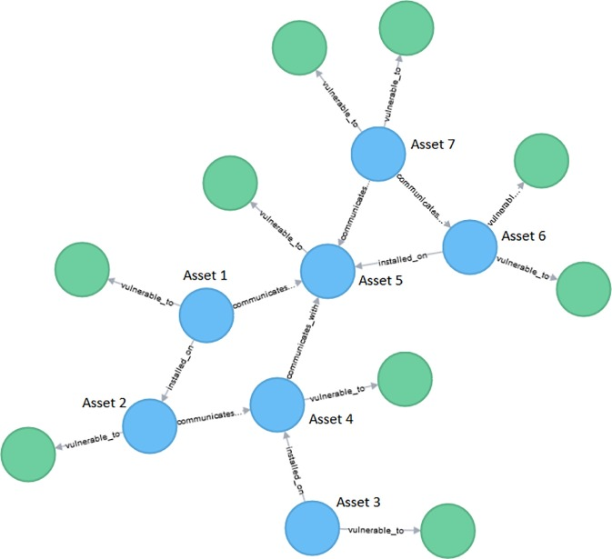
Cyber Attach Path

Slide 24
Healthcare Ecosystem
Consists of distributed, interconnected set of entities and heterogeneous set of actors that relies on the interconnected ICT infrastructure
  Hospitals and social service organizations
  Medical equipment suppliers, single physician practices
  Patient, practitioners
This sizable and massive ecosystem can be considered a widely distributed network, including an interconnected set of healthcare entities
Increasing interdependencies between physical and cyber levels
  Altered the threat landscape posing new cyber threats
  Sophisticated coordinated cyber attacks that could cause a dramatic impact to the healthcare ecosystem

Slide 25
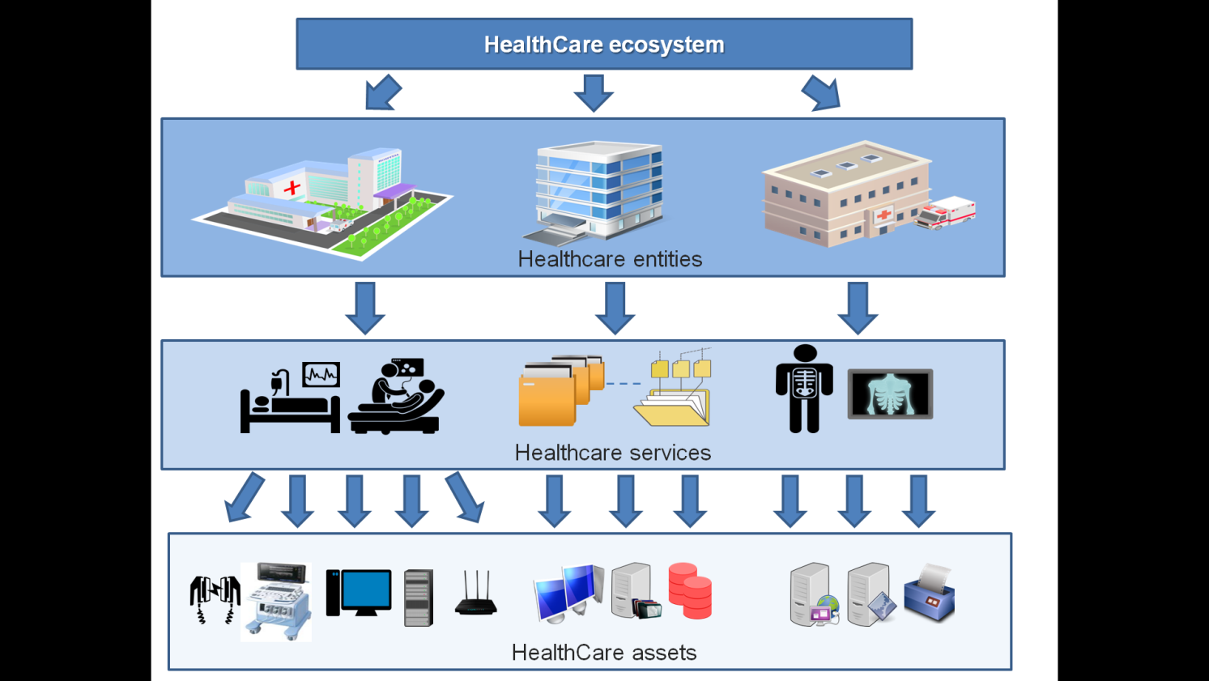

Slide 26
Cyber Attach Path in Healthcare
The assets are dependent upon each other
Each asset may link with single or multiple confirmed vulnerabilities
The threat actor needs certain profile
  attacker capability (knowledge and skill)
  Access vector to exploit a vulnerability
Each attack path
  entry point asset, intermediate point (if any), target point asset, dependencies among the assets, and vulnerabilities

Slide 27
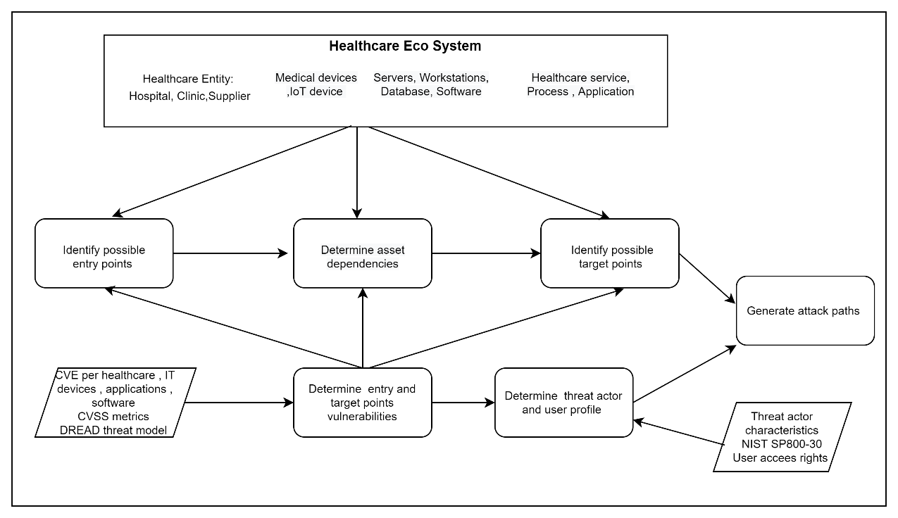
Cyber Attach Path in Healthcare

Slide 28
Attack Path : Step 1 Identify possible entry points
Identify the healthcare ecosystem potential assets which the attacker may consider as an entry point to execute an attack
  medical device and software which run the device, hardware, or other assets within an ICT infrastructure
  A medical device defined by FDA as software, electronic and electrical hardware, including wireless, is a critical asset for the healthcare system
The entry point is a point of failure where the attack exploits the vulnerability to propagate the target point

Slide 29
Attack Path : Step 2 Asset dependencies
Dependencies of these assets within the healthcare ecosystem
Focus on the potential cyber interaction of the entry point asset
  A cyber dependency of assets is assumed a cyber-asset pair (node) interrelation and/or interconnection (edge) aiming to fulfil a healthcare service delivery or specific operation over communication networks

Slide 30
Attack Path : Step 3 Identify possible target points
possible target points that an attacker strives to reach by following the entry point asset and associated dependencies
An attacker needs to exploit single or multiple vulnerabilities to reach target points to achieve its objective
the accessibility of a target point depends on the entry point asset, cyber dependencies, and capability of the actor for possible exploitation

Slide 31
Attack Path : Step 4 entry and target point vulnerabilities
vulnerabilities are preconditions based on the attacker’s profile for a successful attack path campaign
to accurately reflect the exploitability level of the identified vulnerabilities and link the vulnerabilities to formulate the vulnerability chain
These vulnerabilities are identified by following the CVE and NVD published vulnerabilities entries

Slide 32
Attack Path : Step 5 threat actor and user profile
A threat actor needs a certain profile to exploit a vulnerability for a successful attack
Depending on the asset dependencies and nature of the vulnerability, the profile may vary
The threat actor profile includes sub-attributes relating to attacker capability (Very Low, Low, Moderate, High, and Very High) and location (local, adjacent, network, and physical) for an attack campaign by following the NIST SP800-30 guidelines

Slide 33
Attack Path : Step 6 Generate attack paths
described methodology aims to generate the possible attack paths against target point assets
individual and chain vulnerabilities are examined using a number of parameters including assets, vulnerabilities, threat actor profiles, and exploitability level for this purpose
  vulnerability chain demonstrates a series of exploitation of vulnerabilities using appropriate access vectors and escalation of the privilege

Slide 34
Attack Path : Step 7 prioritise an evidence-based vulnerability chain
generate the vulnerabilities chains whose exploitation can lead to possible attack paths on given cyber-dependent assets
evidence relating to the attack path is collected so that we can prioritise which paths need to be taken into consideration for suitable control measures

Slide 35
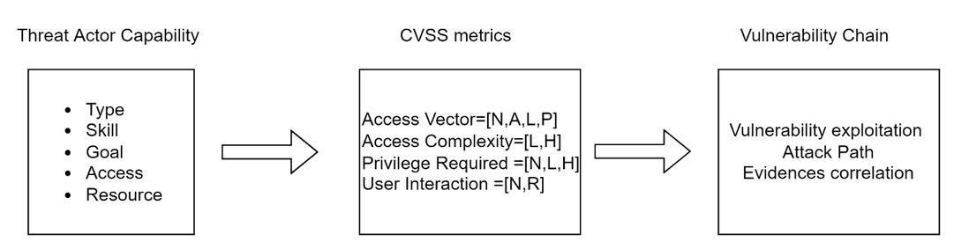
Threat actor capability linking with vulnerability chain

Slide 36
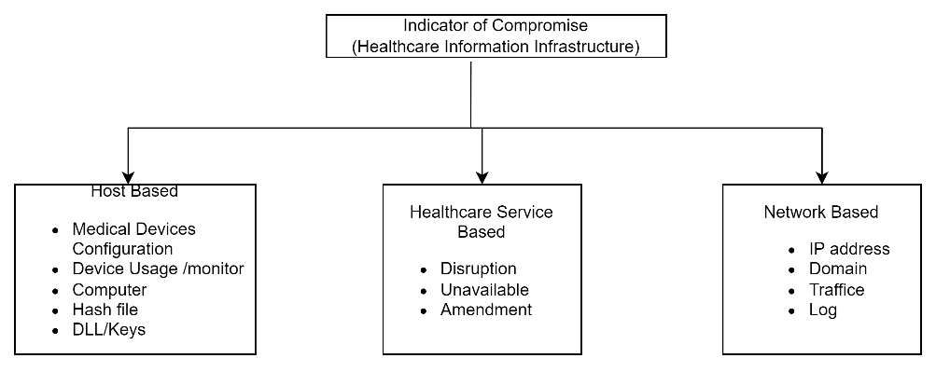
Possible IoCs for healthcare information infrastructure

Slide 37
Risk assessment and management in healthcare
Individual Risk
  Threats targeted at critical healthcare services and relevant assets
Identification and assessment of confirmed vulnerabilities
Impact of the vulnerability on the assets
Individual Risk Level ($R_{{T,A}_{i,j}}= {TL}_{{T,A}_{i,j} }x {VL}_{{v,A}_{i,j} }{ x I}_{{v,A}_{i,j}}$)
R-Individual risk level
T-Threat level
V-Vulnerability level
I-Impact level

Slide 38
Risk assessment and management in healthcare
Cascading Risk
  Risks that are relevant to the assets and services of supply chain healthcare entities
  Vulnerabilities which can be exploited through the dependencies among the assets
  Threat actors may commit an attack by exploiting subsequently a series of vulnerabilities that exist in a set of interconnected assets starting from an approachable asset (asset entry point) ending to the desired targeted asset (asset target point).

Slide 39
Risk assessment and management in healthcare
Risk Control
Minimize the threat actor capability and reduce the probability of the vulnerability exploitation.
Focuses on the vulnerabilities which are common for most of the assets of the healthcare entity.
Treatment strategy should prioritise these vulnerabilities to determine the control.
  Identify the attack paths for cascading risks
  Commons attack points :identifies the assets which need immediate attention to reduce the exploitation and cutoff the most attack paths

Slide 40
Security Controls in Healthcare
Appropriate measurement to manage and mitigate information security risks in order to safeguard the healthcare eco system
  regulate and restrict access to resources, systems and physical areas within healthcare system
protect information and systems' confidentiality, integrity, and availability.
Administrative controls: Policy , procedure and guideline
Physical control: protecting physical assets, i.e., hospital, IT infrastructure
Technical controls: to protect systems and data.

Slide 41
Access Control in Healthcare
only authorized individuals have access to confidential patient data
  Single Sign-On (SSO): Log in once and access multiple authorized resources without the need for repetitive authentication
  Multi-Factor Authentication (MFA): defence in depth strategy
      Password with ID/finger print
Cloud-Based System: flexible and scalable access control
Internal audit: monitor who is accessing and why

Slide 42
Access Control in Healthcare
Physical : electronic locks, proximity cards, biometric readers, and security cameras within healthcare facilities
  Biometric Identification: physiological or behavioral characteristics to authenticate individuals.
  Visitor : hour based visitor management, registration, identification badges
  Alarm Systems: immediate alerts to security personnel in the event of unauthorized access attempts or breaches.
Identity and access management
  role-based access control model to prevent unauthorized access to sensitive health information.

Slide 43
Secure patient data
Protected Health Information (PHI)
  identifiable information in any form that provides a reasonable basis to identify a patient
  name
  DoB
  phone number
  Photographic or other images
  any other data element that can be used to
  identify an individual
  Now mostly in electronic format
    Software generated ecords
    portable storage media

Slide 44
Secure patient data
PHI accessibility is based on
  Need to know and minimum necessary
  Consent management
  Access management
  Document control

Slide 45
Data Security
Monitor and detect any potential privacy or data security breach, including regularly monitoring user network activity
Need to develop Data security policy and follow by all stakeholder within the heath care sector.
Security of medical databases
Only legitimate users able to access the patient data
Integrity and correctness of data
Privacy of patient records and identification

Slide 46
Policy and best practice
Encrypt data in Transit
  Encrypted email, https, secure ftp
Encrypt data at Rest
  Access control
  Monitor secure storage
Secure in-house data storage
Continually assess potential risks and tackle the identified risks with possible mitigrations

Slide 47
Policy and best practice
privacy awareness
Develop a privacy program
Privacy policy
conduct thorough risk assessments on a regular basis to identify vulnerabilities and potential cyber threats and implement proactive risk management strategies

Slide 48
Case Study in healthcare
User-centred Digital Health Living lab Brighton
  User co-production approach while integrating research and innovation processes in a real-life setting
  Key Stakeholder: Residents, council, service providers, academic institutions, and technology companies
Cyberattack Path Generation and Prioritisation for Securing Healthcare Systems https://www.mdpi.com/2076-3417/12/9/4443

Slide 49
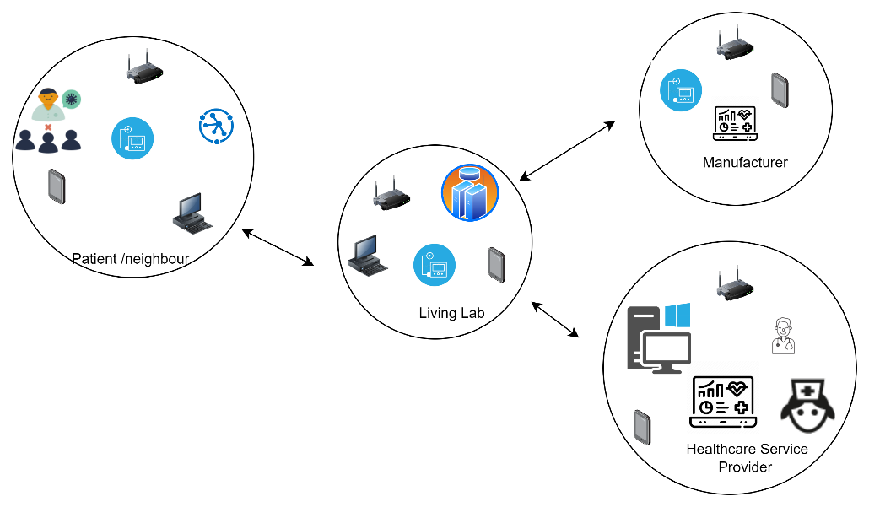
Case Study in healthcare: Context

Slide 50
Identify entry, target point assets, and possible dependencies
Infusion Pump (A1): Braun’s Infusion System 871305U aims to deliver fluid such as nutrients and medications into the patient’s body. Trained healthcare practitioners should program the rate and duration for the medication. The Pump stores patient drug information;
Insulin pump (A2): Medtronic MiniMed 508 is one of the most widely used pumps for delivering a specific amount of insulin to the diabetic patient’s body. The device is programmed to inject a specific amount of insulin set by the doctor into the patient body. The pump stores patient sensitive insulin information;
Insulin management system (A3): Omnipod DASH Insulin Management System 19191 is a tubeless and wireless system that allows continuous insulin delivery for 3 days. It consists of a Pod which is worn directly on the patient’s body and a personal diabetic manager which programs and controls the delivery

Slide 51
Identify entry, target point assets, and possible dependencies
IoT devices (A4): There are several IoT devices which are relevant to the scenario. A heartrate monitor (Maxim’s 700-MAXREFDES117) can be used to monitor the heart rate (wearable device). Additionally, a smart light system (Philips) is also considered for the healthcare service delivery;
Information and communication network (A5): This includes multiple devices, such as routers, WiFi, switches, wireless interface cards, and others that are responsible for the connection from the device to the network;
Computer system (A6): Windows based workstation and servers connected to the medical devices, patient interfaces and servers;
Rugged tablets (A7): These tablets are commonly used for the patient care applications like medication alerts and tracking, Electronic Health Records (EHR) support, blood pressure monitoring, connecting to barcode readers and can directly interface to the other medical equipment. Healthcare practitioners can directly use these tablets for patient treatment.

Slide 52
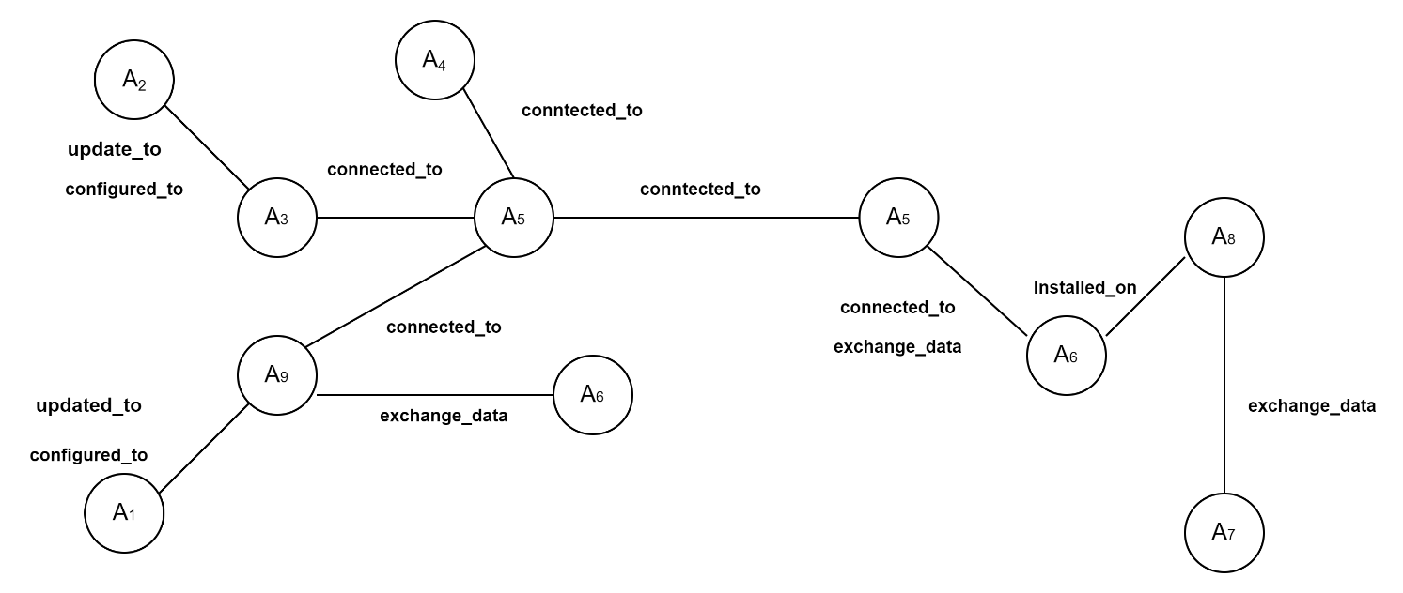
Case Study in healthcare: Asset Dependencies

Slide 53
Case Study in healthcare: Attack Path
Entry Point Asset and Type | Target Point Asset and Type | Dependency Type
A9 (SpaceCom Software) | A1 (Infusion Pump) | Configured_to, Updated_to
A3 (Insulin Management System) | A2 (Insulin Pump) | Configured_to, Updated_to
A8 (Care2X-Hospital Management System) | A6 (Windows System) | Installed_on, Updated_by
A5 (Router) | A6 (Windows System) | Connected_to, Exchange_data
A4 (IoT Device) | A5 (Router) | Connected_to, Exchange_data
A7 (Tablet) | A8 (Care2X-Hospital Management System) | Exchange_data
A9 (SpaceCom Software) | A1 (Infusion Pump) | Configured_to, Updated_to

Slide 54
Case Study in health care: Vulnerabilities
Asset | Vulnerabilities & Exploitability
A1=Braun’s Infusion Pump | A1.V1 = Lack of input validation provides command line access and privilege escalation. TA requires in the same network as device CVE-2021-33886, A1.V3 = VH(8.8) AV:A/AC:L/PR:N/UI:N/S:U/C:H/I:H/A:H
 | A1.V2 = Unrestricted file upload that can overwritten critical files due to privilege escalation CVE-2021-33884, A1.V4 = VH(9.1) CVSS:3.1/AV:N/AC:L/PR:N/UI:N/S:U/C:N/I:H/A:H
A2= Medtronic MiniMed 508 insulin pump | A2.V1 = lack of security (authentication and authorization) in RF communication protocol with other devices such as blood glucose meter and glucose sensor transmitters. TA requires in the same network as device can inject or intercept data and change pump settings CVE-2019-10964, A2.V1 = VH(8.8) CVSS:3.0/AV:A/AC:L/PR:N/UI:N/S:U/C:H/I:H/A:H
A3= Insulin Management System | A3.V1 = improper access control in the wireless RF communication protocol allows local TA to intercept or modify insulin data and change pump settings. CVE-2020-10627 A3.V1 = VH(8.1) CVSS:3.1/AV:A/AC:L/PR:N/UI:N/S:U/C:H/I:H/A:N

Slide 55
Case Study in health care: Vulnerabilities
A4 = IoT device Philips Hue light bulb | A4.V1 = communication protocol can be abused to remotely installed malicious firmware in the light bulb as remote code execution through buffer overflow and spread to other IoT devices that use Zigbee communication protocol. CVE-2020-6007 A4.V1 = H(7.8) CVSS:3.1/AV:A/AC:H/PR:N/UI:R/S:C/C:H/I:H/A:H
A5 = Router (Buffalo, Cisco RV Series – Netgear) | A5.V1 (Buffalo routers) = Bypass authentication procedures on the affected routers though files which do not need authentication and gain root level access. It enables telnet service to connect other devices’ control such as IoT Devices. CVE-2021-20090 A5.V1 = VH(9.8) CVSS:3.1/AV:N/AC:L/PR:N/UI:N/S:U/C:H/I:H/A:H
 | A5.V2 (Cisco RV series) = Remote TA with administrative privileges inject arbitrary commands into operating system due to lack of input level validation through web-based interface. CVE-2021-4012 A5.V2 = H(7.2) CVSS:3.1/AV:N/AC:L/PR:H/UI:N/S:U/C:H/I:H/A:H
 | A5.V3 (Netgear router) = unauthenticated TA can affect the device through buffer overflow attack. CVE-2018-21224 A5.V3 = VH(8.8) CVSS:3.1/AV:A/AC:L/PR:N/UI:N/S:U/C:H/I:H/A:H
A6 = System (Windows Compatible) | A6.V1 = A remote code execution vulnerability allows TA to execute arbitrary code and gain same right as current user. This allows to install program modify files based on the existing user rights. CVE-2019-1236 A6.V1 = H(7.5) CVSS:3.1/AV:N/AC:H/PR:N/UI:R/S:U/C:H/I:H/A:H

Slide 56
Case Study in health care: Vulnerabilities
A7 = Rugged Tablet (Dell) | A7.V1 = A local TA without the necessity of authentication can exploit this vulnerability and execute arbitrary code in system management mode. CVE-2020-5348 A8.V1 = H(7.8) CVSS:3.1/AV:L/AC:L/PR:L/UI:N/S:U/C:H/I:H/A:H
A8 = web-based hospital management system (Care2X) | A8.V1 = A cross site scripting vulnerability exploited during patient registration. TA can send the XSS payload to this vulnerable parameter and take control of another register user. TA needs victim user interaction Exploitability features =PoC and Weaponized Exploit, CVE-2021-36352 A9.V1 = M(5.4) CVSS:3.1/AV:N/AC:L/PR:L/UI:R/S:C/C:L/I:L/A:N
A9 = SpaceCom | A9.V1 = Lack of authentication for critical space com function allows to connect to the pump Exploitability features =PoC and Weaponized Exploit, arbitrary code execution CVE-2021-33882, A1.V1 = VH(8.6) AV:N/AC:L/PR:N/UI:N/S:C/C:N/I:H/A:N
 | A9.V2 = Clear text transmission allows TA to snoop network traffic. Exploitability features =PoC and Weaponized Exploit, arbitrary code execution CVE-2021-33883, A1.V2 = H(7.5) AV:N/AC:L/PR:N/UI:N/S:U/C:H/I:N/A:N

Slide 57
Case Study in health care: Threat Actor Profile
  Can be external and internal
  Motivation such as financial gain, harm to the patient, competitors
  Certain knowledge
    device specific verification information
    transmission radio frequency, and data structure.
    Ex: Infusion Pump: knowledge regarding the access to the local network, CAN bus data structure, escalation of privilege from user access to admin access and the pump configuration
    Ex: Medtronic Insulin Pumps: Knowledge regarding how to access the network and intercept radio frequency and the pump configuration
User : Basic knowledge to operative device, IT

Slide 58
Case Study in health care: Attack Path Generation
Security Incident | Attack path | Evidence chain
Amendment of drug level and pump configuration | A₅,V₁ → A₉,V₁ → A₁,V₁ A₉,V₂ → A₁,V₂ A₈,V₁ → A₉,V₁ → A₁,V₂ A₄,V₁ → A₉,V₁ → A₁,V₁ | A₅,V₁ → A₉,IoC₁ → A₁,IoC₂ A₉,IoC₄ → A₁,IoC₃ A₈,V₁ → A₉, IoC₁ → A₁, IoC₂ A₄,V₁ → A₉, IoC₁ → A₁, IoC₂
Patient data leak | A₅,V₃ → A₆,V₁ → A₈,V₁ A₅,V₃ → A₆,V₂ → A₈,V₁ A₇,V₁ → A₆,V₃ → A₈,V₁ | A₅,V₃ → A₆,IoC₅ → A₈,IoC₆ A₅,V₃ → A₆, IoC₇ → A₈,IoC₆ A₇,V₁ → A₆,V₃ → A₈, IoC₆

Slide 59
Individual vulnerability exploitation
Vulnerability | Asset | Individual Vulnerability Level (IVL) | Threat Actor’s Exploitability Level
 |  |  | Capability = Very Low (VL) | Capability = Low (L) | Capability = Moderate (M) | Capability = High (H) | Capability = Very High (VH)
V1 | A1 | IVL(A1,V1) = VH | M | H | H | VH | VH
V2 | A1 | IVL(A1,V2) = VH | M | H | H | VH | VH
V1 | A9 | IVL(A9,V1) = VH | M | H | H | VH | VH
V2 | A2 | IVL(A9,A2) = H | L | M | H | H | VH
V1 | A6 | IVL (A6,V1) = H | L | L | H | H | VH
V2 | A6 | IVL (A6,V2) = H | L | L | H | H | VH
V1 | A8 | IVL (A8,V1) = VH | M | H | H | VH | VH

Slide 60


