Slide 1



Advanced Critical Infrastructure Security for Health
CSP008_C_H
Presentation by:

Slide 2


Slide 3

Advanced Critical Infrastructure Security for Health
Course Overview
T1.
Introduction to Critical Infrastructure Security
T2.
Common Security Weaknesses and Threat Landscape
T3.
Regulations and Standards

Slide 4

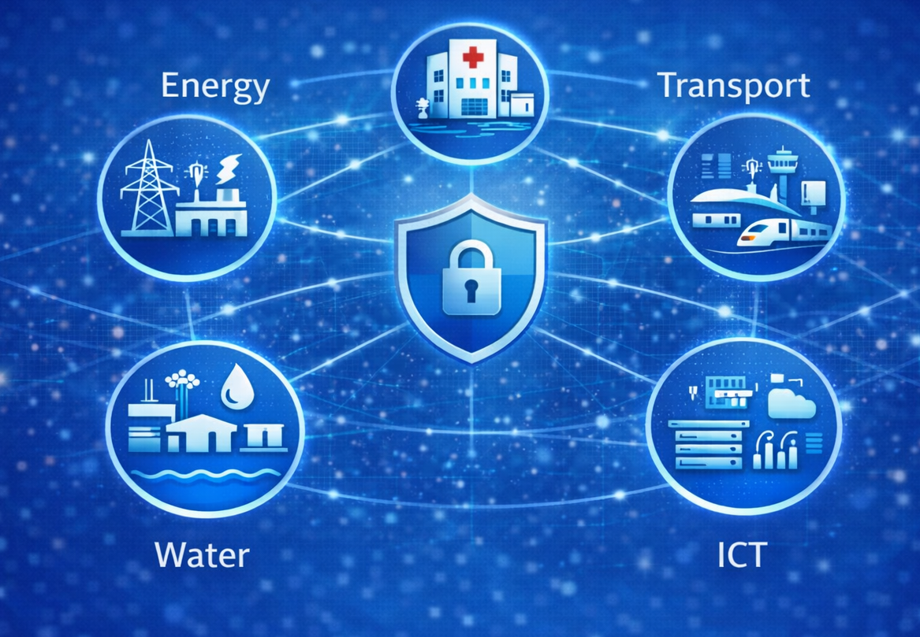
T1: Introduction to Critical Infrastructure Security
Healthcare
CI

Slide 5

Learning Objectives
Define critical infrastructure
Understand sectors and dependencies
Analise frameworks and threats

Slide 6
What Is Critical Infrastructure?
Critical Infrastructure (CI) refers to systems whose disruption would cause:
Severe societal disruption
Economic damage
Risk to human life

Slide 7
Key Characteristics of CI
Critical Infrastructure (CI) refers to systems whose disruption would cause:
High availability (near 100%)
Long system lifecycles
Complex interconnections
High consequence of failure

Slide 8
Why CI Security Matters
Protects human life
Maintains economic stability
Ensures national security

Slide 9
Evolution of CI
Past: isolated systems
Present: connected, digital systems
Result: increased cyber exposure

Slide 10
System-of-Systems Concept
CI operates as interconnected systems:
Energy supports ICT
ICT supports all sectors

Slide 11
CI Sectors Overview
CI
Energy
Water
Transport
Telecommunications
Healthcare
Finance and Government
Energy
Transport
Water
Healthcare
ICT

Slide 12
Energy Sector
Power generation and distribution
Highly automated
Critical for all sectors

Slide 13
Water Sector
Treatment and distribution
SCADA-controlled
Increasing cyber exposure

Slide 14
Healthcare Sector
Hospitals and devices
Sensitive data
Life-critical systems

Slide 15
ICT Sector
Communication backbone
Enables remote control
Critical dependency

Slide 16
Interdependencies Overview
CI sectors depend on each other
Failures propagate

Slide 17
Types of Interdependencies
Interdependencies
Physical
Material flows (power, fuel water)
Cyber
Information/control (networks, SCADA links)
Geographic
Co-location impacts (flood, fire, outage area)
Logical
Policy/economy coupling (market rules, prioritisation)
Physical
Cyber
Geographic
Logical

Slide 18
Cyber Dependencies
Systems interconnected through networks

Slide 19
Logical Dependencies
Business relationships
Regulatory links

Slide 20
Cascading Effects
Failures spread across sectors
Impact increases exponentially

Slide 21
Cascading Example
Power Grid Failure
Loss of electricity supply
Telecom Disruption
Networks and control links fail
Banking Impact
Payments and ATMs unavailable
Emergency Services Affected
Slower response and coordination
Power → Telecom → Banking → Emergency

Slide 22
Complexity Challenges
Hidden dependencies
Non-linear effects
Limited visibility

Slide 23
CI Dependency Heatmap
 | Energy | Transport | Water | Healthcare | ICT
Energy
Transport
Water
Healthcare
ICT
Dependency Level
 |  | Very Low
 |  | Low
 |  | Medium
 |  | High
 |  | Very High

Slide 24
Security Frameworks Need
Standardisation
Risk management
Coordination

Slide 25
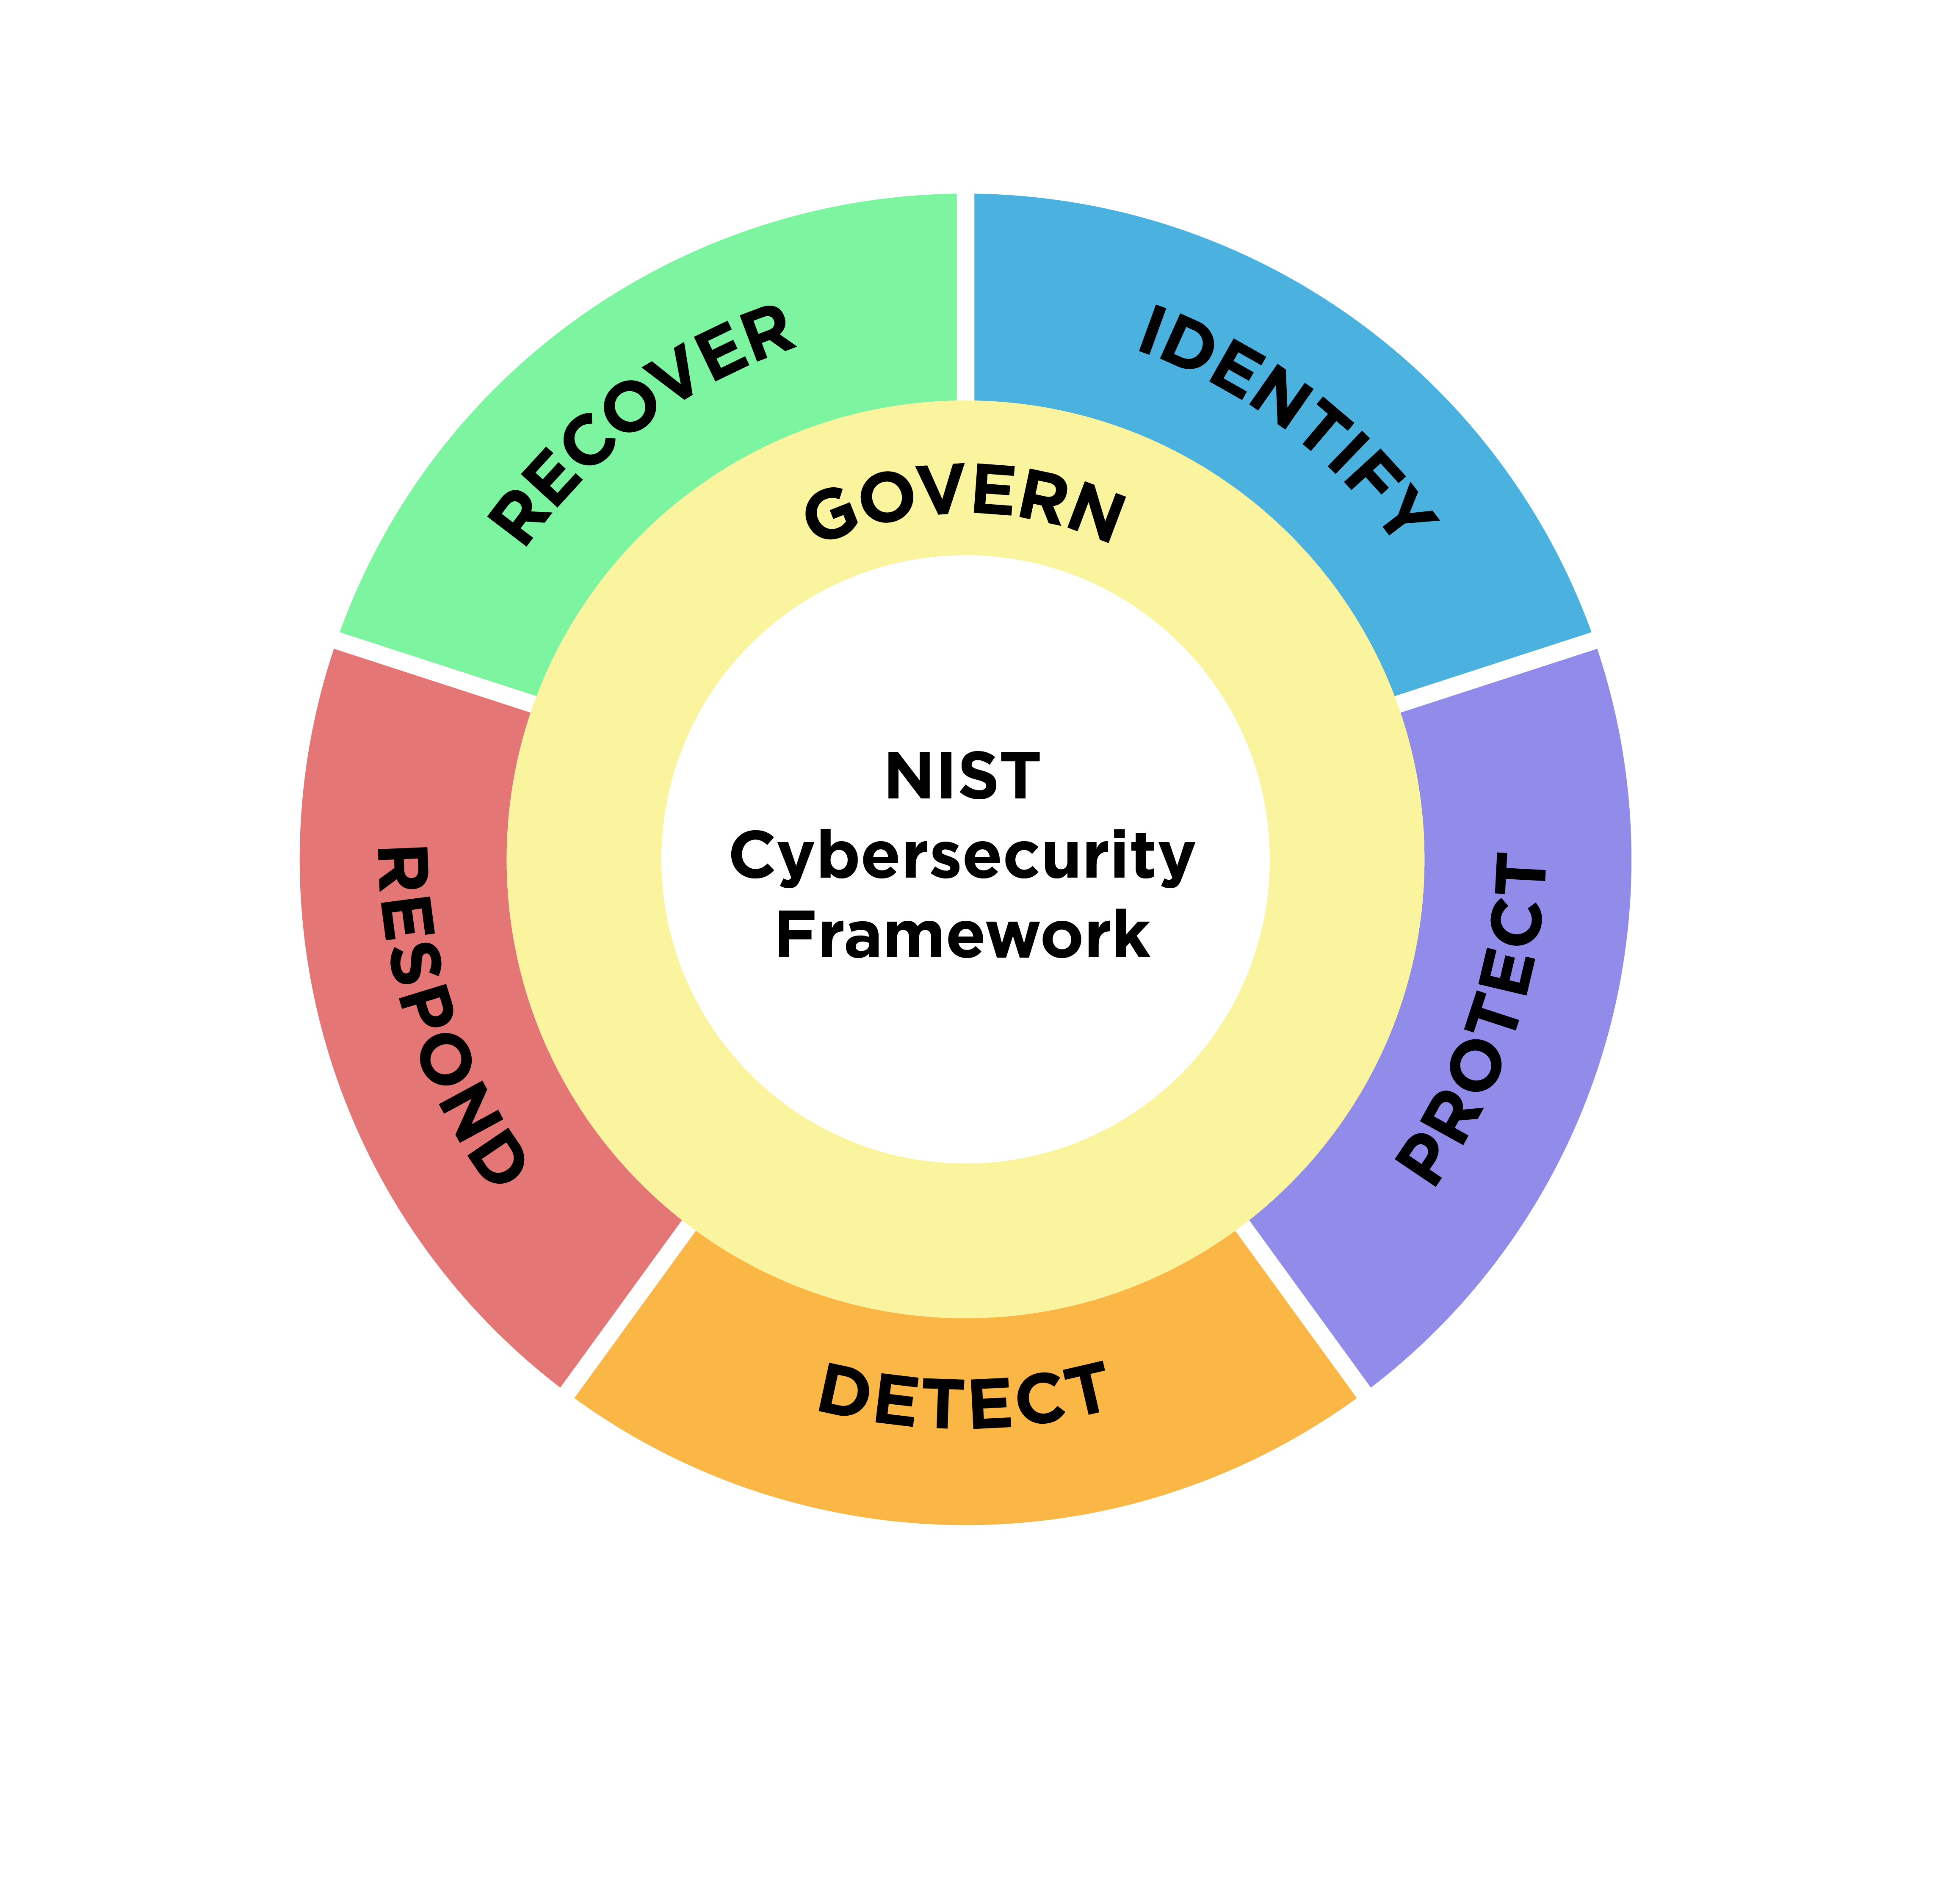
NIST Framework

Slide 26
ISO 27001
Plan
Policies, scope, risk assessment
Do
Implement Controls
Act
Correct and Improve
Check
Monitor, audit, review

Slide 27
Cybersecurity Regulatory and Standards Landscape
NIST CSF
Risk-based framework
ISO/IEC 27001
ISMS and governance
IENISA/NIS2
EU essential services security
ENISA
NIS2 Directive
ETSI
Telecom / ICT standards
Sector-specific Rules
Healthcare, energy, transport

Slide 28
Threat Landscape
Cyber threats
Physical threats
Hybrid threats

Slide 29
Emerging Threats
AI attacks
Supply chain risks
Nation-state conflicts

Slide 30
Key Takeaways
CI is critical and interconnected
Security must be holistic
Threats are evolving

Slide 31

Thank you
Please send all questions to:
gehad@example.com

