Slide 1



Advanced Critical Infrastructure Security for Health
CSP008_C_H
Presentation by:

Slide 2


Slide 3

Advanced Critical Infrastructure Security for Health
Course Overview
T1.
Introduction to Critical Infrastructure Security
T2.
Common Security Weaknesses and Threat Landscape
T3.
Regulations and Standards

Slide 4

T3: Regulations and Standards
Compliance, Governance, and Security in Healthcare and Critical Infrastructure

Slide 5

Learning Objectives
Students should be able to:
Distinguish compliance from actual security
Explain the role of standards in healthcare cybersecurity
Describe NIST, ISO 27001, ISO 27799, GDPR, NIS/NIS2, and related frameworks
Understand governance, risk, and control alignment
Design a realistic compliance-oriented security program

Slide 6
Why Regulations Matter
Regulations and standards matter because they:
Define minimum expectations
Clarify responsibilities
Support auditability
Improve consistency
Enable cross-organizational trust
Promote risk-based decision-making

Slide 7
Compliance Is Not the Same as Security
Compliance means meeting stated requirements.
Security means being resilient against real threats.
An organization may be:
Compliant but fragile
Secure in some controls but non-compliant in governance
Both compliant and resilient
Neither

Slide 8
Compliance vs Security
Compliance
Mandatory requirements
Audits and reporting
Baseline obligations
Security
Overlap
Useful baseline, but not sufficient alone
Real risk reduction
Adversary-focused defense
Resilience and recovery

Slide 9
Cybersecurity Regulatory and Standards Landscape
NIST CSF
Risk-based framework
ISO/IEC 27001
ISMS and governance
IENISA/NIS2
EU essential services security
ENISA
NIS2 Directive
ETSI
Telecom / ICT standards
Sector-specific Rules
Healthcare, energy, transport

Slide 10
The Regulatory Landscape in Healthcare
Healthcare organizations operate under overlapping obligations:
Privacy regulation
Cybersecurity frameworks
Device-related regulation
Incident reporting obligations
Sector-specific governance rules
Third-party requirements

Slide 11
NIST Cybersecurity Framework
NIST CSF organizes security activities into:
Identify
Protect
Detect
Respond
Recover
It is useful because it provides a lifecycle view and a common language across technical and managerial stakeholders.

Slide 12
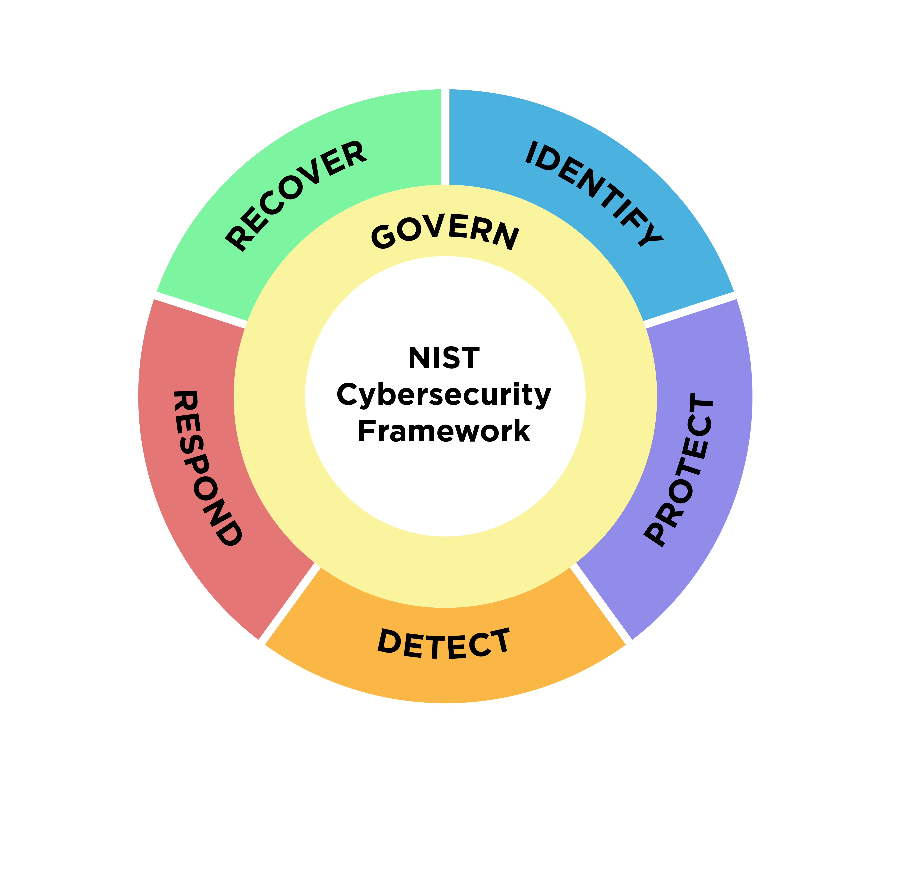
NIST Framework

Slide 13
The Five NIST Functions in Practice
Identify: assets, business context, risks
Protect: access control, awareness, safeguards
Detect: monitoring, anomalies, logging
Respond: incident handling and coordination
Recover: restoration, resilience, lessons learned

Slide 14
ISO/IEC 27001
ISO 27001 is the leading ISMS standard. It defines how an organization establishes, implements, maintains, and continually improves information security management.

Slide 15
NIST Framework

Slide 16
Why ISO/IEC 27001 Matters in Healthcare
Healthcare benefits from ISO/IEC 27001 because it helps:
Define scope and ownership
Organize risk assessment
Link controls to risk treatment
Document policies and procedures
Prepare for audits
Drive continual improvement

Slide 17
ISO 27001, ISO 27002, and Annex A
A simple relationship:
ISO 27001 defines ISMS requirements
Annex A references the control set
ISO 27002 provides implementation guidance for controls

Slide 18
ISO 27799: Healthcare-Specific Security Guidance
ISO 27799 adapts information security guidance to the healthcare domain. It builds on ISO 27001 and ISO 27002 and provides recommendations suited to healthcare language, workflows, and risks.

Slide 19
Governance, Roles, Responsibilities
Effective governance requires:
Clear ownership
Decision authority
Defined accountability
Escalation paths
Policy approval mechanisms
Management oversight

Slide 20
Risk Management as the Core of Compliance
Risk management connects business priorities to security decisions. Typical cycle:
Context and scope
Asset identification
Threat and vulnerability analysis
Impact and likelihood assessment
Risk treatment
Residual risk review

Slide 21
ISO 31000 and Risk Methods
In the healthcare critical infrastructure materials, risk assessment and management are linked to recognized methods such as ISO 31000. Risk methods help institutions decide:
What matters most
Where exposure is highest
Which controls are justified
How to prioritize treatment

Slide 22
Privacy Regulation: GDPR and Health Data
Health data is high-sensitivity personal data. Core concerns include:
Lawful basis
Purpose limitation
Data minimization
Security of processing
Rights of data subjects
Breach response obligations

Slide 23
Legal Frameworks Beyond GDPR
Relevant healthcare security obligations may include:
HIPAA
HITRUST
NIS / NIS2
eIDAS
Medical Device Regulation
In Vitro Diagnostic Regulation
Clinical Trials Regulation

Slide 24
NIS2 and Critical Infrastructure Context
NIS2 expands cybersecurity expectations for essential and important entities. In the healthcare and CI context, it reinforces:
Risk management obligations
Governance accountability
Supply chain attention
Incident reporting
Higher management responsibility

Slide 25
Security Controls: From Policy to Practice
Policies are only meaningful when translated into operational controls, such as:
Access control
Encryption
Logging
Backup and recovery
Endpoint protection
Segmentation
Awareness training
Vendor management

Slide 26
Evidence, Audit, and Assurance
Auditors and assessors look for evidence such as:
Risk registers
Policies and procedures
Training records
Asset inventories
Incident records
Exception handling
Control testing results
Management review outputs

Slide 27
Incident Reporting and Response Duties
Compliance regimes increasingly require organizations to:
Detect incidents
Escalate rapidly
Notify required parties
Preserve evidence
Coordinate response
Learn from events

Slide 28
Secure Patient Data as a Governance Outcome
Governance and regulation ultimately aim to protect:
Patient confidentiality
Data integrity
Service continuity
Trust
Ethical handling of sensitive information

Slide 29
Privacy-Enhancing Technologies and Modern Compliance
Modern compliance increasingly involves technical design choices, including:
Anonymization
Pseudonymization
Differential privacy
Secure sharing approaches
Privacy-preserving AI approaches

Slide 30
Challenges of Implementation
Organizations struggle because of:
Limited resources
Legacy systems
Skills shortages
Fragmented ownership
Clinical operational pressures
Complex supplier ecosystems

Slide 31
Building a Practical Compliance Program
Recommended sequence:
Define scope and governance
Build asset and data inventories
Perform risk assessment
Map obligations and standards
Select and implement controls
Train people
Test and audit
Improve continuously

Slide 32
Key Takeaways
Regulations establish accountability and minimum expectations
Compliance is necessary but not sufficient
ISO 27001 gives structure; ISO 27799 adds healthcare specificity
Risk management is the organizing principle
Healthcare security must align law, governance, technology, and operations

Slide 33

Thank you
Please send all questions to:
gehad@example.com

