Slide 1
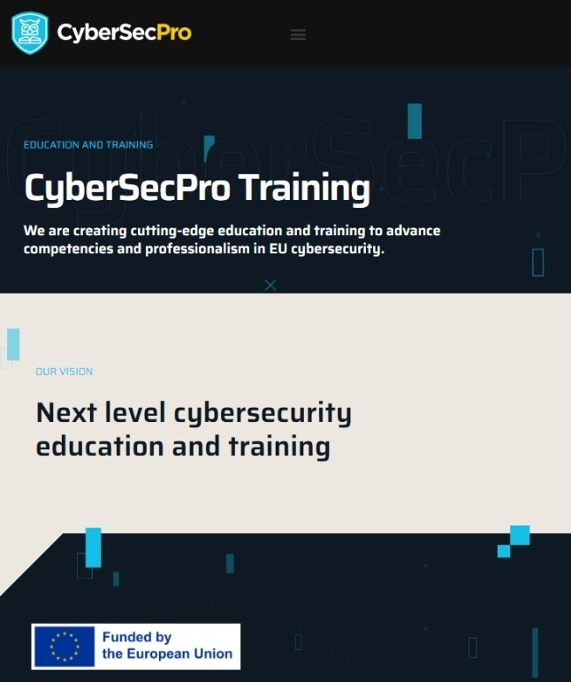


Critical Energy Infrastructure Security
CSP008_C_E
Presentation by:

Slide 2
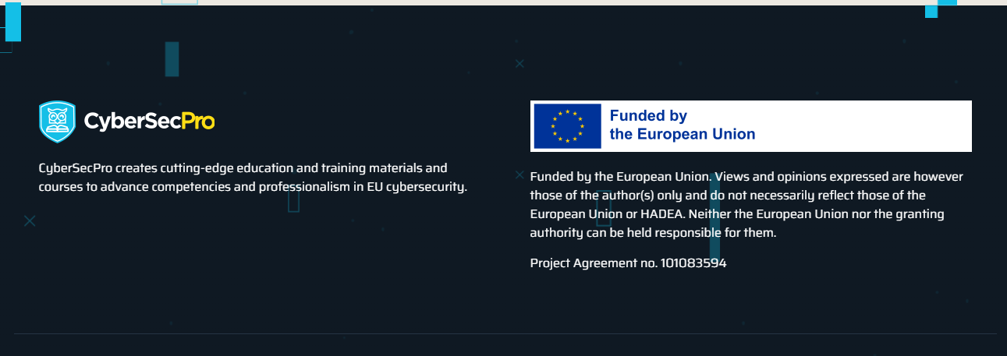

Slide 3


Cybersecurity in Emerging Technologies for the Energy Network
Course Overview
T1.
Introduction to Critical Infrastructure Security and Challenges
T2.
Common Security Weaknesses and Threat Landscape
T3.
Cascading Effects and Risk Assessment
T4.
Regulations and Standards
T5.
Security and Resilience
T6.
Privacy, Ethical, Legal, and Social Implications

Slide 4

T2: Common Security Weaknesses and Threat Landscape
Threats, Vulnerabilities, and Risk Assessment in CEI
From “what is critical” → to “what can go wrong” and “how we decide priorities”
Notes:
Position Topic 2 as the bridge from conceptual context to structured analysis.
Emphasise that risk assessment is the language used to justify security investments and operational changes in energy environments.

Slide 5

Learning Objectives
By the end of this topic, students can:
Identify threat sources, attack vectors, and energy-specific targets
Recognise common OT/ICS vulnerabilities and constraints
Build an asset–threat–vulnerability–impact reasoning chain
Apply a risk assessment workflow appropriate for CEI
Produce a risk register and prioritised mitigation plan
Notes:
State that we’re aiming for practical output: a risk register, not just theory.

Slide 6
Why Risk Is Hard in Energy
Energy infrastructures are cyber-physical (digital actions → physical outcomes)
Availability and safety dominate security priorities
Systems are heterogeneous: legacy OT + modern IT + vendor ecosystems
Impacts include cascading failures into other critical sectors
Notes:
In CEI, incidents are operational events.

Slide 7
Threat vs Vulnerability vs Risk (Definitions)
Threat: something capable of causing harm (actor, event, condition)
Vulnerability: weakness that can be exploited
Risk: likelihood × impact (in a given context)
Control: measure to reduce likelihood and/or impact
Notes:
Most students mix these up. Stress: vulnerabilities exist even without an active attacker; threats exist even without a specific vulnerability.

Slide 8
CEI Threat Taxonomy
Threats to CEI
Cyber
Malware, intrusion
Physical
Sabotage, tampering
Hybrid
Coordinated cyber + physical
Natural/
Accidental
Storms, fire, operator error
Cyber: malware, ransomware, intrusion, data destruction
Physical: sabotage, theft, tampering
Hybrid: coordinated cyber + physical
Natural/accidental: storms, fire, operator errors
Notes:
Energy systems are susceptible to both physical and cyber threats, amplified by digital transformation

Slide 9
Threat Actors & Motivations
Nation-state / APT (strategic disruption, intelligence)
Cybercriminal groups (extortion, monetisation)
Insider (malicious or negligent)
Hacktivists (public pressure)
Supply chain compromise (access via trusted parties)
Notes:
The same vulnerability can be used by different actors with different objectives (e.g., theft vs sabotage).

Slide 10
Attack Surfaces in CEI (Where Attacks Enter)
Corporate IT (email, VPN, cloud)
OT boundary (remote access, vendor connections)
Field devices (RTUs/PLCs, sensors/actuators)
Engineering workstations / HMIs
Third parties (contractors, integrators)
Physical access paths
Notes:
Attack surface expands as connectivity expands.

Slide 11
Typical Attack Paths: IT → OT
Initial access
Phishing/creds/VPN
Lateral move
IT privilege escalation
Cross boundary
Segmentation failure
OT control
HMI/ENG/SCADA access
Physical impact
Setpoint/logic manipulation
Initial access (phishing, stolen creds, exposed remote access)
Privilege escalation and lateral movement
OT access through weak segmentation
Manipulation of control processes / setpoints
Cover tracks / persistence
Notes:
Many high-impact OT incidents start as ordinary IT compromises.

Slide 12
Energy-Specific High-Value Targets
SCADA control servers, HMIs
PLC/RTU logic and firmware
Safety systems (SIS)
Substation automation networks
DER / microgrid controllers
EV charging backends & protocols
Smart meters / head-end systems
Notes:
Use different energy-related examples (distribution, microgrids, EV charging, etc.)

Slide 13
Vulnerabilities: Why OT/ICS Is Different
Long lifecycles, legacy protocols, limited patch windows
Vendor dependencies and certification constraints
Real-time and safety constraints
“Security by isolation” assumptions that no longer hold
Notes:
Mitigation is often architectural (segmentation, monitoring) rather than “just patch it.”

Slide 14
Common OT Vulnerability Classes
Weak authentication / shared accounts
Flat networks and missing segmentation
Unmonitored remote access
Insecure engineering workstation practices
Insecure protocols / plaintext control traffic
Weak change management (logic changes not tracked)
Notes:
Keep it concrete: “If you can’t see it, you can’t secure it.”

Slide 15
Vulnerabilities in the Supply Chain
Compromised updates/tools
Vendor remote support channels
Third-party integrators and contractors
Embedded components and firmware provenance
Notes:
Trust boundary: “you inherit the security posture of your ecosystem.”

Slide 16
Human Factors in Energy Risk
Operator workload, fatigue, and alarm overload
Social engineering and procedural bypass
Shadow IT / workaround culture
Training gaps vs complex systems
Notes:
Many incidents are socio-technical failures, not purely technical.

Slide 17
Risk Assessment Goals in CEI
Prioritise what to protect first
Decide acceptable risk vs required controls
Support compliance and governance
Improve resilience/business continuity
Notes:
Risk assessment as an organisational decision tool, not paperwork.

Slide 18
Risk Assessment Workflow (CEI-friendly)
Scope & boundary
Assets & criticality
Threat & vulnerabilities
Likelihood & impact
Evaluate & prioritise
Threat & monitor
Define scope and system boundary
Identify assets & critical functions
Identify threats and vulnerabilities
Analyse likelihood and impact
Evaluate & prioritise risks
Select controls and plan treatment
Monitor, reassess, improve
Notes:
Iterative approach — assessments must evolve with changing threats and infrastructure.

Slide 19
Step 1: Scoping & Boundaries
What system are we assessing? (substation, microgrid, control centre)
What interfaces exist? (vendor links, IT-OT boundary)
What is “in scope” vs “out of scope”
Assumptions and constraints
Notes:
Most failed assessments are “too broad” or “too narrow.” Scope controls quality.

Slide 20
Step 2: Asset & Function Criticality
Identify critical functions (supply continuity, frequency stability)
Identify assets supporting those functions
Classify criticality (safety, operational, regulatory, financial)
Notes:
Use “function-first”: protect what keeps lights on and keeps people safe.

Slide 21
Step 3: Threat Modelling for CEI
Identify attack paths (IT → OT, remote access, physical)
Identify trust boundaries and privileged roles
Identify safety interactions (cyber actions → physical hazards)
Notes:
The value is not the label, it’s the thinking: “How would an attacker realistically succeed?”

Slide 22
Step 4: Likelihood Estimation (Practical)
Likelihood factors:
Exposure (internet-facing? remote access?)
Exploitability (skill/ease)
Detectability (monitoring maturity)
Threat actor interest
Existing control strength
Notes:
Likelihood is an informed judgement; document reasoning.

Slide 23
Step 5: Impact Estimation (CEI impact dimensions)
Impact categories:
Safety (human harm)
Operational (outage duration/scale)
Physical damage (equipment)
Financial (cost, penalties)
Regulatory/compliance (violations)
Reputational/public trust
Cascading effects (other CIs)
Notes:
Impact is often multi-dimensional — don’t reduce everything to euros only.

Slide 24
Risk Matrix (Use Carefully)
Standard 5×5 matrix: Likelihood vs Impact
Useful for prioritisation, dangerous for false precision
Mitigate by:
  clear definitions
  documented assumptions
  sensitivity analysis
Notes:
Warn students: risk matrices can hide uncertainty; treat them as conversation tools.

Slide 25
Risk Treatment Options
Avoid (change design)
Mitigate (controls)
Transfer (insurance, contracts)
Accept (documented residual risk)
Notes:
In CEI, acceptance requires strong justification and governance sign-off.

Slide 26
Controls: Examples for CEI (Mapped to Threats)
Segmentation & zoning (limit lateral movement)
Strong remote access controls (MFA, bastions)
Allowlisting, configuration hardening
OT-aware monitoring/IDS
Backup/restore & tested recovery
Vendor access governance
Change control & logging for PLC logic
Notes:
Connect controls to risk drivers; avoid “checkbox security.”

Slide 27
Output: Risk Register (What You Deliver)
A CEI risk register should include:
Asset / function
Threat scenario
Vulnerability/condition
Likelihood, impact, risk rating
Existing controls
Recommended treatments
Owner, due date
Residual risk and review date
Notes:
Risk registers make work actionable. Without ownership and dates, it’s not real.

Slide 28
Wrap-up & Bridge to Topic 3
Threats and vulnerabilities are contextual
Risk assessment is iterative and supports resilience
Next: cascading effects modelling and systemic propagation
T1: Foundations
T2: Threats & Risks
T3: Cascading
T4: Regulation
T5: Resilience
T6: Ethics and Society
Notes:
Close with the key shift: risk in CEI is about system behaviour and propagating consequences.

Slide 29

Thank you
Please send all questions to:
gehad@example.com

