Slide 1



Critical Energy Infrastructure Security
CSP008_C_E
Presentation by:

Slide 2


Slide 3


Cybersecurity in Emerging Technologies for the Energy Network
Course Overview
T1.
Introduction to Critical Infrastructure Security and Challenges
T2.
Common Security Weaknesses and Threat Landscape
T3.
Cascading Effects and Risk Assessment
T4.
Regulations and Standards
T5.
Security and Resilience
T6.
Privacy, Ethical, Legal, and Social Implications

Slide 4

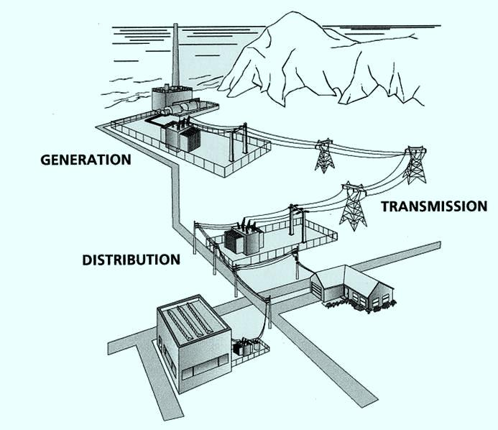
T1: Introduction to Critical Infrastructure Security and Challenges
Critical Energy Infrastructure Security
Notes:
This topic establishes the mental model needed for the entire course. Students should leave this lecture thinking in terms of systems, dependencies, and impact, not just vulnerabilities.

Slide 5

Why Start with Definitions?
“Critical” is not a technical term
Definitions shape:
  Regulation
  Investment priorities
  Security strategies
Different countries → different definitions
Notes:
Stress that security decisions depend on what governments and operators classify as critical.

Slide 6
What Is Critical Infrastructure?
Assets, systems, and networks
Essential for:
  Public safety
  Economic stability
  Social well-being
Severe impact if disrupted
Notes:
Emphasise impact, not technology. A system is critical because of consequences, not because it is complex.

Slide 7
Critical Infrastructure Sectors
CI
Energy
Water
Transport
Telecommunications
Healthcare
Finance and Government
Energy
Water
Transport
Healthcare
Telecommunications
Finance and government
Notes:
These sectors form a mutually dependent ecosystem, not independent silos.

Slide 8
Why Energy Is “Super-Critical”
Enables operation of all other Cis
Continuous service required (24/7)
Failure propagates immediately
Notes:
Simple example: no electricity → no telecom → no emergency response.

Slide 9
Defining Critical Energy Infrastructure (CEI)
CEI includes:
Physical assets
Digital control systems
Communication networks
Market and operational platforms
Cyber/ICT layer
Corporate IT, cloud services, remote access, CTI, monitoring
Control layer (OT)
SCADA, HMI, control networks, engineering workstations
Physical process layer
Substations, breakers, generators, DERs, sensors/actuators
Notes:
CEI is cyber-physical by design, not by accident.

Slide 10
Energy Infrastructure
Value Chain
Generation
Transmission
Distribution
Consumption
Market & Ops coordination
Generation
Transmission
Distribution
Consumption
Coordination and markets
Notes:
Security must cover end-to-end, not isolated components.

Slide 11
Types of Energy Infrastructure
Conventional generation
Renewables
Smart grids
Microgrids
EV charging
Notes:
Decentralisation improves resilience but increases complexity.

Slide 12
Digital Transformation of Energy
Automation and remote control
Data-driven optimization
Integration of IoT / IoE
AI-assisted control
Notes:
Stress that cybersecurity becomes operational risk, not IT risk.

Slide 13
IT vs OT in Energy Systems
Information Technology(IT): business, planning, billing
Operational Technology (OT): control, monitoring, safety
Increasing convergence
Notes:
Why this convergence breaks traditional security assumptions.

Slide 14
IT vs OT: Why security approaches differ
Aspect | IT | OT
Primary priority | Confidentiality / integrity | Availability / safety
Change cadence | Frequent updates | Rare updates, long lifecycles
Downtime tolerance | Often acceptable | Very low tolerance
Protocols | Standard (HPPTS, DNS, etc.) | Industrial / legacy (fieldbus, etc.)
Security controls | EDR, patching, IAM | Segmentation, allowlists, monitoring
Impact of compromises | Data loss, business disruption | Physical damage, safety incidents

Slide 15
Characteristics of OT Systems
Real-time constraints
High availability
Safety-critical
Long lifecycle
Legacy protocols
Notes:
Why patching or rebooting is often impossible in OT.

Slide 16
Security Priorities in CEI
Availability
Safety
Integrity
Confidentiality
Notes:
Emphasise how CEI flips classic IT security thinking.

Slide 17
CEI Threat Landscape
Cyber threats
Physical threats
Hybrid threats
Natural hazards
Notes:
Attacks are rarely purely cyber or physical anymore.

Slide 18
Cyber Threats to CEI
Malware and ransomware
Remote access abuse
Supply chain compromise
Insider threats
Notes:
Many attacks exploit misconfiguration, not zero-days.

Slide 19
Physical and Hybrid Threats
Sabotage
Tampering
Coordinated cyber-physical attacks
Notes:
Physical access often enables cyber compromise.

Slide 20
Interdependencies of
Energy Systems
Energy ↔ Telecom
Energy ↔ Healthcare
Energy ↔ Transport
Notes:
Protecting energy protects everything else.

Slide 21
Types of Interdependencies
Interdependencies
Physical
Material flows (power, fuel water)
Cyber
Information/control (networks, SCADA links)
Geographic
Co-location impacts (flood, fire, outage area)
Logical
Policy/economy coupling (market rules, prioritisation)
Notes:
Some dependencies are hidden and only appear during crises.

Slide 22
Cascading Effects Example
Initial event
Substation outage
Energy impact
Local blackout
Dependency hit
Telecom degradation
Secondary impact
Emergency response delays
System-level
Economic + social disruption
Notes:
Stress non-linearity: small events → large consequences.

Slide 23
Impact of CEI Failures
Economic damage
Safety risks
Social disruption
Political consequences
Notes:
CEI incidents quickly become national security issues.

Slide 24
CEI Security Stakeholders
CEI
Operators/
utilities
Regulators
Government
/CERTs
Vendors/
Suppliers
Society/
End-users
Operators
Regulators
Governments
Vendors
Society
Notes:
Highlight coordination challenges and conflicting incentives.

Slide 25
Security vs Resilience: Operational lifecycle
Security: focuses in preventing and reducing likelihood
Resilience: focuses on absorbing impact and restoring service safety
Prevent
Hardening, controls
Respond
Contain, coordinate
Recover
Restore, validate
Detect
Monitoring, alerts
Notes:
Prepare students for later resilience-focused topics.

Slide 26
Key CEI Security Challenges
Legacy systems
Skills gap
Regulatory complexity
Cost and availability constraints
Notes:
CEI security progress is slow but critical.

Slide 27
CEI Security is Multidisciplinary
Engineering
Cybersecurity
Law and policy
Ethics
Social sciences
Notes:
Reinforce that CEI security is not only for engineers.

Slide 28
How Topic 1 Fits the Course
Foundations → threats → cascading effects
Governance → resilience → ethics
T1: Foundations
T2: Threats & Risks
T3: Cascading
T4: Regulation
T5: Resilience
T6: Ethics and Society
Notes:
Explain how each topic builds logically on this one.

Slide 29
Key Takeaways
Energy is foundational
Cyber-physical systems dominate
Interdependencies amplify risk
Holistic thinking is essential
Notes:
Reinforce systems thinking and critical impact awareness.

Slide 30

Thank you
Please send all questions to:
gehad@example.com

