Slide 1


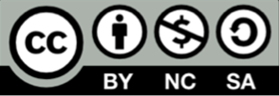
Critical Energy Infrastructure Security
CSP008_C_E
Presentation by:

Slide 2


Slide 3


Cybersecurity in Emerging Technologies for the Energy Network – Course Overview
T1.
Introduction to Critical Infrastructure Security and Challenges
T2.
Common Security Weaknesses and Threat Landscape

Slide 4

Training Outline
Topic-01 - Introduction to Critical Infrastructure Security and Challenges
Overview and Unique Security Challenges
Notes:
Welcome the participants to the session.
Introduce yourself and briefly outline your background in cybersecurity and energy technologies.
Mention the goal of today’s presentation: to provide an overview of cybersecurity challenges in emerging energy technologies.

Slide 5
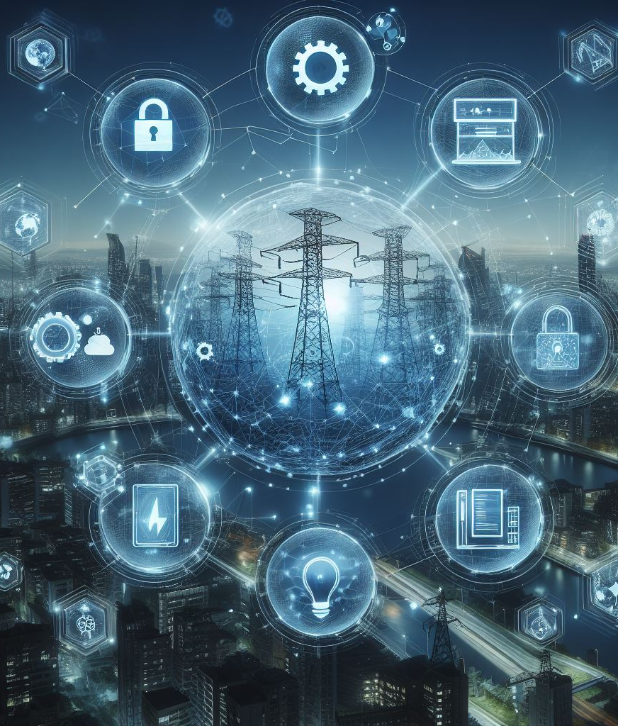
1. Definition and Importance of Critical Infrastructure
Context
Definition: Critical infrastructure refers to the assets, systems, and networks that are essential for the functioning of a society and economy.
Importance: The security and resilience of critical infrastructure are vital for national security, economic stability, public health, and safety.
Examples: Power grids, water supply, transportation systems, communication networks.
Notes:
Introduce the concept of critical infrastructure and why it is crucial.
Highlight examples such as power grids, water supply, transportation systems, and communication networks.
Emphasize the potential consequences of disruptions in these systems, such as economic loss, social chaos, and public health risks.

Slide 6
2. Critical Infrastructure Sectors
Context
Energy: Power plants, electrical grids, oil and gas pipelines.
Transportation: Airports, railways, ports, highways.
Water: Water treatment plants, distribution systems, dams.
Healthcare: Hospitals, emergency services, medical supply chains.
Information Technology: Data centers, cloud services, internet backbone.
Telecommunications: Communication networks, satellite systems.
Notes:
Provide detailed examples of each sector.
Discuss the interdependencies between these sectors, illustrating how a disruption in one can impact others.
For instance, a power outage can affect water treatment plants and hospitals.

Slide 7
3. Interdependencies and Challenges
Context
Interdependencies: Explain how various critical infrastructure sectors depend on each other.
Challenges: Include risks like cyber threats, natural disasters, human errors, and aging infrastructure.
Examples:
  Power outage affecting communication networks.
  Cyber attack on a water treatment plant impacting public health.
Notes:
Use real-world examples to show interdependencies (e.g., how the energy sector relies on telecommunications for grid management).
Discuss the challenges and complexities in securing these interconnected systems.
Highlight the need for coordinated security efforts across different sectors.

Slide 8
4. National and International Security Frameworks
Context
Frameworks: Overview of key frameworks such as NIST, ISO, and EU directives.
NIST (National Institute of Standards and Technology): NIST Cybersecurity Framework, NIST SP 800-53.
ISO (International Organization for Standardization): ISO/IEC 27001, ISO/IEC 27002.
EU Directives: NIS Directive (Network and Information Systems), GDPR (General Data Protection Regulation).
Notes:
Explain the role of these frameworks in enhancing the security posture of critical infrastructures.
Highlight the importance of compliance and how these frameworks help in mitigating risks.
Discuss how these standards provide guidelines for implementing security controls and risk management processes.

Slide 9
5. Global Threat Landscape
Context
Cyber Threats: Malware, ransomware, DDoS attacks, phishing.
Physical Threats: Natural disasters (earthquakes, floods), terrorism, vandalism.
Insider Threats: Disgruntled employees, human error, social engineering.
Impact: Economic losses, disruption of services, safety risks, loss of life.
Notes:
Discuss recent examples of attacks on critical infrastructures globally (e.g., the 2015 Ukrainian power grid cyber attack).
Emphasize the evolving nature of threats and the need for continuous improvement in security measures.
Highlight the role of international cooperation in addressing global threats.

Slide 10
6. Scenario Overview “Cyber Attack on a Power Grid”
Context
Description: A sophisticated cyber attack targets the control systems of a power grid, leading to a major blackout.
Impact: Disruption of electricity supply, economic losses, public safety concerns, critical services affected (e.g., hospitals, transportation).
Notes:
Provide background on the scenario, including the type of attack (e.g., malware, phishing).
Discuss the immediate and long-term impacts of such an attack on society and the economy.
Highlight the cascading effects on other critical infrastructures (e.g., communication networks, water supply).

Slide 11
7. Response and Mitigation
Context
Response: Incident response plan, coordination with national security agencies, public communication.
Mitigation: Strengthening cybersecurity measures, regular audits, employee training, implementing advanced intrusion detection systems, and incident response plans.
Notes:
Explain the steps taken during the incident response, including detection, containment, and recovery.
Discuss the importance of coordination between different stakeholders (e.g., government agencies, private sector).
Highlight the lessons learned and measures implemented to prevent future attacks, such as enhancing threat intelligence sharing and conducting regular cybersecurity drills.

Slide 12
Training Outline:
Topic-02 - Common Security Weaknesses and Threat Landscape
Security Weaknesses in Critical Infrastructure
Specific Security Weaknesses
Threat Landscape
Common Threats to Critical Infrastructure
Vulnerabilities of New Technologies
Scenario Overview “Supply Chain Attack on an Energy Company”
Response and Mitigation

Slide 13
1. Security Weaknesses in Critical Infrastructure
Context
Legacy Systems: Use of outdated technologies and protocols.
Integration Challenges: Issues arising from integrating new IT paradigms like Industry 4.0/5.0.
Examples: Unsupported software, outdated hardware, lack of patches, insecure protocols.
Notes:
Discuss how legacy systems pose significant security risks due to lack of updates and support.
Explain the challenges in integrating modern technologies with existing systems, including compatibility issues and increased attack surfaces.
Provide examples of common vulnerabilities found in legacy systems.

Slide 14
2. Specific Security Weaknesses
Context
Vulnerabilities: Software bugs, misconfigurations, unpatched systems, weak passwords.
Access Control: Weak access management, insufficient authentication mechanisms, lack of multi-factor authentication.
Human Factors: Lack of cybersecurity awareness, insufficient training, social engineering attacks.
Notes:
Provide examples of common vulnerabilities found in critical infrastructure systems.
Emphasize the importance of robust access control measures to prevent unauthorized access.
Discuss the role of human factors in security weaknesses and the need for continuous training and awareness programs.

Slide 15
3. Threat Landscape
Context
Attacker Types: Nation-state actors, cybercriminals, hacktivists, insider threats.
Motivations: Espionage, financial gain, disruption, political agendas.
Techniques: Phishing, malware, ransomware, DDoS attacks, supply chain attacks.
Notes:
Explain the different types of attackers and their motives.
Use case studies to illustrate how different attackers target critical infrastructures.
Discuss recent trends in cyber attack techniques and the importance of staying updated on emerging threats.

Slide 16
4. Common Threats to Critical Infrastructure
Context
Advanced Persistent Threats (APTs): Long-term targeted attacks designed to steal data or disrupt operations.
Supply Chain Attacks: Compromising third-party vendors to infiltrate critical systems.
Ransomware: Encrypting data and demanding ransom for its release.
Insider Threats: Malicious or negligent actions by employees or contractors.
Notes:
Discuss APTs and their characteristics, including their long-term, stealthy nature.
Explain how supply chain attacks work and provide recent examples (e.g., SolarWinds attack).
Highlight the growing threat of ransomware and its impact on critical infrastructure.
Discuss the importance of insider threat programs and monitoring.

Slide 17
5. Vulnerabilities of New Technologies
Context
Industry 4.0/5.0: Increased connectivity and automation bring new security challenges.
IoT Devices: Security risks associated with Internet of Things devices used in critical infrastructure.
Cloud Computing: Data breaches, misconfigurations, and unauthorized access risks.
Artificial Intelligence: Potential for adversarial attacks, data poisoning, and model theft.
Notes:
Highlight the security implications of adopting Industry 4.0/5.0 technologies, including increased attack surfaces.
Discuss specific vulnerabilities related to IoT devices and the need for secure implementation, such as strong encryption and regular firmware updates.
Explain the security challenges associated with cloud computing, including data breaches and misconfigurations.
Provide examples of potential security risks related to AI, such as adversarial attacks and data poisoning.

Slide 18
6. Scenario Overview “Supply Chain Attack on an Energy Company”
Context
Description: Attackers compromise a third-party vendor's software used by an energy company, leading to a breach.
Impact: Unauthorized access to critical systems, potential sabotage, data theft, operational disruptions.
Notes:
Outline the scenario and its impact on the energy company, including the method of attack and the compromised systems.
Discuss the broader implications for the industry and supply chain security, highlighting the need for robust vendor management practices.

Slide 19
6. Response and Mitigation
Context
Response: Incident detection, containment, eradication of the threat, recovery.
Mitigation: Strengthening supply chain security, rigorous vendor assessments, regular security audits, implementing multi-layered security controls.
Notes:
Describe the incident response steps taken to address the supply chain attack, including detection, containment, and eradication of the threat.
Highlight best practices for mitigating supply chain risks, such as conducting thorough vendor assessments, implementing strong security controls, and regularly auditing third-party vendors.
Discuss the importance of continuous monitoring and updating of supply chain security measures to adapt to evolving threats.

Slide 20

Thank you
Please send all questions to:
gehad@example.com

