Slide 1


Topic-1:Introduction to anomaly detection
CSP007_S_H
PRESENTATION BY:
Danijela Boberic Kraticev (UNSPMF)

Slide 2

What is an anomaly?
An anomaly refers to something that deviates from what is considered normal, expected, or standard.
It can be an irregularity, abnormal occurrence, or outlier that stands out from the typical pattern or behavior in a given context.

Slide 3
Categories of different anomalies
Generally fall into these broad categories:
Data point–based anomalies
Context-based anomalies
Collective anomalies
By classifying anomalies into categories, it becomes easier to identify and understand the nature of deviations from the norm.
Different types of anomalies may require distinct responses or mitigation strategies.

Slide 4
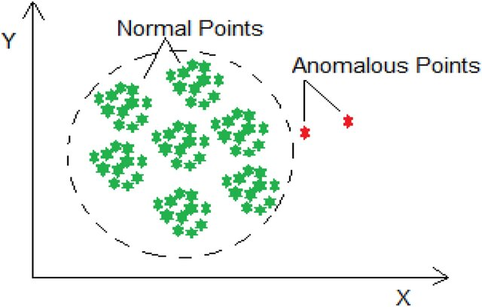
Data Point–Based Anomalies
A point anomaly is where a single datapoint stands out from the expected pattern, range, or norm. In other words, the datapoint is not expected to occur or have a very low probability of occurrence
A key challenge in detecting data point anomalies is to figure out the exact amount of deviation which leads to a potential anomaly.

Slide 5
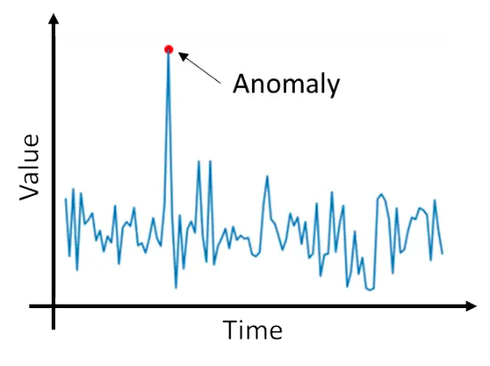
Context-Based Anomalies
Context-based anomalies consist of data points that might seem normal at first but are considered anomalies in their respective contexts.
A good example in this instance is a network intrusion attempt. Traffic might be at its lowest in the early hours of the morning. Therefore, a spike in traffic at 3 a.m. is a contextual anomaly that warrants further action and/or investigation as it could indicate a network intrusion attempt.

Slide 6
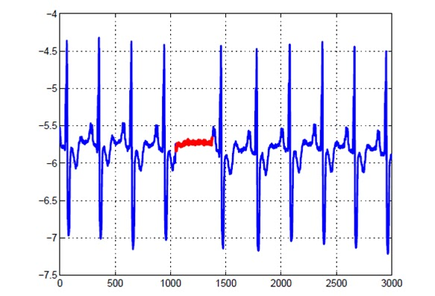
Collective Anomalies
A collective anomaly occurs where single data points looked at in isolation appear normal. When you look at a group of these data points, however, unexpected patterns, behaviours, or results become clear.
An example of collective anomalies can be notices when external hacker decided to hit a company’s website with a distributed denial-of-service (DDoS) attack. All of these spikes are clearly deviants from normal traffic patterns and would be considered anomalous

Slide 7
What is Anomaly Detection?
Anomaly detection is the process in which an advanced algorithm identifies certain data or data patterns to be anomalous.
Falling under anomaly detection are the tasks of:
outlier detection,
noise removal,
novelty detection,
event detection,
change point detection,
anomaly score calculation.
Anomalies do not necessarily represent a malicious event—they simply indicate that the trend deviates from what was normally expected. Anomalies, when flagged, must be investigated to determine whether they are malicious or benign.

Slide 8
Where Is Anomaly Detection Used?
Anomaly detection is utilized across various domains and industries where identifying unusual patterns or deviations from the norm is crucial.
Cybersecurity:
  Detecting unusual network traffic or activities that may indicate a security breach.
  Monitoring network performance for anomalies that may indicate service disruptions.
  Identifying anomalies in user behavior to detect unauthorized access or potential insider threats.
Finance:
  Fraud Detection: Identifying unusual transactions or patterns that may indicate fraudulent activities in banking or credit card transactions.
  Stock Market: Detecting abnormal trading patterns or market anomalies.
Healthcare:
  Monitoring patient data for anomalies that could signal potential health issues or irregularities.
  Detecting unusual patterns in medical imaging for early disease diagnosis.
Internet of Things (IoT):
  Detecting anomalies in sensor data from connected devices to identify potential malfunctions or abnormal behavior.
  Monitoring energy consumption patterns for unusual usage.
…

Slide 9
Network Traffic Anomalies
Anomalies in networks can be defined as network events or operations that deviate from normal network behavior.
Reasons for occurring network traffic anomalies:
malicious activities that misuse normal network services
overloading of networking infrastructure
malfunctioning of network devices
compromises made when setting network parameters
Intrusion detection systems (IDS), security information and event management (SIEM) solutions, and behavioral analytics platforms are commonly used to monitor network traffic, analyze system logs, and identify abnormal activities that may pose security risks.
Network anomalies are broadly categorized into two types:
performance-related anomalies
security-related anomalies

Slide 10
Performance-Related Anomalies
Refer to irregularities or deviations in the behavior or performance of a computer network that impact its operational efficiency and reliability.
These anomalies can manifest in various forms and may include:
Latency spikes: Sudden increases in network latency, causing delays in data transmission or response times.
Packet loss: Unusually high rates of packet loss, resulting in incomplete or corrupted data transmissions.
Bandwidth saturation: Exhaustion of available network bandwidth, leading to congestion and slowdowns in data transfer rates.
Traffic imbalances: Significant disparities in network traffic distribution across different network segments or nodes.
Unusual protocol usage: Abnormal usage or patterns of network protocols, indicating potential misuse or unauthorized activity.
Denial-of-Service (DoS) attacks: Coordinated attempts to overwhelm a network with excessive traffic, disrupting its normal operation.

Slide 11
Security-Related Anomalies
Refer to abnormal patterns or deviations in network or system behavior that may indicate potential security threats, breaches, or vulnerabilities
Some examples of security-related anomalies include:
Unusual access patterns: Anomalies in user access patterns, such as unauthorized attempts to access sensitive data or resources, unusual login times, or suspicious login locations.
Malware activity: Abnormal behavior associated with malware infections, such as unusual file modifications, unexpected network communications, or unauthorized system changes.
Data exfiltration: Anomalies indicating the unauthorized transfer or exfiltration of sensitive data from the network, including unusually large data transfers or unexpected destinations for outbound traffic.
Brute force attacks: Anomalies related to brute force attacks, such as multiple failed login attempts within a short period, indicating an attempt to guess passwords or gain unauthorized access to systems.
Network scanning: Anomalies indicative of network scanning activities, such as repeated port scans, reconnaissance probes, or mapping of network resources, which may precede targeted attacks.

Slide 12
Methods for anomaly detection
Statistical algorithms for anomaly detection
  z-score
  Elliptic envelope
  Local outlier factor
Machine-learning algorithms for anomaly detection
  Density-based scan
  One-class SVM
  Isolation forest
Deep Learning:
  Autoencoders
  Long Short-Term Memory (LSTM) Networks
  Generative Adversarial Networks
Time-Series Analysis
  Moving Averages
  Exponential Smoothing
  Seasonal-Trend decomposition using LOESS (STL)
……

Slide 13
Tools for anomaly detection
Scikit-learn - a machine learning library in Python that provides various algorithms for anomaly detection, including one-class SVM and isolation forests.
TensorFlow, Keras, PyTorch - open-source machine learning libraries that support the development of neural network models for anomaly detection.
Apache Spark MLlib - a distributed machine learning library that includes algorithms for anomaly detection, such as k-means clustering and one-class SVM.
ELKI - An open-source data mining software framework that provides various algorithms for clustering, outlier detection, and distance-based methods.
RapidMiner - a data science platform that offers a visual interface for building and deploying machine learning models, including tools for anomaly detection.
H2O.ai - an open-source software for data analysis that includes machine learning algorithms, such as isolation forests and deep learning, for anomaly detection.
SciPy - a library in Python that includes modules for scientific computing and statistical analysis, offering tools for implementing statistical anomaly detection methods.
OpenCV - an open-source computer vision and machine learning library that includes tools for anomaly detection, particularly in image and video data.
Microsoft Azure Anomaly Detector - a service on the Azure cloud platform that uses machine learning to detect anomalies in time-series data.
Prophet - a forecasting tool developed by Facebook that can be used for time-series anomaly detection.

Slide 14
References
Alla, S., & Adari, S. K. (2019). Beginning anomaly detection using python-based deep learning. New Jersey: Apress.

Slide 15

Thank you
Please send all questions to:
dboberic@uns.ac.rs

