Slide 1



Cybersecurity in Emerging Technologies for the Energy Network
CSP007_S_E
Presentation by:

Slide 2


Slide 3


Cybersecurity in Emerging Technologies for the Energy Network – Course Overview
o1.
Introduction to Cybersecurity in Energy Emerging Technologies
o2.
Securing Energy Emerging Technologies
o3.
Security Tools and Techniques for Energy Emerging Technologies
o4.
The Future of Emerging Technology Security and Its Application in the Energy Networ
o5.
Case Studies

Slide 4

Training Outline:
Topic-01
Introduction to Cybersecurity in Energy Emerging Technologies
Overview of cybersecurity principles and challenges in the context of emerging energy technologies
Introduction to IoE, cloud computing, blockchain, and AI and their significance in the energy sector

Slide 5
Training Outline:
Topic-01
Introduction to Cybersecurity in Energy Emerging Technologies
Overview of cybersecurity principles and challenges in the context of emerging energy technologies
Introduction to IoE, cloud computing, blockchain, and AI and their significance in the energy sector

Slide 6

01_1: Overview of cybersecurity principles and challenges in the context of emerging energy technologies
Context
Internet of Energy (IoE):
  Smart Grids: IoE enables the integration of sensors, meters, and control systems in the electrical grid, allowing real-time monitoring and optimization of energy distribution and consumption. For example, smart meters collect data on energy usage patterns, enabling utilities to implement demand-response programs and optimize grid efficiency.
  Predictive Maintenance: IoE sensors installed in energy infrastructure such as wind turbines and solar panels collect data on equipment health and performance. AI algorithms analyze this data to predict potential equipment failures and schedule preventive maintenance, reducing downtime and optimizing asset lifespan.
Cloud Computing:
  Data Analytics: Energy companies leverage cloud computing platforms to store and analyze vast amounts of data collected from sensors, meters, and other IoT devices. Cloud-based analytics tools enable energy companies to gain insights into energy consumption patterns, optimize energy production and distribution, and forecast demand more accurately.
  Remote Monitoring and Control: Cloud-based control systems allow energy operators to remotely monitor and control energy infrastructure such as power plants, substations, and renewable energy installations. This enables real-time adjustments to energy production and distribution, improving efficiency and reliability.

Slide 7
01_1: Overview of cybersecurity principles and challenges in the context of emerging energy technologies
Context
Blockchain Technology:
  Peer-to-Peer Energy Trading: Blockchain facilitates peer-to-peer energy trading by enabling secure, transparent, and decentralized transactions between energy producers and consumers. For example, households with solar panels can sell excess energy to neighbors through blockchain-enabled platforms, creating a more efficient and decentralized energy market.
  Energy Supply Chain Management: Blockchain can be used to track the provenance of energy resources (e.g., oil, gas, renewable energy certificates) throughout the supply chain, ensuring transparency, traceability, and compliance with regulatory requirements.
Artificial Intelligence (AI):
  Energy Forecasting: AI algorithms analyze historical energy consumption data, weather patterns, market trends, and other factors to forecast future energy demand and supply. This enables energy companies to optimize energy generation, storage, and distribution, reducing costs and ensuring reliable supply.
  Demand-Side Management: AI-powered demand-side management systems analyze real-time data on energy usage patterns and consumer behavior to optimize energy consumption. For example, AI algorithms can adjust thermostat settings in smart buildings or schedule energy-intensive tasks in industrial facilities to reduce peak demand and lower energy costs.

Slide 8
01_1: Overview of cybersecurity principles and challenges in the context of emerging energy technologies
Importance of Cybersecurity in Energy Systems
Energy sector increasingly reliant on digital technologies for efficiency and optimization.
Cyber attacks on energy infrastructure can have severe consequences, including service disruptions, financial losses, and safety risks.
Importance of protecting critical energy assets and data from cyber threats.
Cybersecurity Principles:
  Confidentiality: Ensuring sensitive energy data remains private and accessible only to authorized personnel.
  Integrity: Maintaining the accuracy and reliability of energy systems and data by preventing unauthorized tampering or alterations.
  Availability: Ensuring uninterrupted access to energy resources and services, even in the face of cyber attacks or system failures.
  Resilience: Building resilient energy systems capable of detecting, mitigating, and recovering from cyber attacks swiftly.

Slide 9
01_1: Overview of cybersecurity principles and challenges in the context of emerging energy technologies
Importance of Cybersecurity in Energy Systems
Challenges in Securing Emerging Energy Technologies:
  Complexity: Integration of diverse technologies such as IoT, cloud, blockchain, and AI increases the attack surface and complexity of energy networks.
  Interconnectivity: Interconnected energy systems create potential pathways for cyber attacks to propagate across networks.
  Legacy Infrastructure: Legacy energy infrastructure may lack robust cybersecurity measures, making them vulnerable to exploitation.
  Regulatory Compliance: Compliance with evolving cybersecurity regulations and standards poses challenges for energy companies.
Cybersecurity is paramount in safeguarding energy infrastructure and data against cyber threats.
Understanding cybersecurity principles and addressing challenges are essential for protecting emerging energy technologies.

Slide 10
Training Outline:
Topic-01
Introduction to Cybersecurity in Energy Emerging Technologies
Overview of cybersecurity principles and challenges in the context of emerging energy technologies
Introduction to IoE, cloud computing, blockchain, and AI and their significance in the energy sector

Slide 11
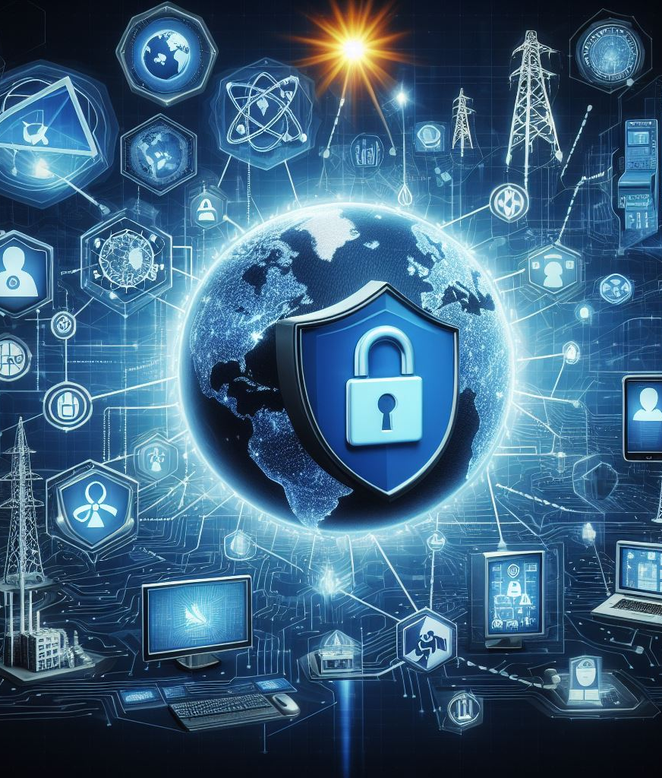
01_2: Introduction to IoE, cloud computing, blockchain, and AI and their significance in the energy sector
Definitions and Significance in the Energy Network
Internet of Energy (IoE):
  Definition: IoE refers to the interconnected network of energy-related devices, sensors, and systems that enable real-time monitoring, control, and optimization of energy resources.
  Significance: IoE facilitates the integration of renewable energy sources, grid optimization, demand-side management, and predictive maintenance in the energy sector.
Cloud Computing:
  Definition: Cloud computing involves the delivery of computing services (e.g., storage, processing, networking) over the internet on a pay-as-you-go basis.
  Significance: Cloud computing enables energy companies to store and process vast amounts of data, deploy scalable applications, and access advanced analytics for energy management and optimization.
Blockchain Technology:
  Definition: Blockchain is a decentralized, distributed ledger technology that enables secure and transparent transactions without the need for intermediaries.
  Significance: In the energy sector, blockchain technology facilitates peer-to-peer energy trading, secure data sharing, transparent billing, and traceability of energy transactions.

Slide 12
01_2: Introduction to IoE, cloud computing, blockchain, and AI and their significance in the energy sector
Definitions and Significance in the Energy Network
Artificial Intelligence (AI):
  Definition: AI involves the development of computer systems capable of performing tasks that typically require human intelligence, such as decision-making, pattern recognition, and natural language processing.
  Significance: AI applications in the energy sector include predictive maintenance, energy forecasting, demand response optimization, and anomaly detection, leading to improved efficiency and reliability.
Integration of IoE, cloud computing, blockchain, and AI transforms the energy sector by enabling:
  Real-time monitoring and control of energy assets.
  Optimization of energy production, distribution, and consumption.
  Enhanced cybersecurity through advanced threat detection and response capabilities.
  Decentralized and democratized energy systems, fostering innovation and sustainability.
IoE, cloud computing, blockchain, and AI play a pivotal role in shaping the future of the energy sector, offering opportunities for innovation, efficiency, and resilience.

Slide 13
Training Outline:
Topic-02
Securing Energy Emerging Technologies
Identification of vulnerabilities and potential cyber threats associated with IoE, cloud, blockchain, and AI
Best practices and strategies for securing each technology to safeguard energy infrastructure and data

Slide 14
Training Outline:
Topic-02
Securing Energy Emerging Technologies
Identification of vulnerabilities and potential cyber threats associated with IoE, cloud, blockchain, and AI
Best practices and strategies for securing each technology to safeguard energy infrastructure and data

Slide 15

02_1: Identification of vulnerabilities and potential cyber threats associated with IoE, cloud, blockchain, and AI
Identification of Vulnerabilities and Potential Cyber Threats
Internet of Energy (IoE):
  Vulnerabilities:
    Insecure IoT devices: Lack of built-in security features and vulnerabilities in IoT devices (e.g., smart meters, sensors) can be exploited for unauthorized access or control.
    Interoperability issues: Integration challenges between different IoT platforms and devices may create security gaps and vulnerabilities in energy networks.
  Potential Cyber Threats:
    Device Compromise: Unauthorized access or compromise of IoT devices can disrupt energy operations, manipulate data, or launch attacks on other network components.
    Data Breaches: Theft or manipulation of sensitive energy data collected by IoT devices can lead to privacy violations, financial losses, or reputational damage.
Notes:
https://energy.ec.europa.eu/news/new-network-code-cybersecurity-eu-electricity-sector-2024-03-11_en

Slide 16
02_1: Identification of vulnerabilities and potential cyber threats associated with IoE, cloud, blockchain, and AI
Identification of Vulnerabilities and Potential Cyber Threats
Cloud Computing:
  Vulnerabilities:
    Data breaches: Weak authentication, insecure APIs, and misconfigured cloud storage can expose sensitive energy data to unauthorized access or theft.
    Insider threats: Malicious insiders or unauthorized users with access to cloud resources can exploit vulnerabilities to disrupt energy services or steal confidential information.
  Potential Cyber Threats:
    Data Leakage: Unauthorized access to cloud-stored energy data can result in leakage of confidential information, intellectual property theft, or regulatory violations.
    Service Disruption: Denial-of-service (DoS) attacks or cloud infrastructure failures can disrupt energy operations, leading to service outages and financial losses.
Notes:
https://energy.ec.europa.eu/news/new-network-code-cybersecurity-eu-electricity-sector-2024-03-11_en

Slide 17
02_1: Identification of vulnerabilities and potential cyber threats associated with IoE, cloud, blockchain, and AI
Identification of Vulnerabilities and Potential Cyber Threats
Blockchain Technology:
  Vulnerabilities:
    Smart contract vulnerabilities: Flaws or vulnerabilities in smart contracts deployed on blockchain networks can lead to unauthorized transactions or manipulation of energy transactions.
    51% attacks: Majority attacks on blockchain networks can compromise the integrity of energy transactions and disrupt consensus mechanisms.
  Potential Cyber Threats:
    Transaction Manipulation: Tampering with blockchain records or smart contracts can alter energy transaction details, leading to financial losses or disputes.
    Sybil Attacks: Creation of multiple fake identities to control a significant portion of blockchain network nodes can undermine network security and consensus mechanisms.
Notes:
https://energy.ec.europa.eu/news/new-network-code-cybersecurity-eu-electricity-sector-2024-03-11_en

Slide 18
02_1: Identification of vulnerabilities and potential cyber threats associated with IoE, cloud, blockchain, and AI
Identification of Vulnerabilities and Potential Cyber Threats
Artificial Intelligence:
  Vulnerabilities:
    Adversarial attacks: Manipulation of input data or AI algorithms can lead to biased decision-making, unauthorized access, or exploitation of AI vulnerabilities.
    Model poisoning: Injection of malicious data into AI training datasets can compromise the integrity and performance of AI models.
  Potential Cyber Threats:
    AI Manipulation: Compromised or manipulated AI algorithms can generate inaccurate energy forecasts, recommendations, or control commands, leading to operational disruptions or financial losses.
    Privacy Violations: Unauthorized access to AI-generated insights or predictions can breach privacy regulations, compromise customer data, or infringe on individual rights.
Identification of vulnerabilities and potential cyber threats associated with IoE, cloud, blockchain, and AI is crucial for developing effective cybersecurity strategies to protect energy infrastructure and data.
Notes:
https://energy.ec.europa.eu/news/new-network-code-cybersecurity-eu-electricity-sector-2024-03-11_en

Slide 19
Training Outline:
Topic-02
Securing Energy Emerging Technologies
Identification of vulnerabilities and potential cyber threats associated with IoE, cloud, blockchain, and AI
Best practices and strategies for securing each technology to safeguard energy infrastructure and data

Slide 20

02_2: Best practices and strategies for securing each technology to safeguard energy infrastructure and data
Best Practices and Strategies
Internet of Energy (IoE):
  Best Practices:
    Implement robust authentication and access controls for IoT devices to prevent unauthorized access.
    Regularly update firmware and software patches to address known vulnerabilities and enhance device security.
    Encrypt communication channels and data transmissions between IoT devices and energy networks to protect against eavesdropping and data interception.
  Strategies:
    Segment network traffic to isolate critical energy systems from IoT devices and implement firewalls to filter malicious traffic.
    Conduct regular vulnerability assessments and penetration testing to identify and address security weaknesses in IoE deployments.
    Establish incident response plans and protocols to mitigate the impact of potential cyber attacks on energy infrastructure.
Notes:
https://energy.ec.europa.eu/news/new-network-code-cybersecurity-eu-electricity-sector-2024-03-11_en

Slide 21
02_2: Best practices and strategies for securing each technology to safeguard energy infrastructure and data
Best Practices and Strategies
Cloud Computing:
  Best Practices:
    Implement multi-factor authentication (MFA) and strong access controls to authenticate users and prevent unauthorized access to cloud resources.
    Encrypt data at rest and in transit to protect sensitive energy data stored in cloud environments from unauthorized access or theft.
    Regularly audit and monitor cloud infrastructure for suspicious activities, unauthorized access attempts, and data breaches.
  Strategies:
    Choose reputable cloud service providers with robust security measures and compliance certifications relevant to the energy sector.
    Implement data loss prevention (DLP) solutions to monitor and control the movement of sensitive energy data within cloud environments.
    Develop and enforce cloud security policies and procedures to ensure compliance with regulatory requirements and industry best practices.
Notes:
https://energy.ec.europa.eu/news/new-network-code-cybersecurity-eu-electricity-sector-2024-03-11_en

Slide 22
02_2: Best practices and strategies for securing each technology to safeguard energy infrastructure and data
Best Practices and Strategies
Blockchain Technology:
  Best Practices:
    Use permissioned blockchain networks with controlled access and consensus mechanisms to prevent unauthorized participation and maintain data integrity.
    Regularly audit and validate smart contracts deployed on blockchain networks to identify and remediate vulnerabilities or security flaws.
    Implement encryption and digital signatures to ensure the confidentiality, integrity, and authenticity of energy transactions recorded on blockchain.
  Strategies:
    Establish governance frameworks and consortium agreements to govern blockchain networks and define roles, responsibilities, and dispute resolution mechanisms.
    Conduct regular security audits and vulnerability assessments of blockchain infrastructure and smart contracts to identify and mitigate security risks.
    Collaborate with industry partners and regulators to establish industry standards and best practices for securing blockchain-based energy transactions.
Notes:
https://energy.ec.europa.eu/news/new-network-code-cybersecurity-eu-electricity-sector-2024-03-11_en

Slide 23
02_2: Best practices and strategies for securing each technology to safeguard energy infrastructure and data
Best Practices and Strategies
Artificial Intelligence (AI):
  Best Practices:
    Train AI models on diverse and representative datasets to improve accuracy, robustness, and fairness while minimizing bias and discrimination.
    Implement explainable AI (XAI) techniques to enhance transparency, interpretability, and accountability of AI-driven decisions in energy applications.
    Regularly evaluate and update AI models to adapt to evolving threats, changes in energy patterns, and emerging cybersecurity risks.
  Strategies:
    Implement model validation and verification processes to assess the performance, reliability, and safety of AI algorithms in energy applications.
    Monitor and analyze AI-generated insights and predictions for anomalies, errors, or adversarial attacks to ensure the integrity and reliability of energy operations.
    Collaborate with cybersecurity experts, AI researchers, and regulatory authorities to develop guidelines and standards for secure and trustworthy AI deployment in the energy sector.
Notes:
https://energy.ec.europa.eu/news/new-network-code-cybersecurity-eu-electricity-sector-2024-03-11_en

Slide 24
Training Outline:
Topic-03
Security Tools and Techniques for Energy Emerging Technologies
Overview of specialized security tools and techniques tailored to the energy sector
Implementation guidelines for deploying security measures such as encryption, access controls, and intrusion detection systems

Slide 25
Training Outline:
Topic-03
Security Tools and Techniques for Energy Emerging Technologies
Overview of specialized security tools and techniques tailored to the energy sector
Implementation guidelines for deploying security measures such as encryption, access controls, and intrusion detection systems

Slide 26

03_1: Overview of specialized security tools and techniques tailored to the energy sector
Specialized Security Tools and Techniques
Securing energy infrastructure and data requires specialized security tools and techniques designed to address the unique challenges and requirements of the energy sector.
Industrial Control System (ICS) Security:
  ICS Firewalls: Purpose-built firewalls designed to protect ICS and supervisory control and data acquisition (SCADA) systems from cyber threats. These firewalls filter network traffic, enforce access controls, and detect anomalous behavior in ICS environments.
  Intrusion Detection Systems (IDS): IDS solutions monitor network traffic for suspicious activities, unauthorized access attempts, and cyber attacks targeting energy infrastructure. IDS can detect and alert operators to potential security incidents in real time, enabling prompt response and mitigation.
Notes:
https://energy.ec.europa.eu/news/new-network-code-cybersecurity-eu-electricity-sector-2024-03-11_en

Slide 27
03_1: Overview of specialized security tools and techniques tailored to the energy sector
Specialized Security Tools and Techniques
Endpoint Protection:
  Endpoint Security Solutions: Endpoint protection platforms (EPP) and antivirus software tailored to the energy sector provide real-time threat detection and prevention capabilities for endpoint devices such as workstations, servers, and IoT devices. These solutions use advanced detection techniques, including behavior analysis and machine learning, to identify and block malware, ransomware, and other cyber threats.
  Device Hardening: Device hardening involves implementing security configurations and controls to reduce the attack surface and vulnerabilities of endpoint devices. This includes disabling unnecessary services, applying security patches and updates, and configuring strong authentication mechanisms.
Encryption and Data Protection:
  Data Encryption: Encryption technologies such as secure sockets layer (SSL), transport layer security (TLS), and virtual private networks (VPN) encrypt data transmissions between energy devices, networks, and cloud environments to protect against eavesdropping and data interception.
  Data Loss Prevention (DLP): DLP solutions monitor and control the movement of sensitive energy data within and outside the organization, preventing unauthorized access, leakage, or theft of confidential information. DLP solutions use content inspection, contextual analysis, and policy enforcement to detect and mitigate data exfiltration risks.
Notes:
https://energy.ec.europa.eu/news/new-network-code-cybersecurity-eu-electricity-sector-2024-03-11_en

Slide 28
03_1: Overview of specialized security tools and techniques tailored to the energy sector
Specialized Security Tools and Techniques
Incident Response and Threat Intelligence:
  Incident Response Planning: Establishing incident response plans and procedures enables energy companies to effectively detect, contain, and recover from cybersecurity incidents. Incident response plans outline roles and responsibilities, communication protocols, and escalation procedures for responding to security breaches and cyber attacks.
  Threat Intelligence Sharing: Collaboration with industry peers, government agencies, and cybersecurity organizations allows energy companies to access threat intelligence and actionable insights into emerging cyber threats, attack techniques, and vulnerabilities relevant to the energy sector.
Notes:
https://energy.ec.europa.eu/news/new-network-code-cybersecurity-eu-electricity-sector-2024-03-11_en

Slide 29
Training Outline:
Topic-03
Security Tools and Techniques for Energy Emerging Technologies
Overview of specialized security tools and techniques tailored to the energy sector
Implementation guidelines for deploying security measures such as encryption, access controls, and intrusion detection systems

Slide 30
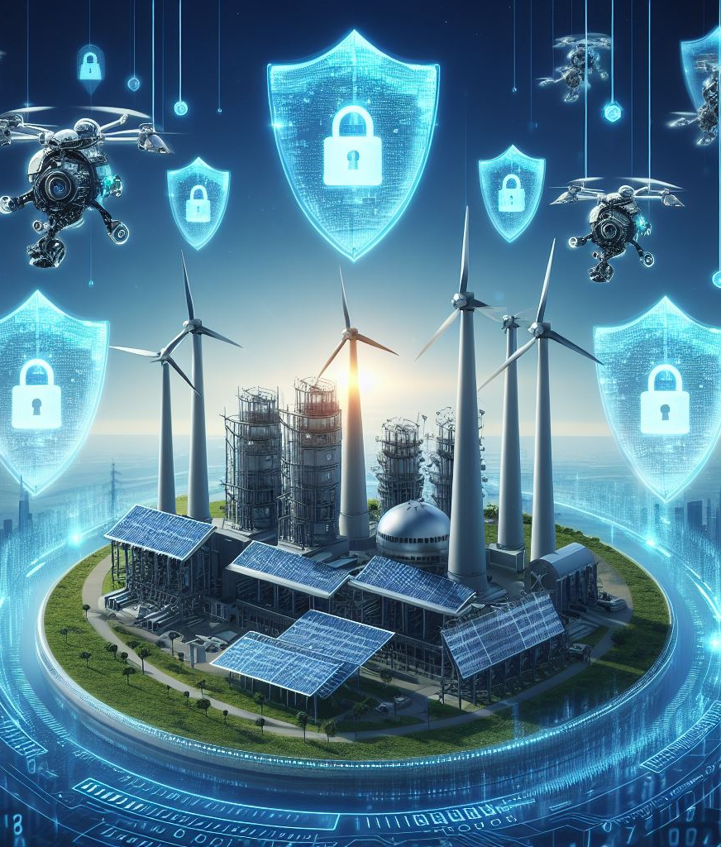
03_2: Implementation guidelines for deploying security measures such as encryption, access controls, and intrusion detection systems
Guidelines
Effective deployment of security measures is crucial to protect energy infrastructure and data from cyber threats. Here are implementation guidelines for key security measures.
Encryption:
  Utilize strong encryption algorithms (e.g., AES, RSA) to protect sensitive data in transit and at rest.
  Implement end-to-end encryption for communication between energy devices, networks, and cloud environments.
  Regularly update encryption protocols and keys to mitigate vulnerabilities and ensure data confidentiality.
Access Controls:
  Implement role-based access controls (RBAC) to enforce least privilege access and restrict unauthorized users from accessing critical energy systems and data.
  Use multi-factor authentication (MFA) mechanisms to verify user identities and prevent unauthorized access to energy infrastructure and applications.
  Monitor and audit user access logs to detect suspicious activities and unauthorized access attempts.
Notes:
https://energy.ec.europa.eu/news/new-network-code-cybersecurity-eu-electricity-sector-2024-03-11_en

Slide 31
03_2: Implementation guidelines for deploying security measures such as encryption, access controls, and intrusion detection systems
Guidelines
Intrusion Detection Systems:
  Deploy network-based IDS to monitor and analyze network traffic for signs of malicious activities, including unauthorized access, malware infections, and anomalous behavior.
  Configure IDS sensors to detect known attack signatures and behavioral anomalies indicative of cyber threats targeting energy infrastructure.
  Integrate IDS with incident response systems to automate response actions and mitigate security incidents in real time.
Firewalls:
  Deploy firewalls at network perimeters, between network segments, and within industrial control systems (ICS) environments to enforce access controls and filter incoming and outgoing traffic.
  Configure firewalls to block unauthorized ports, protocols, and IP addresses while allowing legitimate traffic required for energy operations.
  Regularly update firewall rulesets and firmware to address emerging threats and vulnerabilities.
Notes:
https://energy.ec.europa.eu/news/new-network-code-cybersecurity-eu-electricity-sector-2024-03-11_en

Slide 32
03_2: Implementation guidelines for deploying security measures such as encryption, access controls, and intrusion detection systems
Guidelines
Endpoint Security:
  Implement endpoint protection platforms (EPP) and antivirus software on energy devices, servers, and workstations to detect and prevent malware infections and unauthorized access.
  Enable automatic software updates and patch management to address known vulnerabilities and security flaws in endpoint devices.
  Conduct regular vulnerability scans and endpoint assessments to identify and remediate security weaknesses.
Adhering to implementation guidelines for deploying security measures such as encryption, access controls, intrusion detection systems, and firewalls is essential for enhancing cybersecurity resilience in the energy sector.
Notes:
https://energy.ec.europa.eu/news/new-network-code-cybersecurity-eu-electricity-sector-2024-03-11_en

Slide 33
Training Outline:
Topic-04
The Future of Emerging Technology Security and Its Application in the Energy Network
Exploration of emerging trends and advancements in cybersecurity for energy technologies
Discussion on the integration of advanced technologies like machine learning and predictive analytics for proactive threat detection and mitigation

Slide 34
Training Outline:
Topic-04
The Future of Emerging Technology Security and Its Application in the Energy Network
Exploration of emerging trends and advancements in cybersecurity for energy technologies
Discussion on the integration of advanced technologies like machine learning and predictive analytics for proactive threat detection and mitigation

Slide 35
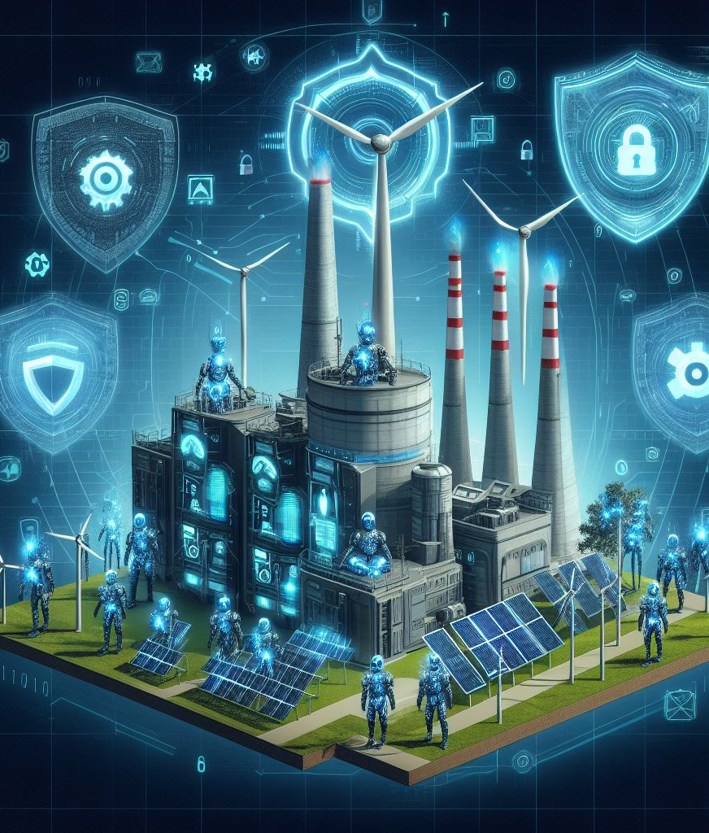
04_1: Exploration of emerging trends and advancements in cybersecurity for energy technologies
Emerging Trends
The rapidly evolving landscape of cybersecurity for energy technologies is characterized by emerging trends and advancements that shape the future of energy security.
Zero Trust Architecture:
  Zero Trust Security Model: Zero Trust architecture assumes that every user, device, and network component is untrusted and must be authenticated and authorized before accessing energy resources.
  Application in Energy Networks: Zero Trust principles are applied to energy networks to enforce strict access controls, least privilege access, and continuous monitoring to prevent unauthorized access and lateral movement by cyber attackers.
Artificial Intelligence (AI) in Cybersecurity:
  AI-Powered Threat Detection: AI algorithms analyze vast amounts of data from energy networks to detect patterns, anomalies, and potential cyber threats in real time.
  Autonomous Response: AI-driven cybersecurity solutions automate threat detection, incident response, and remediation processes to enhance the speed and effectiveness of cybersecurity operations in energy environments.

Slide 36
04_1: Exploration of emerging trends and advancements in cybersecurity for energy technologies
Emerging Trends
Quantum-Safe Cryptography:
  Quantum Computing Threats: Quantum computers pose a threat to traditional cryptographic algorithms (e.g., RSA, ECC) by potentially breaking their encryption mechanisms.
  Quantum-Safe Cryptography: Quantum-safe cryptographic algorithms (e.g., lattice-based cryptography) are designed to resist attacks from quantum computers, ensuring the long-term security of energy data and communications.
Blockchain for Supply Chain Security:
  Supply Chain Attacks: Cyber attacks targeting energy supply chains (e.g., tampering with energy equipment, injecting malware into software updates) pose significant risks to energy infrastructure and operations.
  Blockchain-Based Supply Chain Security: Blockchain technology enables transparent, immutable, and traceable records of energy supply chain transactions, ensuring the integrity and authenticity of energy resources and components.

Slide 37
Training Outline:
Topic-04
The Future of Emerging Technology Security and Its Application in the Energy Network
Exploration of emerging trends and advancements in cybersecurity for energy technologies
Discussion on the integration of advanced technologies like machine learning and predictive analytics for proactive threat detection and mitigation

Slide 38

04_2: Discussion on the integration of advanced technologies like machine learning and predictive analytics for proactive threat detection and mitigation
Advanced Technologies
The integration of advanced technologies such as machine learning (ML) and predictive analytics holds immense potential for enhancing cybersecurity in the energy sector.
Machine Learning for Threat Detection:
  ML Algorithms: Machine learning algorithms analyze vast amounts of data from energy networks to identify patterns, anomalies, and potential cyber threats.
  Behavioral Analysis: ML models learn normal behavior patterns of energy systems and users to detect deviations indicative of malicious activities or cyber attacks.
  Predictive Modeling: ML algorithms forecast future cyber threats based on historical data, enabling energy companies to take proactive measures to prevent security incidents.

Slide 39
04_2: Discussion on the integration of advanced technologies like machine learning and predictive analytics for proactive threat detection and mitigation
Advanced Technologies
Predictive Analytics for Risk Assessment:
  Data-driven Insights: Predictive analytics techniques analyze historical and real-time data from energy networks to identify vulnerabilities, assess risks, and prioritize security measures.
  Risk Scoring: Predictive models assign risk scores to energy assets, systems, and operations based on their susceptibility to cyber threats, potential impact, and likelihood of occurrence.
  Proactive Mitigation Strategies: Predictive analytics enable energy companies to develop proactive mitigation strategies, such as patch management, asset hardening, and incident response planning, to reduce cybersecurity risks.
Integration with Security Operations:
  Threat Intelligence Integration: ML-driven threat detection and predictive analytics solutions integrate with threat intelligence feeds to enhance the accuracy and relevance of security alerts and threat assessments.
  Automated Response: ML algorithms automate incident response processes by prioritizing security alerts, correlating events, and orchestrating response actions to mitigate security incidents in real time.
  Human-Machine Collaboration: ML-driven cybersecurity solutions augment human expertise by providing actionable insights, recommendations, and decision support for security analysts and operators.

Slide 40
04_2: Discussion on the integration of advanced technologies like machine learning and predictive analytics for proactive threat detection and mitigation
Example – Predictive Maintenance in Power Generation
General Electric (GE) uses predictive analytics and machine learning algorithms to optimize the maintenance schedules of power generation equipment, such as gas turbines and wind turbines.
How It Works:
  By analyzing historical performance data, sensor readings, and environmental factors, GE's Predix platform predicts potential equipment failures before they occur. This allows energy companies to schedule preventive maintenance proactively, reducing downtime and minimizing costly repairs.
Benefits:
  Predictive maintenance enables energy companies to optimize asset performance, extend equipment lifespan, and reduce operational costs by avoiding unplanned outages and equipment failures.

Slide 41
04_2: Discussion on the integration of advanced technologies like machine learning and predictive analytics for proactive threat detection and mitigation
Example – Cyber Threat Detection in Smart Grids
Pacific Gas and Electric Company (PG&E), a leading utility in the United States, leverages machine learning and advanced analytics to detect and mitigate cyber threats targeting its smart grid infrastructure.
How It Works:
  PG&E's cybersecurity platform analyzes network traffic, system logs, and security event data using machine learning algorithms to identify patterns indicative of cyber attacks, such as malware infections, unauthorized access attempts, and anomalous behavior.
Benefits:
  By detecting cyber threats in real time, PG&E can respond swiftly to security incidents, isolate compromised systems, and implement proactive measures to prevent further damage. This proactive approach enhances the resilience of the smart grid and ensures the reliability and security of energy delivery to customers.

Slide 42
Training Outline:
Topic-05
Case Studies
Fortum's Cybersecurity Program
Duke Energy's Grid Security Initiative

Slide 43
Training Outline:
Topic-05
Case Studies
Fortum's Cybersecurity Program
Duke Energy's Grid Security Initiative

Slide 44
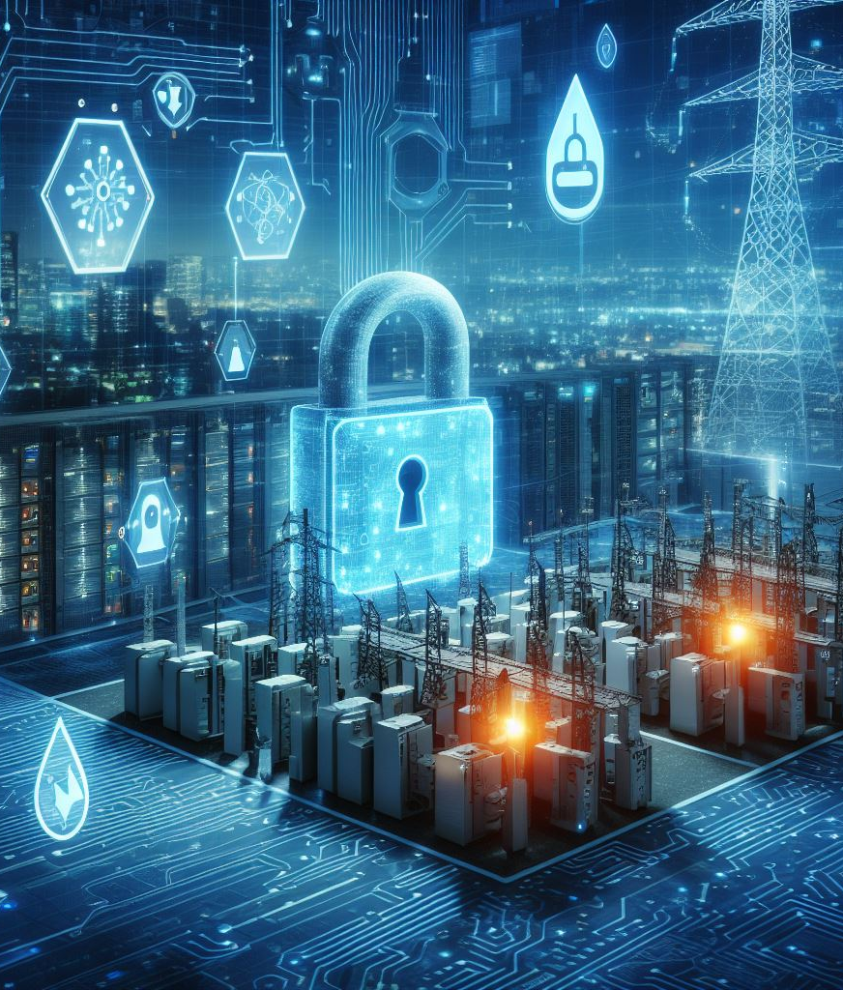
05_1: Fortum's Cybersecurity Program
Case Study
Company: Fortum, a leading energy company based in Finland.
Implementation: Fortum implemented a comprehensive cybersecurity program to protect its energy infrastructure and data from cyber threats.
Strategies:
  Deployed advanced threat detection and response systems powered by machine learning and artificial intelligence.
  Conducted regular cybersecurity training and awareness programs for employees to promote a culture of security.
  Implemented robust access controls, encryption mechanisms, and network segmentation to prevent unauthorized access to critical systems.
Results: Fortum's cybersecurity program successfully detected and mitigated cyber threats, ensuring the resilience and reliability of its energy operations.

Slide 45
Training Outline:
Topic-05
Case Studies
Fortum's Cybersecurity Program
Duke Energy's Grid Security Initiative

Slide 46

05_2: Duke Energy's Grid Security Initiative
Case Study
Company: Duke Energy, one of the largest electric power holding companies in the United States.
Implementation: Duke Energy launched a grid security initiative to enhance the cybersecurity of its power generation and distribution infrastructure.
Strategies:
  Implemented advanced intrusion detection and prevention systems to monitor and protect critical infrastructure from cyber attacks.
  Established partnerships with government agencies, industry partners, and cybersecurity experts to share threat intelligence and best practices.
  Conducted regular cybersecurity assessments and audits to identify vulnerabilities and strengthen security controls.
Results: Duke Energy's grid security initiative improved the resilience and reliability of its energy grid, safeguarding against cyber threats and ensuring uninterrupted energy delivery to customers.

Slide 47

Thank you
Please send all questions to:
gehad@example.com

