Slide 1



Cybersecurity in Emerging Technologies for the Energy Network
CSP007_C_E
Presentation by:

Slide 2


Slide 3


Cybersecurity in Emerging Technologies for the Energy Network – Course Overview
0.
Introduction & Course Context
1.
TOPIC 1 – Introduction to Cybersecurity in Energy Emerging Technologies
2.
TOPIC 2 – Anomaly Detection Techniques
3.
TOPIC 3 – Securing the Energy Emerging Technologies
4.
TOPIC 4 – Data Analysis for Cybersecurity in the Energy Network
5.
TOPIC 5 – Security Tools and Techniques for Energy Emerging Technologie
6.
The Future of Emerging Technology Security in Energy Networks

Slide 4

4. Data Analysis for Cybersecurity in the Energy Network
Topic 4 Overview and Objectives
This topic focuses on how data is used to:
Detect cyber threats and operational anomalies
Understand system behaviour and security posture
Support informed cybersecurity decisions in energy environments
The emphasis is on data-driven reasoning, not only algorithms.
Notes:
Position Topic 4 as the operational backbone of cybersecurity.
Emphasise that most security failures are not due to lack of data, but:
- Poor data use
- Poor interpretation
Explain that this topic connects:
- Topic 2 (detection methods)
- Topic 5 (tools and operations)

Slide 5
4. Data Analysis for Cybersecurity in the Energy Network
Why Data Is Central to Cybersecurity
Cybersecurity Is Fundamentally Data-Driven
Cybersecurity decisions rely on:
Observations of system behaviour
Evidence of deviations and events
Correlation across multiple data sources
Without data, security becomes assumption-based rather than evidence-based.
Notes:
Stress that data is the only window into complex energy systems.
Explain that modern attacks aim to:
- Blend into normal data
- Avoid obvious alarms
Introduce the idea of security visibility.

Slide 6
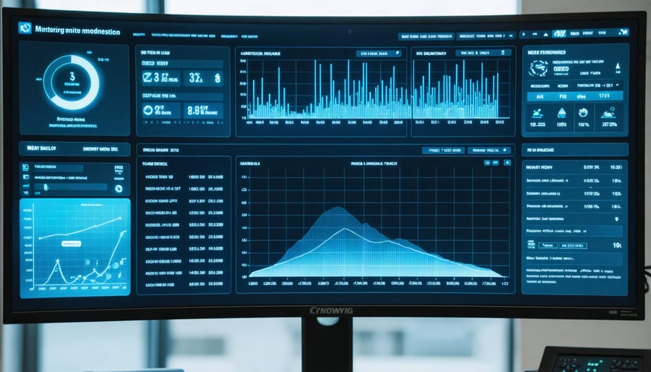
4. Data Analysis for Cybersecurity in the Energy Network
Why Data Is Central to Cybersecurity
Cybersecurity Is Fundamentally Data-Driven
Cybersecurity decisions rely on:
Observations of system behaviour
Evidence of deviations and events
Correlation across multiple data sources
Without data, security becomes assumption-based rather than evidence-based.
Notes:
Stress that data is the only window into complex energy systems.
Explain that modern attacks aim to:
- Blend into normal data
- Avoid obvious alarms
Introduce the idea of security visibility.

Slide 7
4. Data Analysis for Cybersecurity in the Energy Network
The Cybersecurity Data Lifecycle
From Raw Data to Security Insight
Cybersecurity data typically goes through:
Data generation (systems, devices, networks)
Data collection and aggregation
Preprocessing and normalization
Analysis and correlation
Interpretation and decision-making
Each stage affects the quality of security outcomes.
Notes:
Walk through the lifecycle step by step.
Emphasise that errors early propagate downstream.
Highlight that tools often focus on step 4, while problems appear in steps 1–3.

Slide 8
4. Data Analysis for Cybersecurity in the Energy Network
Data Sources in Energy Networks
Where Cybersecurity Data Comes From
Energy cybersecurity relies on diverse data sources:
Field sensors and smart meters
SCADA and EMS systems
Network infrastructure (routers, firewalls)IT systems and cloud platforms
Application and access logs
This diversity is both a strength and a challenge.
Notes:
Emphasise heterogeneity.
Explain that each source has:
- Different timing
- Different semantics
This complicates correlation.

Slide 9
4. Data Analysis for Cybersecurity in the Energy Network
Logs, Telemetry, and Event Data
Understanding Different Data Types
Logs: discrete records of events and actions
Telemetry: continuous measurements over time
Events: significant state changes or alerts
Effective security analysis requires combining all three.
Notes:
Explain with examples:
- Login log
- Power measurement telemetry
Emphasise that no single data type is sufficient alone.

Slide 10
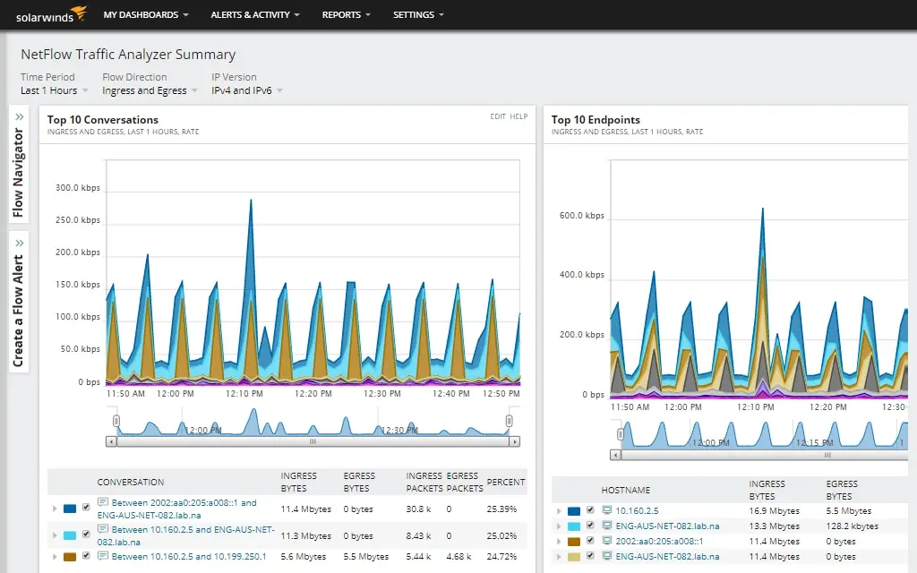
4. Data Analysis for Cybersecurity in the Energy Network
Network Traffic Data in Energy Systems
Why Network Data Matters
Network traffic reveals:
Communication patterns
Unexpected connections
Protocol misuse
Lateral movement
In energy systems, networks often expose the earliest signs of compromise.
Notes:
Explain that many attacks start at the network level.
Mention challenges:
- Proprietary protocols
- Encrypted traffic
Emphasise metadata importance.

Slide 11
4. Data Analysis for Cybersecurity in the Energy Network
Data Preprocessing and Normalisation
Preparing Data for Analysis
Before analysis, data must be:
Cleaned (missing or corrupted values)
Normalised (units, scales, formats)
Time-aligned across sources
Filtered to remove noise
Poor preprocessing leads to unreliable conclusions.
Notes:
Emphasise that preprocessing is not optional.
Explain common issues:
- Clock drift
- Inconsistent sampling
Stress that this step is often underestimated.

Slide 12
4. Data Analysis for Cybersecurity in the Energy Network
Statistical Analysis for Threat Detection
Baseline Statistical Techniques
Statistical methods help to:
Characterise normal behaviour
Detect deviations and outliers
Provide explainable results
Examples include:
Mean and variance analysis
Threshold-based detection
Z-score and residual analysis
Notes:
Stress transparency and interpretability.
Explain why statistics are often used as:
- Baselines
- Validation layers
Mention limitations with non-stationary data.

Slide 13
4. Data Analysis for Cybersecurity in the Energy Network
Correlation and Pattern Analysis
Seeing the Bigger Picture
Correlation analysis helps to:
Link events across systems
Identify multi-stage attacks
Reduce false positives
Security insights often emerge between datasets, not within one.
Notes:
Give an example:
- Login event + network anomaly + load change
Emphasise importance of contextual correlation.
Connect to SOC operations.

Slide 14
4. Data Analysis for Cybersecurity in the Energy Network
Correlation and Pattern Analysis
Learning What “Normal” Means
Behavioural baselines define:
Typical system behaviour
Expected user actions
Normal operational ranges
Baselines must adapt as energy systems evolve.
Notes:
Reinforce link to Topic 2.
Explain danger of static baselines.
Emphasise gradual drift vs sudden change.

Slide 15
4. Data Analysis for Cybersecurity in the Energy Network
User and System Behaviour Analytics
Beyond Simple Thresholds
Behaviour analytics focuses on:
Sequences of actions
Deviations from roles
Unusual timing or frequency
This is particularly useful for detecting insider threats.
Notes:
Explain why insider threats are hard to detect.
Emphasise behavioural context over single events.
Mention privacy and ethical considerations.

Slide 16
4. Data Analysis for Cybersecurity in the Energy Network
Visual Analytics for Cybersecurity
Why Visualisation Matters
Visual analytics helps:
Identify trends and anomalies quickly
Support human intuition
Communicate complex states
Dashboards are decision-support tools, not just displays.
Notes:
Emphasise human-in-the-loop.
Explain risk of dashboard overload.
Stress clarity over completeness.

Slide 17
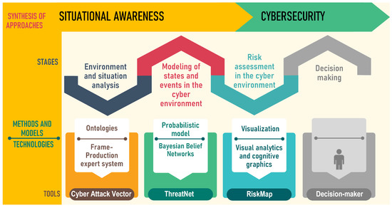
4. Data Analysis for Cybersecurity in the Energy Network
Dashboards and Situational Awareness
Building Situational Awareness
Effective dashboards provide:
System-wide overview
Prioritised alerts
Contextual information
Situational awareness is essential for timely response.
Notes:
Explain concept of situational awareness.
Emphasise prioritisation.
Link to incident response.

Slide 18
4. Data Analysis for Cybersecurity in the Energy Network
Detecting Multi-Stage Attacks
Why Single Alerts Are Not Enough
Advanced attacks:
Unfold slowly
Span multiple systems
Avoid obvious triggers
Data analysis enables detection of attack chains, not isolated events.
Notes:
Explain kill-chain thinking.
Stress importance of temporal correlation.
Mention that energy attacks are often stealthy.

Slide 19
4. Data Analysis for Cybersecurity in the Energy Network
Supporting Incident Response with Data
From Detection to Action
During incidents, data helps to:
Understand scope and impact
Identify affected assets
Guide containment decisions
Poor data leads to delayed or incorrect response.
Notes:
Explain incident response phases.
Emphasise evidence preservation.
Connect to forensic needs.

Slide 20
4. Data Analysis for Cybersecurity in the Energy Network
Challenges: Data Scale and Velocity
Too Much Data, Too Fast
Energy systems generate:
High-frequency telemetry
Large log volumes
Continuous network traffic
Scalability is a major challenge for analysis.
Notes:
Explain why “store everything” is unrealistic.
Mention sampling and aggregation strategies.
Emphasise trade-offs.

Slide 21
4. Data Analysis for Cybersecurity in the Energy Network
Challenges: Data Quality and Noise
Not All Data Is Trustworthy
Common issues:
Sensor faults
Communication errors
Missing or delayed data
Noise can mask attacks or generate false alarms.
Notes:
Explain difference between noise and anomalies.
Emphasise robustness.
Mention redundancy as mitigation.

Slide 22
4. Data Analysis for Cybersecurity in the Energy Network
Challenges: Explainability and Trust
Why Explainability Matters
Operators must:
Understand alerts
Trust analysis outputs
Justify decisions
Black-box analytics reduce trust and adoption.
Notes:
Emphasise human factors.
Explain trade-off between accuracy and explainability.
Connect to AI governance.

Slide 23
4. Data Analysis for Cybersecurity in the Energy Network
Integration with SOC Workflows
Analytics Must Fit Operations
Data analysis supports:
Alert triage
Investigation
Escalation and reporting
Analytics must integrate with operational processes.
Notes:
Explain SOC as a workflow, not a tool.
Emphasise alignment with people and procedures.

Slide 24
4. Data Analysis for Cybersecurity in the Energy Network
Data-Driven Decision Making
From Insight to Action
Effective decisions require:
Timely data
Contextual understanding
Risk-based reasoning
Data supports decisions — it does not replace responsibility.
Notes:
Emphasise accountability.
Explain why automation must be constrained.
Prepare transition to Topic 5 (tools).

Slide 25
4. Data Analysis for Cybersecurity in the Energy Network
Topic 4 Summary
Key Messages
Cybersecurity depends on data quality and use
Correlation and context are essential
Human interpretation remains central
Analytics must support operations
Notes:
Summarise without repeating.
Reinforce mindset over tools.

Slide 26
4. Data Analysis for Cybersecurity in the Energy Network
Transition to Hands-On Lab 2
Next: Hands-On Lab – Security Data Analysis
Analyse logs and network data
Identify suspicious patterns
Discuss interpretation and response
Notes:
Set expectations for Lab 2.
Emphasise reasoning and discussion.
Link lab outcomes to Topic 5.

Slide 27
4. Hands-On Lab 2: Security Data Analysis
4. Hands-On Lab 2: Security Data Analysis
Notes:
Set expectations for Lab 2.
Emphasise reasoning and discussion.
Link lab outcomes to Topic 5.

Slide 28
4. Hands-On Lab 2: Security Data Analysis
Lab 2: Objectives & Scope
Objectives
Analyse heterogeneous cybersecurity data from an energy network
Correlate logs, telemetry, and network information
Identify suspicious patterns and attack indicators
Practice interpretation and response reasoning
Focus
Turning raw data into security insight, not just alerts
Notes:
Explain that this lab builds directly on Topic 4 concepts.
Emphasise that:
- Tools may differ
- Reasoning remains the same
Set expectations:
- Participants will not “find the answer”
- They will practice evidence-based reasoning
Position the lab as SOC-style analysis, not data science.

Slide 29
4. Hands-On Lab 2: Security Data Analysis
Data Sources and Scenario Description
What Data Are Available?
You are analysing data from a monitored energy subsystem, including:
System and application logs
Network communication records
Energy telemetry (measurements over time)
Scenario
An operator reports unusual system behaviour but no explicit alarms
Notes:
Describe the scenario clearly:
- No confirmed attack
- Only “something feels wrong”
Emphasise realism:
- This is how many incidents start
-Ask participants:
- “What data would you look at first — and why?”
Reinforce the idea of hypothesis-driven analysis.

Slide 30
4. Hands-On Lab 2: Security Data Analysis
Step 1: Individual Data Exploration
Looking at Each Data Source Separately
Participants should:
Inspect logs for unusual events or sequences
Examine network data for unexpected connections
Review telemetry for abnormal trends or deviations
Key Question
Does anything look unusual on its own?
Notes:
Describe the scenario clearly:
- No confirmed attack
- Only “something feels wrong”
Emphasise realism:
- This is how many incidents start
-Ask participants:
- “What data would you look at first — and why?”
Reinforce the idea of hypothesis-driven analysis.

Slide 31
4. Hands-On Lab 2: Security Data Analysis
Step 2: Correlation and Pattern Reasoning
Connecting the Dots
Now correlate across data sources:
Do log events align with network anomalies?
Do telemetry changes coincide with access events?
Are patterns temporal, sequential, or role-based?
Insight often emerges from relationships, not events
Notes:
This is the core learning moment of the lab.
Guide participants to:
Build simple timelines
Ask “what happened before and after?”
Emphasise:
Correlation ≠ causation
But correlation guides investigation
Connect this step to:
Kill-chain analysis
SOC triage workflows

Slide 32
4. Hands-On Lab 2: Security Data Analysis
Interpretation, Response, and Discussion
From Data to Decision
For the observed patterns:
Is this likely benign, faulty, or malicious?
What evidence supports your conclusion?
What additional data would you request?
What would be the next operational step?
Key Lesson
Security decisions are made under uncertainty
Notes:
Drive discussion rather than answers.
Encourage multiple interpretations.
Ask:
- “Would you escalate this? Why or why not?”
Emphasise:
- False certainty is dangerous
- Documentation and reasoning matter
Close by linking outcomes to:
- Topic 5 (tools and operational controls)
- Topic 6 (preparedness and resilience)

Slide 33

Thank you

