Slide 1



Cybersecurity in Emerging Technologies for the Energy Network
CSP007_C_E
Presentation by:

Slide 2


Slide 3


Cybersecurity in Emerging Technologies for the Energy Network – Course Overview
0.
Introduction & Course Context
1.
TOPIC 1 – Introduction to Cybersecurity in Energy Emerging Technologies
2.
TOPIC 2 – Anomaly Detection Techniques
3.
TOPIC 3 – Securing the Energy Emerging Technologies
4.
TOPIC 4 – Data Analysis for Cybersecurity in the Energy Network
5.
TOPIC 5 – Security Tools and Techniques for Energy Emerging Technologie
6.
The Future of Emerging Technology Security in Energy Networks
Notes:
Welcome participants and briefly introduce yourself.
Position this course as advanced, not introductory.
Emphasise that this course sits at the intersection of energy systems and cybersecurity, not generic IT security.
Highlight that energy infrastructures are critical, safety-relevant, and long-lived, making cybersecurity fundamentally different from enterprise IT.
Set expectations: this course combines technical depth, applied reasoning, and strategic thinking.

Slide 4

2. Anomaly Detection Techniques
Topic 2 Overview & Objectives
Topic 2: Anomaly Detection Techniques
Why detection matters in energy systems
From rule-based to data-driven detection
Role of machine learning and time-series analysis
Operational constraints and trade-offs
Notes:
Position anomaly detection as the first realistic line of defence in energy cybersecurity.
Emphasise that:
- Prevention is never perfect
- Detection enables timely response
Clarify that anomaly detection applies to:
- Cyber attacks
- Faults
- Misconfigurations
This topic bridges theory and operations.

Slide 5
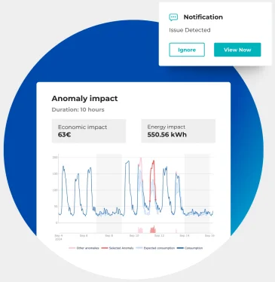
2. Anomaly Detection Techniques
Why Anomaly Detection Is Critical in Energy
Limits of Signature-Based Security
Unknown attacks are common
Energy systems evolve continuously
Zero-day and stealthy behaviours
Cyber and physical anomalies overlap
Notes:
Explain why signature-based IDS alone are insufficient.
Stress that attackers often:
- Blend into normal behaviour
- Act slowly
In energy systems, small deviations can have large impacts.
Introduce anomaly detection as a way to surface the unexpected.

Slide 6
2. Anomaly Detection Techniques
Detection, Prevention, and Response
Where Anomaly Detection Fits
Prevention → firewalls, access control
Detection → anomaly and intrusion detection
Response → mitigation and recovery
Detection enables response
Notes:
Emphasise cybersecurity as a process, not a product.
Detection is the decision trigger.
In energy, response actions must be:
Proportionate
Context-aware
This slide prepares students for later SOC discussions.

Slide 7
2. Anomaly Detection Techniques
What Is an Anomaly?
Definition: An anomaly is a pattern in data that does not conform to expected behaviour
May indicate attacks
May indicate faults
Requires interpretation
Notes:
Stress that anomalies are signals, not conclusions.
Explain the difference between:
- Anomaly ≠ attack
Human judgement remains essential.

Slide 8
2. Anomaly Detection Techniques
Point Anomalies
Point Anomalies
Single data point deviates strongly
Often easy to detect
May still be ambiguous
Example:
Sudden spike in power consumption
Notes:
Give intuitive examples:
- Sensor spikes
- Sudden network bursts
Explain limitations:
Noise
Sensor failure
Good entry point for beginners.

Slide 9
2. Anomaly Detection Techniques
Contextual Anomalies
Contextual Anomalies
Abnormal only in a specific context
Context = time, location, system state
Example:
High consumption at night in residential area
Notes:
Emphasise importance of context awareness.
Explain why static thresholds fail.
Link to time-series modelling.

Slide 10
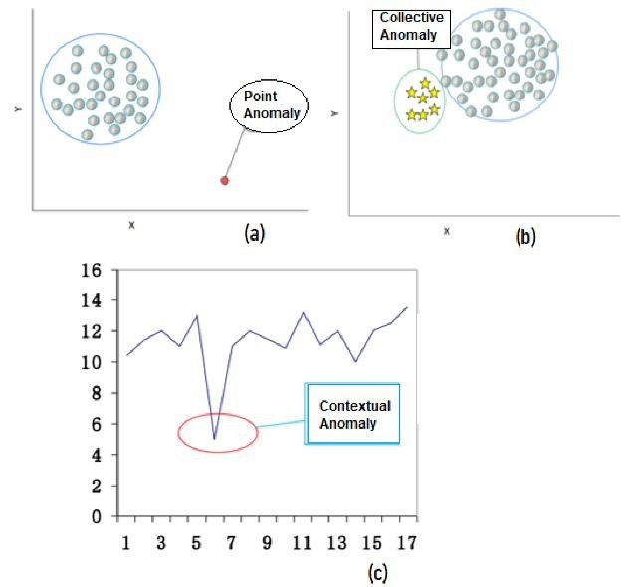
2. Anomaly Detection Techniques
Collective Anomalies
Collective Anomalies
Group of values forms abnormal pattern
Individual points may appear normal
Example:
Slow, coordinated manipulation over time
Notes:
Explain relevance for stealthy attacks.
Collective anomalies are:
- Harder to detect
- Often more dangerous
This motivates advanced ML techniques.

Slide 11
2. Anomaly Detection Techniques
Data Sources for Anomaly Detection in Energy
Where the Data Comes From
Sensors and meters
Control systems (SCADA/EMS)
Network traffic
Logs and events
Notes:
Stress heterogeneity of data sources.
Explain data quality challenges:
- Missing data
- Time misalignment
Prepare ground for Topic 4 (data analysis).

Slide 12
2. Anomaly Detection Techniques
Rule-Based vs Data-Driven Detection
Two Detection Paradigms:
Rule-based
Explicit thresholds
Easy to explain
Limited adaptability
Data-driven
Learns behaviour
Adaptive
Requires data quality
Notes:
Explain why many utilities still rely on rules.
Stress explainability vs adaptability trade-off.
Position ML as augmentation, not replacement.

Slide 13
2. Anomaly Detection Techniques
Supervised Machine Learning
Supervised Detection
Requires labelled data
Learns known attack patterns
High accuracy for known threats
Examples:
Classification models
Notes:
Explain why labelled attack data is rare in energy.
Mention risk of:
- Overfitting
- Concept drift
Useful for specific, well-known scenarios.

Slide 14
2. Anomaly Detection Techniques
Unsupervised Machine Learning
Unsupervised Detection
No labelled data required
Learns “normal” behaviour
Flags deviations
Examples:
Clustering, density-based methods
Notes:
This is the most common approach in energy.
Emphasise sensitivity to:
- Training window
- System changes
Explain why validation is challenging.

Slide 15
2. Anomaly Detection Techniques
Semi-Supervised Approaches
Semi-Supervised Detection
Trained mostly on normal data
Limited labelled anomalies
Balance between precision and flexibility
Notes:
Explain why this is often a practical compromise.
Mention relevance for:
- New installations
- Gradual system changes

Slide 16
2. Anomaly Detection Techniques
Distance-Based and Clustering Methods
Semi-Supervised Detection
Distance-Based Detection
k-NN
Clustering (e.g., DBSCAN)
Density estimation
Notes:
Explain intuition:
- Normal points cluster together
- Anomalies are isolated
Emphasise scalability issues in large systems.

Slide 17
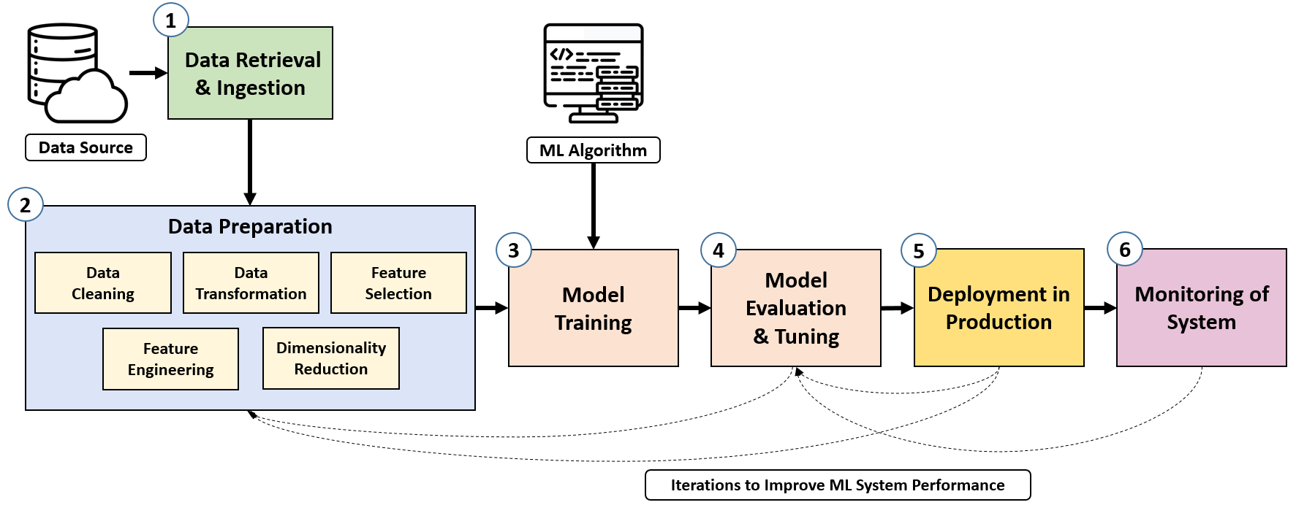
2. Anomaly Detection Techniques
Statistical Anomaly Detection
Statistical Methods
Mean and variance
Z-score
Probability distributions
Notes:
Highlight simplicity and transparency.
Explain limitations:
- Assumptions of stationarity
Often used as baseline methods.

Slide 18
2. Anomaly Detection Techniques
Time-Series Data in Energy Systems
Why Time-Series Matter
Energy behaviour is temporal
Strong daily and seasonal patterns
Temporal dependencies
Notes:
Explain why treating energy data as static is wrong.
Stress importance of:
- Trend
- Seasonality
Prepares next slides.

Slide 19
2. Anomaly Detection Techniques
Seasonality and Trends
Typical Energy Patterns
Daily cycles
Weekly patterns
Seasonal effects
Notes:
Explain how ignoring seasonality causes false alarms.
Use intuitive examples (winter vs summer).

Slide 20
2. Anomaly Detection Techniques
ARIMA-Based Detection
Statistical Time-Series Models
Forecast expected behaviour
Flag large residuals
Interpretable and lightweight
Notes:
Explain ARIMA at high level.
Stress suitability for:
- Stable systems
Mention limitations with non-linear behaviour.

Slide 21
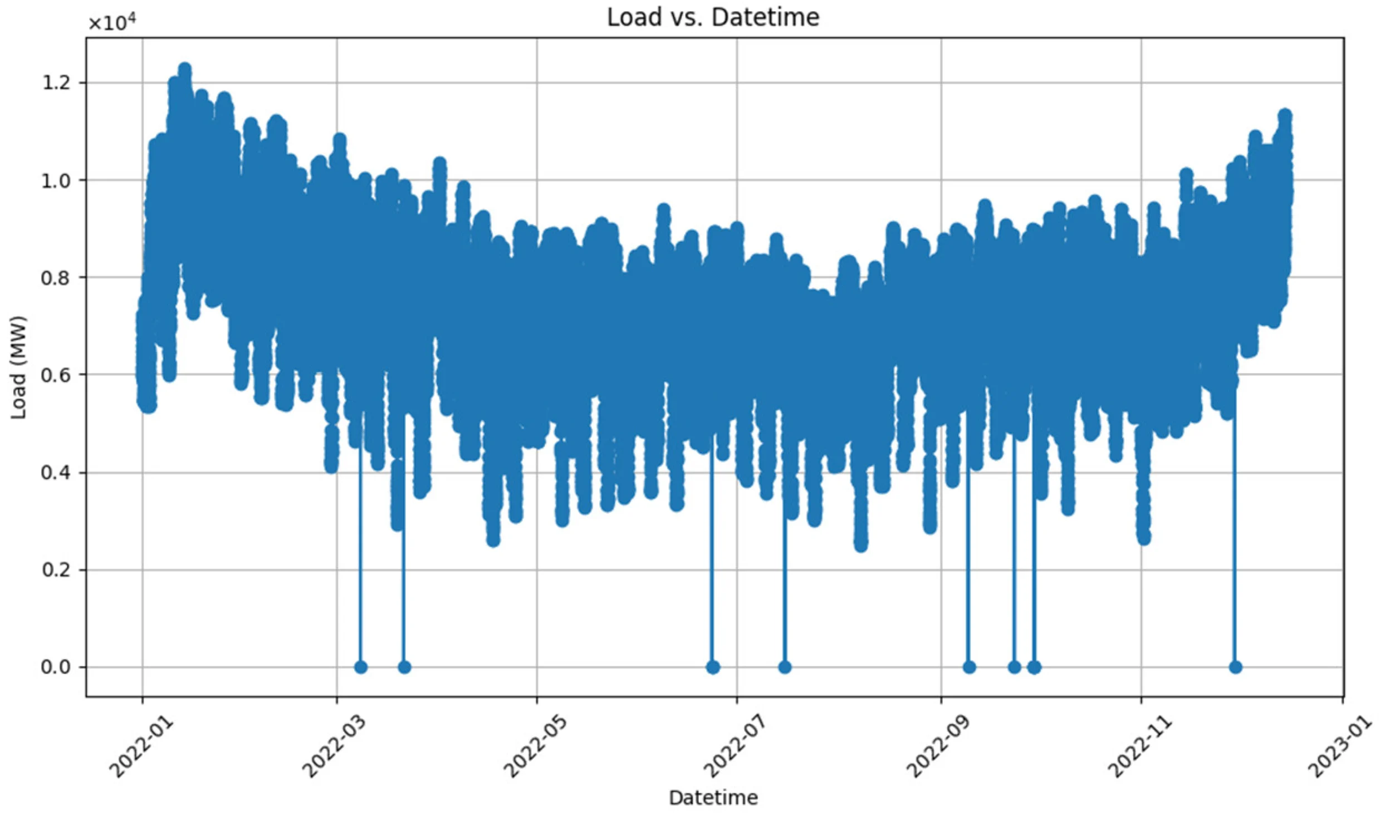
2. Anomaly Detection Techniques
LSTM and Deep Learning Models
Deep Learning for Sequences
Capture long-term dependencies
Handle complex patterns
Higher computational cost
Notes:
Emphasise power vs complexity trade-off.
Explain why explainability is harder.
Mention deployment challenges at the edge.

Slide 22
2. Anomaly Detection Techniques
Model Training and Validation Challenges
Practical Difficulties
Concept drift
Changing operating conditions
Lack of ground truth
Notes:
Explain that “normal” changes over time.
Stress need for:
- Retraining
- Monitoring model performance

Slide 23
2. Anomaly Detection Techniques
False Positives and False Negatives
Detection Trade-Offs
False positives → alarm fatigue
False negatives → missed attacks
Balance is context-dependent
Notes:
Emphasise operational consequences.
Explain why energy operators lose trust quickly.
Detection thresholds must be tuned carefully.

Slide 24
2. Anomaly Detection Techniques
Anomaly Detection in Smart Grids
Smart Grid Use Cases
Load manipulation
Meter tampering
Data injection attacks
Notes:
Use concrete scenarios.
Emphasise scale: thousands or millions of meters.

Slide 25
2. Anomaly Detection Techniques
Anomaly Detection in SCADA Systems
FSCADA-Specific Challenges
Legacy protocols
Deterministic behaviour
Safety-critical operations
Notes:
Explain why deviations in SCADA are rare but serious.
Detection must be extremely reliable.

Slide 26
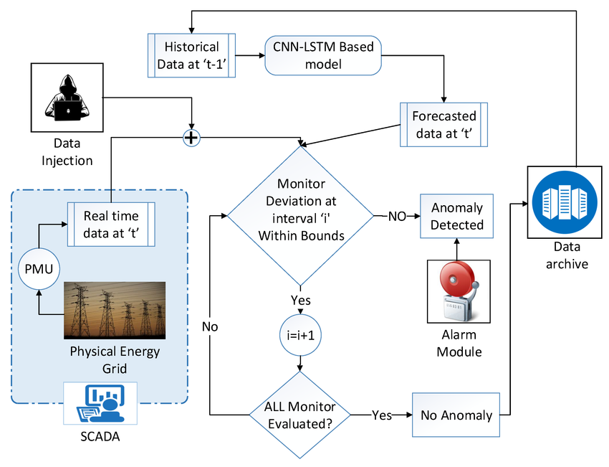
2. Anomaly Detection Techniques
Anomaly Detection in Smart Meters
Smart Meter Context
Consumption profiling
Fraud detection
Privacy considerations
Notes:
Explain why deviations in SCADA are rare but serious.
Detection must be extremely reliable.

Slide 27
2. Anomaly Detection Techniques
Operational Constraints in Live Energy Systems
Reality Check
No downtime allowed
Limited compute at edge
Safety before security
Notes:
Emphasise why detection systems must be:
- Lightweight
- Reliable
Detection errors can cause outages.

Slide 28
2. Anomaly Detection Techniques
Tool Support for Anomaly Detection
Where Detection Is Implemented
Edge devices
Central platforms
SOC environments
Notes:
Explain deployment choices.
Detection location affects:
- Latency
- Visibility

Slide 29
2. Anomaly Detection Techniques
Integration with SOC and Monitoring
From Detection to Action
Alerts and prioritization
Correlation with other signals
Human decision-making
Notes:
Detection without response is useless.
SOC integration is a maturity indicator.

Slide 30
2. Anomaly Detection Techniques
Topic 2 Summary
Key Takeaways
Anomaly detection is essential
Context matters more than algorithms
Trade-offs are unavoidable
Human oversight remains critica
Notes:
Reinforce mindset over tools.
Prepare students for the hands-on lab.

Slide 31
2. Anomaly Detection Techniques
Topic 2 Summary
Key Takeaways
Anomaly detection is essential
Context matters more than algorithms
Trade-offs are unavoidable
Human oversight remains critica
Notes:
Set expectations for the lab:
- Exploration
- Reasoning
- Discussion
Emphasise learning, not perfect accuracy.

Slide 32
2. HANDS-ON LAB 1 — Anomaly Detection in Energy Data
2. HANDS-ON LAB 1 — Anomaly Detection in Energy Data
Notes:
Set expectations for the lab:
- Exploration
- Reasoning
- Discussion
Emphasise learning, not perfect accuracy.

Slide 33
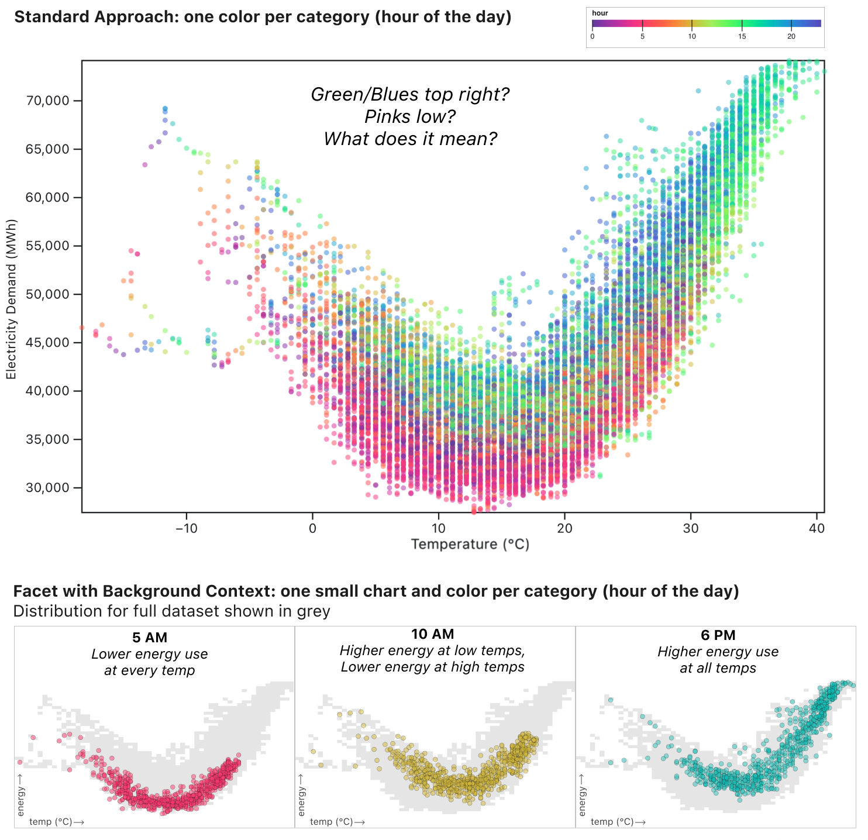
2. HANDS-ON LAB 1 — Anomaly Detection in Energy Data
Lab 1: Objectives & Context
Objectives
Explore energy time-series data
Identify normal vs abnormal behaviour
Apply anomaly detection techniques
Interpret results in an energy context
Focus
Understanding why something looks anomalous — not just detecting it
Notes:
Clearly state that this is not a software training session.
Emphasise that:
- There is no single correct answer
- Interpretation matters more than detection accuracy
Frame the lab as a cyber-physical reasoning exercise:
- Is the anomaly a fault?
- An attack?
- A benign operational change?
Explain how this lab connects directly to Topic 2 theory.

Slide 34
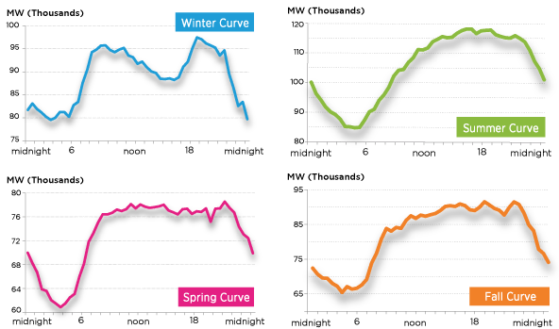
2. HANDS-ON LAB 1 — Anomaly Detection in Energy Data
Dataset Overview & Energy Context
What Data Are We Working With?
Energy consumption / load time series
Regular sampling intervals
Includes:
  Daily patterns
  Seasonal effects
  Irregular deviations
Assumption
Data comes from a monitored energy asset or subsystem
Notes:
Explain the origin of the data (realistic scenario):
- Smart meters
- Substation measurements
- Aggregated loads
Emphasise:
- Energy data is never perfectly clean
- Missing values and noise are normal
Ask participants:
- “What would normal behaviour look like here?”

Slide 35
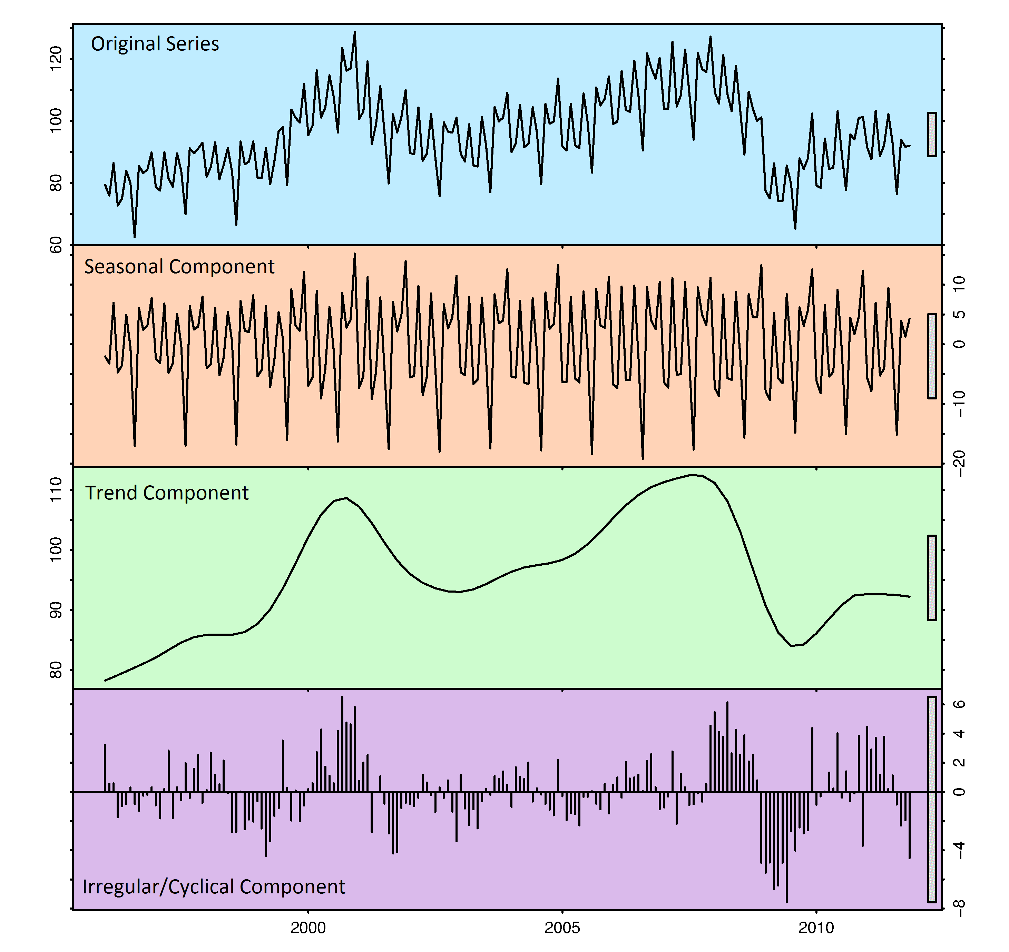
2. HANDS-ON LAB 1 — Anomaly Detection in Energy Data
Step 1: Exploring Normal Behaviour
Understanding the Baseline
Visual inspection of time series
Identify:
  Trends
  Seasonality
  Repeating patterns
Key Question
What does normal look like?
Notes:
Stress that baseline understanding is mandatory before detection.
Encourage participants to:
- Look at multiple time windows
- Compare weekdays vs weekends
Explain that many false positives come from:
- Ignoring seasonality
- Using naïve thresholds
This step reinforces contextual anomaly concepts.

Slide 36
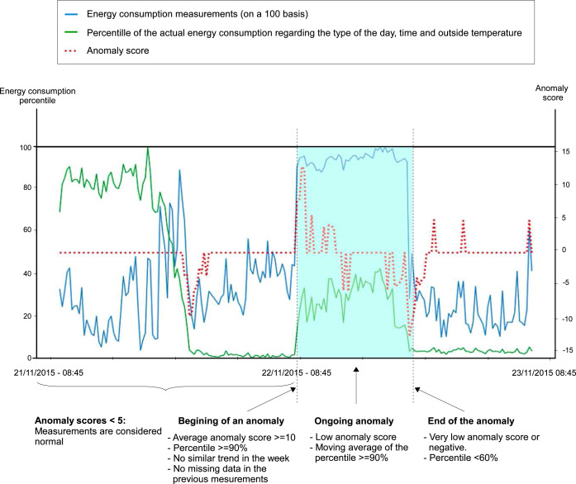
2. HANDS-ON LAB 1 — Anomaly Detection in Energy Data
Step 2: Applying Anomaly Detection
Detecting Deviations
Simple statistical thresholds
Moving averages or residuals
Distance-based or clustering methods
Output
Candidate anomalies — not confirmed attacks
Notes:
Stress that baseline understanding is mandatory before detection.
Encourage participants to:
- Look at multiple time windows
- Compare weekdays vs weekends
Explain that many false positives come from:
- Ignoring seasonality
- Using naïve thresholds
This step reinforces contextual anomaly concepts.

Slide 37

2. HANDS-ON LAB 1 — Anomaly Detection in Energy Data
Step 3: Interpretation & Discussion
From Anomaly to Insight
For each detected anomaly:
Could this be operational?
Could this be a fault?
Could this be malicious?
What additional data would help?
Key Lesson
Context determines meaning
Notes:
Stress that baseline understanding is mandatory before detection.
Encourage participants to:
- Look at multiple time windows
- Compare weekdays vs weekends
Explain that many false positives come from:
- Ignoring seasonality
- Using naïve thresholds
This step reinforces contextual anomaly concepts.

Slide 38

Thank you

