Slide 1



Cybersecurity in Emerging Technologies for the Energy Network
CSP007_C_E
Presentation by:

Slide 2


Slide 3


Cybersecurity in Emerging Technologies for the Energy Network – Course Overview
0.
Introduction & Course Context
1.
TOPIC 1 – Introduction to Cybersecurity in Energy Emerging Technologies
2.
TOPIC 2 – Anomaly Detection Techniques
3.
TOPIC 3 – Securing the Energy Emerging Technologies
4.
TOPIC 4 – Data Analysis for Cybersecurity in the Energy Network
5.
TOPIC 5 – Security Tools and Techniques for Energy Emerging Technologie
6.
The Future of Emerging Technology Security in Energy Networks
Notes:
Welcome participants and briefly introduce yourself.
Position this course as advanced, not introductory.
Emphasise that this course sits at the intersection of energy systems and cybersecurity, not generic IT security.
Highlight that energy infrastructures are critical, safety-relevant, and long-lived, making cybersecurity fundamentally different from enterprise IT.
Set expectations: this course combines technical depth, applied reasoning, and strategic thinking.

Slide 4

1. Introduction to Cybersecurity in Energy Emerging Technologies
Topic 1 Overview & Objectives
Topic 1: Introduction to Cybersecurity in Energy Emerging Technologies
Understand the energy–cybersecurity context
Identify key emerging technologies
Recognise new threat surfaces and risks
Frame cybersecurity constraints in energy systems
Notes:
Position Topic 1 as the conceptual foundation for the entire course.
Emphasise that later topics assume familiarity with:
Energy digitalisation
Cyber-physical risks
Clarify that this topic answers “why energy cybersecurity is special”, not “how to configure tools”.

Slide 5
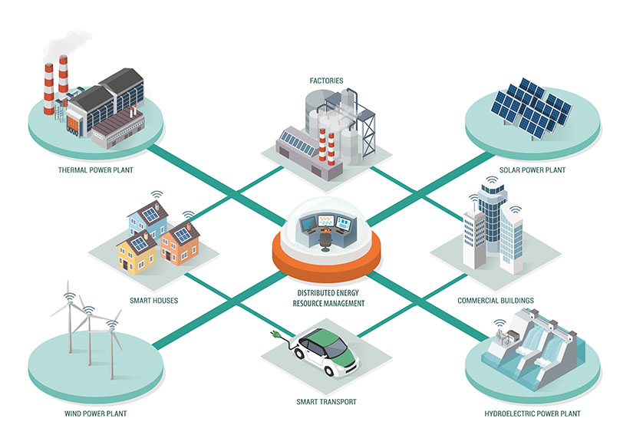
1. Introduction to Cybersecurity in Energy Emerging Technologies
Energy Sector Digitalisation Trends
Key Drivers of Digitalisation
Decarbonisation and renewables
Distributed energy resources (DERs)Real-time monitoring and control
Automation and optimization
Market liberalisation and flexibility
Notes:
Explain how climate goals drive digital complexity.
Highlight that decentralisation multiplies endpoints.
Stress that flexibility and automation increase cyber dependency.
Connect digitalisation directly to cybersecurity exposure.

Slide 6
1. Introduction to Cybersecurity in Energy Emerging Technologies
From Traditional Grids to Smart Energy Systems
Traditional Energy Systems
Centralised generation
One-way energy flow
Limited connectivity
Smart Energy Systems
Distributed generation
Bi-directional flows
Data-driven control
Notes:
Contrast closed, predictable systems with open, dynamic ones.
Emphasise that cybersecurity assumptions from the past no longer hold.
Use this slide to explain why legacy security models fail.

Slide 7
1. Introduction to Cybersecurity in Energy Emerging Technologies
Internet of Energy (IoE): Concept and Scope
What Is the Internet of Energy?
Energy assets connected via networks
Sensors, actuators, platforms, analytics
Integration of IT, OT, and IoT
Real-time monitoring and optimization
Notes:
Define IoE clearly — students often confuse it with IoT.
Explain that IoE is:
Broader
Safety-critical
Cyber-physical by nature
Emphasise scale and heterogeneity.

Slide 8
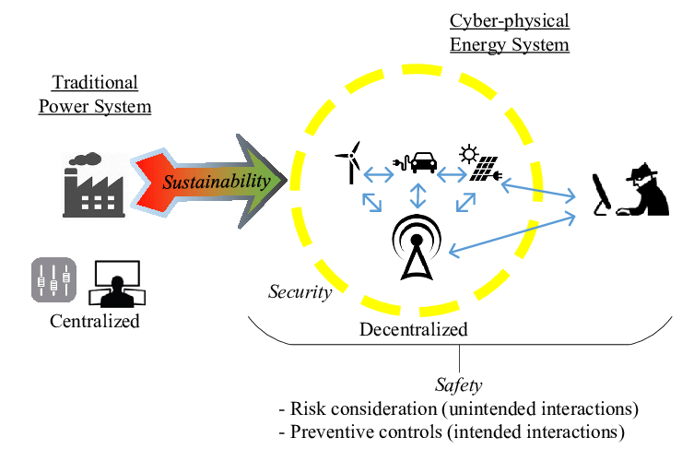
1. Introduction to Cybersecurity in Energy Emerging Technologies
Internet of Energy (IoE): Concept and Scope
What Is the Internet of Energy?
Energy assets connected via networks
Sensors, actuators, platforms, analytics
Integration of IT, OT, and IoT
Real-time monitoring and optimization
Notes:
Define IoE clearly — students often confuse it with IoT.
Explain that IoE is:
Broader
Safety-critical
Cyber-physical by nature
Emphasise scale and heterogeneity.

Slide 9
1. Introduction to Cybersecurity in Energy Emerging Technologies
Cloud Computing in Energy Systems
Why the Cloud Is Used in Energy
Centralised analytics
Scalability and elasticity
Cost optimization
Integration with AI and big data
Notes:
Explain typical cloud use cases:
Forecasting
Monitoring
Market platforms
Clarify that cloud ≠ insecure by default.
Introduce idea of shared responsibility (expanded later).

Slide 10
1. Introduction to Cybersecurity in Energy Emerging Technologies
Artificial Intelligence in Energy Operations
AI as a Core Enabler
Demand forecasting
Predictive maintenance
Fault detection
Optimisation of generation and storage
Notes:
Emphasise AI’s dependence on data integrity.
Explain that AI introduces:
New attack surfaces
New failure modes
This slide prepares students for AI security in Topic 3.

Slide 11
1. Introduction to Cybersecurity in Energy Emerging Technologies
Blockchain Use Cases in Energy
Why Blockchain Appears in Energy
Peer-to-peer energy trading
Traceability of energy origin
Decentralised marketplaces
Trust without central authority
Notes:
Stress that blockchain is not always needed, but often proposed.
Explain that security ≠ correctness.
Mention that blockchain introduces new types of vulnerabilities, not fewer ones

Slide 12
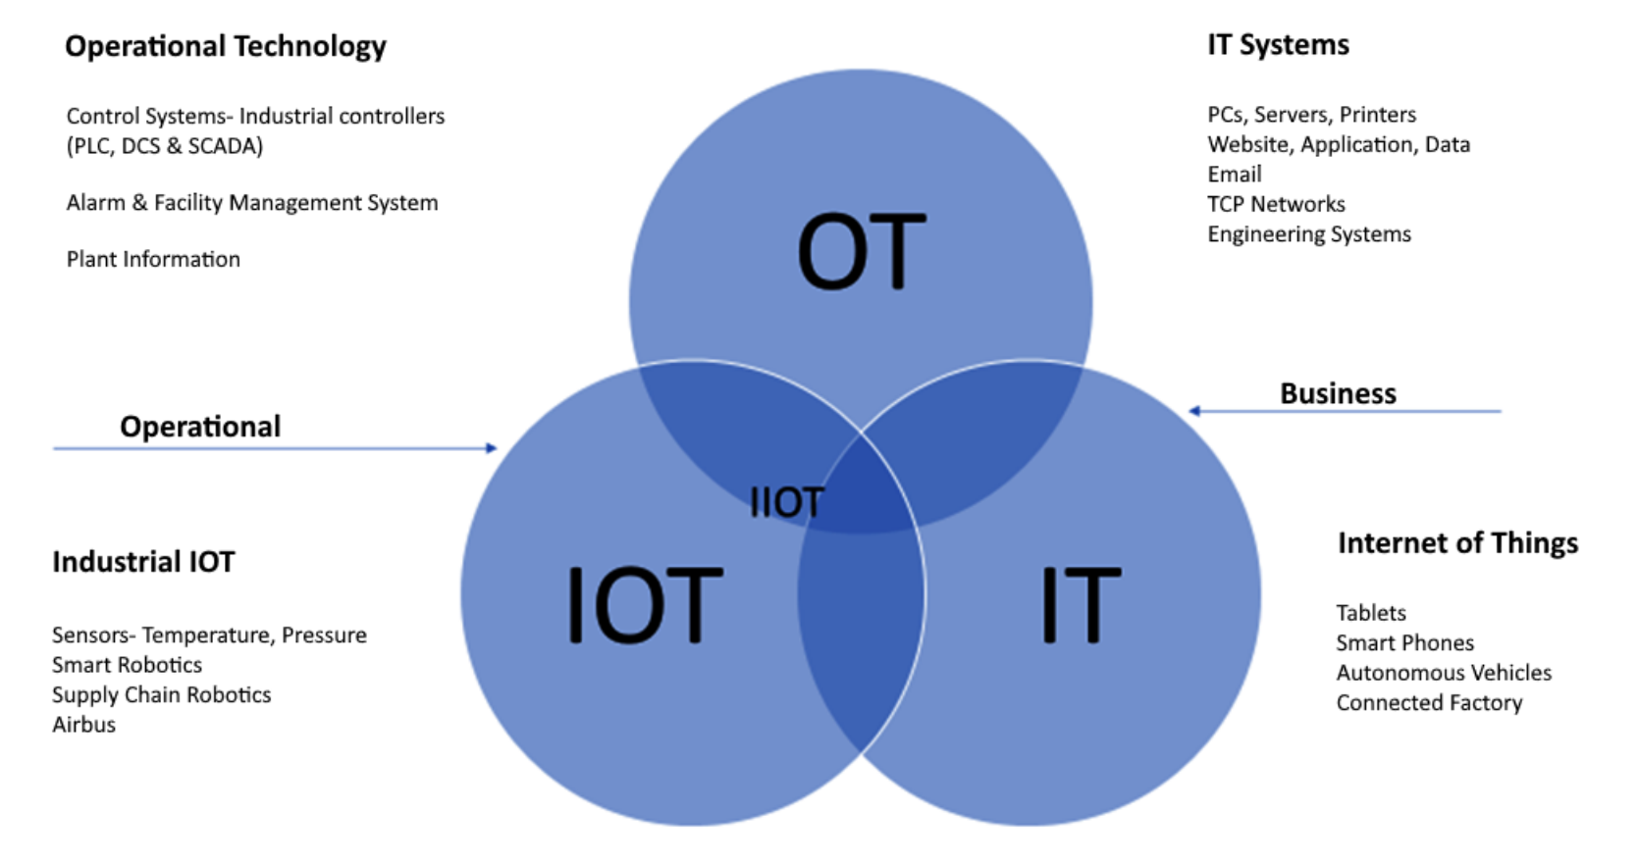
1. Introduction to Cybersecurity in Energy Emerging Technologies
Convergence of IT, OT, and IoE
System Convergence
IT: business and enterprise systems
OT: control and automation systems
IoE: connected energy assets
Shared networks, shared risks
Notes:
This is one of the most important slides in Topic 1.
Explain why IT security controls often break OT assumptions.
Emphasise different priorities:
IT → confidentiality
OT → availability & safety

Slide 13
1. Introduction to Cybersecurity in Energy Emerging Technologies
Cybersecurity Fundamentals Revisited for Energy
The CIA Triad — Rebalanced
Confidentiality
Integrity
Availability
In energy systems:
Availability and safety dominate
Notes:
Explain that CIA still applies, but weights change.
Use examples:
Temporary data leak vs grid outage
Emphasise why patching, scanning, and testing must be cautious.

Slide 14
1. Introduction to Cybersecurity in Energy Emerging Technologies
Expanded Attack Surface in Energy Ecosystems
Where Attacks Can Occur
Field devices and sensors
Communication networks
Cloud platforms
Control rooms
Third-party integrations
Notes:
Explain “attack surface” intuitively.
Stress that attackers often exploit:
Weakest link
External dependencies
Introduce the idea of systemic risk.

Slide 15
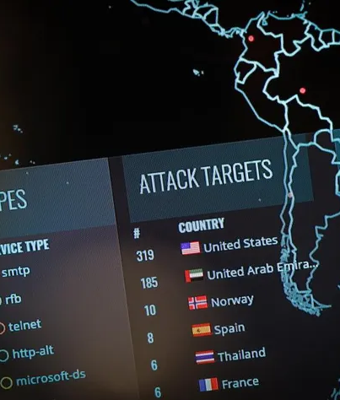
1. Introduction to Cybersecurity in Energy Emerging Technologies
Typical Threat Actors Targeting Energy
Where Attacks Can Occur
Who Attacks Energy Systems?
Cybercriminal groups
Nation-state actors
Hacktivists
Insider threats
Notes:
Emphasise motivation differences:
Financial
Political
Strategic
Explain why energy is a geopolitical target.
Avoid sensationalism — focus on threat modelling.

Slide 16
1. Introduction to Cybersecurity in Energy Emerging Technologies
Common Attack Vectors in Energy Systems
How Attacks Happen
Phishing and credential theft
Remote access abuse
Exploiting legacy systems
Supply-chain compromise
Notes:
Stress that attacks are often not sophisticated exploits.
Explain role of:
Poor segmentation
Weak access control
Connect to future topics on tools and controls.

Slide 17
1. Introduction to Cybersecurity in Energy Emerging Technologies
Safety, Availability, and Reliability Constraints
Operational Constraints
Systems must not stop
Failures can cause physical harm
Maintenance windows are limited
Security actions must be non-disruptive
Notes:
Emphasise that cybersecurity decisions can have physical consequences.
Explain why:
“Just patch it”
“Just scan it”
is often unacceptable.
This prepares students for realistic security trade-offs.

Slide 18
1. Introduction to Cybersecurity in Energy Emerging Technologies
Regulatory Landscape Overview
Energy + Cybersecurity Regulation
Critical infrastructure protection
Data protection requirements
Sector-specific cybersecurity rules
National and EU-level frameworks
Notes:
Keep regulation high-level here.
Explain regulation as:
Minimum baseline
Not a guarantee of security
Policy details can vary by country.

Slide 19
1. Introduction to Cybersecurity in Energy Emerging Technologies
Data Protection and Privacy in Energy
Why Data Matters
Smart meters reveal behaviour
Energy data is personal data
Privacy violations damage trust
Security and privacy are linked
Notes:
Explain how consumption patterns can reveal:
Occupancy
Habits
Stress privacy-by-design importance.
Connect privacy failures to reputational damage.

Slide 20
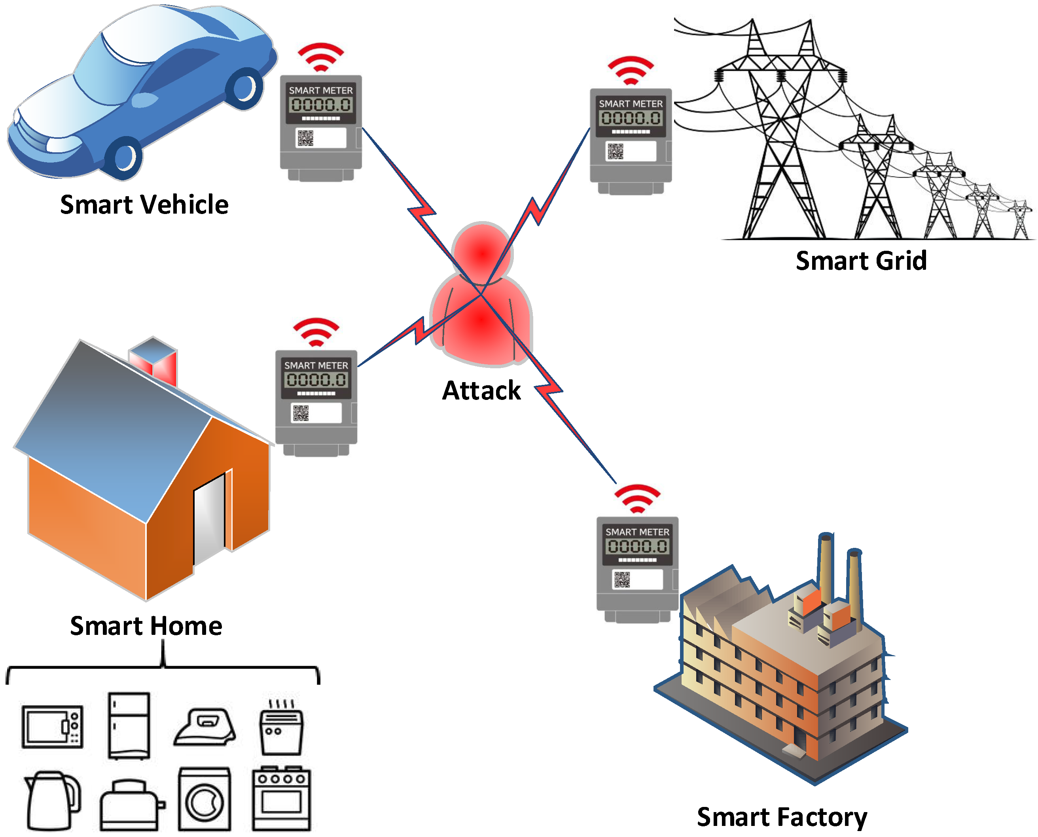
1. Introduction to Cybersecurity in Energy Emerging Technologies
Data Protection and Privacy in Energy
Why Data Matters
Smart meters reveal behaviour
Energy data is personal data
Privacy violations damage trust
Security and privacy are linked
Notes:
Explain how consumption patterns can reveal:
Occupancy
Habits
Stress privacy-by-design importance.
Connect privacy failures to reputational damage.

Slide 21
1. Introduction to Cybersecurity in Energy Emerging Technologies
Compliance vs Security
Not the Same Thing
Compliance = meeting requirements
Security = managing real risk
Compliant systems can still be insecure
Security requires continuous effort
Notes:
This slide is key for professionals.
Emphasise:
Audits are snapshots
Threats evolve continuously
Encourage a risk-based mindset.

Slide 22
1. Introduction to Cybersecurity in Energy Emerging Technologies
Summary of Emerging Technology Risks
Key Risk Themes
Increased connectivity
System complexity
Legacy + modern coexistence
Human and organisational factors
Notes:
Synthesize rather than repeat.
Emphasise interdependencies.
Prepare students mentally for deeper technical topics.

Slide 23
1. Introduction to Cybersecurity in Energy Emerging Technologies
Topic 1 Key Takeaways
What You Should Remember
Energy cybersecurity is cyber-physical
Digitalisation increases exposure
Availability and safety dominate
One-size-fits-all security does not work
Notes:
Reinforce the mental model.
Explicitly say:
“Everything from Topic 2 onward builds on this understanding.”
Transition to Topic 2: Anomaly Detection Techniques.

Slide 24

Thank you

