Slide 1



Cybersecurity in Emerging Technologies for the Energy Network
CSP007_C_E
Presentation by:

Slide 2


Slide 3


Cybersecurity in Emerging Technologies for the Energy Network – Course Overview
o1.
Introduction to Cybersecurity in Energy Emerging Technologies
o2.
Anomaly Detection Techniques

Slide 4

Training Outline
Topic-01 - Introduction to Cybersecurity in Energy Emerging Technologies
Overview and Unique Security Challenges
Overview of cybersecurity principles and challenges in the context of emerging energy technologies
Introduction to IoE, cloud computing, blockchain, and AI and their significance in the energy sector
Notes:
Welcome the participants to the session.
Introduce yourself and briefly outline your background in cybersecurity and energy technologies.
Mention the goal of today’s presentation: to provide an overview of cybersecurity challenges in emerging energy technologies.

Slide 5

1. Overview of Emerging Technologies
Context
Introduction to Key Technologies:
  Internet of Things (IoT):
    Devices and sensors connected to the internet.
    Examples: Smart meters, grid sensors, and connected home devices.
  Cloud Computing:
    On-demand delivery of IT resources via the internet.
    Examples: Data storage, computing power, and application services.
  Blockchain:
    Distributed ledger technology for secure transactions.
    Examples: Energy trading platforms, supply chain management.
Artificial Intelligence (AI):
    Machine learning and algorithms for decision-making.
    Examples: Predictive maintenance, demand forecasting.
Transformative Impact:
  Enhanced efficiency and reliability of energy systems.
  Introduction of new vulnerabilities and attack surfaces.
Notes:
Explain the significance of emerging technologies in the energy sector.
Briefly describe IoT, Cloud Computing, Blockchain, and AI.
Highlight how these technologies enhance efficiency and reliability but also introduce new cybersecurity challenges.
Mention that this session will cover the unique security issues associated with each technology.

Slide 6
2. Impact on Cybersecurity Landscape
Context
Increased Attack Surface:
  More entry points for attackers due to interconnected devices.
  Complexity in managing security across diverse technologies.
New Vulnerabilities:
  Weaknesses in IoT device security.
  Cloud misconfigurations leading to data breaches.
  Blockchain-specific threats like 51% attacks.
  AI manipulation and data privacy issues.
Need for Robust Security Measures:
  Comprehensive strategies to secure all layers of technology.
  Importance of proactive and adaptive cybersecurity practices.
Notes:
Explain the significance of emerging technologies in the energy sector.
Briefly describe IoT, Cloud Computing, Blockchain, and AI.
Highlight how these technologies enhance efficiency and reliability but also introduce new cybersecurity challenges.
Mention that this session will cover the unique security issues associated with each technology.

Slide 7
3. Unique Security Challenges of IoT
Context
Device Heterogeneity:
  Variety of devices with different security capabilities.
Large-Scale Deployment:
  Managing security for millions of devices.
Weak Security Protocols:
  Inadequate security in some IoT devices.
Examples:
  Vulnerable smart meters and grid sensors.
Notes:
Define IoT and give examples relevant to the energy sector, such as smart meters and grid sensors.
Explain the heterogeneity of devices and the challenge this poses for security.
Discuss the difficulties in managing security for large-scale deployments.
Highlight common security weaknesses in IoT devices.

Slide 8
4. Unique Security Challenges of Cloud Computing
Context
Shared Responsibility Model:
  Division of security responsibilities between provider and user.
Data Breaches:
  Risks of unauthorized access to sensitive data.
Misconfigurations:
  Common cause of security incidents in cloud environments.
Examples:
  Misconfigured S3 buckets exposing data.
Notes:
Explain the shared responsibility model in cloud computing and its implications for security.
Discuss common cloud security issues, including data breaches and misconfigurations.
Provide an example of a misconfigured cloud storage bucket leading to data exposure.
Stress the importance of proper configuration and management.

Slide 9
5. Unique Security Challenges of Blockchain
Context
51% Attacks:
  Control of the majority of network's hash rate to alter transactions.
Smart Contract Vulnerabilities:
  Bugs and exploits in smart contract code.
Examples:
  DAO hack due to a vulnerability in smart contracts.
Notes:
Briefly explain blockchain technology and its use cases in the energy sector.
Discuss the concept of a 51% attack and its implications.
Explain smart contract vulnerabilities and provide an example, such as the DAO hack.
Emphasize the need for secure coding practices and thorough testing.

Slide 10
6. Unique Security Challenges of AI
Context
Adversarial Attacks:
  Manipulation of AI models to produce incorrect results.
Data Privacy Issues:
  Ensuring the privacy of data used for training AI models.
Examples:
  Adversarial examples causing AI misclassification.
Notes:
Define AI and its applications in the energy sector.
Explain adversarial attacks and how they can manipulate AI models.
Discuss data privacy issues associated with training AI models.
Provide examples of adversarial attacks causing misclassification.
Highlight the importance of securing AI models and training data.

Slide 11
7. Unique Security Challenges of AI
Context
Key Regulations:
  GDPR: General Data Protection Regulation for data privacy.
  NERC CIP: Critical Infrastructure Protection standards for energy sector.
  Energy Policy Act: Regulatory framework for energy infrastructure.
Importance of Compliance:
  Legal and financial implications of non-compliance.
  Enhancing overall security posture through adherence to regulations.
Strategies for Compliance:
  Regular audits and assessments.
  Implementation of industry best practices.
Notes:
Provide an overview of key regulations affecting cybersecurity in the energy sector, such as GDPR and NERC CIP.
Discuss the implications of non-compliance, including legal and financial consequences.
Explain how adhering to these regulations enhances overall security.
Suggest strategies for achieving compliance, such as regular audits and implementing best practices.

Slide 12
8. Summary of Topic 1
Context
Recap of the significance of cybersecurity in emerging energy technologies.
Highlighted the unique security challenges for IoT, cloud computing, blockchain, and AI.
Discussed the importance of regulatory and compliance considerations.
Preparation for Topic 2: Anomaly Detection Techniques.
Notes:
Recap the main points covered in this session.
Reiterate the importance of cybersecurity in emerging energy technologies.
Highlight the unique security challenges associated with IoT, cloud computing, blockchain, and AI.
Mention that the next topic will delve into anomaly detection techniques.

Slide 13
Training Outline:
Topic-02 - Anomaly Detection Techniques
Overview anomaly detection techniques
Importance of machine learning and time series methods
Real-world applications and benefits of anomaly detection

Slide 14

1. Introduction to Anomaly Detection
Context
Definition:
  The process of identifying patterns in data that do not conform to expected behavior.
Importance in Cybersecurity:
  Detecting unusual activities that may indicate security threats.
Types of Anomalies:
  Point Anomalies: Single data point significantly different from others.
  Contextual Anomalies: Data points that are anomalous in a specific context.
  Collective Anomalies: A group of data points that collectively behave anomalously.
  Source: https://research.einar.partners/mystery-of-predictions-in-anomaly-detection/
Notes:
Define anomaly detection and its role in cybersecurity.
Explain why detecting anomalies is crucial for identifying potential threats.
Describe the three types of anomalies: point, contextual, and collective.
Provide examples for each type to illustrate their significance.
IMAGE: https://research.einar.partners/wp-content/uploads/2021/12/Types-of-anomaly-EP-v2.jpg

Slide 15
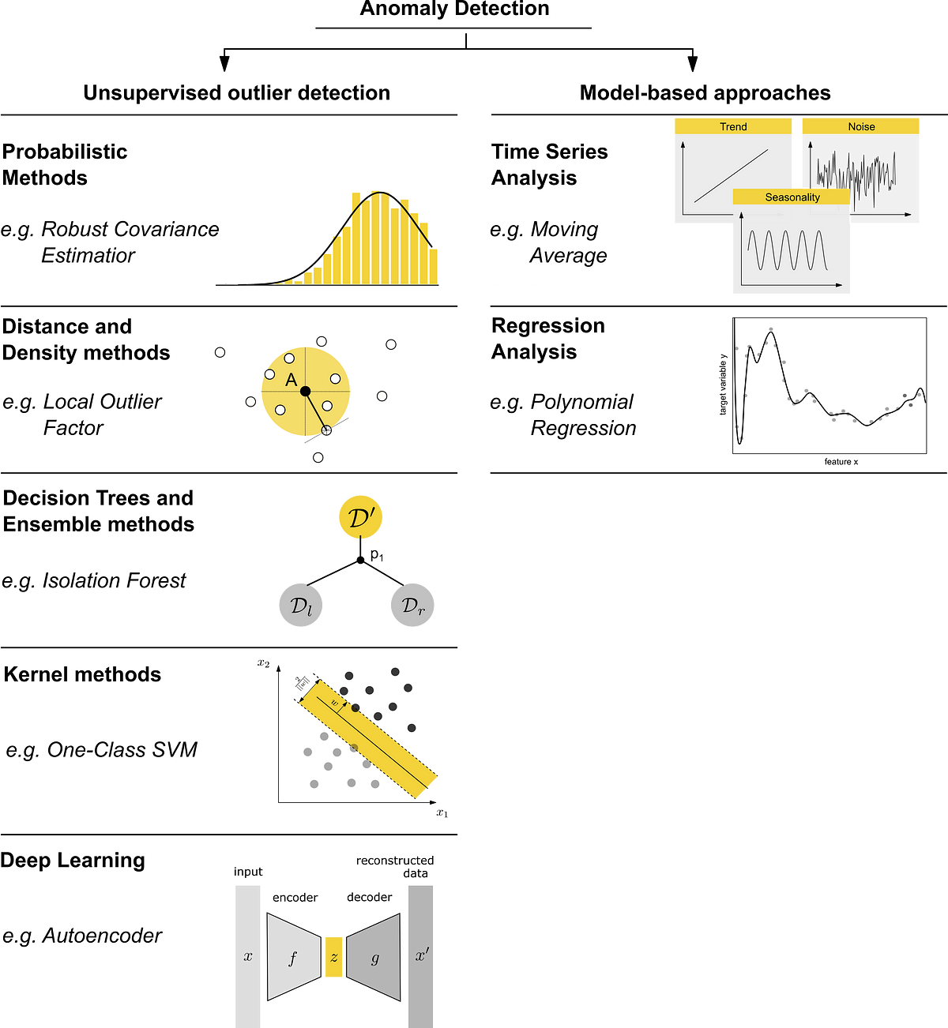
2. Machine Learning-Based Methods
Context
Supervised Learning:
  Using labeled data to train models to recognize anomalies.
  Example algorithms: Decision Trees, Random Forests.
Unsupervised Learning:
  Detecting anomalies without labeled data by identifying deviations from the norm.
  Example algorithms: k-Nearest Neighbors (k-NN), Clustering.
Common Algorithms:
  k-Nearest Neighbors (k-NN):
  Identifies anomalies based on distance metrics.
Support Vector Machines (SVM):
  Classifies data points into normal and anomalous.
Neural Networks:
  Deep learning models for complex pattern recognition.
Advantages:
  Ability to adapt to new types of threats.
  Improved accuracy over traditional rule-based methods.
  Source: https://towardsdatascience.com/a-comprehensive-beginners-guide-to-the-diverse-field-of-anomaly-detection-8c818d153995
Notes:
Introduce machine learning-based methods for anomaly detection.
Differentiate between supervised and unsupervised learning.
Discuss common algorithms used in anomaly detection, such as k-NN, SVM, and neural networks.
Explain the advantages of using machine learning for detecting anomalies, including adaptability and accuracy.
IMAGE: https://miro.medium.com/v2/resize:fit:1200/1*XIlxmGNnjAUwDCjPtLYjcA.png

Slide 16
3. Time Series Anomaly Detection
Context
Importance in Energy Systems:
  Continuous monitoring of time-dependent data like energy consumption.
Techniques:
  ARIMA (Autoregressive Integrated Moving Average):
    Statistical analysis for forecasting and anomaly detection.
  LSTM (Long Short-Term Memory) Networks:
    Neural network models for handling sequential data.
  STL (Seasonal-Trend Decomposition):
    Decomposes time series data into seasonal, trend, and residual components.
Applications:
  Detecting irregularities in energy production and consumption.
  Monitoring for signs of tampering or unauthorized access.
Notes:
Discuss the importance of time series data in the energy sector, such as monitoring energy consumption patterns.
Introduce ARIMA, LSTM, and STL techniques for time series anomaly detection.
Explain how each technique works and their applications in detecting irregularities in energy data.
Provide examples of time series anomalies in energy systems.

Slide 17
4. Real-World Applications of Anomaly Detection
Context
Case Study 1: Unauthorized Access Detection
  Monitoring network traffic for unusual access patterns.
  Example: Identifying unauthorized access to SCADA systems.
Case Study 2: Smart Grid Monitoring
  Analyzing energy flow data for irregularities.
  Example: Detecting anomalies in smart meter data indicating tampering.
Case Study 3: Predictive Maintenance
  Using anomaly detection to predict equipment failures.
  Example: Identifying early signs of malfunction in turbines.
Notes:
Present real-world case studies of anomaly detection in the energy sector.
Case Study 1: Explain how anomaly detection can identify unauthorized access to SCADA systems.
Case Study 2: Describe how anomaly detection helps monitor smart grids for irregularities.
Case Study 3: Discuss the use of anomaly detection for predictive maintenance in energy equipment.
Emphasize the benefits of implementing anomaly detection systems.

Slide 18
5. Tools for Anomaly Detection
Context
Popular Tools:
  Splunk:
    Data analytics and monitoring platform.
  ELK Stack (Elasticsearch, Logstash, Kibana):
    Open-source toolset for searching, analyzing, and visualizing log data.
  Apache Spot:
    Open-source cybersecurity analytics platform.
Features and Benefits:
  Real-time data analysis and visualization.
  Scalability to handle large datasets.
  Integration with other security tools.
Practical Demonstration:
  Brief demo (if applicable) showing the tool in action.
Notes:
Introduce popular tools used for anomaly detection, such as Splunk, ELK Stack, and Apache Spot.
Highlight the features and benefits of each tool.
If possible, provide a brief demo or screenshots of the tools in action.
Explain how these tools can be integrated into energy cybersecurity frameworks.

Slide 19
6. Summary of Topic 2
Context
Recap of the key points on anomaly detection techniques.
Importance of machine learning and time series methods.
Real-world applications and benefits of anomaly detection.
Introduction to Topic 3: Securing the Energy Emerging Technologies.
Notes:
Recap the key points covered in this session on anomaly detection techniques.
Emphasize the importance of machine learning and time series methods for effective anomaly detection.
Highlight the real-world applications and benefits of these techniques.
Introduce the next topic: Securing the Energy Emerging Technologies.

Slide 20

Thank you
Please send all questions to:
gehad@example.com

