Slide 1



Cybersecurity in Emerging Technologies for the Energy Network
CSP007_C_E
Presentation by:

Slide 2


Slide 3


Cybersecurity in Emerging Technologies for the Energy Network – Course Overview
0.
Introduction & Course Context
1.
TOPIC 1 – Introduction to Cybersecurity in Energy Emerging Technologies
2.
TOPIC 2 – Anomaly Detection Techniques
3.
TOPIC 3 – Securing the Energy Emerging Technologies
4.
TOPIC 4 – Data Analysis for Cybersecurity in the Energy Network
5.
TOPIC 5 – Security Tools and Techniques for Energy Emerging Technologie
6.
The Future of Emerging Technology Security in Energy Networks
Notes:
Welcome participants and briefly introduce yourself.
Position this course as advanced, not introductory.
Emphasise that this course sits at the intersection of energy systems and cybersecurity, not generic IT security.
Highlight that energy infrastructures are critical, safety-relevant, and long-lived, making cybersecurity fundamentally different from enterprise IT.
Set expectations: this course combines technical depth, applied reasoning, and strategic thinking.

Slide 4

3. Securing the Energy Emerging Technologies
Topic 3 Overview and Scope
This topic focuses on:
How emerging technologies are actually deployed in energy systems
Where their main security weaknesses appear
Which security principles and controls are effective in practice
We examine security across:
Internet of Energy (IoE)
Cloud computing
Blockchain-based energy platforms
Artificial Intelligence systems
Notes:
Position this topic as the core technical security module.
Emphasise that the focus is architectural and systemic, not vendor-specific.
Explain that students should already understand:
- Energy digitalisation (Topic 1)
- Detection logic (Topic 2)
Stress that the goal is risk-informed security design, not “perfect security”.

Slide 5
3. Securing the Energy Emerging Technologies
Internet of Energy (IoE): Reference Architecture
Typical IoE Architecture Layers
Physical layer: Sensors, smart meters, actuators, inverters, substations
Communication layer: Field networks, gateways, wireless and wired links
Platform layer: Data aggregation, analytics, control platforms
Application layer: Monitoring dashboards, optimisation, market interaction
Each layer introduces distinct security risks and trust boundaries.
Notes:
Walk through the architecture bottom-up.
Emphasise that trust boundaries exist between layers.
Explain why “secure device ≠ secure system”.
Highlight that attacks often move vertically across layers.

Slide 6
3. Securing the Energy Emerging Technologies
Trust Boundaries and Attack Surfaces in IoE
Typical IoE Architecture Layers
Where Trust Is Assumed – and Broken
Field devices often operate in untrusted environments
Gateways aggregate multiple data sources
Platforms assume data integrity from below
Applications rely on platform correctness
A compromised lower layer can propagate impact upward.
Notes:
Introduce the concept of implicit trust.
Explain why energy devices are often:
- Physically accessible
- Hard to monitor
Stress lateral and vertical attack movement.
This slide prepares students for defense-in-depth thinking.

Slide 7
3. Securing the Energy Emerging Technologies
Common IoE Vulnerabilities
Typical IoE Architecture Layers
Typical Weaknesses in IoE Deployments
Weak or hard-coded device credentials
Infrequent firmware updates
Legacy communication protocols
Lack of device authentication
Limited logging and visibility
Many vulnerabilities stem from operational constraints, not negligence.
Notes:
Emphasise that IoE security problems are often systemic.
Explain why:
- Devices have long lifetimes
- Patch cycles are slow
Connect vulnerabilities to realistic attacker opportunities.

Slide 8
3. Securing the Energy Emerging Technologies
Device-Level Security Challenges
Why Securing Field Devices Is Hard
Limited CPU, memory, and power
Long deployment lifetimes (10–20 years)
Physical exposure
Vendor lock-in and proprietary firmware
Security controls must be lightweight and robust.
Notes:
Explain why endpoint security tools don’t work here.
Emphasise:
- Secure boot
- Device identity
Mention that compromise is often assumed, not prevented.

Slide 9
3. Securing the Energy Emerging Technologies
Network-Level Threats in IoE
IoE Communication Risks
Unencrypted field communications
Man-in-the-middle attacks
Replay attacks
Network segmentation gaps
Networks often become the main attack vector in IoE.
Notes:
Explain that many energy protocols were not designed for hostile environments.
Introduce replay and spoofing intuitively.
Emphasise importance of segmentation and encryption.

Slide 10
3. Securing the Energy Emerging Technologies
Data Security Issues in IoE
IoE Communication Risks
Protecting Energy Data
Integrity of sensor measurements
Authenticity of control commands
Confidentiality of consumption data
Privacy implications for end users
Data manipulation can lead to unsafe physical actions.
Notes:
Explain why data integrity is often more critical than confidentiality.
Connect data security to:
- AI systems
- Control logic
Mention privacy risks from fine-grained energy data.

Slide 11
3. Securing the Energy Emerging Technologies
Data Security Issues in IoE
IoE Communication Risks
Protecting Energy Data
Integrity of sensor measurements
Authenticity of control commands
Confidentiality of consumption data
Privacy implications for end users
Data manipulation can lead to unsafe physical actions.
Notes:
Explain why data integrity is often more critical than confidentiality.
Connect data security to:
- AI systems
- Control logic
Mention privacy risks from fine-grained energy data.

Slide 12
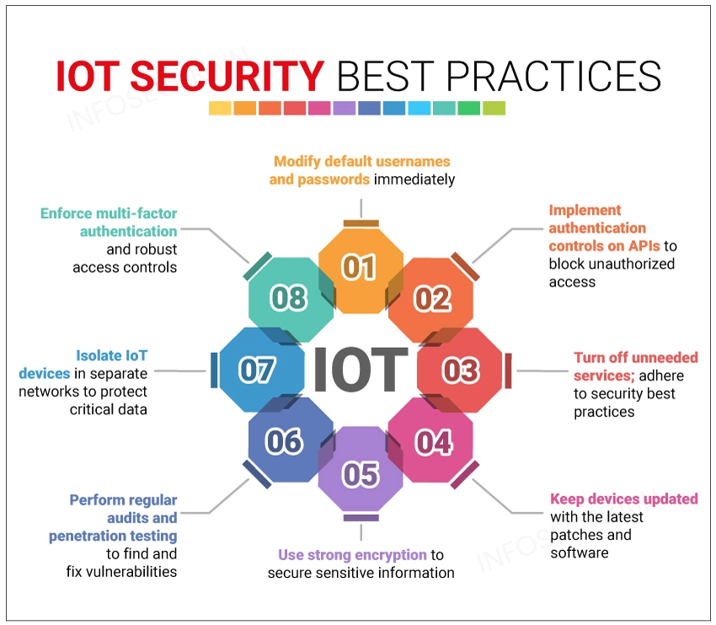
3. Securing the Energy Emerging Technologies
IoE Security Best Practices
Foundational Security Measures
Strong device identity and authentication
Secure communication channels
Network segmentation and zoning
Monitoring and anomaly detection
Secure lifecycle management
Security must be built-in, not retrofitted.
Notes:
Stress that no single control is sufficient.
Emphasise layered security.
Transition naturally to cloud security.

Slide 13
3. Securing the Energy Emerging Technologies
Secure Communication in Energy Systems
Why Communication Security Matters
Prevents eavesdropping and manipulation
Ensures command authenticity
Enables trusted automation
Common mechanisms:
TLS, IPsec, VPNs
Message authentication codes
Secure key management
Notes:
Explain difference between:
- Encryption
- Authentication
Emphasise key management challenges at scale.
Avoid protocol deep dives here (conceptual focus).

Slide 14
3. Securing the Energy Emerging Technologies
Identity and Authentication for IoE Devices
Device Identity Is Foundational
Each device must be uniquely identifiable
Authentication must be mutual
Credentials must be protected over time
Weak identity undermines all other controls.
Notes:
Emphasise that “IP address ≠ identity”.
Explain risk of cloned or impersonated devices.
Prepare ground for IAM discussion in Topic 5.

Slide 15
3. Securing the Energy Emerging Technologies
Cloud Service Models in Energy
How Cloud Is Used in Energy
IaaS for infrastructure hosting
PaaS for analytics and data pipelines
SaaS for monitoring and market platforms
Cloud enables scale — but changes risk distribution.
Notes:
Clarify that cloud is usually:
- Control-adjacent
- Not directly controlling physical assets
Introduce shared responsibility idea.

Slide 16
3. Securing the Energy Emerging Technologies
Shared Responsibility Model Explained
Who Secures What?
Cloud provider:
  Physical infrastructure
  Underlying platform security
Energy organisation:
  Configurations
  Access control
  Data protection
Misunderstanding this model causes many incidents.
Notes:
Stress that “cloud provider security” ≠ customer security.
Use misconfiguration examples.
This is a key exam-worthy concept.

Slide 17
3. Securing the Energy Emerging Technologies
Cloud Threat Landscape in Energy
Typical Cloud Threats
Misconfigured storage or services
Excessive privileges
Credential leakage
Insecure APIs
Most cloud incidents are configuration-related.
Notes:
Emphasise that attackers often don’t hack — they log in.
Connect to IAM importance.
Prepare for cloud monitoring discussion.

Slide 18
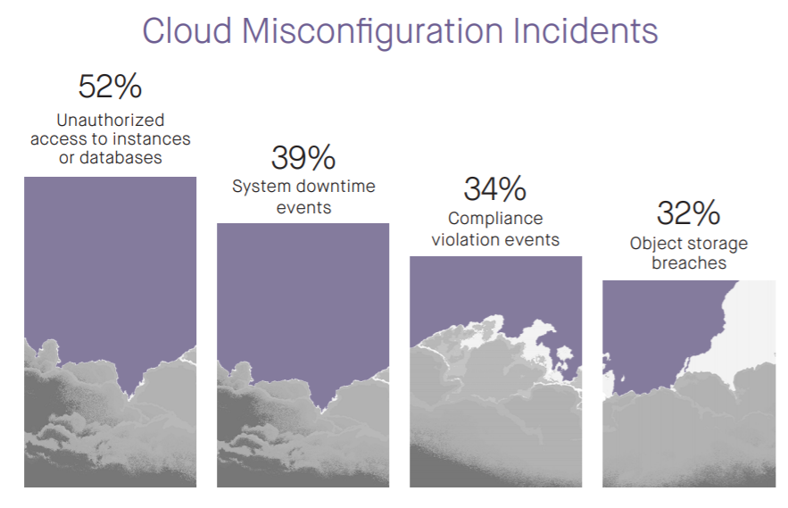
3. Securing the Energy Emerging Technologies
Cloud Security Controls and Hardening
Effective Cloud Security Measures
Least privilege access
Strong identity management
Encryption at rest and in transit
Continuous monitoring and auditing
Security must be continuous, not periodic.
Notes:
Explain “security posture” concept.
Mention automation benefits but avoid tool details.
Emphasise auditability.

Slide 19
3. Securing the Energy Emerging Technologies
Monitoring and Auditing Cloud Environments
Typical Cloud Threats
Why Visibility Matters
Detect misconfigurations early
Track access and changes
Support incident investigation
Logs are only useful if reviewed and correlated.
Notes:
Connect to SOC workflows.
Explain importance of timestamps and integrity.
Transition to blockchain security.

Slide 20
3. Securing the Energy Emerging Technologies
Blockchain Fundamentals (Energy Context)
Why Blockchain Appears in Energy
Decentralised trust
Immutable records
Peer-to-peer transactions
Common in:
Energy trading
Certification of origin
Flexibility markets
Notes:
Clarify that blockchain is not mandatory for energy.
Emphasise trade-offs.
Avoid hype.

Slide 21
3. Securing the Energy Emerging Technologies
Security Properties of Blockchain
Why Blockchain Appears in Energy
What Blockchain Does Well
Tamper-resistant records
Distributed consensus
Transparency
Security depends on correct design and implementation.
Notes:
Emphasise that properties are not absolute.
Introduce idea of economic security.
Prepare for vulnerabilities.

Slide 22
3. Securing the Energy Emerging Technologies
Blockchain Attack Vectors
Common Blockchain Threats
51% attacks
Sybil attacks
Smart contract flaws
Key compromise
Blockchain shifts trust — it does not eliminate risk.
Notes:
Explain attacks conceptually, not mathematically.
Emphasise smart contract risks.
Link to energy market implications.

Slide 23
3. Securing the Energy Emerging Technologies
Smart Contract Vulnerabilities
Why Smart Contracts Are Risky
Immutable once deployed
Code errors become permanent
Logic flaws can be exploited
Security requires rigorous testing and validation.
Notes:
Stress that “code is law” is dangerous without safeguards.
Connect to financial and operational losses.

Slide 24
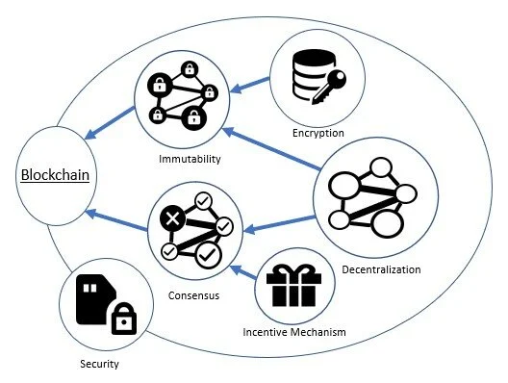
3. Securing the Energy Emerging Technologies
Blockchain Security Mitigation Strategies
Reducing Blockchain Risk
Formal verification
Audited smart contracts
Multi-signature mechanisms
Governance and upgrade paths
Security is partly technical, partly organisational.
Notes:
Emphasise governance importance.
Transition to AI security.

Slide 25
3. Securing the Energy Emerging Technologies
AI Systems in Energy Pipelines
Where AI Is Used
Forecasting and optimization
Fault detection
Decision support
AI systems influence real operational decisions.
Notes:
Emphasise AI as part of control loops.
Introduce dependency on data quality.

Slide 26
3. Securing the Energy Emerging Technologies
Data Security for AI Systems
Why Data Is the Weakest Link
Training data poisoning
Manipulated sensor inputs
Bias amplification
Compromised data leads to unsafe decisions.
Notes:
Explain poisoning intuitively.
Connect to anomaly detection and integrity.

Slide 27
3. Securing the Energy Emerging Technologies
Model Security and Integrity
Protecting AI Models
Model theft
Model manipulation
Unauthorised updates
Models must be protected like critical assets.
Notes:
Explain that models are intellectual property.
Mention deployment pipeline security.

Slide 28
3. Securing the Energy Emerging Technologies
Adversarial Attacks on AI
How AI Can Be Tricked
Carefully crafted inputs
Small perturbations
Hard to detect
Adversarial attacks exploit model assumptions.
Notes:
Avoid math; use intuitive examples.
Stress relevance in cyber-physical settings.

Slide 29
3. Securing the Energy Emerging Technologies
Securing AI Training and Deployment Pipelines
End-to-End AI Security
Secure data ingestion
Controlled training environments
Model validation and monitoring
Controlled deployment
AI security is a lifecycle problem.
Notes:
Emphasise pipeline thinking.
Transition to cross-technology risks.

Slide 30
3. Securing the Energy Emerging Technologies
Cross-Technology Security Dependencies
Why Technologies Cannot Be Secured in Isolation
IoE feeds cloud platforms
Cloud feeds AI models
AI influences control actions
A weakness in one layer propagates.
Notes:
Emphasise cascading risk.
This is a synthesis slide.

Slide 31
3. Securing the Energy Emerging Technologies
Risk Propagation Across Technologies
From Local Compromise to System Impact
Compromised sensor → corrupted data
Corrupted data → wrong analytics
Wrong analytics → unsafe decisions
Security failures amplify across layers.
Notes:
Walk through a concrete example.
Reinforce systemic thinking.

Slide 32
3. Securing the Energy Emerging Technologies
Defense-in-Depth Across Technologies
Layered Security Strategy
Prevent where possible
Detect continuously
Limit impact
Enable recovery
No single control is sufficient.
Notes:
Tie back to anomaly detection.
Introduce resilience mindset.

Slide 33
3. Securing the Energy Emerging Technologies
Topic 3 Synthesis
What We Learned
Each technology introduces unique risks
Integration multiplies complexity
Security must be architectural and continuous
Notes:
Synthesize, do not repeat.
Prepare students for data analysis topic.

Slide 34
3. Securing the Energy Emerging Technologies
Topic 3 Key Takeaways
Key Messages
Energy security is cyber-physical
Availability and safety dominate
Security is a lifecycle concern
Integration is the main risk multiplier
Notes:
Reinforce exam-relevant insights.
Signal transition.

Slide 35
3. Securing the Energy Emerging Technologies
Preparing for Topic 4
Next: Data Analysis for Cybersecurity
Security generates data
Data enables detection and response
Analytics supports decision-making
Notes:
Make a smooth transition.
Connect controls to observability.

Slide 36
3. Securing the Energy Emerging Technologies
Topic 3 Closing Slide
Securing Emerging Energy Technologies
Security is not about eliminating risk
It is about understanding, managing, and containing it
Notes:
Close with a strong conceptual message.
Encourage reflection before moving on.

Slide 37

Thank you

