Slide 1


Network and IoMT Security
CSP006_S_H
Presentation by:
KOUTRAS DIMITRIS

Slide 2


Slide 3
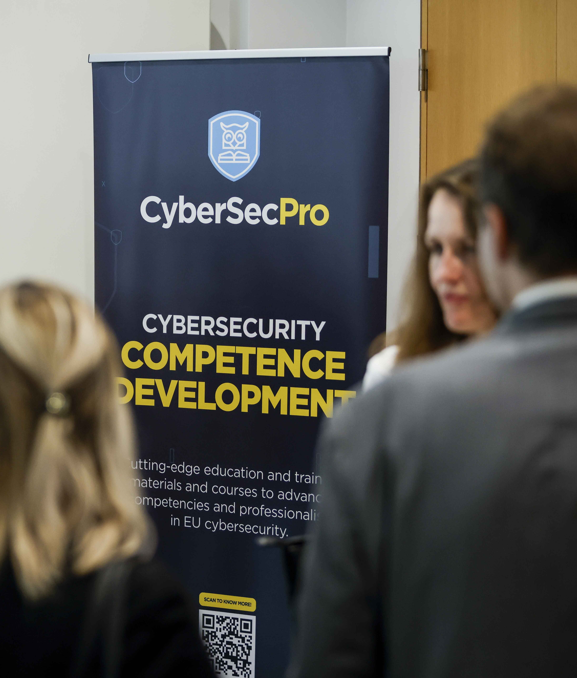
Value Propositions
Benefits to Participants
Analysis of network security at various layers.
Integration of the emerging field of Internet of Medical Things (IoMT).
Comprehensive knowledge on securing data transmission.
Understanding potential vulnerabilities in network layers.
Implementation of robust security policies with detailed analyses of real-world medical case studies focused on IoMT communication protocols.

Slide 4
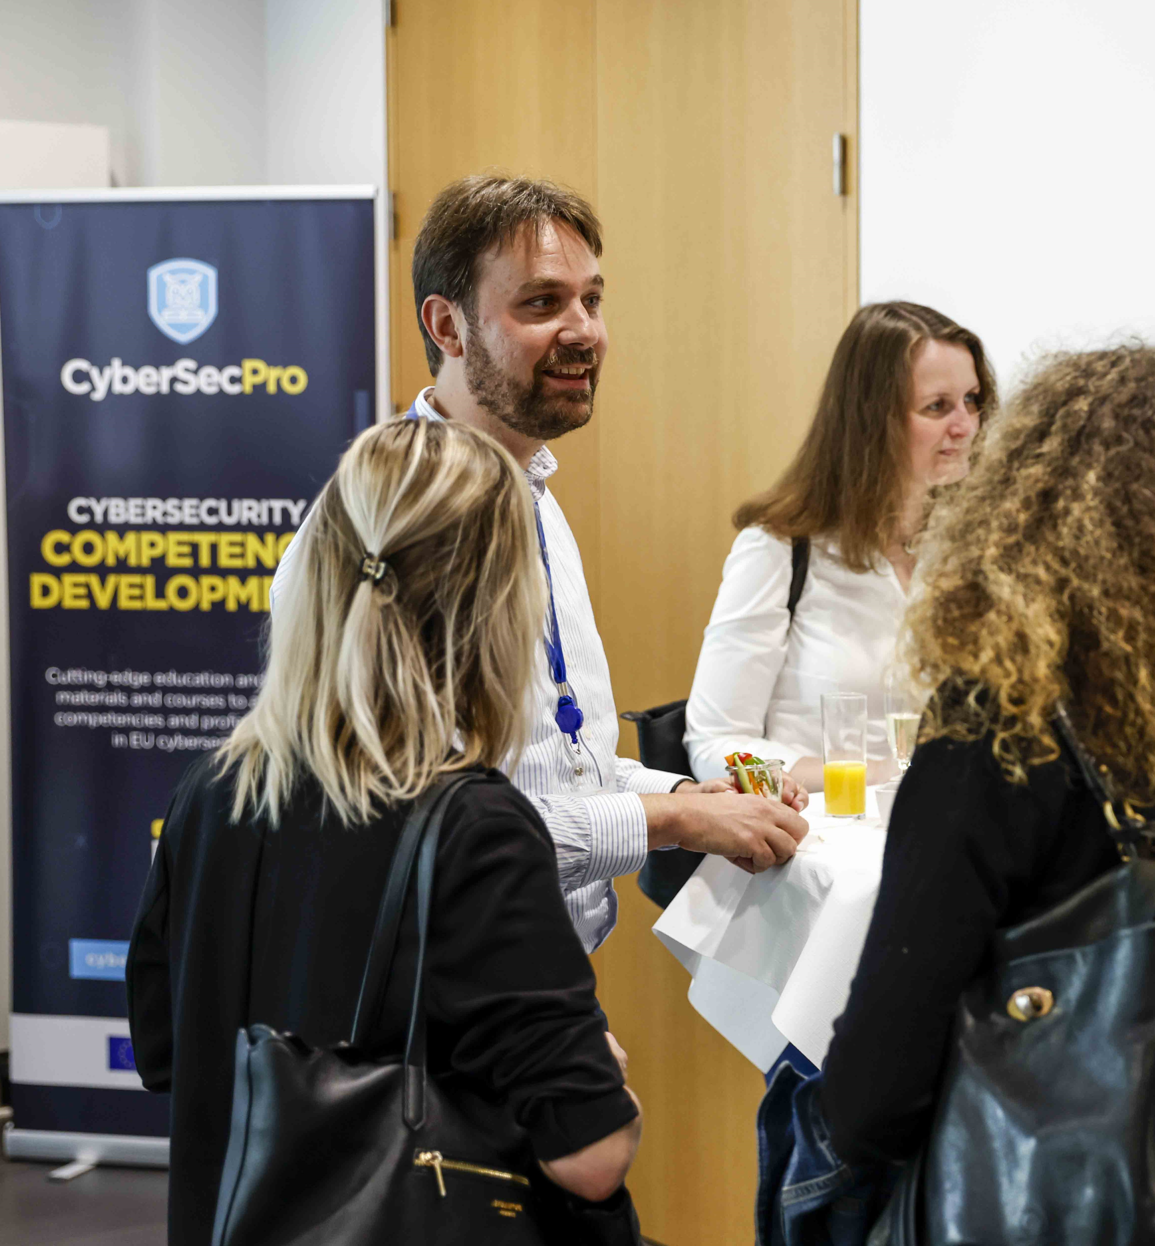
WHO
Profile of Training Participants
Managers and Leaders
Working-life professionals
SMEs and Public Sector Employees
Cybersecurity practitioners and enthusiasts

Slide 5

WHO
Profile of Trainer
Dimitris Koutras is a PhD candidate in network security, at the University of Piraeus, Department of Informatics. He obtained a bachelor’s degree in Information technology and computer technology engineering from the Technological educational institute of Central Greece (Lamia-2016). Then he also obtained a Master of Science (M.Sc.) in security management engineering from the University of Piraeus (Piraeus-2019). He currently participates in European research programs as a researcher of University of Piraeus Research center. He also participates as a trainer in various cybersecurity seminars, concerning maritime, healthcare and supply chain. He holds an ISO 27001:2013 lead auditor, certification in information security. His research work concerns network security analysis, risk assessment and operating systems security. Dimitris has collaborated with UPRC on several major projects, including CyberSec for Europe, CyberSecPro, MELITY and ARTEMIS, funded by the European Union and the Greek government.

Slide 6


Background Knowledge and Prerequisites
Background knowledge:
Basic understanding of computers and networking
Familiarity with common internet security threats and vulnerabilities
Awareness of cybersecurity
Prerequisites:
None

Slide 7

Cyber Threat Intelligence
In IoT systems
Koutras Dimitris
dkoutras@unipi.gr

Slide 8
Role of CTI
Threat Identification:
Monitoring Sources: CTI teams identify potential threats by monitoring various sources such as open-source intelligence, dark web forums, and threat feeds.
Example: Detecting a new ransomware variant being discussed in hacker forums before it becomes widespread.
Analyzing Patterns: They analyze patterns and behaviors of threat actors to anticipate future attacks.
Example: Recognizing repeated login attempts from suspicious IP addresses indicating a brute force attack.
Early Detection: Continuous surveillance and reporting help in early detection and mitigation of threats.
Example: Identifying and mitigating a phishing campaign targeting employees by detecting similar phishing emails.

Slide 9

Role of CTI
Risk Assessment:
Impact Assessment: CTI assesses the potential impact of identified threats on critical infrastructures(CI).
Example: Evaluating the potential damage of a discovered zero-day vulnerability in widely-used municipal software.
Threat Prioritization: They prioritize threats based on their severity and likelihood of occurrence.
Example: Ranking threats from a new malware strain higher than older, less prevalent threats due to its rapid spread.
Resource Allocation: This information helps CI allocate resources effectively to mitigate high-risk threats.
Example: Advising a city government to focus on updating firewall rules after identifying a surge in attempted intrusions.

Slide 10
Role of CTI
Actionable Insights:
Providing IOCs: CTI provides actionable intelligence, including indicators of compromise (IOCs) and recommended mitigation strategies.
Example: Sharing IOCs related to a recent data breach to help companies identify if they have been targeted.
Tailored Insights: They tailor their insights to the specific needs and contexts of CI entities.
Example: Offering specific recommendations to a school district to secure its online learning platforms against cyber threats.
Regular Updates: Regular updates and briefings ensure that CI are prepared for emerging threats.
Example: Weekly threat briefings that include recent attack patterns and new vulnerability disclosures.

Slide 11

Mission
24x7x365 Security Operations Center (SOC):
Continuous Monitoring: The SOC offers continuous monitoring and incident detection services.
Example: Detecting and responding to a distributed denial-of-service (DDoS) attack on a city's public website.
Incident Response: Analysts in the SOC respond to alerts and investigate suspicious activities.
Example: Investigating unusual login attempts and preventing unauthorized access to government databases.
Coordination: They coordinate with other teams to provide a rapid response to incidents.
Example: Working with the CIRT to contain and remediate a ransomware outbreak in a local government office.

Slide 12
Mission
Cyber Incident Response Team (CIRT):
Incident Management: The CIRT is responsible for managing and mitigating cybersecurity incidents.
Example: Handling a breach where sensitive citizen data was accessed and working to secure the affected systems.
Support During Incidents: They provide on-site and remote support to CI during an incident.
Example: Assisting a county in recovering from a cyberattack by guiding them through the restoration of services.
Post-Incident Analysis: Post-incident, they conduct thorough analyses to improve future responses.
Example: Analyzing the root cause of a successful phishing attack and implementing stronger email security measures.

Slide 13
Mission
Comprehensive Support:
Training and Resources: Certificate organizations and European programs provide training and resources to enhance the cybersecurity capabilities of CI.
Example: Conducting workshops on best practices for securing IoT devices used in public infrastructure.
Access to Tools: They offer access to tools and technologies that improve threat detection and response.
Example: Providing CI with threat detection software that integrates with their existing security systems.
Collaborative Initiatives: Collaborative initiatives and information sharing strengthen the overall security posture of CI.
Example: Participating in regional cybersecurity information sharing groups to discuss emerging threats and solutions.

Slide 14
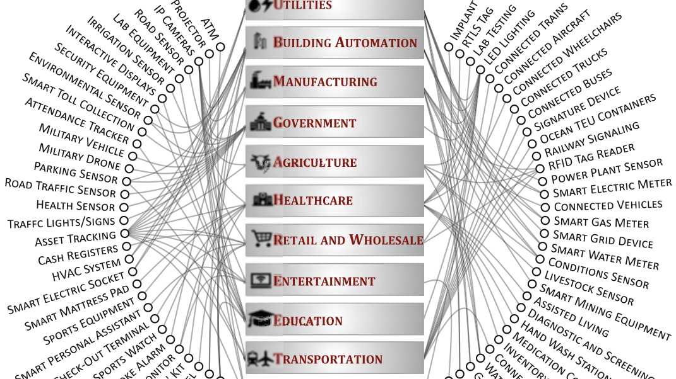

Slide 15
Function of CTI
Collection:
Multiple Sources: CTI teams gather data from multiple sources, including internal networks, external threat feeds, and global cybersecurity communities.
Example: Aggregating data from international cyber threat reports to understand new malware trends.
Advanced Tools: They utilize advanced tools and technologies to collect relevant data efficiently.
Example: Using automated scripts to scrape dark web forums for chatter about potential exploits.
Collaboration: Collaboration with other intelligence agencies and organizations enhances data collection efforts.
Example: Partnering with federal agencies to gain access to broader threat intelligence resources.

Slide 16
Function of CTI
Analysis:
Pattern Identification: Collected data is analyzed to identify patterns, trends, and potential threats.
Example: Identifying a spike in phishing emails targeting specific government sectors.
Machine Learning: CTI analysts use machine learning and artificial intelligence to enhance analysis.
Example: Employing machine learning algorithms to detect anomalies in network traffic that could indicate an intrusion.
Reports and Assessments: Detailed reports and threat assessments are generated to inform decision-makers.
Example: Providing a monthly threat landscape report that highlights emerging threats and recommended actions.

Slide 17
Function of CTI
Dissemination:
Timely Sharing: Analyzed intelligence is shared with relevant stakeholders in a timely manner.
Example: Sending out immediate alerts to SLTTs about a newly discovered critical vulnerability in commonly used software.
Secure Channels: CTI teams use secure communication channels to disseminate sensitive information.
Example: Using encrypted emails and secure portals to share detailed threat reports with authorized personnel.
Regular Updates: Regular updates and alerts keep stakeholders informed about the evolving threat landscape.
Example: Providing daily or weekly updates on new threats, vulnerabilities, and mitigation strategies.

Slide 18
Collaborative Initiative
Information Sharing
Collaborate with Organizations
Participation in Forums
Identifying Widespread Threats

Slide 19
Collaborative Initiative
Joint Exercises:
Coordination Exercises: Collaborative exercises and simulations improve coordination and response strategies.
Example: Conducting joint cyber defense exercises with companies to practice response to a simulated cyberattack.
Identifying Gaps: These exercises help in identifying gaps and improving the overall effectiveness of cybersecurity measures.
Example: Discovering and addressing weaknesses in incident response plans during a tabletop exercise.
Culture of Improvement: They foster a culture of collaboration and continuous improvement.
Example: Regularly reviewing and updating incident response protocols based on lessons learned from exercises.

Slide 20
Collaborative Initiative
Community Engagement:
Stay Updated: CTI teams engage with the broader cybersecurity community to stay updated on the latest trends and developments.
Example: Following cybersecurity blogs, attending conferences, and participating in professional networks.
Knowledge Sharing: They participate in conferences, workshops, and seminars to share knowledge and learn from others.
Example: Presenting case studies and findings at cybersecurity symposiums.
Building Relationships: Building strong relationships with other entities enhances the effectiveness of threat intelligence efforts.
Example: Establishing partnerships with local universities for research collaborations and student internships.

Slide 21
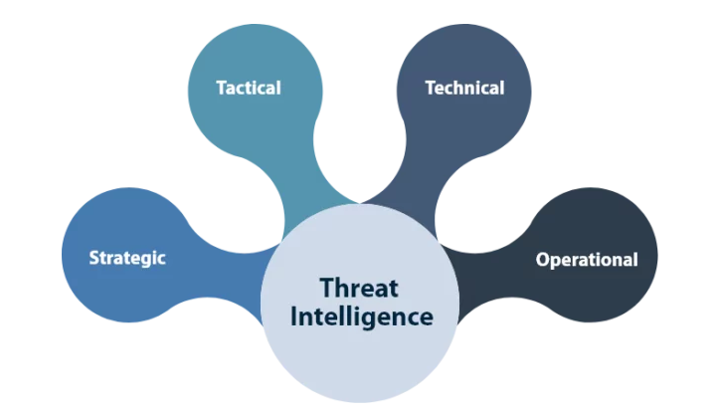
Intelligence Cycle

Slide 22
Intelligence Cycle
Strategic Threat Intelligence
  Provides a high-level overview of the organization's threat landscape
  Offers insights into threat actors, their goals, and the potential severity of attacks, helping shape long-term security policies and resource allocation.
  Includes preventive measures to mitigate identified risks, aligning security initiatives with business objectives.

Slide 23
Intelligence Cycle
Tactical Threat Intelligence
  Helps understand attack vectors and build defense strategies to counteract identified threats.
  Identifies vulnerabilities in security systems that attackers could exploit and how to recognize these threats.
  Findings are used to enhance existing security controls and eliminate network vulnerabilities.

Slide 24
Intelligence Cycle
Technical Threat Intelligence
  Provides the basis for analyzing and responding to specific threats with precise technical details.
  Ensures that security teams can act swiftly to neutralize threats before they evolve.

Slide 25
Intelligence Cycle
Operational Threat Intelligence
  Delivers detailed insights into the nature, motive, timing, and execution of attacks.
  Information is often gathered through infiltration of hacker chat rooms and online discussions, making it challenging to obtain.

Slide 26
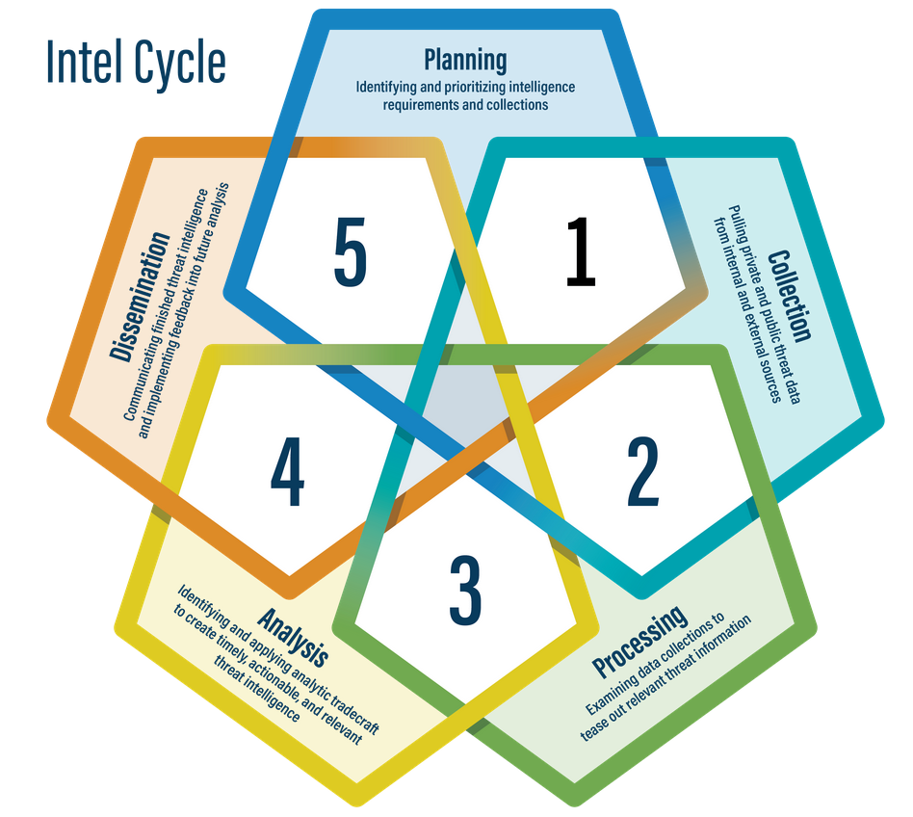

Slide 27
Intel Cycle scenario
Defining Requirements-Setting specific goals for monitoring unauthorized access to IoT medical devices and ensuring the integrity of patient health records stored on connected devices.
Plan Development-Creating a schedule for regular vulnerability assessments of IoT medical devices and implementing continuous network monitoring for unusual activity.
Review and Adjustment-Updating the plan to include new threat vectors identified from recent intelligence reports, such as ransomware targeting hospital IoT devices.
Source Identification-Deploying IoT security solutions that collect logs from medical devices and monitor network traffic for signs of malicious activity.

Slide 28
Intel Cycle scenario
Strategy Implementation-Using an IoT security platform to continuously collect and analyze data from connected medical devices, looking for anomalies that indicate potential security issues.
Organizing Data-Utilizing machine learning algorithms to process and categorize network traffic data, identifying patterns that deviate from normal device behavior.
Validation-Validating detected anomalies by comparing them with known threat signatures and consulting threat intelligence databases for correlation.
Threat Analysis-Detecting a pattern of abnormal communication from several insulin pumps, indicating a potential coordinated attack on these devices.
Reporting-Generating a report that highlights vulnerabilities in the hospital’s insulin pump network and recommending specific mitigation strategies, such as firmware updates and enhanced access controls.
Sharing Intelligence-Sending out alerts and updates to hospital IT staff, medical device manufacturers, and healthcare administrators about detected threats and recommended actions, including immediate device isolation and security patch deployment.

Slide 29
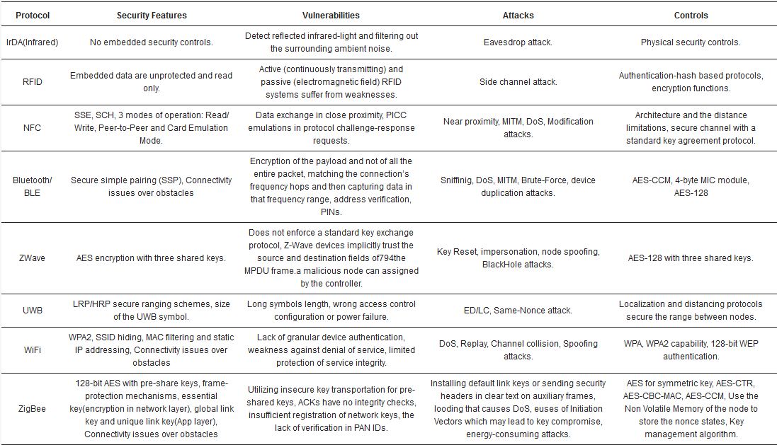

Slide 30
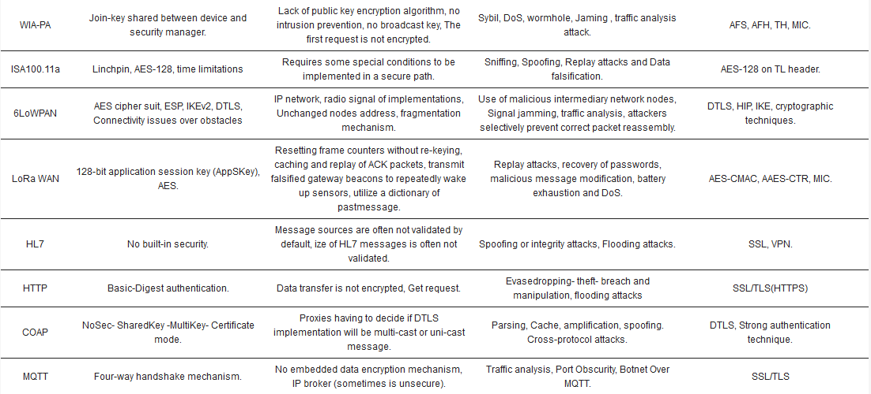

Slide 31
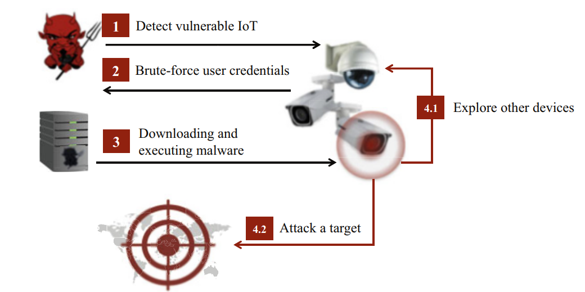
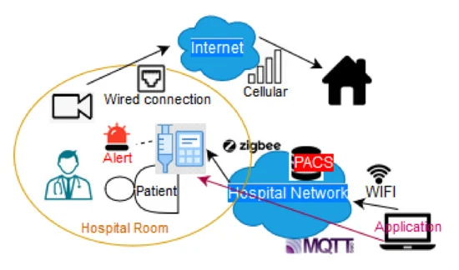
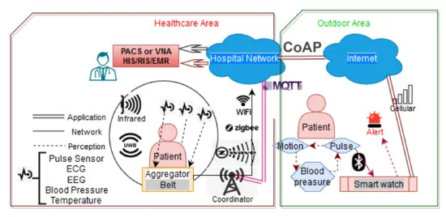
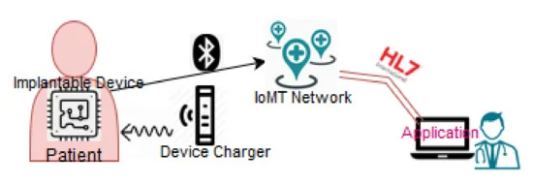
Real case Scenarios

Slide 32

Example - Shodan /Camera/nginx
Shodan Search: The attacker uses Shodan, a search engine for internet-connected devices, to search for IP cameras exposed to the internet.
Search Query: They use a specific query like "camera" and filter results to find devices running the Nginx web server.
Result: The attacker identifies an IP camera used in a healthcare facility's security system that is accessible via Nginx.
Examining Headers: Using tools like curl or browser developer tools, the attacker inspects the HTTP headers of the IP camera's web interface.
Revealing Server Info: The headers reveal that the camera is running on a Nginx server with a default or outdated configuration, potentially exposing version information.
Known Vulnerabilities: They cross-reference the Nginx version with known vulnerabilities using databases like CVE Details or Exploit-DB.
Accessing the Admin Interface: The attacker navigates to the administrative interface of the IP camera, which is exposed due to the Nginx misconfiguration.

Slide 33

Example - Shodan /Camera/nginx
Brute Forcing Credentials: Using a tool like Hydra, they perform a brute force attack to guess the administrative credentials, leveraging common default passwords.
Gaining Access-Modifying Settings
Backdoor Installation- Nginx Log Manipulation:
Streaming Video: The attacker configures the camera to stream video feeds to an external server, monitoring sensitive areas within the healthcare facility.
Sensitive Data Access: If the camera is connected to other networked devices, they use this foothold to explore and access additional sensitive data.
Mitigation and Response
Post-Incident Analysis
Strategic Improvements

