Slide 1



Cyber Threat Intelligence in the Energy Network
CSP006
Presentation by:

Slide 2


Slide 3


Cyber Threat Intelligence in the Energy Network – Course Overview
o1.
Foundations of Cyber Threat Intelligence (CTI) – Taxonomy, Lifecycle, Security Controls and Standards
o2.
Threat Modelling and Analysis in the Energy Network
o3.
Energy Data Sources and Collection
o4.
Energy Data Analysis and Data Processing
o5.
Threat Actors and Tactics in the Energy Network
o6.
Vulnerabilities Assessment Techniques
o7.
Cyber Threat Intelligence Information Sharing, Dissemination, Communication, and Implementation
o8.
Anomaly Detection in the Energy Network
o9.
Practical Threat Modelling and Security Investigation

Slide 4

Training Outline:
Day-1
Topic-01: Foundations of Cyber Threat Intelligence (CTI) – Taxonomy, Lifecycle, Security Controls and Standards
Introduction to Cyber Threat Intelligence
Taxonomy of Cyber Threat Intelligence
Lifecycle of Cyber Threat Intelligence
Security Controls and Standards

Slide 5
Training Outline:
Day-1
Topic-01: Foundations of Cyber Threat Intelligence (CTI) – Taxonomy, Lifecycle, Security Controls and Standards
Introduction to Cyber Threat Intelligence
Taxonomy of Cyber Threat Intelligence
Lifecycle of Cyber Threat Intelligence
Security Controls and Standards

Slide 6
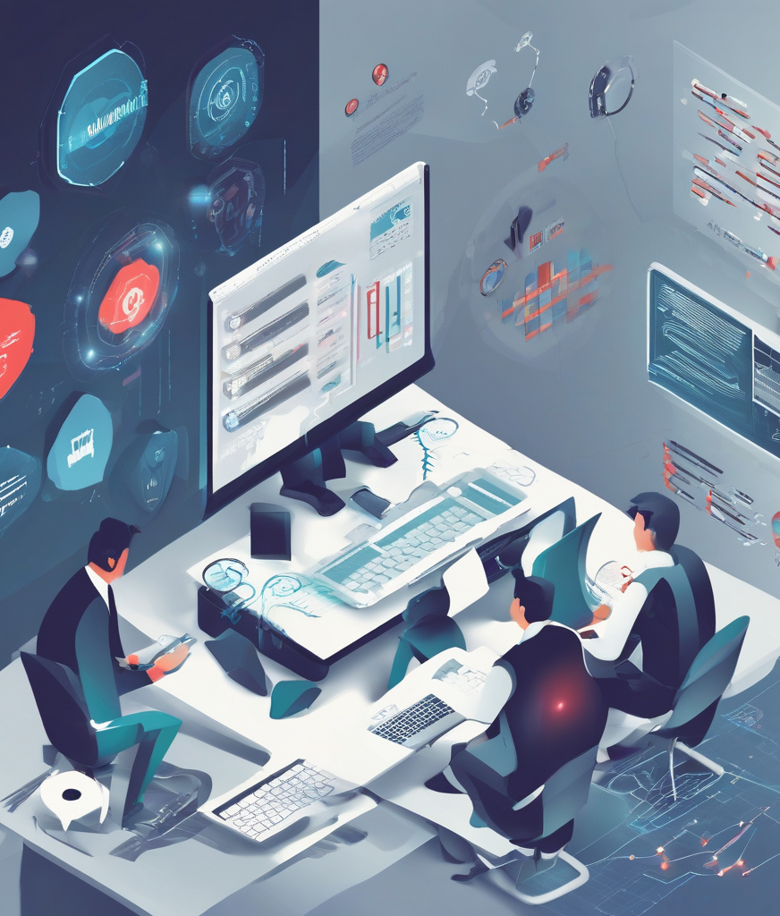
01_1: Introduction to Cyber Threat Intelligence
Definition and Importance in the Energy Network
“The primary objective of CTI is to realize a knowledge advantage over cyber threat actors. […] CTI expedites early detection of malicious behavior, preferably before a malicious actor gains a foothold in the network. […] CTI provides sense-making and insight into the relevant threat environment to decisionmakers”*.
CTI proactively identifies and mitigates cybersecurity risks, improving the resilience of critical infrastructure and safeguarding against malicious attacks.
* Oosthoek, K., & Doerr, C. (2021). Cyber Threat Intelligence: A Product Without a Process? International Journal of Intelligence and CounterIntelligence, 34(2), 300–315.

Slide 7
01_1: Introduction to Cyber Threat Intelligence
Definition and Importance in the Energy Network
CTI aims to ensure the security and stability of the Energy Network by providing actionable insights into emerging cyber threats.
At the level of Critical Infrastructures:
  The Energy Network comprises critical infrastructure essential for powering industries, homes, and essential services.
    CTI aims to protect this infrastructure from cyber threats that could disrupt operations, cause outages, or compromise safety.
Concerning Reliability and Resilience of the network:
  Reliability and resilience are paramount in the Energy Network to maintain uninterrupted supply and prevent cascading failures.
  CTI aims to assist in identifying vulnerabilities and threats that could undermine reliability, enabling proactive measures to enhance resilience.

Slide 8
01_1: Introduction to Cyber Threat Intelligence
Definition and Importance in the Energy Network
Role of CTI in safeguarding Sensitive Data and Assets:
  Energy companies store vast amounts of sensitive data and assets, including customer information, operational data, and intellectual property.
  CTI helps safeguard these assets by detecting and mitigating cyber threats such as data breaches, espionage, or sabotage attempts.
Supporting compliance with Regulatory Requirements:
  EU, March 2024: first-ever network code on sector-specific rules for cybersecurity aspects of cross-border electricity flows (C/2024/1383).
  CTI aims to assist organisations in meeting these compliance requirements by providing insights into emerging threats and best practices for cybersecurity.
Notes:
https://energy.ec.europa.eu/news/new-network-code-cybersecurity-eu-electricity-sector-2024-03-11_en

Slide 9
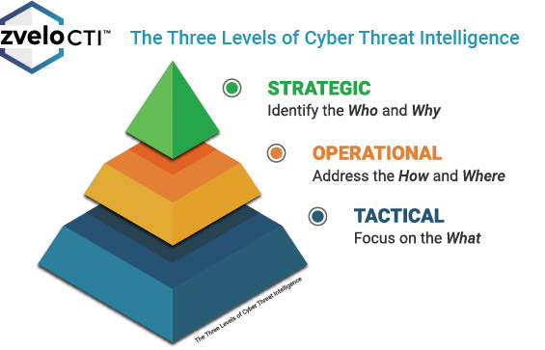
01_2: Taxonomy of Cyber Threat Intelligence
Introduction to the taxonomy of Cyber Threat Intelligence
CTI is categorised into different levels to align with different organizational objectives and timeframes:
  Strategic,
  Operational, and
  Tactical
Source: https://zvelo.com/strategic-operational-tactical-cyber-threat-intelligence/
Notes:
https://energy.ec.europa.eu/news/new-network-code-cybersecurity-eu-electricity-sector-2024-03-11_en

Slide 10
Training Outline:
Day-1
Topic-01: Foundations of Cyber Threat Intelligence (CTI) – Taxonomy, Lifecycle, Security Controls and Standards
Introduction to Cyber Threat Intelligence
Taxonomy of Cyber Threat Intelligence
Lifecycle of Cyber Threat Intelligence
Security Controls and Standards

Slide 11


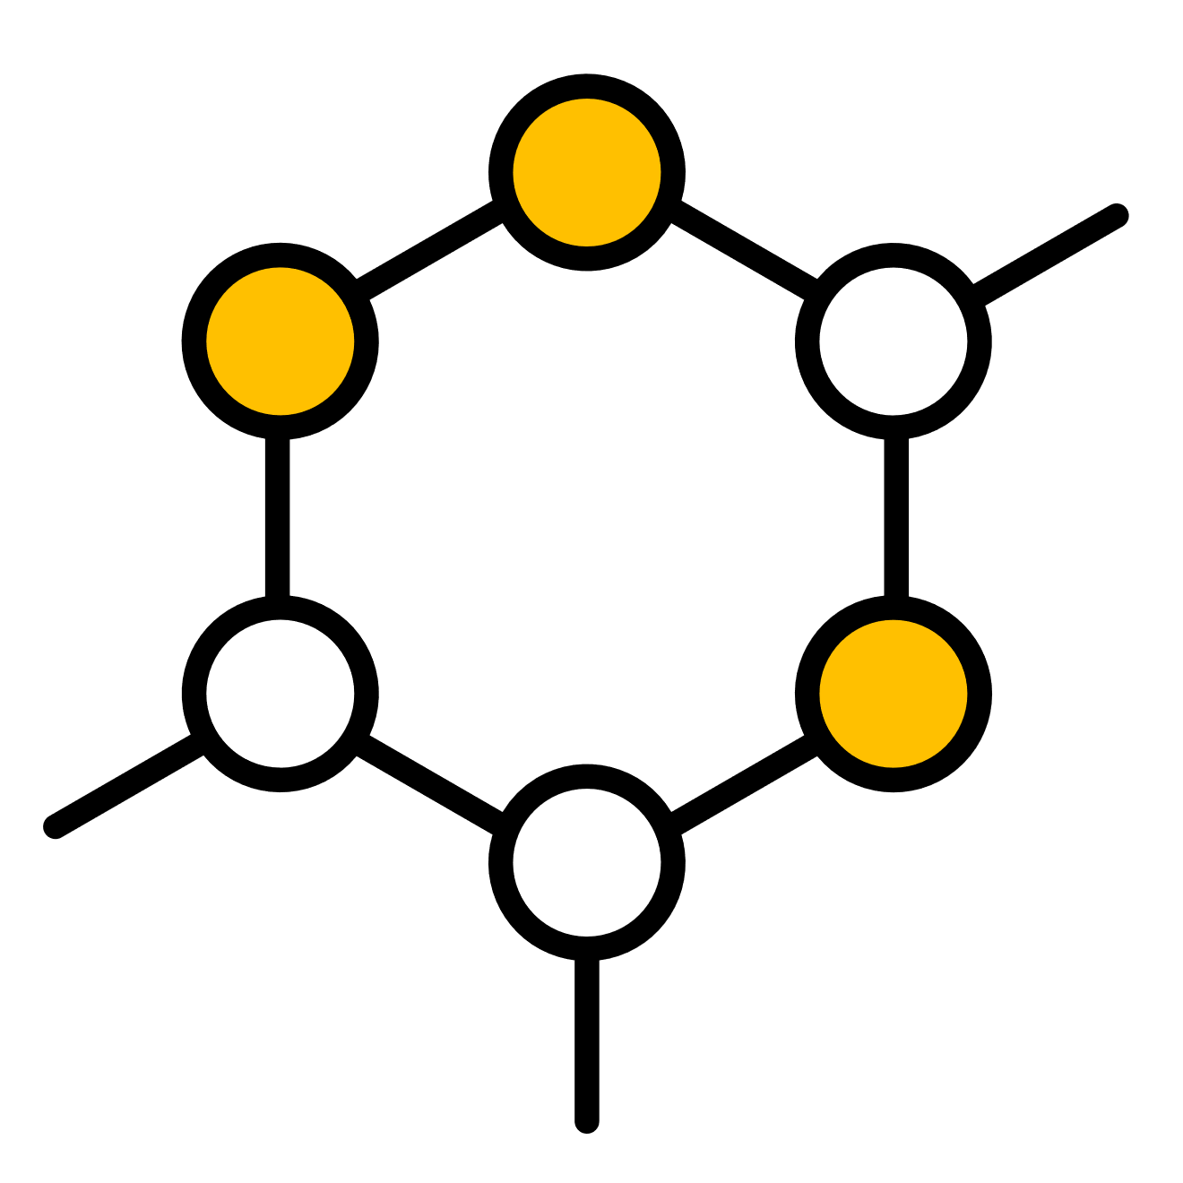
01_2: Taxonomy of Cyber Threat Intelligence
Strategic
Operational
Tactical
Aims to support executives in making informed decisions (high-level overview)
Who and Why
Aims to comprehend the threat actors and their methods of operation
How and Where
Aims to translate knowledge about threats into tangible detection capabilities
What

Slide 12
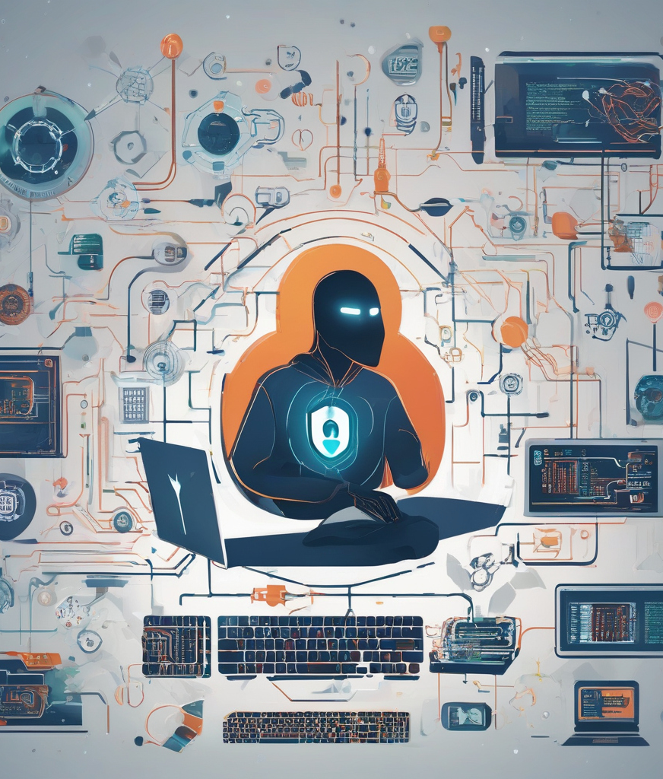
01_2: Taxonomy of Cyber Threat Intelligence
Introduction to the taxonomy of Cyber Threat Intelligence
Strategic CTI focuses on long-term trends, emerging threats, and geopolitical factors that could impact the organization's overall security posture.
It identifies the who and why:
  Who is behind a specific threat or family of threats.
  Why is an organization being targeted.
Examples of strategic CTI:
  Analysis of nation-state cyber capabilities.
  Assessment of industry-specific threats and trends.
  Predictive analysis of future cyber threats and risks.
  Strategic CTI reveals that the nation-state actor has a history of targeting critical infrastructure sectors, including energy, as part of its geopolitical agenda to exert influence and disrupt rival nations' economies.
Notes:
https://energy.ec.europa.eu/news/new-network-code-cybersecurity-eu-electricity-sector-2024-03-11_en

Slide 13
01_2: Taxonomy of Cyber Threat Intelligence
Introduction to the taxonomy of Cyber Threat Intelligence
Operational CTI provides actionable insights into specific threats, campaigns, or adversaries targeting the organization's networks, systems, and assets.
It identifies the how and where:
  How includes the Tactics, Techniques, and Procedures (TTP).
  Where assists organisations conducting threat hunts in advance or after an incident.
  Examples of operational CTI:
    Analysis of phishing campaigns targeting employees.
    Threat actor profiles and TTPs relevant to the organization's industry sector.
    Monitoring network traffic and conducting behavioral analysis to detect anomalous activities indicative of a cyber intrusion or compromise.
    A utility company operating a large-scale power grid infrastructure detects unusual network traffic patterns and suspicious activities within its network. Operational CTI reveals that the threat actors are employing sophisticated tactics, such as lateral movement and reconnaissance, to gain unauthorized access to critical systems within the energy network.
Notes:
https://energy.ec.europa.eu/news/new-network-code-cybersecurity-eu-electricity-sector-2024-03-11_en

Slide 14
01_2: Taxonomy of Cyber Threat Intelligence
Introduction to the taxonomy of Cyber Threat Intelligence
Tactical CTI offers immediate and actionable intelligence to support day-to-day security operations, including incident response and threat hunting.
It is related to the what, such as domain names, IP addresses, and file names.
Examples of Tactical CTI:
  Real-time alerts on active cyber threats detected within the organization's network.
  Forensic analysis of security incidents to identify root causes and containment measures.
  Threat intelligence feeds providing up-to-date information on cyber threats relevant to the organization's assets and infrastructure.
  The security operations team receives alerts indicating suspicious access attempts to external domains from endpoints within the energy network. Tactical CTI reveals that the threat actors are using sophisticated phishing techniques to lure employees into accessing malicious websites hosting exploit kits or malware payloads.
Notes:
https://energy.ec.europa.eu/news/new-network-code-cybersecurity-eu-electricity-sector-2024-03-11_en

Slide 15
01_2: Taxonomy of Cyber Threat Intelligence
Introduction to the taxonomy of Cyber Threat Intelligence
Time Horizon:
  Strategic: long-term.
  Operational: mid-term.
  Tactical: short-term.
Scope:
  Strategic: organizational-wide.
  Operational: specific threats or adversaries.
  Tactical: immediate security operations.
Use Cases:
  Strategic: decision-making and planning.
  Operational: incident response and threat detection.
  Tactical: real-time defense and mitigation.
Notes:
https://energy.ec.europa.eu/news/new-network-code-cybersecurity-eu-electricity-sector-2024-03-11_en

Slide 16
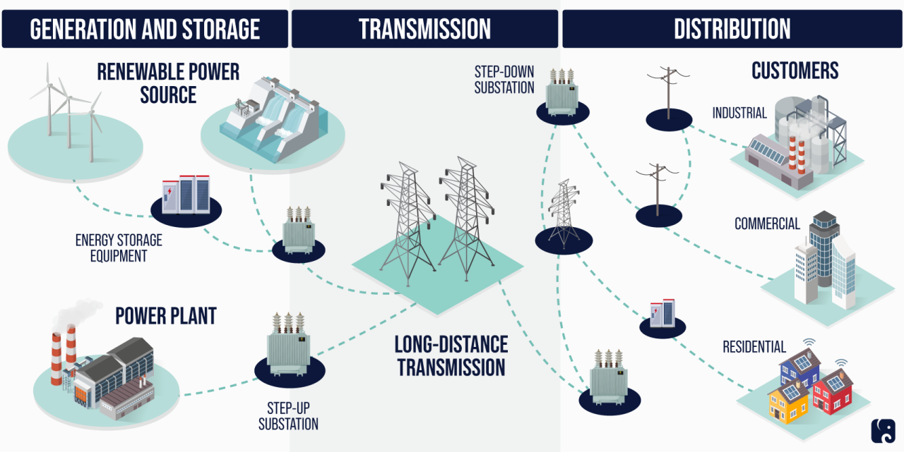
01_2: Taxonomy of Cyber Threat Intelligence
Introduction to the taxonomy of Cyber Threat Intelligence
Within the context of the Energy Network:
  Strategic CTI: analysis of geopolitical factors impacting energy security.
  Operational CTI: monitoring for cyber threats targeting energy infrastructure and supply chains.
  Tactical CTI: real-time alerts and incident response for cyber incidents affecting energy operations.
Source: https://www.rpc.senate.gov/policy-papers/ infrastructure-cybersecurity-the-us-electric-grid
Notes:
https://energy.ec.europa.eu/news/new-network-code-cybersecurity-eu-electricity-sector-2024-03-11_en

Slide 17
Training Outline:
Day-1
Topic-01: Foundations of Cyber Threat Intelligence (CTI) – Taxonomy, Lifecycle, Security Controls and Standards
Introduction to Cyber Threat Intelligence
Taxonomy of Cyber Threat Intelligence
Lifecycle of Cyber Threat Intelligence
Security Controls and Standards

Slide 18
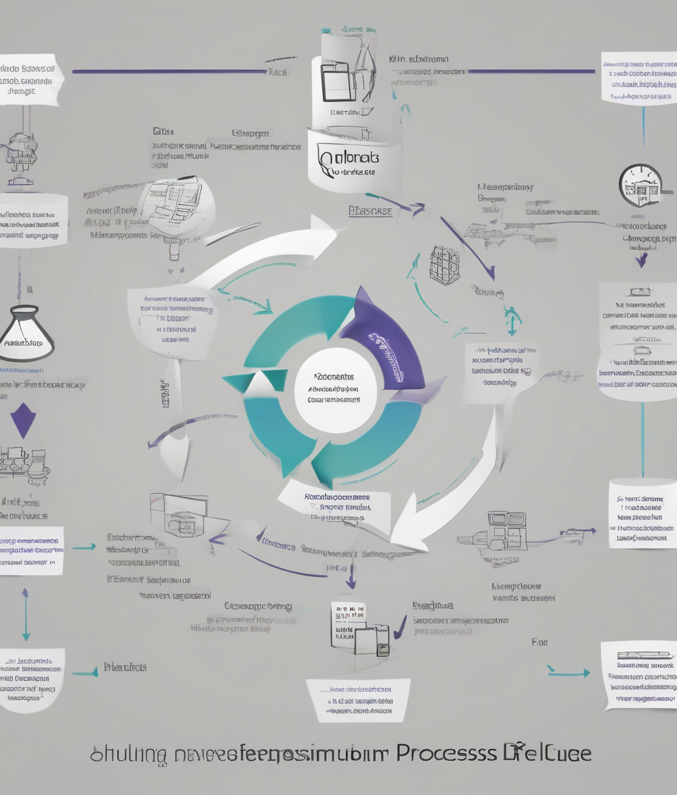
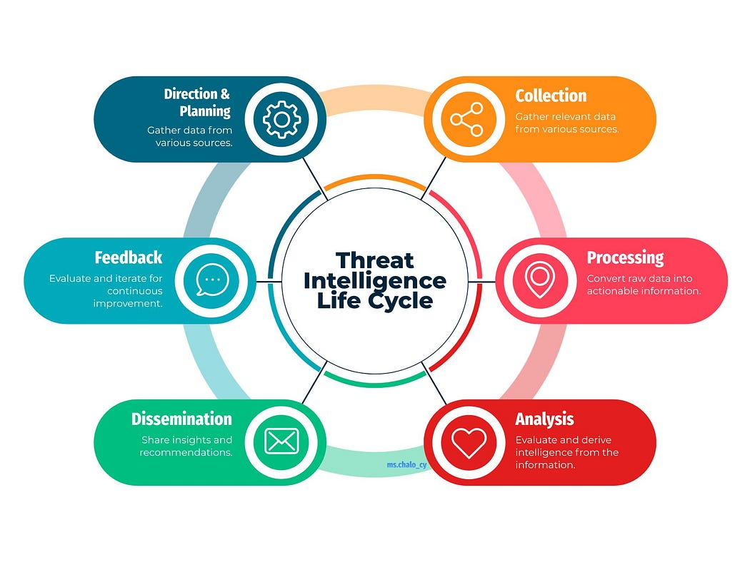
01_3: Lifecycle of Cyber Threat Intelligence
Phases of the CTI Lifecycle
Source: https://mschalocy.medium.com/ threat-intelligence-life-cycle-2012a5645806

Slide 19
01_3: Lifecycle of Cyber Threat Intelligence
Phases of the CTI Lifecycle
Direction and Planning: setting goals, defining intelligence requirements
  Setting CTI goals and objectives.
  Defining intelligence requirements.
  Establishing governance structures and resource allocation.
  Gathering data from various sources.

Slide 20
01_3: Lifecycle of Cyber Threat Intelligence
Phases of the CTI Lifecycle
Collection: gathering raw data and intelligence
  Gathering relevant raw data and intelligence from various internal and external sources.
  Sources include open-source intelligence (OSINT), human intelligence (HUMINT), and technical intelligence (TECHINT).

Slide 21
01_3: Lifecycle of Cyber Threat Intelligence
Phases of the CTI Lifecycle
Processing and Exploitation: converting raw data into actionable intelligence
  Converting raw data into actionable intelligence.
  Normalising and enriching data.
  Identifying relevant patterns and trends.

Slide 22
01_3: Lifecycle of Cyber Threat Intelligence
Phases of the CTI Lifecycle
Analysis and Production: analysing intelligence, producing finished products
  Analysing intelligence to identify threats and vulnerabilities.
  Producing finished intelligence products tailored to stakeholders' needs.
  Examples include threat assessments, situational reports, and intelligence briefings.

Slide 23
01_3: Lifecycle of Cyber Threat Intelligence
Phases of the CTI Lifecycle
Dissemination and Integration: distributing intelligence, integrating into decision-making
  Distributing intelligence products to relevant stakeholders.
  Integrating intelligence into decision-making processes.
  Fostering collaboration and information sharing among stakeholders.

Slide 24
01_3: Lifecycle of Cyber Threat Intelligence
Phases of the CTI Lifecycle
Evaluation and Feedback: assessing effectiveness, gathering feedback
  Assessing the effectiveness of CTI activities and processes.
  Gathering feedback from stakeholders.
  Refining intelligence requirements and methodologies based on lessons learned.
  Evaluate and iterate for continuous improvement.

Slide 25
01_3: Lifecycle of Cyber Threat Intelligence
Phases of the CTI Lifecycle
Case study: Detection and Mitigation of a Cyber Attack on Energy Infrastructure
  Scenario: a large energy company operates a regional network of power plants, substations, and distribution systems critical for providing electrical energy for a large number of customers. The company's Security Operations Center (SOC)* receives alerts indicating suspicious activity within its network, raising concerns about a potential cyber attack targeting the energy infrastructure.
  Direction and Planning: the company's cybersecurity team sets goals to protect the energy infrastructure from cyber threats, defining intelligence requirements to enhance threat detection and response capabilities.
  Collection: the SOC gathers raw data and intelligence from various internal sources, including network logs, endpoint telemetry, and security appliances, to identify potential indicators of compromise (IOCs) associated with the suspicious activity.
  Processing and Exploitation: analysts process and analyse the collected data, leveraging threat intelligence feeds and advanced analytics tools to identify patterns and anomalies indicative of a cyber attack on the energy network.
  *Centralised unit within an organization responsible for monitoring, detecting, analysing, and responding to cybersecurity incidents.

Slide 26
01_3: Lifecycle of Cyber Threat Intelligence
Phases of the CTI Lifecycle
Case study: Detection and Mitigation of a Cyber Attack on Energy Infrastructure
  Scenario: a large energy company operates a regional network of power plants, substations, and distribution systems critical for providing electrical energy for a large number of customers. The company's Security Operations Center (SOC) receives alerts indicating suspicious activity within its network, raising concerns about a potential cyber attack targeting the energy infrastructure.
  Analysis and Production: the SOC conducts in-depth analysis of the identified IOCs, correlating them with known threat actor TTPs and industry-specific vulnerabilities. Finished intelligence products, such as threat assessments and incident reports, are produced to provide actionable insights to stakeholders.
  Dissemination and Integration: intelligence findings are disseminated to relevant stakeholders, including network engineers, system administrators, and executive leadership, to facilitate informed decision-making and response coordination. Intelligence is integrated into security tools and processes, such as firewall rules, intrusion detection systems, and incident response playbooks, to enhance the organization's defensive posture.
  Evaluation and Feedback: after the cyber attack incident is mitigated, the SOC conducts a post-incident review to evaluate the effectiveness of CTI processes and response actions. Feedback from stakeholders is gathered to identify areas for improvement and refine intelligence requirements for future threat detection and response efforts.

Slide 27
01_3: Lifecycle of Cyber Threat Intelligence
Phases of the CTI Lifecycle
Case study: Detection and Mitigation of a Cyber Attack on Energy Infrastructure
  Scenario: a large energy company operates a regional network of power plants, substations, and distribution systems critical for providing electrical energy for a large number of customers. The company's Security Operations Center (SOC) receives alerts indicating suspicious activity within its network, raising concerns about a potential cyber attack targeting the energy infrastructure.
  By leveraging the CTI lifecycle, the energy company successfully detects and mitigates the cyber attack on its infrastructure, preventing disruption to electricity supply and safeguarding critical assets.
  Continuous improvement efforts based on post-incident analysis and stakeholder feedback strengthen the organization's resilience against future cyber threats, ensuring the reliability and security of the energy network.

Slide 28
Training Outline:
Day-1
Topic-01: Foundations of Cyber Threat Intelligence (CTI) – Taxonomy, Lifecycle, Security Controls and Standards
Introduction to Cyber Threat Intelligence
Taxonomy of Cyber Threat Intelligence
Lifecycle of Cyber Threat Intelligence
Security Controls and Standards

Slide 29
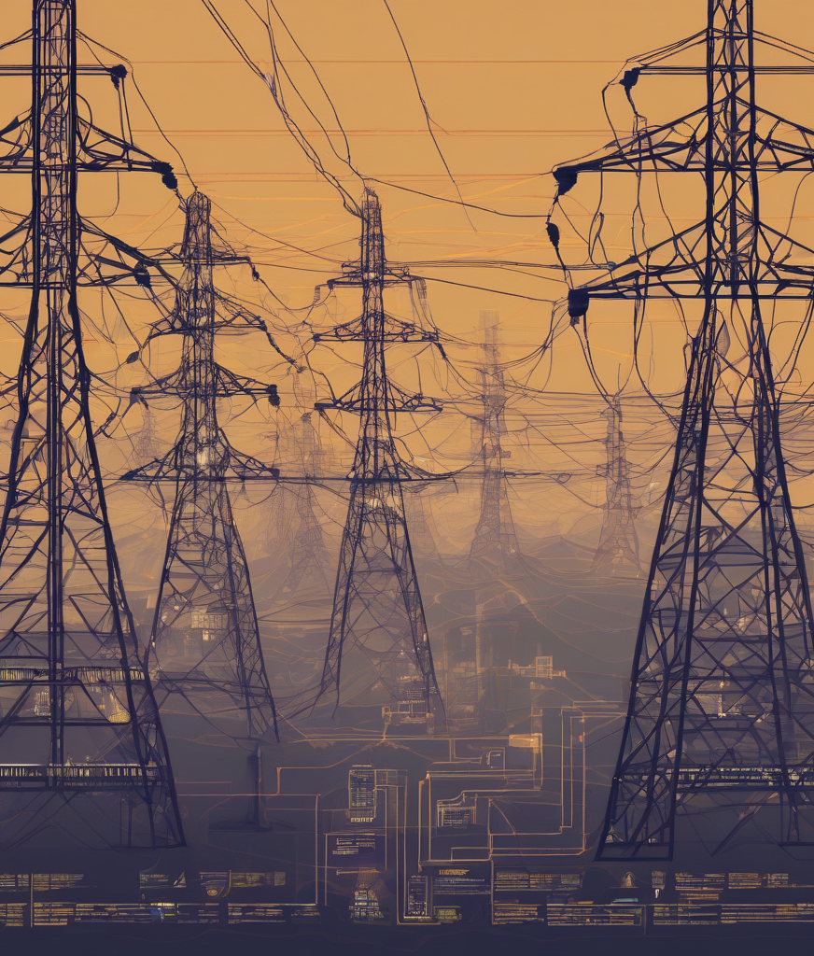
01_4: Security Controls and Standards
Ensuring Cybersecurity Compliance and Resilience
Security controls and standards:
  Security controls: measures implemented to safeguard information systems and protect against cybersecurity threats.
  Ensure cybersecurity by providing a structured framework for implementing and maintaining effective measures to safeguard against cyber threats and vulnerabilities.
  Provide a comprehensive framework that outlines best practices, guidelines, and requirements for organisations to establish robust cybersecurity measures.
  By adhering to these standards, organisations can systematically implement controls, assess their security posture, and continuously improve their cybersecurity resilience to mitigate risks and protect against evolving threats.

Slide 30
01_4: Security Controls and Standards
Ensuring Cybersecurity Compliance and Resilience
Common security standards: ISO/IEC 27001:2022 – Information security, cybersecurity and privacy protection, Information security management systems, Requirements.
  Standard defining the requirements that an Information Security Management Systems (ISMS) must meet.
  It offers guidance to companies of any size and across all sectors on establishing, implementing, maintaining, and continually enhancing an information security management system.
  Adhering to ISO/IEC 27001 signifies that an organisation has implemented a system to manage risks associated with the security of its data assets, ensuring compliance with the best practices and principles outlined in this international standard.

Slide 31
01_4: Security Controls and Standards
Ensuring Cybersecurity Compliance and Resilience
Common security standards: CIS Controls.
  Developed by the Center for Internet Security (CIS), are a set of prioritized cybersecurity best practices, offering actionable guidance for organisations to enhance their cybersecurity posture and mitigate common cyber threats.
  20 high-level security controls categorized into three implementation groups: Basic, Foundational, and Organisational.
  These controls are based on real-world attack patterns and provide practical recommendations for improving cybersecurity defences.
  Basic Controls:
    Focus on essential cybersecurity hygiene practices.
    Examples include inventory and control of hardware assets, inventory and control of software assets, and continuous vulnerability management.
  Foundational Controls:
    Provide foundational security measures to prevent common cyber-attacks.
    Examples include secure configuration of hardware and software, continuous vulnerability assessment and remediation, and controlled use of administrative privileges.
  Organisational Controls:
    Address more advanced security capabilities and risk management practices.
    Examples include data recovery capabilities, secure configuration for network devices, and boundary defence.

Slide 32
01_4: Security Controls and Standards
Ensuring Cybersecurity Compliance and Resilience
Case study: Implementation of CIS Controls in an Energy Network Environment.
  Scenario: to safeguard its critical infrastructure from cyber threats, a grid operator company implements CIS Controls tailored to the energy sector.
  Basic Controls: inventory and control of software assets.
    Software applications and operating systems used in the energy network are regularly inventoried and tracked.
    Unauthorized or outdated software is promptly identified and removed to minimize security risks.
  Foundational Controls: secure configuration for network devices, such as firewalls, routers, and switches.
    Network devices are configured according to industry best practices and security guidelines.
    Default passwords are changed, unnecessary services are disabled, and access controls are enforced to prevent unauthorized configuration changes.
  Organisational controls: account monitoring and control.
    User accounts with access to critical systems and data are monitored for suspicious activities.
    An identity and access management (IAM) system is implemented to enforce least privilege principles and ensure only authorized users have access to sensitive information.

Slide 33

Thank you
Please send all questions to:
gehad@example.com

