Slide 1



Cyber Threat Intelligence in the Energy Network
CSP006
Presentation by:

Slide 2


Slide 3


Cyber Threat Intelligence in the Energy Network – Course Overview
o1.
Foundations of Cyber Threat Intelligence (CTI) – Taxonomy, Lifecycle, Security Controls and Standards
o2.
Threat Modelling and Analysis in the Energy Network
o3.
Energy Data Sources and Collection
o4.
Energy Data Analysis and Data Processing
o5.
Threat Actors and Tactics in the Energy Network
o6.
Vulnerabilities Assessment Techniques
o7.
Cyber Threat Intelligence Information Sharing, Dissemination, Communication, and Implementation
o8.
Anomaly Detection in the Energy Network
o9.
Practical Threat Modelling and Security Investigation

Slide 4

Training Outline:
Day-3
Topic-03: Energy Data Sources and Collection
Types of Energy Data
Energy Data Collection Techniques
Data Storage and Management
Case Study

Slide 5
Training Outline:
Day-3
Topic-03: Energy Data Sources and Collection
Types of Energy Data
Energy Data Collection Techniques
Data Storage and Management
Case Study

Slide 6
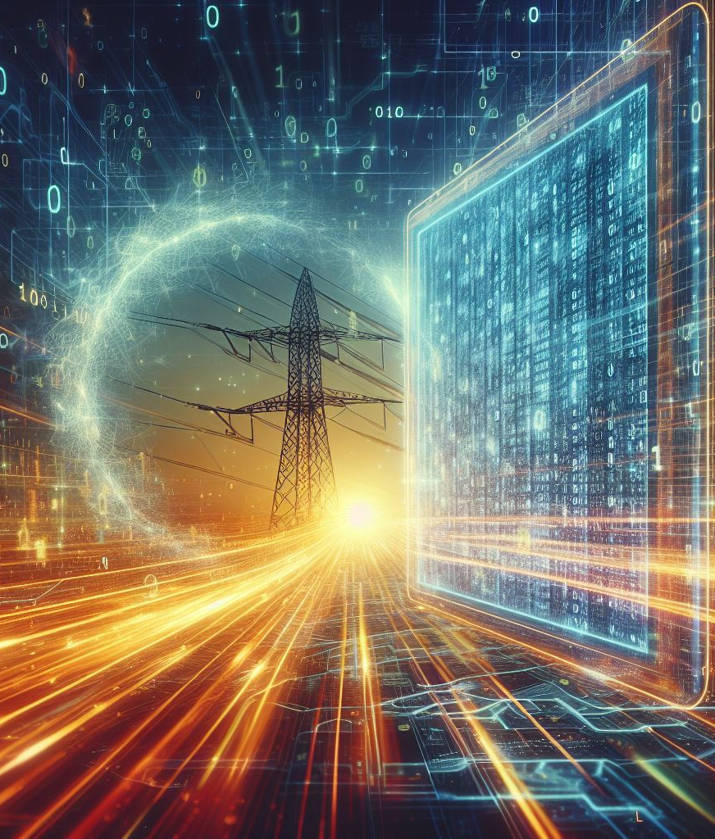
03_1: Types of Energy Data
Understanding the Landscape of Data Sources in the Energy Network
As the energy landscape continues to evolve, the volume and complexity of data generated within this sector have surged exponentially.
From power generation facilities to distribution networks, from renewable energy installations to end-users, every aspect of the energy ecosystem generates vast amounts of data that must be effectively managed, analyzed, and secured.
Data sources:
  SCADA Systems (Supervisory Control and Data Acquisition): SCADA systems serve as the nerve center of energy infrastructure, collecting real-time data from sensors and control devices across power generation, transmission, and distribution networks. SCADA data includes information on equipment status, operational parameters, and grid performance, enabling operators to monitor and control critical assets remotely.
  IoT Devices (Internet of Things): These devices include smart meters, sensors, actuators, and connected devices embedded within infrastructure components such as turbines, transformers, and substations. IoT data provides granular insights into asset condition, environmental conditions, and energy consumption patterns, enabling predictive maintenance, asset optimization, and demand response initiatives.

Slide 7
03_1: Types of Energy Data
Understanding the Landscape of Data Sources in the Energy Network
Data sources:
  Sensor Data and Telemetry: Sensors deployed across energy facilities capture data on environmental conditions, equipment performance, and operational parameters. These sensors measure temperature, pressure, flow rates, vibration, and other physical variables, providing real-time telemetry data for monitoring and analysis. Sensor data enables early detection of equipment failures, optimization of energy production, and compliance with safety and regulatory standards.
  Network Logs and Traffic Data: Network logs and traffic data generated by IT and OT (Operational Technology) networks provide visibility into network activity, communications, and security events. These data sources include logs from firewalls, routers, switches, and intrusion detection systems (IDS), as well as network traffic captures and packet captures. Analysis of network logs and traffic data helps detect anomalies, identify malicious activity, and mitigate cybersecurity threats targeting energy infrastructure.
  Enterprise Data and Business Systems: Enterprise data systems, such as asset management systems, enterprise resource planning (ERP) systems, and customer relationship management (CRM) platforms, contain valuable information on asset inventories, financial transactions, and customer interactions. Integration of enterprise data with operational data sources enables holistic analysis and optimization of business processes, supply chains, and customer service delivery within the energy sector.

Slide 8
03_1: Types of Energy Data
Understanding the Landscape of Data Sources in the Energy Network
Structured vs. Unstructured Data:
  Structured Data: Data that has a predefined format and is organized in a specific manner for easy processing and analysis.
  Unstructured Data: Data that lacks a predefined structure and does not fit into a traditional database format.
  Examples of Structured Data Sources:
    SCADA (Supervisory Control and Data Acquisition) systems: Centralized control systems used to monitor and control industrial processes, including energy generation and distribution.
    Database systems: Repositories of structured data containing information such as customer records, equipment inventories, and maintenance schedules.
  Examples of Unstructured Data Sources:
    Text documents: Reports, emails, and documentation related to energy operations and security.
    Images and videos: Surveillance footage, satellite imagery, and visual documentation of energy infrastructure.

Slide 9
03_1: Types of Energy Data
Understanding the Landscape of Data Sources in the Energy Network
Structured vs. Unstructured Data:
  Challenges of Structured Data Sources:
    Vulnerabilities in SCADA Systems: SCADA systems are prime targets for cyber attacks. Vulnerabilities in SCADA systems can lead to unauthorized access, manipulation of control settings, and disruptions to energy production and distribution processes.
    Data Tampering and Integrity Attacks: Attackers may attempt to tamper with structured data stored in databases or data repositories, leading to data corruption, falsification of records, and inaccurate reporting of operational metrics. Data integrity attacks can undermine the reliability and trustworthiness of critical data used for decision-making and compliance purposes.
    Insider Threats and Privilege Abuse: Authorized personnel with privileged access may abuse their credentials to steal sensitive information, sabotage systems, or disrupt operations. Effective access controls and monitoring mechanisms are essential for mitigating insider threats and preventing unauthorized data access or manipulation.

Slide 10
03_1: Types of Energy Data
Understanding the Landscape of Data Sources in the Energy Network
Structured vs. Unstructured Data:
  Challenges of Unstructured Data Sources:
    Data Leakage and Exfiltration: Unstructured data sources, such as text documents, emails, and multimedia files, present challenges related to data leakage and exfiltration. Attackers may exploit vulnerabilities in email systems, file servers, or cloud storage platforms to steal confidential information, intellectual property, or sensitive operational data from energy organizations.
    Malware and Phishing Attacks: Malware and phishing attacks targeting unstructured data sources can lead to data breaches, ransomware infections, and credential theft. Phishing emails containing malicious attachments or links may trick employees into disclosing sensitive information or installing malware, compromising the security of energy networks and data assets.
    Compliance and Data Privacy Risks: Compliance with data privacy regulations, such as GDPR, presents challenges for managing unstructured data in the energy network. Organizations must implement robust data protection measures, encryption techniques, and access controls to ensure compliance with regulatory requirements and protect sensitive information from unauthorized disclosure or misuse.

Slide 11
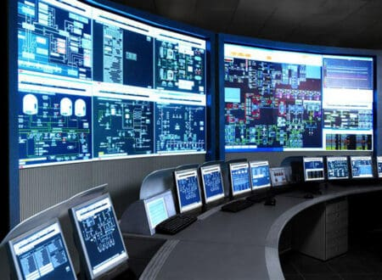
03_1: Types of Energy Data
Understanding the Landscape of Data Sources in the Energy Network
SCADA Systems:
  SCADA (Supervisory Control and Data Acquisition) systems are central to the operation of energy infrastructure, providing real-time monitoring, control, and automation of critical processes.
  These systems collect data from sensors, meters, and control devices distributed throughout power plants, substations, and transmission networks.
  They facilitate remote operation and control of equipment, allowing operators to adjust settings, initiate shutdown procedures, and respond to emergencies from a centralized location.
  Vulnerabilities:
    SCADA systems are susceptible to cyber attacks, including malware infections, denial-of-service (DoS) attacks, and unauthorized access.
    Vulnerabilities in SCADA protocols, weak authentication mechanisms, and insecure network connections pose significant risks to the integrity and reliability of SCADA data.
Source: https://www.smart-energy.com/ regional-news/asia/scada-india/

Slide 12
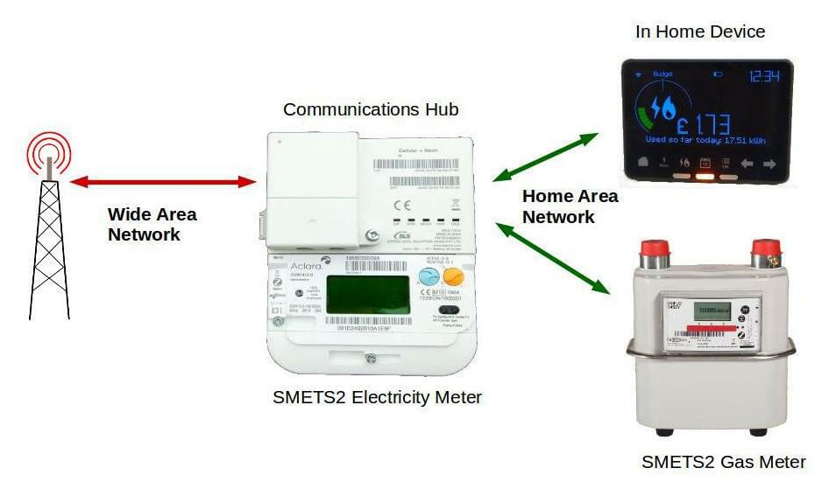
03_1: Types of Energy Data
Understanding the Landscape of Data Sources in the Energy Network
IoT (Internet of Things) Devices:
  Interconnected smart devices embedded within energy infrastructure to monitor, control, and optimize operations, such as:
    Smart Meters: Devices installed at consumer premises to measure and record energy consumption in real-time, enabling accurate billing and demand response.
    Sensors: Devices deployed throughout energy infrastructure to monitor environmental conditions (temperature, humidity, air quality), equipment health (vibration, pressure, flow), and security parameters (intrusion detection, surveillance).
    Actuators: Devices capable of remotely controlling equipment and processes, such as valves, switches, and pumps, to optimize energy efficiency and respond to operational requirements.
  IoT devices enable remote monitoring and management of energy assets, reducing the need for manual intervention and onsite inspections.
  Vulnerabilities:
    Vulnerabilities in IoT firmware and software, including weak authentication mechanisms, default credentials, and unencrypted communications, expose devices to cyber attacks.
    Inadequate security controls and patch management practices make IoT devices susceptible to malware infections, data breaches, and unauthorized access.
    Lack of standardized security protocols and regulatory oversight complicates efforts to secure IoT devices and mitigate cybersecurity risks effectively.
Source: https://www.smartme.co.uk/ how-they-work.html

Slide 13
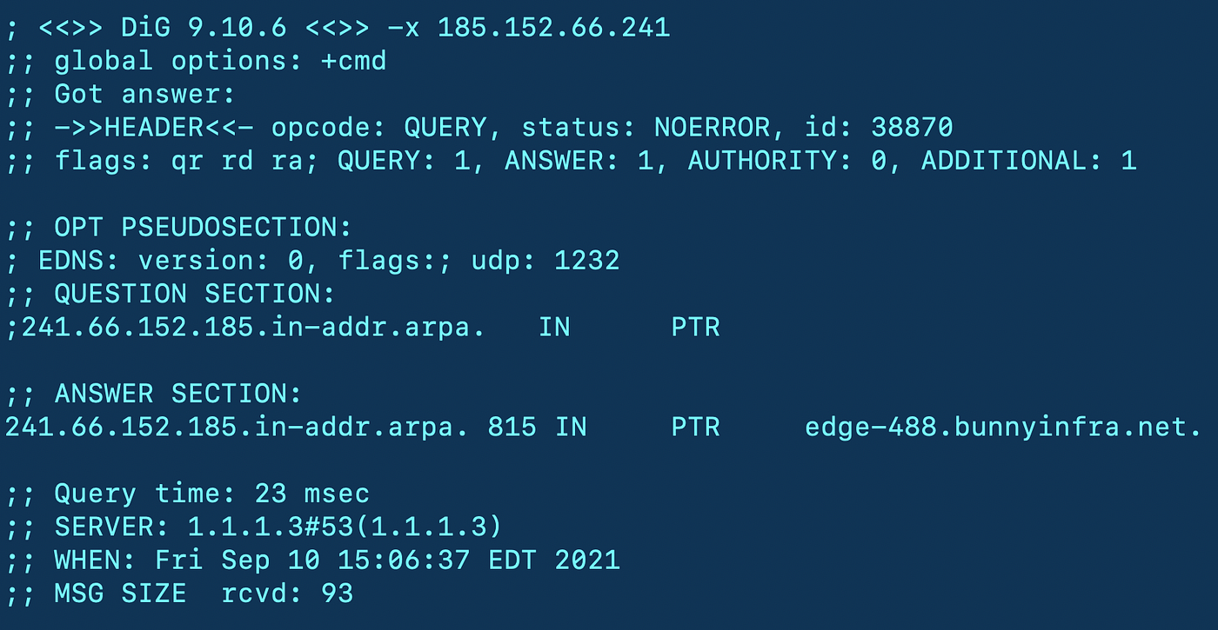
03_1: Types of Energy Data
Understanding the Landscape of Data Sources in the Energy Network
Network Logs:
  Records of communication events, activities, and transactions occurring within computer networks. These logs capture metadata such as source and destination IP addresses, timestamps, protocols, and data payloads, providing insights into network traffic and security incidents. They can be:
    Event Logs: Records of system events and activities generated by operating systems, applications, and network devices.
    Traffic Logs: Records of network traffic flows, including source and destination IP addresses, ports, protocols, and data transfer volumes.
    Access Logs: Records of user interactions with network resources, such as file shares, web servers, and databases, including authentication attempts, file accesses, and resource requests.
  Vulnerabilities:
    Inadequate logging of authentication events in energy management systems (EMS) allows attackers to conduct brute-force attacks without triggering alerts or generating log entries, facilitating unauthorized access to critical infrastructure.
    Default or weak credentials used to access SCADA systems or network devices allow attackers to gain unauthorized access to energy logs, manipulate system settings, and disrupt energy operations without detection.
    Transmission of energy logs over unencrypted channels or using outdated protocols such as Telnet or FTP exposes log data to interception by adversaries, enabling them to capture sensitive information or inject malicious commands into log streams.
Source: https://medium.com/cloud-security/the-network-logs-you-need-9a5aa540bb81

Slide 14
Training Outline:
Day-3
Topic-03: Energy Data Sources and Collection
Types of Energy Data
Energy Data Collection Techniques
Data Storage and Management
Case Study

Slide 15
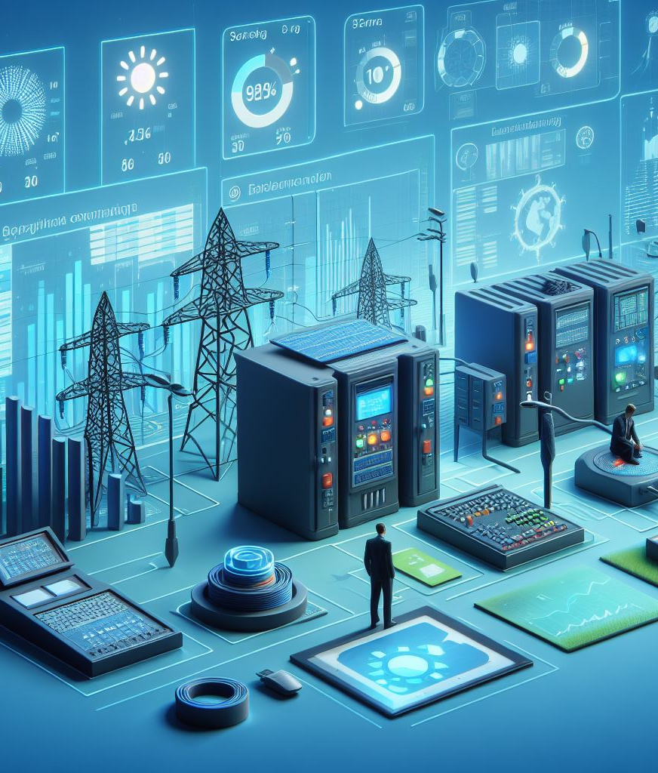
03_2: Energy Data Collection Techniques
Data Collection Methods
Passive vs. Active Data Collection Methods:
  Data collection methods in the energy sector encompass passive and active approaches.
  Passive Data Collection: It involves monitoring and recording data without directly interacting with energy infrastructure or systems.
    Examples are collecting network logs, sensor readings, and telemetry data from energy assets without actively initiating data collection processes.
    There is limited control over data availability and granularity, and reliance on existing data sources and infrastructure.
  Active Data Collection: It involves actively querying or probing energy infrastructure to retrieve specific data points or perform targeted measurements. Examples:
    Sending requests to SCADA systems, querying API endpoints, conducting on-site inspections or measurements.
    It has a potential impact on operational systems, it is resource-intensive, and requires coordination and authorization.

Slide 16
03_2: Energy Data Collection Techniques
Data Collection Methods
Leveraging APIs and Data Feeds from Energy Infrastructure:
  APIs (Application Programming Interfaces) and data feeds provide structured access to data and services offered by energy infrastructure and systems.
  API Integration:
    APIs enable programmable access to energy infrastructure, allowing developers to retrieve data, send commands, and interact with energy systems.
    Examples: Integrating with utility APIs to access consumption data, querying weather APIs for environmental data, interfacing with SCADA APIs for real-time monitoring.
    It requires authentication and authorization, there are rate limits, and issues related to data consistency and reliability.
  Data Feeds from Energy Infrastructure:
    Data feeds provide continuous streams of data from energy infrastructure, such as SCADA systems, smart meters, and IoT devices.
    Examples: Streaming telemetry data from sensors, receiving event notifications from SCADA systems, subscribing to real-time market data from energy exchanges.
    There may be issues related to data volume and velocity, network bandwidth requirements, data processing and storage capabilities.

Slide 17
03_2: Energy Data Collection Techniques
Data Collection Methods
Data Scraping and Web Crawling Techniques:
  Data scraping refers to the automated extraction of structured data from web pages or online sources using scraping tools or scripts. Examples:
    Scraping energy consumption data from utility websites.
    Extracting pricing information from energy market platforms.
    Aggregating news articles related to energy trends.
  Web crawling involves systematically traversing the web to discover and index web pages and content for further analysis or retrieval. Examples:
    Crawling energy-related forums and blogs for user-generated content.
    Indexing academic papers and research publications on energy topics.

Slide 18
03_2: Energy Data Collection Techniques
Data Collection Methods
Data Acquisition from Third-Party Sources and Partnerships:
  Third-party data sources and partnerships provide access to external data sets, expertise, and resources for enriching energy data analytics.
  Data Exchange Partnerships: Collaborative partnerships with data providers, utilities, research institutions, or government agencies to exchange or access data sets for mutual benefit. Examples:
    Sharing weather data with energy companies for demand forecasting.
    Collaborating with smart meter vendors to access consumption data.
    Partnering with academic institutions for research projects.
  Data Marketplaces and Aggregators: Serve as platforms for buying, selling, or exchanging data sets and services from multiple providers. Examples:
    Accessing energy market data from commercial data providers.
    Purchasing satellite imagery for environmental monitoring.
    Subscribing to industry-specific data feeds.

Slide 19
Training Outline:
Day-3
Topic-03: Energy Data Sources and Collection
Types of Energy Data
Energy Data Collection Techniques
Data Storage and Management
Case Study

Slide 20
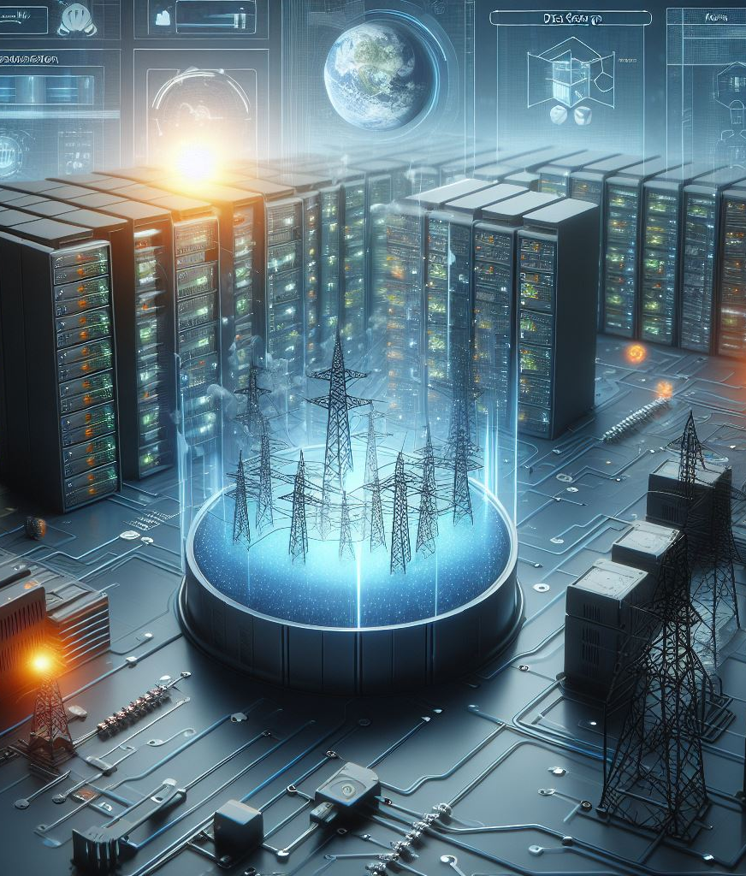
03_3: Data Storage and Management
Storage of Energy Data
Secure Storage Options for Energy Data:
  Essential for protecting sensitive energy data from unauthorized access, tampering, and data breaches. Various storage options offer different levels of security, scalability, and compliance with regulatory requirements.
  On-Premises Storage Solutions: Involves storing energy data within an organization's physical infrastructure, such as servers, storage arrays, and data centers. Examples:
    Network-attached storage (NAS).
    Storage area networks (SAN).
    Direct-attached storage (DAS).
  Cloud Storage Services: Provides scalable, on-demand storage resources over the internet, offered by cloud service providers (CSPs) on a subscription basis. Examples:
    Amazon S3.
    Microsoft Azure Blob Storage.
    Google Cloud Storage.
  Hybrid Storage Architectures: Combines on-premises infrastructure with cloud storage services to leverage the benefits of both environments. Examples:
    Hybrid cloud storage solutions integrating on-premises storage with public or private cloud services for data tiering, backup, and disaster recovery.

Slide 21
03_3: Data Storage and Management
Storage of Energy Data
Implementing Data Governance Policies and Access Controls:
  Data governance policies define the framework for managing and protecting energy data throughout its lifecycle, ensuring compliance with regulatory requirements and organizational standards.
  Data classification involves categorizing energy data based on its sensitivity, value, and regulatory requirements, while data tagging adds metadata attributes for identification and management.
    Examples: Classifying energy data as public, internal, confidential, or regulated, tagging data with labels indicating sensitivity, ownership, and access permissions.
  Access controls restrict access to energy data based on user roles, permissions, and authentication mechanisms, ensuring that only authorized users can view, modify, or delete data.
    Examples: Role-based access control (RBAC), access control lists (ACLs), multi-factor authentication (MFA), encryption-based access controls.
  Data lifecycle management encompasses the processes and policies for managing energy data from creation to disposal, including data retention, archiving, and deletion.
    Examples: Defining retention periods for different types of energy data, archiving historical data for compliance and analytics purposes, securely deleting data at the end of its lifecycle.

Slide 22
03_3: Data Storage and Management
Storage of Energy Data
Backup and Disaster Recovery Strategies for Critical Energy Data:
  Backup and disaster recovery strategies are essential for ensuring the availability, integrity, and resilience of critical energy data in the event of data loss, corruption, or disruptive incidents.
  Backup strategies involve creating copies of energy data at regular intervals and storing them in secondary locations for recovery purposes, protecting against data loss due to hardware failures, human errors, or cyber attacks.
    Examples: Full backups, incremental backups, differential backups, continuous data protection (CDP).
    Disaster recovery planning involves developing comprehensive strategies and procedures for restoring critical energy data and IT infrastructure after disruptive events, such as natural disasters, cyber attacks, or system failures.
    Examples: Disaster recovery sites, failover clusters, data replication, virtual machine snapshots, cloud-based disaster recovery services.
  Testing and maintenance activities ensure the effectiveness and readiness of backup and disaster recovery strategies, validating recovery procedures, and identifying areas for improvement.
    Examples: Regular testing of backup and recovery processes, conducting disaster recovery drills and simulations, updating recovery plans based on lessons learned.

Slide 23
Training Outline:
Day-3
Topic-03: Energy Data Sources and Collection
Types of Energy Data
Energy Data Collection Techniques
Data Storage and Management
Case Study

Slide 24
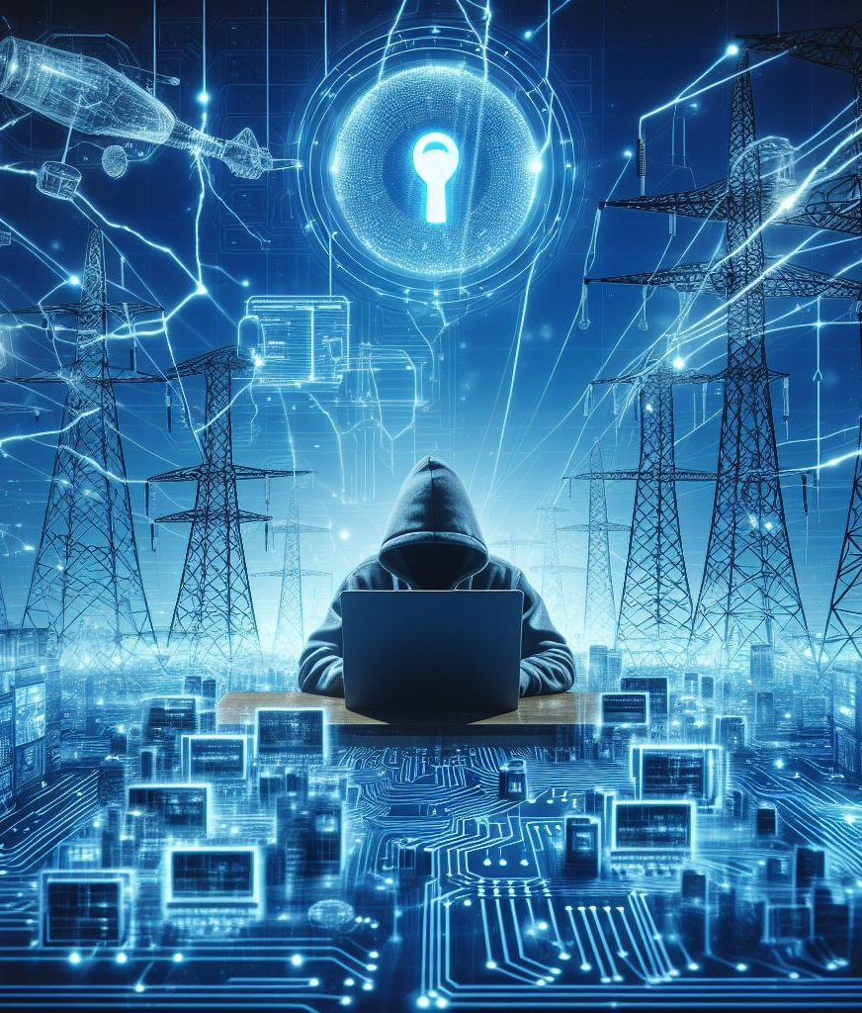
03_4: Case Study
Energy Data Breach in a Large Utility Company
Case study:
  Energy data breach that occurred in a large utility company, resulting in unauthorized access to sensitive customer information and operational data. The utility company, which provides electricity and gas services to millions of customers, experienced a cyber attack targeting its customer billing system and operational control systems. The attack exploited vulnerabilities in the company's network infrastructure, allowing attackers to gain unauthorized access to customer databases, SCADA systems, and network monitoring tools.
  Incident timeline:
    Initial Compromise: The attack began with a spear-phishing campaign targeting employees with access to sensitive systems and data. Malicious emails containing malware-laden attachments or links were sent to employees, tricking them into divulging their credentials or executing malicious code.
    Lateral Movement: After gaining initial access, the attackers used stolen credentials to move laterally across the network, escalating privileges and compromising additional systems and servers.

Slide 25
03_4: Case Study
Energy Data Breach in a Large Utility Company
Case study:
  Incident timeline:
    Data Exfiltration: Once inside the network, the attackers targeted customer databases containing personally identifiable information (PII), billing records, and payment data. They exfiltrated large volumes of sensitive data to external servers controlled by the attackers.
    SCADA System Compromise: In parallel, the attackers targeted the utility's SCADA systems, which control and monitor critical infrastructure such as power plants, substations, and distribution networks. By exploiting vulnerabilities in SCADA protocols and weak authentication mechanisms, the attackers gained unauthorized access to control systems, posing a significant risk to operational safety and reliability.
    Detection and Response: The breach was detected when abnormal network activity and data exfiltration attempts were identified by the company's security monitoring tools and threat detection systems. Incident response teams were immediately mobilized to contain the breach, investigate the extent of the intrusion, and mitigate further damage.

Slide 26
03_4: Case Study
Energy Data Breach in a Large Utility Company
Case study:
  Impact:
    Data Breach: The compromise of customer databases resulted in the exposure of sensitive PII, including names, addresses, contact information, and payment details, impacting millions of customers and exposing them to identity theft and fraud.
    Operational Disruption: The unauthorized access to SCADA systems and operational control networks raised concerns about the potential for physical damage, service disruptions, and safety risks. The company temporarily suspended certain operations and implemented manual control measures to mitigate operational risks.
    Reputational Damage: The breach eroded customer trust and confidence in the utility company's ability to protect their data and deliver reliable services. Negative publicity and media scrutiny further tarnished the company's reputation and brand image.

Slide 27
03_4: Case Study
Energy Data Breach in a Large Utility Company
Case study:
  Lessons Learned:
    Importance of Cyber Hygiene: The breach underscores the critical importance of implementing basic cybersecurity hygiene practices, such as employee awareness training, strong password policies, and regular security updates and patches.
    Defense-in-Depth Approach: Energy organizations should adopt a defense-in-depth approach to cybersecurity, combining multiple layers of security controls, including network segmentation, access controls, intrusion detection systems, and endpoint protection.
    Incident Response Preparedness: Timely detection and response are essential for mitigating the impact of cyber attacks. Energy companies should develop and regularly test incident response plans, establish communication protocols, and collaborate with industry partners and government agencies for coordinated response efforts.
    Continuous Monitoring and Threat Intelligence: Proactive monitoring of network traffic, system logs, and security alerts can help detect and mitigate cyber threats before they escalate into full-scale breaches. Leveraging threat intelligence feeds and information sharing platforms can enhance situational awareness and threat detection capabilities.

Slide 28
Training Outline:
Day-4
Topic-04: Energy Data Analysis and Data Processing
Data Cleaning and Preprocessing
Data Analysis Tools and Technologies
Interpreting Data for Cyber Threat Detection
Case Study

Slide 29
Training Outline:
Day-4
Topic-04: Energy Data Analysis and Data Processing
Data Cleaning and Preprocessing
Data Analysis Tools and Technologies
Interpreting Data for Cyber Threat Detection
Case Study

Slide 30

04_1: Data Cleaning and Preprocessing
Techniques for Cleaning and Filtering Data
Data Cleaning:
  Data cleaning refers to the process of identifying and correcting errors, inconsistencies, and inaccuracies in the dataset.
    Clean data is essential for accurate analysis and reliable insights.
    Common challenges are missing values, outliers, and inconsistencies in data.
  Techniques:
    Handling Missing Values: Strategies like imputation, deletion, or estimation to deal with missing data.
    Outlier Detection and Treatment: Methods for identifying and handling outliers that may skew analysis results.
    Data Standardization and Normalization: Techniques to transform data into a common scale or format for better comparison.

Slide 31
04_1: Data Cleaning and Preprocessing
Techniques for Cleaning and Filtering Data
Data Cleaning:
  Data Cleaning Process:
    Data Exploration: Initial exploration to identify potential issues in the dataset.
    Data Preprocessing: Applying cleaning techniques to address identified issues.
    Validation and Quality Checks: Verifying the integrity and quality of the cleaned data.
  Examples of Data Cleaning Tools:
    OpenRefine (https://openrefine.org/): OpenRefine is a powerful free, open source tool for working with messy data: cleaning it; transforming it from one format into another; and extending it with web services and external data. OpenRefine can be used to clean data collected from IoT sensors or SCADA systems in the energy network, identifying and correcting errors or anomalies in the dataset.
    Alteryx Designer Cloud (https://www.alteryx.com/): Alteryx is a comprehensive data analytics platform that includes features for data cleaning, blending, and analysis. It offers a drag-and-drop interface for performing complex data transformations and cleaning operations. Alteryx can be used to clean and preprocess data from various energy-related sources, such as energy consumption data, weather data, and operational data from power plants, enabling analysts to derive valuable insights for optimizing energy efficiency and operations.

Slide 32
Training Outline:
Day-4
Topic-04: Energy Data Analysis and Data Processing
Data Cleaning and Preprocessing
Data Analysis Tools and Technologies
Interpreting Data for Cyber Threat Detection
Case Study

Slide 33
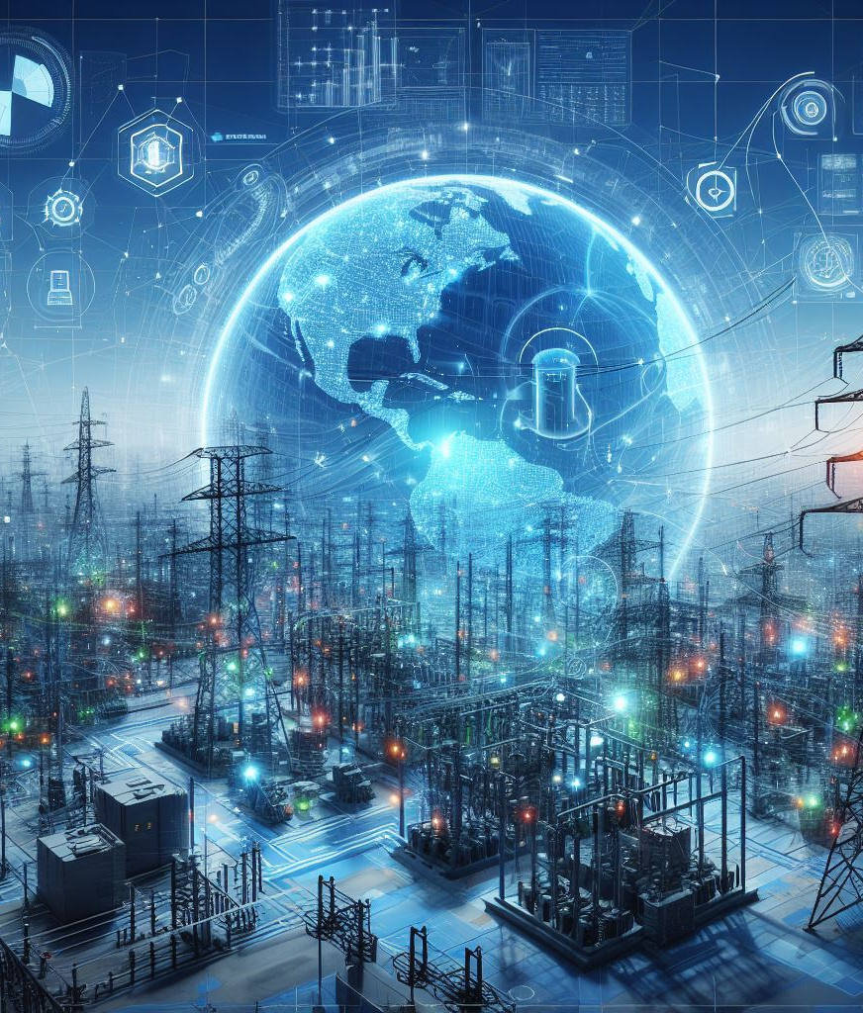



04_2: Data Analysis Tools and Technologies
Overview of Data Analysis Tools Commonly Used in Cybersecurity
Data Analysis Tools:
  Data analysis tools facilitate the extraction of insights from large and complex datasets.
  Commonly used tools:
Programming Languages
Data Visualization Tools
Statistical Software
Python, R, and SQL for data manipulation and analysis
Tableau, Power BI, and Matplotlib for creating visual representations of data
SPSS, SAS, and MATLAB for advanced statistical analysis

Slide 34
Training Outline:
Day-4
Topic-04: Energy Data Analysis and Data Processing
Data Cleaning and Preprocessing
Data Analysis Tools and Technologies
Interpreting Data for Cyber Threat Detection
Case Study

Slide 35
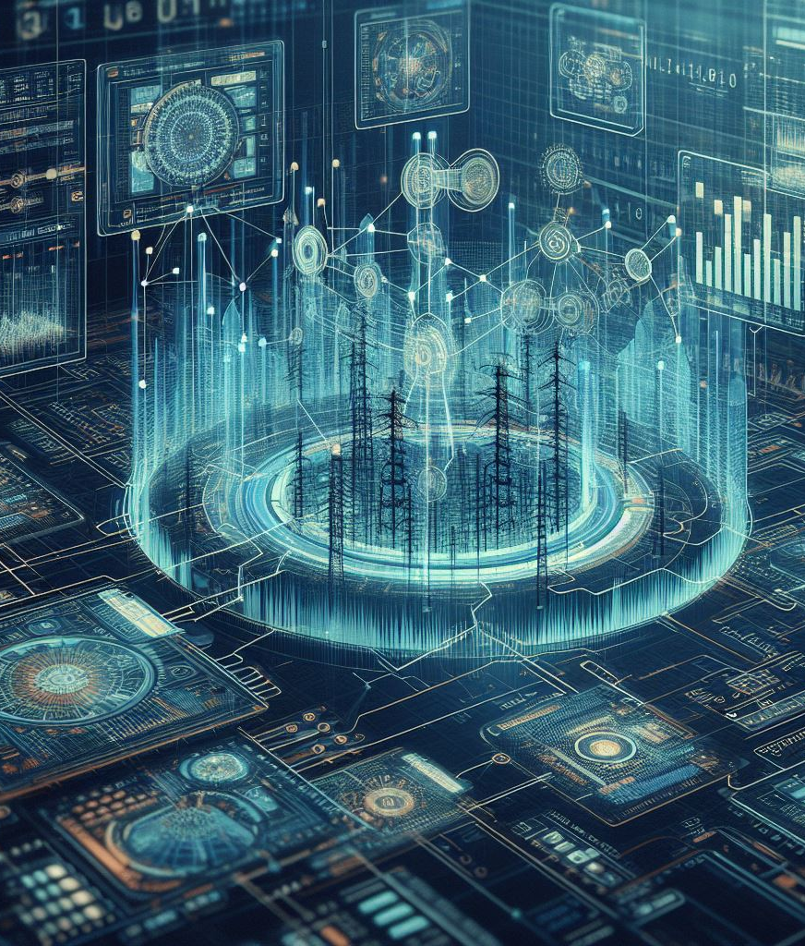
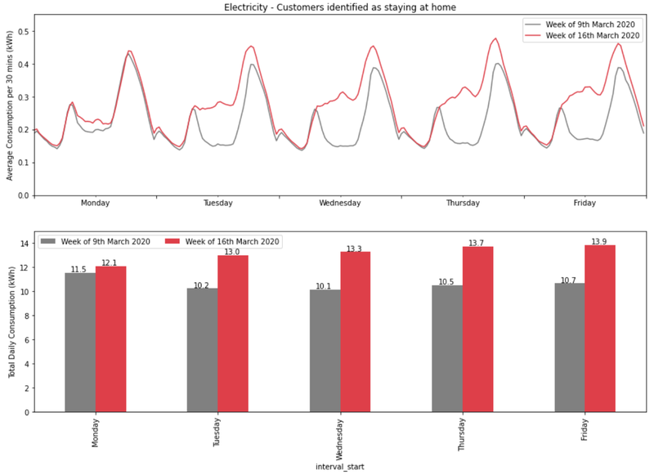
04_3: Interpreting Data for Cyber Threat Detection
Identifying Patterns and Anomalies in Energy Data
Understanding Data Patterns:
  Data patterns are recurring trends, or relationships present in a dataset. Its understanding is crucial for identifying anomalies and potential cyber threats.
  Types of Data Patterns:
    Seasonality: Regular fluctuations in data that occur at specific intervals, such as daily, weekly, or yearly patterns.
    Trends: Long-term tendencies in data, indicating gradual changes in behavior or values.
    Anomalies: Unexpected deviations from patterns due to, e.g., cybersecurity threats or unusual activities.
Source: https://octopus.energy/blog/domestic-energy-usage-patterns-during-social-distancing/

Slide 36
04_3: Interpreting Data for Cyber Threat Detection
Identifying Patterns and Anomalies in Energy Data
Detecting Anomalies:
  Anomalies, also known as outliers or deviations, are data points that significantly differ from the norm or expected behavior.
  Detecting anomalies is essential for identifying potential cyber threats or security breaches.
  Techniques for anomaly detection:
    Statistical Methods: Utilize statistical techniques such as mean, standard deviation, and z-score to identify data points that fall outside normal ranges.
    Machine Learning Algorithms: Train models to recognize patterns in data and flag instances that deviate from learned patterns.
    Domain-Specific Approaches: Develop customized anomaly detection algorithms tailored to the characteristics of the energy network data.

Slide 37
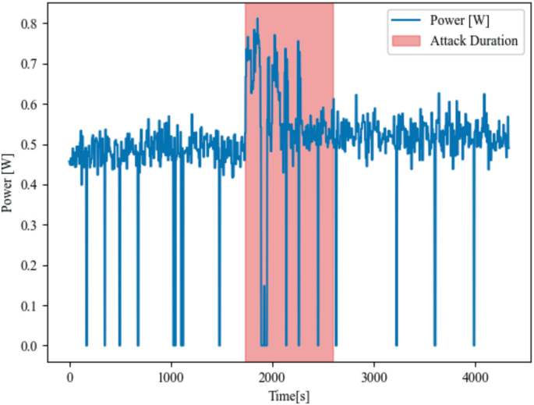
04_3: Interpreting Data for Cyber Threat Detection
Identifying Patterns and Anomalies in Energy Data
Correlating Data with Cyber Threats:
  Certain data patterns or anomalies may serve as indicators of potential cyber threats or security incidents.
  Examples include unusual spikes in network traffic, unexpected changes in system configurations, or unauthorized access attempts.
Visualization for Threat Detection:
    Visual representations of data facilitate the identification and interpretation of patterns, anomalies, and trends.
    Graphs, charts, and dashboards provide intuitive insights into complex datasets, aiding in threat detection and decision-making.
Source: Schorr, V., et al. (2024). Power Consumption Analysis as a Detection Indicator for Cyberattacks on Smart Home Devices. In: Jørgensen, B.N., da Silva, L.C.P., Ma, Z. (eds) Energy Informatics. EI.A 2023. Lecture Notes in Computer Science, vol 14468. Springer

Slide 38
Training Outline:
Day-4
Topic-04: Energy Data Analysis and Data Processing
Data Cleaning and Preprocessing
Data Analysis Tools and Technologies
Interpreting Data for Cyber Threat Detection
Case Study

Slide 39
04_4: Case Study
Unusual Network Activity
Case Study:
  In a large metropolitan area, an energy utility company operates a network of power plants, substations, and distribution grids that supply electricity to millions of customers. The company relies heavily on digital control systems and IoT devices to monitor and manage its infrastructure efficiently. However, this interconnected network also presents a significant cybersecurity risk, as it is susceptible to cyber threats that could disrupt power supply or compromise sensitive data.
  One day, the company's cybersecurity team notices unusual network activity originating from one of its critical substations. The network traffic patterns indicate a potential cyber intrusion, raising concerns about the security of the energy infrastructure. Further investigation reveals suspicious logins to the control systems and unauthorized attempts to access sensitive data repositories.
  Data Analysis Approach:
    Data Collection and Aggregation: The cybersecurity team collects network traffic logs, system event logs, and access logs from various components of the energy network, including substations, control systems, and data servers. They aggregate the collected data to create a comprehensive dataset that encompasses a wide range of network activities and system events.
    Data Cleaning and Preprocessing: The team cleans the dataset to remove noise, outliers, and irrelevant data points that could hinder the analysis process. They address missing values, standardize formats, and normalize data to ensure consistency and accuracy.

Slide 40
04_4: Case Study
Unusual Network Activity
Case Study:
  Data Analysis and Pattern Identification:
    Using statistical analysis and machine learning algorithms, the team identifies patterns and anomalies in the dataset that may indicate potential cyber threats.
    They look for irregularities in login patterns, network traffic spikes, unauthorized access attempts, and unusual system behaviors.
  Threat Detection and Correlation:
    By correlating the identified anomalies with known cyber threat indicators and attack signatures, the team narrows down potential security threats.
    They analyze the context of the anomalies to determine the severity and impact of the detected threats on the energy infrastructure.
  Visualization and Reporting:
    The team visualizes the analysis results using interactive dashboards, charts, and graphs to provide stakeholders with intuitive insights into the detected threats.
    They generate detailed reports outlining the findings, including the identified threats, their potential impact, and recommended mitigation measures.

Slide 41
04_4: Case Study
Unusual Network Activity
Case Study:
  Mitigation and Response:
    Based on the analysis findings, the cybersecurity team implements immediate mitigation measures to contain the detected threats and prevent further damage.
    They isolate the affected systems, revoke unauthorized access privileges, and deploy additional security controls to strengthen the network defenses.
    The team collaborates with law enforcement agencies and cybersecurity experts to investigate the root cause of the intrusion and identify the perpetrators.
  Outcome:
    Through proactive data analysis and threat detection techniques, the energy utility company successfully mitigates the cyber threat and safeguards its critical infrastructure from potential disruptions.
    The incident highlights the importance of leveraging data analysis tools and techniques to enhance cybersecurity resilience in the energy network and mitigate emerging threats effectively.

Slide 42
Training Outline:
Day-5
Topic-05: Threat Actors and Tactics in the Energy Network
Introduction to Threat Actors
Nation-State Threat Actors
Cybercriminal Groups
Insider Threats
Hacktivists and Ideologically Motivated Threat Actors

Slide 43
Training Outline:
Day-5
Topic-05: Threat Actors and Tactics in the Energy Network
Introduction to Threat Actors
Nation-State Threat Actors
Cybercriminal Groups
Insider Threats
Hacktivists and Ideologically Motivated Threat Actors

Slide 44

05_1: Introduction to Threat Actors
Introduction
Threat Actors:
  Threat actors targeting energy networks are driven by a variety of motivations, influencing their behavior and objectives. Examples:
    Financial Gain: Some threat actors seek monetary rewards through ransom payments, theft of valuable data, or selling access to compromised systems.
    Geopolitical Influence: Nation-state actors may engage in cyber espionage or sabotage to gain strategic advantages or exert influence over rival nations.
    Disruption of Services: Hacktivist groups may target energy infrastructure to protest against perceived injustices or advance ideological agendas.
    Sabotage: Threat actors may aim to disrupt critical infrastructure operations, causing widespread disruption and economic damage.
  By understanding what motivates threat actors, organizations can prioritize investments in threat detection, incident response, and risk mitigation strategies.

Slide 45
Training Outline:
Day-5
Topic-05: Threat Actors and Tactics in the Energy Network
Introduction to Threat Actors
Nation-State Threat Actors
Cybercriminal Groups
Insider Threats
Hacktivists and Ideologically Motivated Threat Actors

Slide 46
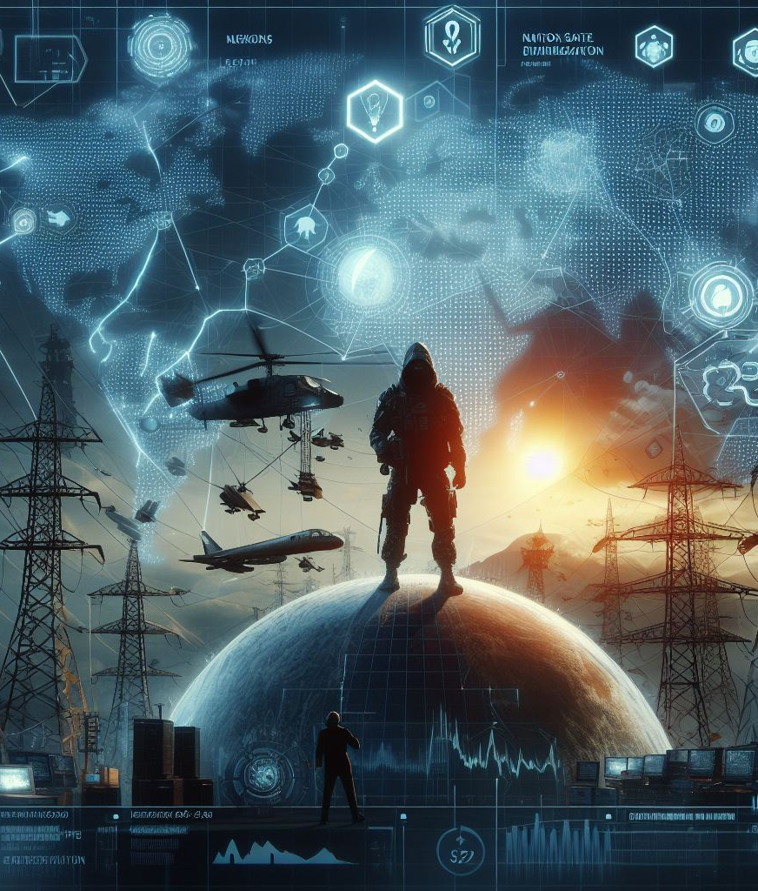
05_2: Nation-State Threat Actors
Characteristics and Examples
Nation-State Threat Actors:
  Nation-state threat actors are sponsored or affiliated with governments and possess significant resources, expertise, and strategic objectives.
  Characteristics: Advanced capabilities, extensive resources, long-term planning, and geopolitical motivations distinguish them from other threat actor categories.
  Tactics and Techniques: Nation-state threat actors employ sophisticated tactics and techniques to achieve strategic objectives, such as cyber espionage, sabotage, and disruption. Examples:
    Stuxnet Worm (2010): Developed jointly by the United States and Israel, Stuxnet targeted Iran's nuclear facilities, including uranium enrichment centrifuges. Stuxnet caused physical damage to Iran's nuclear infrastructure, demonstrating the potential of cyber attacks to disrupt critical systems.
    Dragonfly (2011-2014): Believed to be sponsored by Russia, the Dragonfly cyber espionage group targeted energy companies in the United States and Europe. Dragonfly used spear-phishing emails and watering hole attacks to gain access to energy sector networks and gather intelligence. The campaign aimed to gather information about energy infrastructure vulnerabilities and potentially disrupt energy supplies in targeted regions.
  Geopolitical Implications: Nation-state cyber operations in the energy sector have significant geopolitical implications, including potential escalation of tensions between nations and disruption of global energy supplies.

Slide 47
Training Outline:
Day-5
Topic-05: Threat Actors and Tactics in the Energy Network
Introduction to Threat Actors
Nation-State Threat Actors
Cybercriminal Groups
Insider Threats
Hacktivists and Ideologically Motivated Threat Actors

Slide 48

05_3: Cybercriminal Groups
Characteristics and Examples
Cybercriminal Groups:
  Cybercriminal groups are organized entities that engage in illicit activities for financial gain, targeting individuals, businesses, and critical infrastructure sectors like energy.
  Characteristics: Adaptable, profit-driven, and often operate as part of underground economies or cybercrime-as-a-service (CaaS) models.
  Tactics and Techniques: Cybercriminal groups employ a variety of tactics and techniques to monetize their activities, including ransomware attacks, data breaches, and theft of intellectual property. Examples:
    Ransomware Attacks: Encrypting victims' data and demanding ransom payments in exchange for decryption keys, disrupting operations and causing financial losses. The WannaCry ransomware attack (2017) targeted critical infrastructure, including healthcare and energy, encrypting data and demanding Bitcoin payments.
    Data Breaches: Unauthorized access to sensitive information, such as customer data or proprietary technology, for exploitation or sale on underground markets. The Equifax data breach (2017) compromised the personal information of over 147 million individuals, highlighting the impact of large-scale data breaches.
    Theft of Intellectual Property: Stealing trade secrets, research findings, or proprietary software for competitive advantage or resale to competitors. The APT10 group (2018) targeted global technology and energy companies, stealing intellectual property related to industrial control systems and sensitive business operations.

Slide 49
05_3: Cybercriminal Groups
Characteristics and Examples
Cybercriminal Groups:
  Financial Motivations: Cybercriminal groups are primarily motivated by financial incentives, seeking to maximize profits through extortion, fraud, and theft. Some cybercriminal groups operate like legitimate businesses, offering ransomware-as-a-service (RaaS) platforms or specialized malware tools for sale or rent. The lucrative nature of cybercrime drives the proliferation of cybercriminal groups and the development of increasingly sophisticated attack techniques.
  Impacts: Cybercriminal attacks on energy networks can disrupt operations, compromise sensitive data, and cause financial losses, posing significant risks to infrastructure resilience and public safety. Data breaches can lead to regulatory penalties, reputational damage, and legal liabilities, while ransomware attacks can result in operational downtime and financial extortion.

Slide 50
Training Outline:
Day-5
Topic-05: Threat Actors and Tactics in the Energy Network
Introduction to Threat Actors
Nation-State Threat Actors
Cybercriminal Groups
Insider Threats
Hacktivists and Ideologically Motivated Threat Actors

Slide 51

05_4: Insider Threats
Characteristics and Examples
Insider Threats:
  Insider threats refer to security risks posed by individuals within an organization who misuse their access privileges to intentionally or unintentionally cause harm.
  Characteristics: Insiders can include employees, contractors, third-party vendors, or partners with legitimate access to organizational systems and data.
  Motivations: Insider threats can stem from various motivations, including financial gain, disgruntlement, ideology, espionage, or negligence. Examples:
    Financial Gain: An employee may steal sensitive data or intellectual property for personal profit or to sell to external parties.
    Disgruntlement: A disgruntled employee may seek revenge against the organization by sabotaging systems or leaking confidential information.
    Espionage: Insider spies may be recruited by external actors or competing organizations to gather intelligence or disrupt operations.
    Negligence: Unintentional insider threats can arise from careless or negligent behavior, such as clicking on phishing emails or mishandling sensitive data.

Slide 52
05_4: Insider Threats
Characteristics and Examples
Insider Threats:
  Examples:
    Edward Snowden (2013): Former USA National Security Agency (NSA) contractor, Edward Snowden leaked classified documents revealing extensive government surveillance programs to the media. Snowden claimed to expose government overreach and violations of privacy rights, highlighting ideological motivations as a form of insider threat.
    Triton Malware (2017): The Triton malware targeted industrial control systems (ICS) at a Saudi petrochemical plant, causing operational disruptions. Investigations revealed evidence of insider collaboration with external threat actors to deploy the Triton malware, highlighting the insider threat's role in facilitating cyber attacks on critical infrastructure.
  Detection and Mitigation Strategies: Implementing access controls, monitoring user activities, conducting periodic security audits, and promoting a culture of security awareness are essential for mitigating insider threats.
  Impact on Energy Networks: Insider threats can have severe consequences for energy networks, including operational disruptions, data breaches, regulatory violations, and reputational damage. They pose unique challenges due to insiders' intimate knowledge of organizational systems, making them potentially more difficult to detect and mitigate than external threats.

Slide 53
Training Outline:
Day-5
Topic-05: Threat Actors and Tactics in the Energy Network
Introduction to Threat Actors
Nation-State Threat Actors
Cybercriminal Groups
Insider Threats
Hacktivists and Ideologically Motivated Threat Actors

Slide 54
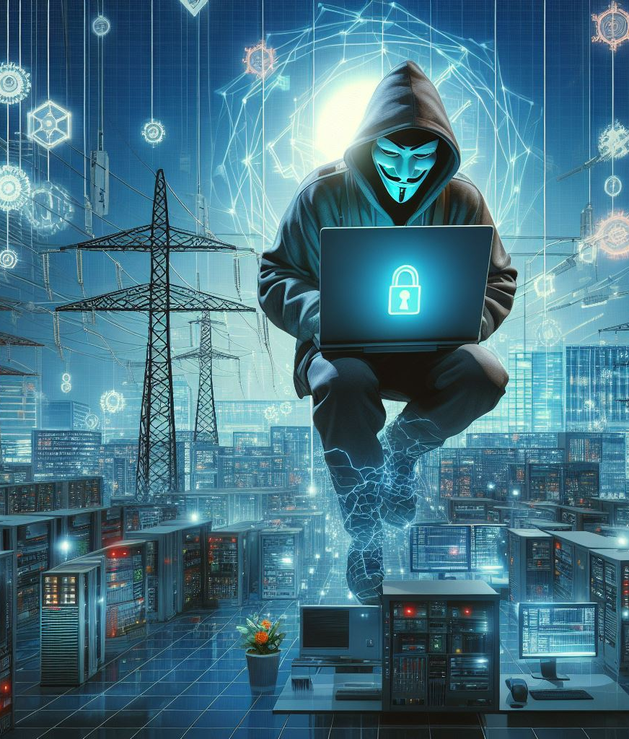
05_5: Hacktivists and Ideologically Motivated Threat Actors
Characteristics and Examples
Hacktivists and Ideologically Motivated Threat Actors:
  Hacktivists are individuals or groups who engage in cyber attacks or digital activism to promote political, social, or ideological causes.
  Characteristics: Hacktivists often operate under pseudonyms, leverage hacking techniques for activism, and may target governments, corporations, or other entities perceived as adversaries.
  Motivations: Hacktivists are driven by a desire to effect change or raise awareness about societal issues through digital means. Examples:
    Political Activism: Hacktivists may target government websites or institutions to protest against perceived injustices, censorship, or human rights violations.
    Social Causes: Activist groups may conduct cyber attacks to advocate for environmental conservation, animal rights, or other social justice issues.
    Ideological Beliefs: Hacktivist campaigns may be motivated by ideological agendas, such as anarchism, anti-capitalism, or anti-globalization.

Slide 55
05_5: Hacktivists and Ideologically Motivated Threat Actors
Characteristics and Examples
Hacktivists and Ideologically Motivated Threat Actors:
  Tactics: Hacktivists employ a range of tactics, including website defacements, distributed denial-of-service (DDoS) attacks, data breaches, and propaganda dissemination. They leverage hacking tools and social engineering techniques to exploit vulnerabilities in target systems or manipulate public opinion.
  Examples:
    The hacktivist collectives Anonymous and LulzSec launched Operation Anti-Security (#AntiSec), targeting government and corporate websites, including those of energy companies. It aimed to expose government corruption and corporate greed through data breaches and website defacements.
    The DarkSide ransomware group (believed to be based in Russia) targeted Colonial Pipeline, one of the largest fuel pipelines in the United States, causing a temporary shutdown and fuel shortages in several states. DarkSide claimed to be apolitical but sought financial gain through ransomware attacks, highlighting the intersection of criminal motives with ideological rhetoric.
  Detection and Mitigation Strategies: Implementing robust cybersecurity measures, monitoring online chatter for threat indicators, and fostering open dialogue with activist communities can help mitigate hacktivist risks.
  Impact on Energy Networks: Hacktivist attacks on energy infrastructure can disrupt operations, damage reputation, and pose significant challenges for incident response and recovery efforts. DDoS attacks may cause service disruptions, while data breaches can lead to the exposure of sensitive information or compromise operational systems.

Slide 56

Thank you
Please send all questions to:
gehad@example.com

