Slide 1
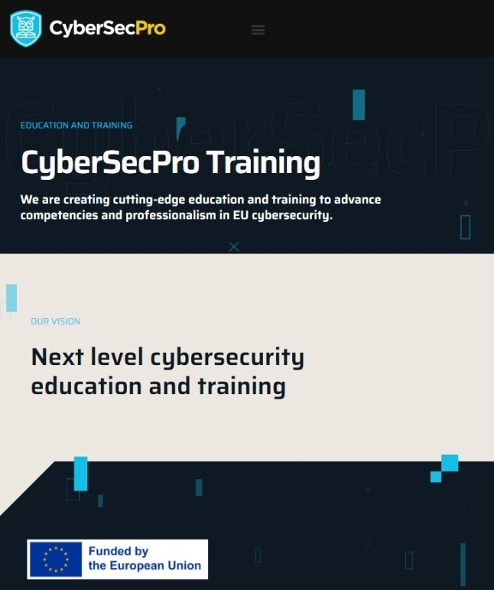


Cyber Threat Intelligence in the Energy Network
CSP006
Presentation by:

Slide 2


Slide 3


Cyber Threat Intelligence in the Energy Network – Course Overview
o1.
Foundations of Cyber Threat Intelligence (CTI) – Taxonomy, Lifecycle, Security Controls and Standards
o2.
Threat Modelling and Analysis in the Energy Network
o3.
Energy Data Sources and Collection
o4.
Energy Data Analysis and Data Processing
o5.
Threat Actors and Tactics in the Energy Network
o6.
Vulnerabilities Assessment Techniques
o7.
Cyber Threat Intelligence Information Sharing, Dissemination, Communication, and Implementation
o8.
Anomaly Detection in the Energy Network
o9.
Practical Threat Modelling and Security Investigation

Slide 4

Training Outline:
Day-2
Topic-02: Threat Modelling and Analysis in the Energy Network
Introduction to Threat Modelling
Threat Landscape in the Energy Network
Impact Analysis
Developing Threat Models for Energy Infrastructure
Mitigation Strategies

Slide 5
Training Outline:
Day-2
Topic-02: Threat Modelling and Analysis in the Energy Network
Introduction to Threat Modelling
Threat Landscape in the Energy Network
Impact Analysis
Developing Threat Models for Energy Infrastructure
Mitigation Strategies

Slide 6



02_1: Introduction to Threat Modelling
IDENTIFY
ASSESS
MITIGATE
Identify all the assets that can potentially be targeted by threats
Assess vulnerabilities, identify the threats capable of exploiting them, and quantify impacts
Define countermeasures or safeguards to protect assets against the threats

Slide 7

02_1: Introduction to Threat Modelling
Understanding the Concept and Importance
Definition: Threat modelling is a proactive and systematic approach to identifying, assessing, and mitigating potential cybersecurity threats to a system, network, or application.
Importance:
  It aims to anticipate potential attack vectors, vulnerabilities, and impacts on the security posture of the organization.
  By comprehensively understanding potential threats, organizations can implement effective security controls and mitigation strategies to strengthen their defenses.

Slide 8
02_1: Introduction to Threat Modelling
Understanding the Concept and Importance
Case study: Smart Grid Infrastructure – applying threat modelling to enhance the resilience and security of critical infrastructure against evolving threats
  Identify assets:
    Smart meters: devices installed at consumer premises to monitor real-time electrical energy usage
    Control systems: centralized systems to manage energy generation, distribution, and billing
    Communication networks: infrastructure facilitating data exchange between the elements of the ecosystem
    Storage systems: batteries used for storing surplus energy generated by renewables
  Analyse threats:
    Unauthorized access: hackers gaining unauthorized access to smart meters or control systems, potentially manipulating energy consumption data or disrupting grid operations
    Data tampering: manipulation of data transmitted between smart meters and control systems, leading to inaccurate billing or exploitation of vulnerabilities in energy trading platforms
    Supply chain risks: compromise of components or software obtained from third-party suppliers, resulting in vulnerabilities in smart grid devices or control systems
    Cyber espionage: theft of sensitive information related to energy infrastructure operations, customer data, or intellectual property, posing risks to national security and competitive advantage

Slide 9
02_1: Introduction to Threat Modelling
Understanding the Concept and Importance
Case study: Smart Grid Infrastructure
  Assess vulnerabilities:
    Insecure communication protocols: weak encryption or lack of authentication mechanisms in communication protocols used by smart meters and control systems.
    Legacy systems: use of outdated or unsupported software and hardware components in critical infrastructure, susceptible to known vulnerabilities and exploits.
    Insider threats: malicious or negligent actions by employees or contractors with privileged access to energy network infrastructure.
    Interconnected systems: dependencies between different components of the energy network, creating potential pathways for attackers to propagate threats and disrupt operations.
  Quantify impacts:
    Financial losses: disruption of energy supply leading to revenue losses for utility providers, fines for non-compliance with service level agreements, and costs associated with remediation and legal proceedings.
    Operational disruptions: service outages impacting residential, commercial, and industrial consumers, leading to productivity losses, damage to equipment, and negative public perception.
    Safety risks: compromised integrity of energy infrastructure posing risks to public safety, environmental damage, and potential loss of life in extreme scenarios.

Slide 10
02_1: Introduction to Threat Modelling
Understanding the Concept and Importance
Case study: Smart Grid Infrastructure
  Develop mitigation strategies:
    Implement strong authentication: enforce multi-factor authentication for access to control systems and smart grid devices, with regular password updates and access control policies.
    Encryption and data integrity: encrypt data transmission between smart meters and control systems using industry-standard encryption algorithms and protocols to prevent tampering and eavesdropping.
    Patch management: establish a robust patch management process to promptly apply security updates and patches to address known vulnerabilities in software and hardware components.
    Employee training: Provide comprehensive cybersecurity training for employees and contractors to raise awareness about security best practices, social engineering techniques, and incident response procedures.
    Physical security measures: deploy physical security controls, such as surveillance cameras, access controls, and perimeter fencing, to protect critical infrastructure components from unauthorized access and physical attacks.

Slide 11
Training Outline:
Day-2
Topic-02: Threat Modelling and Analysis in the Energy Network
Introduction to Threat Modelling
Threat Landscape in the Energy Network
Impact Analysis
Developing Threat Models for Energy Infrastructure
Mitigation Strategies

Slide 12

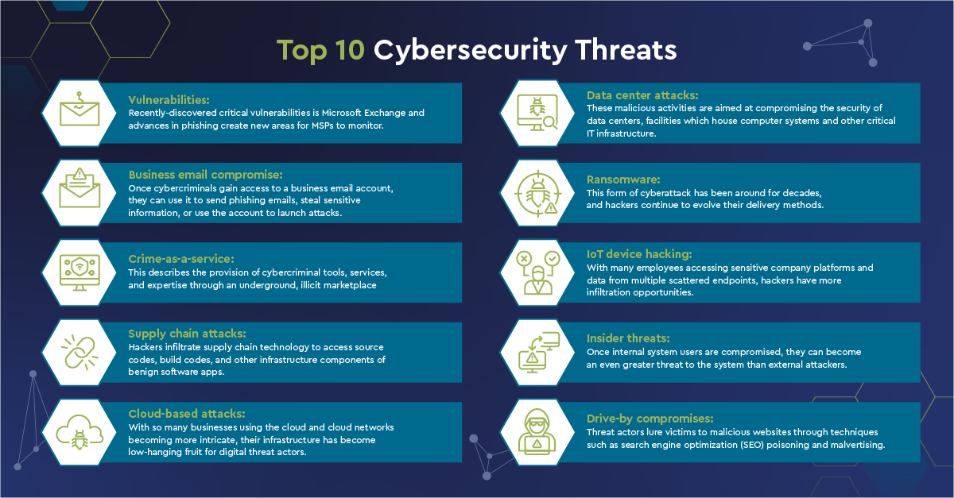
02_2: Threat Landscape in the Energy Network
Understanding Cyber Threats Facing Energy Infrastructure
Source: https://www.connectwise.com/blog/ cybersecurity/common-threats-and-attacks

Slide 13
02_2: Threat Landscape in the Energy Network
Understanding Cyber Threats Facing Energy Infrastructure
Examples of types of threats:
  Vulnerabilities
  Certain threats aim to exploit vulnerabilities in connected devices to compromise their functionality, gain unauthorized access to networks, and launch cyber attacks on energy systems.
  IoT vulnerabilities pose significant risks to energy infrastructure due to the proliferation of interconnected devices and their integration into critical operations and control systems.
  Insecure authentication and authorization: many IoT devices lack robust authentication mechanisms, relying on default credentials or weak passwords that are easily guessable or susceptible to brute-force attacks. Insecure authentication allows attackers to gain unauthorized access to IoT devices, control systems, or network infrastructure.
  Lack of encryption: IoT devices may transmit data over unencrypted channels, exposing sensitive information to interception or tampering by eavesdroppers. The absence of encryption mechanisms leaves IoT communications vulnerable to man-in-the-middle attacks, data exfiltration, or unauthorized data manipulation.
  Outdated firmware and software: IoT devices often run outdated or unsupported firmware and software versions, making them susceptible to known vulnerabilities and exploits. Attackers can exploit unpatched devices to gain control over IoT networks, inject malware payloads, or launch denial-of-service attacks.
  Malware infections on IoT devices can exfiltrate sensitive data from energy systems, including operational data, customer information, or intellectual property. Attackers may steal proprietary information for espionage, financial gain, or extortion, compromising the confidentiality and integrity of energy company data.

Slide 14
02_2: Threat Landscape in the Energy Network
Understanding Cyber Threats Facing Energy Infrastructure
Examples of types of threats:
  Business email compromise: malware (malicious software)
  Broad category of software programs designed to infiltrate, damage, or gain unauthorized access to computer systems and networks.
  Malware can disrupt operations, steal sensitive information, and cause financial and reputational damage to companies.
  Examples: viruses (malicious programs that attach themselves to legitimate files or programs and replicate when executed), worms (self-replicating malware that spread across networks without requiring user interaction), and trojans (malware disguised as legitimate software or files to trick users into installing them).
  Viruses targeting energy systems can corrupt or delete critical files, disrupt operations, and compromise the integrity of control systems.
  Worms can rapidly spread through energy networks, infecting control systems, and disrupting communication between devices. They can overload network bandwidth, degrade system performance, and facilitate unauthorized access to sensitive information.
  rojans targeting energy systems can infiltrate control systems, exfiltrate sensitive data, and provide unauthorized access to attackers.
Business email compromise: ransomware
  Type of malicious cyber attack in which attackers encrypt files or lock access to computer systems and demand a ransom payment in exchange for restoring access.
  Can be delivered through various vectors, including malicious email attachments, compromised websites, exploit kits, or remote desktop protocol (RDP) vulnerabilities.
  Once executed, ransomware encrypts files on the system of the victim and displays a ransom note, instructing the victim on how to pay the ransom to regain access to their data or systems.
  Attackers may target energy management systems, operational technology (OT) networks, or supervisory control and data acquisition (SCADA) systems, disrupting energy generation, distribution, or transmission processes.

Slide 15
02_2: Threat Landscape in the Energy Network
Understanding Cyber Threats Facing Energy Infrastructure
Examples of types of threats:
  Business email compromise: pishing
  Form of cyber attack in which attackers use deceptive emails, text messages, or other communication methods to trick individuals into providing sensitive information, such as login credentials, personal details, or financial data.
  Typically involve impersonating legitimate entities, such as energy providers, government agencies, or trusted organizations, to deceive recipients into taking action, such as clicking on malicious links, downloading infected attachments, or disclosing confidential information.
  Attackers often employ social engineering techniques to exploit human vulnerabilities, manipulate emotions, and induce recipients to divulge sensitive information or perform actions that benefit the attackers.
  Attackers may impersonate utility providers and send fraudulent emails requesting login credentials or personal information from employees responsible for managing control systems or accessing sensitive data.
  Pishing can also target customers or consumers of energy services, attempting to deceive them into disclosing personal information, financial details, or account credentials. For example, attackers may send fake emails or text messages claiming to offer refunds, discounts, or urgent notifications about energy bills, prompting recipients to click on malicious links or provide sensitive information.

Slide 16



02_2: Threat Landscape in the Energy Network
Understanding Cyber Threats Facing Energy Infrastructure
Examples of types of threats:
  Insider threats:
  Risks posed by individuals within an organization who have access to sensitive information, systems, or networks and may intentionally or unintentionally misuse their privileges to compromise security, steal data, or disrupt operations.
  Insider threats can arise from employees, contractors, or third-party vendors with legitimate access to critical systems and pose significant risks to energy systems due to the potential for insider abuse, sabotage, or negligence.
  Malicious insiders with access to SCADA systems or energy management systems may tamper with settings, alter configurations, or inject malicious code, leading to equipment failures, power outages, or safety hazards.
Malicious
Negligent
Compromised
Employees or contractors who intentionally misuse their access privileges to steal sensitive information, sabotage systems, or disrupt operations
Employees, contractors, or third-party vendors who inadvertently compromise security through careless or negligent behavior
Individuals whose credentials or privileges been compromised by external threat actors through, e.g., phishing attacks or credential theft

Slide 17
Training Outline:
Day-2
Topic-02: Threat Modelling and Analysis in the Energy Network
Introduction to Threat Modelling
Threat Landscape in the Energy Network
Impact Analysis
Developing Threat Models for Energy Infrastructure
Mitigation Strategies

Slide 18

02_3: Impact Analysis
Types of Impact
It is crucial to conduct impact analysis to assess the consequences of cyber attacks, mitigate risks, and enhance resilience of energy infrastructure.
Types of impacts:
  Operational impact: disruption or degradation of energy system operations, including power generation, distribution, and transmission.
  Financial impact: financial losses incurred as a result of cyber attacks, including revenue losses, remediation costs, and regulatory fines.
  Reputational impact: damage to the reputation and credibility of energy companies due to public perception of security incidents and data breaches.
  Safety and environmental impact: risks to public safety, environmental damage, and potential loss of life resulting from cyber attacks on energy infrastructure.

Slide 19
02_3: Impact Analysis
Types of Impact
Examples of operational impacts:
  Disruption of energy supply: interruption or degradation of power generation, transmission, or distribution processes, leading to service outages for residential, commercial, and industrial consumers.
  Damage to equipment: malicious manipulation of control systems, SCADA systems, or industrial controllers, causing equipment failures, production delays, or safety hazards.
  Operational delays: disruption of routine operations, maintenance activities, or emergency response procedures due to cyber attacks on energy infrastructure.

Slide 20
02_3: Impact Analysis
Types of Impact
Examples of financial impacts:
  Revenue losses: decrease in revenue due to service outages, customer defection, or regulatory fines resulting from cyber attacks on energy infrastructure.
  Remediation costs: expenses associated with incident response, forensic investigations, system recovery, and security enhancements following cyber attacks.
  Legal and regulatory costs: costs incurred for regulatory compliance, legal fees, settlements, and compensation payments resulting from cybersecurity incidents.

Slide 21
02_3: Impact Analysis
Types of Impact
Examples of reputational impacts:
  Loss of trust and confidence: erosion of public trust and confidence in energy companies' ability to safeguard customer data, maintain service reliability, and protect against cyber threats.
  Brand damage: negative publicity, media scrutiny, and social media backlash resulting from security incidents and data breaches, tarnishing the reputation and credibility of energy companies.
  Customer churn: increase in customer churn rates, customer complaints, and customer dissatisfaction due to perceived security vulnerabilities and breaches of privacy.

Slide 22
02_3: Impact Analysis
Types of Impact
Examples of safety and environmental impacts:
  Public safety risks: exposure to safety hazards, physical harm, or loss of life resulting from accidents, equipment failures, or operational disruptions caused by cyber attacks on energy infrastructure.
  Regulatory compliance: non-compliance with environmental regulations, health and safety standards, or industry best practices due to cybersecurity incidents and breaches of safety protocols.

Slide 23
Training Outline:
Day-2
Topic-02: Threat Modelling and Analysis in the Energy Network
Introduction to Threat Modelling
Threat Landscape in the Energy Network
Impact Analysis
Developing Threat Models for Energy Infrastructure
Mitigation Strategies

Slide 24

02_4: Developing Threat Models for Energy Infrastructure
What is Threat Modeling?
Review of key components of threat modeling:
  Identify assets: identify and prioritize critical assets, systems, and data within the energy infrastructure that require protection.
  Assess threats: identify potential threats, vulnerabilities, and attack vectors that could compromise the security and integrity of energy systems.
  Mitigate risks: analyze the likelihood and impact of identified threats to prioritize mitigation efforts and allocate resources effectively.

Slide 25
02_4: Developing Threat Models for Energy Infrastructure
Identifying Assets
Types of Assets:
  Physical assets: infrastructure components such as power plants, substations, transmission lines, and control systems.
  Digital assets: data repositories, network infrastructure, software applications, and communication systems used to monitor and manage energy operations.
Asset classification:
  Categorize assets based on their criticality, sensitivity, and value to energy operations to prioritize protection efforts.

Slide 26
02_4: Developing Threat Models for Energy Infrastructure
Assessing Threats
Types of threats:
  Cyber attacks: malware, phishing, ransomware, denial-of-service (DoS) attacks targeting energy systems and digital infrastructure.
  Physical threats: physical intrusions, sabotage, vandalism, or natural disasters that can impact the physical integrity of energy infrastructure.
  Insider threats: malicious or negligent actions by employees, contractors, or third-party vendors with access to critical systems and data.
Threat actors:
  Identify potential threat actors, including nation-state actors, cybercriminals, hacktivists, insiders, and competitors targeting energy infrastructure.

Slide 27
02_4: Developing Threat Models for Energy Infrastructure
Mitigating Risks
Risk factors:
  Likelihood: assess the probability of threats exploiting vulnerabilities and impacting energy operations.
Impact: evaluate the potential consequences of threats on energy infrastructure, including operational disruptions, financial losses, and reputational damage.
Risk prioritization: prioritize risks based on their significance, severity, and potential impact on energy systems and critical operations.

Slide 28
Training Outline:
Day-2
Topic-02: Threat Modelling and Analysis in the Energy Network
Introduction to Threat Modelling
Threat Landscape in the Energy Network
Impact Analysis
Developing Threat Models for Energy Infrastructure
Mitigation Strategies

Slide 29
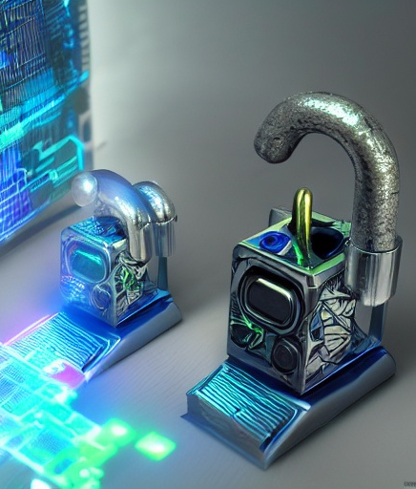
02_5: Mitigation Strategies
Implementing Security Controls
Security controls:
  Access control: implement role-based access control (RBAC) mechanisms to restrict access to critical systems and data based on user roles and permissions.
  Encryption: encrypt sensitive data at rest and in transit to protect against unauthorized access and data breaches.
  Intrusion detection and prevention systems (IDPS): deploy IDPS solutions to detect and block malicious activities, including intrusion attempts, malware infections, and suspicious network traffic.
  Patch management: regularly update and patch software, firmware, and operating systems to address known vulnerabilities and reduce the risk of exploitation by cyber threats.

Slide 30
02_5: Mitigation Strategies
Reducing Attack Surface and Strengthening Defenses
Best Practices:
  Network segmentation: segment networks and systems to contain cyber threats and prevent lateral movement within the network.
  Least privilege principle: enforce the principle of least privilege to limit user access rights and permissions to only what is necessary for performing job functions.
  Secure configuration: configure devices, applications, and systems securely by disabling unnecessary services, enabling firewalls, and enforcing strong authentication mechanisms.
  Regular audits and assessments: conduct regular security audits, vulnerability assessments, and penetration tests to identify and remediate security weaknesses proactively.

Slide 31
02_5: Mitigation Strategies
Integrating Threat Modelling
Benefits of Integration:
  Proactive risk identification: identify and prioritize cybersecurity risks proactively through systematic threat modeling exercises.
  Informed decision-making: provide stakeholders with valuable insights into potential threats, vulnerabilities, and mitigating controls to make informed risk management decisions.
  Continuous improvement: foster a culture of continuous improvement by integrating threat modeling into existing risk management processes and frameworks.
Integration Strategies:
  Incorporate threat modeling into risk assessment methodologies, such as the ISO 27001, to assess and prioritize cybersecurity risks.
  Establish cross-functional teams to facilitate collaboration between cybersecurity experts, risk management professionals, and subject matter experts in threat modeling activities.
  Integrate threat modeling outputs, such as threat profiles, attack trees, and risk matrices, into risk management documentation and decision-making processes.

Slide 32

Thank you
Please send all questions to:
gehad@example.com

