Slide 1

Data Protection and Privacy Technologies for Maritime
CSP005_SA_M
Presentation by:
Prof. Dr. Shareeful Islam

Slide 2


Outline
o1.
Goals: Who-What-Why you need to take this training
o2.
Training logistics: When-Where-How
o3.
Learning outcomes
o4.
Training outlines
o5.
Exercises details
o6.
Practical information and requirements
o7.
Registration information and contacts

Slide 3



Goals: Who-What-Why you need to take this training
WHO
WHAT
WHY
WHO can attend the training modules and profiles of the attendees
Foundational of cybersecurity essentials and management for managers, leaders and working-professionals
Equipping participants with the knowledge and skills necessary to make a strategy to protect critical systems and data

Slide 4



CSP Training Logistic: When-Where-How
WHEN
WHERE
HOW
Time schedule:
ONLINE-ONSITE-Location Information
Delivery Method

Slide 5

WHO
Profile of Training Participants
IT service professional
Governance and compliance
Management
SMEs and Public Sector Employees
Cyber security operator

Slide 6

WHO
Prof. Dr. Shareeful Islam
Highly motivated and committed cyber security and risk management professional with experience in research, training and consultancy.
Consultant for managing cyber security risks and information security management system to develop risks management framework following ISO 27001:2013, ISO31000:2018, NIST-CSF, STIX threat modelling, CIS_CSC and other relevant standards in various business environments.
Certified Management of Risks (MoR), PRINCE 2 practitioner and a subject matter expert in Risk Management
Knowledge about data privacy and compliance
Over 90 peer reviewed publications with top journals and conference
https://scholar.google.com/citations?user=IAxS1lsAAAAJ&hl=en

Slide 7

WHAT
Training Topics
Data privacy principles
An overview of GDPR and implementation
Maritime Threats and Vulnerabilities in relation to privacy
Privacy Impact assessment
Privacy scenario analysis and technologies
Policy and best practice

Slide 8

Training Outline: Part 1
Topic 1-: Overview of Privacy principles , GDPR, policy
Data Privacy Principles and Alignment with Maritime Sector
GDPR Key Principles
Introduction to privacy policies
Privacy policy for maritime sector
Consent management , retention and DPIA for maritime agents
Topic-2: Privacy Risk and Technologies
Privacy threats and risks in maritime sector
Overview of privacy technologies

Slide 9
Training Outline: Part 2
Topic-3: best practice
Privacy scenario analysis and reporting
best practice guideline for overall privacy awareness

Slide 10

Background Knowledge and Prerequisites
Background knowledge:
Basic understanding of privacy
Familiarity with common internet security threats and vulnerabilities
Awareness of cybersecurity
Prerequisites:
None

Slide 11

Resources: Books and Reference Materials
  General Data Protection Regulation
  https://gdpr-info.eu/

Slide 12

Registration: How to register and other practical information
The specific registration process for the Cybersecurity Essentials and Management training may vary depending on the training provider or institution. However, the general steps are typically straightforward and can be completed online or in person.
Online Registration
In-Person Registration
Additional Practical Information

Slide 13
Protection of Personal Data
January 2012, the European Commission proposed a comprehensive reform of data protection rules in the EU.
  To back control over of their personal data
  to simplify the regulatory environment for business
  Personal data can only be gathered legally under strict conditions(Bank account,social media)
Officially Directive 95/46/EC on the protection of individuals with regard to the processing of personal data and on the free movement of such data
Scope
  Personal data are defined as "any information relating to an identified or identifiable natural person ("data subject"); an identifiable person is one who can be identified, directly or indirectly, in particular by reference to an identification number or to one or more factors specific to his physical, physiological, mental, economic, cultural or social identity;"

Slide 14
What is data protection?
Data protection is the fair and proper use of information about people.
It’s part of the fundamental right to privacy – but on a more practical level.
It’s really about building trust between people and organisations. It’s about treating people fairly and openly, recognising their right to have control over their own identity and their interactions with others, and striking a balance with the wider interests of society. It’s also about removing unnecessary barriers to trade and co-operation. It exists in part because of international treaties for common standards that enable the free flow of data across borders.
Data protection is essential to innovation. Good practice in data protection is vital to ensure public trust in, engagement with and support for innovative uses of data in both the public and private sectors.

Slide 15
Privacy Principles
The seven principles governing for protection of personal data were:
  Notice—data subjects should be given notice when their data is being collected;
  Purpose—data should only be used for the purpose stated and not for any other purposes;
  Consent—data should not be disclosed without the data subject’s consent;
    the individual has given clear consent for you to process their personal data for a specific purpose

Slide 16
Privacy Principles
Security—collected data should be kept secure from any potential abuses;
Disclosure—data subjects should be informed as to who is collecting their data;
Access—data subjects should be allowed to access their data and make corrections to any inaccurate data; and
Accountability—data subjects should have a method available to them to hold data collectors accountable for following the above principles.

Slide 17

Personal Data Terms
Data Types:
  Personal Data: Data that identifies a living individual or as result of combinations of data relating to or being about a person
  an individual is identifiable will depend on all the means likely and reasonably to be used either by the controller or by any other person to identify an individual.
  Ex: Name, address, postcode, e-mail , DoB, Bank statement

Slide 18
Few more words…
Personal data means information about a particular living individual. This might be anyone, including a customer, client, employee, partner, member, supporter, business contact, public official or member of the public. It doesn’t need to be ‘private’ information – even information which is public knowledge or is about someone’s professional life can be personal data.
Different pieces of information, which collected together can lead to the identification of a particular person, also constitute personal data.
Personal data that has been de-identified, encrypted or pseudonymised but can be used to reidentify a person remains personal data and falls within the scope of the GDPR. Personal data that has been rendered anonymous in such a way that the individual is not or no longer identifiable is no longer considered personal data. For data to be truly anonymised, the anonymisation must be irreversible.

Slide 19
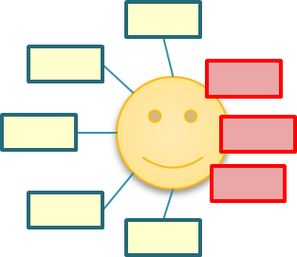
Special categories of personal data
data revealing: racial or ethnic origin, political opinions, religious or philosophical beliefs, or trade union membership, and the processing of genetic data, biometric data for the purpose of uniquely identifying a natural person, data concerning health or data concerning a natural person's sex life or sexual orientation
«genetic data»:data relating to the inherited or acquired genetic characteristics of a natural person which give unique information about the physiology or the health of that natural person and which result, in particular, from an analysis of a biological sample from the natural person in question,
«biometric data»:data resulting from specific technical processing relating to the physical, physiological or behavioural characteristics of a natural person, which allow or confirm the unique identification of that natural person
  ex. facial images or dactyloscopic data
«health data»:data related to the physical or mental health of a natural person
Separate «special» category: criminal convictions and offenses

Slide 20
Defining information
Personal information | Sensitive personal information
Name | Race
Address | Religion
Date of birth | Political opinion
Email address | Trade union membership
Photographs | Sexual orientation
IP address – the unique digital address attributed to your digital devices | Sex life
Location data | Gender identity
Online behaviours – traced through 'cookies' | Health information
Profiling and analytics data | Biometric data
 | Genetic data

Slide 21
Data Processing
Any operation or set of operations performed on personal data or on sets of personal data
  collection, recording, receipt
  storage, backup, filing, retention
  display, scanning, review
  deletion, destruction
  editing, updating, modification
  copying, transmission, transfer, release

Slide 22
Examples of processing
staff management and payroll administration
access to/consultation of a contacts database containing personal data
sending promotional emails
shredding documents containing personal data
posting/putting a photo of a person on a website
storing IP addresses or MAC addresses
video recording (CCTV)

Slide 23
When can you process personal data?
PERSONAL DATA | SPECIAL CATEGORIES OF PD
Consent | Explicit consent
Necessary for performance of contract | Required to comply with employment, social security, or social protection legislation
Necessary for compliance with legal obligation | Protect vital interests of individual
Protect vital interests of individual | In connection with legal proceedings and administration of justice
Necessary for performance of a task in the public interest | Information already made public by data subject
Necessary for the purposes of legitimate interests | Necessary for medical reasons or public interest in relation to public health
 | Necessary for archiving, scientific or historical research, or statistical purposes

Slide 24

Data Subject
‘personal data’ means any information relating to an identified or identifiable natural person …’
This is the technical term for the individual whom particular personal data is about.
What are identifiers and related factors?
An individual is ‘identified’ or ‘identifiable’ if you can distinguish them from other individuals.
A name is perhaps the most common means of identifying someone.
However whether any potential identifier actually identifies an individual depends on the context.
A combination of identifiers may be needed to identify an individual.

Slide 25
Data Breach
Someone who is not entitled to see the data but obtain access without consent
When data gets lost, destroyed, or seen by an unauthorised third party.
  This can be accidental, for example leaving information on a train or accidentally shredding the wrong piece of paper.
  Can be malicious
It is necessary to notify any breach within 72 hours to National data protection Authority
https://ico.org.uk/for-organisations/report-a-breach/

Slide 26
Personal Data Terms
Data Controller
  The Data Controller determines the purposes for which and the manner in which personal data is processed.
  It can do this either on its own or jointly or in common with other organisations (who would be Joint Controllers).
  A controller is the person that decides how and why to collect and use the data. This will usually be an organisation, but can be an individual (eg. a sole trader, a doctor, a lawyer etc).
  Exercises overall control over the ‘why’ and the ‘how’ of a data processing activity
  Ex: Generally, company /university acts as data controller, Employees are agent of data controller will be treated as data controllers for the purposes of the GDPR

Slide 27

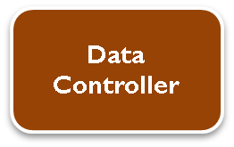
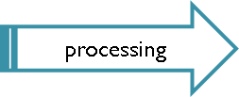
Any natural or legal person, public authority, agency or other body which, alone or jointly with others, determines the purposes and means of the processing of personal data’
ATTENTION!:where the purposes and means of such processing are determined by Union or Member State law, the controller or the specific criteria for its nomination may be provided for by Union or Member State law

Slide 28
Data Controller -KALIMBASIERIS MARITIME
As a Data Controller we collect and process information from our clients, our current or candidate employees, our suppliers or our collaborators for the proper execution of our contractual obligations. More specifically we collect and process under certain legal bases and specific purposes:
Contact data related to Clients, Brokers, Ship Managers, Workshops, Public Services and/or other relevant connections to Kalimbassieris Maritime’s business.
Payment details: invoice and payment records, billing address, bank account number or credit card number, cardholder or accountholder name, SWIFT and IBAN details, payment date and payment amount, records of cheques.
Information about current and/or former employees, personnel representatives and temporary manpower.
https://kalimbassieris.com/privacy-policy/

Slide 29
Personal Data Terms
Data Processor
  Processor is any person (other than an employee of the data controller) or organisation who processes the data on behalf of the Data Controller
    Ex: Supplier,
  Processor cannot make decisions about the ‘why’ and the ‘how’ of a data processing activity to process personal data that was supplied to it via the Data Controller
Data subject
  a natural person whose personal data is processed by a data controller or processor.

Slide 30
Personal Data Terms
The Data Protection Officer (DPO) is a specific role which will be a legal requirement for many organisations
  The law requires that in certain circumstances organisations must have a named Data Protection Officer (DPO). One of these is where there is large scale processing of “special categories of personal data”.
  The DPO has an education and compliance role regarding GDPR and is the first point of contact for the wider world. They must report to a senior level in the organisation and be independent – so similar to Internal Audit.
Data profiling – usually an automated process of evaluating personal aspects such as age or gender

Slide 31
General Data Protection Regulation(GDPR)
GDPR replaces the Data Protection Directive 95/46/EC
Designed to harmonize data privacy laws across Europe, to protect and empower all EU citizens data privacy and to reshape the way organizations across the region approach data privacy
  Tougher fines for non-compliance and breaches
    Under GDPR organizations in breach of GDPR can be fined up to 4% of annual global turnover or €20 Million (whichever is greater).
    There is a tiered approach to fines e.g. a company can be fined 2% for not having their records in order
  Gives people more control over what companies can do with their data.

Slide 32
General Data Protection Regulation(GDPR)
Principles relating to processing of personal data (Article 5 GDPR)
Lawfulness, fairness and transparency
    Personal data shall be processed lawfully, fairly and in a transparent manner in relation to the data subject
Purpose limitation
    Personal data shall be collected for specified, explicit and legitimate purposes and not further processed in a manner that is incompatible with those purposes
  Data minimisation
    Data must be "adequate, relevant and limited to what is necessary in relation to the purposes for which they are processed
  Accuracy
      Personal data shall be accurate and, where necessary, kept up to date
      Inaccurate or outdated data should be deleted or amended and data controllers are required to take "every reasonable step" to comply with this principle.

Slide 33
General Data Protection Regulation(GDPR)
  Storage limitation
      Personal data shall be kept in a form which permits identification of data subjects for no longer than is necessary for the purposes for which the personal data are processed
      This means there should be a regular review process in place with methodical cleansing of databases.
  Integrity and confidentiality
  Personal data shall be processed in a manner that ensures appropriate security of the personal data, including protection against unauthorised or unlawful processing and against accidental loss, destruction or damage, using appropriate technical or organisational measures
  Accountability
  The controller shall be responsible for, and be able to demonstrate compliance with the GDPR

Slide 34
General Data Protection Regulation(GDPR)
Policies and procedures (Article 5)
  the company must have and implement data protection policies.
    General Data Protection Policy
    Data Subject Access Rights Procedure
    Data Retention Policy
    Data Breach Escalation and Checklist
    Employee Privacy Policy and Notice
    Processing customer data policy
    Guidance on privacy notices

Slide 35
General Data Protection Regulation(GDPR)
Breach notification(Article 33)
  Does the company have procedures in place to enable it to report a breach to the regulator within 72 hours of becoming aware of it?
  The breach must be investigated and details provided to the regulator about the nature of the breach, likely consequences and mitigations being taken to address it.
  Data processors will also be required to notify their customers, the controllers, “without undue delay” after first becoming aware of a data breach.

Slide 36
GDPR Implementation
Action list
  Make everyone aware of this
  Nominate a dedicated lead for this
  List everywhere you store data
  Create a simple explanation of why you need to hold the data - what's the purpose?
  Contact everyone, explain this, and ask for their consent to hold their data
  Data update after consent
  Have this written down in a policy
Have you made everyone aware of this?
    Employees/Board/Trustees
    Service users
    Members
    Supporters
    Donors
    Anyone else?
Who is your lead?
  DPO as contact person for policy

Slide 37
GDPR Implementation
Where is the data store?
  Local and cloud based operating systems
  Spreadsheets and databases
  Paper records of the above
  Personal electronic and paper files
  Handwritten notes and lists
  Anything else/anywhere else?
Purpose
  Purposes must be “specified, explicit and legitimate”
  You must set out your purposes clearly and unambiguously
  In Maritime, you need to be very specific when share passenger data to a third party

Slide 38
GDPR Implementation
Gaining consent
  Being transparent and providing accessible information to individuals about how you will use their personal data is a key element of this
  The most common way to provide this information is in a privacy notice
  The best privacy notices are as short as they can be, written in language that is plain
  You should ask individuals to positively opt-in
  You should give them sufficient information to make a choice about opting in
  If your consent mechanism consists solely of an “I agree” box with no supporting information then people are unlikely to be fully informed and the consent cannot be considered valid
The starting point of a privacy notice should be to tell people:
    Who you are
    What you are going to do with their information
    And who it will be shared with
Upon Consent
  how long the consent lasts and when reminders need to be sent
  Be clear about what parts someone is consenting to as they may not positively opt in to all the options
Policies
  a List of policies are required to comply with GDPR

Slide 39
GDPR : Implementation-Policies
Personal Data Protection Policy (Article 24)
  A data protection policy is a statement that sets out how your organisation protects personal data.
Privacy Notice (Articles 12, 13, and 14)
  A privacy notice is a public statement of how your organisation applies (and complies with) the GDPR’s data processing principles.
  An essential part of compliance, it serves two purposes: to promotes transparency, and to provide individuals with more control over the way their data is used.
Employee Privacy Notice (Articles 12, 13 and 14)
  Under the GDPR, you must be more transparent and open than ever before about the employee-related data you process.
  It is also a core GDPR principle for employers to process HR related data in a fair and transparent way.

Slide 40
GDPR : Implementation-Policies
Data Retention Policy (Articles 5, 13, 17, and 30)
  A data retention (or records retention) policy outlines your organisation’s protocol for retaining information.
  It is important that your organisation only retains data for as long as it’s needed.
  This is because holding on to data for longer than necessary can take up valuable storage space and incur unnecessary costs.
  When writing your data retention policy, you should consider two key factors
    How you are going to organise information so it can be accessed at a later date; and
    How you will dispose of information that is no longer needed.
Data Retention Schedule (Article 30)
  A data retention (or records retention) schedule is a policy that defines how long data items must be kept.

Slide 41
GDPR : Implementation-Policies
Inventory of Processing Activities (Article 30)
  This document is mandatory if:
    more than 250 employees; or
    The processing the you carry out is likely to result in a risk to the rights and freedoms of data subjects; or
    The processing is not occasional; or
    The processing includes special categories of data;
    The processing includes personal data relating to criminal convictions and offences.

Slide 42
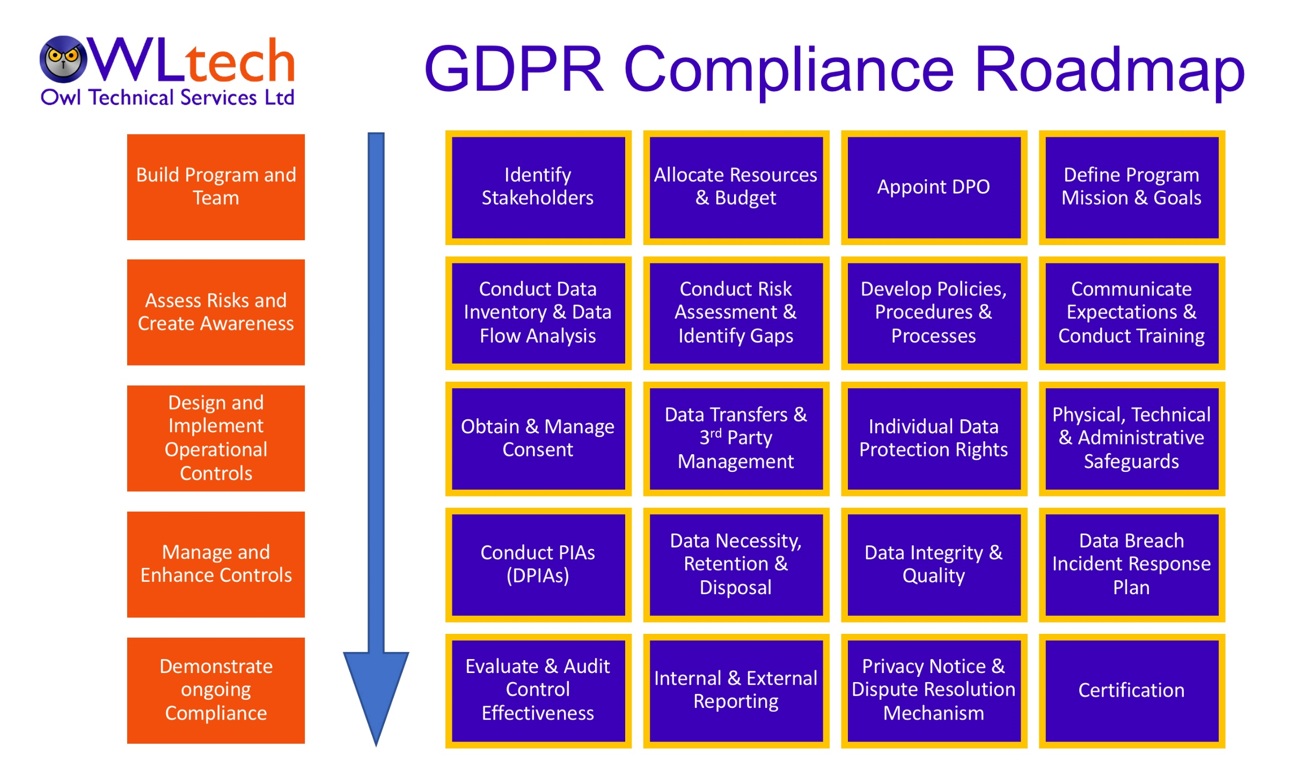

Slide 43
Privacy Technologies
privacy-enhancing measures
  such as data minimization, pseudonymization, and encryption, maritime organizations can reduce privacy risks and proactively protect personal data.
Strict access controls to prevent unauthorized access to personal data
Sensitive personal data should be encrypted both in transit and at rest
data protection agreements with responsibilities and obligations to third parties suppliers in Maritime

Slide 44
Privacy Enhancing Technology
Technology that enhances user control and removes personal identifiers
Differential Privacy : Injection of noise to datasets or query output, allowing the extraction of valuable insights without compromising individual privacy.
Homomorphic Encryption: Computation to performed on encrypted data without decrypting it first, ensuring privacy during data processing
Synthetic data: Artificial data generated by data synthesis algorithms. Replicate real data
Masking: removing or replacing personally identifiable information from a dataset to prevent the individual identification.

Slide 45
Privacy Enhancing Technology
Encryption tools
  SSL-Secure Socket Layer
  P3P (Platform for Privacy Preferences)-Users declare their privacy policy on their browsers
Pseudonymization: Allows replacing identifiable information within a dataset with artificial identifiers, aliases, or pseudonyms.
Federated Learning: ML model allows train across decentralized devices or servers while keeping the data localized and private.

Slide 46
GDPR-Maritime Context
The GDPR applies to a ship owner, operator or crewing agent who processes personal data and who is established in the EEA, regardless of the flag of the ship and the nationality of the crew.
Data processing: Both automated and non-automated processing of data
  collection, recording, organisation, structuring, storage, adaptation or alteration
Data controller
  controller engages a third party (e.g., service provider) to process personal data
  Ex: Ship owner collects crew data and ship owner will be considered a controller for the collection of crew data
    Ship owner are controllers for the disclosure of crew members’ personal data to port authorities
    a ship manager is a controller when it manages such data transmission to the authorities
https://shipip.com/eu-general-data-protection-regulation-gdpr-in-the-shipping-sector/

Slide 47
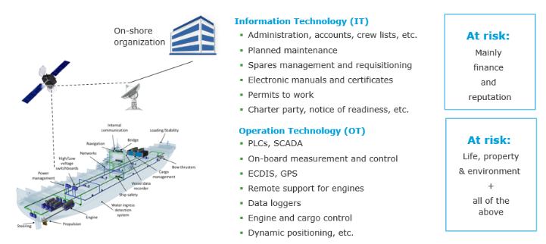
https://www.dnv.com/maritime/insights/topics/maritime-cyber-security/

Slide 48
Personal data used in Maritime
  Maritime sectors are likely to be affected as they hold a large volume of personal and sensitive data of key stakeholder
    Passengers, vessel crew, suppliers, employee, port authorities, regulatory bodies, technology providers, and industry associations.
  Personal data
    passenger information, crew information, travel documents, training records, bank details
    cargo manifests, shipping schedules
  Sensitive data
    personal injury claim or a claim involving a minor;
  shipping companies share this information with third parties such as port agents and P&I clubs
    cruise and ferry sectors-claims may be brought by individuals under data privacy legislation

Slide 49
Cyber attack in maritime
July 5, 2023, the Port of Nagoya(Japan’s largest and busiest port) struck by a ransomware attack
  disrupted the port’s communication systems, hindering the processing of import and export operations
  Operational downtime, financial losses, and cargo delivery delays.
  June 2017Maersk Cyber Attack hit by non-Petya malware
  virus stopped the company’s operations in Rotterdam, Los Angeles, Mumbai, Auckland, and many more ports around the world
  $250-300 million loss due to the disrupted business operations in July
  What else
Operational Disruption: Cyberattacks can compromise navigation, propulsion, and communication systems, leading to operational chaos and safety hazards.
https://www.txone.com/blog/protecting-global-trade-from-rising-maritime-risks/
https://linkedin.com/pulse/4-cases-cyber-security-failures-shipping-history-chronis-kapalidis/

Slide 50
Impact of GDPR in Maritime
  Require a response at various technological and policy levels-collaboration between all the various stakeholders.
  Challenging due to
    adoption of advanced technologies, such as the Internet of Things (IoT), automation, and data analytics,
    Lack of governance framework that effectively addresses emerging threats relating to privacy
    shore-based offices of shipping companies are often the target of hackers
    ships become more connected to the internet

Slide 51
Maritime Sector
Data Privacy awareness and training
Privacy policy
  Clear policies and procedures for collection, storage, processing, retention, and disposal of data, and ensuring regular audits and reviews to ensure compliance with data protection requirements
Appoint a data protection officer to ensure compliance
  responsibility for data protection compliance
Consent management
  records and manages consent.
Data breach notification
  Right procedures are in place to detect, report and investigate a personal data breach,
Privacy Impact Assessment and Risk Management

Slide 52
Privacy Policy
A policy is a document that states in writing how a company plans to protect the company's physical and information technology assets.
A set of rules that dictates acceptable and unacceptable behavior
  Organization’s intention and principles relating to information security
Element in a policy
  Coverage: comprehensive, apply explicitly to all possible situations already exist or will be exist in future within organization
  Durability: grow and adapt well in particular survive with the system’s growth and expansion without change
  Management support: Provide clear management direction and commitment
  Role and responsibilities: All roles and responsibilities must be agreed among all the responsible parties
  Periodic review : Should have revision after certain interval

Slide 53
Privacy notices under GDPR
Presented to data subject whenever new processing is undertaken
Consider a layered approach to notification
Must explain:
  personal data being processed with purpose
  purpose of processing,
  legal base of processing, including an analysis of legitimate interest
  intended retention periods,
  data subject rights and where they can lodge a complaint
  source of data and conditions of processing,
  intended recipients and international transfers
  existence of automated decision making, including profiling

Slide 54
Privacy notices under GDPR
Article 12 requires that the information or communication in question must comply with the following rules:
it must be concise, transparent, intelligible and easily accessible (Article 12.1);
clear and plain language must be used (Article 12.1);
the requirement for clear and plain language is of particular importance when
providing information to children (Article 12.1);
it must be in writing “or by other means, including where appropriate, by electronic means” (Article 12.1);
where requested by the data subject it may be provided orally (Article 12.1) ; and
it generally must be provided free of charge (Article 12.5).

Slide 55
Privacy Policy in Maritime
https://kalimbassieris.com/privacy-policy/
https://kbsmaritime.com/privacy-policy/

Slide 56
Consent

Definition: Consent must be a freely given, specified, informed and unambiguous indication of an crew, passenger and other relevant stakeholder wishes
by which he or she, by a statement or by a clear affirmative action, signifies agreement to the processing
of personal data relating to him or her
Consent is only one of the legitimate grounds for processing personal data under the GDPR.
It should only be used where an individual is offered a genuine choice to either accept or decline what is being offered. It would not be appropriate to rely on consent if, for example, the individual had no choice but to use the service or to accept the terms:
e.g. access to free wifi only if the user consents to receiving marketing materials would be unacceptable as the two things are unrelated.
There must be some form of clear affirmative action – a “positive opt in”.
Consent cannot be inferred from silence, pre-ticked boxes or inactivity.
Consent must be as easily revoked as it is given, and therefore clear processes should be in place for
individuals to withdraw consent.

Slide 57
Components of valid consent
Freely given
Free means real choice for the data subject
Where there is a clear inequality between the da subject and the controller consent cannot be considered as “freely given”
  In cases, where the controller is public authority consent is really difficult to be considered as free
The data subject may always have the right to object or withdraw his/her consent without suffering any detriment
Specified
Purpose determination
Separate consent for each purpose
  General purposes should be avoided
  It may cover more than one processings as long as they have the main purpose
Separate and clear information on processing before consent
Data controllers should provide data subjects with information on the categories of data processed for each purpose, in order for the data subjects to be able to know the effects or risks of the processing

Slide 58
Components of valid consent
Information provided should be at least the following:
  Controller’s identity
  Purpose of each processing for which consent is needed
  Categories of data collected and processed/ right to withdraw
  Use of automated decision making, including profiling
  In case there is a transfer to third countries, information on the risks
Ways/Methods of providing information
  GDPR doesn’t give specific direction, defines though that it should be clear and in simple words
  Language and text comprehensible by an average citizen .no legal text or terms
informed
GDPR requires declaration or affirmative action of the data subject
  Not acceptance after simple information with no further action
  Pre-ticked or opt-out boxes are not considered as valid consent
  Any means may be used for reception of consent as long as controller can prove that consent is given
    Ideally in written form!
    Recording if appropriate prior information has been provided
By electronic means…
  Controllers can create their own systems as long as they are based on GDPR rules and principles, ex:
    Swipe, mobile rotation in 8 etc.
    A simple scroll in the text doesn’t meet the requirement
affirmative declaration of consent

Slide 59
Data Privacy Impact Assessment
Aim is to identify risk relating to processing of personal data
Mitigate the risk
mandatory where the processing of personal data is likely to result in a high risk to the rights and freedoms of individual data subjects.
7 Steps
Step 1: Determine the necessity of DPIA
  Article 35(3) sets out three types of processing that always require a DPIA:
    1) Systematic and extensive profiling with significant effects
    2) Large-scale use of sensitive data
    3) Public monitoring
https://www.itgovernance.co.uk/blog/gdpr-six-key-stages-of-the-data-protection-impact-assessment-dpia

Slide 60
Data Privacy Impact Assessment
Step 2: Describe the processing
How and why
  Nature/Scope/Context/Purpose
Step 3: Consider consultation
  Based on existing contacts
  New potential users
Step 4: Assess necessity and proportionality
  Necessity ->lawfulness of the processing of personal data
    processing operations, retention periods and the categories of data processed
    Proportionality -> adequate and relevant for the purpose of the processing
Step 5: Identify and assess risks
  Risk relating to processing of personal data
Step 6: Risk mitigation
Step 7: Documentation

Slide 61
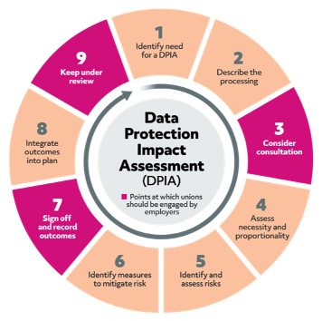
https://prospect.org.uk/about/data-protection-impact-assessments-a-union-guide/

Slide 62
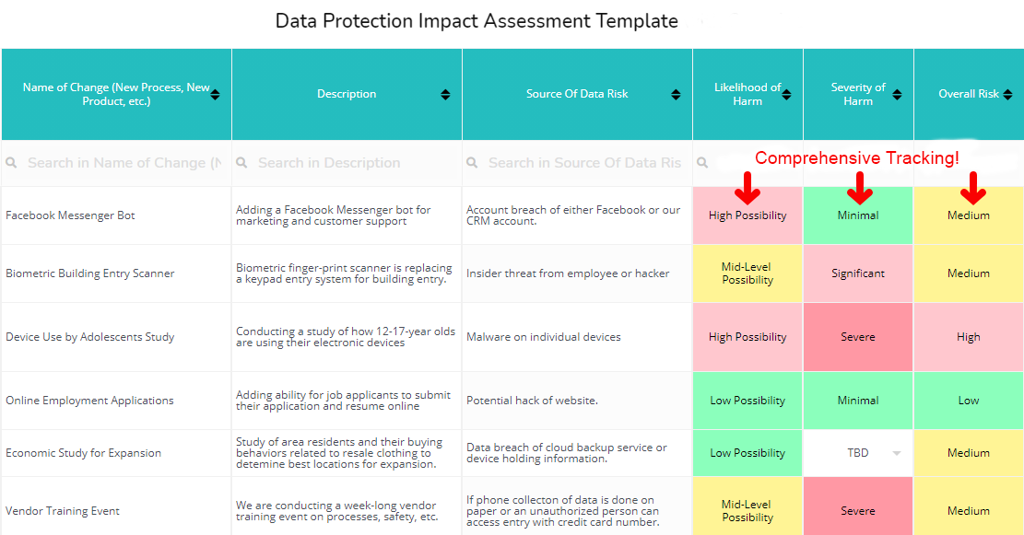
https://www.ocmsolution.com/data-protection-assessment-tool/

Slide 63
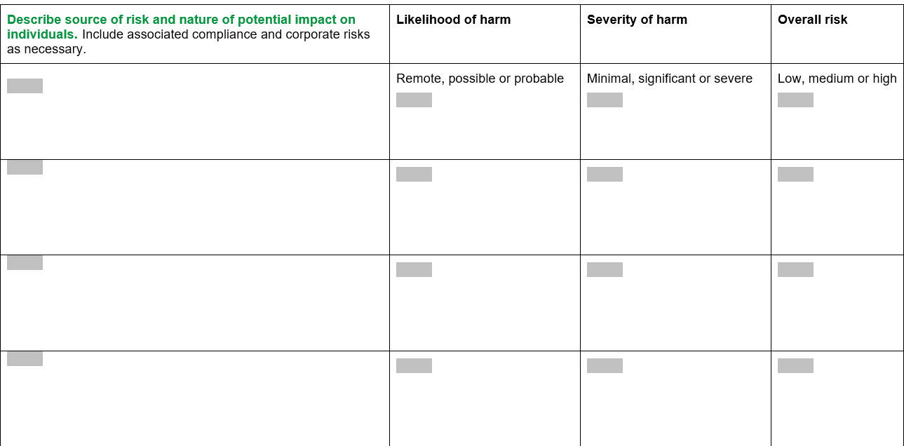

Slide 64
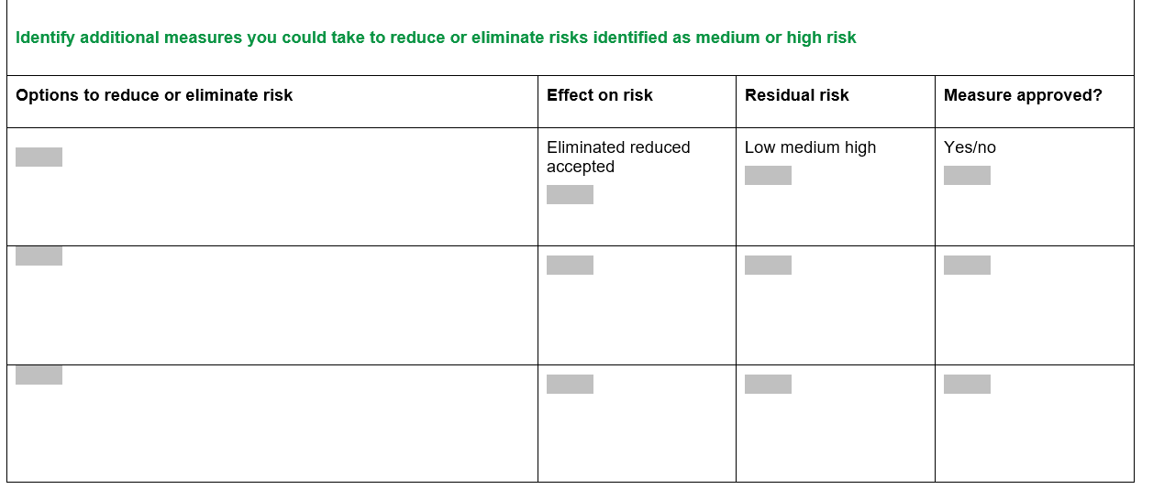
https://assets.publishing.service.gov.uk/media/5ec6a4a5d3bf7f45fa0989e5/SCC__ICO_DPIA_Template_V4_.docx

Slide 65
Best practice guideline for overall privacy awareness
Develop a privacy program
Privacy policy
conduct thorough risk assessments on a regular basis to identify vulnerabilities and potential cyber threats and implement proactive risk management strategies,
strict guidelines for the collection, storage, processing, and sharing of personal data.
Privacy awareness and training
Accurate DPIA
Monitor and continuous improvement

Slide 66


