Slide 1




DATA PROTECTION AND PRIVACY TECHNOLOGIES FOR ENERGY
CSP005_S_E
SLIDE SET #6: Hardware Security Module
Presentation by:
ANTONIOS NTIB

Slide 2


Slide 3
Outline
Crypto is great, but real-world security also needs hardware support
Design considerations and tradeoffs when designing hardware security modules

Slide 4
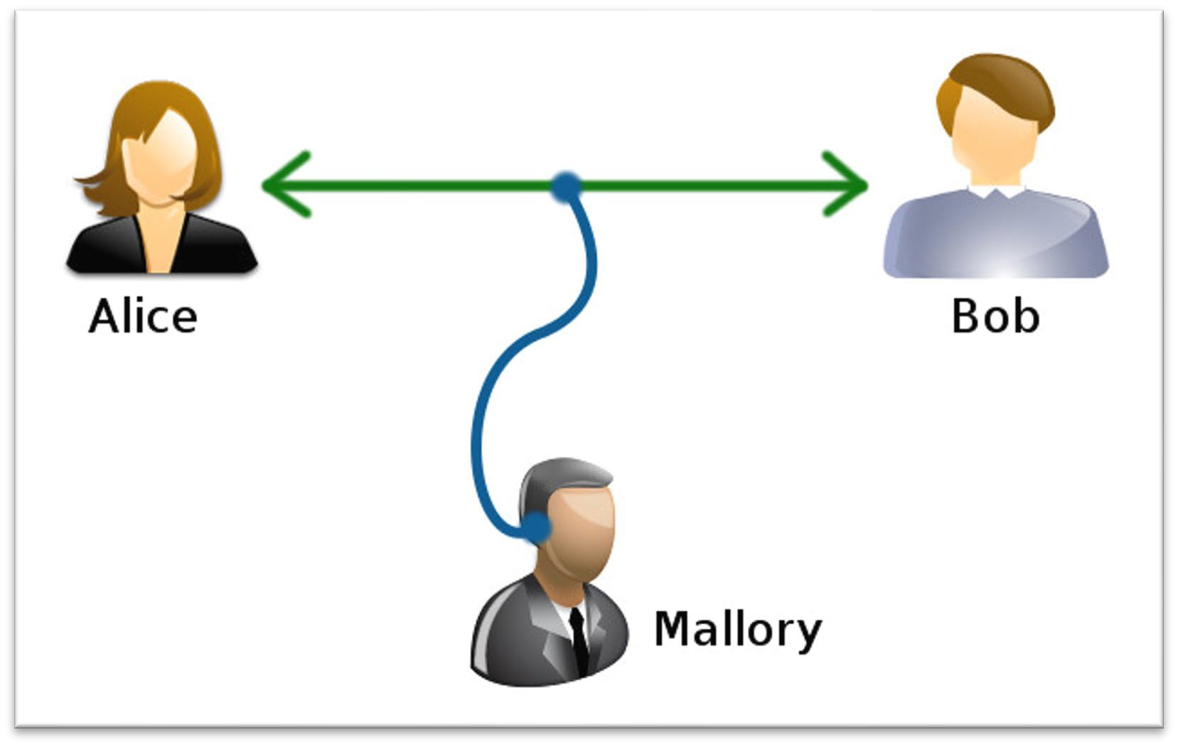
Security Property and Crypto Primitives
Confidentiality
  Symmetric
  Asymmetric
Integrity
Freshness

Slide 5
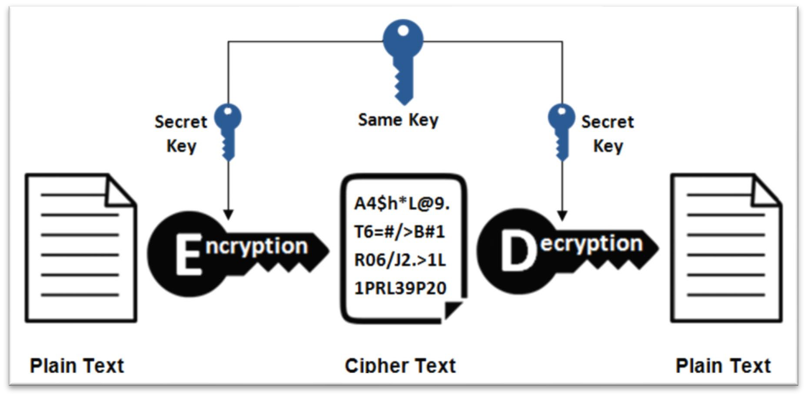
Symmetric Cryptography
One-time-pad (OTP)
Encryption:
ciphertext = key ⨁ plaintext
Decryption:
plaintext = key ⨁ ciphertext
How about encrypting arbitrary length message? Any problems?

Slide 6
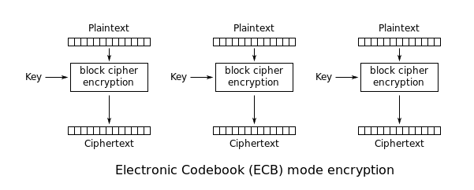
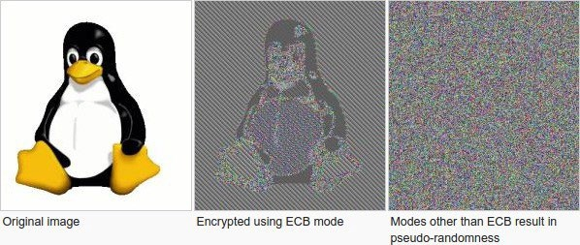
Block ciphers (e.g., DES, AES)
Divide data in blocks and encrypt/decrypt each block
AES block size can be 128, 192, 256 bits
ECB IS NOT RECOMMENDED

Slide 7
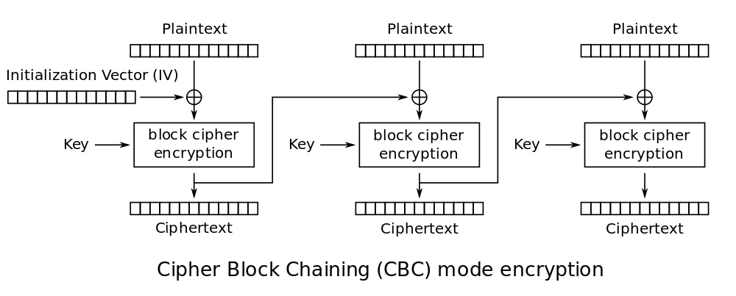
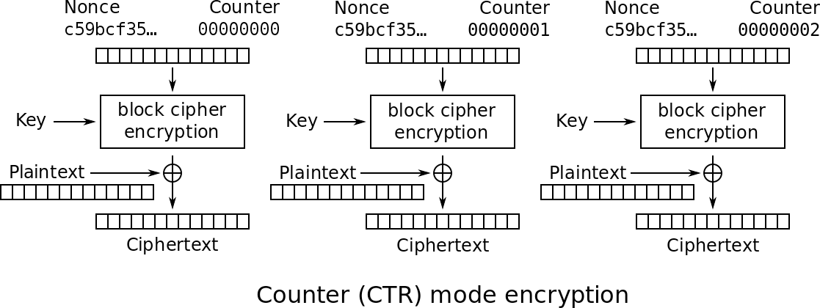
Block ciphers (e.g., DES, AES)
IV can be public, but need to ensure to not reuse IV for the same key.
Real-world application: file/disk encryption and memory encryption. How to exchange the shared key between two parties?

Slide 8

Asymmetric Cryptography (e.g., RSA)
A pair of keys:
  Private key (K_{private} – kept as secret)
  Public key (K_{public} – safe to release publicly)
Computation:
  Encrypt(plaintext, K_{public}) = ciphertext
  Decrypt(ciphertext, K_{private}) = plaintext
Mail box is public; Box key is private
Computationally more expensive, so usually use asymmetric cryptography to negotiate a shared key (e.g., DKE key exchange), then use symmetric cryptography
How to announce and obtain the public key?

Slide 9
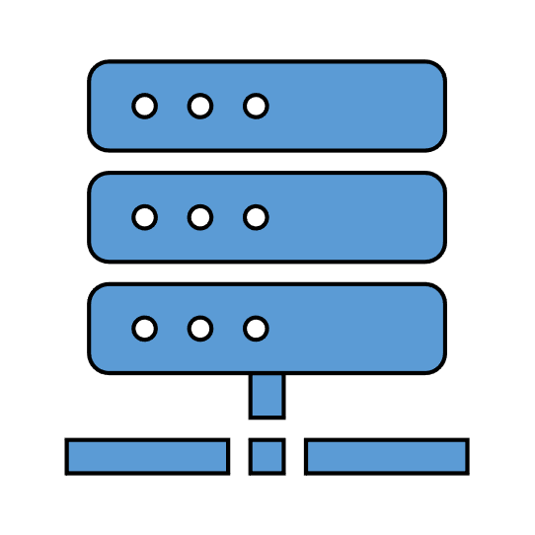



Public Key Infrastructures (PKIs)
Certificate Authority
Bob has a private key K_{private} and wants to claim he corresponds to a public key K_{public}
Analogy: public key is like a government-issued ID, need to be validated by an authority.
What is Bob’s public key?
Alice
Bob

Slide 10


Public Key Infrastructures (PKIs)
Bob has a private key K_{private} and wants to claim he corresponds to a public key K_{public}
Analogy: public key is like a government-issued ID, need to be validated by an authority.
Establish a chain of trust
Real-world use cases: identify website, identify hardware chips/processors
Certificate Authority
Bob’s public key is Kpublic
Sign using the CA’s private key
Alice
Bob

Slide 11
Integrity (MAC/Signature)
Hash(m) = h
Use as fingerprints
Message (long)
Hash value (length depends on algorithm)
One-way hash
  Practically infeasible to invert, and difficult to find collision
Avalanche effect
  “Bob Smith got an A+ in ELE386 in Spring 2005”→ 01eace851b72386c46
  “Bob Smith got an B+ in ELE386 in Spring 2005”→ 936f8991c111f2cefaw
When message is long
  Divide message into blocks, and keep extending the hash by adding previous hash

Slide 12
Integrity + Crypto
Using symmetric crypto:
Using asymmetric crypto:
  Sign: sig = dec(hash, K_{private})
  Verify:
    hash’= SHA(message)
    sig = enc(hash’, K_{public})
Certificate Authority
hash | = | SHA(message)
HMAC | = | enc(hash, key)
Bob’s public key is Kpublic
Sign using the CA’s private key
Alice
Bob

Slide 13

Freshness
Goal: to block replay attack
Certificate Authority
Bob’s public key is Kpublic_old
Sign using the CA’s private key
Alice
Bob

Slide 14

Freshness
Certificate Authority
Goal: to block replay attack
Nounces + Integrity
  Nonce is a one-time use random number
  Should not reuse the same nounce
What is Bob’s public key?
+ Nounce
Alice
Bob

Slide 15


Freshness
Certificate Authority
Goal: to block replay attack
Nounces + Integrity
  Nonce is a one-time use random number
  Should not reuse the same nounce
Challenge-response
Bob’s public key is Kpublic
+ Nounce
Sign using the CA’s private key
Alice
Bob

Slide 16



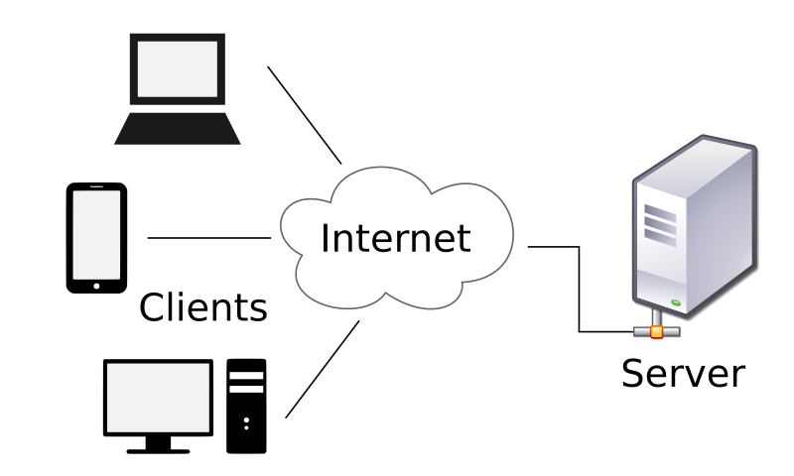

Hardware establishes root of trust.
Security Contexts #1
b) A remote server wants to trust anae)ndA-unseenr,de-u.gs.e, rwwhaentjsotinointrgusat a
company’s highly-secure net
c) device, rootkits?
work.
remote server, e.g., bank server.
Lost

Slide 17
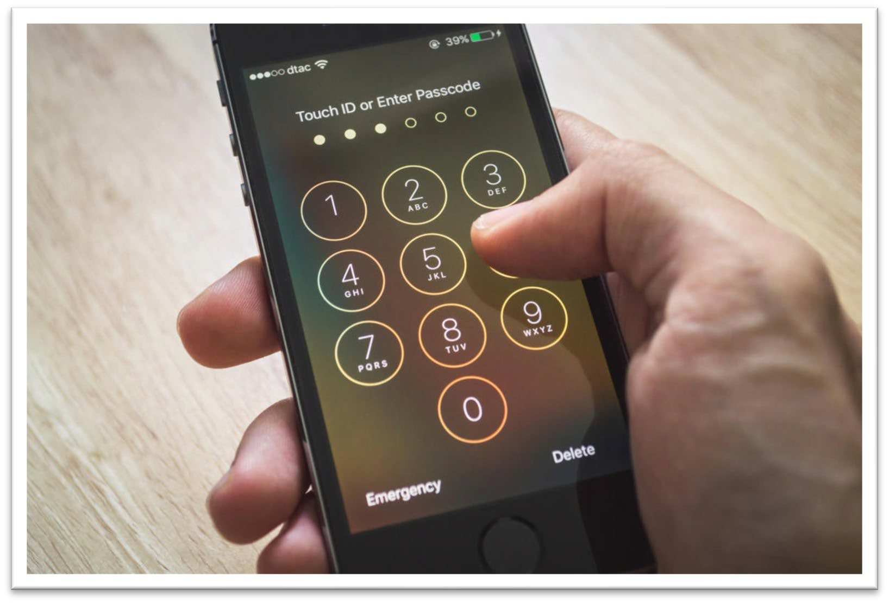



Security Contexts #2
Software piracy (copying and reselling software to gain benefits).
Disk lost or removed, leading to confidentiality leakage.
Data encryption with weak passwords, such as, 6-digit passcode.
Bind data/application with hardware.

Slide 18



Security Contexts #3
Remote computation where the host hypervisor and OS is not trusted.
Remote Computer managed by untrusted infrastructure provider
Container runs trusted software
Software Provider Data Owner
Hardware offers stronger isolation.

Slide 19
What Can Hardware Security Modules Offer?
Establish root of trust
Bind data and applications with the hardware device
Offer stronger isolation
More efficient

Slide 20
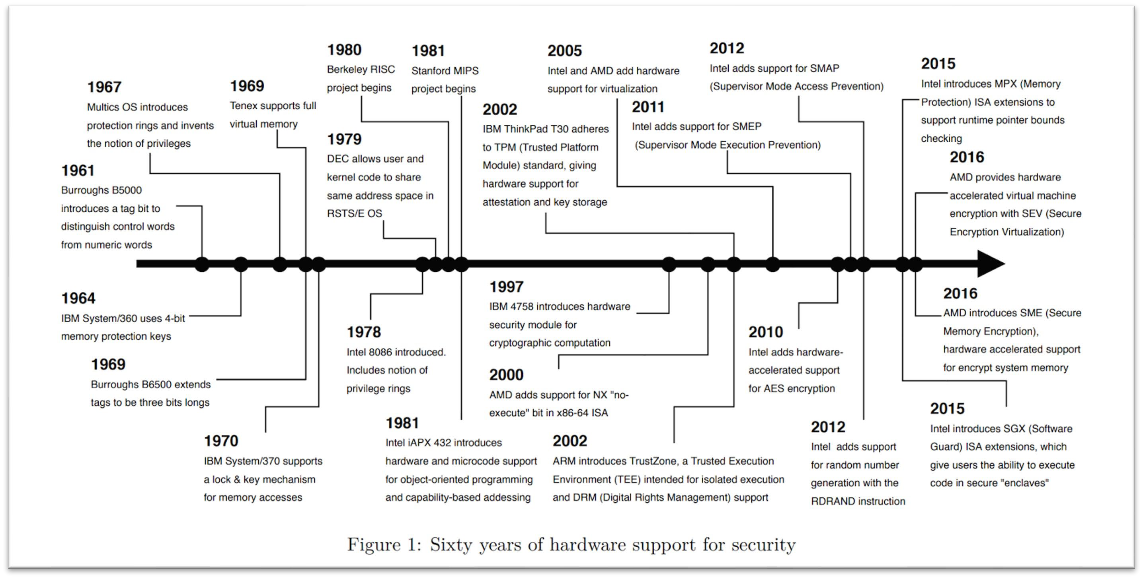
Secure Processors
Introduction to Security for Computer Architecture Students. Adam Hastings, Mohammed Tarek, Simha Sethumadhavan. https://www.cs.columbia.edu/~simha/ch1_supplement.pdf
19

Slide 21


Before IBM 4758 (1999)
Crypto Accelerators
  Better performance
  Simple functionality
  Narrow interface
Crypto ASIC
(AES, RSA, etc.)
CPU
20

Slide 22

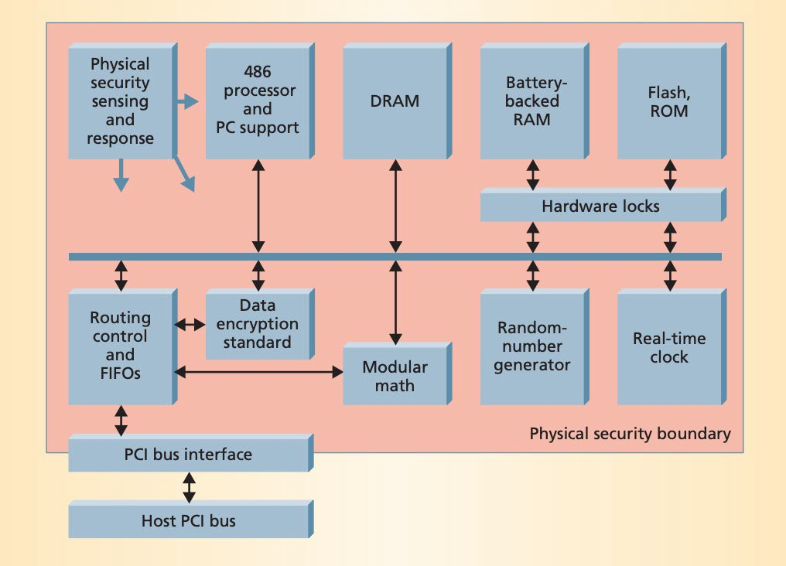


IBM 4758 (1999) -- 4765 (2012)
Stores the firmware and secret keys
Goal: a programmable, secure co-processor.
High level idea: virtual locker room
Programmable Secure
Co-processor
CPU
21

Slide 23
Software Layer Design and Concerns
Software stack:
  Application
  OS, kernel (microkernel)
  Loaders, firmware, etc.
Use cases:
  Solve music/software piracy issue
  Run an SSL server inside to store the agreed symmetric session keys
  Bank application
Problems:
  Update software is tricky
  Bad programmability due to microkernel

Slide 24

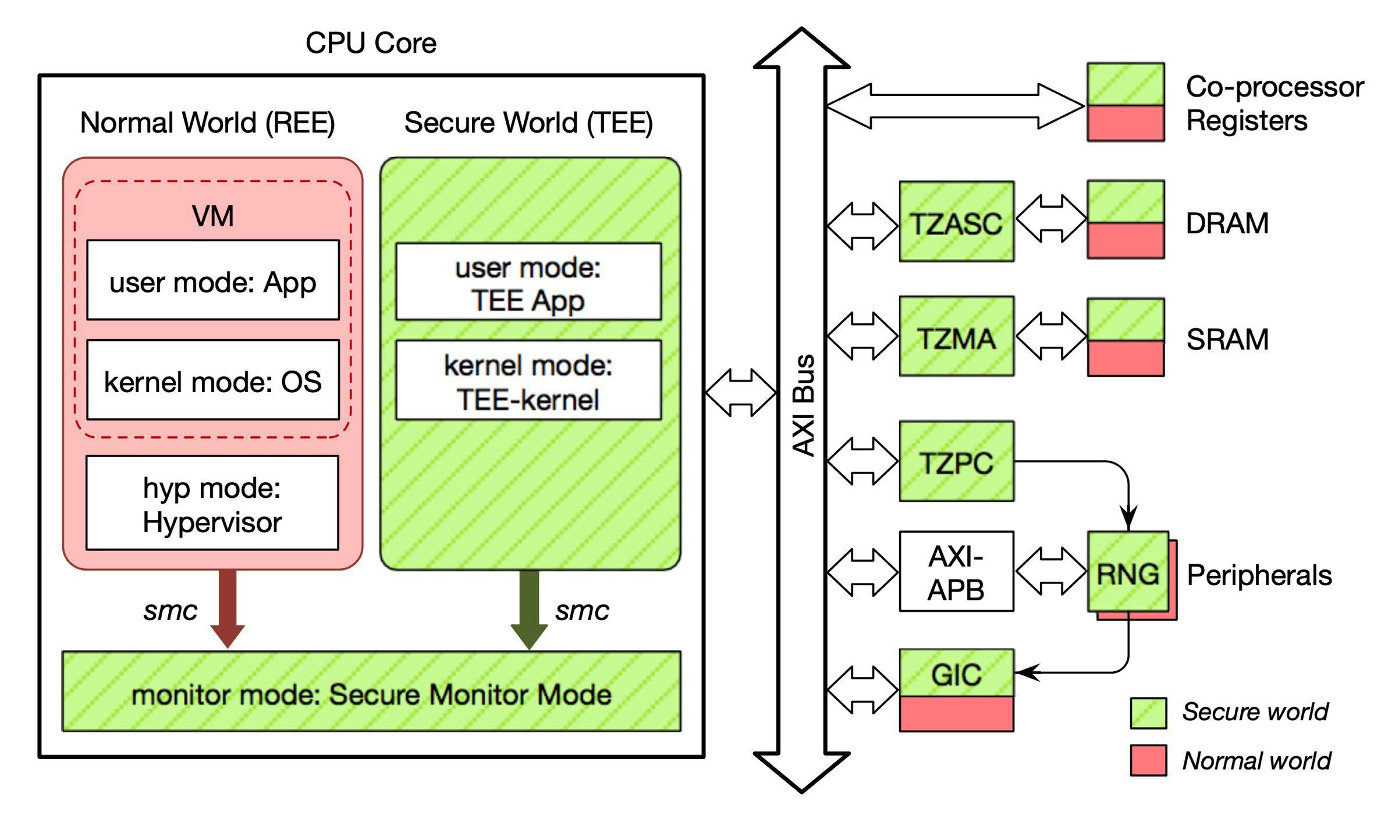


Compare to TrustZone
Programmable Secure
Co-processor
CPU
IBM 4758
ARM TrustZone

Slide 25
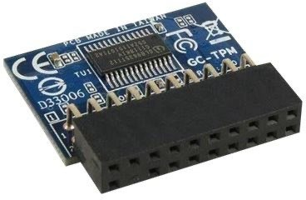

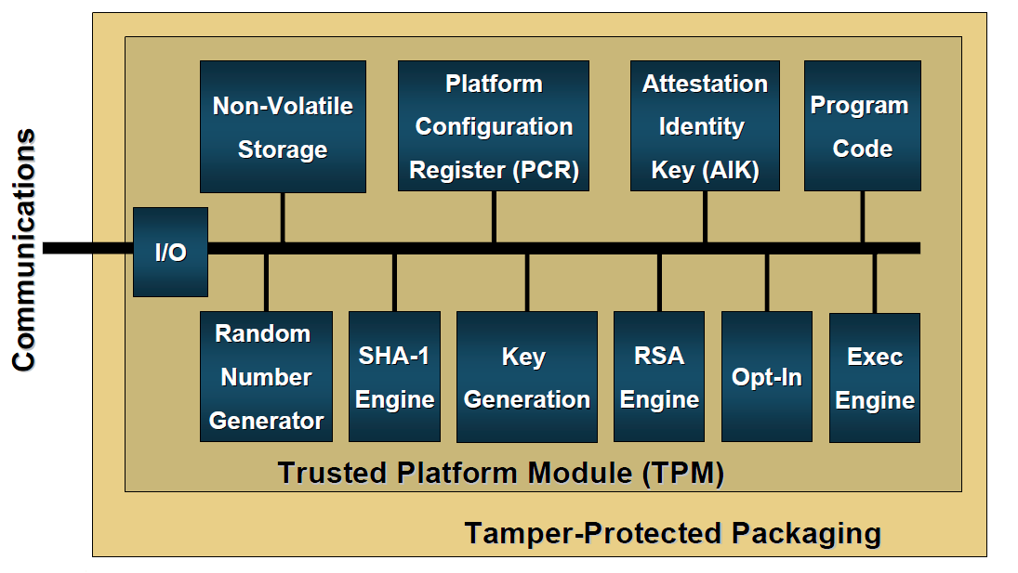
Trusted Platform Module (TPM)
“Commoditized IBM 4758”
Standard LPC interface – attaches to commodity motherboards
Weaker computation capability
Use cases:
  Disk encryption and password protection (“seal”)
  Verify platform integrity (firmware+OS)

Slide 26
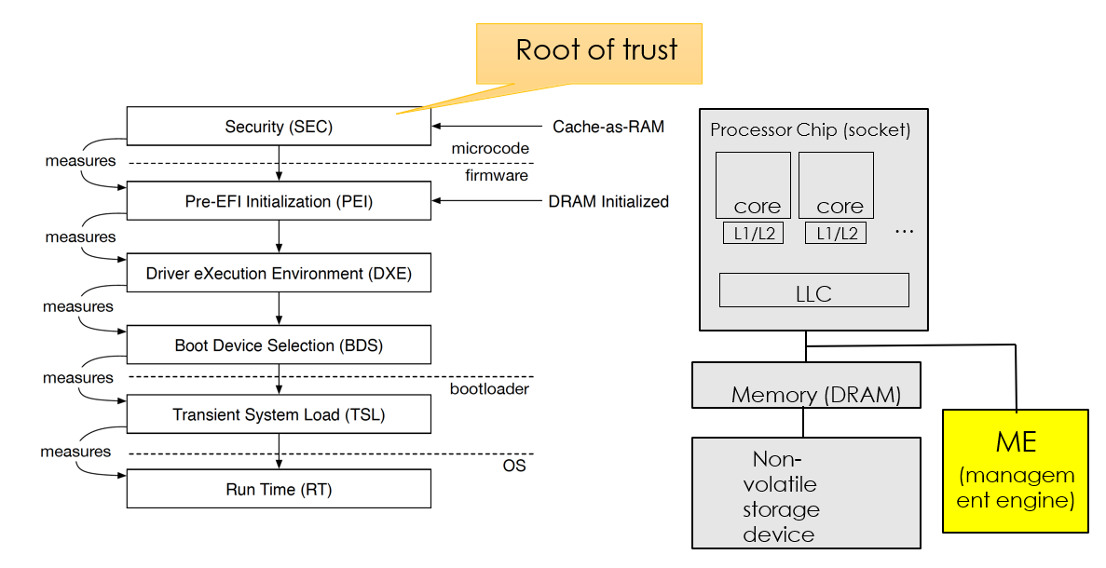
Boot Process (UEFI)
How to perform the measurement?

Slide 27
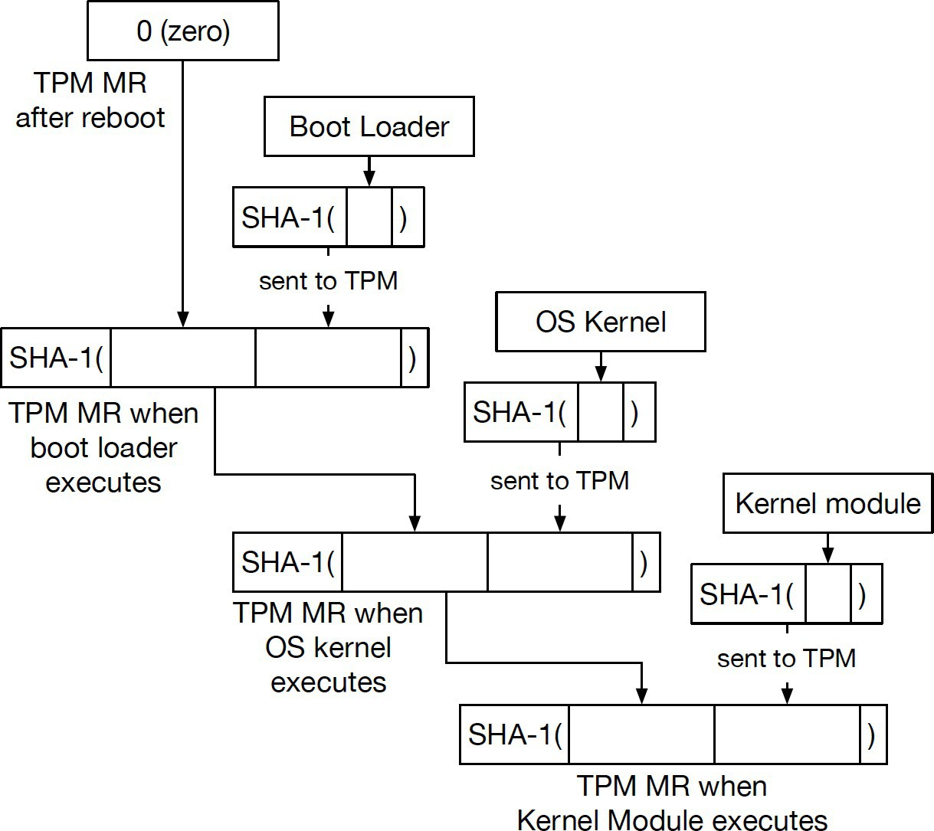
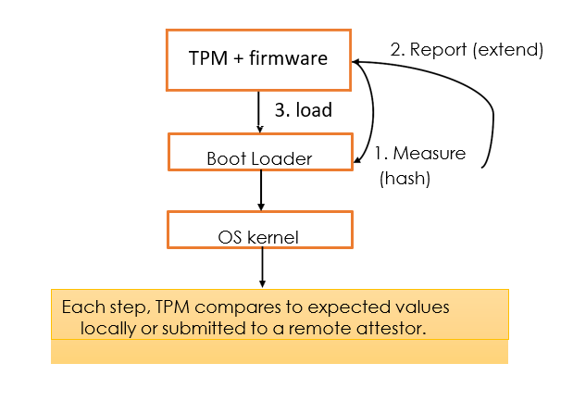
Secure Boot using TPM
PCR: platform configuration register

Slide 28
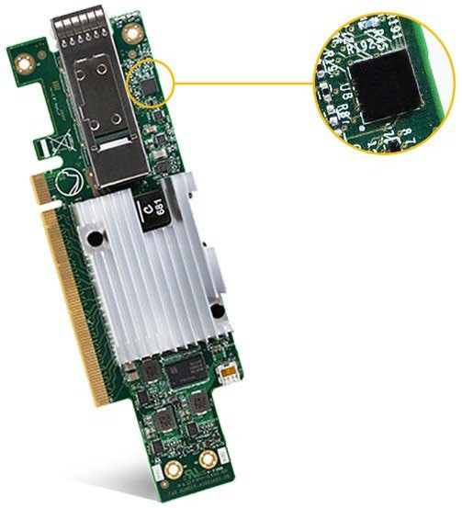
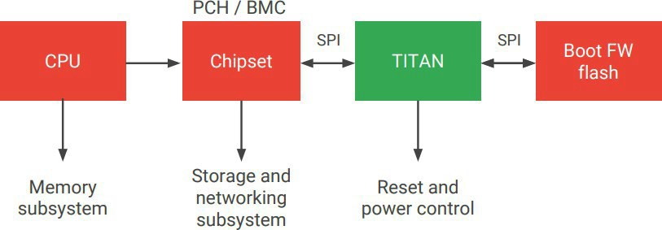
Open-source Choice: Google Titan
from https://www.hotchips.org/hc30/1conf/1.14_Google_Titan_GoogleFinalTitanHotChips2018.pdf

Slide 29


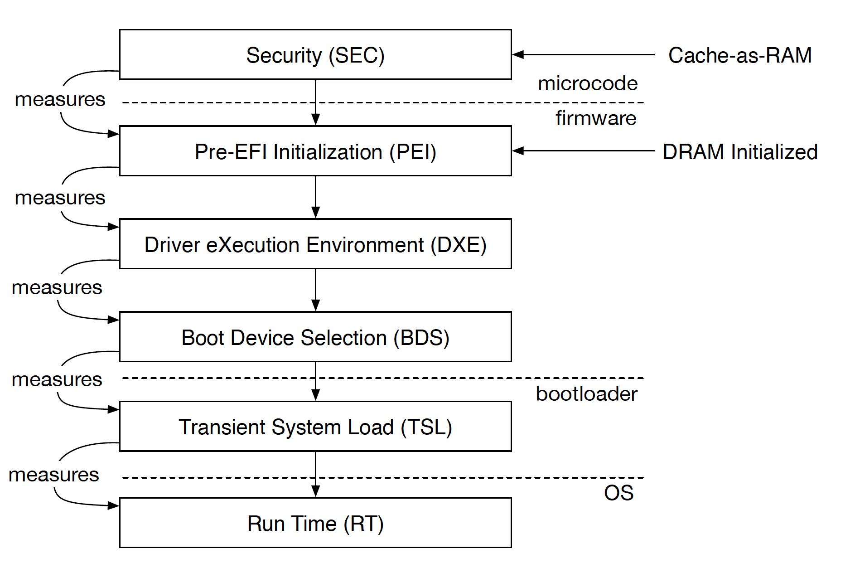


Security Problems of Using TPM
Root of trust
Assume the first-stage bootloader is securely embedded in motherboard
Not easy to use with frequent software/kernel update
Time to check, time to use
TPM Reset attacks
exploiting software vulnerabilities and using software to report false hash values
Han et al. A Bad Dream: Subverting Trusted Platform Module While You Are Sleeping. Usenix Security’18 Wojtczuk et al. Attacking Intel TXT® via SINIT code execution hijacking. 2011
TPM
CPU

Slide 30

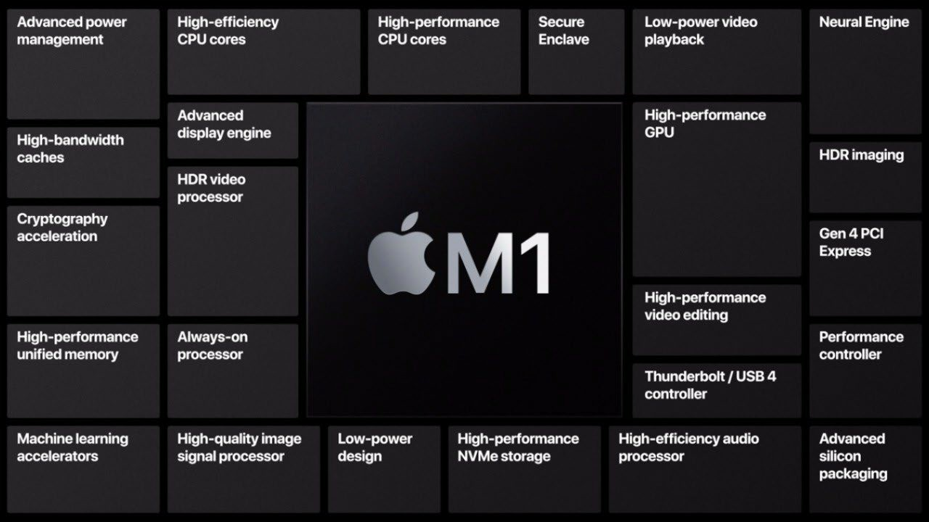
Apple Secure Enclave
Additional Goals:
Prevent jailbreak
Easy to use
Advantage: one company controls both the hardware and the software

Slide 31
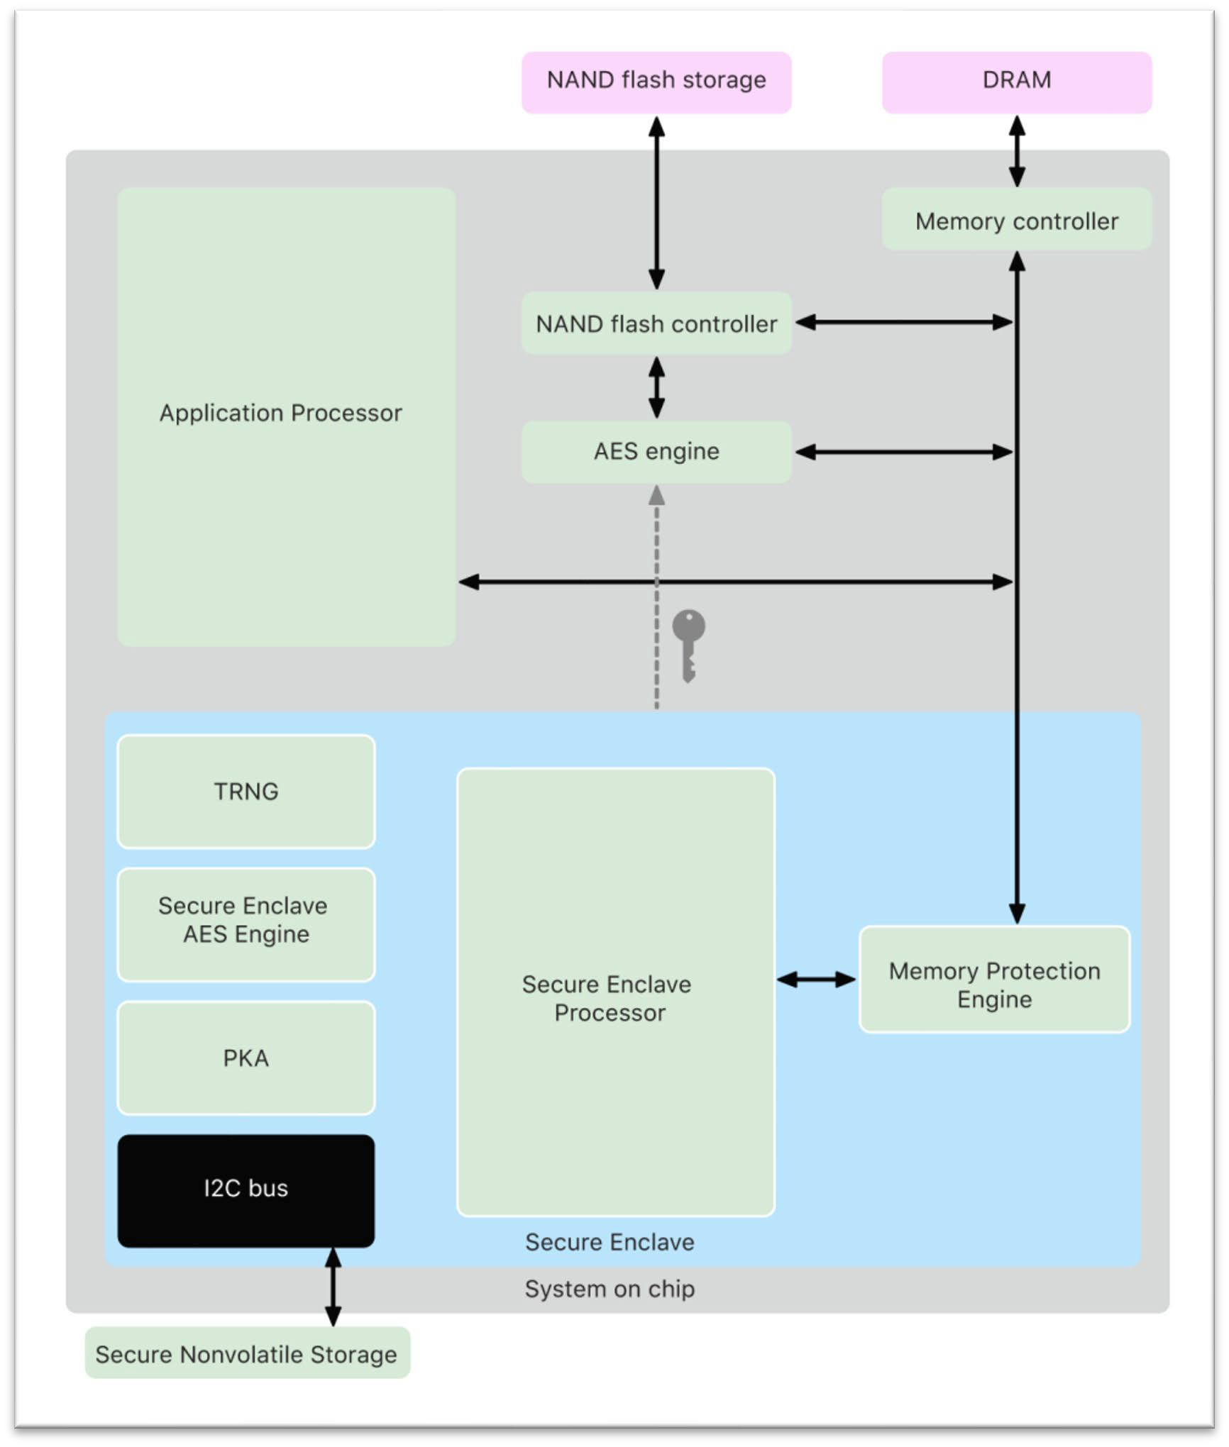
Isolation
Why separate cores?
Similar to IBM 4758
Strong isolation
Block vulnerabilities due to software bugs (running L4 microkernel) and side channels
Different from IBM 4758
Not general-purpose, only run secure enclave functionality

Slide 32

Crypto Keys
The Secure Enclave includes a unique ID (UID) root cryptographic key.
Unique to each device
Randomly generated
Fused into the SoC at manufacturing time
Not visible outside the device

Slide 33



Secure Non-volatile Storage
For easy to use: short passcode. But weaker security?
Passcode + UID -> passcode entropy
Brute-force has to be performed on the device under attack
Escalating time delays
Erase data when exceeding attempt count
All user data encryption keys

Slide 34
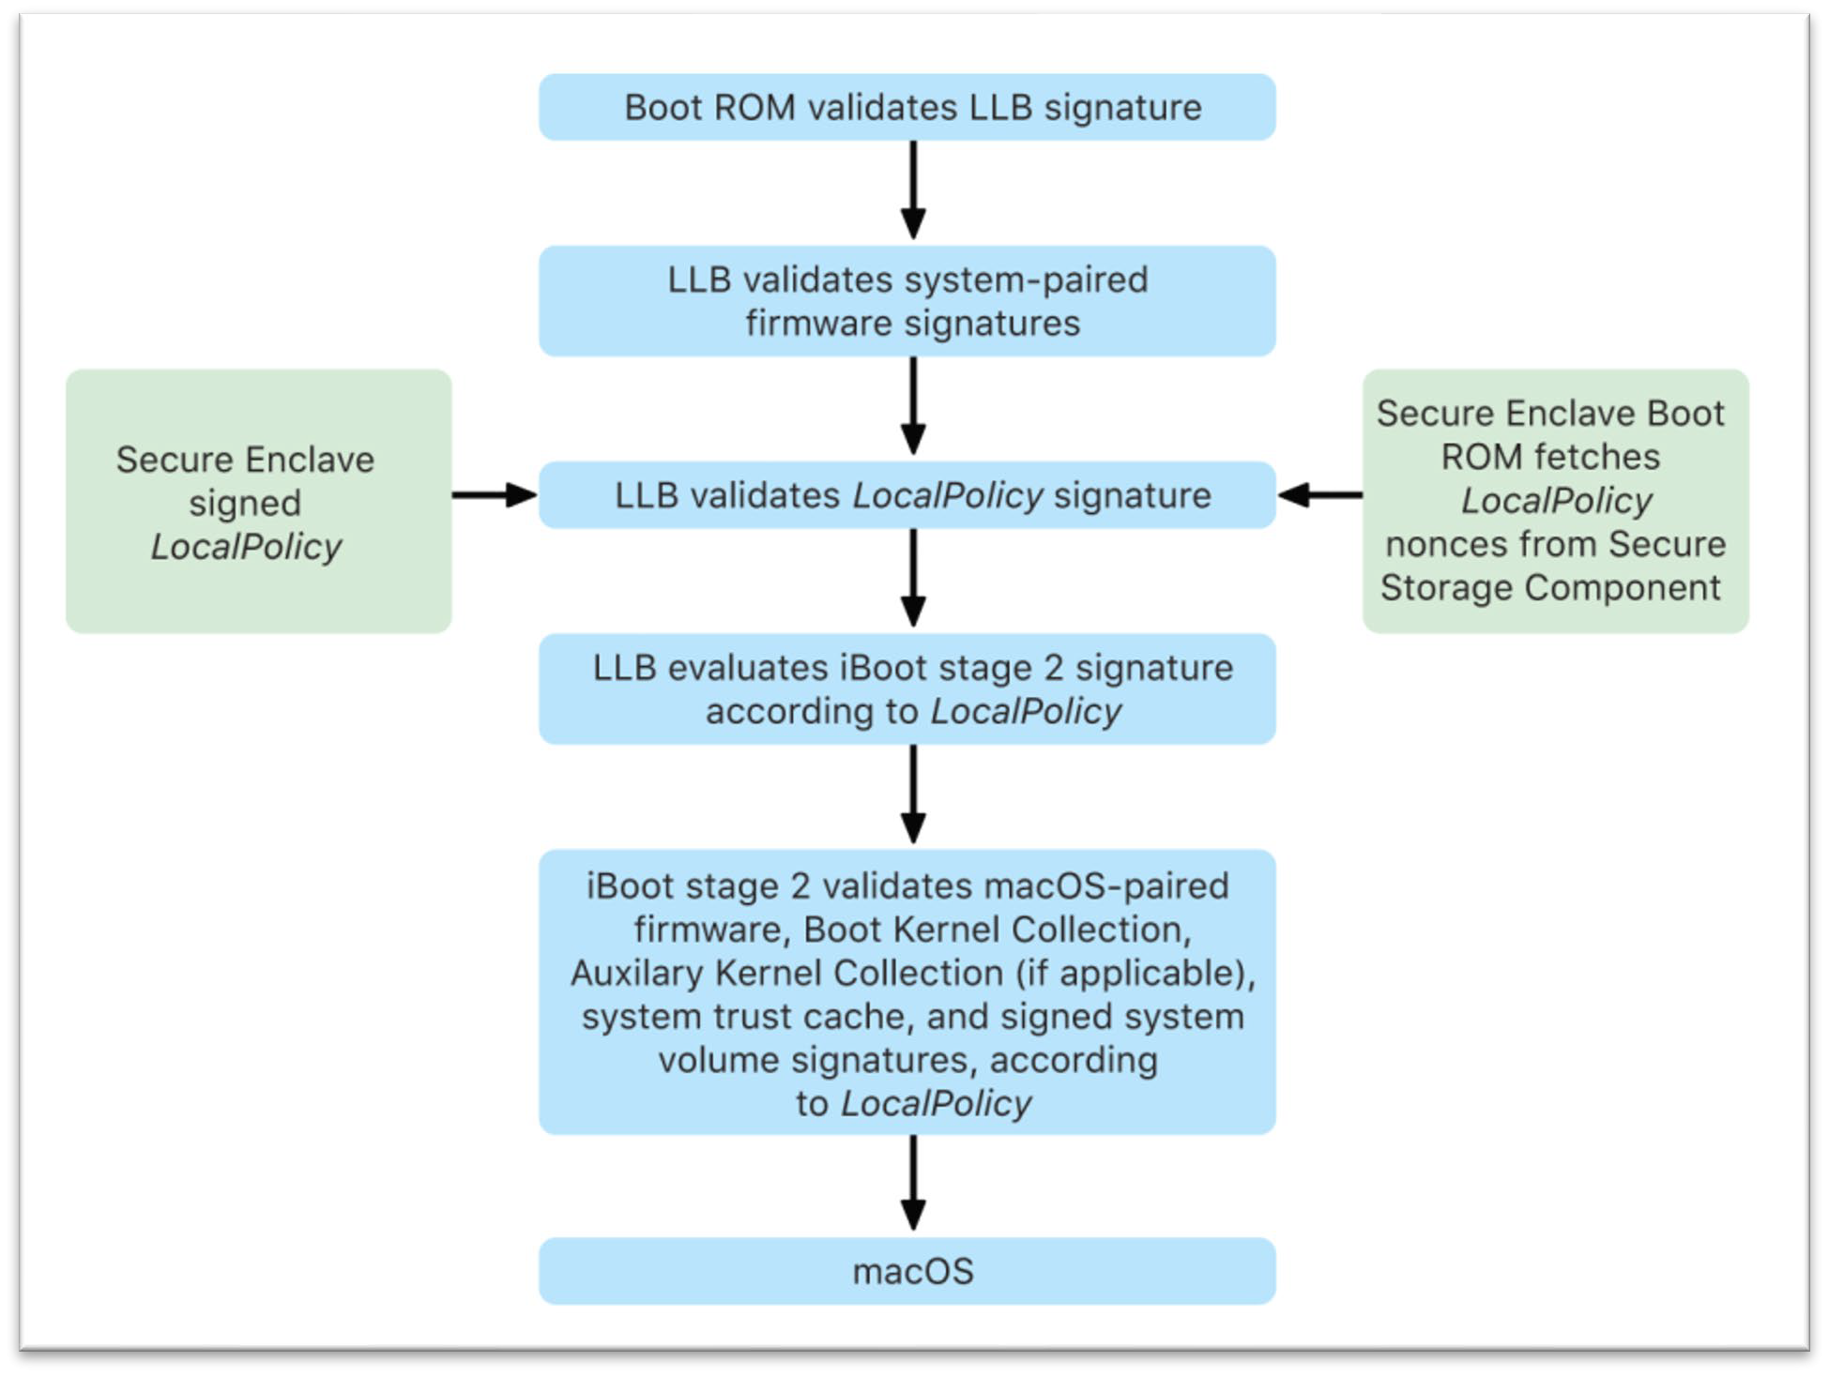
Secure Boot
Similar to TPM but with more constraints
Each step is signed by Apple to prevent loading non-Apple systems
  Using Apple Root Certificate authority public key
Verify more components, including
operating system, kernel extensions, etc.
Keep track of version number to prevent rolling back to older/vulnerable versions

Slide 35
Summary
What Can Hardware Security Modules Offer?
  Establish root of trust
  Bind data and applications with the hardware device
  Offer stronger isolation
  More efficient

Slide 36

Thank you

