Slide 1




DATA PROTECTION AND PRIVACY TECHNOLOGIES FOR ENERGY
CSP005_S_E
SLIDE SET #2: Analysis of DAC (Discretionary Access Control) Weaknesses
Presentation by:
ANTONIOS NTIB

Slide 2


Slide 3
Why Computers are Vulnerable?
Programs are buggy
Humans make mistakes
Access control is not good enough
  Discretionary Access Control (DAC) used in Unix and Windows assume that programs are not buggy

Slide 4
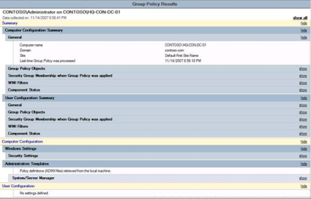
Access Control Check
Given an access request, return an access control decision based on the policy
  allow / deny
Access Control Check
A Request
Allow / Deny
The Policy

Slide 5
Discretionary Access Control
No precise definition. Basically, DAC allows access rights to be propagated at subject’s discretion
  often has the notion of owner of an object
  used in UNIX, Windows, etc.
According to TCSEC (Trusted Computer System Evaluation Criteria)
  "A means of restricting access to objects based on the identity and need-to-know of users and/or groups to which they belong. Controls are discretionary in the sense that a subject with a certain access permission is capable of passing that permission (directly or indirectly) to any other subject."
Often compared to Mandatory Access Control

Slide 6
Analysis why DAC is not Good enough
DAC causes the Confused Deputy problem
  Solution: use capability-based systems
DAC does not preseves confidentiality when facing Trojan horses
  Solution: use Mandatory Access Control (BLP)
DAC implementation fails to keep track of for which principals a subject (process) is acting on behalf of
  Solution: fixing the DAC implementation to better keep track of principals

Slide 7
The Confused Deputy Problem
User
System Admin
SYSX/FORT $OUTPUT
Compiler Program
SYSX (Dir)
FORT
STAT
BILL
Write to the bill file
Write output file
SYSX/BILL
$Output
The Confused Deputy by Norm Hardy

Slide 8
Analysis of The Confused Deputy Problem
The compiler runs with authority from two sources
  the invoker (i.e., the programmer)
  the system admin (who installed the compiler and controls billing and other info)
It is the deputy of two masters
There is no way to tell which master the deputy is serving when performing a write
Solution: Use capability

Slide 9
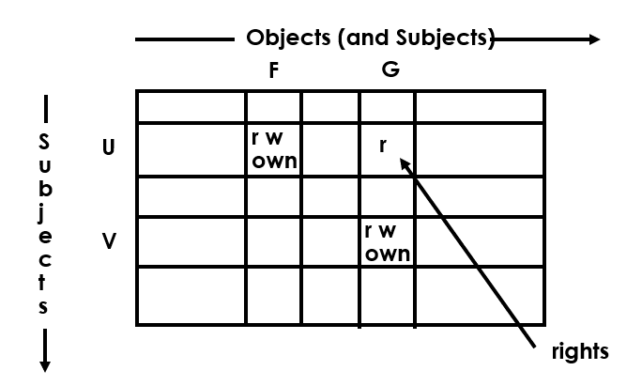
ACCESS MATRIX MODEL

Slide 10
IMPLEMENTATION OF AN ACCESS MATRIX
Access Control Lists
  Encode columns
Capabilities
  Encode rows
Access control triples
  Encode cells

Slide 11
ACCESS CONTROL LISTS (ACLs)
F
U:r
U:w
U:own
G
U:r
V:r
V:w
V:own
each column of the access matrix is stored with the object corresponding to that column

Slide 12
CAPABILITY LISTS
U F/r, F/w, F/own, G/r
V G/r, G/w, G/own
each row of the access matrix is stored with the subject corresponding to that row

Slide 13
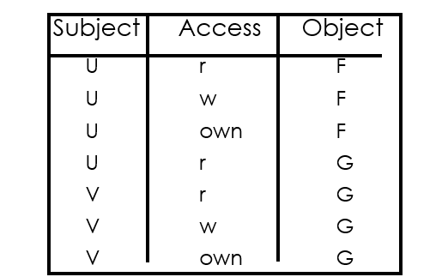
ACCESS CONTROL TRIPLES
commonly used in relational DBMS

Slide 14
Different Notions of Capabilities
Capabilities as a row representation of Access Matrices
Capabilities used in POSIX/Linux as a way to divide the root power into multiple pieces that can be given out separately
Capabilities as a way of implementing the whole access control systems
  Subjects have capabilities, which can be passed around
  When access resources, subjects select capabilities to access
    An example is open file descriptors
  We will examine this last notion in more depth

Slide 15
More on Capability Based Access Control
  Simulated by: a UNIX system where only owner of a file can open the file, and file sharing is done by passing opened file descriptors around
Subjects have capabilities, which
  Give them accesses to resources
    E.g., like keys
  Are transferable and unforgeable tokens of authority
    Can be passed from one process to another
      Similar to opened file descriptors
Why capabilities may solve the confused deputy problems?
  When access a resource, must select a capability, which also selects a master

Slide 16
How the Capability Approach Solves the Confused Deputy Problem
SYSX/FORT $OUTPUT
1 | 2 | 3
SYSX/STAT
SYSX/BILL
$OUTPUT
Invoker must pass in a capability for $OUTPUT, which is stored in slot 3.
Writing to output uses the capability in slot 3.
Invoker cannot pass a capability it doesn’t have.

Slide 17
Capability vs. ACL
Consider two security mechanisms for bank accounts.
One is identity-based. Each account has multiple authorized owners. You go into the bank and shows your ID, then you can access all accounts you are authorized.
  Once you show ID, you can access all accounts.
  You have to tell the bank which account to take money from.
The other is token-based. When opening an account, you get a passport to that account and a PIN, whoever has the passport and the PIN can access

Slide 18
Capabilities vs. ACL: Ambient Authority
Ambient authority means that a user’s authority is automatically exercised, without the need of being selected.
  Causes the confused deputy problem
  Violates the least privilege principle
No Ambient Authority in capability systems

Slide 19
Capability vs. ACL: Naming
ACL systems need a namespace for objects
In capability systems, a capability can serve both to designate a resource and to provide authority.
ACLs also need a namespace for subjects or principals
  as they need to refer to subjects or principals
Implications
  the set of subjects cannot be too many or too dynamic
  most ACL systems grant rights to user accounts principals, and do not support fine-grained subject rights management

Slide 20
Conjectures on Why Most Real-world OS Use ACL, rather than Capabilities
Capability is more suitable for process level sharing, but not user-level sharing
  user-level sharing is what is really needed
Processes are more tightly coupled in capability-based systems because the need to pass capabilities around
  programming may be more difficult

Slide 21
INHERENT WEAKNESS OF DAC
Unrestricted DAC allows information flows from an object which can be read to any other object which can be written by a subject
  Suppose A is allowed to read some information and B is not, A can reads and tells B
Suppose our users are trusted not to do this deliberately. It is still possible for Trojan Horses to copy information from one object to another.
Notes:
Suppose

Slide 22
TROJAN HORSE EXAMPLE
ACL
File F
A:r
A:w
File G
B:r
A:w
Principal B cannot read file F

Slide 23
TROJAN HORSE EXAMPLE
File F
ACL
Principal A
A:r
A:w
executes
read
Program Goodies
Trojan Horse
write
File G
B:r
A:w
Principal B can read contents of file F copied to file G

Slide 24
Buggy Software Can Become Trojan Horse
When a buggy software is exploited, it execute the code/intention of the attacker, while using the privileges of the user who started it.
This means that computers with only DAC cannot be trusted to process information classified at different levels
  Mandatory Access Control is developed to address this problem
  We will cover this in the next topic

Slide 25
DAC’s Weaknesses Caused by The Gap
A request: a subject wants to perform an action
  E.g., processes in OS
The policy: each principal has a set of privileges
  E.g., user accounts in OS
Challenging to fill the gap between the subjects and the principals
  relate the subject to the principals

Slide 26
Unix DAC Revisited (1)
Action | Process | Effective UID | Real Principals
User A Logs In | shell | User A | User A
Load Binary “Goodie” Controlled by user B | Goodie | User A | ? ?
When the Goodie process issues a request, what principal(s) is/are responsible for the request?
Under what assumption, it is correct to say that User A is responsible for the request?
Assumption: Programs are benign, i.e., they only do what they are told to do.

Slide 27
UNIX DAC Revisited (2)
Action | Process | Effective UID | Real Principals
 | shell | User A | User A
Load AcroBat Reader Binary | AcroBat | User A | User A
Read File Downloaded from Network | AcroBat | User A | ? ?
When the AcroBat process (after reading the file) issues a request, which principal(s) is/are responsible for the request?
Under what assumption, it is correct to say that User A is responsible for the request?
Assumption: Programs are correct, i.e., they handle inputs correctly.

Slide 28
Why DAC is vulnerable?
Implicit assumptions
  Software are benign, i.e., behave as intended
  Software are correct, i.e., bug-free
The reality
  Malware are popular
  Software are vulnerable
The problem is not caused by the discretionary nature of policy specification!
  i.e., owners can set policies for files

Slide 29
Why DAC is Vulnerable? (cont’)
A deeper reason in the enforcement mechanism
  A single invoker is not enough to capture the origins of a process
When the program is a Trojan
  The program-provider should be responsible for the requests
When the program is vulnerable
  It may be exploited by input-providers
  The requests may be issued by injected code from input-providers
Solution: include input-providers as the principals

Slide 30

Thank you

