Slide 1
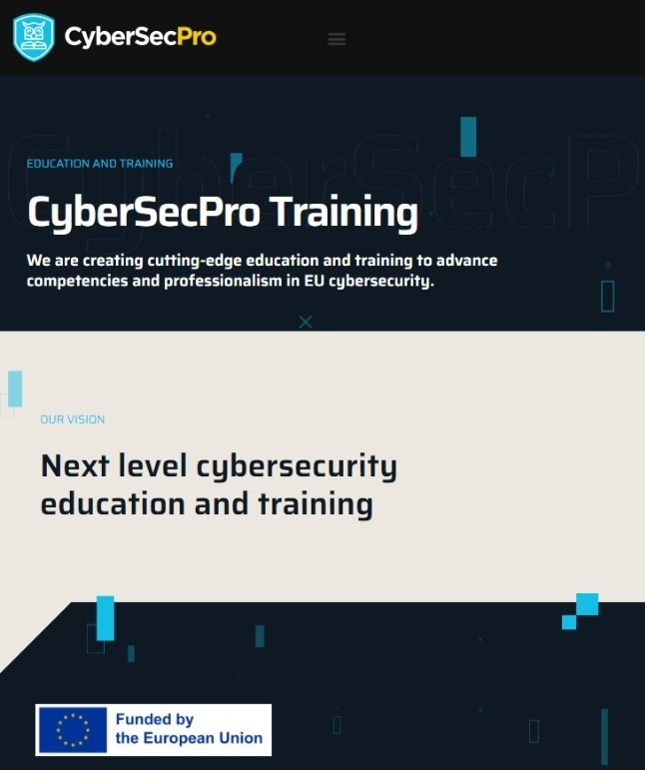



DATA PROTECTION AND PRIVACY TECHNOLOGIES FOR ENERGY
CSP005_S_E
SLIDE SET #8: Operating Systems Security Basics & Unix Access Control
Presentation by:
ANTONIOS NTIB

Slide 2


Slide 3
Announcements and Outline
Outline of this topic
  Brief overview of the goals of OS security
  Memory protection, CPU modes, and system calls
  Access control basic concepts
  Security principles
  UNIX File System permissions
  UNIX processes

Slide 4
What Security Goals Does Operating System Provide?
Originally: time-sharing computers: enabling multiple users to securely share a computer
  Separation and sharing of processes, memory, files, devices, etc.
What is the threat model?
  Users may be malicious, users have terminal access to computers, software may be malicious/buggy, and so on
Security mechanisms
  Memory protection
  Processor modes
  User authentication
  File access control

Slide 5
What Security Goals Does Operating System Provide?
More recent past and present: Networked desktop computers: ensure secure operation in networked environment
New threat?
  Attackers coming from the network. Network-facing programs on computers may be buggy. Users may be hurt via online communication.
Security mechanisms
  Authentication; Access Control
  Secure Communication (using cryptography)
  Logging & Auditing
  Intrusion Prevention and Detection
  Recovery

Slide 6
What Security Goals Does Operating System Provide?
Present and near future: mobile computing devices:
New threat?
  Apps (programs) may be malicious or questionable.
  More tightly connected with personal life of the owner.
Security mechanisms?
  Isolation of each app.
  Help users assess risks of apps.
  Risk communication.

Slide 7
Memory Protection: Access Control to Memory
Ensures that one user’s process cannot access other’s memory
  fence
  relocation
  base/bounds register
  segmentation
  paging
  …
Operating system and user processes need to have different privileges

Slide 8
CPU Modes (a.k.a. processor modes or privilege
System mode (privileged mode, master mode, supervisor mode, kernel mode)
  Can execute any instruction
  Can access any memory locations, e.g., accessing hardware devices,
  Can enable and disable interrupts,
  Can change privileged processor state,
  Can access memory management units,
  Can modify registers for various descriptor tables .
  Reading: http://en.wikipedia.org/wiki/CPU_modes

Slide 9
User Mode
User mode
  Access to memory is limited,
  Cannot execute some instructions
  Cannot disable interrupts,
  Cannot change arbitrary processor state,
  Cannot access memory management units
Transition from user mode to system mode can only happen via well defined entry points, i.e., through system calls
Reading: http://en.wikipedia.org/wiki/CPU_modes

Slide 10
System Calls
Guarded gates from user mode (space, land) into kernel mode (space, land)
  use a special CPU instruction (often an interruption), transfers control to predefined entry point in more privileged code; allows the more privileged code to specify where it will be entered as well as important processor state at the time of entry.
  the higher privileged code, by examining processor state set by the less privileged code and/or its stack, determines what is being requested and whether to allow it.
  http://en.wikipedia.org/wiki/System_call

Slide 11
Kernel space vs User space
Part of the OS runs in the kernel model
  known as the OS kernel
Other parts of the OS run in the user mode, including service programs (daemon programs), user applications, etc.
  they run as processes
  they form the user space (or the user land)
Why root user is more powerful than normal users?
Notes:
Analogy. Bank.

Slide 12
Privilege Levels
Security is often achieved by running control/protection code at a higher privilege level
Components running at the same level can be isolated by a higher-privilege component
If attack and defense are at the same level, then it is an arms’ race and there can be no guarantee

Slide 13
Access control
A reference monitor mediates all access to resources
  Principle: Complete mediation: control all accesses to resources
Reference
monitor
?
Resource
User process
access request
policy

Slide 14
ACCESS MATRIX MODEL
Objects (and Subjects)
F
G
S
u
b
j
e
c
t
s
U
r w
own
r
V
r w
own
rights

Slide 15
ACCESS MATRIX MODEL
Basic Abstractions
  Subjects
  Objects
  Rights
The rights in a cell specify the access of the subject (row) to the object (column)

Slide 16
PRINCIPALS AND SUBJECTS
A subject is a program (application) executing on behalf of some principal(s)
A principal may at any time be idle, or have one or more subjects executing on its behalf
What are subjects in UNIX?
What are principals in UNIX?

Slide 17
OBJECTS
An object is anything on which a subject can perform operations (mediated by rights)
Usually objects are passive, for example:
File
Directory (or Folder)
Memory segment
But, subjects (i.e. processes) can also be objects, with operations performed on them
kill, suspend, resume, send interprocess communication, etc.

Slide 18
Basic Concepts of UNIX Access Control: Users, Groups, Files, Processes
Each user account has a unique UID
  The UID 0 means the super user (system admin)
A user account belongs to multiple groups
Subjects are processes
  associated with uid/gid pairs, e.g., (euid, egid), (ruid, rgid), (suid, sgid)
Objects are files

Slide 19
USERS AND PRINCIPALS
USERS
PRINCIPALS
Unit of Access Control
and Authorization
Real World User
the system authenticates the human user to a particular principal

Slide 20
USERS AND PRINCIPALS
There should be a one-to-many mapping from users to principals
  a user may have many principals, but
  each principal is associated with an unique user
This ensures accountability of a user's actions
What does the above imply in UNIX?

Slide 21
Organization of Objects
In UNIX, almost all objects are modeled as files
  Files are arranged in a hierarchy
  Files exist in directories
  Directories are also one kind of files
Each object has
  owner
  group
  12 permission bits
    rwx for owner, rwx for group, and rwx for others
    suid, sgid, sticky

Slide 22
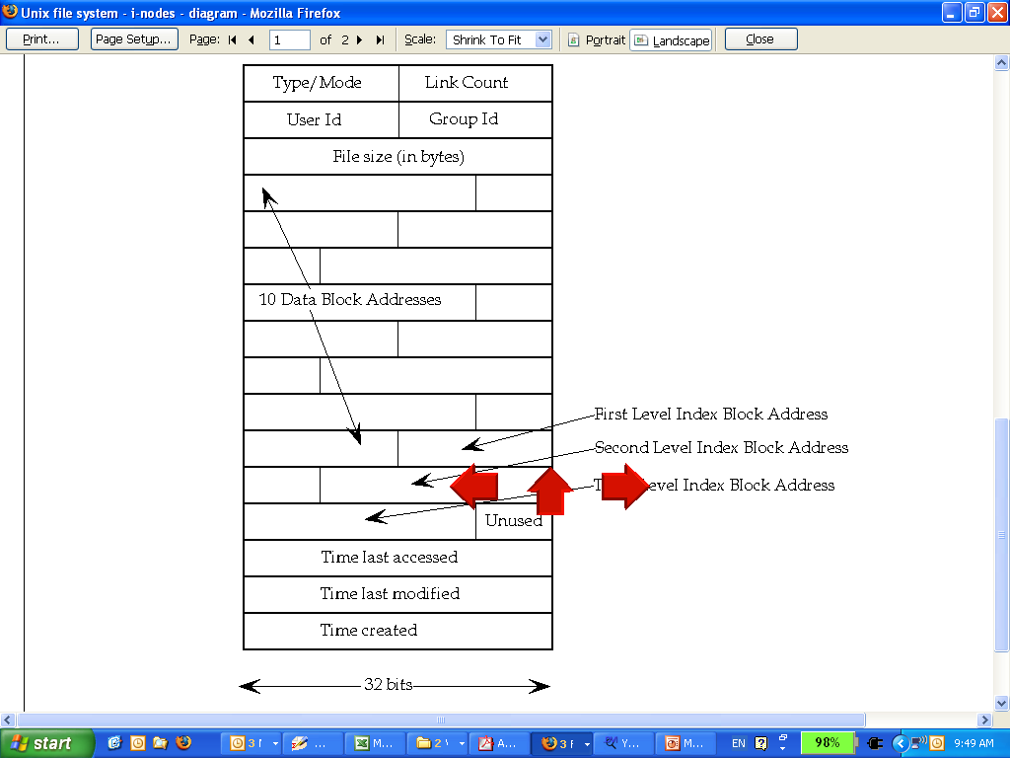
UNIX inodes
Each file corresponds to an inode

Slide 23
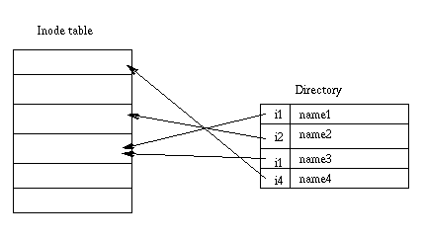
UNIX Directories

Slide 24
Basic Permissions Bits on Files (Non-directories)
Read controls reading the content of a file
  i.e., the read system call
Write controls changing the content of a file
  i.e., the write system call
Execute controls loading the file in memory and execute
  i.e., the execve system call

Slide 25
Permission Bits on Directories
Read bit allows one to show file names in a directory
The execution bit controls traversing a directory
  does a lookup, allows one to find inode # from file name
  chdir to a directory requires execution
Write + execution control creating/deleting files in the directory
  Deleting a file under a directory requires no permission on the file
Accessing a file identified by a path name requires execution to all directories along the path

Slide 26
The suid, sgid, sticky bits
 | suid | sgid | sticky bit
non-executable files | no effect | affect locking (unimportant for us) | not used anymore
executable files | change euid when executing the file | change egid when executing the file | not used anymore
directories | no effect | new files inherit group of the directory | only the owner of a file can delete

Slide 27
Some Examples
What permissions are needed to access a file/directory?
  read a file: /d1/d2/f3
  write a file: /d1/d2/f3
  delete a file: /d1/d2/f3
  rename a file: from /d1/d2/f3 to /d1/d2/f4
  …
File/Directory Access Control is by System Calls
  e.g., open(2), stat(2), read(2), write(2), chmod(2), opendir(2), readdir(2), readlink(2), chdir(2), …

Slide 28
The Three Sets of Permission Bits
Intuition:
  if the user is the owner of a file, then the r/w/x bits for owner apply
  otherwise, if the user belongs to the group the file belongs to, then the r/w/x bits for group apply
  otherwise, the r/w/x bits for others apply

Slide 29
Other Issues On Objects in UNIX
Accesses other than read/write/execute
  Who can change the permission bits?
    The owner can
  Who can change the owner?
    Only the superuser
Rights not related to a file
  Affecting another process
  Operations such as shutting down the system, mounting a new file system, listening on a low port
    traditionally reserved for the root user

Slide 30
Security Principles Related to Access Control
Psychological acceptability is related to configuring access control policies.
Complete mediation
Fail-safe defaults
Least privilege

Slide 31
Principle of Complete mediation
Every access to every object must be checked for authority. This principle, when systematically applied, is the primary underpinning of the protection system. It forces a system-wide view of access control, which in addition to normal operation includes initialization, recovery, shutdown, and maintenance. It implies that a foolproof method of identifying the source of every request must be devised. It also requires that proposals to gain performance by remembering the result of an authority check be examined skeptically. If a change in authority occurs, such remembered results must be systematically updated.

Slide 32
How Complete Mediation Can Be Violated
Any system that can directly access disk may bypass file-system level access control

Slide 33
Principle of Fail-safe defaults
Base access decisions on permission rather than exclusion. This principle[…] means that the default situation is lack of access, and the protection scheme identifies conditions under which access is permitted. The alternative, in which mechanisms attempt to identify conditions under which access should be refused, presents the wrong psychological base for secure system design. A conservative design must be based on arguments why objects should be accessible, rather than why they should not.

Slide 34
Application of Fail-Safe Defaults
E.g., whitelisting instead of black listing, e.g., for anti-virus products
  Challenge, deal with novel unknown
Firewall policies use default deny
A guest account with privilege violates fail-safe defaults

Slide 35
Principle of Least Privilege
Every program and every user of the system should operate using the least set of privileges necessary to complete the job. Primarily, this principle limits the damage that can result from an accident or error. It also reduces the number of potential interactions among privileged programs to the minimum for correct operation, so that unintentional, unwanted, or improper uses of privilege are less likely to occur. [……] The military security rule of "need-to-know" is an example of this principle.

Slide 36
Subjects vs. Principals
Access rights are specified for user accounts (principals).
Accesses are performed by processes (subjects)
The OS needs to know on which user accounts’ behalf a process is executing
How is this done in Unix?

Slide 37
Process User ID Model in Modern UNIX Systems
Each process has three user IDs
  real user ID (ruid) owner of the process
  effective user ID (euid) used in most access control decisions
  saved user ID (suid)
and three group IDs
  real group ID
  effective group ID
  saved group ID

Slide 38
Process User ID Model in Modern UNIX Systems
When a process is created by fork
  it inherits all three users IDs from its parent process
When a process executes a file by exec
  it keeps its three user IDs unless the set-user-ID bit of the file is set, in which case the effective uid and saved uid are assigned the user ID of the owner of the file
In addition, a process may change the user ids via system calls

Slide 39
The Need for suid/sgid Bits
Some operations are not modeled as files and require user id = 0
  halting the system
  bind/listen on “privileged ports” (TCP/UDP ports below 1024)
  non-root users need these privileges
File level access control is not fine-grained enough
System integrity requires more than controlling who can write, but also how it is written

Slide 40
Security Problems of Programs with suid/sgid
These programs are typically setuid root
Violates the least privilege principle
  every program and every user should operate using the least privilege necessary to complete the job
Why violating least privilege is bad?
How would an attacker exploit this problem?
How to solve this problem?

Slide 41
Changing effective user IDs
A process that executes a set-uid program can drop its privilege; it can
  drop privilege permanently
    removes the privileged user id from all three user IDs
  drop privilege temporarily
    removes the privileged user ID from its effective uid but stores it in its saved uid, later the process may restore privilege by restoring privileged user ID in its effective uid

Slide 42
What Happens during Logging in
login
pid | 2235
euid | 0
ruid | 0
suid | 0
login
pid | 2235
euid | 500
ruid | 500
suid | 500
bash
pid | 2235
euid | 500
ruid | 500
suid | 500
setuid(500)
exec(“bash”)
fork()
After the login process verifies that the entered password is correct, it issues a setuid system call.
The login process then loads the shell, giving the user a login shell.
The user types in the passwd command to change his password.

Slide 43
bash
pid | 2235
euid | 500
ruid | 500
suid | 500
passwd
pid | 2297
euid | 500
ruid | 500
suid | 500
Drop privilege permanently
bash
pid | 2297
euid | 500
ruid | 500
suid | 500
passwd
pid | 2297
euid | 0
ruid | 500
suid | 0
exec(“passwd”)
passwd
pid | 2297
euid | 500
ruid | 500
suid | 0
The fork call creates a new process, which loads “passwd”, which is owned by root user, and has setuid bit set.
Drop privilege temporarily

Slide 44

Thank you
Office hours:
M-Th 3:00pm-4:30pm room C402
Please send all questions to:
gehad@example.com

