Slide 1




DATA PROTECTION AND PRIVACY TECHNOLOGIES FOR ENERGY
CSP005_S_E
SLIDE SET #10: GDPR: General Analysis
Presentation by:
ANTONIOS NTIB

Slide 2


Slide 3

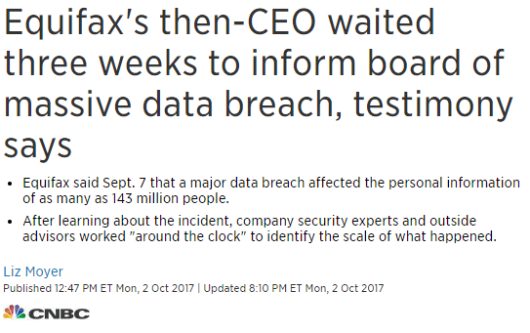

Over 3 million data records are lost or stolen every single day*
98% of cloud applications are not GDPR-ready**
New technologies, new risks & new opportunities!
Results of GDPR survey November 2017
1

Slide 4
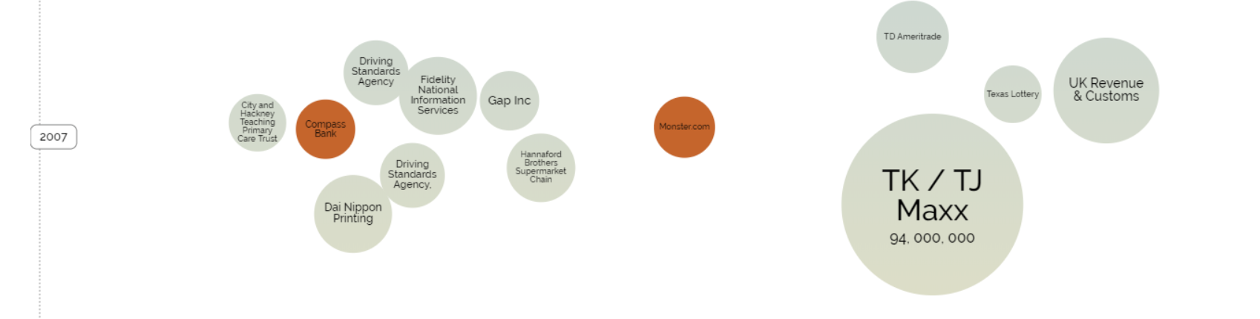
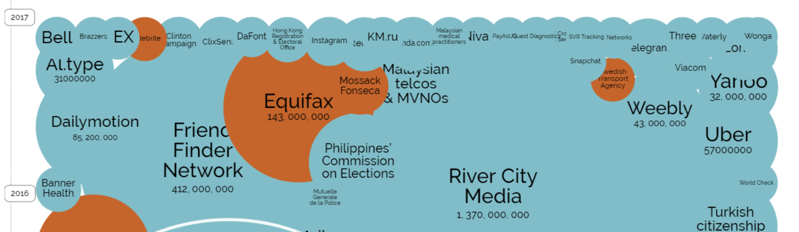
2

Slide 5
DPA VS GDPR
Data Protection Act (DPA) | General Data Protection Regulation
Applies to the UK | Applies to the whole EU and any global company holding data on EU citizens
Enforced by the Information Commissioner's Office (ICO) | Compliance will be monitored by a Supervisory Authority in each country
No need for any business to have a dedicated DPO | A DPO is mandatory for certain businesses
Subject access requests are £10 per transaction and need to be within 40 days | Free of charge and must be within 30 days
Breach notifications not mandatory for most organisations | Mandatory and must be within 72 hours
No requirement for an organisation to remove all data they hold on an individual | Individual will have 'Right to erasures - which include all data including web records with all information being permanently deleted
Privacy Impact Assessment are not a legal requirement | PIAs will be mandatory and must be carried out when there is a high risk to the freedoms of the individual
Data collection does not necessarily require an opt-in under the current Data Protection Act. | Individual must opt-in. There must be clear privacy notices. These notices must be concise and transparent
Covered personal data and sensitive data. | Now also includes online identifiers, location data, and generic data.
Maximum fine £500,000 | Maximum fine 4% of annual turnover or Euro 20 million (Whichever is greater).
Responsibility rests with the Data Controller | Responsibility is with both the controller and processor, with the controller being able to seek damages from the processor
Parental consent for minors not required | Parental consent is now required for minors
3

Slide 6
Give control back to citizens and residents over their personal data.
Simplify the regulatory environment by unifying regulations across the EU.
Update the 1995 Data Protection Directive.
Systems
EU General Data Protection Regulation
Processes
Organisation
4

Slide 7
Article 5
Adequate, relevant and limited
Accurate
Kept in a form which permits identification no longer than necessary
Ensure appropriate security
Spcified, explicit and legitimate purposes
Lawfully processes, fairly in a transparent manner
The GDPR provides the following rights for individuals:
The right to be informed
The right of access
The right to rectification
The right to erase
The right to restrict processing
The right to data portability
The right to object
5

Slide 8
RIGHTS
Rights | Description
The right to be informed | This right encompasses your obligated to provide ‘fair processing information’, typically through a privacy notice.
The right of access | This right allows individuals to be aware of and verify the lawfulness of the processing.
The right to rectification | Individuals have the right to change their personal data if it is inaccurate or incomplete.
The right to be erased | This right enables an individual to request the deletion or removal of personal data where there is no compelling reason for its continued processing.
The right to restrict processing | This right enables individuals to have a right to ‘block’ or suppress processing of personal data. When processing is restricted, you are permitted to store the personal data, but not further process it. You can retain just enough information about the individual to ensure that the restriction is respected in future.​
The right to data portability | This right allows individuals to obtain and reuse their personal data for their own purposes across different services. It allows them to move, copy or transfer personal data easily from one IT environment to another in a safe and secure way, without hindrance to usability.
Rights related to automated decision making | This right gives allows individuals to object to processing based on legitimate interests or the performance of a task in the public interest/exercise of official authority (including profiling); direct marketing (including profiling).​
6

Slide 9
Data controller or processor?
Controller
Maintain records of personal data and processing activities
Processor
Processes data on behalf of a controller
Legal liability
Legal liability
7

Slide 10
Data controller or processor? (cont’d)
Collects the personal data in the first place, and the legal basis for doing so. --> DATA CONTROLLER
Can decide what IT systems or other methods to use to collect personal data. --> Data Processor
Decide which items of personal data to collect, i.e. the content of the data. --> DATA CONTROLLER
Example businesses: market research companies, cloud providers, accountants. --> Data Processor
Decide the purpose or purposes the data are to be used for. --> DATA CONTROLLER
Decide how long to retain the data or whether to make non-routine amendments to the data. --> DATA CONTROLLER
8

Slide 11
What involves Managing data?
Personal data and unique identifierS
  Name
  Online identifiers
  Location data: IP Addresses, mobile device IDs.
Pseudonymous data
  Encrypted data is still subject to GDPR rules
  [GDPR encourages pseudonymising data because it enhances security]
Genetic data and biometric data
  Genetic data and biometric data are both treated as sensitive personal data under the GDPR.
Personal Data
Information Assets
Asset Register (AR)
Information Asset Register (IAR)
Data Processing Register (DPR)
Prepare for your Privacy Impact Assessment
9

Slide 12
Information asset: a body of knowledge that is organised and managed as a single entity. Like any other corporate asset, an organization's information assets have financial value. That value of the asset increases in direct relationship to the number of people who are able to make use of the information.
10

Slide 13
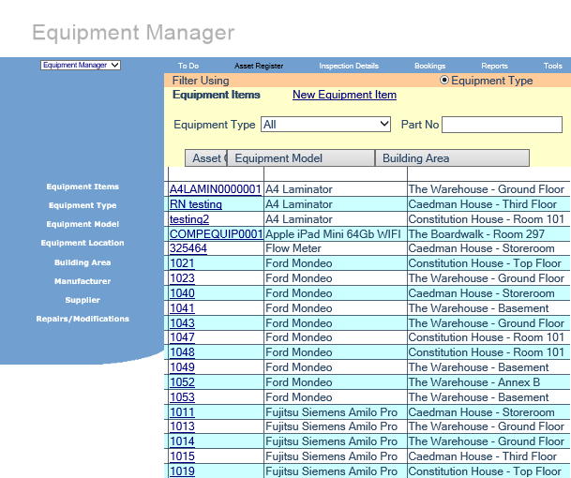
ISO 55000 (NOT MANDATORY BUT IMPORTANT)
ISO 55000 defines Asset management as the "coordinated activity of an organization to realize value from assets". In turn, Assets are defined as follows: "An asset is an item, thing or entity that has potential or actual value to an organization".
This is a register of fixed assets in a firm. The register tends to show the owner of the asset, their value, their location, their set up etc. Information that is necessary to manage the assets within a company. Not mandatory for GDPR but helps inform the Information Asset Register which in turns helps inform the Data Processing Register.
11

Slide 14
Your information asset register needs to have:
  Information held and processes
  Where it is stored
  How it moves
  Who we share it with
  What the data is
  Assign a classification
  Level of protection reflecting its classification
  Indicator of Integrity,
  Availability and Confidentiality
12

Slide 15
The name and contact details of the controller. Where applicable, the joint controller, the controller’s representative and the data protection officer;
The purposes of the processing;
A description of the categories of data subjects and of the categories of personal data;
The categories of recipients to whom the personal data have been or will be disclosed including recipients in third countries or international organisations;
13

Slide 16
Register type | What is considered this type of asset?
Asset register (AR) | Fixed assets Limited information on the data contained
Information asset register (IAR) | Personal or commercial Information on format Location and confidentiality
Data processing register (DPR) | Detailed record of personal data processed What, when, how, legal purpose, format, controls, security, retention
14

Slide 17
Results from GDPR survey November 2017
15

Slide 18
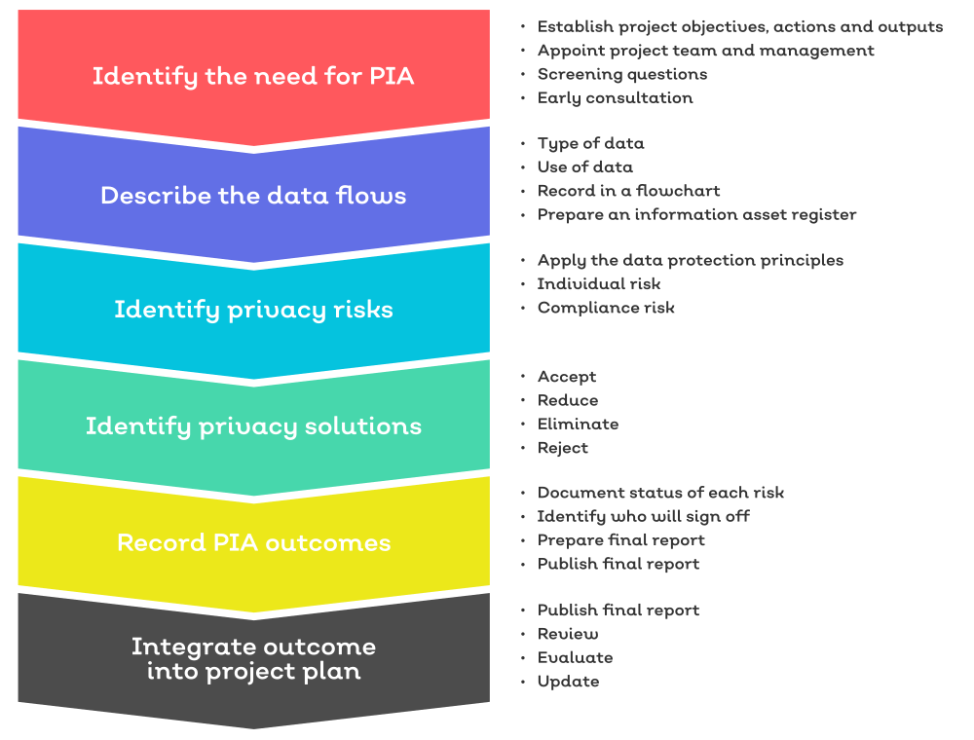
Data protection impact assessments (DPIAs) help organisations to identify the most effective way to comply with their data protection obligations and meet individuals’ expectations of privacy.​
DPIAs can be an integral part of taking a privacy by design approach.​
The GDPR sets out the circumstances in which a DPIA must be carried out​.
16

Slide 19
You must carry out a DPIA when​ using new technologies, and​ when the processing is likely to result in a high risk to the rights and freedoms of individuals.​
Processing that is likely to result in a high risk includes (but is not limited to):​
Systematic and extensive processing activities, including profiling and where decisions that have legal effects – or similarly significant effects – on individuals might be made.
Large-scale processing of special categories of data or personal data relating to criminal convictions or offences. This includes processing a considerable amount of personal data at regional, national or supranational level; that affects a large number of individuals; and that involves a high risk to rights and freedoms e.g. based on the sensitivity of the processing activity.​
Large scale, systematic monitoring of public areas (such as CCTV).
17

Slide 20
Privacy Impact Assessment
A tool to identify the most effective way to comply with GDPR obligations.
Understand what personal data is transferred, processed, handled, stored and passed on by the organisation.
An effective PIA will allow organisations to identify risk and implement controls.
Conducting a PIA involves working with employees, stakeholders, partner organisations and the people affected to identify and reduce privacy risks.
PIAs are an integral part of taking a privacy by design approach.
18

Slide 21
Benefits Of Privacy Impact Assessment
Improve transparency
Make it easier to understand how and why information is being used/held
Demonstrate how personal data processing complies with the DPA
Best practice – improve customer confidence
Identify risk
Implement a robust process
Deeper customer insights
Stronger decision making when building policies, systems and technical controls
Improve efficiency - reduce overheads
Boost profitability
19

Slide 22
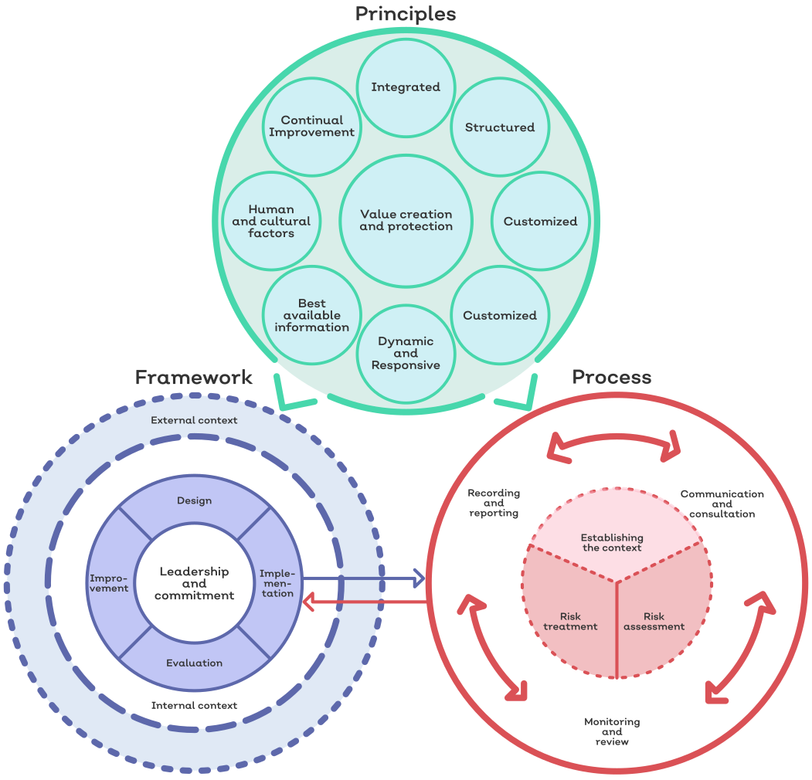
ISO 31000
  Supporting the GDPR process
  Key definitions
  Stakeholders
  Managing outputs of PIA
20

Slide 23
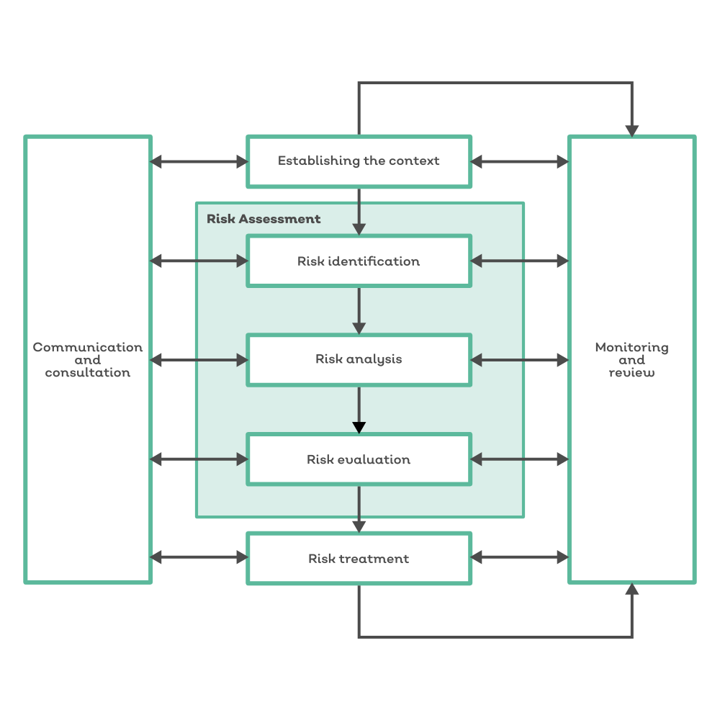
ISO 31000: Risk Management
Establishing the Context
Risk Assessment
Risk Identification
Risk Analysis
Risk Evaluation
Risk Treatment
Monitoring and Review
Communication and Consultation
21

Slide 24
Who owns data/Permission levels
Risks
Internal / HR
Financial
Sales and Marketing
IT
Third parties
Customers
Risks can be categorised and different permissions applied
Multiple assets can be identified as associated to a risk
Net and Target Assessments can be carried out against a risk
Multiple control types and controls can be applied to a risk
Sign off on risks and in turn complete the PIA
Evidence of compliance includes: Risk Register, Risk Assessments and Risk Reporting
22

Slide 25
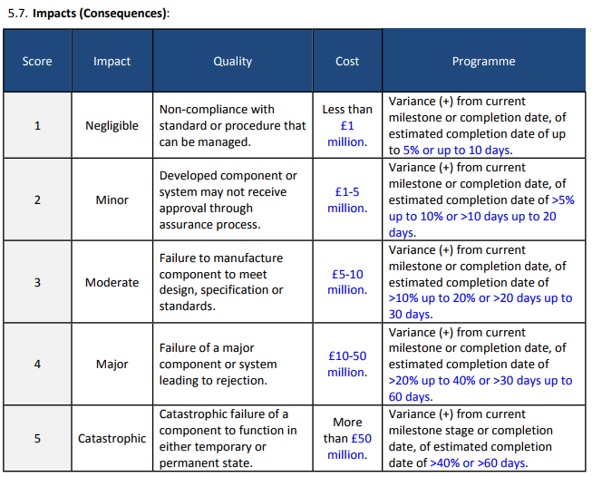
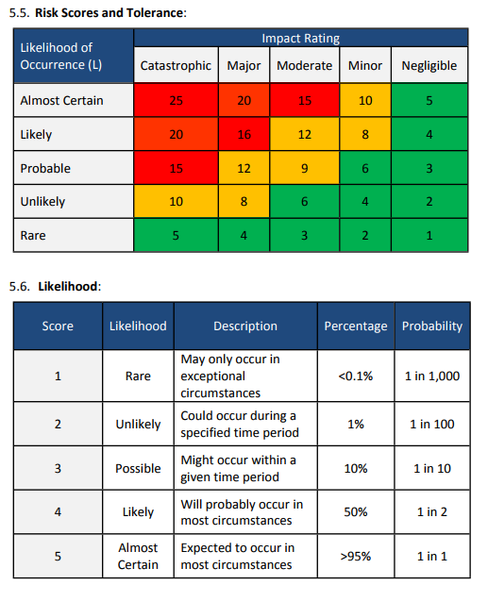
23

Slide 26
Policies and Procedures
Output of PIA – processes and procedures to manage the Risks and Controls:
  Retention Policies
  Labelling Procedures
  Privacy Statement
  GDPR Statement
  Risk Management Process
  NDAs (Non-Disclosure Agreement)
  Contracts
  Security Breach Management – see later
24
Notes:
So what does GDPR ask for?
The GDPR contains explicit provisions about documenting your processing activities:
You must maintain records on several things such as processing purposes, data sharing and retention.
You may be required to make the records available to the ICO on request.
Documentation can help you comply with other aspects of the GDPR and improve your data governance.
Controllers and processors both have documentation obligations.
For small and medium-sized organisations, documentation requirements are limited to certain types of processing activities.
Information audits or data-mapping exercises can feed into the documentation of your processing activities.
Records must be kept in writing.
Most organisations will benefit from maintaining their records electronically.
Records must be kept up to date and reflect your current processing activities.
We have produced some basic templates to help you document your processing activities.
What’s new under the GDPR?
The documentation of processing activities is a new requirement under the GDPR.
There are some similarities between documentation under the GDPR and the information you provided to the ICO as part of registration under the Data Protection Act 1998.
You need to make sure that you have in place a record of your processing activities by 25 May 2018
Who needs to document their processing activities?
Controllers and processors each have their own documentation obligations.
If you have 250 or more employees, you must document all your processing activities.
There is a limited exemption for small and medium-sized organisations. If you have less than 250 employees, you only need to document processing activities that:
are not occasional; or
could result in a risk to the rights and freedoms of individuals; or
involve the processing of special categories of data or criminal conviction and offence data.
You must document the following information under Article 30 of the GDPR:
The name and contact details of your organisation (and where applicable, of other controllers, your representative and your data protection officer).
The purposes of your processing.
A description of the categories of individuals and categories of personal data.
The categories of recipients of personal data.
Details of your transfers to third countries including documenting the transfer mechanism safeguards in place.
Retention schedules.
A description of your technical and organisational security measures.
As part of your record of processing activities, it can be useful to document (or link to documentation of) other aspects of your compliance with the GDPR and the UK’s Data Protection Bill. Such documentation may include:
information required for privacy notices, such as:
the lawful basis for the processing
the legitimate interests for the processing
individuals’ rights
the existence of automated decision-making, including profiling
the source of the personal data;
records of consent;
controller-processor contracts;
the location of personal data;
Data Protection Impact Assessment reports;
records of personal data breaches;
information required for processing special category data or criminal conviction and offence data under the Data Protection Bill, covering:
the condition for processing in the Data Protection Bill
the lawful basis for the processing in the GDPR
your retention and erasure policy document
Under the GDPR, you have a general obligation to implement technical and organisational measures to show that you have considered and integrated data protection into your processing activities.
There are some useful checklists in your guides.
Documentation of processing activities – requirements
☐ If we are a controller for the personal data we process, we document all the applicable information under Article 30(1) of the GDPR.
☐ If we are a processor for the personal data we process, we document all the applicable information under Article 30(2) of the GDPR.
If we process special category or criminal conviction and offence data, we document:
☐ the condition for processing we rely on in the Data Protection Bill;
☐ the lawful basis for our processing; and
☐ whether we retain and erase the personal data in accordance with our policy document.
☐ We document our processing activities in writing.
☐ We document our processing activities in a granular way with meaningful links between the different pieces of information.
☐ We conduct regular reviews of the personal data we process and update our documentation accordingly.
Best Practices for the Documentation of processing activities
When preparing to document our processing activities we:
☐ do information audits to find out what personal data our organisation holds;
☐ distribute questionnaires and talk to staff across the organisation to get a more complete picture of our processing activities; and
☐ review our policies, procedures, contracts and agreements to address areas such as retention, security and data sharing.
As part of our record of processing activities we document, or link to documentation, on:
☐ information required for privacy notices;
☐ records of consent;
☐ controller-processor contracts;
☐ the location of personal data;
☐ Data Protection Impact Assessment reports; and
☐ records of personal data breaches.
☐ We document our processing activities in electronic form so we can add, remove and amend information easily.

Slide 27
Security Breaches Management
Overview
  Importance
  Consequences
Key Requirements
  Clearly defined R+R
  Clearly defined process
  Evidence Gathering and its retention / storage
  Reporting
  Timeframes
  Role of the DPO
(Close relationship with 27001.)
25
Notes:
Introduction to this session

Slide 28
Example of data breach:
Access by an unauthorised third party;
Deliberate or accidental action (or inaction) by a controller or processor;
Sending personal data to an incorrect recipient;
Computing devices containing personal data being lost or stolen;
Alteration of personal data without permission; and
Loss of availability of personal data.
26
Notes:
What is a personal data breach?
Broadly defined as a security incident that has affected the confidentiality, integrity or availability of personal data. In short, there will be a personal data breach whenever any personal data is lost, destroyed, corrupted or disclosed; if someone accesses the data or passes it on without proper authorisation; or if the data is made unavailable and this unavailability has a significant negative effect on individuals.
Examples
Personal data breaches can include:
access by an unauthorised third party;
deliberate or accidental action (or inaction) by a controller or processor;
sending personal data to an incorrect recipient;
computing devices containing personal data being lost or stolen;
alteration of personal data without permission; and
loss of availability of personal data.
Recital 87 of the GDPR makes clear that when a security incident takes place, you should quickly establish whether a personal data breach has occurred and, if so, promptly take steps to address it, including telling the ICO if required
In assessing risk to rights and freedoms, it’s important to focus on the potential negative consequences for individuals. GDPR states that:
“A personal data breach may, if not addressed in an appropriate and timely manner, result in physical, material or non-material damage to natural persons such as loss of control over their personal data or limitation of their rights, discrimination, identity theft or fraud, financial loss, unauthorised reversal of pseudonymisation, damage to reputation, loss of confidentiality of personal data protected by professional secrecy or any other significant economic or social disadvantage to the natural person concerned’’.
A breach can have a range of adverse effects on individuals, which include emotional distress, and physical and material damage. Some personal data breaches will not lead to risks beyond possible inconvenience to those who need the data to do their job. Other breaches can significantly affect individuals whose personal data has been compromised. You need to assess this case by case, looking at all relevant factors.
Examples:
The theft of a customer database, the data of which may be used to commit identity fraud, would need to be notified, given the impact this is likely to have on those individuals who could suffer financial loss or other consequences.
On the other hand, you would not normally need to notify the ICO, for example, about the loss or inappropriate alteration of a staff telephone list

Slide 29
Data breaches are usually preventable
The average time between breach and discovery is
188 Days
27
http://www.computerworlduk.com/security/most-data-breaches-still-discovered-by-third-parties-3615783/
Notes:
Why is Training, Awareness and Competency Important?
GDPR is EVERYONES responsibility
188 days between breach and discovery is a frightening statistic, especially considering the potential fines!
Staff need to be aware of their responsibilities in relation to GDPR.
Most NCF arise from human error
Many risks are people related
Everyone is responsible for GDPR
The fines for non-compliance are significant.
Requirement of many related standards including BS 10012:2017 Data Protection
How to Train.
On-Line Courses
Workshops
Presentations
Quizzes
→ Example Quiz in TRGMGR - Interactive

Slide 30
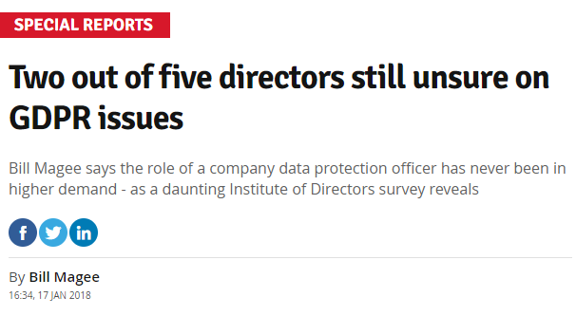
Developing your communication plan
Top-down engagement
Implement a data protection policy
Build data protection in from the ground up
Communications, training and development
Access management
28
Notes:
A Communications Plan.
A good idea to ensure that all staff members know what is required with regards to communications is to create a communications plan.
To develop a plan for communication you have to consider some basic questions:
Why do you want to communicate with the community? (What’s your purpose?)
Whom do you want to communicate it to? (Who’s your audience?)
What do you want to communicate? (What’s your message?)
How do you want to communicate it? (What communication channels will you use?)
Whom should you contact and what should you do in order to use those channels? (How will you actually distribute your message?)of any sort, you have to consider some basic questions:
Why do you want to communicate with the community? (What’s your purpose?)
Whom do you want to communicate it to? (Who’s your audience?)
What do you want to communicate? (What’s your message?)
How do you want to communicate it? (What communication channels will you use?)
Whom should you contact and what should you do in order to use those channels? (How will you actually distribute your message?)
Here are a few of the ways that you can start to engage employees in the importance of data protection:
Top down engagement: Technology and data are now so important, that data protection and cyber security have become executive level issues. There’s no point expecting employees to get on board with the new rules if the CEO doesn’t know what’s required and why. The management team must lead by example, while working together to ensure the message is communicated effectively across the whole business.
Implement a data protection policy: Processes and procedures regarding data and security should be outlined in a clear and concise policy, which all employees should read and sign. The document should include key dos and don’ts regarding handling sensitive information, customers rights, as well as password security and how to detect and report any data concerns or suspicious activity. It can form part of the induction of new employees, and act as a reference guide, if ever anybody has a query about handling data.
Build data protection in from the ground up: The GDPR advises taking a ‘privacy by design’ approach, whereby data protection is hardwired into the processes and behaviours of the organisation. You can encourage this by including a data protection element in the mission and values of your company, as well as including it in job descriptions, employee contracts and progress reviews. That way it always stays front of mind with staff and that they understand its importance.
Communication, training and development: The new regulations provide a good excuse to kick start regular training on data protection and cyber security issues. Cyber training is often overlooked – a recent Government survey found that only 20 per cent of businesses have ever given staff some kind of cyber security training. And while it might sound dull, it doesn’t have to be. Try to be creative about how you do it by organising quizzes, events and learning from examples of where organisations have been caught out.
Access management: While cultural change is important, it’s also crucial that you have controls in place with regards to who can access what data. That means that only those employees that need certain information should be able to gain entry to the files in question, with password protection in place at the very least, and further authentication if possible. The access levels required by each employee should be tracked on an ongoing basis so that nobody has any log-ins they don’t need. Privileges should be automatically revoked and details changed when employees leave the company.
Data protection isn’t something you can do once and forget about for another year or two. As technology evolves and the data keeps getting bigger, it requires constant focus to ensure you’re sticking to the rules, while protecting your customers and your business reputation at the same time. It’s time for data to come out of the back room and into the heart of the business.

Slide 31
Framing your approach
Strategic Outcome | Objective (so that) | Activity (we will)
Fix our data Be totally trusted with data: Internally – colleagues can use data and take decisions with confidence Externally – members and customers feel safe, secure and respected. Regulatory and legal compliance | ‘Why this data’ For collecting / holding / using | The information interpretation of the business problems and objectives Build a collective & consistent language and understanding group-wide Identify meaningful & important data sets, and related heat maps Record data set relationships
 | Why this data Relevant / correct/ clean / consistent data | Definition of data (sets & attributes) & classifications (legal / regulatory / other) Set quality criterion & define standards Define implementation methods & management processes to ensure adherence
 | Where is the data Visibility of data at rest and tracking movement across the estate (physical and digital) | Define and build business orientated information landscapes & technically oriented data models & structures Track data of interest tags / audit / Data Flows / Lineage / Provenance Data Waivers to manage production data outside production environment
 | How is the data used Definition, oversight & assurance through | Development of Member data principles Development & alignment of artefacts including policy group-wide Implement & run policy & standards for Digital
 | Who is responsible | Define and support implementation of Ownership / stewardship / custodianship Define accountabilities and embed into role profiles & objectives Define and build problem solving & escalation structures
 | When do we do what with the data | Develop retention policy & build schedule Embed processes to manage data retention and deletion Define requirements for technical capabilities including audit / logs and tags
29
Notes:
Consider how best to frame your approach.
This is clean, clear way to communicate some of the activities to the wider business.

Slide 32
Roles & Responsibilities
As an Analyst
I must
understand what personal data is
So that
I can apply the right working practices and enact associated policy
As a Technology Owner
I must
be able to find personal information about an individual
So that
We can answer A Subject Access Request
As a Product Manager
I must
Understand how and why an individual's data is processed
So that
We can action a request to restrict processing
30
Notes:
You could User Story the information.
So different types of employee understand how and why GDPR affects them.
We use this technique to help design our product!

Slide 33

8 step communications plan
Purpose
Identify your audience
Plan and design your message
Consider your resources
Contingency plan
Strategy and messaging
Create an action plan
Refine
31
31
Notes:
One way to look at planning for communication is as an eight-step process. The steps are:
Identify the purpose of your communication
Identify your audience
Plan and design your message
Consider your resources
Plan for obstacles and emergencies
Strategize how you’ll connect with the media and others who can help you spread your message
Create an action plan
Decide how you’ll evaluate your plan and adjust it, based on the results of carrying it out

Slide 34
Training & Repetition
Reiterate importance of GDPR
Relates to everyone as we all have personal data
Guidance needs to be from top down
Imperative to involve and empower staff
32
Notes:
Most if not all organisations will be aware of the Data Protection Act so the move to GDPR should not be a jump into the complete unknown.
Many of the GDPR’s main concepts and principles are much the same as those in the current Data Protection Act (DPA), so if you are complying properly with the current law then most of your approach to compliance will remain valid under the GDPR and can be the starting point to build from. However, there are new elements and significant enhancements, so you will have to do some things for the first time and some things differently.
As discussed it is essential to plan your approach to GDPR compliance now and to gain ‘buy in’ from key people in your organisation. As discussed you may need, for example, to put new procedures in place to deal with the GDPR’s new transparency and individuals’ rights provisions. In a large or complex business this could have significant budgetary, IT, personnel, governance and communications implications.
The GDPR places greater emphasis on the documentation that data controllers must keep to demonstrate their accountability. Compliance with all the areas will require organisations to review their approach to governance and how they manage data protection as a corporate issue. One aspect of this might be to review the contracts and other arrangements you have in place when sharing data with other organisations.

Slide 35
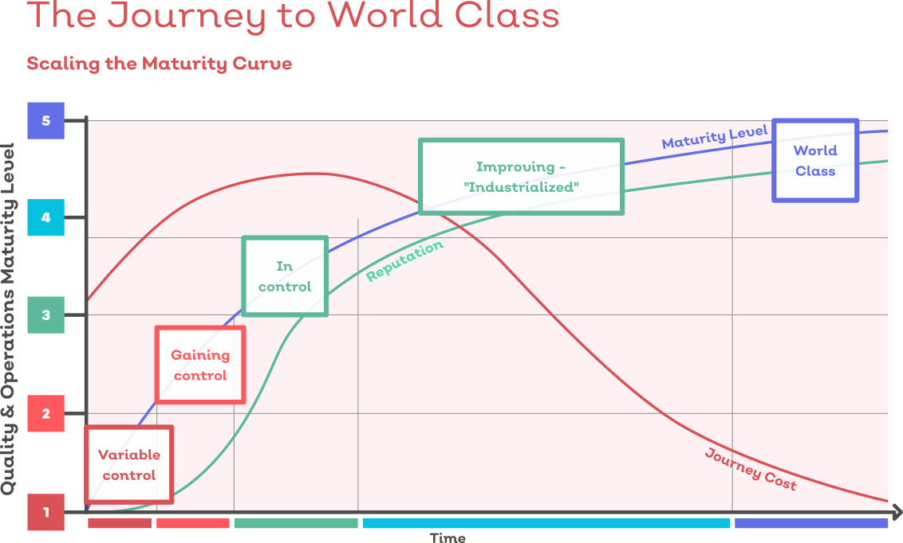
It takes time for people to learn……
Quantitatively measure your current cultural values.
Intentionally align culture, strategy, and structure.
Ensure staff and stakeholder participation.
Communicate and demonstrate the change, again and again and again and then … again.
Manage the emotional response — yours and your employees.
33
Notes:
Managing the cultural change to take GDPR into account shouldn’t need to differ to any other cultural change.
To manage culture change, the first step is to observe and understand your organization’s culture as it is now, and to determine which values will best align with your strategy and structure.
Quantitatively measure your current cultural values.
The first step to culture change is knowing where your current culture stands; that is, what employees believe your organisation’s current values are. This will allow you to get a good idea of how much change is needed and enable accountability and the ability to track your culture change more precisely over time.
Intentionally align culture, strategy, and structure.
Be sure that the culture change fits with the company’s business strategy and that both fit with the organisation’s structure (its formal systems and policies). Reconsider formal reporting relationships, job descriptions, selection and recruiting practices, performance appraisal, reward or compensation structures, and training and development. Supporting change and innovation both structurally and culturally have been found to be critical to the success of culture change initiatives. Make changes where appropriate to support the new culture.
Ensure staff and stakeholder participation.
Change can’t succeed without the meaningful involvement of many people throughout the organisation. Participation can range from individually offering ideas, solutions, and reactions to concepts, to taking part in team meetings to design and build the new culture and organisational structure. Use a balanced approach, keeping in mind that input from a wide range of people can generate excitement and motivation to change, but make sure that you have a separate change structure in place (e.g., change sponsor, change committee) that can make timely and clear decisions to prevent an ambiguous vision or delay key actions.
Communicate and demonstrate the change, again and again and again and then … again.
Frequent and copious communication — both upward and downward — is necessary during the change process. Use words and actions to convey the vision of the desired future, and repeat your message much more often than you think is necessary. Most leaders greatly underestimate how many repetitions it takes for a message to sink in. Role model appropriate behaviours by demonstrating your constant commitment to the future state and provide a vivid image of what it will look and feel like. Use new language or metaphors to create memorable images (one long-term care organization described its facilities as a collection of neighbourhoods or houses rather than an institution). Leaders clearly and visibly dedicated to change have been found to be one of the singular success factors of culture change.
Manage the emotional response — yours and your employees.

Slide 36

Thank you

