Slide 1




DATA PROTECTION AND PRIVACY TECHNOLOGIES FOR ENERGY
CSP005_S_E
SLIDE SET #11: GDPR: Extensive Analysis, responsibilities and obligations of data processors and controllers
Presentation by:
Antonios ntib

Slide 2


Slide 3
The definitions of ‘data controller’ and ‘data processor’ under the GDPR.
The responsibilities and obligations of controllers and processors.
The data breach reporting responsibilities of controllers and processors.
The liability of, and penalties that may be imposed on, data processors and controllers.
The appointment of joint controllers and subcontracting processors
1

Slide 4
The definitions of ‘data controller’ and ‘data processor’ under the GDPR.
The responsibilities and obligations of controllers and processors.
The data breach reporting responsibilities of controllers and processors.
The liability of, and penalties that may be imposed on, data processors and controllers.
The appointment of joint controllers and subcontracting processors
2

Slide 5
Article 99: Entry into force and application
EU organizations that process the personal data of EU residents have only a short time to make sure that they are compliant.
The Regulation extends the data rights of individuals, and requires organizations to develop clear policies and procedures to protect personal data, and adopt appropriate technical and organizational measures
8 April 2016
Council of the European Union adopted the GDPR
12 April 2016
The GDPR was adopted by the European Parliament.
4 May 2016
The official text of the Regulation was published in the Official Journal of the EU
The Regulation entered into force
The GDPR will apply
25 May 2018
24 May 2016
3

Slide 6
Definitions
The definitions of ‘data controller’ and ‘data processor’ under the GDPR.
The responsibilities and obligations of controllers and processors.
The data breach reporting responsibilities of controllers and processors.
The liability of, and penalties that may be imposed on, data processors and controllers.
The appointment of joint controllers and subcontracting processors
4

Slide 7
Definitions (cont’d)
Article 4(1) ‘Personal data’ means any information relating to an identified or identifiable natural person (‘data subject’); an identifiable person is one who can be identified, directly or indirectly.
5

Slide 8
Definitions (cont’d)
Article 4(1) ‘Personal data’ means any information relating to an identified or identifiable natural person (‘data subject’); an identifiable person is one who can be identified, directly or indirectly.
Article 4(7) ‘Controller means the natural or legal person, public authority, agency or any other body that, alone or jointly with others, determines the purposes and means of the processing.
6

Slide 9
Definitions (cont’d)
Article 4(8) ‘Data processor’ means a natural or legal person, public authority, agency or any other body that processes personal data on behalf of the controller.
Article 4(2) ‘Processing’ means any operation or set of operations that is performed upon personal data or sets of personal data, whether or not by automated means, such as collection, recording, organisation, structuring, storage, adaptation or alteration, retrieval, consultation, use, disclosure by transmission, dissemination or otherwise making available, alignment or combination, erasure or destruction.
7

Slide 10
Definitions (cont’d)
Article 4(8) ‘Data processor’ means a natural or legal person, public authority, agency or any other body that processes personal data on behalf of the controller.
Article 4(2) ‘Processing’ means any operation or set of operations that is performed upon personal data or sets of personal data, whether or not by automated means, such as collection, recording, organisation, structuring, storage, adaptation or alteration, retrieval, consultation, use, disclosure by transmission, dissemination or otherwise making available, alignment or combination, erasure or destruction.
8

Slide 11
Responsibilities and obligations: Data Processors - Controllers
To comply with the GDPR, data controllers must determine:
The legal basis for collecting data;
Which items of personal data to collect, i.e. the content of the data;
The purpose or purposes the data is to be used for;
Which individuals to collect data about;
Whether to disclose the data and, if so, to whom;
Whether subject access and other individuals’ rights apply, i.e. the application of exemptions; and
How long to retain the data or whether to make non-routine amendments to the data.
9

Slide 12
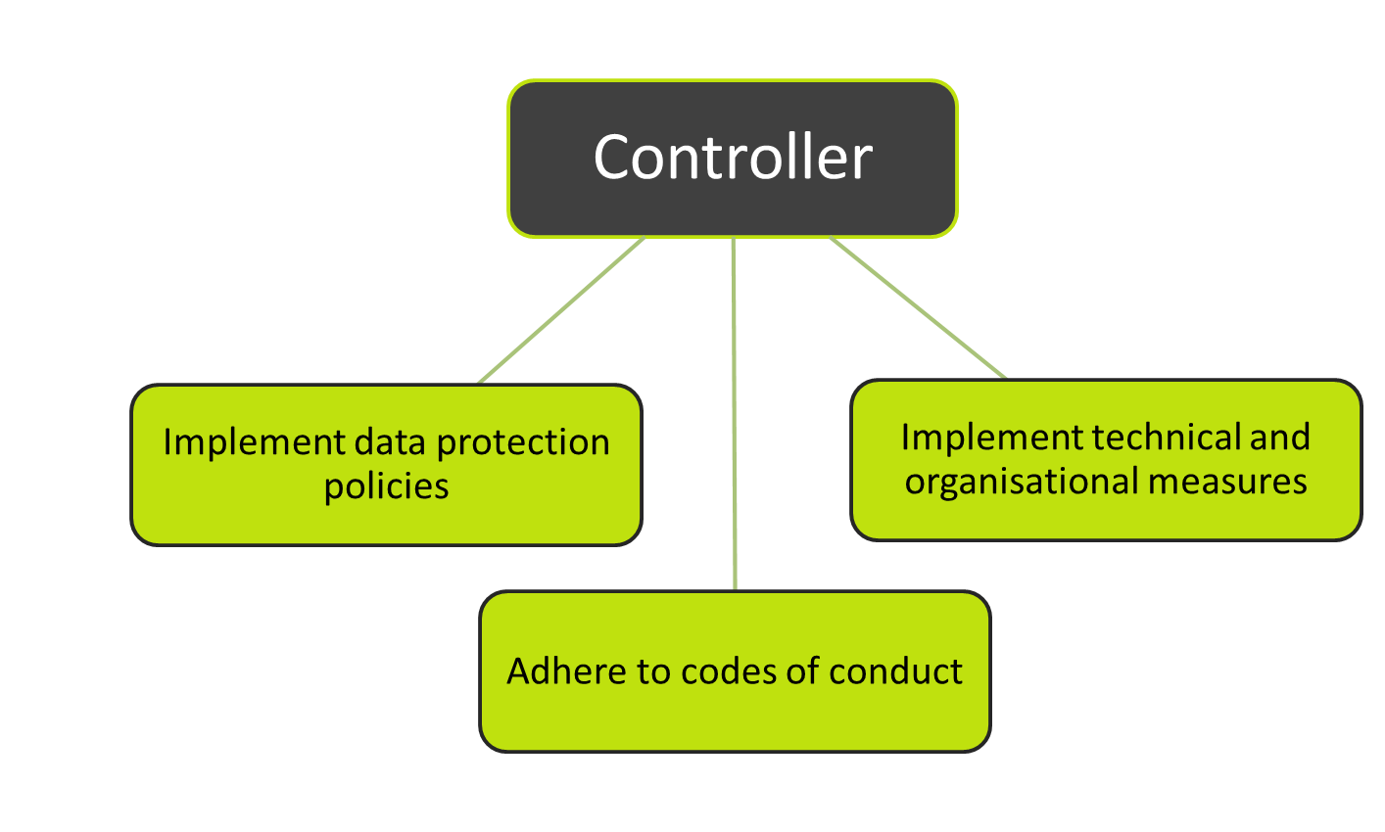
Responsibilities and obligations: Data Processors - Controllers (cont’d)
10

Slide 13
Responsibilities and obligations: Data Processors - Controllers (cont’d)
Article 28 (Data Processor)
A legal contract must make sure that the processor:
Processes the personal data only on documented instructions from the controller;
Makes sure that persons authorised to process the personal data observe confidentiality;
Takes appropriate security measures;
Respects the conditions for engaging another processor;
Assists the controller by appropriate technical and organisational measures;
Assists the controller in ensuring compliance with the obligations to the security of processing;
Deletes or returns all the personal data to the controller after the end of the provision of services; and
Makes available to the controller all information necessary to demonstrate compliance with the Regulation.
12

Slide 14
Responsibilities and obligations: Data Processors - Controllers (cont’d)
Within the terms of the agreement with the data controller and their contract, a data processor may decide:
What IT systems or other methods to use to collect personal data;
How to store the personal data;
The detail of the security surrounding the personal data;
The means used to transfer the personal data from one organisation to another;
The means used to retrieve personal data about certain individuals;
The method for making sure a retention schedule is adhered to; and
The means used to delete or dispose of the data.
13

Slide 15
Responsibilities and obligations: Data Processors - Controllers (cont’d)
Article 5: Principles relating to processing of personal data
“The controller shall be responsible for, and be able to demonstrate compliance with, paragraph 1 (‘accountability’).”
1
  Processed lawfully, fairly and in a transparent manner
2
  Collected for specified, explicit and legitimate purposes
3
  Adequate, relevant and limited to what is necessary
4
  Accurate and, where necessary, kept up to date
5
  Retained only for as long as necessary
6
  Processed in an appropriate manner to maintain security
15

Slide 16
Responsibilities and obligations: Data Processors - Controllers (cont’d)
Article 12, clause 2 (and recital 59): The controller must facilitate the exercise of data subject rights.
The right to be informed.
The right of access.
The right to rectification.
The right to erasure.
The right to restrict processing.
The right to data portability.
The right to object.
Rights in relation to automated decision making and profiling.
1
2
3
4
5
6
7
8
16

Slide 17
Responsibilities and obligations: Data Processors - Controllers (cont’d)
Article 30: Records of processing activities
The controller or their representative shall maintain a record of processing activities containing all of the following information:
The name and contact details of the controller, joint controller, the controller's representative and data protection officer (DPO);
The purposes of the processing;
A description of the categories of data subjects and of the categories of personal data;
The categories of recipients to whom the personal data has been or will be disclosed;
International transfers of personal data and the documentation of appropriate safeguards;
The envisaged time limits for erasure of the different categories of data;
A general description of the technical and organisational security measures implemented.
17

Slide 18
Responsibilities and obligations: Data Breaches
The definition of a personal data breach in the GDPR:
A ‘personal data breach’ means a breach of security leading to the accidental or unlawful destruction, loss, alteration, unauthorised disclosure of, or access to, personal data transmitted, stored or otherwise processed.
18

Slide 19
Responsibilities and obligations: Data Breaches (cont’d)
Obligation for the data processor to notify the data controller:
Notification without undue delay after becoming aware.
No exemptions.
All data breaches have to be reported.
19

Slide 20
Responsibilities and obligations: Data Breaches (cont’d)
Obligation for the data processor to notify the data controller:
Notification without undue delay after becoming aware.
No exemptions.
All data breaches have to be reported.
20

Slide 21
Responsibilities and obligations: Data Breaches (cont’d)
Obligation for the data controller to notify the supervisory authority:
Notification without undue delay and not later than 72 hours.
Unnecessary in certain circumstances.
Description of the nature of the breach.
No requirement to notify if unlikely to result in a risk to the rights and freedoms of natural entities. Failure to report within 72 hours must be explained.
21

Slide 22
Responsibilities and obligations: Data Breaches (cont’d)
Obligation for the data controller to notify the supervisory authority:
Notification without undue delay and not later than 72 hours.
Unnecessary in certain circumstances.
Description of the nature of the breach.
No requirement to notify if unlikely to result in a risk to the rights and freedoms of natural persons.
Failure to report within 72 hours must be explained.
22

Slide 23
Responsibilities and obligations: Data Breaches (cont’d)
Obligation for the data controller to communicate a personal data breach to data subjects:
Communication to the data subject without undue delay if high risk.
Communication in clear plain language.
Supervisory authority may compel communication with the data subject.
Exemptions if:
Appropriate technical and organisational measures are taken;
A high risk to a data subject will not materialise; or
Communication with a data subject would involve disproportionate effort.
23

Slide 24
Rights, remedies, liabilities and penalties
  Article 79: Natural entities have rights
  Judicial remedy where their rights have been infringed as a result of the processing of personal data.
  In the courts of the Member State where the controller or processor has an establishment.
  In the courts of the Member State where the data subject habitually resides.
  Any person who has suffered material or non-material damage shall have the right to receive compensation from the controller or processor.
  The controller involved in processing shall be liable for damage caused by processing.
25

Slide 25
Rights, remedies, liabilities and penalties (cont’d)
  Article 79: Natural entities have rights
  Judicial remedy where their rights have been infringed as a result of the processing of personal data.
  In the courts of the Member State where the controller or processor has an establishment.
  In the courts of the Member State where the data subject habitually resides.
  Any person who has suffered material or non-material damage shall have the right to receive compensation from the controller or processor.
  The controller involved in processing shall be liable for damage caused by processing.
26

Slide 26
Rights, remedies, liabilities and penalties (cont’d)
  In each case, fines will be effective, proportionate and dissuasive.
  Fines administered will take into account technical and organisational measures implemented.
  €10,000,000 or, in the case of an undertaking, up to 2% of the total worldwide annual turnover of the preceding financial year.
  €20,000,000 or, in the case of an undertaking, up to 4% of the total worldwide annual turnover in the preceding financial year.
28

Slide 27
Rights, remedies, liabilities and penalties (cont’d)
  Article 83: General conditions for imposing administrative fines
  The nature, gravity and duration of the infringement;
  The intentional or negligent character of the infringement;
  Any action taken by the controller or processor to mitigate the damage suffered by data subjects;
  The degree of responsibility of the controller or processor taking into account technical and organisational measures implemented by them;
29

Slide 28
Rights, remedies, liabilities and penalties (cont’d)
  Article 82: Right to compensation and liability
  Any person who has suffered material or non-material damage shall have the right to receive compensation from the controller or processor.
  The controller involved in processing shall be liable for damage caused by processing.
  The processor is liable only for damage caused by processing or where it has acted contrary to lawful instructions of the controller.
  Exemption for the controller and processor where they are not responsible.
  Joint and several liability to ensure effective compensation.
  Compensation clawback provision.
30

Slide 29
Rights, remedies, liabilities and penalties (cont’d)
  Article 82: Right to compensation and liability
  Any person who has suffered material or non-material damage shall have the right to receive compensation from the controller or processor.
  The controller involved in processing shall be liable for damage caused by processing.
  The processor is liable only for damage caused by processing or where it has acted contrary to lawful instructions of the controller.
  Exemption for the controller and processor where they are not responsible.
  Joint and several liability to ensure effective compensation.
  Compensation claw back provision.
31

Slide 30
Synergy between Data Controllers (Joint Controllers)
  Article 26: Joint controllers
  When two or more controllers jointly determine the purposes and means of processing, they shall be joint controllers.
  Article 29: Working party guidance
  Joint controllers should appoint one establishment, which has the power to implement decisions about processing with respect to all the joint controllers.
32

Slide 31
Synergy between Data Controllers (Joint Controllers) (cont’d)
  Article 26: Joint controllers
  When two or more controllers jointly determine the purposes and means of processing, they shall be joint controllers.
  Article 29: Working party guidance
  Joint controllers should appoint one establishment, which has the power to implement decisions about processing with respect to all the joint controllers.
33

Slide 32
Synergy between Data Controllers (Joint Controllers) (cont’d)
  Article 26: Joint controllers shall:
  Determine the responsibilities and obligations in a transparent manner and determine their respective responsibilities for compliance;
  Designate a point of contact for exercising the rights of the data subject; and
  Decide on the respective duties to:
  Provide data subjects with access to the information collected; and
  Provide information about the controller where personal data has not been obtained from the data subject.
33

Slide 33
Synergy between Data Controllers (Joint Controllers) (cont’d)
  Article 26: Joint controllers shall:
  Determine the responsibilities and obligations in a transparent manner and determine their respective responsibilities for compliance;
  Designate a point of contact for exercising the rights of the data subject; and
  Decide on the respective duties to:
  Provide data subjects with access to the information collected; and
  Provide information about the controller where personal data has not been obtained from the data subject.
34

Slide 34
Synergy between Data Controllers (Joint Controllers) (cont’d)
  Article 27: Representatives of controllers or processors not established in the Union
  Where the controller or the processor is not established in the Union:
  They shall designate in writing a representative in the Union.
  A representative shall be established where data processing or profiling resides.
  The representative shall be mandated to be addressed by supervisory authorities and data subjects for the purposes of the Regulation.
  The designation of a representative does not absolve the controller or processor from legal liabilities.
35

Slide 35
Synergy between Data Controllers (Joint Controllers) (cont’d)
  Article 26: Joint controllers shall:
  Determine the responsibilities and obligations in a transparent manner and determine their respective responsibilities for compliance;
  Designate a point of contact for exercising the rights of the data subject; and
  Decide on the respective duties to:
  Provide data subjects with access to the information collected; and
  Provide information about the controller where personal data has not been obtained from the data subject.
36

Slide 36
Synergy between Data Controllers (Joint Controllers) (cont’d)
  Data processors may appoint a sub-processor
  Data processors may only process data on behalf of a controller where a written agreement is made between the two parties.
  The agreement should outline the obligations and responsibilities, as set out in the GDPR.
  Data processors may not engage a sub-processor or contract a data processing service provider without the controller’s authorisation.
37

Slide 37
Synergy between Data Controllers (Joint Controllers) (cont’d)
  Sub-processors or subcontracted processors shall:
  Only process data in accordance with the controller’s instructions;
  Maintain records of data processing activities;
  Make sure that persons authorized to process the personal data observe confidentiality;
  Take appropriate security measures;
  Assist the controller by applying appropriate technical and organisational measures;
  Assist the controller in ensuring compliance with the obligations to the security of processing;
  Delete or return all the personal data to the controller after the end of the provision of services; and
  Make available to the controller all information necessary to demonstrate compliance with the Regulation.
38

Slide 38

Thank you
Office hours:
M-Th 3:00pm-4:30pm room C402
Please send all questions to:
gehad@example.com

