Slide 1


Network Security Strategies for Health Systems:
A Focus on Endpoints
CSP004_S_H
PRESENTATION BY: Dimitra Siaili

Slide 2


Slide 3



Goals: Who-What-Why you need to take this training
WHO
WHAT
WHY
The seminar equips attendees with strategies to enhance network security and the participants gain insights into defending digital health infrastructure.
Healthcare domain and/or IT professionals with Basic IT Knowledge
Safeguarding healthcare systems through endpoint protection & best practices for securing endpoints.

Slide 4



CSP Training Logistic: When-Where-How
WHEN
WHERE
HOW
Time schedule:
2024 – 2025
CyberSecPro EU funded project
ONSITE
Concept analysis

Slide 5

Value Propositions
Benefits to Participants
Level of Training Module: Basic
Cybersecurity Professional Training
Through case studies and collaboration, participants gain insights into defending digital health infrastructure. The seminar equips attendees with strategies to enhance network security, ensuring the integrity and confidentiality of healthcare data amidst evolving cyber threats.
Rooted with European Cybersecurity Skills Framework
Cutting-edge insights from industry-academic experts
Certificate of attendance
Helps with skills development and career advancement

Slide 6

WHO
Profile of Training Participants
Healthcare IT Professionals: This includes network administrators, IT support staff, and cybersecurity specialists who are directly responsible for implementing and maintaining the security of healthcare systems.
Healthcare Administrators and Executives: Chief Information Officers (CIOs), Chief Technology Officers (CTOs), and Chief Information Security Officers (CISOs) who oversee the overall IT strategy and cybersecurity policies in healthcare organizations.
Clinical Staff with IT Responsibilities: Physicians, nurses, and other healthcare providers who use digital systems and need to understand the importance of cybersecurity to protect patient data.
Health Information Management (HIM) Professionals: Individuals who manage patient data, including health information managers and medical records technicians, as they need to ensure the confidentiality and integrity of health records.
Compliance and Risk Management Officers: Professionals who oversee compliance with healthcare regulations such as HIPAA, GDPR, and other data protection laws. They need to understand the cybersecurity measures necessary to maintain compliance.

Slide 7
WHO
Profile of Training Participants
Hospital and Clinic Management: Directors and managers of hospitals, clinics, and other healthcare facilities who need to be aware of the importance of endpoint protection to make informed decisions about resource allocation and security investments.
Healthcare Consultants and Auditors: Those who provide consulting services or conduct audits in healthcare settings, as they need to be up-to-date with the latest best practices in cybersecurity.
Software Developers and Vendors: Developers who create healthcare software and applications, as well as vendors who supply IT solutions to healthcare organizations, to ensure their products meet security standards.
Public Health Officials: Individuals working in public health agencies who manage large-scale health data and need to ensure its security against cyber threats.
Students and Academics: Students studying healthcare administration, health informatics, or cybersecurity, as well as academic researchers focusing on healthcare IT and cybersecurity.

Slide 8


WHO
Profiles of Trainer
Dimitra Siaili is an accomplished Researcher and Project Manager specializing in EU-funded cybersecurity projects at ITML. Leveraging her academic foundation in Electrical Engineering and Computer Technology from the Polytechnic School of Patras, encompassing both undergraduate and postgraduate studies, she has demonstrated proficiency in spearheading extensive research initiatives. In addition to her cybersecurity prowess, Dimitra brings extensive experience in the realms of smart cities and IoT, having contributed significantly to projects aimed at enhancing urban infrastructure and connectivity. ITML stands at the forefront of innovation, pioneering cybersecurity solutions through involvement in dozens of groundbreaking research projects. With a steadfast commitment to excellence, ITML harnesses its expertise on cybersecurity to deliver cutting-edge technologies and services tailored to meet the evolving challenges of the digital landscape. Renowned for its strategic collaborations and track record of success in securing EU funding, ITML continues to shape the future of cybersecurity, empowering businesses, and organizations worldwide to navigate the complexities of cyberspace with confidence.

Slide 9

WHAT
Training Topics
Introduction to Network Security in Healthcare
Endpoint Protection Fundamentals
Cybersecurity Threat Landscape in Healthcare
Best Practices for Endpoint Security
Regulatory Compliance & Standards
Case Studies & Real-World Examples
Collaboration & Knowledge Sharing

Slide 10

WHY
Learning Outcomes
Explain unique cybersecurity challenges in healthcare.
Present industry best practices for securing healthcare endpoints.
Detail the evolving threat landscape and common attack vectors.
Cover regulatory compliance standards like HIPAA and HITRUST.
Teach risk assessment and identification in healthcare networks.
Train in implementing tailored endpoint security measures.
Develop incident response skills specific to healthcare.
Guide the creation of compliant cybersecurity policies and procedures.
Enhance proficiency in using security technologies, fostering collaboration, and promoting a culture of cybersecurity awareness.

Slide 11

Training Outline
Part-1
Topic-1 Introduction to Network Security in Healthcare
Understanding the unique challenges and vulnerabilities faced by healthcare organizations in maintaining secure networks
Topic-2: Endpoint Protection Fundamentals
Exploring the concept of endpoints in the context of healthcare networks and the significance of protecting these endpoints from cyber-attacks
Topic-3 Cybersecurity Threat Landscape in Healthcare
Analysis of the evolving threat landscape specific to healthcare, including ransomware, data breaches, and other malicious activities targeting healthcare systems.
Topic-4: Best Practices for Endpoint Security
Discussion of industry best practices and strategies for implementing robust endpoint security measures tailored to healthcare environments.

Slide 12
Training Outline
Part-2
Topic-5: Regulatory Compliance and Standards
Overview of regulatory requirements and industry standards governing cybersecurity in healthcare, such as HIPAA (Health Insurance Portability and Accountability Act) and HITRUST (Health Information Trust Alliance).
Topic-6: Example of a SIEM
Example of how, via the several Security Infusion agents, data can be collected and evaluated on the endpoint. The evaluation on the edge device will be inducted through a cloud-based manager.
Topic-7: Collaboration and Knowledge Sharing
Opportunities for networking and collaboration among participants to exchange insights, challenges, and best practices in the field of healthcare cybersecurity and endpoint protection.

Slide 13


Evaluation method
Outline the evaluation elements and assessment process
Self-assessment forms a fundamental component, providing each participant with an opportunity to reflect on their learning journey and gauge their understanding of the cybersecurity strategies discussed.
Additionally, evaluation from the trainer encompasses participant communication and interaction, with a focus on fostering critical thinking through open discussions. This collaborative environment not only enhances participants' comprehension of cybersecurity concepts but also encourages exploration of critical aspects specific to the energy domain.
Upon successful completion of the seminar, participants will receive a Certificate of Attendance, acknowledging their dedication to expanding their knowledge of cybersecurity within the context of Healthcare.

Slide 14

Background Knowledge and Prerequisites
Background knowledge:
Basic understanding of computers and networking
Basic IT and security Knowledge
Awareness of cybersecurity
_{Prerequisites:}
None

Slide 15

Technical Tools and Other Requirement
Technical Tools
Nothing Prerequisite
_{Other Requirements}
Knowledge of Basic Computer Concepts / Awareness of Internet Security Practices / Willingness to Learn and Experiment / Active Participation

Slide 16

Resources: Books and Reference Material
National Institute of Standards and Technology (NIST), "Implementing the Health Insurance Portability and Accountability Act (HIPAA) Security Rule: A Cybersecurity Resource Guide" (NIST SP 800-66 Revision 2)​ (NIST)​​ (NIST Computer Security Resource Center)​.
HIPAA Journal, "HSCC & HHS Release Guide to Help Healthcare Organizations Adopt the NIST Cybersecurity Framework"​ (HIPAA Journal)​.
Office for Civil Rights (OCR), U.S. Department of Health & Human Services (HHS), "HIPAA Security Rule"​ (NIST)​.
“Cybersecurity Risk Associated with Endpoint and IoT Devices: An Examination of Endpoint Print Device Security” , Kimberlee Ann Brannock, Dissertation
“Health Care Cybersecurity Challenges and Solutions Under the Climate of COVID-19: Scoping Review, Ying He PhD, Aliyu Aliyu MSc, Mark Evans PhD, Cunjin Luo PhD (jmir)

Slide 17

Registration: How to register and other practical information
The specific registration process for the Cybersecurity Essentials and Management training may vary depending on the training provider or institution. However, the general steps are typically straightforward and can be completed online or in person.
Online Registration
In-Person Registration
Additional Practical Information

Slide 18

Course progress
o1.
Introduction to Network Security in Healthcare
o2.
Endpoint Protection Fundamentals
o3.
Cybersecurity Threat Landscape in Healthcare
o4.
Best Practices for Endpoint Security
o5.
Regulatory Compliance & Standards
o6.
Example of a SIEM
o7.
Collaboration & Knowledge Sharing

Slide 19

Introduction to Network Security in Healthcare
The critical role of network security in healthcare cannot be underestimated.
Ensuring the confidentiality, integrity, and availability of sensitive patient data is paramount.
Healthcare organizations face unique challenges and vulnerabilities due to the complex and interconnected nature of their systems.

Slide 20
Introduction to Network Security in Healthcare
Challenges in Healthcare
  Complex IT Ecosystems: Healthcare facilities operate diverse and integrated IT systems, including electronic health records (EHRs), medical devices, and administrative systems, creating a broad attack surface.
  High Value of Data: Medical records are lucrative targets for cybercriminals due to their detailed personal, financial, and medical information, making healthcare a prime target for data breaches.
  Interconnectedness/Interoperability: The interconnectedness of healthcare systems poses unique challenges, including diverse devices and legacy systems. The need for seamless data exchange among various healthcare providers and systems increases the risk of vulnerabilities being exploited.
  Regulatory Compliance: Compliance with stringent regulations (e.g., HIPAA, GDPR) adds layers of complexity to managing and securing networks.

Slide 21

Introduction to Network Security in Healthcare
Vulnerabilities in Healthcare Network Security
Medical Devices
  Legacy Systems: Many medical devices run on outdated software that lacks modern security features, making them susceptible to cyberattacks.
  IoT Vulnerabilities: Internet of Things (IoT) devices in healthcare, such as wearable patient monitors, often have weak security protocols.
Human Factor
  Insider Threats: Both malicious and inadvertent insider actions can lead to significant security breaches.
  Social Engineering: Healthcare staff may be targeted by phishing and other social engineering attacks due to their access to critical systems and data.
  Lack of Technological Familiarity: Healthcare workers often lack in-depth knowledge of cybersecurity practices, making them more vulnerable to falling for phishing scams, malware, and other cyber threats.
Third-Party Risks
  Vendor Systems: Third-party vendors with access to healthcare networks can introduce vulnerabilities.
  Supply Chain Attacks: Compromised software or hardware from suppliers can infiltrate healthcare networks.

Slide 22

Introduction to Network Security in Healthcare
Consequences of Network Security Breaches
Patient Safety
  Disrupted Care: Cyberattacks can disrupt critical healthcare services, potentially leading to adverse patient outcomes.
  Tampering with Medical Devices: Compromised medical devices can lead to incorrect dosages or malfunctions, posing direct risks to patient health.
Financial and Reputational Damage
  Costly Breaches: The financial repercussions of data breaches include fines, legal fees, and the cost of remediation.
  Reputation Loss: Breaches erode patient trust and damage the reputation of healthcare institutions, affecting patient retention and acquisition.
Regulatory Consequences
  Non-Compliance Penalties: Failure to comply with regulations like HIPAA can result in severe penalties.
  Increased Scrutiny: Breaches can lead to heightened regulatory scrutiny and the need for more stringent compliance measures.

Slide 23
Course progress
o1.
Introduction to Network Security in Healthcare
o2.
Endpoint Protection Fundamentals
o3.
Cybersecurity Threat Landscape in Healthcare
o4.
Best Practices for Endpoint Security
o5.
Regulatory Compliance & Standards
o6.
Example of a SIEM
o7.
Collaboration & Knowledge Sharing

Slide 24
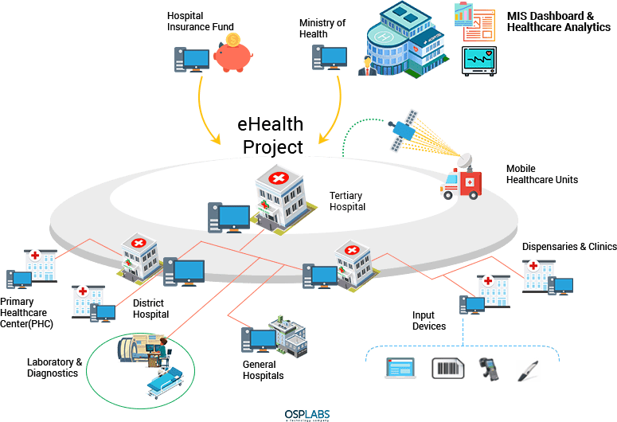
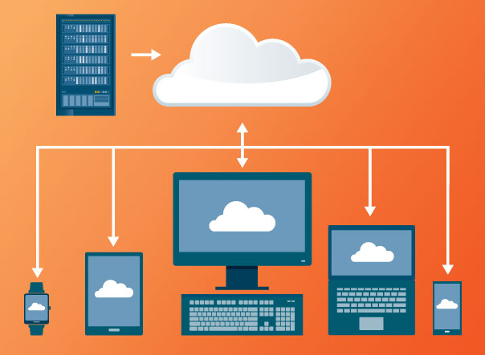

Endpoint Protection Fundamentals
Definition of Endpoints
Endpoints: Devices and systems that connect to a network and communicate with it, such as computers, smartphones, tablets, medical devices, and servers.
Endpoint Examples in Healthcare: Electronic health record (EHR) systems, diagnostic equipment, patient monitoring devices, administrative computers, doctors’ computers, hospitals’ computers, mobile devices used by healthcare providers etc.

Slide 25
Endpoint Protection Fundamentals
Importance of Endpoints
Data Access Points: Endpoints serve as access points to sensitive patient data and critical healthcare applications.
Attack Vectors: Each endpoint represents a potential entry point for cyber attackers to infiltrate the network

Slide 26
Course progress
o1.
Introduction to Network Security in Healthcare
o2.
Endpoint Protection Fundamentals
o3.
Cybersecurity Threat Landscape in Healthcare
o4.
Best Practices for Endpoint Security
o5.
Regulatory Compliance & Standards
o6.
Example of a SIEM
o7.
Collaboration & Knowledge Sharing

Slide 27

Cybersecurity Threat Landscape in Healthcare
Key Threats
Ransomware Attacks: Malicious software that encrypts data and demands a ransom for its release.
Data Breaches: Unauthorized access to confidential patient information, leading to identity theft and other malicious activities.
Advanced Persistent Threats (APTs): Prolonged and targeted cyberattacks aimed at stealing data or compromising systems over an extended period.

Slide 28
Cybersecurity Threat Landscape in Healthcare
Ransomware and Data Breaches:
Primary Threats to Healthcare
Ransomware Attacks
  Mechanism: Attackers use phishing emails, exploit vulnerabilities, or deploy malicious software to encrypt critical data.
  Impact: Disruption of healthcare services, loss of access to patient records, and significant financial demands for decryption keys.
  Example: The WannaCry ransomware attack in 2017 affected numerous healthcare organizations worldwide, causing widespread disruption.
Data Breaches
  Sources: Can result from insider threats, phishing attacks, or direct hacking of systems.
  Consequences: Exposure of sensitive patient data, leading to identity theft, financial loss, and damage to the organization's reputation.
  Regulatory Implications: Non-compliance with regulations like HIPAA can result in hefty fines and increased scrutiny.

Slide 29
Cybersecurity Threat Landscape in Healthcare
Beyond Ransomware and Data Breaches: Other Threats
Phishing and Social Engineering
  Methods: Attackers use deceptive emails, messages, or calls to trick healthcare staff into revealing sensitive information or installing malware.
  Impact: Compromise of user credentials, unauthorized access to systems, and initiation of further attacks.
Medical Device Hacking
  Vulnerabilities: Many medical devices have outdated software, weak security configurations, and are connected to the internet.
  Risks: Compromised devices can lead to incorrect dosages, disrupted treatment, or altered diagnostic data, posing direct risks to patient safety.
Supply Chain Attacks
  Definition: Attacks that target third-party vendors or software used by healthcare organizations.
  Impact: Compromised software or hardware can serve as a backdoor into the healthcare network, leading to widespread infection and data theft.

Slide 30
Course progress
o1.
Introduction to Network Security in Healthcare
o2.
Endpoint Protection Fundamentals
o3.
Cybersecurity Threat Landscape in Healthcare
o4.
Best Practices for Endpoint Security
o5.
Regulatory Compliance & Standards
o6.
Example of a SIEM
o7.
Collaboration & Knowledge Sharing

Slide 31
Endpoint Protection Fundamentals
Risks Associated with Endpoints in Healthcare
Data Breaches: Compromised endpoints can lead to unauthorized access to sensitive patient information.
Operational Disruptions: Attacks on endpoints can disrupt clinical and administrative operations, affecting patient care and organizational efficiency.
Propagation of Malware: Infected endpoints can serve as launchpads for malware to spread across the network.

Slide 32

Endpoint Protection Fundamentals
Key Components of Endpoint Protection
Antivirus and Anti-Malware: Protect endpoints from malicious software.
Firewalls: Monitor and control incoming and outgoing network traffic based on predetermined security rules.
Encryption: Ensure data transmitted to and from endpoints is encrypted to protect against interception.

Slide 33
Endpoint Protection Fundamentals
Endpoint Protection Strategies
Comprehensive Security Policies: Establish and enforce clear security policies for endpoint protection.
User Education and Training: Conduct ongoing training for healthcare staff to recognize and respond to potential security threats.
Access Controls: Implement strong authentication mechanisms and access controls to limit endpoint access to authorized users only.
  Multi-Factor Authentication (MFA): Enforce MFA to add an extra layer of security to endpoint access.
  Least Privilege Access: Apply the principle of least privilege, ensuring users have only the access necessary for their roles.
  Continuous Monitoring: Implement continuous monitoring and logging of endpoint activity to identify and mitigate threats quickly.

Slide 34

Endpoint Protection Fundamentals
Endpoint Protection Strategies
Regular Updates and Patching: Keep software and operating systems up to date to close security vulnerabilities.
Βackups: Safer solution for ransomware that ask for payment to unlock your data.
Endpoint Detection and Response (EDR): Use EDR tools to continuously monitor endpoint activities, detect suspicious behavior, and respond to threats in real-time.
Security Information and Event Management (SIEM): Implement SIEM systems to collect, analyze, and correlate security event data from various sources, providing a comprehensive view of potential threats and facilitating faster incident response.

Slide 35
Endpoint Protection Fundamentals
Next-Generation Security Solutions
Behavioral Analysis: Utilize machine learning and AI to identify and mitigate anomalies in endpoint behavior.
Zero Trust Architecture: Implement a Zero Trust model where no device, user, or system is trusted by default, and continuous verification is required.
Healthcare-Specific Measures
Network Segmentation: Segment the network to isolate medical devices and critical systems from other parts of the network, reducing the impact of a potential breach.
Medical Device Security: Apply security patches, use secure configurations, and conduct regular risk assessments for all medical devices.
Employee Training
Awareness Programs: Conduct regular training sessions to educate healthcare staff on endpoint security best practices and the latest cyber threats, including Phishing attacks Simulations

Slide 36
Endpoint Protection Fundamentals
Case Study 1:
Ransomware Attack on a Hospital
Case Study 2: Securing IoT Medical Devices
Incident: A ransomware attack compromised hospital endpoints, encrypting patient records and disrupting services.
Response: The hospital implemented advanced EDR solutions and enhanced staff training to prevent future incidents.
Incident: A healthcare provider identified vulnerabilities in their IoT medical devices that could be exploited remotely.
Response: The provider deployed network segmentation and updated device firmware, alongside implementing strict access controls.
Lessons Learned
Proactive Measures: Regular risk assessments and proactive security measures can significantly reduce the risk of endpoint compromises.
Continuous Improvement: Security is an ongoing process that requires continuous monitoring, updates, and staff education to adapt to evolving threats.

Slide 37
Course progress
o1.
Introduction to Network Security in Healthcare
o2.
Endpoint Protection Fundamentals
o3.
Cybersecurity Threat Landscape in Healthcare
o4.
Best Practices for Endpoint Security
Regulatory Compliance & Standards
o5.
o6.
Example of a SIEM
o7.
Collaboration & Knowledge Sharing

Slide 38
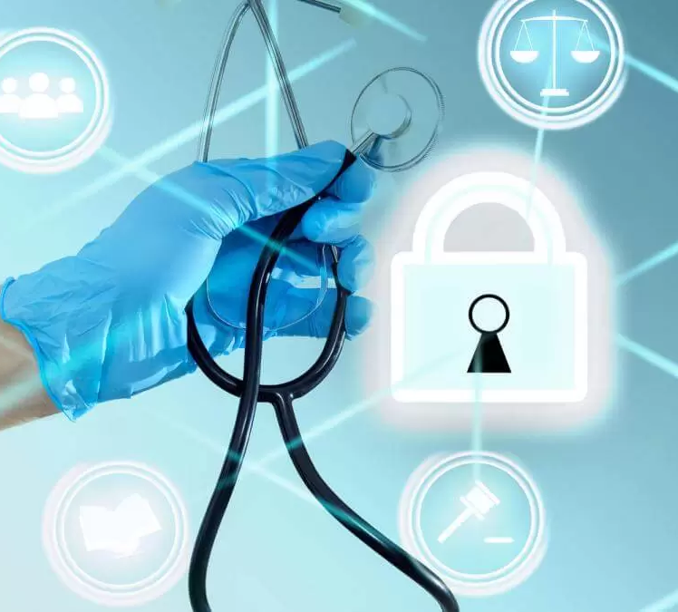
Regulatory Compliance & Standards
Introduction to Regulatory Compliance
Purpose: To protect sensitive patient information and ensure data privacy and security.
Key Regulations:
HIPAA (Health Insurance Portability and Accountability Act): Establishes national standards to protect electronic protected health information (ePHI) from unauthorized access.
HITRUST (Health Information Trust Alliance): Provides a certifiable framework to manage risk and compliance in healthcare.

Slide 39
Regulatory Compliance & Standards
HIPAA Security Rule Overview
Objective: Safeguard the confidentiality, integrity, and availability of ePHI.
Core Components:
  Administrative Safeguards: Policies and procedures designed to clearly show how the entity will comply with the act.
  Physical Safeguards: Measures to protect electronic systems, equipment, and data from threats, environmental hazards, and unauthorized intrusion.
  Technical Safeguards: Technology and policies that protect ePHI and control access to it.

Slide 40
Regulatory Compliance & Standards
HIPAA Security Rule Overview
Implementation Guidelines
  Risk Analysis and Management: Conduct regular risk assessments and implement measures to mitigate identified risks.
  Access Controls: Ensure only authorized personnel have access to ePHI.
  Audit Controls: Implement hardware, software, and procedural mechanisms to record and examine access and other activity in information systems that contain or use ePHI.

Slide 41
Regulatory Compliance & Standards
HITRUST Common Security Framework (CSF)
Purpose: Provides organizations with a comprehensive, flexible, and efficient approach to regulatory compliance and risk management.
Components:
  Control Categories: Includes various categories such as access control, incident management, and risk management.
  Compliance Mapping: Aligns with multiple regulations, frameworks, and standards such as HIPAA, NIST, and ISO.
Certification Process:
  Assessment: Organizations undergo rigorous assessments to ensure compliance with HITRUST CSF.
  Certification: Achieving HITRUST CSF certification demonstrates that an organization meets the highest standards for protecting ePHI.

Slide 42
Regulatory Compliance & Standards
Practical Steps for Compliance
Steps to Achieve Compliance
Develop Comprehensive Policies and Procedures: Ensure all staff are trained and aware of their responsibilities.
Conduct Regular Audits and Assessments: Regularly evaluate compliance status and address any identified gaps.
Implement Robust Security Measures: Use encryption, secure access controls, and regular updates to protect ePHI.
Stay Updated with Regulatory Changes: Continuously monitor and adapt to new regulations and standards in the healthcare industry.

Slide 43
Regulatory Compliance & Standards
Discussion Points
How do healthcare organizations balance security and accessibility of health information?
What are the challenges and benefits of achieving HITRUST certification?

Slide 44
Course progress
o1.
Introduction to Network Security in Healthcare
o2.
Endpoint Protection Fundamentals
o3.
Cybersecurity Threat Landscape in Healthcare
o4.
Best Practices for Endpoint Security
Regulatory Compliance & Standards
o5.
o6.
Example of a SIEM
o7.
Collaboration & Knowledge Sharing

Slide 45

Example of a SIEM
As said, a very useful endpoint protection strategy is to implement a Security Information and Event Management (SIEM) system to collect, analyze and correlate security event data from various sources, providing a comprehensive view of potential threats and facilitating faster incident response.
(635) Security Infusion for Event Management and IT Monitoring - YouTube

Slide 46
Course progress
o1.
Introduction to Network Security in Healthcare
o2.
Endpoint Protection Fundamentals
o3.
Cybersecurity Threat Landscape in Healthcare
o4.
Best Practices for Endpoint Security
Regulatory Compliance & Standards
o5.
o6.
Example of a SIEM
o7.
Collaboration & Knowledge Sharing

Slide 47

Collaboration & Knowledge Sharing
Please Raise Your Hand &
Introduce Yourself!
Profile info: Do you work within the healthcare sector? Are you a cybersecurity specialist? How familiar are you with the discussed topics?
Thoughts on the Seminar: What aspects resonated with you the most?
Additional Thoughts: Do you have anything to add?

Slide 48

Thank you
Please send all questions to:
disiaili@itml.gr
Dimitra Siaili

