Slide 1




Network Security For Energy
CSP004_C_E
SLIDE SET #6: Malware Defense & Intrusion Detection
PRESENTATION BY:
ANTONIOS NTIB

Slide 2
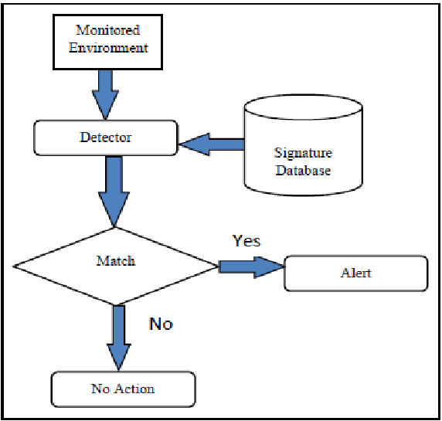
Malware Defense & Intrusion Prevention/Detection: Important or Not For the Energy Sector?
1. Signature-based detection
Signature-based detection uses known digital indicators of malware to identify suspicious behavior. Lists of indicators of compromise (IOCs), often maintained in a database, can be used to identify a breach. While IOCs can be effective in identifying malicious activity, they are reactive in nature. As a result, CrowdStrike uses indicators of attack (IOA) to proactively identify in-process cyberattacks.
2. Dynamic malware analysis
Dynamic malware analysis executes suspected malicious code in a safe environment called a sandbox. This closed system enables security professionals to watch and study the malware in action without the risk of letting it infect their system or escape into the enterprise network.

Slide 3
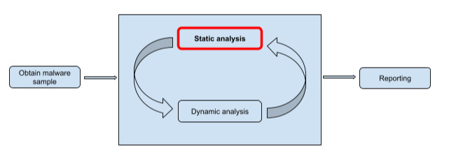
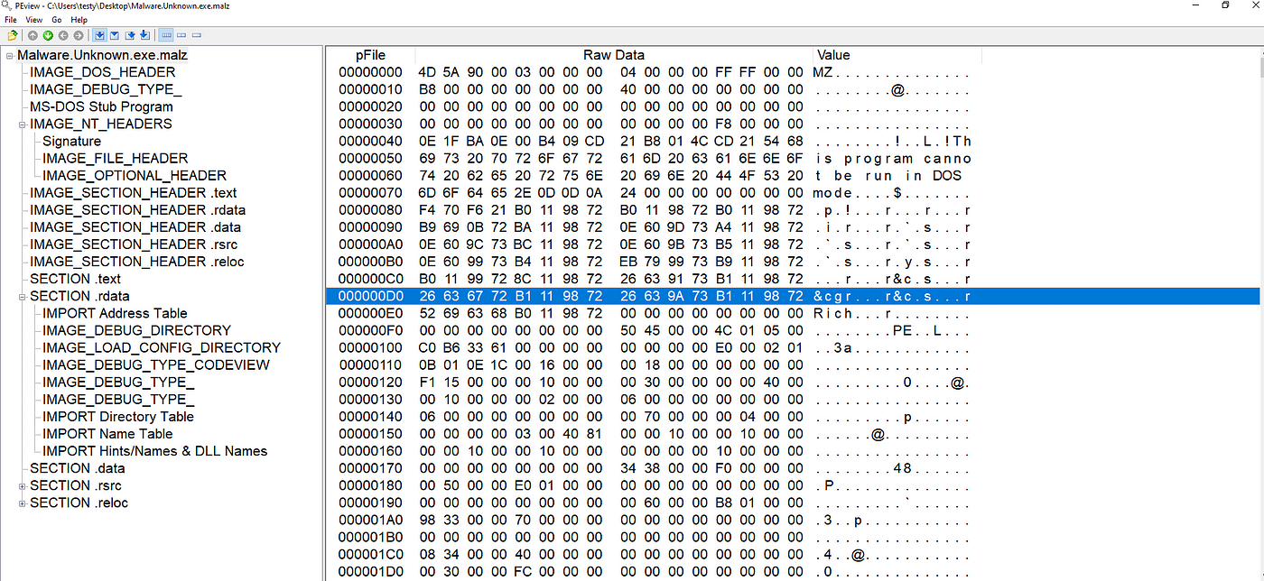
Malware Defense & Intrusion Prevention/Detection: Important or Not For the Energy Sector?
2. Static file analysis
Examining a file’s code, without running it, to identify signs of malicious intent. File names, hashes, strings such as IP addresses, and file header data can all be evaluated to determine whether a file is malicious. While static file analysis is a good starting point, proficient security teams use additional techniques to detect advanced malware that can go unidentified during static analysis.

Slide 4
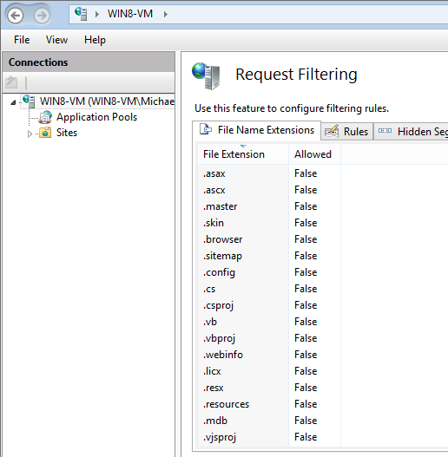
Malware Defense & Intrusion Prevention/Detection: Important or Not For the Energy Sector? (cont’d)
4. Dynamic monitoring of mass file operations
Observing mass file operations such as rename or delete commands to identify signs of tampering or corruption. Dynamic monitoring often uses a file integrity monitoring tool to track and analyze the integrity of file systems through both reactive forensic auditing and proactive rules-based monitoring.
5. File extensions blocklist/blocklisting
File extensions are letters occurring after a period in a file name, indicating the format of the file. This classification can be used by criminals to package malware for delivery. As a result, a common security method is to list known malicious file extension types in a “blocklist” to prevent unsuspecting users from downloading or using the dangerous file.

Slide 5
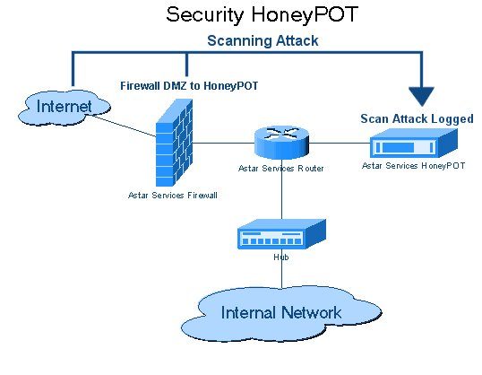
Malware Defense & Intrusion Prevention/Detection: Important or Not For the Energy Sector? (cont’d)
7. Malware honeypot/honeypot files
A malware honeypot mimics a software application or an application programming interface (API) to draw out malware attacks in a controlled, non-threatening environment. Similarly, a honeypot file is a decoy file to draw and detect attackers.

Slide 6
Malware Defense & Intrusion Prevention/Detection: Important or Not For the Energy Sector? (cont’d)
8. Application allowlist/allowlisting
The opposite of a blocklist/blocklisting, where an organization authorizes a system to use applications on an approved list. Allowlisting can be very effective in preventing nefarious applications through rigid parameters. However, it can be difficult to manage and reduce an organization’s operational speed and flexibility.
9. File entropy/measuring changes of a files’ data
As threat intelligence and cybersecurity evolves, adversaries increasingly create dynamic malware executables to avoid detection. This results in modified files that have high entropy levels. As a result, a file’s data change measured through entropy can identify potential malware.

Slide 7
Anti-Virus Software
Goal: Find malware programs on a system, in transmission, etc.
Main deployed approach: Signature-based detection
  Uses pattern matching
  Searches for known patterns of data belonging to malwares in executable programs or other types of files
  Maintains and updates a blacklist of signatures
Problems
  Cannot detect new malwares, variants of malwares, etc.
  Hard to keep up with new malware
    More malwares are created each day than benign programs
1

Slide 8
Polymorphic Malware
  Uses a polymorphic engine (a mutation engine or mutating engine) to generate multiple copies of the same malware that look different
    E.g., serve a different version to each computer subject to a drive-by download attack
  Typically encrypts the majority of the code, each time with a different key is used
  Weakness: decryption code often remains the same, and may be detected and/or used as signatures
2

Slide 9
Metamorphic Malware
A malware automatically changes itself each time it propagates
Each new version has different code, though the same functionality
Uses techniques that include
  Adding varying lengths of NOP instructions, permuting use of registers, add useless instructions, use functional equivalent instructions, reorder functions, reorder data structures, etc.
3

Slide 10
Semantic, or Heuristics Based Malware Detection
Static approach: Looks for specific code behavior instead of specific strings
Dynamic approach: Execute the program to identify potentially malicious behavior
Main limitations
  Performance overhead
  Potential of high false positives
4

Slide 11
Application Whitelisting
Instead of finding malwares and stop then, list all known good/allowed programs and only run them.
Typically deployed by enterprise, who can afford to maintain a list of allowed programs
5

Slide 12
CodeShield: Personalized Application Whitelisting
Goal: Practical Application Whitelisting on Windows desktops
  Give the user flexibility
    Allow the user to add software to the whitelist
  Maintain the security advantage of whitelisting
    New software isn’t automatically allowed onto whitelist
    Protect against certain types of Social Engineering attacks
Not designed to stop all infection
  Make persistence harder
  Prevent most current attacks
Focus on usability
  A key challenge of many security mechanisms is the ability for a typical user to understand and use it
Christopher S. Gates, Ninghui Li, Jing Chen, Robert Proctor: CodeShield: towards personalized application whitelisting. ACSAC 2012
6

Slide 13
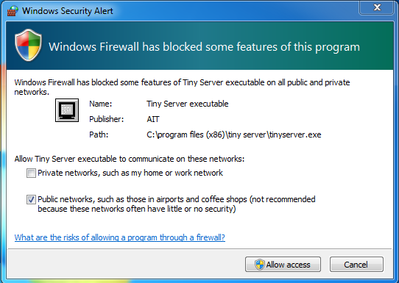
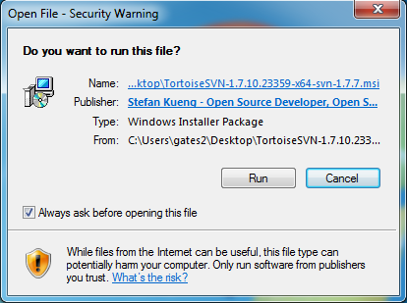
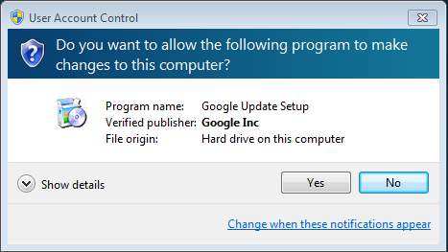
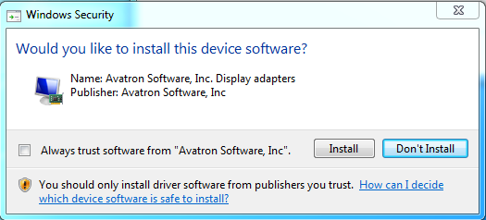
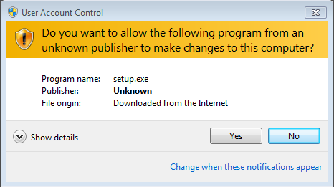
Analysis of Existing Security Interface
Users are asked questions they do not know how to answer and presented with info that is difficult to understand
Users are asked to make a decision too often
Users are made to passively respond and provided an easy and insecure way out
7

Slide 14
Design Principles
Reduce – decrease the number of times users are asked to make a decisions
Simplify – ask questions that a user can understand
Safe (Fail Safe Defaults) – do not provide an easy and insecure way out.
Active – avoid passively respond to security prompts
8

Slide 15
Design of Personalized Whitelisting
Normal Mode
Only execute known software
Trusted Signatures = add to whitelist
Trusted Installers = add to whitelist
All else blocked
Installation Mode
Execute all software
Executed = added to whitelist
Written = added to whitelist
Try to exit installation mode quickly
“Stopping” vs “Warning” approach
The decision a user needs to make
  “Do I want to install new software now”
9

Slide 16
Design Principles in Practice
Reduce – there is a single security decision to make for installing any application
Simplify – this paradigm more closely matches how typical users understand their actions. “I’m adding something new”
Safe (Fail Safe Defaults) – Not allowing new code is the easiest action
Active – In order to add new software, the user needs to actively participate and initiate the action.
10

Slide 17
Installation Mode vs Normal Mode
This dual mode can more closely match the mental model of a typical user.
  Users may not understand “Do you want to allow this program to make changes”
  But most can be educated about “Do you want to add something new to your computer right now”
Furthermore, users can be educated about when not to enter installation mode.
11

Slide 18
The Burden Benefit of Installation Mode
Simple switch to installation mode
  Advantage – it’s easy
  Disadvantage – user may enter installation mode often
High overhead switch to installation mode (ex. reboot)
  Advantage – it makes a user less likely to switch unless needed
  Disadvantage – high overhead may lead to annoyance
Advantage of reboot
  Clear out memory, malware in memory can’t take advantage of installation mode
  Minimal number of applications active just after reboot
12

Slide 19
Network IDSs
Deploying sensors at strategic locations
  E.G., Packet sniffing via tcpdump at routers
Inspecting network traffic
  Watch for violations of protocols and unusual connection patterns
Monitoring user activities
  E.g., look into the data portions of the packets for malicious code, or known exploits
Inspection ability limited by encryption
  Data portions and some header information can be encrypted
  The decryption engine may still be there, especially for exploit
13

Slide 20
Architecture of Network IDS
Signature matching
(& protocol parsing when needed)
Protocol identification
TCP reassembly
Packet capture libpcap
Packet stream
14

Slide 21
Host-Based IDSs
Running on a single host
Monitoring
  Shell commands
  System call sequences
  Etc.
15

Slide 22
Misuse Detection (aka Signature detection)
pattern matching
Intrusion Patterns
intrusion
activities
Example: if (src_ip == dst_ip) then “land attack”
*This causes some TCP implementation to keep sending ack packet to itself.
Can’t detect new attacks
16

Slide 23
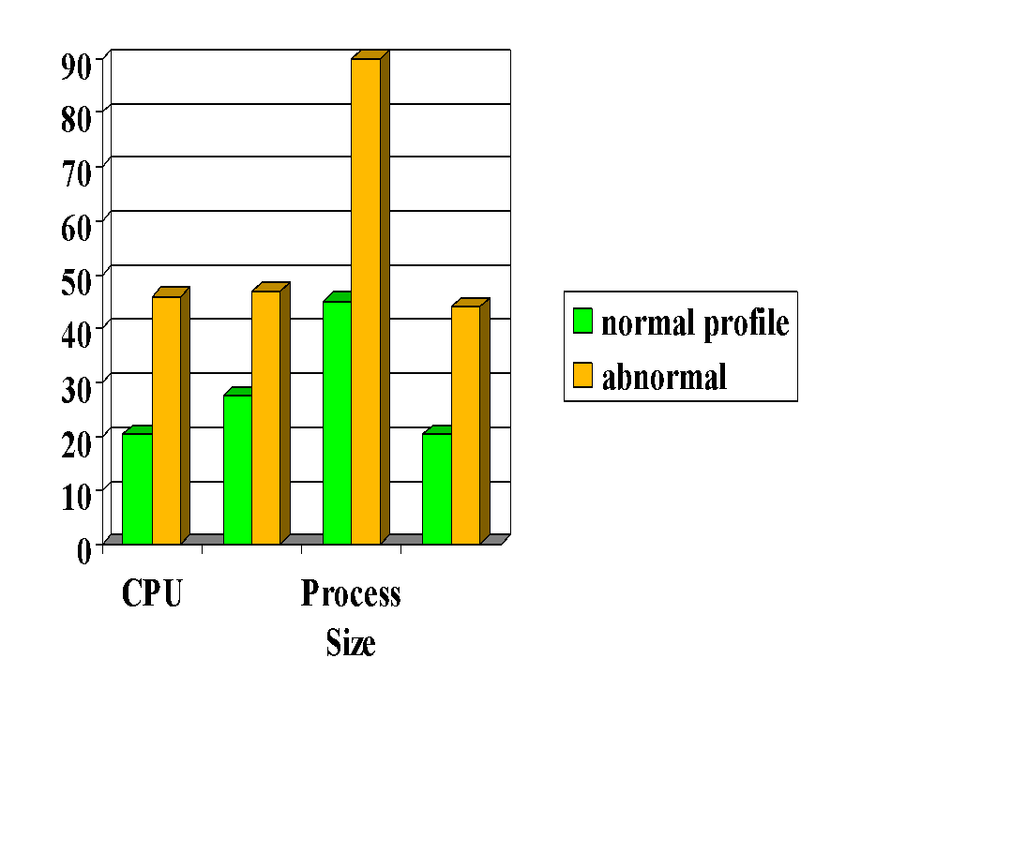

Anomaly Detection
probable intrusion
activity measures
Problem: Relatively high false positive rate
Anomalies can just be new normal activities.
Anomalies caused by other element faults
  E.g., router failure or misconfiguration, P2P misconfiguration
17

Slide 24
Problems with Current IDSs
Inaccuracy for exploit based signatures
Cannot recognize unknown anomalies/intrusions
Cannot provide quality info for forensics or situational-aware analysis
  Hard to differentiate malicious events with unintentional anomalies
    Anomalies can be caused by network element faults, e.g., router misconfiguration, link failures, etc., or application (such as P2P) misconfiguration
    Cannot tell the situational-aware info: attack scope/target/strategy, attacker (botnet) size, etc.
18

Slide 25

Thank you

