Slide 1




Network Security For Energy
CSP004_C_E
SLIDE SET #1: LINUX OS PREREQUISITES
PRESENTATION BY:
ANTONIOS NTIB

Slide 2
Security for the Energy Sector
Energy encompasses many aspects, some traditional, others sector specific
The infrastructure covers everything from power generation, distribution, storage, aggregation and so on.
this means that we need to have control over the infrastructure,
in 2022 advanced cyber-warfare disrupted Ukraine’s power grid.
and, confidence over the information that we receive
e.g. telemetry, usage information from smart meters etc.
Traditional aspects include
customer data, billing, accounting, personnel management, etc.
Thus the energy sector must guard against both types of attack.

Slide 3
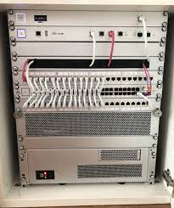

Security for the Energy Sector
In these notes we will explore the tools that will enable us to secure the Energy Sector.
We start from the operating systems that power many elements of the Energy Sector, namely Linux.
Many physical elements , such as network equipment, such routers, switches, inside power plants and administrating offices, Wireless Access Points, etc… are running firmware based on Linux.
Linux is completely versatile. One can have it self-hosted or cloud-based.
Also its functionality can be modified to suit the particular application, from embedded devices to data centers.

Slide 4
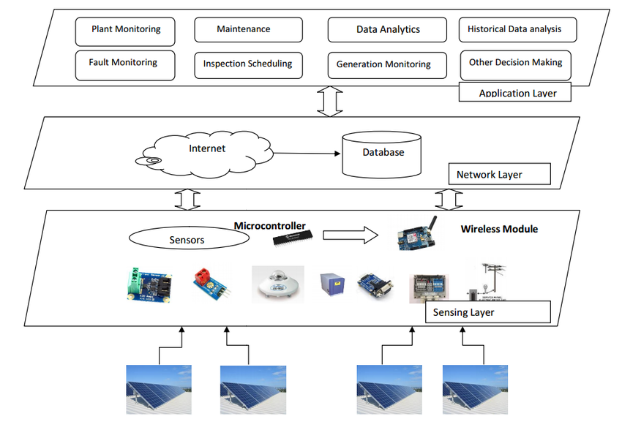

Why Learn Linux for real-use cases on the Energy Sector?
Servers that are crucial infrastructure of the Energy Sector may run some kind of Linux Distribution E.g.: Supreme Petrochem
(Source: https://www.suse.com/sector/energy/)
Smart Devices, such sensors, smart meters, etc.. are running software based on Linux Distributions or the Linux Kernel (vanilla-flavored). E.g: Nobel Grid – EU Project: Horizon 2020 (H2020-646184) Deliverable 3.3

Slide 5
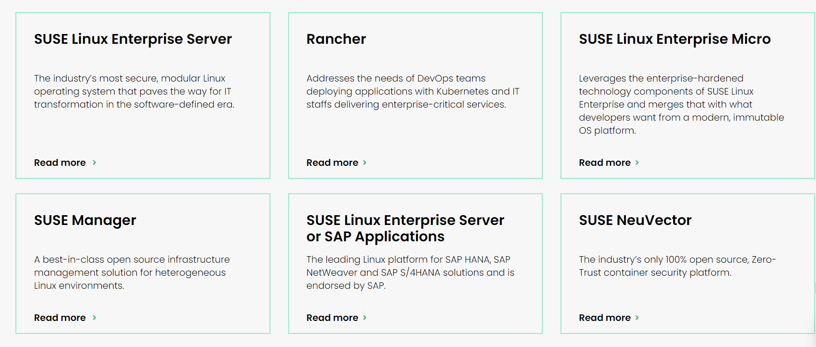
Why Learn Linux for real-use cases on the Energy Sector? (cont’d)
A wide-spectrum of tools for networking and security. Example: Kali Linux, Parrot OS, etc… (Source: https://www.kali.org/tools/)
Scada-based software and SCADA-related software can/could/is preferrable to run in Linux-Based OSes. E.g.: SCADA Edge Devices.

Slide 6
Linux Overview
The LINUX OS architecture resembles a lot with an onion. What this means is that the Linux OS is built in 4 basic layers and each layer sits on top of the other, like an onion:
Hardware: The hardware is the core of the LINUX system and it embodies the operational processes with diverse hardware components connected to the system. The components include Read Access Memory (RAM), Read-Only Memory (ROM), motherboard, Central Processing Unit (CPU) and other storage devices.
Kernel: The Kernel could be otherwise called “the heart of the OS”. It provides the interface between the application and data processing at the system level. It works explicitly with the hardware for connection and follow-up communication. In a raw implementation, assuming you save a file in the ROM (or Hard drive), it will only understand how to manipulate the data to be saved with the influence of the kernel. The kernel has all it takes to manage end-to-end encryption at any request within the confines of the operating system. It also provides the lowest-level abstraction for resource application software and carries out the interactions between hardware and other components of the system. In a nutshell, the kernel handles processes in CPU management, memory management, device management, end-to-end user management, input/output processes and other core functional managements.
2

Slide 7
Linux Overview(cont’d)
Shell: LINUX has avenues for making processes to have development interfaces. The shell is an interface where users can perform input into the system using commands. It can be used to install application programs, update the kernel, run system status checks and other runarounds within the OS. The Shell is classified into two types:command-line shells and graphical shells. While they both perform operations, the command-line shell provides a command-line interface (CLI) and the graphical interface provides the graphical user interface (GUI). Other types of shell include Korn shell, Bourne shell, C shell and POSIX shell.
Utilities & Application Programs: This includes the diverse programs used to fiddle around the OS. They are liable to do a specialized task and ensure users and developers perform whatever is required.
3

Slide 8
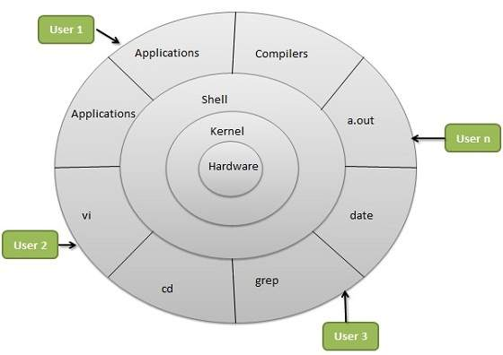
4

Slide 9
Directory Scheme on Linux Systems
Full Directory Listing
/ | "root." (of the tree directory). The starting point for the Linux file system hierarchy. Unrelated to the root user.
/bin | Binaries and other executable programs.
/boot | Files needed to boot the operating system.
/cdrom | Mount point for CD-ROMs.
/cgroup | Control Groups hierarchy.
/dev | Device files, typically controlled by the operating system andthesystem administrators.
/etc | System configuration files.
/export | Shared file systems. Most commonly found on Solaris systems.
/home | Home directories.
/lib | System Libraries.
/lib64 | System Libraries, 64 bit.
/lost+found | Used by the file system to store recovered files after a file system check has been performed.
/media | Used to mount removable media like CD-ROMs.
/mnt | Used to mount external file systems.
5

Slide 10
Directory Scheme on Linux Systems
/opt | Optional or third party software.
/proc | Provides information about running processes.
/root | The home directory for the root account.
/sbin | System administration binaries.
/selinux | Used to display information about SELinux.
/srv | Contains data which is served by the system.
/srv/www | Web server files.
/srv/ftp | FTP files.
/sys | Used to display and sometimes configure the devices and busses known to the Linux kernel.
/tmp | Temporary space, typically cleared on reboot. This directory can be used by the OS and users alike.
/usr | User related programs, libraries, and documentation. The subdirectories in /usr relate to those described above and below.
/usr/bin | Binaries and other executable programs.
/usr/lib | Libraries.
/usr/local | Locally installed software that is not part of the base operating system.
/usr/sbin | System administration binaries.
/var, /var/log | Variable data, most notably log files.
6

Slide 11
Some daily used Linux Commands…
ls - Lists directory contents. You will use ls to display information about files and directories.
cd “directory path” : Changes the current directory to “directory path”. E.g.: cd /home, cd /etc/default, cd .. or cd ../.. . If you execute cd without specifying a directory, cd changes the current directory to your home directory. This is how you navigate around the system using terminal.
pwd : Displays the present working directory name. If you don't know what directory E.g.: you are in /usr/bin if you type pwd it will display usr/bin
cat “file” : Concatenates and displays files. This is the command you run to view the contents of a file. E.g.: you have a file foo.txt and inside you have type the sentence: Hello everyone! I study Physics… . When you type cat foo.txt it will output: Hello everyone! I study Physics…
echo [argument] : Displays arguments to the screen.
man command : Displays the online manual for command. Type q to quit viewing the manual page. The documentation provided by the man command is commonly called "man pages."
exit, logout, or Ctrl-d : Exits the shell or your current session.
clear : Clears the screen.
If you are not sure what command to use, you can search through the man pages with man -k KEYWORD. From there you can read the man page for the command or ask it for help with -h or --help.
7

Slide 12
Example
$ man -k time
Output:
adjtime_config (5) - information about hardware clock setting and drift factor
bootparam (7) - introduction to boot time parameters of the Linux kernel
chrt (1) - manipulate the real-time attributes of a process
date (1) - print or set the system date and time
Date::Parse (3pm) - Parse date strings into time values
flatpak (1) - Build, install and run applications and runtimes
flatpak-build-sign (1) - Sign an application or runtime
flatpak-create-usb (1) - Copy apps and/or runtimes onto removable media.
flatpak-enter (1) - Enter an application or runtime's sandbox
flatpak-flatpakref (5) - Reference to a remote for an application or runtime
flatpak-info (1) - Show information about an installed application or runtime
8

Slide 13
flatpak-install (1) - Install an application or runtime
flatpak-list (1) - List installed applications and/or runtimes
flatpak-metadata (5) - Information about an application or runtime
flatpak-pin (1) - Pin runtimes to prevent automatic removal
flatpak-remote-info (1) - Show information about an application or runtime in a remote
flatpak-remote-ls (1) - Show available runtimes and applications
flatpak-run (1) - Run an application or open a shell in a runtime
flatpak-search (1) - Search for applications and runtimes
flatpak-uninstall (1) - Uninstall an application or runtime
flatpak-update (1) - Update an application or runtime
hp-timedate (1) - Time/Date Utility
hwclock (8) - time clocks utility
kbdrate (8) - reset the keyboard repeat rate and delay time
ldconfig (8) - configure dynamic linker run-time bindings
localtime (5) - Local timezone configuration file
modules (5) - kernel modules to load at boot time
openssl-s_time (1ssl) - SSL/TLS performance timing program
openssl-ts (1ssl) - Time Stamping Authority command
org.freedesktop.timedate1 (5) - The D-Bus interface of systemd-timedated
pacmd (1) - Reconfigure a PulseAudio sound server during runtime
pam_time (8) - PAM module for time control access
pam_timestamp (8) - Authenticate using cached successful authentication attempts
pam_timestamp_check (8) - Check to see if the default timestamp is valid
rtc (4) - real-time clock
rtcwake (8) - enter a system sleep state until specified wakeup time
rtkitctl (8) - Realtime Policy and Watchdog daemon control
s_time (1ssl) - OpenSSL application commands
slabtop (1) - display kernel slab cache information in real time
sleep (1) - delay for a specified amount of time
sudoers_timestamp (5) - Sudoers Time Stamp Format
sysctl (8) - configure kernel parameters at runtime
systemd-debug-generator (8) - Generator for enabling a runtime debug shell and masking specific units at boot
systemd-run (1) - Run programs in transient scope units, service units, or path-, socket-, or timer-triggered service units
systemd-time-wait-sync (8) - Wait until kernel time is synchronized
systemd-time-wait-sync.service (8) - Wait until kernel time is synchronized
systemd-timedated (8) - Time and date bus mechanism
9

Slide 14
systemd-timedated.service (8) - Time and date bus mechanism
systemd-timesyncd (8) - Network Time Synchronization
systemd-timesyncd.service (8) - Network Time Synchronization
systemd-tmpfiles-clean.timer (8) - Creates, deletes and cleans up volatile and temporary files and directories
systemd-user-runtime-dir (5) - System units to start the user manager
systemd.time (7) - Time and date specifications
systemd.timer (5) - Timer unit configuration
tc-etf (8) - Earliest TxTime First (ETF) Qdisc
tc-taprio (8) - Time Aware Priority Shaper
time (1) - run programs and summarize system resource usage
time (7) - overview of time and timers
time.conf (5) - configuration file for the pam_time module
Time::Zone (3pm) - - miscellaneous timezone manipulations routines
time_namespaces (7) - overview of Linux time namespaces
time_t (3) - overview of system data types
timedatectl (1) - Control the system time and date
timeout (1) - run a command with a time limit
timer_t (3) - overview of system data types
timespec (3) - overview of system data types
timesyncd.conf (5) - Network Time Synchronization configuration files
timesyncd.conf.d (5) - Network Time Synchronization configuration files
timeval (3) - overview of system data types
touch (1) - change file timestamps
tsget (1ssl) - Time Stamping HTTP/HTTPS client
tzfile (5) - timezone information
tzselect (1) - view timezones
tzselect (8) - select a timezone
uptime (1) - Tell how long the system has been running.
user-runtime-dir@.service (5) - System units to start the user manager
vcstime (8) - Show time in upper right hand corner of the console screen
zdump (8) - timezone dumper
zic (8) - timezone compile
10

Slide 15
Navigation
Directories are simply containers for files and other directories. They provide a tree
like structure for organizing the system. Directories can be accessed by their name and they can also be accessed using a couple of shortcuts. Linux uses the symbols . And .. to represent directories. . is the current directory and .. and is the parent
directory.
Symbols Description:
/ is the directory separator. Directories end in a forward slash and this is often
assumed. Windows uses \
The directory separator is optional for the last subdirectory in a path or command. For example, the following commands work identically.
$ cd /usr/bin (is equivalent to cd /usr/bin/)
Other examples:
$ cd /var/tmp/
$ cd /home/ubuntu/Downloads
Using the shortcuts can make navigation easier.
For example, type cd .. to go to the directory just above your current directory.
12

Slide 16
Manipulation
The mkdir command is used to create directories and the rmdir command removes them.
mkdir [-p] directory - Creates a directory. Use the -p (parents) option to create intermediate directories.
rmdir [-p] directory - Remove a directory. Use the -p (parents) option to remove all the specified directories. rmdir only removes empty directories. To remove directories and their contents, use rm.
rm -rf directory - Recursively removes the directory and all files and directories in that directory structure. When you use the rm command from the terminal you need to remember that this deletes the file. There is no trash folder for the terminal commands.
The Trash function/folder is used by GUI operations. So if you rm a file or a folder then it is pretty much gone. So please be careful before you execute this command.
Examples:
$ mkdir MyNewFolder
$ mkdir – p MyNewFolder/MyFiles
$ rm -rf MyNewFolder (not rmdir MyNewFolder, because MyNewFolder has MyFiles folder in it)
13

Slide 17
Listing All Files, Including Hidden Files
Files or directories that begin with a period (.) are considered hidden and are not
displayed by default. To show these hidden files and directories, use the -a option.
$ ls -a
Output:
. Documents .pam_environment .thunderbird
.. Downloads Pictures .var
.bash_history .fontconfig .profile Videos
.bash_logout .gnupg Public .wget-hsts
.bashrc .lesshst snap wireguird_amd64.deb
.cache .local .ssh
.config .mozilla .sudo_as_admin_successful
Desktop Music Templates

Slide 18
Up until this point when you have used options, you have preceded each option with a hyphen (-). Examples are -l and -a. Options that do not take arguments can be combined. Only one hyphen is required followed by the options. If you want to show a long ls listing with hidden files you could run ls -l -a or
ls -la. You can even change the order of the flags, so ls -al works too. They are all equivalent.
$ ls -l
Output:
total 2656
drwxr-xr-x 2 und3rd06012 und3rd06012 4096 Dec 28 21:28 Desktop
drwxr-xr-x 2 und3rd06012 und3rd06012 4096 Dec 26 20:53 Documents
drwxr-xr-x 3 und3rd06012 und3rd06012 4096 Dec 28 21:37 Downloads
drwxr-xr-x 2 und3rd06012 und3rd06012 4096 Dec 26 20:53 Music
drwxr-xr-x 2 und3rd06012 und3rd06012 4096 Dec 26 20:53 Pictures
drwxr-xr-x 2 und3rd06012 und3rd06012 4096 Dec 26 20:53 Public
drwx------ 8 und3rd06012 und3rd06012 4096 Dec 27 18:55 snap
drwxr-xr-x 2 und3rd06012 und3rd06012 4096 Dec 28 02:51 Templates
drwxr-xr-x 2 und3rd06012 und3rd06012 4096 Dec 26 20:53 Videos
-rw-rw-r-- 1 und3rd06012 und3rd06012 2682154 Oct 1 00:41 wireguird_amd64.deb

Slide 19
$ ls -l -a (ls -la or ls -al)
Output:
total 2728
drwxr-x--- 20 und3rd06012 und3rd06012 4096 Dec 28 21:28 .
drwxr-xr-x 3 root root 4096 Dec 26 10:15 ..
-rw------- 1 und3rd06012 und3rd06012 1990 Dec 28 21:42 .bash_history
-rw-r--r-- 1 und3rd06012 und3rd06012 220 Dec 26 10:15 .bash_logout
-rw-r--r-- 1 und3rd06012 und3rd06012 3771 Dec 26 10:15 .bashrc
drwx------ 21 und3rd06012 und3rd06012 4096 Dec 28 20:53 .cache
drwx------ 16 und3rd06012 und3rd06012 4096 Dec 28 02:56 .config
drwxr-xr-x 2 und3rd06012 und3rd06012 4096 Dec 28 21:28 Desktop
drwxr-xr-x 2 und3rd06012 und3rd06012 4096 Dec 26 20:53 Documents
drwxr-xr-x 3 und3rd06012 und3rd06012 4096 Dec 28 21:37 Downloads
drwxr-xr-x 2 und3rd06012 und3rd06012 4096 Dec 27 15:40 .fontconfig
drwx------ 2 und3rd06012 und3rd06012 4096 Dec 28 21:34 .gnupg
-rw------- 1 und3rd06012 und3rd06012 20 Dec 28 04:09 .lesshst
drwx------ 3 und3rd06012 und3rd06012 4096 Dec 26 20:53 .local
drwx------ 3 und3rd06012 und3rd06012 4096 Dec 28 02:33 .mozilla
drwxr-xr-x 2 und3rd06012 und3rd06012 4096 Dec 26 20:53 Music
-rw-r--r-- 1 und3rd06012 und3rd06012 310 Dec 27 18:13 .pam_environment
drwxr-xr-x 2 und3rd06012 und3rd06012 4096 Dec 26 20:53 Pictures
-rw-r--r-- 1 und3rd06012 und3rd06012 807 Dec 26 10:15 .profile
drwxr-xr-x 2 und3rd06012 und3rd06012 4096 Dec 26 20:53 Public
drwx------ 8 und3rd06012 und3rd06012 4096 Dec 27 18:55 snap
drwx------ 2 und3rd06012 und3rd06012 4096 Dec 27 15:26 .ssh
-rw-r--r-- 1 und3rd06012 und3rd06012 0 Dec 27 15:14 .sudo_as_admin_successful
drwxr-xr-x 2 und3rd06012 und3rd06012 4096 Dec 28 02:51 Templates
drwx------ 6 und3rd06012 und3rd06012 4096 Dec 28 02:33 .thunderbird
drwxr-xr-x 3 und3rd06012 und3rd06012 4096 Dec 27 16:45 .var
drwxr-xr-x 2 und3rd06012 und3rd06012 4096 Dec 26 20:53 Videos
-rw-rw-r-- 1 und3rd06012 und3rd06012 165 Dec 28 20:41 .wget-hsts
-rw-rw-r-- 1 und3rd06012 und3rd06012 2682154 Oct 1 00:41 wireguird_amd64.deb

Slide 20
Listing Files by Type
When you use the -F option for ls a character is appended to the file name that reveals what type it is.
$ ls
Output:
whereas the below command outputs the following:
$ ls -lF
Output:
Symbol Meaning
/ : Directory.
@ : Link. The file that follows the -> symbol is the target of the link.
* : Executable program.
Desktop Downloads Pictures snap Videos
Documents Music Public Templates wireguird_amd64.deb
Desktop Downloads Pictures snap Videos
Documents Music Public Templates wireguird_amd64.deb
total 2656
drwxr-xr-x 2 und3rd06012 und3rd06012 4096 Dec 28 21:28 Desktop/
drwxr-xr-x 2 und3rd06012 und3rd06012 4096 Dec 26 20:53 Documents/
drwxr-xr-x 3 und3rd06012 und3rd06012 4096 Dec 28 21:37 Downloads/
drwxr-xr-x 2 und3rd06012 und3rd06012 4096 Dec 26 20:53 Music/
drwxr-xr-x 2 und3rd06012 und3rd06012 4096 Dec 26 20:53 Pictures/
drwxr-xr-x 2 und3rd06012 und3rd06012 4096 Dec 26 20:53 Public/
drwx------ 8 und3rd06012 und3rd06012 4096 Dec 27 18:55 snap/
drwxr-xr-x 2 und3rd06012 und3rd06012 4096 Dec 28 02:51 Templates/
drwxr-xr-x 2 und3rd06012 und3rd06012 4096 Dec 26 20:53 Videos/
-rw-rw-r-- 1 und3rd06012 und3rd06012 2682154 Oct 1 00:41 wireguird_amd64.deb

Slide 21
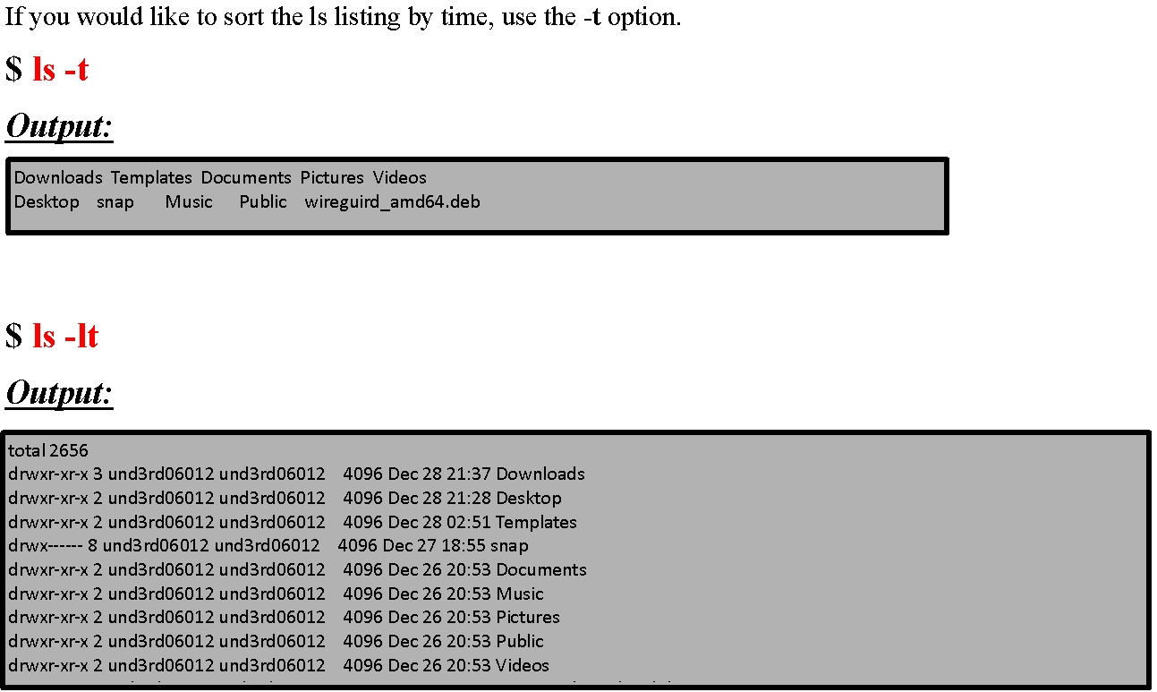
Listing Files by Time

Slide 22
Secret Decoder Ring for Permissions
Now you may have noticed that when a command like ls -lf on the first column of the output there are some weird string next to the files and folder, such as: drwxr-xr-x or drwx------. These strings basically indicate the permissions that the files and folder have.
The first character is the type. The next three characters represent the permissions available to the user, also known as the owner of the file. The next three characters represent the permissions available to the members of the file's group. The final three characters represent the permissions available to all others. In this representation order has meaning and it is important because it indicates the permissions for the users with strict order. Permission types will be displayed for user, followed by group, and finally for others. Also, the permission types of read, write, and execute are displayed in that order. If a particular permission is not granted a hyphen (-) will take its place.
Here is a representation of the permission information displayed by ls -l.
$ ls –l

Slide 23
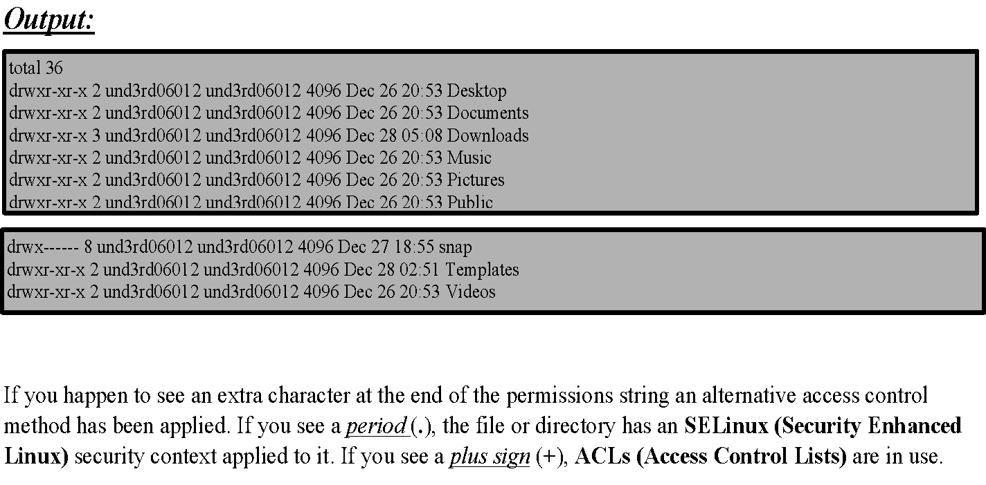

Slide 24
Security-Enhanced Linux (SELinux) is a Linux kernel security module that provides a mechanism for supporting access control security policies, including mandatory access controls (MAC).
Access control lists (ACLs) provides an additional, more flexible permission mechanism for file systems. It is designed to assist with UNIX file permissions. ACLs allows you to give permissions for any user or group to any disc resource. ACLs (access control lists) can be used as an expansion of the traditional permission concept for file system objects. With ACLs, permissions can be defined more flexibly than with the traditional permission concept.

Slide 25
Changing Permissions
Permissions are also known as modes. That is why the command you use to change permissions is called chmod, short for "change mode". There are two ways to specify the mode. The first way is called symbolic mode. The symbolic mode format is chmod user_category operator permission. Here is a table view of the chmod command symbolic mode format:
chmod : The change mode command.
ugoa : The user category. One or more of u for user, g for group, o for other, a for all.
+-= : one of +, -, or =. Use + to add permissions, - to subtract them, or = to explicitly set them.

Slide 26
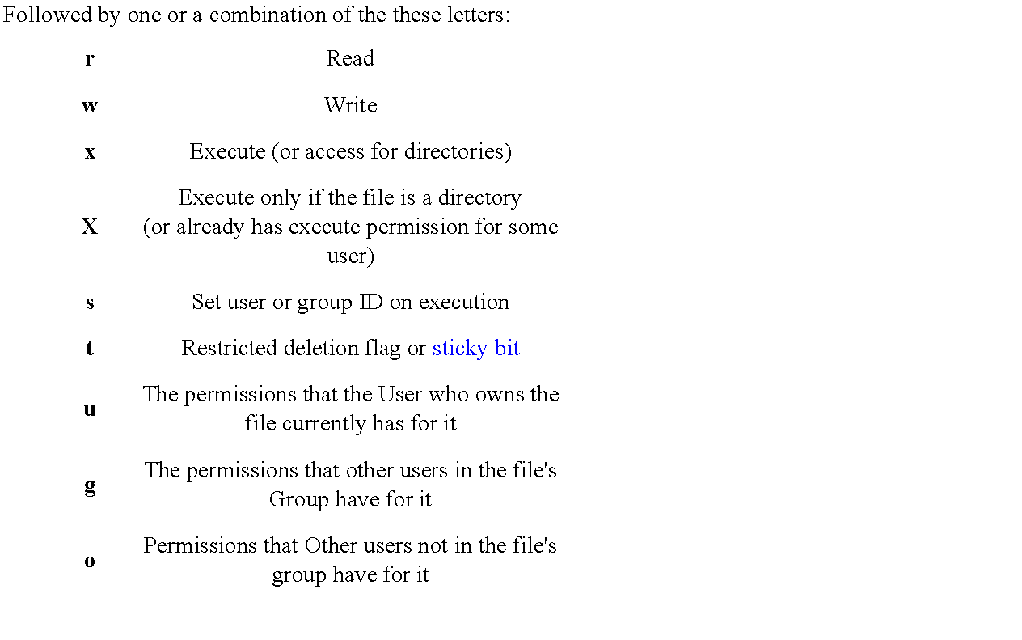

Slide 27
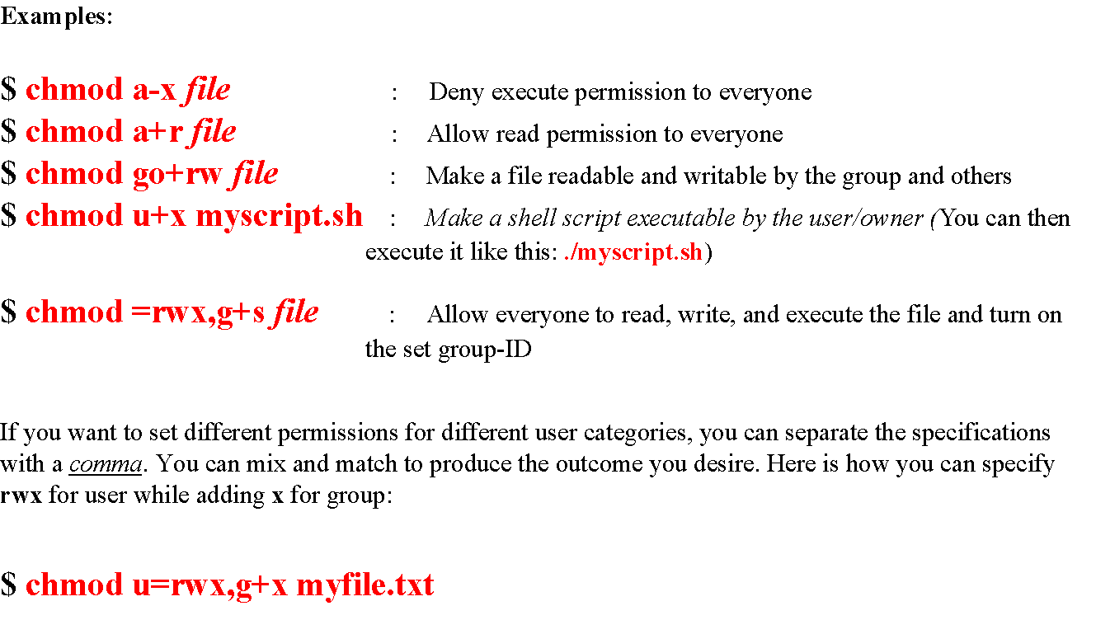

Slide 28
Numeric Based Permissions
In addition to symbolic mode, octal mode can be used with chmod to set file and directory permissions. Understanding the concepts behind symbolic mode will help you learn octal mode. In octal mode permissions are based in binary.
Each permission type is treated as a bit that is either set to off (0) or on (1). In permissions, order has meaning. Permissions are always in read, write, and execute order. If r, w, and x are all set to off, the binary representation is 000.
If they are all set to on, the binary representation is 111. To represent read and execute permissions while omitting write permissions, the binary number is 101.

Slide 29
r | w | x | Explanation
0 | 0 | 0 | Binary value for off
1 | 1 | 1 | Binary value for on
0 | 0 | 0 | Base 10 (decimal) value for off
4 | 2 | 1 | Base 10 (decimal) value for on

Slide 30
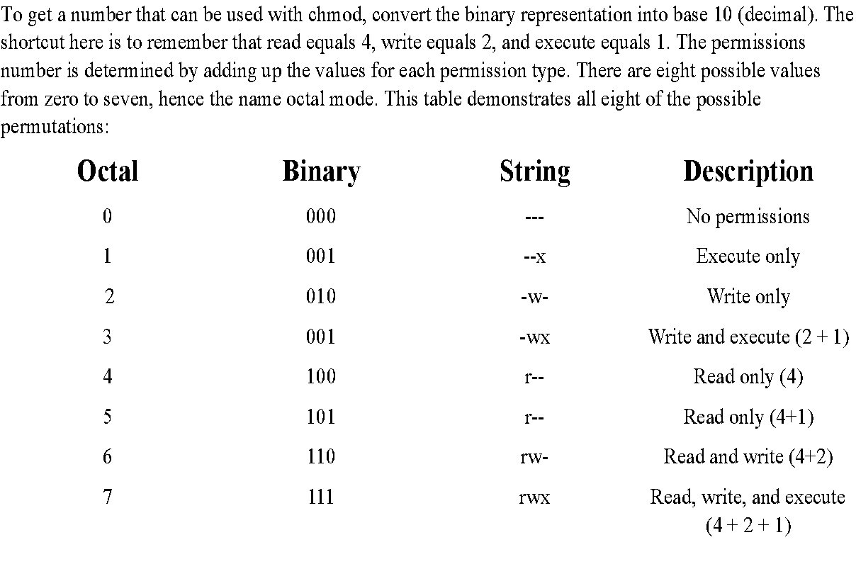

Slide 31
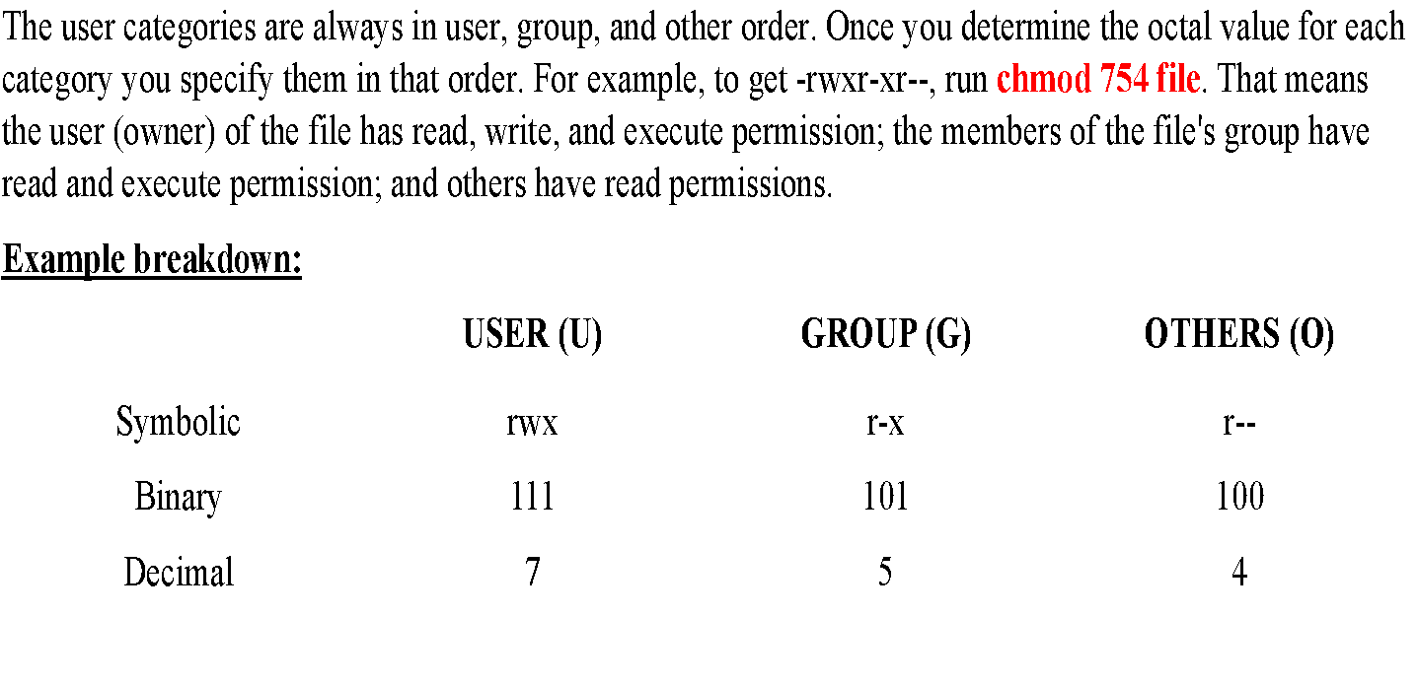

Slide 32
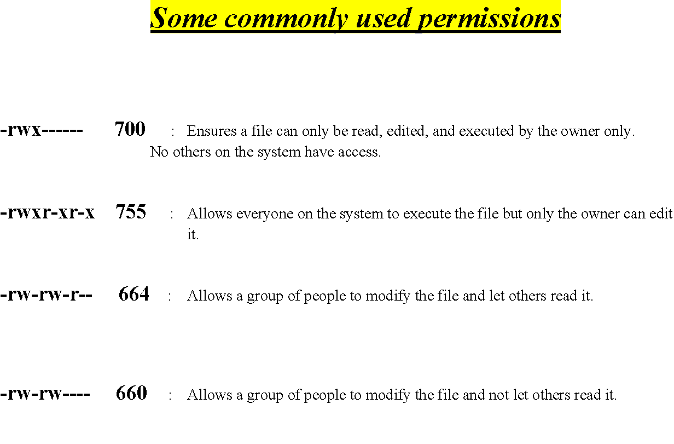

Slide 33
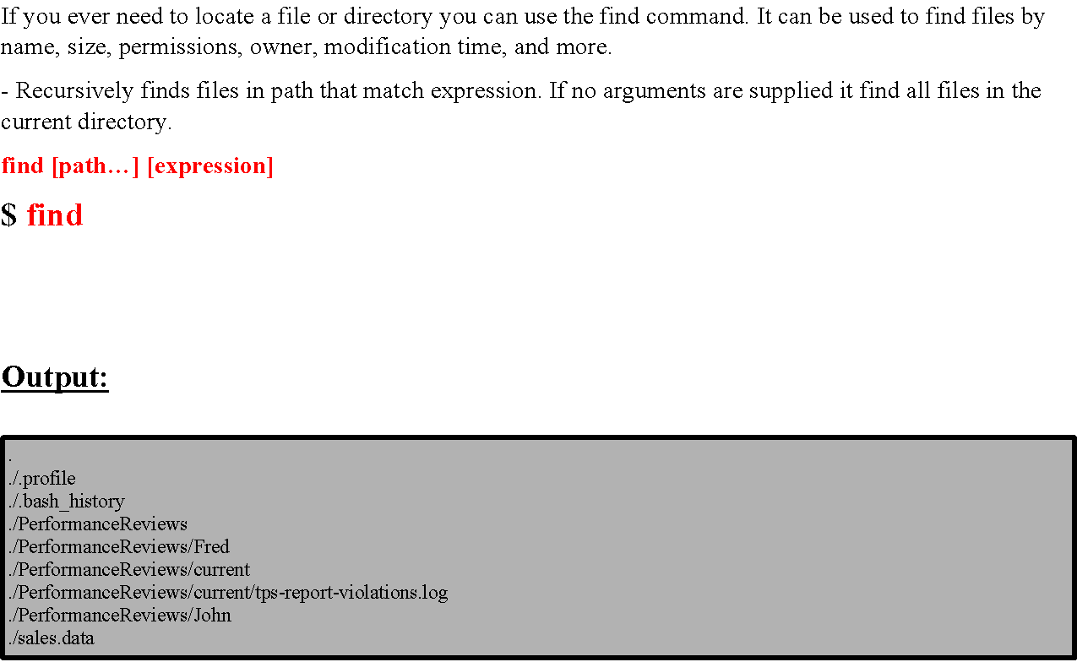
Finding Files

Slide 34
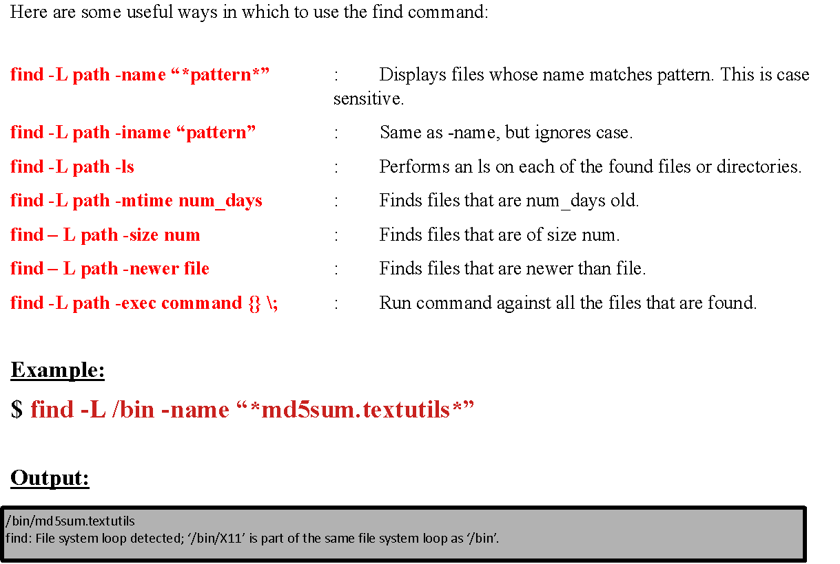

Slide 35
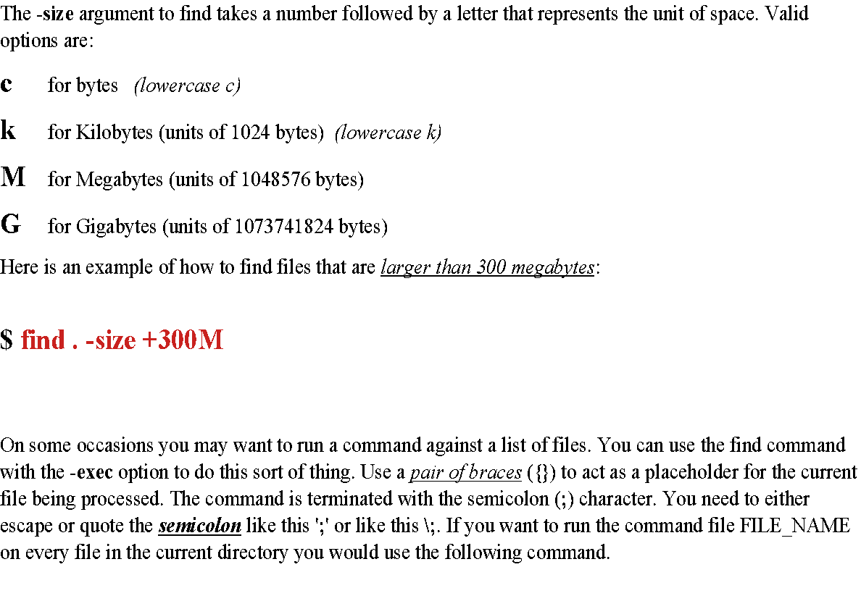

Slide 36
On some occasions you may want to run a command against a list of files. You can use the find command with the -exec option to do this sort of thing. Use a pair of braces ({}) to act as a placeholder for the current file being processed. The command is terminated with the semicolon (;) character. You need to either escape or quote the semicolon like this ';' or like this \;. If you want to run the command file FILE_NAME on every file in the current directory you would use the following command.
$ find -L /opt -exec file {} \;

Slide 37
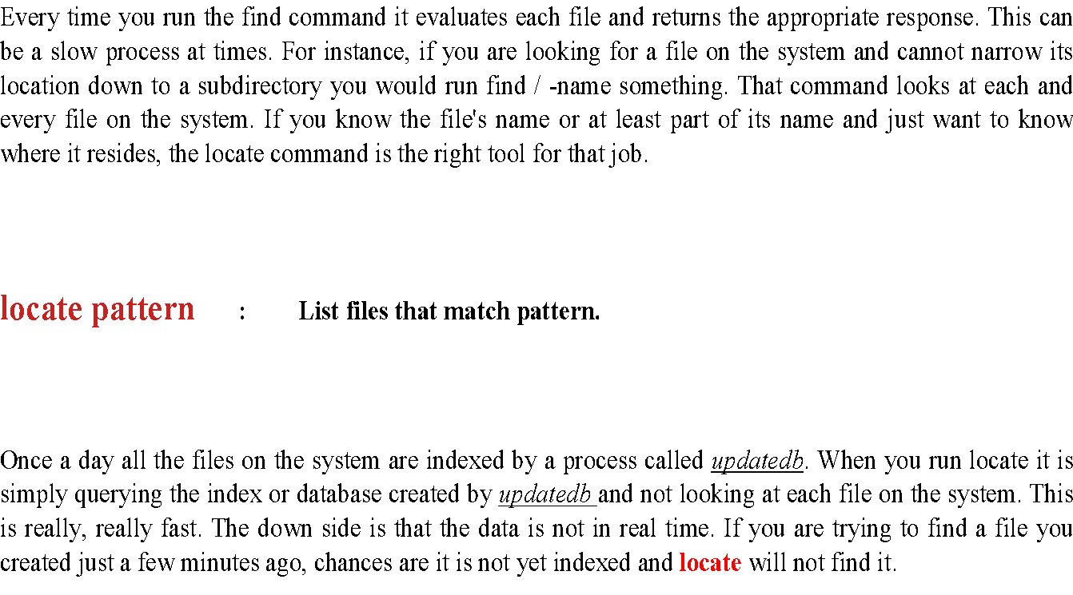
Locate (a faster find command with a “trap”)

Slide 38
Viewing and Editing Files
Here are some simple commands that display the contents of files to the terminal:
cat filename : Display the entire contents of file.
more filename : Browse through a text file.
less filename : Like more but allows backward movement and pattern searches.
head filename : Output the beginning (or top) portion of file.
tail filename : Output the ending (or bottom) portion of file.

Slide 39
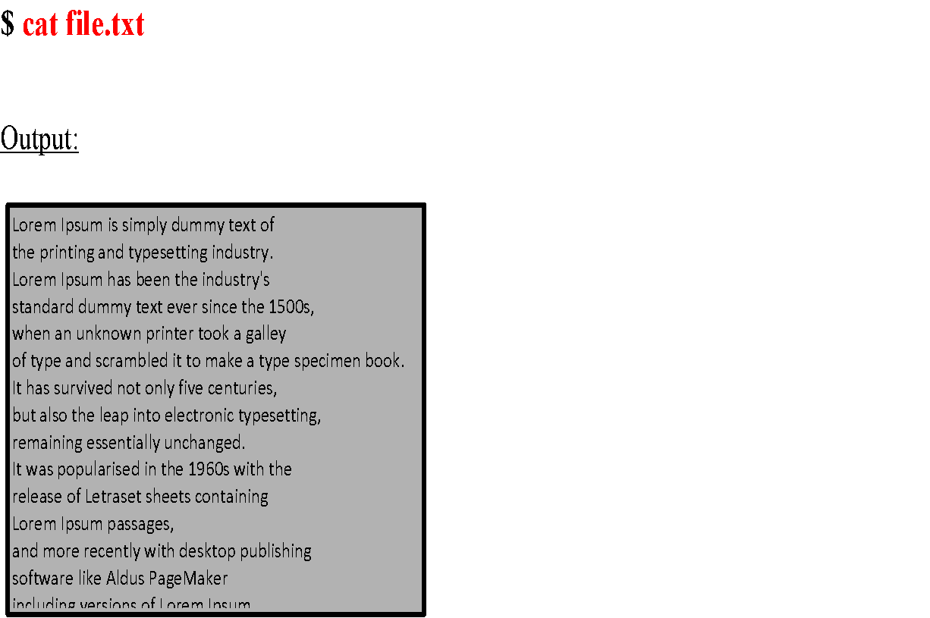

Slide 40
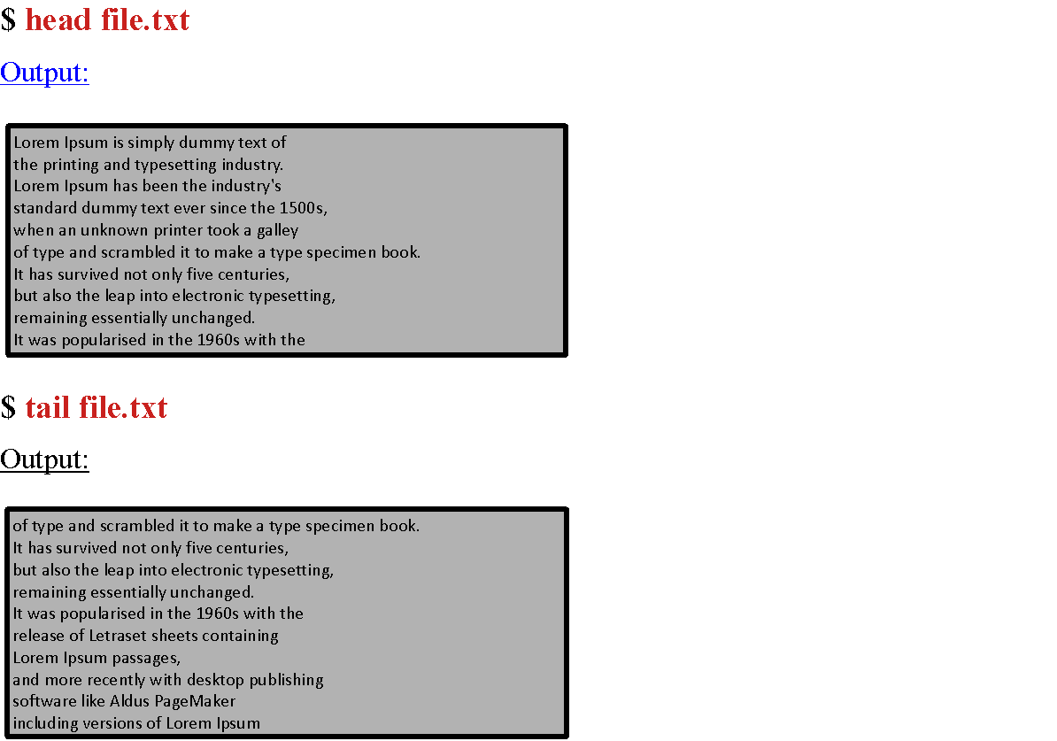

Slide 41
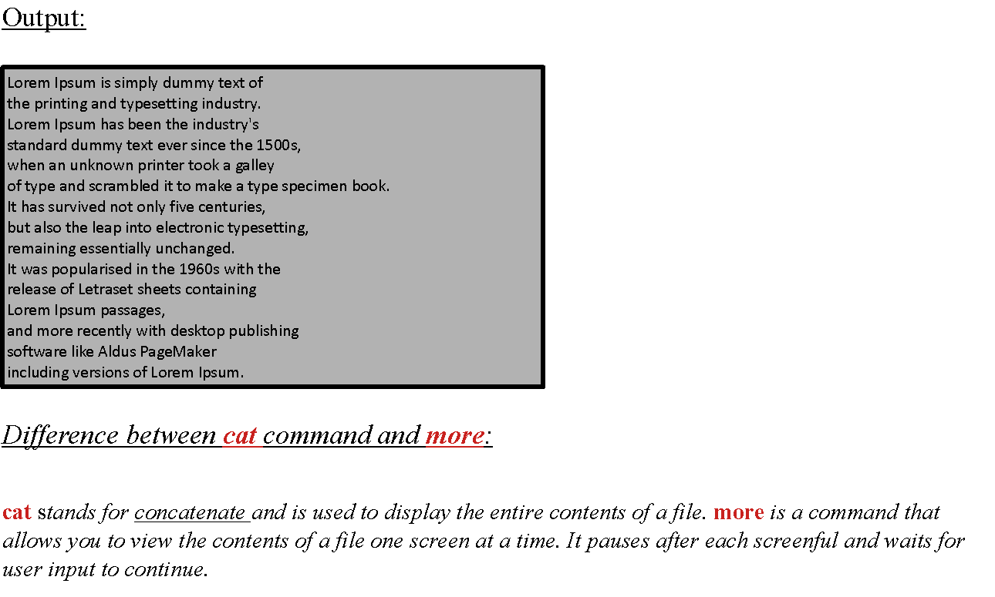
By default head and tail only display ten lines. You can override this behavior and tell them to display a specified number of lines. The format is -n where n is the number of lines you want to display. If you only want to display the first line of a file use head -1 file. Want to display the last three lines? Then run tail -3 file.

Slide 42
Nano
If you need to edit a file right now and do not want to spend any time learning obscure editor commands, use nano.
Nano is a clone of pico, so if for some reason the nano command is not available, pico probably is. It's not as powerful as some other editors, but it's definitely easier to learn.
When you start nano you will see the file's contents and a list of commands at the bottom of the screen. To run the commands, replace the caret symbol (^) with the Ctrl key. For example, to exit nano type Ctrl + x.
The up and down arrow keys will take you to the previous or next lines as expected.
The right and left arrow keys let you navigate forwards and backwards on the same line. Simply type the desired text into the editor. To save the file, type Ctrl + o.
If you forget to save the file before you exit, nano will ask you if you want to save the file. To learn more type Ctrl + g for help.

Slide 43
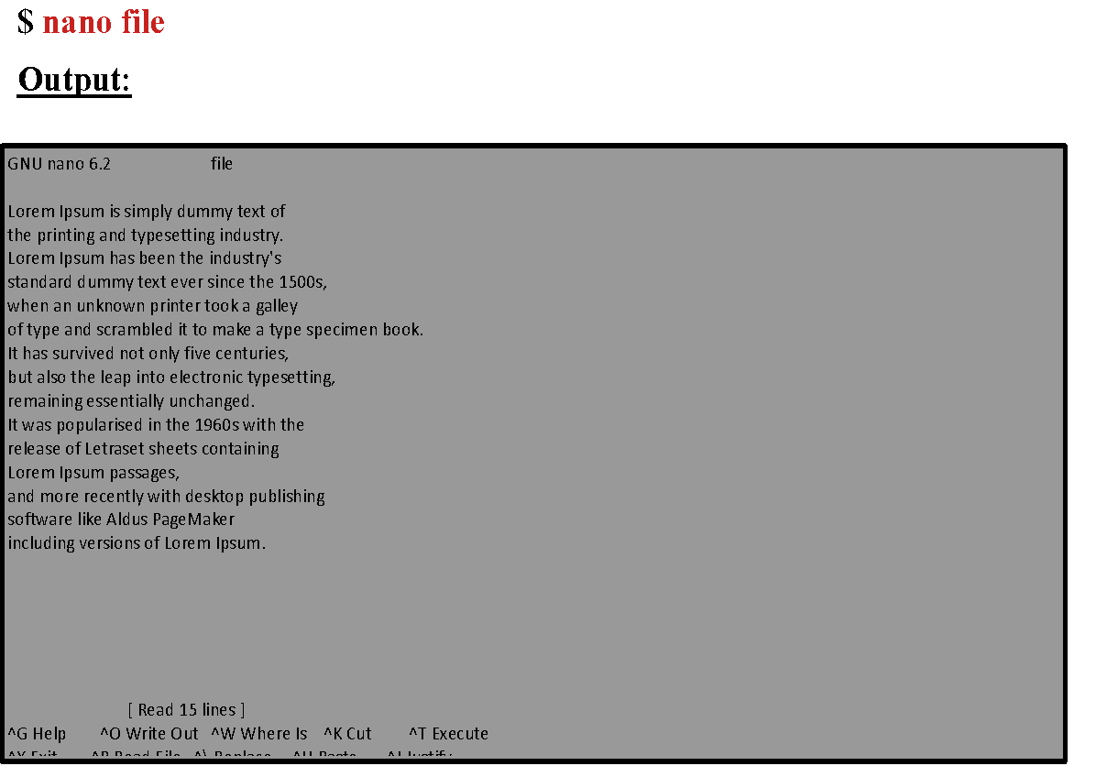

Slide 44
Vi – Vi Improved (Vim)
Vi/Vim is a Unix text editor that's included in Linux, BSD, and macOS. It's known for being fast and efficient, in part because it's a small application that can run in a terminal (although it also has a graphical interface), but mostly because it can be controlled entirely with the keyboard with no need for menus or a mouse.
Vim is also commonly referred to as Vi because when it was written by Bill Joy in the late 1970s, it was short for visual editor.
Some of the additional features of vim include syntax highlighting, the ability to edit files over the network, multi-level undo/redo, and screen splitting. On many Linux distributions when you invoke vi, you are actually running vim.
One advantage of knowing vi is that vi or a vi variant like vim is always available on the system. Another advantage is that once you learn the key mappings for vi you can apply them to other commands like man, more, less, view, and even your shell.

Slide 45
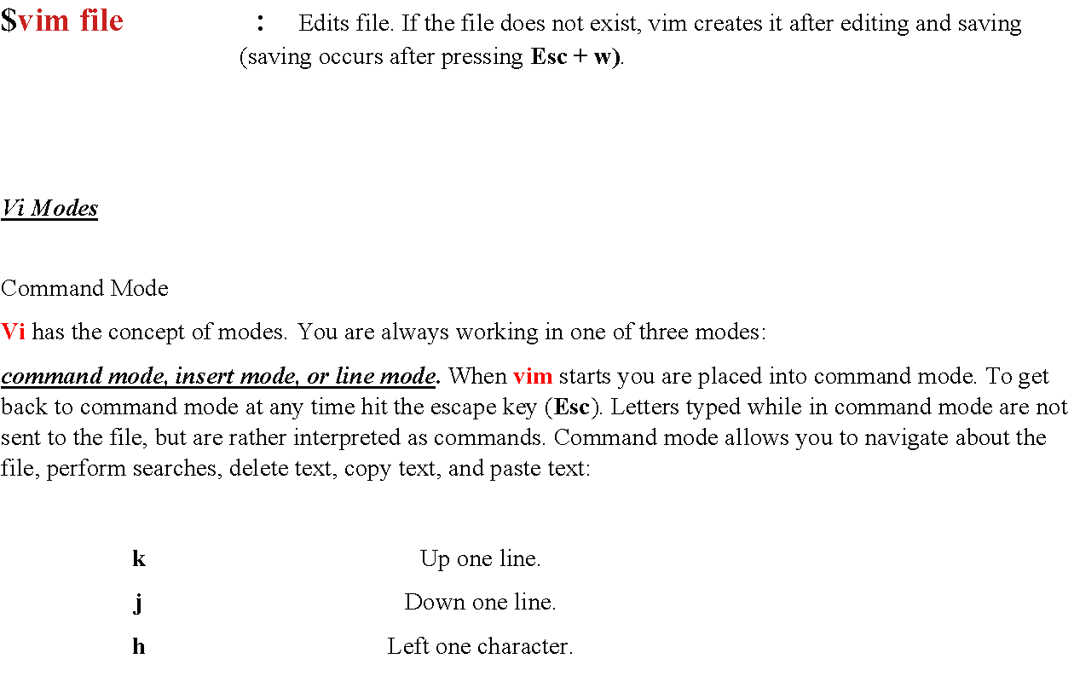

Slide 46
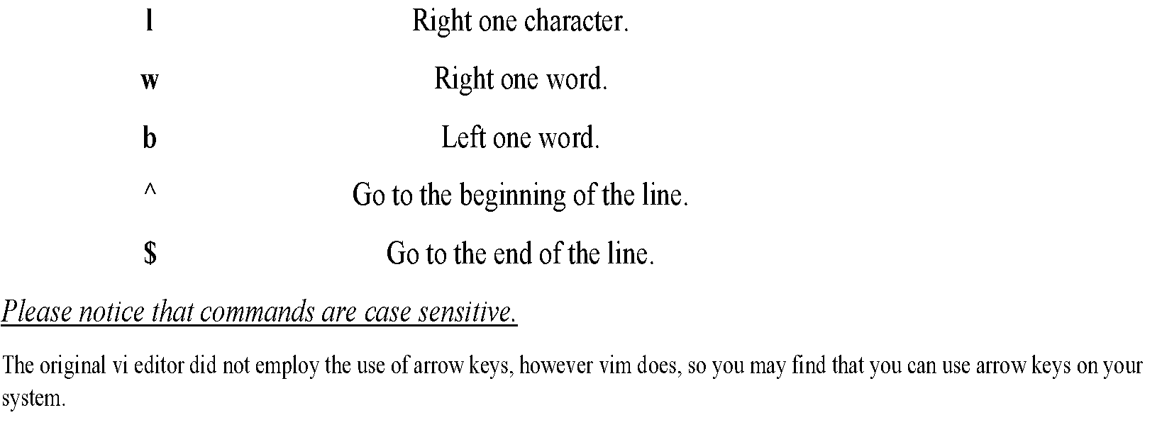
Insert mode
To enter insert mode, press one of the following keys:
i : insert at the cursor position.
I : insert at the beginning of the line.
a : Append after the cursor position.
A : Append at the end of the line.
After entering into insert mode, type the desired text. When you are finished, press the Esc button to return to command mode.

Slide 47
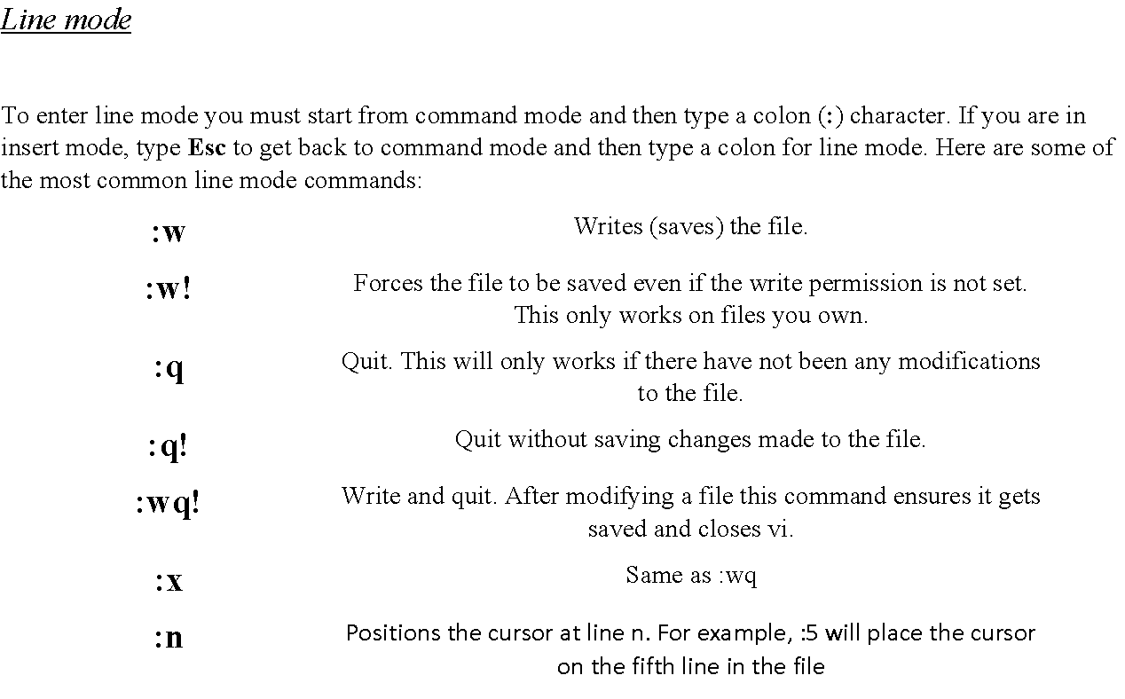

Slide 48
Basic Text Manipulation
x | delete character under the cursor
X | delete character before the cursor
dw | Delete a word. To delete five words, type d5w.
dd | delete line To delete 3 lines, type 3dd.
D | delete from cursor to end of line
p | paste after the cursor
P | paste at the cursor
+p | paste from system clipboard after the cursor
+P | paste from system clipboard at the cursor
v | switch to visual mode
V | switch to visual line mode
y | copy (yank)
+y | copy to system clipboard
y<position> | Yank the <position>. For example, to yank a word type yw. To yank three words type y3w.
u | undo
r | Replace the current character.
cw | Change the current word.
cc | Change the current line.
c$ | Change the text from the current position to the end of the line.
C | Same as c$.
~ | Reverses the case of a character.
Ctrl + r | redo
/<pattern> | Start a forward search for <pattern>.
?<pattern> | Start a reverse search for <pattern>.

Slide 49
Emacs
$emacs file : Edits file
When reading emacs documentation know that C-<char> means to hold down the Ctrl key while pressing <char>.
For example, C-h means to hold down the Ctrl key while pressing the h key.
If you see C-h t, that means to hold down Ctrl key while pressing the h key, release the Ctrl key and then type the letter t.
When you see M-<char>, that means hold down the "meta" key, which is the Alt key, while pressing <char>.
You can also substitute the Esc key for the Alt key. So M-f translates to holding down the Alt key and pressing f or pressing and releasing Esc followed by typing the f key. You may need to use Esc for the meta key since Alt may be intercepted by your terminal program, for instance. If you want to simplify things, always use Esc for the meta key as it will work in all situations

Slide 50
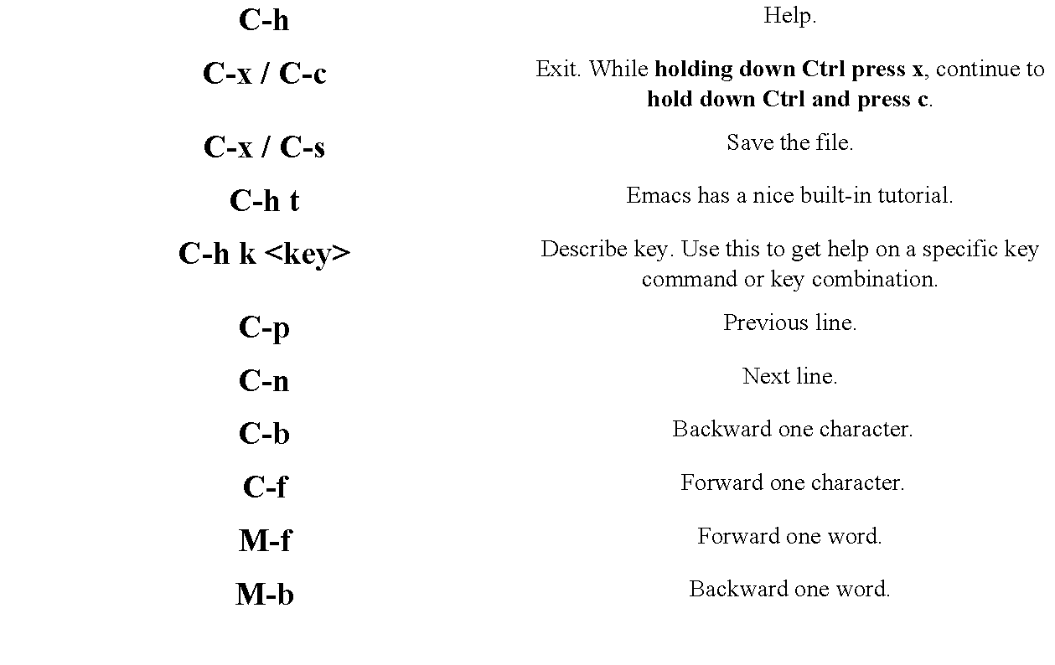

Slide 51
C-a | Go to the beginning of the line.
C-e | Go to the end of the line.
M-< | Go to the beginning of the file.
M-> | Go to the end of the file.
C-d | Delete a character.
M-d | Delete a word.
C-k | Kill (cut) the rest of the current line of text. To kill the entire line, position the cursor at the beginning of the line.
C-y | Yank (or paste) from the previously killed text.
C-x u | Undo. Keep repeating for multi-level undo.
C-s | Start a forward search. Type the text you are looking for. Press C-s again to move to the next occurrence. Press Enter when you are done searching
C-r | Start a reverse search.
C-u N <command> | Repeat <command> N times. For instance, to kill three lines of text type Ctrl-U 3 Ctrl-k.
You have only scratched the surface with the vi and emacs editors. There is so much more to learn if you are interested. Both editors have features that include macros, global replace, and more. Also, vim and emacs have GUI based version as well. Emacs and gvim.
Also there are some other more user friendly editors like gedit or kedit. Also, Linux has it’s own Microsoft Office-like suites. These are LibreOffice and Apache OpenOffice. They include apps for editing, viewing and creating document files, excel files, powerpoint files, etc.

Slide 52
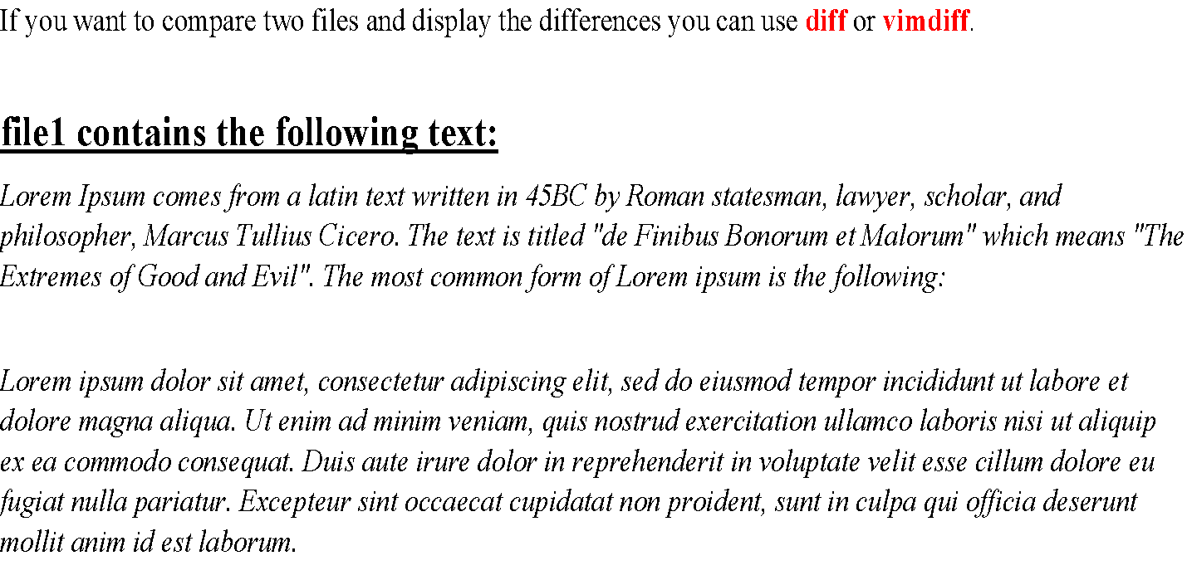
Comparing Files

Slide 53
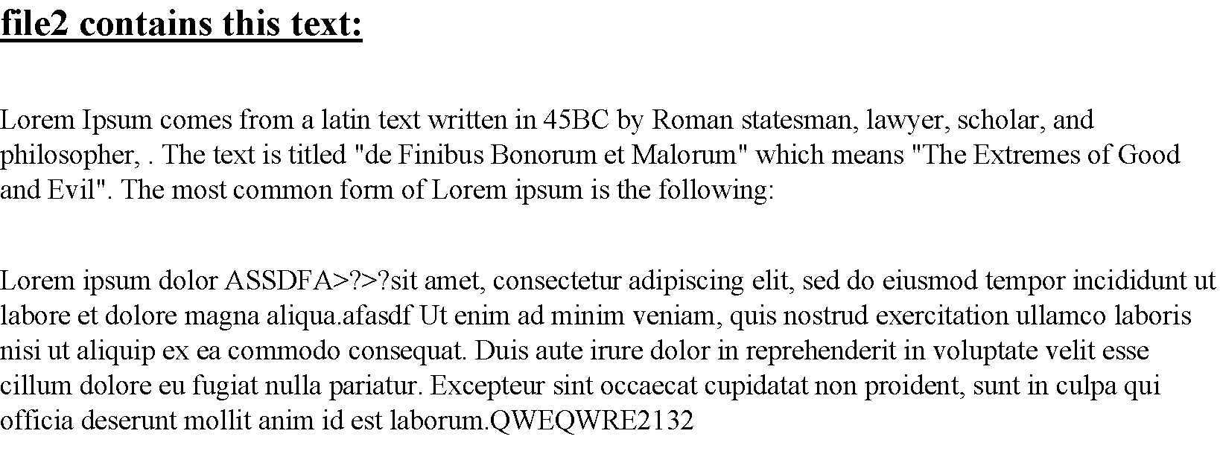

Slide 54
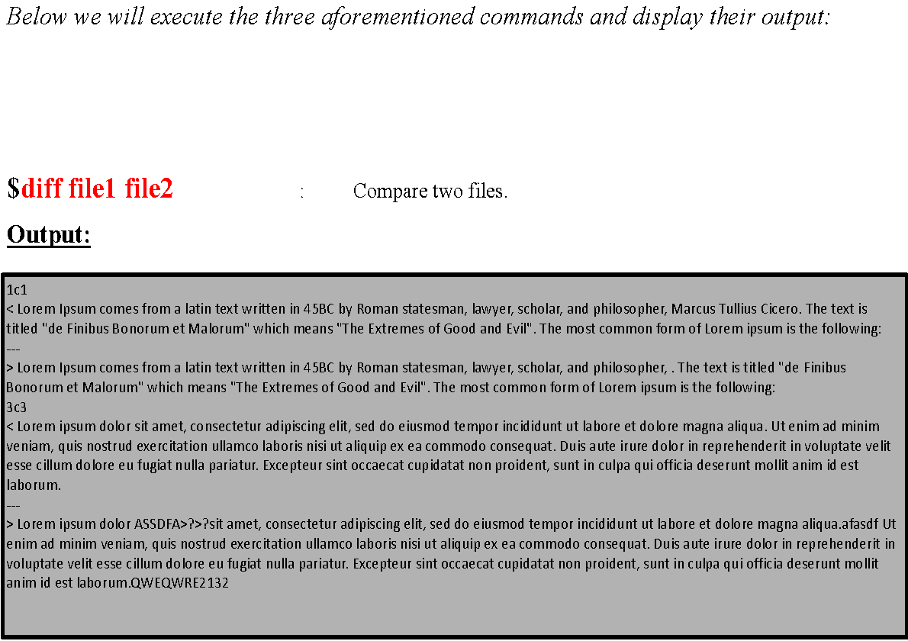

Slide 55
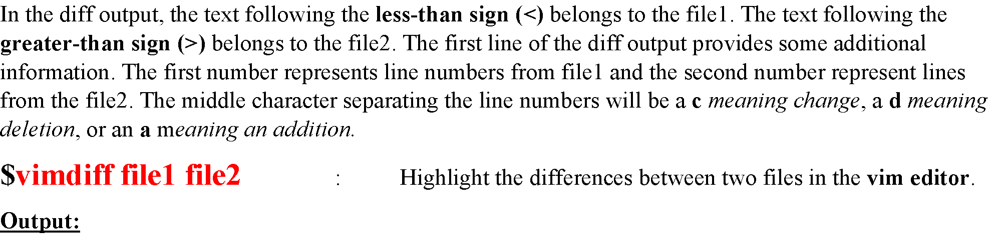
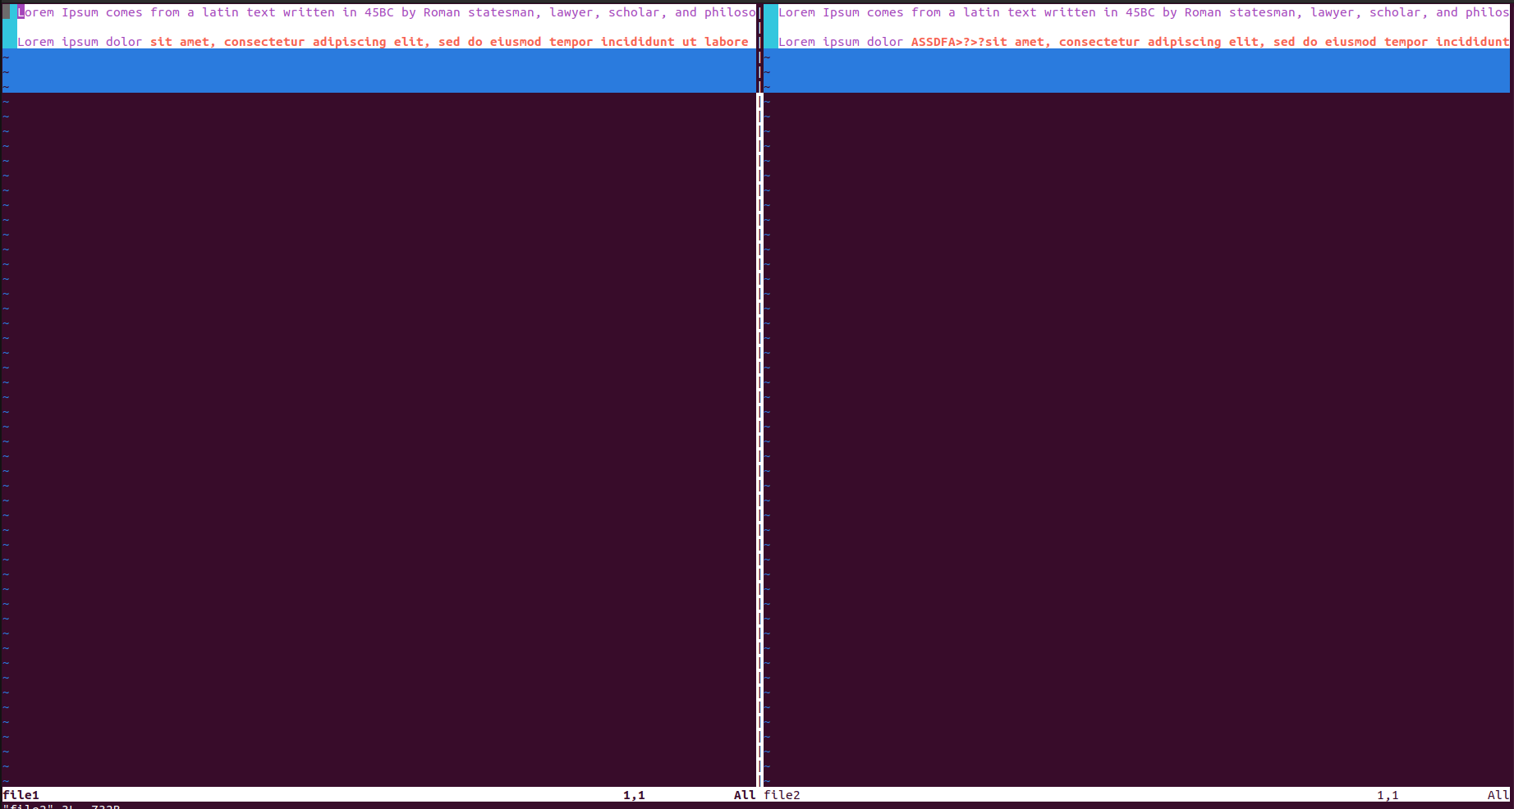

Slide 56
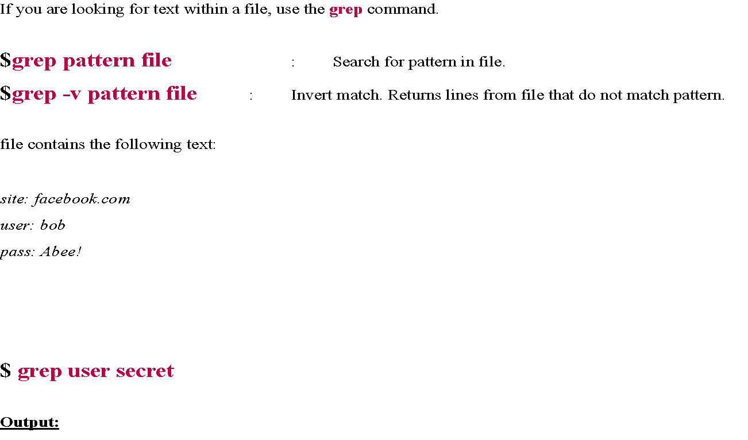

Searching for Text in ASCII Files

Slide 57
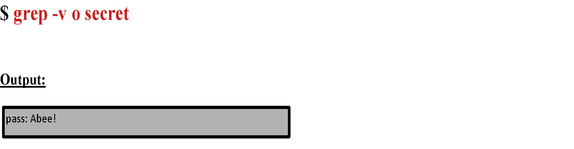
$ grep o secret
Output:
site: facebook.com
user: bob

Slide 58
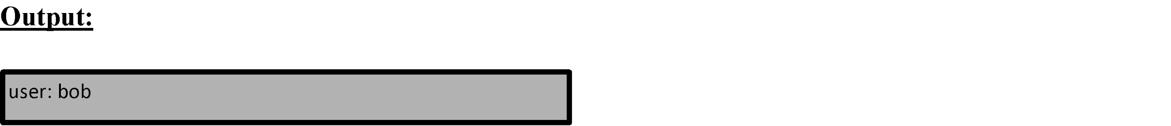
Here are some more common options to use with grep.
grep -i : Perform a search, ignoring case.
grep -c : Count the number of occurrences in a file.
grep -n : Precede output with line numbers from the file.
$ grep User secret
Outputs nothing. However the following outputs this:
$ grep -i User secret

Slide 59
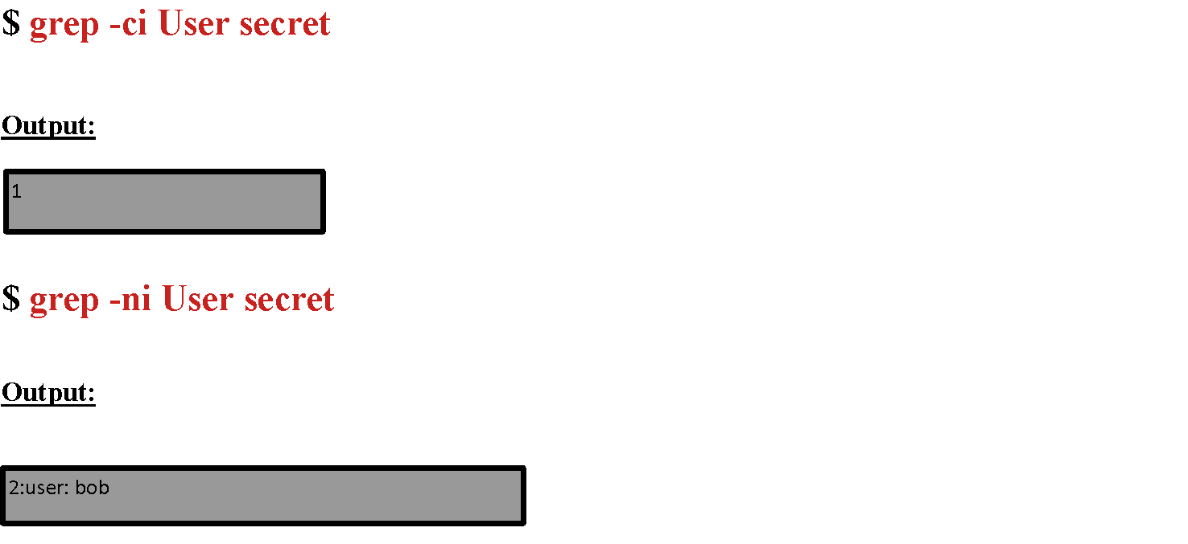

Slide 60
Searching For Text in Binary Files
If you run grep against a binary file, it will simply display whether or not that information was found in the file, but it will not display the surrounding text. To look at textual data within a binary file use the strings command.
$strings file : Display printable strings in binary files.

Slide 61
Deleting, Copying, Moving, and Renaming Files
Removing Files
To delete files using terminal commands use the rm command:
$rm file : Removes file.
$rm -r directory : Remove the directory and its contents recursively. If you want to remove a directory with rm, you have to supply the -r argument.
$rm -f file : Force removal and never prompt for confirmation.
$rm s* : Deletes every file which names start with s in the current path (not the folders)

Slide 62
Copying Files
To copy files, use the cp command. If you want to create a copy of a file you can run cp source_file destination_file. You can also copy a file, or a series of files, to a directory by using cp file(s) dir.
$cp source_file destination_file : Copy source_file to destination_file.
$cp source_file1 [source_fileN…] destination_director : Copy source_files to destination_directory.
$cp -i source_file destination_ : Runs cp in interactive mode. If the destination_file exists, cp will prompt you before it overwrites the file.
$cp -r source_directory destination : Copy source_directory recursively to destination. If destination exists, copy source_directory into destination otherwise create destination with the contents
            of directory.

Slide 63
Moving and Renaming Files
The way to rename files or directories in Linux is to use the mv command. The mv command moves files from one location to another. This can be used to relocate files or directories and it can be used to rename them also.
$mv source destination : Move files or directories. If destination is a directory, source will be moved into destination. Otherwise source will be renamed to destination.
$mv -i source destination : Runs mv in interactive mode. If the destination exists, mv will prompt you before it overwrites the file.

Slide 64
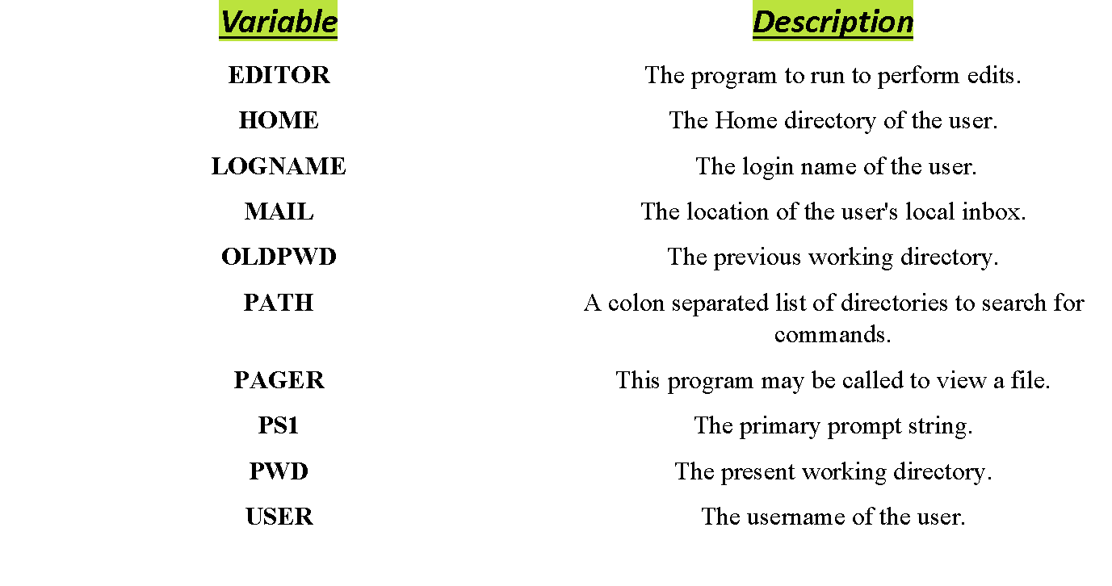
Common Environment Variables

Slide 65
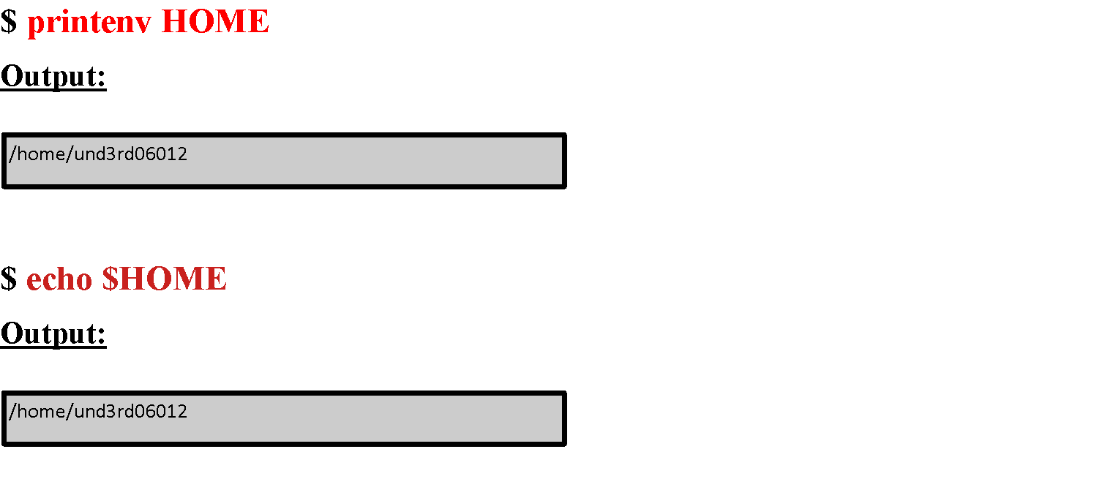
Viewing Environment Variables
If you know the name of the environment variable that you want to examine, you can run echo $VARIABLE_NAME or printenv VARIABLE_NAME. If you want to examine all the environment variables that are set, use the env or printenv commands.

Slide 66
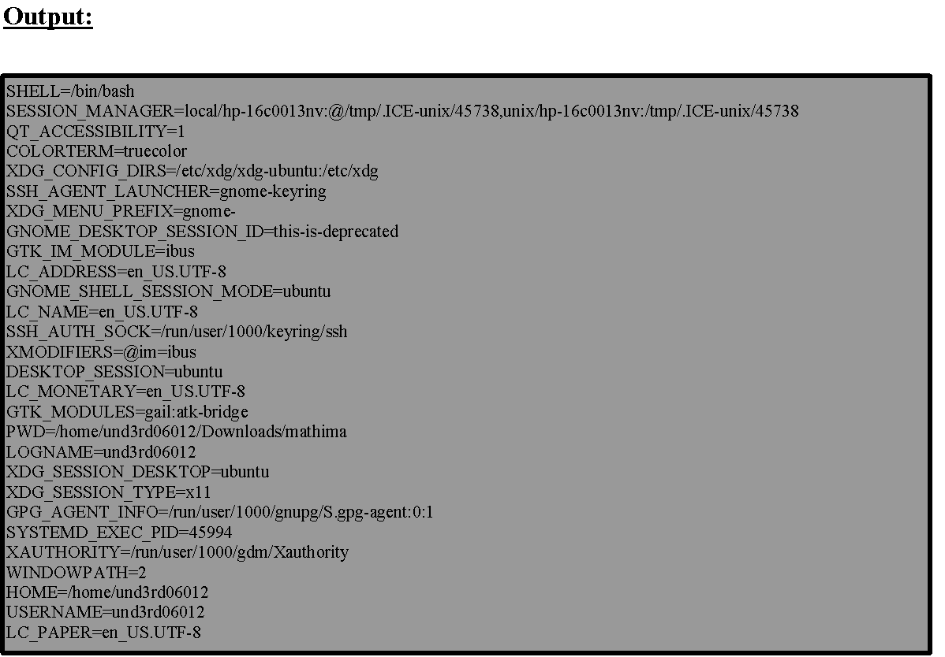
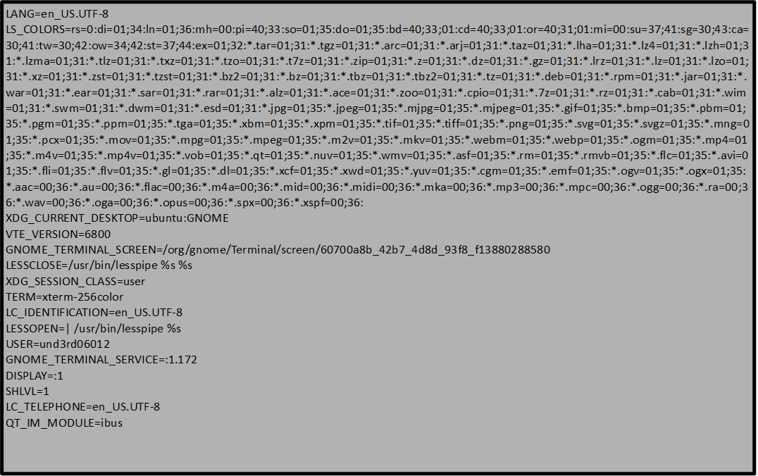
$ printenv or $ env
2
1
LC_MEASUREMENT=en_US.UTF-8
PAPERSIZE=letter
XDG_RUNTIME_DIR=/run/user/1000
LC_TIME=en_US.UTF-8
XDG_DATA_DIRS=/usr/share/ubuntu:/usr/share/gnome:/home/und3rd06012/.local/share/flatpak/exports/share:/var/lib/flatpak/exports/share:/usr/local/share/:/usr/share/:/var/lib/snapd/desktop
PATH=/usr/local/sbin:/usr/local/bin:/usr/sbin:/usr/bin:/sbin:/bin:/usr/games:/usr/local/games:/snap/bin:/snap/bin
GDMSESSION=ubuntu
DBUS_SESSION_BUS_ADDRESS=unix:path=/run/user/1000/bus
LC_NUMERIC=en_US.UTF-8
_=/usr/bin/printenv
OLDPWD=/home/und3rd06012/Downloads
3

Slide 67
Exporting Environment Variables
When a process is started it inherits the exported environment variables of the process that spawned it. A variable that is set or changed only effects the current running process unless it is exported. The variables that are not exported are called local variables. The export command allows variables to be used by subsequently executed commands. Here is an example:
$ export PAGER=less

Slide 68
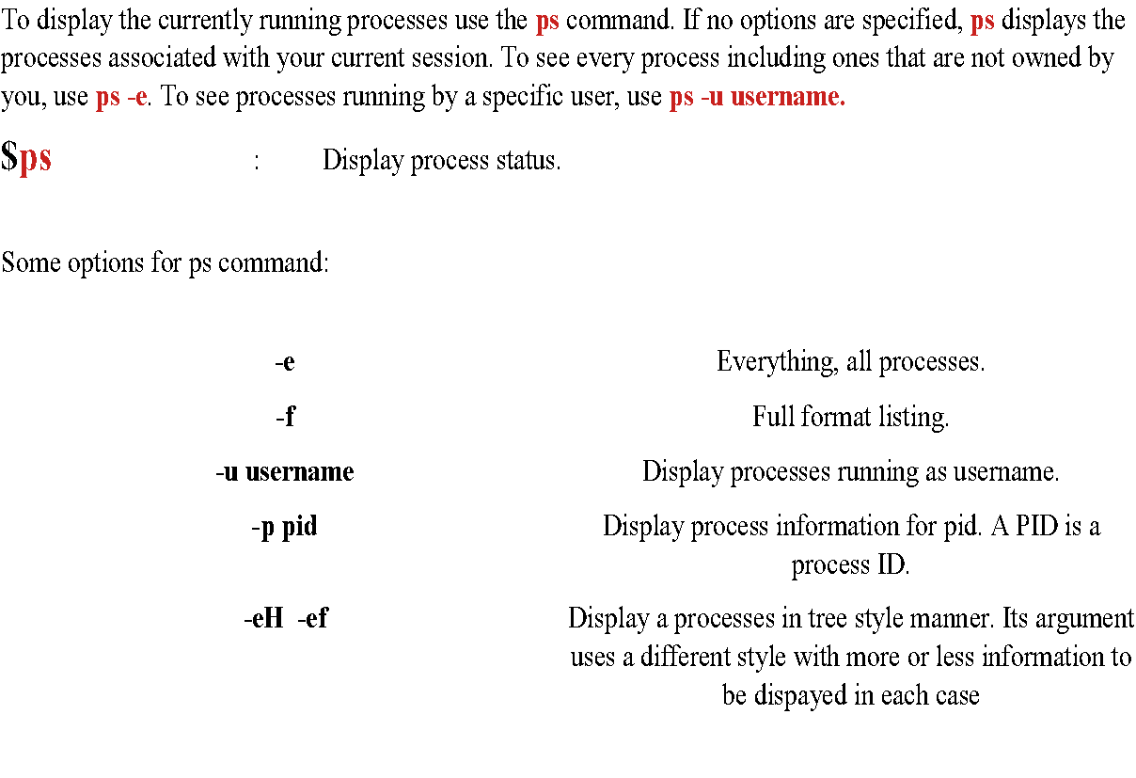
Listing Processes and Displaying Information

Slide 69
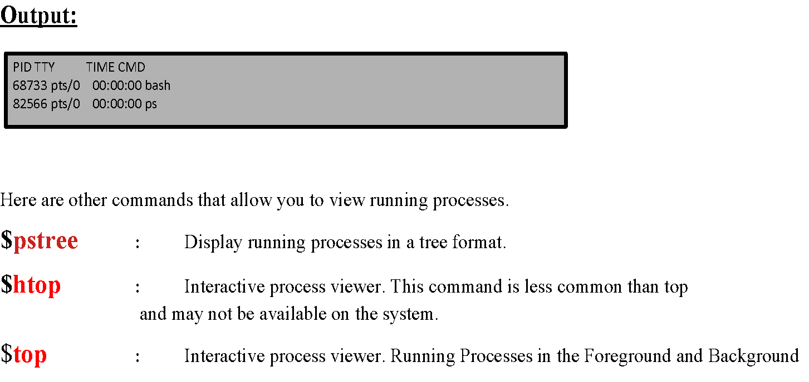

Slide 70
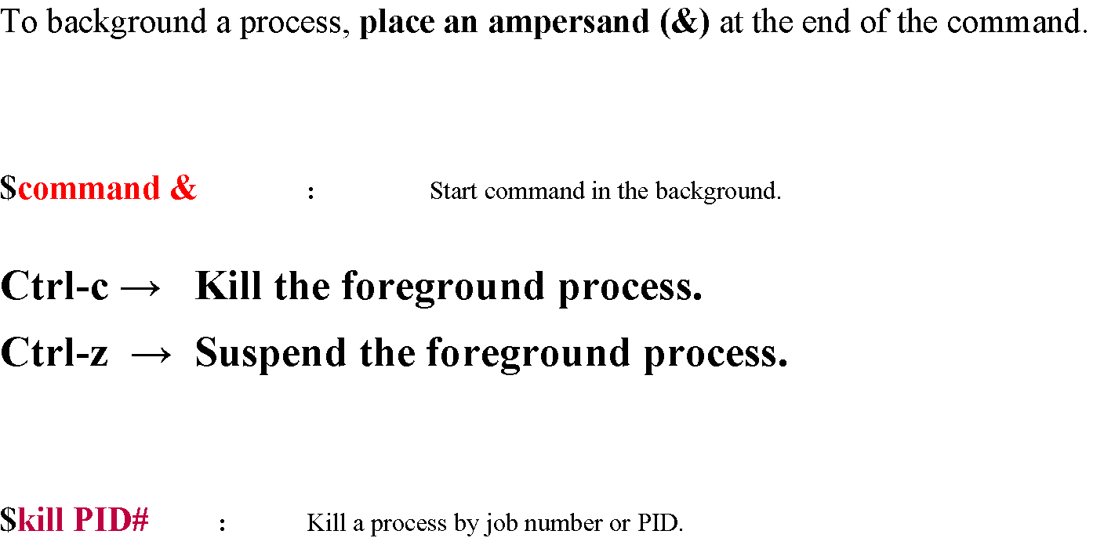

Slide 71
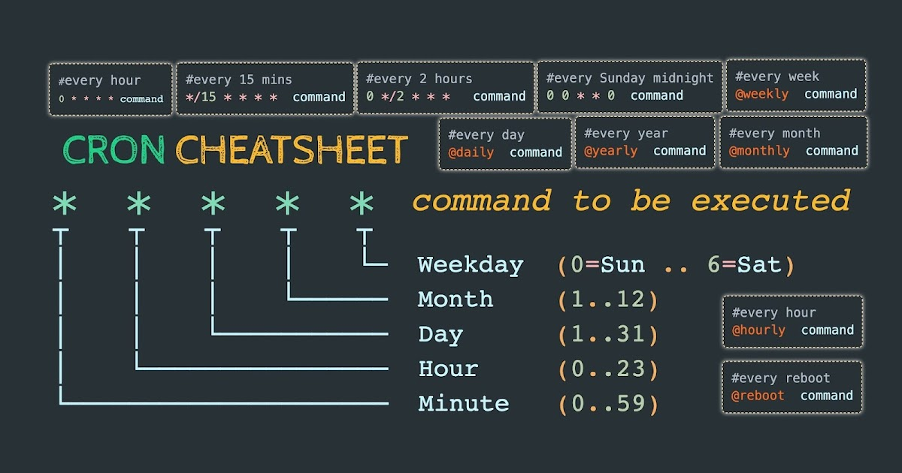
Crontab
Cron is an essential part of any system, as it automates various scheduled tasks. The crontab command is used to edit and manage cron jobs.
Creating a cron job is not difficult, but it can become tricky when dealing with multiple users and environments.
Crontab syntax is mostly the same across all Linux distributions and servers, so once you get the hang of it you’ll be scheduling tasks in no time!
In this picture you can see how crontab is being used to install automated actions in a system:

Slide 72
Examples:
0 2 * * * /bin/sh backup.sh → Schedule a cron to execute at 2 am daily.
0 5,17 * * * /scripts/script.sh → Schedule a cron to execute twice a day.
The above example command will execute at 5 AM and 5 PM daily. You can specify multiple time stamps by comma- separated.
* * * * * /scripts/script.sh → Schedule a cron to execute every minute.
* * * jan,may,aug * /script/script.sh → Schedule a cron to execute on selected months.
0 17 * * sun,fri /script/script.sh → Schedule a cron to execute on selected days. If you required scheduling a task to be executed for selected days only. The below example will run on each Sunday and Friday at 5 PM.
* * * * * /scripts/script.sh
* * * * * sleep 30; /scripts/script.sh → Schedule a cron to execute every 30 Seconds. To schedule a task to execute every 30 seconds is not possible by time parameters, But it can be done by scheduling the same cron twice as below.
@yearly /scripts/script.sh → Schedule tasks to execute yearly ( @yearly ).

Slide 73
SUPER USER (su) – SUPER USER DO (sudo)
Su
Basically, you can do anything to the system as the root user. It is the all-powerful administrative account. And, unlike other more chatty operating systems, you won't see a, "Are you sure?" dialog to be sure that the rm -rf * command you just issued was in /opt/tmp rather than at /. As you can imagine, errors made as the root user can be irreversible and devastating. There is an alternative: sudo.
sudo
sudo, which is an acronym for superuser do or substitute user do, is a command that runs an elevated prompt without a need to change your identity. Depending on your settings in the /etc/sudoers file, you can issue single commands as root or as another user. To continue running commands with root power, you must always use the sudo command.

Slide 74
Installing Software on Debian Based Linux Distributions (Debian, Ubuntu, etc...)
The Debian and Ubuntu distributions use a package manager called APT, the Advanced Packaging Tool. APT is comprised of a few small utilities with the two most commonly used ones being apt-cache and apt-get.
$apt-cache search <search-string> : Search for search-string.
$sudo apt-get install <name-of-package> : Installs package.
$sudo apt-get remove <name-of-package> : Remove/uninstall package, leaving behind configuration files.
$sudo apt-get purge<name-of-package> : Remove/uninstall package, deleting configuration files.
$sudo apt-cache show <name-of-package> : Display information about package.

Slide 75
The dpkg command
In addition the apt utilities, you can use the dpkg command to interact with the package manager:
$dgpk -l : Lists all the installed packages.
$dpkg -S /path/to/file : List the package that contains file.
$dpkg -i package.deb : Install a package from the file named package.deb.
$dpkg -L package : List all files that belong to package.

Slide 76

Thank you!

