Slide 1




Network Security For Energy
CSP004_C_E
SLIDE SET #9: Public Key Encryption and Digital Signatures
PRESENTATION BY:
ANTONIOS NTIB

Slide 2
Review of Secret Key (Symmetric) Cryptography
Confidentiality
  stream ciphers (uses PRNG)
  block ciphers with encryption modes (CBC or CTR)
Integrity
  Cryptographic hash functions
  Message authentication code (keyed hash functions)
Limitation: sender and receiver must share the same key
  Needs secure channel for key distribution
  Impossible for two parties having no prior relationship
  Needs many keys for n parties to communicate
1

Slide 3
Concept of Public Key Encryption
Each party has a pair (K, K⁻¹) of keys:
    K is the public key, and used for encryption
    K⁻¹ is the private key, and used for decryption
    Satisfies D_{K-1}[E_{K}[M]] = M
Knowing the public-key K, it is computationally infeasible to compute the private key K⁻¹
  How to check (K,K⁻¹) is a pair?
    Offers only computational security. Secure Public Key encryption is impossible when P=NP, as deriving K⁻¹ from K is in NP.
  The public key K may be made publicly available, e.g., in a publicly available directory
    Many can encrypt, only one can decrypt
  Public-key systems aka asymmetric crypto systems
2

Slide 4
Public Key Cryptography Early History
Proposed by Diffie and Hellman, documented in “New Directions in Cryptography” (1976)
  Public-key encryption schemes
  Key distribution systems
  Digital signature
Public-key encryption was proposed in 1970 in a classified paper by James Ellis
  paper made public in 1997 by the British Governmental Communications Headquarters
Concept of digital signature is still originally due to Diffie & Hellman
3

Slide 5
Public Key Encryption Algorithms
Most public-key encryption algorithms use either modular arithmetic number theory, or elliptic curves
RSA
  based on the hardness of factoring large numbers
El Gamal
  Based on the hardness of solving discrete logarithm
  Use the same idea as Diffie-Hellman key agreement
4

Slide 6
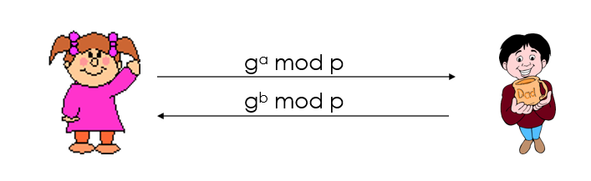
Diffie-Hellman Key Agreement Protocol
  Not a Public Key Encryption system, but can allow A and B to agree on a shared secret in a public channel (against passive, i.e., eavesdropping only adversaries)
  Setup: p prime and g generator of Zp*, p and g public.
gª mod p
Pick random, secret a
Compute and send gª mod p
Pick random, secret b
Compute and send g^{b} mod p
K = (g^{b} mod p)ª = g^{ab} mod p
K = (gª mod p)^{b} = g^{ab} mod p
5

Slide 7
Diffie-Hellman
Example: Let p=11, g=2, then
A chooses 4, B chooses 3, then shared secret is (2³)⁴ = (2⁴)³ = 2¹² = 4 (mod 11)
Adversaries sees 2³=8 and 2⁴=5, needs to solve one of 2^{x}=8 and 2^{y}=5 to figure out the shared secret.
a | 1 | 2 | 3 | 4 | 5 | 6 | 7 | 8 | 9 | 10 | 11
gª | 2 | 4 | 8 | 16 | 32 | 64 | 128 | 256 | 512 | 1024 | 2048
gª mod p | 2 | 4 | 8 | 5 | 10 | 9 | 7 | 3 | 6 | 1 | 2
6

Slide 8
Security of DH is based on Three Hard Problems
Discrete Log (DLG) Problem: Given <g, h, p>, computes a such that gª = h mod p.
Computational Diffie Hellman (CDH) Problem: Given <g, gª mod p, g^{b} mod p> (without a, b) compute g^{ab} mod p.
Decision Diffie Hellman (DDH) Problem: distinguish (gª,g^{b},g^{ab}) from (gª,g^{b},g^{c}), where a,b,c are randomly and independently chosen
If one can solve the DL problem, one can solve the CDH problem. If one can solve CDH, one can solve DDH.
7

Slide 9
Assumptions
DDH Assumption: DDH is hard to solve.
CDH Assumption: CDH is hard to solve.
DLG Assumption: DLG is hard to solve
DDH assumed difficult to solve for large p (e.g., at least 1024 bits).
Warning:
  New progress in 2013 can solve discrete log for p values with some properties. No immediate attack against practical setting yet.
  Look out when you need to use/implement public key crypto
  May want to consider Elliptic Curve-based algorithms, require shorter keys than discrete log (for 128-bit security require 256 bit key size)
8

Slide 10
El Gamal Encryption
  Public key <g, p, h=gª mod p>
  Private key is a
  To encrypt: chooses random b, computes C=[g^{b} mod p, g^{ab} * M mod p].
    Idea: for each M, sender and receiver establish a shared secret g^{ab} via the DH protocol. The value g^{ab} hides the message M by multiplying it.
  To decrypt C=[c₁,c₂], computes M where
    ((c₁ª mod p) * M) mod p = c₂.
      To find M for x * M mod p = c₂, compute z s.t. x*z mod p =1, and then M = C₂*z mod p
CDH assumption ensures M cannot be fully recovered.
IND-CPA security requires DDH.
9

Slide 11
RSA Algorithm
Invented in 1978 by Ron Rivest, Adi Shamir and Leonard Adleman
  Published as R L Rivest, A Shamir, L Adleman, "On Digital Signatures and Public Key Cryptosystems", Communications of the ACM, vol 21 no 2, pp120-126, Feb 1978
Security relies on the difficulty of factoring large composite numbers
Essentially the same algorithm was discovered in 1973 by Clifford Cocks, who works for the British intelligence
10

Slide 12
RSA Public Key Crypto System
Key generation:
1. Select 2 large prime numbers of about the same size, p and q
  Typically each p, q has between 512 and 2048 bits
2. Compute n = pq, and Φ(n) = (q-1)(p-1)
3. Select e, 1<e< Φ(n), s.t. gcd(e, Φ(n)) = 1
  Typically e=3 or e=65537
4. Compute d, 1< d< Φ(n) s.t. ed ≡ 1 mod Φ(n)
  Knowing Φ(n), d easy to compute.
Public key: (e, n)
Private key: d
11

Slide 13
RSA Description (cont.)
Encryption
Given a message M, 0 < M < n M ∈ Z_{n}− {0}
use public key (e, n)
compute C = Me mod n C ∈ Z_{n}− {0}
Decryption
Given a ciphertext C, use private key (d)
Compute C^{d} mod n = (Me mod n)^{d} mod n = M^{ed} mod n = M
12

Slide 14
RSA Example
p = 11, q = 7, n = 77, Φ(n) = 60
d = 13, e = 37 (ed = 481; ed mod 60 = 1)
Let M = 15. Then C ≡ Me mod n
  C ≡ 15³⁷ (mod 77) = 71
M ≡ C^{d} mod n
  M ≡ 71¹³ (mod 77) = 15
13

Slide 15
RSA Example 2
Parameters:
  p = 3, q = 5, n= pq = 15
  Φ(n) = ?
Let e = 3, what is d?
Given M=2, what is C?
How to decrypt?
14

Slide 16
Hard Problems on Which RSA Security Depends
C = Me mod (n=pq)
Plaintext: M
Ciphertext: C
C^{d} mod n
Factoring Problem: Given n=pq, compute p,q
Finding RSA Private Key: Given (n,e), compute d s.t. ed = 1 (mod Φ(n)).
  Given (d,e) such that ed = 1 (mod Φ(n)), there is a clever randomized algorithm to factor n efficiently.
  Implication: cannot share the modulus n among multiple users
RSA Problem: From (n,e) and C, compute M s.t. C = Me
  Aka computing the e’th root of C.
  Can be solved if n can be factored
15

Slide 17
RSA Security and Factoring
Security depends on the difficulty of factoring n
  Factor n ⇒ compute Φ(n) ⇒ compute d from (e, n)
  Knowing e, d such that ed = 1 (mod Φ(n)) ⇒ factor n
The length of n=pq reflects the strength
  700-bit n factored in 2007
  768 bit n factored in 2009
RSA encryption/decryption speed is quadratic in key length
1024 bit for minimal level of security today (roughly 80 bit security)
  likely to be breakable in near future
Minimal 2048 bits recommended for current usage (roughly 112 bit security)
NIST suggests 15360-bit RSA keys are equivalent in strength to 256-bit
Factoring is easy to break with quantum computers
16

Slide 18
RSA Encryption & IND-CPA Security
The RSA assumption, which assumes that the RSA problem is hard to solve, ensures that the plaintext cannot be fully recovered.
Plain RSA does not provide IND-CPA security.
  For Public Key systems, the adversary has the public key, hence the initial training phase is unnecessary, as the adversary can encrypt any message he wants to.
17

Slide 19
Real World Usage of Public Key Encryption
Often used to encrypt a symmetric key:
  To encrypt a message M under an RSA public key (n,e), generate a new AES key K, compute [K^{e} mod n, AES-CBC_{K}(M)]
Alternatively, one can use random padding:
  E.g., computer (M || r) ^{e} mod n to encrypt a message M with a random value r
  More generally, uses a function F(M,r), and encrypts as F(M,r) ^{e} mod n
  From F(M,r), one should be able to recover M
  This provides randomized encryption
18

Slide 20
Digital Signatures: The Problem
Consider the real-life example where a person pays by credit card and signs a bill; the seller verifies that the signature on the bill is the same with the signature on the card
Contracts are valid if they are signed.
Signatures provide non-repudiation.
  ensuring that a party in a dispute cannot repudiate, or refute the validity of a statement or contract.
Can we have a similar service in the electronic world?
19

Slide 21
Digital Signatures
MAC: One party generates MAC, one party verifies integrity.
Digital signatures: One party generates signature, many parties can verify.
Digital Signature: a data string which associates a message with some originating entity.
Digital Signature Scheme:
  a signing algorithm: takes a message and a (private) signing key, outputs a signature
  a verification algorithm: takes a (public) verification key, a message, and a signature
Provides:
  Authentication, Data integrity, Non-Repudiation
20

Slide 22
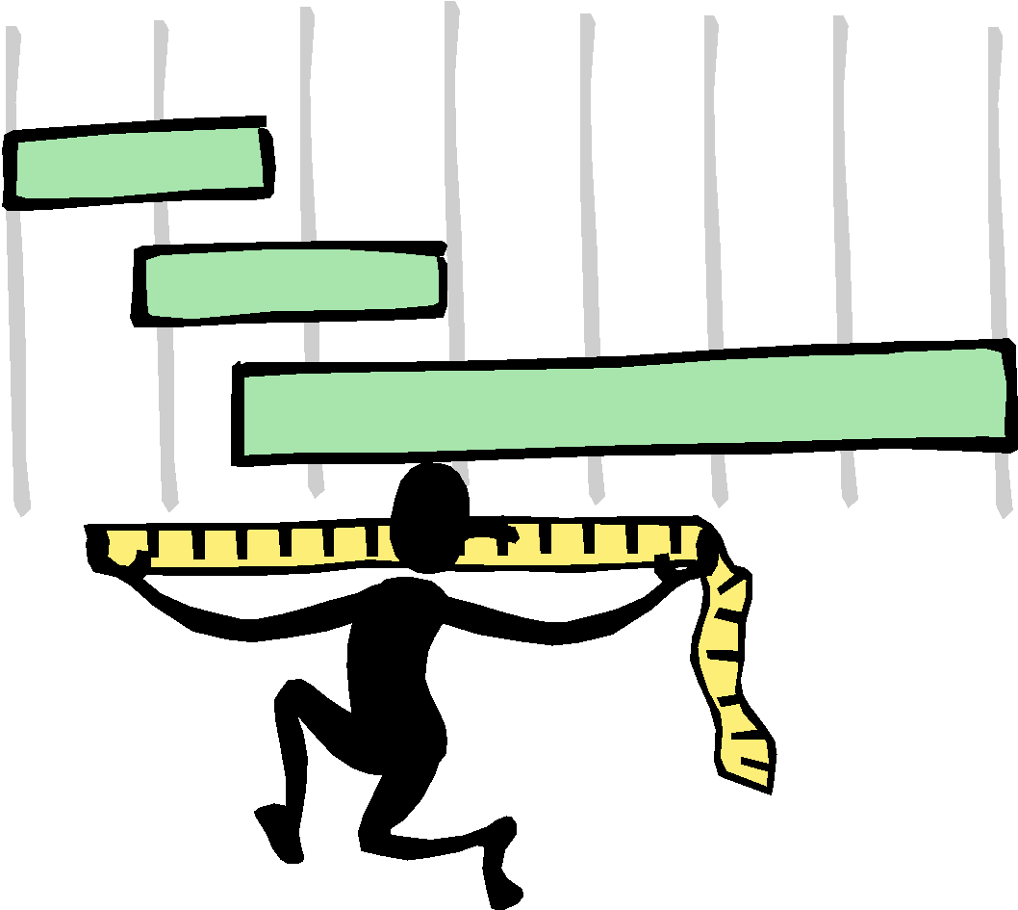
Digital Signatures and Hash
Very often digital signatures are used with hash functions, hash of a message is signed, instead of the message.
Hash function must be:
  Strong collision resistant
21

Slide 23
RSA Signatures
Key generation (as in RSA encryption):
Select 2 large prime numbers of about the
same size, p and q
Compute n = pq, and Φ = (q - 1)(p - 1)
Select a random integer e, 1 < e < Φ, s.t.
gcd(e, Φ) = 1
Compute d, 1 < d < Φ s.t. ed ≡ 1 mod Φ
Public key: (e, n) used for verification
Private key: d, used for generation
22

Slide 24
RSA Signatures with Hash (cont.)
Signing message M
Verify 0 < M < n
Compute S = h(M)^{d} mod n
Verifying signature S
Use public key (e, n)
Compute S^{e} mod n = (h(M)^{d} mod n)^{e} mod n = h(M)
23

Slide 25
Non-repudiation
Nonrepudiation is the assurance that someone cannot deny something. Typically, nonrepudiation refers to the ability to ensure that a party to a contract or a communication cannot deny the authenticity of their signature on a document or the sending of a message that they originated.
24

Slide 26
The Big Picture
 | Secret Key Setting | Public Key Setting
Secrecy / Confidentiality | Stream ciphers Block ciphers + encryption modes | Public key encryption: RSA, El Gamal, etc.
Authenticity / Integrity | Message Authentication Code | Digital Signatures: RSA, DSA, etc.
25

Slide 27
Elliptic Curve Encryption
What are Elliptic Curves?
  Curve with standard form y² = x³ + ax + b a, b ϵ ℝ
Characteristics of Elliptic Curve
  Forms an abelian group
  Symmetric about the x-axis
  Point at Infinity acting as the identity element

Slide 28
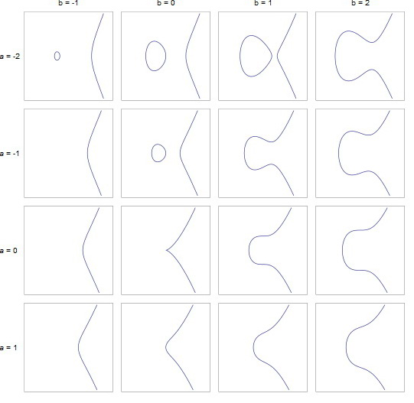
Elliptic Curve Encryption (cont’d)
Examples of Elliptic Curves

Slide 29
Elliptic Curve Encryption (cont’d)
Finite Fields
aka Galois Field
GF(p^{n}) = a set of integers {0, 1, 2, …, p^{n} -1)
where p is a prime, n is a positive integer
It is denoted by {F, +, x}
where + and x are the group operators

Slide 30
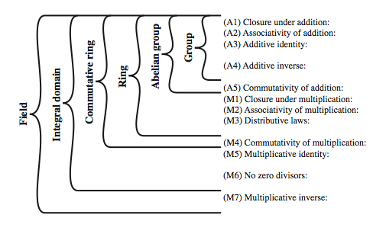
Elliptic Curve Encryption (cont’d)
Group, Ring, Field

Slide 31
Elliptic Curve Encryption (cont’d)
Why Elliptic Curve Cryptography?
Shorter Key Length
Lesser Computational Complexity
Low Power Requirement
More Secure

Slide 32
Elliptic Curve Encryption (cont’d)
Comparable Key Sizes for Equivalent Security
Symmetric Encryption (Key Size in bits) | RSA and Diffie-Hellman (modulus size in bits) | ECC Key Size in bits
56 | 512 | 112
80 | 1024 | 160
112 | 2048 | 224
128 | 3072 | 256
192 | 7680 | 384
256 | 15360 | 512

Slide 33
Elliptic Curve Encryption (cont’d)
What is Elliptic Curve Cryptography?
Implementing Group Operations
  Main operations - point addition and point multiplication
  Adding two points that lie on an Elliptic Curve – results in a third point on the curve
  Point multiplication is repeated addition
  If P is a known point on the curve (aka Base point; part of domain parameters) and it is multiplied by a scalar k, Q=kP is the operation of adding P + P + P + P… +P (k times)
  Q is the resulting public key and k is the private key in the public-private key pair

Slide 34
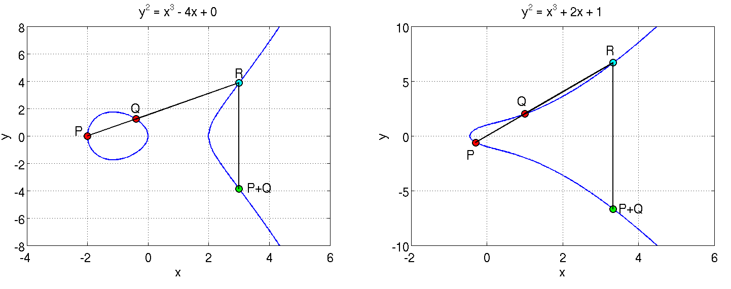
Elliptic Curve Encryption (cont’d)
Adding two points on the curve
P and Q are added to obtain P+Q which is a reflection of R along the X axis

Slide 35
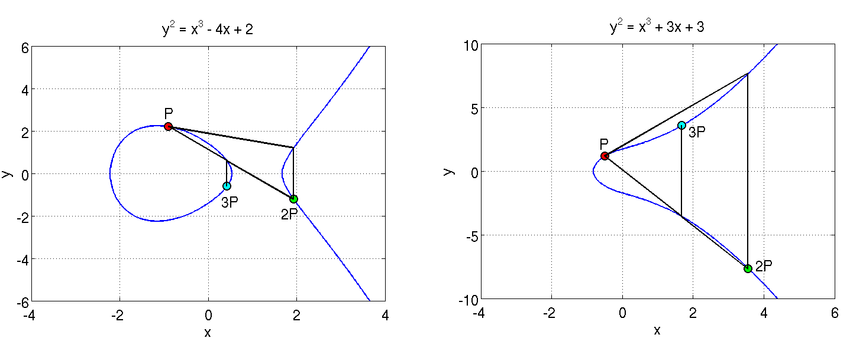
Elliptic Curve Encryption (cont’d)
A tangent at P is extended to cut the curve at a point; its reflection is 2P
Adding P and 2P gives 3P
Similarly, such operations can be performed as many times as desired to obtain Q = kP

Slide 36
Elliptic Curve Encryption (cont’d)
Discrete Log Problem
  The security of ECC is due the intractability or difficulty of solving the inverse operation of finding k given Q and P
  This is termed as the discrete log problem
  Methods to solve include brute force and Pollard’s Rho attack both of which are computationally expensive or unfeasible
  The version applicable in ECC is called the Elliptic Curve Discrete Log Problem
  Exponential running time

Slide 37
ECC in Windows DRM v2.0
A Practical Example :
Finite field chosen
p = 785963102379428822376694789446897396207498568951
Gx = 771507216262649826170648268565579889907769254176
Gy = 390157510246556628525279459266514995562533196655
y² = x³ + 317689081251325503476317476413827693272746955927x + 790528966078787587181205720257185354321100651934
Gx and Gy constitute the agreed upon base point (P) and the numbers in the above equation are values for the parameters a and b

Slide 38
Elliptic Curve Schemes
Elliptic Curve Digital Signature Algorithm (ECDSA)
Elliptic Curve Pintsov Vanstone Signature(ECPVS)
Elliptic Curve Diffie-Hellman (ECDH)

Slide 39
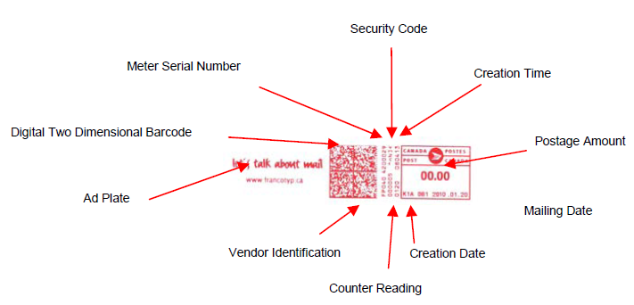
Elliptic Curve Digital Signature Algorithm (ECDSA)
Elliptic curve variant of Digital Signature Algorithm
Canadian postage stamp that uses ECDSA

Slide 40
ECDSA
Signature Generation
Once we have the domain parameters and have decided on the keys to be used, the signature is generated by the following steps.
1. A random number k, 1 ≤ k ≤ n-1 is chosen
2. kG = (x₁,y₁) is computed. x₁ is converted to its corresponding integer x₁’
3. Next, r = x₁ mod n is computed
4. We then compute k⁻¹ mod q
5. e = HASH(m) where m is the message to be signed
6. s = k⁻¹(e + dr) mod n
where d is the private key of the sender.
We have the signature as (r,s)

Slide 41
ECDSA
Signature Verification
At the receiver’s end the signature is verified as follows:
1. Verify whether r and s belong to the interval [1, n-1] for the signature to be valid.
2. Compute e = HASH(m). The hash function should be the same as the one used for signature generation.
3. Compute w = s⁻¹ mod n.
4. Compute u₁ = ew mod n and u₂ = rw mod n.
5. Compute (x₁,y₁) = u₁G + u₂Q.
6. The signature is valid if r = x₁ mod n, invalid otherwise.

Slide 42
ECDSA (cont’d)
This is how we know that the verification works the way we want it to:
We have, s = k⁻¹(e + dr) mod n which we can rearrange to obtain, k = s⁻¹(e + dr) which is
s⁻¹e + s⁻¹rd
This is nothing but we + wrd = (u₁ + u₂d) (mod n)
We have u₁G + u₂Q = (u₁ + u₂d)G = kG which translates to v = r.

Slide 43
Elliptic Curve Pintsov Vanstone Signature (ECPVS)
Signature scheme using Elliptic Curves
More efficient than RSA as overhead is extremely low

Slide 44
ECPVS
Signature Generation
The plaintext message is split into two parts: part C representing the data elements requiring confidentiality and part V representing the data elements presented in plaintext. Both the parts are signed. The signature is generated as follows:
1. A random number k, 1 ≤ k ≤ n-1 is chosen.
2. Calculate the point R on the curve (R = kG).
3. Use point R and a symmetric encryption algorithm to get e = T_{R}(C).
4. Calculate a variable d such that d = HASH(e || I_{A} || V)
where I_{A} is the identity of the mailer terminal.
5. Now calculate the other part of the signature s as follows: s= ad + k(mod n); where a is the private key of the sender.
The signature pair (s,e) is transmitted together with the portion V of the plaintext.

Slide 45
ECPVS (cont’d)
Signature Verification
  Retrieve Q_{A} (Q_{A} is mailer A’s public key)
  Calculate the variable d = HASH(e || I_{A} || V) using the same HASH algorithm as the one used for generating the signature.
  Compute U = sG – dQ_{A}.
  Recover C = T_{u}⁻¹(e).
  Run a redundancy test on C. If the test fails, discard the message. Else, the plaintext is recovered.
  We have, s = ad + k. Multiply by base point G to obtain sG = adG + kG which is dQ_{A} + R
  Therefore, R = sG – dQ_{A} which is U. Comparing the decrypted versions, m and m’ obtained using U and R, we ascertain the validity of the signature

Slide 46
Elliptic Curve Diffie-Hellman (ECDH)
Elliptic curve variant of the key exchange Diffie-Hellman protocol.
Decide on domain parameters and come up with a Public/Private key pair
To obtain the private key, the attacker needs to solve the discrete log problem

Slide 47
ECDH
How the key exchange takes place:
1. Alice and Bob publicly agree on an elliptic curve E over a large finite field F and a point P on that curve.
2. Alice and Bob each privately choose large random integers, denoted a and b
3. Using elliptic curve point-addition, Alice computes aP on E and sends it to Bob. Bob computes bP on E and sends it to Alice.
4. Both Alice and Bob can now compute the point abP Alice by multiplying the received value of bP by her secret number a and Bob vice-versa.
5. Alice and Bob agree that the x coordinate of this point will be their shared secret value.

Slide 48
Pros and Cons
Pros
  Shorter Key Length
    Same level of security as RSA achieved at a much shorter key length
  Better Security
    Secure because of the ECDLP
    Higher security per key-bit than RSA
  Higher Performance
    Shorter key-length ensures lesser power requirement – suitable in wireless sensor applications and low power devices
    More computation per bit but overall lesser computational expense or complexity due to lesser number of key bits

Slide 49
Pros and Cons (cont’d)
Cons
  Relatively newer field
    Idea prevails that all the aspects of the topic may not have been explored yet – possibly unknown vulnerabilities
    Doesn’t have widespread usage
  Not perfect
    Attacks still exist that can solve ECC (112 bit key length has been publicly broken)
    Well known attacks are the Pollard’s Rho attack (complexity O(√n) ), Pohlig’s attack, Baby Step,Giant Step etc

Slide 50

Thank you

