Slide 1




Network Security For Energy
CSP004_C_E
SLIDE SET #4: Cryptography Terminology & Classic Ciphers
PRESENTATION BY:
ANTONIOS NTIB

Slide 2
Goals of Cryptography
The most fundamental problem cryptography addresses: ensure security of communication over insecure medium
What does secure communication mean?
  confidentiality (secrecy)
    only the intended recipient can see the communication
  integrity (authenticity)
    the communication is generated by the alleged sender
What does insecure medium mean?
  Two basic possibilities:
    Passive attacker: the adversary can eavesdrop
    Active attacker: the adversary has full control over the communication channel
1
Notes:
Now the goal of cryptography is much broader.
In general, cryptography cannot help in availability.

Slide 3
Approaches to Secure Communication
Steganography
    “covered writing”
    hides the existence of a message
    depends on secrecy of method
Cryptography
    “hidden writing”
    hide the meaning of a message
    depends on secrecy of a short key, not method
2

Slide 4
Basic Terminology for Encryption
Plaintext original message
Ciphertext transformed message
Key secret used in transformation
Encryption
Decryption
Cipher algorithm for encryption/decryption
3

Slide 5
Shift Cipher
The Key Space:
  [0 .. 25]
Encryption given a key K:
  each letter in the plaintext P is replaced with the K’th letter following corresponding number (shift right)
Decryption given K:
  shift left
History: K = 3, Caesar’s cipher
4
Notes:
One can argue that Caeser Cipher is not a cipher, because there is no random key.

Slide 6
Shift Cipher: Cryptanalysis
Can an attacker find K?
  YES: by a bruteforce attack through exhaustive key search.
        key space is small (<= 26 possible keys).
  How much ciphertext is needed?
Lessons:
  Key space needs to be large enough.
  Exhaustive key search can be effective.
5

Slide 7
Mono-alphabetic Substitution Cipher
The key space: all permutations of Σ = {A, B, C, …, Z}
Encryption given a key π:
  each letter X in the plaintext P is replaced with π(X)
Decryption given a key π:
  each letter Y in the cipherext P is replaced with π⁻¹(Y)
Example:
A B C D E F G H I J K L M N O P Q R S T U V W X Y Z
π= B A D C Z H W Y G O Q X S V T R N M L K J I P F E U
BECAUSE → AZDBJSZ
6
Notes:
Cipher alphabet

Slide 8
Strength of the Mono-alphabetic Substitution Cipher
Exhaustive search is difficult
  key space size is 26! ≈ 4×10²⁶ ≈ 2⁸⁸
Dominates the art of secret writing throughout the first millennium A.D.
Thought to be unbreakable by many back then
How to break it?
7

Slide 9
Cryptanalysis of Substitution Ciphers: Frequency Analysis
Basic ideas:
  Each language has certain features: frequency of letters, or of groups of two or more letters.
  Substitution ciphers preserve the language features.
  Substitution ciphers are vulnerable to frequency analysis attacks.
  How much ciphertext is required?
8

Slide 10
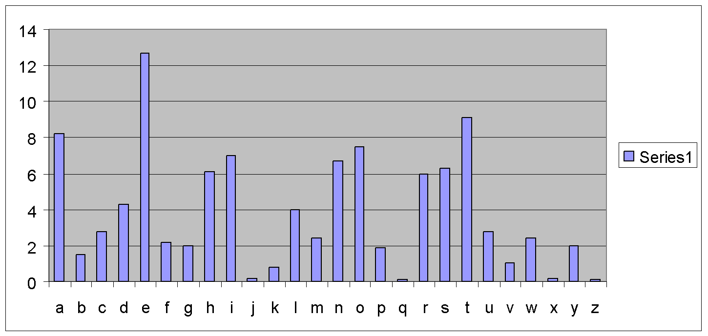
Frequency of Letters in English
9

Slide 11
How to Defeat Frequency Analysis?
Use larger blocks as the basis of substitution. Rather than substituting one letter at a time, substitute 64 bits at a time, or 128 bits.
  Leads to block ciphers such as DES & AES.
Use different substitutions to get rid of frequency features.
  Leads to polyalphabetical substituion ciphers, and to stream ciphers such as RC4
10

Slide 12
Towards the Polyalphabetic Substitution Ciphers
Main weaknesses of monoalphabetic substitution ciphers
  In ciphertext, different letters have different frequency
    each letter in the ciphertext corresponds to only one letter in the plaintext letter
Idea for a stronger cipher (1460’s by Alberti)
  Use more than one substitutions, and switch between them when encrypting different letters
    As result, frequencies of letters in ciphertext are similar
Developed into an easy-to-use cipher by Vigenère (published in 1586)
11

Slide 13
The Vigenère Cipher
Treat letters as numbers: [A=0, B=1, C=2, …, Z=25]
Number Theory Notation: Z_{n}= {0, 1, …, n-1}
Definition:
Given m, a positive integer, P = C = (Z₂₆)^{n}, and K = (k₁, k₂, … , k_{m}) a key, we define:
Encryption:
e_{k}(p₁, p₂… p_{m}) = (p₁+k₁, p₂+k₂…p_{m}+k_{m}) (mod 26)
Decryption:
d_{k}(c₁, c₂… c_{m}) = (c₁-k₁, c₂-k₂ … c_{m}- k_{m}) (mod 26)
Example:
Plaintext: C R Y P T O G R A P H Y
Key: L U C K L U C K L U C K
Ciphertext: N L A Z E I I B L J J I
12

Slide 14
Security of Vigenere Cipher
Vigenere masks the frequency with which a character appears in a language: one letter in the ciphertext corresponds to multiple letters in the plaintext. Makes the use of frequency analysis more difficult.
Any message encrypted by a Vigenere cipher is a collection of as many shift ciphers as there are letters in the key.
13

Slide 15
Vigenere Cipher: Cryptanalysis
Find the length of the key.
  Kasisky test
  Index of coincidence (we won’t cover here)
Divide the message into that many shift cipher encryptions.
Use frequency analysis to solve the resulting shift ciphers.
  How?
Vigenere-like substitution ciphers were regarded by many as practically unbreakable for 300 years. In 1863, a Prussian major named Kasiski proposed a method for breaking a Vigenere cipher that consisted of finding the length of the keyword and then dividing the message into that many simple substitution cryptograms. Frequency analysis could then be used to solve the resulting simple substitutions checking which of the 26 possible shifts give rises to the correct decryption. Can be done by checking how well the resulting frequency distribution matches that of the underling language.
14

Slide 16
Kasisky Test for Finding Key Length
Observation: two identical segments of plaintext, will be encrypted to the same ciphertext, if they occur in the text at a distance Δ such that Δ is a multiple of m, the key length.
Algorithm:
  Search for pairs of identical segments of length at least 3
  Record distances between the two segments: Δ1, Δ2, …
  m divides gcd(Δ1, Δ2, …)
15

Slide 17
Example of the Kasisky Test
Key K I N G K I N G K I N G K I N G K I N G K I N G
PT t h e s u n a n d t h e m a n i n t h e m o o n
CT D P R Y E V N T N B U K W I A O X B U K W W B T
Repeating patterns (strings of length 3 or more) in ciphertext are likely due to repeating plaintext strings encrypted under repeating key strings; thus the location difference should be multiples of key lengths.
16

Slide 18
One-Time Pad
Fix the vulnerability of the Vigenere cipher by using very long keys
Key is a random string that is at least as long as the plaintext
Encryption is similar to shift cipher
Invented by Vernam in the 1920s
17

Slide 19
One-Time Pad
Let Z_{m} ={0,1,…,m-1} be the alphabet.
Plaintext space = Ciphtertext space = Key space = (Z_{m})^{n}
The key is chosen uniformly randomly
Plaintext X = (x₁ x₂ … x_{n})
Key K = (k₁ k₂ … k_{n})
Ciphertext Y = (y₁ y₂ … y_{n})
e_{k}(X) = (x₁+k₁ x₂+k₂ … x_{n}+k_{n}) mod m
d_{k}(Y) = (y₁-k₁ y₂-k₂ … y_{n}-k_{n}) mod m
18

Slide 20
The Binary Version of One-Time Pad
Plaintext space = Ciphtertext space =
Keyspace = {0,1}^{n}
Key is chosen randomly
For example:
Plaintext is 11011011
Key is 01101001
Then ciphertext is 10110010
19

Slide 21
Bit Operators
Bit AND
  0 ∧ 0 = 0 0 ∧ 1 = 0 1 ∧ 0 = 0 1 ∧ 1 = 1
Bit OR
  0 ∨ 0 = 0 0 ∨ 1 = 1 1 ∨ 0 = 1 1 ∨ 1 = 1
Addition mod 2 (also known as Bit XOR)
  0 ⊕ 0 = 0 0 ⊕ 1 = 1 1 ⊕ 0 = 1 1 ⊕ 1 = 0
20

Slide 22
Key Randomness in One-Time Pad
One-Time Pad uses a very long key, what if the key is not chosen randomly, instead, texts from, e.g., a book are used as keys.
  this is not One-Time Pad anymore
  this can be broken
Corollary: The key in One-Time Pad should never be reused.
  If it is reused, it is Two-Time Pad, and is insecure!
21
Notes:
Given a ciphertext that is the XOR of two English texts, how to break it by bruteforce attack?
How to break it without bruteforce attack? Exploiting the structure of the message.

Slide 23
Usage of One-Time Pad
To use one-time pad, one must have keys as long as the messages.
To send messages totaling certain size, sender and receiver must agree on a shared secret key of that size.
  typically by sending the key over a secure channel
Key agreement is difficult to do in practice.
Can’t one use the channel for sending the key to send the messages instead?
Why is OTP still useful, even though difficult to use?
Because is unbreakable provided the key is random.
22

Slide 24
Usage of One-Time Pad
The channel for distributing keys may exist at a different time from when one has messages to send.
The channel for distributing keys may have the property that keys can be leaked, but such leakage will be detected
  Such as in Quantum cryptography
23

Slide 25
Adversarial Models for Ciphers
The language of the plaintext and the nature of the cipher are assumed to be known to the adversary.
Ciphertext-only attack: The adversary knows only a number of ciphertexts.
Known-plaintext attack: The adversary knows some pairs of ciphertext and corresponding plaintext.
Chosen-plaintext attack: The adversary can choose a number of messages and obtain the ciphertexts
Chosen-ciphertext attack: The adversary can choose a number of ciphertexts and obtain the plaintexts.
24
Notes:
What kinds of attacks against ciphers have we considered so far?
How to carry out known-plaintext attack?

Slide 26
The Open Design Security Principle
Kerckhoffs's Principle:
  A cryptosystem should be secure even if everything about the system, except the key, is public knowledge.
Shannon's maxim:
  "The enemy knows the system."
Security by obscurity doesn’t work
Should assume that the adversary knows the algorithm; the only secret the adversary is assumed to not know is the key
25
Notes:
The key can be selected randomly. The algorithm cannot.
The key can be changed easily; the algorithm cannot.
The key is short and can be more easily hidden.

Slide 27

Thank you

