Slide 1




Network Security For Energy
CSP004_C_E
SLIDE SET #7: Man-in-the-Middle (MITM) Attack
PRESENTATION BY:
ANTONIOS NTIB

Slide 2
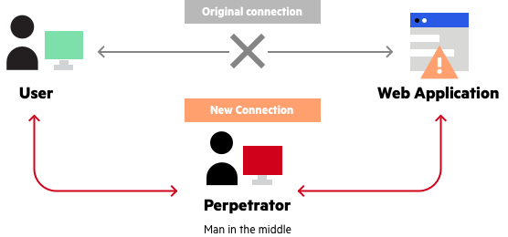
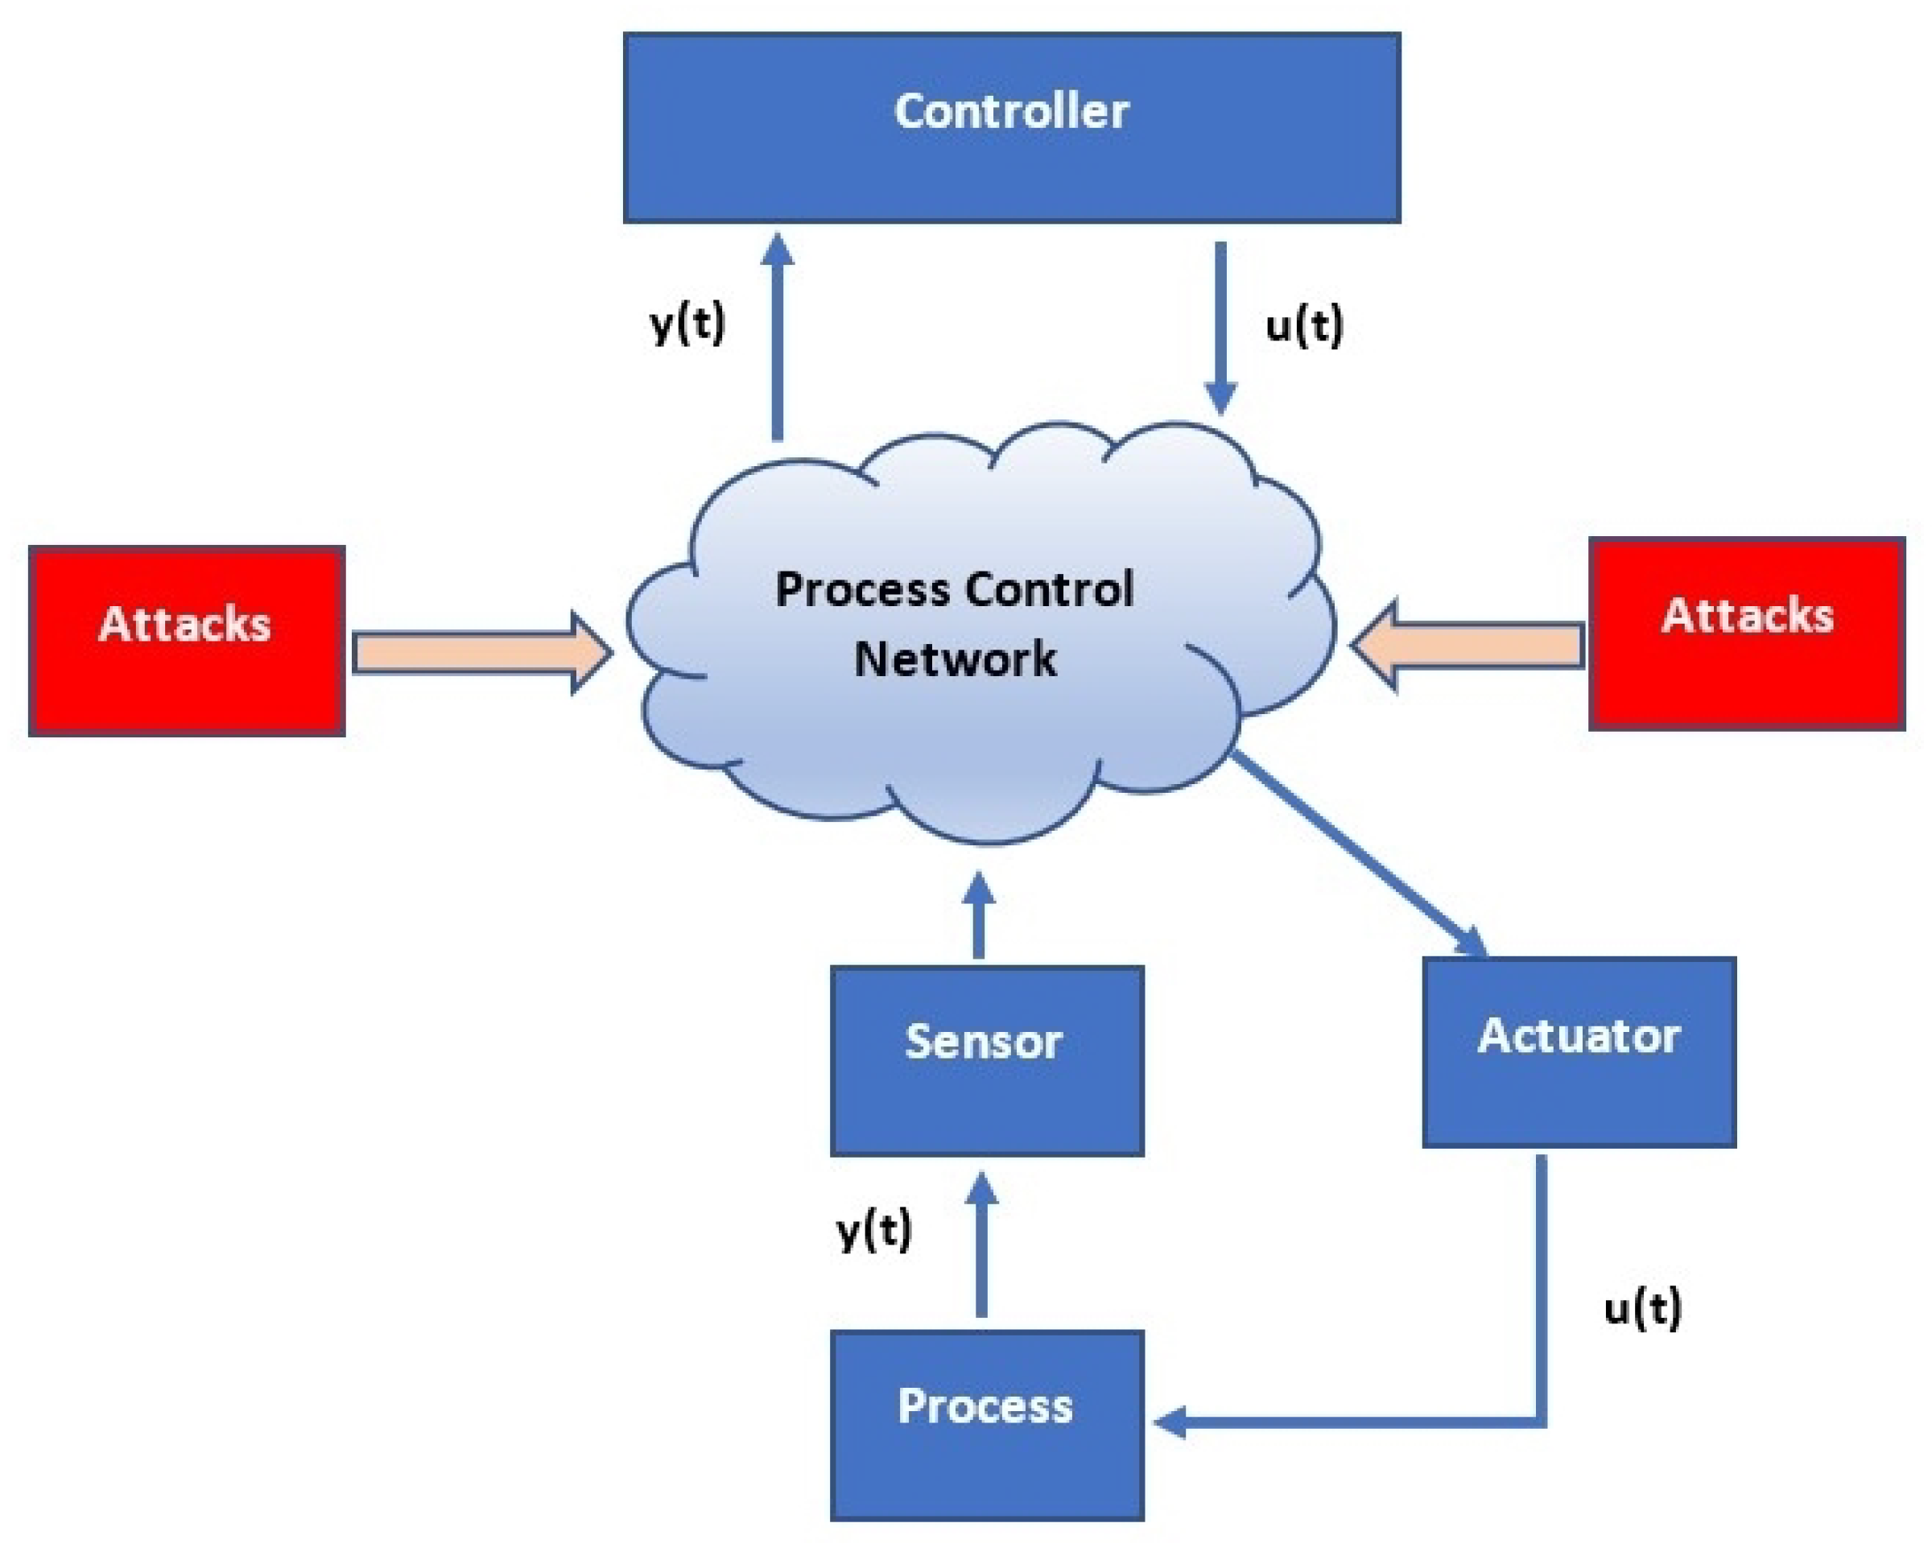
MITM Attacks: Real incidents on the Energy Sector
MiTM attacks are type of attacks which could be used by cyber criminals in order to intercept communication between power plants, end-users/consumers and Energy Providers as well as stealing data from the internal networks used by employees of a power plant. By implementing security policies and issuing certificates for services used and provided by Energy Providers the validity and privacy of data hardens and all parties involved in the production, delivery and consumption of energy services have reduced risk for their data to be leaked.

Slide 3
Man-in-the-Middle (MITM) Attack
A man-in-the-middle (MITM) attack is a cyber attack in which a threat actor puts themselves in the middle of two parties, typically a user and an application, to intercept their communications and data exchanges and use them for malicious purposes like making unauthorized purchases or hacking.
By secretly standing between the user and a trusted system, such as a website or application, a cybercriminal can easily obtain sensitive data. The user assumes they're interacting exclusively with a trustworthy site and willingly relinquishes login credentials, financial information, or other compromising data.
1

Slide 4
SSL and Man-In-The-Middle
Several factors and breaches contribute to a MITM attack. The most common loopholes are the absence of a valid SSL certificate, fraudulent SSL issuance, or improper SSL configuration.
2

Slide 5
Things that happen during a MITM attack:
The client initiates a connection to a website with an SSL certificate, intending to establish a secure connection.
The attacker intercepts this connection and pretends to be the website, generating a fake SSL certificate that appears valid.
The client’s browser, unaware of the attack, receives the fake certificate and assumes it’s legitimate, as it can be challenging to detect a forged certificate.
The attacker acts as a middleman, decrypting the client’s encrypted communication, reading its contents, and potentially modifying the data.
3

Slide 6
Things that happen during a MITM attack: (cont’d)
The attacker then re-encrypts the communication using a legitimate SSL certificate from an authentic website.
The server receives the modified communication from the attacker, unaware of tampering, and responds accordingly.
The attacker repeats this process for each session between the client and the server, effectively eavesdropping or manipulating the entire conversation.
4

Slide 7
Types of Man-in-the-Middle Attacks
A man-in-the-middle attack in cyber security qualifies as any circumstance where a threat actor places themselves between a user and an entity such as a network, website, or application to obtain information. The method by which hackers obtain that information varies using different forms of spoofing, a method of impersonating trusted online entities or websites. The main types of MITM attacks include:
IP Spoofing: A cybercriminal alters the Internet Protocol (IP) address of a website, email address, or device and spoofs the entity—making the user think they're interacting with a trusted source when they're really passing information to a malicious actor.
5

Slide 8
Types of Man-in-the-Middle Attacks (cont’d)
Email Hijacking: Attackers secretly gain access to a banking or credit card company's email accounts to monitor transactions and steal information. They might also use the email account or a spoofed email address slightly different from the actual one to provide false
instructions to the customers, such as wiring money into a new checking account.
DNS Spoofing: For Domain Name System (DNS) spoofing, a spammer creates and operates a fake website that the user is familiar with and routes them to it to acquire user credentials or other information.
6

Slide 9
Types of Man-in-the-Middle Attacks (cont’d)
HTTPS Spoofing: A user assumes a website has the HyperText Transfer Protocol Secure (HTTPS), meaning they have their computer data encrypted to the website host. However, they were secretly redirected to a non-secure HTTP website, allowing criminals to track interactions and steal information.
Wi-Fi Eavesdropping: Spammers create public Wi-Fi networks or hotspots that appear to be a nearby business or other trusted source. Users who connect then have all their activity and sensitive data intercepted.
7

Slide 10
Types of Man-in-the-Middle Attacks
SSL Hijacking: An extension of HTTPS spoofing, hijacking the Secure Sockets Layers (SSL) is when a hacker takes this protocol responsible for encrypting HTTPS connections and intercepts user data traveling between them and the server they're connecting to.
Session Hijacking: Commonly known as browser cookie theft, an attacker will steal information stored on web browser cookies, such as saved passwords.
Ettercap: Open-source tool for analyzing network protocols, hosts, and activity. Can intercept network traffic data, capture credentials, and decrypt password data.
8

Slide 11
Types of Man-in-the-Middle Attacks (cont’d)
dsniff: A suite of password and network analysis tools that lets users pull passwords, email contents, and files, intercept network traffic data, and deploy man-in-the- middle attacks using HTTPS redirects.
Cain and Abel: Initially created as a password recovery tool, it developed into a packet sniffing and analysis software to evaluate a network and perform spoofing while also being able to carry out other cyber attacks such as brute force.
9

Slide 12
SSL -> Prevention of Man-In-The-Middle Attacks
SSL prevents this type of attack through several mechanisms, which act as multilayer security against even the most relentless threats
Encryption: SSL/TLS encrypts the data exchanged between the client and server using cryptographic algorithms. This encryption ensures that even if an attacker intercepts the data, they cannot decipher its contents without the encryption key.
10

Slide 13
SSL -> Prevention of Man-In-The-Middle Attacks (cont’d)
Authentication: SSL/TLS uses digital certificates to authenticate the server’s identity. These certificates are issued by trusted Certificate Authorities (CAs) and contain information that verifies the server’s identity, preventing attackers from impersonating the server and tricking the client into connecting to a malicious entity.
Integrity: SSL adds a digital signature to the transmitted data, which allows the recipient to verify that the data hasn’t been tampered with during transmission. If an attacker alters the intercepted data, the digital signature will become invalid, alerting the recipient of potential tampering.
11

Slide 14
How Does SSL Prevent Man-In-The-Middle Attacks?
The contribution of the HTTPS protocol in stopping Man-in-the-Middle attacks derives from the concept of the SSL Certificates and the Certificate Authorities – all part of Public Key Infrastructure (PKI). It relies on the private key, which establishes a secure connection when it’s associated with the corresponding certificate.
The question is: if a Client is connecting to a Server, can an attacker, who gets between them, receive the SSL certificate and successfully decrypt the data?
Indeed, the attacker can receive the same certificate because the last one contains the public key and the domain name the server sends to anyone who wants to connect to it. However, the attacker can’t decrypt the information because only the server owns the matching private key that can decrypt the data.
So, because the server keeps this private key secret, the hacker can’t use the website’s certificate. They have to use one of their own, convincing the Certificate Authority to either sign the certificate or use it as it is. Thus, if the attacker’s certificate is not validated by a trusted Certificate Authority, the client’s web browser won’t trust it.
12

Slide 15
How Does SSL Prevent Man-In-The-Middle Attacks? (cont’d)
Attackers may also try to forge the SSL Certificate and provide their own public key to the client. This action will nullify the CA’s signature, while the browser will display warnings about the invalid SSL Certificate.
Therefore, the specific structure of the SSL Certificate prevents Man-in-the-Middle attacks, protects your customers from dealing with hackers, and ensures the trustworthiness of your company.
13

Slide 16
How to Prevent Man-in-the-Middle Attacks
Prioritize HTTPS connections: Avoid websites with no HTTPS connection indicated in the website address. You can also implement DNS over HTTPS, which encrypts DNS requests, hiding your online activity.
Avoid unsecure/public WiFi: Though it may seem convenient, public WiFi could be a trap used to target users that don't have solid cyber awareness.
Incorporate MFA: Multi-factor authentication (MFA) helps avoid issues you might have after a cybercriminal obtains credentials. Acquiring an additional authentication factor such as a hardware token or face scan prevents the hacker from being able to access an account.
14

Slide 17
How to Prevent Man-in-the-Middle Attacks (cont’d)
Practice network segmentation: Zero Trust Architecture is an excellent framework for network security, particularly for using principles such as network segmentation to defend against man-in-the-middle attacks. This element of Zero Trust refers to dividing the network into secured segments to isolate incidents and prevent lateral movement by threat actors.
15

Slide 18
How to Prevent Man-in-the-Middle Attacks (cont’d)
Encrypt your emails: For email hijacking, secure/multipurpose internet mail extensions (S/MIME) encrypt email contents and certify emails with certificates to authenticate senders. Use a certificate management system: Automated solutions for managing network SSL certificates ensure a centralized and streamlined method for remediating expired ones susceptible to hijacking.
Utilize Privileged Access Management (PAM): Implement privileged access controls to enforce least privilege and restrict account creation and permissions to the minimal level technical staff need to do their job.
16

Slide 19
MITM Attack Concepts to Know
Some concepts to know to get an easier grasp on a MITM attack include:
Spoofing: Technique commonly used in man-in-the- middle attacks where a trusted system, such as a website or IP address, pretends to be something else through replication or delusion to gain a target's confidence.
Hijacking: Tactics for MITM where an attacker entirely takes control over an email account, website, or SSL to insert themselves between a user and system.
17

Slide 20
MITM Attack Concepts to Know (cont’d)
Phishing: Often done through email or on websites, it's a tactic commonly used in MITM attacks where a spammer or criminal attempts to steal information or deliver malware by pretending to be a trusted sender or legitimate website.
Eavesdropping: Part of the MITM attack process where a successful hacker intercepts data transmissions and communications between two users or users and services.

Slide 21

Thank you

